Slide 1
Advanced control for the future using the magic of feedback and simple elements*
Sigurd Skogestad
Department of Chemical Engineering
Norwegian University of Science and Technology (NTNU)
Trondheim
17th Seminar on Power Electronics and Control (SEPOC) – November 9–12, 2025
"Applied Computing and Cutting-Edge Solutions in Power Electronics and Control for Industry 5.0"
Floranopolis
*a.k.a. Advanced regulatory control (ARC)

Slide 2
Abstract
Advanced control refers to any control strategy that goes beyond basic single-loop PID control. It becomes necessary for processes involving multiple inputs, changing objectives or constraints, additional measurements, or measured disturbances. Many engineers intuitively think, “This is getting complicated—we need a model and optimization (e.g., MPC).” However, model-based control is often expensive to implement and highly sensitive to model uncertainty. Fortunately, there is a more robust yet less appreciated alternative: advanced PID architectures. These rely primarily on measurements (data) and feedback and consist of smart combinations of PID controllers with simple elements such as cascade control, selectors, split-range control, and ratio control.
My prediction: The future of advanced control will continue to be built on these simple PID architectures—just as they are today—despite having been largely neglected by academia for the past 80 years. Model-based control (e.g., MPC) will be added on top in specific applications, such as for strongly coupled processes or when future disturbances are known. Machine learning and AI (including tools like ChatGPT) are unlikely to be used extensively for real-time control, except in soft sensor (estimation) tasks. However, they will become important tools for offline tasks such as model development, software generation, control architecture design, and controller tuning.
Before ChatGPT: «Advanced control» is anything that comes in addition to single-loop PID control. It is needed for processes with extra inputs, changing control objectives and constraints, extra measurements and measured disturbances. The intuition of most engineers is that «this becomes very difficult, so we will need a model and optimization (MPC)». However, model-based control is costly to implement and sensitive to uncertainty. Fortunately, there is another option, mainly based on measurements (data) and feedback, which is much more robust but much less understood: Advanced PID-architectures that interconnect in a smart way PID controllers and other simple elements (cascade, selectors, split range control, ratio control).
My prediction: Advanced control in the future will use simple PID-architectures as the basis (as they do today - in spite of being neglected by academics for 80 years). It will be complemented with model-based control (MPC) for certain applications, for example, for strongly coupled processes or for cases where future disturbances are known. ML/AI will not be much used for online control, except for estimation (soft sensors). However, ML/AI (chatGPT) will be used for offline purposes, including developing models, writing software, suggesting control architectures and tuning controllers.

Slide 3
Workshop on “Multivariable control Using Decomposition and Simple Elements"
How can you control a complex plant effectively using simple elements with a minimal amount of modelling? How can you put optimization into the control layer?
Industry has been using simple and effective “advanced regulatory control” (ARC) schemes for almost 100 years, yet they remain poorly understood and therefore underused. The objective of the workshop is to provide a systematic approach for designing such control systems. The target audience includes both practicing control engineers as well as PhD students and teachers from academia.
The workshop explores the standard advanced control elements commonly used in industry for designing advanced control systems. These elements include cascade, ratio, feedforward, decoupling, selectors, split range, and more, collectively referred to as "advanced regulatory control" (ARC). Numerous examples are provided, with a particular focus on process control. I emphasize the shortcomings of model-based optimization methods, such as model predictive control (MPC), and challenge the view that MPC can solve all control problems, while ARC solutions are outdated, ad-hoc and difficult to understand. On the contrary, decomposing the control systems into simple ARC elements is very powerful and allows for designing control systems for complex processes with only limited information. With the knowledge of the control elements presented in the workshop, participants should be able to understand most industrial ARC solutions (which can be a challenge!) and propose alternatives and improvements.

Slide 4
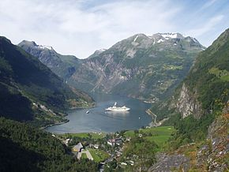



Trondheim
Arctic circle
Geiranger fjord
Midnight or midday?
Trondheim

Slide 5

About Sigurd Skogestad
•1955: Born in Flekkefjord, Norway
•1974-1978: MS (Siv.ing.) studies in chemical engineering at NTNU
• 1979: Military service (FFI)
•1980-1983: Worked at Norsk Hydro F-senter (process simulation)
•1983-1987: PhD student at Caltech (supervisor: Manfred Morari)
•1987-present: Professor of chemical engineering at NTNU
• 1994-95: Visiting Professor UC Berkeley
• 2001-02: Visiting Professor UC Santa Barbara
•1999-2009: Head of ChE Department, NTNU
•2015-.2023: Director SUBPRO (Subsea research center at NTNU)
Non-professional interests:
mountain skiing (cross country)
orienteering (running around with a map)
grouse hunting
1973

Slide 6

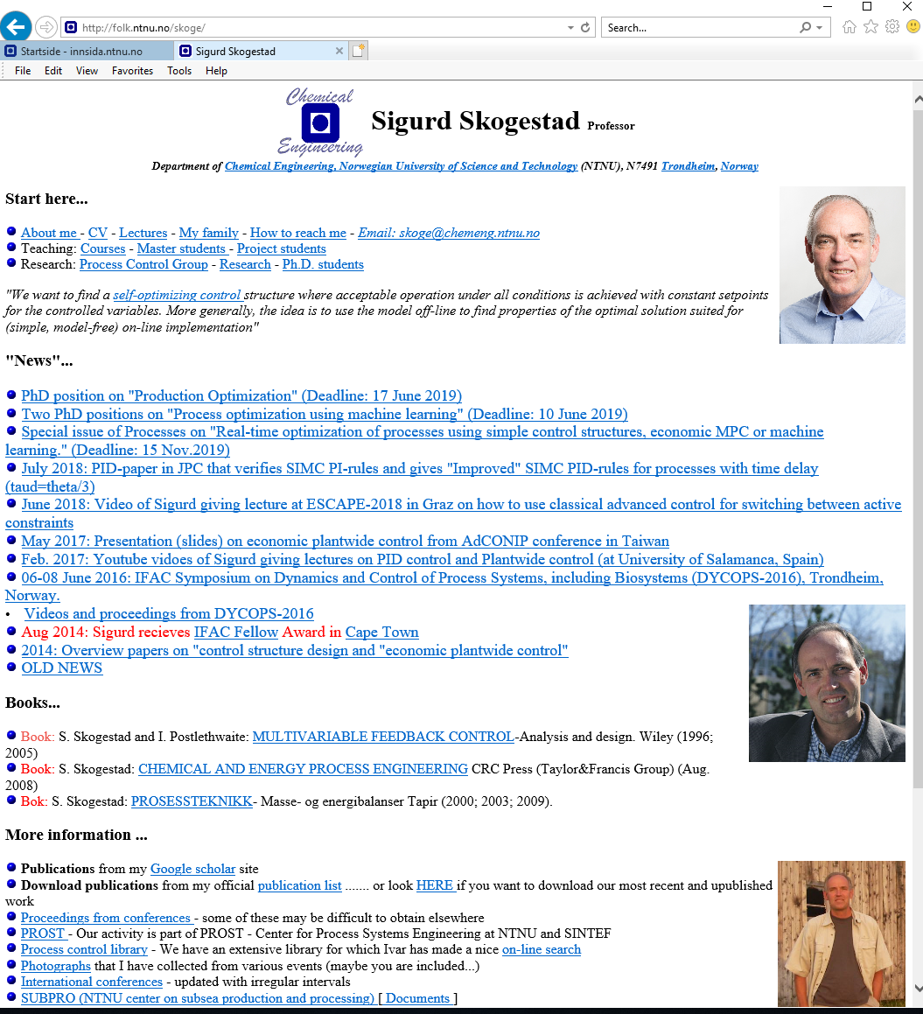
“The goal of my research is to develop simple yet rigorous methods to solve problems of engineering significance”

Slide 7
My research focus
Control for economic optimization
  Control of changing active constraints
Control for linearization, stabilization and robustness
Keep it simple!
  Make use of the magic of feedback

Slide 8
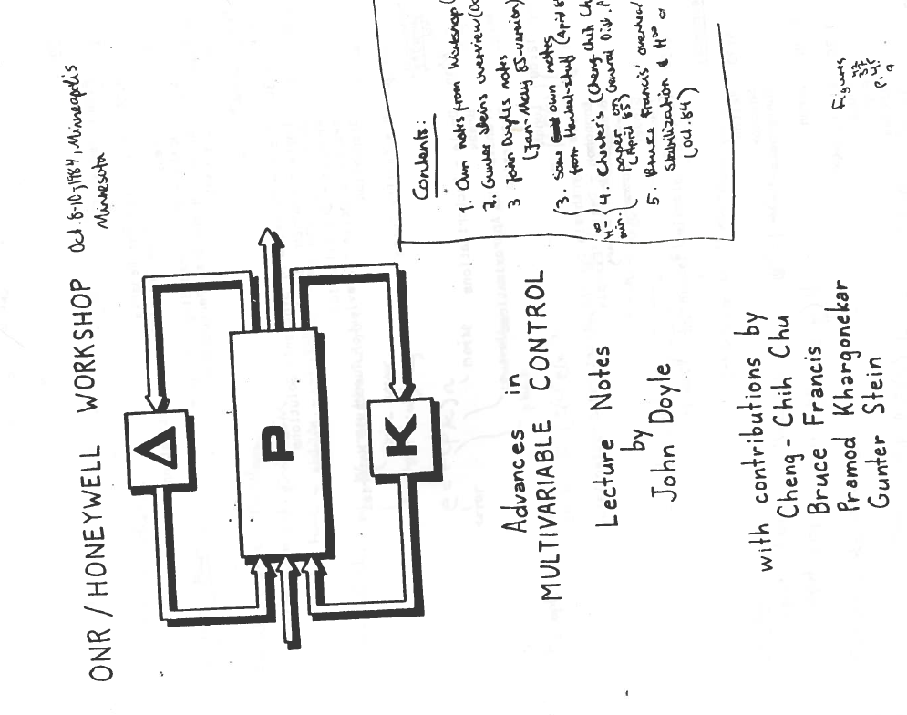
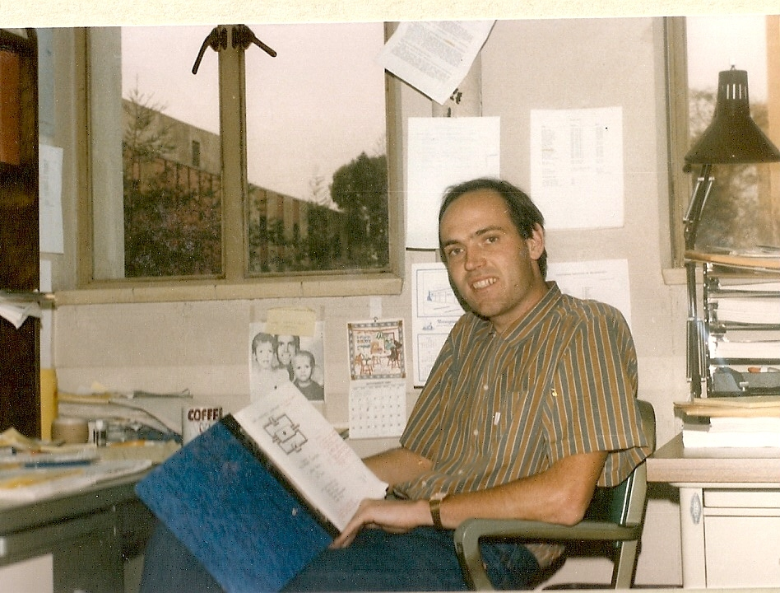
October 1984
Robust control takes off!

Slide 9
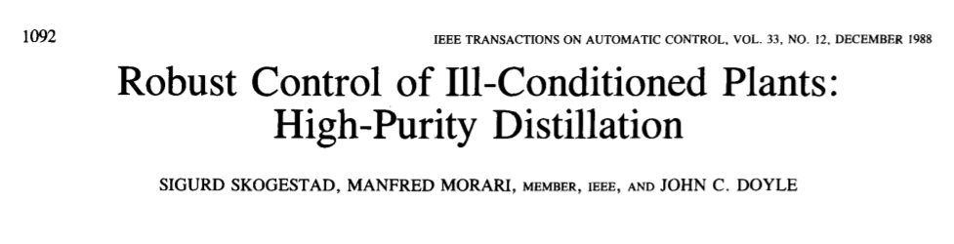
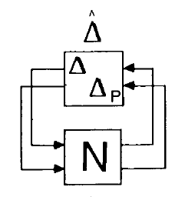
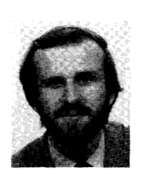
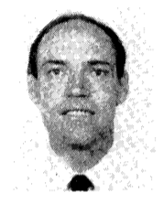
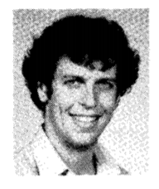
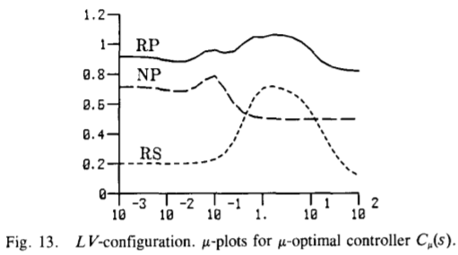

Slide 10
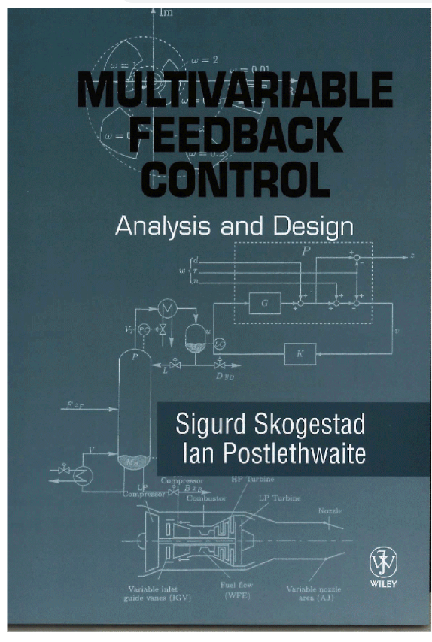
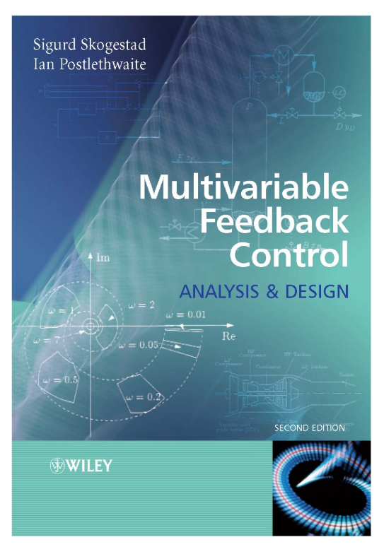
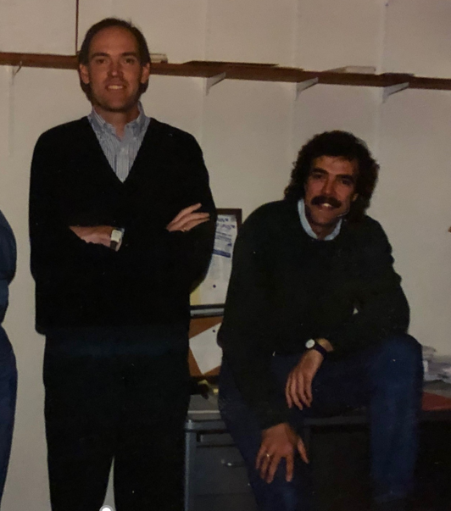
Robust control
Berkeley, Dec. 1994
1996
2005

Slide 11
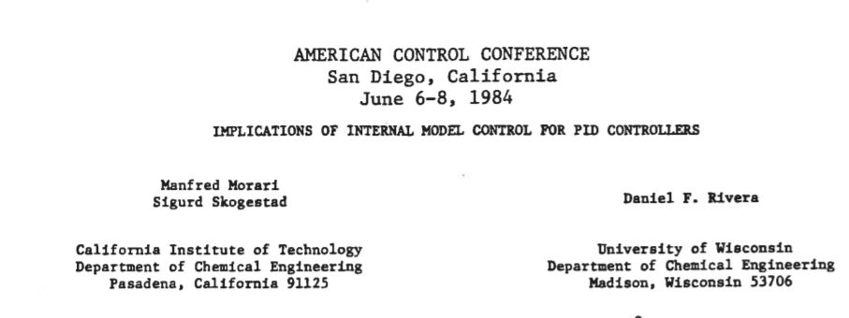
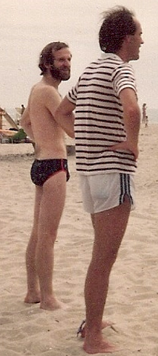
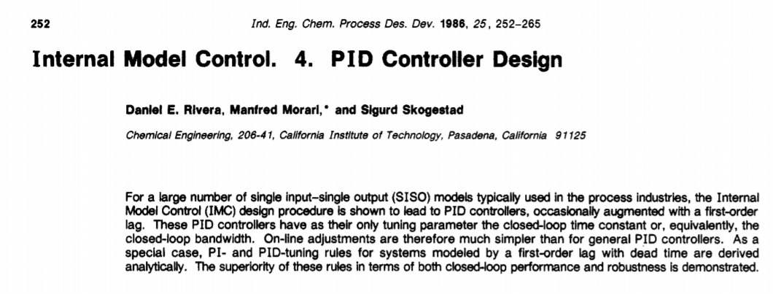
IMC PID tuning rule
(1984, 1986)

Slide 12
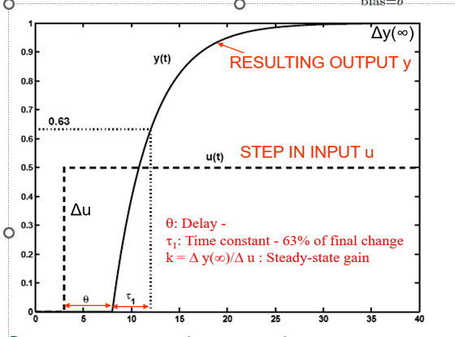
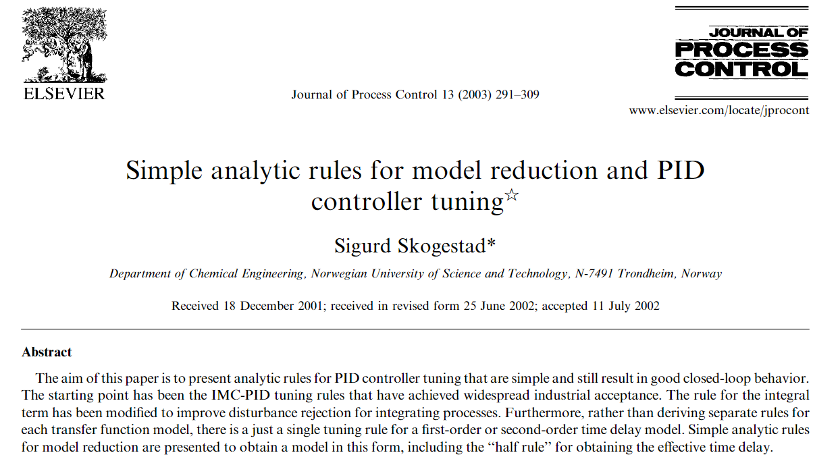

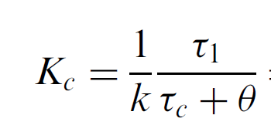



SIMC* PID tuning rule (2001,2003)
Tuning parameter:
$$τ_{c}≥θ$$
=λ
*SIMC = Simple/Skogestad IMC

Slide 13
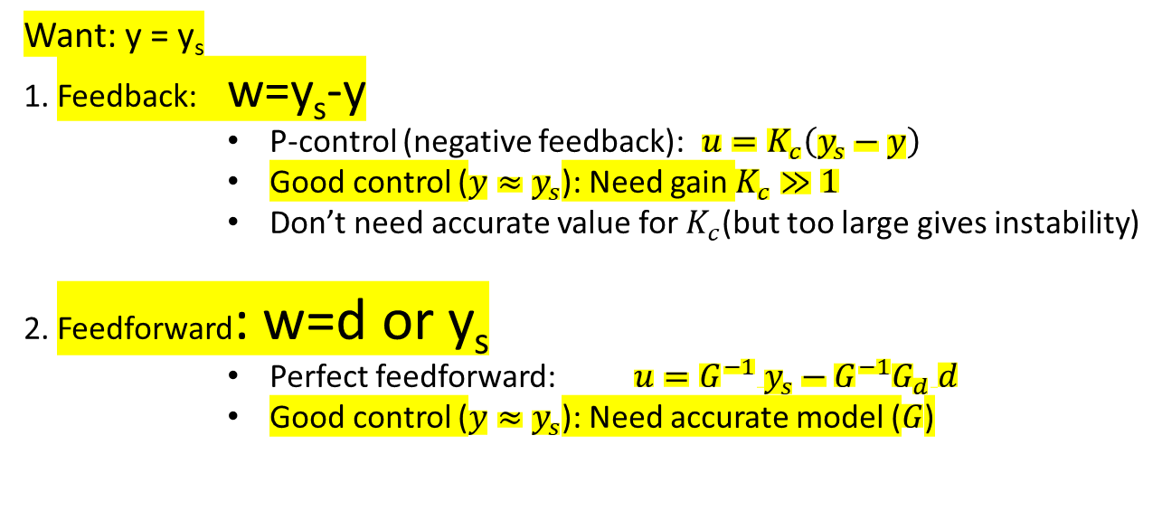
What is control?
Generating actions u from measurements w (data) to stay at setpoint y_{s}
d
w
measured online data
u
Actions (MVs)
Controller
(algorithm)
y
Process G
Want: y = y_{s}
1. Feedback: w=y_{s}-y
      P-control (negative feedback): $u=K_{c}\left(y_{s}−y\right)$
      Good control ($y≈y_{s}$): Need gain $K_{c}≫1$
      Don’t need accurate value for $K_{c}$(but too large gives instability)
2. Feedforward: w=d or y_{s}
      Perfect feedforward: $u=G^{−1} y_{s}−G^{−1}G_{d} d$
      Good control ($y≈y_{s}$): Need accurate model ($G$)

Slide 14

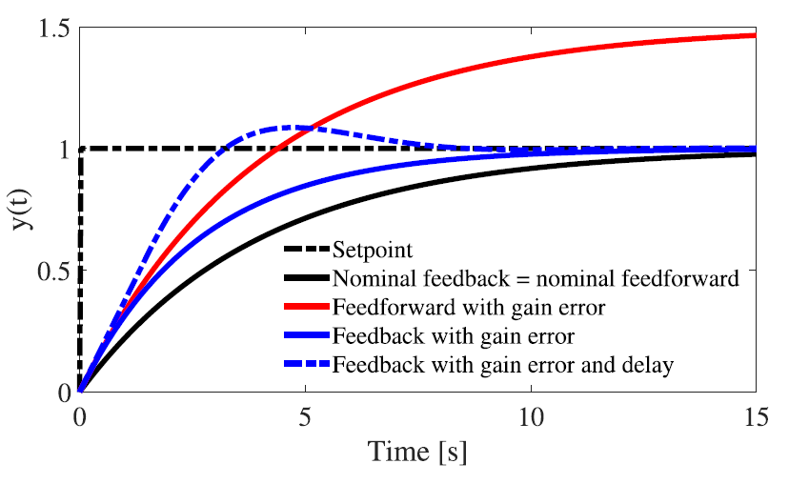



Feedforward versus feedback
Example: Setpoint response
u
G(s)
y
    Identical nominally
    Change process gain from k=3 to k’=4.5
(speed up a little)
    This can be achieved both with feedback (PI) and feedforward (nominally):
y_{s}
C_{Fy}(s)
u
y_{s}
C(s)
u
y
G(s)
Feedforward is sensitive to model error
With MPC: Not clear which solution you get

Slide 15
Feedback is needed / used for
Uncertainty about disturbances
Uncertainty in model
Linearization
Stabilization

Slide 16
Linearizing effect of feedback

Slide 17
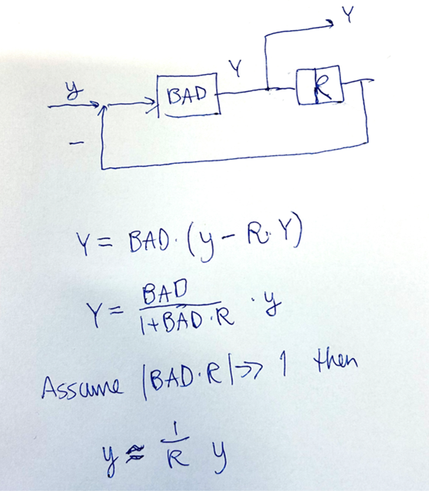
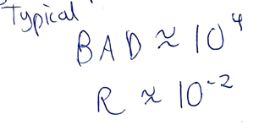
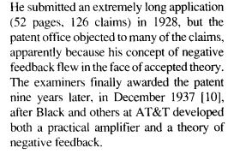

The negative feedback amplifier
Harold Black (on a New York ferry, 02 August 1927):
Amplification was required to send telephone signals across the US in the 1920s and it required 12 amplifications on the way, so they better be fairly accurate.
The original idea of all engineers is to think feedforward (Bell Labs)
Feedforward: Y = BAD y
With feedback: Y = (1/R) y (R: accurate resistance)
$Y=\frac{1}{R} y$

Slide 18
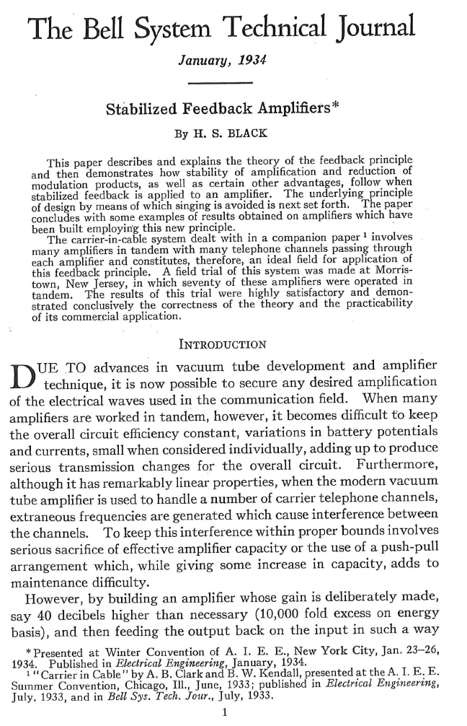
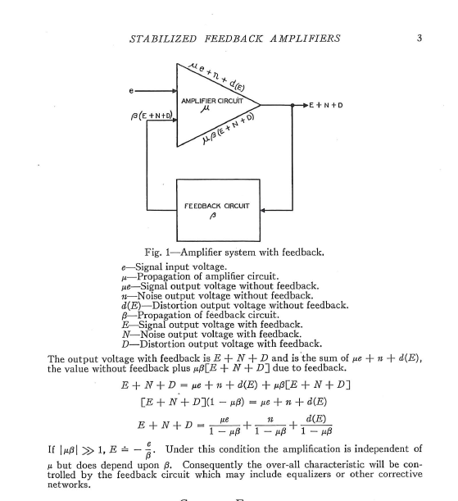
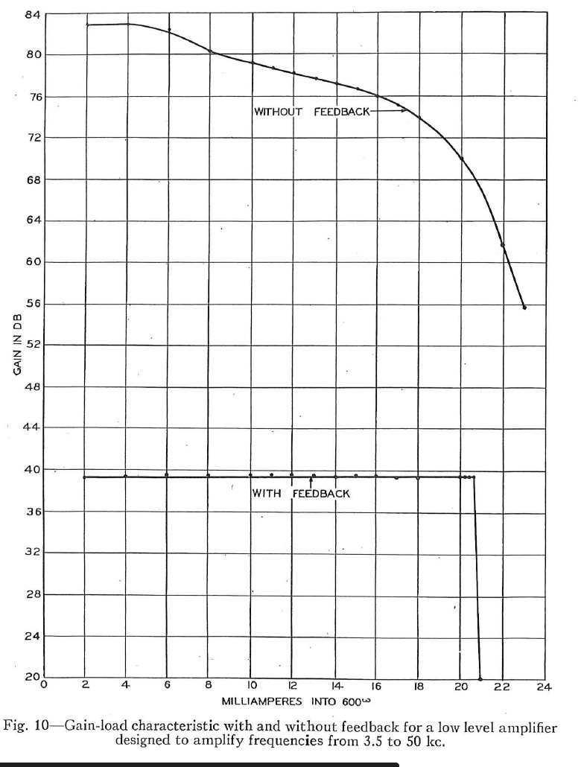
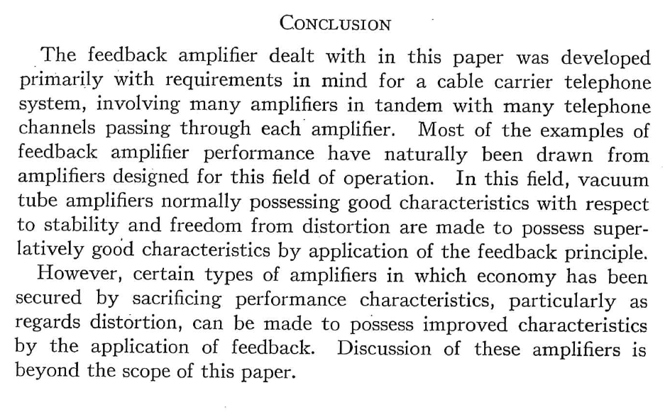
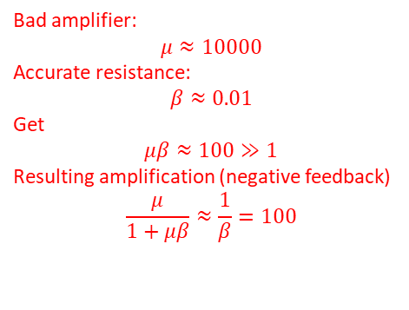
Experiment
10000
1000
100
10
Bad amplifier:
$μ≈10000$
Accurate resistance:
$$β≈0.01$$
Get
$$μβ≈100≫1$$
Resulting amplification (negative feedback)
$$\frac{μ}{1+μβ}≈\frac{1}{β}=100$$
Proving that Black’s invention worked also initiated the idea of freqyency analysis( Nyquist)

Slide 19
Linearization of valve using cascade control
Benefits: 1. Local distrurbance rejection, 2. Linearization
Does nonlinearity disappear?
WITHOUT CASCADE
WITH CASCADE (2 controllers)
flow in
measured
level
H_{s}
flow in
measured
level
H_{s}
y=H
y=H
LC
LC
MV=z
valve position
master
MV=q_{s}
FC
y₂=q
slave
MV₂=z
measured
flow
flow out
flow out

Slide 20
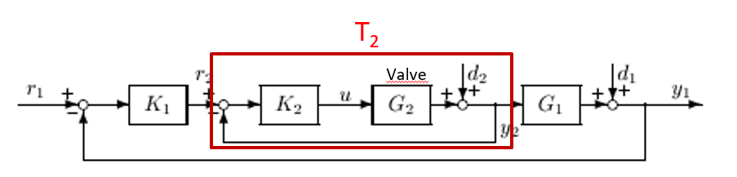
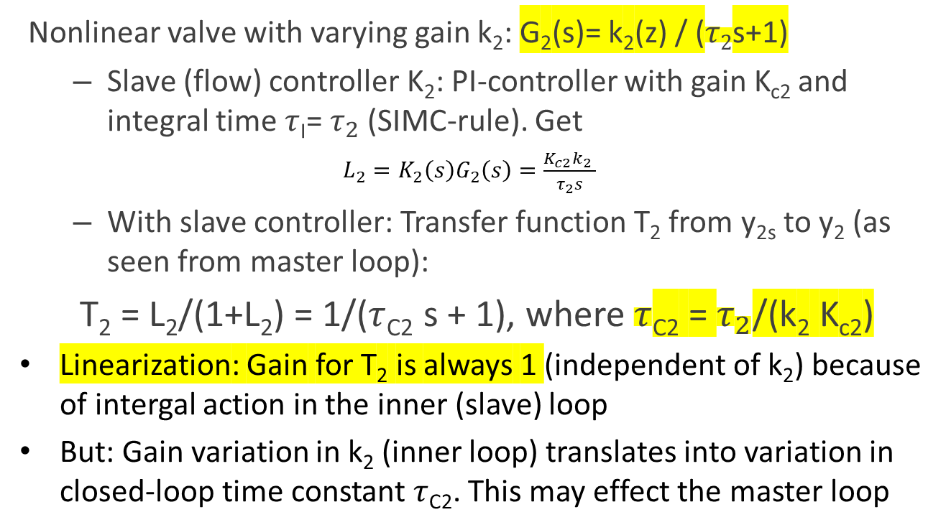
No, it moves to the time constant of the slave loop
– OK - if we we have time scale separation between master and slave
Does nonlinearity disappear?
Nonlinear valve with varying gain k₂: G₂(s)= k₂(z) / ($τ2$s+1)
  Slave (flow) controller K₂: PI-controller with gain K_{c2} and integral time $τ$_{I}= $τ_{2}$ (SIMC-rule). Get
          $L_{2}=K_{2}\left(s\right)G_{2}\left(s\right)=\frac{K_{c2}k_{2} }{τ_{2}s}$
  With slave controller: Transfer function T₂ from y_{2s} to y₂ (as seen from master loop):
T₂ = L₂/(1+L₂) = 1/($τ$_{C2} s + 1), where $τ$_{C2} = $τ_{2}$/(k₂ K_{c2})
Linearization: Gain for T₂ is always 1 (independent of k₂) because of intergal action in the inner (slave) loop
But: Gain variation in k₂ (inner loop) translates into variation in closed-loop time constant $τ$_{C2}. This may effect the master loop
f(z)
1
linear valve
0
0
1
k₂(z) = slope = df/dz
G₁T₂ = «Process» for tuning master controller K₁

Slide 21
Stabilization
The only way we can change dynamics (poles) and stabilize is by feedback
So: Stabilization with feedforward does NOT work
  Example: level control
    G(s) = k’/s
    Integrating process with pole at s=0. At the limit to instability
    It is practically impossible to control level by trying to set q_{out}=q_{in} using feedforward.
    We get «internal instability»: Level will eventually go out of bound
But we need to be careful: Feedback often causes oscillations and even instability

Slide 22
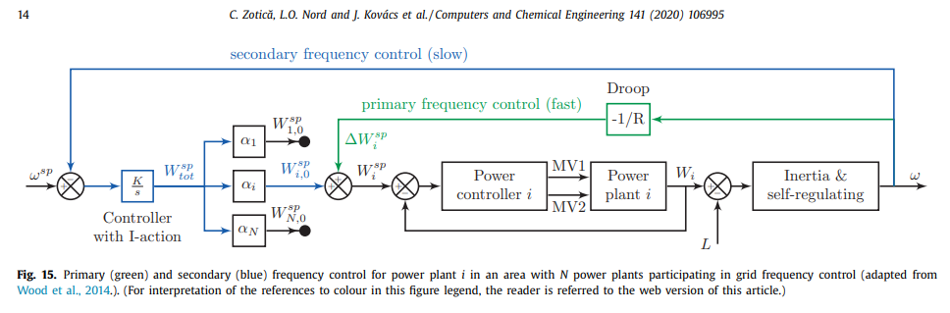
Stabilization of the grid using P-control. Early 1930s
Initial idea (not workabler): Centralized coordination of power producers
1930s: Use grid frequency («level») as (local) measure of imbalance between supply and demand. And: Stabilize frequency using local P-control for all power producers
It’s the same as level control with many flows in and out
Need to have some back-off from maximum power for this to work (90%)
Many local P-controllers, but only one centralized I-controller
Local
P-control
Centralized
I-control

Slide 23
Inflow
Inflow
Inflow (producer)
y =
Frequency
or Level
y_{s} = setpoint
Outflow (consumer)
Outflow
$$\frac{dy}{dt}=In1+In2+In3 −Out1 −Out2={Σ_{i}(u}_{0i}+K_{ci}(y_{s}−y))$$
Everyone contributes to stabilization of y

Slide 24
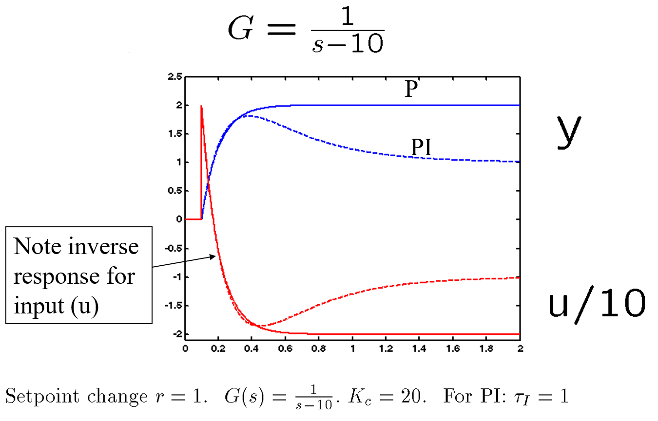

Stabilization using feedback: Instability moves to input (RHP-zero)
General proof: $u=G^{−1} T y_{s}$

Slide 25
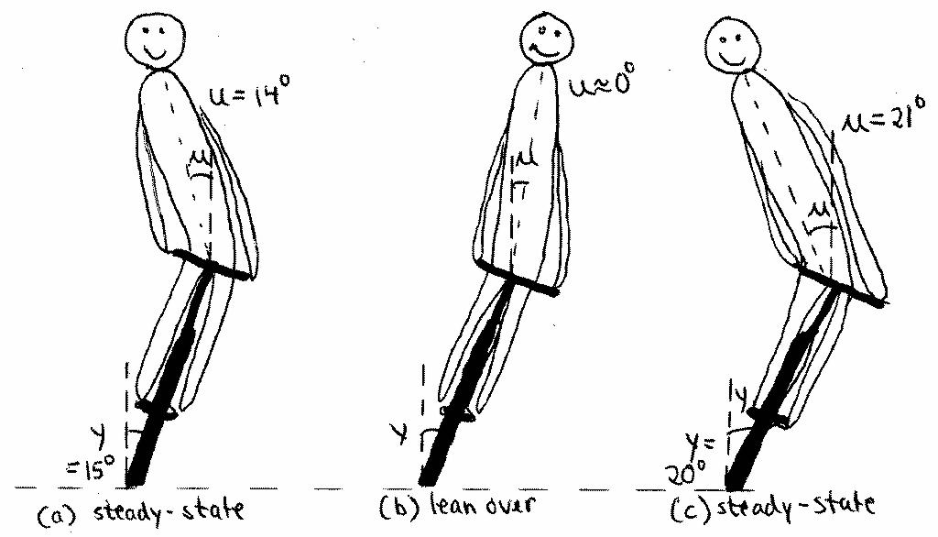
Inverse response for bicycle / motorcycle caused by underlying instability
Move first in right direction
But end up moving in opposite direction

Slide 26
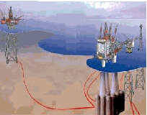




Stabilization: Anti-slug control (IFAC, 2002)
Two-phase flow
(liquid and vapor)
Slug (liquid) buildup

Slide 27
Anti slug-control - control structure
SP
PIC
PT
Slug-catcher
PT
Undesired slug flow (limit cycle) unless feedback
control is used to stabilize a steady flow regime
(desired, but open-loop unstable)
Measurement y

Slide 28
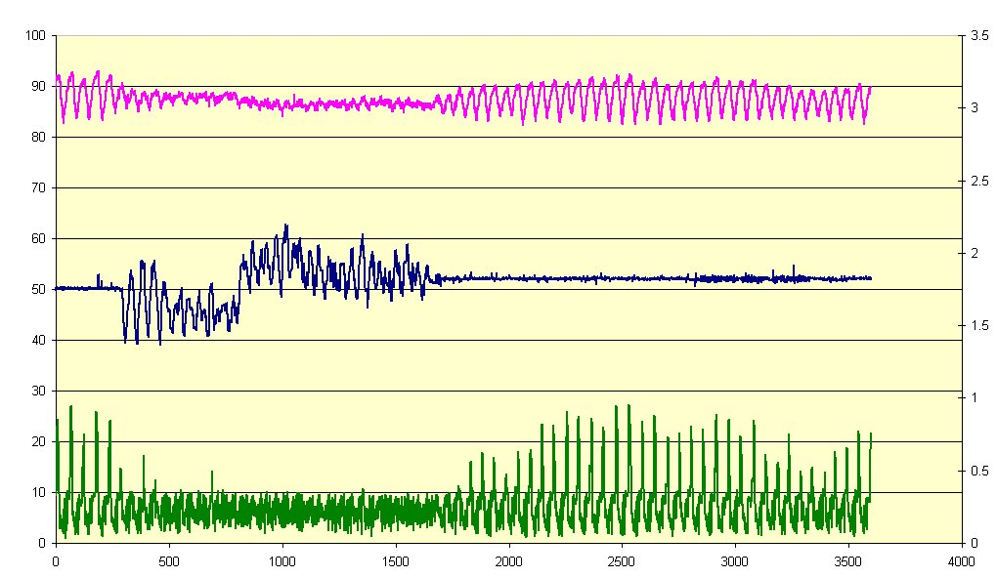
Anti slug control – experimental data (Statoil/SINTEF)
Pressure (y)
Controller ON
OFF
INPUT u
Density

Slide 29
Anti slug-control - control structure
Input u =
Want open valve (80%)
SP
PIC
PT
Slug-catcher
PT

Slide 30
Anti slug-control - control structure
VPC: Cannot be too fast because of
inverse response caused by underlying instability
SP
PIC
VPC
SP=80%
PT
Slug-catcher
PT

Slide 31
«Transformed inputs» v
Combining feedforward with feedback in an extremely simple way
Most effective for static feedforward
  Dynamic generalzation (= «feedback linearization») usually unrealistic because of many derivatives
Static model: y =f(u,d)
Select transformed inputs (= controller outputs): v = f(u,d)
Invert to get physical inputs: u = f⁻¹(v,d)
Then response from v to y is: y= I v (linear, decoupled, perfect disturbance rejection)
d
y_{s}
_{V}
u
y
FeedbackController
Calculation block (static FF)
Process
y
Looks like magic but ut works
S. Skogestad, C. Zotica, N. Alsop., «Transformed inputs for linearization, decoupling and feedforward control», J. Proc. Control, 2023

Slide 32
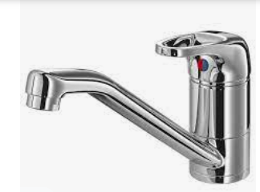
Example decoupling: Mixing of hot (u₁) and cold (u₂) water
Want to control
  y₁ = Temperature T
  y₂ = total flow F
Inputs, u=flowrates
May use two SISO PI-controllers
  TC
  FC
Insight: Get decoupled response with transformed inputs
  TC sets flow ratio, v₁ = u₁/u₂
  FC sets flow sum, v₂ = u₁ + u₂
Decoupler: Need «static calculation block» to solve for inputs
u₁ = v₁ v₂ / (1+ v₁)
u₂ = v₂ / (1 + v₁)
u₁
T
F
u₂
v₂=sum
v₁=ratio

Slide 33
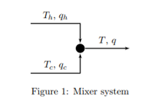

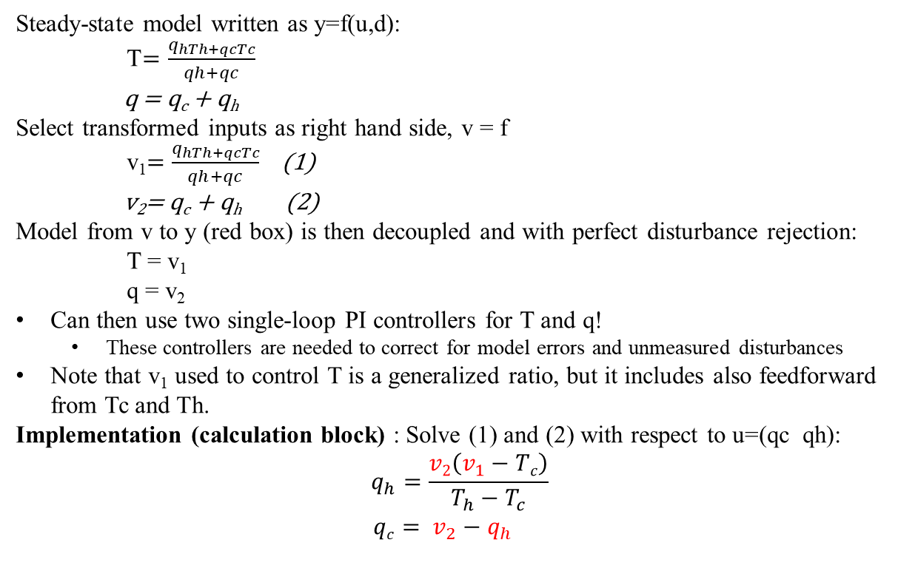
TRANSFORMED INPUTS v=f(u,d): GENERAL APPROACH FOR COMBINED FEEDBACK,
FEEDFORWARD, DECOUPLING AND LINEARIZATION
Example: Mixing of hot and cold water
d
y_{s}
_{V}
u
y
Controller
Calculation block (static)
Process
y
Generalized ratio
It’s almost magic!
Decoupler with feedforward:

Slide 34
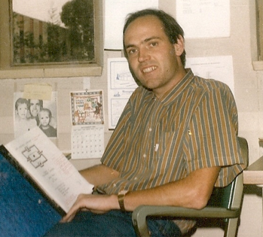
How we design a control system for a complete chemical plant?
Sigurd at Caltech (1984)
Where do we start?
What should we control? and why?
etc.
etc.
Notes:
34

Slide 35
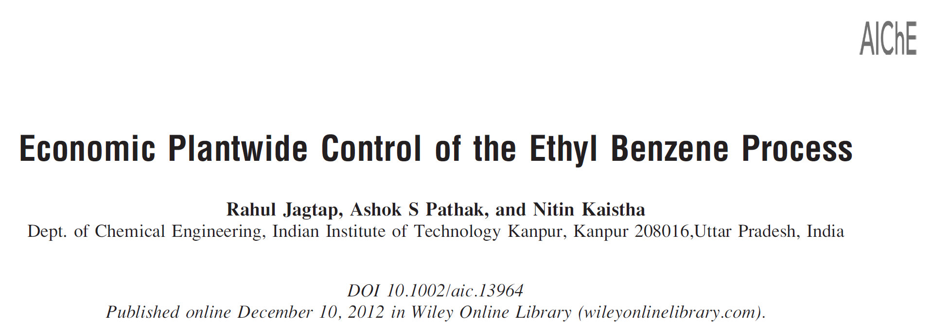
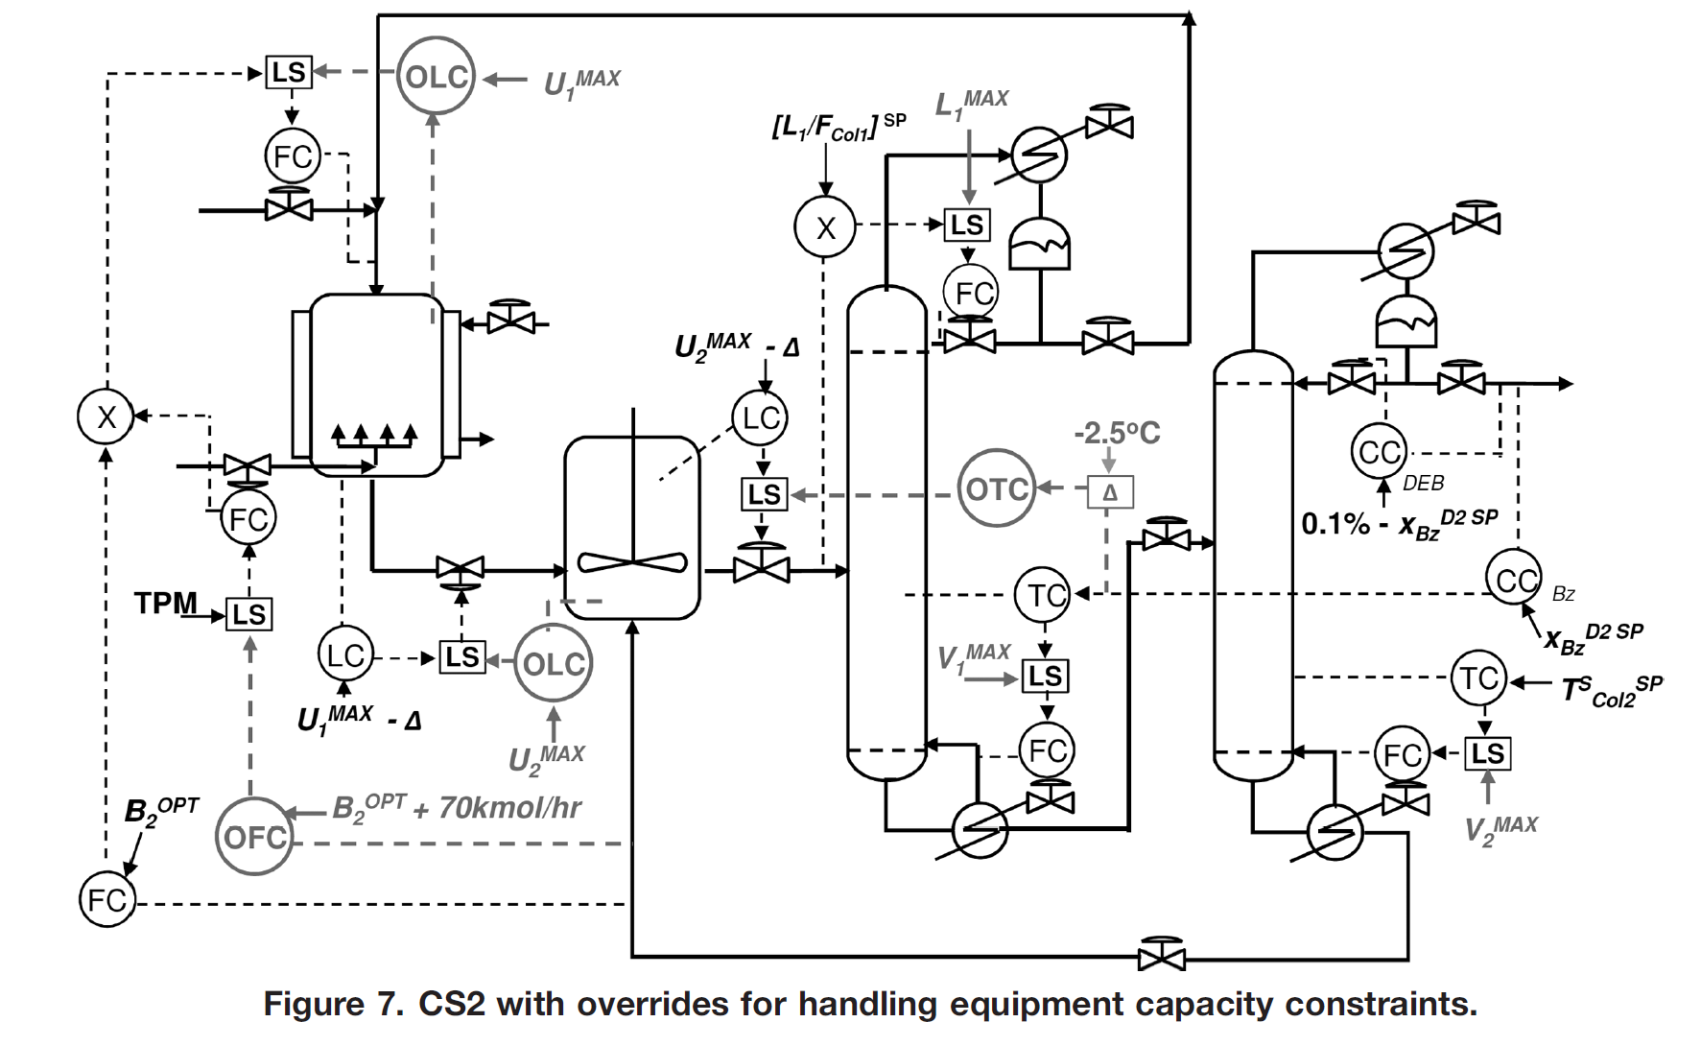



A1: Benzene
A2: Ethylene
B: Ethylbenzene (product)
C: Diethylbenzene (undersired, recycled to extinction)
A1+A2 $→$B
B + A2 $→$C
C + A1 $→2B$
A1, A2 (recycle)
A1(feed)
A1+A2 $→$B
B + A2 $→$C
B (product)
A2(feed)
C + A1 $→2B$
C (recycle)

Slide 36
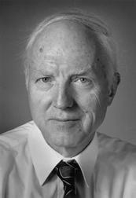
Control system structure*
Alan Foss (“Critique of chemical process control theory”, AIChE Journal,1973):
The central issue to be resolved ... is the determination of control system structure*. Which variables should be measured, which inputs should be manipulated and which links should be made between the two sets?
There is more than a suspicion that the work of a genius is needed here, for without it the control configuration problem will likely remain in a primitive, hazily stated and wholly unmanageable form.
The gap is present indeed, but contrary to the views of many, it is the theoretician who must close it.
*Current terminology: Control system architecture
Notes:
36

Slide 37
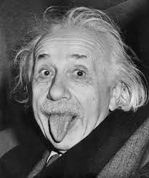
Control system structure*
Alan Foss (“Critique of chemical process control theory”, AIChE Journal,1973):
The central issue to be resolved ... is the determination of control system structure*. Which variables should be measured, which inputs should be manipulated and which links should be made between the two sets?
There is more than a suspicion that the work of a genius is needed here, for without it the control configuration problem will likely remain in a primitive, hazily stated and wholly unmanageable form.
The gap [between theory and practice] is present indeed, but contrary to the views of many, it is the theoretician who must close it.
*Current terminology: Control system architecture
Notes:
37

Slide 38
Main objectives of a control system
Economics: Implementation of acceptable (near-optimal) operation
Regulation: Stable operation
ARE THESE OBJECTIVES CONFLICTING?
Usually NOT
  Different time scales
    Stabilization → fast time scale
  Stabilization doesn’t “use up” any degrees of freedom
    Reference value (setpoint) available for layer above
    But it “uses up” part of the time window (frequency range)

Slide 39
Two fundamental ways of decomposing the controller
Vertical (hierarchical; cascade)
Based on time scale separation
Decision: Selection of CVs that connect layers
Horizontal (decentralized)
Usually based on distance
Decision: Pairing of MVs and CVs within layers
MV
PROCESS
In addition: Decomposition of controller into smaller elements (blocks):
Feedforward element, nonlinear element, estimators (soft sensors), switching elements
CV = controlled variable MV = manipulated variable

Slide 40
Time scale separation: Control* layers
Two objectives for control: Stabilization and economics
Supervisory (“advanced”) control layer
Tasks:
  Follow set points for CV1 from economic optimization layer
  Switch between active constraints (change CV1)
  Look after regulatory layer (avoid that MVs saturate, etc.)
Regulatory control (PID layer):
  Stable operation (CV2)
setpoint
setpoint
MV
PROCESS
*My definition of «control» is that the objective is to track setpoints
CV = controlled variable

Slide 41
«Advanced» control
Mainly used in the «supervisory» control layer
Two main options
  Standard «Advanced regulatory control» (ARC) elements
    This option is preferred if it gives acceptable performance
  Model predictive control (MPC)
    Requires a lot more effort to implement and maintain
  What about machine learning (AI)?
    No, it requires way too much data - would take years to learn
setpoint
setpoint
PROCESS

Slide 42
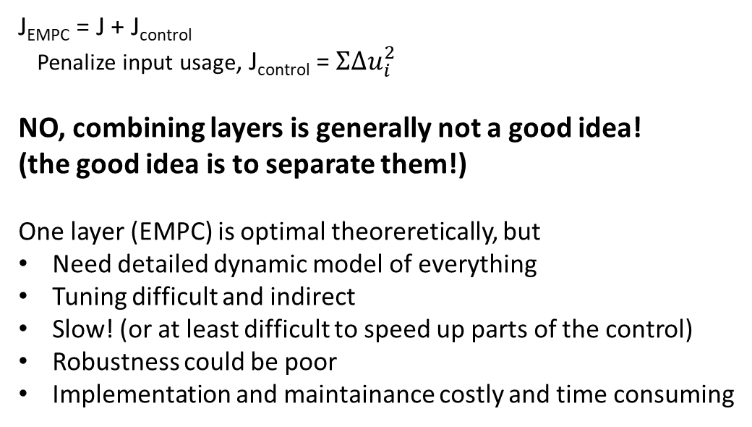
Combine control and optimization into one layer?
EMPC: Economic model predictive “control”’
J_{EMPC} = J + J_{control}
Penalize input usage, J_{control} = $ΣΔu_{i}^{2}$
NO, combining layers is generally not a good idea!
(the good idea is to separate them!)
One layer (EMPC) is optimal theoreretically, but
Need detailed dynamic model of everything
Tuning difficult and indirect
Slow! (or at least difficult to speed up parts of the control)
Robustness could be poor
Implementation and maintainance costly and time consuming
Economic
cost J
EMPC
(no setpoints,
CV1, CV2)
setpoint
setpoint
Typical economic cost function:
J [$/s] = cost feed + cost energy – value products
PROCESS
CV = controlled variable
RTO = real-time optimization

Slide 43
Combine control and optimization into one layer?
EMPC: Economic model predictive “control”
Another thing: EMPC is not even control (for me).
My definition of «control» is that the objective is to track setpoints
I would call «Economic MPC» for «Dynamic economic optimization» or «Dynamic RTO»
I would not even call it «optimizing control»
  I use this term when the setpoints are directly related to economics,
  like control cost gradient to zero (J_{u}=0)
Conclusing EMPC: Use only when economics are truly dynamic (batch, frequent grade change)
Economic
cost J
EMPC
(no CV1)
setpoint
setpoint
PROCESS
CV = controlled variable
RTO = real-time optimization

Slide 44
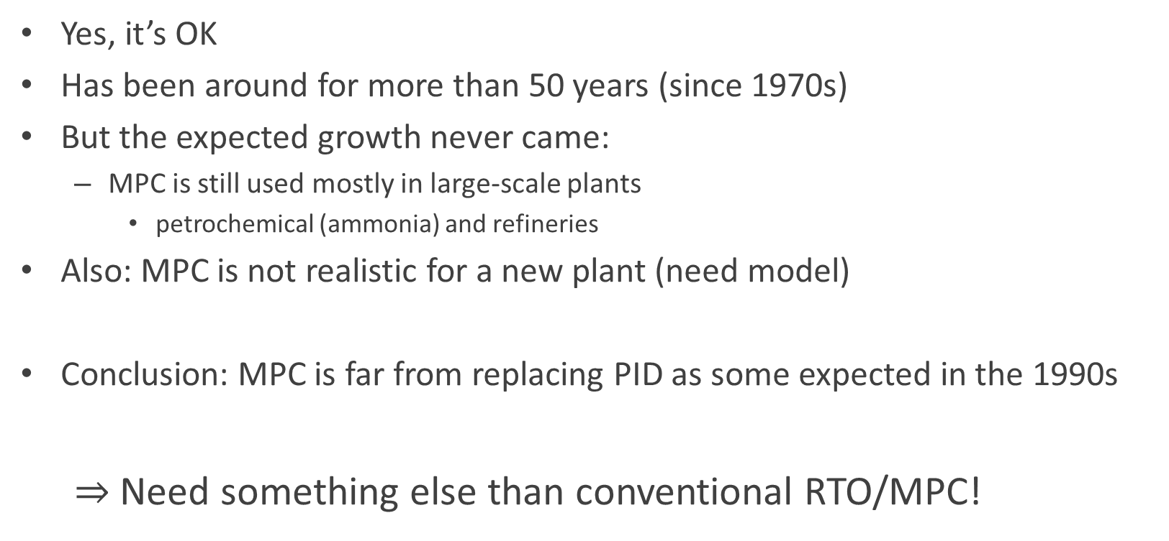
What about «conventional» MPC and RTO?
Yes, it’s OK
Has been around for more than 50 years (since 1970s)
But the expected growth never came:
  MPC is still used mostly in large-scale plants
    petrochemical (ammonia) and refineries
Also: MPC is not realistic for a new plant (need model)
Conclusion: MPC is far from replacing PID as some expected in the 1990s
  $⇒$Need something else than conventional RTO/MPC!
MPC = model predictive control
RTO = real-time optimization

Slide 45
A more fundamental problem with MPC / EMPC
All claimed stability results are «wrong»
They assume that we can measure all states perfectly
… or estimate them with a separate estimator block (LQG)

Slide 46

John Doyle (1985):
There are two ways a theorem can be wrong
(from an engineering point of view):
Either it’s simply wrong
Or the assumptions make no sense
Fact:
Essentially all stability and convergence results for optimal control, MPC and nonlinear control assume full state information, that is, perfect measurement of all states (LQ-control)
Or they assume that one can simply add a Kalman filter for any unmeasured states (LQG)

Slide 47
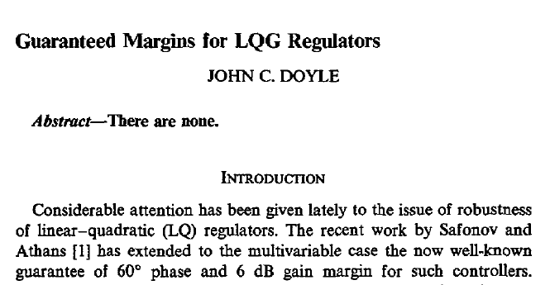
Practical «Solution» for some cases: Loop transfer recovery (LTR).
Artificial small weight on measurement noise to make estimator fast

Slide 48

Doyle counterexample
w
y
u
G(s)
$$y=\frac{1}{{(s−1)}^{2}} u$$
%Process
A=[1 1; 0 1]; B=[0;1]; C=[1 0]; D=0;
SYS=ss(A,B,C,D), G=tf(SYS)
s=tf('s'); Gd=G*s;
% LQG from Doyle with sw=1
q=1; Q=[1 1; 1 1]; QXU = blkdiag(q*Q,1);
sw=1; QW=[1 1;1 1]; QWV = blkdiag(sw*QW,1);
KLQG = lqg(SYS,QXU,QWV); C=tf(KLQG)
GML GM PM wc DM=PM/wc
LQG Doyle (w=1) 0.92 1.06 9 1.19 0.132
LQG Doyle (w=1e12) 0.904 1.0000007 18 3.97 0.252
SIMC-PID (tauc=0.1) 0.333 infinity 46 10.4 0.0774
%Note: The SIMC-PID is tuned for double integrating process
tauc=0.1; Kc=1/(4*tauc^2); taui=4*tauc ; taud=4*tauc ; tauf=tauc/10;
cpid = Kc*(1+1/(taui*s))*(taud*s+1)/(tauf*s+1);

Slide 49
“Advanced control”
Would like: Feedback solutions that can be implemented with minimum need for models
“Classical advanced regulatory control“ (ARC) based on single-loop PIDs?
  YES!
  Extensively used by industry
  Problem for engineers: Lack of design methods
    Has been around since 1930’s
    But almost completely neglected by academic researchers
  Main fundamental limitation: Based on single-loop (need to choose pairing)
ARC = Advanced regulatory control

Slide 50
QUIZ
What are the three most important inventions of process control?
Hint 1: According to Sigurd Skogestad
Hint 2: All were in use around 1940
SOLUTION
PID controller, in particular, I-action
Cascade control
Ratio control
None of these are easily implemented using MPC

Slide 51
Ratio control
Feedforward control without a model y=f(u,d)
Just process insight
Example: Food recipe
  1 part sugar
  3 parts milk
  3 parts coffee
  MIX

Slide 52

Usually: Combine ratio (feedforward) with feedback
  Example cake baking: Use recipe (ratio control = feedforward), but a good cook adjusts the ratio to get desired result (feedback)

Slide 53

Ratio control combined with feedback
The correct ratio setpoint is found by feedback control (VC) based on keeping the measured controlled variable y at its desired setpoint y_{s}..
  So also here no model is needed (just data)
F₁
F₂
Mixing
Typical ratio control scheme (solid red lines) with outer feedback loop (dashed red lines) to set the correct ratio.
In the figure, y is viscosity, but generally it can be any intensive variable

Slide 54

When should we use ratio control?
Answer: When fixing the ratio of all extensive variables (e.g., F₂/F₁) gives constant intensive variables (y).
The use of ratio control assumes the
  Scaling or scale-up property: We get the same steady-state solution if we increase all extensive variables (flows and heat rates) by the same factor compared to a basis. (Reklaitis, 1981)
For this to hold we must assume constant process efficiencies (Skogestad, 2009):
  The scaling property holds if the process efficiencies are independent of the throughput.
Similar to the use in thermodynamics, the scaling property holds for equilibrium systems. The scaling property (and thus the use of ratio control) applies to many process units, including
  Mixing
  Equilibrium reactors
  Equilibrium flash and equilibrium distillation
G.V. Reklaitis, Introduction to material & energy balances. Wiley (1983)
S. Skogestad. Chemical end energy process engineering, CRC press (2009)

Slide 55
  Cases where ratio control should not be used:
Heat exchangers (because the area is fixed during operation)
  This means, for example, that we should not fix the ratio between hot and cold flow.
  For the scaling property to hold for a heat exchanger, we would need to increase the heat transfer area A proportionally to the flow rates. This is reasonable during design but not during operation.
Non-equilibrium reactors (because the volume is fixed)
  Extent of reaction depends on kinetics and reactor volume
Compressors with varying thermodynamic efficiency
  This includes most real compressors
Mixing processes where one feed stream is fixed
Distillation with a fixed stream (e.g. heat input)

Slide 56
Intro….
How can you control a complex plant effectively using simple elements with a minimal amount of modelling?
How can you put optimization into the control layer?
Industry has been using simple and effective as “advanced regulatory control” (ARC) schemes based on PID controllers for almost 100 years. The objective of my work is to provide a systematic approach for designing such control systems.
The main competitor to ARC is MPC (model predictive control), but the costs of implementing and maintaining MPC solutions are high. Moreover, in most cases ARC solutions (including cascade, ratio, split range and selector control) are more flexible and easier to tune. The main problem right now is that the knowledge and competence about ARC strategies is very low, especially in academia, but also in industry the knowledge is dying out. The result is that people turn off good ARC applications, simply because they don't understand what they are doing.
The reason for the lack of training and knowledge is that there has a been belief in academia since the 1980s, that ARC solutions (and PID control) are old-fashioned and will soon be replaced by MPC. However, MPC has now been around for 50 years, and yet the use of MPC is far from increasing as expected. The latest hype is that, if MPC is too complex, then machine learning is the solution. No, it is not, because or the lack of rich data (with sufficiently large input excitations) in most control applications, in particular in process control.
In summary, there is a need to change the mindset of people, both in academia and industry, People need to realize that ARC solutions should be a central part of the future. MPC of course has its place, but mainly as an improvement for large-scale applications that can afford the effort.
The talk will emphasize the above points and in addition present a systematic approach to ARC methods based on my recent paper (which is open access).
Reference: Sigurd Skogestad, ''Advanced control using decomposition and simple elements''.
Published in: Annual Reviews in Control, vol. 56 (2023), Article 100903 (44 pages).
Sigurd Skogestad is a Professor in chemical engineering at the Norwegian University of Science and Technology (NTNU) in Trondheim. He received his PhD from Caltrech in 1987 and he is the principal author together with Ian Postlethwaite of the book "Multivariable feedback control" published by Wiley in 1996 (first edition) and 2005 (second edition). The goal of his research is to develop simple yet rigorous methods to solve problems of engineering significance. Research interests include the use of feedback as a tool to (1) reduce uncertainty (including robust control), (2) change the system dynamics (including stabilization), and (3) generally make systema more well-behaved (including self-optimizing control). Other interests include limitations on performance in linear systems, control structure design and plantwide control, interactions between process design and control, and distillation column design, control and dynamics. His other main interests are mountain skiing (cross country), orienteering (running around with a map) and grouse hunting.

Slide 57




ARC: Standard Advanced control elements
Each element links a subset of inputs with a subset of outputs. Results in simple local design and tuning
ARC = advanced reguklatory control
Sigurd Skogestad, ''Advanced control using decomposition and simple elements''.
Annual Reviews in Control, vol. 56 (2023), Article 100903 (44 pages).

Slide 58


Common ARC elements
E1. Cascade control
Have Extra output (state) measurements
E2. Ratio control
“Feedforward” for mixing process
E12. Decoupling elements
Have interactive process
E13. Linearization elements / Adaptive gain
Have Nonlinear process
E5-E7. Split-range control (or multiple controllers or VPC)
Need extra inputs (MV) to handle all conditions (steady state) (MV-MV switching)
E3. Valve position control (VPC) (Input resetting/Midranging control)
Have extra inputs dynamically
E4. Selectors
Have changes in active constraints (CV-CV switching)
Often static nonlinear «function block»
One unifying approach is «Transformed inputs» (similar to feedback linearization)
ARC = Advanced regulatory control
VPC = Valve position control
CV = Controlled variable
MV = manipulated variable

Slide 59

How design standard ARC elements?
Industrial literature (e.g., Shinskey).
Many nice ideas. But not systematic. Difficult to understand reasoning
Academia: Very little work
  I feel alone

Slide 60
Constraint switching
(because it is optimal at steady state)
CV-CV switching
  Control one CV at a time
  Use selectors
MV-MV switching
  Use one MV at a time
  Use split range control, split parallel control or VPC
MV-CV switching
  MV saturates so must give up CV
  Two alterntaives:
    Simple («do nothing»). If we followed input saturation rule
    Complex (repairing of loops). Need to combine MV-MV and CV-CV switching
Process
Process
Process
Process

Slide 61

Example adaptive cruise control:
CV-CV switch (min-selector) followed by MV-MV switch (split range control)

Slide 62
QUIZ Compressor control
SOLUTION
F_{max}=
19 t/h
MAX
Zmin=0
MAX
FC
MAX
Zmin=0
z
z
z
F_{min}=
10 t/h
p_{min}=
30bar
F_{min}=
10 t/h
FC
PC
FC
PC
p_{max}=
37bar
p₀
F₀
p
F
p₀
F₀
p
F
CW
CW
Suggest a solution which achieves
p< p_{max}= 37 bar (max delivery pressure)
P₀ > p_{min} = 30 bar (min. suction pressure)
F < F_{max} = 19 t/h (max. production rate)
F₀ > F_{min} = 10 t/h (min. through compressor
to avoid surge)
All these 4 constraints are satisfied by a large z
-> MAX-selector

Slide 63

Cow case study (Norway, outdoor 15C to -20C)
Fan: u₁
CO₂ transmitter
Happy cows
y1=C (CO2) less than 1000 ppm
y2=T between 5C and 20C
Not too much draft or noise from fan
  50% fan speed is good
Unhappy cows
y2=T less than 0C
Even more unhappy
y1=C above 3000 ppm (poor air quality)
MVs
u1=fan (cheap)
u2=heater (expensive)
Heater: u₂
Temperature transmitter
CT
TT
Disturbances:
Number of cows (they generate CO2 and heat)
  Because of heat from cows it’s always colder outside
Outdoor temperature (between 15C and -20C)
  The cows are outside in the summer
M.Adlouni / Gemini

Slide 64
Lower CO2 (less than 1000ppm) is satisfied by large fan speed $⇒$ MAX-selector
u₁=50%
SP=1000ppm
Happy cows
y1=C (CO2) less than 1000 ppm
y2=T between 5C and 20C
Not too much draft or noise from fan
  50% fan speed is good
Unhappy cows
y2=T less than 0C
Even more unhappy
y1=C above 3000 ppm (poor air quality)
MVs
u1=fan (cheap)
u2=heater (expensive)
CC
MAX
u1
CI
TI

Slide 65

Winter: T (inside) may drop to 5C.
Control: Higher T (above 5C) is satisfied by small fan speed $⇒$ MIN-selector
u₁=50%
SP=5C
MIN
TC
SP=1000ppm
Happy cows
y1=C (CO2) less than 1000 ppm
y2=T between 5C and 20C
Not too much draft or noise from fan
  50% fan speed is good
Unhappy cows
y2=T less than 0C
Even more unhappy
y1=C above 3000 ppm (poor air quality)
MVs
u1=fan (cheap)
u2=heater (expensive)
CC
MAX
u1
CI
TI

Slide 66
Winter (colder): Cannot reduce fan more because CO2 > 1000 ppm.
Start heater. Use split parallell control (could use split range control instead)
u₁=50%
SP=5C
MIN
TC
SP=1000ppm
Happy cows
y1=C (CO2) less than 1000 ppm
y2=T between 5C and 20C
Not too much draft or noise from fan
  50% fan speed is good
Unhappy cows
y2=T less than 0C
Even more unhappy
y1=C above 3000 ppm (poor air quality)
MVs
u1=fan (cheap)
u2=heater (expensive)
CC
MAX
SP=4C
u1
TC
CI
u2
TI

Slide 67

Winter (even colder outide): Heater at max and T drops to 0C.
To avoid freezing unhappy cows: reduce fan speed and accept CO2 > 1000 ppm
Recall: Higher T (above 0C) is satisfied by small fan speed $⇒$ MIN-selector
u₁=50%
SP=5C
MIN
TC
SP=1000ppm
Happy cows
y1=C (CO2) less than 1000 ppm
y2=T between 5C and 20C
Not too much draft or noise from fan
  50% fan speed is good
Unhappy cows
y2=T less than 0C
Even more unhappy
y1=C above 3000 ppm (poor air quality)
MVs
u1=fan (cheap)
u2=heater (expensive)
CC
MAX
SP=0C
TC
MIN
SP=4C
u1
TC
CI
u2
TI

Slide 68

Winter (even colder outside): CO2 reaches unacepptable level (3000ppm)
Recall: Lower CO2 is satisfied by large fan speed $⇒$ MAX-selector
u₁=50%
SP=5C
MIN
TC
SP=1000ppm
Happy cows
y1=C (CO2) less than 1000 ppm
y2=T between 5C and 20C
Not too much draft or noise from fan
  50% fan speed is good
Unhappy cows
y2=T less than 0C
Even more unhappy
y1=C above 3000 ppm (poor air quality)
MVs
u1=fan (cheap)
u2=heater (expensive)
CC
MAX
SP=0C
TC
SP=3000ppm
MIN
CC
MAX
SP=4C
u1
TC
CI
u2
TI

Slide 69

Lower T (below 20C) is satisfied by large fan speed $⇒$ MAX-selector
(Consistent with large fan speed (MAX-selector) to keep CO2 < 3000ppm!)
u₁=50%
SP=5C
MIN
TC
SP=1000ppm
Happy cows
y1=C (CO2) less than 1000 ppm
y2=T between 5C and 20C
Not too much draft or noise from fan
  50% fan speed is good
Unhappy cows
y2=T less than 0C
Even more unhappy
y1=C above 3000 ppm (poor air quality)
MVs
u1=fan (cheap)
u2=heater (expensive)
CC
MAX
SP=0C
TC
SP=3000ppm
MIN
SP=20C
CC
MAX
TC
SP=4C
u1
TC
CI
u2
TI

Slide 70
FINAL OPTIMAL CONTROL STRUCTURE:
4 TCs, 2 CCs, 4 selectors
u₁=50%
SP=5C
MIN
TC
SP=1000ppm
CC
MAX
SP=0C
Happy cows
y1=C (CO2) less than 1000 ppm
y2=T between 5C and 20C
Not too much draft or noise from fan
  50% fan speed is good
Unhappy cows
y2=T less than 0C
Even more unhappy
y1=C above 3000 ppm (poor air quality)
MVs
u1=fan (cheap)
u2=heater (expensive)
TC
SP=3000ppm
MIN
SP=20C
CC
MAX
TC
SP=4C
u1
TC
CI
u2
TI
If extreme cold: Use blankets for cows
If very hot: Spray water on cows

Slide 71
Conclusion. The future of process control
1. «Advanced regulatory control» (ARC) or «Advanced PID»:
  Works very well in many cases
  Optimization by feedback (active constraint switching)
  Need to pair input and output.
    Advantage: The engineer can specify directly the solution
    Problem: Unique pairing may not be possible for complex cases
  Need model only for parts of the process (for tuning)
  Challenge: Need better teaching and design methods
2. MPC may be better (and simpler) for some complex multivariable cases
  But combine with lower-layer PID (cascade and ratio control)
  Main challenge MPC: Need dynamic model for whole process (costly)
  Other challenge: Tuning may be difficult
(3.= Machine learning: NO, not enough relevant data )

Slide 72


In summary, ‘‘PID control’’ researchers are recommended
to switch their attention to ‘‘advanced PID control’’, that is, the
interconnection of the PID controller with the other advanced control
elements.
Sigurd Skogestad, ''Advanced control using decomposition and simple elements''.
Annual Reviews in Control, vol. 56 (2023), Article 100903

Slide 73


Optimal centralized
Solution (EMPC)
Academic process control community fish pond
Simple solutions that
work (ARC = PID++)
Sigurd (me)
Jose Luis
Please join me, we feel a little alone

Slide 74


Slide 75










NOTE
«That something works doesn’t mean that it couldn’t be much better or simpler (PID), or even both better and simpler at the same time».
Example: Sensor in wrong room
y₁
y₂
IT WORKS BY THE MAGIC OF FEEDBACK!
But it could be much better
G
y₁
y₂
y = temperature = output = controlled variable

