Slide 1
Negative feedback amplifier
Sigurd Skogestad
2024

Slide 2
Linearizing effect of feedback

Slide 3
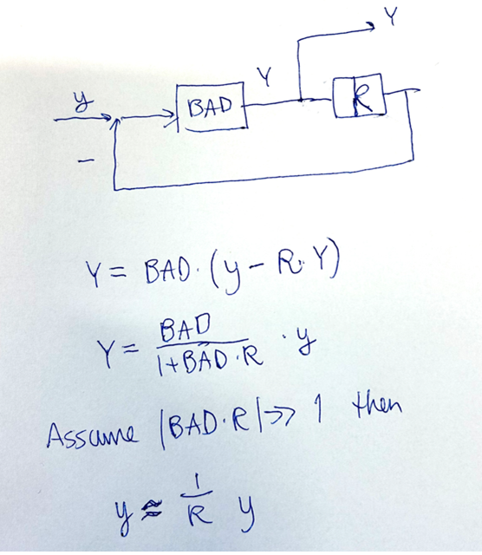
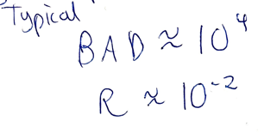
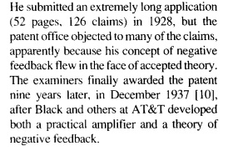
The negative feedback amplifier
Harold Black (on a New York ferry, 02 August 1927):
Amplification was required to send telephone signals across the US in the 1920s and it required 12 amplifications on the way, so they better be fairly accurate.
The original idea of all engineers is to think feedforward (Bell Labs)
Y = BAD y

Slide 4
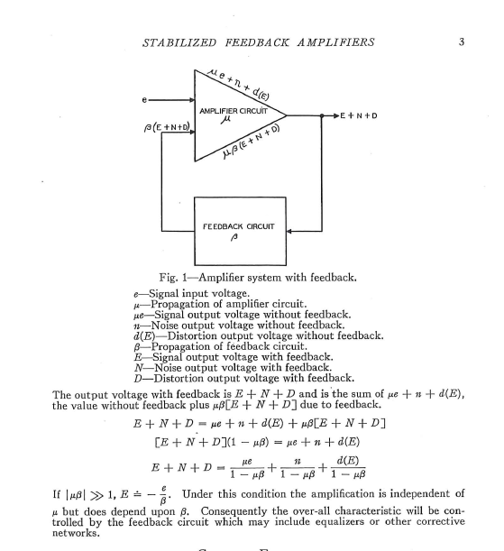
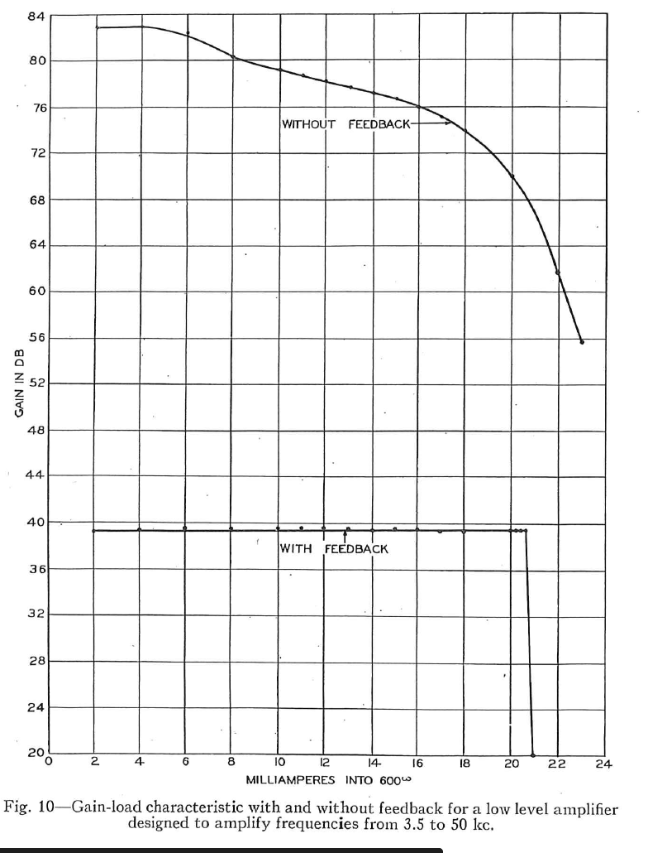
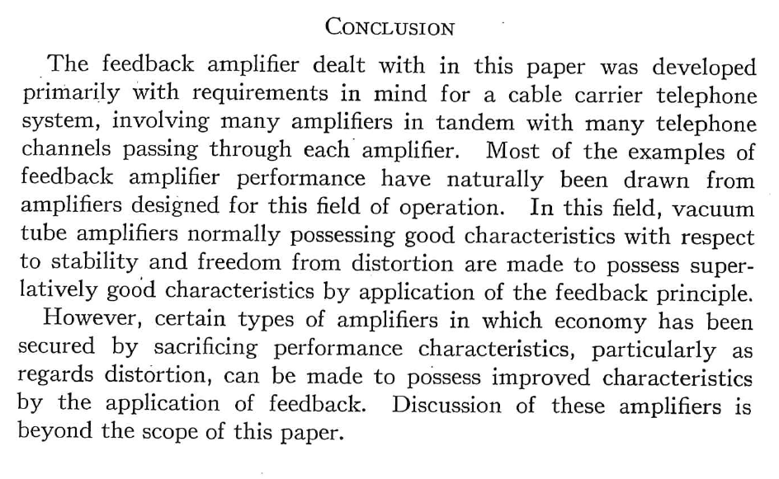
Experiment
10000
1000
100
10
Bad amplifier:
$μ≈10000$
Accurate resistance:
$$β≈0.01$$
Get
$$μβ≈100≫1$$
Resulting amplification (negative feedback)
$$\frac{μ}{1+μβ}≈\frac{1}{β}=100$$
Proving that Black’s invention worked also initiated the idea of freqyency analysis( Nyquist)

Slide 5
Linearization of valve using cascade control
Benefits: 1. Local distrurbance rejection, 2. Linearization
Does nonlinearity disappear?
WITHOUT CASCADE
WITH CASCADE (2 controllers)
flow in
measured
level
H_{s}
flow in
measured
level
H_{s}
y=H
y=H
LC
LC
MV=z
valve position
master
MV=q_{s}
FC
y₂=q
slave
MV₂=z
measured
flow
flow out
flow out

Slide 6
No, it moves to the time constant for slave loop – OK if we we have time scale separation between master and slave
Nonlinear valve with varying gain k₂: G₂(s)= k₂(z) / ($τ2$s+1)
Slave (flow) controller K₂: PI-controller with gain K_{c2} and integral time $τ$_{I}= $τ_{2}$ (SIMC-rule). Get
$L_{2}=K_{2}\left(s\right)G_{2}\left(s\right)=\frac{K_{c2}k_{2} }{τ_{2}s}$
With slave controller: Transfer function T₂ from y_{2s} to y₂ (as seen from master loop):
T₂ = L₂/(1+L₂) = 1/($τ$_{C2} s + 1), where $τ$_{C2} = $τ_{2}$/(k₂ K_{c2})
Linearization: Gain for T₂ is always 1 (independent of k₂) because of intergal action in the inner (slave) loop
But: Gain variation in k₂ (inner loop) translates into variation in closed-loop time constant $τ$_{C2}. This may effect the master loop
f(z)
1
linear valve
0
0
1
k₂(z) = slope = df/dz
G₁T₂ = «Process» for tuning master controller K₁

