Slide 1
ECONOMIC PROCESS DESIGN, OPERATION
& PLANTWIDE CONTROL
An Intensive Industrial Short Course
Module 2
Chemical Process Design: Qualitative Tradeoffs

Slide 2
A Typical Chemical Process
A
B
22
AB
22
C
ABCD
A + B → C
C + B → D
CD
D

Slide 3
ChE Design Issues
Reactor
  How big Volume
  How hot Temperature
  What internal composition
Recycle and Product Columns
  How tall Height
  How thick Diameter
  Pressure
  Feed location
  Reboiler and Condenser size

Slide 4
Reactor Design Issues
All reactions proceed faster
Relative change
side reaction rate > main reaction rate
Higher conversion of reactants (less recycle load)
Produce more junk D per kg C
AB
Hotter
ABCD
Reaction rates not affected
Higher conversion of reactants (less recycle load)
Bigger
A + B → C
C + B → D
Excess A
Environment
B composition << A composition
Suppresses side reaction

Slide 5
Distillation Basics
Ab
.
.
.
AB
.
.
.
Ba

Slide 6
Distillation Basics
Comp. Profile
Temp. Profile
Condenser
Heavy Component
Light component
Reboiler
0
Conc.
1
T_{c}
Temperature
T_{b}
T_{c:}Condenser T, T_{b}: Reboiler T
T_{c} < T_{b}

Slide 7
Distillation Design Basics
N_{R} increasing
B leakage up the top decreases
N_{S} increasing
A leakage in bottoms decreases
P
L increasing
B leakage up the top decreases
A leakage in bottoms increases
22
L
Ab
A leakage in bottoms decreases
B leakage in top increases
V increasing
N_{R}
P increasing
Usually, separation more difficult
AB
N_{S}
Run column at lowest pressure with a water cooled condenser
V
Ba

Slide 8
Distillation Design Extremes
Total Reflux (N_{MIN})
  Shortest possible tower for desired separation
  Infinite reboiler duty for given feed rate
Minimum Reflux (L_{MIN})
  Infinitely tall column that gives desired separation
  Minimum reboiler duty for given feed rate
22
L
Ab
N_{R}
AB
N_{S}
V
Ba

Slide 9
Distillation Design Economic Trade-off
Given x_{Dist} and x_{Bot}
J = Capital Cost/3 + Yearly Energy Cost
Near Optimum Design
DESIGN RULES OF THUMB
L ~ 1.2-1.3 L_{MIN}
N ~ 2-3 N_{MIN}
J
L_{MIN}
L →

Slide 10
Designing a Chemical Process
A
B
22
AB
22
T_{Rxr}
V_{Rxr}
x^{B}_{Rxr}
C
x^{C}_{Dist1}
x^{D}_{Dist2}
ABCD
A + B → C
C + B → D
C production rate and quality specified
x^{B}_{Bot1}
CD
x^{C}_{Bot2}
D

Slide 11
The Process Design Problem
Given objectives
  Production rate of desired product
  Product quality guarantees: x^{B}_{Dist2}^{MAX}, x^{D}_{Dist2}^{MAX}
Economic Design Objective
  Maximize J over design variables
  J = [Product Revenue - Raw Material - Energy Cost] per year - Capital Cost/3

Slide 12
Qualitative Separation Tradeoffs
A
B
22
AB
22
C
x^{C}_{Dist1}
x^{D}_{Dist2}^{MAX}
J
ABCD
log[x^{C}_{Dist1}]
A + B → C
C + B → D
J
Optimum
log[x^{C}_{Bot2}]
x^{B}_{Bot1}^{MAX}
x^{C}_{Bot2}
CD
D

Slide 13
Qualitative Reactor Trade-Offs
A
B
J
V_{Rxr}
22
AB
22
T_{Rxr}
V_{Rxr}
x^{B}_{Rxr}
C
ABCD
A + B → C
J
C + B → D
x^{B}_{Rxr}
J
T_{Rxr}
CD
D

Slide 14
Qualitative Tradeoffs’ Summary
Variable Choice Comment
T_{Rxr} Optimum Value Selectivity vs recycle & reactor cost
V_{Rxr} Optimum Value Reactor cost vs recycle cost
x^{B}_{Rxr} Optimum small value Selectivity vs recycle cost
x^{D}_{Dist2} Maximum allowed No product giveaway
x^{B}_{Bot1} Maximum allowed No product giveaway
x^{C}_{Bot2} Optimum small value Product loss vs product column cost
x^{C}_{Dist1} Optimum small value Recycle vs recycle column cost
Simple qualitative reasoning reveals much about the nature of the design problem and associated trade-offs

Slide 15
The Overall Design Approach
Qualitative
Reasoning
Quantitative
Optimization
Process
Simulation
Lectures supplemented with a simulation laboratory

Slide 16
Need for “Thought Experiments”
To understand the physics of the process
Develop intuitive engineering judgment
Forces one to think, understand and finally explain the dominant effects in “plain English”
Essential to the making of a good engineer

Slide 17
The Design Procedure
Given a process flowsheet
Perform qualitative trade-offs thought experiments
  Obtain “dominant” and “local” design variables
Use heuristics to fix “local” design variables
Simulate process to quantitatively obtain optimum for dominant design variables

Slide 18
Summary
I hear and I forget, I see and I remember, I do and I understand.
Confucius
If you can't explain it to a six year old, you don't understand it yourself.
Einstein

Slide 19
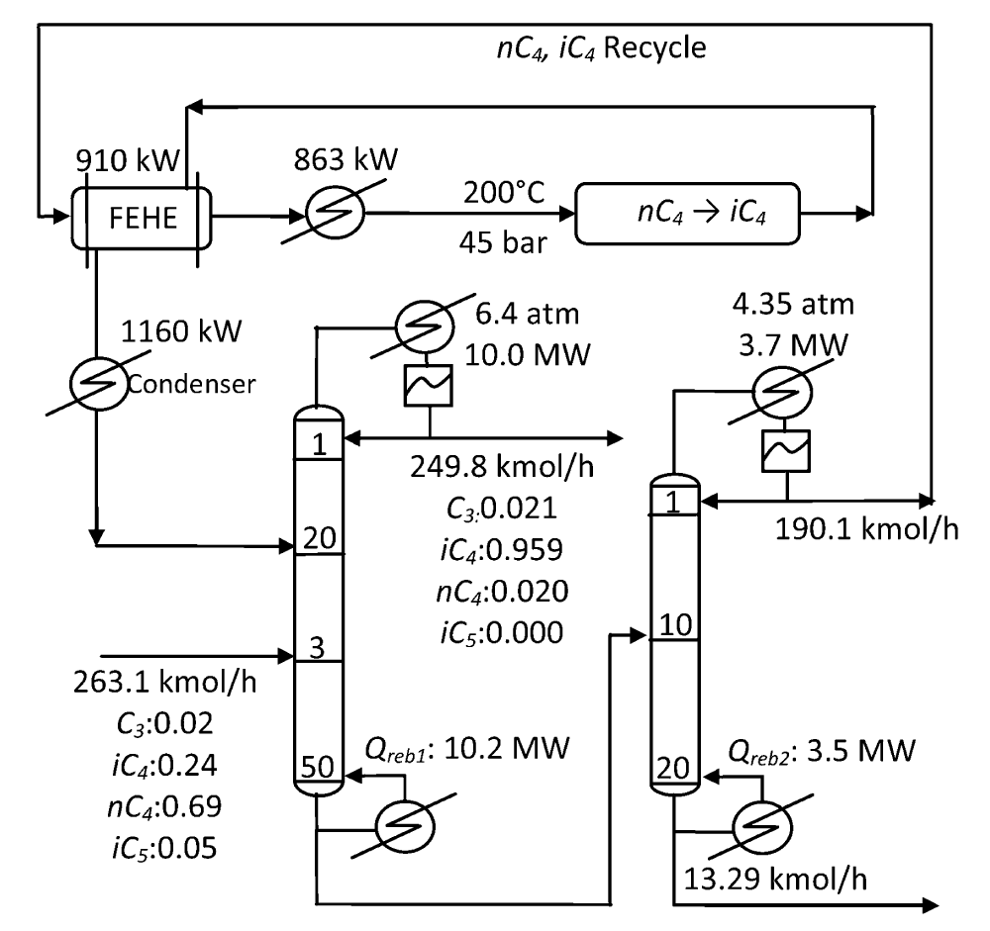
Qualitative Process Design Exercise 1
Butane Isomerization process

Slide 20
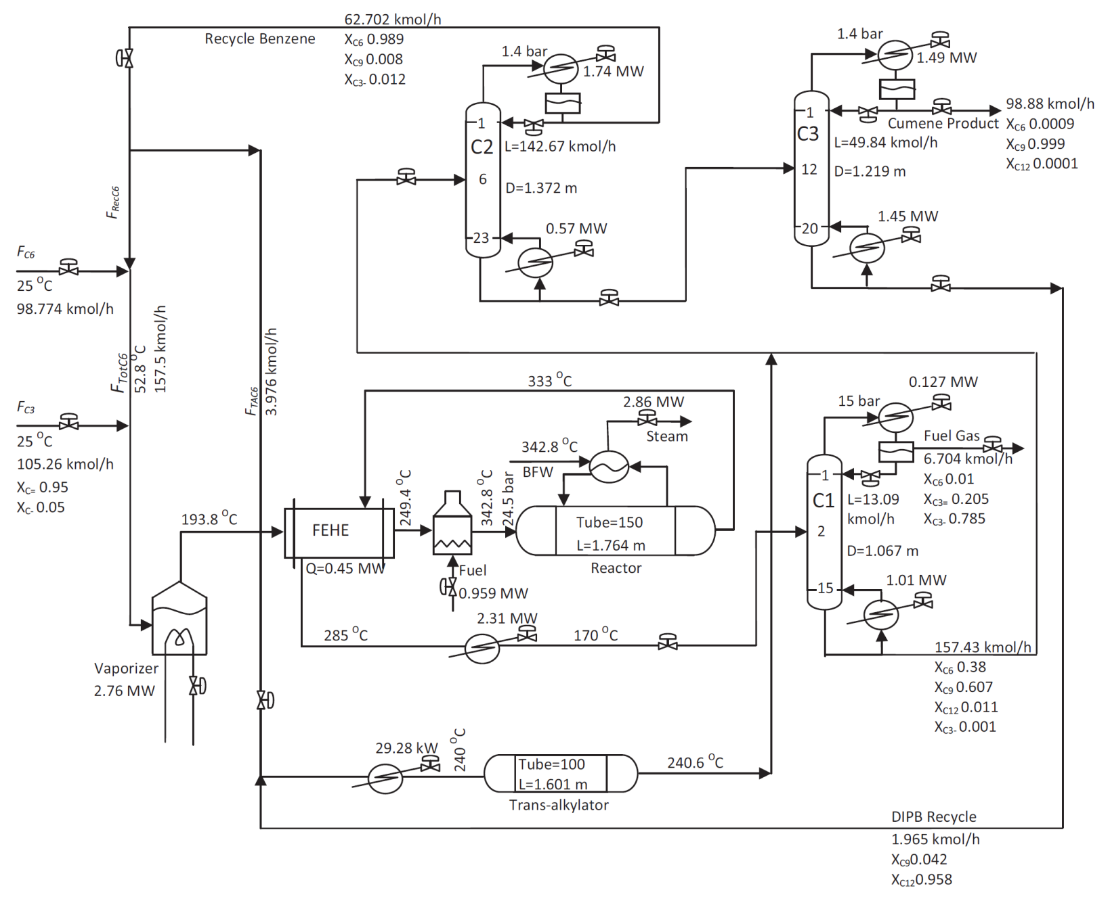
Qualitative Process Design Exercise 2
Cumene Process

Slide 21
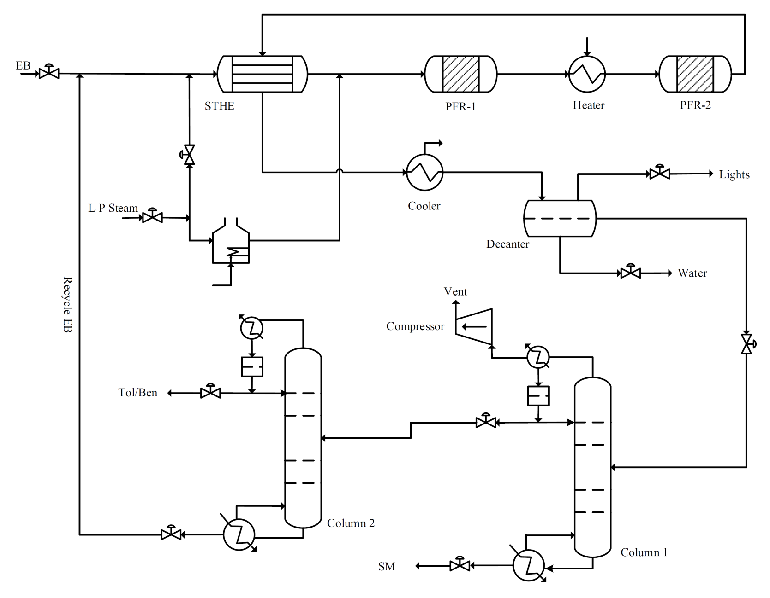
Qualitative Process Design Exercise 3
Styrene Monomer Process

