Slide 1
ECONOMIC PROCESS DESIGN, OPERATION
& PLANTWIDE CONTROL
An Intensive Industrial Short Course
Module 1.2
The DOF Specification Conundrum

Slide 2
Choosing Specification Variables
Given the process operating DOF, what variables to specify to exhaust the DOF
Why does it matter?
Considerations in choosing the best “specified variable set”

Slide 3
The “Recycle” Effect
Recycle A, B
A
SET 1
F_{A}
F_{B}
Q_{Rxr}
LVL_{Rxr}
L
Q_{R}
Comments
Any excess A/B must go out with C (CONTAMINATION)
T_{Rxr} floats
C impurity in recycle floats
Impurity in product C floats
B
A + B → C
SET 2
F_{A}
F_{B}
T_{Rxr}
LVL_{Rxr}
x_{D}^{C}
x_{B}^{B}
Comments
Any excess A/B must go out
with C (CONTAMINATION)
Clashes with OMB (No convergence)
C

Slide 4
The “Recycle” Effect
Recycle A, B
A
SET 3
F_{A}
F_{Rxr}^{B}
T_{Rxr}
LVL_{Rxr}
x_{D}^{C}
x_{B}^{B}
Comments
F_{Rxr}^{A} floats with F_{A}
F^{B} is calculated as make-up
Specification set does not clash with convergence of OMB
B
A + B → C
SET 4
F_{Rxr}^{A}
F_{Rxr}^{B}
T_{Rxr}
LVL_{Rxr}
x_{D}^{C}
x_{B}^{B}
Comments
F_{A} and F_{B} are now calculated make-up streams
Specification set does not clash with convergence of OMB
C

Slide 5
Overall Material Balance and On-Target Product Quality
Product quality constraint and OMB constraint require fresh feeds to be stoichiometrically balanced
Stoichiometric balancing automatically achieved by fixing recycle loop component flow rates
DO NOT SPECIFY VARIABLES LINKED BY OVERALL MATERIAL/ENERGY BALANCE

Slide 6
Good vs Poor Specs: Example 1
D & B
Q_{C} & Q_{R}
x_{hk}^{D} and x_{hk}^{B}
L & Q_{R}
x_{hk}^{D} & x_{lk}^{B}

Slide 7
Good vs Poor Specs: Example 2
A
B
A + B → C
C + B → D
22
AB
22
C
ABCD
F_{A} F_{B} T_{Rxr} LVL_{Rxr} [L/D D]_{Col1} [L/D D]_{Col2}
F_{A} F_{B} T_{Rxr} LVL_{Rxr} [x_{hk}^{D} x_{lk}^{B}]_{Col1} [x_{hk}^{D} x_{lk}^{B}]_{Col2}
F_{A} F_{Rxr}^{B} T_{Rxr} LVL_{Rxr} [x_{hk}^{D} x_{lk}^{B}]_{Col1} [x_{hk}^{D} x_{lk}^{B}]_{Col2}
F_{Rxr}^{A} F_{Rxr}^{B} T_{Rxr} LVL_{Rxr} [x_{hk}^{D} x_{lk}^{B}]_{Col1} [x_{hk}^{D} x_{lk}^{B}]_{Col2}
CD
D

Slide 8
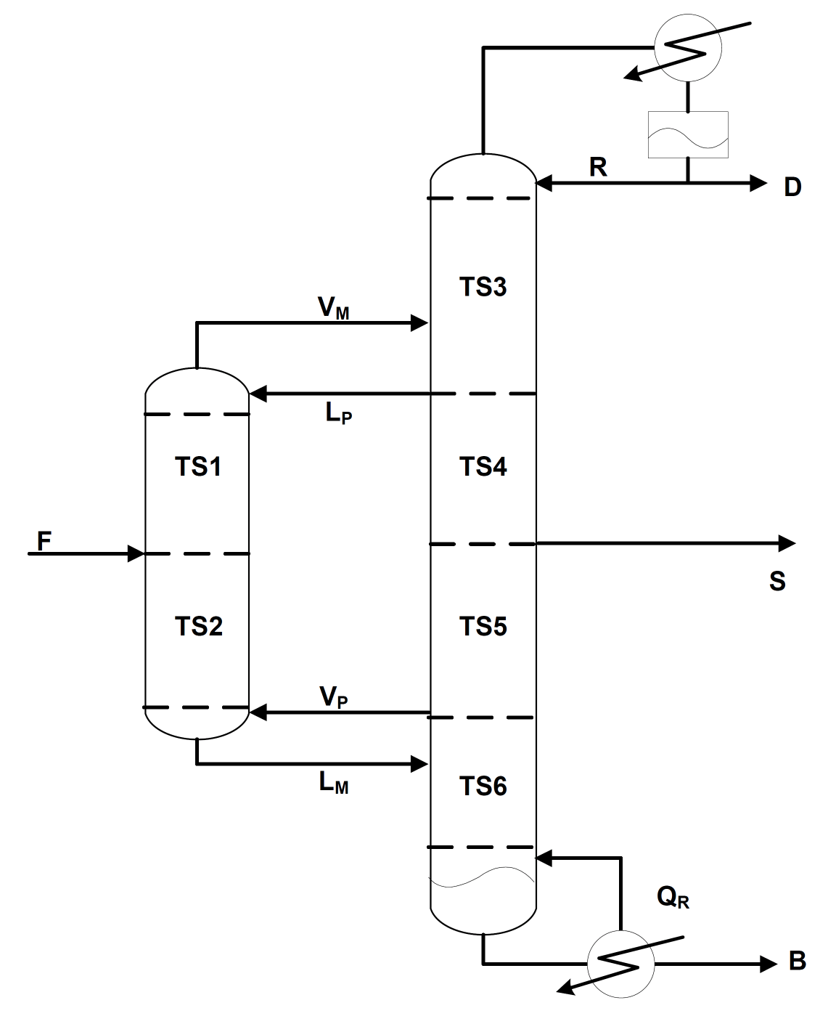
Good Specs Exercise 1

Slide 9
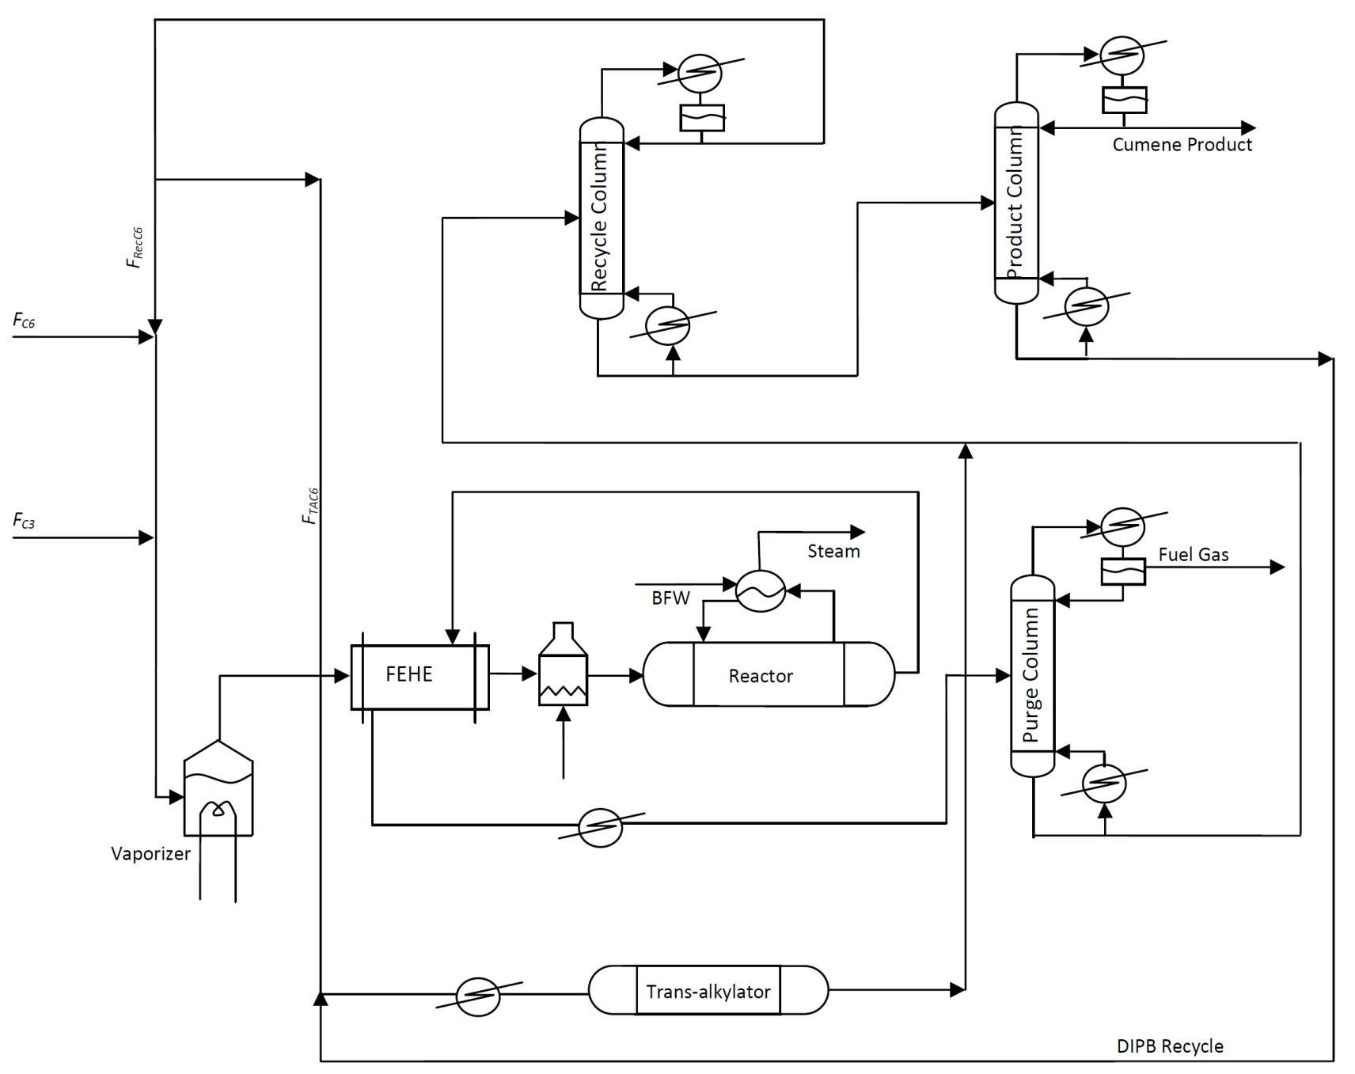
Good Specs Exercise 2

Slide 10
Good Specs Exercise 3
Fresh Benzene
Fresh Ethylene
Ethylene Benzene
Ethyl Benzene Process

Slide 11
Good Specs Example 4
Recycle I excess ammonia recycle
HX-1
Gas recycle
Packed Bed
Reactor
FEHE
FNH₃
Vaporizer
Compressor 1
Compressor 2
Total NH₃
310 º F
HX-2
FIPA
Flash Drum
MIPA
product recovery
MIPA
Recovery column
(Column 2)
water rich stream
Ammonia
Recovery column
(Column 1)
HX-3
Decanter
Water recovery column
(Column 3)
DIPA rich stream
Water
Recycle II DIPA (total) , IPA(total) and H₂O (inseparable) recycle

