Slide 1
Supervisory control
Decomposition: vertical and horizontal
Constraint switching.

Slide 2
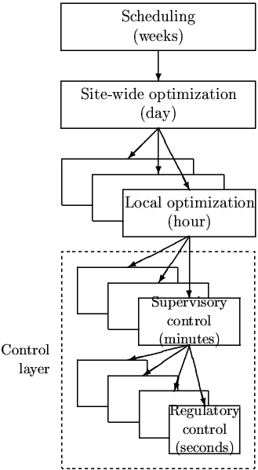
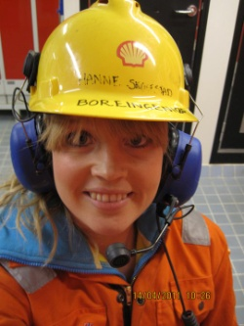
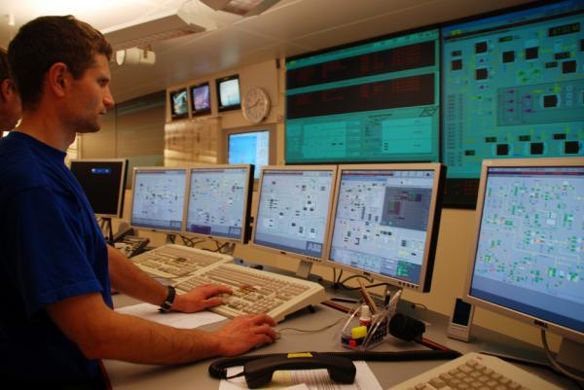
Practical operation: Hierarchical (cascade) structure
based on time scale separation
Manager
NOTE: Control system is
decomposed both
Hierarhically (in time)
Horizontally (in space)
Process engineer
Operator/RTO
Status industry:
RTO is rarely used.
MPC is used in the petrochemical and refining industry, but in general it is much less common than was expected when MPC «took off» around 1990
ARC is common
Manual control still common…
Operator/Advanced regulatory control (ARC)/MPC
PID-control
May include some
ratio/feedforward and cascade control
u = valves

Slide 3
Two fundamental ways of decomposing the controller
Vertical (hierarchical; cascade)
Based on time scale separation
Decision: Selection of CVs that connect layers
Horizontal (decentralized)
Usually based on distance
Decision: Pairing of MVs and CVs within layers
CV1
CV2
CV = controlled variable
MV = manipulated variable

Slide 4
What is the difference between optimization and control?
My definition:
Optimization:
Minimizes economic cost
Control:
Follow setpoints y_{s}
CV1_{s}
CV2_{s}
u = valves

Slide 5
Cost functions in layers
Manager
Process engineer
RTO: Minimize economic cost
J$ = cost feed + cost energy – value products
RTO (usually steady state)
CV1_{s}
Setpoint control
J_{c1} = Q(y₁-y_{1s})² + RΔu₁² (MPC)
(+ look after other variables,
Avoid constraints)
”Advanced control”/MPC
u₁=CV_{s}
PID: Stabilize + avoid drift
J_{c2} = Q(y₂-y_{2s})² + RΔu²
+ look at Gain margin…
(or just use SIMC-rules!)
PID-control
May include some
feedforward and cascade
u = valves

Slide 6
Use of data in layers (feedback)
Engineer: Must choose what to control (H and H₂)
H and H₂ are usually selection matrices
Typically:
y₁=Hy = active constraints + «self-optimizing» variables
y₂=H₂y = drifting variables (levels, pressures, temperatures)
y_{1s}
y₁=CV₁
y_{2s}
y₂=CV₂
H
H₂
u = valves
d
PROCESS
n^{y}
y = all measurements

Slide 7
Use of data
Optimization layer:
Needs model parameters and disturbances
Estimates of disturbances and present state
(including model parameters, e.g. stage efficiency)
y_{1s}
y₁=CV₁
MPC
^ ^
d, x
y_{2s}
y₂=CV₂
Data reconciliation (static)
Or
Estimator (e.g. Kalman filter)
H
H₂
u = valves
d
PROCESS
n^{y}
y = all measurements (including u and possibly d)

Slide 8
Use of models
RTO layer:
Nonlinear model of whole process
usually physical and static
y_{1s}
y₁=CV₁
MPC layer:
Multivariable dynamic linear model for each unit
usually from data
MPC
^ ^
d, x
y_{2s}
y₂=CV₂
Data reconciliation (static)
Or
Estimator (e.g. EKF)
PID-layer:
Dynamic linear model for each loop
usually from data.
May use physical model for linearization, decoupling and feedforward
see: input transformation
H
H₂
Nonlinear model
u = valves
d
PROCESS
n^{y}
y = all measurements (including u and possibly d)

Slide 9
Is there a problem with model consistency between layers?
Quote from a recent paper I reviewed
“One of the difficulties in practical implementations of classic Real-Time Optimization (RTO) strategy is the integration between optimization (RTO) and control layers (MPC), mainly due to the differences between the models used in each layer, which may result in unreachable setpoints coming from optimization to the control layer. In this context, Economic Model Predictive Control (EMPC) is a strategy where optimization and control problems are solved simultaneously.”
Is this likely to happen?
No, This is a myth and no reason for choosing EMPC
Truth: With integral action in the control layer (MPC), the process will go to the setpoints (y_{1s}=CV1_{s}) desired by the RTO layer, irrespective of any model error in the MPC layer
  J_{MPC} = Q(y₁-y_{1s})² + RΔu₁²
Of course, the setpoints from the RTO layer must correspond to a feasible steady state, but the model in the MPC layer does not affect this
Of course, there may be economic losses dynamically, for example, dynamic constraints may mean it takes some time to reach the setpoints
(day)
RTO
s
s
PROCESS

Slide 10
Main objectives operation
Economics: Implementation of acceptable (near-optimal) operation
Regulation: Stable operation around given setpoint
ARE THESE OBJECTIVES CONFLICTING?
IS THERE ANY LOSS IN ECONOMICS?
Usually NOT
  Different time scales
    Stabilization fast time scale
  Stabilization doesn’t “use up” any degrees of freedom
    Reference value (setpoint) available for layer above
    But it “uses up” part of the time window

Slide 11
Hierarchical structure: Degrees of freedom unchanged
No degrees of freedom lost as setpoints y_{2s} replace inputs u as new degrees of freedom for control of y₁
Cascade control:
y₁
y_{2s}
C_{PID}
u
G
y₂
y_{2s}=New DOF
u=Original DOF

Slide 12
Example: Exothermic reactor (unstable)
Want to control y₁=CV1=composition (+ level)
  u = cooling flow (F)
  CV₁ = composition (c)
  CV₂ = temperature (T)
feed
CV_{1s}
CV₁=c
L_{s}=max
CC
CV_{2s}
LC
TC
CV₂=T
product
u
cooling

Slide 13
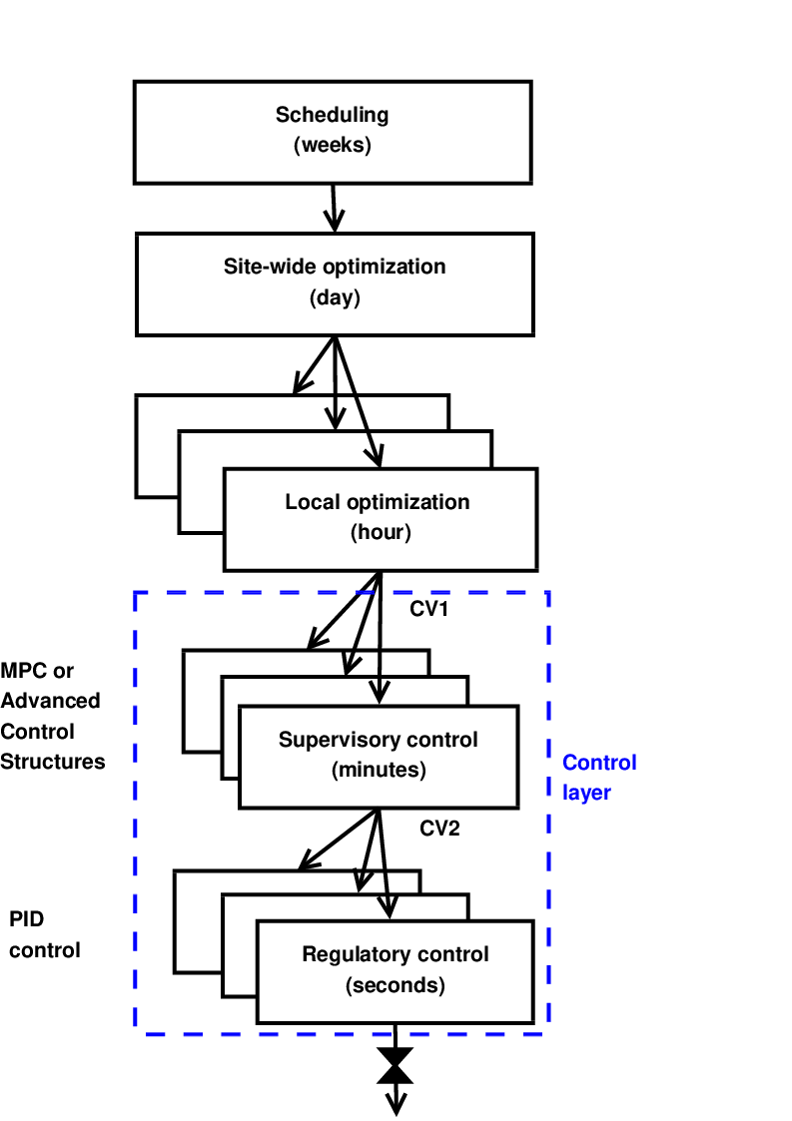
Systematic procedure for economic process control
Start “top-down” with economics (steady state):
Step 1: Define operational objectives (J) and constraints
Step 2: Optimize steady-state operation
Step 3: Decide what to control (CVs)
  Step 3A: Identify active constraints = primary CV1.
  Step 3B: Remaining unconstrained DOFs: Self-optimizing CV1 (find H)
Step 4: Where do we set the throughput? TPM location
Then bottom-up design of control system (dynamics):
Step 5: Regulatory control
  Control variables to stop “drift” (sensitive temperatures, pressures, ....)
  Inventory control radiating around TPM
Finally: Make link between “top-down” and “bottom up”
Step 6: “Advanced/supervisory control”
    Control economic CVs: Active constraints and self-optimizing variables
    Look after variables in regulatory layer below (e.g., avoid saturation)
Step 7: Real-time optimization (Do we need it?)
RTO
CV₁
CV₂
MVs
Process
S. Skogestad, ``Control structure design for complete chemical plants'',
Computers and Chemical Engineering, 28 (1-2), 219-234 (2004).

Slide 14
Step 3: Sigurd’s rules for CV selection
Always control active constraints! (almost always)
Purity constraint on expensive product always active (no overpurification):
  (a) "Avoid product give away" (e.g., sell water as expensive product)
  (b) Save energy (costs energy to overpurify)
Unconstrained optimum:
Look for “self-optimizing” variables. They should
  Be sensitive to the MV
  have close-to-constant optimal value
NEVER try to control a variable that reaches max or min at the optimum
  In particular, never try to control directly the cost J
  Assume we want to minimize J (e.g., J = V = energy) - and we make the stupid choice os selecting CV = V = J
    Then setting J < Jmin: Gives infeasible operation (cannot meet constraints)
    and setting J > Jmin: Forces us to be nonoptimal (which may require strange operation)

Slide 15
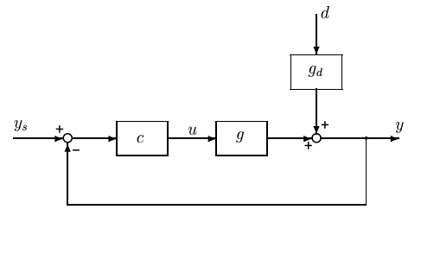
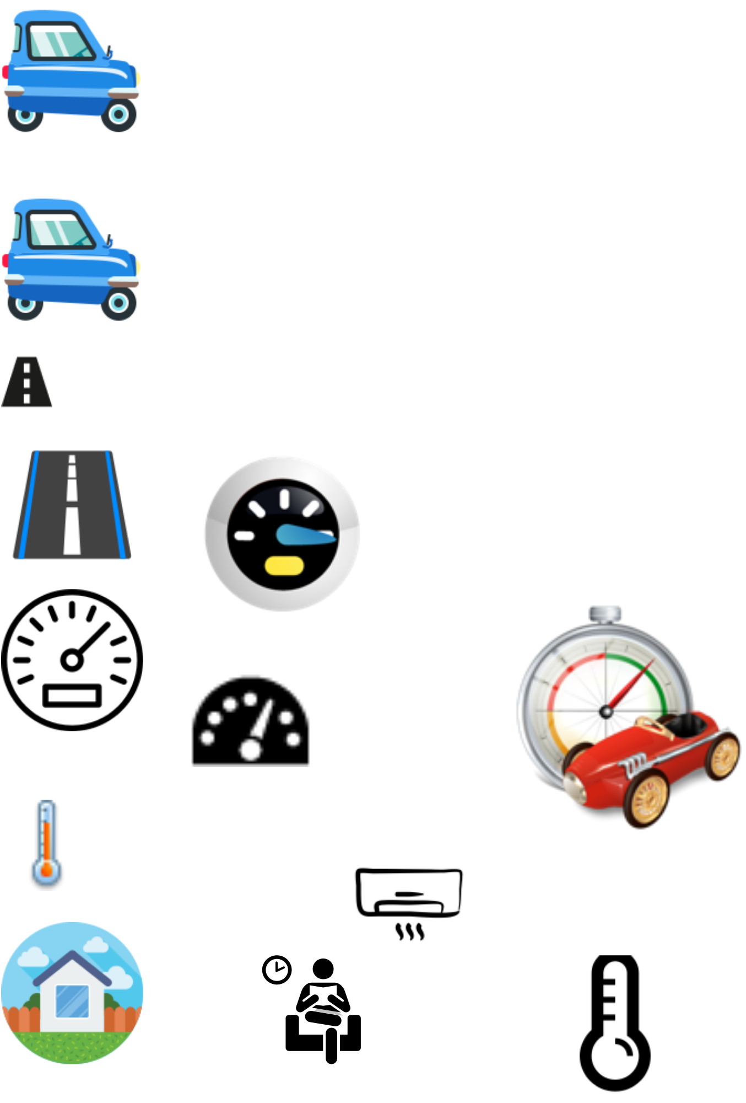
Cruise control: Optimization with
PI-controller
y^{sp} = y^{max}
PI
max y
s.t. y ≤ y^{max}
u ≤ u^{max}
Example: Drive as fast as possible to airport (u=power, y=speed, y^{max} = 110 km/h)
Optimal solution has two active constraint regions:
  y = y^{max} → speed limit
  u = u^{max} → max power
Note: Positive gain from MV (u) to CV (y)
Solved with PI-controller
  y^{sp} = y^{max}
  Anti-windup: I-action is off when u=u^{max}
s.t. = subject to
y = CV = controlled variable

Slide 16
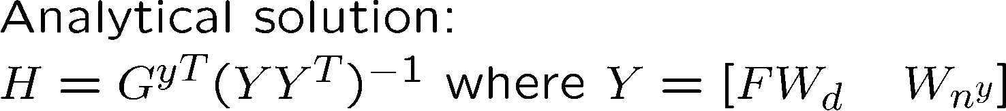
The less obvious case: Unconstrained optimum
2. Control self-optimizing variables
J
u = unconstrained MV
What to control? y=CV=?
J^{opt}
u^{opt}

Slide 17
Step 4: Inventory control and TPM (later!)

Slide 18
Step 5: Design of regulatory control layer
MV2
Process
CV2
Usually single-loop PID controllers
Choice of CVs (CV2):
CV2 = «drifting variables»
  Levels, pressures
  Some temperatures
CV2 may also include economic variables (CV1) that we want to control on a fast time scale
  Hard constraints
Choice of MV2s and pairings (MV2-CV2):
  Main rule: “Pair close”. Want:
    Large gain
    Small delay
    Small time constant
  Avoid MVs that may saturate in regulatory layer
    Otherwise, will need logic for re-pairing (MV-CV switching)
    The exception is if you follow the Input saturation rule: “Pair a MV that may saturate with a CV that can be given up (when the MV saturates) “
  Avoid pairing on negative steady-state RGA-elements
    It’s possible, but then you must be sure that the loops are always working (no manual contriol or MV-saturation)
May include cascade loops (flow control!) and some feedforward, decoupling, linearization
CV2
↕
MV2

Slide 19
Main rule: “Pair close”
The response (from input to output) should be fast, large and in one direction.
Avoid time delay and inverse responses!

Slide 20
Objectives of regulatory control layer
Allow for manual operation
Simple decentralized (local) PID controllers that can be tuned on-line
Take care of “fast” control
Track setpoint changes from the layer above
Local disturbance rejection
Stabilization (mathematical sense)
Avoid “drift” (due to disturbances) so system stays in “linear region”
  “stabilization” (practical sense)
Allow for “slow” control in layer above (supervisory control)
Make control problem easy as seen from layer above
Use “easy” and “robust” measurements (pressure, temperature)
Simple structure
Contribute to overall economic objective (“indirect” control)
Should not need to be changed during operation

Slide 21
Step 6: Design of Supervisory layer

Slide 22
Objectives supervisory layer:
Perform “advanced” economic/coordination control tasks.
  Control primary variables CV1 at setpoint using as degrees of freedom (MV):
    Setpoints to the regulatory layer (CV2s)
    ”unused” degrees of freedom (valves)
  Feedforward from disturbances (if helpful)
  Make use of extra inputs
  Make use of extra measurements
Keep an eye on stabilizing layer
  Avoid saturation in stabilizing layer
Switch control structures (CV1) depending on operating region
  Active constraints
  self-optimizing variables
Implementation supervisory control layer:
Alternative 1: Advanced regulatory control based on ”simple elements” (decentralized control)
Alternative 2: MPC

Slide 23
A little on feedforward control

Slide 24
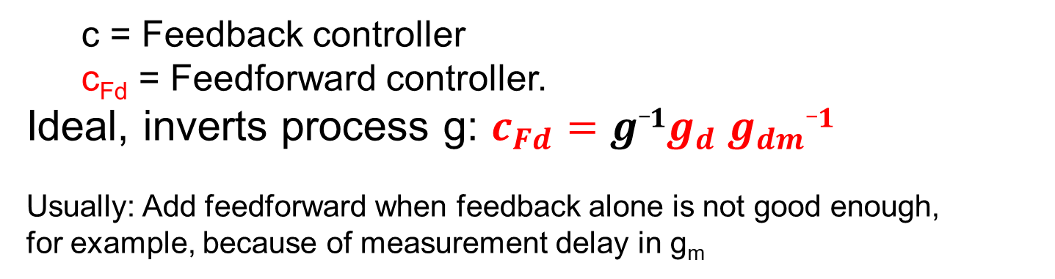
Feedforward control: Measure disturbance (d)
d_{m}
g_{dm}
c_{Fd}
Process
e
y_{m}
g_{m}
Block diagram of feedforward control
  c = Feedback controller
  c_{Fd} = Feedforward controller.
Ideal, inverts process g: $c_{Fd}=g_1g_{d} g_{dm}_1$
Usually: Add feedforward when feedback alone is not good enough,
for example, because of measurement delay in g_{m}

Slide 25
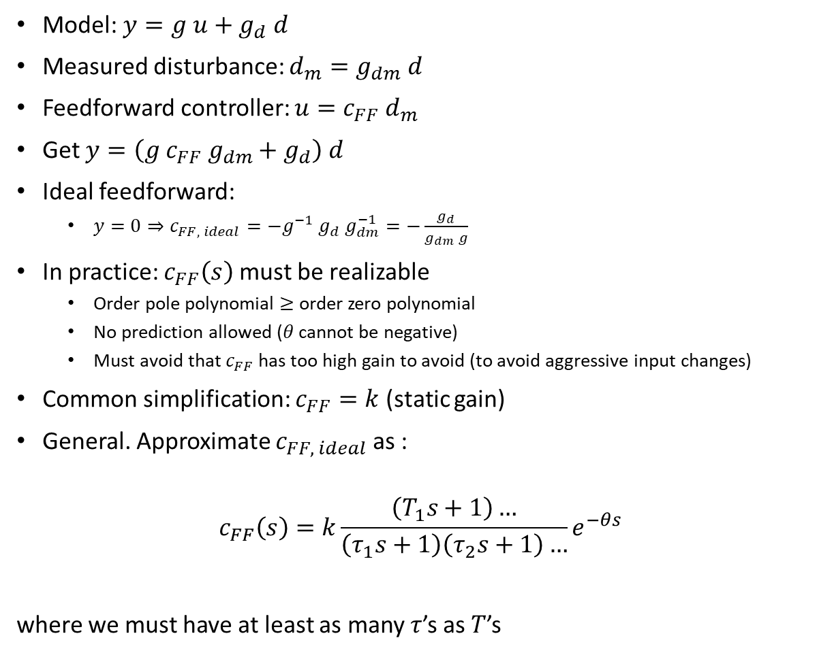
Details Feedforward control
Measurement
d
d_{m}
Model: $y=g u+g_{d} d$
Measured disturbance: $d_{m}=g_{dm} d$
Feedforward controller: $u=c_{FF} d_{m}$
Get $y=\left(g c_{FF} g_{dm}+g_{d}\right) d$
Ideal feedforward:
  $y=0⇒c_{FF, ideal}=−g^{−1} g_{d} g_{dm}^{−1}=−\frac{g_{d}}{g_{dm} g}$
In practice: $c_{FF}\left(s\right)$ must be realizable
  Order pole polynomial $≥$ order zero polynomial
  No prediction allowed ($θ$ cannot be negative)
  Must avoid that $c_{FF}$ has too high gain to avoid (to avoid aggressive input changes)
Common simplification: $c_{FF}=k$ (static gain)
General. Approximate $c_{FF, ideal}$as :
$$c_{FF}\left(s\right)=k\frac{\left(T_{1}s+1\right)…}{\left(τ_{1}s+1\right)\left(τ_{2}s+1\right)…}e^{−θs}$$
where we must have at least as many $τ$’s as $T$’s
g_{dm}
c_{FF}
g_{d}
u
g
y

Slide 26
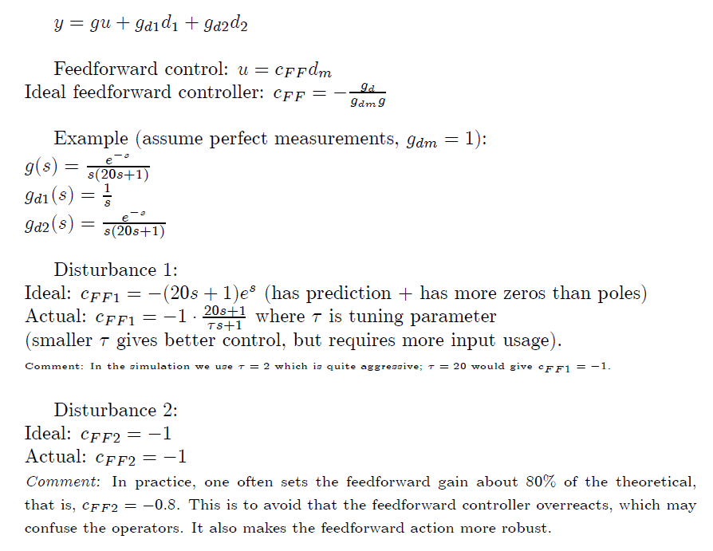
Example feedforward
«Chicken factor»

Slide 27
What is best? Feedback or feedforward?

Slide 28
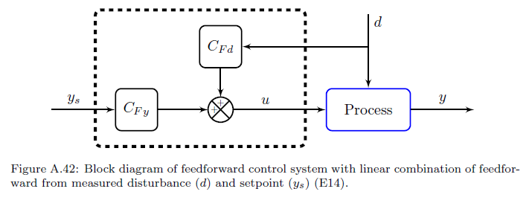
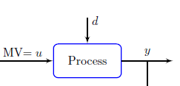


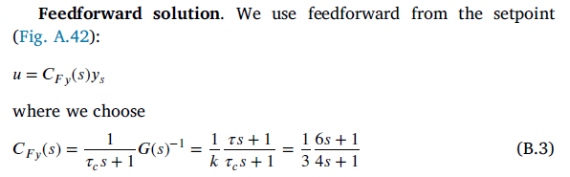


Example: Feedback vs. feedforward for setpoint control
of uncertain process
y = G(s) u

Slide 29
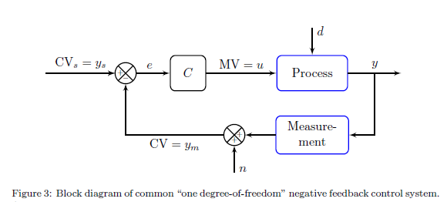
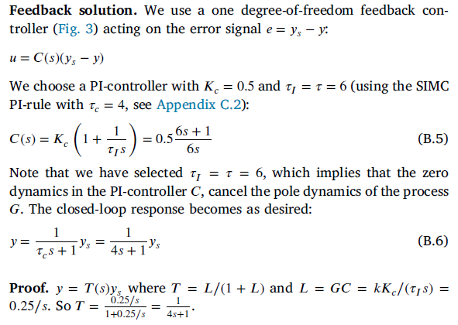
Example: Feedback vs. feedforward for setpoint control
of uncertain process
y = G(s) u

Slide 30

But what happens if the process changes?
  Consider a gain change so that the model is wrong
    Process gain from k=3 to k’=4.5

Slide 31
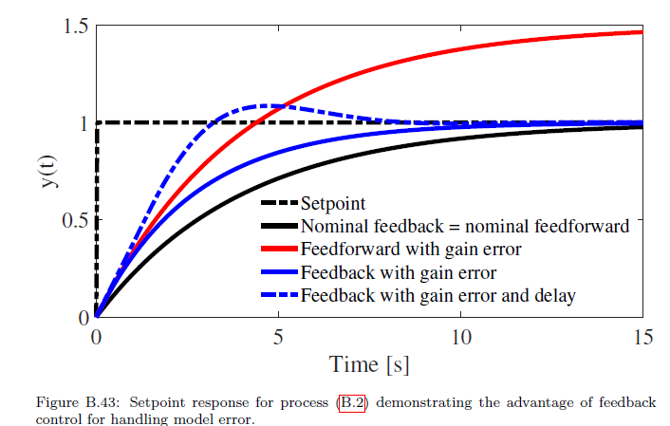
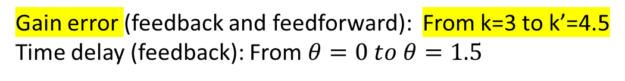
Gain error (feedback and feedforward): From k=3 to k’=4.5
Time delay (feedback): From $θ=0 to θ=1.5$

Slide 32
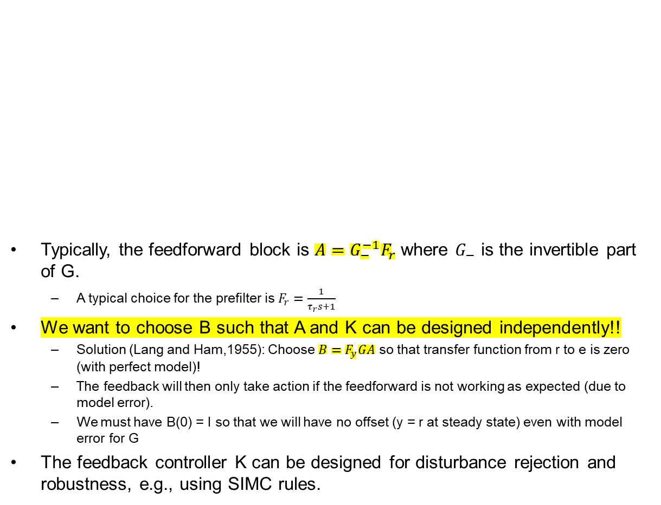
Combine: Two degrees-of-freedom control
Typically, the feedforward block is $A=G_{−}^{−1}F_{r}$ where $G_{−}$ is the invertible part of G.
  A typical choice for the prefilter is $F_{r}=\frac{1}{τ_{r}s+1}$
We want to choose B such that A and K can be designed independently!!
  Solution (Lang and Ham,1955): Choose $B=F_{y}GA$ so that transfer function from r to e is zero (with perfect model)!
  The feedback will then only take action if the feedforward is not working as expected (due to model error).
  We must have B(0) = I so that we will have no offset (y = r at steady state) even with model error for G
The feedback controller K can be designed for disturbance rejection and robustness, e.g., using SIMC rules.
e

Slide 33
Introduction to switching:
Need to control active constraints
But active constraints may change during operation
Four cases:
A. MV-MV switching
B. CV-CV switching
MV-CV switching
  C. Simple (if we follow input saturation rule*). Example: car to airport
  D. Complex (combine MV-MV and CV-CV)
*Input saturation rule: “Pair a MV that may saturate with a CV that can be given up (when the MV saturates) “

Slide 34
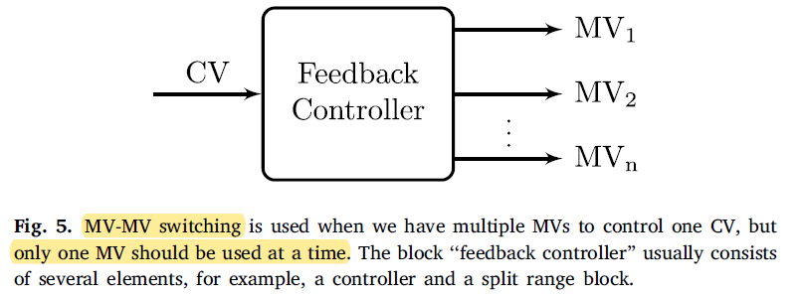
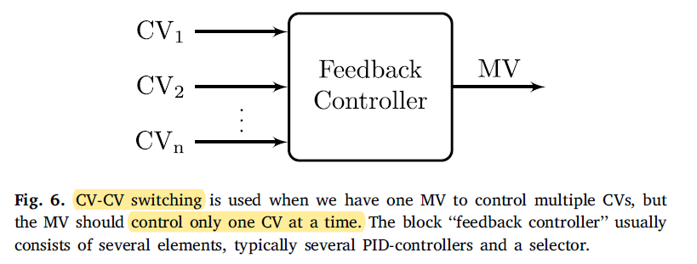

Slide 35
A. MV-MV switching
Process
Need several MVs to cover whole steady-state range (because primary MV may saturate)*
Note that we only want to use one MV at the time.
Three main solutions for “selecting the right MV”:
  Alt.1: (Standard) Split-range control (SRC) (one controller)
  Alt 1’: Generalized SRC (many controllers)
  Alt.2 Many controllers with different setpoints
  Alt.3 Valve position control
In addition: MPC
Which is best? It depends on the case!
* Adriana Reyes-Lua Cristina Zotica, Sigurd Skogestad, «Optimal Operation with Changing Active Constraint Regions using Classical Advanced Control,, Adchem Conference, Shenyang, China. July 2018 ,
A. Reyes-Lúa and S. Skogestad. “Multi-input single-output control for extending the operating range: Generalized split range control using the baton strategy”. Journal of Process Control 91 (2020)

Slide 36
B. CV-CV switching
Process
One MV
Many CVs, but control only one at a time
Solution: Selector

Slide 37
The four switching cases in more detail
A. MV-MV switching (because MV may saturate)
  Need many MVs to cover whole steady-state range
  Use only one MV at a time
  Three options:
    A1. Split-range control,
    A2. Different setpoints,
    A3. Valve position control (VPC)
B. CV-CV switching (because we may reach new CV constraint)
  Must select between CVs
  One option: Many controllers with Max-or min-selector
Plus the combination: MV-CV switching
C. Simple MV-CV switching: CV can be given up
  We followed «input saturation rule»
  Don’t need to do anything (except anti-windup in controller)
D. Complex MV-CV switching: CV cannot be given up (need to «re-pair loops»)
  Must combine MV-MV switching (three options) with CV-CV switching (selector)
Process
Process
Process
Process
Note: we are here assuming that the constraints are not conflicting so that switching is possible
Adriana Reyes-Lua and Sigurd Skogestad, Systematic Design of Active Constraint Switching Using Classical Advanced Control Structures, Ind.Eng.Chem.Res, 2020

Slide 38
Advanced regulatory control (ARC)
Using simple standard elements

Slide 39
The three main inventions of process control
(became widely used in the process industry in the 1930s)
PID control, and in particular integral action (“bias reset)
Cascade control
Ratio control (special case of feedforward which needs no explicit model)
The last two are used if standard feedback is not good enough, typically because of delay in measurement of y.
  Cascade: Use extra output measurement (y₂)
  Ratio/feedforward: Use disturbance measurement (d)

Slide 40
The three main inventions of process control can only indirectly and with effort be implemented with MPC
Integral action with MPC: Need to add artificial integrating disturbance in estimator
    ARC: Just add an integrator in the controller (use PID)
Cascade control with MPC: Need model for how u and d affect y₁ and y₂.
    ARC: Just need to know that control of y₂ indirectly improves control of y₁
3. Ratio control with MPC: Need model for how u and d affect property y
    ARC: Just need the insight that it is good for control of y to keep the ratio R=u/d constant
Because of this, MPC should be on top of a regulatory control layer with the setpoints for y₂ and R as MVs.

Slide 41
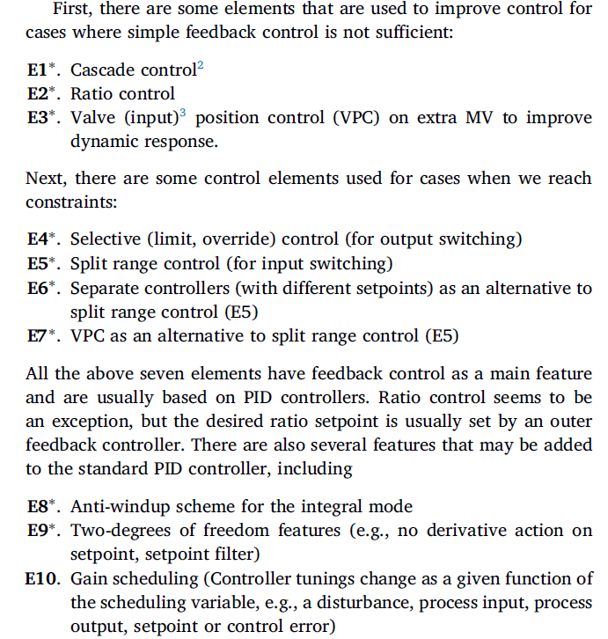
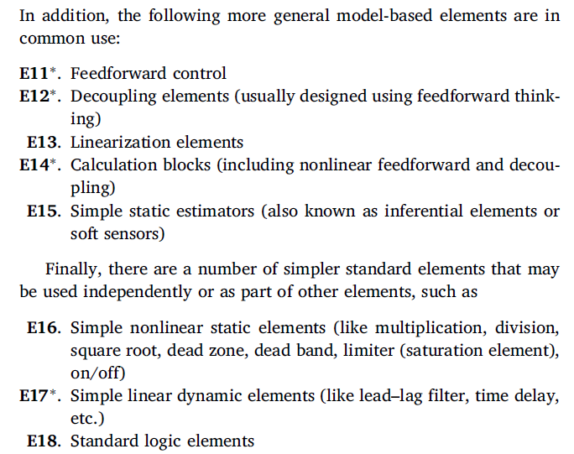
Standard Advanced control elements
Gives a decomposed control system:
Each element links a subset of inputs with a subset of putputs
Results in simple local tuning

