Slide 1
Self-optimizing control Theory
Sigurd Skogestad

Slide 2
Outline
Skogestad procedure for control structure design:
  Top Down
    Step S1: Define operational objective (cost) and constraints
    Step S2: Identify degrees of freedom and optimize operation for disturbances
    Step S3: Implementation of optimal operation
      Control active constraints
      Control self-optimizing variables for unconstrained, c=Hy
    Step S4: Where set the production rate? (Inventory control)
  Bottom Up
    Step S5: Regulatory control: What more to control (secondary CV’s)?
    Step S6: Supervisory control
    Step S7: Real-time optimization

Slide 3
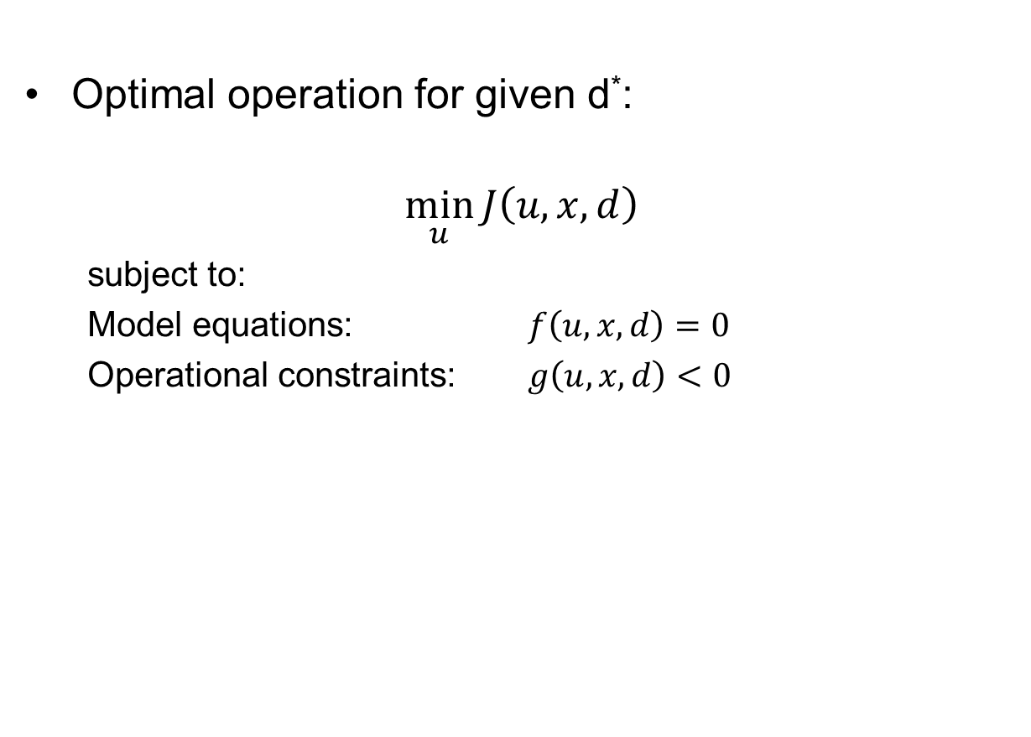
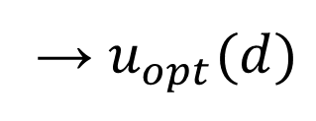
Step S3: Implementation of optimal operation
Optimal operation for given d*:
$$\min_{u}{J\left(u,x,d\right)}$$
  subject to:
  Model equations: $f\left(u,x,d\right)=0$
  Operational constraints: $g\left(u,x,d\right)<0$
→ $u_{opt}(d)$
Problem: Usally cannot keep $u_{opt}$ constant because disturbances d change
How should we adjust the degrees of freedom (u)?
What should we control?

Slide 4
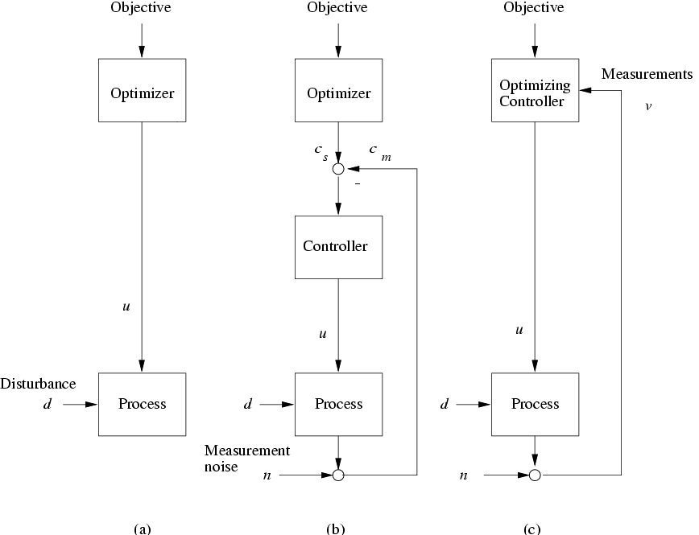
“Optimizing Control”
y

Slide 5
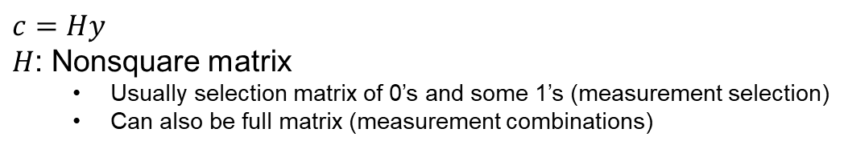

“Self-Optimizing Control”
Self-optimizing control: Constant setpoints give acceptable loss
What should we control?
(What is c? What is H?)
$$H$$
y
$c=Hy$
$H$: Nonsquare matrix
  Usually selection matrix of 0’s and some 1’s (measurement selection)
  Can also be full matrix (measurement combinations)

Slide 6
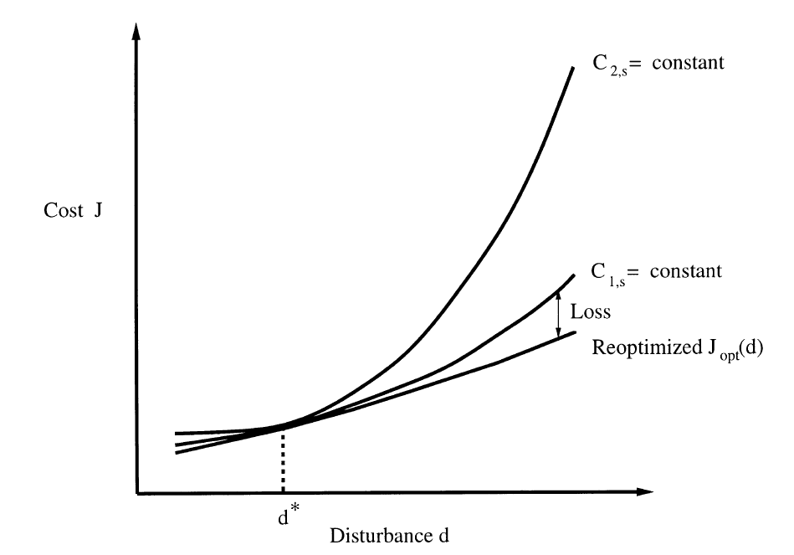
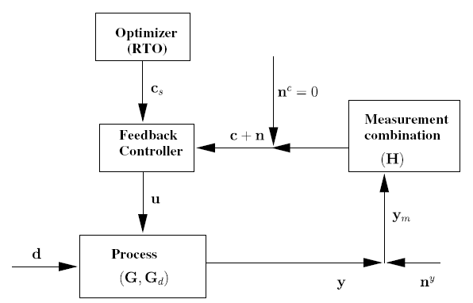
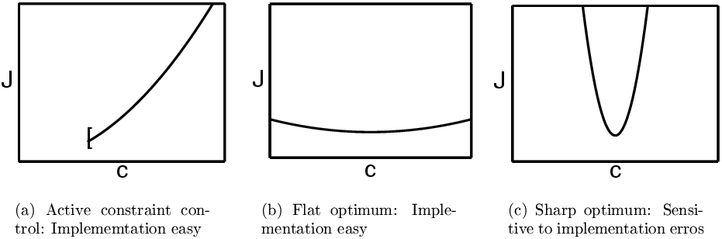
Self-optimizing control
Self-optimizing control is when we can achieve an acceptable loss with constant setpoint values for the controlled variables
c
Good
BAD

Slide 7

Recap: marathon runner
Optimal operation - Runner
CV = heart rate is good “self-optimizing” variable
Simple and robust implementation
Disturbances are indirectly handled by keeping a constant heart rate
May have infrequent adjustment of setpoint (c_{s})
select one measurement
J=T
c = heart rate
c_{opt}
c=heart rate

Slide 8
Optimal operation
Cost J
J_{opt}
c_{opt}
Controlled variable c

Slide 9
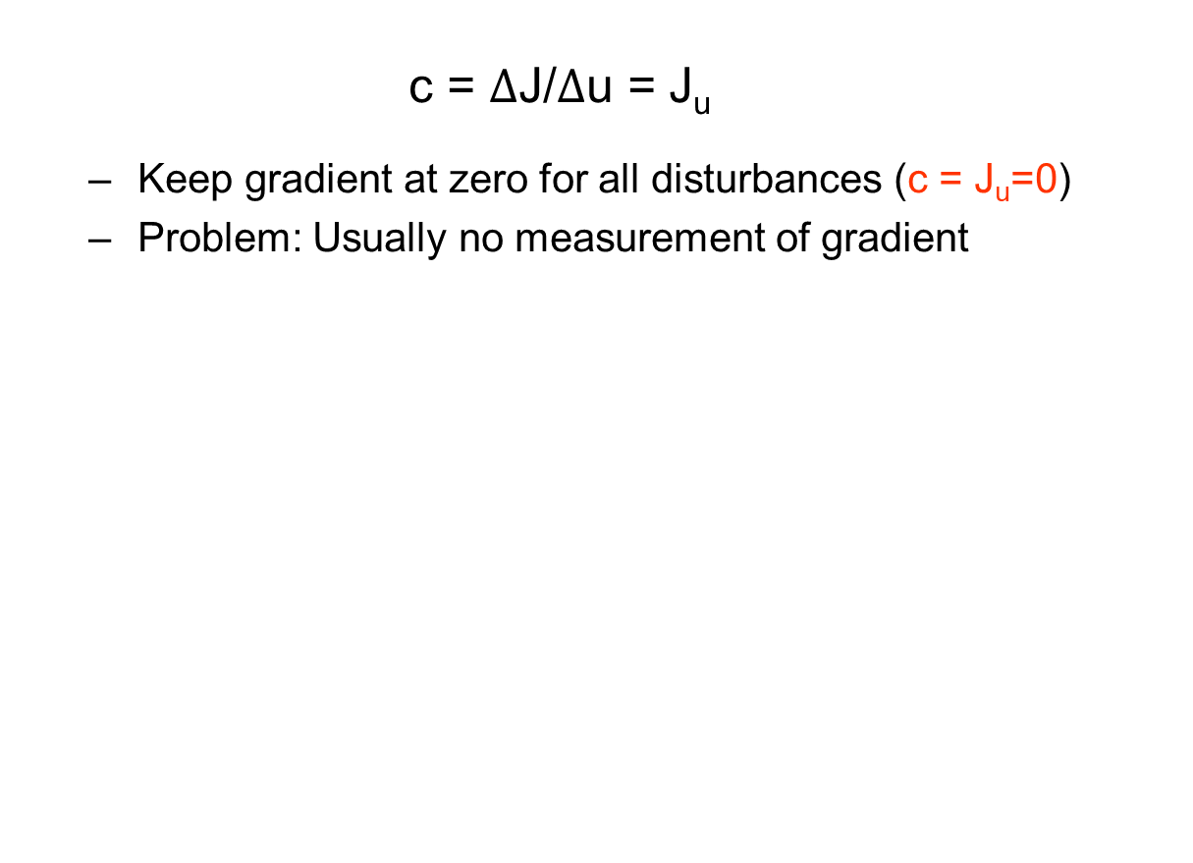
The ideal “self-optimizing” variable is the gradient, J_{u}
Unconstrained degrees of freedom
  $$\text{c}\text{ = }Δ\text{J}\text{/}Δ\text{u}\text{ = }\text{Ju}$$
  Keep gradient at zero for all disturbances (c = J_{u}=0)
  Problem: Usually no measurement of gradient
cost J
J_{u}<0
J_{u}<0
J_{u}=0
u_{opt}
u
J_{u}
0
*I.J. Halvorsen, S. Skogestad, Indirect on-line optimization through setpoint control, in: AIChE 1997 Annual Meeting, Los Angeles; paper 194h.
*I.J. Halvorsen, S. Skogestad, J.C. Morud, V. Alstad, Optimal selection of controlled variables, Industrial & Engineering Chemistry Research 42 (14) (2003) 3273–3284
Notes:
9

Slide 10
Unconstrained optimum: NEVER try to control a variable that reaches max or min at the optimum
J
J>J_{min}
J_{min}
J<J_{min}
?
u
  In particular, never try to control directly the cost J
  Assume we want to minimize J (e.g., J = V = energy) - and we make the stupid choice os selecting CV = V = J
    Then setting J < J_{min}: Gives infeasible operation (cannot meet constraints)
    and setting J > J_{min}: Forces us to be nonoptimal (two steady states: may require strange operation)

Slide 11
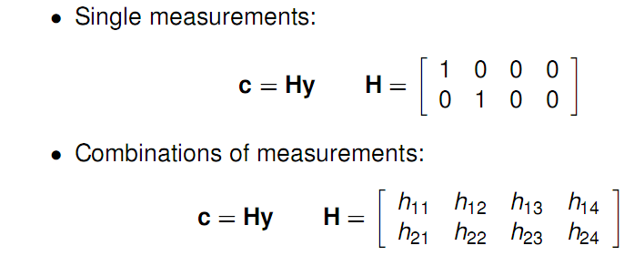
Measurements or mesurement combinations
Ideally: c = J_{u}
In practice: c = Hy
steady-state
control error
controlled
variable
disturbance
measurement noise

Slide 12
Optimal measurement combination
Candidate measurements (y): Include also inputs u
control error
H
controlled
variable
disturbance
measurement noise

Slide 13
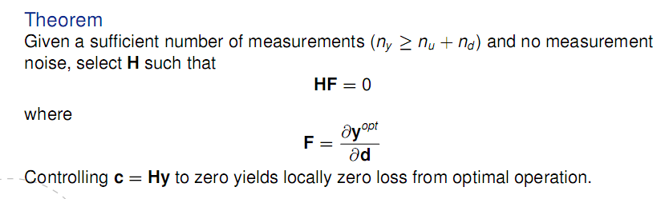

Nullspace method
No measurement noise (n^{y}=0)
Proof: Given ${∂y}^{opt}=F ∂d$, and $c=Hy$:
$∂c^{opt}=H ∂y^{opt}=HF ∂d$
To make $∂c^{opt}=0$ for any $∂d$, we must have $HF=0$.
V. Alstad, S. Skogestad, Null space method for selecting optimal measurement combinations as controlled variables,
Industrial & Engineering Chemistry Research 46 (2007) 846–853.
Jäschke, J., Cao, Y., & Kariwala, V. (2017). Self-optimizing control–A survey. Annual Reviews in Control, 43, 199–223.

Slide 14
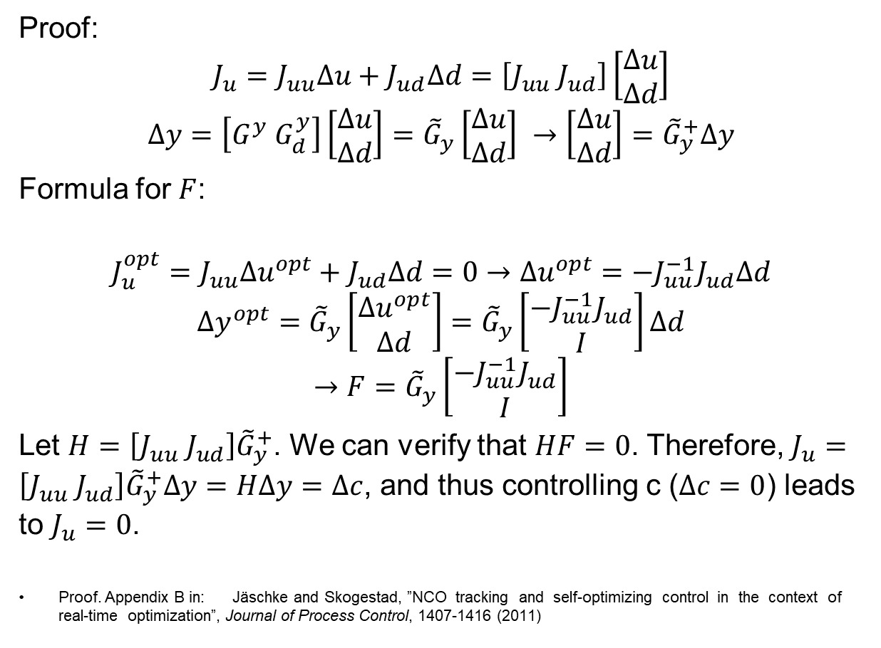
Nullspace method gives J_{u}=0
Proof:
$$J_{u}=J_{uu}Δu+J_{ud}Δd=\left[J_{uu} J_{ud}\right]\left[\begin{matrix}Δu \\ Δd\end{matrix}\right]$$
$$Δy=\left[G^{y} G_{d}^{y}\right]\left[\begin{matrix}Δu \\ Δd\end{matrix}\right]={\tilde{G}}_{y}\left[\begin{matrix}Δu \\ Δd\end{matrix}\right] →\left[\begin{matrix}Δu \\ Δd\end{matrix}\right]={\tilde{G}}_{y}^{+}Δy$$
Formula for $F$:
$$J_{u}^{opt}=J_{uu}Δu^{opt}+J_{ud}Δd=0→Δu^{opt}=−J_{uu}^{−1}J_{ud}Δd$$
$$Δy^{opt}={\tilde{G}}_{y}\left[\begin{matrix}Δu^{opt} \\ Δd\end{matrix}\right]={\tilde{G}}_{y}\left[\begin{matrix}−J_{uu}^{−1}J_{ud} \\ I\end{matrix}\right]Δd$$
$$→F={\tilde{G}}_{y}\left[\begin{matrix}−J_{uu}^{−1}J_{ud} \\ I\end{matrix}\right]$$
Let $H=\left[J_{uu} J_{ud}\right]{\tilde{G}}_{y}^{+}$. We can verify that $HF=0$. Therefore, $J_{u}=\left[J_{uu} J_{ud}\right]{\tilde{G}}_{y}^{+}Δy=HΔy=Δc$, and thus controlling c ($Δc=0$) leads to $J_{u}=0$.
Proof. Appendix B in: Jäschke and Skogestad, ”NCO tracking and self-optimizing control in the context of real-time optimization”, Journal of Process Control, 1407-1416 (2011)

Slide 15
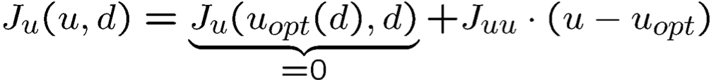
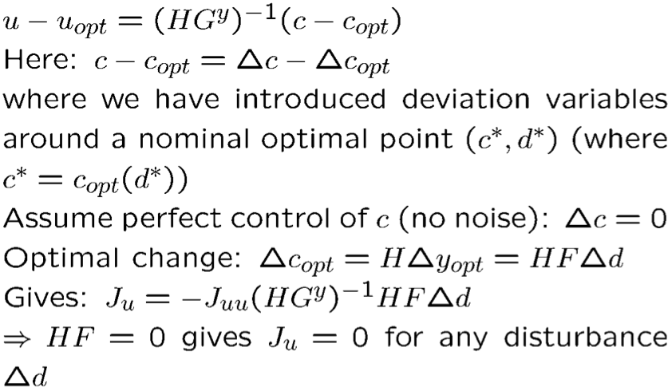
Nullspace method (HF=0) gives J_{u}=0
Proof (constant d):
Proof. Appendix B in: Jäschke and Skogestad, ”NCO tracking and self-optimizing control in the context of real-time optimization”, Journal of Process Control, 1407-1416 (2011)

Slide 16
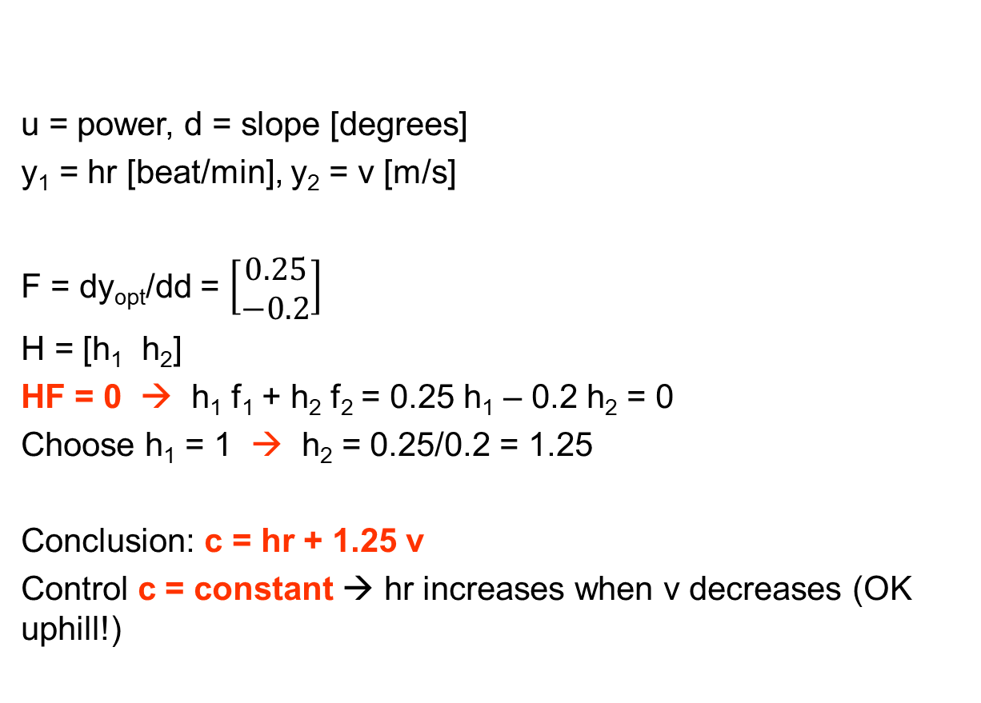
Example. Nullspace Method for Marathon runner
u = power, d = slope [degrees]
y₁ = hr [beat/min], y₂ = v [m/s]
F = dy_{opt}/dd = $\left[\begin{matrix}0.25 \\ −0.2\end{matrix}\right]$
H = [h₁ h₂]
HF = 0 → h₁ f₁ + h₂ f₂ = 0.25 h₁ – 0.2 h₂ = 0
Choose h₁ = 1 → h₂ = 0.25/0.2 = 1.25
Conclusion: c = hr + 1.25 v
Control c = constant → hr increases when v decreases (OK uphill!)

Slide 17
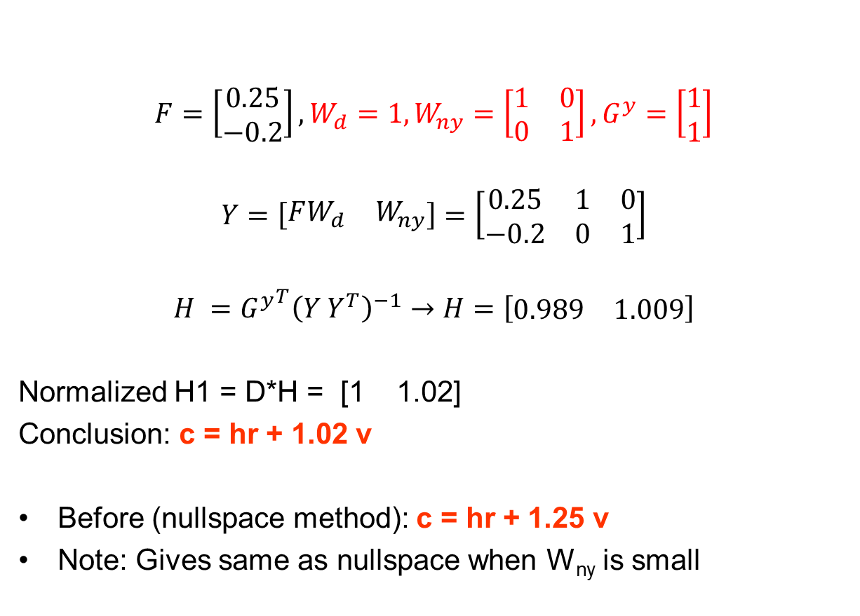
Marathon runner: Exact local method
$$F=\left[\begin{matrix}0.25 \\ −0.2\end{matrix}\right],W_{d}=1, W_{ny}=\left[\begin{matrix}1 & 0 \\ 0 & 1\end{matrix}\right], G^{y}=\left[\begin{matrix}1 \\ 1\end{matrix}\right]$$
$$Y=\left[\begin{matrix}FW_{d} & W_{ny}\end{matrix}\right]=\left[\begin{matrix}0.25 & 1 & 0 \\ −0.2 & 0 & 1\end{matrix}\right]$$
$$H ={G^{y}}^{T}{\left(Y Y^{T}\right)}^{−1}→H=\left[\begin{matrix}0.989 & 1.009\end{matrix}\right]$$
Normalized H1 = D*H = [1 1.02]
Conclusion: c = hr + 1.02 v
Before (nullspace method): c = hr + 1.25 v
Note: Gives same as nullspace when W_{ny} is small

Slide 18
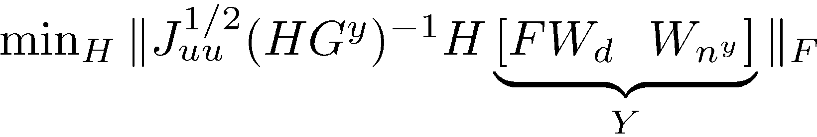

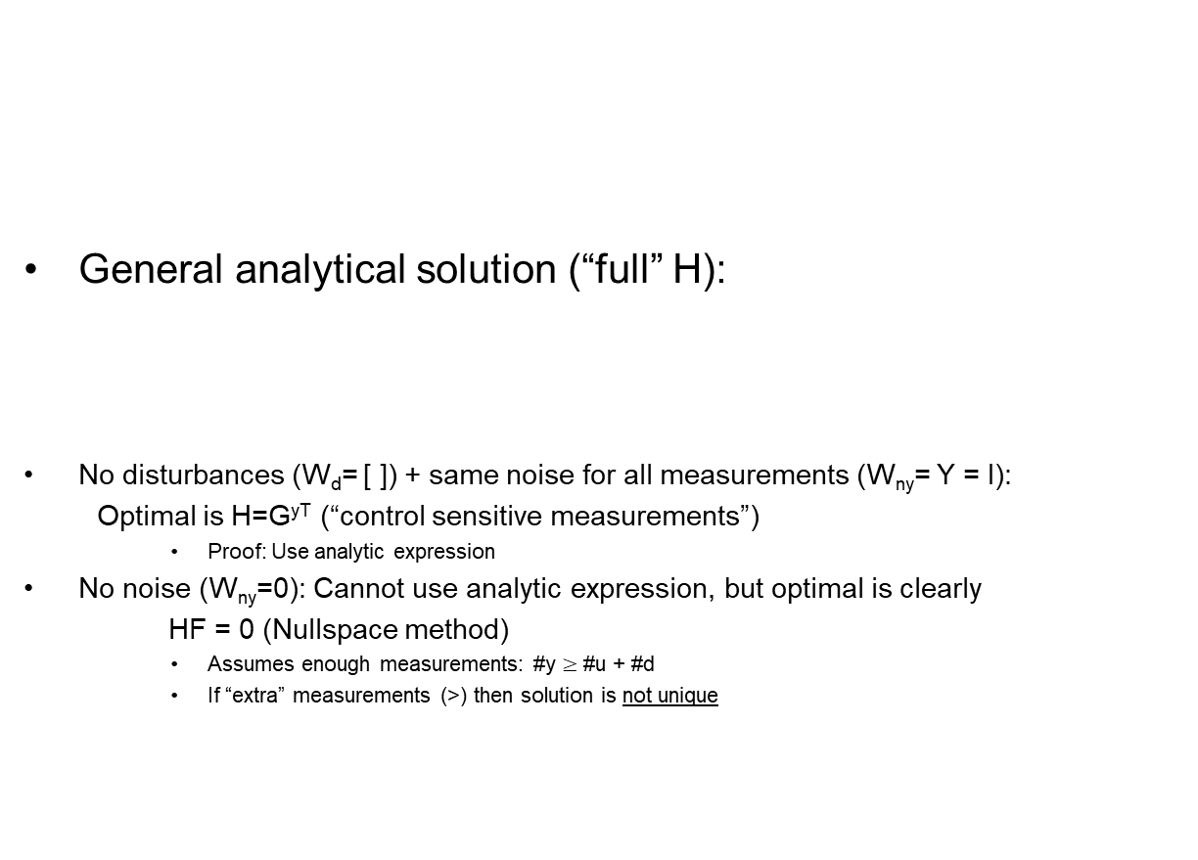
Extension: "Exact local method" (with measurement noise)
General analytical solution (“full” H):
No disturbances (W_{d}= [ ]) + same noise for all measurements (W_{ny}= Y = I):
Optimal is H=G^{yT} (“control sensitive measurements”)
    Proof: Use analytic expression
No noise (W_{ny}=0): Cannot use analytic expression, but optimal is clearly
HF = 0 (Nullspace method)
    Assumes enough measurements: #y $≥$ #u + #d
    If “extra” measurements (>) then solution is not unique
V. Alstad, S. Skogestad, E.S. Hori, Optimal measurement combinations as controlled variables, Journal of Process Control 19 (1) (2009) 138–148.
Jäschke, J., Cao, Y., & Kariwala, V. (2017). Self-optimizing control–A survey. Annual Reviews in Control, 43, 199–223.

Slide 19
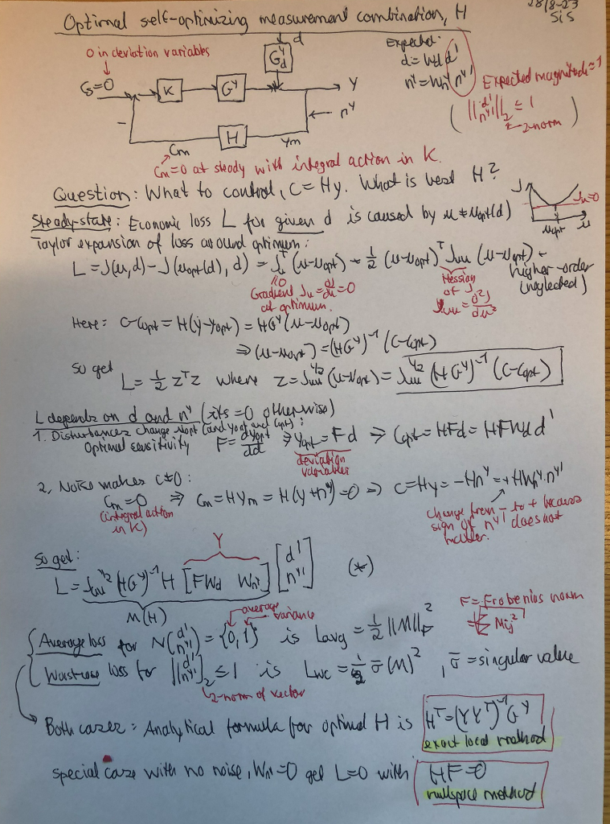
Note: HF=0 -> copt=0 (Nullspace method)
z

Slide 20
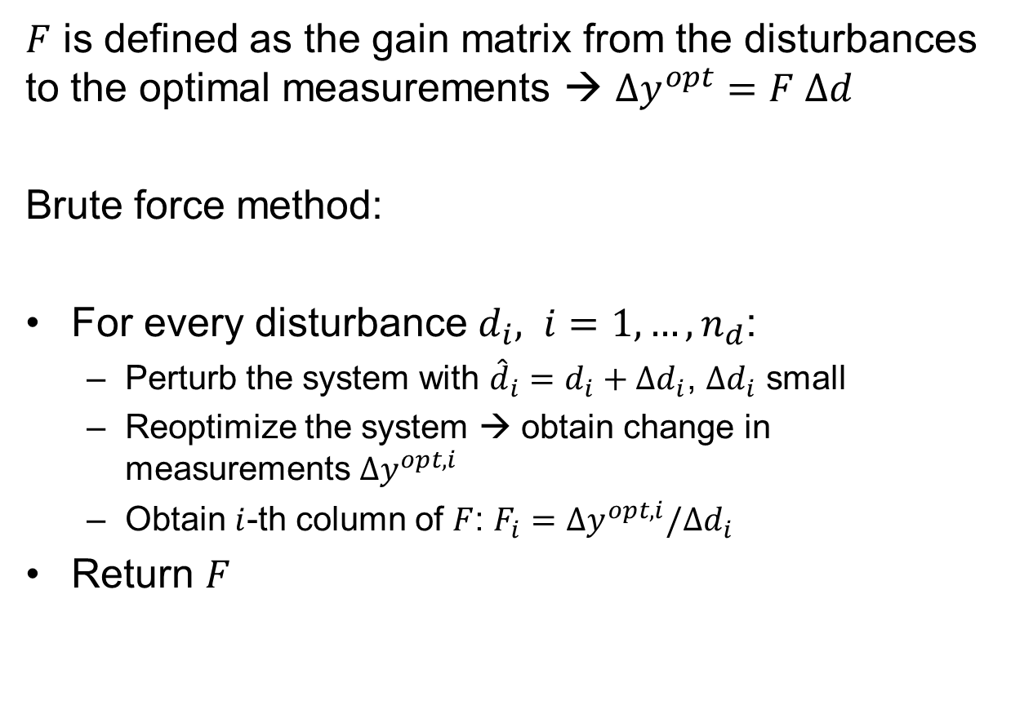
Obtaining F
$F$ is defined as the gain matrix from the disturbances to the optimal measurements → $Δy^{opt}=F Δd$
Brute force method:
For every disturbance $d_{i}, i=1,…,n_{d}$:
  Perturb the system with ${\hat{d}}_{i}=d_{i}+Δd_{i}$, $Δd_{i}$ small
  Reoptimize the system → obtain change in measurements $Δy^{opt,i}$
  Obtain $i$-th column of $F$: $F_{i}=Δy^{opt,i}/Δd_{i}$
Return $F$

Slide 21
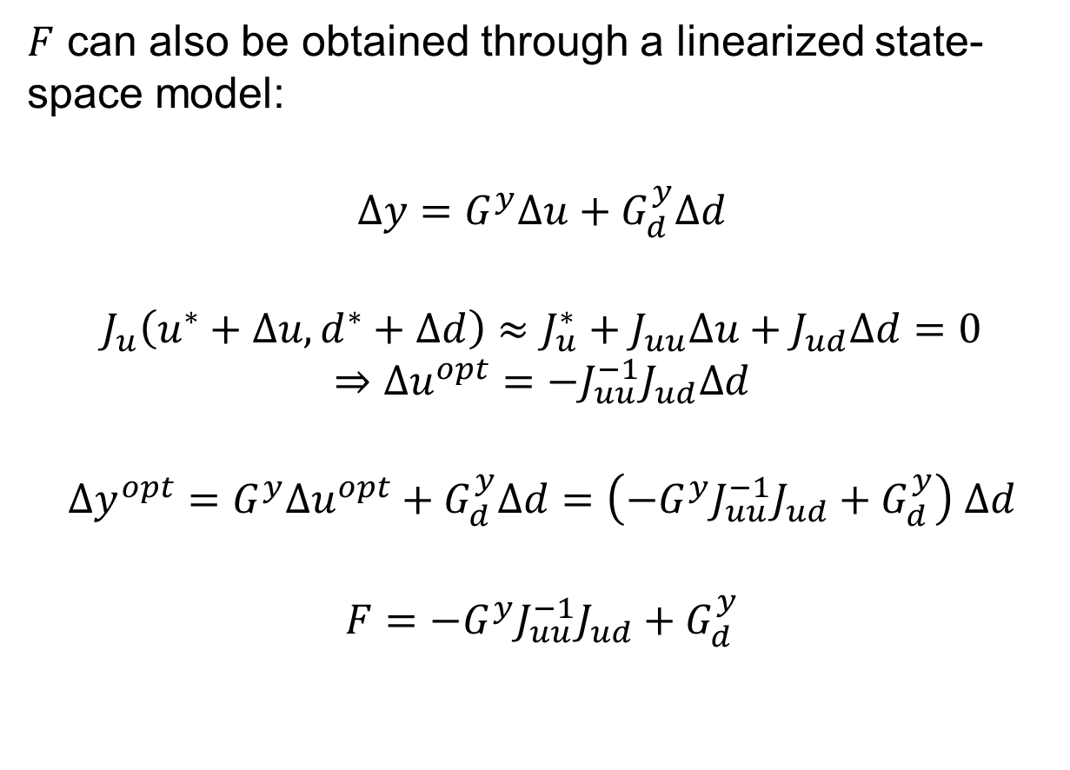
Linearization method for F
$F$ can also be obtained through a linearized state-space model:
$$Δy=G^{y}Δu+G_{d}^{y}Δd$$
$$J_{u}\left(u^{∗}+Δu, d^{∗}+Δd\right)≈J_{u}^{∗}+J_{uu}Δu+J_{ud}Δd=0$$
$$⇒Δu^{opt}=−J_{uu}^{−1}J_{ud}Δd$$
$$Δy^{opt}=G^{y}Δu^{opt}+G_{d}^{y}Δd=\left(−G^{y}J_{uu}^{−1}J_{ud}+G_{d}^{y}\right) Δd$$
$$F=−G^{y}J_{uu}^{−1}J_{ud}+G_{d}^{y}$$
0

Slide 22
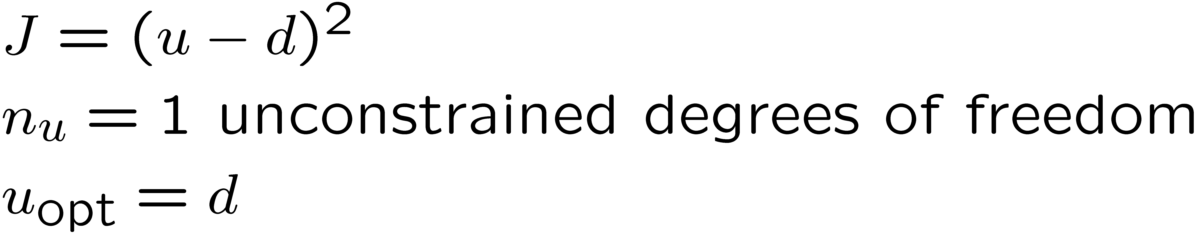
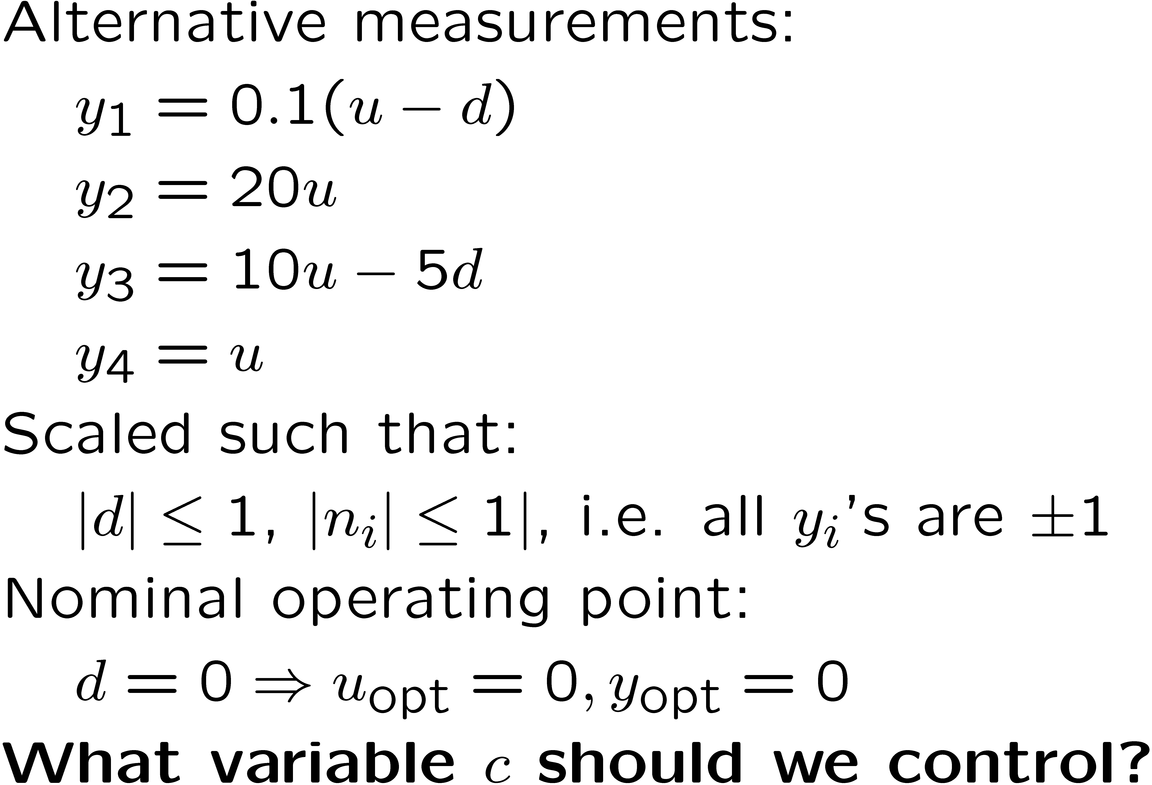
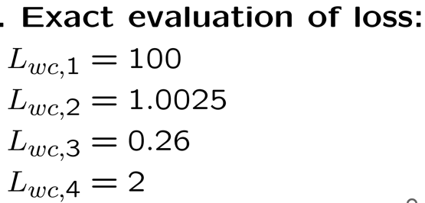
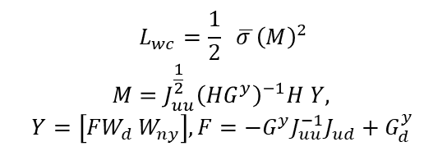
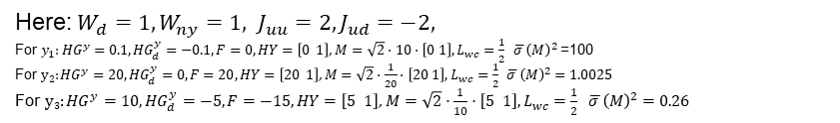
Toy Example.
Single measurements
$$L_{wc}=\frac{1}{2} \overline{σ }{\left(M\right)}^{2}$$
$$M=J_{uu}^{\frac{1}{2}}{\left({HG}^{y}\right)}^{−1}H Y,$$
$$Y=\left[{FW}_{d} W_{ny}\right], F=−G^{y}J_{uu}^{−1}J_{ud}+G_{d}^{y}$$
Here: $W_{d}=1, W_{ny}=1, J_{uu}=2, J_{ud}=−2,$
For $y_{1}:{HG}^{y}=0.1, {HG}_{d}^{y}=−0.1, F=0, HY=\left[0 1\right]$, $M=\sqrt{2}⋅10⋅\left[0 1\right], L_{wc}=\frac{1}{2} \overline{σ }{\left(M\right)}^{2}$ =100
For $y2:{HG}^{y}=20, {HG}_{d}^{y}=0, F=20, HY=\left[20 1\right]$, $M=\sqrt{2}⋅\frac{1}{20}⋅\left[20 1\right], L_{wc}=\frac{1}{2} \overline{σ }{\left(M\right)}^{2}=1.0025$
For $y3:{HG}^{y}=10, {HG}_{d}^{y}=−5, F=−15, HY=\left[5 1\right]$, $M=\sqrt{2}⋅\frac{1}{10}⋅\left[5 1\right], L_{wc}=\frac{1}{2} \overline{σ }{\left(M\right)}^{2}=0.26$
Reference: I. J. Halvorsen, S. Skogestad, J. Morud and V. Alstad, “Optimal selection of controlled variables”, Industrial & Engineering Chemistry Research, 42 (14), 3273-3284 (2003).

Slide 23
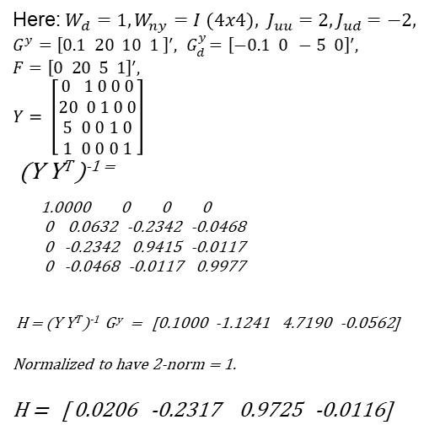
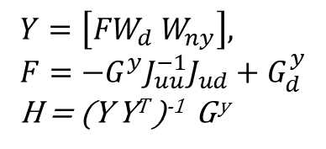
Toy Example. Exact local method. Combine all measurements
$$Y=\left[{FW}_{d} W_{ny}\right],$$
$$F=−G^{y}J_{uu}^{−1}J_{ud}+G_{d}^{y}$$
H = (Y Y^{T} )⁻¹ G ^{y}
Here: $W_{d}=1, W_{ny}=I (4x4), J_{uu}=2, J_{ud}=−2,$
$$G^{y}={\left[0.1 20 10 1 \right]}^{′},{ G}_{d}^{y}={\left[−0.1 0 −5 0\right]}^{′},$$
$$F={\left[0 20 5 1\right]}^{′},$$
$$Y= \left[\begin{aligned}0 1 0 0 0 \\ 20 0 1 0 0 \\ 5 0 0 1 0 \\ 1 0 0 0 1\end{aligned}\right]$$
(Y Y^{T} )⁻¹ ⁼
1.0000 0 0 0
0 0.0632 -0.2342 -0.0468
0 -0.2342 0.9415 -0.0117
0 -0.0468 -0.0117 0.9977
H = (Y Y^{T} )⁻¹ G ^{y} = [0.1000 -1.1241 4.7190 -0.0562]
^{Normalized to have 2-norm = 1.}
H = [ 0.0206 -0.2317 0.9725 -0.0116]
Reference: V. Alstad et al. , Journal of Process Control 19 (2009) 138–148

Slide 24
Toy Example: Nullspace method (not unique)

Slide 25
Toy Example. Nullspace method with 2 measurements

Slide 26

Conclusion: GOOD “SELF-OPTIMIZING” CV = c
Optimal value $c_{opt}$ is constant (independent of disturbance d):
  → Want small optimal sensitivity: $F_{c}=\frac{Δc_{opt}}{Δd}=HF$
c is “sensitive” to input u (MV) (to reduce effect of measurement noise)
  → Want large gain $G=HGy= \frac{Δc}{Δu}$
(Equivalently: Optimum should be flat!)
Good
BAD

