Slide 1
Plantwide process control
Introduction
Sigurd Skogestad, NTNU

Slide 2
Shortcourse PSE Asia 2019: Economic process control
13 January 2019 from 9:00-17:00 at Faculty of Engineering, Chulalongkorn University
Presenters:
Professor Sigurd Skogestad, NTNU
Professor Nitin Kaistha, IIT Kanpur (case studies)
This workshop focuses on the big picture when designing a control system for process plants. The overall objectives is to maximize the operational profit. This should also be the basis for designing the control system, all the way from PID controllers at the bottom of the control hierarchy to the possible RTO layer at the top.
09.00 Session 1. Overview of economic plantwide control
- Control degrees of freedom
- Our paradigm: Hierarchical decision (control) layer
- What is optimal operation?
- Distillation examples
10.00 Session 2. What to control? (Selection of primary controlled variables based on economics)
- Degrees of freedom
- Optimization
- Active constraints
- Self-optimizing control
11.00 Case studies
12.00 Lunch
13.00 Session 3. Where to set the production rate and bottleneck
- Inventory control
- Consistency
- Radiation rule
- Location of throughput manipulator (TPM)
14.00 Session 4. Design of the regulatory control layer ("what more should we control")
- PID control, Stabilization
- Secondary controlled variables (measurements)
- Pairing with inputs
15.00 Session 5 Design of supervisory control layer
- Cascade control
- Switching between active constraints
- MV saturation (SIMO controllers) : Split range control / Controllers with different setpoints
- CV changes: Selectors
- Decentralized versus centralized (MPC)
Session 6. Real-time optimization (see plenary tomorrow)
Alternative implementations:
- Conventional RTO
- Dynamic RTO / Economic MPC
- Combination with Self-optimizing control
- Extremum seeking control / NCO tracking / Hill climbing
16.00 Session 7 Case studies (throughout the day)
- Case studies using Hysys

Slide 3
Part 1. Plantwide control
Introduction to plantwide control (what should we really control?)
Introduction.
  Objective: Put controllers on flow sheet (make P&ID)
  Two main objectives for control: Longer-term economics (CV1) and shorter-term stability (CV2)
  Regulatory (basic) and supervisory (advanced) control layer
Optimal operation (economics)
  Define cost J and constraints
  Active constraints (as a function of disturbances)
  Selection of economic controlled variables (CV1). Self-optimizing variables.

Slide 4
Why control?
Operation
Actual value(dynamic)
Steady-state (average)
time
In practice never steady-state:
  Feed changes
  Startup
  Operator changes
  Failures
  …..
Control is needed to reduce the effect of disturbances
30% of investment costs are typically for instrumentation and control
“Disturbances” (d’s)

Slide 5
Countermeasures to disturbances (I)
Eliminate/Reduce the disturbance
  Design process so it is insensitive to disturbances
      Example: Use buffertank to dampen disturbances
  Detect and remove source of disturbances
      “Statistical process control”
      Example: Detect and eliminate variations in feed composition
T_{in}
T_{out}
∞
inflow
outflow

Slide 6
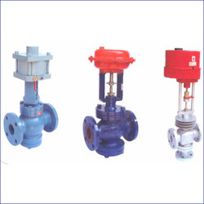
Countermeasures to disturbances (II)
II. Process control
Do something (usually manipulate valve)
to counteract the effect of the disturbances
  (a) Manual control: Need operator
  (b) Automatic control: Need measurement + automatic valve + computer
    Goals automatic control:
      Smaller variations
        more consistent quality
        More optimal
      Smaller losses (environment)
      Lower costs
      More production
    Industry: Still large potential for improvements!

Slide 7
Classification of variables
d
u
input (MV)
Process
y
output (CV)
Independent variables (“the cause”):
  Inputs (MV, u): Variables we can adjust (valves)
  Disturbances (DV, d): Variables outside our control
Dependent (output) variables (“the effect or result”):
  (c) Primary outputs (CVs, y₁): Variables we want to keep at a given setpoint
  (d) Secondary outputs (y₂): Extra measurements that we may use to improve control

Slide 8
Inputs for control (MVs)
Usually: Inputs (MVs) are valves.
  Physical input is valve position (z), but we often simplify and say that flow (q) is input
Valve Equation

Slide 9
Notation feedback controllers (P&ID)
T_{s}
(setpoint CV)
T
(measured CV)
TC
MV (could be valve)
2nd letter:
C: controller
I: indicator (measurement)
T: transmitter (measurement)
1st letter: Controlled variable (CV) = What we are trying to control (keep constant)
T: temperature
F: flow
L: level
P: pressure
DP: differential pressure (Δp)
A: Analyzer (composition)
C: composition
X: quality (composition)
H: enthalpy/energy

Slide 10
Example: Level control
Inflow (d)
H_{s}
H
LC
Outflow (u)
CLASSIFICATION OF VARIABLES:
INPUT (u): OUTFLOW (Input for control!)
OUTPUT (y): LEVEL
DISTURBANCE (d): INFLOW

Slide 11
How we design a control system for a complete chemical plant?
Where do we start?
What should we control? and why?
etc.
etc.

Slide 12
Plantwide control =
Control structure design
Not the tuning and behavior of each control loop,
But rather the control philosophy of the overall plant with emphasis on the structural decisions:
  Selection of controlled variables (“outputs”)
  Selection of manipulated variables (“inputs”)
  Selection of (extra) measurements
  Selection of control configuration (structure of overall controller that interconnects the controlled, manipulated and measured variables)
  Selection of controller type (LQG, H-infinity, PID, decoupler, MPC etc.).
That is: Control structure design includes all the decisions we need make to get from ``PID control’’ to “PhD” control

Slide 13
Previous work on plantwide control:
Page Buckley (1964) - Chapter on “Overall process control” (still industrial practice)
Greg Shinskey (1967) – process control systems
Alan Foss (1973) - control system structure
Bill Luyben et al. (1975- ) – case studies ; “snowball effect”
George Stephanopoulos and Manfred Morari (1980) – synthesis of control structures for chemical processes
Ruel Shinnar (1981- ) - “dominant variables”
Jim Downs (1991) - Tennessee Eastman challenge problem
Larsson and Skogestad (2000): Review of plantwide control

Slide 14
Alan Foss (“Critique of chemical process control theory”, AIChE Journal,1973):
The central issue to be resolved ... is the determination of control system structure. Which variables should be measured, which inputs should be manipulated and which links should be made between the two sets? There is more than a suspicion that the work of a genius is needed here, for without it the control configuration problem will likely remain in a primitive, hazily stated and wholly unmanageable form. The gap is present indeed, but contrary to the views of many, it is the theoretician who must close it.

Slide 15
Main objectives control system
Economics: Implementation of acceptable (near-optimal) operation
Regulation: Stable operation
ARE THESE OBJECTIVES CONFLICTING?
Usually NOT
  Different time scales
    Stabilization fast time scale
  Stabilization doesn’t “use up” any degrees of freedom
    Reference value (setpoint) available for layer above
    But it “uses up” part of the time window (frequency range)

Slide 16
Optimal operation (economics)
Example of systems we want to operate optimally
Process plant
  minimize J=economic cost
Runner
  minimize J=time
«Green» process plant
  Minimize J=environmental impact (with given economic cost)
General multiobjective:
  Min J (scalar cost, often $)
  Subject to satisfying constraints (environment, resources)

Slide 17
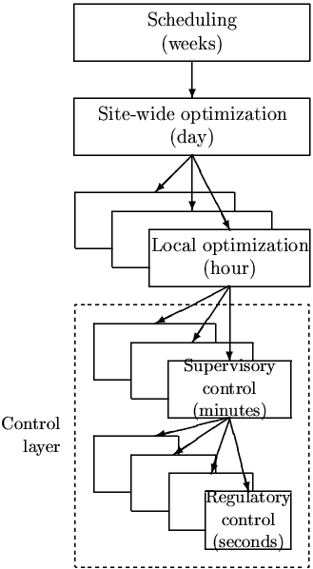
Theory: Optimal operation
Objectives
Theory:
  Model of overall system
  Estimate present state
  Optimize all degrees of freedom
Problems:
  Model not available
  Optimization complex
  Not robust (difficult to handle uncertainty)
  Slow response time
Process control:
  Excellent candidate for centralized control
CENTRALIZED
OPTIMIZER
Present state
Model of system
(Physical) Degrees of freedom

Slide 18
Practice: Engineering systems
Most (all?) large-scale engineering systems are controlled using hierarchies of quite simple controllers
  Large-scale chemical plant (refinery)
  Commercial aircraft
100’s of loops
Simple components:
  on-off + PI-control + nonlinear fixes + some feedforward
Same in biological systems

Slide 19
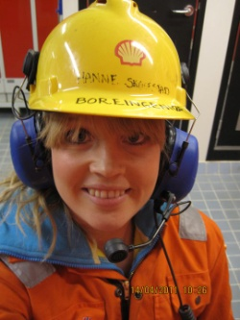
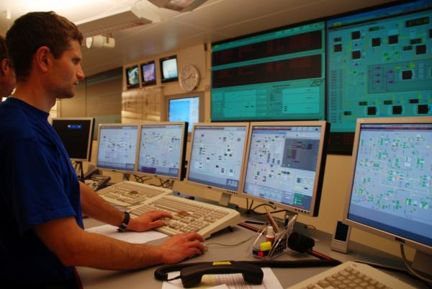
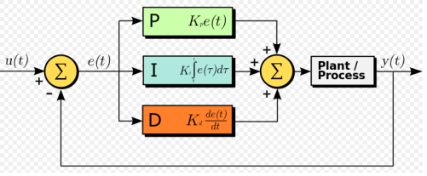
Our Paradigm
Practical operation: Hierarchical structure
Manager
Process engineer
Operator/RTO
Operator/”Advanced control”/MPC
PID-control
u = valves

Slide 20
Practice: Process operation
Practice:
Hierarchical structure
Each layer has its own goal (”default action”):
  Keep CV at given setpoint
Boss: layer above (adjusts setpoint)
Goal each layer: Action without boss is «Self-optimizing»
CV = controlled variable

Slide 21
Dealing with complexity
Plantwide control: Objectives
The controlled variables (CVs)
interconnect the layers
OBJECTIVE
Min J (economics)
RTO
c_{s} = y_{1s}
Follow path (+ look after other variables)
MPC
y_{2s}
Stabilize + avoid drift
PID
u (valves)
Notes:
21

Slide 22
Translate optimal operation into simple control objectives:
What should we control?
CV₁ = c ? (economics)
CV₂ = ? (stabilization)

Slide 23
CV1 = Economic controlled variables
Systematic procedure for selecting economic controlled variables (CV1)
  Active constraints
  Remaining unconstrained degrees of freedom:
    «Self-optimizing» variables

Slide 24
Outline
Skogestad procedure for control structure design
  I Top Down
    Step S1: Define operational objective (cost) and constraints
    Step S2: Identify degrees of freedom and optimize operation for disturbances
    Step S3: Implementation of optimal operation
      What to control ? (primary CV’s) (self-optimizing control)
    Step S4: Where set the production rate? (Inventory control)
  II Bottom Up
    Step S5: Regulatory control: What more to control (secondary CV’s) ?
    Step S6: Supervisory control
    Step S7: Real-time optimization

Slide 25
Step S1. Define optimal operation (economics)
What are we going to use our degrees of freedom (u=MVs) for?
Typical cost function*:
*No need to include fixed costs (capital costs, operators, maintainance) at ”our” time scale (hours)
Note: J=-P where P= Operational profit
J = cost feed + cost energy – value products

Slide 26
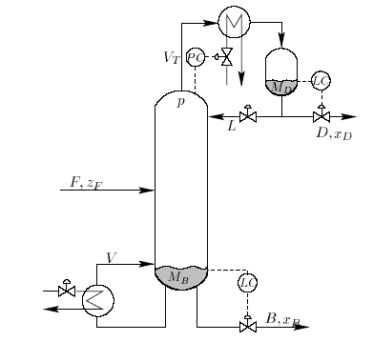
Optimal operation distillation column
Distillation at steady state with given p and F: N=2 DOFs, e.g. L and V (u)
Cost to be minimized (economics)
  J = - P where P= p_{D} D + p_{B} B – p_{F} F – p_{V}V
Constraints
  Purity D: For example x_{D, impurity} · max
  Purity B: For example, x_{B, impurity} · max
  Flow constraints: min · D, B, L etc. · max
  Column capacity (flooding): V · V_{max}, etc.
  Pressure: 1) p given (d) 2) p free (u): p_{min} · p · p_{max}
  Feed: 1) F given (d) 2) F free (u): F · F_{max}
Optimal operation: Minimize J with respect to steady-state DOFs (u)
cost energy (heating+ cooling)
value products
cost feed

Slide 27
Step S2. Optimize
(a) Identify degrees of freedom
(b) Optimize for expected disturbances
Need good model, usually steady-state
Optimization is time consuming! But it is offline
Main goal: Identify ACTIVE CONSTRAINTS
A good engineer can often guess the active constraints

Slide 28
Step S2a: Degrees of freedom (DOFs) for operation
Steady-state DOFs
NOT as simple as one may think!
To find all operational (dynamic) degrees of freedom:
Count valves! (N_{valves})
“Valves” also includes adjustable compressor power, etc.
Anything we can manipulate!
BUT: not all these have a (steady-state) effect on the economics

Slide 29
Steady-state degrees of freedom (DOFs)
Steady-state DOFs
IMPORTANT!
DETERMINES THE NUMBER OF VARIABLES TO CONTROL!
No. of primary CVs = No. of steady-state DOFs
Methods to obtain no. of steady-state degrees of freedom (N_{ss}):
Equation-counting
  N_{ss} = no. of variables – no. of equations/specifications
  Very difficult in practice
Valve-counting (easier!)
  N_{ss} = N_{valves} – N_{0ss} – N_{specs}
  N_{valves}: include also variable speed for compressor/pump/turbine
  N_{specs}: Equality constraints (normally included in constraints)
  N_{0ss} = variables with no steady-state effect
    Inputs/MVs with no steady-state effect (e.g. extra bypass)
    Outputs/CVs with no steady-state effect that need to be controlled (e.g., liquid levels)
Potential number for some units (useful for checking!)
Correct answer: Will eventually find it when we perform optimization
CV = controlled variable

Slide 30
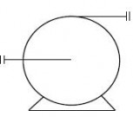
Does a pump give a degree of freedom?
Yes, if it has variable speed drive

Slide 31
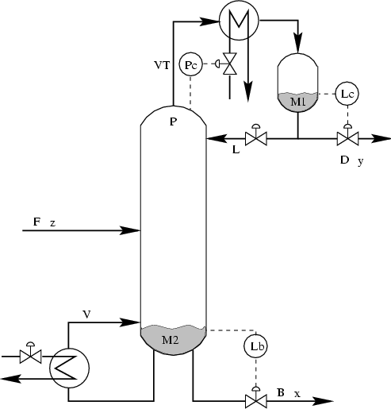
Steady-state DOFs
Typical Distillation column
4
5
3
1
4 DOFs:
With given feed and pressure:
NEED TO IDENTIFY 2 more CV’s
- Typical: Top and btm composition
6
2
N_{valves} = 6 , N_{0y} = 2* ,
N_{DOF,SS} = 6 -2 = 4 (including feed and pressure as DOFs)
*N_{0y} : no. controlled variables (liquid levels) with no steady-state effect

Slide 32
Steady-state degrees of freedom (N_{ss}):
3. Potential number for some process units
Steady-state DOFs
each external feedstream: 1 (feedrate)
splitter: n-1 (split fractions) where n is the number of exit streams
mixer: 0
compressor, turbine, pump: 1 (work/speed) (BUT: Must have variable speed)
adiabatic flash tank: 0*
liquid phase reactor: 1 (holdup reactant)
gas phase reactor: 0*
heat exchanger: 1 (bypass or flow of cooling/heating)
column (e.g. distillation) excluding heat exchangers: 0* + no. of sidestreams
pressure* : add 1DOF at each extra place you set pressure (using an extra valve, compressor or pump), e.g. in adiabatic flash tank, gas phase reactor or absorption column
*Pressure is normally assumed to be given by the surrounding process and is then not a degree of freedom
Ref: Araujo, Govatsmark and Skogestad (2007)
Extension to closed cycles: Jensen and Skogestad (2009)
Real number may be less, for example, if there is no bypass valve or no variable speed

Slide 33
Steady-state DOFs
Distillation column (with feed and pressure as DOFs)
split
“Potential number”,
N_{ss}= 0 (column distillation) + 1 (feed) + 2*1 (heat exchangers) + 1 (split) = 4
With given feed and pressure: N’_{ss} = 4 – 2 = 2

Slide 34
Step S2b: Optimize for expected disturbances
What are the optimal values for our degrees of freedom u (MVs)?
Minimize J with respect to u for given disturbance d (usually steady-state):
  min_{u} J(u,x,d)
  subject to:
  Model equations (e,g, Hysys): f(u,x,d) = 0
  Operational constraints: g(u,x,d) < 0
  OFTEN VERY TIME CONSUMING
  Commercial simulators (Aspen, Unisim/Hysys) are set up in “design mode” and often work poorly in “operation (rating) mode”.
  Optimization methods in commercial simulators often poor
    We use Matlab or even Excel “on top”
J = cost feed + cost energy – value products

Slide 35
Step S3: Implementation of optimal operation
Have found the optimal way of operation. How should it be implemented?
What to control ? (primary CV’s).
  Active constraints
  Self-optimizing variables (for unconstrained degrees of freedom)
Objective: Move optimization into control layer

Slide 36

Optimal operation of runner
Optimal operation - Runner
  Cost to be minimized, J=T
  One degree of freedom (u=power)
  What should we control?

Slide 37
1. Optimal operation of Sprinter
Optimal operation - Runner
  100m. J=T
  Active constraint control:
    Maximum speed (”no thinking required”)
    CV = power (at max)

Slide 38
2. Optimal operation of Marathon runner
Optimal operation - Runner
    40 km. J=T
    What should we control? CV=?
    Unconstrained optimum
J=T
u_{opt}
u=power

Slide 39
Optimal operation - Runner
Self-optimizing control: Marathon (40 km)
Any self-optimizing variable (to control at constant setpoint)?
    c₁ = distance to leader of race
    c₂ = speed
    c₃ = heart rate
    c₄ = level of lactate in muscles

Slide 40
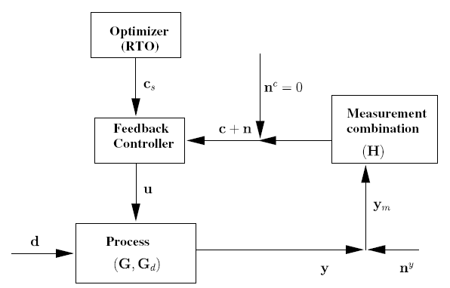
Conclusion Marathon runner
Optimal operation - Runner
J=T
c_{opt}
c=heart rate
select one measurement
c = heart rate
CV = heart rate is good “self-optimizing” variable
Simple and robust implementation
Disturbances are indirectly handled by keeping a constant heart rate
May have infrequent adjustment of setpoint (c_{s})

Slide 41
Step 3. What should we control (c)?
(primary controlled variables y₁=c)
Selection of controlled variables c
  Control active constraints!
  Unconstrained variables: Control self-optimizing variables!

Slide 42
Expected active constraints distillation
Selection of CV₁
Both products (D,B) generally have purity specs
Valuable product: Purity spec. always active
  Reason: Amount of valuable product (D or B) should always be maximized
    Avoid product “give-away” (“Sell water as methanol”)
    Also saves energy
Control implications:
ALWAYS Control valuable product at spec. (active constraint).
May overpurify (not control) cheap product
methanol
+ water
valuable
product
methanol
+ max. 0.5%
water
cheap product
(byproduct)
water
+ max. 2%
methanol

Slide 43
Example with Quiz:
Optimal operation of two distillation columns in series

Slide 44
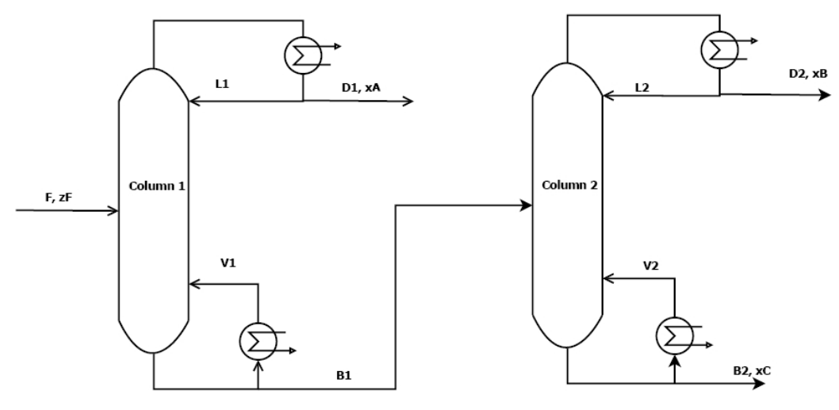
Operation of Distillation columns in series
With given F (disturbance): 4 steady-state DOFs (e.g., L and V in each column)
QUIZ 1
N=41
α_{AB}=1.33
> 95% A
p_{D1}=1 $/mol
N=41
α_{BC}=1.5
> 95% B
p_{D2}=2 $/mol
F ~ 1.2mol/s
p_{F}=1 $/mol
< 4 mol/s
< 2.4 mol/s
> 95% C
p_{B2}=1 $/mol
Cost (J) = - Profit = p_{F} F + p_{V}(V₁+V₂) – p_{D1}D₁ – p_{D2}D₂ – p_{B2}B₂
Energy price: p_{V}=0-0.2 $/mol (varies)
QUIZ: What are the expected active constraints?
1. Always. 2. For low energy prices.
DOF = Degree Of Freedom
Ref.: M.G. Jacobsen and S. Skogestad (2011)

Slide 45
Operation of Distillation columns in series
With given F (disturbance): 4 steady-state DOFs (e.g., L and V in each column)
SOLUTION QUIZ 1
Hm….?
N=41
α_{AB}=1.33
> 95% A
p_{D1}=1 $/mol
N=41
α_{BC}=1.5
> 95% B
p_{D2}=2 $/mol
1. x_{B} = 95% B
Spec. valuable product (B): Always active!
Why? “Avoid product give-away”
F ~ 1.2mol/s
p_{F}=1 $/mol
< 4 mol/s
< 2.4 mol/s
2. Cheap energy: V₁=4 mol/s, V₂=2.4 mol/s
Max. column capacity constraints active!
Why? Overpurify A & C to recover more B
> 95% C
p_{B2}=1 $/mol
Cost (J) = - Profit = p_{F} F + p_{V}(V₁+V₂) – p_{D1}D₁ – p_{D2}D₂ – p_{B2}B₂
Energy price: p_{V}=0-0.2 $/mol (varies)
QUIZ: What are the expected active constraints?
1. Always. 2. For low energy prices.
DOF = Degree Of Freedom
Ref.: M.G. Jacobsen and S. Skogestad (2011)

Slide 46
Control of Distillation columns in series
QUIZ 2
PC
PC
LC
LC
Given
LC
LC
QUIZ. Assume low energy prices (pV=0.01 $/mol).
How should we control the columns?
HINT: CONTROL ACTIVE CONSTRAINTS
Red: Basic regulatory loops

Slide 47
Control of Distillation columns in series
SOLUTION QUIZ 2
Hm…….
HINT: CONTROL ACTIVE CONSTRAINTS!
PC
PC
LC
LC
x_{B}
1 unconstrained DOF (L1):
Use for what?? CV=?
Not: CV= x_{A} in D1! (why? x_{A} should vary with F!)
Maybe: constant L1? (CV=L1)
Better: CV= x_{A} in B1? Self-optimizing?
CC
x_{BS}=95%
Given
MAX V1
MAX V2
General for remaining unconstrained DOFs:
LOOK FOR “SELF-OPTIMIZING” CVs = Variables we can keep constant
WILL GET BACK TO THIS!
LC
LC
QUIZ. Assume low energy prices (pV=0.01 $/mol).
How should we control the columns?
HINT: CONTROL ACTIVE CONSTRAINTS
Red: Basic regulatory loops

Slide 48
Comment: Distillation column control in practice
Add stabilizing temperature loops
  In this case: use reflux (L) as MV because boilup (V) may saturate
  T_{1s} and T_{2s} then replace L₁ and L₂ as DOFs.
Replace V1=max and V2=max by dpmax-controllers (assuming max. load is limited by flooding)
See next slide

Slide 49
Control of Distillation columns in series
Comment: In practice
PC
PC
LC
LC
x_{B}
T1
TC
T2
TC
T2_{s}
CC
T1_{s}
x_{BS}=95%
Given
MAX V1
MAX V2
LC
LC

Slide 50

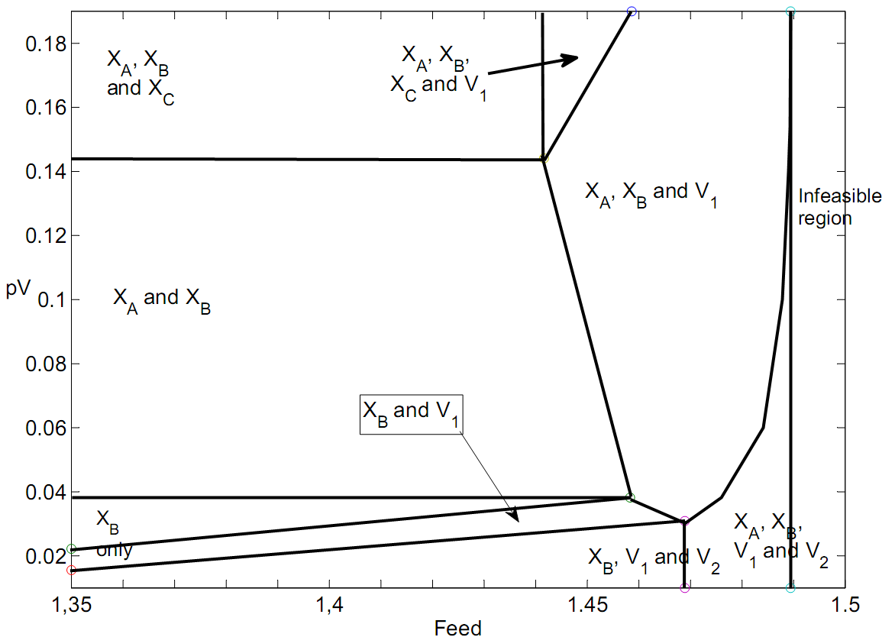
Active constraint regions for two distillation columns in series
Distillation example: Not so simple
0
Mode 1
1
Energy
price
1
Mode 2: operate at BOTTLENECK
Higher F infeasible because
all 5 constraints reached
[$/mol]
2
3
2
0
1
[mol/s]
Cheap energy: 1 remaining unconstrained DOF (L1)
-> Need to find 1 additional CVs (“self-optimizing”)
More expensive energy: 3 remaining unconstrained DOFs
-> Need to find 3 additional CVs (“self-optimizing”)
CV = Controlled Variable

Slide 51
How many active constraints regions?
Maximum:
  n_{c} = number of constraints
BUT there are usually fewer in practice
Certain constraints are always active (reduces effective n_{c})
Only n_{u} can be active at a given time
  n_{u} = number of MVs (inputs)
Certain constraints combinations are not possibe
  For example, max and min on the same variable (e.g. flow)
Certain regions are not reached by the assumed disturbance set
Distillation
n_{c} = 5
  2⁵ = 32
x_{B} always active
2^4 = 16
-1 = 15
In practice = 8

Slide 52
More on: Optimal operation
minimize J = cost feed + cost energy – value products
Two main cases (modes) depending on marked conditions:
Mode 1. Given feedrate
Mode 2. Maximum production
Comment: Depending on prices, Mode 1 may include many subcases (active constraints regions)

Slide 53
Mode 1. Given feedrate
Amount of products is then usually indirectly given and
Optimal operation is then usually unconstrained
J = cost feed– value products + cost energy
Often constant
“maximize efficiency (energy)”
Control:
Operate at optimal trade-off
NOT obvious what to control
CV = Self-optimizing variable
J = energy
c_{opt}
c

Slide 54
Mode 2. Maximum production
J = cost feed + cost energy – value products
Assume feedrate is degree of freedom
Assume products much more valuable than feed
Optimal operation is then to maximize product rate
“max. constrained”, prices do not matter
Control:
Focus on tight control of bottleneck
“Obvious what to control”
CV = ACTIVE CONSTRAINT
J
Infeasible
region
c_{max}
c

Slide 55
CV = Active constraint
More on: Active output constraints
Need back-off
c ≥ c_{constraint}
J
Loss
J_{opt}
Back-off
c
If constraint can be violated dynamically (only average matters)
  Required Back-off = “measurement bias” (steady-state measurement error for c)
If constraint cannot be violated dynamically (“hard constraint”)
  Required Back-off = “measurement bias” + maximum dynamic control error
  Want tight control of hard output constraints to reduce the back-off. “Squeeze and shift”-rule
The backoff is the “safety margin” from the active constraint and is defined as the difference between the constraint value and the chosen setpoint
Backoff = |Constraint – Setpoint|

Slide 56
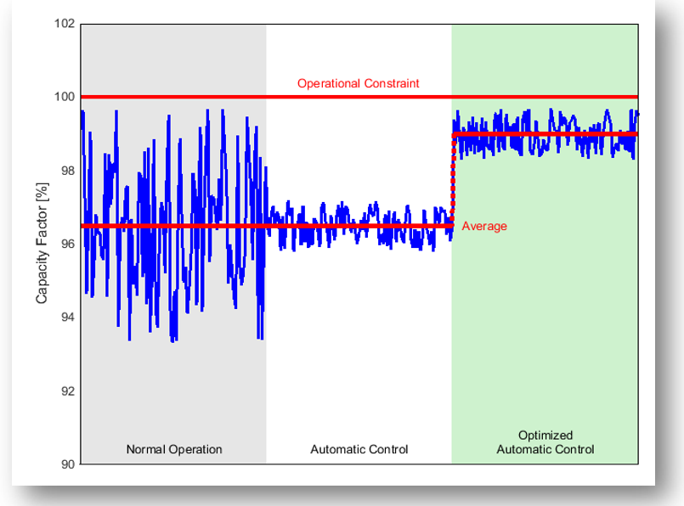
CV = Active constraint
Hard Constraints: «SQUEEZE AND SHIFT»

Slide 57
Hard Constraints: «SQUEEZE AND SHIFT»
CV = Active constraint
Rule for control of hard output constraints:
“Squeeze and shift”!
Reduce variance (“Squeeze”) and “shift” setpoint c_{s} to reduce backoff
SQUEEZE
© Richalet
SHIFT

Slide 58



CV = Active constraint
Example. Optimal operation = max. throughput.
Want tight bottleneck control to reduce backoff!
Back-off
= Lost production
Time

Slide 59
Example back-off. x_{B} = purity product > 95% (min.)
CV = Active constraint
D₁
x_{B}
D₁ directly to customer (hard constraint)
  Measurement error (bias): 1%
  Control error (variation due to poor control): 2%
  Backoff = 1% + 2% = 3%
  Setpoint x_{Bs}= 95 + 3% = 98% (to be safe)
  Can reduce backoff with better control (“squeeze and shift”)
D₁ to large mixing tank (soft constraint)
  Measurement error (bias): 1%
  Backoff = 1%
  Setpoint x_{Bs}= 95 + 1% = 96% (to be safe)
  Do not need to include control error because it averages out in tank
x_{B}
x_{B,product}
±2%
8

Slide 60
Unconstrained optimum:
Control “self-optimizing” variable.
Which variable is best?
Often not obvious (marathon runner)

Slide 61
Control of Distillation columns. Cheap energy
Example.
PC
PC
LC
LC
x_{B}
Overpurified
CC
x_{BS}=95%
Given
MAX V1
MAX V2
LC
LC
Overpurified
1 unconstrained DOF (L1): What is a good CV?
Not: CV= x_{B} in D1! (why? Overpurified, so x_{B,opt} increases with F)
Maybe: constant L1? (CV=L1)
Better: CV= x_{A} in B1? Self-optimizing?
Overpurified: To avoid loss of valuable product B

Slide 62
Solution.
Control of Distillation columns. Cheap energy
PC
PC
LC
LC
x_{B}
CC
x_{BS}=95%
CC
x_{AS}=2.1%
Given
MAX V1
MAX V2
LC
LC
Notes:
62

Slide 63
What happens if we increase the federate?
PC
PC
LC
LC
x_{B}
CC
x_{BS}=95%
CC
x_{AS}=2.1%
Given
(TPM)
MAX V1
MAX V2
LC
LC
Is this control structure still OK??
Notes:
63

Slide 64
TPM
Increase federate: Reach x_{A}-constraint
PC
PC
LC
LC
x_{B}
x_{A}
CC
x_{BS}=95%
CC
x_{AS}=95%
Given
(TPM)
MAX V1
MAX V2
LC
LC
Notes:
64

Slide 65
TPM
Increase federate further: Reach also x_{C}-constraint (Bottleneck)
PC
PC
LC
LC
x_{B}
x_{A}
CC
x_{BS}=95%
TPM used
as MV
CC
x_{AS}=95%
MAX V1
MAX V2
LC
LC
x_{C}
CC
x_{CS}=95%
Notes:
65

Slide 66
Move TPM
Move TPM to F2 (closer to bottleneck) and rearrange level loop
PC
PC
LC
LC
x_{B}
x_{A}
CC
x_{BS}=95%
CC
x_{AS}=95%
MAX V1
MAX V2
LC
LC
TPM used
as MV
x_{C}
CC
x_{CS}=95%
Notes:
66

Slide 67
Q1: I have to set back-off on output active constraints, right? Should I set it before evaluating losses? How much back-off should be set, 5%?
[Sigurd Skogestad] 5% is a good start, but it depends mostly on the measurement accuracy. Note that it must be a hard output constraint.
The value of the active constraint is usually considered a disturbance; this also takes care of the backoff variation
Q2: When I consider input active constraints as disturbance too. Ex. Temp feed to SOFC (T0f, T0a) are active at upper bound. Should I set +10% on this disturbance change or just -10%.
Is it possible to set +10% in this case?
[Sigurd Skogestad] Yes, the actual available input could be larger than what you think
Q3: In region I, I would like to try same structure as in region II which means Uf,MCFC set at 75% (upper bound) but it is an input active constraint
which considered as disturbance too. Hence Uf,MCFC doesn’t a disturbance in region I, am I right? Then region I have 4 disturbances but region II and III have 5 disturbances, am I right?
[Sigurd Skogestad] No, because also the value of the active constraint is usually considered as a disturbance
Q4: Do I need back-off on input active constraints too?
Answer: Input constraint: Normally not, except of it is a bottleneck constraint and the TPM is located somewhere else

Slide 68
More on: WHAT ARE GOOD “SELF-OPTIMIZING” VARIABLES?
Unconstrained variables
Intuition: “Dominant variables” (Shinnar)
More precisely
  Optimal value of CV is constant
  CV is “sensitive” to MV (large gain)

Slide 69

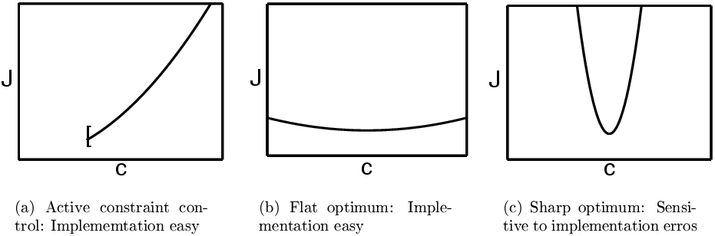
GOOD “SELF-OPTIMIZING” CV=c
Unconstrained optimum
Optimal value c_{opt} is constant (independent of disturbance d):
  c is “sensitive” to MV=u (to reduce effect of measurement noise)
Equivalently: Optimum should be flat
Good
Good
BAD

Slide 70
Conclusion optimal operation
ALWAYS:
1. Control active constraints and control them tightly!!
  Good times: Maximize throughput -> tight control of bottleneck
2. Identify “self-optimizing” CVs for remaining unconstrained degrees of freedom
Use offline analysis to find expected operating regions and prepare control system for this!
  One control policy when prices are low (nominal, unconstrained optimum)
  Another when prices are high (constrained optimum = bottleneck)
ONLY if necessary: consider RTO on top of this

