Slide 1
Throughput Manipulation:
The Key to Robust Plantwide Control
The NIT Jalandhar Lecture
30th October 2018
Nitin Kaistha
Chemical Engineering
Indian Institute of Technology Kanpur

Slide 2
Outline
About ChE@IITK
Plantwide Control Basics
  Why do we need a control system
  The control system as variability transformer
  Variability propagation around recycle loops
  Control structure guideline for recycle loops
  Throughput Manipulation
  PWCS Exercise
  PWCS Design Steps
Example Case Studies
Summary

Slide 3
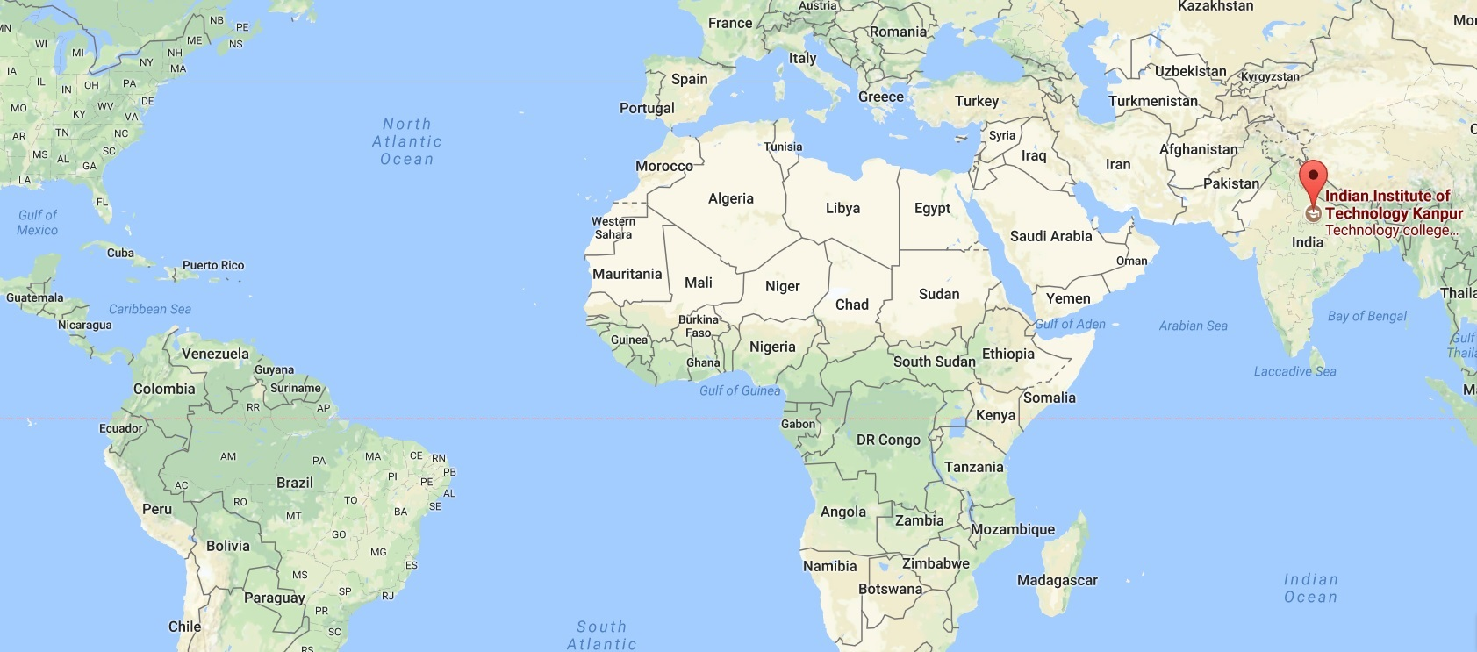
India

Slide 4
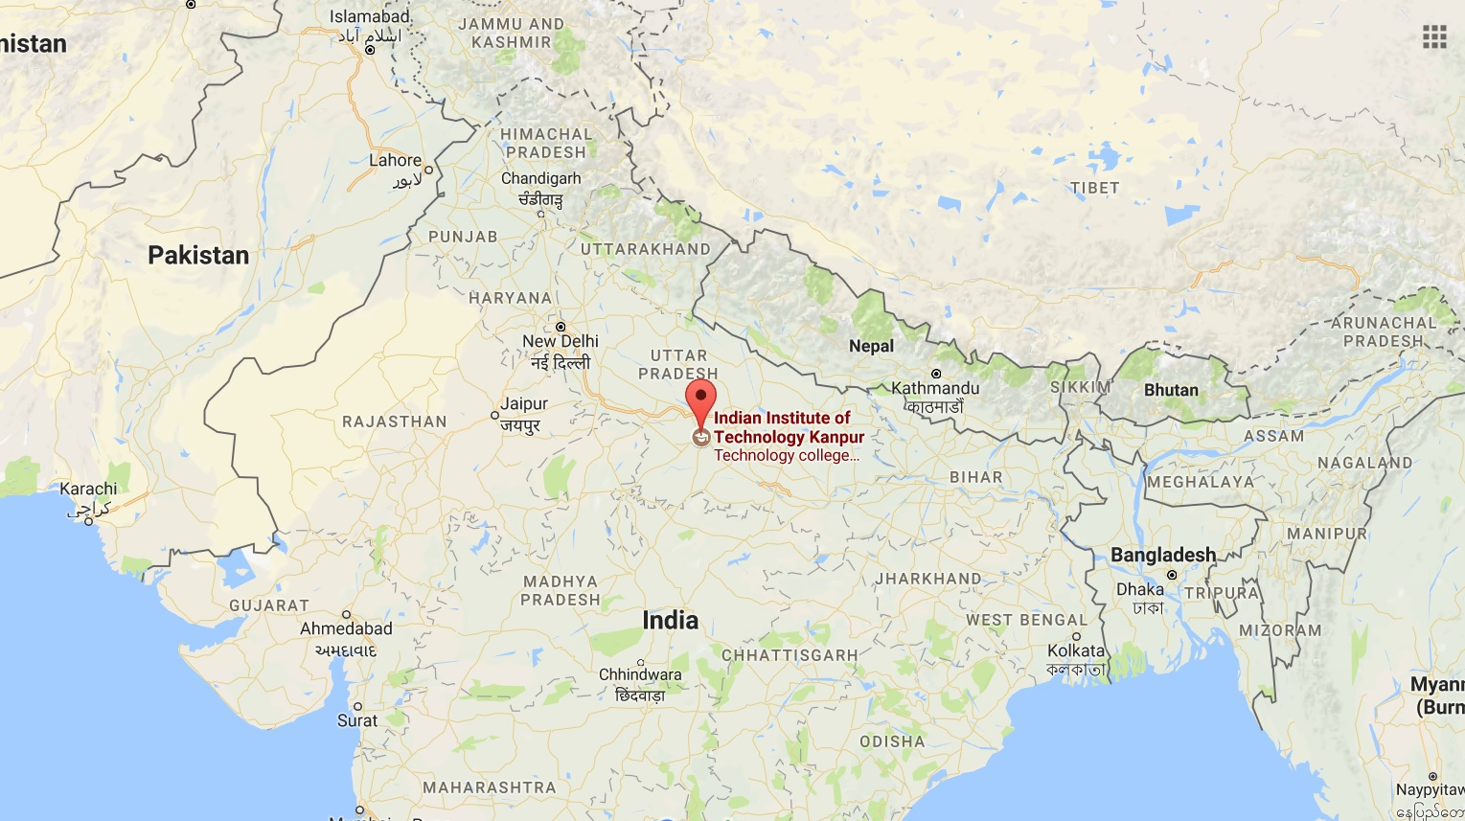
Kanpur

Slide 5
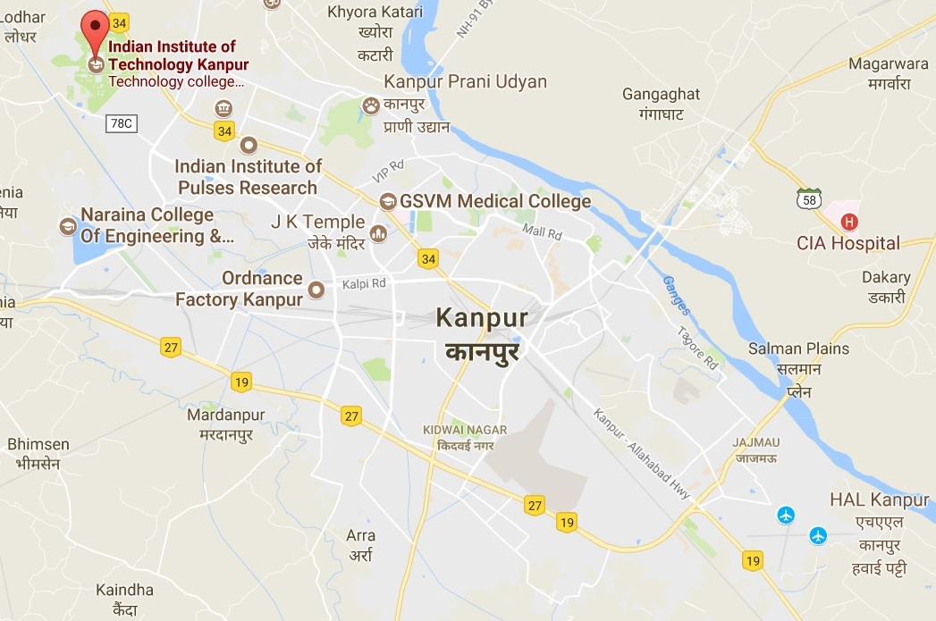
IIT Kanpur

Slide 6
ChE@IITK
21 Faculty Members
Programs
  B Tech (4 yr) and Dual (5 yr)
    ~80 freshmen each year
    ~60 B Tech and ~20 Dual
  M Tech (2 yr)
    20-25 join every year
  PhD (4-6 yr)
    ~15 join every year

Slide 7
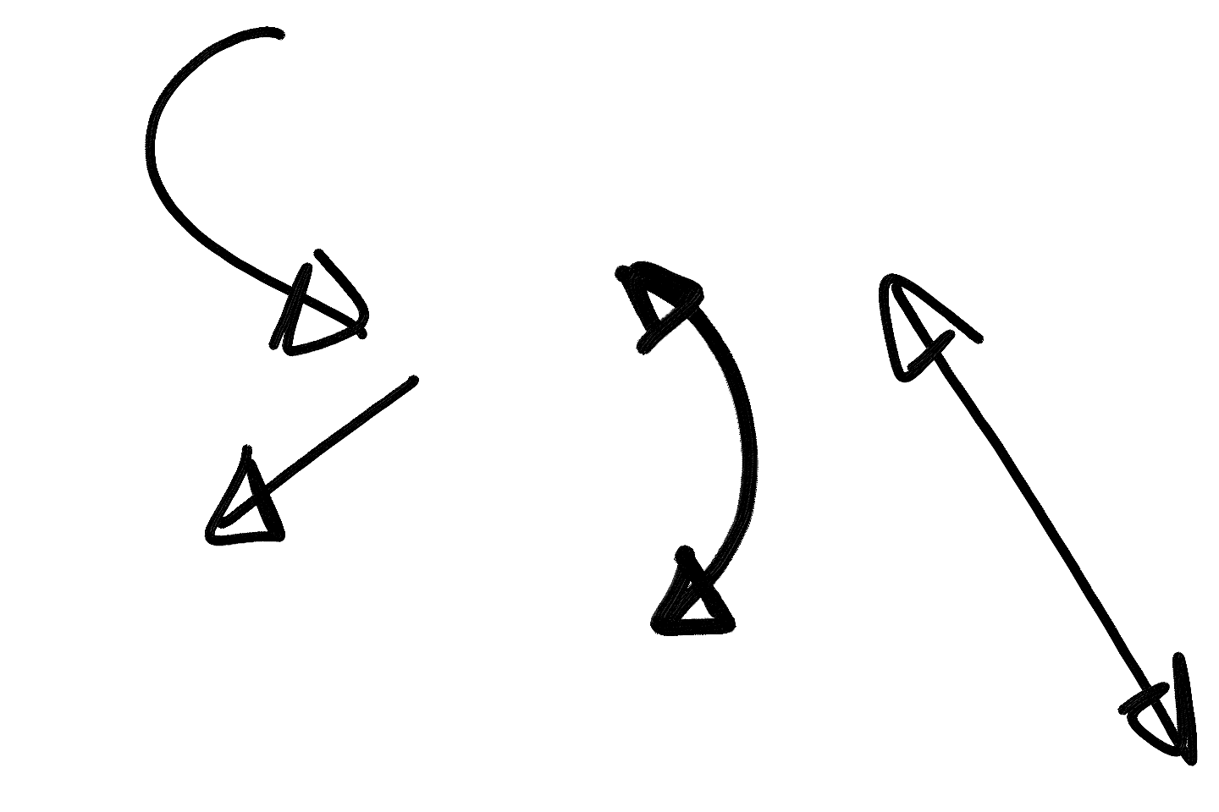



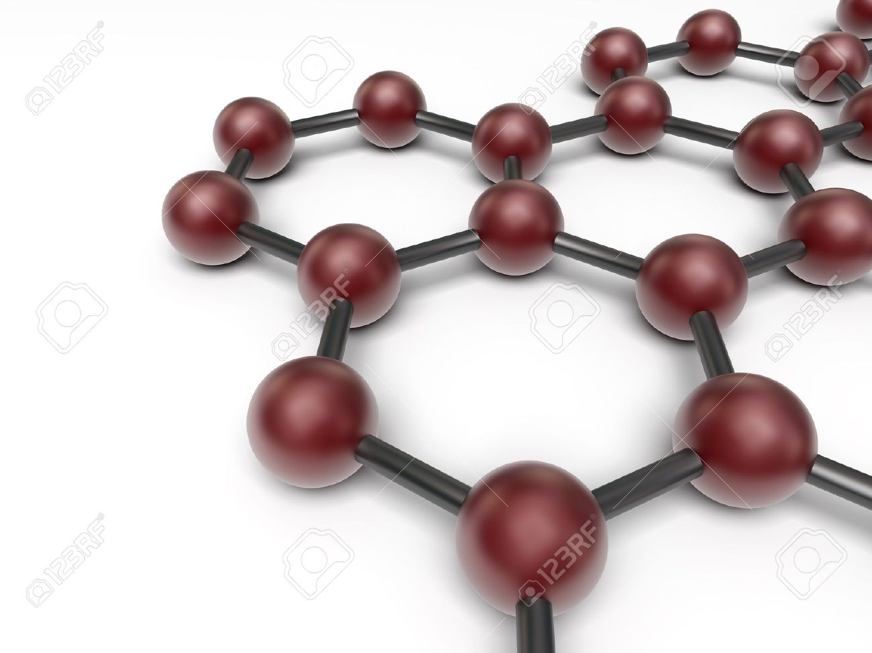

ChE@IITK: Research
Research Areas @ IITK: Research
Sustainable Process Engineering
Energy and Environment
CHE @ IITK
Research Areas
Advanced Materials, Nano-Science and Nano-Tech
Complex fluids, Colloids and Soft Matter
16

Slide 8
PWC Basics: A Simple Chemical Process
Fresh A
Recycle A
REACTOR
C
O
L
U
M
N
Cooling
Duty
A → B
FEHE
MATERIAL RECYCLE
ENERGY RECYCLE
PROCESS INTEGRATION
Minimizes
A consumed per kg B product
Steam consumed per kg B product
ENHANCES PROCESS PROFITABILITY
Product B

Slide 9
PWC Basics: Chemical Process Operation
Key Production Objectives
Safety
Stability
Economics
Production
Rate
Product
Quality
Effluent
Specs
Operate plant to meet production objectives 24X7
Production Objective Itself Can Change
Process Disturbances
Ambient
Conditions
Raw material
Quality
Sensor
Noise
Equipment
Characteristics

Slide 10
PWC Basics
Safety
Stability
Operate Process at Steady State
≡
0
Accumulation Rate Rate Generation
Rate In Out Rate
=
−
+
Need PWC to drive accumulation of all independent inventories to zero

Slide 11
PWC Basics
Regulatory Control System
  Drives all inventory accumulation terms to zero
  Ensures plant operation around a steady state
What steady state to operate at
  Economic Optimum
    Minimize expensive utility consumption
    Maximize production

Slide 12
Plantwide Control Hierarchy
PLANTWIDE CONTROL SYSTEM
Optimization Layer
(updates every few hrs)
Economic Operation
SETPOINT
Supervisory Control Layer
(updates every few mins)
Measurements
SETPOINT
Safe & Stable Operation
Regulatory Control Layer
(updates every few secs)
SIGNAL TO VALVE
PLANT

Slide 13
Regulatory PWCS Design
What to Control
  All independent inventories (DOF)
    Material – Liquid level or gas pressure
    Energy – Temperature or vapor pressure
    Component – Composition, tray temperature (inferential)
  Throughput or Production Rate
Degree of tightness of control
  Should energy inventories be tightly controlled?
  Should surge level inventories be tightly controlled?
What to manipulate
  The largest term on the RHS of the inventory balance
    Richardson’s Rule
  Pair close
    Fast dynamics
    Tight closed loop control

Slide 14
Control Structure Alternatives
TPM
FC
Recycle A
Fresh A
PC
RC
LC
TC
REACTOR
C
O
L
U
M
N
Cooling
Water
A → B
LC
TC
LC
Product B

Slide 15
Alternative Control Structures
Alternative Control Structures
TPM
FC
Recycle A
Fresh A
PC
RC
LC
TC
REACTOR
C
O
L
U
M
N
Cooling
Water
A → B
LC
TC
LC
Product B

Slide 16
Alternative Control Structures
LC
Recycle A
Fresh A
PC
RC
LC
TC
REACTOR
C
O
L
U
M
N
Cooling
Water
A → B
LC
TC
TPM
FC
Product B

Slide 17
Alternative Control Structures
LC
Recycle A
Fresh A
PC
RC
LC
TC
REACTOR
TPM
C
O
L
U
M
N
Cooling
Water
A → B
FC
TC
LC
Product B

Slide 18
Alternative Control Structures
LC
Recycle A
Fresh A
PC
RC
LC
TC
REACTOR
C
O
L
U
M
N
Cooling
Water
A → B
TC
TPM
FC
LC
Product B

Slide 19
Alternative Control Structures
LC
Recycle A
Fresh A
PC
TPM
RC
FC
TC
REACTOR
C
O
L
U
M
N
Cooling
Water
A → B
LC
TC
LC
Product B

Slide 20
PWCS Design: Key Points
Location of through-put manipulator a key decision for inventory management
Several alternative ‘reasonable’ plant-wide control structures
Which one is the ‘best’
How do you bring method to the madness

Slide 21
The Transformation of Variability Perspective
HEAT EXCHANGER EXAMPLE
TC
Steam in
Control
Valve
TT
Transmitter
Process Stream in
HEAT EXCHANGER
Process Stream out
Condensate out
Steam Flow
Steam Flow
Temperature
Temperature
CONTROL
SYSTEM
Agent for transformation / management of process variability

Slide 22
Where to Transform Variability
Surge level
  Does not affect steady state
  Regulate loosely for filtering out flow transients
Energy Inventories
  Regulate tightly to guarantee safety (rxn runaway?)
Product quality
  Regulate tightly
  Minimize “free” product give-away
Production rate
  Often “loose” is OK (eg meet the monthly target)
Recycle loop circulation rates
  Regulate tightly
  All equipment inside recycle loop see low variability
  May need to let it float for overall balance closure

Slide 23
A Common Energy Recycle Loop
TC
T_{R}
TPM
FC
Feed
T₀↑
FEHE
T_{R}
T_{E}
Q_{FEHE}
Q_{Htr}≠0
REACTOR
PC
Q_{Cool}
T_{C}
LC
Temperature controller transforms energy balance variability out of recycle loop
Regulates energy recycled in FEHE

Slide 24
A Common Energy Recycle Loop
TC
TC
T_{R}
TPM
0%
FC
Feed
T₀↑
FEHE
T_{R}
T_{E}
Q_{FEHE}
Q_{Htr}=0
REACTOR
PC
Q_{Cool}
T_{C}
LC
Temperature controller transforms energy balance variability out of recycle loop
Regulates energy recycled in FEHE

Slide 25
Material Recycle Snowball Effect
TPM
FC
Recycle A
Fresh A
PC
RC
LC
TC
REACTOR
C
O
L
U
M
N
Cooling
Water
A → B
LC
Recycle loop shows large swings
Large Throughput De-rating
R
TC
%
F_{A}
LC
Time
Product B

Slide 26
Material Recycle Snowball Effect
TPM
FC
Recycle A
Fresh A
PC
RC
LC
TC
REACTOR
C
O
L
U
M
N
Cooling
Water
A → B
LC
No large swings in recycle rate
Lower Throughput De-rating
TC
LC
Product B

Slide 27
Key Guideline for Recycle Loops
Structure the control system to transform variability out of the recycle loop
  Hold what’s going around the recycle loop
Energy Recycle Loop
  Hold a temperature inside the recycle loop
Material Recycle Loop
  Hold component rate(s) going around recycle loop
  Material balance control structure brings in fresh component(s) that are recycled as make-up streams

Slide 28
More on Recycle Loops: Nonlinearity
NO FEASIBLE STEADY STATES
Recycle Rate
Snowballing
Fresh Feed Rate
Fixing the fresh feed rate of a recycled component is NOT a good idea
Possibility of overfeeding induced instability

Slide 29
PWC Basics: Throughput Manipulation
THROUGHOUT MANIPULATOR (TPM)
The setpoint adjusted to effect a change in production/processing rate
TPM
*
FC
Unit 1
LC
Unit 2
LC
Unit 3
LC
Lost production
TPM
*
LC
Unit 1
LC
Unit 2
FC
Unit 3
LC
No (min) production loss

Slide 30
PWC Basics: TPM Selection
When is TPM choice flexible
  Large storage tanks supply the fresh feed(s)
  Variability in storage tank level is acceptable
    Allows structures that bring in fresh feed(s) as make-up
Usually plant designs have large recycle rates
  Design in the snowballing region
  Capacity bottleneck then is likely inside the loop
Where to locate the TPM
  Inside the recycle loop
  If multiple recycle loops, on a common branch
  If bottleneck is known, AT the bottleneck

Slide 31
Key PWC Guidelines
Configure control structure to transform recycle rate variability out of the recycle loop
Provide control DOFs for fast “local” control
“Pair” locally for fast control
Choose TPM at bottleneck constraint to transform variability away from bottleneck
  Almost always, bottleneck is inside the recycle loop

Slide 32
PWCS Design Exercise I
TPM at Fresh B Feed
X
CC
PC
FC
F_{A}
TPM
FC
LC
FC
F_{B}
C
O
L
U
M
N
LC
A + B → C
TC
TC
LC
Product C

Slide 33
PWCS Exercise I Continued
Beware of subtle plantwide recycle loop inventory drifts
Stoichiometric feed balancing
Plantwide balances close slowly due to recycle
Always examine process input-output structure
Every component must find a way out or get consumed (DOWNS’ DRILL)
FC
F_{A}
IC
Recycle A
P_{C}
IC
Recycle B
F_{B}
For (near) pure C product, F_{A} = F_{B}

Slide 34
PWCS Design Exercise I Continued
IC
FC
IC
F
P
Recycle
FC
IC
F
IC
P
Recycle

Slide 35
PWCS Design Exercise I Continued
TPM at Fresh B Feed
DOF:
Feed A
Feed B
Heat Qrx
Column feed F
Reflux L
Boilup V (Qb)
Bottoms B
Distillate (recycle) D
Cooling column (Qc)
Levels (2) that neeed to be controlled with no steady-stafe effect:
Md
Mb
Given (setpoint) (1): (can be given up)
Feedrate
Column pressure
Active constraints (3) :
Max reactor volume
Max reactor temperature
Min. product purity xC (no giveway)
Self-optimizing (2)
A/B in feed
L/F
?
X
CC
PC
FC
?
F_{A}
TPM
FC
LC
FC
F_{B}
C
O
L
U
M
N
MAX
LC
A + B → C
MAX
TC
TC
MIN
Other constraints (MV):
Max. heating (Qbmax) -> give up p
Max. column pressure drop (floowing)
Max. cooling (Qcmax) -> min-sel. With Qb to F
Max. heating reactor (Qrx)
Other constraints (CV)
Max. pressure (p) -> selector to Qb
LC
Product C

Slide 36
PWCS Design Exercise II
TPM at Product Stream: On Demand Operation
?
X
CC
PC
FC
?
F_{A}
MAX
LC
LC
FC
F_{B}
C
O
L
U
M
N
MIN
TC
A + B → C
MAX
TC
LC
FC
TPM
Product C

Slide 37
PWCS Design Exercise III
TPM Location Flexible: At Reactor Feed
?
X
CC
PC
FC
?
F_{A}
TPM
FC
LC
FC
F_{B}
C
O
L
U
M
N
MAX
LC
A + B → C
MAX
TC
TC
MIN
LC
Product C

Slide 38
PWCS Design Exercise IV
TPM Location Flexible: At Column Boil-up
?
X
CC
PC
FC
?
F_{A}
MAX
LC
LC
FC
F_{B}
C
O
L
U
M
N
MIN
TC
A + B → C
TPM
MAX
TC
FC
LC
Product C

Slide 39
Throughput Maximization Exercise I
?
MAX
CC
MAX - δ
X
PC
FC
?
Large back-off
F_{A}
TPM
FC
LC
FC
F_{B}
C
O
L
U
M
N
MAX
LC
A + B → C
MAX
TC
TC
MIN
MAX
- δ
LC
ΔPC
‘Long’ loop
Product C

Slide 40
Throughput Maximization Exercise II
NOT A LIKELY SCENARIO FOR ON-DEMAND STRUCTURES
?
MAX
MAX - δ
Lower back-off
X
CC
PC
FC
?
F_{A}
MAX
LC
LC
FC
F_{B}
C
O
L
U
M
N
MIN
TC
A + B → C
MAX
TC
MAX - δ
LC
ΔPC
FC
TPM
Product C

Slide 41
Throughput Maximization Exercise III
?
X
CC
PC
MAX
FC
?
MAX - δ
F_{A}
Lower back-off
TPM
FC
LC
FC
F_{B}
C
O
L
U
M
N
MAX
LC
A + B → C
MAX
TC
TC
MIN
MAX - δ
LC
ΔPC
Product C

Slide 42
Throughput Maximization Exercise IV
MAX
MAX - δ
?
Negligible back-off
X
CC
PC
FC
?
F_{A}
MAX
LC
LC
LC
FC
F_{B}
C
O
L
U
M
N
MIN
TC
A + B → C
TPM
MAX
TC
FC
LC
ΔPC
MAX - δ
Product C

Slide 43
PWCS Design Steps
DOF analysis and control objectives
  Production rate
  Product quality
  Safety limits (eg UFL < gas loop composition < LFL)
  Economic
Choose TPM
  Feed set by an upstream process
  On demand operation (utility plants)
  Flexible
    Inside the recycle loop at the feed of the most non-linear/fragile unit
    If bottleneck is known, at the bottleneck inside the recycle loop
Design “local” loops for closing all independent material and energy balances around the TPM
  Radiate outwards from the TPM
  Check consistency of material / energy balance closure (Downs’ Drill)
Choose loop setpoints “wisely”
  Usually governed by economic considerations

Slide 44
Case Study I: Ester Purification Process
Recycle
Q_{Cnd}
L
D
F_{H2O}
F_{Col}
Distillation column
Q_{Reb}
Ethyl acetate
Ethanol
Water
Extractor
F_{Feed}
F_{Tot}
F_{Ester}
F_{Alc-wash}

Slide 45
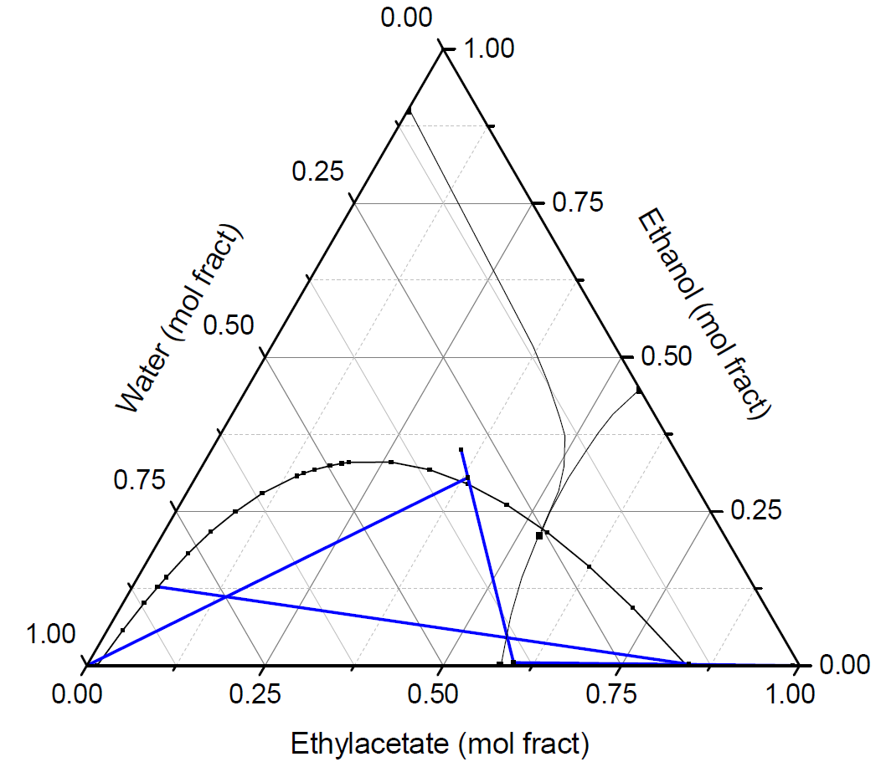
Flowsheet Material Balances
Recycle
Q_{Cnd}
L
D
F_{H2O}
F_{Col}
Alcohol wash
Fresh feed
Distillation column
LLX feed
Column feed
Q_{Reb}
Extractor
F_{Feed}
F_{Tot}
F_{Ester}
Water feed
Product
F_{Alc-wash}
EtOH-H2O recycle

Slide 46
Control Objective
Operate plant to maximize ester production
BOTTLENECK
  Maximum water solvent rate to the extractor
    Hydraulic constraint
  Limits alcohol extraction capacity

Slide 47
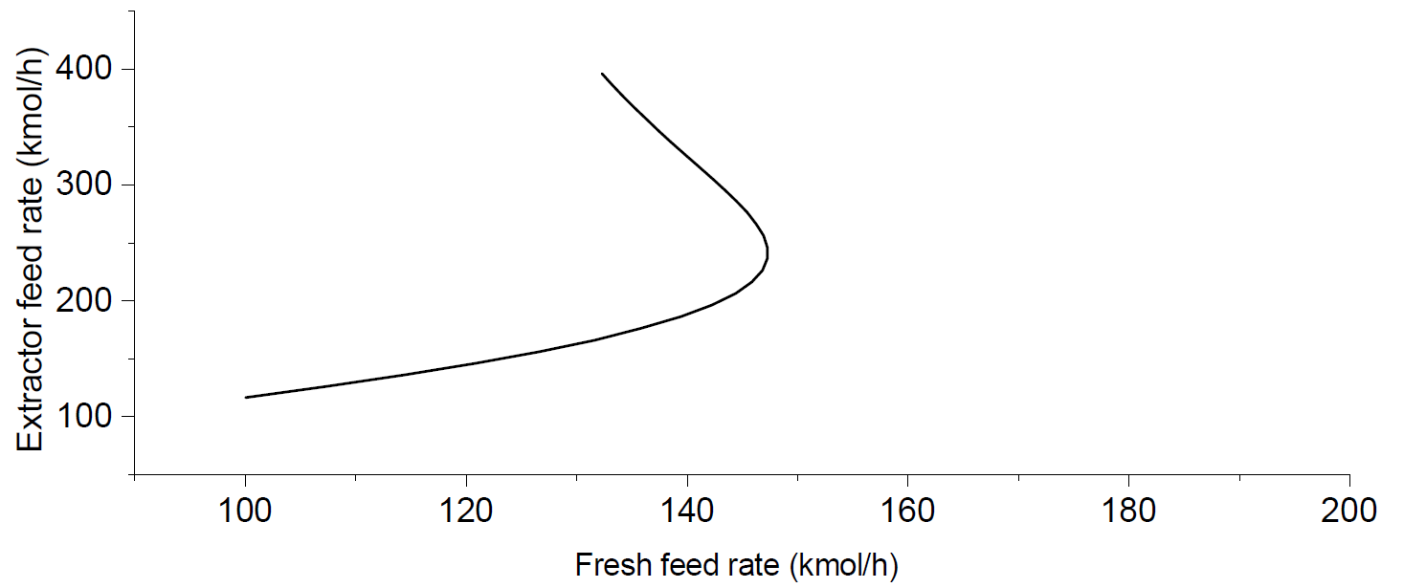
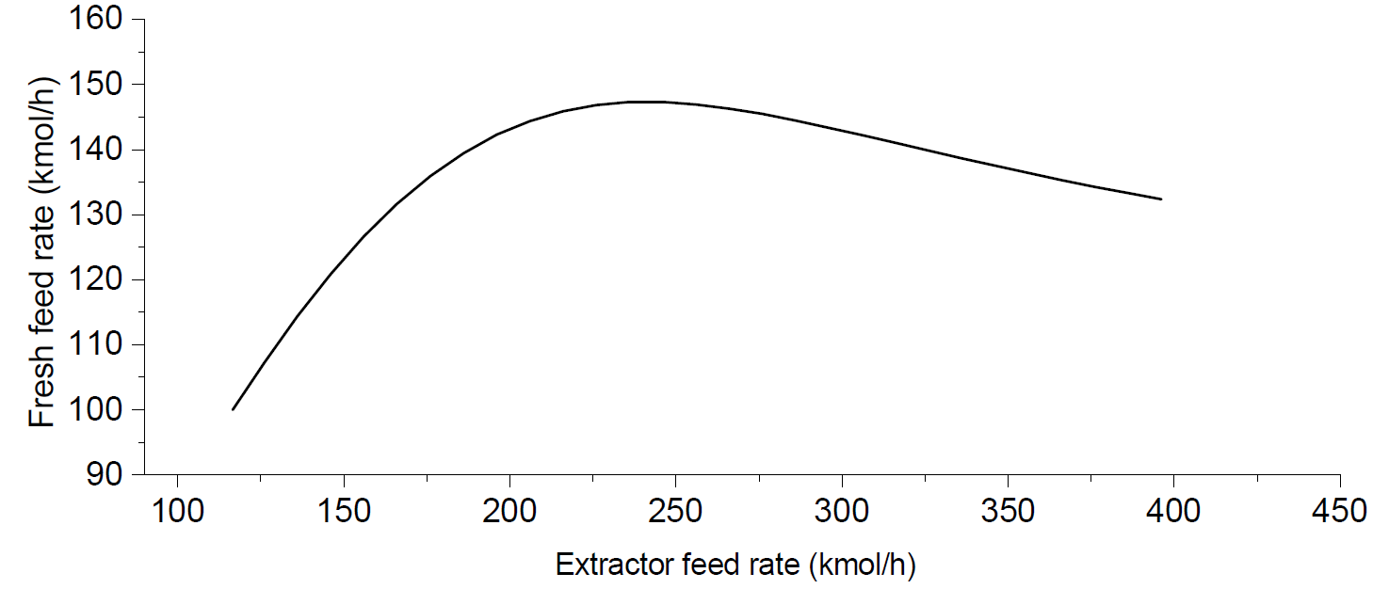
Steady State Bifurcation Analysis
Fresh Water Rate = MAX
(b)
(a)
Infeasible setpoint
No setpoint Infeasibility

Slide 48
Control Structure 2
Recycle
PC
Q_{Cnd}
MAX
X
FC
LC
FC
LC
L
D
F_{H2O}
F_{Col}
Distillation column
TC
Q_{Reb}
TPM
FC
Extractor
LC
F_{Feed}
F_{Tot}
F_{Ester}
LC
F_{Alc-wash}

Slide 49
CS1: TPM at Bottleneck Feed
Recycle
PC
Q_{Cnd}
MAX
X
FC
LC
FC
LC
L
D
F_{H2O}
F_{Col}
Distillation column
TC
Q_{Reb}
TPM
FC
Extractor
LC
F_{Feed}
F_{Tot}
F_{Ester}
LC
F_{Alc-wash}

Slide 50
CS1: TPM at Bottleneck Feed
Recycle
PC
Q_{Cnd}
MAX
X
FC
LC
FC
LC
L
D
F_{H2O}
F_{Col}
Distillation column
TC
Q_{Reb}
TPM
FC
Extractor
LC
F_{Feed}
F_{Tot}
F_{Ester}
LC
F_{Alc-wash}

Slide 51
CS2: TPM at Fresh Feed
Recycle
PC
Q_{Cnd}
MAX
X
FC
LC
FC
LC
L
D
F_{H2O}
F_{Col}
Distillation column
TC
Q_{Reb}
TPM
FC
Extractor
LC
F_{Feed}
F_{Tot}
F_{Ester}
LC
F_{Alc-wash}

Slide 52
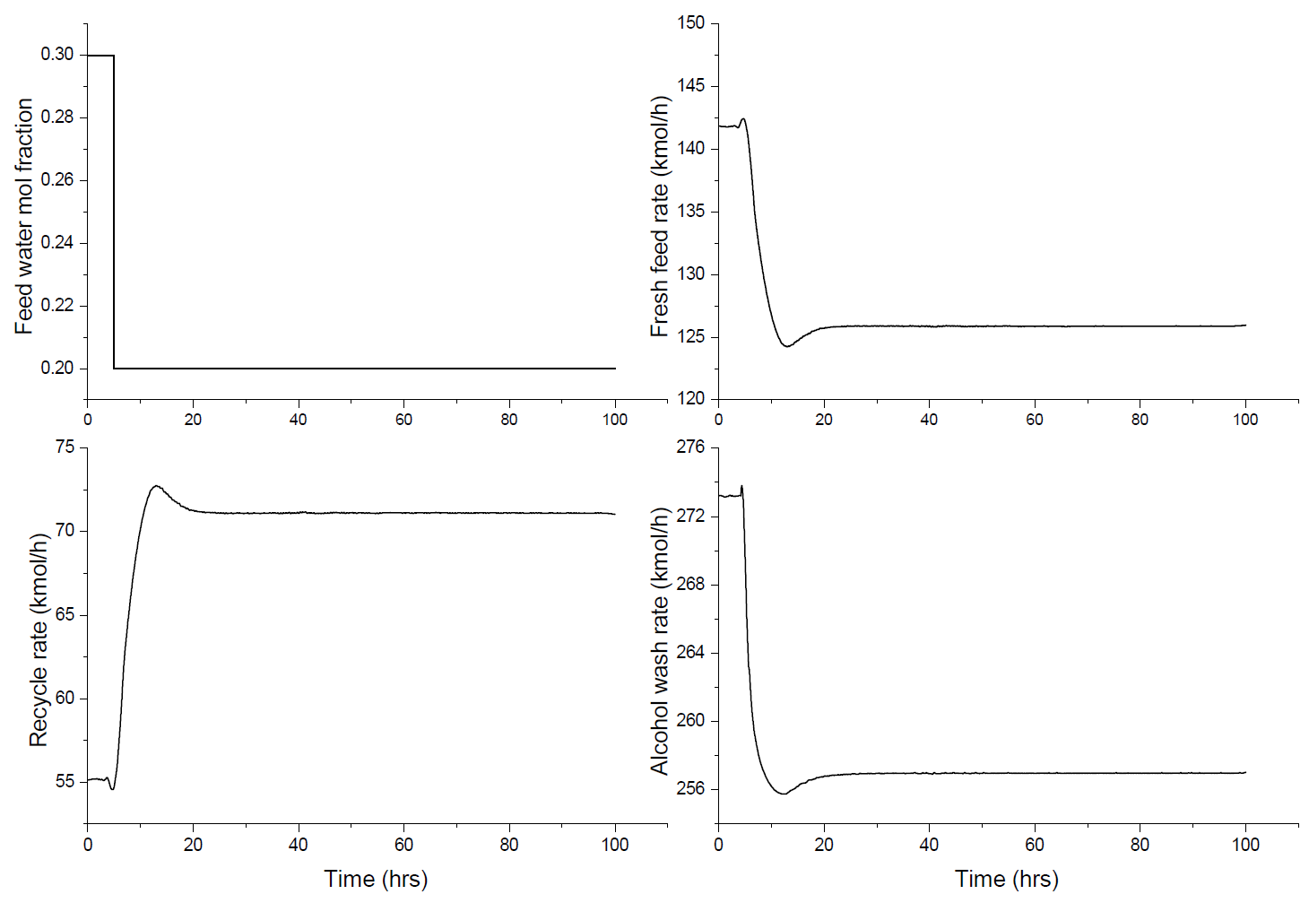
CS1 Closed Loop Transients
Large Feed Composition Change

Slide 53
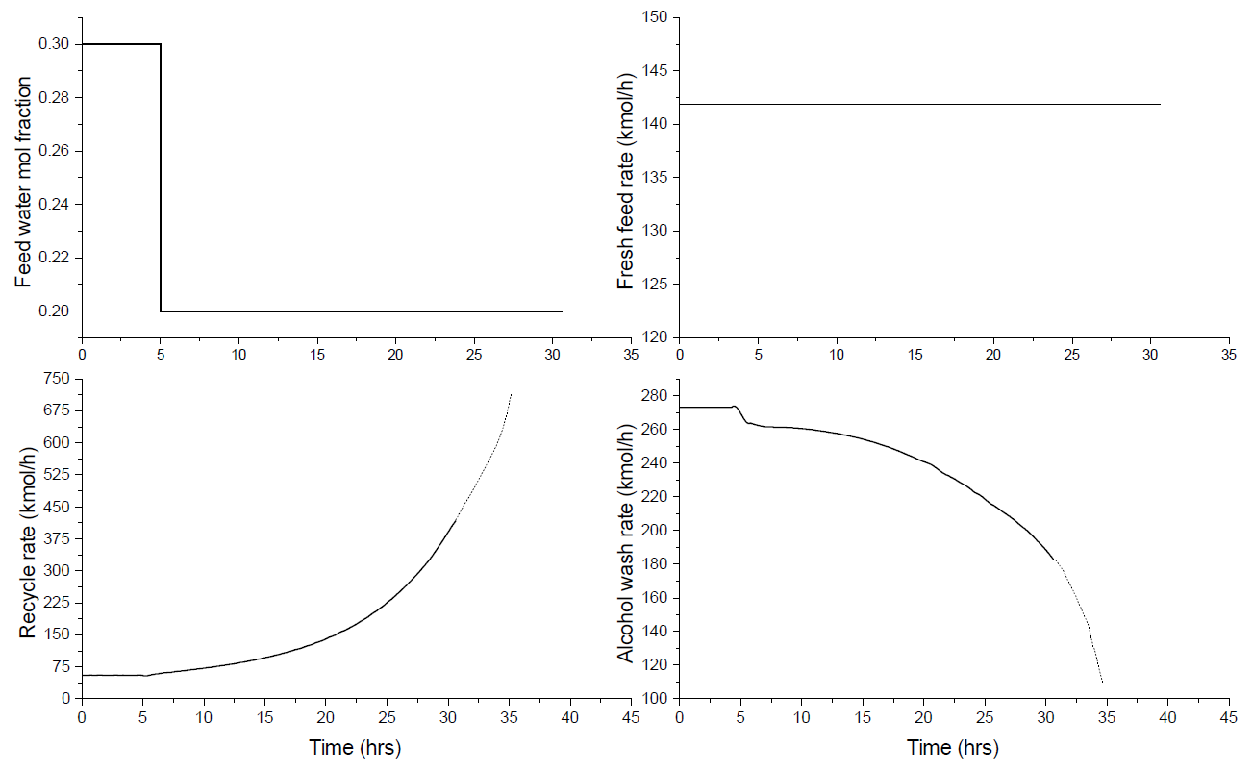
CS2 Closed Loop Transients
Large Feed Composition Change

Slide 54
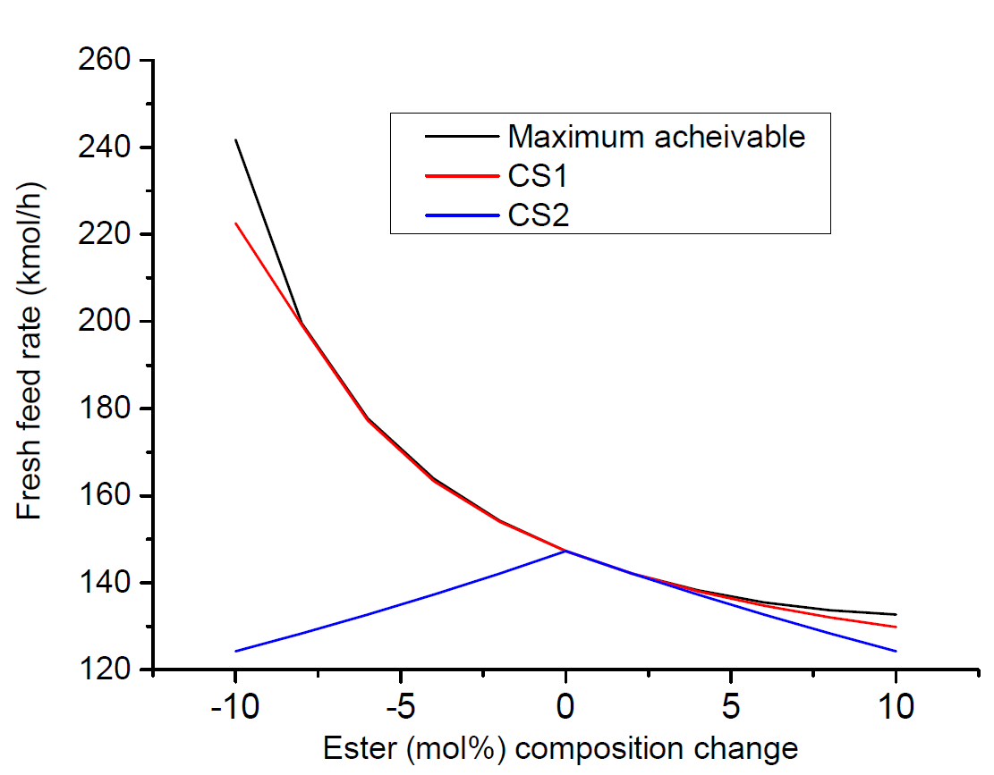
Throughout Maximization Results
CS1 → Self regulatory
CS2 → Overfeeding infeasibility
174 kmol/h
Nominal maximum throughput
147.3 kmol/h
136 kmol/h

Slide 55
CASE STUDY 2: Simple Recycle Process
F_{A}
F_{B}
C
O
L
U
M
N
A + B → C
Excess A environment
BOTTLENECK CONSTRAINT
Maximum Column Boilup
Product C

Slide 56
Control Structure 0
X
CC
PC
FC
F_{A}
FC
LC
FC
F_{B}
LC
C
O
L
U
M
N
A + B → C
Excess A environment
TPM
TC
TC
FC
LC
Product C

Slide 57
Control Structure 1
X
CC
PC
FC
F_{A}
FC
LC
FC
F_{B}
LC
C
O
L
U
M
N
TPM
FC
A + B → C
Excess A environment
TC
TC
LC
Product C

Slide 58
Control Structure 2
X
CC
PC
FC
F_{A}
TPM
FC
LC
FC
F_{B}
C
O
L
U
M
N
LC
A + B → C
Excess A environment
TC
TC
LC
Product C

Slide 59
Control Structure 3
X
CC
PC
FC
F_{A}
FC
FC
TPM
FC
F_{B}
LC
C
O
L
U
M
N
LC
A + B → C
Excess A environment
TC
TC
LC
Product C

Slide 60
Control Structure 4
X
CC
PC
FC
F_{A}
FC
FC
FC
F_{B}
LC
TPM
C
O
L
U
M
N
LC
A + B → C
Excess A environment
TC
TC
LC
Product C

Slide 61
Maximum Throughput Results
CS0
CS2, CS1, CS3, CS4, CS0

Slide 62
Managing Unconstrained DOFs
Hill
Climber
X
CC
PC
FC
F_{A}
FC
LC
FC
X
L/F ^{selfopt}
F_{B}
LC
U_{R}^{MAX}
C
O
L
U
M
N
A + B → C
Excess A environment
V^{MAX}
T_{R}^{MAX}
TC
TC
FC
T_{Col}^{MIN}
~3-5% additional throughput for same boil-up
LC
≡
~3-5% steam savings per kg throughput
Product C

Slide 63
Summary
Key guideline for recycle system PWC
  Structure control system to hold recycle rate by manipulating in / out streams in loop
Holding a fresh feed rate constant is NOT a good idea
Locate TPM at bottleneck inside recycle loop
Economic considerations play a major role in regulatory control layer design
Quantitative case study results
  Significantly higher maximum achievable throughput with fresh feed as make-up stream
COMMON SENSE MUST PREVAIL

