Slide 1
P8
Tranformed inputs
Briefly on pro and cons of MPC
RTO
ESC

Slide 2
Nonlinear feedforward, decoupling and linearization
Tranformed inputs: Extremely simple and effective way of achieving feedforward, decoupling and linearization

Slide 3
Feedforward control
Feedforward control relies on model
as opposed to feedback which relies mostly on data
Feedback control: Linear model is often OK
Feedforward control: Much less likely that linear model is OK because of process changes and disturbances
Here: Nonlinear feedforward control using Input transformations based on static process model

Slide 4
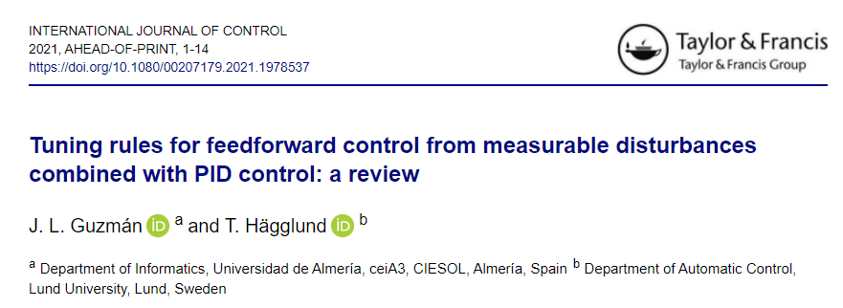
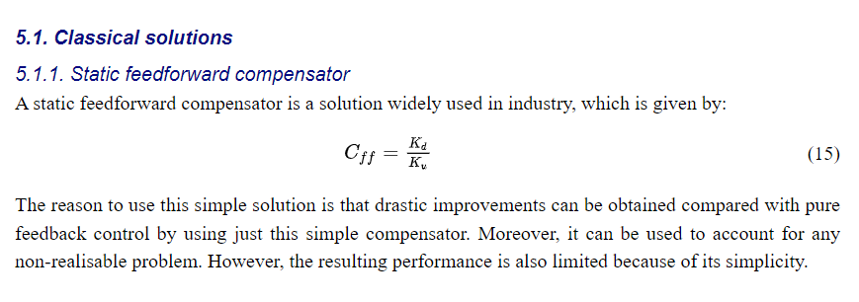
STATIC MODEL IS OFTEN OK, even for linear feedforward:

Slide 5
Use of transformed inputs
d
Transformed system
_{w}
y_{s}
Controller
C
(dynamic)
v =g(u,w,y,d)
_{=transformed input}
Input calculation
(Static calculation block that inverts g)
Process
(dynamic)
y
u=
g⁻¹(v,..,d)
y
Transformed input v =g(u,w,y,d)
Replaces the physical input u for control of y.
Aim: Transformed system is easier to control
  May include:
    Decoupling
    Linearization
    Feedforward
Examples
  v = u/d (ratio control for feedforward)
  v = u₁/u₂ (ratio control for decoupling)
  v = u₁+ d (from mass balance)
  v = w(u,d) = F
Input calculation block: Inverts g to find resulting u
  u = v*d
  u1 = v*u2
  u1 = v – d
  Flow controller finds u for given v=F by feedback (cascade control)

Slide 6
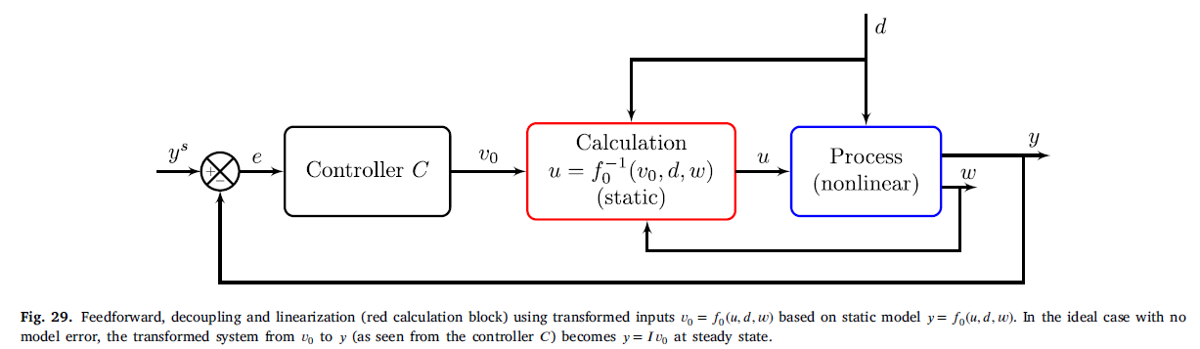
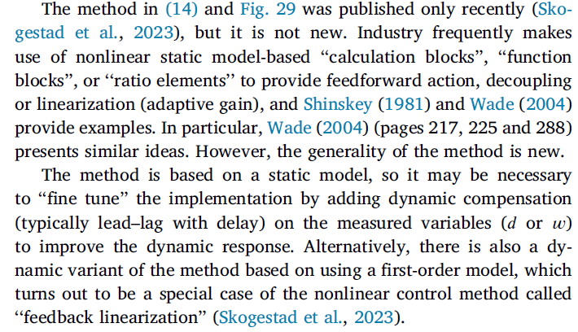

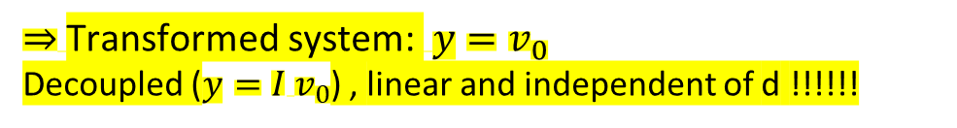
Systematic approach for finding transformed inputs from static model
Static model: $y=f_{0 }\left(u,d,w\right)$
Define $v_{0}= \text{Transformed} \text{input}$ = $f_{0 }\left(u,d,w\right)$ (so v₀=g=RHS of steady-state model. Extremely simple!)
Invert by solving with respect to $u$for given $y=v_{0}$: $u=f_{0}^{−1}(v_{0},d,w)$ (14)
$⇒$Transformed system: $y=v_{0}$
Decoupled ($y={I v}_{0}$) , linear and independent of d !!!!!!
Ideal case v₀=y^{s}. So feedback controller C corrects for model error and unmeasured disturbances.
y = controlled variable (main output)
w = measured state (output) which is treated as measured disturbance (for example, a recycle flow in a process)

Slide 7
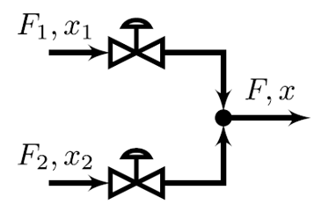
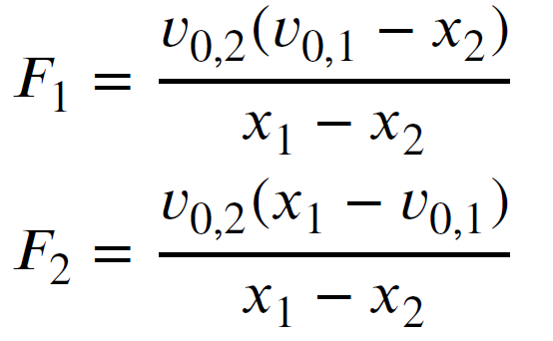

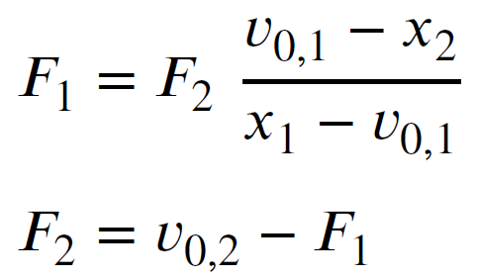
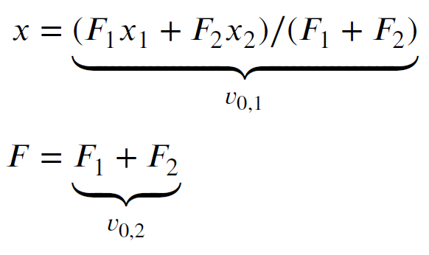
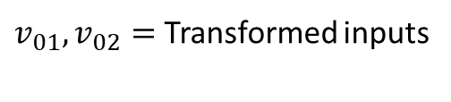
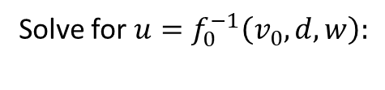
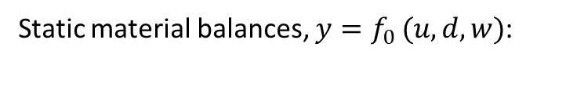
Example: Blending process
Solve for $u=f_{0}^{−1}\left(v_{0},d,w\right):$
(17)
This can be implemented directly and give y=v₀.
Alternative simple implementation. Solving (16a) with respect to F1 and (16b) with respect to F2 gives:
Static material balances, $y=f_{0 }(u,d,w)$:
(18)
(16)
$v_{01},v_{02}=$ Transformed inputs

Slide 8
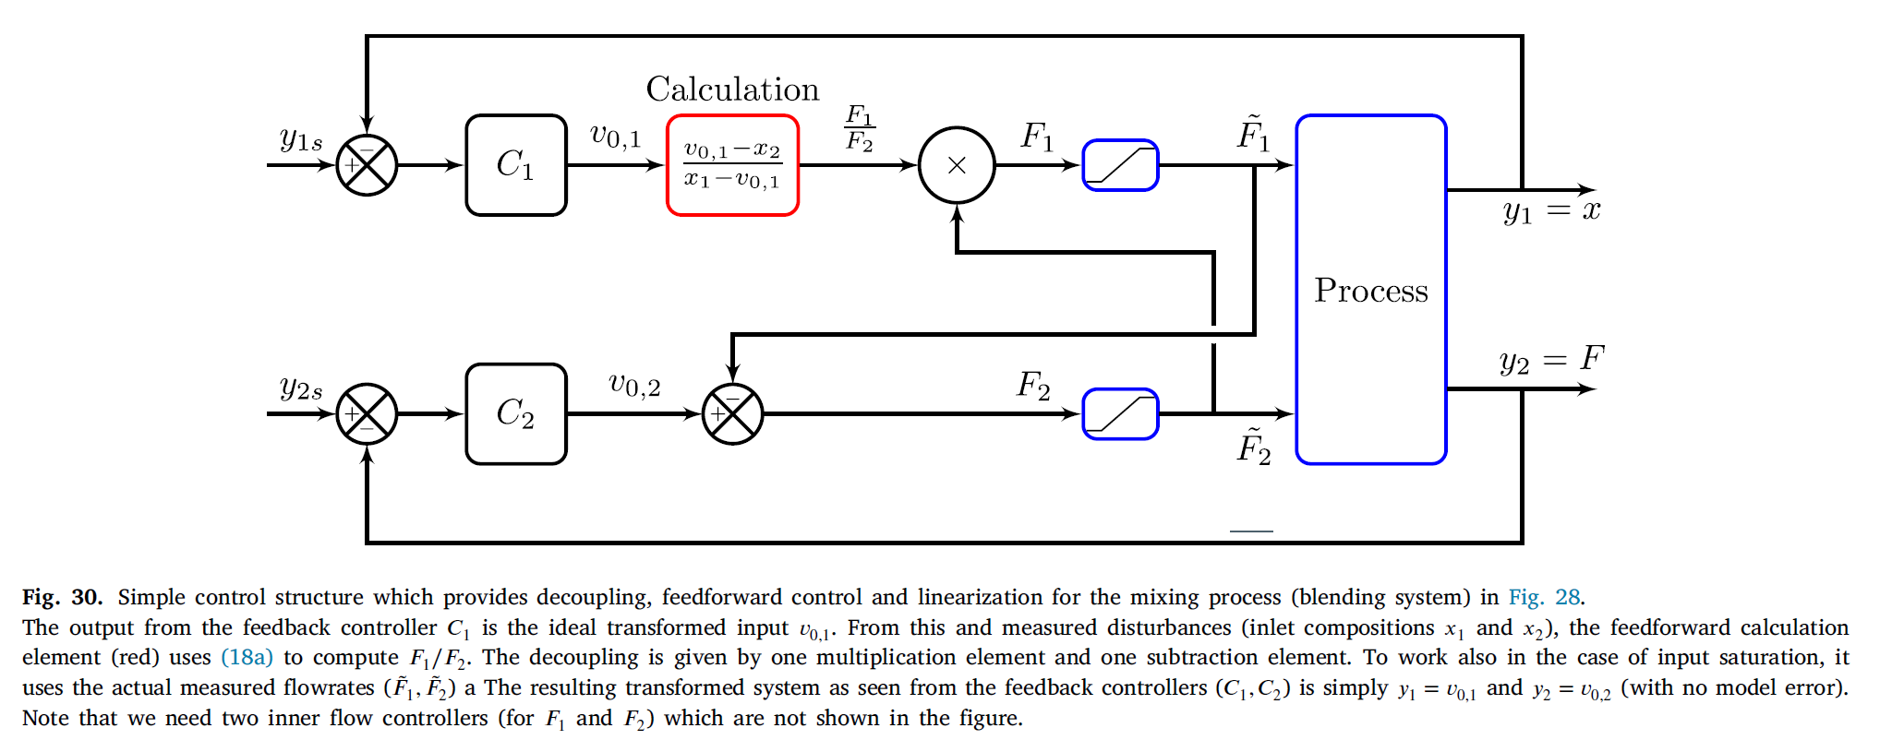
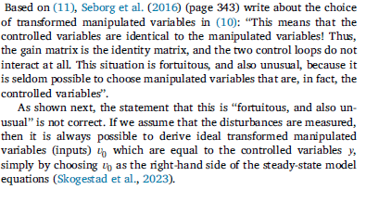
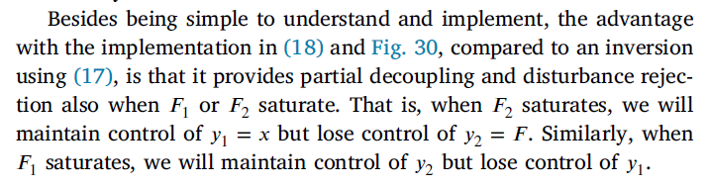
(11)

Slide 9
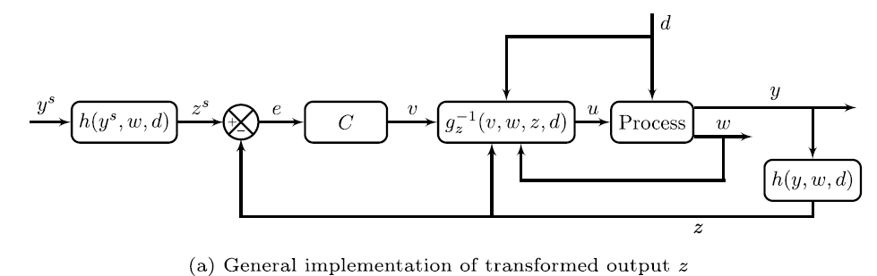
Also: Transformed outputs z
No fundamental advantage, but can simplify input transformation
For example, y=T, z=H (enthalpy)

Slide 10
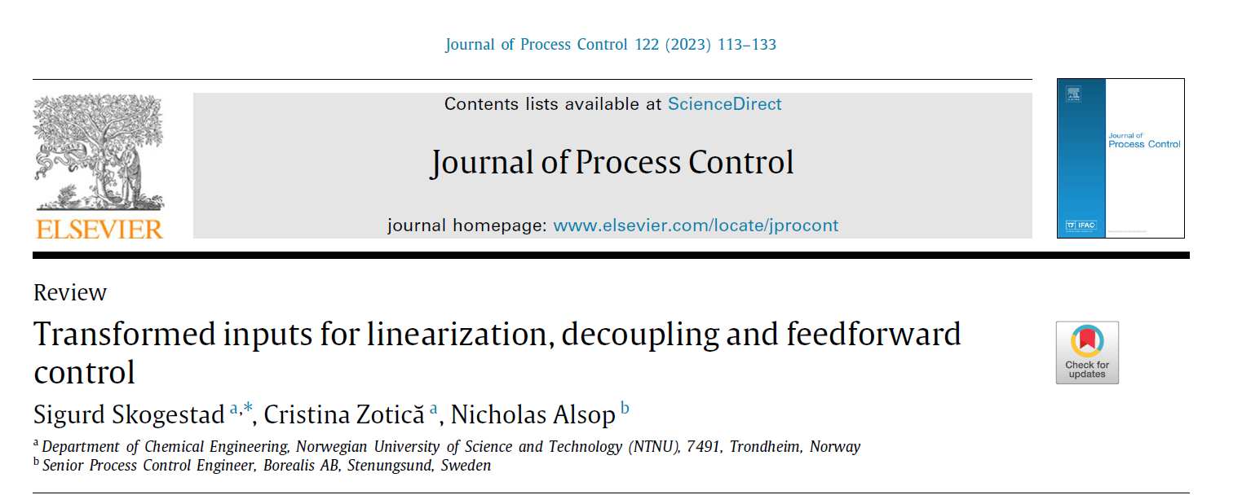
More on transformed inputs

Slide 11
MPC and RTO

Slide 12
What about MPC?
First industrial use in the 1970s
Became common in the refining and petrochemical industry in the 1980s
In the 1990s a bright future was predicted for MPC in all industries (chemical, thermal power, …)
30 years later: We know that this did not happen (yes, it is used in other industries, but much less than some predicted)
Why? First, the performance benefits of MPC compared to ARC are often minor (if any)
In addition, MPC has some limitations
  Expensive to obtain model
  Does not easily handle integral action, cascade and ratio control
  Normally, cannot be used at startup (so need ARC anyway)
  Can be difficult to tune. Difficult to incorporate fast control tasks (because of centralized approach)
  Computations can be slow
  Robustness (e.g., gain margin) handled indirectly
Advantages of MPC
  Very good for interactive multivariable dynamic processes
  Coordinates feedforward and feedback
  Coordinates use of many inputs
  Makes use of information about future disturbances, setpoints and prices (predictive capabilities of MPC)
  Can handle nonlinear dynamic processes (nonlinear MPC)
What about constraints
  Not really a major advantage with MPC; can be handled well also with ARC
MPC = model predictive control
ARC = advanced regulatory control

Slide 13
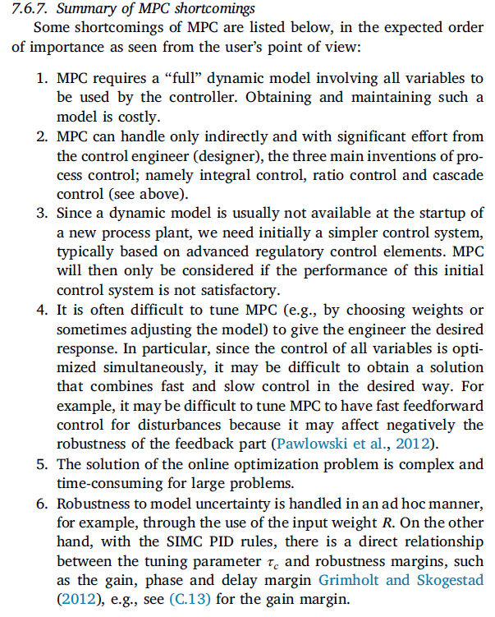
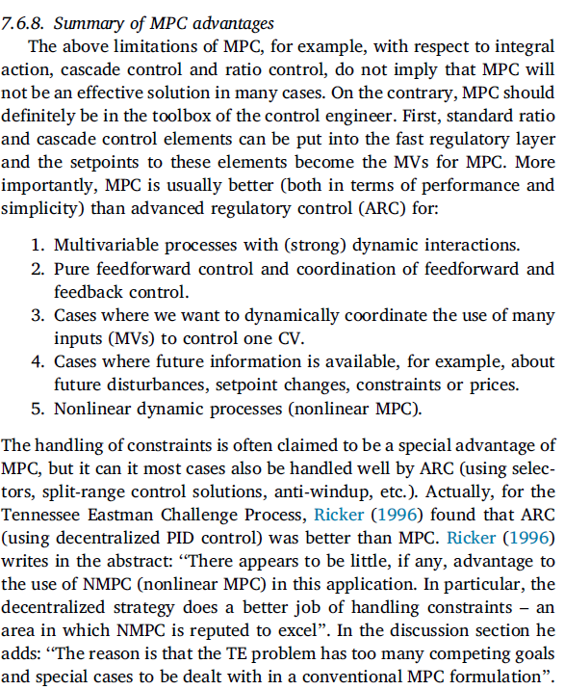

Slide 14
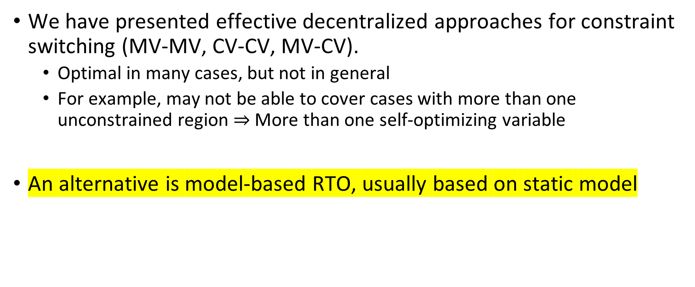
Optimal operation and constraints switching
We have presented effective decentralized approaches for constraint switching (MV-MV, CV-CV, MV-CV).
  Optimal in many cases, but not in general
  For example, may not be able to cover cases with more than one unconstrained region $⇒$More than one self-optimizing variable
An alternative is model-based RTO, usually based on static model
RTO = Real-time optimization

Slide 15
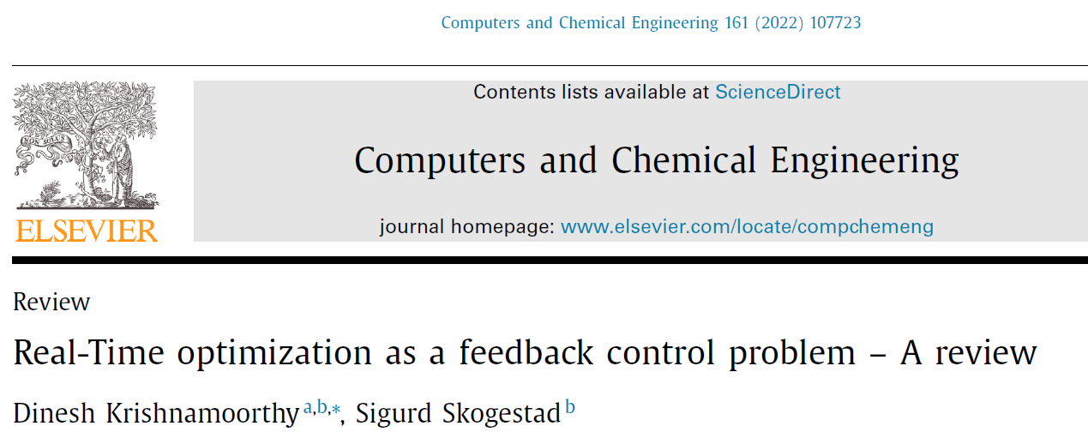
Economic real-time optimization(RTO)
Alternative RTO approaches:
Model-based
Separate RTO layer (online dynamic or steady-state optimization)
Feedback-optimizing control (put optimization into control layer)
    Alt.1. (Most general): Based on dual decomposition (iterate on Lagrange multipliers λ)
    Alt.2 (Tighter constraint control): Region-based with reduced gradient
Data-based
Hill-climbing methods = Extremum-seeking control (model free. But need to measure cost J)

Slide 16
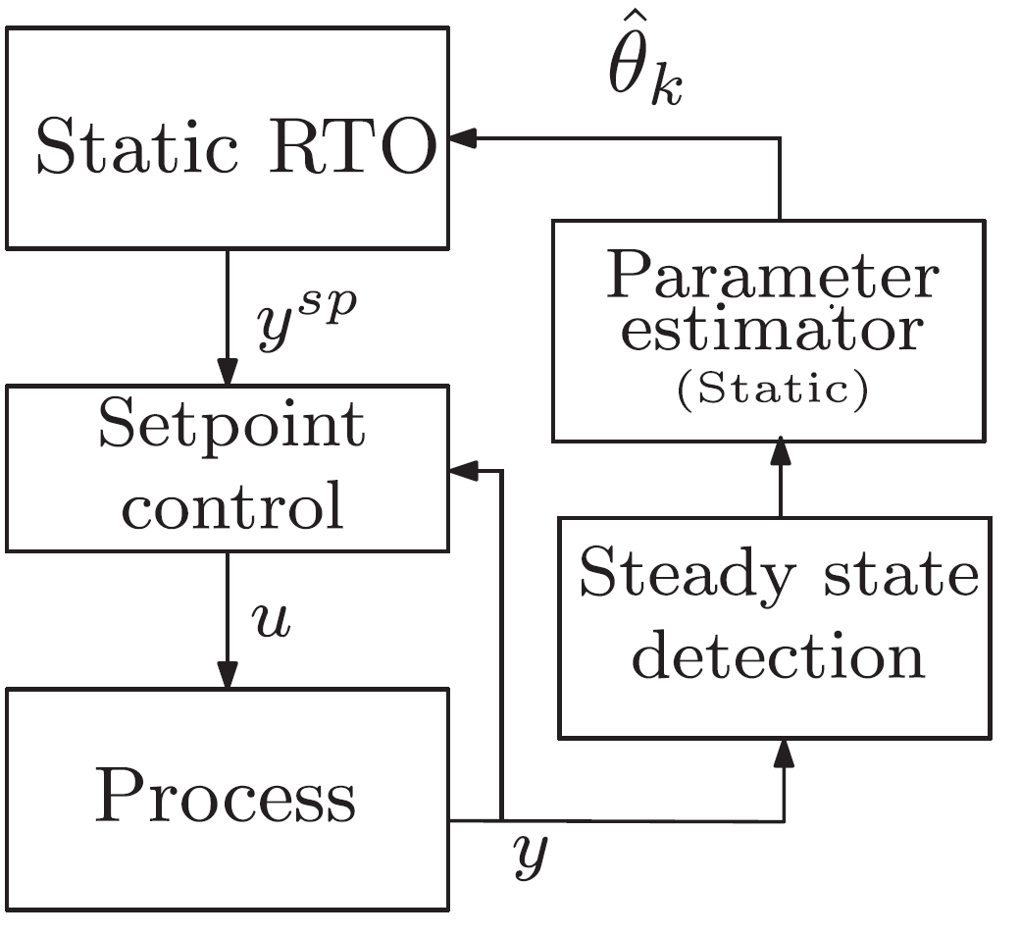

I. Conventional (commercial) steady-state RTO
Fairly common in refining and petrochemical industy.
Two-step approach:
Step 1. “Data reconciliation”:
  Steady-state detection
  Update estimate of d: model parameters, disturbances (feed), constraints
Step 2. Re-optimize to find new optimal steady state
Data reconciliation
$$d$$

Slide 17
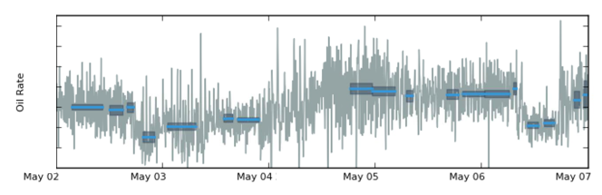
Steady-state wait time
Transient measurements cannot be used → system must “settle”
Large chunks of data discarded
Steady state detection issues
  Erroneously accept transient data
  Non-stationary drifts

Slide 18
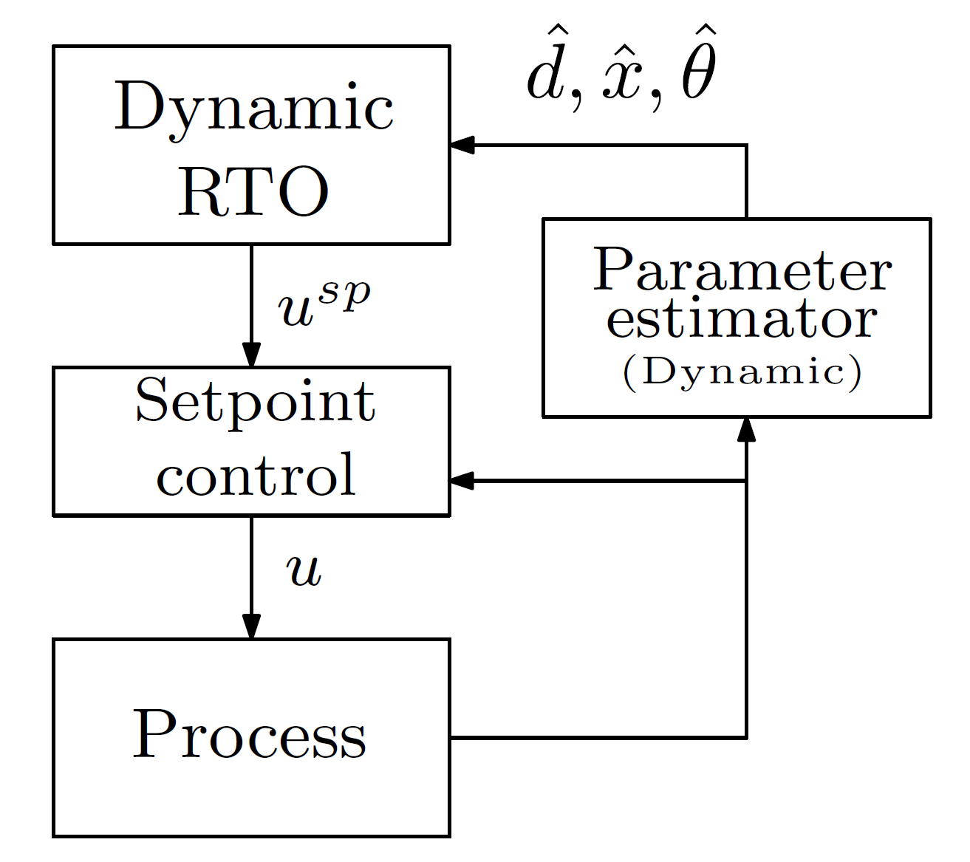
How to avoid steady state wait time?
1. Dynamic RTO = EMPC

Slide 19
How to avoid steady state wait time?
2. Hybrid RTO
Static

Slide 20
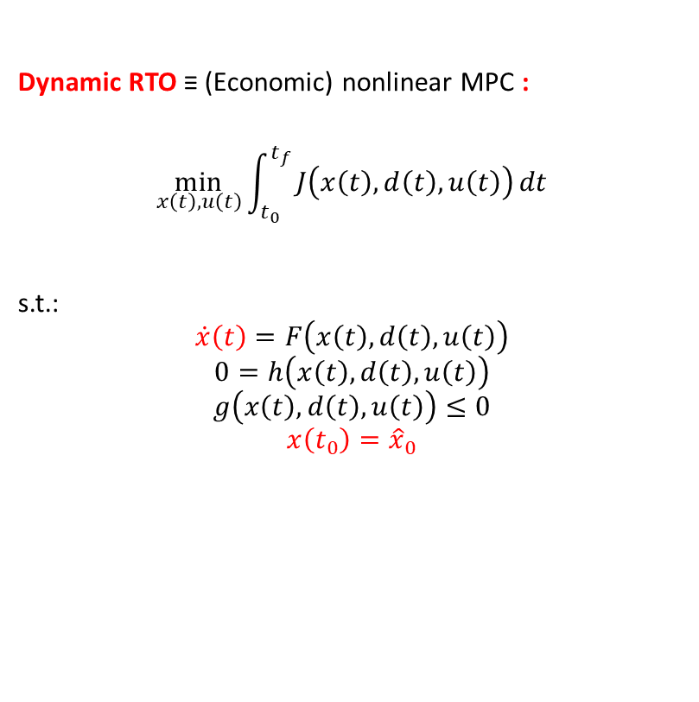

RTO problem
Steady-state RTO (used in Hybrid RTO):
$$\min_{x,u}{J\left(x,d,u\right)}$$
s.t.:
$$0=F\left(x,d,u\right)$$
$$0=h\left(x,d,u\right)$$
$$g\left(x,d,u\right)≤0$$
Dynamic RTO ≡ (Economic) nonlinear MPC :
$$\min_{x\left(t\right),u\left(t\right)}{\int_{t_{0}}^{t_{f}}{J\left(x\left(t\right),d\left(t\right),u\left(t\right)\right)}dt}$$
s.t.:
$$\dot{x}\left(t\right)=F\left(x\left(t\right),d\left(t\right),u\left(t\right)\right)$$
$$0=h\left(x\left(t\right),d\left(t\right),u\left(t\right)\right)$$
$$g\left(x\left(t\right),d\left(t\right),u\left(t\right)\right)≤0$$
$$x\left(t_{0}\right)={\hat{x}}_{0}$$
Now we calculate not only an optimal point, but an optimal trajectory!’
BUT Much more complex that static RTO, and may not give much economic benefit

Slide 21
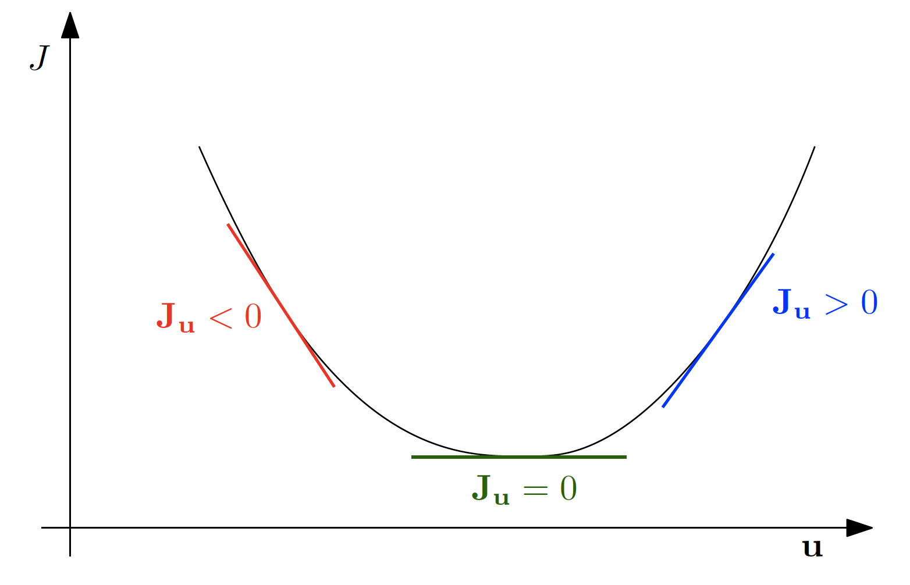
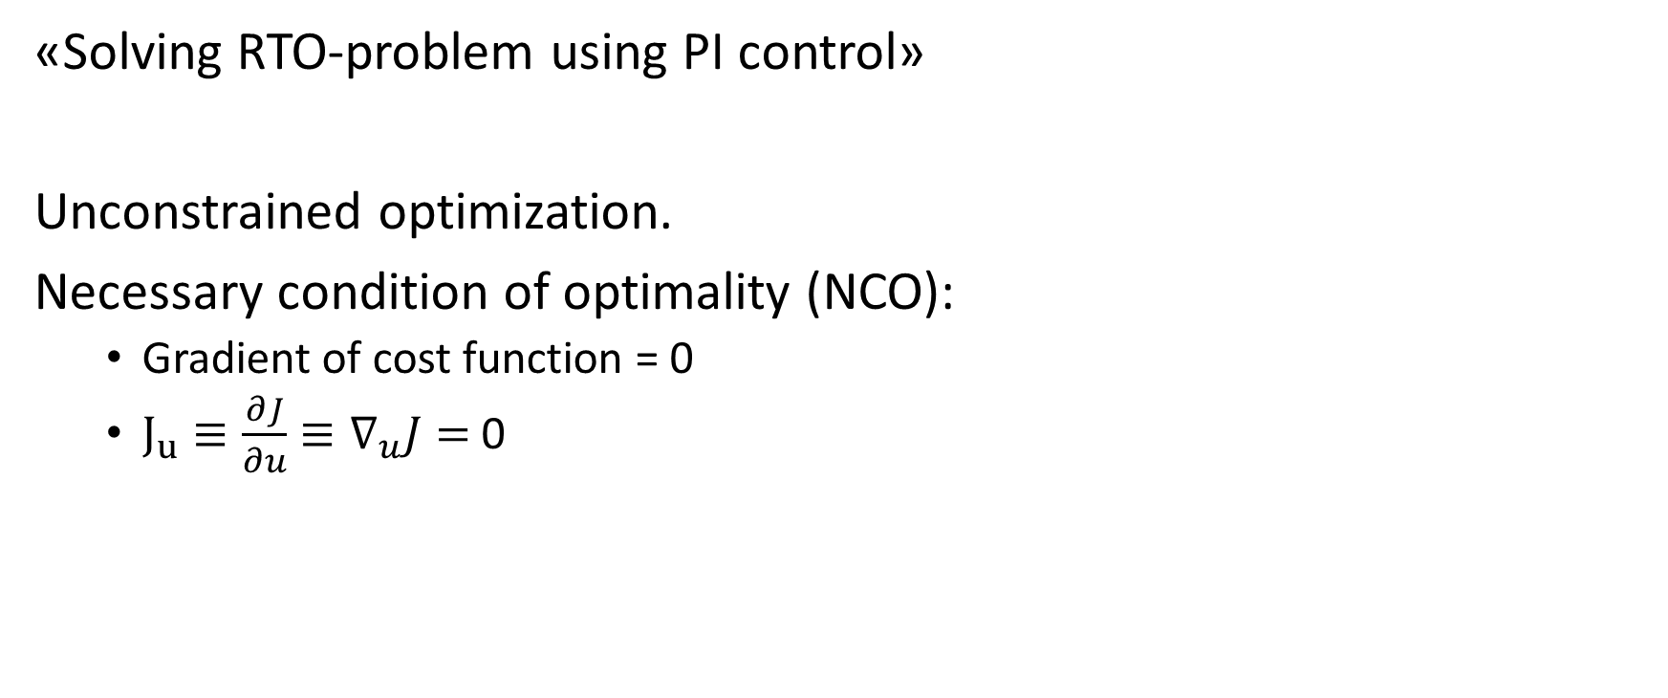
II. Feedback RTO (unconstrained case)
Feedback RTO
«Solving RTO-problem using PI control»
Unconstrained optimization.
Necessary condition of optimality (NCO):
  Gradient of cost function = 0
  $J_{u}≡\frac{∂J}{∂u}≡∇_{u}J=$0

Slide 22
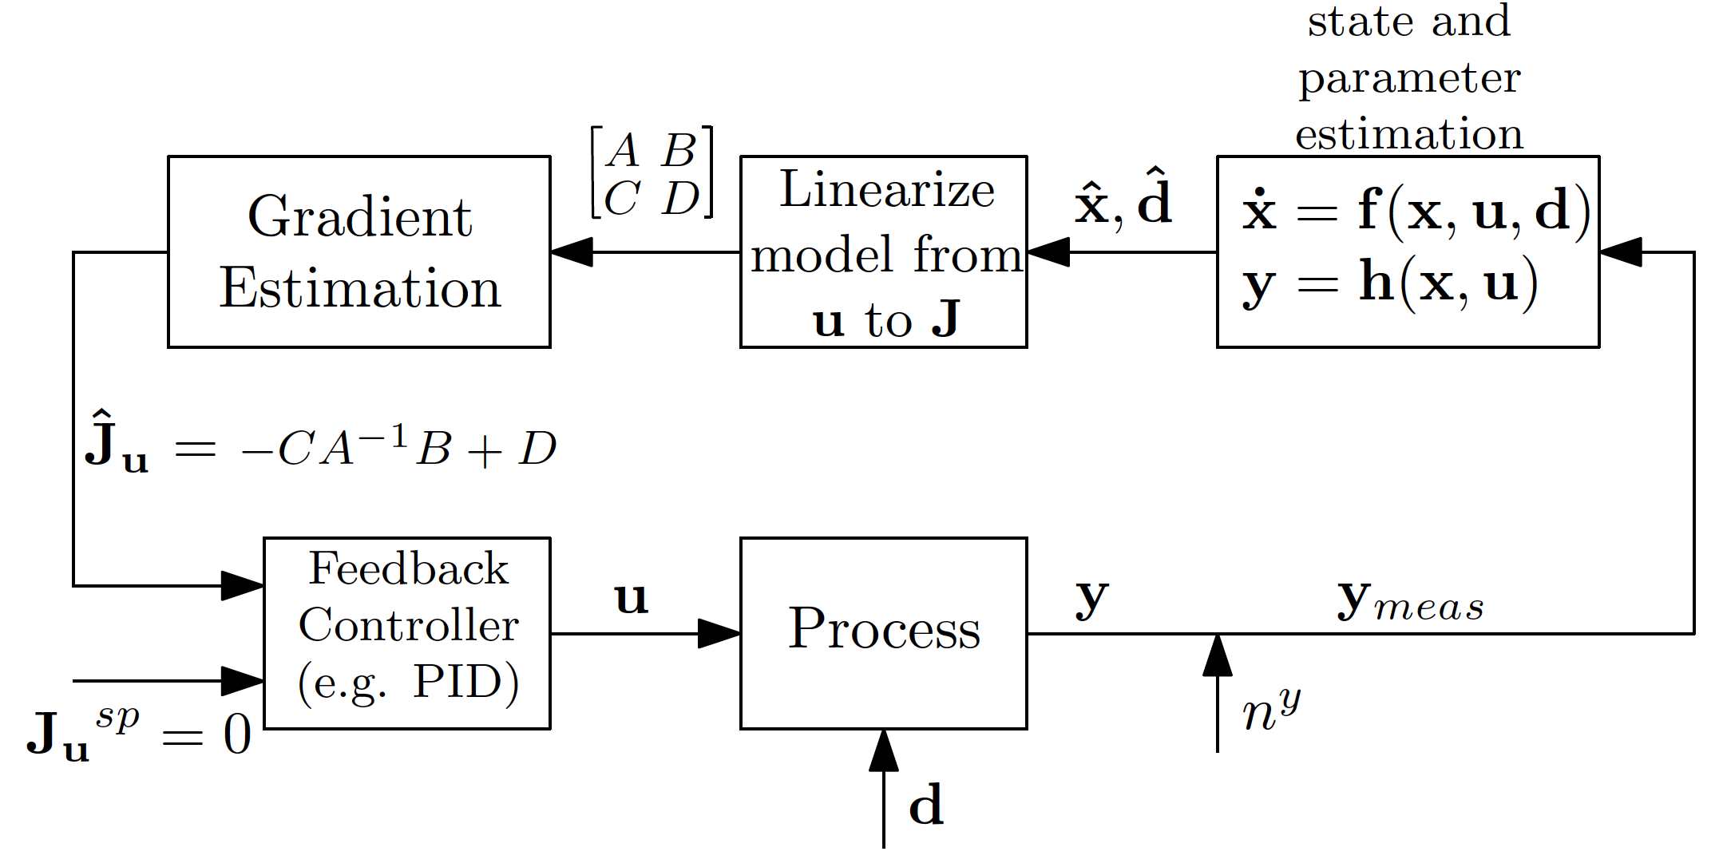
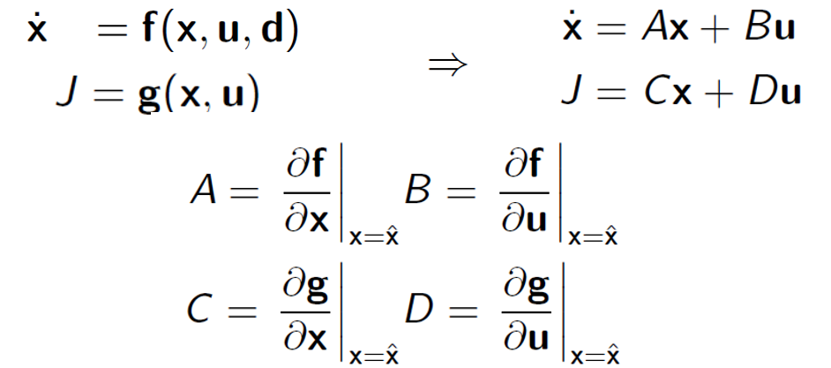
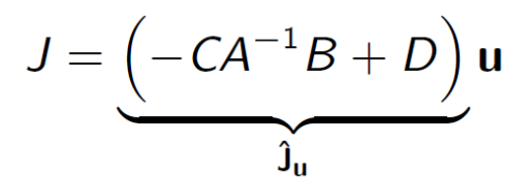

II. Feedback RTO (unconstrained case)
Feedback RTO
Gradient estimator
Linearize the dynamic model
Kalman Filter
Trick, set $\dot{x}=0, to get estimate of static gradient:$
Note: This is one simple way of doing the gradient estimation
D Krishnamoorthy, E Jahanshahi, S Skogestad. Feedback Real-Time Optimization Strategy Using a Novel Steady-state Gradient Estimate and Transient Measurements. Industrial & Engineering Chemistry Research, 2019

Slide 23
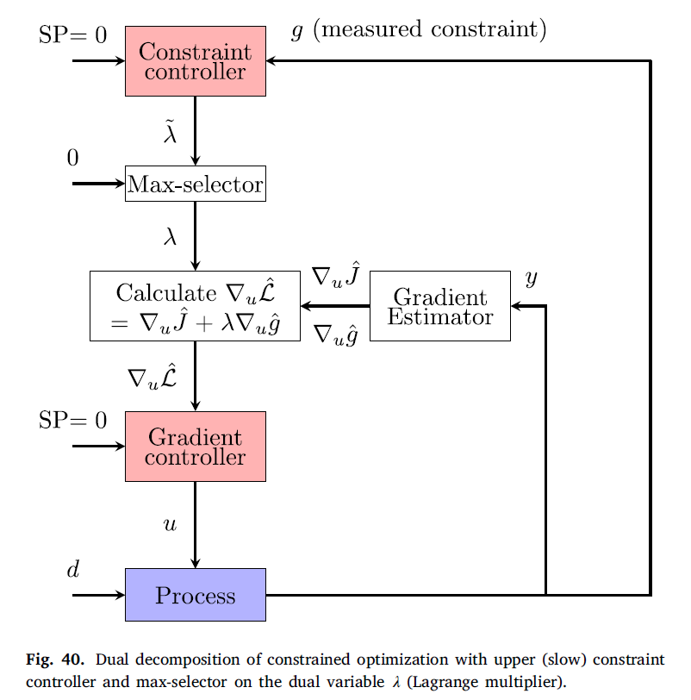
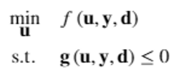


Feedback RTO
II. Feedback RTO (with constraints)
Alt.1A: Feedback implementation using dual decomposition and feedback control to compute u (Krishnamoorthy, Dirza, Skogestad)
Master
Constrained optimization problem
Single-loop PI controllers
J
Solution: Turn into unconstrained optimization problem
using Lagrange multipliers
J
min_{u,λ} L
  u = primal variables = inputs
  λ ≥ 0 = dual variables = Lagrange multipliers = shadow prices
Necessary conditions of optimality (KKT-conditions)
Alt.A. Use controllers also here
(complementary condition)

Slide 24
Feedback RTO
II. Feedback RTO (with constraints)
Alt.1A: Feedback implementation using dual decomposition and feedback control to compute u (Krishnamoorthy, Dirza, Skogestad)
Master
Single-loop PI controllers
«Primal-dual feedback control»
Makes use of «dual decomposition» of constrained optimization
Selector on dual variables λ
Very nice for cases with shared utility g, for example steam plant
  Local cost: L_{i} = J_{i} + λ g_{i}
Problem 1: Constraint control on slow time scale (upper layer)
  Can be fixed using override at bottom of hiearchy (Risvan Dirza)
Problem 2: Alt.A Single-loop control in lower layer (L_{u}=0) may not be possible for coupled processes so may need to use Alt. B.
Alt.A. Use controllers also here

Slide 25

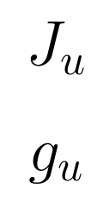
Alternative 1B: Dual composition with optimization/solver for computing u (primal variables)
Feedback RTO
Constraint control
(n_{c} slower PI/I-controllers)
g (measured constraint)
«Primal-dual feedback control»
Makes use of «dual decomposition» of constrained optimization
Selector on dual variables λ
Very nice for cases with shared utility g, for example steam plant
  Local cost: L_{i} = J_{i} + λ g_{i}
Problem 1: Constraint control on slow time scale (upper layer)
  Can be fixed using override at bottom of hiearchy (Risvan Dirza)
Problem 2: Alt.A Single-loop control in lower layer (L_{u}=0) may not be possible for coupled processes so may need to use Alt. B.
Alt.B: May need to add filter to avoid instability
SP=0
0
MAX
Dual variables
Unconstrained optimization
(n_{u} PID-controllers or solver)
SP=0
Gradient estimator
Alt.B. Use solver here
u
Primal variables
Filter
d
Process
y
g (measured constraint)
λ = Lagrange multipliers = shadow prices = dual variables
«Optimal Resource Allocation using Distributed Feedback-based Real-time Optimization». Risvan Dirza, Sigurd Skogestad, Dinesh Krishnamoorthy. IFAC Adchem Conference, 2021

Slide 26


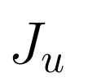

Alternative 2: Region-based Feedback-RTO with «direct» constraint control
Feedback RTO
Optimality condition
Constraint controllers
(fast PID-controllers)
g (constraints paired with u1)
Define N as nullspace of active constraints
SP=0
SP=0
u1
u1o
J_{u1}
Optimality condition becomes
MAX/
MIN
PID
J_{u2}
$$N^{T}L_{u}=N^{T}J_{u}=0$$
J_{u1}, J_{u2} = N^{T}J_{u} (want=0), reduced gradients
(«self-optimizing variables»)
Gradient estimator
u1
u2
Selector on primal variables (inputs)
Similar to selectors in APC
Limitation: need to pair each constraint with an input u, may not work if many constraints
d
Process
y
g (measured constraint)
«Online Process Optimization with Active Constraint Set Changes using Simple Control Structure», D. Krishnamoorthy and S. Skogestad, I&EC Res., 2019
«Optimal controlled variables for ̈ polynomial systems». Jaschke, J.; Skogestad, S., J. Process Control, 2012

Slide 27
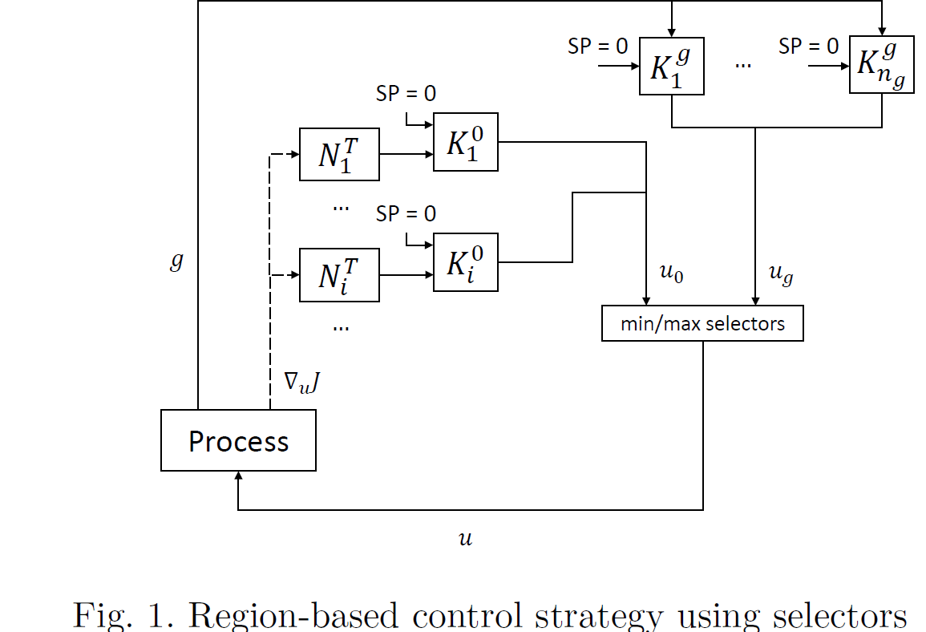
Feedback RTO
L. Bernadino, D. Krishnamoorthy and S. Skogestad, Comparison of Simple Feedback Control
Structures for Constrained Optimal Operation, Dycops-2022, IFAC PapersOnLine 55-7 (2022) 883–888

Slide 28
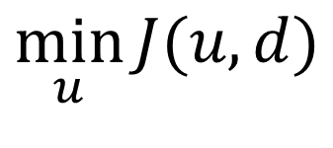
Model-free optimization:
Extremum Seeking Control (ESC) based on measuring cost J
$$\min_{u}{J(u,d)}$$
Why ESC?
Expensive to obtain model (for J): Use data-based ESC instead of model-based RTO
May also be used on top of RTO
  «Adapt» setpoint for J_{u} (to a nonzero bias value) to correct for model error
  Aka «modifier adaptation»
Main problems with ESC:
Cost function J often not measured
  For chemical process J=p_{F}F – p_{P}P – p_{Q}Q
  need model (!) to estimate flows F, P and utility Q
Very slow. Typically 100 times slower than process dynamics

Slide 29






Data-based optimization: “Hill-climbing” / “Extremum seeking control”
Drive gradient J_{u}=dJ/du to zero.
Probe the system
Observe how the cost changes
Estimate Gradient
Decide which way to move
$$J$$
J_{u}=0 at top of hill
$$∆J=0$$
$$∆J$$
$$u$$
$$∆u$$
$$∆u$$

Slide 30
Equivalent: Minimize cost J (go to bottom of valley)
u_{opt}
Optimal setpoint: J_{u}=0
If Hessian J_{uu} is constant:
  J_{u} as a function of u is a straight line with slope J_{uu}
Nice properties for feedback control of J_{u}
No dynamics: Pure I-controller optimal
  SIMC-rule: K_{I} = 1/(J_{uu} τ_{c})
J_{u}
0

Slide 31
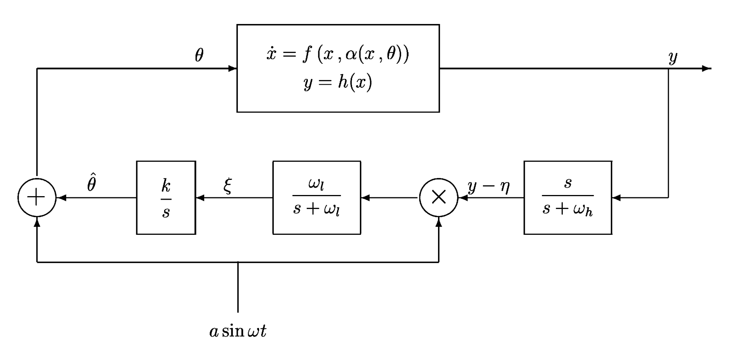

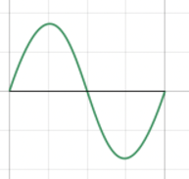
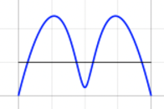
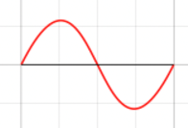
Classical Extremum seeking control using sinusoids
u
Process
J
I-controller
Gradient Estimation
u_{c}
K_{I}
Simple to implement (don’t need computer), but
Prohibitively slow convergence for systems with slow dynamics
Typically 100 times slower than the system dynamics !
Averaging
Remove bias in J
One side of optimum: Same phase
Other side: opposite phase
Multiplication trick: Draper & Li (1951)
Theory: Krstic & Wang (Automatica, 2000)

Slide 32

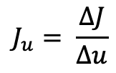

More common today: Estimate Steady-state gradient using discrete perturbations (steps)
J
Usually only one input. Simplest: step change in u:
  Hill climbing control (Shinskey, 1967)
  Evolutionary operation (EVOP) (1960’s)
  NCO tracking (Francois & Bonvin, 2007)
  “Peturb and observe” = Maximum power point tracking (MPPT) (2010’s).
More advanced variants which may also be applied to multivariable systems
  Least squares estimation
  Fast Fourier transform (Dinesh Krishnamoorthy)
To avoid waiting for steady state
  Fitting of data to ARX model (difficult to make robust)
$$∆J$$
u
$$∆u$$
$$J_{u}= \frac{ΔJ}{Δu}$$
Note: Assumes steady state -> samling (step) time > 3-10 time process time constant

Slide 33
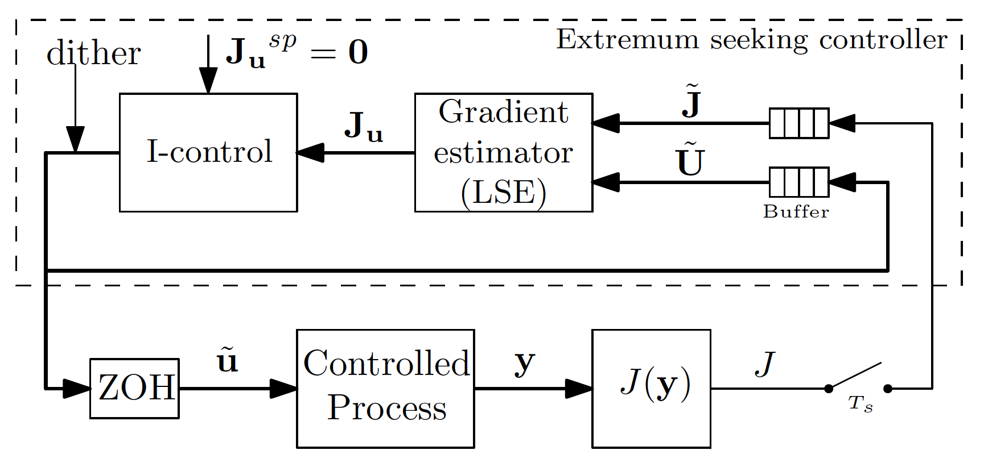




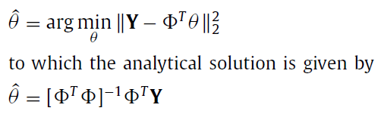
Least square Extremum seeking control
LSE: Fit a linear model
Using least squares fit
Note: Assumes no dynamics -> samling time > 3-10 time process constant
Hunnekens et al. (2011, 2014)

Slide 34
Summary extremum seeking control
Idea: Estimate the cost gradient J_{u} from data and drive it to zero
Common to all methods:
  Need measurement of cost J
  Must wait for steady state (except ARX method which fails frequently)
  Must assume no «fast» disturbances (while optimizing)
Algorithm needs two layers on top of process:
  1. Optimization layer (slowest): Drive J_{u} to zero (may use I-controller)
  2. Lower estimation layer: Estimate the local gradient J_{u} using data
    Must wait for the process to reach steady state
  Need time scale separation between layers.
    At best this means that the optimization needs to be 10 times slower than the process.
    Often it needs to be 100 times slower.
  Useful for fast processes with settling time a few seconds
  Not useful for many chemical processes where time constant typically are several minutes
    10 minutes * 100 = 1000 minutes = 16 hours
    Unllikely with 16 hours without disturbance

Slide 35
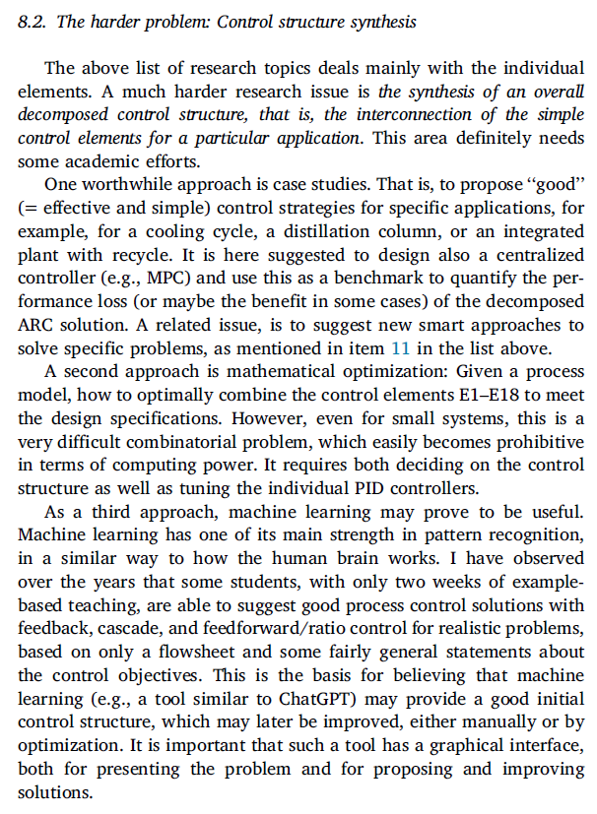
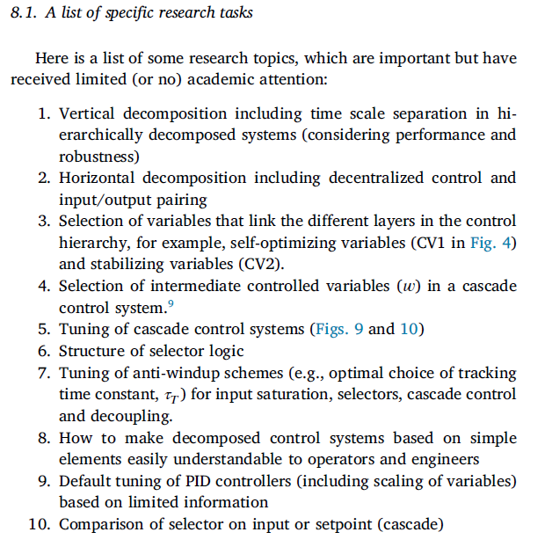
ARC: Research tasks

Slide 36

Complex optimal centralized Solution (EMPC, FL)
Present Academic control community fish pond
Simple solutions
that work (ARC, PID)
Sigurd
FL = feedback linearization

Slide 37

Complex optimal centralized Solution (EMPC, FL)
Future Academic control community fish pond
Simple solutions
that work (SRC,PID)

