Slide 1
more on switching

Slide 2
Implementing optimal operation by switching
Most people think
  You need a detailed nonlinear model and an on-line optimizer (RTO) if you want to optimize the process
  You need a dynamic model and model predictive control (MPC) if you want to handle constraints
  The alternative is Machine Learning
No! In many cases you just need to measure the constraints and use PID control
  «Conventional advanced regulatory control (ARC)»
How can this be possible?
  Because optimal operation is usually at constraints
  Feedback with PID-controllers can be used to identify and control the active constraints
  For unconstrained degrees of freedom, one often have «self-optimizing» variables
This fact is not well known, even to control professors
  Because most ARC-applications are ad hoc
  Few systematic design methods exists
Today ARC and MPC are in parallel universes
  Both are needed in the control engineer's toolbox

Slide 3
Change of active constraints. Four cases
CV-CV switching (because we may reach new CV constraint)
  Must select between CVs
  «Only» option: Many controllers with selector
MV-MV switching (because MV may saturate)
  Need many MVs to cover whole steady-state range
  Use only one MV at a time
  Three options:
    A1. Split range control,
    A2. Different setpoints,
    A3. Valve position control (VPC)
Now: MV-CV switching
Simple MV-CV switching: CV can be given up when reach MV saturation
  This means we followed «input saturation rule»
  Don’t need to do anything
Complex MV-CV switching: CV cannot be given up (need to «repair loops»)
  Must combine MV-MV switching (three options) with CV-CV switching (selector)
Process
Already
covered
Process
Process
Process
Adriana Reyes-Lua and Sigurd Skogestad, Systematic Design of Active Constraint Switching Using Classical Advanced Control Structures, Ind.Eng.Chem.Res, 2020
Note: we are here assuming that the constraints are not conflicting so that switching is possible

Slide 4
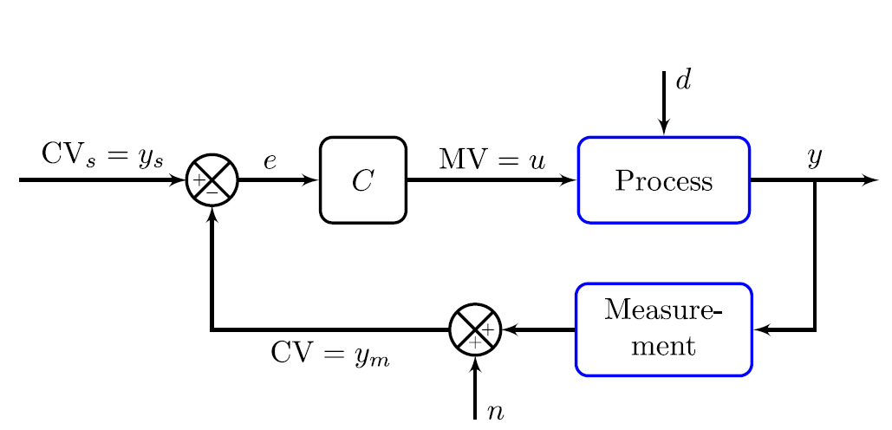
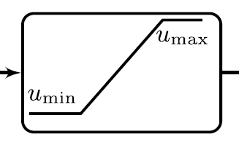
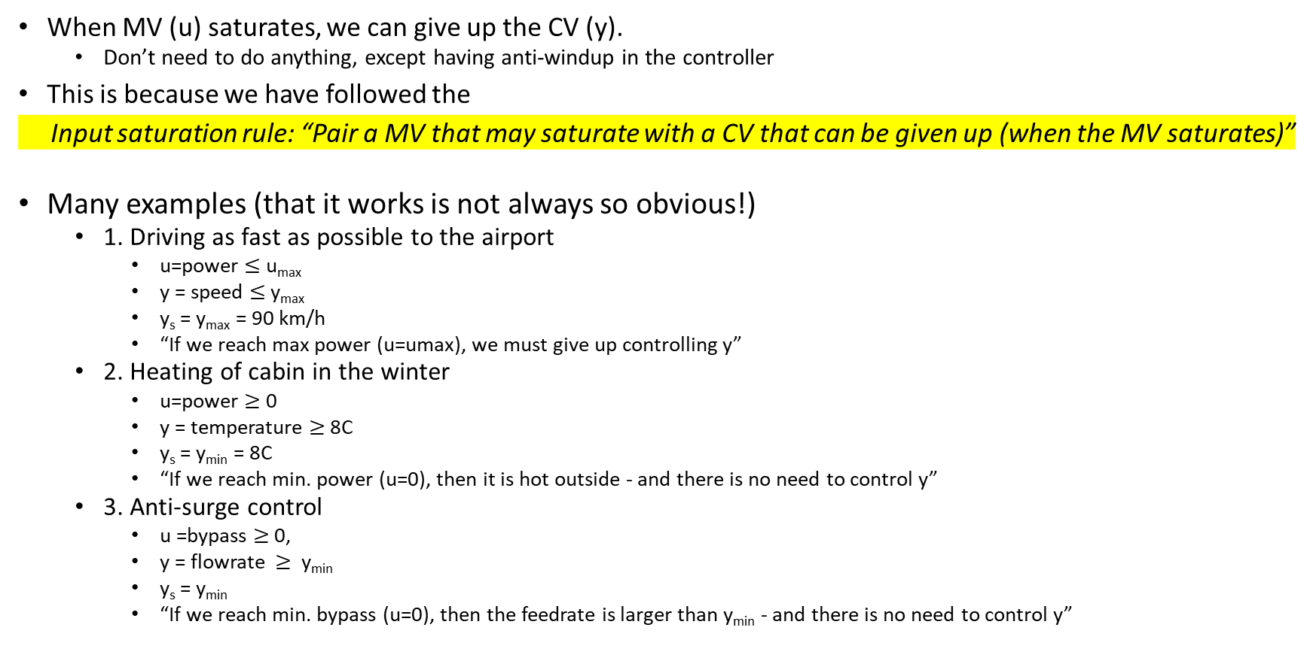
Simple MV-CV switching
When MV (u) saturates, we can give up the CV (y).
  Don’t need to do anything, except having anti-windup in the controller
This is because we have followed the
Input saturation rule: “Pair a MV that may saturate with a CV that can be given up (when the MV saturates)”
Many examples (that it works is not always so obvious!)
  1. Driving as fast as possible to the airport
    u=power $≤$ u_{max}
    y = speed $≤$ y_{max}
    y_{s} = y_{max} = 90 km/h
    “If we reach max power (u=umax), we must give up controlling y”
  2. Heating of cabin in the winter
    u=power $≥$ 0
    y = temperature $≥$ 8C
    y_{s} = y_{min} = 8C
    “If we reach min. power (u=0), then it is hot outside - and there is no need to control y”
  3. Anti-surge control
    u =bypass $≥$ 0,
    y = flowrate $≥$ y_{min}
    y_{s} = y_{min}
    “If we reach min. bypass (u=0), then the feedrate is larger than y_{min} - and there is no need to control y”

Slide 5
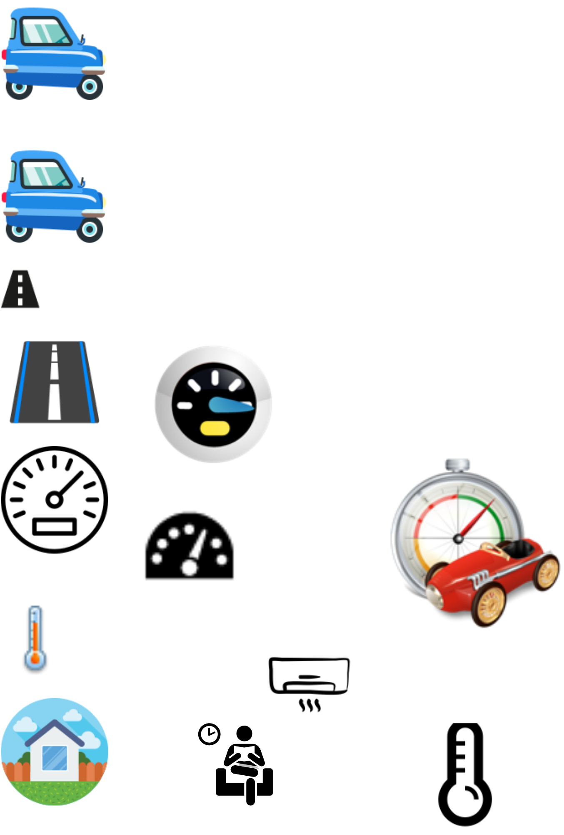
Optimization with PI-controller
Simple MV-CV switching, Example 1
max y
s.t. y ≤ y^{max}
u ≤ u^{max}
Example: Drive as fast as possible to airport (u=power, y=speed, y^{max} = 110 km/h)
Optimal solution has two active constraint regions:
  y = y^{max} → speed limit
  u = u^{max} → max power
Solved with PI-controller
  y^{sp} = y^{max}
  Anti-windup: I-action is off when u=u^{max}
s.t. = subject to
y = CV = controlled variable

Slide 6
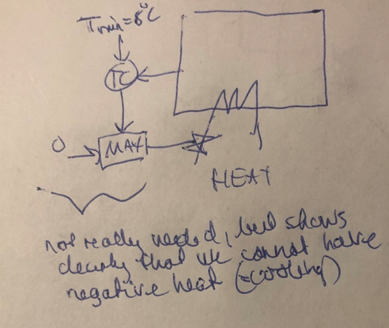
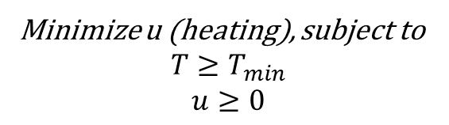
Avoid freezing in cabin
Simple MV-CV switching, Example 2
Minimize u (heating), subject to
$$T≥T_{min}$$
$$u≥0$$
    Keep CV=T>T_{min} = 8C in cabin in winter by using MV=heating
    If it’s hot outside (>8C), then the heat will go to zero (MV=Q=0), but this does not matter as the constraint is over-satisfied.

Slide 7
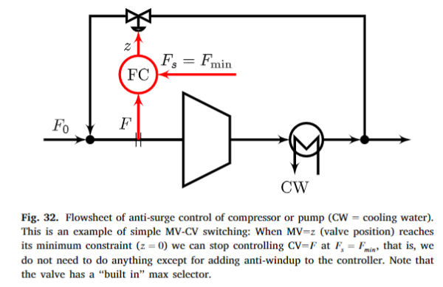
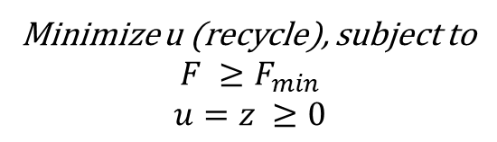
Anti-surge control (= min-constraint on F)
Simple MV-CV switching, Example 3
Minimize u (recycle), subject to
$$F ≥F_{min}$$
$$u=z ≥0$$
    Keep minimum flow F_{min} for pump or compressor using recycle valve.
    If the flow F₀ (and thus F) becomes large then the recycle valve will close (MV=0), but this does not matter as the constraint on F is over-satisfied.
We satisfy the input saturation rule:
«Pair a MV =z that may saturate with a CV =F that can be given up (when the MV saturates at z=0)”

Slide 8
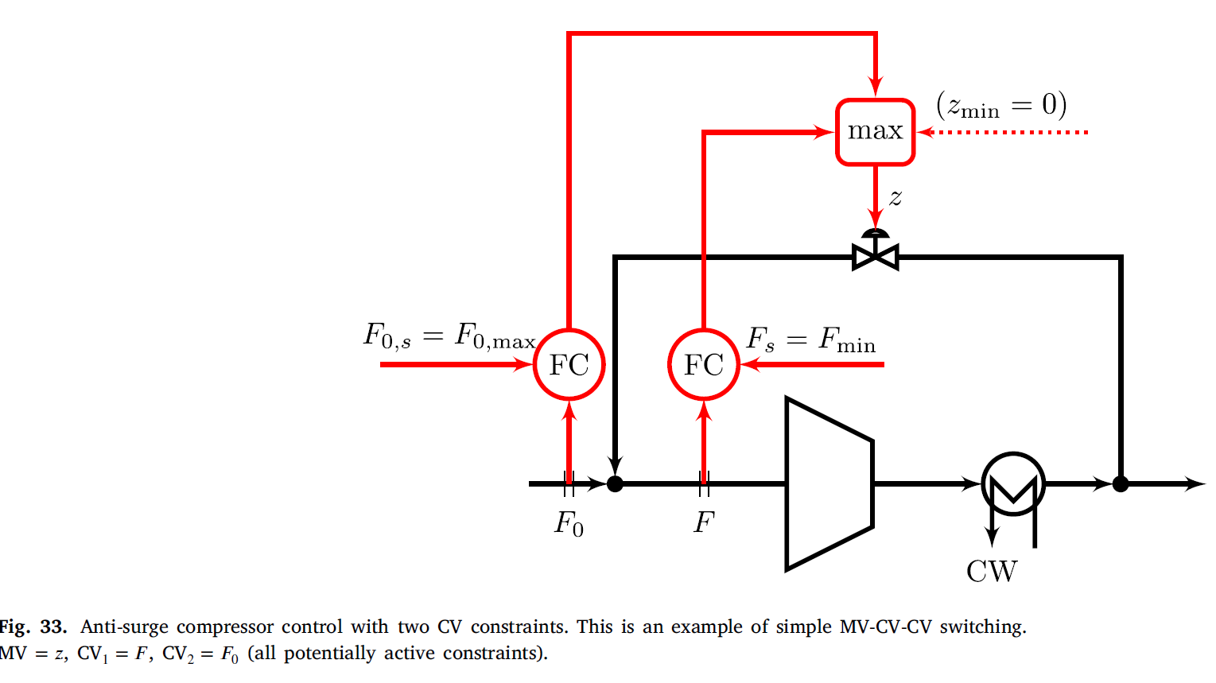
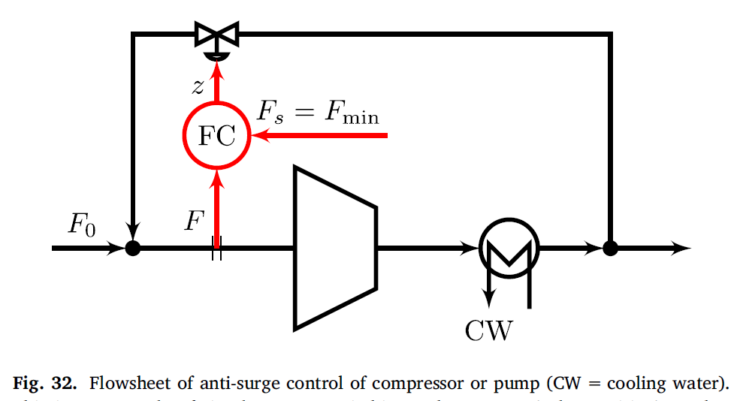
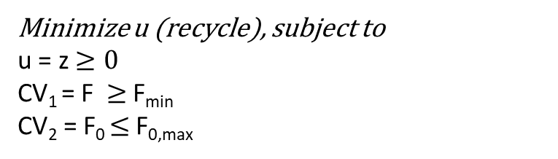
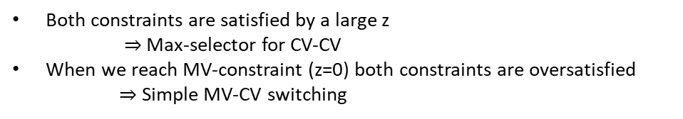
Example: Compressor with max-constraint on F₀
(in addition to the min-constraint on F)
MV-CV-CV switching
Minimize u (recycle), subject to
u = z $≥0$
CV₁ = F $≥$ F_{min}
CV₂ = F₀ $≤$ F_{0,max}
Both constraints are satisfied by a large z
$⇒$Max-selector for CV-CV
When we reach MV-constraint (z=0) both constraints are oversatisfied
$⇒$Simple MV-CV switching

Slide 9
Complex MV-CV switching
  Didn’t follow input saturation rule
  This is a repairing of loops
  Need to combine MV-MV switching with CV-CV-switching
The CV-CV switching always uses a selector
As usual, there are three alternatives for the MV-MV switching:
  Split range control (block /\): Has problems because limits may change
  Several controllers with different setpoints (often the best for MV-CV switching)
  Valve position control (Gives «long loop» but avoids repairing).
  +4. Shinskey alternative (not covered here)

Slide 10
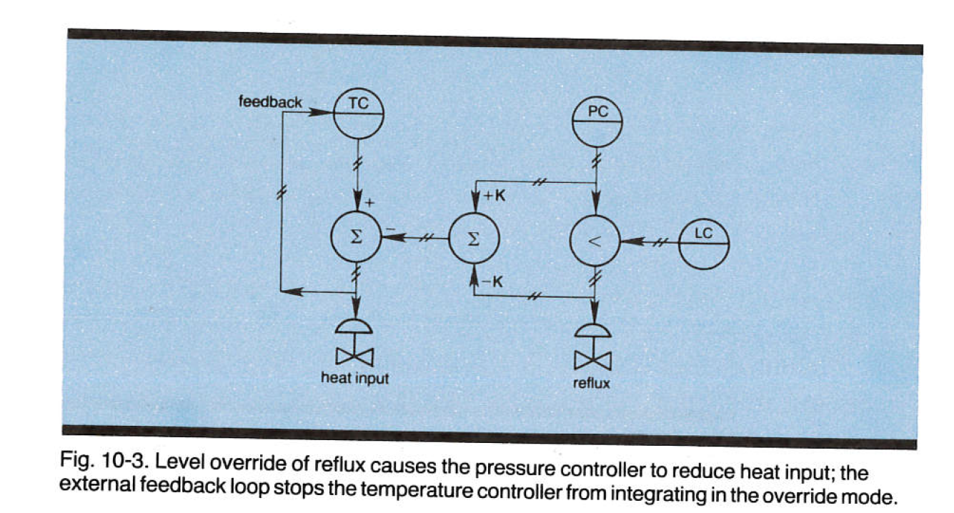
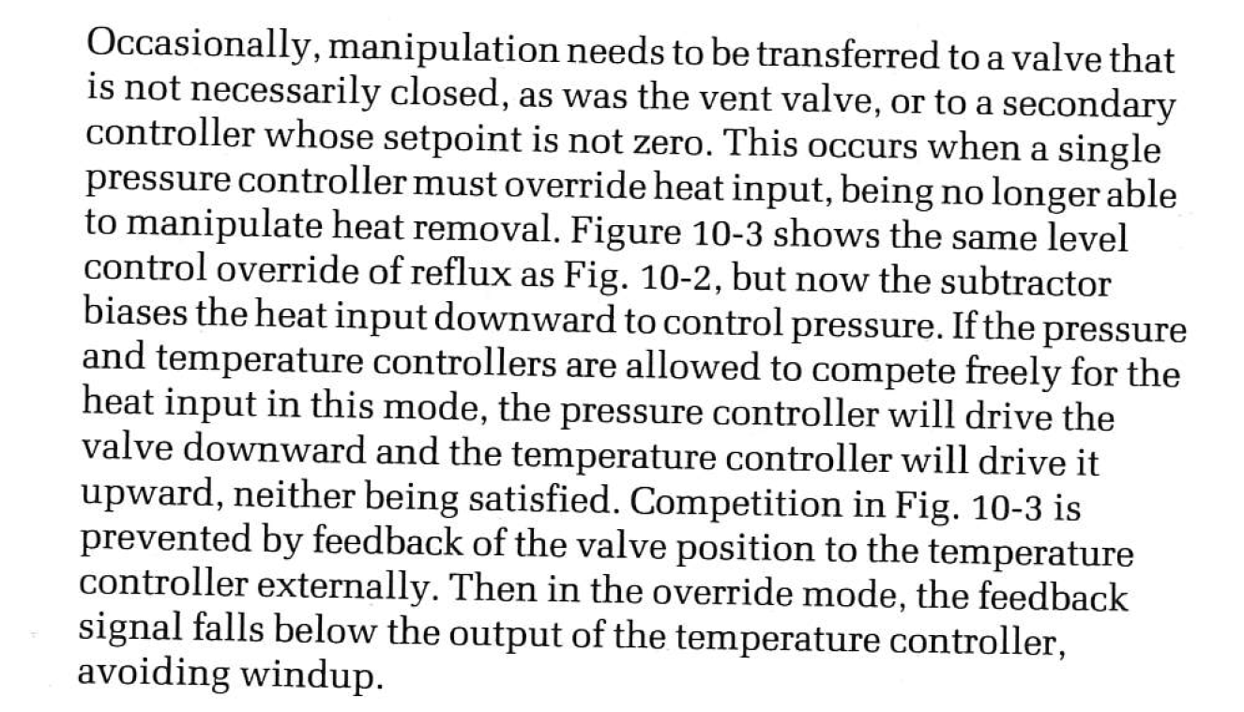
Complex CV-MV switching (Alt. 4)
Alt. 4. Shinskey. Flooded condenser,
y3
y1
y2
u1
u2
Two controllers (TC for y3, PC for y1) are in some cases competing for the same input (u1), but PC wins because of the smart use of anti-windup back to TC, which stops TC from working (integrating) when the input from PC is non-zero
Normally: Use u1 to control y3, and u2 to control y1
When y2 reaches min: Must use to u2 to control y2, and since y1 cannot be given up we must do a repairing of loops where y3 is given up and u1 is used to control y1
Comment: Alt.2 with two controllers (PC) works fine here and is simpler,
See next page.

Slide 11
Example: Furnace control
Complex MV-CV switching
Furnace control : Cannot give up control of y₁=T₁. What to do?
u_{A}
TC
T_{1s} = 500C
MIN
u_{B}
T_{2max}=700C
LS
TC
y₁=T₁
Inputs (MV)
u = Fuel gas flowrate
u₂ = Process flowrate
Output (CV)
y₁ = process temperature T₁
(with desired setpoint)
u=min(u_{A},u_{B})
y₂=T₂
Flue gas
Process fluid
u₂
Normally u₂
is used for something else
u=Fuel gas
Air

Slide 12
Cannot give up controlling T₁
Solution: Cut back on process feed (u₂) when T₁ drops too low
Complex MV-CV switching
TC
Using MV-MV switching
T_{1s} = 500C
T’_{1s} = T_{1s}-5C=495C
u_{A}
TC
TC
MIN
u_{B}
T_{2max}=700C
LS
TC
y₁=T₁
Inputs (MV)
u = Fuel gas flowrate
u₂ = Process flowrate
Output (CV)
y₁ = process temperature
(with desired setpoint)
u=min(u_{A},u_{B})
y₂=T₂
MIN
Flue gas
u₂
Note: Standard Split Range Control (Alt. 1) is not good here for MV-MV switching.
Could be two reasons for too little fuel
  Fuel is cut back by override (safety)
  Fuel at max,
So don’t know limit for MV1 to use in SRC-block.
Process fluid
CV-CV switching
u=Fuel gas
Air
u = input = manipulated variable (MV)
y = output = controlled variable (CV)

Slide 13
Use Alt. 2: Two controllers
Complex CV-MV switching
T_{1s} = 500C
T’_{1s} = T_{1s}-5C=495C
u_{A}
TC
TC
MIN
u_{B}
T_{2max}=700C
LS
TC
y₁=T₁
Inputs (MV)
u = Fuel gas flowrate
u2 = Process flowrate
Output (CV)
y₁ = process temperature
(with desired setpoint)
u=min(u_{A},u_{B})
y₂=T₂
MIN
Flue gas
u₂
Process fluid
u=Fuel gas
Air
u = input = manipulated variable (MV)
y = output = controlled variable (CV)

Slide 14
More on inventory control

Slide 15
Level control
Pairing: Use in- or outflow
  Radiation rule
  Don’t cross TPM
Tuning: Tight or slow («averaging») level control
  Averaging is good to dampen flow disturbances
  «Floating» (uncontrolled level) is good for isolating process parts
    But requires tight control when we reach max- or min level

Slide 16
Example : Level control
MV1 = z0 (inflow valve position)
MV2 = z1 (outflow valve position) (likely to saturate)
CV1 = F0 (inflow): Should be controlled at setpoint F_{0,s} (if possible)
CV2 = level: must always be controlled (at some SP)
Process
SP
Nominal design (follow “pair-close” rule)
F_{0,s}
z₁
LC
FC
F₀ [m3/s]
F_{10,m}
z0
Disturbance
F₁ [m3/s]
z1
Problem: outflow-valve may saturate at fully open (z1=1) and then we lose level control
Note: We did not following the “input saturation rule” which says:
Pair MV that may saturate (z1) with CV that can be given up (F0)

Slide 17
This gives simple MV-CV switching (if z1 saturates at fully open)
Reverse pairing (follows “input saturation rule”):
SP
z₀
LC
F_{0,s}
F_{0,m}
F₀ [m3/s]
FC
«long loop»
Disturbance
F₁ [m3/s]
BUT with Reverse pairing: Get “long loop” for F0
In addition: loose control of y2= level if z0 (F0-valve) saturates
«Long loop» = Works through other loops

Slide 18
This is complex MV-CV switching
Alternative solution: Follow “Pair close”-rule and use Complex MV-CV switching.
When z1 saturates at max, use the other MV (z0) for level control and give up controlling F0
Get: “Bidirectional inventory control”
LC
Using
MV-MV
switching
CV-CV
switching
SP-H
SP-L
F_{0,s}
F’_{0,s}
z₁
MIN
LC
LC
FC
F₀ [m3/s]
F_{0,m}
Disturbance
F₁ [m3/s]
Three alternsatives for MV-MV switching
SRC (problem since F_{0s} varies)
Two controllers
VPC (“Long loop” for z1, backoff)

Slide 19
Alt. 3 MV-MV switching: VPC
Bidirectional inventory control
SP
F_{0,s}
F’_{0,s}
z₁
MIN
LC
FC
VPC
z_{1,s} = 0.9
(must be lower than 1=fully open, back-off)
F₀ [m3/s]
F_{10,m}
z0
Disturbance
F₁ [m3/s]
z₁
VPC: “reduce inflow (F₀) if outflow valve (z₁) approaches fully open”

Slide 20
Alt. 2 MV-MV switching: Two controllers (Shinskey 1981, recommended)
Bidirectional inventory control
SP-H
SP-L
F_{0,s}
F’_{0,s}
z₁
MIN
LC
LC
FC
May also have a min-selector on this side if the outflow may be used for something else
F₀ [m3/s]
F_{1,m}
Disturbance
F₁ [m3/s]
SP-L = low level setpoint
SP-H = high level setpoint
In addition: Use of two setpoints is good for using buffer dynamically!!
Use low setpoint when level is controlled by product (outflow): Have room for feed if outflow stops temporarily.
Use high setpoint when level is controlled by feed (inflow): Can keep producing if inflow stops temporarily.

Slide 21
Bidirectional control block of Shinskey with two controllers (performs MV-MV switching)
Level
Inflow
LC1
SP-H
Outflow
SP-L
LC2
Both controllers need anti-windup.
Both controllers should be tightly tuned (SIMC) if we want small backoffs with SP-H close to 100% and SP-L close to 0% (to make maximum use of the inventory to delay flow disturbances as long as possible).
If we also want to smoothen (average out) flow disturbances then we may use «averaging level control» with smooth tunings, but then the levels will vary more and we need more back-off. Thus, the two objectives of delaying flow disturbances and dynamically averaging out flow disturbances are competing.

Slide 22
Inventory control for units in series and TPM
TPM (“gas pedal”) = Variable used for setting the throughput/production rate (for the entire process).
Where is the TPM located for the process?
  Usually at the feed, but not always!
  Important for dynamics
  Determines the inventory control structure
Rule (Price et al., 1994): Inventory control (Level and pressure) must be radiating around TPM:
TPM
TPM
TPM

Slide 23
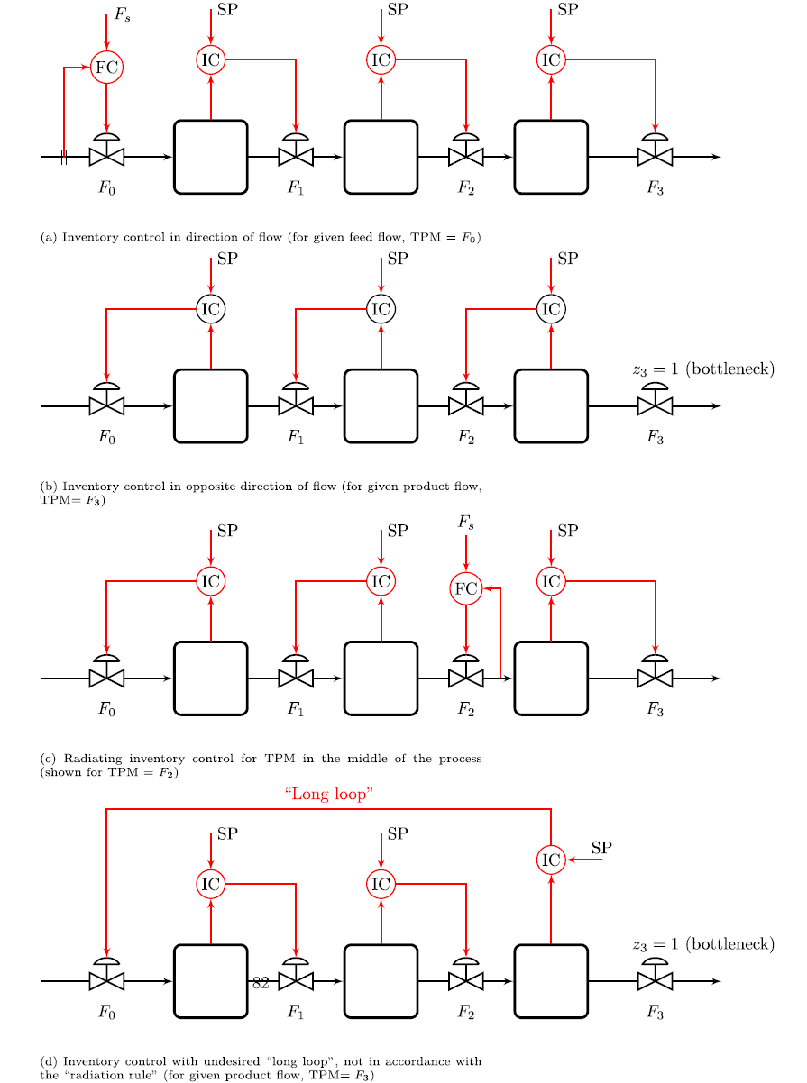
Inventory control for units in series
TPM
Follows radiation rule
TPM
Radiating rule:
Inventory control should be ‘‘radiating’’ around a given flow (TPM).
TPM
Does NOT follow radiation rule
TPM

Slide 24
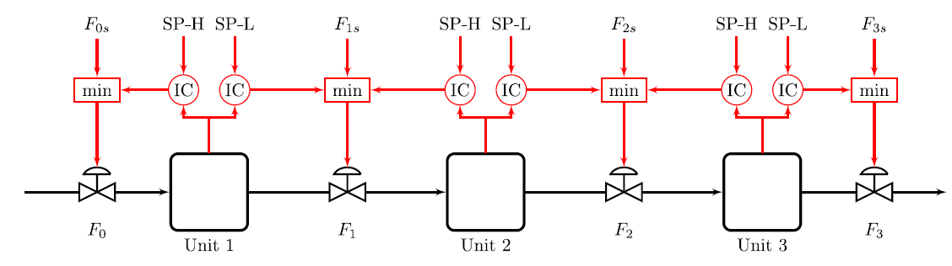

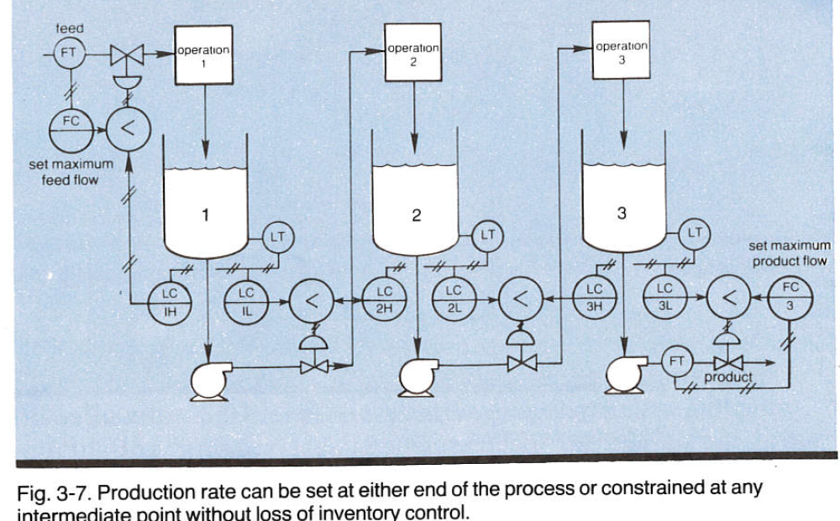
Generalization of bidirectional inventory control
Bidirectional inventory control
Reconfigures automatically with optimal buffer management!!
Maximize
throughput:
F_{s}=∞
F.G. Shinskey, «Controlling multivariable processes», ISA, 1981, Ch.3
Cristina Zotica, Krister Forsman, Sigurd Skogestad ,»Bidirectional inventory control with optimal use of
intermediate storage», Computers and chemical engineering, 2022
,

Slide 25
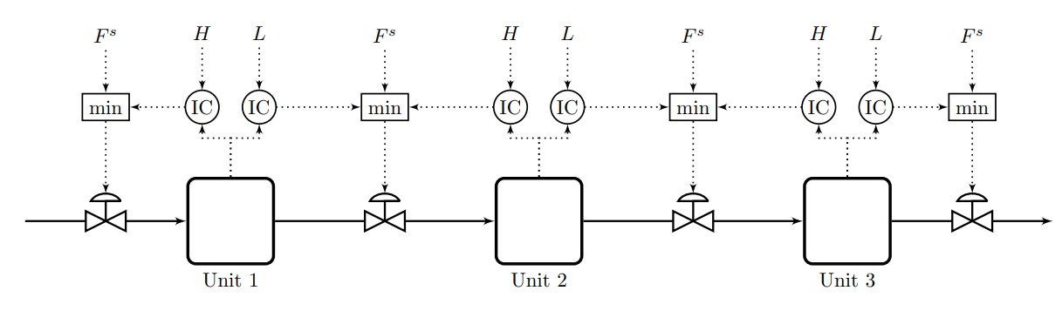
Given product flow
=∞
=∞
=∞
1
F₀=1
F₁=1
F₂=1
F₃=1
All levels are high (SP-H)

Slide 26
=∞
=∞
1
0.5
F₀=1
F₁=0.5
F₂=1
F₃=1
Temporary reduction in flow F1 (feed to unit 2)

Slide 27
=∞
=∞
1
0.5
F₀=0.5
F₁=0.5
F₂=1
F₃=1
Level 1 constant:
Reduction in feed to unit 1
Level in unit 2 drops

Slide 28
=∞
=∞
1
0.5
F₀=0.5
F₁=0.5
F₂=0.5
F₃=1
Level 2 reaches SP-L:
Flow reduction
moves to unit 3

Slide 29
=∞
=∞
1
0.5
F₀=0.5
F₂=0.5
F₃=0.5
Flow reduction reaches product after some time

Slide 30
=∞
=∞
=∞
1
F₀=0.5
F1
F₂=0.5
F₃=0.5
Temporary flow reduction in F1 is over.
Get z₁=1 (fully open).
System recovers: Temporary need F₀ > 1

Slide 31
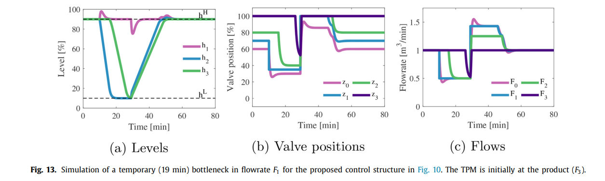
=∞
=∞
=∞
1
F₀=1.6
z₂=1:Fully open
Fully open
F₃=1

Slide 32



=∞
=∞
=∞
1
Final steady state
All levels are high (SP-H)
F₀=1
F₁=1
F₂=1
F₃=1

Slide 33
=∞
=∞
1
F₀=1
F₁=1
F₂=1
F₃=1
Challenge: Can MPC be made to do his? Optimally reconfigure loops and find optimal buffer?
YES. Use «trick»/insight of unachievable high setpoints on all flows

Slide 34
Comments on Bidirectional inventory control
It’s almost like magic (meaning that it’s difficult to understand what is actually happening)
It both moves the TPM optimally and gives optimal levels.
It is not clear how to generate such simple solutions in general: It is more like an invention.
One cannot generally except to be able to solve complex problems without coordination as shown here, so in other cases MPC may be a better solution – especially if we have information about expected disturbanbces.

Slide 35
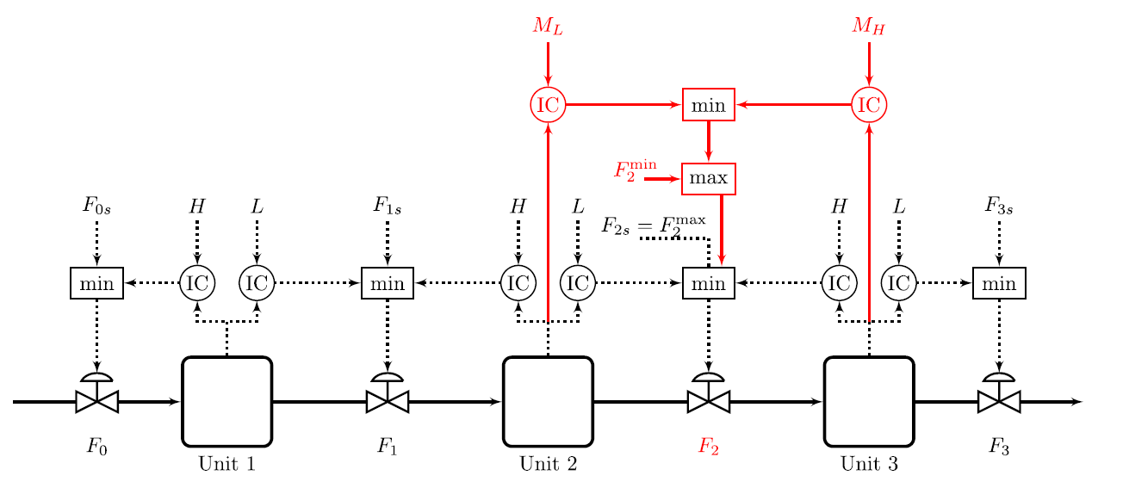
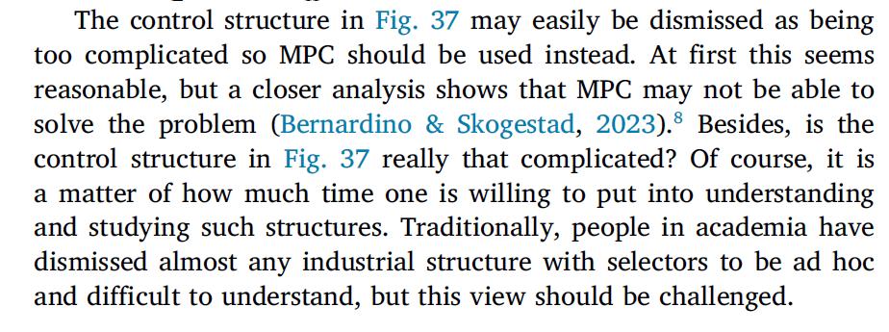
16 July 2022
Extension . Bidirectional inventory control with minimum flow for F₂
Max flow: F_{s}=∞
𝐿 = 10%,
𝑀_{𝐿} = 40%,
𝑀_{𝐻} = 60%
𝐻 = 90%.

Slide 36
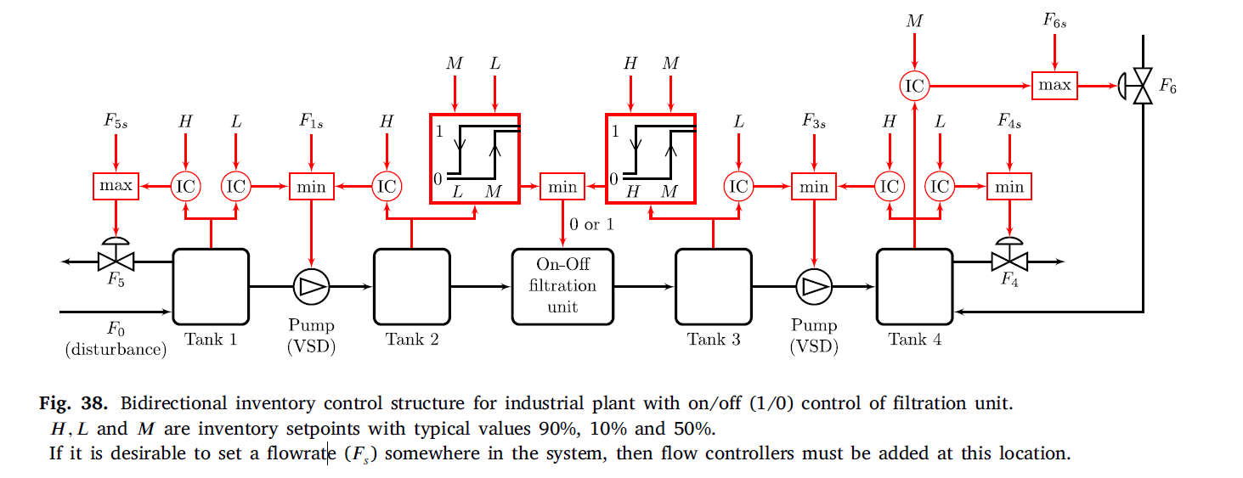

Slide 37
Comments on Inventory control (level, pressure)
All inventories (level, pressure) must be regulated by
  Controller, or
  “self-regulated” (e.g., overflow for level, open valve for pressure)
  Exception closed system: Must leave one inventory (level) uncontrolled
Usually only one TPM
  To get consistent mass balance: Can only fix same flow once
  But there are exceptions
    Multiple feeds (they are then usually set in ratio to the “main” TPM)
    Recycle systems often have a flow that can be set freely
Rule for maximizing production for cases where we cannot rearrange inventory loops (that is, we don’t use bidirectional inventory control): Locate TPM at expected bottleneck
  Otherwise you will need a “long loop” and you get loss in production because of backoff from constraint

Slide 38
Summary: Systematic design of advanced regulatory control (ARC) system
Process
First design simple control system for nominal operation
  With single-loop PID control we need to make pairing between inputs (MVs) and outputs (CVs):
  Should try to follow two rules
    «Pair close rule» (for dynamics).
    «Input saturation rule»:

Slide 39
Then: design of switching schemes
Make a list of possible new contraints that may be encountered (because of disturbances, parameter changes, price changes)
Reach constraint on new CV
  Simplest: Find an unused input (simple MV-CV switching)
  Otherwise: CV-CV switching using selector (may involve giving up a CV-constraint or a self-optimizing CV)
Reach constraint on MV (which is used to control a CV)
  Simplest (If we followed input saturation rule):
    Can give ip controlling the CV (Simple MV-CV switching)
    Don’t ned to do anything
  Otherwise (if we cannot give up controlling CV)
    Simplest: Find an unused input
      MV-MV switching
    Otherwise: Pair with a MV that already controls another CV
      Complex MV-CV switching
      Must combine MV-MV and CV-CV switching
Is this always possible? No, pairing inputs and outputs may be impossible with many constraints.
May then instead use RTO or feedback-RTO
Maybe MPC?

Slide 40
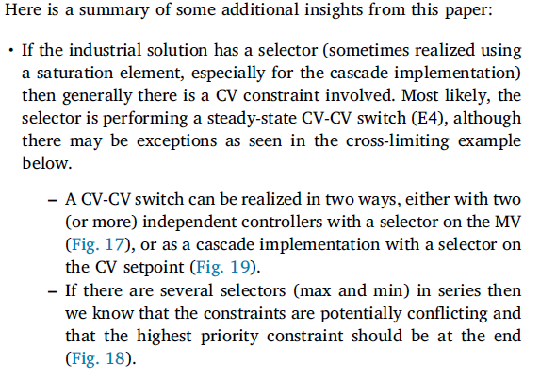
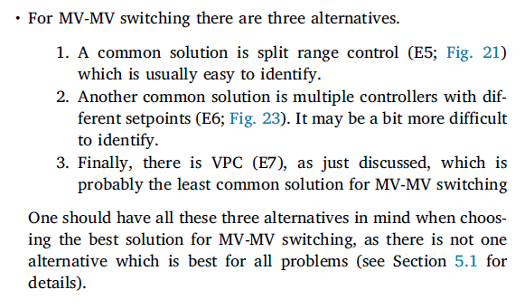
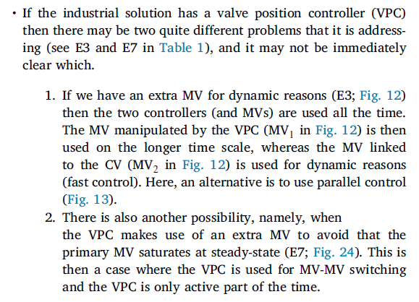

Slide 41
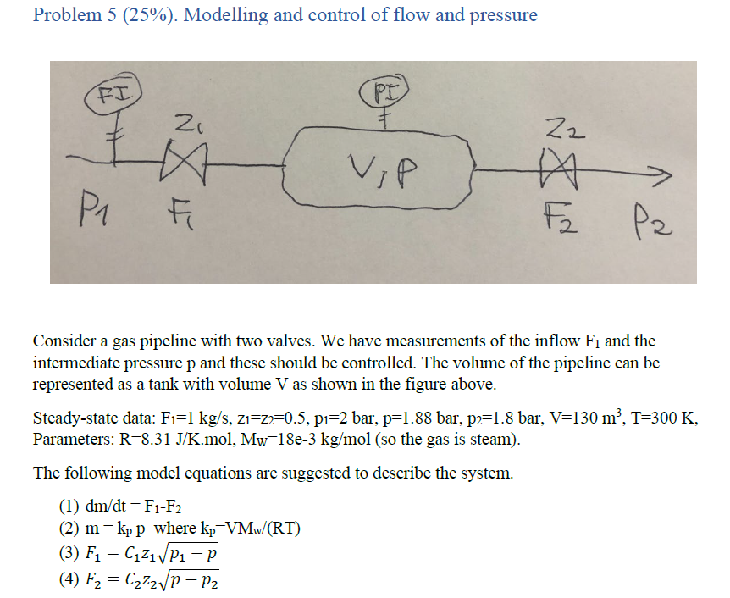
QUIZ
What happens if we do not follow radiation rule (5b)?
Suggest a control structure
What if we want to control p2 instead of p?

Slide 42
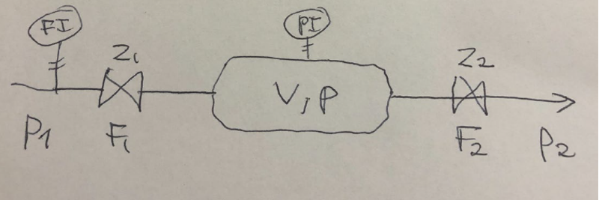
The «obvious» pair-close pairing os OK. However, interactions between loops may be severe. Suggest tuning the FC first, and the PC about 5 times slower.
FC
PC

Slide 43
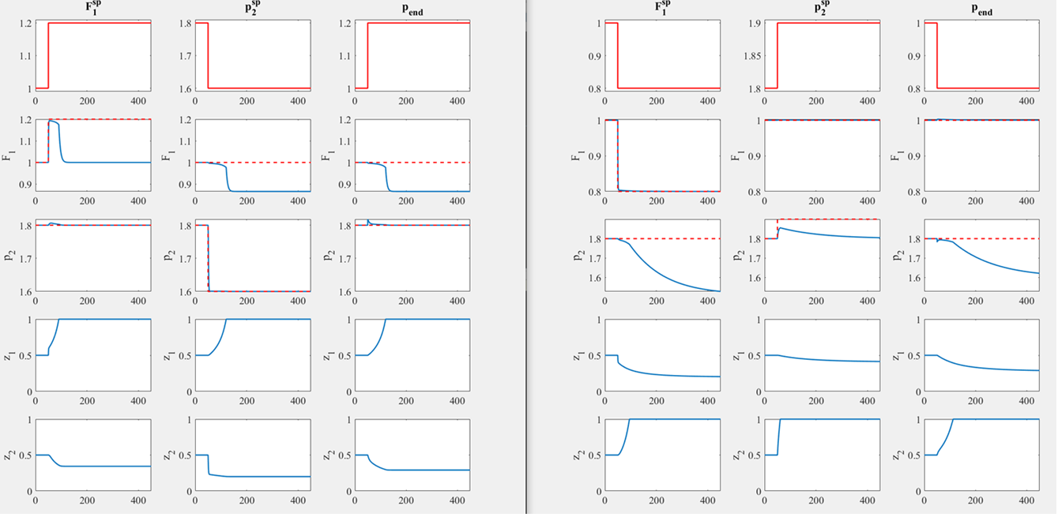
NO!
Not consistent
FC
PC
(b)
F₃ = c₃(p₂-p_{end})^{1/2}
Disturbances
in F1, p2, pend
Opposite
Disturbances
z1 to
fully open
(lose control
of F1)
Or: z2 to
fully open
(lose control
of p2)

Slide 44
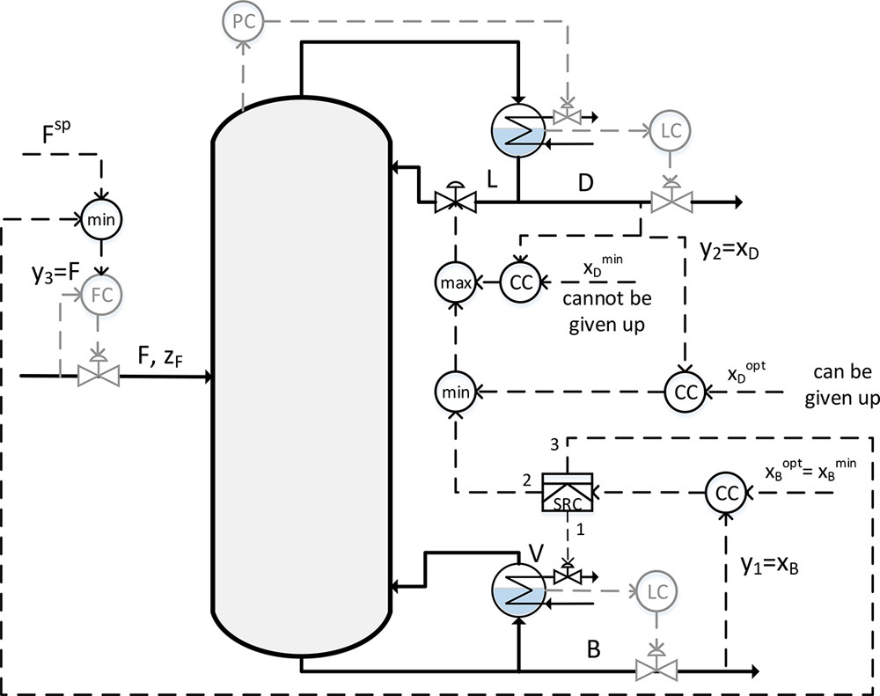
Distillation example.
CV1=xB (cannot be given up)
MV1=V (can reach max)
MV2=L (normally used for xD)
MV3=F (has setpoint)
Can be given up
=95% light
Spec. is max 5% heavy in top, but heavy in top gives economic loss. Economic optimal over-purification of top product (xDopt) depends on prices p
=98%
Bottom product is the most valuable and should always be kept at its purity constrant (xBmin).
Split range control*:
Normally we control xB with V
If V reaches Vmax then we instead use reflux L (and give up xDopt)
If L is not availabe (beacuse it’s used to control sDmin) then we instead use the feedrate F to control xB
*Split range control can be replaced by three controllers with different setpoints for xB
TC
=95% heavy
“Systematic Design of Active Constraint Switching Using Classical Advanced Control Structures”
Adriana Reyes-Lúa and Sigurd Skogestad
Industrial & Engineering Chemistry Research 2020 59 (19), 9342-9342
This is an example where MPC may be preferred

Slide 45
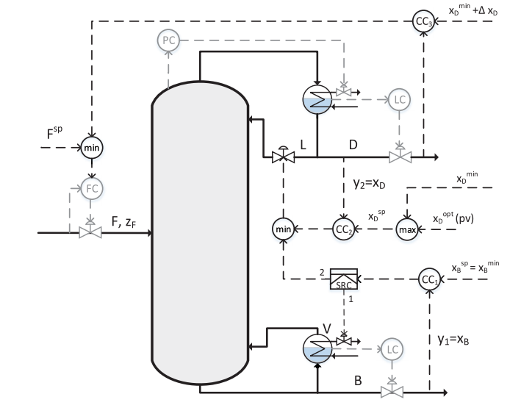
Alternative solution with different setpoints
= 94% light
Cannot be given up
=95% light
=98% (but can change and be lower if energy (V) is expensive, so this is the reason for the max-selector)
This solution looks simpler, but it is not as good dynamically in cases where we need to limit feed F to the column.
We then use F to control top composition, and L to control bottom compoistion.
The reverse pairing is better (which is what we get with the other solution)

Slide 46
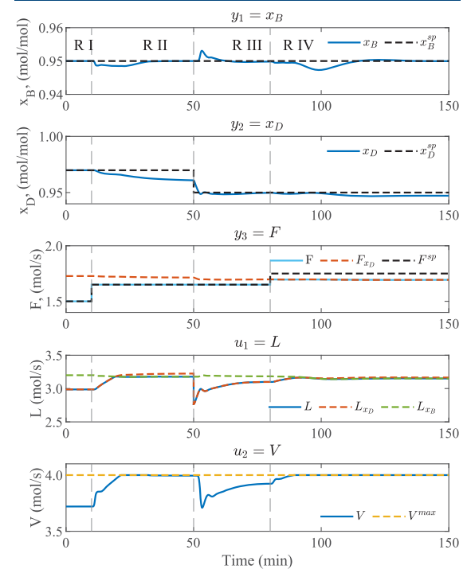
Simulation of alternative solution. The problematic pairing is used toward the end (t>80), but it’s not really tested because there are no disturbances

Slide 47
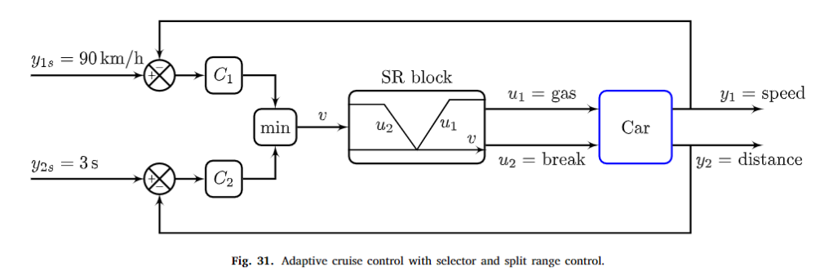
Example adaptive cruise control:
CV-CV switch followed by MV-MV switch
Note: This is not Complex MV-CV switching, because then the order would be opposite.

