Slide 1
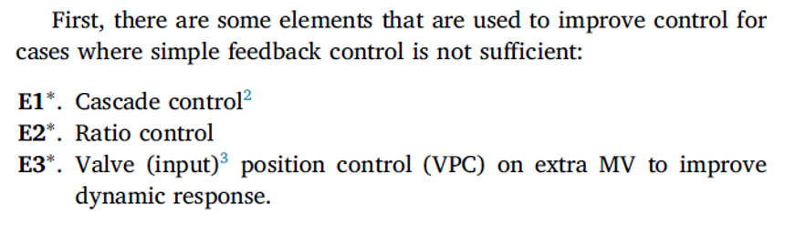
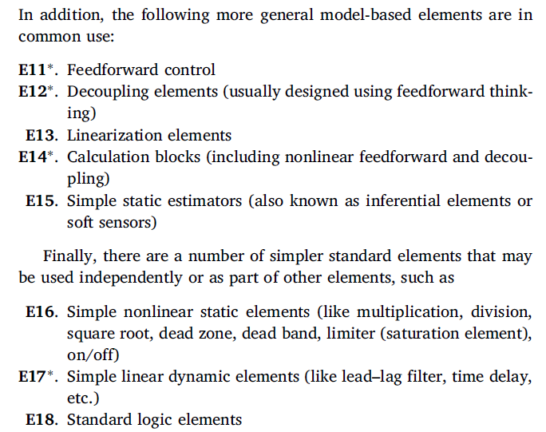
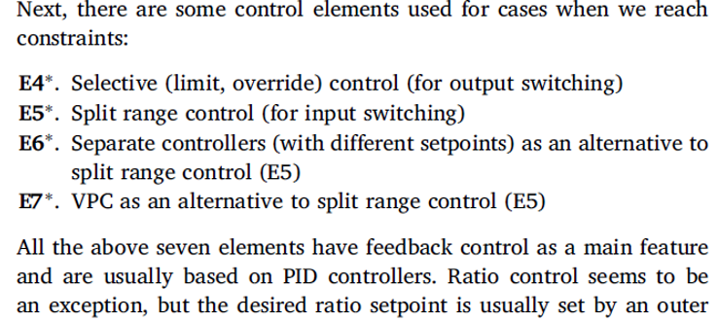
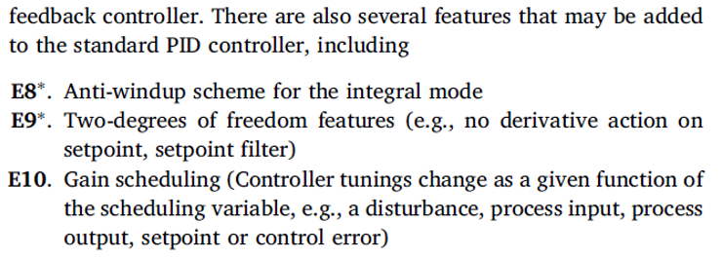
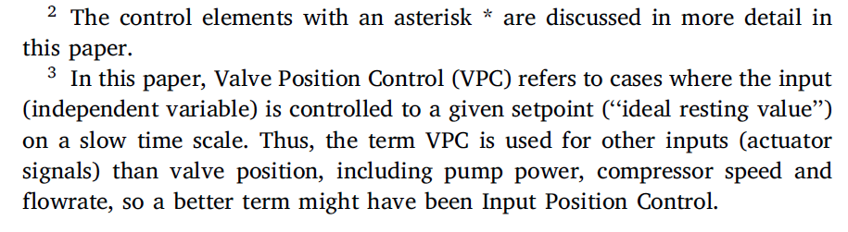
Standard Advanced control elements
Sigurd Skogestad, ''Advanced control using decomposition and simple elements''.
Annual Reviews in Control, vol. 56 (2023), Article 100903 (44 pages).
Each element links a subset of inputs with a subset of outputs
Results in simple local tuning

Slide 2
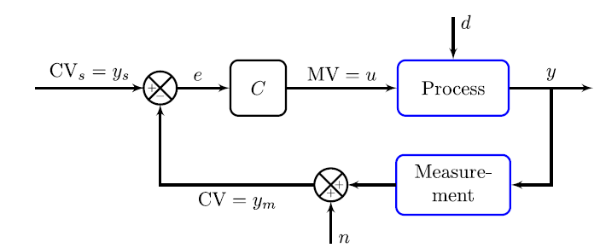
MV-CV Pairing. Two main pairing rules (supervisory layer*):
Most basic element: Single-loop PID control (E0)
“Pair-close rule” : The MV should have a large, fast, and direct effect on the CV.
“Input saturation rule”: Pair a MV that may saturate with a CV that can be .given up (when the MV saturates).*
  Exception: Have extra MV so we use MV-MV switching (e.g., split range control)
“ RGA-rule”
  Avoid pairing on negative steady-state RGA-element. Otherwise, the loop gain may change sign (for example, if the input saturates) and we get instability with integral action in the controller.
Additional rule for interactive systems:
*For regulatory (stabilizing) control, we usually want to avoid using any MV that may saturate (so Rule 2 becomes: Avoid using a MV that may saturate), but for the supervisory layer this is not possible

Slide 3
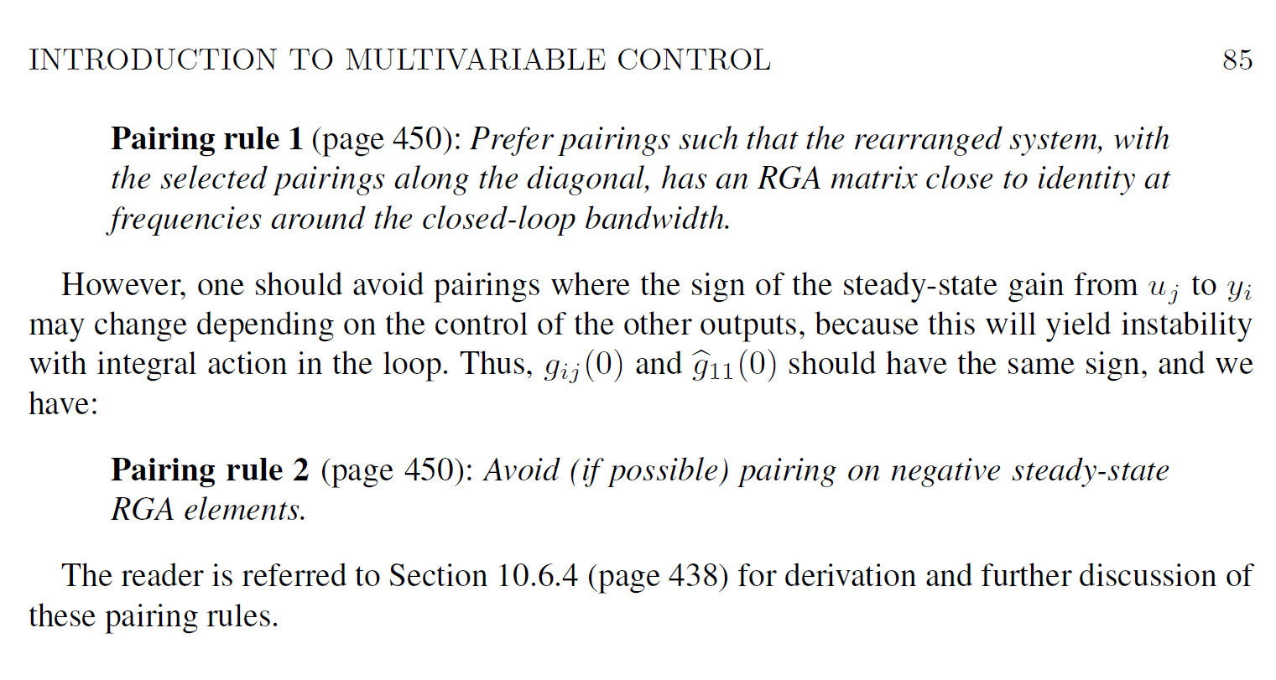
Details on RGA-rule
S. Skogestad & I. Postlethwaite, Multivariable feedback control, 2nd Edition, Wiley, 2005

Slide 4
Most common “Advanced regulatory control” structures
Used when single-loop feedback control (PID) alone is not good enough
Cascade control (measure and control internal variable) E1
Feedforward control (measure disturbance, d) E11
    (Very*) special case: ratio control E2
Extra MV dynamically: Valve position control E3
    Also known as input resetting or midranging
Change in CV: Selectors (max, min) E4
Extra MV steady state: Split range control (+2 alternatives) E5 (+E6, E7)
All of these are extensively used in practice, but little academic work
*Ratio control is a «very» special case of feedforward because it requires no model for the output (property) y we want to control.

Slide 5
Standard advanced control elements
E1-E18

Slide 6
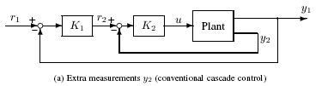
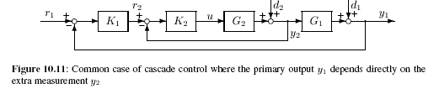
E1. Cascade control
1 input u
1 (main) output y₁
1 extra measurement y₂
Key assumption: Control of y₂ indirectly makes it easier to control y₁
Solution: Primary controller (master) controls y₁ by setting setpoint r₂=y₂^{sp} to a fast secondary controller (slave) which manipulates u
General case (“parallel cascade”)
Not always helpful…
y₂ must be closely related to y₁
Master controller
Slave controller
Special common case (“series cascade”)

Slide 7
Example: Flow controller on valve (very common!)
Helpful to reduce valve nonlinearity and provide local disturbance rejection (d=p₁, p₂)
  y = level H in tank (or could be temperature etc.)
  u = valve position (z)
  y₂ = flowrate q through valve
WITHOUT CASCADE
WITH CASCADE
flow in
H_{s}
flow in
H_{s}
H
H
LC
LC
MV=z
valve position
master
MV=q_{s}
FC
q
p₁ p₂
slave
z
flow out
measured
flow
flow out

Slide 8
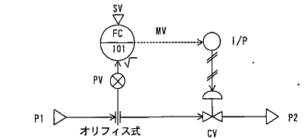
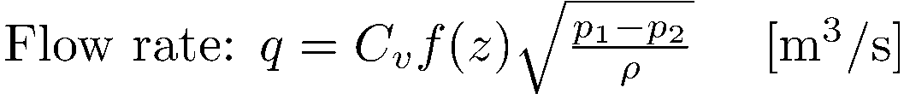
What are the benefits of adding a flow controller (inner cascade)?
q_{s}
Extra measurement y₂ = q
q
z
f(z)
Counteracts nonlinearity in valve, f(z)
  With a fast flow controller we can assume q = q_{s} (in spite of nonlinearity in the valve)
Eliminates effect of disturbances in p₁ and p₂
(FC reacts faster than outer level loop)
1
linear valve
0
0
z
(valve opening)
1

Slide 9
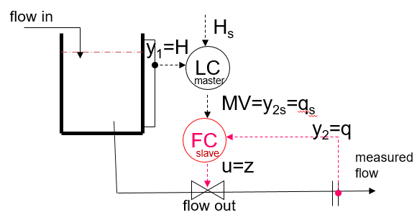
Block diagram flow controller
p₁
p₂
d_{i2}
d_{i1}
Valve
Example: Level control with slave flow controller:
u = z (valve position, flow out)
y₁ = H
y₂ = q
d’₁ = flow in
d₂ = p₁-p₂
Transfer functions:
G₂ = k(z)/(τs+1) where k(z) = dq/dz (nonlinear!)
G₁ = - 1/(As)
K₁ = Level controller (master)
K₂ = Flow controller (slave)
f(z)
1
linear valve
0
0
1
k(z) = slope df/dz

Slide 10
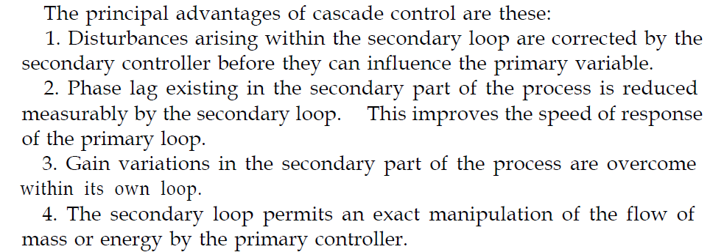
Shinskey (1967)

Slide 11
When use (series) cascade ?
Master
controller
Slave
controller
d_{i2}
d_{i1}
Use cascade control (with an extra secondary measurement y₂) when one or more of the following occur:
Significant disturbances d₂ and d_{i2} inside slave loop (and y₂ can be controlled faster than y₁)
The plant G₂ is nonlinear or varies with time or is uncertain.
Measurement delay for y₁
  Note: In the flowsheet above, y₁ is the measured output, so any measurement delay is included in G₁
Integrating dynamics (including slow dynamics or unstable) in both G₁ and G₂, (because without cascade a double integrating plant G₁G₂ is difficult to control)
Design / tuning
First design K₂ (“fast loop”) to deal with d₂ and d_{i2} (based on model G₂)
Then, with K₂ closed, design K₁ to deal with d₁ and d_{i1} (based on model G₁T₂)

Slide 12
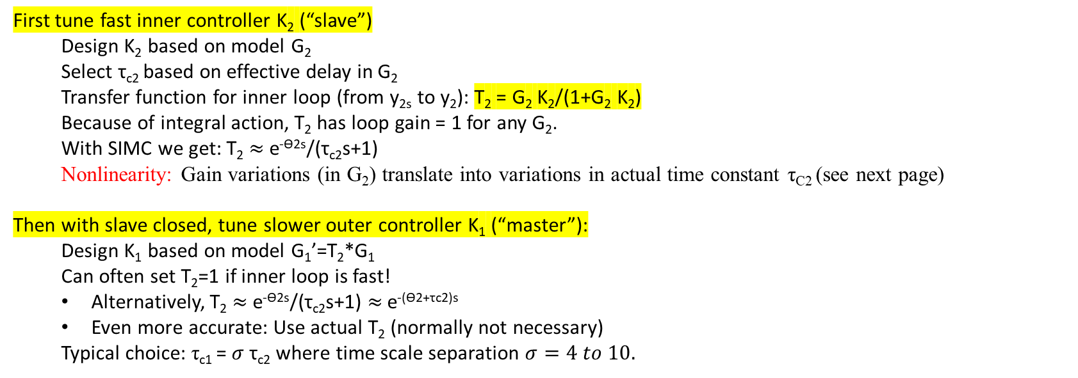
Transfer functions and tuning
T₂
d’₁
First tune fast inner controller K₂ (“slave”)
  Design K₂ based on model G₂
  Select τ_{c2} based on effective delay in G₂
  Transfer function for inner loop (from y_{2s} to y₂): T₂ = G₂ K₂/(1+G₂ K₂)
  Because of integral action, T₂ has loop gain = 1 for any G₂.
  With SIMC we get: T₂ $≈$ e^{-ϴ2s}/(τ_{c2}s+1)
  Nonlinearity: Gain variations (in G₂) translate into variations in actual time constant τ_{C2} (see next page)
Then with slave closed, tune slower outer controller K₁ (“master”):
  Design K₁ based on model G₁’=T₂*G₁
  Can often set T₂=1 if inner loop is fast!
  Alternatively, T₂ $≈$ e^{-ϴ2s}/(τ_{c2}s+1) $≈$ e^{-(ϴ2+τc2)s}
  Even more accurate: Use actual T₂ (normally not necessary)
  Typical choice: τ_{c1} = $σ$ τ_{c2} where time scale separation $σ=4 to 10.$

Slide 13
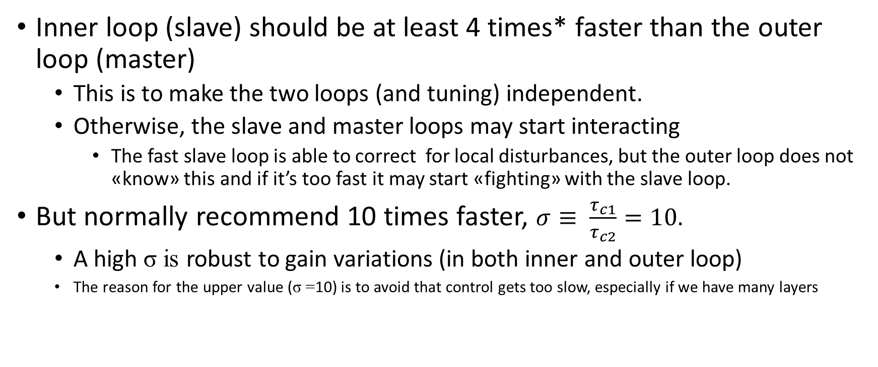
Time scale separation is needed for cascade control to work well
Inner loop (slave) should be at least 4 times* faster than the outer loop (master)
  This is to make the two loops (and tuning) independent.
  Otherwise, the slave and master loops may start interacting
    The fast slave loop is able to correct for local disturbances, but the outer loop does not «know» this and if it’s too fast it may start «fighting» with the slave loop.
But normally recommend 10 times faster, $σ≡ \frac{τ_{c1}}{τ_{c2}}=10.$
  A high σ is robust to gain variations (in both inner and outer loop)
  The reason for the upper value (σ =10) is to avoid that control gets too slow, especially if we have many layers
* Shinskey (Controlling multivariable processes, ISA, 1981, p.12)

Slide 14
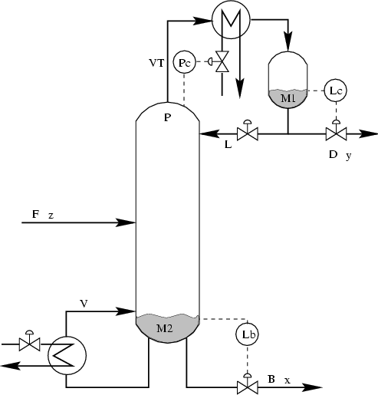
Cascade control distillation
3 layers of cascade
y_{s}
With flow loop +
T-loop in top
y
XC
τ_{c}=1500s
=25 min
T_{s}
T
TC
τ_{c}=150s
L_{s}
L
FC
τ_{c}=15s
z
XC
Problem with many layers:
Eats up the time window

Slide 15
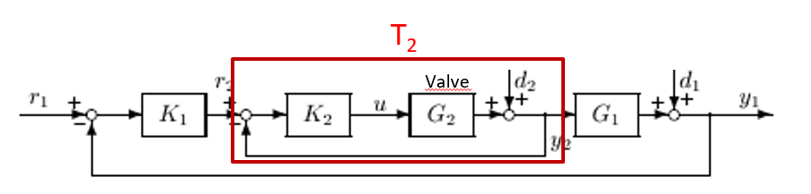
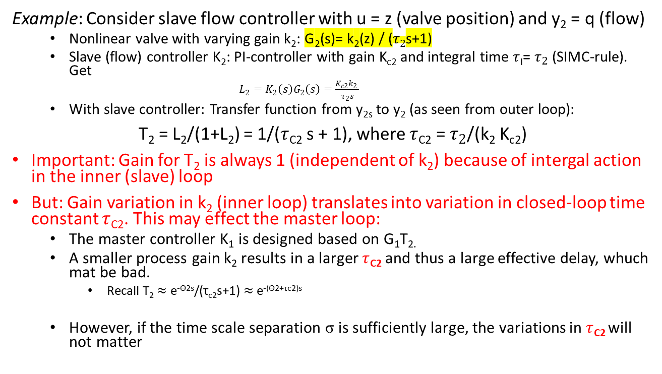
Counteracting nonlinearity using cascade control
Example: Consider slave flow controller with u = z (valve position) and y₂ = q (flow)
  Nonlinear valve with varying gain k₂: G₂(s)= k₂(z) / ($τ2$s+1)
  Slave (flow) controller K₂: PI-controller with gain K_{c2} and integral time $τ$_{I}= $τ_{2}$ (SIMC-rule). Get
          $L_{2}=K_{2}\left(s\right)G_{2}\left(s\right)=\frac{K_{c2}k_{2} }{τ_{2}s}$
  With slave controller: Transfer function from y_{2s} to y₂ (as seen from outer loop):
T₂ = L₂/(1+L₂) = 1/($τ$_{C2} s + 1), where $τ$_{C2} = $τ_{2}$/(k₂ K_{c2})
Important: Gain for T₂ is always 1 (independent of k₂) because of intergal action in the inner (slave) loop
But: Gain variation in k₂ (inner loop) translates into variation in closed-loop time constant $τ$_{C2}. This may effect the master loop:
  The master controller K₁ is designed based on G₁T_{2.}
  A smaller process gain k₂ results in a larger $τ$_{C2} and thus a large effective delay, whuch mat be bad.
    Recall T₂ $≈$ e^{-ϴ2s}/(τ_{c2}s+1) $≈$ e^{-(ϴ2+τc2)s}
  However, if the time scale separation σ is sufficiently large, the variations in $τ$_{C2} will not matter
f(z)
1
linear valve
0
0
1
k₂(z) = slope = df/dz
G₁T₂ = «Process» for tuning master controller K₁

Slide 16
Cascade control block diagram
Which disturbances motivate the use of cascade control?
d₂
d₁
d_{1o}
r₁
C₁
r₂
C₂
u
+
P₂
y₂
+
P₁
+
y₁
Answer: d₂

Slide 17
E2. Ratio control
Special (and most common) case of feedforward
Example: Process with two feeds F₁ (d) and F₂ (u), where ratio should be constant.
Use multiplication block:
(F₂/F₁)_{s}
F₁
(measured flow
disturbance)
F₂
(MV: manipulated variable)
x
Often (F₂/F₁)_{s} is adjusted using feedback control in a cascade fashion.

Slide 18
EXAMPLE: CAKE BAKING MIXING PROCESS
RATIO CONTROL
with outer feedback trim (to adjust ratio setpoint)
R=(F₂/F₁)_{s}
d=F_{1,m}
u= F_{2,s}
x
Flour
(solid)
FC
F_{2,m}
Water
y_{m}
∞
VC
y
Viscosity y [cP]
y_{s}
Product

Slide 19
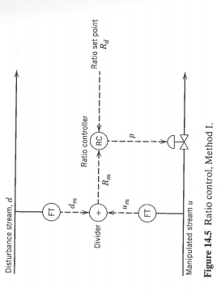
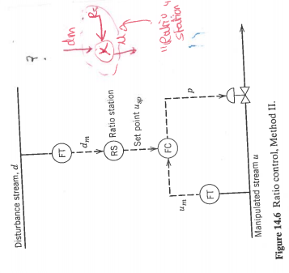
Ratio control
Avoid divisions in implementation! (avoid divide by 0)
Process control textbooks has some bad/strange suggestions, for example, division (bad) and “ratio stations” (complex):
Seborg:
Bad solution
Avoid divisions (divide by 0 if u =0, for example, at startup)
This is complicated. What is RS?
Ok if implemented as shown in red at right

Slide 20
Theory of Ratio control
Assumes that «scaling property» holds (physical insight): Keep ratio R (between extensive variables) constant in order to keep property y constant
  y: (any!) intensive variable
Implementation
  Feedforward: R=u/d
  Decoupling: R=u₁/u₂
    u,d: extensive variables
  Setpoint for R may be found by «feedback trim»
Don’t really need a model (no inverse as in «normal» feedforward!)
Scaling property holds for mixing and equilibrium processes
    Rato control is almost always used for mixing of reactants
  Requires that all extensive variables are scaled by same amount
    So does not hold for heat exchanger (since area A is constant) or non-equilibrium reactor (since volume V is constant)
    So should not keep L/F constant for distillation column with saturated (max) heat input (V)

Slide 21
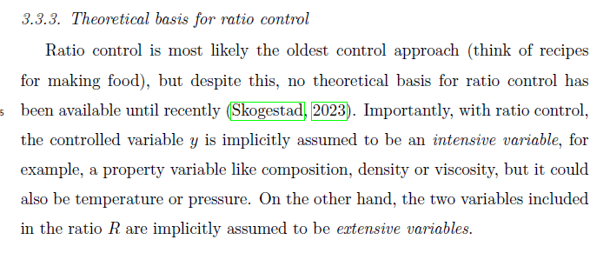
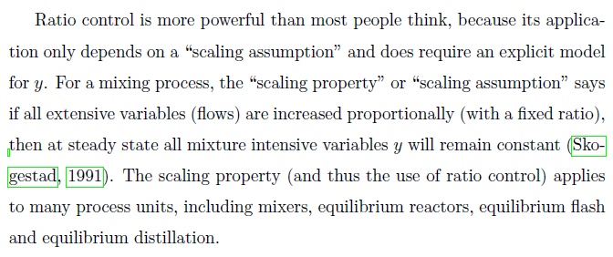
From paper by Skogestad (2023)

Slide 22
Implementation of ratio control: u = R d (in unscaled/physical units)
R=(F₂/F₁)_{s}
d=F_{1,m}
u= F_{2,s}
x
Flour
(solid)
FC
F_{2,m}
Water
y_{m}
∞
VC
y
Viscosity y [cP]
y_{s}
Product
LINEARITY OF RATIO CONTROL: This way of implementing ratio control makes it easy to tune the outer feedback loop (VC controller) because
The gain from MV = R_{s} to CV=y (here viscosity) does not depend on the disturbance d=F₁.
Proof: This is general for this way of implanting ratio control, because a given change in R has the same effect on the property y, independent of the total flow is.

Slide 23
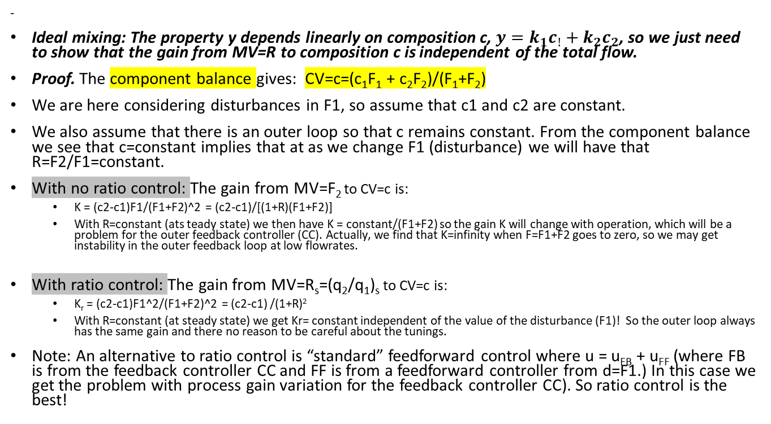
Proof of constant gain for ideal mixing
-
Ideal mixing: The property y depends linearly on composition c, $y=k_{1}c_{!}+k_{2}c_{2}$, so we just need to show that the gain from MV=R to composition c is independent of the total flow.
Proof. The component balance gives: CV=c=(c₁F₁ + c₂F₂)/(F₁+F₂)
We are here considering disturbances in F1, so assume that c1 and c2 are constant.
We also assume that there is an outer loop so that c remains constant. From the component balance we see that c=constant implies that at as we change F1 (disturbance) we will have that R=F2/F1=constant.
With no ratio control: The gain from MV=F₂ to CV=c is:
  K = (c2-c1)F1/(F1+F2)^2 = (c2-c1)/[(1+R)(F1+F2)]
  With R=constant (ats teady state) we then have K = constant/(F1+F2) so the gain K will change with operation, which will be a problem for the outer feedback controller (CC). Actually, we find that K=infinity when F=F1+F2 goes to zero, so we may get instability in the outer feedback loop at low flowrates.
With ratio control: The gain from MV=R_{s}=(q₂/q₁)_{s} to CV=c is:
  K_{r} = (c2-c1)F1^2/(F1+F2)^2 = (c2-c1) /(1+R)²
  With R=constant (at steady state) we get Kr= constant independent of the value of the disturbance (F1)! So the outer loop always has the same gain and there no reason to be careful about the tunings.
Note: An alternative to ratio control is “standard” feedforward control where u = u_{FB} + u_{FF} (where FB is from the feedback controller CC and FF is from a feedforward controller from d=F1.) In this case we get the problem with process gain variation for the feedback controller CC). So ratio control is the best!

Slide 24
Valve position control (VPC)
Have extra MV (input): One CV, many MVs
Process
Two different cases of VPC:
E3. Have extra dynamic MV
  Both MVs are used all the time
E7. Have extra static MV
  MV-MV switching: Need several MVs to cover whole range at steady state
  We want to use one MV at a time

Slide 25
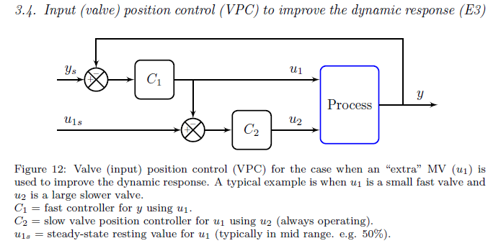
E3. VPC for extra dynamic input
u₂ = main input for steady-state control of CV
(but u₂ is poor for directly controlling y
  e.g. time delay or u₂ is on/off )
u₁ = extra dynamic input for fast control of y
u₁
Process
y
u₂
Example 1: Large (u₂) and small valve (u₁) (in parallell) for controlling total flowrate (y=F)
  The large valve (u₂) has a lot of stiction which gives oscillations if used alone for flow control
  The small valve (u₁) has less stiction and gives good flow control, but it’s too small to use alone
Example 2: Strong base (u₂) and weak base (u₁) for neutralizing acid (disturbance) to control y=pH
  Do pH change gradually (in two tanks) with the strong base (u₂) in the first tank and the weak base (u₁) in the last tank. u1 controls the pH in the last tank (y)
VPC
Alternative term for dynamic VPC:
Mid-ranging control (Sweden)

Slide 26
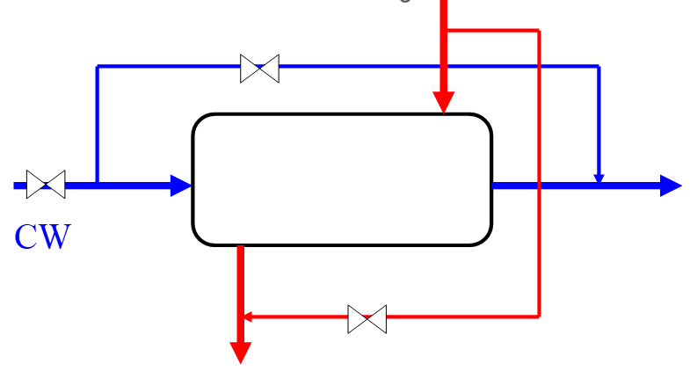
Example: Heat exchanger with bypass
T
z_{B}
Want tight control of y=T.
u₁=z_{B} (bypass)
u₂=CW
Proposed control structure?

Slide 27
Attempt 1. Use u₂=cooling water: TOO SLOW
TC
T
z_{B}=0 (closed)

Slide 28
Attempt 2. Use u₁=z_{B}=bypass. SATURATES
(at z_{B}=0=closed if CW too small)
=constant
T
z_{B}
TC
Advantage: Very fast response (no delay)
Problem: z_{B} is too small to cover whole range
+ not optimal to fix at large bypass (waste of CW)

Slide 29
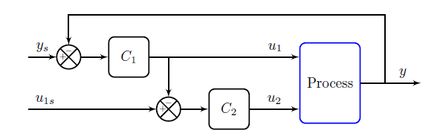
What about VPC?
T
z_{B}
Want tight control of y=T.
u₁= z_{B}
u₂=CW
Proposed control structure?
Main control: u₂=CW
Fast control: u₁=z_{B}

Slide 30
Attempt 3 (proposed): VPC
SP=50%
T
z_{B}
VPC
TC
Fast control of y: u₁ = z_{B}
Main control (VPC): u₂=CW (slow loop)
Need time scale separation between the two loops

Slide 31
Comment on heat exchanger example
The above example assumes that the flows on the two sides are «balanced» (mc_{P} for cooling water (CW) and hot flow (H) are not too different) such that both the bypass flow (u1) and CW flow (u2) have an effect on T (CV)
There are two «unbalanced» cases:
  If CW flow is small, then T-outCW will always approach T-inH, so from a total energy balance, the bypass will have almost zero steady-state effect on T.
  If CW flow is large, then T-outH (before bypass mixing point) will always approach T-inCW, so CW will have almost zero effect on T. (both steady state and dynamically)
This illustrates that heat exchanger may behave very nonlinearly, and a good control structure for one heat exchanger case, may not work well for another case

Slide 32
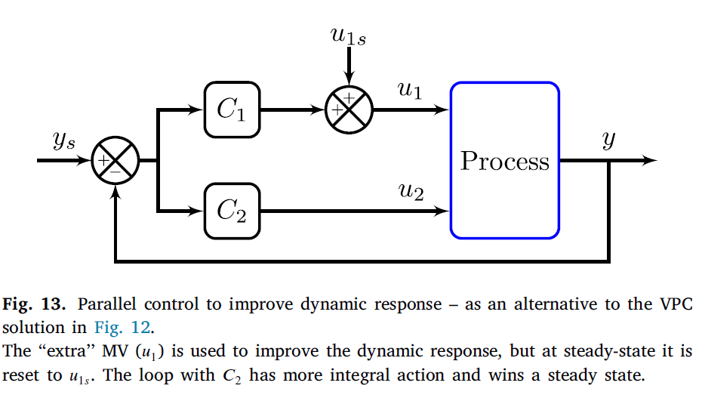
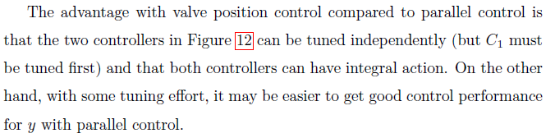
Alternative to VPC: Parallell control

Slide 33
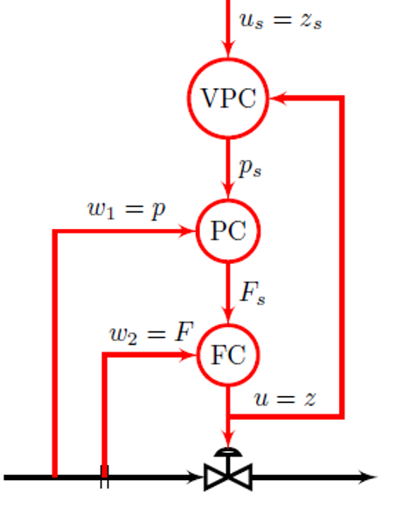
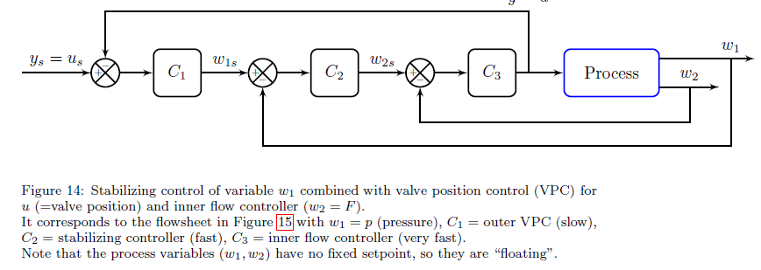

VPC with one MV: Stabilizing control with resetting of MV
VPC
Note: u is both an MV and a CV
Two-phase flow: Liquid and gas
Reservoir

Slide 34
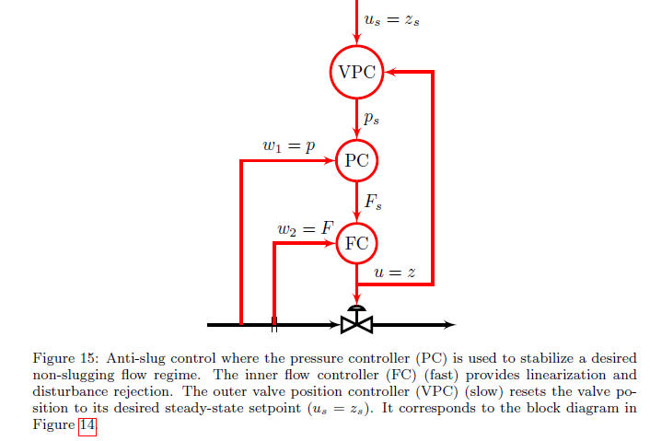
Example: Anti-slug control

Slide 35
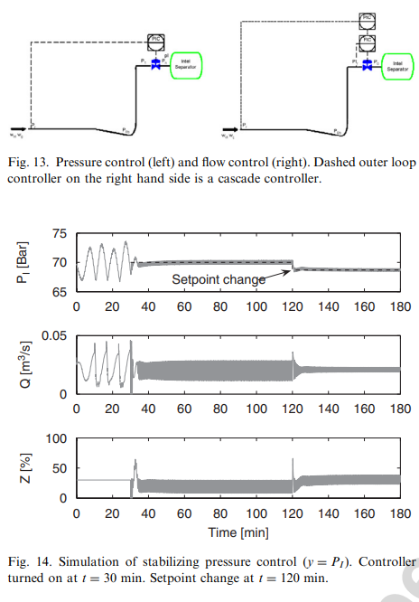
Example: Anti-slug control
Simulation without VPC (the system is unstable before PC is turned on):

Slide 36
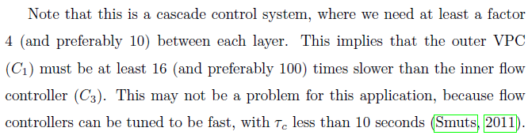
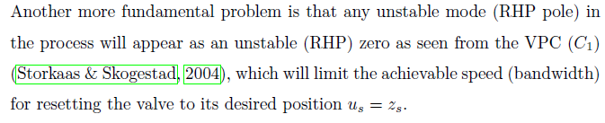
Example: Anti-slug control

Slide 37
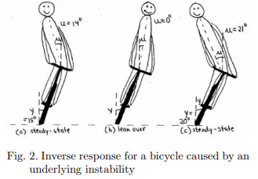
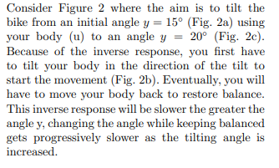
Example: Stabilize bycycle
Comment: Another example is a motorcycle where tilting is required for making turns.
Espen Storkaas and Sigurd Skogestad, "Cascade Control of unstable systems with application to stabilization of slug flow", IFAC-symposium Adchem'2003, Hong Kong, Presented: Jan. 2004 (original conference date: June 2003.)

Slide 38
Constraint switching
(because it is optimal at steady state)
CV-CV switching
  Control one CV at a time
MV-MV switching
  Use one MV at a time
MV-CV switching
  MV saturates so must give up CV
  Simple («do nothing») and
  Complex (repairing of loops)
Process
Process
Process
Process

Slide 39
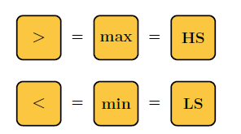
E4. Selector (for CV-CV switching*)
Process
Many CVs paired with one MV.
But only one CV controlled at a time.
Use: Max or Min selector
Sometimes called “override”
  But this term may be misleading
Selector is generally on MV (compare output from many controllers)
Note: Selectors are logic blocks
*Only option for CV-CV switching. Well, not quite true: Selectors may be implemented in other ways, for example, using «if-then»-logic.

Slide 40
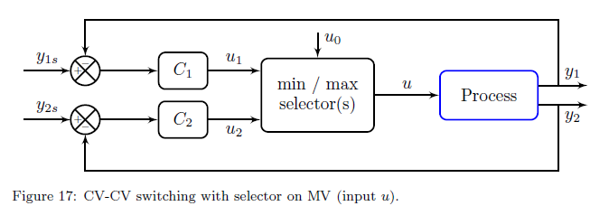
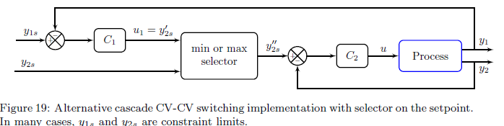
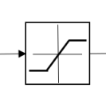
Implementation selector
u
Process
y₁
y₂
…
Alt. I (General). Several controllers (different CVs)
    Selector on MVs
      Must have anti windup for C₁ and C₂ !
Alt. II (Less general) Controllers in cascade
    Selector on CV setpoint
    Good alternative if CVs (y₁ and y₂) are related so that cascade is good
    In this case: Selector may be replaced by saturation element
    (with y_{2s} as the max or min)
Alt. III (For special case where all CVs have same bound). One controller
    Selector is on CVs (Auctioneering)
    Also assumes that dynamics from u to y₁ and y₂ are similar; otherwise use Alt.I
    Example: Control hot-spot in reactor or furnace.
u=max(u₀,u₁,u₂)
y₁
y₂
y=max(y₁,y₂)
u
>
c
y_{s}

Slide 41
Example Alt. III
CV-CV switching
Hot-spot control in reactor or furnace
T₁
T₂
.
.
.
T_{n}
y=max(T_{i})
u=Q
>
C
Comment: Could use General Alternative I (many controllers) for hot-spot control, with each temperature controller (c₁, c₂,…) computing the heat input (u₁=Q₁, u₂=Q₂, ….) and then select u = min(u₁, u₂, …), but it is more complicated.

Slide 42
Furnace control
CV-CV switching
with safety constraint (Alt. I)
u₁
TC
T_{1s} = 500C
Input (MV)
u = Fuel gas flowrate
Output (CV)
y₁ = process temperature T₁
(desired setpoint or max constraint)
y₂ = furnace temperature T₂
(max constraint)
Rule: Use min-selector for constraints that are satisfied with a small input
MIN
u₂
TC
T_{2max}=700C
y₁=T₁
HP steam
u=min(u₁,u₂)
y₂=T₂
Flue gas
Process fluid (water)
u = input = manipulated variable (MV)
y = output = controlled variable (CV)
u=Fuel gas
Air

Slide 43
Furnace control with cascade (Alt. II, selector on CV-sp)
CV-CV switching, alternative solution
T_{2max} = 700C
T_{2s}
MIN
u₁
TC
T_{1s} = 500C
Comparison
The cascade solution is less general but it may be better in this case.
Why better? Inner T2-loop is fast and always active and may improve control of T1.
u₂
TC
y₁=T₁
y₂=T₂
Flue gas
Process fluid
u=Fuel gas
Air
Comment: For both Alt. I and II, we loose control of T1 (it drops below T1s=500C) when T2=T2max. If this is not acceptable then we need to something- More on this later!

Slide 44
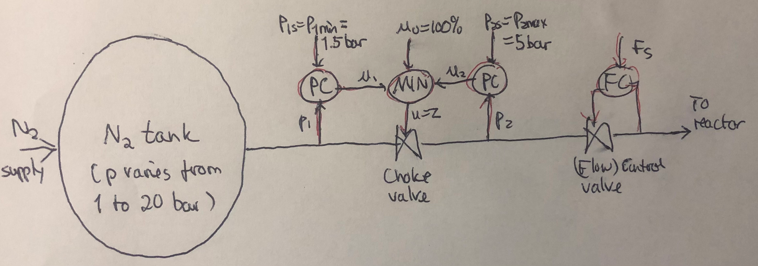
Example Alt. I (Choke valve)
CV-CV switching
The choke valve is normally fully open to avoid unnecessary pressure drop (normally, we may have p1=4.5 bar, p2=4 bar)
But may close choke valve to avoid too low p1 (if N2 supply stops) or too high p2 (if p1 is high).
Here Alt. II (cascade) should not be used (Why? Cascade control makes it necessary to have one loop slow, which makes little sense since control of p1 does not improve control of p2 (or vice-versa).
Comment 1: Strictly speaking. the input u0=100% to the min-block is not needed, since the valve has a “bulit-in” min-selector at fully open (see later). But including it is not wrong - and it shows more clearly that we normally want u0=100%.
Comment 2: There may be quite a lot of interaction between the pressure and flow control. The best solution is probably to make one fast and one slow. In this case, it seems most reasonable to make the pressure control fast. But if fast flow control is needed, we may do it opposite.
Comment 3: I here use the term “choke valve” when the aim is to regulate pressure; and “control valve” when it is to regulate flow (but other people may not agree on this)

Slide 45
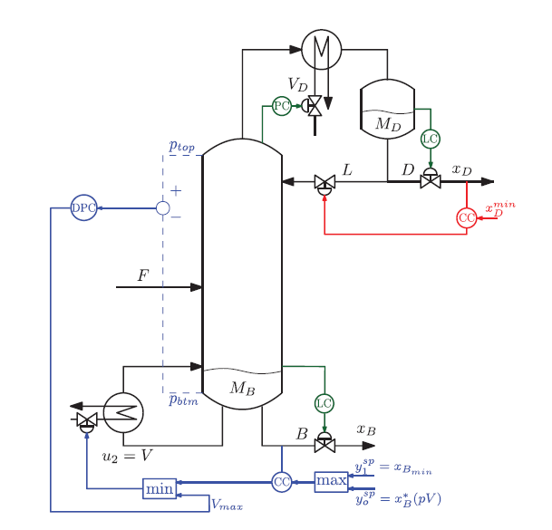

Distillation example
CV-CV switching
Always control xD at constraint
(valueable product) to
avoid «product give-way»
Note: A selector where one input is a constant (like the max-block for xB) may be replaced by a saturation element
From RTO
Avoid flooding using constraint on DP
(Alt. I: selector in input)
May overpurity bottom to get more of the valuable product
(Alt. II: Selector on setpoint)

Slide 46
Design of selector structure
CV-CV switching
Rule 1 (max or min selector)
Use max-selector for constraints that are satisfied with a large input
Use min-selector for constraints that are satisfied with a small input
Rule 2 (order of max and min selectors):
If need both max and min selector: Potential infeasibility (conflict)
Order does not matter if problem is feasible
If infeasible: Put highest priority constraint at the end
“Systematic design of active constraint switching using selectors.”
Dinesh Krishnamoorthy , Sigurd Skogestad. Computers & Chemical Engineering, Volume 143, (2020)

Slide 47
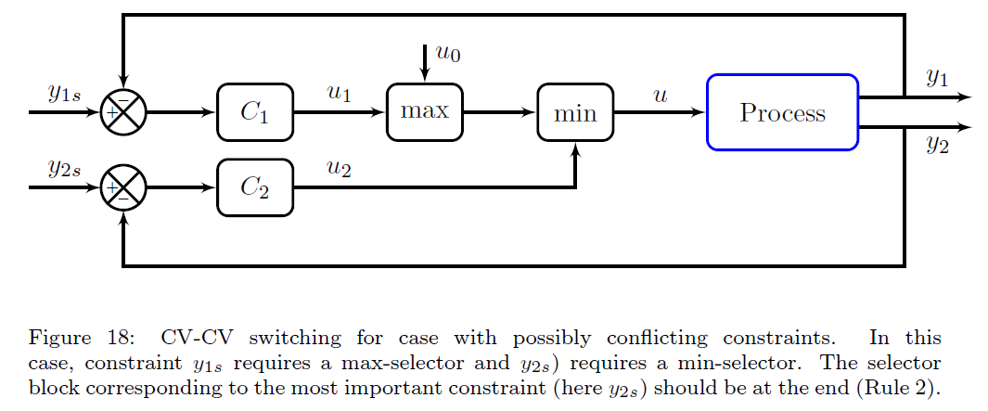
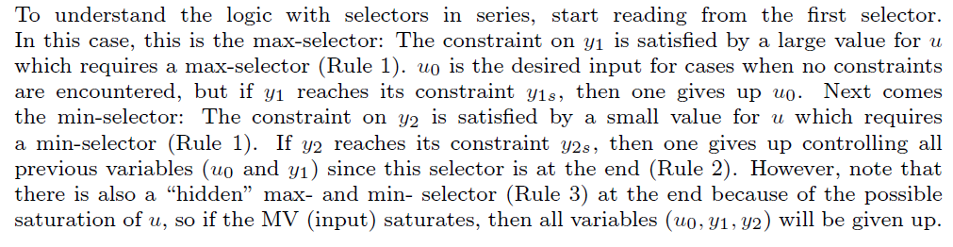
Rule 2 (order of selectors)

Slide 48
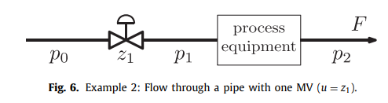
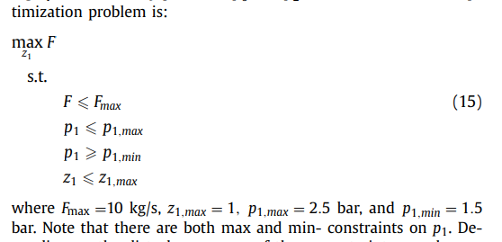
Example. Maximize flow with pressure constraints
CV-CV switching
Input u = z₁
Want to maximize flow, J=-F:
Op
The two p1-constraints are not conflicting, because they are on the same variable.
However the Fmax-constraint and p1min-constraint may be conflicting: Must choose which is most important.

Slide 49
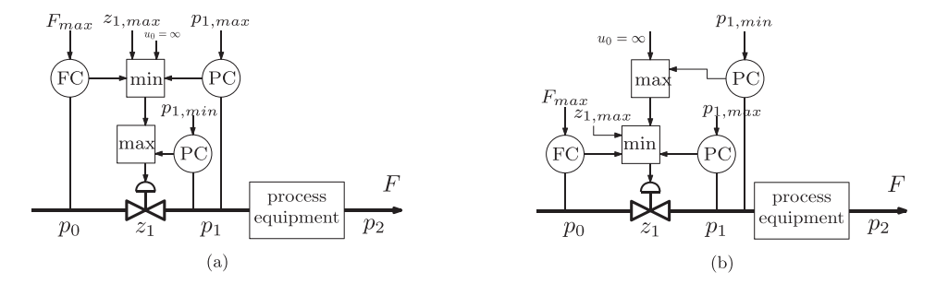
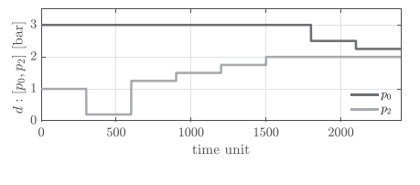
CV-CV switching
Disturbances in p₀ and p₂ (unmeasured)

Slide 50
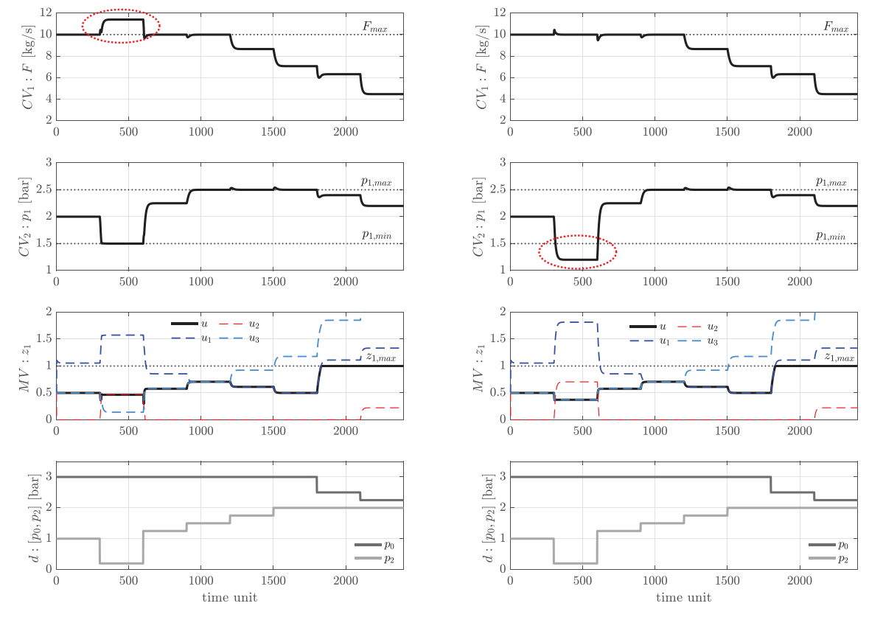
CV-CV switching
t>1800: u=zmax=1

Slide 51
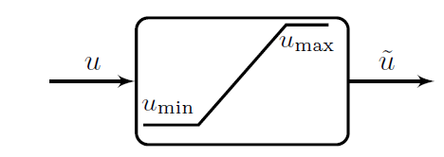
Valves have “built-in” selectors
CV-CV switching
Rule 3 (a bit opposite of what you may guess)
  A closed valve (u_{min}=0) gives a “built-in” max-selector (to avoid negative flow)
  An open valve (u_{max}=1) gives a “built-in” min-selector
  So: Not necessary to add these as selector blocks (but it will not be wrong).
  The “built-in” selectors are never conflicting because cannot have closed and open at the same time
  Another way to see this is to note that a valve works as a saturation element
Saturation element may be implemented in three ways (equivalent because never conflict)
Min-selector followed by max-selector
Max-selector followed by min-selector
Mid-selector

Slide 52



Quiz. Is this OK?
CV-CV switching
Cristina: I am looking at a control solution using selectors for keeping the pressure within constraints, while maximizing the valve opening. See figure This is for the valve before a steam turbine. This should work OK, right? Of course, if pmax is reached while the valve is fully open, the turbine bypass will have to open.
Answer:
Rule 1. Yes, the rule is to use a max-selector for a constraint which is satisfied with a large input.
And since the pressure is measured upstream, the pressure will get lower if we increase the valve opening, making it easier to satisfy the pmax-constraint. So yes, this is OK.
Rule 1. Similar for the min-block with pmin.
Rule 2. Since you have two constraints on the same variable, you cannot have infeasibility so the order of the min. and max-blocks doesn’t matter for pmin and pmax.
Rule 2. Yes, the desired value uo=zmax should always enter the first block.
Conclusion: yes, it works.
BUT….
Comment 1: But note that there is also a “hidden” min-selector just before the valve because of the valve which has zmax. And also a “hidden” max-selector because of zmin (a fully closed valve). These constraints may be inconsistent with the pressure constraints.
Comment 2: Since the order of the two selectors does not matter in this case, one may instead use the “equivalent” alternative with the max-block first. But we then see clearly that the constraint on pmax will never be activated, because ztmax is large. I guess this makes sense since you want to have the valve as open as possible, so then the you will always be at the pmin-constraint or have a fully open valve. So you can cut the pmax-constraint (and thus the max-selector) as you anyway want to open the valve as much as possible.
In addition, you can also cut the min-selector because there is already a “hidden” min-selector with zmax. (On the other hand, it will not be wrong to keep them.)
Final conclusion: Yes, it works, but it’s much too complicated.
All what is shown can be replaced by a pressure controller (PC) with setpoint p^{min}.

Slide 53



E5. Split-range control (SRC) (for MV-MV switching)
For MVs (u) that have same effect (same sign) on the output (y) (Fig. 21), we need to define the order in which the MVs will be used. This is done by the order in in the SR-block.
Example: With two heating sources, we need to decide which to use first (see next Example)
Advantage: SRC is easy to understand and implement!
Disadvantages:
Only one controller C $⇒$ Same integral time for all inputs u_{i} (MVs)
  Controller gains can be adjusted with slopes in SR-block!
Does not work well for cases where constraint values for u_{i} change

Slide 54
Challenges selectors
CV-CV switching
Standard approach requires pairing of each active constraint with a single input
  May not be possible in complex cases
  See RTO/feedback-based RTO
Stability analysis of switched systems is still an open problem
  Undesired switching may be avoided in many ways:
    Filtering of measurement
    Tuning of anti-windup scheme
    Minimum time between switching
    Minimum input change

Slide 55


Split range control:
Donald Eckman (1945)
MV-MV switching

Slide 56


MV-MV switching
Example split range control: Room temperature with 4 MVs
1
MVs (two for summer and two for winter):
AC (expensive cooling)
CW (cooling water, cheap)
HW (hot water, quite cheap)
Electric heat, EH (expensive)
y=T
4
3
2
SR-block:
C_{PI} – same controller for all inputs (one integral time)
But get different gains by adjusting slopes α in SR-block

Slide 57

MV-MV switching
Simulation Split-range control (SRC)
d=T^{amb}
summer
1
winter
y=T
4
3
2

Slide 58


MV-MV switching
Disadvantages Standard Split-range control (SRC):
Must use same integral/derivative time for all MVs
Does not work well when constraint values change (SR-block problem)
Alternative: Generalized SRC (Baton strategy: multiple independent controllers)
y=T
d=T^{amb}
All four controllers need anti-windup
A. Reyes-Lúa and S. Skogestad. “Multi-input single-output control for extending the operating range:
Generalized split range control using the baton strategy”. Journal of Process Control 91 (2020)

Slide 59
MV-MV switching
Disadvantages Standard Split-range control (SRC):
Must use same integral/derivative time for all MVs
Does not work well when constraint values change (SR-block problem)
Alternative: Generalized SRC (Baton strategy: multiple independent controllers)
y=T
d=T^{amb}
All four controllers need anti-windup
A. Reyes-Lúa and S. Skogestad. “Multi-input single-output control for extending the operating range:
Generalized split range control using the baton strategy”. Journal of Process Control 91 (2020)

Slide 60

Comparison of standard and generalized SRC
MV-MV switching
Generalized split range control:
Different (smaller) integral times for each input
Gives faster settling for most inputs
A. Reyes-Lúa and S. Skogestad. “Multi-input single-output control for extending the operating range:
Generalized split range control using the baton strategy”. Journal of Process Control 91 (2020)

Slide 61
What about Model Predictive control (MPC)?

Slide 62

Comparison of
Generalized SRC and MPC
MV-MV switching
Responses
MPC: Similar response to standard SRC
MPC: Faster initially, uses several input simultanously
MPC: Slower settling
Disadvantage MPC:
Complex: Requires full dynamic model
Does not use on input at a time
A. Reyes-Lúa and S. Skogestad. “Multi-input single-output control for extending the operating range:
Generalized split range control using the baton strategy”. Journal of Process Control 91 (2020)

Slide 63


E6. Separate controllers with different setpoints (for MV-MV switching)
Comment on the blue blocks: Saturation can occur for any physical input, but they are explicitly shown for cases where the saturation is either the reason for or part of the control logic.
Advantages E6 (compared to split range control, E5):
Simple to implement (no logic)
Controllers can be tuned independently (different integral times)
Switching by feedback: Do not need to know constraint values
  Big advantage when switching point varies (complex MV-CV switching)
Disadvantages:
Temporary loose control during switching
Setpoint not constant
  Can be an advantage (for example, may give energy savings for room heating)

Slide 64
E6: MV-MV switching
Example: Room heating with one CV (T) and 4 MVs
MVs (two for summer and two for winter):
AC (expensive cooling)
CW (cooling water, cheap)
HW (hot water, quite cheap)
Electric heat, EH (expensive)
y=T
Alt. A2 for MV-MV switching. Multiple controllers with different setpoints
23ºC
C₁
Disadvantage (comfort):
Different setpoints
Advantage (economics) :
Different setpoints (energy savings)
22ºC
C₂
21ºC
C₃
20ºC
C₄

Slide 65

d=T^{amb}
1
y=T
4
3
2
A Reyes-Lua, S Skogestad. Multiple-Input Single-Output Control for Extending the Steady-State Operating Range - Use of Controllers with Different Setpoints. Processes 7 (12), 941

Slide 66
Want separate controllers.
Fixes that avoid using different setpoints
Alt.1: «Baton strategy» (a bit complicated).
Alt.2 (simpler, but gives temporary setpoint change at MV-MV switch): Introduce a (slow) outer cascade (master controller) that resets the setpoint of the active controller to y_{s}, while maintaining the setpoint distances

Slide 67

Fix: Outer cascade to avoid different setpoints

Slide 68

E7. VPC on main steady-state input (for MV-MV switching)
VPC
Advantages E7 (for MV-MV switching): Always use u₁ to control y
  For example, u₂ may only allow discrete changes (e.g., u₂=0,1,2,3)
  or dynamics for u₂ may be very slow
Disadvantages E7:
We cannot let u₁ become fully saturated because then control of y is lost
  This means that we cannot use the full range for u₁ (potential economic loss)
Related: When u₂ is used, we need to keep using a ‘‘little’’ of u₁.
  Example: May need to use both heating and cooling at the same time (when u1 normally should be off).

Slide 69


Example MV-MV switching: Pressure control
(Alt. 3 may be the best in this case)
MV-MV switching
INERT
z₃
CV=p
MV1=heat (Q)
MV2=inert
MV3=vent
Normal: Control CV=p using MV1=Q = z1
but if Q=0 (because of too hot feed) we must use MV3=vent =z3
and if Q=max (becase of too cold feed) we must use MV2=inert = z2
Hot water
Hotter water
Alt.3: VPC (z2 and z3 could here be on/off valves)
Always use Q (z1) to control p.
Need two VPC’s:
Use vent (z3) to avoid Q=0 (z1=0.1)
Use inert (z2) to avoid Q=max (z1=0.9)
z2=0 and z3=0 when 0.1<z1<0.9
=1 bar
z₁
z₂
z₃
z₃
Example: Heating water to 213C = Control steam pressure at 20 bar*.
«Inert» (z2) could be HP steam.
z₂
=0.9 bar
z₂
=1 bar
=1.1 bar
* Rule of thumb: p[bar] = [T[C]/100]^4
z₃
Example: Heating water with intermediate storage. «Inert» could be HP steam.

Slide 70
Example MV-MV switching: Pressure control
(Alt. 3 may be the best in this case)
MV-MV switching
INERT
z₃
CV=p
MV1=heat (Q)
MV2=inert
MV3=vent
Normal: Control CV=p using MV1=Q
but if Q=0 we must use MV3=vent
and if Q=max we must use MV2=inert
Hot water
Hotter water
Alt.3: VPC (z2 and z3 could here be on/off valves)
Always use Q (z1) to control p.
Need two VPC’s:
Use vent (z3) to avoid Q=0 (z1=0.1)
Use inert (z2) to avoid Q=max (z1=0.9)
z2=0 and z3=0 when 0.1<z1<0.9
=20 bar
z₁
z₂
z₃
z₃
z₂
=0.9 bar
z₂
=1 bar
=1.1 bar
z₃

Slide 71
Example MV-MV switching: Pressure control
(Alt. 3 may be the best in this case)
MV-MV switching
INERT
z₃
CV=p
MV1=heat (Q)
MV2=inert
MV3=vent
Normal: Control CV=p using MV1=Q
but if Q=0 we must use MV3=vent
and if Q=max we must use MV2=inert
Hot water
Hotter water
Alt.3: VPC (z2 and z3 could here be on/off valves)
Always use Q (z1) to control p.
Need two VPC’s:
Use vent (z3) to avoid Q=0 (z1=0.1)
Use inert (z2) to avoid Q=max (z1=0.9)
z2=0 and z3=0 when 0.1<z1<0.9
=20 bar
z₁
z₂
z₃
z₃
z₂
=19 bar
z₂
=20 bar
=21 bar
z₃

Slide 72

Example MV-MV switching: Pressure control
(Alt. 3 may be the best in this case)
MV-MV switching
INERT
z₃
CV=p
MV1=heat (Q)
MV2=inert
MV3=vent
Normal: Control CV=p using MV1=Q
but if Q=0 we must use MV3=vent
and if Q=max we must use MV2=inert
Hot water
Hotter water
Alt.3: VPC (z2 and z3 could here even be on/off valves)
Always use Q (z1) to control p.
Need two VPC’s:
Use vent (z3) to avoid Q small (z1=0.1)
Use inert (z2) to avoid Q large (z1=0.9)
z2=0 and z3=0 when 0.1<z1<0.9
=20 bar
z₁
z₂
z₃
z₃
z₂
=20 bar
=21 bar
z₂
=20 bar
=21 bar
z₃

Slide 73


Beware: Two different applications of VPC (E3 and E7)
E3 (Fig. 12)
E7 (Fig. 24)
The VPC schemes in Figure 12 (E3 - VPC on dynamic input) and Figure 24 (E7) seem to be the same
  In fact, they are the same - except for the blue saturation elements - which tells that in Figure 24 (E7) the saturation has to be there for the structure to work as expected
But their behavior is very different!
  In Figure 12 (E3) both inputs are used all the time
    u₁ is used to improve the dynamic response
    u2 is the main steady-state input (and used all the time)
    u_{1s} is typically 50% (mid-range)
  In Figure 24 (E7)
    u₁ is the main input (and used all the time)
    u₂ is only used when u₁ approaches saturation (for MV-MV switching)
    The setpoint u_{1s} is typically close to the expected saturation constraint (10% or 90%)
I frequently see people confuse these two elements -
which is very understandable!

Slide 74

Summary MV-MV switching

Slide 75
Summary MV-MV switching
Process
Need several MVs to cover whole steady-state range (because primary MV may saturate)*
Note that we only want to use one MV at the time.
  Alt.1 Split-range control (one controller) (E5)
    Advantage: Easy to understand because SR-block shows clearly sequence of MVs
    Disdvantages: (1) Need same tunings (integral time) for all MVs . (2) May not work well if MV-limits inside SR-block change with time, so: Not good for MV-CV switching
  Alt.2 Several controllers with different setpoints (E6)
    Advantages: 1. Simple to implement, do not need to keep track of MVs. 2. Can have independent tunings. .
    Disadvantage: Setpoint varies (which can be turned into an advantage in some cases)
  Alt.3 Valve position control (E7)
    Advantage: Always use “primary” MV for control of CV (avoids repairing of loops)
    Disadvantages: Gives some loss, because primary MV always must be used (cannot go to zero).
Which is best? It depends on the case!
*Optimal Operation with Changing Active Constraint Regions using Classical Advanced Control, Adriana Reyes-Lua Cristina Zotica, Sigurd Skogestad, Adchem Conference, Shenyang, China. July 2018 ,

Slide 76






E8. Anti-windup for the integral mode
Without anti-windup:
With anti-windup using tracking:

Slide 77


Anti-windup with cascade control
Outer loop
Inner loop
valve
u tracks $\tilde{u}$
Selector: y_{2s} tracks y₂ only when valve saturates*
|.|
* The selector makes sure we use anti windup in the outer loop only when the inner loop (u) is saturating, and not just because the inner loop is a little slow.

Slide 78




Why the selector? Cascade simulations from Greg McMillan to illustrate the «side effect» of anti-windup in the outer loop when using e_{T1}=y_{2s}-y₂ all the time. tauT=tauI. (23 Jan. 2023)
WITHOUT Anti-windup
WITH Anti-windup
The simulations with anti-windup are without the selector block on the previous page.
So the selector avoids the «side effect»!
Side-effect of anti-windup:
slows down I-action in outer loop.
Remedy: Select larger tauT
Time scale separation = 5
This is the best
Make outer loop even faster. Time scale separation = 2.5
This is also good, because side effect is helping but just «by luck»
Oopss..
Oscillations (as expected)

Slide 79

E9. Two degrees-of-freedom control
One degree-of freedom control: Controller uses e=y_{s}-y
Two degrees-of freedom control: y and y_{s} used differently.
  For example, no derivative action on setpoint,
  More generally, setpoint filter F_{s}:

Slide 80



Measurement filter F(s)
Very common, especially with noisy measurements
  Used also alone (without F_{s})
  Most common: First-order filter
  Recommended: $τ_{F}≤\frac{τ_{c}}{2}$ (preferably smaller, typically $τ_{F}=0.1 τ_{c}$)
  $τ_{c}$: Closed-loop time constant (SIMC)

Slide 81
E10. Gain scheduling
Very popular for PID within EE and ME, e.g., airplanes, automotive.
Controller (PID) tunings change as a given function of the scheduling variable, e.g.,
  disturbance d
  process input u
  process output y
  setpoint y_{s}
  control error e=y_{s}-y

Slide 82



E11. Feedforward control
Linear feedforward, u = C_{Fd}d_{m} + c e
If perfect measurements: g_{m}=1, g_{dm}=1
General: Feedforward inverts process:
$$Linear: c_{Fd,ideal}=g_1g_{d} g_{dm}_1$$
Main problem feedforward:
  Sensitive to model error and changes (nonlinearity)
Nonlinear feedforward based on input transformations (with setpoint v from feedback):

Slide 83
Avoid fighting of feedforward and feedback (with B)
e
Typically, for a setpoint change r, the feedforward block is A = G₋⁻¹F_{r} where G₋ is the invertible part of G.
  A typical choice for the prefilter is F_{r} = 1/(τ_{r}s+1)
  Example. G=(-3s+1)exp(-4s)/(7s+1)^2, Fv=1 (perfect measurement) and taur=2. Use “IMC-like” design and write G = G₊ G₋ where G₊=exp(-4s)(-3s+1)/(3s+1) and G₋=(3s+1)/(7s+1)^2. Gives A = (7s+1)^2/(3s+1)(2s+1)
We want to choose B such that A and K can be designed independently!!
  Solution* (Lang and Ham ,1955): Choose B=F_{y}GA so that transfer function from r to the controller input (e) is zero (with perfect model) !!
  The feedback will then only take action if the feedforward is not working as expected (due to model error).
  We must have B(0)=I so that we will have no offset (y=r at steady state) even with model error for G
  Example. B(s) = F_{y}GA = F_{y}G₊F_{r} = exp(-4s)(-3s+1)/(3s+1)(2s+1). Note that B(0)=1.
The feedback controller K can be designed for disturbance rejection and robustness, e.g., using SIMC rules.
  Example. Approximate as first-order with delay process with theta=4+3+7/2=10.5 and tau1=7+7/2=10.5, and use SIMC! With tauc=theta get Kc=0.5 and taui=10.5.
The same approach applies to disturbances (d=r) with a feedforward controller Cff and measurement Gdm, but then GA is replaced by (G Cff Gdm + Gd). So we get B = Fy (G Cff Gdm + Gd). Note that Fy=Gm in many cases.
*See my note on Two degrees …. in mlokal/sis Krister and….

Slide 84

Example FF with B
(SIMC)
C_{FF,ideal} = - G_{d}/G = -e^{s}
Prediction; not possible, so use
C_{FF} = -1
FIX

Slide 85






E12. Linear decoupling

Slide 86
E13. Linearization elements
Typically, logarithm or nonlinear feedforward blocks
General approach: See Input transformations

Slide 87
E14. Calculation block based on transformed input
SEE LATER

Slide 88
E11. Simple static estimators
Inferential element
Soft sensor

Slide 89


Additional standard elements
E16. Simple nonlinear static elements
  Multpliction
  Division (avoid or at least be careful)
  Square root
  Dead zone
  Dead band
  Limiter (saturation element)
  On/off
E17. Simple linear dynamic elements
  Lead-lag filter
  Time delay
  … more…
E18. Standard logic elements
  If, then, else
  Example: Select depending on sign of another signal:

Slide 90

What about the Smith Predictor? Forget it!

Slide 91


A smart invention: Cross-limiting control

Slide 92


Slide 93
Comment on need for rules
The human brain (at least mine) has problems in analyzing even quite simple cases
Two «simple» cases are:
  choice of max- and min- selectors
  how to get consistent inventory control
I frequently need to og back to the «selector rules» or the «radiation rule» to get this right.

