Slide 1
TPM + Plantwide control rules
Sigurd Skogestad
Norwegian University of Science and Technology

Slide 2
Outline
Skogestad procedure for control structure design:
  Top Down
    Step S1: Define operational objective (cost) and constraints
    Step S2: Identify degrees of freedom and optimize operation for disturbances
    Step S3: Implementation of optimal operation
      What to control? (primary CV’s) (self-optimizing control)
    Step S4: Where set the production rate? (Inventory control)
  Bottom Up
    Step S5: Regulatory control: What more to control (secondary CV’s)?
    Step S6: Supervisory control
    Step S7: Real-time optimization

Slide 3
Step S4. Where set production rate?
Very important decision that determines the structure of the rest of the inventory control system!
May also have important economic implications
Link between Top-down (economics) and Bottom-up (stabilization) parts
  Inventory control is the most important part of stabilizing control
“Throughput manipulator” (TPM)
  = MV for controlling throughput (production rate, network flow)
Where set the production rate = Where locate the TPM?
  Traditionally: At the feed
  For maximum production (with small backoff): at the bottleneck

Slide 4
Production rate set at inlet:
Inventory control in direction of flow*
TPM
* Required to get “local-consistent” inventory control

Slide 5
Production rate set at outlet:
Inventory control opposite flow*
TPM
* Required to get “local-consistent” inventory control

Slide 6
Production rate set inside process*
TPM
* Required to get “local-consistent” inventory control

Slide 7
General: “Need radiating inventory control around TPM” (Georgakis)

Slide 8
Consistency of inventory control
Consistency (required property):
  An inventory control system is said to be consistent if the steady-state mass balances (total, components and phases) are satisfied for any part of the process, including the individual units and the overall plant.
Notes:
8

Slide 9
Local-consistency rule
  Rule 1. Local-consistency requires that
  1. The total inventory (mass) of any part of the process must be locally regulated by its in- or outflows, which implies that at least one flow in or out of any part of the process must depend on the inventory inside that part of the process.
  2. For systems with several components, the inventory of each component of any part of the process must be locally regulated by its in- or outflows or by chemical reaction.
  3. For systems with several phases, the inventory of each phase of any part of the process must be locally regulated by its in- or outflows or by phase transition.
Proof: Mass balances
Note: Without the word “local” one gets the more general consistency rule

Slide 10
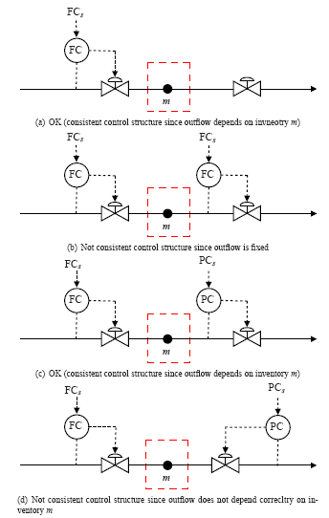

Consistent?
QUIZ 1
p₁
_{z}
p₂
Controlling pressure at outlet is possible, but not consistent! (m is uncontrolled)

Slide 11
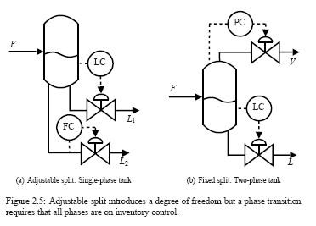
Flow split: May give extra DOF
Split: Extra DOF (FC)
Flash: No extra DOF
TPM
TPM

Slide 12
Closed system: Must leave one inventory uncontrolled
Control smallest inventory!
(b) is best if m₁ is large

Slide 13
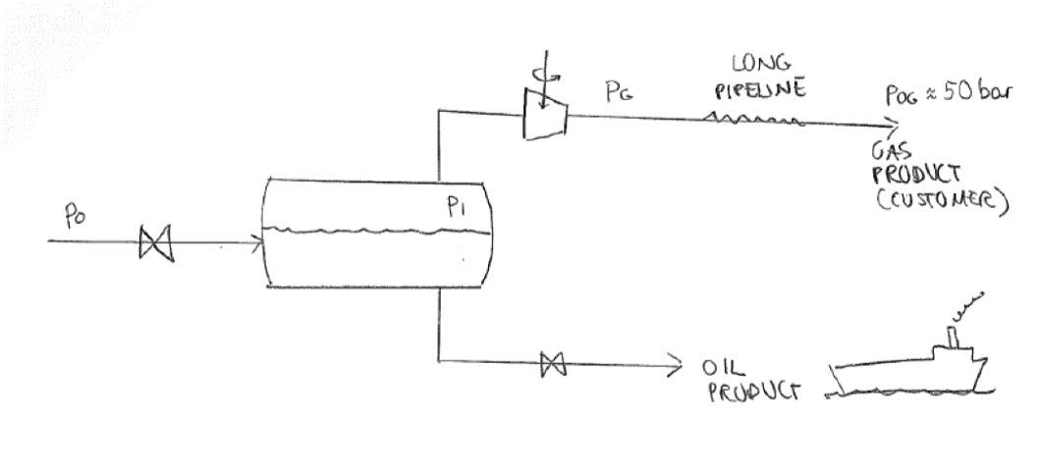
Example: Separator control
(oil-gas separation offshore)

Slide 14
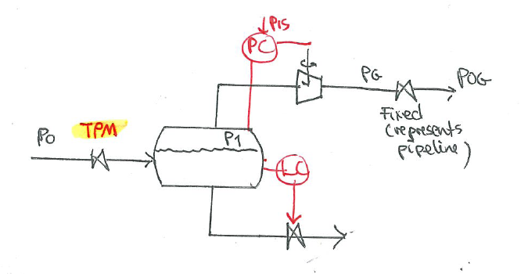
Example: Separator control
Alternative TPM locations
Compressor could be replaced by valve if p₁>p_{G}

Slide 15
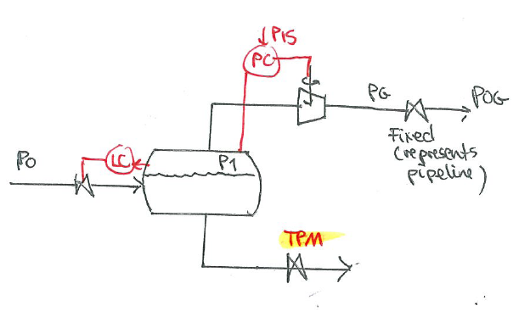
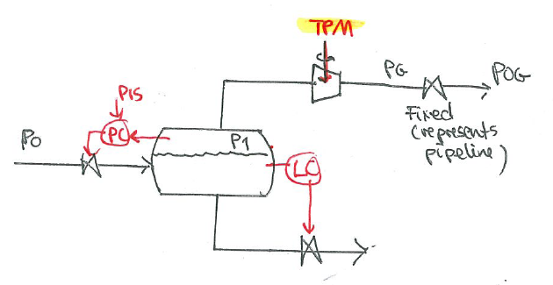
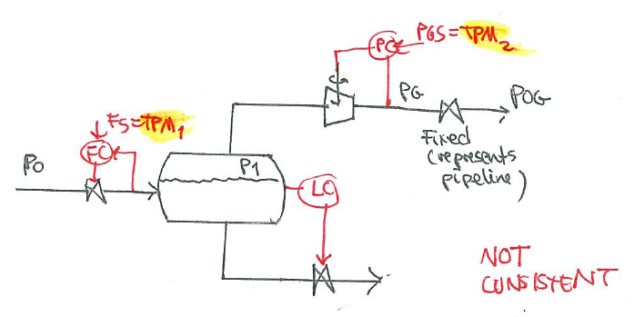
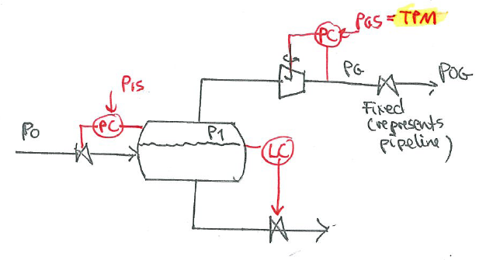
Alt.1
Alt.2
Alt.3
Alt.4
Similar to original but NOT CONSISTENT
(two TPMs)

Slide 16
Location of sensors
Location flow sensor (before or after valve or pump): Does not matter from consistency point of view
  Locate to get best flow measurement
    Before pump: Beware of cavitation
    After pump: Beware of noisy measurement
Location of pressure sensor (before or after valve, pump or compressor): important from consistency point of view

Slide 17
General consistency rule
Inventory loop must not cross TPM
Rule applies also to case with «long loops», which is when we don’t try have local consistency.

Slide 18
FC
PC
FC
PC
PC
FC
FC
PC
PC
FC
For each of the five structures; Where is the TPM? Is it consistent?

Slide 19
FC
PC
Solution according to radiation rule
TPM
NO
FC
PC
TPM
YES
PC
FC
TPM
NO
FC
PC
YES
(it does not matter where the flow is measured; the valve determines the location of the TPM)
TPM
PC
FC
YES
TPM
Note: Can never control pressure at ends (upstream first control valve or downstream last valve)!

Slide 20
FC
PC
PC
FC
PC
FC
FC
PC
FT
PT
Same sensor location as case 3.
Can you control both flow and
pressure using valves 1 and 2,
Valves 2 and 3?
1
2
3
Some more. For each of the five structures; Where is the TPM? Is it feasible?

Slide 21
FC
PC
TPM
NO
PC
FC
NO. Rule:
Another loop
cannot cross the TPM,
TPM
PC
FC
NO, cannot cross TPM
TPM
FC
PC
TPM
NO
FC
PC
YES. More possibilities,
4 possible, 2 impossible
TPM
Some more. For each of the five structures; Where is the TPM? Is it feasible?

Slide 22
Where should we place the TPM? (Dynamics!)
TPM = MV used to control throughput
Traditionally: TPM = Main feed valve (or pump/compressor)
  Gives inventory control “in direction of flow”
Consider moving TPM if:
There is an important CV that could otherwise not be well controlled
  Special case: Max. production is important: Locate TPM at process bottleneck* !
    TPM can then be used to achieve tight bottleneck control (= achieve max. production)
    Economics: Max. production is very favorable in “sellers marked”
If placing it at the feed may yield infeasible operation (“overfeeding”)
  If “snowballing” is a problem (accumulation in recycle loop), then consider placing TPM inside recycle loop
BUT: Avoid a variable that may (optimally) saturate as TPM (unless it is at bottleneck)
  Reason: To keep controlling CV=throughput, we would need to reconfigure (move TPM)**
*Bottleneck: Last constraint to become active as we increase throughput -> TPM must be used for bottleneck control
**Input saturation pairing rule (to reduce need for reassigning loops): “Pair MV that may (optimally) saturate with CV that may be given up”
Notes:
Stopped here

Slide 23
Often optimal: Locate TPM at bottleneck!
"A bottleneck is a unit where we reach a constraint which makes further increase in throughput infeasible"
If feed is cheap and available: locate TPM at bottleneck (dynamic reasons)
If the flow for some time is not at its maximum through the bottleneck, then this loss can never be recovered.

Slide 24
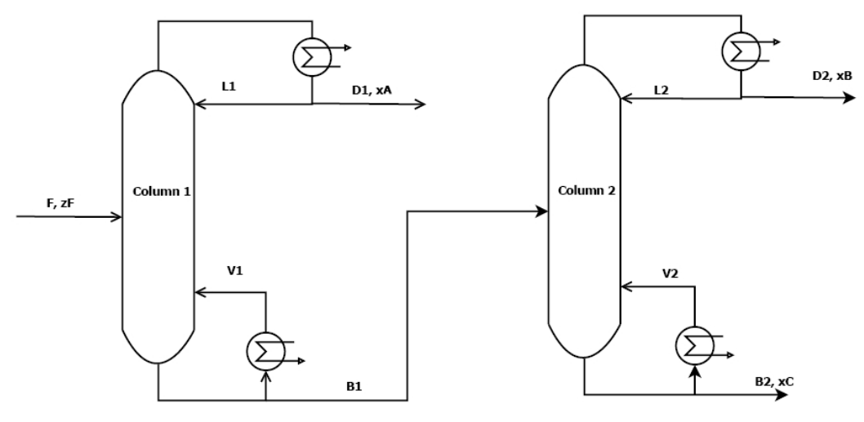
Example: two distillation columns in series
4 steady-state DOFs
TPM

Slide 25

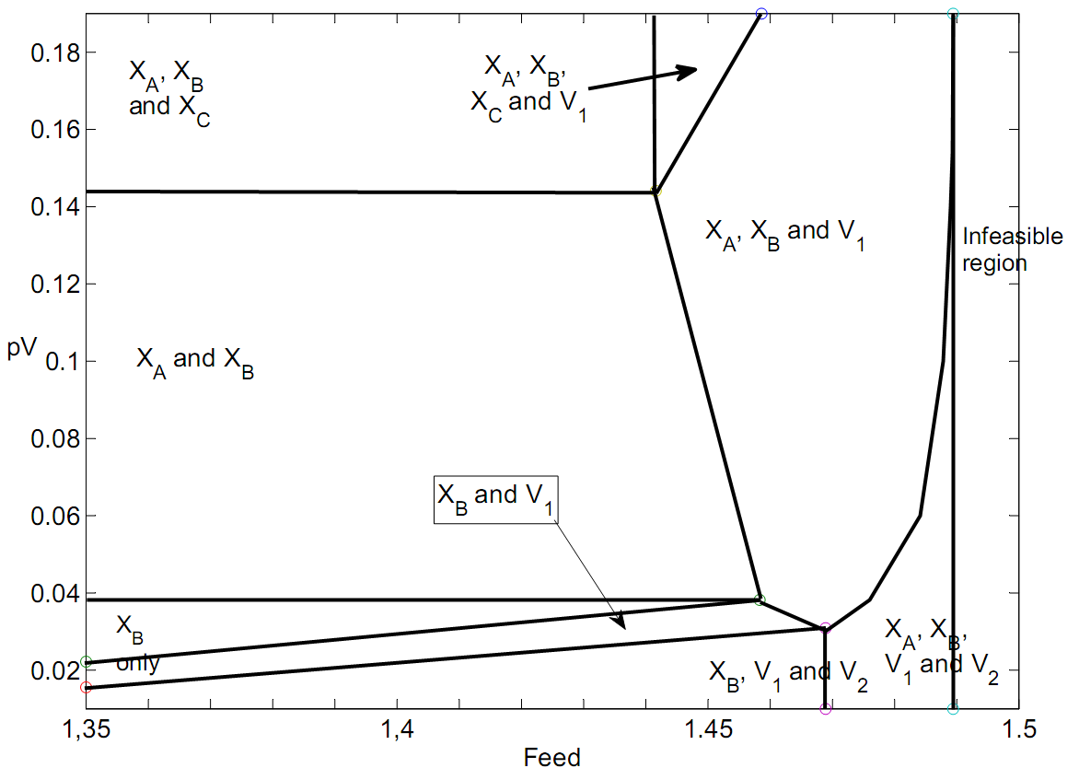
Active constraint regions for two distillation columns in series
Energy
price
[$/mol]
x_{A}, x_{B}, x_{C},
V₁ and V₂
0
1
[mol/s]
operate at BOTTLENECK
Higher F infeasible because
all 5 constraints reached

Slide 26
Control of distillation columns
Energy price = 0.02$/mol (low)
PC
PC
LC
LC
Overpurified
CC
TPM
Self-optimizing:
x_{A,opt} = 2%
x_{B,s} = 95%
CC
F = 1.45 mol/s
MAX
MAX
LC
LC
Overpurified
Overpurified: To avoid loss of valuable product B

Slide 27
Increase feedrate: reach x_{A} constraint
PC
PC
LC
LC
CC
CC
TPM
x_{A,s} = 95%
x_{B,s} = 95%
F = 1.48 mol/s
MAX
MAX
LC
LC
Overpurified
Implement: Use Max-selector for L1

Slide 28
Increase feedrate further: reach also x_{C} constraint → infeasible
PC
PC
LC
LC
CC
CC
TPM
x_{A,s} = 95%
x_{B,s} = 95%
F = 1.50 mol/s
MAX
MAX
LC
LC
x_{C} UNCONTROLLED!
Will drop below 95% C if F gets too large

Slide 29
Feasible operation with 5 constraints (process bottleneck): TPM as MV
PC
PC
LC
LC
CC
CC
TPM
x_{A,s} = 95%
x_{B,s} = 95%
MAX
MAX
LC
LC
CC
«long loop»
x_{C,s} = 95%
Implement: Use Min-selector for F
Possible solution to avoid long loop: Move TPM to B1 =feed column 2 (and change LC in column 1)
Comment: This may be undesirable because there is a delay from feed to bottom level (typically 1 min)

Slide 30
Can we find a simple structure
(with selectors) that works in all regions? I don’t think so
Energy
price
[$/mol]
x_{A}, x_{B}, x_{C},
V₁ and V₂
0
1
[mol/s]
operate at BOTTLENECK
Higher F infeasible because
all 5 constraints reached
Need to find self-optimizing variables for remaining unconstrained DOFs in all regions

Slide 31
«Long loop»
Loop that depends on other loops being closed to work
Typical case: pair variables with process gain = 0 (open loop)

Slide 32
Single-loop alternatives for bottleneck control
Bottleneck.
Want max flow here
Traditional: Manual control of feed rate
TPM
Alt.1. Feedrate controls bottleneck flow (“long loop”…):
F_{max}
FC
TPM
Alt. 2: Feedrate controls lost task (another “long loop”…):
F_{max}
TPM
Alt. 3: Reconfigure all upstream inventory loops:
Alt. 3 can be done automatically! Will come back to this later!
F_{max}
TPM
Notes:
Consistency??

Slide 33
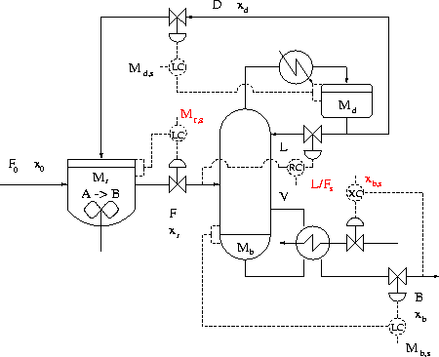
EXAMPLE: Recycle plant (Luyben, Yu, etc.)
Recycle of unreacted A (+ some B)
5
Feed of A
4
1
2
Given feedrate F₀ and
column pressure:
3
Product (98.5% B)
Dynamic DOFs: N_{m} = 5
Column levels: N_{0y} = 2
Steady-state DOFs: N₀ = 5 - 2 = 3

Slide 34
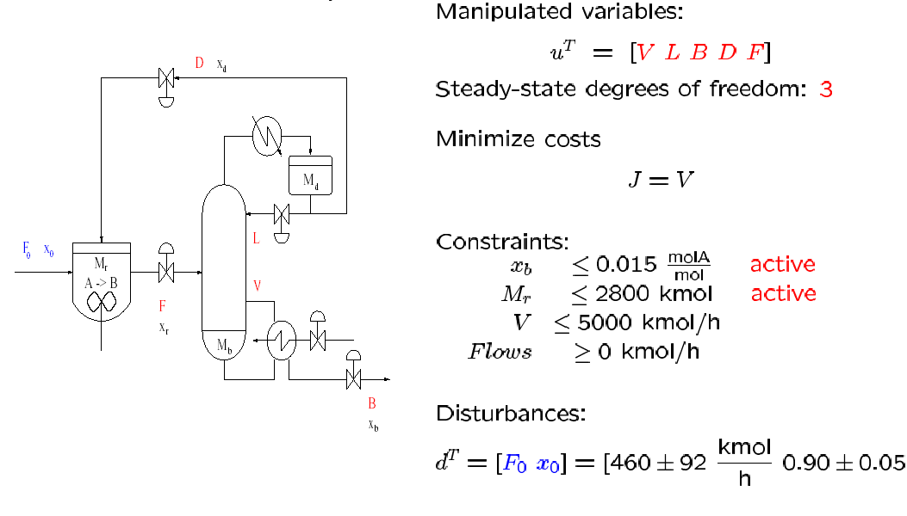
Recycle plant: Optimal operation
1 remaining unconstrained degree of freedom

Slide 35
Control of recycle plant
Active constraint
M_{r} = M_{rmax}
Self-optimizing
L/F constant: Easier than “two-point” control
Assumption: Minimize energy (V)
Active constraint
x_{B} = x_{Bmin}

Slide 36
Modified Luyben’s law to avoid snowballing
Luyben law no. 1 (“Plantwide process control”, 1998, pp. 57): “A stream somewhere in all recycle loops must be flow controlled”
Luyben rule is OK dynamically (short time scale)…
BUT economically (steady-state): Recycle should increase with throughput
Modified Luyben’s law 1 (by Sigurd): “Consider moving the TPM inside the recycle loop”

Slide 37
NOTE: There are actually two recycles!
One through the reactor (D or F)
One through the column (L)
One flow inside both recycle loops: V
Alternative: TPM=V if we want to break both recycle loops!
PC
TC

Slide 38
Changing TPM to V
PC
LC
Simulations (to be done) confirm
This is the best!
LC
XC
L
L and F for composition control: OK!
TC
F
TPM
LC
XC

Slide 39
What about keeping V constant?
(in addition to having another TPM)
PC
LC
TPM
L
NO! Never control cost J=V
LC
F0
TC
F
V
LC
XC

Slide 40
Conclusion TPM (production rate manipulator)
Think carefully about where to place it!
Difficult to undo after design

Slide 41
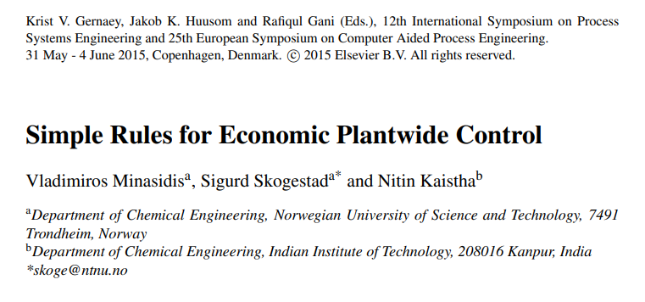
Summary: Rules for plantwide control
Here we present a set of simple rules for economic plantwide control to facilitate a close-to-optimal control structure design in cases where the optimization of the plant model is not possible.
The rules may be conflicting in some cases and in such cases, human reasoning is strongly advised.
https://folk.ntnu.no/skoge/publications/2015/minasidis-pse-escape-2015/

Slide 43
Rule 1: Control the active constraints.
In general, process optimization is required to determine the active constraints, but in many cases these can be identified based on a good process knowledge and engineering insight. Here is one useful rule:
Rule 1A: The purity constraint of the valuable product is always active and should be controlled.
This follows, because we want to maximize the amount of valuable product and avoid product “give away” (Jacobsen and Skogestad, 2011). Thus, we should always control the purity of the valuable product at its specification.
For “cheap” products we may want to overpurify (purity constraint may not be active) because this may reduce the loss of a more valuable component.
In other cases, we must rely on our process knowledge and engineering insight. For reactors with simple kinetics, we usually find that, the reaction and conversion rates are maximized by operating at maximum temperature and maximum volume (liquid phase reactor). For gas phase reactor, high pressure may increase the reaction rate, but this must be balanced against the compression costs.
Rules for Step S3: Selection of primary (economic) controlled variables, CV1

Slide 44
Rule 2: Control “self-optimizing” variables (for remaining unconstrained DOFs).
This choice is usually not obvious, as there may be several alternatives, so this rule is in itself not very helpful. The ideal self-optimizing variable, at least, if it can be measured accurately, is the gradient of the cost function. Ju, which should be zero for any disturbance. Unfortunately, it is rarely possible to measure this variable directly and the “self-optimizing” variable may be viewed as an estimate of the gradient Ju
The two main properties of a good “self-optimizing” (CV1=c=Hy) variable are:
Its optimal value is insensitive to disturbances (such that the optimal sensitivity dc_{opt}/dd =F^{c} = HF = is small)
It is sensitive to the plant inputs (so the process gain dc/du = G = HG^{y} is large).
The following rule shows how to combine the two desired properties:
Rule 2A: Select the set CV1=c such that the ratio G⁻¹F^{c} is minimized.
This rule is often called the “maximum scaled gain rule”.

Slide 45
Rule 3: Never try to control the cost J
(or any other variable that reaches a maximum or minimum at the optimum)
First, the cost function J has no sensitivity to the plant inputs at the optimal point and so G = 0 which violates Rule 2A.
Second, if we specify J lower than its optimal value, then clearly, the operation will be infeasible
Also, specifying J higher than its optimal value is problematic, as we have multiplicity of solutions. As mentioned above, rather controlling the cost J, we should control its gradient, Ju.
J
J>J_{min}
J_{min}
J<J_{min}
?
u

Slide 46
Rule 4: Locate the TPM close to the process bottleneck
The justification for this rule is to take advantage of the large economic benefits of maximizing production in times when product prices are high relative to feed and energy costs (Mode 2). To maximize the production rate, one needs to achieve tight control of the active constraints, in particular, of the bottleneck, which is defined as the last constraint to become active when increasing the throughput rate (Jagtap et al., 2013).
Rules for Step S4: Location of throughput manipulator (TPM)

Slide 47
Rule 5: Locate the TPM inside the recycle loop, if there is one.
The point is to avoid “overfeeding” the recycle loop which may easily occur if we operate close to the throughput where “snowballing” in the recycle loop occurs. This is a restatement of Luyben’s rule “Fix a Flow in Every Recycle Loop” (Luyben et al., 1997). From this perspective, snowballing can be thought of as the dynamic consequence of operating close to a bottleneck which is within a recycle system.
In many cases, the process bottleneck is located inside the recycle loop and Rules 4 and 5 give the same result.

Slide 48
Rule 6: Arrange the inventory control loops around the TPM location according to the radiation rule.
The radiation rule (Price et al., 1994), says that the inventory loops upstream of the TPM location must be arranged opposite of flow direction. For flow downstream of TPM location it must be arranged in the same direction. This ensures “local consistency”, i.e., all inventories are controlled by their local in or outflows.
Rules for Step S5: Structure of regulatory control layer.

Slide 49
Rule 7: Select “sensitive/drifting” variables as controlled variables CV 2 for regulatory control
This will generally include inventories (levels and pressures), plus certain other drifting (integrating) variables, for example, a reactor temperature or a sensitive temperature in a distillation column. This ensures “stable operation, as seen from an operator’s point of view.
Some component inventories may also need to be controlled, especially for recycle systems. For example, according to “Down’s drill” one must make sure that all component inventories are “self-regulated” by flows out of the system or by removal by reactions, otherwise their composition may need to be controlled (Luyben, 1999).

Slide 50
Rule 8: Economically important active constraints should be selected as controlled variables CV 2 in the regulatory layer
Economic variables CV 1 are generally controlled in the supervisory layer. Moving them to the faster regulatory layer may ensure tighter control with a smaller backoff. The backoff is the difference between the actual average value (setpoint) and the optimal value (constraint).

Slide 51
Rule 9: “Pair-close” rule: The pairings should be selected such that, effective delays and loop interactions are minimal.

Slide 52
Rule 10: : Avoid using MVs that may optimally saturate (at steady state) to control CVs in CV 2.
The reason is that we want to avoid re-configuring the regulatory control layer. To follow this rule, one needs to consider also other regions of operation than the nominal, for example, operating at maximum capacity (Mode 2) where we usually have more active constraints.

Slide 53
Rule 11: MVs that may optimally saturate (at steady state) should be paired with the subset of CV 1 that may be given up.
This is the «input saturation pairing rule»
This rule applies for cases when we use decentralized control in the supervisory layer and we want to avoid reconfiguration of loops. The rule follows because when a MV optimally saturates, then, there will be one less degree of freedom, so there will be a CV1 which may be given up without any economic loss. The rule should be considered together with rule 10.

Slide 54
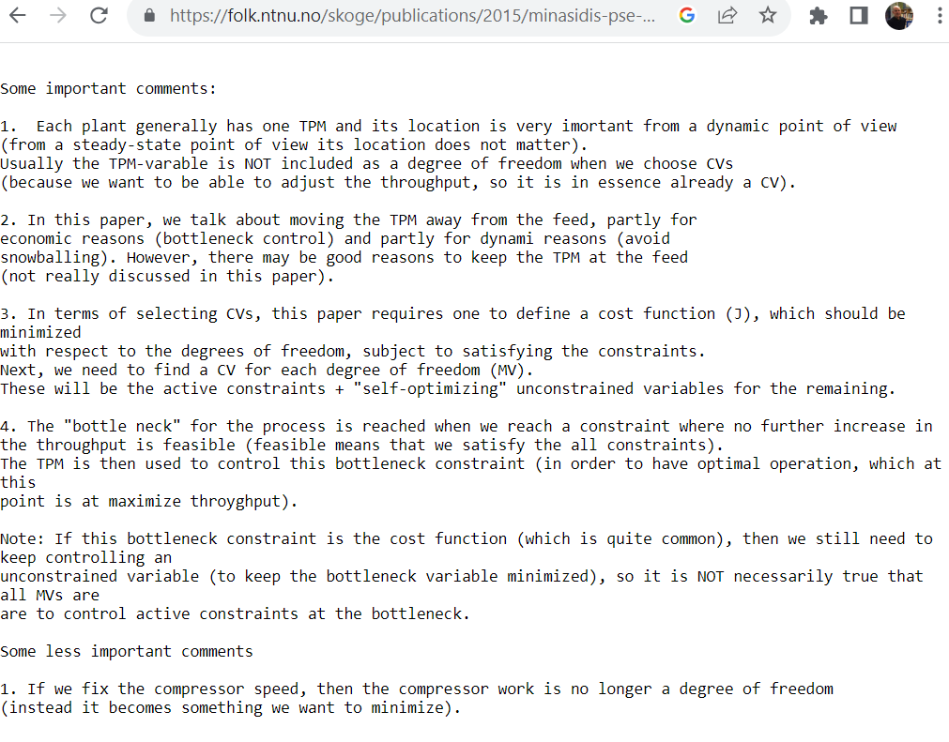

Slide 55
Plantwide control. Other references
The following paper summarizes the procedure:
  S. Skogestad, ''Control structure design for complete chemical plants'', Computers and Chemical Engineering, 28 (1-2), 219-234 (2004).
There are many approaches to plantwide control as discussed in the following review paper:
  T. Larsson and S. Skogestad, ''Plantwide control: A review and a new design procedure'' Modeling, Identification and Control, 21, 209-240 (2000).
The following paper updates the procedure:
  S. Skogestad, ''Economic plantwide control'', Book chapter in V. Kariwala and V.P. Rangaiah (Eds), ''Plant-Wide Control: Recent Developments and Applications'', Wiley (2012).
More information:
http://www.nt.ntnu.no/users/skoge/plantwide
All papers available at: http://www.nt.ntnu.no/users/skoge/

