Slide 1
PID tuning using the SIMC rule
Sigurd Skogestad

Slide 2
Lecture outline
SIMC rule for first order systems
Closed loop tuning
Half-rule for higher order models

Slide 3
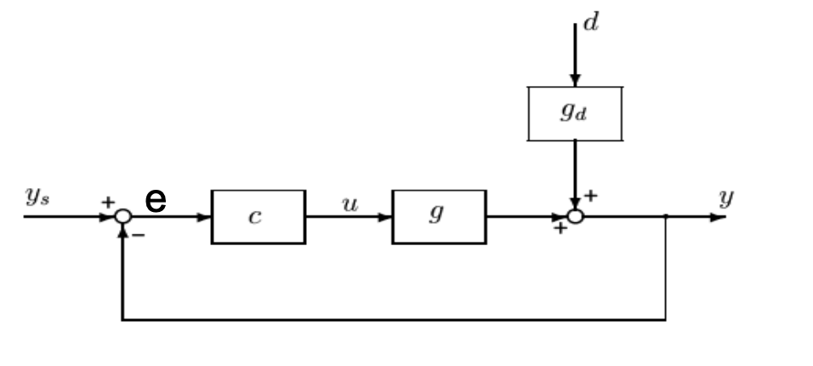
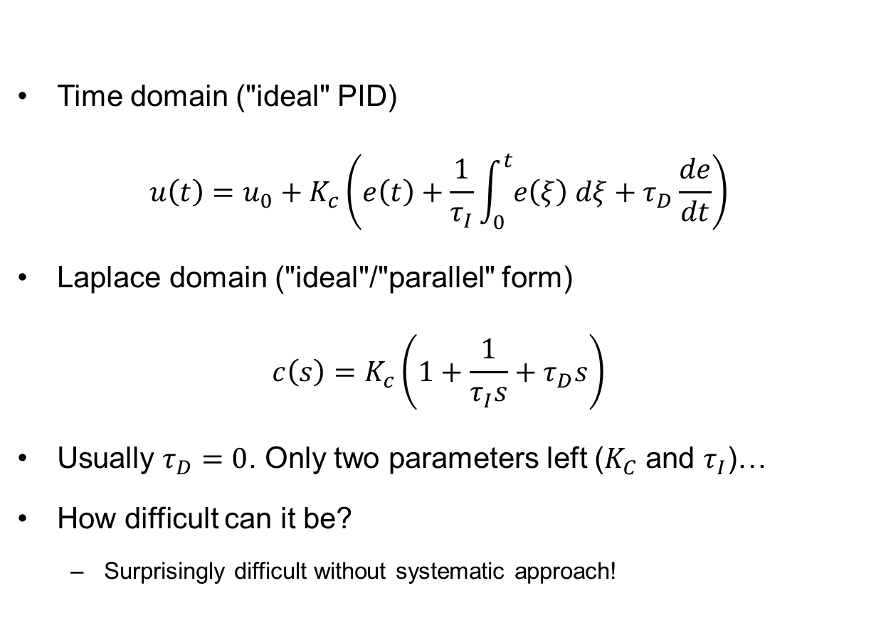
PID controller
Time domain ("ideal" PID)
$$u\left(t\right)=u_{0}+K_{c}\left(e\left(t\right)+\frac{1}{τ_{I}}\int_{0}^{t}{e\left(ξ\right) dξ}+τ_{D}\frac{de}{dt}\right)$$
Laplace domain ("ideal"/"parallel" form)
$$c\left(s\right)=K_{c}\left(1+\frac{1}{τ_{I}s}+τ_{D}s\right)$$
Usually $τ_{D}=0$. Only two parameters left ($K_{C}$ and $τ_{I}$)…
How difficult can it be?
  Surprisingly difficult without systematic approach!

Slide 4
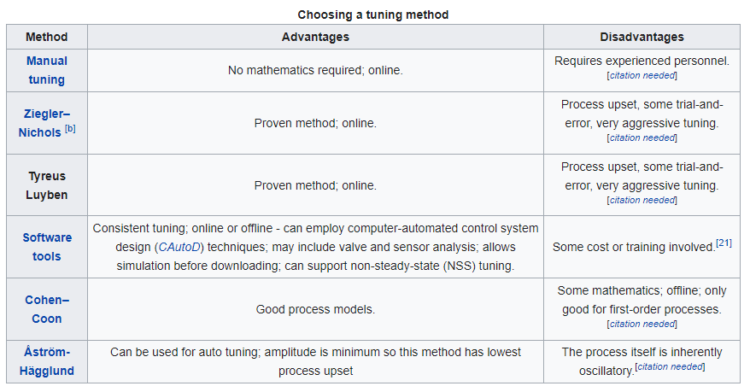
PID tuning – wikipedia
No, less agressive
Version of ZN
BAD
method
??
SIMC Has tuning parameter, analytically derived, works also on The process must not be
delay processes(where ZN does not work) oscillatory
https://en.wikipedia.org/wiki/PID_controller#Loop_tuning
Hm…. SIMC tuning is not mentioned – maybe someone can update wiki

Slide 5
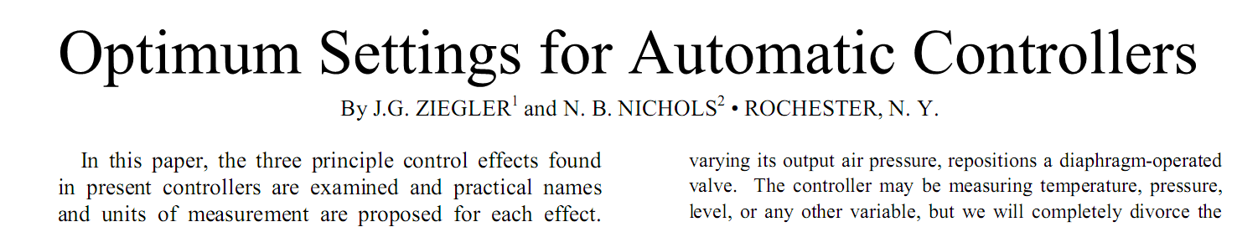
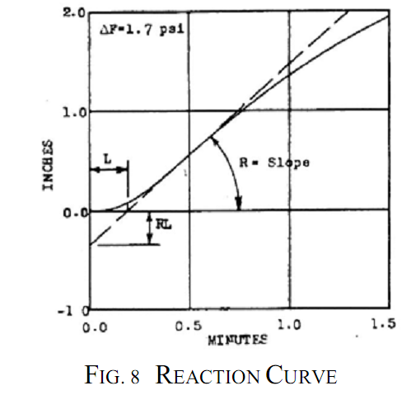
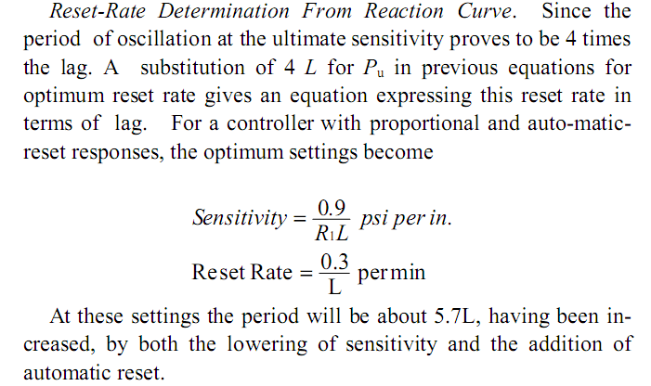
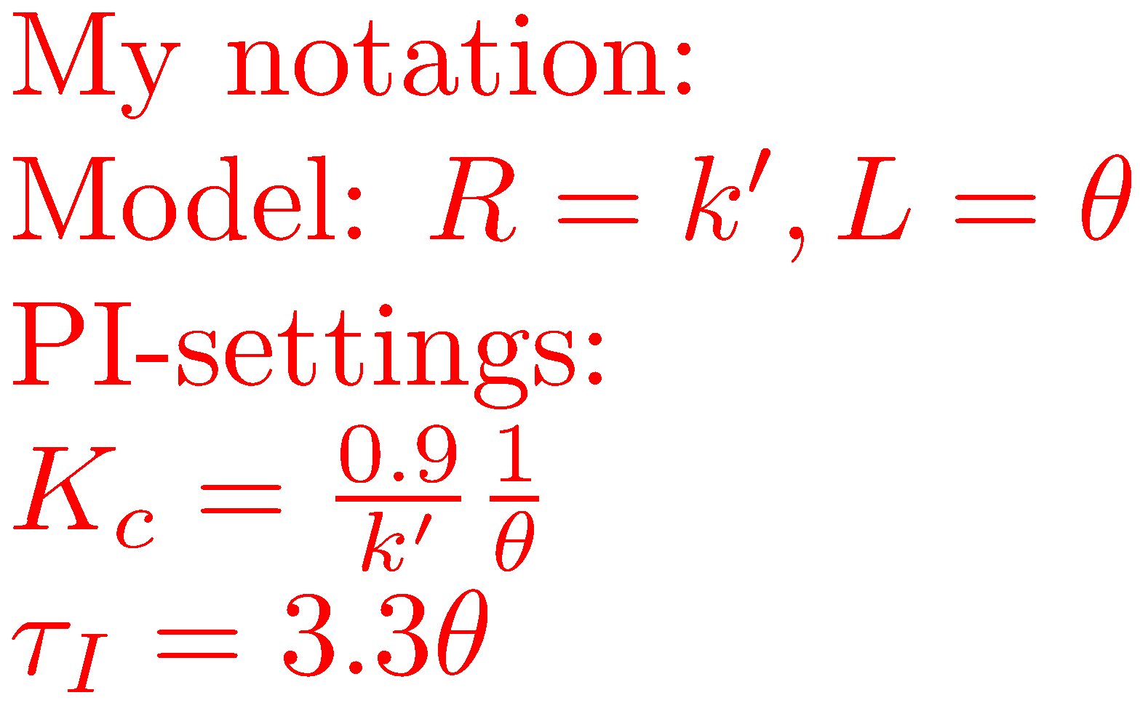
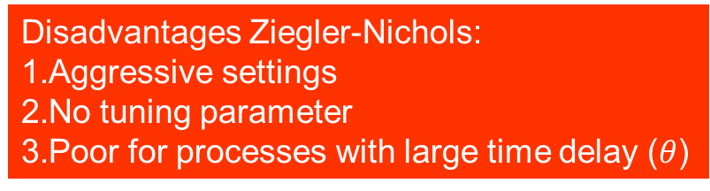
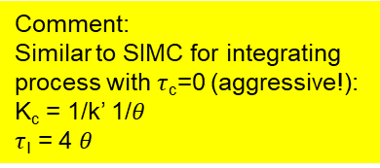
Trans. ASME, 64, 759-768 (Nov. 1942).
Disadvantages Ziegler-Nichols:
Aggressive settings
No tuning parameter
Poor for processes with large time delay ($θ$)
Comment:
Similar to SIMC for integrating process with $τ$_{c}=0 (aggressive!):
K_{c} = 1/k’ 1/$θ$
$τ$_{I} = 4 $θ$

Slide 6
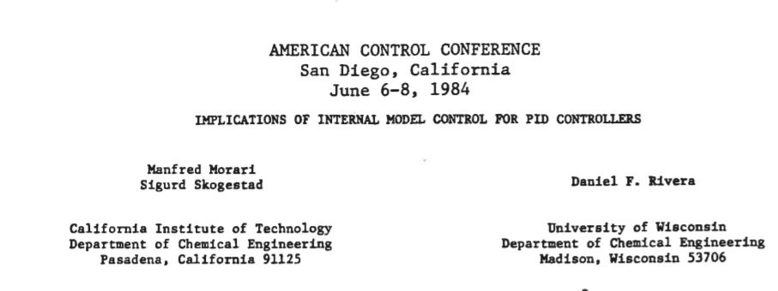
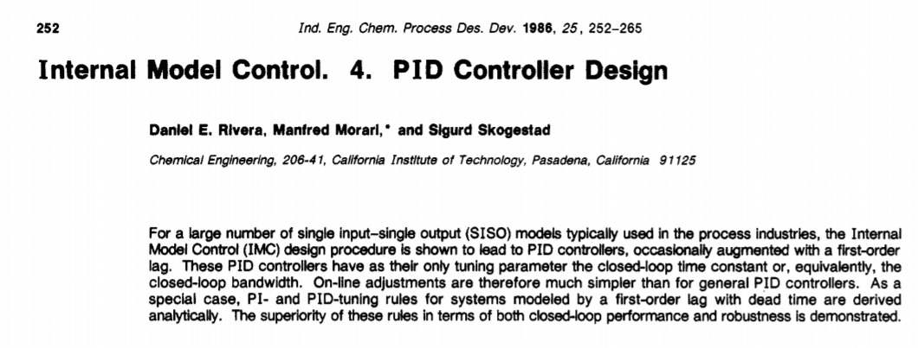

Slide 7
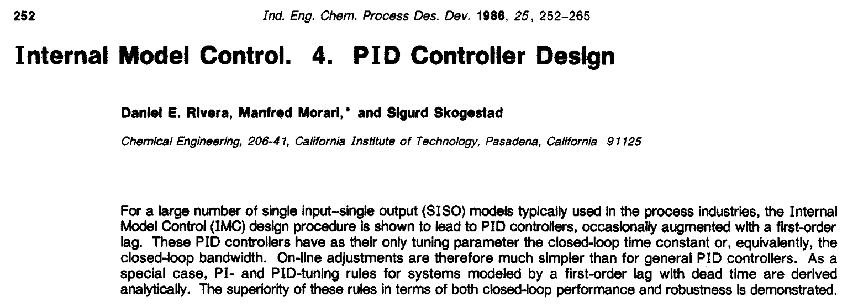
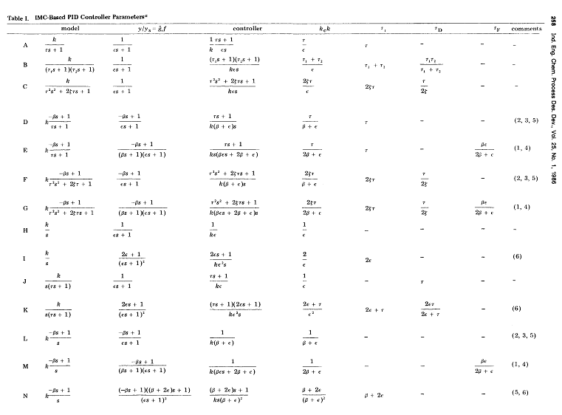
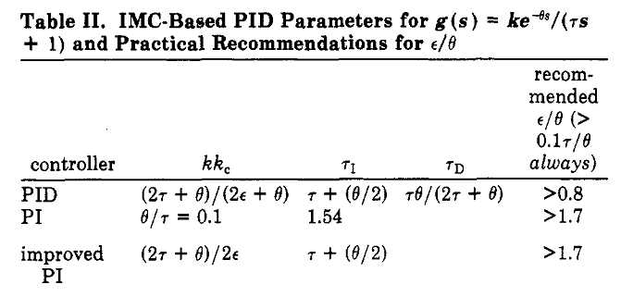
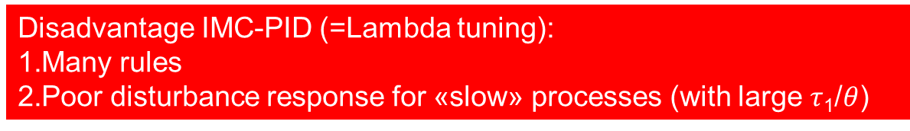
Disadvantage IMC-PID (=Lambda tuning):
Many rules
Poor disturbance response for «slow» processes (with large $τ$₁/$θ$)

Slide 8
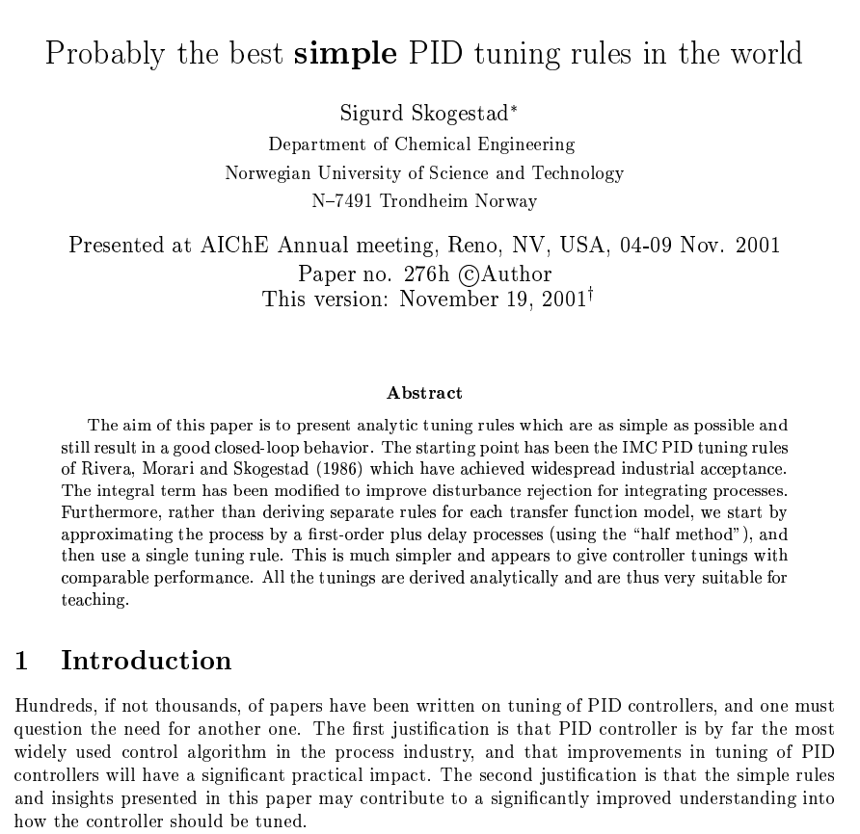


Slide 9
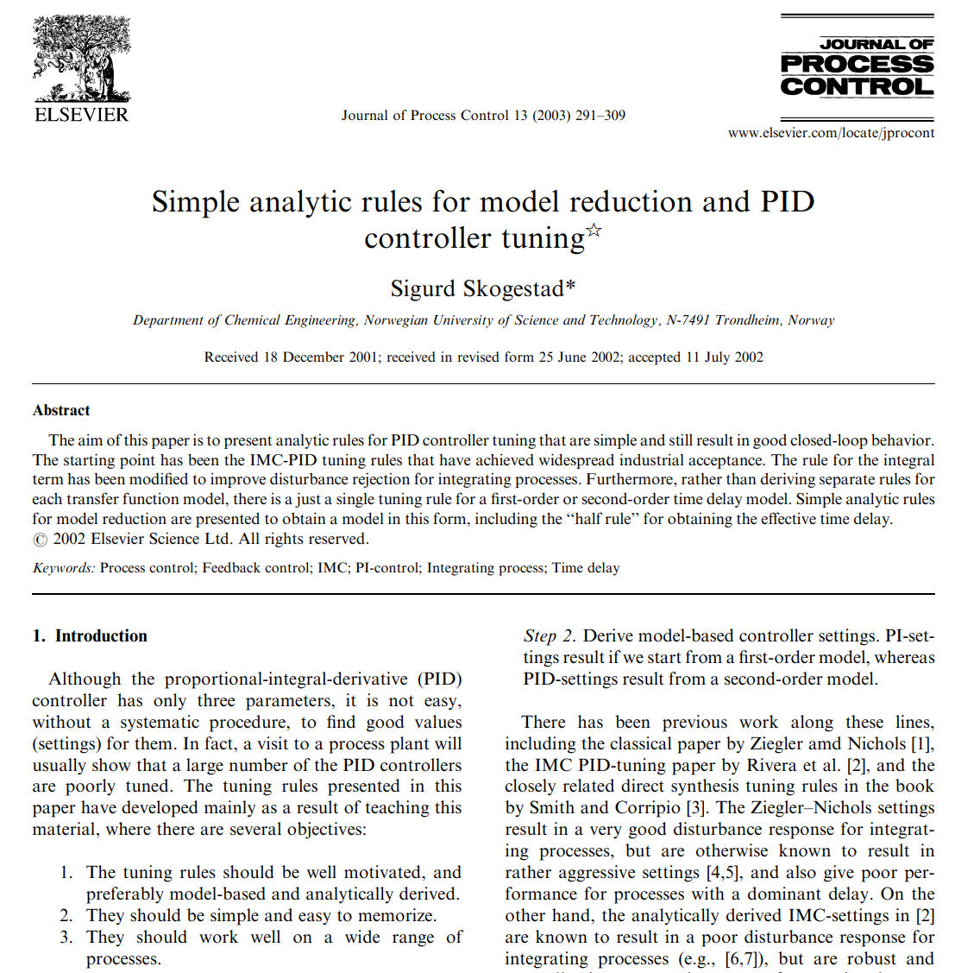

Slide 10
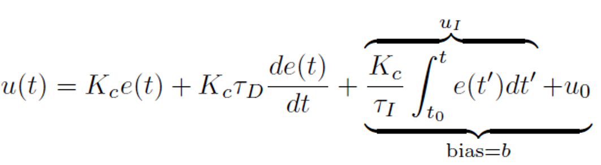
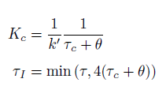
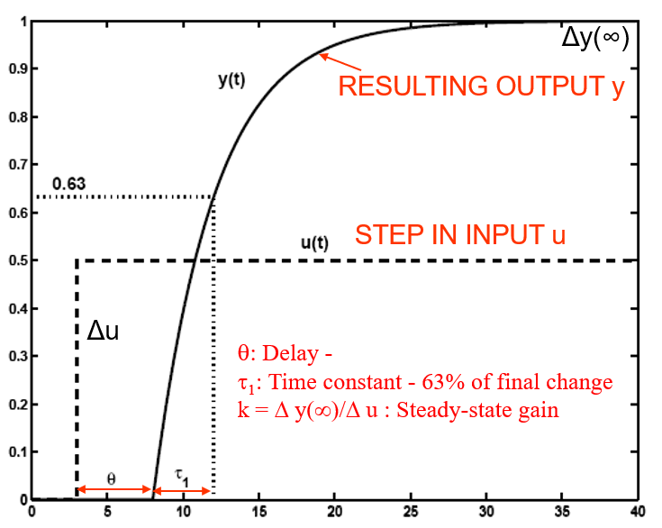

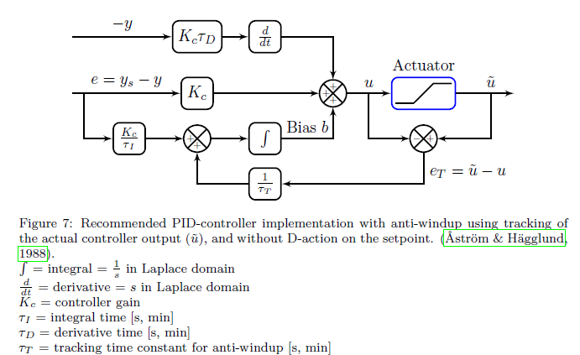
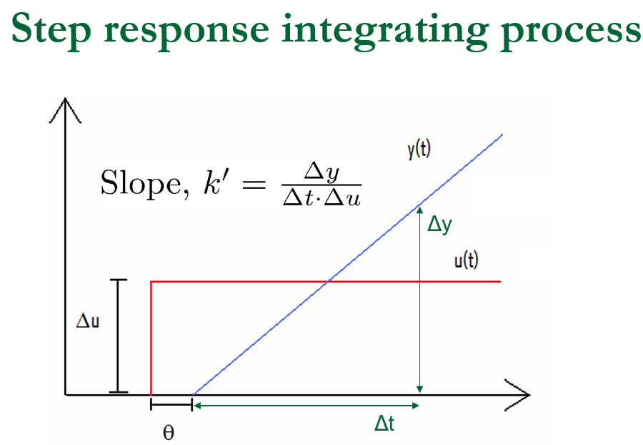
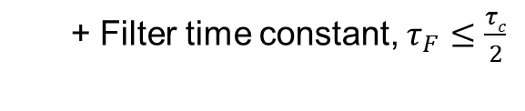
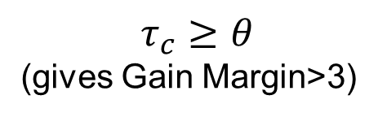
Summary SIMC PID tuning rule
Only one tuning parameter:
Closed-loop time constant:
$$τ_{c}≥θ$$
(gives Gain Margin>3)
1
+ Filter time constant, $τ_{F}≤\frac{τc}{2}$
With anti windup
k’=k/τ₁

Slide 11
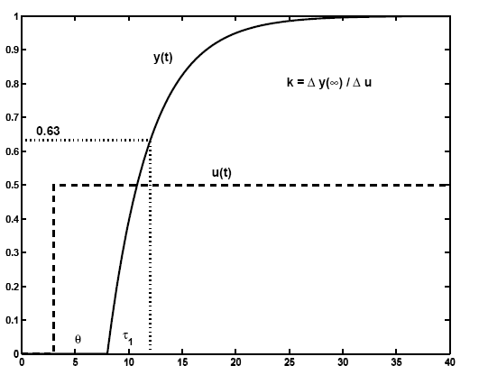
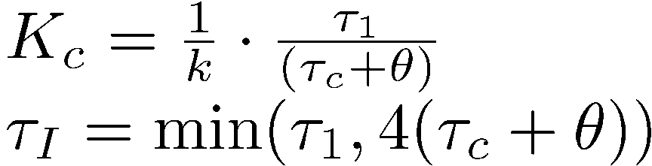
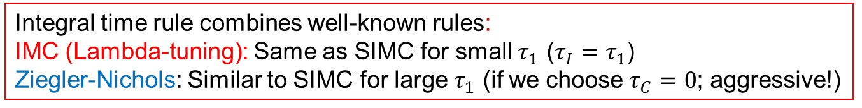
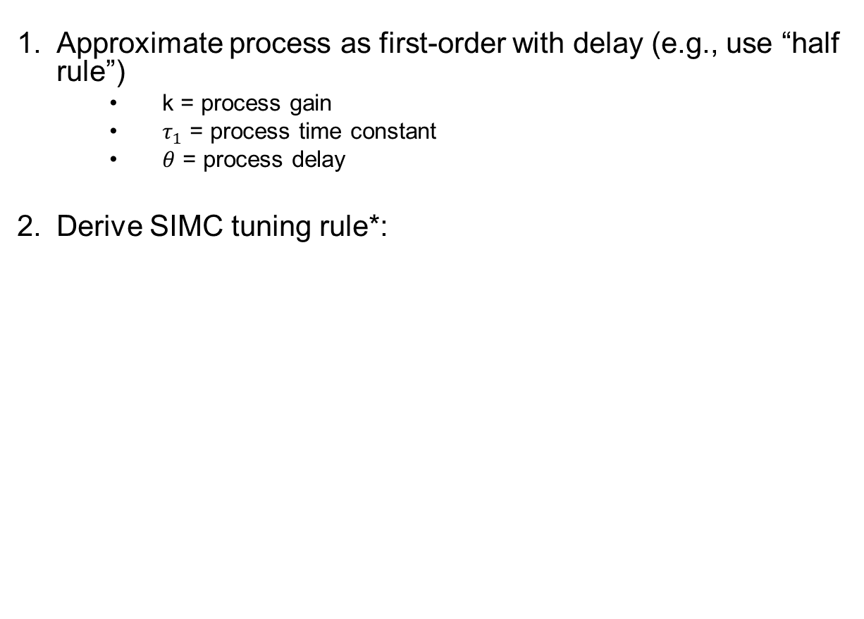
SIMC PI tuning rule
Approximate process as first-order with delay (e.g., use “half rule”)
    k = process gain
    $τ_{1}$ = process time constant
    $θ$ = process delay
Derive SIMC tuning rule*:
Open-loop step response
$τ_{C}≥θ$: Desired closed-loop response time (tuning parameter)
Integral time rule combines well-known rules:
IMC (Lambda-tuning): Same as SIMC for small $τ_{1}$ ($τ_{I}=τ_{1}$)
Ziegler-Nichols: Similar to SIMC for large $τ_{1}$ (if we choose $τ_{C}=0$; aggressive!)
S. Skogestad, “Simple analytic rules for model reduction and PID controller design”, J.Proc.Control, Vol. 13, 291-309, 2003
(*) “Probably the best simple PID tuning rules in the world”

Slide 12
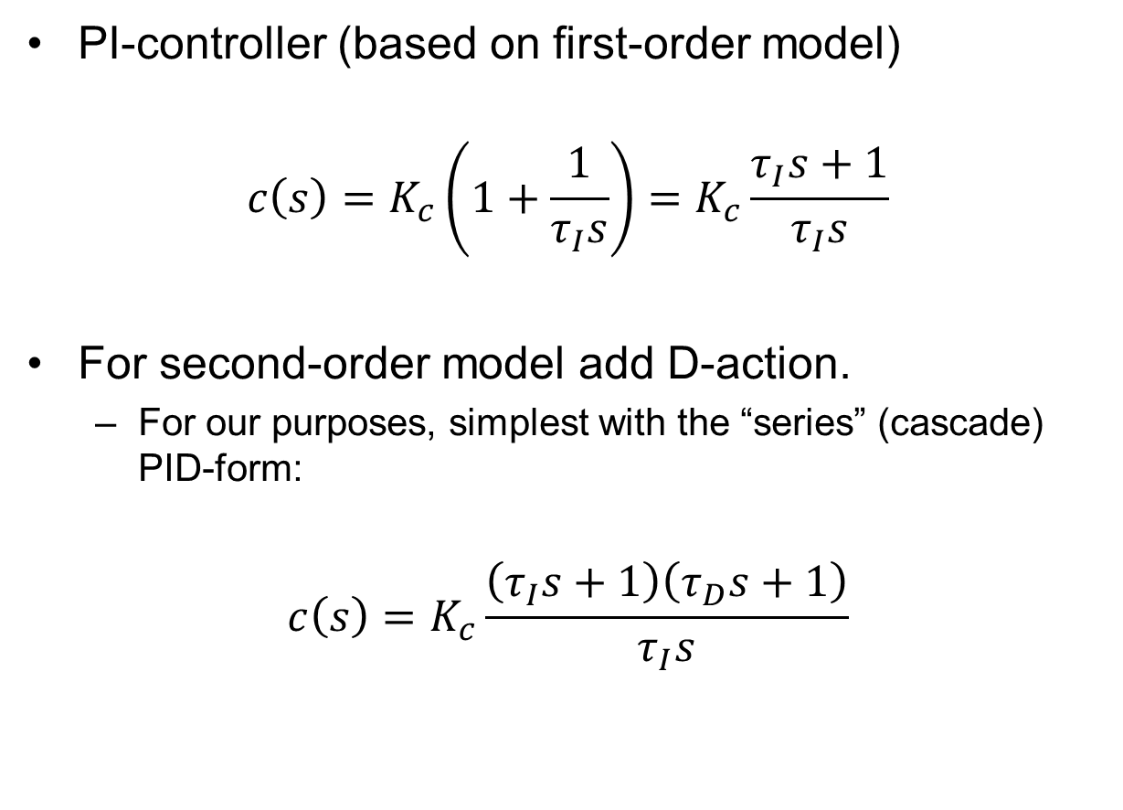
Derivation of SIMC-PID tuning rules
PI-controller (based on first-order model)
$$c\left(s\right)=K_{c}\left(1+\frac{1}{τ_{I}s}\right)=K_{c}\frac{τ_{I}s+1}{τ_{I}s}$$
For second-order model add D-action.
  For our purposes, simplest with the “series” (cascade) PID-form:
$$c\left(s\right)=K_{c}\frac{\left(τ_{I}s+1\right)\left(τ_{D}s+1\right)}{τ_{I}s}$$

Slide 13
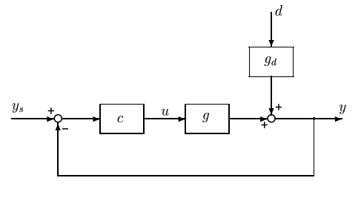

Basis: Direct synthesis (IMC)
Closed-loop response to setpoint change:
$$y=T y_{s}, T\left(s\right)=\frac{gc}{1+gc}$$
Idea: specify desired response $T$ and from this get the controller:
$$c=\frac{1}{g}⋅\frac{1}{\frac{1}{T}−1}$$
Notes:
Go to blackboard at this point!

Slide 14
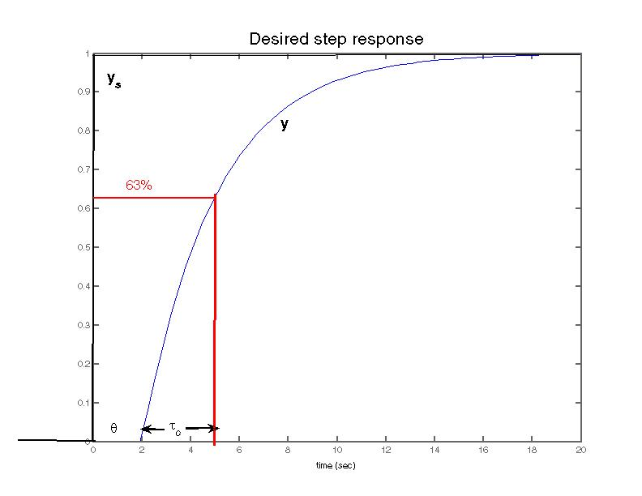
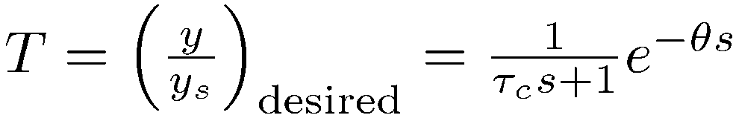
SIMC-tunings
Time delay is not really desired
but it cannot be avoided
NOTE: Setting the steady-state gain = 1 in T will result in integral action in the controller!

Slide 15
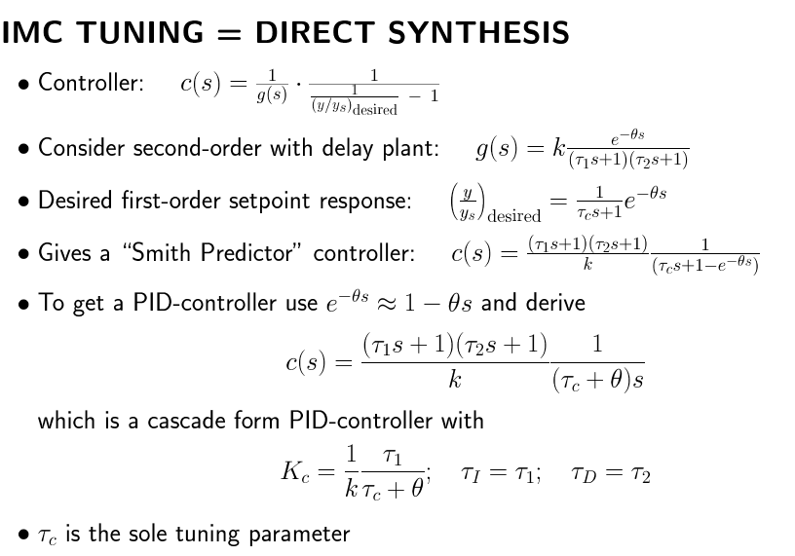
IMC Tuning = Direct Synthesis
SIMC-tunings
Algebra:
IMC-tuning is the same as “Lambda-tuning”: τ_{c} is sometimes called λ
Surprisingly, this PID-controller is generally better, or at least more robust with respect to changes in the time delay θ, than the Smith Predictor controller from which it was derived. We are lucky ☺.
Reference: Chriss Grimholt and Sigurd Skogestad. ''Should we forget the Smith Predictor?'' (2018)
In 3rd IFAC conference on Advances in PID control, Ghent, Belgium, 9-11 May 2018. In IFAC papers Online (2018) .

Slide 16
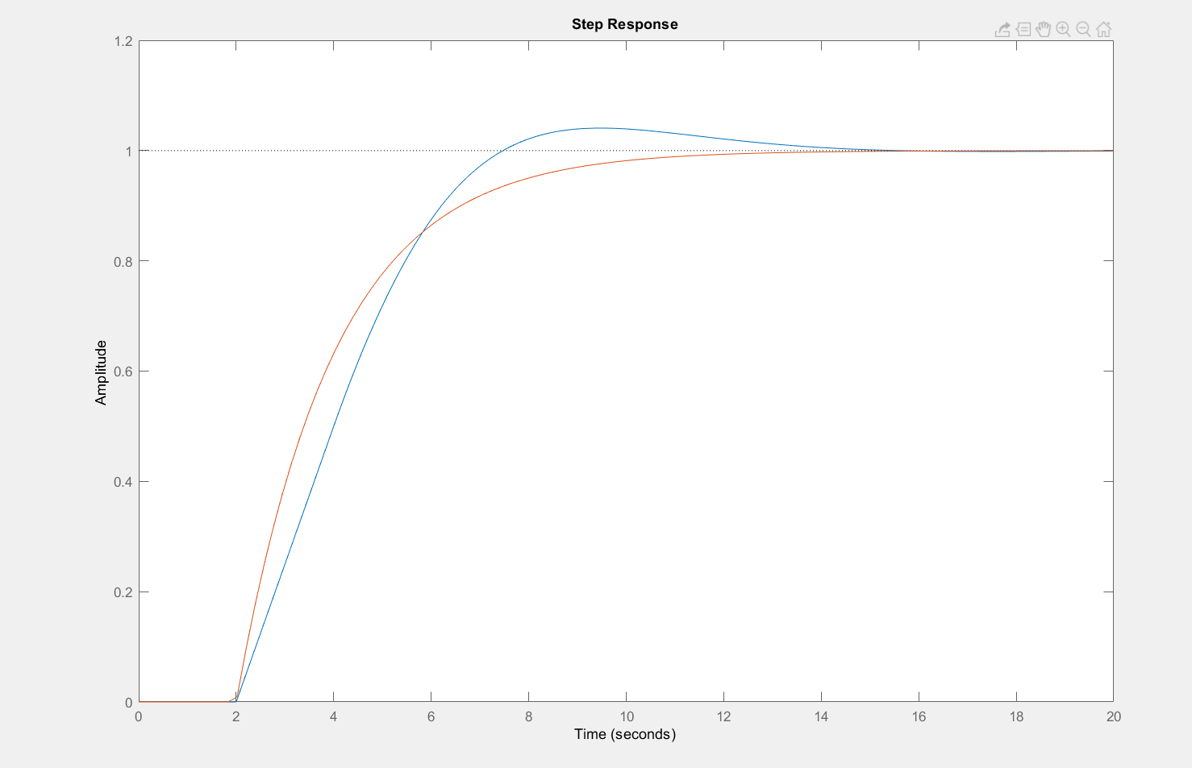
Example step setpoint response
(with choice τ_{c}=θ =2)
y (PI)
PI: Overshoot (y=1.04) is from approximation exp(-θs) $≈$ 1 - θs
Red: «ideal» = «originally desired» (with Smith Predictor)
s=tf(‘s’);
k=1; tau=10; theta=2;
g = k*exp(-theta*s)/(tau*s+1);
tauc=theta;
Kc=(1/k)*(tau/(tauc+theta)); % Kc=2.5
taui=tau;
c = Kc*(1+ 1/(taui*s));
T = g*c/(1+g*c);
Tideal = exp(-theta*s)/(tauc*s+1);
step(T,Tideal,20)

Slide 17
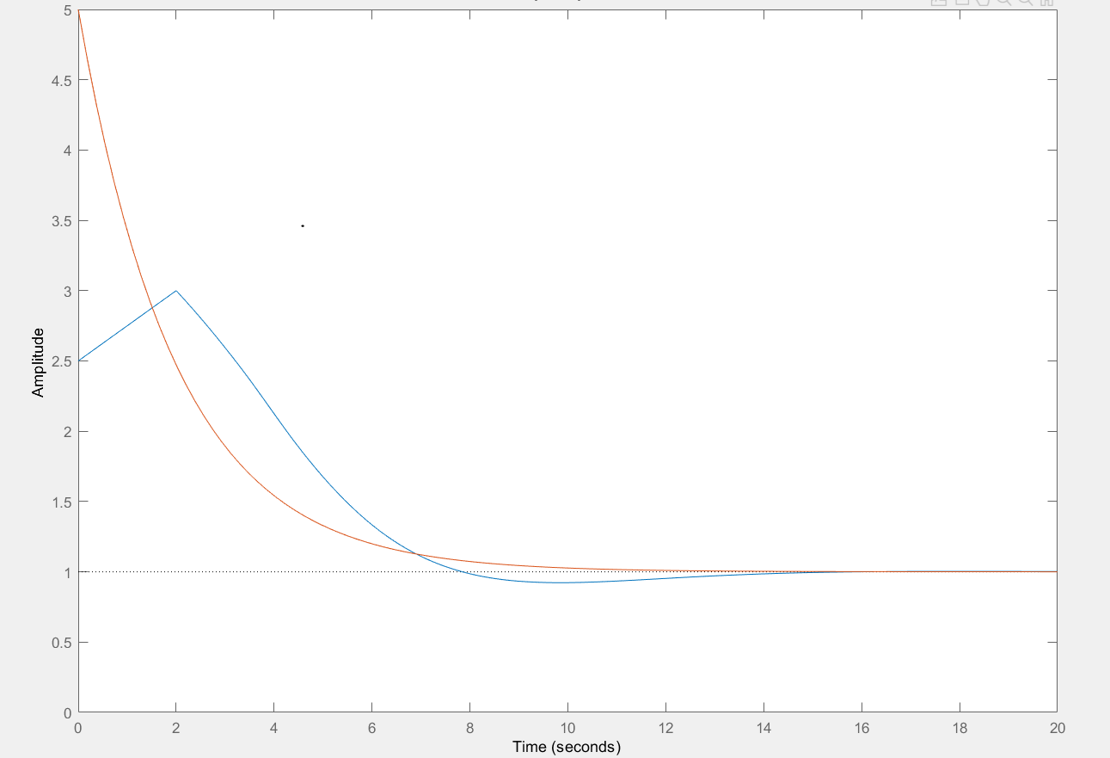
Input usage for setpoint response
Red: «ideal» (with Smith Predictor)
The process has a «natural» time constant τ=10, and we use control to «speed it up» to τ_{c}=2.
This is why we get an overshoot for the input
(for PI-control, u starts at 0, jumps up to K_{c}=2.5 and then I-action increases it to 3 at its peak, before settling at its steady-state value of 1).
u (PI)
%Input usage
figure(2);
KS = c/(1+g*c);
KSideal = (1/k)*(tau*s+1)/(tauc*s+1);
step(KS,KSideal,20);
axis([0 20 0 5])

Slide 18
Integral time
Found: Integral time = dominant time constant (τ_{I} = τ₁)
Gives P-controller for integrating process (τ_{I} = ∞)
  This works well for setpoint changes
  But: τ_{I} needs to be modified (reduced) for integrating disturbances
  Example. “Almost-integrating process” with disturbance at input:
  G(s) = e^{-s}/(30s+1)
    Original integral time τ_{I} = 30 gives poor disturbance response
    Try reducing it!
d
u
y
c
g

Slide 19
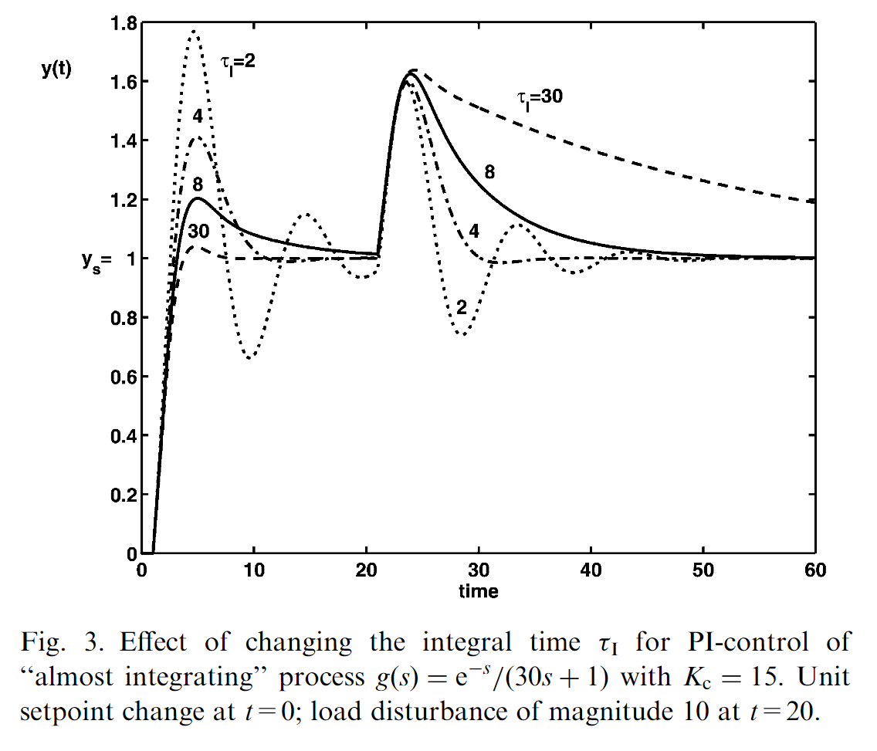
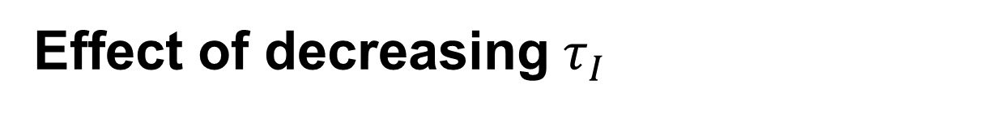
Effect of decreasing $τ_{I}$
SIMC
SIMC modification:
Decrease integral time to improve disturbance rejection
for slow processes (with large τ)!

Slide 20
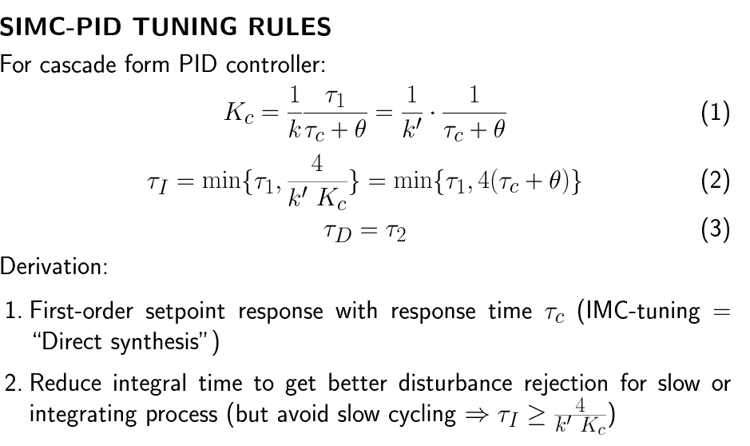
Conclusion: SIMC-PID Tuning Rules
One tuning parameter: τ_{c}

Slide 21
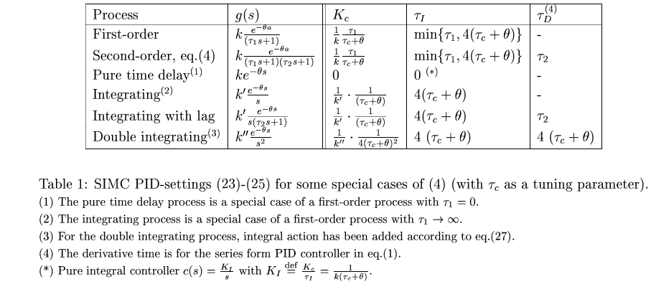
Some special cases
One tuning parameter: τ_{c}
(1)(*) Note that we get pure I-controller for static process with delay.

Slide 22
Selection of tuning parameter τ_{c}
Two main cases
TIGHT CONTRO L: Want “fastest possible control” subject to having good robustness
    Want tight control of active constraints (“squeeze and shift”)
SMOOTH CONTROL: Want “slowest possible control” subject to acceptable disturbance rejection
    Prefer smooth control if fast control is not required
TIGHT CONTROL (τ_{c} small):
SMOOTH CONTROL (τ_{c} large):

Slide 23
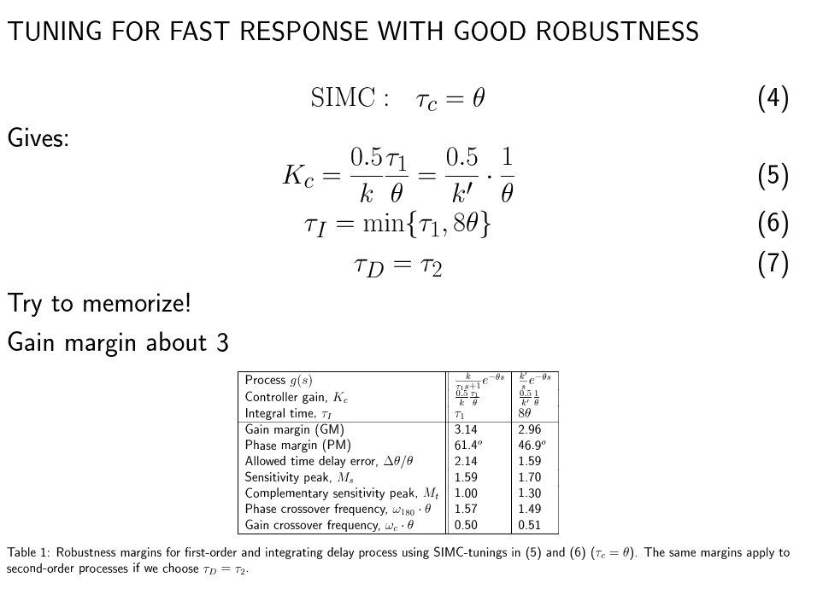
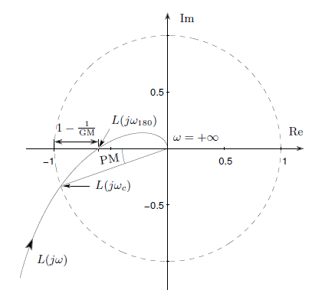

TIGHT CONTROL
1/M_{s}

Slide 24
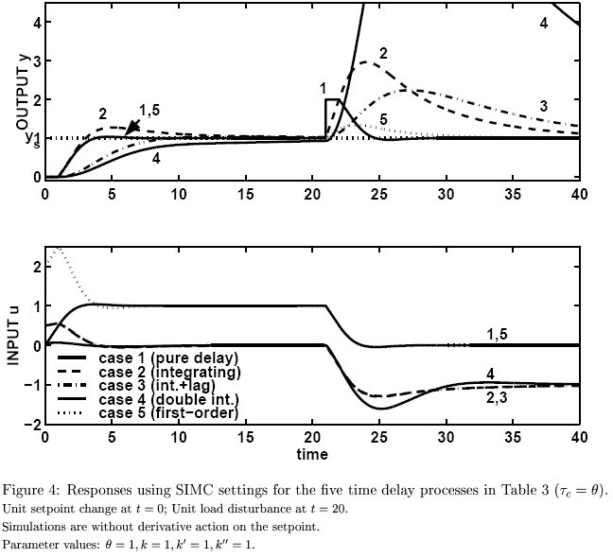
TIGHT CONTROL
Typical closed-loop SIMC responses with the choice τ_{c}=θ

Slide 25

TIGHT CONTROL
Example 2. Compare PI and PID
s=tf('s')
g=(-0.3*s+1)*(0.08*s+1)/((2*s+1)*(s+1)*(0.4*s+1)*(0.2*s+1)*(0.05*s+1)^3)
k=1;
tau1=2.5, tau2=0, theta=1.47, tauc=theta % 1st order
%tau1=2, tau2=1.2, theta=0.77, tauc=theta % 2nd order
Kc=(1/k)*tau1/(tauc+theta) % Kc. PI: 0.85 PID: 1.30
taui=min(tau1,4*(tauc+theta)) % taui. PI: 2.50 PID: 2
taud=tau2; % taud. PI: 0 PID: 1.2
cpi=Kc*(1+1/(taui*s));
cd=(taud*s+1)/(0.1*taud*s+1);
cpid=cpi*cd;
L = cpid*g
S=inv(1+L)
%setpoint response
Ty=g*cpi*S, Ty=minreal(Ty); % without D-action on setpoint
Tuy=cpi*S, Tuy=minreal(Tuy); % without D-action on setpoint
%Input disturbance
gd=g;
Td=gd*S; Td=minreal(Td);
Tud=-gd*cpid*S; Tud=minreal(Tud);
Typi=Ty; Tdpi=Td; Tuypi=Tuy; Tudpi=Tud;
%Typid=Ty; Tdpid=Td; Tuypid=Tuy; Tudpid=Tud;
figure(1),step(Typi,'blue',Typid,'blue--',Tuypi,'red',Tuypid,'red--',15)
figure(2),step(Tdpi,'blue',Tdpid,'blue--',Tudpi,'red',Tudpid,'red--',15)
Note: tau2>theta , so 2nd order and PID gives
perfromance improvement compared to PI

Slide 26
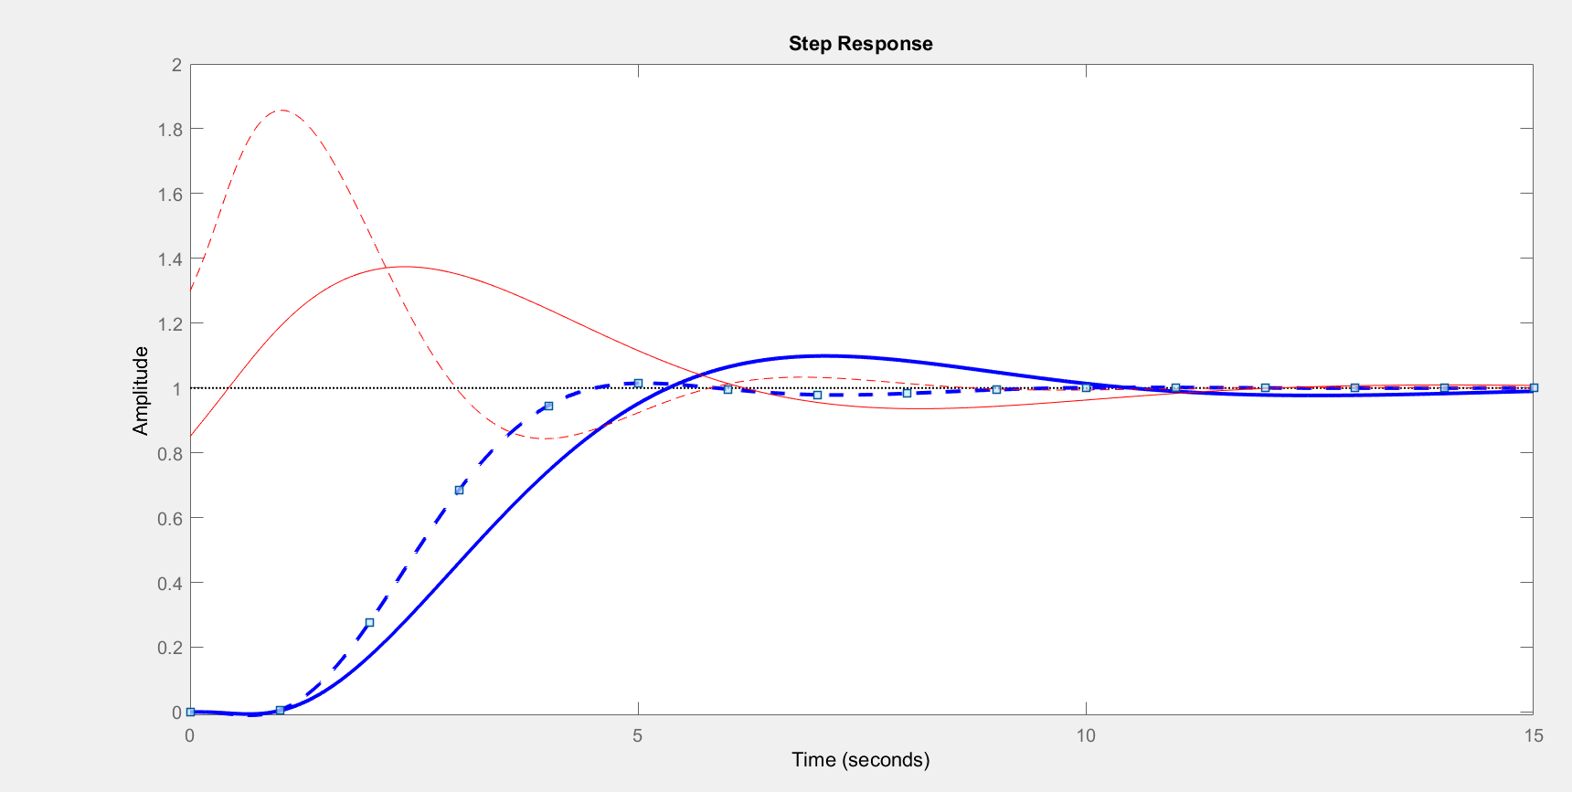
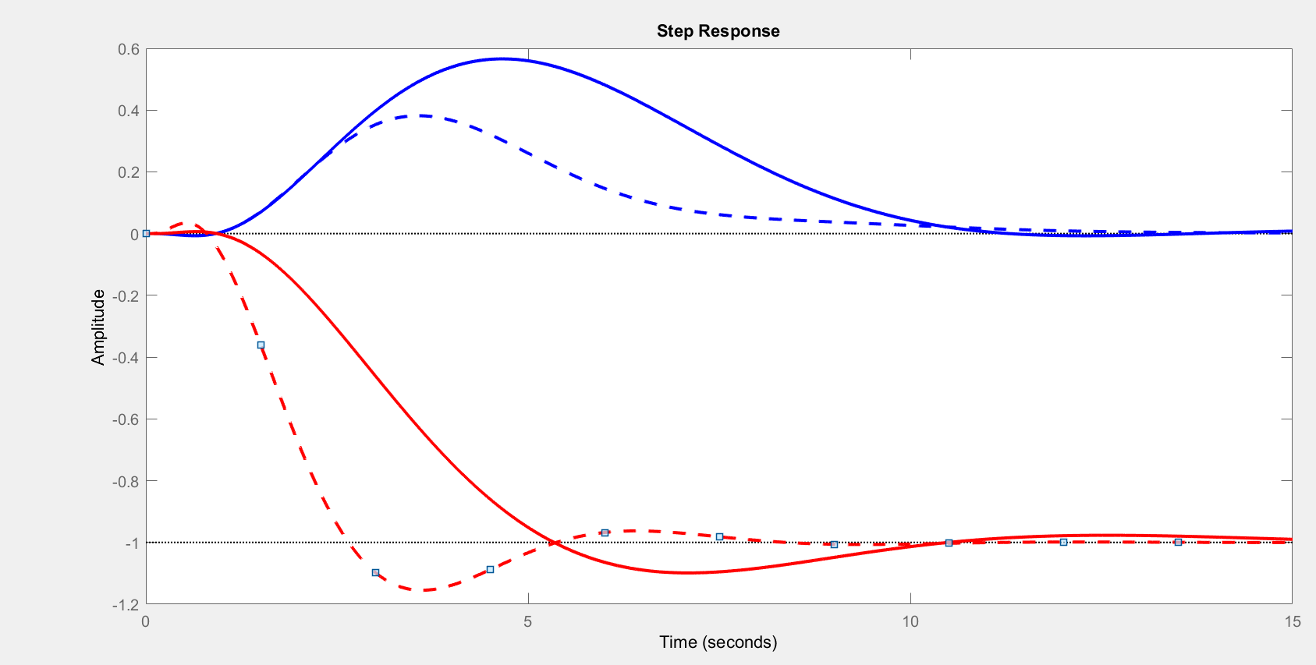
Example 2.
PID
STEP SETPOINT CHANGE (y_{s})
(note: without D-action on setpoint,
so u jumps initially to Kc also for PID)
Input u
PI
PID
Output y
Comparison of
PI and PID - -
PI
Output y
PI
STEP INPUT DISTURBANCE (g_{d}=g)
PID
Conclusion:
PID is quite a lot better.
(expected since tau2=1.2
> theta=0.77)
Input u
PI
PID

Slide 27
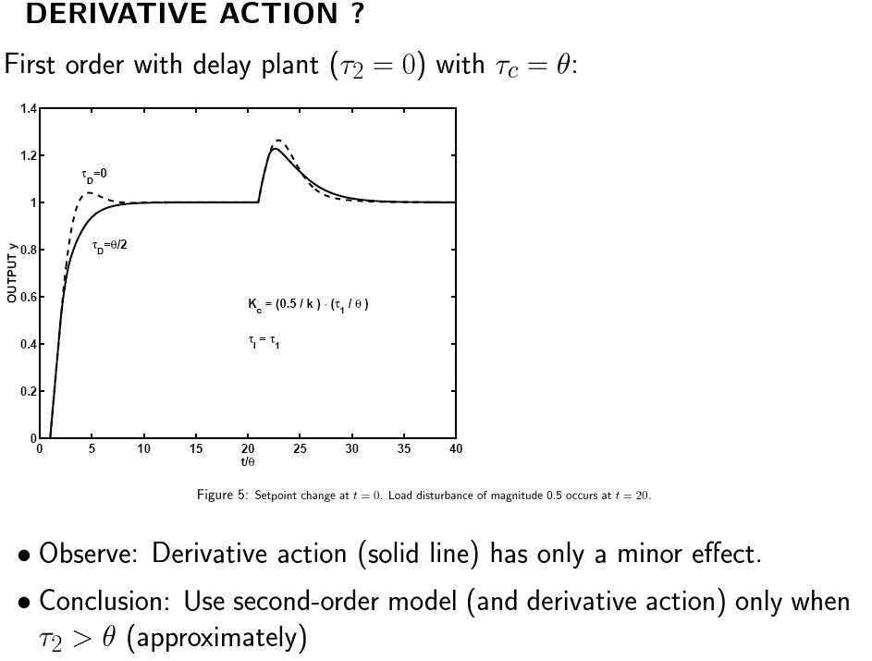
SIMC-tunings
Conclusion D-action (for series-form PID):
1. Use PID with τ_{D} = τ₂ for dominant 2nd order processes with τ₂ >θ (otherwise, add τ₂/2 to effective delay θ and use PI)
2. Use derivative action (PID) for unstable processes, for example, a double integrating process (not so common in process control).
3. Derivative action (PID) can help a little to speed up response for a process with time delay (e.g. use τ_{D} = θ/3), but we then need to reduce τ_{C} (i.e., increase K_{c}) to get the performance benefit (e.g., reduce τ_{C} from θ to θ/2).
We did not do this in the above simulation, so this is why the benefit of D-action is small.
Example 3 (next slide): Compare SIMC-PI with PID with τ_{D} = θ/3 using τ_{C} = θ (red curve, small benefit) and τ_{C} = θ/2 (yellow curve, less overshoot).
4. If you end up using a “large” τ_{c}, such that you have τ_{c} > 2τ_{D} (approximately), then D-action is not helping much and you may consider PI-control instead. Example: See above simulation which has τ_{c}= θ and τ_{D}= θ/2, that is, τ_{c} = 2τ_{D}.

Slide 28
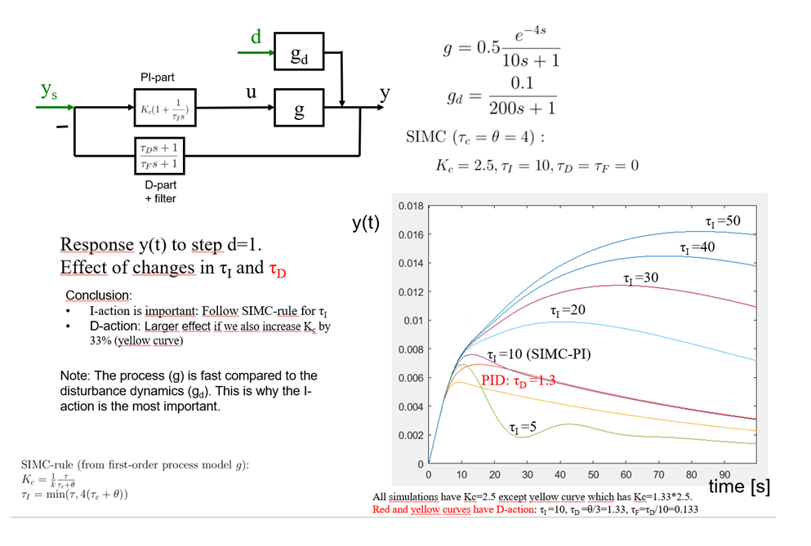
Example 3 (disturbance response Dynea reactor):
(1) Effect of wrong tau-I, (2) Use of tau-D to reduce overshoot
Note: Often D-action requires much more input usage - but in this example the input usage (not shown) is almost the same for all controllers. This is because the disturbance is so «slow» (almost integrating)

Slide 29
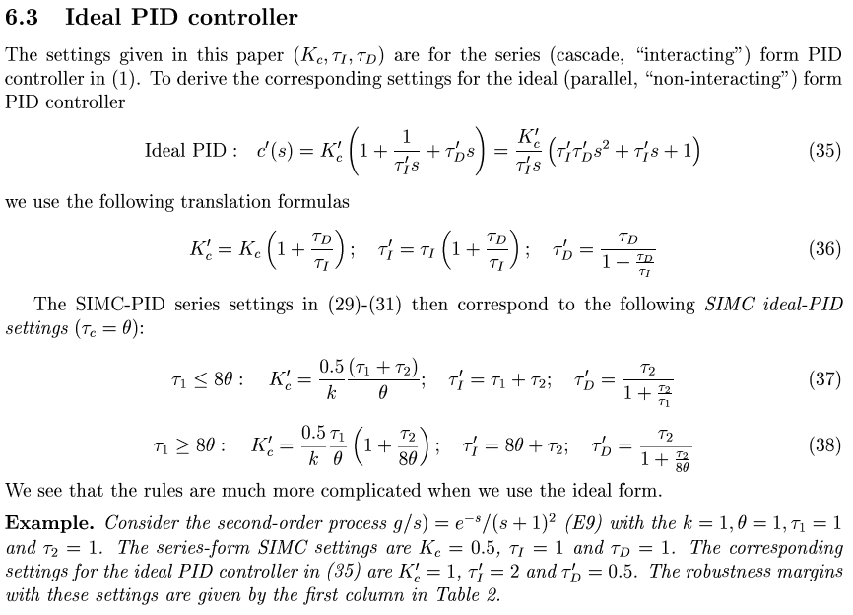
Too complicated

Slide 30
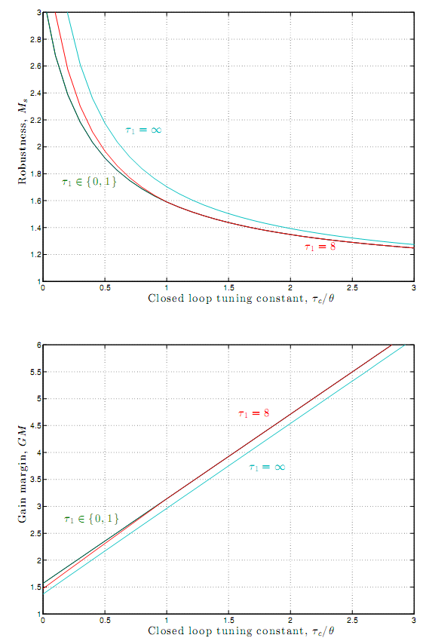
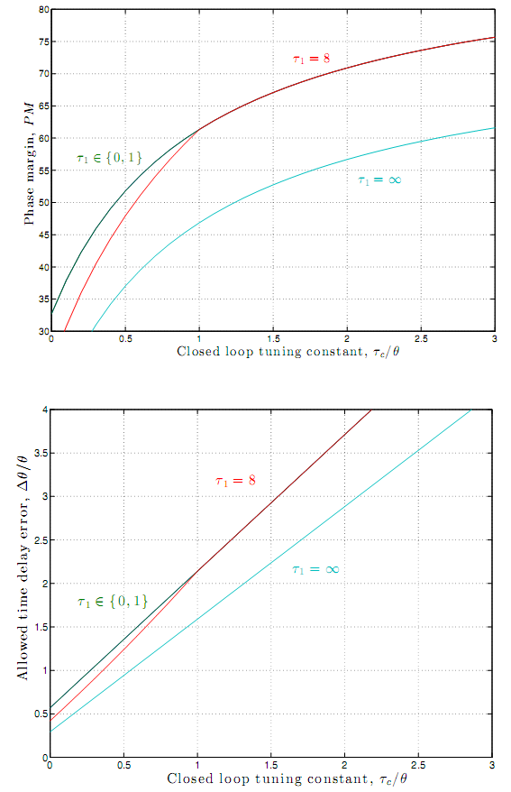


SIMC: Tuning parameter (τ_{c}) correlates nicely with robustness measures. GM and DM increase linearly with τ_{c}
M_{s}
PM
60º
1.6
1
1/M_{s}
GM
DM=
Δθ /θ =
PM/ω_{c}
2
3
1
τ_{c} /θ
τ_{c} /θ

Slide 31

When do we need «tight control»? For hard constraints
«SQEEZE and SHIFT» RULE
Squeeze
Shift
Setpoint
Original
tuning
Improved
tuning
Optimized
operation
time

Slide 32
Tuning for smooth control
SMOOTH CONTROL
Tuning parameter: τ_{c} = desired closed-loop response time
Selecting τ_{c}=θ if we need “tight control” of y.
Other cases: “Smooth control” of y is sufficient, so select τ_{c} > θ for
  slower control
  smoother input usage
    less disturbing effect on rest of the plant
  less sensitivity to measurement noise
  better robustness
Question: Given that we require some disturbance rejection.
  What is the largest possible value for τ_{c} ?
  ANSWER: τ_{c,max} =1/ω_{d} (where ω_{d} is defined as the frequence where |g_{d}(jω_{d})| = y_{max}/d_{max} )
Proof. y=Sgd d, where S=(1+L). Require |y|<ymax at all frequencies, so |S| < |gd| d/ymax at all frequencies.
The integral action takes care of most of the disturbance rejection, so usually, the «worst-case» frequency is where |S| reaches 1, which is approximately at wc=1/tauc.
So define wd as the frequency where (gd/g) d/ymax = 1 and we must require wc > wd or equivalently tauc < 1/wd. Thus we have tauc.maxc=1(wd.
This bound may be optimistic if there are disturbances with two or more «slow» poles, because then the worst-case frequency may be lower than wc.
Comment: An simpler (but sometimes conservative) answer is to select Kc,min =|ud|/|ymax| where |ud| is the input magnitude to reject the maximum disturbance. (Given Kc,min we may obtain the corresponding tauc,max using the SIMC-rule for Kc).
.
More detailed proof: S. Skogestad, ``Tuning for smooth PID control with acceptable disturbance rejection'', Ind.Eng.Chem.Res, 45 (23), 7817-7822 (2006).

Slide 33
Conclusion PID tuning
|u_{d}|
ud= input change required to reject disturbance
ymax = largest allowed output change
3. Derivative time: Use for dominant second-order processes (τ_{D}= τ₂) … and
in rare cases to speed up the response with time delay (τ_{D}= θ/3).

Slide 34
Level control
LEVEL CONTROL
Level control often causes problems
Typical story:
  Level loop starts oscillating
  Operator detunes by decreasing controller gain
  Level loop oscillates even more
  ......
???
Explanation: Level is by itself unstable and requires control.

Slide 35
Level control: Can have both fast and slow oscillations
LEVEL CONTROL
Slow oscillations (K_{c} too low): P > π τ_{I}
Fast oscillations (K_{c} too high): P < π τ_{I}
Fast oscillations: Caused by (effective) time delay
Here: Consider the common slow oscillations
P=period of oscillations = 2π/ω

Slide 36


How avoid slowly oscillating levels?
LEVEL CONTROL
0.1 ¼ 1/π²

Slide 37
Case study oscillating level
LEVEL CONTROL
We were called upon to solve a problem with oscillations in a distillation column
Closer analysis: Problem was oscillating reboiler level in upstream column
Use of Sigurd’s rule solved the problem

Slide 38

LEVEL CONTROL

Slide 39

Need a model for tuning
Model: Dynamic effect of change in input u (MV) on output y (CV)
First-order + delay model for PI-control
$$G\left(s\right)=\frac{k}{τ_{1}s+1}e^{−θs}$$
Second-order model for PID-control
$$G\left(s\right)=\frac{k}{\left(τ_{1}s+1\right)\left(τ_{2}s+1\right)}e^{−θs}$$
  Recommend: Use second-order model only if $τ_{2}≥θ$

Slide 40
1. Step response experiment
Make step change in one u (MV) at a time
Record the output (s) y (CV)

Slide 41
1A. Open-loop setting
Δy(∞)
RESULTING OUTPUT y
STEP IN INPUT u
Δu
θ: Delay - Time where output does not change
τ₁: Time constant - Additional time to reach
63% of final change
k = Δ y(∞)/Δ u : Steady-state gain

Slide 42



Step response of integrating process
Δy
Δt
Imagine this as a 1st order with "infinite" $τ_{1}$:
$$G\left(s\right)=\frac{k}{τ_{1}s+1}≈\frac{k}{τ_{1}s}=\frac{k^{′}}{s}$$

Slide 43

1B. Closed-loop setpoint response
Shams’ method: P-controller with about 20-40% overshoot
Kc0=1.5
Δys=1
Δy∞
OBTAIN 5 DATA IN RED (wait for first overshoot
and undershoot), and then read off:
tp=4.4, dyp=0.79; dyu=0.54, Kc0=1.5, dys=1
dyinf = 0.45*(dyp + dyu)
Mo =(dyp -dyinf)/dyinf % Mo=overshoot (about 0.3)
b=dyinf/dys
A = 1.152*Mo^2 - 1.607*Mo + 1.0
r = 2*A*abs(b/(1-b))
%2. OBTAIN FIRST-ORDER MODEL:
k = (1/Kc0) * abs(b/(1-b))
theta = tp*[0.309 + 0.209*exp(-0.61*r)]
tau = theta*r
3. CAN THEN USE SIMC PI-rule
Δyp=0.79
Δyu=0.54
tp=4.4
Example 2: Get k=0.99, theta =1.68, tau=3.03
Ref: Shamssuzzoha and Skogestad (JPC, 2010)
+ modification by C. Grimholt (Project, NTNU, 2010; see also PID-book 2012,
Sigurd Skogestad and Chriss Grimholt. ''The SIMC Method for Smooth PID Controller Tuning'' (2012))

Slide 44

2. Model reduction
Start with complicated stable model on the form
$$G_{0}\left(s\right)=k_{0}\frac{\left(T_{10}s+1\right)\left(T_{20}s+1\right)…}{\left(τ_{10}s+1\right)\left(τ_{20}s+1\right)…}e^{−θ_{0}s}$$
Want to get a simplified model on the form
$$G\left(s\right)=\frac{k}{\left(τ_{1}s+1\right)\left(τ_{2}s+1\right)}e^{−θs}$$
Most important parameter is the “effective” delay $θ$

Slide 45


Details:

Slide 46


Example 1
Half rule

Slide 47
s=tf('s')
g=(-0.1*s+1)/[(5*s+1)*(3*s+1)*(0.5*s+1)]
g1 = exp(-2.1*s)/(6.5*s+1)
g2 = exp(-0.35*s)/[(5*s+1)*(3.25*s+1)]
step(g,g1,g2)
Example 2
1
Step Response
0.8
Original (third-order with inverse response)
First-order approx. using half rule
Second-order approx. using half rule
0.6
Amplitude
0.4
Step Response
0.4
0.35
0.2
0.3
0.25
0
Amplitude
0.2
0.15
-0.2
0
5
10
15
20
25
30
0.1
35
40
Time (seconds)
0.05
0
-0.05
0
0.5
1
1.5
2
2.5
3
3.5
4
4.5
5
Time (seconds)

Slide 48


MODEL, Approach 2
3
half rule
Comment: The subtraction of T0=0.08 from the effective delay follows from the approximation (0.08s+1)/(0.2s+1) $≈\frac{1}{\left(0.2−0.08\right)s+1 }$ (rule T3).
Alternatively, we could have used the approximation (0.08s+1)/(0.05s+1) $≈1$ (rule T1b) which would reduce the effective delay by 0.05 (instead of 0.08). In any case, it only has a small effect om the effective delay, so it does not matter much for the final result.

Slide 49
MODEL, Approach 2
3
half rule

Slide 50
Example 3.
g0: Original complicated system
(with 2 zeros and 8 poles)
g2: 2nd order with delay (half rule, θ=0.77)
g1: 1st order with delay (half rule, θ=1.47)

Slide 51


Example 4. Integrating process
Doesn’t look so good
But it’s OK
Example. g0 = 5/(s*(3*s+1)),
g = 5*exp(-1.5*s)/s,
step(g,g0,10)

Slide 52
Higher-order example
Original 7th order, g₀
1st-order, half rule, g₁
2nd-order, half rule, g₂
1st-order, closed loop, g_{cl}

Slide 53


Approximation of LHP-zeros
We should approximate T₀ by a “close-by” τ_{0 .}
BUT: The goal is to use the model for control purposes, so we would like to keep (i.e., not approximate) the τ which is closest to the desired τ_{c}.
τ_{c} = desired closed-loop time constant
In Example E3, we have two possible values for τ₀ , namely 20 and 1. Since T₀=15, it seems clear that we should select the closest τ₀ = 20 and use rule T2.
But what if T₀=2, maybe selecting τ₀ = 1 is better (and using rule T1)?
No, this is not clear. Since τ_{c} is between 0.05 (PID) and 0.15 (PI), we may want to keep τ =1 which is closest to τ_{c} ,that is, also in this case select τ₀ = 20 (and use rule T2)
This may seem surprising, but it turns out that it will not matter very much in the case for the PI/PID-tunings (try!), because k/tau1 (and thus Kc) will not change much and because tauI = min(tau,4(tauc+theta)).
Of course, if T₀ gets much closer to 1, then we should select τ₀ = 1.
Generally, the LHP-zeros approximation rules results in acceptable (robust) PI/PID-settings, but not necessarily the “optimal” settings.
g0
g1
g2
PID-controller (from 2nd order model) will give performance improvement because τ₂ > θ

Slide 54


Step response (without control)
g0
g0 = 2*(15*s+1)/((20*s+1)*(s+1)*(0.1*s+1)^2)
g1=1.5*exp(-0.15*s)/(1.05*s+1)
g2=1.5*exp(-0.05*s)/((s+1)*(0.15*s+1))
step(g0,g1,g2,1)
g1, g2
g1
Note: It’s the initial
response that matters
for feedback control
(time from 0 to about 5*tauc)
g0, g2

Slide 55


Simulation with control is as expected: Better performance with controller based on g₂ (PID) than g₁ (PI) but more input usage
y(t)
PI
y(t)
g = 2*(15*s+1)/((20*s+1)*(s+1)*(0.1*s+1)^2)
gd=g
Using g1:
PI. tauc=0.15
Kc=(1/1.5)*1.05/(2*0.15)=2.33
taui=min(1.05,8*tauc)=1.05
taud=0
Using g2
PID. tauc=0.05
Kc=(1/1.5)*1.00/(2*0.05)=6.66
taui=min(1.05,8*tauc)=0.4
taud=0.15, tauf=0.015
PID
PID
u(t)
PI

Slide 56


Example: Approximation of zero for flow control
Extra slide
  $G_{0}\left(s\right)=1.2\left(\frac{15s+1}{9 s+1}\right)$
Note that $T_{0}=15>τ_{0}=9$ so we get an overshoot in the step response
How should we approximate this as a first-order with delay model? It will depend on the value for tauc. If we apply the LHP-zero approximation rules then we get:
  Small tauc (tauc<9): (15s+1)/(9s+1) $≈$ 15/9 (Rule T1) $⇒$ G(s)= k = 1.2*15/9 = 2
  Intermediate tauc (9<taux<15): (15s+1)/(9s+1) $≈$ 15/tauc (Rule T1a) $⇒$ G(s)= k = 18/tauc
  Large tauc (tauc>15) . (15s+1)/(9s+1) $≈$ 1 (Rule T1b) $⇒$ G(s)= k = 1.2
In all three cases we get $G\left(s\right)=k$so we get $τ_{1}=0$and in all three cases the SIMC PI-controller becomes a pure I-controller C(s)=KI/s where KI = 1/(k*tauc). Here tauc is free to choose.
Flow controller, The transfer function G₀(s) is typical for a control valve where u=z=valve position and y=F =flow. Consider a typical valve equation $F=Cz\sqrt{p_{1}−p_{2}}$. Following a step change in z, F will immediately jump (to 1.2*15/9=2), but then it will drop down again (to 1.2) because of the reduction in the pressure drop $p_{1}−p_{2}$which for gases may take some time ($τ_{0}=9$ in this case). (See Exam 2022, Problem 5 for how to derive G₀)
  For liquids the dynamics are fast because of small compressibility and can be neglected. Thus, for liquids we always have case 3 (tule T1b). However, the short-term flow overshoot may result in the phenomena of “water hammering”.
  For gases, also cases 1 or 2 may happen if the valve is close to a large gas holdup (large tank or large pipeline).
  For a flow controller, a typical value is tauc=10s.
  Some commercial controllers do not allow a pure I-controller. In this case, select taui as some small value (say taui=1s) and use Kc=KI*taui, that is, Kc=(1/k)*(taui/tauc) .
  However, if the dynamics for changing z or measuring F are slow compared to the desired closed-loop response time tauc, then a better approximatiom of the valve may be G=k/(tau1*s+1). In this case a PI-controller with tauc=tu1 is recommened (SIMC-rule).
y(t)
Step in u at t=10

Slide 57
Shams’ method: Closed-loop setpoint response with P-controller with about 20-40% overshoot
Alternative to Ziegler-Nichols closed-loop experiment: Obtains more information and avoids cycling.
K_{c0}=1.5
Δy_{s}=1
Δy∞
Start from steady state and do step P-response
OBTAIN DATA IN RED (first overshoot
and undershoot), and then:
dyinf = 0.45*(dyp + dyu) % estimate dyinf (so don’t wait)
Mo =(dyp -dyinf)/dyinf % Mo=overshoot (about 0.3)
b=dyinf/dys % offset parameter
A = 1.152*Mo^2 - 1.607*Mo + 1.0
r = 2*A*abs(b/(1-b))
2. OBTAIN FIRST-ORDER with DELAY MODEL:
k = (1/Kc0) * abs(b/(1-b))
theta = tp*[0.309 + 0.209*exp(-0.61*r)]
tau = theta*r
3. CAN THEN USE SIMC PI-rule
Δyp=0.79
Δyu=0.54
tp=4.4
Example 2: Get k=0.99, theta =1.67, tau=3.0
Ref: Shamssuzzoha and Skogestad (JPC, 2010) + modification by C. Grimholt (PID-book 2012)

Slide 58


