Slide 1
Plantwide process control
Sigurd Skogestad
Norwegian University of Science and Technology

Slide 2
Part 1. Plantwide control
Introduction
  Objective: Put controllers on flow sheet (make P&ID)
  Two main objectives for control: Longer-term economics (CV1) and shorter-term stability (CV2)
  Regulatory (basic) and supervisory (advanced) control layer
Optimal operation (economics)
  Define cost J and constraints
  Active constraints (as a function of disturbances)
  Selection of economic controlled variables (CV1). Self-optimizing variables.

Slide 3
Why do we need control?
Operation
Actual value(dynamic)
Steady-state (average)
time
In practice steady state doesn’t happen:
  Feed changes
  Startup
  Operator changes
  Failures
  …..
Control is needed to reduce the effect of disturbances
30% of investment costs are typically for instrumentation and control
“Disturbances” (d’s)

Slide 4
Countermeasures to disturbances (I)
Eliminate/reduce the disturbance
  Design process so it is insensitive to disturbances
      Example: Use buffer tank to dampen disturbances
  Detect and remove source of disturbances
      “Statistical process control”
      Example: Detect and eliminate variations in feed composition
T_{in}
T_{out}
∞
inflow
outflow

Slide 5
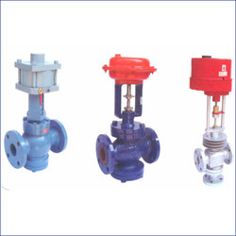
Countermeasures to disturbances (II)
Process control
Do something (usually manipulate a valve) to
counteract the effect of the disturbance
  Manual control: Need operator
  (b) Automatic control: Need measurement + automatic valve + computer
    Goals automatic control:
      Smaller variations
        more consistent quality
        More optimal
      Smaller losses (environment)
      Lower costs
      More production
    Industry: Still large potential for improvements!

Slide 6
Classification of variables
Independent variables (“the cause”):
  (a) Inputs (MV, u): Variables we can adjust (valves)
  (b) Disturbances (DV, d): Variables outside our control
Dependent (output) variables (“the effect or result”):
  (c) Primary outputs (CVs, y₁): Variables we want to keep at a given setpoint
  (d) Secondary outputs (y₂): Extra measurements that we may use to improve control
d
u
input (MV)
y
output (CV)
Process

Slide 7
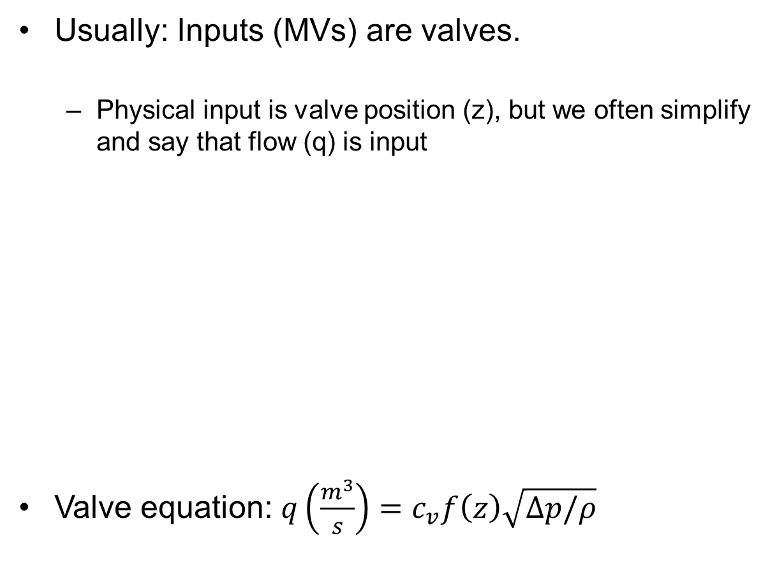
Inputs for control (MVs)
Usually: Inputs (MVs) are valves.
  Physical input is valve position (z), but we often simplify and say that flow (q) is input
Valve equation: $q\left(\frac{m^{3}}{s}\right)=c_{v}f\left(z\right)\sqrt{Δp/ρ}$

Slide 8
Feedback vs. feedforward control
Feedback: «reactive» → sees changes in output and tries to correct it through manipulation
Feedforward: «predictive» → uses disturbance measurement to improve control action
Example: cooking
  Feedforward: follow recipe exactly
  Feedback: look at colour, taste, texture

Slide 9
Notation feedback controllers (P&ID)
T_{s}
(setpoint CV)
T
(measured CV)
TC
MV (e.g., a valve)
1st letter: Controlled variable (CV)
T: temperature
F: flow
L: level
P: pressure
DP: differential pressure (Δp)
A: Analyzer (composition)
C: composition
X: quality (composition)
H: enthalpy/energy
…
2nd letter:
C: controller
I: indicator (measurement)
T: transmitter (measurement)

Slide 10
Example: Level control
Inflow
H_{s}
H
LC
Outflow
INPUT (u): OUTFLOW (Input for control!)
OUTPUT (y): LEVEL
DISTURBANCE (d): INFLOW

Slide 11
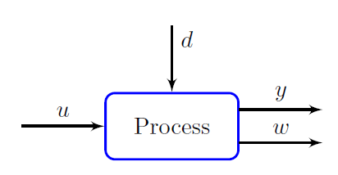
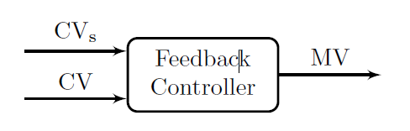
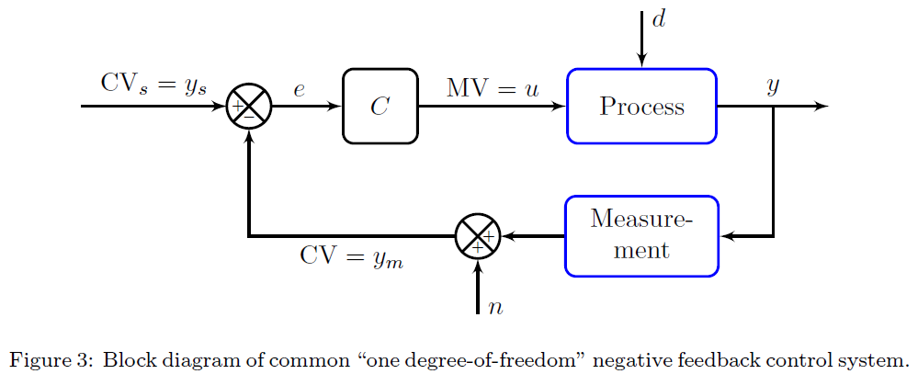

NOTATION and BLOCK DIAGRAMS
MV = manipulated variable (controller output)
CV = controlled variable (controller input)
u = process input (adjustable)
d = disturbance (non-adjustable)
y = process output (with setpoint y_{s})
w = extra measured process variable (state x, y₂)
Combine:
$$e=y_{s}−y_{m}$$
Block diagrams: All lines are signals (information)

Slide 12
What is best? Feedback or feedforward?

Slide 13
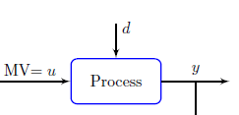
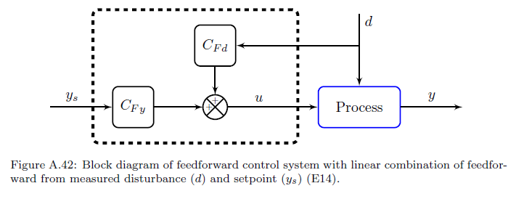


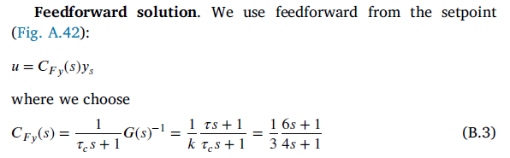


Example: Feedback vs. feedforward for setpoint control of uncertain process
G
y = G(s) u

Slide 14
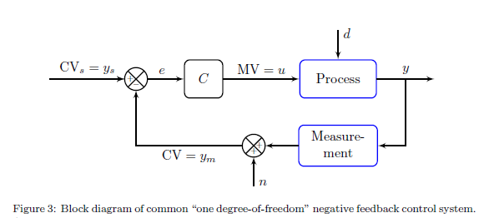
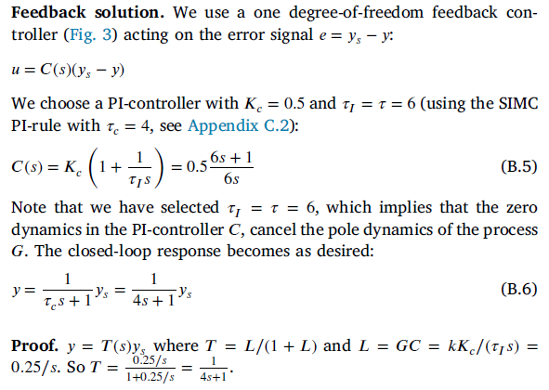
Example: Feedback vs. feedforward for setpoint control of uncertain process
G
y = G(s) u

Slide 15

But what happens if the process changes?
  Consider a gain change so that the model is wrong
    Process gain from k=3 to k’=4.5

Slide 16
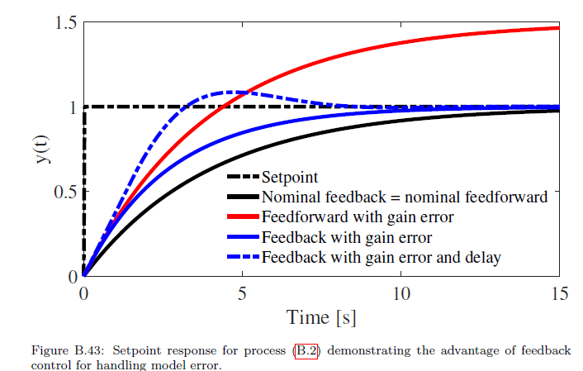
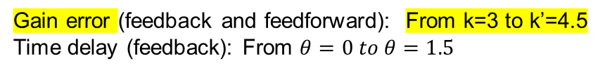
Gain error (feedback and feedforward): From k=3 to k’=4.5
Time delay (feedback): From $θ=0 to θ=1.5$

Slide 17
How can we design a control system for a complete chemical plant?
Where do we start?
What should we control? And why?

Slide 18
Plantwide control =
Control structure design
Not the tuning and behavior of each control loop…
But rather the control philosophy of the overall plant with emphasis on the structural decisions:
  Selection of controlled variables (“outputs”)
  Selection of manipulated variables (“inputs”)
  Selection of (extra) measurements
  Selection of control configuration (structure of overall controller that interconnects the controlled, manipulated and measured variables)
  Selection of controller type (LQG, H-infinity, PID, decoupler, MPC etc.)

Slide 19
Main objectives of a control system
Economics: Implementation of acceptable (near-optimal) operation
Regulation: Stable operation
ARE THESE OBJECTIVES CONFLICTING?
Usually NOT
  Different time scales
    Stabilization → fast time scale
  Stabilization doesn’t “use up” any degrees of freedom
    Reference value (setpoint) available for layer above
    But it “uses up” part of the time window (frequency range)

Slide 20
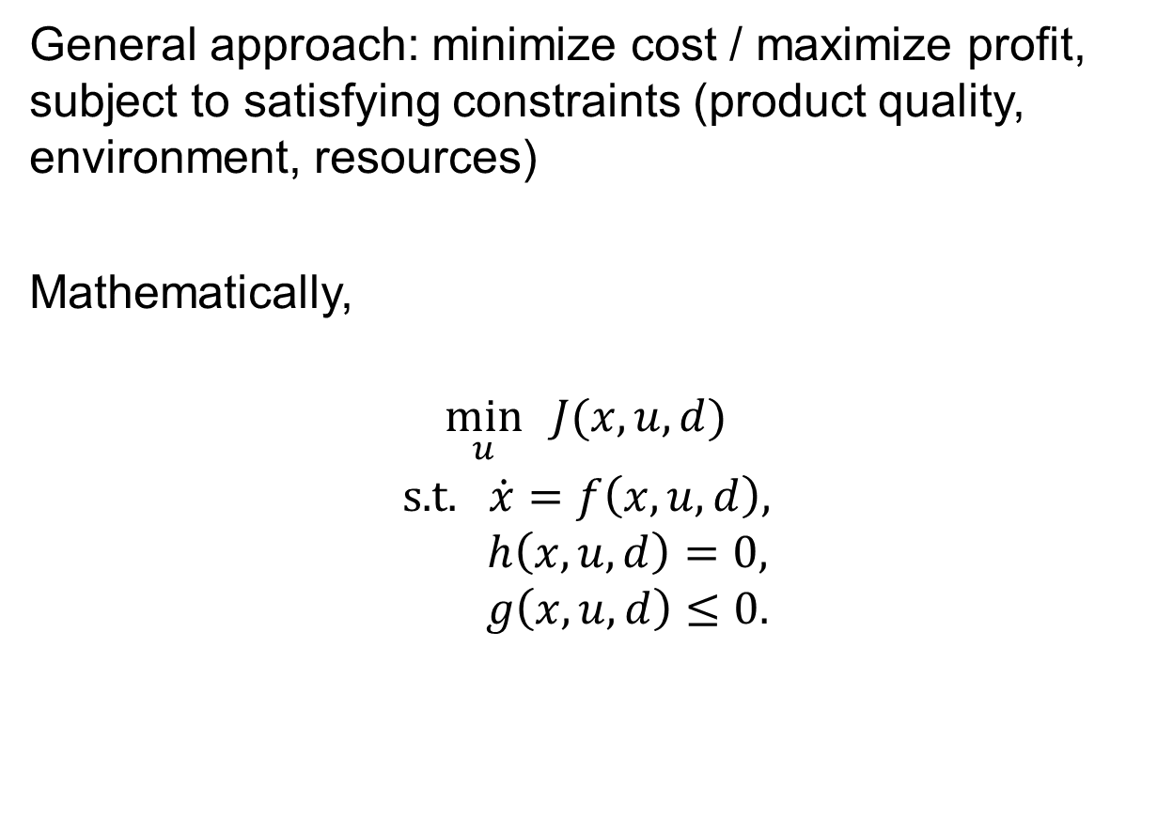
Optimal operation
General approach: minimize cost / maximize profit, subject to satisfying constraints (product quality, environment, resources)
Mathematically,
$$\min_{u}{ J(x,u,d)}$$
$$\text{s}\text{.}\text{t}\text{.} \dot{x}=f\left(x,u,d\right),$$
$$h\left(x,u,d\right)=0,$$
$$g\left(x,u,d\right)≤0.$$

Slide 21

Optimal operation (in theory)
objectives
$$\min_{u}{ J(x,u,d)}$$
$$\text{s}\text{.}\text{t}\text{.} \dot{x}=f\left(x,u,d\right),$$
$$h\left(x,u,d\right)=0,$$
$$g\left(x,u,d\right)≤0.$$
CENTRALIZED OPTIMIZER
present state
degrees of freedom
model of system
(example: Economic MPC)
Problems:
Model not available
Optimization is complex
Not robust (difficult to handle uncertainty)
Slow response time
Procedure:
Obtain model of overall system
Estimate present state
Optimize all degrees of freedom

Slide 22
Engineering systems
Most (all?) large-scale engineering systems are controlled using hierarchies of quite simple controllers
  Large-scale chemical plant (refinery)
  Commercial aircraft
100’s of loops
Simple components:
  on-off + PI-control + nonlinear fixes + some feedforward

Slide 23
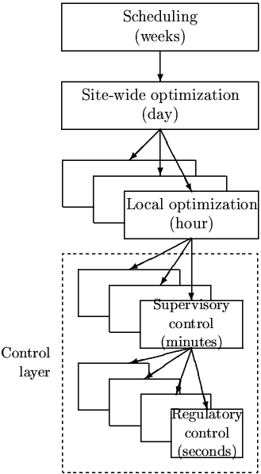
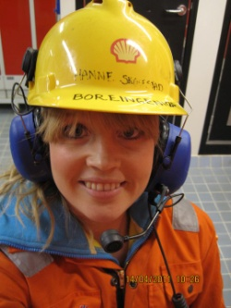
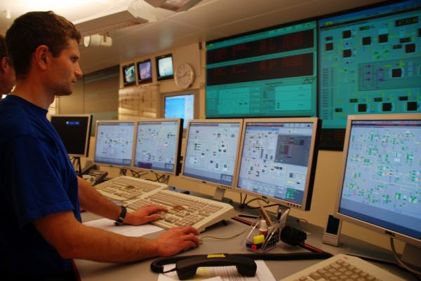
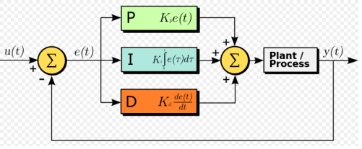
Practical operation: Hierarchical structure
Manager
Process engineer
Operator/RTO
Operator/”Advanced control”/MPC
PID-control
u = valves

Slide 24
Optimal operation and control objectives:
What should we control?
CV₁ (economics)
CV₂ (stabilization)

Slide 25
Outline
Skogestad procedure for control structure design:
  Top Down
    Step S1: Define operational objective (cost) and constraints
    Step S2: Identify degrees of freedom and optimize operation for disturbances
    Step S3: Implementation of optimal operation
      What to control? (primary CV’s) (self-optimizing control)
    Step S4: Where set the production rate? (Inventory control)
  Bottom Up
    Step S5: Regulatory control: What more to control (secondary CV’s)?
    Step S6: Supervisory control
    Step S7: Real-time optimization

Slide 26
Step S1. Define optimal operation (economics)
What are the ultimate goals of the operation?
Typical cost function*:
*No need to include fixed costs (capital costs, operators, maintainance) at ”our” time scale (hours)
Note: J=-P where P= Operational profit
J = cost feed + cost energy – value products

Slide 27
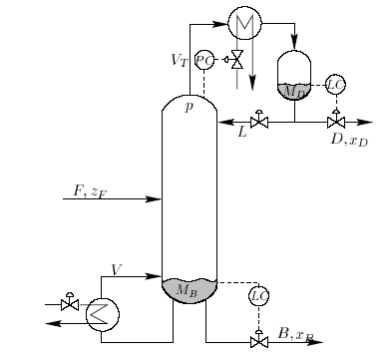
Example: distillation column
Distillation at steady state with given p and F: N=2 DOFs, e.g. L and V (u)
Cost to be minimized (economics)
  J = - P where P= p_{D} D + p_{B} B – p_{F} F – p_{V}V
Constraints
  Purity D: For example, x_{D, impurity} ≤ max
  Purity B: For example, x_{B, impurity} ≤ max
  Flow constraints: min ≤ D, B, L etc. ≤ max
  Column capacity (flooding): V ≤ V_{max}, etc.
  Pressure: 1) p given (d) 2) p free (u): p_{min} ≤ p ≤ p_{max}
  Feed: 1) F given (d) 2) F free (u): F ≤ F_{max}
Optimal operation: Minimize J with respect to steady-state DOFs (u)
cost energy (heating + cooling)
value products
cost feed

Slide 28
Outline
Skogestad procedure for control structure design:
  Top Down
    Step S1: Define operational objective (cost) and constraints
    Step S2: Identify degrees of freedom and optimize operation for disturbances
    Step S3: Implementation of optimal operation
      What to control? (primary CV’s) (self-optimizing control)
    Step S4: Where set the production rate? (Inventory control)
  Bottom Up
    Step S5: Regulatory control: What more to control (secondary CV’s)?
    Step S6: Supervisory control
    Step S7: Real-time optimization

Slide 29

Step S2. Optimize
(a) Identify degrees of freedom
(b) Optimize for expected disturbances
    Need good model, usually steady-state
    Optimization is time consuming! But it is offline
    Main goal: Identify ACTIVE CONSTRAINTS
    A good engineer can often guess the active constraints

Slide 30
Step S2a: Degrees of freedom (DOFs) for operation
Steady-state DOFs
NOT as simple as one may think!
To find all operational (dynamic) degrees of freedom:
Count valves! (N_{valves})
“Valves” also includes adjustable compressor power, etc.
Anything we can manipulate!
BUT: not all these have a (steady-state) effect on the economics

Slide 31
Steady-state degrees of freedom (DOFs)
Steady-state DOFs
IMPORTANT!
DETERMINES THE NUMBER OF VARIABLES TO CONTROL!
No. of primary CVs = No. of steady-state DOFs
Methods to obtain no. of steady-state degrees of freedom (N_{ss}):
Equation-counting
  N_{ss} = no. of variables – no. of equations/specifications
  Very difficult in practice
Valve-counting (easier!)
  N_{ss} = N_{valves} – N_{0ss} – N_{specs}
  N_{valves}: include also variable speed for compressor/pump/turbine
  N_{specs}: Equality constraints (normally included in constraints)
  N_{0ss} = variables with no steady-state effect
    Inputs/MVs with no steady-state effect (e.g. extra bypass)
    Outputs/CVs with no steady-state effect that need to be controlled (e.g., liquid levels)
Potential number for some units (useful for checking!)
Correct answer: Will eventually find it when we perform optimization
CV = controlled variable

Slide 32
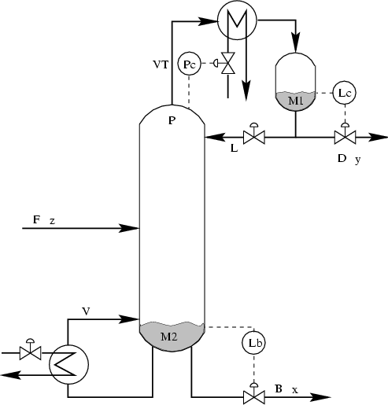
Example: typical distillation column
Steady-state DOFs
4
5
3
1
4 DOFs:
With given feed and pressure:
NEED TO IDENTIFY 2 more CV’s
- Typical: Top and btm composition
6
2
N_{valves} = 6 , N_{0y} = 2* ,
N_{DOF,SS} = 6 -2 = 4 (including feed and pressure as DOFs)
*N_{0y} : no. controlled variables (liquid levels) with no steady-state effect

Slide 33
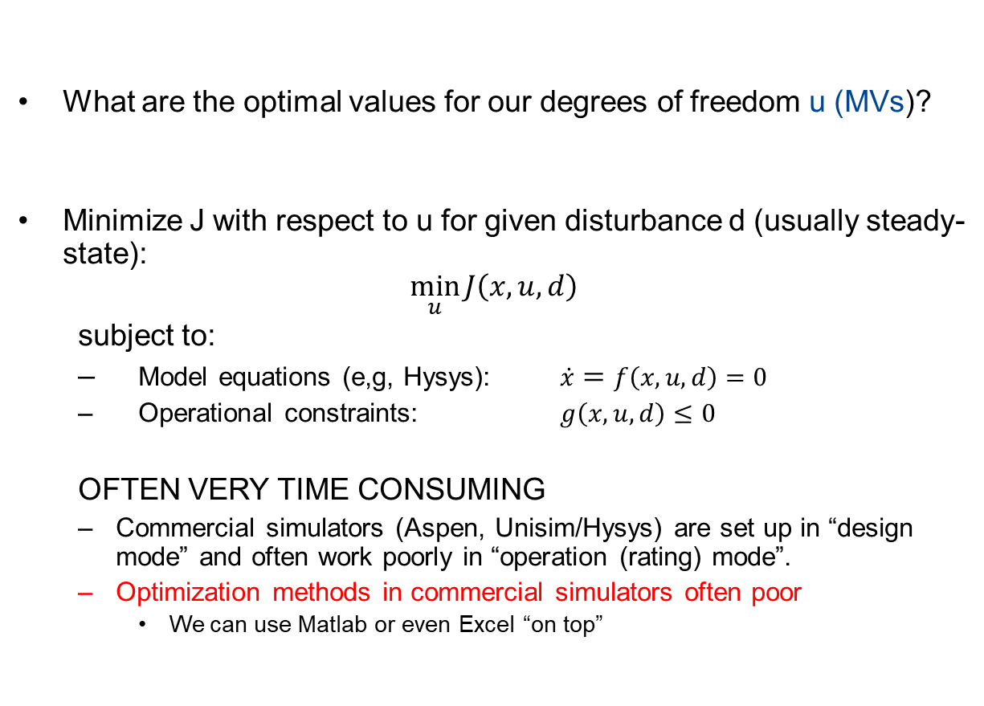
Step S2b: Optimize for expected disturbances
What are the optimal values for our degrees of freedom u (MVs)?
Minimize J with respect to u for given disturbance d (usually steady-state):
$$\min_{u}{J\left(x,u,d\right)}$$
  subject to:
  Model equations (e,g, Hysys): $\dot{x}=f\left(x,u,d\right)=0$
  Operational constraints: $g\left(x,u,d\right)≤0$
  OFTEN VERY TIME CONSUMING
  Commercial simulators (Aspen, Unisim/Hysys) are set up in “design mode” and often work poorly in “operation (rating) mode”.
  Optimization methods in commercial simulators often poor
    We can use Matlab or even Excel “on top”
J = cost feed + cost energy – value products
  …. BUT A GOOD ENGINEER CAN OFTEN GUESS THE SOLUTION (active constraints)

Slide 34
Outline
Skogestad procedure for control structure design:
  Top Down
    Step S1: Define operational objective (cost) and constraints
    Step S2: Identify degrees of freedom and optimize operation for disturbances
    Step S3: Implementation of optimal operation
      What to control? (primary CV’s) (self-optimizing control)
    Step S4: Where set the production rate? (Inventory control)
  Bottom Up
    Step S5: Regulatory control: What more to control (secondary CV’s)?
    Step S6: Supervisory control
    Step S7: Real-time optimization

Slide 35
Step S3. Implementation of optimal operation
Now we have found the optimal way of operation. How should it be implemented?
What to control? (primary CV’s)
  Active constraints
  Self-optimizing variables (for unconstrained degrees of freedom)

Slide 36

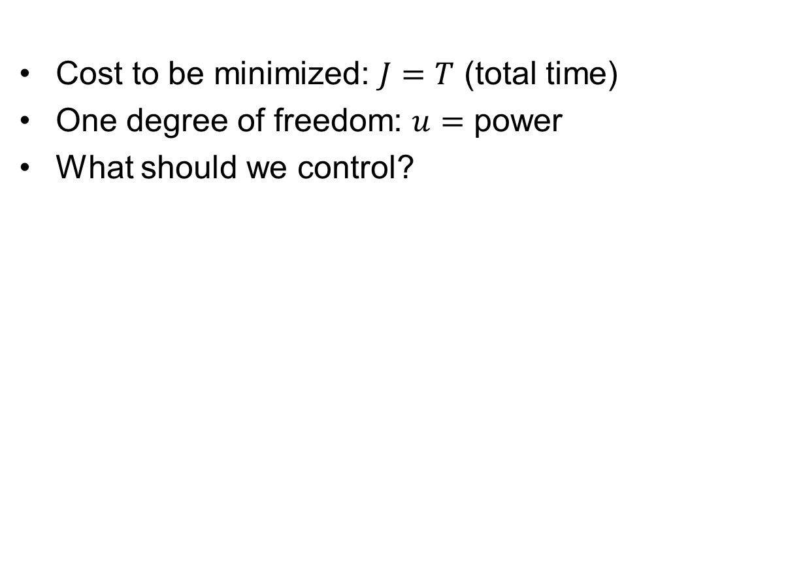
Optimal operation of runner
Optimal operation - Runner
Cost to be minimized: $J=T$ (total time)
One degree of freedom: $u=$ power
What should we control?

Slide 37
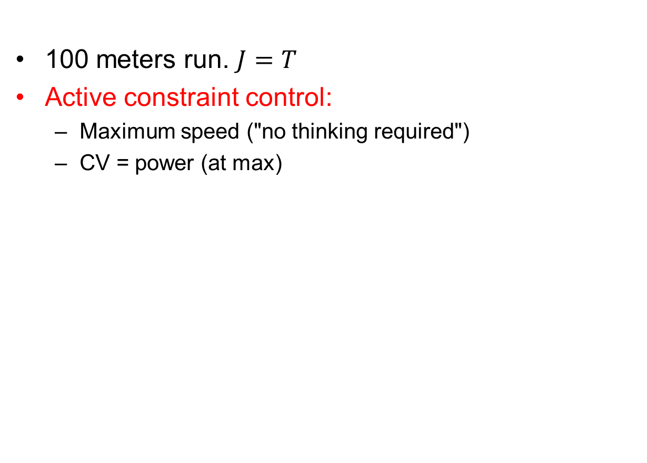
1. Sprinter case
Optimal operation - Runner
100 meters run. $J=T$
Active constraint control:
  Maximum speed ("no thinking required")
  CV = power (at max)

Slide 38
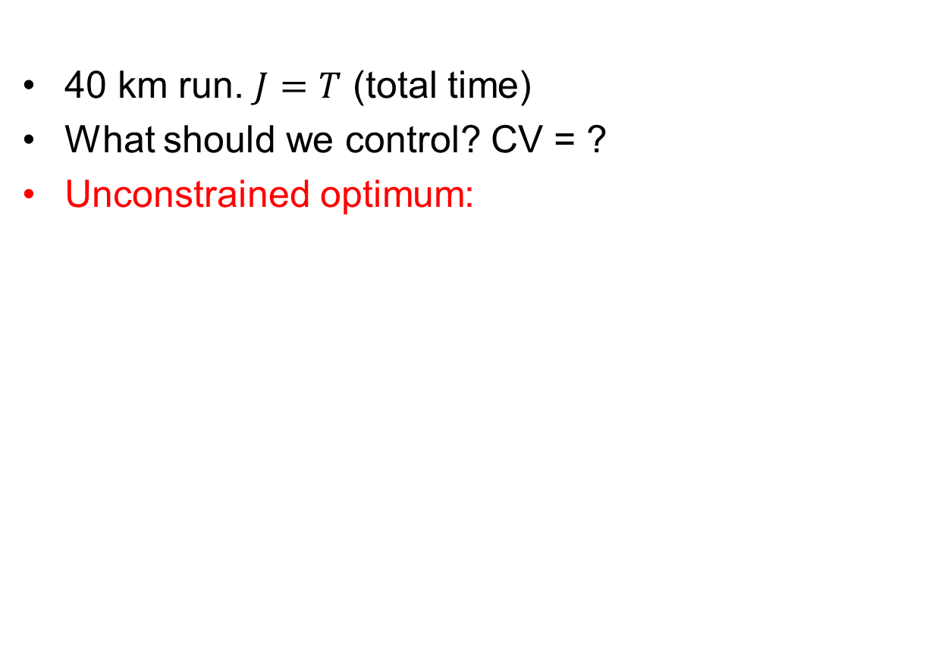
2. Marathon runner case
Optimal operation - Runner
40 km run. $J=T$ (total time)
What should we control? CV = ?
Unconstrained optimum:
J = T
u_{opt}
u = power

Slide 39
Self-optimizing control: Marathon
Optimal operation - Runner
Any self-optimizing variable (to control at constant setpoint)?
  c₁ = distance to leader of race
  c₂ = speed
  c₃ = heart rate
  c₄ = level of lactate in muscles

Slide 40
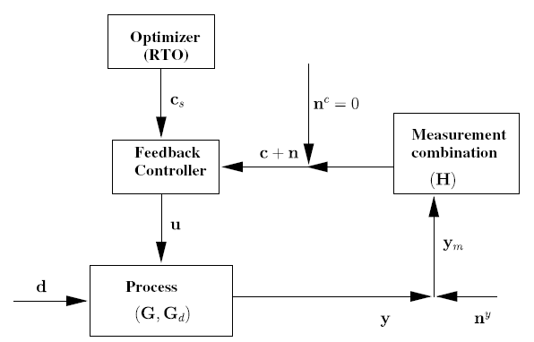
Conclusion Marathon runner
Optimal operation - Runner
CV = heart rate is good “self-optimizing” variable
Simple and robust implementation
Disturbances are indirectly handled by keeping a constant heart rate
May have infrequent adjustment of setpoint (c_{s})
select one measurement
J=T
c = heart rate
c_{opt}
c=heart rate

Slide 41
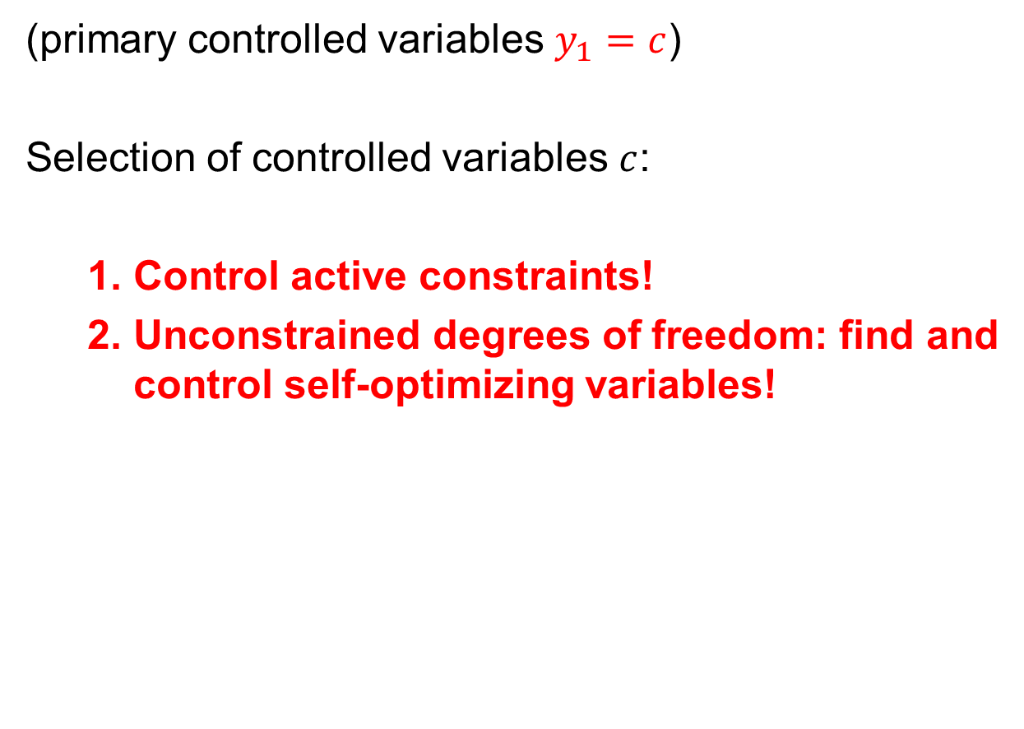
Step S3: What should we control (c)?
(primary controlled variables $y_{1}=c$)
Selection of controlled variables $c$:
  Control active constraints!
  Unconstrained degrees of freedom: find and control self-optimizing variables!
Notes:
First lecture: ended on this slide

Slide 42
Sigurd’s rules for CV selection
Always control active constraints! (almost always)
Purity constraint on expensive product always active (no overpurification):
  (a) "Avoid product give away" (e.g., sell water as expensive product)
  (b) Save energy (costs energy to overpurify)
Unconstrained optimum: NEVER try to control a variable that reaches max or min at the optimum
  In particular, never try to control directly the cost J
  - Assume we want to minimize J (e.g., J = V = energy) - and we make the stupid choice os selecting CV = V = J - Then setting J < J_{min}: Gives infeasible operation (cannot meet constraints) - and setting J > J_{min}: Forces us to be nonoptimal (which may require strange operation; see Exercise on recycle process)

Slide 43
Distillation: expected active constraints
Both products (D, B) generally have purity specs
Valuable product: Purity spec. always active
  Reason: Amount of valuable product (D or B) should always be maximized
    Avoid product “give-away” (“Sell water as methanol”)
    Also saves energy
Control implications:
ALWAYS Control valuable product at spec. (active constraint)
May overpurify (not control) cheap product
methanol
+ water
valuable
product
methanol
+ max. 0.5%
water
cheap product
(byproduct)
water
+ max. 2%
methanol

Slide 44
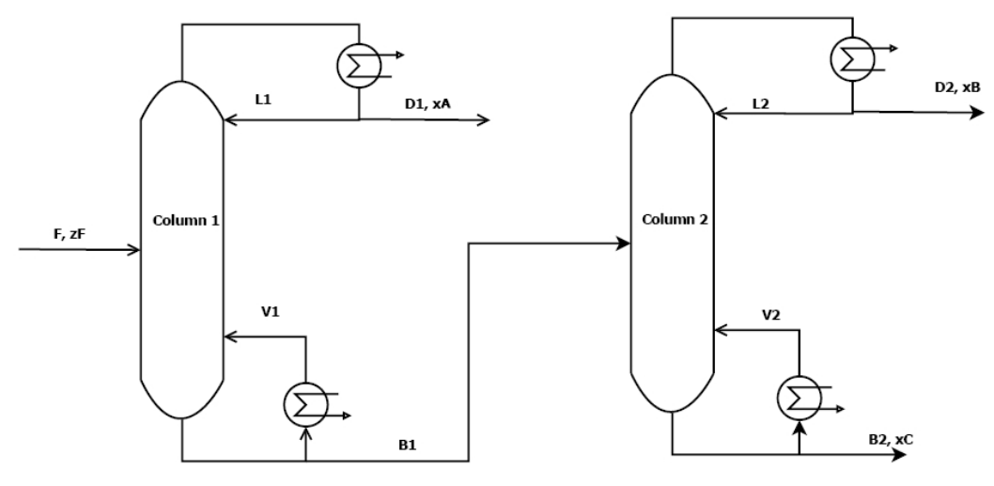
Operation of distillation columns in series
QUIZ 1
With given feed and pressures (disturbances): 4 steady-state DOFs (e.g., L and V in each column)
N=41
α_{AB}=1.33
> 95% B
p_{D2}=2 $/mol
> 95% A
p_{D1}=1 $/mol
N=41
α_{BC}=1.5
F ~ 1.2mol/s
p_{F}=1 $/mol
< 4 mol/s
< 2.4 mol/s
> 95% C
p_{B2}=1 $/mol
Cost (J) = - Profit = p_{F} F + p_{V}(V₁+V₂) – p_{D1}D₁ – p_{D2}D₂ – p_{B2}B₂
Energy price: p_{V}=0-0.2 $/mol (varies)
QUIZ: What are the expected active constraints?
1. Always. 2. For low energy prices.
DOF = Degree Of Freedom
Ref.: M.G. Jacobsen and S. Skogestad (2011)

Slide 45
Operation of distillation columns in series
SOLUTION QUIZ 1
With given feed and pressures (disturbances): 4 steady-state DOFs (e.g., L and V in each column)
N=41
α_{AB}=1.33
> 95% B
p_{D2}=2 $/mol
> 95% A
p_{D1}=1 $/mol
N=41
α_{BC}=1.5
1. x_{B} = 95% B
Spec. valuable product (B): Always active!
Why? “Avoid product give-away”
F ~ 1.2mol/s
p_{F}=1 $/mol
< 4 mol/s
< 2.4 mol/s
2. Cheap energy: V₁=4 mol/s, V₂=2.4 mol/s
Max. column capacity constraints active!
Why? Overpurify A & C to recover more B
> 95% C
p_{B2}=1 $/mol
Cost (J) = - Profit = p_{F} F + p_{V}(V₁+V₂) – p_{D1}D₁ – p_{D2}D₂ – p_{B2}B₂
Energy price: p_{V}=0-0.2 $/mol (varies)
QUIZ: What are the expected active constraints?
1. Always. 2. For low energy prices.
DOF = Degree Of Freedom
Ref.: M.G. Jacobsen and S. Skogestad (2011)

Slide 46
Control of distillation columns in series
QUIZ 2
PC
PC
LC
LC
Given
LC
LC
QUIZ. Assume low energy prices (p_{V}=0.01 $/mol).
How should we control the columns?
HINT: CONTROL ACTIVE CONSTRAINTS
Red: Basic regulatory loops

Slide 47
Control of distillation columns in series
SOLUTION QUIZ 2
PC
PC
LC
LC
1 unconstrained DOF (L1):
Use for what?? CV=?
Not: CV= x_{A} in D1! (why? x_{A} should vary with F!)
Maybe: constant L1? (CV=L1)
Better: CV= x_{A} in B1? Self-optimizing?
CC
Given
x_{B,s} = 95%
MAX V1
MAX V2
General for remaining unconstrained DOFs:
LOOK FOR “SELF-OPTIMIZING” CVs = Variables we can keep constant
WILL GET BACK TO THIS!
LC
LC
QUIZ. Assume low energy prices (p_{V}=0.01 $/mol).
How should we control the columns?
HINT: CONTROL ACTIVE CONSTRAINTS
Red: Basic regulatory loops

Slide 48

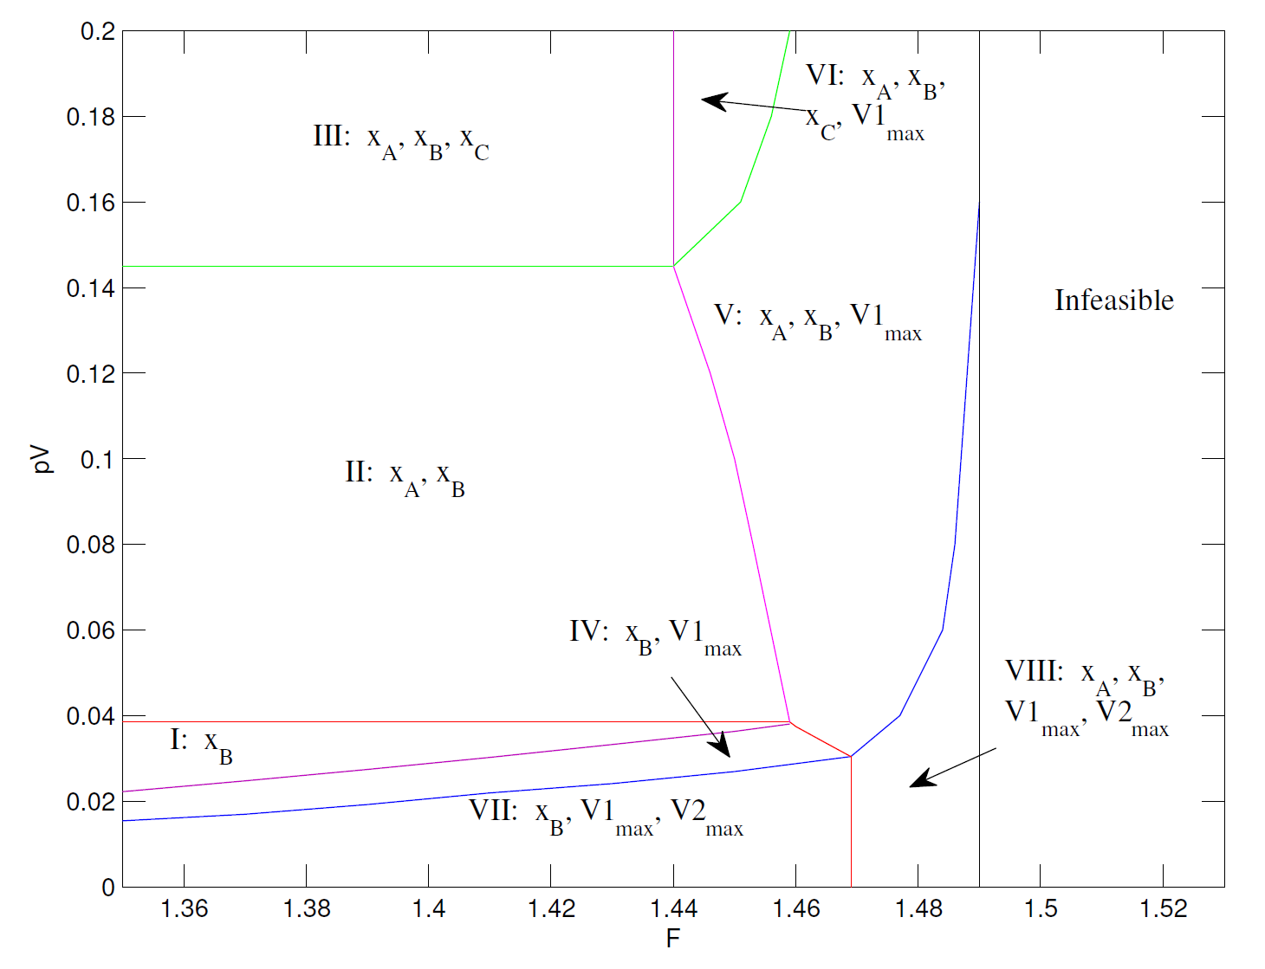
Active constraint regions for two distillation columns in series
Distillation example: Not so simple

Slide 49
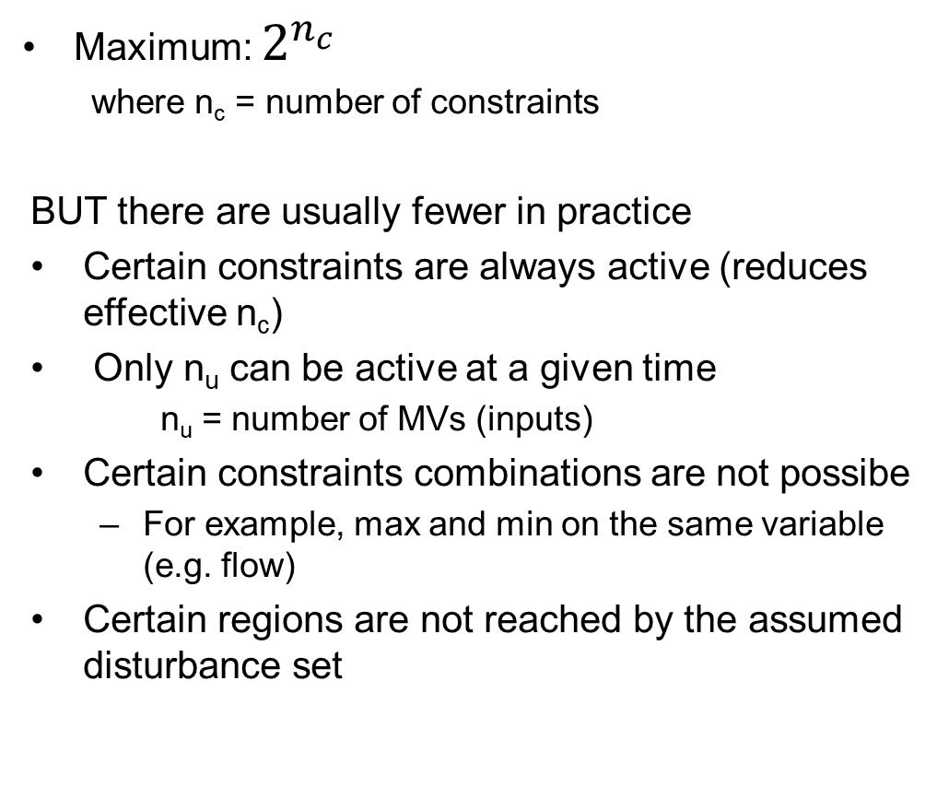
How many active constraints regions?
Maximum: $2^{n_{c}}$
  where n_{c} = number of constraints
BUT there are usually fewer in practice
Certain constraints are always active (reduces effective n_{c})
Only n_{u} can be active at a given time
  n_{u} = number of MVs (inputs)
Certain constraints combinations are not possibe
  For example, max and min on the same variable (e.g. flow)
Certain regions are not reached by the assumed disturbance set
Distillation
n_{c} = 5
  2⁵ = 32
x_{B} always active
2⁴ = 16
-1 = 15
In practice = 8

Slide 50
More on: Optimal operation
Two main cases (modes) depending on market conditions:
Mode 1. Given feed rate
Mode 2. Maximum production (more constrained)
Comment: Depending on prices, Mode 1 may include many subcases (active constraints regions)
min J = cost feed + cost energy – value products

Slide 51
Mode 1. Given feedrate
Amount of products is then usually indirectly given and
Optimal operation is then usually unconstrained
J = cost feed – value products + cost energy
Often constant
“maximize efficiency (energy)”
Control:
Operate at optimal trade-off
NOT obvious what to control
CV = Self-optimizing variable
J = energy
c_{opt}
c

Slide 52
Mode 2. Maximum production
Assume feed rate is degree of freedom
Assume products much more valuable than feed
Optimal operation is then to maximize product rate
“max. constrained”, prices do not matter
J = cost feed + cost energy – value products
Control:
Focus on tight control of bottleneck
“Obvious what to control”
CV = ACTIVE CONSTRAINT
J
Infeasible
region
c_{max}
c

Slide 53
More on: Active output constraints
Need back-off
If constraint can be violated dynamically (only average matters)
  Required Back-off = “measurement bias” (steady-state measurement error for c)
If constraint cannot be violated dynamically (“hard constraint”)
  Required Back-off = “measurement bias” + maximum dynamic control error
c ≥ c_{constraint}
The backoff is the “safety margin” from the active constraint and is defined as the difference between the constraint value and the chosen setpoint
Backoff = | Constraint – Setpoint |
J
Loss
J_{opt}
Back-off
c
  Want tight control of hard output constraints to reduce the back-off. “Squeeze and shift”-rule

Slide 54
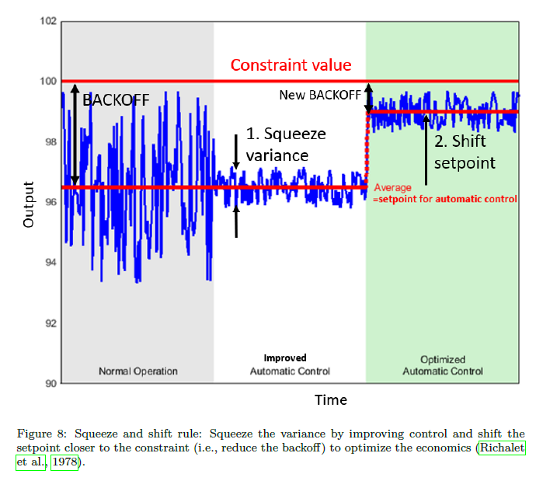
Motivation for better control:
Squeeze and shift rule
y

Slide 55



Example: max. throughput.
Want tight bottleneck control to reduce backoff!
Back-off
= Lost production
Time

Slide 56

Example: purity on distillate
D₂
x_{B}
x_{B} = purity of product > 95% (min.)
D₂ directly to customer (hard constraint)
  Measurement error (bias): 1%
  Control error (variation due to poor control): 2%
  Backoff = 1% + 2% = 3%
  Setpoint x_{Bs}= 95 + 3% = 98% (to be safe)
  Can reduce backoff with better control (“squeeze and shift”)
D₂ to large mixing tank (soft constraint)
  Measurement error (bias): 1%
  Backoff = 1%
  Setpoint x_{Bs}= 95 + 1% = 96% (to be safe)
  Do not need to include control error because it averages out in tank
x_{B}
x_{B,product}
±2%
$$∞$$

Slide 57
Unconstrained optimum
Control “self-optimizing” variable!
Which variable is best?
Often not obvious (marathon runner)
What are good self-optimizing variables?
  Optimal value of CV is constant
  CV is “sensitive” to MV (large gain)

Slide 58
Conclusion optimal operation
ALWAYS:
1. Control active constraints and control them tightly!!
  Good times: Maximize throughput → tight control of bottleneck
2. Identify “self-optimizing” CVs for remaining unconstrained degrees of freedom
Use offline analysis to find expected operating regions and prepare control system for this!
  One control policy when prices are low (nominal, unconstrained optimum)
  Another when prices are high (constrained optimum = bottleneck)
ONLY if necessary: consider RTO on top of this

