Slide 1
Advanced control structures
Sigurd Skogestad

Slide 2
Optimal operation and control of process
Given process plant
Want to Maximize profit P => Minimize economic cost J$=-P [$/s]
  J$ = cost feed + cost energy – value products
    Excluding fixed costs (capital costs, personell costs, etc)
Subject to satisfying constraints on
    Products (quality)
    Inputs (max, min)
    States = Internal process variables (pressures, levels, etc)
      Safety
      Environment
      Equipment degradation
Degrees of freedom = manipulated variables (MVs) = inputs u

Slide 3
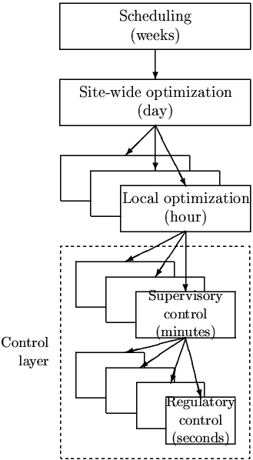
In theory: Centralized controller is always optimal (e.g., EMPC)
Objectives
Approach:
  Model of overall system
  Estimate present state
  Optimize all degrees of freedom
Process control:
  Excellent candidate for centralized control
Problems:
  Model not available
  Objectives = ?
  Optimization complex
  Not robust (difficult to handle uncertainty)
  Slow response time
CENTRALIZED
OPTIMIZER
Present state
Model of system
(Physical) Degrees of freedom, u= valve positions

Slide 4
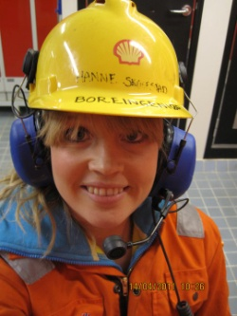

Practical operation: Hierarchical (cascade) structure
based on time scale separation
Manager
NOTE: Control system is
decomposed both
Hierarhically (in time)
Horizontally (in space)
Process engineer
Operator/RTO
Status industry:
RTO is rarely used.
MPC is used in the petrochemical and refining industry, but in general it is much less common than was expected when MPC «took off» around 1990
ARC is common
Manual control still common…
Operator/Advanced regulatory control (ARC)/MPC
PID-control
May include some
ratio/feedforward and cascade control
u = valves

Slide 5
Two fundamental ways of decomposing the controller
Vertical (hierarchical; cascade)
Based on time scale separation
Decision: Selection of CVs that connect layers
Horizontal (decentralized)
Usually based on distance
Decision: Pairing of MVs and CVs within layers
CV1
CV2
CV = controlled variable
MV = manipulated variable

Slide 6
What is the difference between optimization and control?
My definition:
Optimization:
Minimizes economic cost
Control:
Follow setpoints y_{s}
CV1_{s}
CV2_{s}
u = valves

Slide 7
Cost functions in layers
Manager
Process engineer
RTO: Minimize economic cost
J$ = cost feed + cost energy – value products
RTO (usually steady state)
CV1_{s}
Setpoint control
J_{c1} = Q(y₁-y_{1s})² + RΔu₁² (MPC)
(+ look after other variables,
Avoid constraints)
”Advanced control”/MPC
u₁=CV_{s}
PID: Stabilize + avoid drift
J_{c2} = Q(y₂-y_{2s})² + RΔu²
+ look at Gain margin…
(or just use SIMC-rules!)
PID-control
May include some
feedforward and cascade
u = valves

Slide 8
Use of data in layers (feedback)
Engineer: Must choose what to control (H and H₂)
H and H₂ are usually selection matrices
Typically:
y₁=Hy = active constraints + «self-optimizing» variables
y₂=H₂y = drifting variables (levels, pressures, temperatures)
y_{1s}
y₁=CV₁
y_{2s}
y₂=CV₂
H
H₂
u = valves
d
PROCESS
n^{y}
y = all measurements

Slide 9
Use of data
Optimization layer:
Needs model parameters and disturbances
Estimates of disturbances and present state
(including model parameters, e.g. stage efficiency)
y_{1s}
y₁=CV₁
MPC
^ ^
d, x
y_{2s}
y₂=CV₂
Data reconciliation (static)
Or
Estimator (e.g. Kalman filter)
H
H₂
u = valves
d
PROCESS
n^{y}
y = all measurements (including u and possibly d)

Slide 10
Use of models
RTO layer:
Nonlinear model of whole process
usually physical and static
y_{1s}
y₁=CV₁
MPC layer:
Multivariable dynamic linear model for each unit
usually from data
MPC
^ ^
d, x
y_{2s}
y₂=CV₂
Data reconciliation (static)
Or
Estimator (e.g. EKF)
PID-layer:
Dynamic linear model for each loop
usually from data.
May use physical model for linearization, decoupling and feedforward
see: input transformation
H
H₂
Nonlinear model
u = valves
d
PROCESS
n^{y}
y = all measurements (including u and possibly d)

Slide 11
Is there a problem with model consistency between layers?
Quote from a recent paper I reviewed
“One of the difficulties in practical implementations of classic Real-Time Optimization (RTO) strategy is the integration between optimization (RTO) and control layers (MPC), mainly due to the differences between the models used in each layer, which may result in unreachable setpoints coming from optimization to the control layer. In this context, Economic Model Predictive Control (EMPC) is a strategy where optimization and control problems are solved simultaneously.”
Is this likely to happen?
No, This is a myth and no reason for choosing EMPC
Truth: With integral action in the control layer (MPC), the process will go to the setpoints (y_{1s}=CV1_{s}) desired by the RTO layer, irrespective of any model error in the MPC layer
  J_{MPC} = Q(y₁-y_{1s})² + RΔu₁²
Of course, the setpoints from the RTO layer must correspond to a feasible steady state, but the model in the MPC layer does not affect this
Of course, there may be economic losses dynamically, for example, dynamic constraints may mean it takes some time to reach the setpoints
(day)
RTO
s
s
PROCESS

Slide 12
Main objectives operation
Economics: Implementation of acceptable (near-optimal) operation
Regulation: Stable operation around given setpoint
ARE THESE OBJECTIVES CONFLICTING?
IS THERE ANY LOSS IN ECONOMICS?
Usually NOT
  Different time scales
    Stabilization fast time scale
  Stabilization doesn’t “use up” any degrees of freedom
    Reference value (setpoint) available for layer above
    But it “uses up” part of the time window

Slide 13
Hierarchical structure: Degrees of freedom unchanged
No degrees of freedom lost as setpoints y_{2s} replace inputs u as new degrees of freedom for control of y₁
Cascade control:
y₁
y_{2s}
C_{PID}
u
G
y₂
y_{2s}=New DOF
u=Original DOF

Slide 14
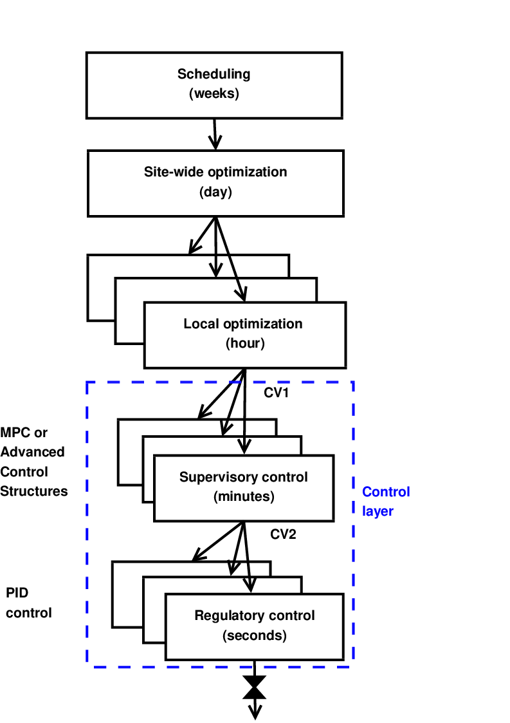
Systematic procedure for economic process control
Start “top-down” with economics (steady state):
Step 1: Define operational objectives (J) and constraints
Step 2: Optimize steady-state operation
Step 3: Decide what to control (CVs)
  Step 3A: Identify active constraints = primary CV1.
  Step 3B: Remaining unconstrained DOFs: Self-optimizing CV1 (find H)
Step 4: Where do we set the throughput? TPM location
Then bottom-up design of control system (dynamics):
Step 5: Regulatory control
  Control variables to stop “drift” (sensitive temperatures, pressures, ....)
  Inventory control radiating around TPM
Finally: Make link between “top-down” and “bottom up”
Step 6: “Advanced/supervisory control”
    Control economic CVs: Active constraints and self-optimizing variables
    Look after variables in regulatory layer below (e.g., avoid saturation)
Step 7: Real-time optimization (Do we need it?)
RTO
CV₁
CV₂
MVs
Process
S. Skogestad, ``Control structure design for complete chemical plants'',
Computers and Chemical Engineering, 28 (1-2), 219-234 (2004).

Slide 15
Step 3: Sigurd’s rules for CV selection
Always control active constraints! (almost always)
Purity constraint on expensive product always active (no overpurification):
  (a) "Avoid product give away" (e.g., sell water as expensive product)
  (b) Save energy (costs energy to overpurify)
Unconstrained optimum:
Look for “self-optimizing” variables. They should
  Be sensitive to the MV
  have close-to-constant optimal value
NEVER try to control a variable that reaches max or min at the optimum
  In particular, never try to control directly the cost J
  Assume we want to minimize J (e.g., J = V = energy) - and we make the stupid choice os selecting CV = V = J
    Then setting J < Jmin: Gives infeasible operation (cannot meet constraints)
    and setting J > Jmin: Forces us to be nonoptimal (which may require strange operation)

Slide 16
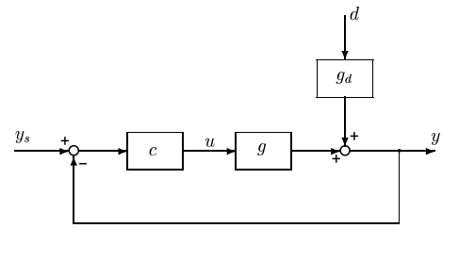
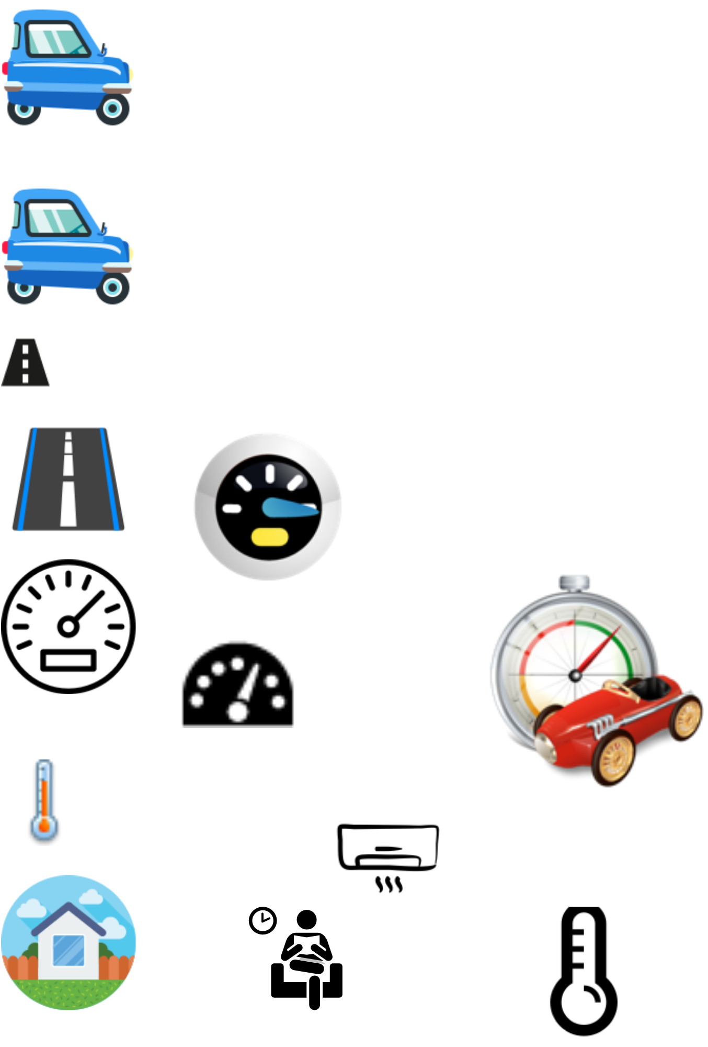
Optimization with PI-controller
Control active constraints
y^{sp} = y^{max}
PI
max y
s.t. y ≤ y^{max}
u ≤ u^{max}
Example: Drive as fast as possible to airport (u=power, y=speed, y^{max} = 110 km/h)
Optimal solution has two active constraint regions:
  y = y^{max} → speed limit
  u = u^{max} → max power
Note: Positive gain from MV (u) to CV (y)
Solved with PI-controller
  y^{sp} = y^{max}
  Anti-windup: I-action is off when u=u^{max}
s.t. = subject to
y = CV = controlled variable

Slide 17
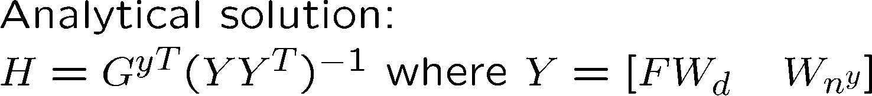
The less obvious case: Unconstrained optimum
2. Control self-optimizing variables
u = unconstrained MV
What to control? y=CV=?
J
J^{opt}
u^{opt}

Slide 18
Step 4: Inventory control and TPM (later!)

Slide 19
Step 5: Design of regulatory control layer
MV
Process
CV
Usually single-loop PID controllers
Choice of CVs (CV2):
CV2 = «drifting variables»
  Levels, pressures
  Some temperatures
CV2 may also include economic variables (CV1) that need to be controlled on a fast time scale
  Hard constraints
Choice of MVs and pairings (MV-CV):
  Main rule: “Pair close”. Want:
    Large gain
    Small delay
    Small time constant
  Avoid pairing on negative steady-state RGA-elements
    It’s possible, but then you must be sure that the loops are always working (no manual contriol or MV-saturation)
  Generally: Avoid MVs that may saturate in regulatory layer
    Otherwise, will need logic for re-pairing (MV-CV switching)
May include cascade loops (flow control!) and some feedforward, decoupling, linearization

Slide 20
Step 6: Design of Supervisory layer

Slide 21
Objectives supervisory layer:
Perform “advanced” economic/coordination control tasks.
  Control primary variables CV1 at setpoint using as degrees of freedom (MV):
    Setpoints to the regulatory layer (CV2s)
    ”unused” degrees of freedom (valves)
  Feedforward from disturbances (if helpful)
  Make use of extra inputs
  Make use of extra measurements
Keep an eye on stabilizing layer
  Avoid saturation in stabilizing layer
Switch control structures (CV1) depending on operating region
  Active constraints
  self-optimizing variables
Implementation supervisory control layer:
Alternative 1: Advanced regulatory control based on ”simple elements” (decentralized control)
Alternative 2: MPC

Slide 22
The three main inventions of process control
(became widely used in the process industry in the 1930s)
PID control, and in particular integral action (“bias reset)
Cascade control
Ratio control (special case of feedforward which needs no explicit model)
The last two are used if standard feedback is not good enough, typically because of delay in measurement of y.
  Cascade: Use extra output measurement (y₂)
  Ratio/feedforward: Use disturbance measurement (d)

Slide 23
The three main inventions of process control can only indirectly and with effort be implemented with MPC
Integral action with MPC: Need to add artificial integrating disturbance in estimator
    ARC: Just add an integrator in the controller (use PID)
Cascade control with MPC: Need model for how u and d affect y₁ and y₂.
    ARC: Just need to know that control of y₂ indirectly improves control of y₁
3. Ratio control with MPC: Need model for how u and d affect property y
    ARC: Just need the insight that it is good for control of y to keep the ratio R=u/d constant
Because of this, MPC should be on top of a regulatory control layer with the setpoints for y₂ and R as MVs.

Slide 24
Advanced regulaory control (ARC)

Slide 25
“Advanced regulatory control” structures
If single-loop feedback control (PID) alone is not good enough
Design based on simple elements:
Cascade control (measure and control internal variable)
Feedforward control (measure disturbance, d)
    Including ratio control
Change in CV: Selectors (max, min)
Extra MV dynamically: Valve position control
    Also known as input resetting or midranging
Extra MV steady state: Split range control (+2 alternatives)
Multivariable control (MIMO)
    Single-loop control (decentralized)
    Decoupling
    MPC (model predictive control)
Extensively used in practice, but little academic work

Slide 26
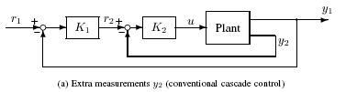

1. Cascade control
1 input u, 1 (main) output y₁, and an extra measurement y₂
Definition: A primary controller (master) gives setpoint y₂^{sp} to a secondary controller (slave) that controls u
$T_{2}$ = “new plant”

Slide 27
2. Feedforward control
1 input u, 1 measured disturbance d
Definition: Measure d and adjust u based on models of how u and d affects y
Most common → Ratio control
Measurement
d
d_{m}
This is particularly useful if feedback control is not effective because the measurement of y is lacking or delayed. In industry the disturbance is sometimes called the “wild variable”. Feedforward control is usually used in combination with feedback in an additive manner.
g_{dm}
c_{ff}
g_{d}
u
g
y

Slide 28
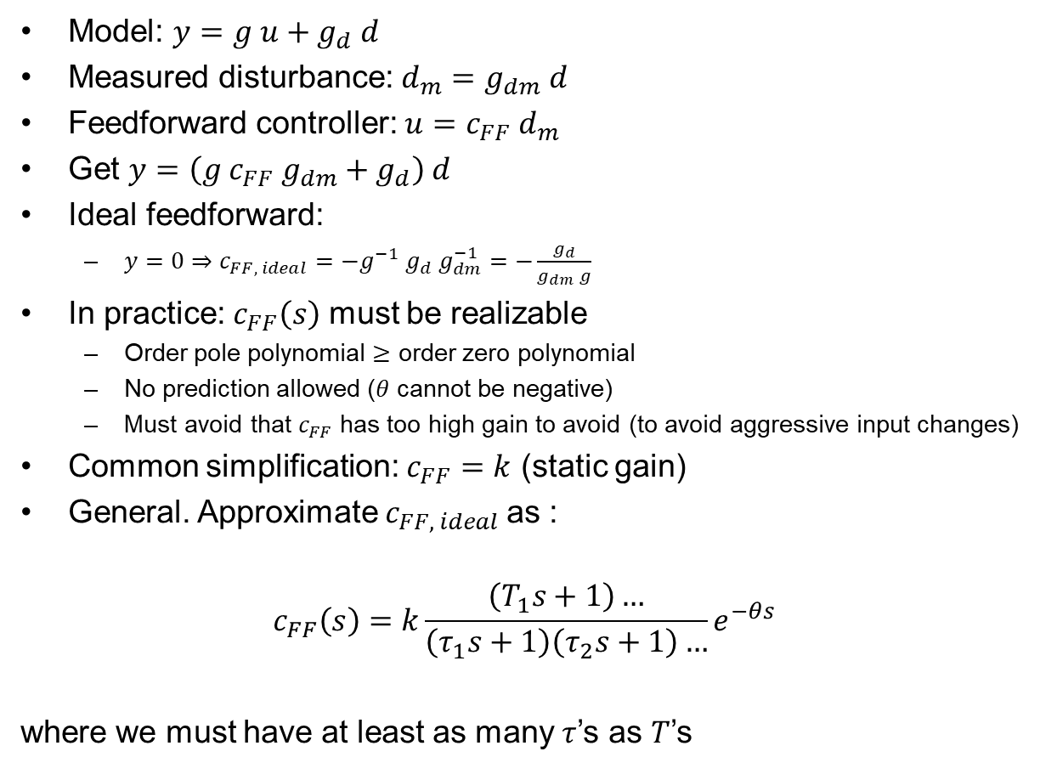
Feedforward control
Measurement
d
d_{m}
Model: $y=g u+g_{d} d$
Measured disturbance: $d_{m}=g_{dm} d$
Feedforward controller: $u=c_{FF} d_{m}$
Get $y=\left(g c_{FF} g_{dm}+g_{d}\right) d$
Ideal feedforward:
  $y=0⇒c_{FF, ideal}=−g^{−1} g_{d} g_{dm}^{−1}=−\frac{g_{d}}{g_{dm} g}$
In practice: $c_{FF}\left(s\right)$ must be realizable
  Order pole polynomial $≥$ order zero polynomial
  No prediction allowed ($θ$ cannot be negative)
  Must avoid that $c_{FF}$ has too high gain to avoid (to avoid aggressive input changes)
Common simplification: $c_{FF}=k$ (static gain)
General. Approximate $c_{FF, ideal}$as :
$$c_{FF}\left(s\right)=k\frac{\left(T_{1}s+1\right)…}{\left(τ_{1}s+1\right)\left(τ_{2}s+1\right)…}e^{−θs}$$
where we must have at least as many $τ$’s as $T$’s
g_{dm}
c_{FF}
g_{d}
u
g
y

Slide 29
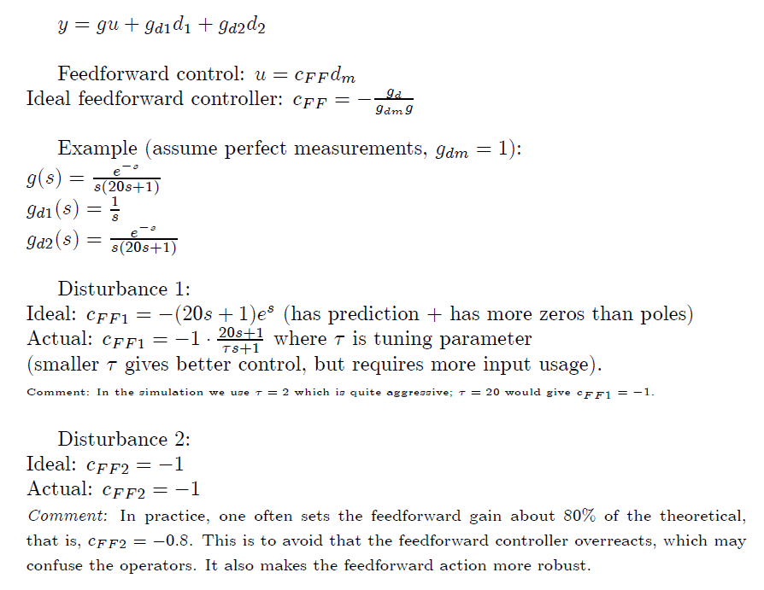
Example feedforward
«Chicken factor»

Slide 30
Ratio control
Most common case of feedforward
Example: Process with two feeds q₁ (d) and q₂ (u), where ratio should be constant.
Use multiplication block:
(q₂/q₁)_{s}
(CV: desired flow ratio)
q₁
(measured flow
disturbance)
q₂
(MV: manipulated variable)
x
“Measure disturbance (d=q₁) and adjust input (u=q₂) such that ratio is at given value (q₂/q₁)_{s}”
Often (q₂/q₁)_{s} is adjusted using feedback control in a cascade fashion.

Slide 31
Example: mixing process
(q₂/q₁)_{s}
q_{1,m}
q_{2,s}
x
q₁ [m3/s]
C₁ [mol/m3]
FC
q_{2,m}
Concentrate
C₂=0
Water
∞
H
LC
CC
c_{m}
c
q [m3/s]
c [mol/m3]
c_{s}
Diluted product
Potential problem for outer feedback loop (composition controller):
Gain from MV = (q2/q1)_{s} to CV=c will vary because of multiplication with q_{1,m}.
So if large variations in q1 are expected: Outer loop needs robust tunings (to get high gain margin; use large tauc in SIMC)

Slide 32
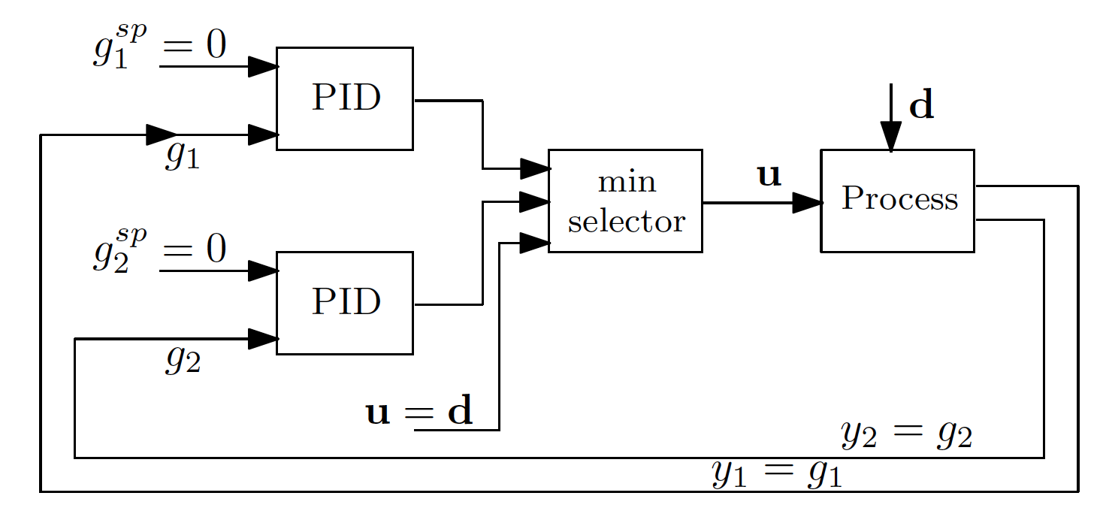
3. Selector logic
One input and many outputs
Each output has a separate controller
A selector block chooses which calculated input to use
min/max selector → depends on gain of constraint

Slide 33
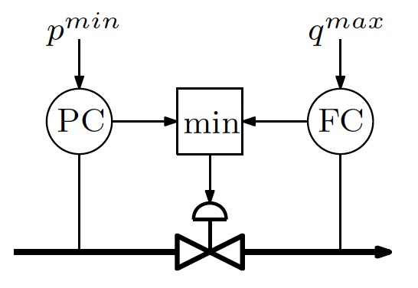
Example
q^{max}
p
_{choke}
q
p^{min}

Slide 34
Example
q^{max}
p
_{choke}
q
p^{min}

Slide 35
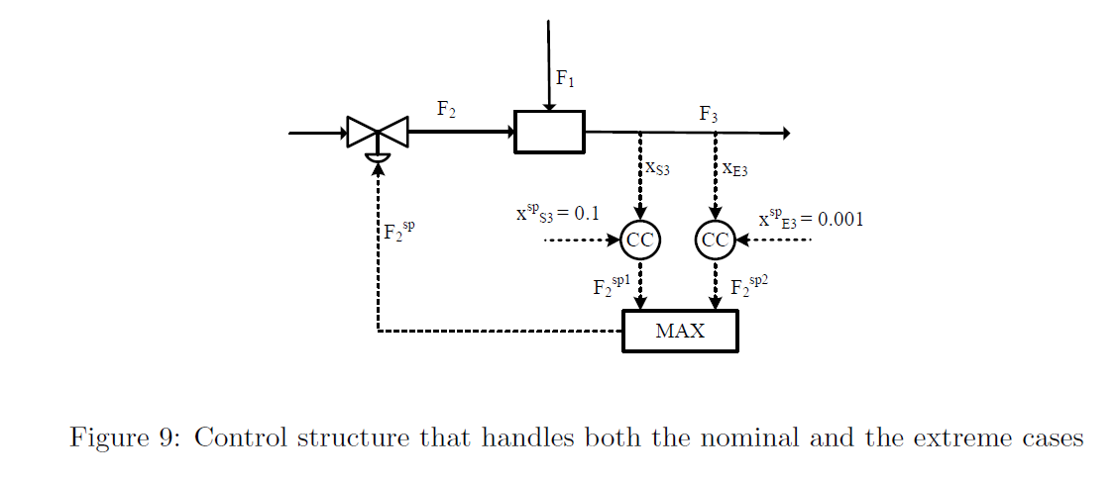
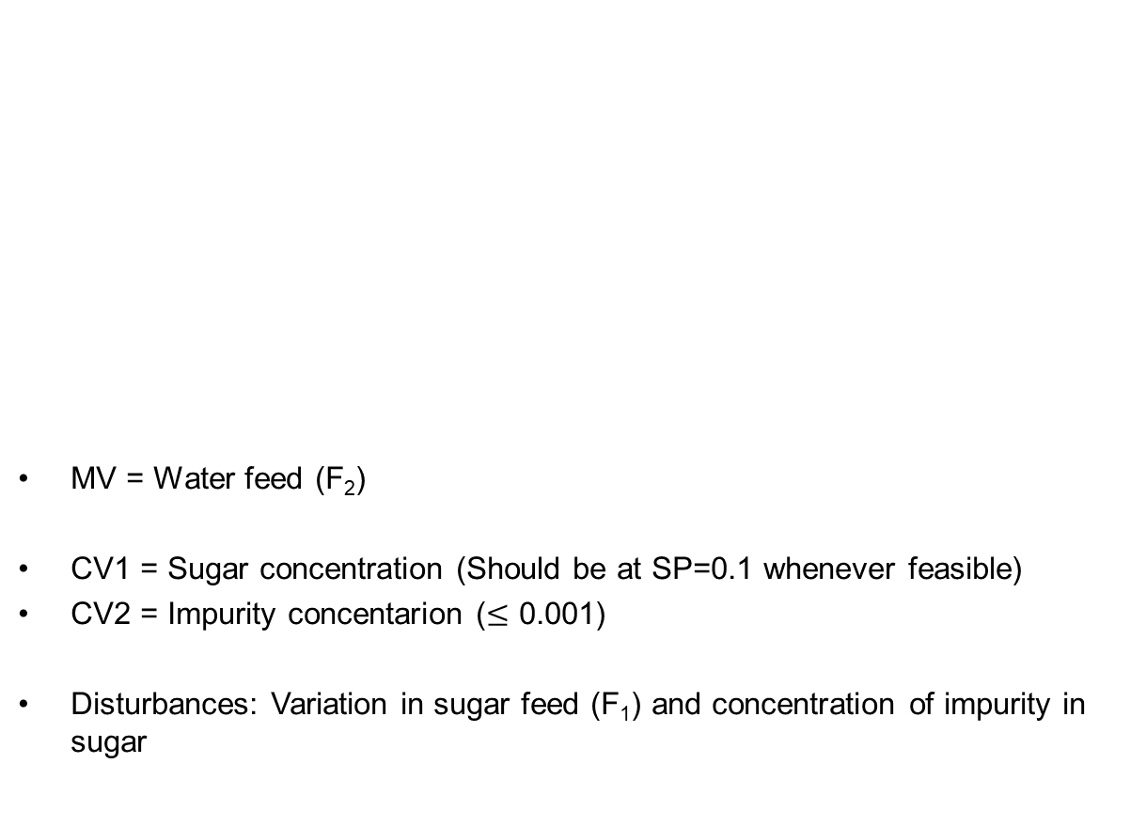
Blending process with max selector
MV = Water feed (F₂)
CV1 = Sugar concentration (Should be at SP=0.1 whenever feasible)
CV2 = Impurity concentarion ($≤$ 0.001)
Disturbances: Variation in sugar feed (F₁) and concentration of impurity in sugar
SUGAR with some impurity
WATER
CV1
CV2

Slide 36
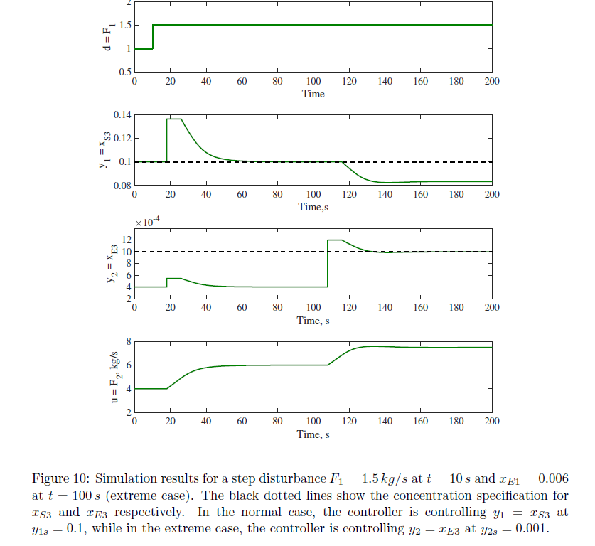
Blending process with max selector

Slide 37
Mid-selector
1 input and 1 output
Used for range control – y must be within y^{max} and y^{min}
Input must be ideally at u^{s} if y is within the range
u = mid(u^{min},u^{s},u^{max})
Take action only when y goes out of range, if not keep u = desired u^{s}

Slide 38
Controller anti-windup
Stops integral action when the controller is deselected or saturated.
This is used to (correctly) initialize the states of the controller when a controller is reactivated.
Select

Slide 39
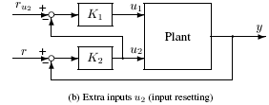
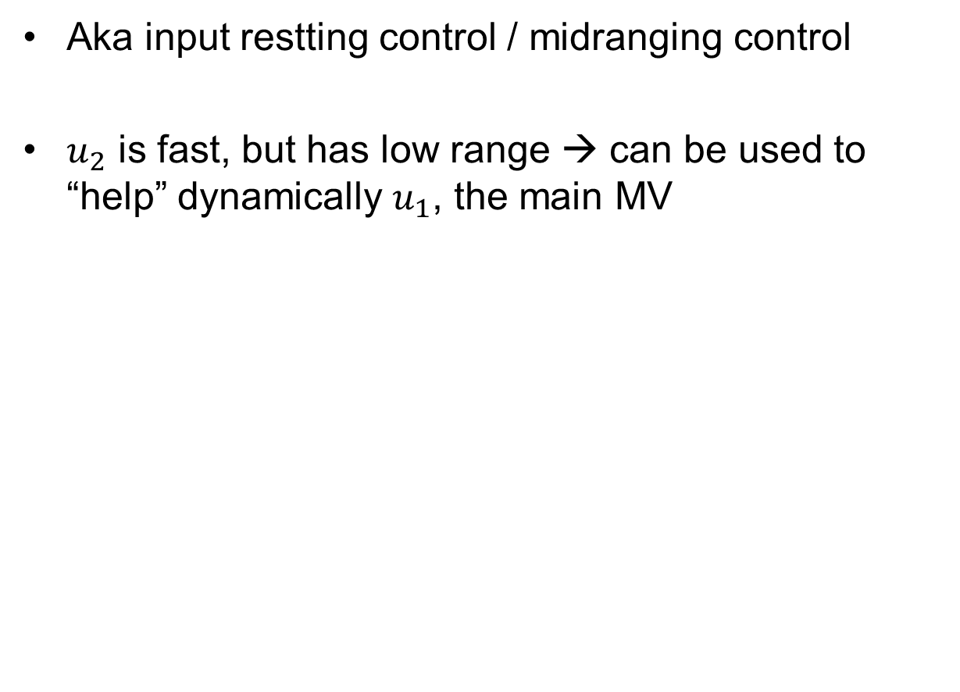
4. Valve position control
Aka input restting control / midranging control
$u_{2}$ is fast, but has low range → can be used to “help” dynamically $u_{1}$, the main MV

Slide 40
Example: heat exchanger w/ bypass
closed
q_{B}
T_{hot}
Want tight control of T_{hot}
Primary input: CW
Secondary input: q_{B}
Proposed control structure?

Slide 41
Alternative 1
closed
q_{B}
TC
T_{hot}
Use primary input CW: TOO SLOW

Slide 42
Alternative 2
closed
q_{B}
T_{hot}
TC
Use “dynamic” input q_{B}
Advantage: Very fast response (no delay)
Problem: q_{B} is too small to cover whole range
+ has small steady-state effect

Slide 43
Alternative 3: Valve position control
closed
q_{B}
T_{hot}
q_{Bs}
FC
TC
TC: Gives fast control of T_{hot} using the “dynamic” input q_{B}
FC: Resets q_{B} to its setpoint (IRV) (e.g. 5%) using the “primary” input CW
IRV = ideal resting value

Slide 44
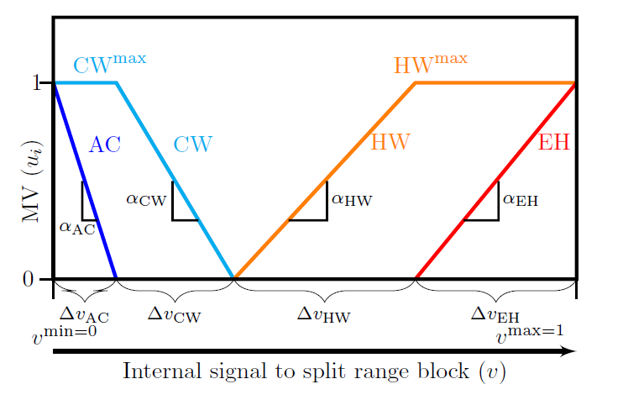
5. Split-range control
Need several inputs to cover whole range (because primary input may saturate at steady-state)
Example 1: Control of room temperature using AC (summer), heater (winter), fireplace (winter cold)

Slide 45
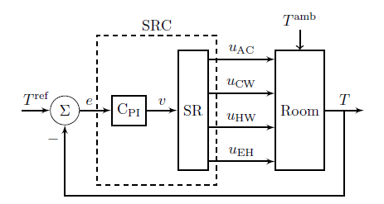
Split-range control (SRC): one CV, multiple MVs
Example: Room heating with 4 MVs
MVs:
AC (expensive cooling)
CW (cooling water; cheap)
HW (hot water, quite cheap)
Electric heat, EH (expensive)
y=T

Slide 46
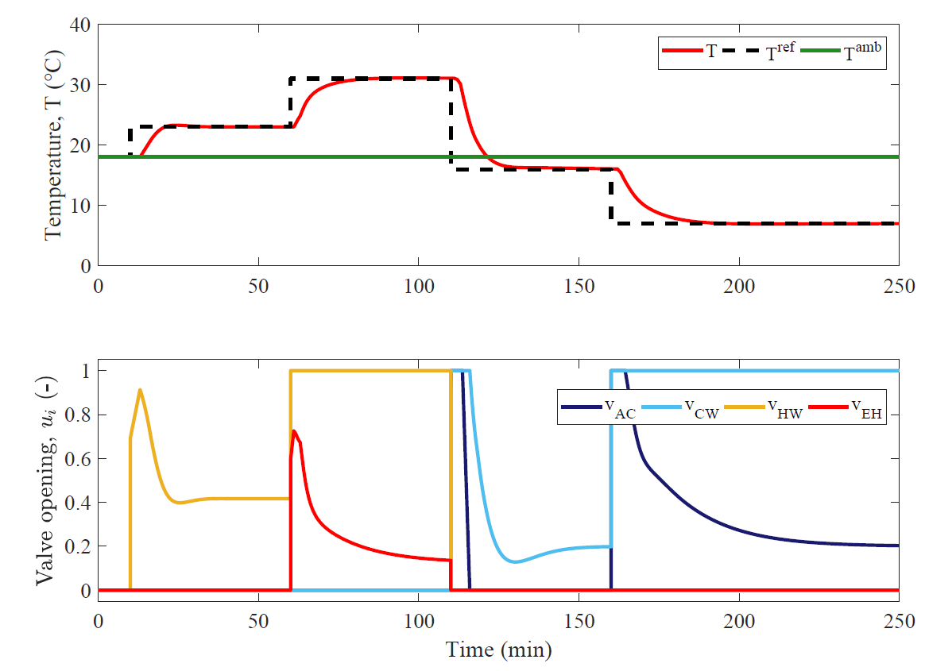
Simulation – temperature SP changes

Slide 47
6. Multivariable control
Pairing rules:
“Pair-close” rule: The pairings should be selected such that, effective delays and loop interactions are minimal.
Avoid using MVs that may optimally saturate (at steady state) to control CVs in the regulatory layer (CV2)
MVs that may optimally saturate (at steady state) should be paired with the subset of CV1 that may be given up.
Prefer pairing such that the rearranged system with selected pairings along the diagonal, has an RGA matrix close to Identity
Avoid pairing on negative steady-state RGA elements

Slide 48
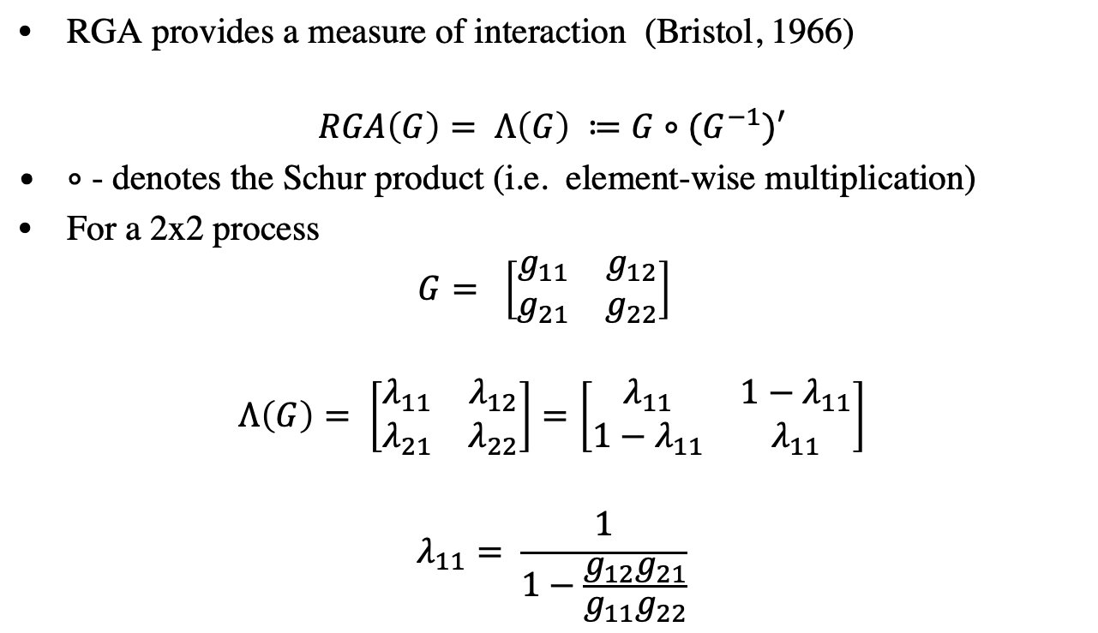
Relative Gain Array – RGA
G is usually evaluated at steady state, $G(0)$, or at some frequency, $G(iω)$

Slide 49
Pairing and decoupling
To get ideal decoupling, off-diagonal elements should have smaller effective delay than the diagonal elements
Thus, we should pair on elements with small effective delay (“pair close rule”)
Pairing on negative steady-state RGA elements is not a problem if we use decoupling
  Because negative RGA-elements are caused by interactions, which is what we are cancelling with decoupling

Slide 50
Decentralized (= single-loop) control
Use for: Noninteracting process and no change in active constraints
+ Tuning may be done on-line
+ No or minimal model requirements
+ Easy to fix and change
- Need to determine pairing
- Performance loss compared to multivariable control
- Logic required for reconfiguration when active constraints move

Slide 51
Decentralized control tuning
Independent design
  Use when small interactions (Dynamic RGA close to I)
Sequential design (similar to cascade)
  Start with fast loop
  NOTE: If close on negative steady-state RGA, system will go unstable of fast (inner) loop saturates
  Sequential vs. independent design
    + Generally better performance
    - outer loop gets slow
    - loops depend on each other

Slide 52
Model predictive control (MPC)
Use for: Interacting process and changes in active constraints
+ Easy handling of feedforward control
+ Handling of dynamic constraints
    no need for logic
    smooth transition
- Requires multivariable dynamic model + state estimator
- Tuning may be difficult
- Less transparent
“Everything goes down at the same time”
Logic still required for reconfiguration when active constraints move

Slide 53
MPC versus decoupling
Both MPC and decoupling require a multivariable process model
MPC is usually preferred instead of decoupling because it can also handle feedforward control, nonsquare processes, etc.
While MPC can deal with satisfying constraints, optimal operation requires change in CVs as well (must define control priorities)

Slide 54

Revisiting optimal operation
Do we really need real-time optimization?
Sometimes not!
We often know or can guess the active constraints
  Example: Drive from A → B in shortest time
  Just use a PI-controller
    CV = speed → speed limit 50km/h
    MV = gas pedal

Slide 55
Active constraints
Optimal operation:
Need to switch between regions using control system

Slide 56
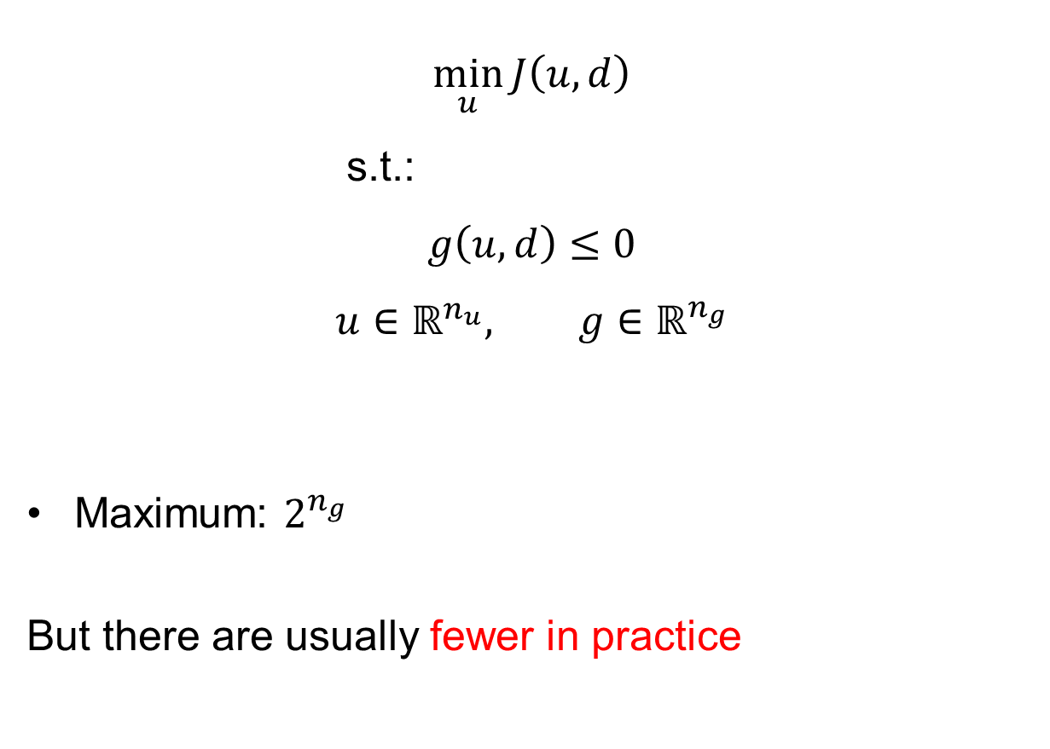
How many operating regions?
$$\min_{u}{J\left(u,d\right)}$$
s.t.:
$$g\left(u,d\right)≤0$$
$$u∈ℝ^{n_{u}}, g∈ℝ^{n_{g}}$$
Maximum: $2^{n_{g}}$
But there are usually fewer in practice

Slide 57
Changing active contraints
Procedure for maintaining optimal operation when changing between active constraint regions
Step 1: Define all the constraints
Step 2: Identify relevant active constraint combinations and switches
Step 3: Propose a control structure for the nominal operating point.
Step 4: Propose switching schemes (see next)
Step 5: Design controllers for all cases (active constraint combinations)

Slide 58
Switching between active constraints
Output to Output (CV - CV) switching (SIMO)
  Selector
Input to output (CV – MV) switching
  Do nothing if we follow the pairing rule: «Pair MV that saturates with CV that can be given up»
Input to input (MV – MV) switching (MISO)
  Split range control
  OR: Valve position control (= midranging control)

Slide 59
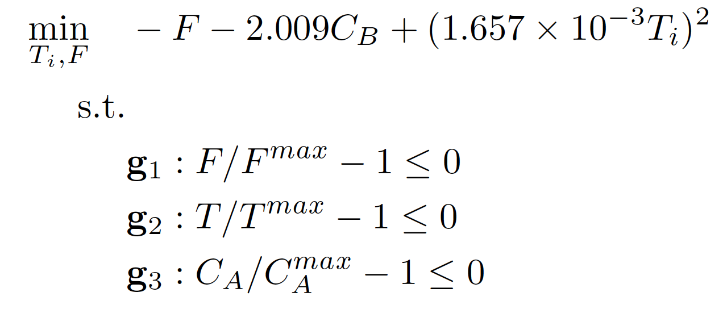
Example: Exothermic Reactor
Krishnamoorthy, D. & Skogestad, S. “Online process optimization with changes in active constraint sets using simple feedback control structures”. Ind. Eng. Chem. Res (2019). Vol. 58 (30), p. 13555-13567

Slide 60
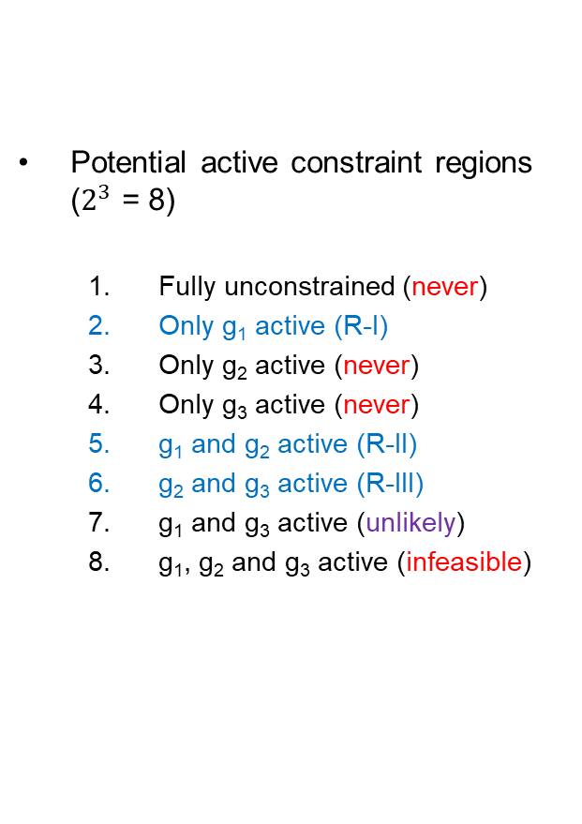
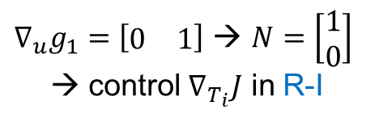
Active constraints
Potential active constraint regions ($2^{3}$ = 8)
  Fully unconstrained (never)
  Only g₁ active (R-I)
  Only g₂ active (never)
  Only g₃ active (never)
  g₁ and g₂ active (R-II)
  g₂ and g₃ active (R-III)
  g₁ and g₃ active (unlikely)
  g₁, g₂ and g₃ active (infeasible)
$∇_{u}g_{1}=\left[\begin{matrix}0 & 1\end{matrix}\right]$ → $N=\left[\begin{matrix}1 \\ 0\end{matrix}\right]$
→ control $∇_{T_{i}}J$ in R-I
2 MV and 4 CV
Notes:
Always produce as much as possible!
Reactant increases → reaction becomes stronger → control temperature
Reactant increases further → activates Ca constraint → increase residence time so that A is consumed

Slide 61
Proposed control structure design
Notes:
Does gain of c matter? According to Krishnamoorthy in Computers and Chemical Engineering 143 (2020) 107106, no!

Slide 62
Simulation results

Slide 63
SUMMARY

Slide 64
Skogestad procedure for control structure design
  Top Down
    Step S1: Define operational objective (cost) and constraints
    Step S2: Identify degrees of freedom and optimize operation for disturbances
    Step S3: Implementation of optimal operation
      What to control? (primary CV’s) (self-optimizing control)
    Step S4: Where set the production rate? (Inventory control)
  Bottom Up
    Step S5: Regulatory control: What more to control (secondary CV’s)?
    Step S6: Supervisory control
    Step S7: Real-time optimization

Slide 65
Summary: 12 Rules for plantwide control
Here we present a set of simple rules for economic plantwide control to facilitate a close-to-optimal control structure design in cases where the optimization of the plant model is not possible.
The rules may be conflicting in some cases and in such cases, human reasoning is strongly advised.

Slide 66
Rule 1: Control the active constraints.
In general, process optimization is required to determine the active constraints, but in many cases these can be identified based on a good process knowledge and engineering insight. Here is one useful rule:
Rule 1A: The purity constraint of the valuable product is always active and should be controlled.
This follows, because we want to maximize the amount of valuable product and avoid product “give away” (Jacobsen and Skogestad, 2011). Thus, we should always control the purity of the valuable product at its specification.
For “cheap” products we may want to overpurify (purity constraint may not be active) because this may reduce the loss of a more valuable component.
In other cases, we must rely on our process knowledge and engineering insight. For reactors with simple kinetics, we usually find that, the reaction and conversion rates are maximized by operating at maximum temperature and maximum volume (liquid phase reactor). For gas phase reactor, high pressure may increase the reaction rate, but this must be balanced against the compression costs.
Rules for Step S3: Selection of primary (economic) controlled variables, CV1

Slide 67
Rule 2: Control the “self-optimizing” variables with unconstrained DOFs.
This choice is usually not obvious, as there may be several alternatives, so this rule is in itself not very helpful. The ideal self-optimizing variable, at least, if it can be measured accurately, is the gradient of the cost function. Ju, which should be zero for any disturbance. Unfortunately, it is rarely possible to measure this variable directly and the “self-optimizing” variable may be viewed as an estimate of the gradient Ju
The two main properties of a good “self-optimizing” (CV1=c=Hy) variable are:
Its optimal value is insensitive to disturbances (such that the optimal sensitivity dc_{opt}/dd =F^{c} HF = is small)
It is sensitive to the plant inputs (so the process gain dc/du = G = HG^{y} is large).
The following rule shows how to combine the two desired properties:
Rule 2A: Select the set CV1=c such that the ratio G⁻¹F^{c} is minimized.
This rule is often called the “maximum scaled gain rule”.

Slide 68
Rule 3: Never try to control the cost J.
(or any other variable that reaches a maximum or minimum at the optimum)
First, the cost function J has no sensitivity to the plant inputs at the optimal point and so G = 0 which violates Rule 2A.
Second, if we specify J lower than its optimal value, then clearly, the operation will be infeasible.
Also, specifying J higher than its optimal value is problematic, as we have multiplicity of solutions. As mentioned above, rather than controlling the cost J, we should control its gradient, J_{u}.
Control the cost gradient instead (ideal self-optimizing variable)
J
J>J_{min}
J_{min}
J<J_{min}
?
u

Slide 69
Rule 4: Locate the TPM close to the process bottleneck.
The justification for this rule is to take advantage of the large economic benefits of maximizing production in times when product prices are high relative to feed and energy costs (Mode 2). To maximize the production rate, one needs to achieve tight control of the active constraints, in particular, of the bottleneck, which is defined as the last constraint to become active when increasing the throughput rate (Jagtap et al., 2013).
Rules for Step S4: Location of throughput manipulator (TPM)

Slide 70
Rule 5: Locate the TPM inside the recycle loop, if there is one.
The point is to avoid “overfeeding” the recycle loop which may easily occur if we operate close to the throughput where “snowballing” in the recycle loop occurs. This is a restatement of Luyben’s rule “Fix a Flow in Every Recycle Loop” (Luyben et al., 1997). From this perspective, snowballing can be thought of as the dynamic consequence of operating close to a bottleneck which is within a recycle system.
In many cases, the process bottleneck is located inside the recycle loop and Rules 4 and 5 give the same result.

Slide 71
Rule 6: Arrange the inventory control loops around the TPM location according to the radiation rule.
The radiation rule (Price et al., 1994), says that the inventory loops upstream of the TPM location must be arranged opposite of flow direction. For flow downstream of TPM location it must be arranged in the same direction. This ensures “local consistency”, i.e., all inventories are controlled by their local in or outflows.
Rules for Step S5: Structure of regulatory control layer.

Slide 72
Rule 7: Select “sensitive/drifting” variables as controlled variables CV2 for regulatory control.
This will generally include inventories (levels and pressures), plus certain other drifting (integrating) variables, for example,
  a reactor temperature
  a sensitive temperature/composition in a distillation column.
This ensures “stable operation”, as seen from an operator’s point of view.
Some component inventories may also need to be controlled, especially for recycle systems. For example, according to “Down’s drill” one must make sure that all component inventories are “self-regulated” by flows out of the system or by removal by reactions, otherwise their composition may need to be controlled (Luyben, 1999).

Slide 73
Rule 8: Economically important active constraints (a subset of CV1) should be selected as controlled variables CV2 in the regulatory layer.
Economic variables, CV1, are generally controlled in the supervisory layer. Moving them to the faster regulatory layer may ensure tighter control with a smaller backoff.
Backoff: difference between the actual average value (setpoint) and the optimal value (constraint).

Slide 74
Rule 9 (“Pair-close” rule): The pairings should be selected such that, effective delays and loop interactions are minimal.

Slide 75
Rule 10: Avoid using MVs that may optimally saturate (at steady state) to control CVs in the regulatory layer (CV2)
The reason is that we want to avoid re-configuring the regulatory control layer. To follow this rule, one needs to consider also other regions of operation than the nominal, for example, operating at maximum capacity (Mode 2) where we usually have more active constraints.

Slide 76
Rule 11: MVs that may optimally saturate (at steady state) should be paired with the subset of CV1 that may be given up.
This rule applies for cases when we use decentralized control in the supervisory layer, and we want to avoid reconfiguration of loops.
The rule follows because when a MV optimally saturates, then there will be one less degree of freedom, so there will be a CV1 which may be given up without any economic loss. The rule should be considered together with rule 10.
Example: Gives correct answer for the process where we want to control flow and have p > p_{min}: Pair the valve (MV) with CV1 (p) which may be given up.
Rules for Step S6: Structure of supervisory control layer.

Slide 77
Rule 12: Do not pair on negative RGA elements (multivariable control)
This rule applies for cases when we use decentralized control in the supervisory layer and we want to avoid reconfiguration of loops.

Slide 78
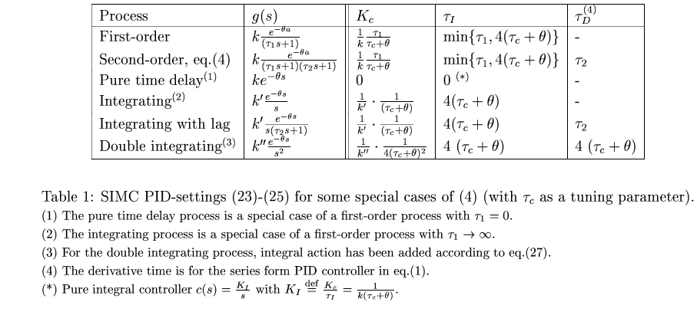

SIMC tuning rules for PID
One tuning parameter: $τ_{c}$

Slide 79
Main references on plantwide control
The following paper summarizes the procedure:
  S. Skogestad, “Control structure design for complete chemical plants”, Computers and Chemical Engineering, 28 (1-2), 219-234 (2004).
There are many approaches to plantwide control as discussed in the following review paper:
  T. Larsson and S. Skogestad, “Plantwide control: A review and a new design procedure” Modeling, Identification and Control, 21, 209-240 (2000).
The following paper updates the procedure:
  S. Skogestad, “Economic plantwide control”, Book chapter in V. Kariwala and V.P. Rangaiah (Eds), Plant-Wide Control: Recent Developments and Applications, Wiley (2012).
More information:
http://www.nt.ntnu.no/users/skoge/plantwide
All papers available at: http://www.nt.ntnu.no/users/skoge/

Slide 80
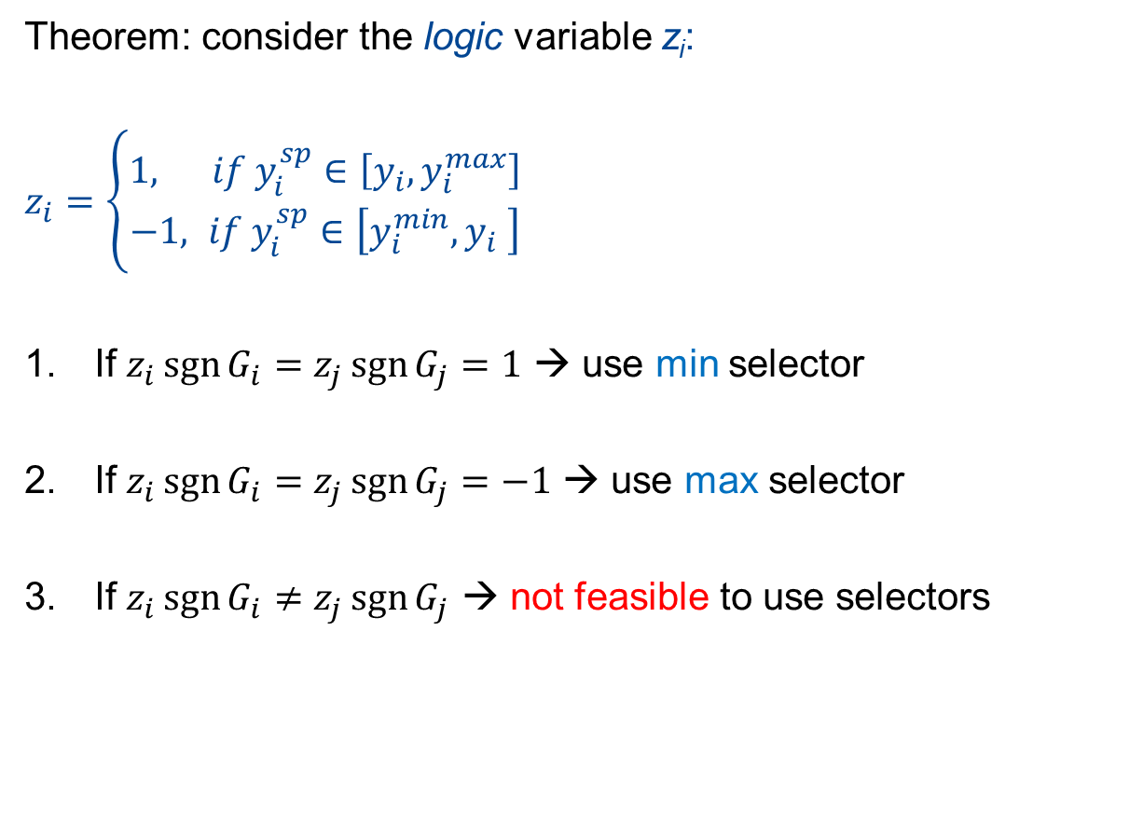
When to use min / max select?
Theorem: consider the logic variable z_{i}:
$z_{i}=\left\{\begin{matrix}1, if y_{i}^{sp}∈\left[y_{i},y_{i}^{max}\right] \\ −1, if y_{i}^{sp}∈\left[y_{i}^{min},y_{i} \right]\end{matrix}\right.$
If $z_{i}\operatorname{sgn}{G_{i}}=z_{j}\operatorname{sgn}{G_{j}}=1$ → use min selector
If $z_{i}\operatorname{sgn}{G_{i}}=z_{j}\operatorname{sgn}{G_{j}}=−1$ → use max selector
If $z_{i}\operatorname{sgn}{G_{i}}≠z_{j}\operatorname{sgn}{G_{j}}$ → not feasible to use selectors
NB! Need to use anti-windup/bumpless transfer on control loops that are not closed!
Proof: Krishnamoorthy & Skogestad, Ind. Eng. Chem. Res (2019), Krishnamoorthy, PhD Thesis (2019)

Slide 81
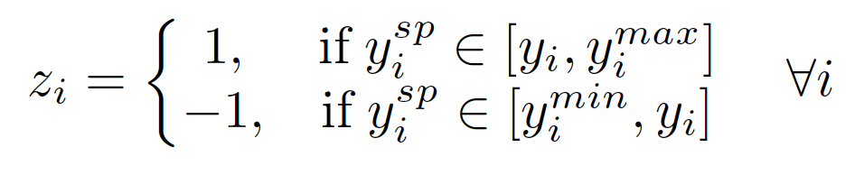

Intuitive Example
-1 1
1 1
-1 -1
1 1
p^{max}
q^{max}
q^{max}
p
q
p
q
p^{min}
_{choke}
_{choke}

Slide 82
For more case examples
Krishnamoorthy, D., and Skogestad, S., 2019. Online process optimization with changes in active constraint sets using simple feedback control structures, Ind. Eng. Chem. Res. Vol. 58 (30), pp. 13555-13567
  CSTR process (Economou and Morari, 1986)
  CSTR process (Srinivasan et al. 2008)
Krishnamoorthy, D., Fjalestad, K. and Skogestad, S., 2019. Optimal Control of offshore oil and gas production using simple feedback controllers, Control Engineering Practice, Vol. 91(c), pp. 104107
  Network of gas-lifted oil wells
  Electrical submersible pump lifted oil wells (Equinor large scale pilot plant in Porsgrunn)

Slide 83
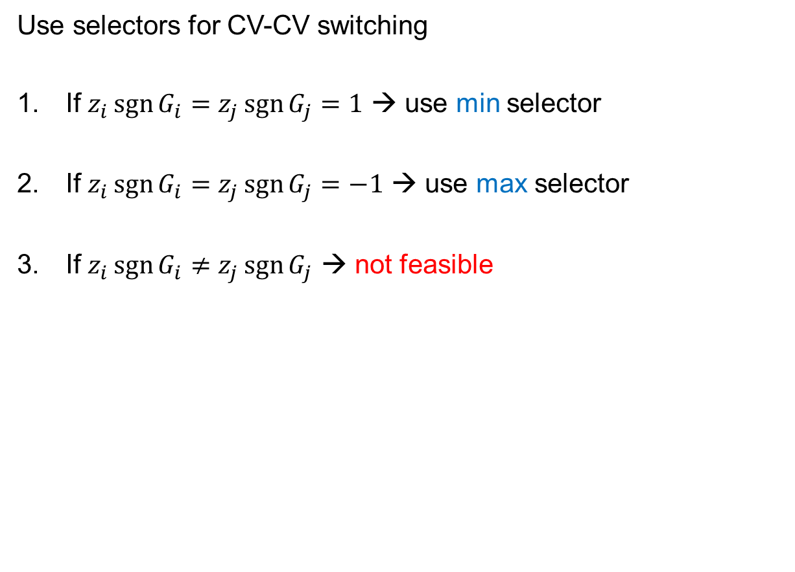
Summary – selectors
Use selectors for CV-CV switching
If $z_{i}\operatorname{sgn}{G_{i}}=z_{j}\operatorname{sgn}{G_{j}}=1$ → use min selector
If $z_{i}\operatorname{sgn}{G_{i}}=z_{j}\operatorname{sgn}{G_{j}}=−1$ → use max selector
If $z_{i}\operatorname{sgn}{G_{i}}≠z_{j}\operatorname{sgn}{G_{j}}$ → not feasible

