Slide 1
Perspectives and future directions in control structure selection
Sigurd Skogestad
NTNU
Trondheim
16 Aug. 2017

Slide 2
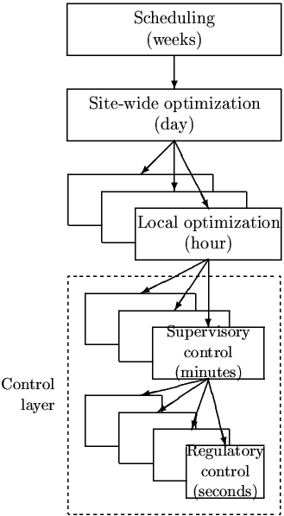
Control structure selection
Optimal: minimize cost J subject to constraints (for varying disturbances)
Cost J: Should include both economics and robustness
Optimal solution is centralized
  «One big optimizing controller» (economic MPC)
So: Control structures selection arises because we want to use non-optimal hiearchical (vertical) and/or decentralized (horizontal) decomposition
RTO / Extremum seeking / Manual
MPC / «advanced control»
PID

Slide 3
Control structure decisions
Basic control layer (single-loop decentralized control)
  Selection of stabilizing CVs (CV2)
  Selection of MV2
  Pairing of CV2 with MV2
    Usually fairly obvious once TPM has been located
Advanced control layer (decentralized or MPC)
  Selection of «econonomic» CVs (CV1) (also when we use MPC)
    Active constraints
    Self-optimizing variables c = Hy (which require infrequent update of setpoints)
      Control structure decision: Structure of H (which measurements y?)
  Selection of MV1 to control CV1:
      CV2_{s} / unused MV (also when we use MPC)
  Feedforward control
  Pairing of CV1 and MV1 (if decentralized control)
      Classical: «pair close» and avoid pairing on negative RGA-elements (integrity)
      New issue: Prepare for constraint switching
Supervisory control: Switching between active constraint regions
  Alternative: Single control structure in several regions (with acceptable loss)?
CV1_{s}
CV2_{s}
MV
TPM = throughput manipulator (traditionally the feed rate)

Slide 4
Switching between active constraint regions (Supervisory control)
Reach new constraint (because of disturbance or setpoint change):
CV constraint
  Give up another less important CV (max/min selector)
MV constraint (the MV is used for control of a CV, otherwise it would not saturate)
  Low-priority CV (e.g., self-optimizing variable or throughput): No special action needed; Give up CV («let CV float»)
  Important CV (active constraint): Must find another MV
    Split range control (SRC) or some other logic
    Suboptimal (avoid switching): Use the other MV for valve position control (= Input resetting = Midranging)
  Notes.
  Case 1: This case is preferable so get pairing rule:
    «MV that may saturate should be paired with CV that may be given up»
    Alternative interpretaton: «Avoid using MV that may optimally saturate (steady-state) to control important CV»
  Case 2: Unless there is an «unused» MV, we must find another MV that is controlling a CV which can be given up, e.g., using a selector

Slide 5
Switching between active constraint regions (Supervisory control)….
Designing a supervisory control system in a systematic manner requires precomputing and analyzing all possible future scenarios (caused by disturbances and price changes)
Relevant issue also for MPC
  MPC can handle some switches but not all (must anyway define priority for MPC)
Graphical can be useful
  Optimal contraint regions as function of disturbances (max- two disturbances)
  CV values / cost as function of MVs (max two MVs)

Slide 6
Implementation of optimal operation using simple control elements
Sigurd Skogestad and Krister Forsman

Slide 7
Basis. Want (close-to) Optimal Operation
MVs should always contribute to optimizing operation (minimize cost J)
Control active constraints
For remaining unconstrained degrees of freedom: Control self-optimizing variables (so that setpoints only need infrequent updates)
Disturbances are the main problem:
Optimal constraint variables may change!
Optimal setpoints change
Question:
How can we implement optimal operation in a simple manner?
Using feedback as our smart tool/trick!

Slide 8
Rules
Control actice constraints
MV that may saturate should be paired with CV that may be given up
  Alternative interpretation of rule: Avoid using MV that may optimally saturate (steady-state) to control important CV (active constraint)
TPM should be located close to bottleneck
  Reason: Avoid «long loop» (and resulting backoff) when we have max. throughput
  Bottleneck: Last constraint to be reached as we increase throughput
Arrange the inventory control loops (for level, pressures, etc.) around the TPM location according to the radiation rule (Georgakis)
Select “sensitive/drifting” variables as controlled variables CV₂ for regulatory control.

Slide 9
More rules
Never control the cost function J (at fixed value)
  May give infeasibility and certainly non-optimal operation
Never do inventory control across TPM-location
  Corresponds to pairing on zero

Slide 10
Example: Maximize flow through a cooler
The temperature must be kept a a given setpoint, e.g. 45 degrees.
”Traditional” structure:
Cooling water
Product
TC
FC
The operator
gives the setpoint for the flow
Weakness of this structure: there is no automatic mechanism that guarantees maximum flow.

Slide 11
T_{CW}
Cooling water
T
Product
TC
FC
q_{s}
2 MVs: q, q_{cw} (both have max-constraints; q<q_{max}, qcw<qcw_{max})
2 CVs (at constraints): T=45C (always),
q = q_{s} (can be given up if infeasible)
Cost J=? (not needed, because solution always at constraints)

Slide 12
Active constraint regions
T_{CW}
45C
qcw=qcw_{max} (bottleneck 1 -> max achievable q)
Infeasible region
Feasible region
q=q_{max} (bottleneck 2)
q_{s}
0
q_{max}
Three active constraints regions (in all regions T=45C):
  q = qs
  qcw = max (CW valve is bottleneck)
  q = max (product valve is bottleneck)
Need control structure thatr can handle all these regions.

Slide 13
T_{CW}
SRC:
Cooling water
q
T
u
Product
TC
FC
qcw
u
SRC
min
q_{s}
u
Three active constraints regions (in all regions T=45C):
  Given setpoint for flow: q = qs
  Bottleneck 1: qcw = max (CW valve) SRC + min.select
  Bottleneck 2: q = max (product valve) No action needed, just give up q

Slide 14
Alternative, slightly suboptimal solution, using «valve position control»
T_{CW}
Cooling water
T
Product
TC
FC
u
min
VPC
q_{s} (operator)
z_{s}
Setpoint valve position for CW = at 95% of max. opening
(so some backoff)
Comment: 1. Has the advantage of not changing the controller for T.
2. With q_{s} large (infeasible setpoint) one can have q=qmax (as long as q_{CW} < max)
3. But cannot quite achieve fully open CW valve (so some loss = backoff)

Slide 15
Alternative, slightly suboptimal solution, using two temperature controllers
with different setpoints
T_{CW}
Cooling water
T_{s}=
45C
T_{s}=
47C
Product
TC
TC
FC
u
min
q_{s} (operator)
Comment: 1. Similar to SRC, but avoids the SRC block.
2. Advantage: Two separate controllers
3. Disadvantage: Temperature a bit higher when we reach CW-constraint

Slide 16
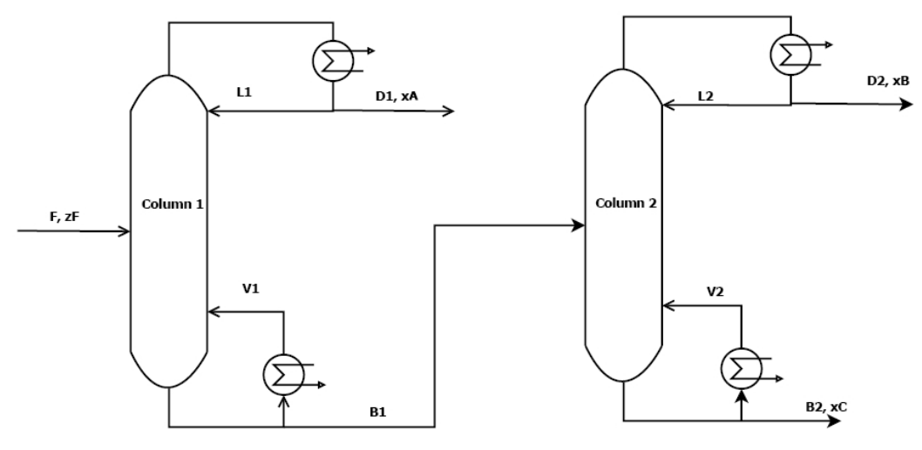
Distillation example
Separate components A (light) and B (heavy)
Cost (J) = - Profit = p_{F} F + p_{V}V – p_{D}D – p_{B}B
Prices: p_{F}=p_{D}=1 $/mol, p_{B}=2 $/mol, Energy p_{V}= 0-0.2 $/mol (varies)
With given feed and pressures: 2 steady-state DOFs.
3 constraints
  Product purities (D,B) > 95%
  capacity constraint on V
x_{A}>95%
V<4 mol/s
xB>95%
Valueable product
«Avoid product give-away» -> Valueable product constraint always active -> xB=95%
DOF = Degree Of Freedom
Notes:
16

Slide 17
Three active constraint regions (+ bottleneck):
x_{A} and x_{B}
Bottleneck!
3 active constraints:
x_{A}, x_{B} and V
p_{V}
Region 1
(bottleneck)
x_{B}
2^2=4
Infeasible region
Region 2
x_{B} and V
1.45
F
1.0
PC
LC
Regulatory control
of levels and pressure
x_{A}
TPM
FC
F_{S}
LC

Slide 18
Three active constraint regions (+ bottleneck):
x_{A} and x_{B}
Bottleneck!
3 active constraints:
x_{A}, x_{B} and V
p_{V}
Region 1
(bottleneck)
x_{B}
Infeasible region
Region 2
x_{B} and V
1.45
F
1.0
PC
LC
Region 1
x_{A}
TPM
x_{As}=99.1% (self-optimizing; can give up)
CC
FC
x_{Bs}=95% (always active!)
CC
F_{S}
LC

Slide 19
Three active constraint regions (+ bottleneck):
x_{A} and x_{B}
Bottleneck!
3 active constraints:
x_{A}, x_{B} and V
p_{V}
Region 1
(bottleneck)
x_{B}
Infeasible region
Region 2
x_{B} and V
1.45
F
1.0
PC
LC
Region 2
TPM
x_{A}
x_{As}=99.1%
SRC:
min
CC
FC
x_{Bs}=95%
_{L}
SRC
CC
F_{S}
u
V
LC
u

Slide 20
Three active constraint regions (+ bottleneck):
x_{A} and x_{B}
Bottleneck!
3 active constraints:
x_{A}, x_{B} and V
p_{V}
Region 1
(bottleneck)
x_{B}
Infeasible region
Region 2
x_{B} and V
1.45
F
1.0
PC
LC
Bottleneck
Region (all regions)
CC
x_{As}=95%
x_{A}
x_{As}=99.1%
min
CC
FC
x_{Bs}=95%
_{L}
SRC
min
CC
F_{S}
u
V
LC
u

Slide 21
Alternatives
Recerse pairing (pair on negative RGA)
Valve position control (use L to avoid V saturating)
Problem
Price changes (pv). Must be handled by «feed forward» since they do not affect the process
That is, optimal «overpurification» setpoint (which is 99.1% in this example), depends on price pv.
At some point it becomes 95% and we have the «xA xB»-region! So all regions are handled by a single structure

Slide 22
Operation of Distillation columns in series
Cost (J) = - Profit = p_{F} F + p_{V}(V₁+V₂) – p_{D1}D₁ – p_{D2}D₂ – p_{B2}B₂
Prices: p_{F}=p_{D1}=P_{B2}=1 $/mol, p_{D2}=2 $/mol, Energy p_{V}= 0-0.2 $/mol (varies)
With given feed and pressures: 4 steady-state DOFs.
Here: 5 constraints (3 products > 95% + 2 capacity constraints on V)
=
N=41
α_{AB}=1.33
> 95% A
p_{D1}=1 $/mol
N=41
α_{BC}=1.5
> 95% B
p_{D2}=2 $/mol
F ~ 1.2mol/s
p_{F}=1 $/mol
=
=
< 4 mol/s
< 2.4 mol/s
> 95% C
p_{B2}=1 $/mol
QUIZ: What are the expected active constraints?
1. Always. 2. For low energy prices.
DOF = Degree Of Freedom
Ref.: M.G. Jacobsen and S. Skogestad (2011)
Notes:
22

Slide 23
Control of Distillation columns. Cheap energy
Example.
PC
PC
LC
LC
A
x_{B}
B
Overpurified
CC
x_{BS}=95%
Given
MAX V1
MAX V2
LC
LC
C
Overpurified
Overpurified: To avoid loss of valuable product B

Slide 24
Solution.
Control of Distillation columns. Cheap energy
PC
PC
LC
LC
x_{B}
CC
x_{BS}=95%
CC
x_{AS}=2.1%
Given
MAX V1
MAX V2
LC
LC
Notes:
24

Slide 25
What happens if we increase the federate?
PC
PC
LC
LC
x_{B}
CC
x_{BS}=95%
CC
x_{AS}=2.1%
Given
(TPM)
MAX V1
MAX V2
LC
LC
Is this control structure still OK??
Notes:
25

Slide 26
TPM
Increase federate: Reach x_{A}-constraint
PC
PC
LC
LC
x_{B}
x_{A}
CC
x_{BS}=95%
CC
x_{AS}=95%
Given
(TPM)
MAX V1
MAX V2
LC
LC
Notes:
26

Slide 27
TPM
Increase federate further: Reach also x_{C}-constraint (Bottleneck)
PC
PC
LC
LC
x_{B}
x_{A}
CC
x_{BS}=95%
TPM used
as MV
CC
x_{AS}=95%
MAX V1
MAX V2
LC
LC
x_{C}
CC
x_{CS}=95%
Notes:
27

Slide 28
Move TPM
Move TPM to F2 (closer to bottleneck) and rearrange level loop
PC
PC
LC
LC
x_{B}
x_{A}
CC
x_{BS}=95%
CC
x_{AS}=95%
MAX V1
MAX V2
LC
LC
x_{C}
CC
TPM (used
as MV)
x_{CS}=95%
Notes:
28

Slide 29

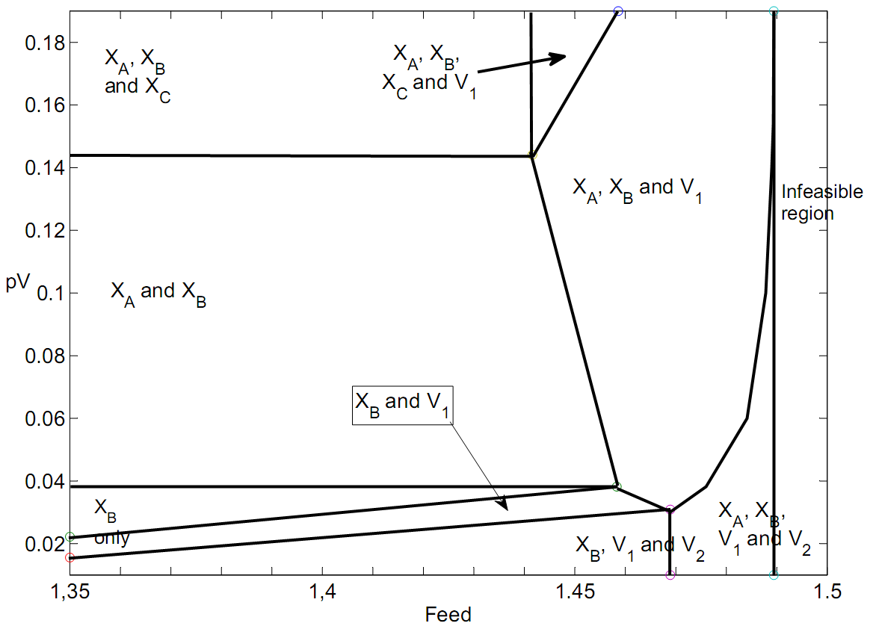
Active constraint regions for two distillation columns in series
Distillation example: Not so simple
0
1
Mode 1 (expensive energy)
Energy
price
1
Mode 2: operate at BOTTLENECK. F=1,49
Higher F infeasible because
all 5 constraints reached
[$/mol]
2
3
2
0
1
[mol/s]
Mode 1, Cheap energy: 3 active constraints -> 1 remaining unconstrained DOF (L₁) -> Need to find 1 additional CVs (“self-optimizing”)
More expensive energy: Only 1 active constraint (xB) ->3 remaining
unconstrained DOFs -> Need to find 3 additional CVs (“self-optimizing”)
CV = Controlled Variable

Slide 30
How many active constraints regions?
Maximum:
  n_{c} = number of constraints
BUT there are usually fewer in practice
Certain constraints are always active (reduces effective n_{c})
Only n_{u} can be active at a given time
  n_{u} = number of MVs (inputs)
Certain constraints combinations are not possibe
  For example, max and min on the same variable (e.g. flow)
Certain regions are not reached by the assumed disturbance set
Distillation
n_{c} = 5
  2⁵ = 32
x_{B} always active
2^4 = 16
-1 = 15
In practice = 8

Slide 31
xA
xB
7
L1
L2
6
F
V1
V2
xAb
xC
8
5
2
1
4
Bottleneck
3
CV regions with suggested pairings
MV | 1 | 2 | 3 | 4 | Bottleneck (5 constraints)
F | F | « | « | « | xC=0.95 (min.select)
L1 | xA=0.991 | XAb=0.023 (SRC+min.select)* | « | xA=0.95 (max.select) | «
V1 | XAb=0.023 | V1=max | « | « | «
L2 | xB=0.95 | « | « | « | «
V2 | xC=0.993 | « | V2=max | « | «
Blue: unconstrained optimal values (depend on energy price)
*Could avoid with reverse pairing in region 1 (pair on negative RGA)

Slide 32
Constraints: xA, xC, V1, V2 (xB always active)
No constraints (1)
xA (5) (handled OK, happens when energy is expensive so xAopt reaches 95%)
xC (handled OK, happens if column 2 is shorter and energy expensive so xCopt reaches 95%)
V1 (2)
V2 (handled OK, happens if column 2 is shorter)
xA, xC (6) (handled OK)
xA, V1 (8) (NOT handled, two constraints in column 1, so will be bottleneck!)
xA, V2 (handled OK, happens if column 2 is shorter)
xC, V1 (handled OK)
xC, V2 (NOT handled, three constraints in column 2, so must use column 1 to control xC)
V1, V2 (3)
xA, xC, V1 (7) (NOT handled; bottleneck; see region 7)
xA, V1, V2 (4)
xc, V1, V2 (NOT handled, see region 10)
xA, xB, V1, V2 (Bottleneck)

Slide 33
Solution for low federate
PC
PC
LC
LC
x_{A}
CC
x_{BS}=95%
TPM
x_{AS}=99.1%
CC
FC
CC
CC
x_{CS}=99.3%
F_{S}
x_{AbS}=2.31%
LC
LC
Notes:
33

Slide 34
Solution for higher feedrate
PC
PC
LC
LC
x_{A}
CC
x_{BS}=95%
TPM
x_{AS}=99.1%
min
CC
FC
CC
max
SRC
CC
x_{CS}=99.3%
F_{S}
max
x_{AbS}=2.31%
LC
LC
Notes:
34

Slide 35
Solution for all regions
PC
PC
LC
LC
x_{As}=95%
x_{A}
CC
CC
x_{Bs}=95%
TPM
max
x_{As}=99.1%
min
CC
FC
CC
SRC
CC
x_{Cs}=99.3%
F_{S}
min
x_{Ab,s}=2.31%
LC
LC
CC
x_{Cs}=95%
Notes:
35

