Slide 1
Example of feedforward with B
Date: 23.11.2016
I have discussed this with Karl Johan Åstrøm and I have written a separate note on the issue (mlokal/sis)
03 Feb. 2022: Similar for measured disturbance! See last slide.
In any case, for FF control it’s difficult to beat MPC!

Slide 2
Theory: 7. Two degrees-of-freedom control*
e
Typically, for a setpoint change r, the feedforward block is A = G₋⁻¹F_{r} where G₋ is the invertible part of G.
  A typical choice for the prefilter is F_{r} = 1/(τ_{r}s+1)
  Example. G=(-3s+1)exp(-4s)/(7s+1)^2, Fv=1 (perfect measurement) and taur=2. Use “IMC-like” design and write G = G₊ G₋ where G₊=exp(-4s)(-3s+1)/(3s+1) and G₋=(3s+1)/(7s+1)^2. Gives A = (7s+1)^2/(3s+1)(2s+1)
We want to choose B such that A and K can be designed independently!!
  Solution* (Lang and Ham ,1955): Choose B=F_{y}GA so that transfer function from r to the controller input (e) is zero (with perfect model) !!
  The feedback will then only take action if the feedforward is not working as expected (due to model error).
  We must have B(0)=I so that we will have no offset (y=r at steady state) even with model error for G
  Example. B(s) = F_{y}GA = F_{y}G₊F_{r} = exp(-4s)(-3s+1)/(3s+1)(2s+1). Note that B(0)=1.
The feedback controller K can be designed for disturbance rejection and robustness, e.g., using SIMC rules.
  Example. Approximate as first-order with delay process with theta=4+3+7/2=10.5 and tau1=7+7/2=10.5, and use SIMC! With tauc=theta get Kc=0.5 and taui=10.5.
The same approach applies to disturbances (d=r) with a feedforward controller Cff and measurement Gdm, but then GA is replaced by (G Cff Gdm + Gd). So we get B = Fy (G Cff Gdm + Gd). Note that Fy=Gm in many cases.
*See my note on Two degrees …. in mlokal/sis

Slide 3
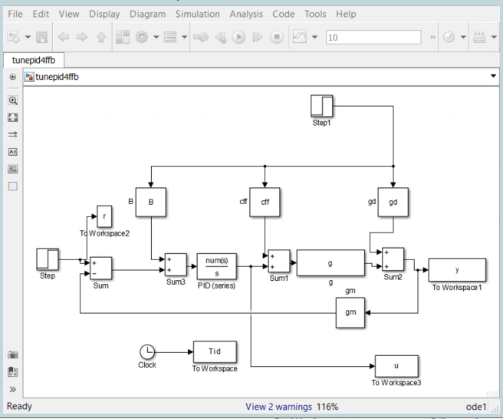
g=exp(-s), gd=1, gm=1
Cff=-1
Pure I-controller with Ki=0.5 (SIMC)
B = (cff*g*gdm + gd)*gm = 1 - exp(-s)

Slide 4
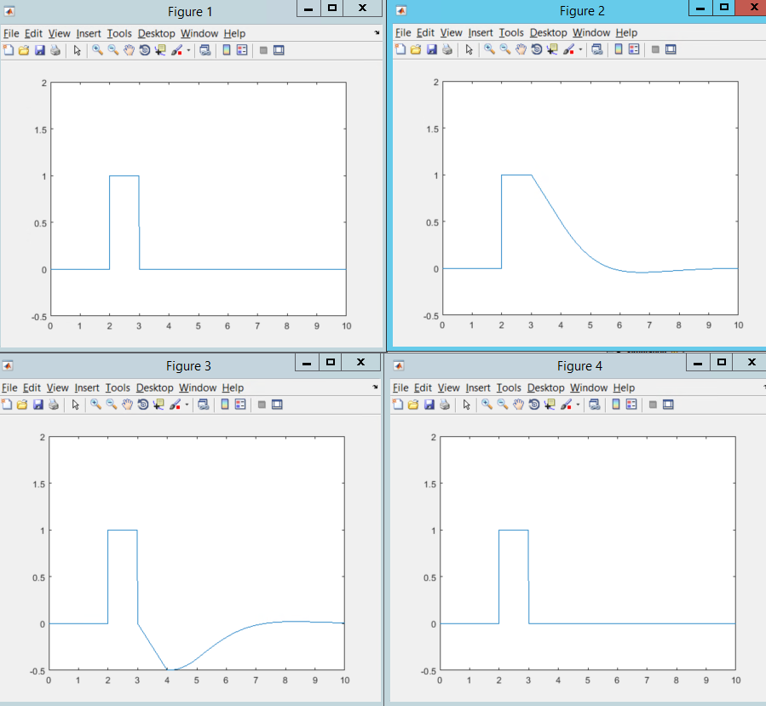
G(s) = e^{-s}
G_{d}=1
Only Feedforward, C_{ff}=-1
Only Feedback, C(s) = 0.5/s
Feedforward + Feedback
(get «overshoot» compared to pure ff)
Feedforward + Feedback + B
(recovers pure feedforward)
B = c_{ff}*g + g_{d} = 1 - e^{-s}
Input C(s): e = y – y_{s} + B d

Slide 5
