Slide 1
Coordinated Feedback-optimizing Control for Large Scale Process
with application of field-wide oil & gas production system
Risvan Dirza
Department of Chemical Engineering
Norwegian University of Science and Technology (NTNU)
Norwegian University of Science and Technology
June 2024
PhD Defence

Slide 2
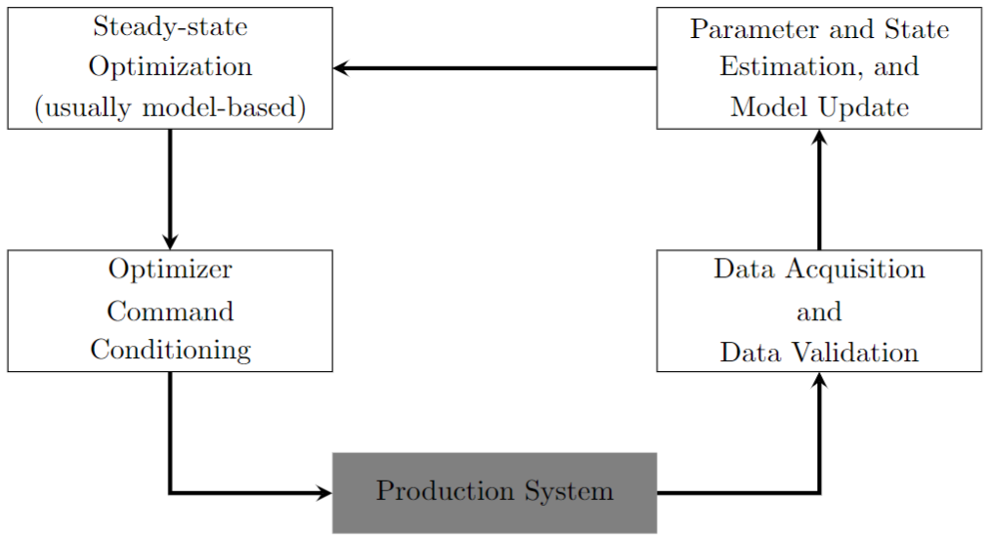
What is RTO?
Automate optimal decision making in real-time.
Continuous analysis of real-time production data.
4 Components

Slide 3
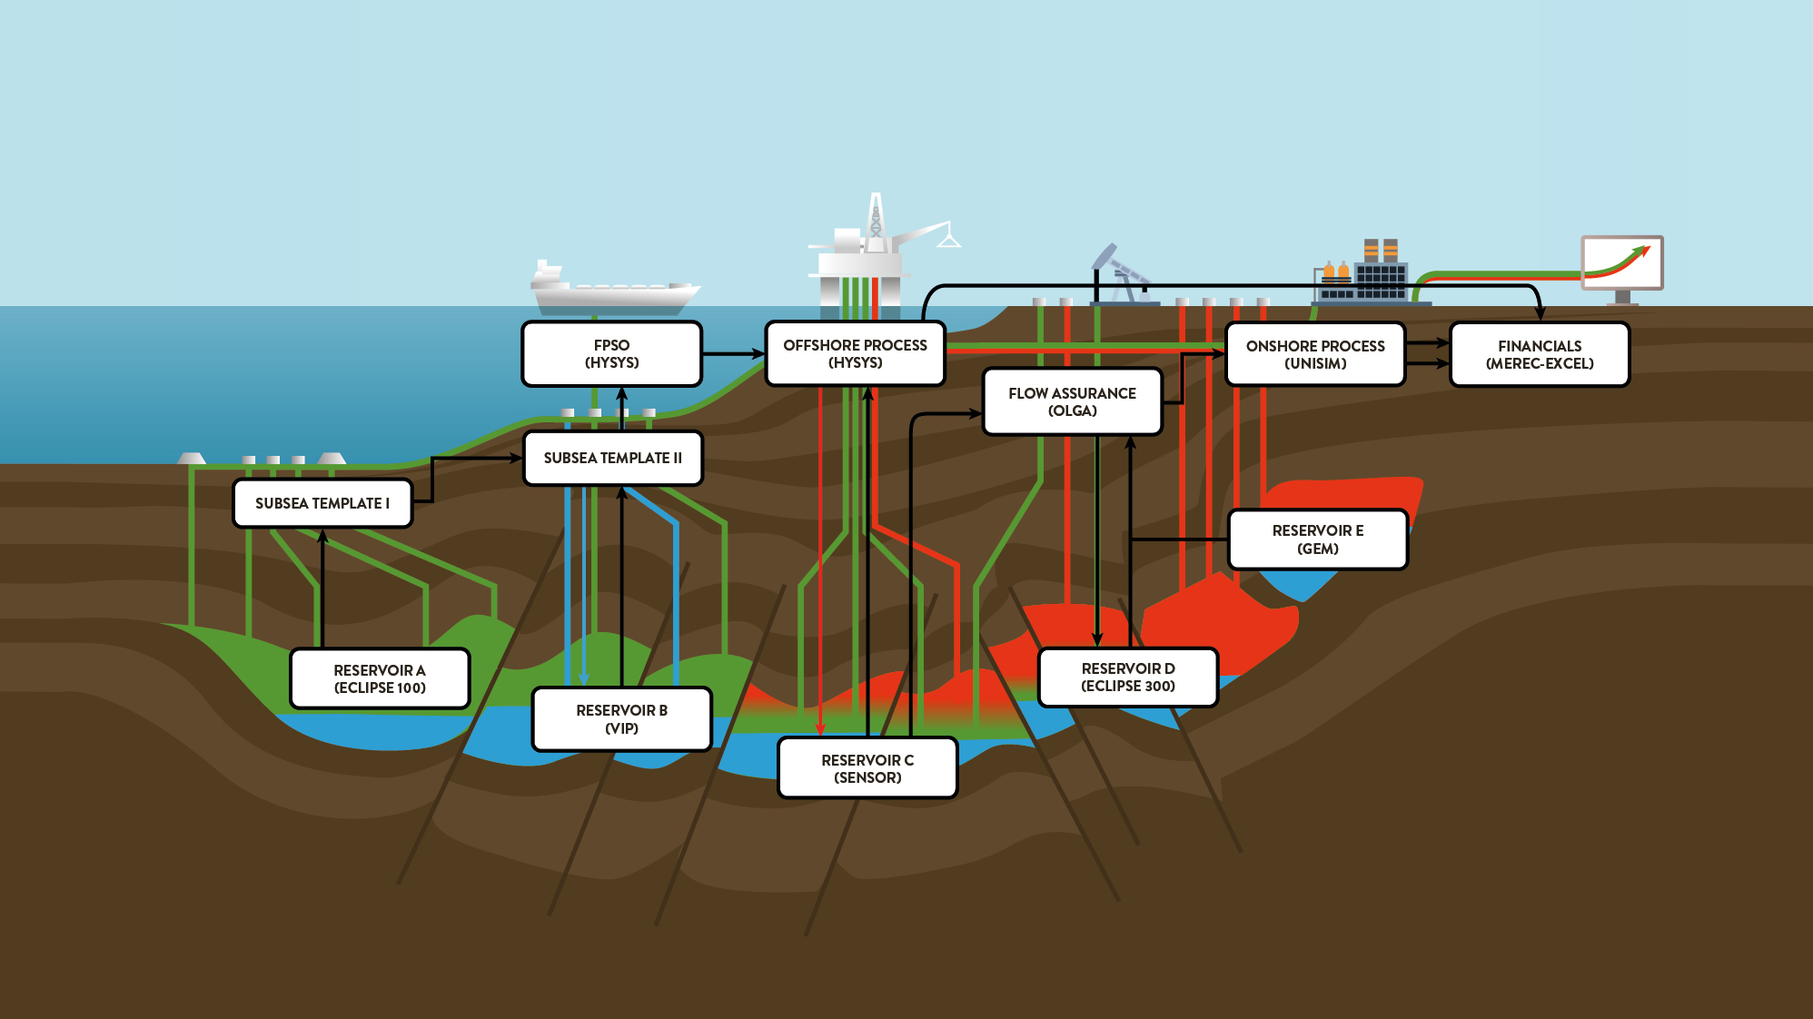
Optimization in Oil & Gas Industry

Slide 4
Main Research Questions
What strategies can be employed to optimize the operation of a complex, large-scale oil and/or gas production system with diverse sub-processes, varying timescales, and potential numerous constraints, utilizing simple tools like PID controllers, selectors, and small-scale solvers (if necessary)?

Slide 5
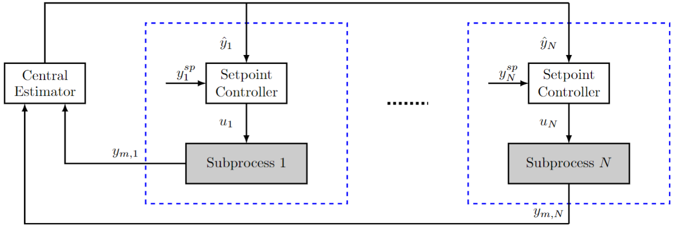
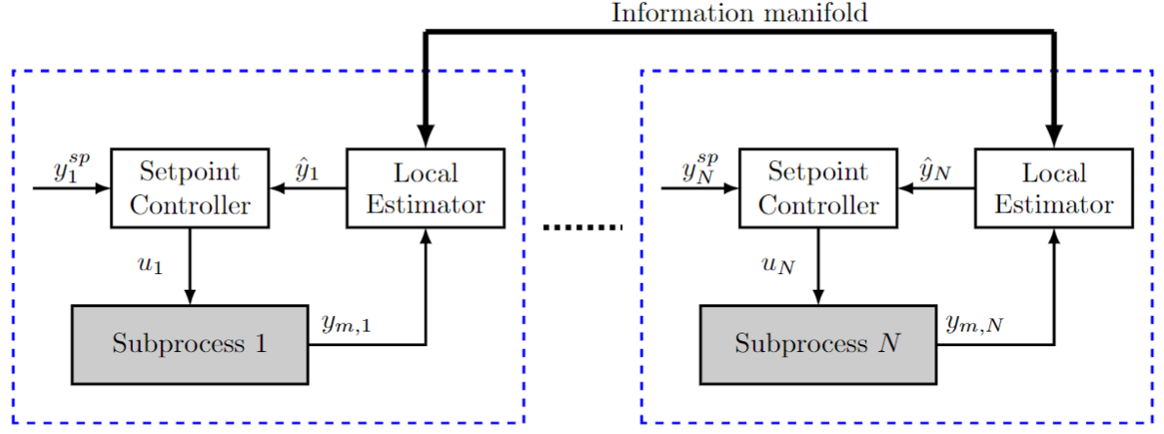
Thesis Structures
Part I: Distributed Feedback-optimizing Control
Part II: Distributed Feedback-optimizing System
Part III: Addressing Practical Issues

Slide 6
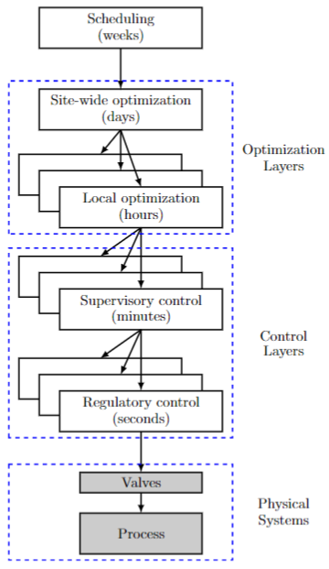
Optimal Production Operation – State of the Art
Control Structure of Optimal Production Operation

Slide 7
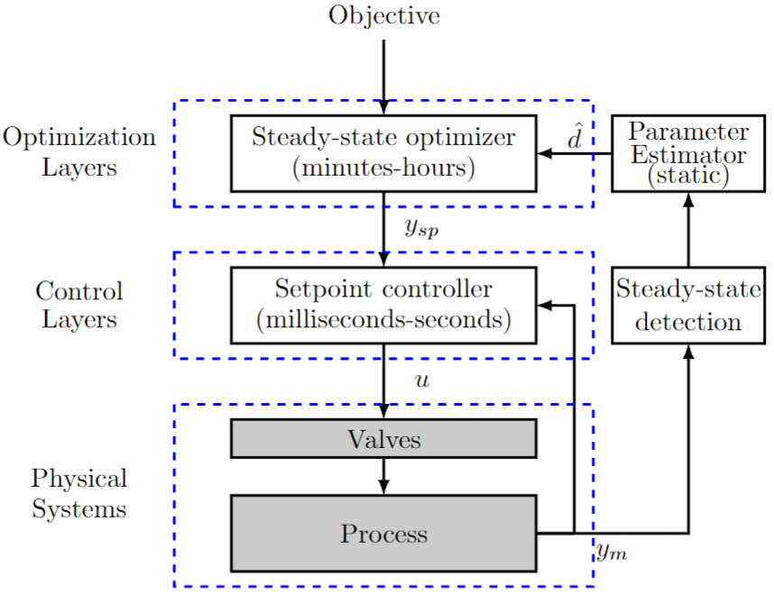
Optimal Production Operation – State of the Art
Traditional SSRTO
Issue : Steady-state wait time
Issue : Non-transparent constraint control

Slide 8
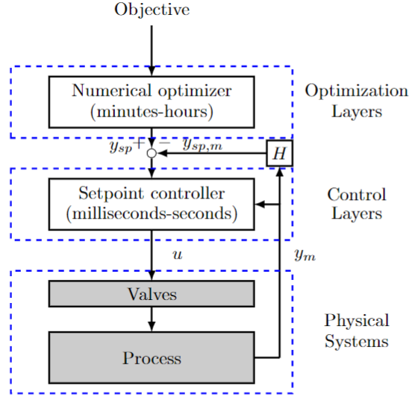
Optimal Production Operation – State of the Art
Traditional SOC
Advantage : Active (transparent-) constraint control
Issue : Sub-optimal performance
Issue : Constant set of active constraints

Slide 9
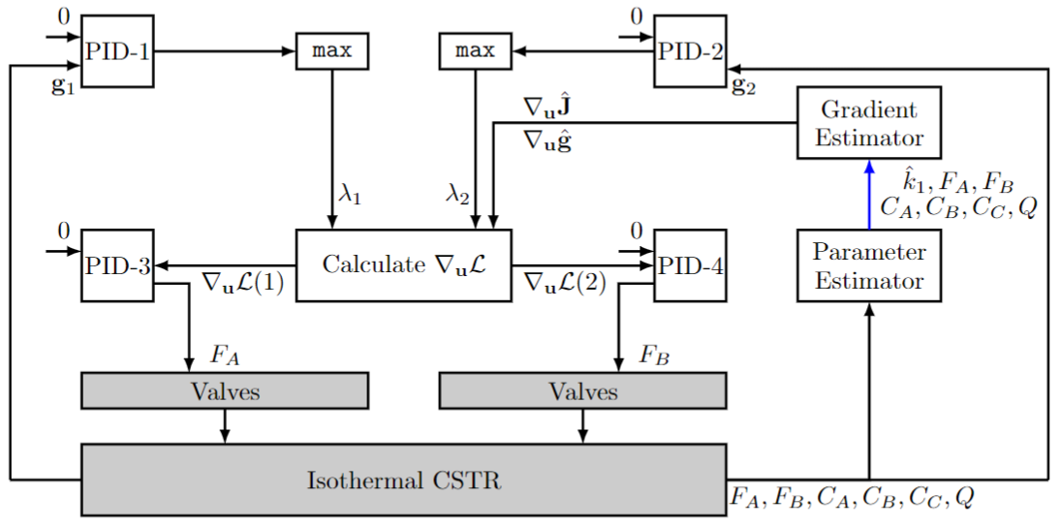
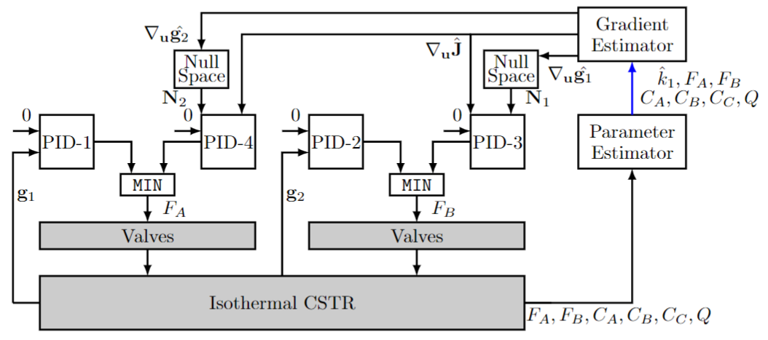
Num. Example – Isothermal CSTR
Reduced Gradient FOC
Primal Dual FOC
PART I

Slide 10
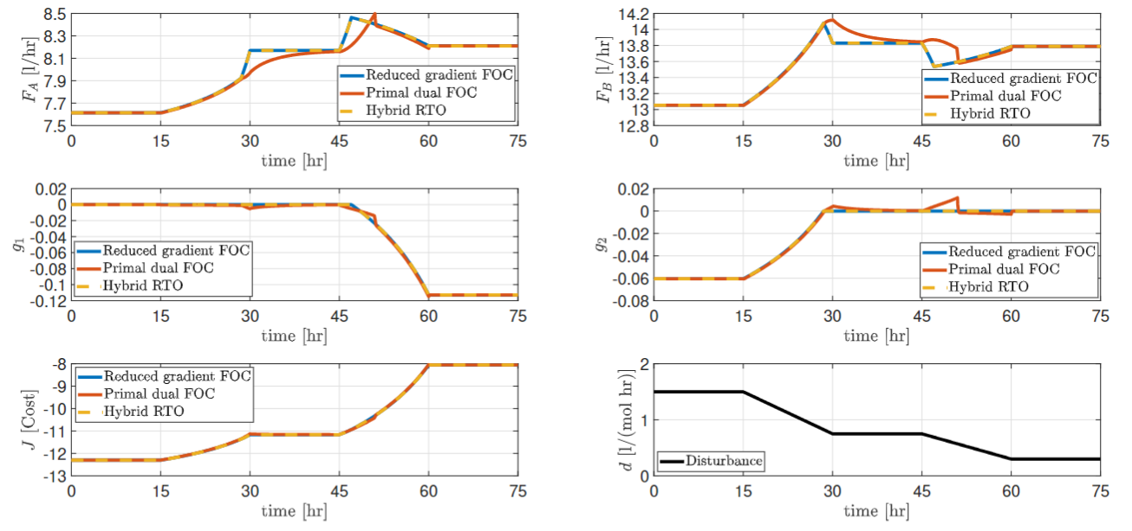
Num. Example – Isothermal CSTR
PART I
Compare control structure performance

Slide 11
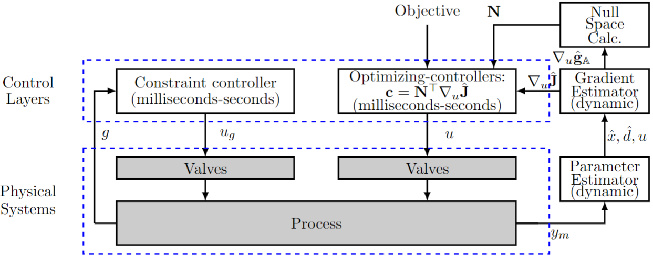
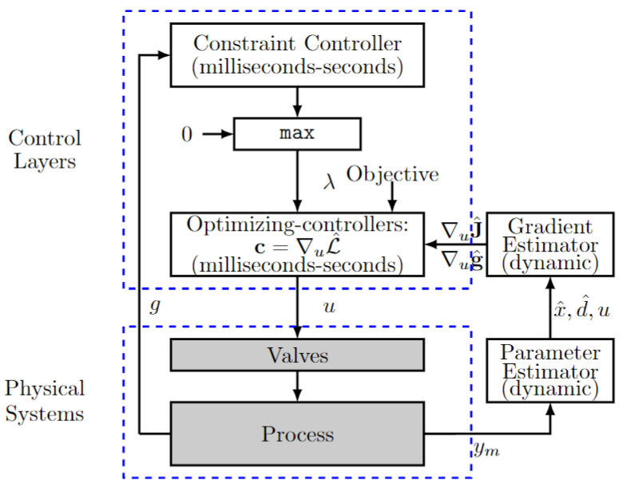
Preliminary Definitions
Direct Constraint Control
Directly updating a primal MVs
Ex. Reduced gradient approach
PART I
Indirect Constraint Control
Indirectly updating a primal MVs
Intermediate variable exists
Ex. Cascade constraint control

Slide 12
Why do we need override?
Indirect Constraint Control
Indirectly updating a primal MVs
Intermediate variable exists
Ex. Cascade constraint control
Technical Motivations
Steady-state gradients
Accurate estimation
Favorable matrix condition
Enough measurement
May fail to control constraint in steady-state.
Dual MVs
Slow update
May lead to significant dynamic constraint violation
PART I

Slide 13
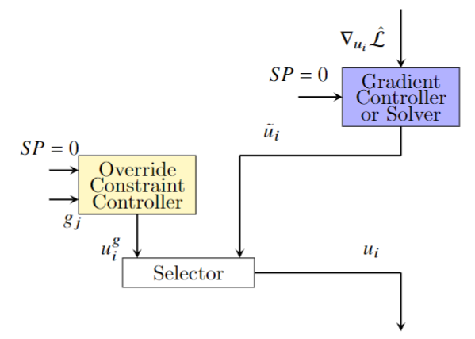
Primal-Dual Framework with Override
Override Constraint Controller
Incorporate fast override controller
Add selector
PART I
Override pairings
Pair close rule
Input saturation rule
Tuning of override controller
Time scale separation
4-10 faster than gradient controller

Slide 14
Primal-Dual Framework with Override
Override Constraint Controller
Choice of selector
Min
Gain > 0, and upper bound
Gain < 0, and lower bound
Max
Gain > 0, and lower bound
Gain < 0, and upper bound
PART I

Slide 15
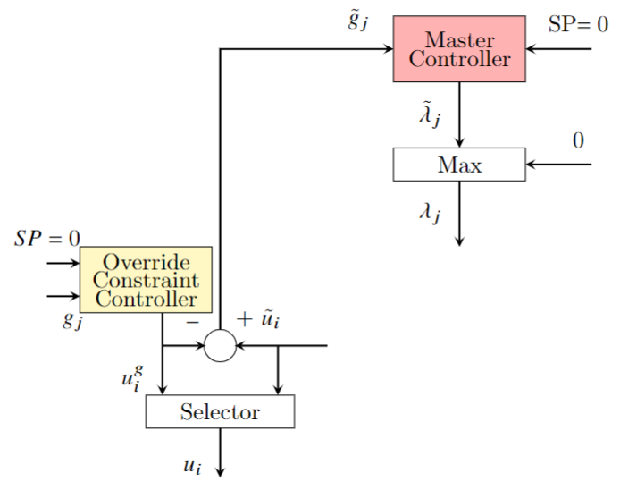
Primal-Dual Framework with Override
Auxiliary Constraints
To allow active constraint switching
Replace original with aux. constraint
Auxiliary constraint:
${\tilde{g}}_{j}={\tilde{u}}_{i}−u_{i}^{g}$
PART I

Slide 16
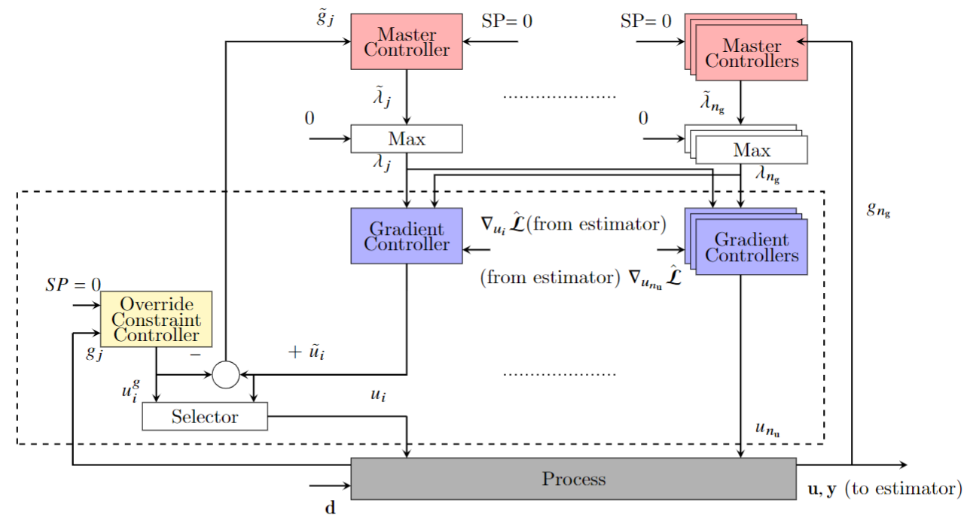
Primal-Dual Framework with Override
PART I
Original Primal-Dual Framework
Outer layer controller = Constraint controller
Indirect constraint controller
Active constraint switching
Proposed approach
Outer layer controller = Master controller
Active constraint switching
Override controller
Direct constraint controller

Slide 17
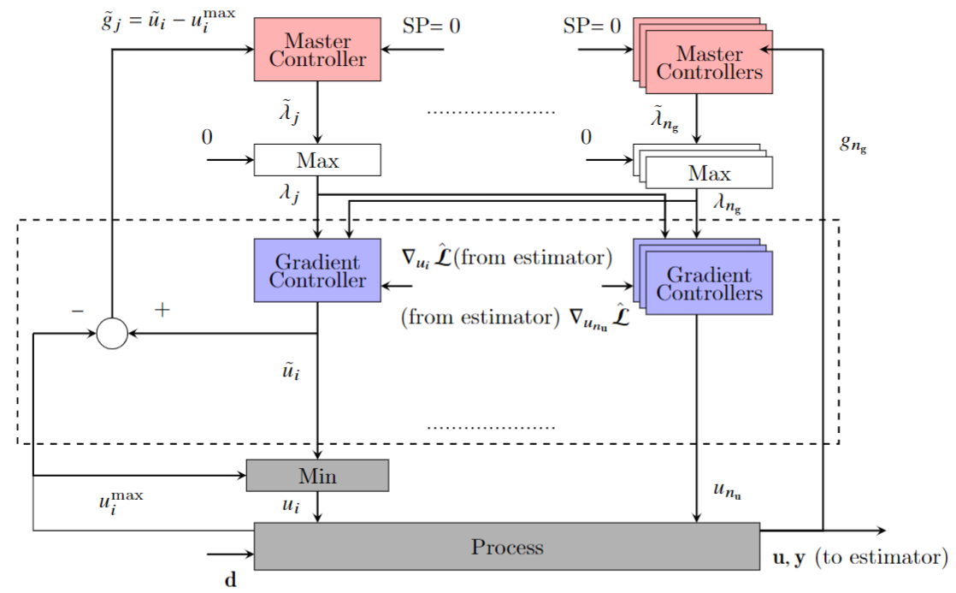
Primal-Dual Framework with Override
Implicit Override
PART I

Slide 18
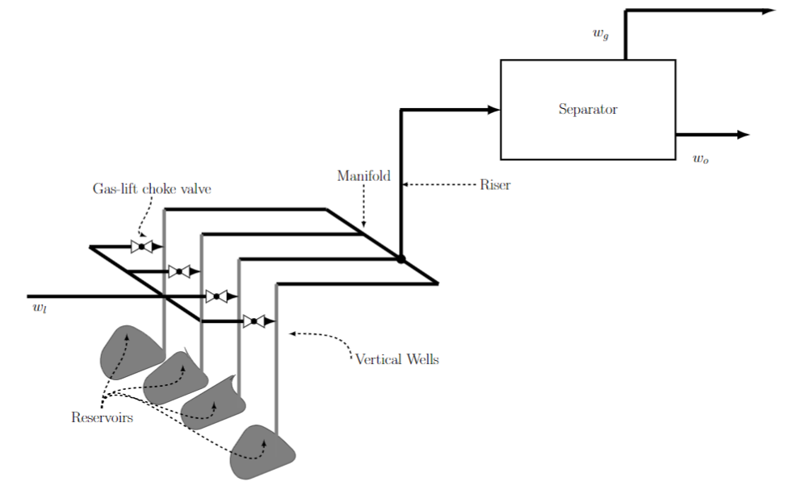
Numerical Examples
Case Description
PART I

Slide 19
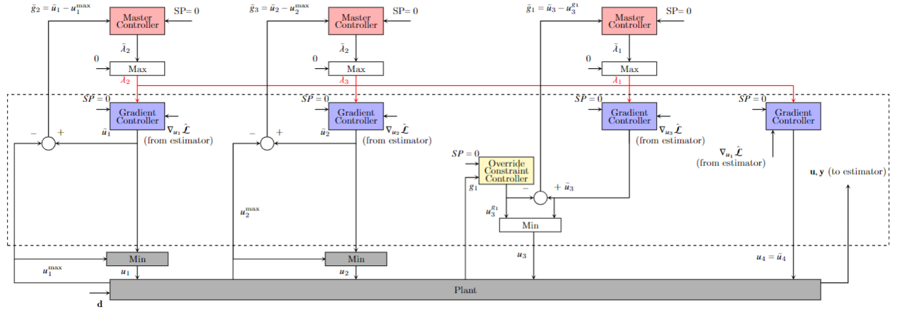
Numerical Examples
Proposed Control Structure
PART I

Slide 20
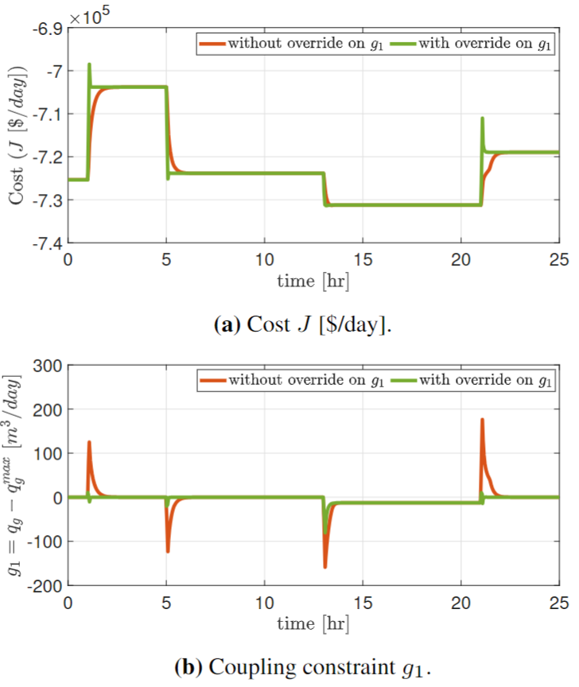
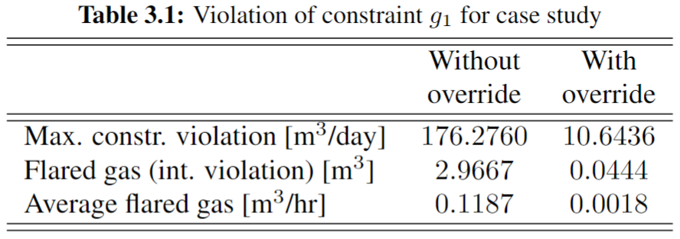
Numerical Examples
Tight Constraint Control
PART I

Slide 21
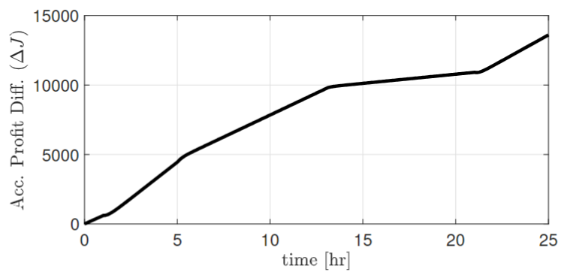
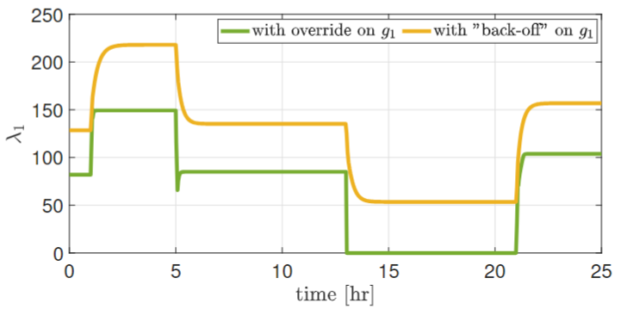
Numerical Examples
Back-off Reduction
PART I

Slide 22
Interactive Systems in Primal Dual Framework
Definition
Decomposed (decoupled) system
Weakly interactive system
Highly interactive system
PART II

Slide 23
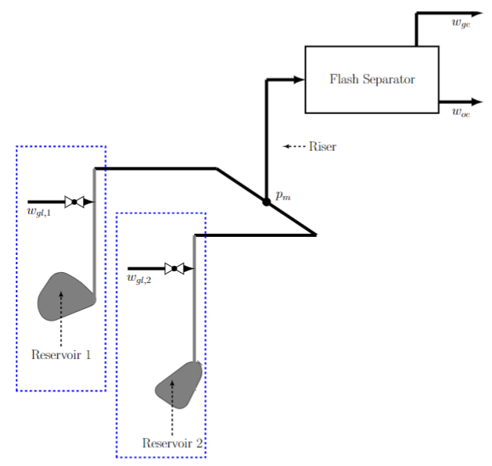
Interactive Gas Lift Optimization
PART II

Slide 24
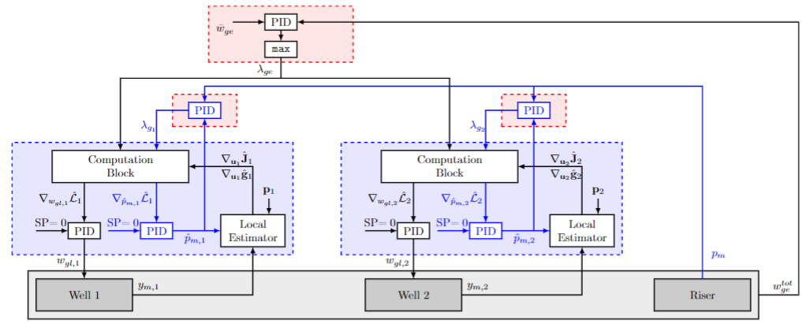
Dual-based dFoS with predictors
PART II

Slide 25
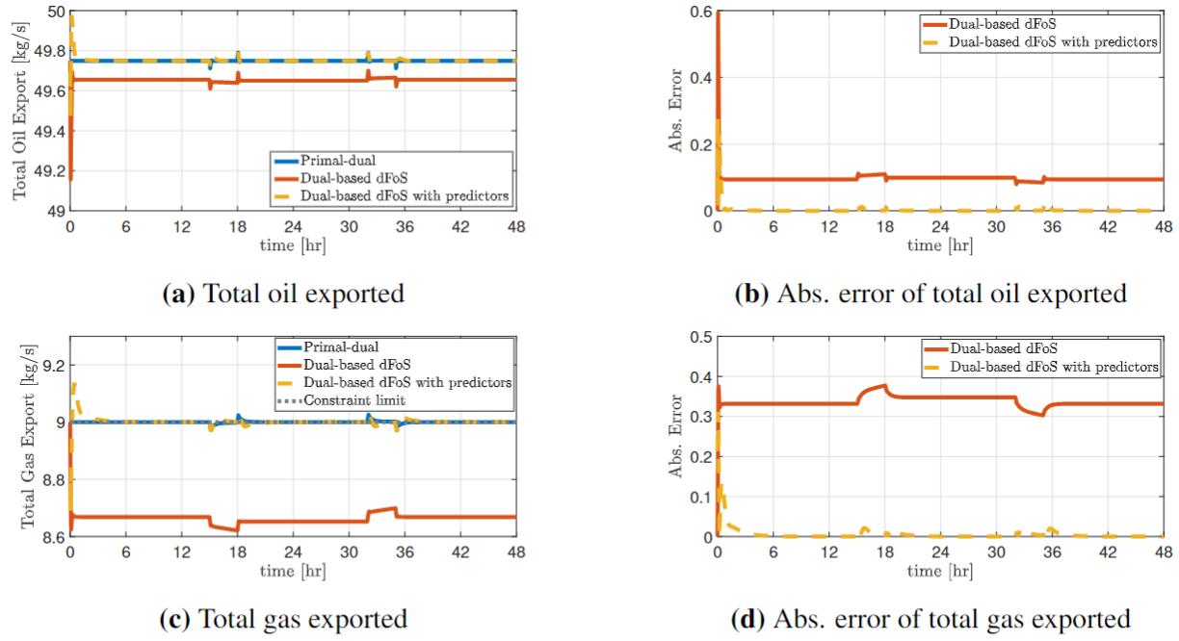
Numerical Examples
Simulation Results
PART II

Slide 26
Numerical Examples
Simulation Results
PART II

Slide 27
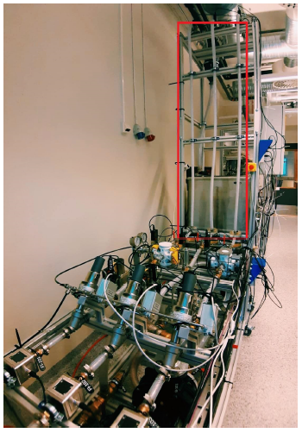
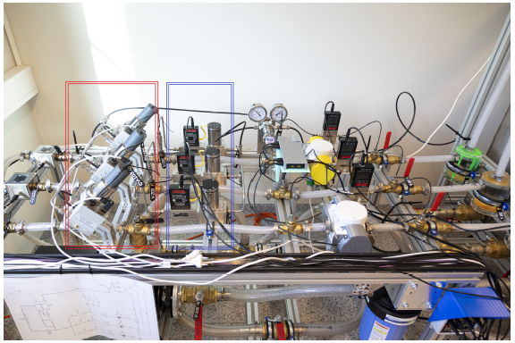
Experimental Setup
Mimicking a subsea production system
PART II

Slide 28
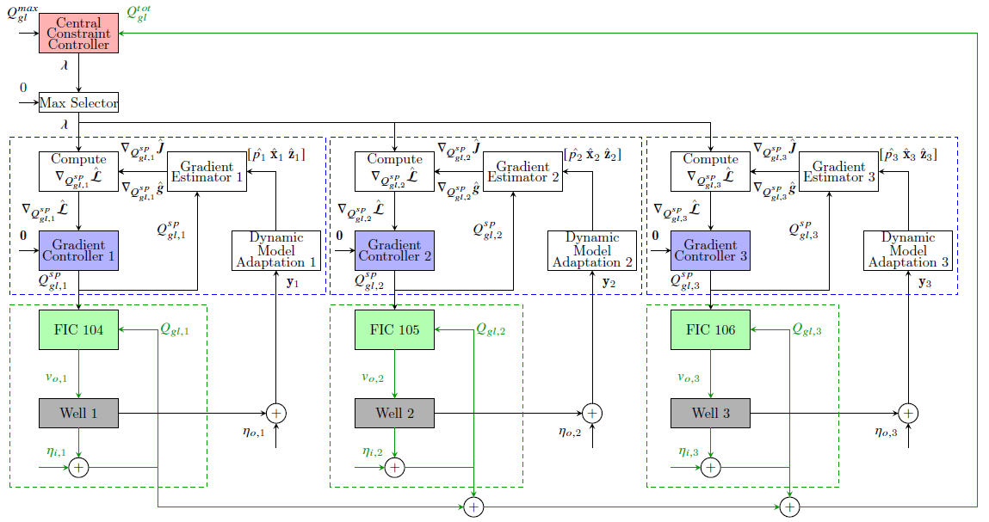
Dual-based DFOS Setup
Control Structure Design
PART II

Slide 29
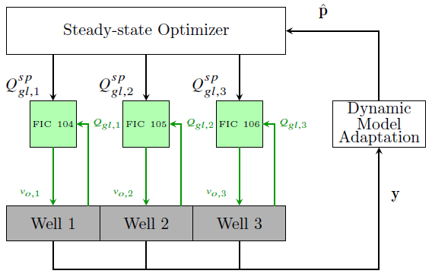
Dual-based DFOS Setup
Benchmark
Hybrid RTO
Execution period : 10 seconds
Use solver to provide optimal setpoints
PART II

Slide 30
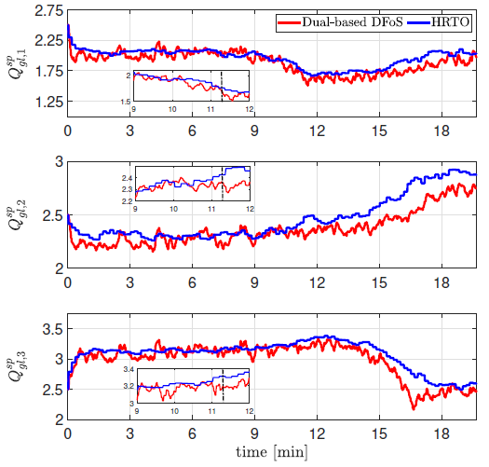
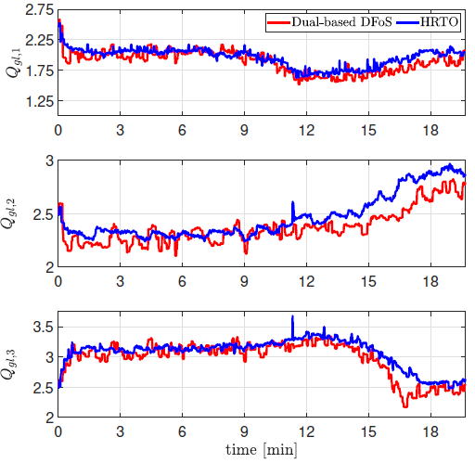
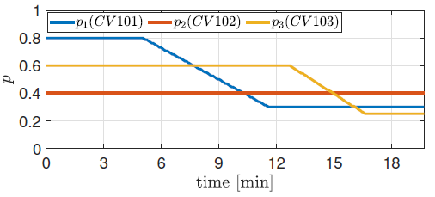
Results and Discussion
PART II

Slide 31
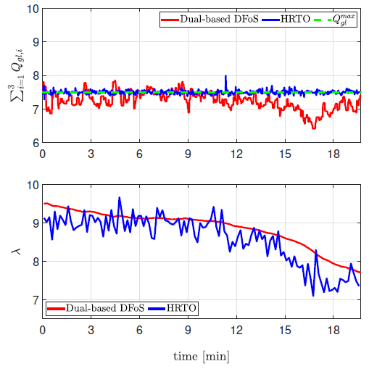
Results and Discussion
Constraint satisfaction
PART II

Slide 32
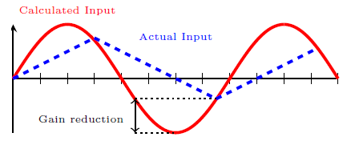
Why do we need multi-input override?
Case :
Limited input rate
Several available MVs
Critical constraints
Slow constraint control.
PART II

Slide 33
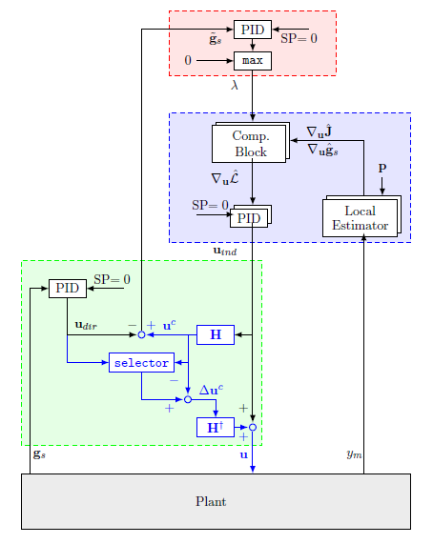
Multi-input override
Transform multi-to single-input
PART II

Slide 34
Multi-input override
Construction selection matrix
Gain matrix
Gain ratio matrix
Disturbance sensitivity
PART II

Slide 35
Multi-input override
Combining correction
Calculate correction factor
Correction factor selection for multiple constraints
Calculate corrected input
PART II

Slide 36
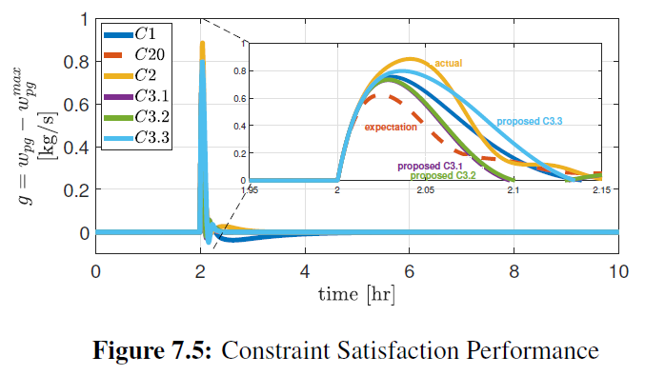
Numerical Examples
Simulation Results
C1: Standard dual-based dFoS
C20: Expected dual-based dFoS with single-input override
C2: Actual dual-based dFoS with single-input override
C3.1: ~ multi-input override with gain matrix
C3.2: ~ multi-input override with gain ratio matrix
C3.3: ~ multi-input override with disturbance sensitivity
PART II

Slide 37
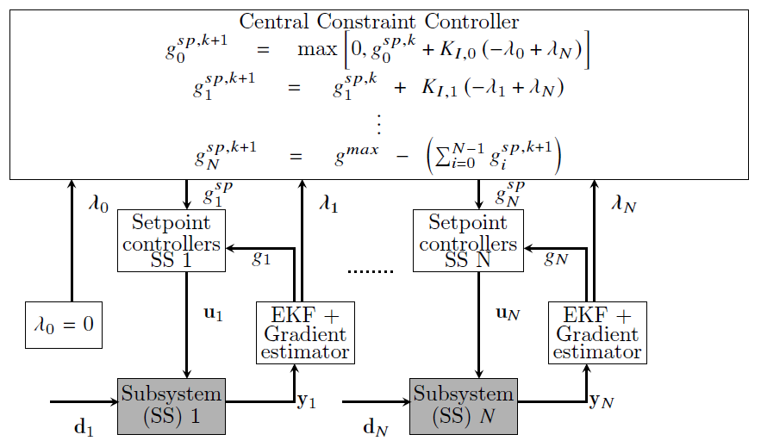
Primal-based DFoS with Compensator
Local setpoint update by constraint controllers
PART II
Normal subsystem

Slide 38
Primal-based DFoS with Compensator
Local setpoint update by constraint controllers
PART II
Virtual subsystem

Slide 39
Primal-based DFoS with Compensator
Local setpoint update by constraint controllers
PART II
Compensator subsystem

Slide 40
Primal-based DFoS with Compensator
Local setpoint controllers
PART II
Special Case
No need for shared input constraints

Slide 41
Primal-based DFoS with Compensator
Local Lagrange multiplier estimation
PART II
Remark
Lagrange mult. of virtual subsystem is 0

Slide 42
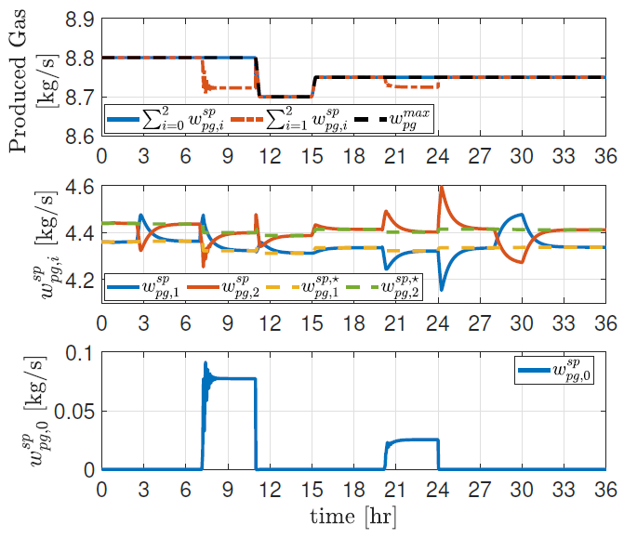
Numerical Examples
Simulation Results (1)
PART II

Slide 43
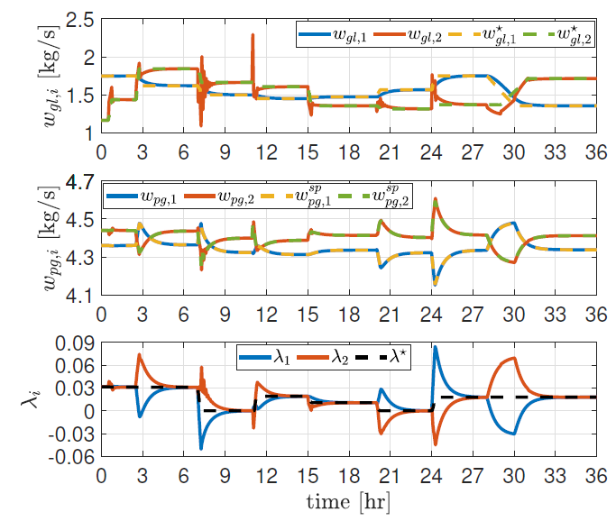
Numerical Examples
Simulation Results (2)
PART II

Slide 44
A Comparative Study of DFoS: Experimental Validation in a Gas-lifted Oil Well Rig
PART II

Slide 45
Experimental Setup
Optimization problem setup
$$J\left(Q_{gl}^{sp},p\right)≔\sum_{i=1}^{3}{f_{i}\left(Q_{gl,i}^{sp},p_{i}\right)}$$
PART II
$$≔−20Q_{l,1}\left(Q_{gl,1}^{sp},p_{1}\right)−25Q_{l,2}\left(Q_{gl,2}^{sp},p_{2}\right)−30Q_{l,3}\left(Q_{gl,3}^{sp},p_{3}\right)$$
$$g\left(Q_{gl}^{sp},p\right)≔Q_{gl,1}^{sp}+Q_{gl,2}^{sp}+Q_{gl,3}^{sp}−Q_{gl}^{max}$$

Slide 46
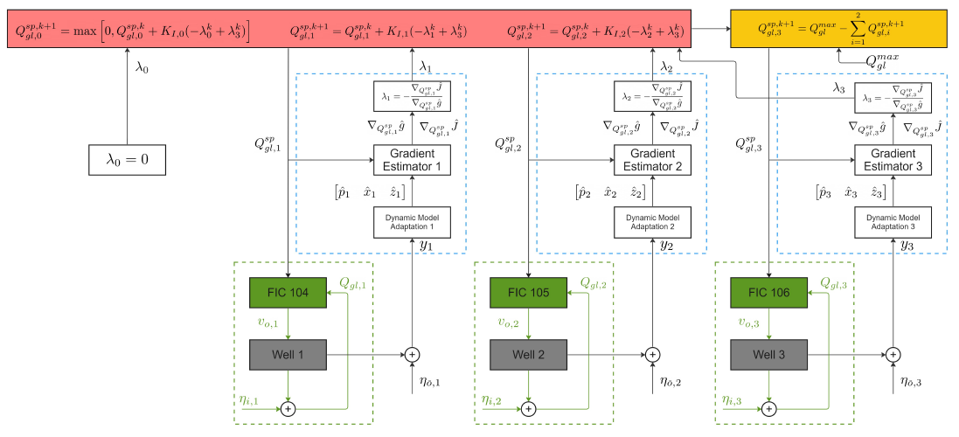
Primal-based DFOS Setup
Control Structure Design
PART II
Compensator Subsystem Selection
Positive cumulated profit difference based on expected disturbance trajectory

Slide 47
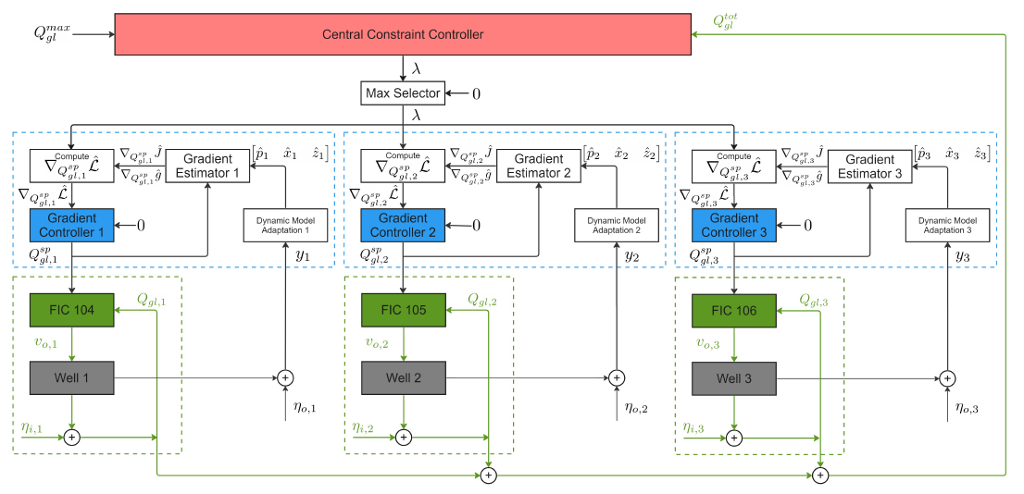
Dual-based DFOS Setup
Control Structure Design
Extra control layer
PART II

Slide 48
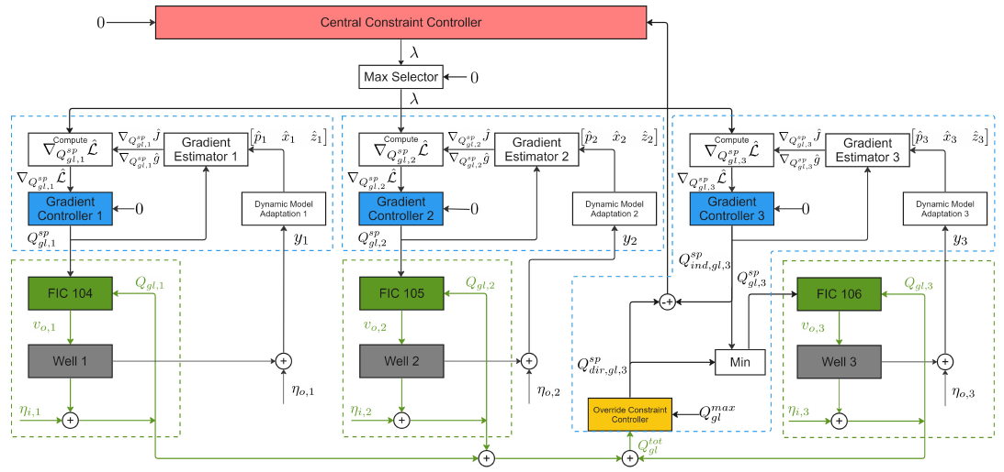
Dual-based DFOS Setup with Override
Override Subsystem Selection
Avoid local input constraint
Lowest dynamic violation
Control Structure Design
PART II

Slide 49
Benchmark
Dual-based DFOS with Back-off
Back-off until no constraint violation
Naïve Approach
Constant Valve Position
PART II

Slide 50
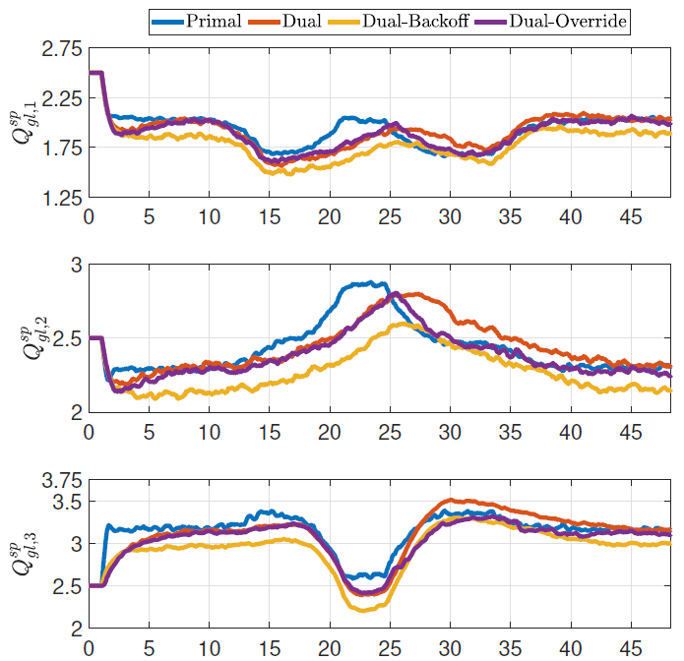
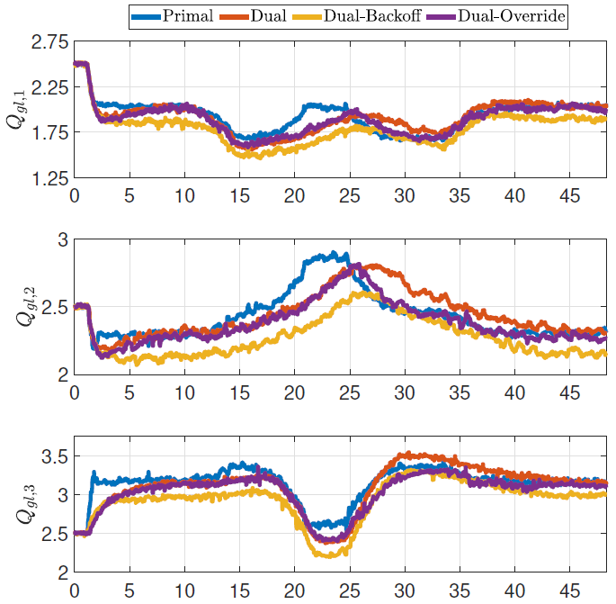
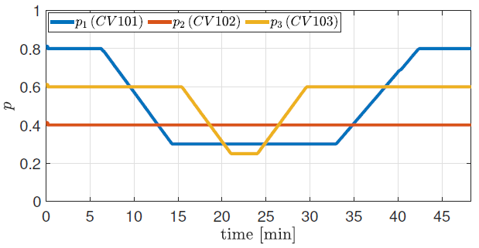
Results and Discussion
PART II

Slide 51
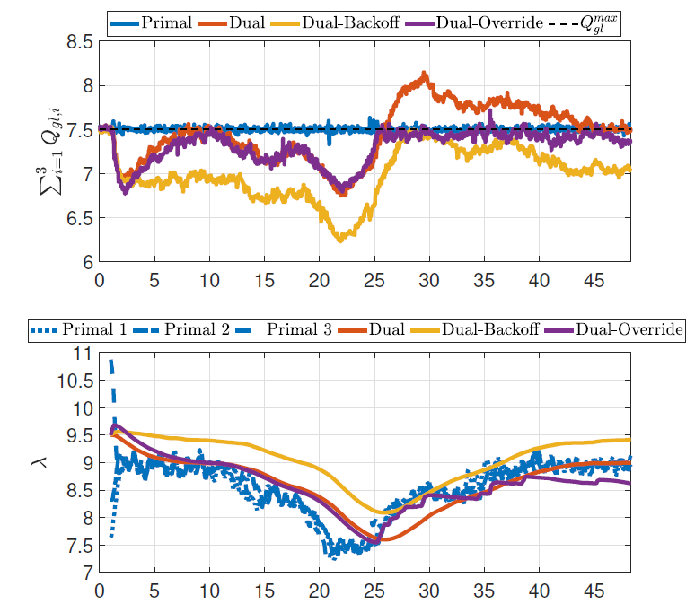
Results and Discussion
Constraint satisfaction
PART II

Slide 52
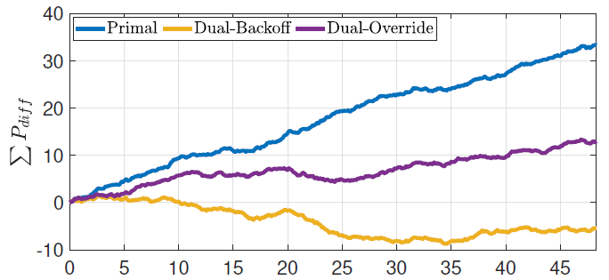
Results and Discussion
Profit difference compared to naïve approach
PART II

Slide 53
Why traditional SOC is still necessary?
Limited available measurements
Costly suitable model development leading to infrequent update
Inaccurate parameter/gradient estimation
Numerical issues
Costly dynamic model development and dynamic estimator
PART III

Slide 54
Gas-Lifted Optimization Problem
PART III

Slide 55
Recirculated Gas-Lifted Optimization Problem
PART III

Slide 56
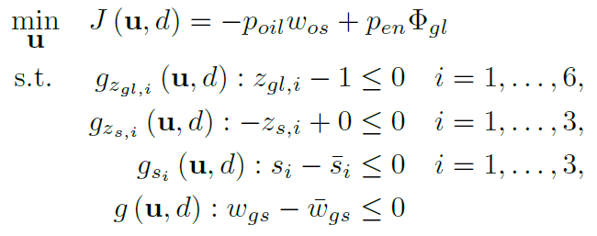
Steady-state optimization problem
Maximize oil revenue
Minimize gas lift cost
GLC has max. opening
SCV has min. opening
Surge constraints
PART III
Max export/produced gas constraints
Available measurements
Disturbances

Slide 57
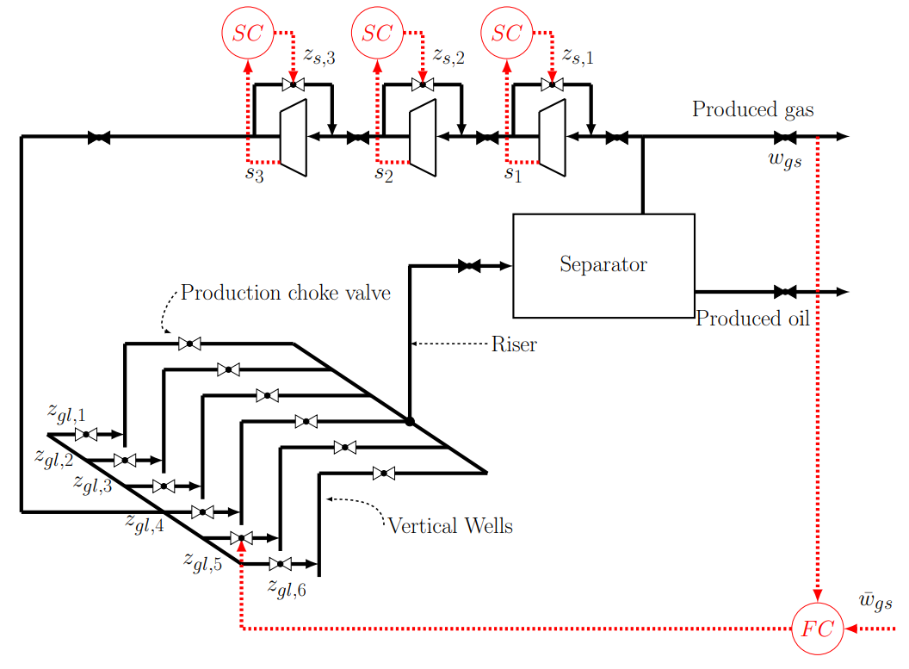
Self-optimizing Control Structures
Structure 1
Keep the valve position $\left(u=u^{∗}\right)$
Structure 2
Control active constraints
$z_{gl,5}→g\left(u,d\right)$
$z_{s,i}→g_{z_{s,i}}\left(u,d\right)$
PART III

Slide 58
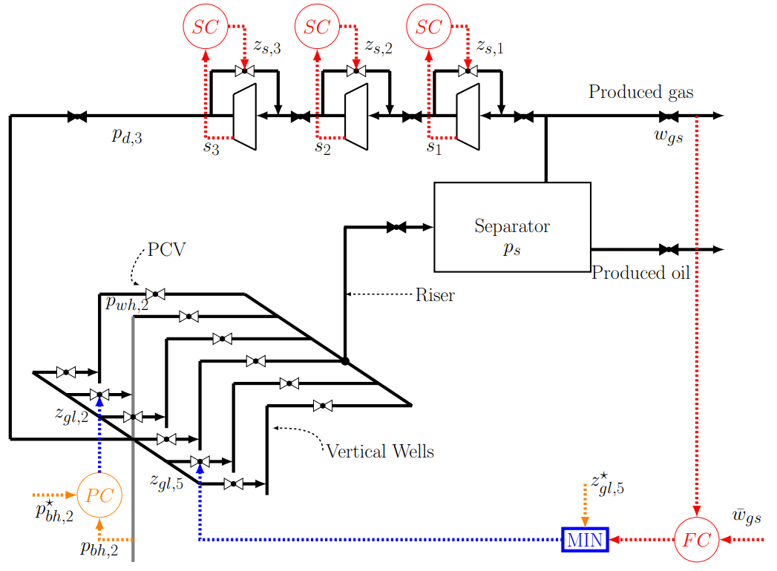
Self-optimizing Control Structures
Structure 3
Region I
Control active constraints
$z_{gl,5}→g\left(u,d\right)$
$z_{s,i}→g_{z_{s,i}}\left(u,d\right)$
Control bottomhole pressure as self-optimizing control variable
$z_{gl,2}→p_{bh,2}$
Region II
Control active constraint
$z_{s,i}→g_{z_{s,i}}\left(u,d\right)$
Control self-optimizing control variables
$z_{gl,2}→p_{bh,2}$
$z_{gl,5}=z_{gl,5}^{∗}$
PART III

Slide 59
Self-optimizing Control Structures
Structure 4
Region I
Control active constraints
$z_{gl,5}→g\left(u,d\right)$
$z_{s,i}→g_{z_{s,i}}\left(u,d\right)$
Control wellhead pressure as self-optimizing control variable
$z_{gl,2}→p_{wh,2}$
Region II
Control active constraint
$z_{s,i}→g_{z_{s,i}}\left(u,d\right)$
Control self-optimizing control variables
$z_{gl,2}→p_{wh,2}$
$z_{gl,5}=z_{gl,5}^{∗}$
PART III

Slide 60
Self-optimizing Control Structures
Structure 5
Region I
Control active constraints
$z_{gl,5}→g\left(u,d\right)$
$z_{s,i}→g_{z_{s,i}}\left(u,d\right)$
Control tubing pressure as self-optimizing control variable
$z_{gl,2}→{∆p}_{bw,2}$
Region II
Control active constraint
$z_{s,i}→g_{z_{s,i}}\left(u,d\right)$
Control self-optimizing control variables
$z_{gl,2}→{∆p}_{bw,2}$
$z_{gl,5}=z_{gl,5}^{∗}$
PART III

Slide 61
Self-optimizing Control Structures
Structure 6
Region I
Control active constraints
$z_{gl,5}→g\left(u,d\right)$
$z_{s,i}→g_{z_{s,i}}\left(u,d\right)$
Control tubing pressure as self-optimizing control variable
$z_{gl,2}→c≔0.521p_{bh,2}+0,854p_{wh,2}$
Region II
Control active constraint
$z_{s,i}→g_{z_{s,i}}\left(u,d\right)$
Control self-optimizing control variables
$z_{gl,2}→c≔0.521p_{bh,2}+0,854p_{wh,2}$
$z_{gl,5}=z_{gl,5}^{∗}$
Null space method:
PART III

Slide 62
Self-optimizing Control Structures
Structure 7
Region I
Control active constraints
$z_{gl,5}→g\left(u,d\right)$
$z_{s,i}→g_{z_{s,i}}\left(u,d\right)$
Control tubing pressure as self-optimizing control variable
$z_{gl,2}→c(1)$
$z_{gl,4}→c(2)$
Region II
Control active constraint
$z_{s,i}→g_{z_{s,i}}\left(u,d\right)$
Control self-optimizing control variables
$z_{gl,2}→c(1)$
$z_{gl,4}→c(2)$
$z_{gl,5}=z_{gl,5}^{∗}$
Null space method:
PART III

Slide 63
Simulations Results
Steady-state monthly loss
PART III

Slide 64
Conclusions
Part I : Small-scale i.e., non-decomposable systems
Primal-dual framework for automatic active constraint switching
Integrating override controller and auxiliary constraint for critical constraints
Part II : Large-scale systems
Dual-based distributed feedback-optimizing system with solution predictors for system decomposition
Experimental validation in Gas-lift Oil Rig (vertical decomposition)– vs. Hybrid RTO and Naïve approach
Dual-based distributed feedback-optimizing system with single-input override for critical constraints and non-performing estimators (not presented).
Dual-based distributed feedback-optimizing system with multi-input override for case with limited input rate.
Primal-based distributed feedback-optimizing system with compensator for critical constraints.
Experimental validation in Gas-lift Oil Rig (total input constraints)– all approaches.
Part III: Practical issues
Graph-based primal for eliminating the coordinator (not presented)
Self-optimizing for recirculated gas-lift oil production optimization with limited measurements

