Slide 1
Data analytics and machine learning in chemical processes: History and future challenges
Cristina Zotică
Department of Chemical Engineering
Norwegian University of Science and Technology (NTNU)
24 February 2023
PhD Defence – Trial lecture

Slide 2
Scope

Slide 3
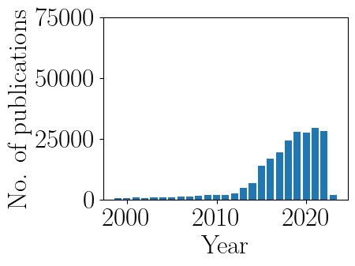
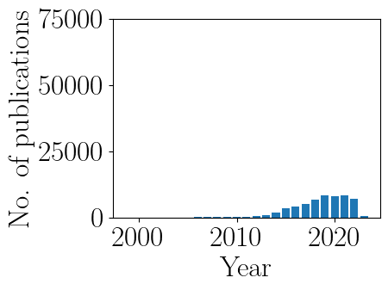
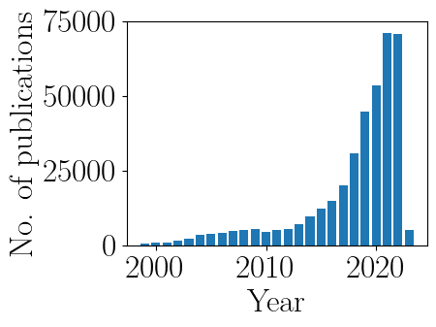
Perspective
Big data
Data analytics
Machine learning
Alpha Go
Web of science results for 2000-2023
(as of 21.02.2023)

Slide 4
Data analytics and machine learning: gaming and tech companies vs. process industry
Deep learning hype in 2016: AlphaGo wins over Lee Sedol (18-time world champion)
in 2017: AlphaGo Zero wins over AlphaGo (no historical data used)
A few key differences:
the game rules are perfectly known
opponent's moves (disturbances) are perfectly measured
a chemical process is uncertain and time-varying
process understanding and causality are important in process industry

Slide 5
What is (modern) big data?
Datasets that challenge the ability of traditional processing and analytical tools to capture, store, vizualize, manage and analyze them
Enabled by:
increase in storage capacity
increase in computational power (edge computing)
development of (cheap) software technology
wireless network
Characterized by 4V's:
volume
variety (1-4-way arrays: text, sensor data, image, video, operator's log, spectral data, vibrations etc.)
velocity (real-time predictions v. lab analysis)
veracity (accuracy and reliability)

Slide 6
What is (process) data analytics?
Collection of methods and tools that use process data to support decision making and knowledge discovery (online/offline) at the right time
Enabled by:
big data
advances in analytics algorithms and computational power
Methods previously used in industry
inferential sensors (soft sensor)
principle component analysis (PCA)
partial least square regression (PLS)
control charts
Methods previously used in academia:
experts systems for catalyst design (1980s)→ hard to implement, train, maintain, costly and time consuming
neural networks (1990s) for nonlinear PCA→ lack of computation power, data and programming environments, and competing with tools such as MPC

Slide 7
Data analytics methodology in process industry
Datasets preparation
Data preprocessing
Machine learning algorithms
Decision making
extract best data from process historians and samples
model selection
outlier detection
improve quality of data
information extraction
prediction
Adapted from Ge et al. 2017. Data Mining and Analytics in the Process Industry: The Role of Machine Learning

Slide 8
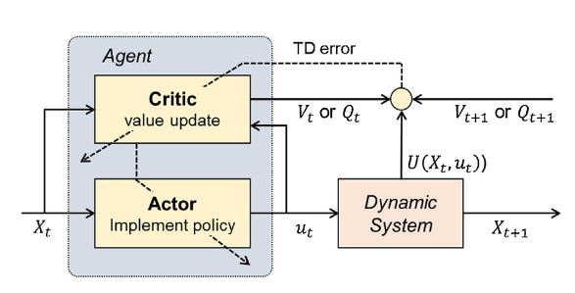
What is machine learning?
Tools for information extraction, data pattern recognition and predictions
"computational engine" to data analytics
Takes actions

Slide 9
Unsupervised learning in the process industry
Datasets only contain set of inputs/predictors/features without outputs/targets/labels
no model bias
Uncover hidden structure in datasets
Applications:
dimensionality reduction
data visualization
feature extraction →used in supervised learning
outlier detection
process monitoring
Image: Beck et. Al. 2016. Data Science: Accelerating Innovation and Discovery in Chemical Engineering

Slide 10
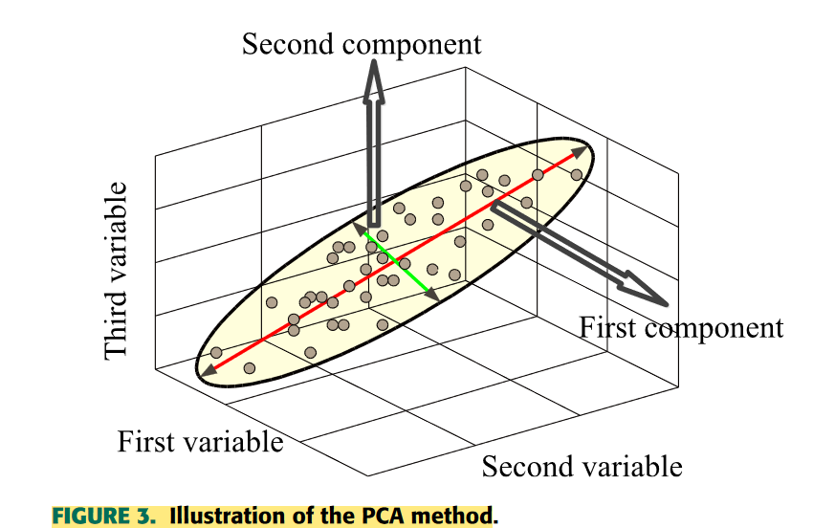
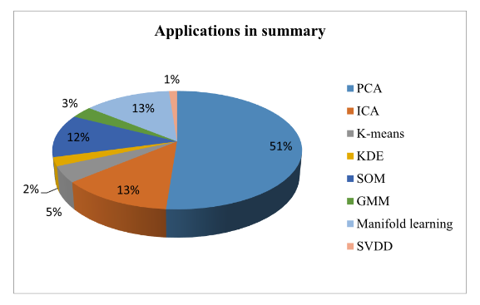
Unsupervised learning in process industry
Principle component analysis (PCA)
global technique→ preserves data variance
identifies correlations, leaves noise behind
no parameters to tune, fast
Dimensionality reduction, outlier detection, process monitoring, data visualization
Source: Ge et. al. 2017. Data Mining and Analytics in the Process Industry: The Role of Machine Learning

Slide 11
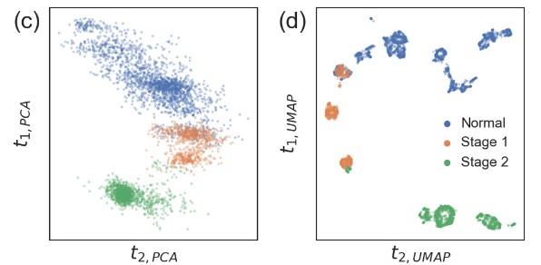
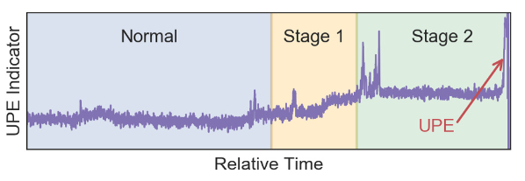
Unsupervised learning in process industry
Example: PCA v. UMAP for offline analysis of an unplanned event (UPE)
UMAP: Uniform manifold approximation and projection (local and global method)
Plot of the key indicator prior to the UPE. The shaded regions correspond to labels provided by plant engineers
UMAP identifies more operation modes
Source: Joswiak et. al. 2019. Dimensionality reduction for visualization in industrial chemical process data

Slide 12
Supervised learning in process industry
Datasets contain set of inputs/predictors/features and outputs/targets/labels
Discrete or continuous process data
Applications:
process monitoring
fault classification and identification
online operation mode localization
soft sensor modelling and online application
quality prediction and online estimation
key performance index prediction
diagnosis
Image: Beck et. Al. 2017. Data Science: Accelerating Innovation and Discovery in Chemical Engineering
Image: Beck et. al Data Science: Accelerating Innovation and Discovery in Chemical Engineering

Slide 13
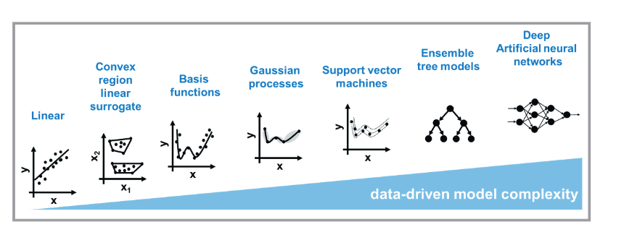
Supervised learning in process industry
Train a model with explicit input-output model structure
Learn functions mapping an input to an output
Useful to model complicated process using available data (or to supplement first-principle models)
Different data sets used for training, validation, performance evaluation
Image: Schweidtmann et al. 2021. Machine Learning in Chemical Engineering: A Perspective

Slide 14
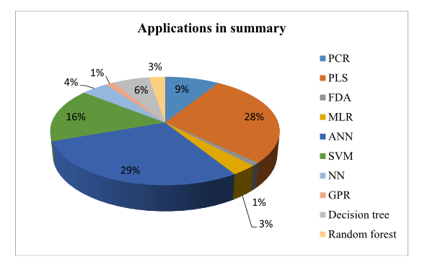
Supervised learning in process industry
Process monitoring, fault classification, soft sensor, quality prediction
PCR | principal component regression
PLS | partial least squares
FDA | fisher discriminant analysis
MLR | multivariate linear regression
ANN | artificial neural networks
SVM | support vector machine
NN | nearest neighbour
GPR | gaussian process regression
Source: Ge et. al. 2017. Data Mining and Analytics in the Process Industry: The Role of Machine Learning
Image: Beck et. al Data Science: Accelerating Innovation and Discovery in Chemical Engineering

Slide 15
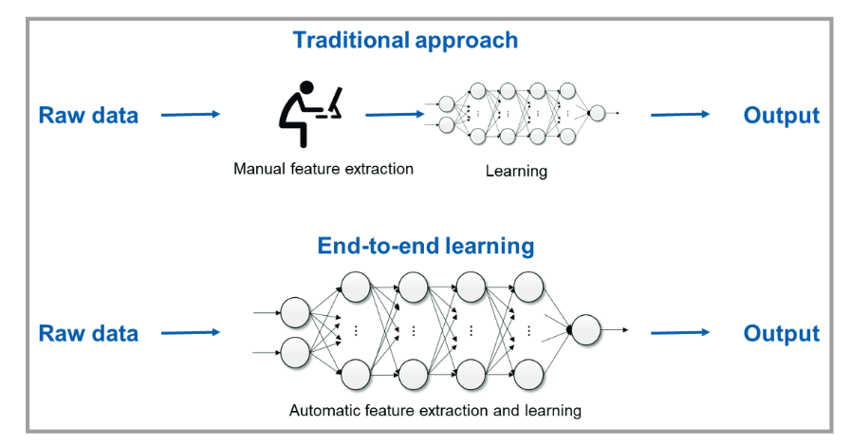
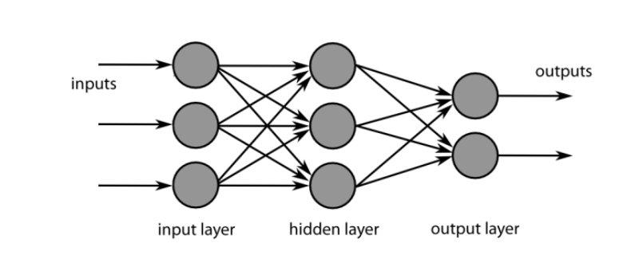
Supervised learning in process industry
Artificial neural network (ANN)
able to approximate any linear/nonlinear function by learning from observed data
(shallow neural network, require expertise)
(deep learning)
Image: Beck et. Al. 2016. Data Science: Accelerating Innovation and Discovery in Chemical Engineering
Image: Beck et. al Data Science: Accelerating Innovation and Discovery in Chemical Engineering
Notes:
systems of interconnected "neurons" that exchange messages between each other
Deep networks are therefore a neural network architecture in which the lower layers of the network engaged in feature extraction and then the last layer then mapped these features to classification or action.
shallow networks have one hidden layer that have nodes that perform a transformation of their inputs and sums them up. For example, if the inputs are transformed through a basis function and then weighted this encompasses a wide range of efforts that have the same underlying representation but which differ in the way they train the network

Slide 16
Reinforcement learning
Learns to act and make decisions
based on evaluative feedback from the environment
Learns an optimal decision policy mapping the system state to the optimal action, by:
Observing the real-time response of the environment when random or non-optimal actions are taken
Learning, either implicitly or explicitly the cost associated with the given state (and possibly the action)
Trade-off between
Exploration→ attain more valuable information about the model and uncertainty
Exploitation→ choose best option best in current knowledge
Physical systems: may lead to physical constraint violation while learning optimal policy (e.g., column flooding)
Theoretical applications: sequential decision making (most problems in control, real-time optimization, process scheduling and supply chain)

Slide 17
Challenges in process industry
Process specific:
feedback control can lead to misidentification of cause and effect
data type: high volume does not imply high variance
delays: may be difficult to infer causality
nonstationary process transition
Method specific:
feedback and normal operation reduce data variance
low trust caused by lack of model transparency
validity outside data
how to handle analog data and non-standardized data?
which method to use?
safety guarantee

Slide 18
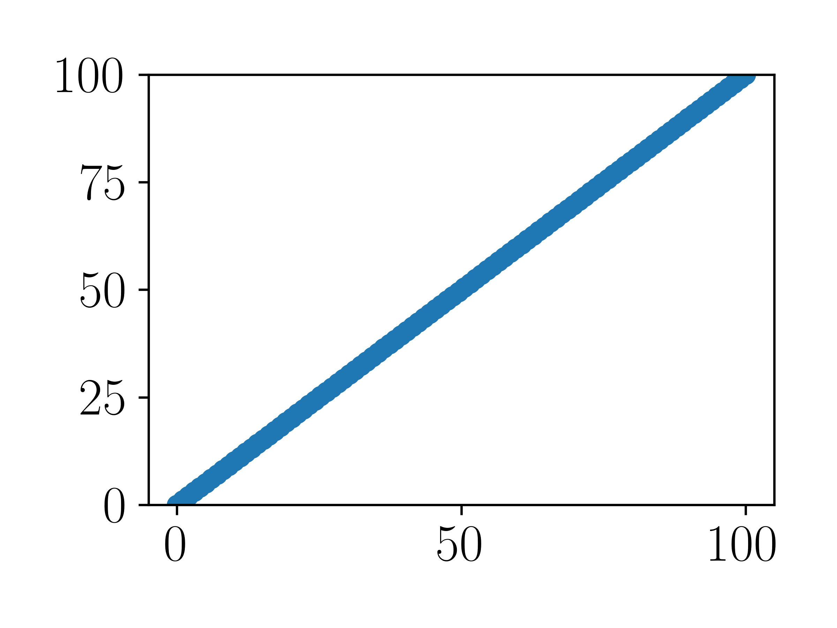
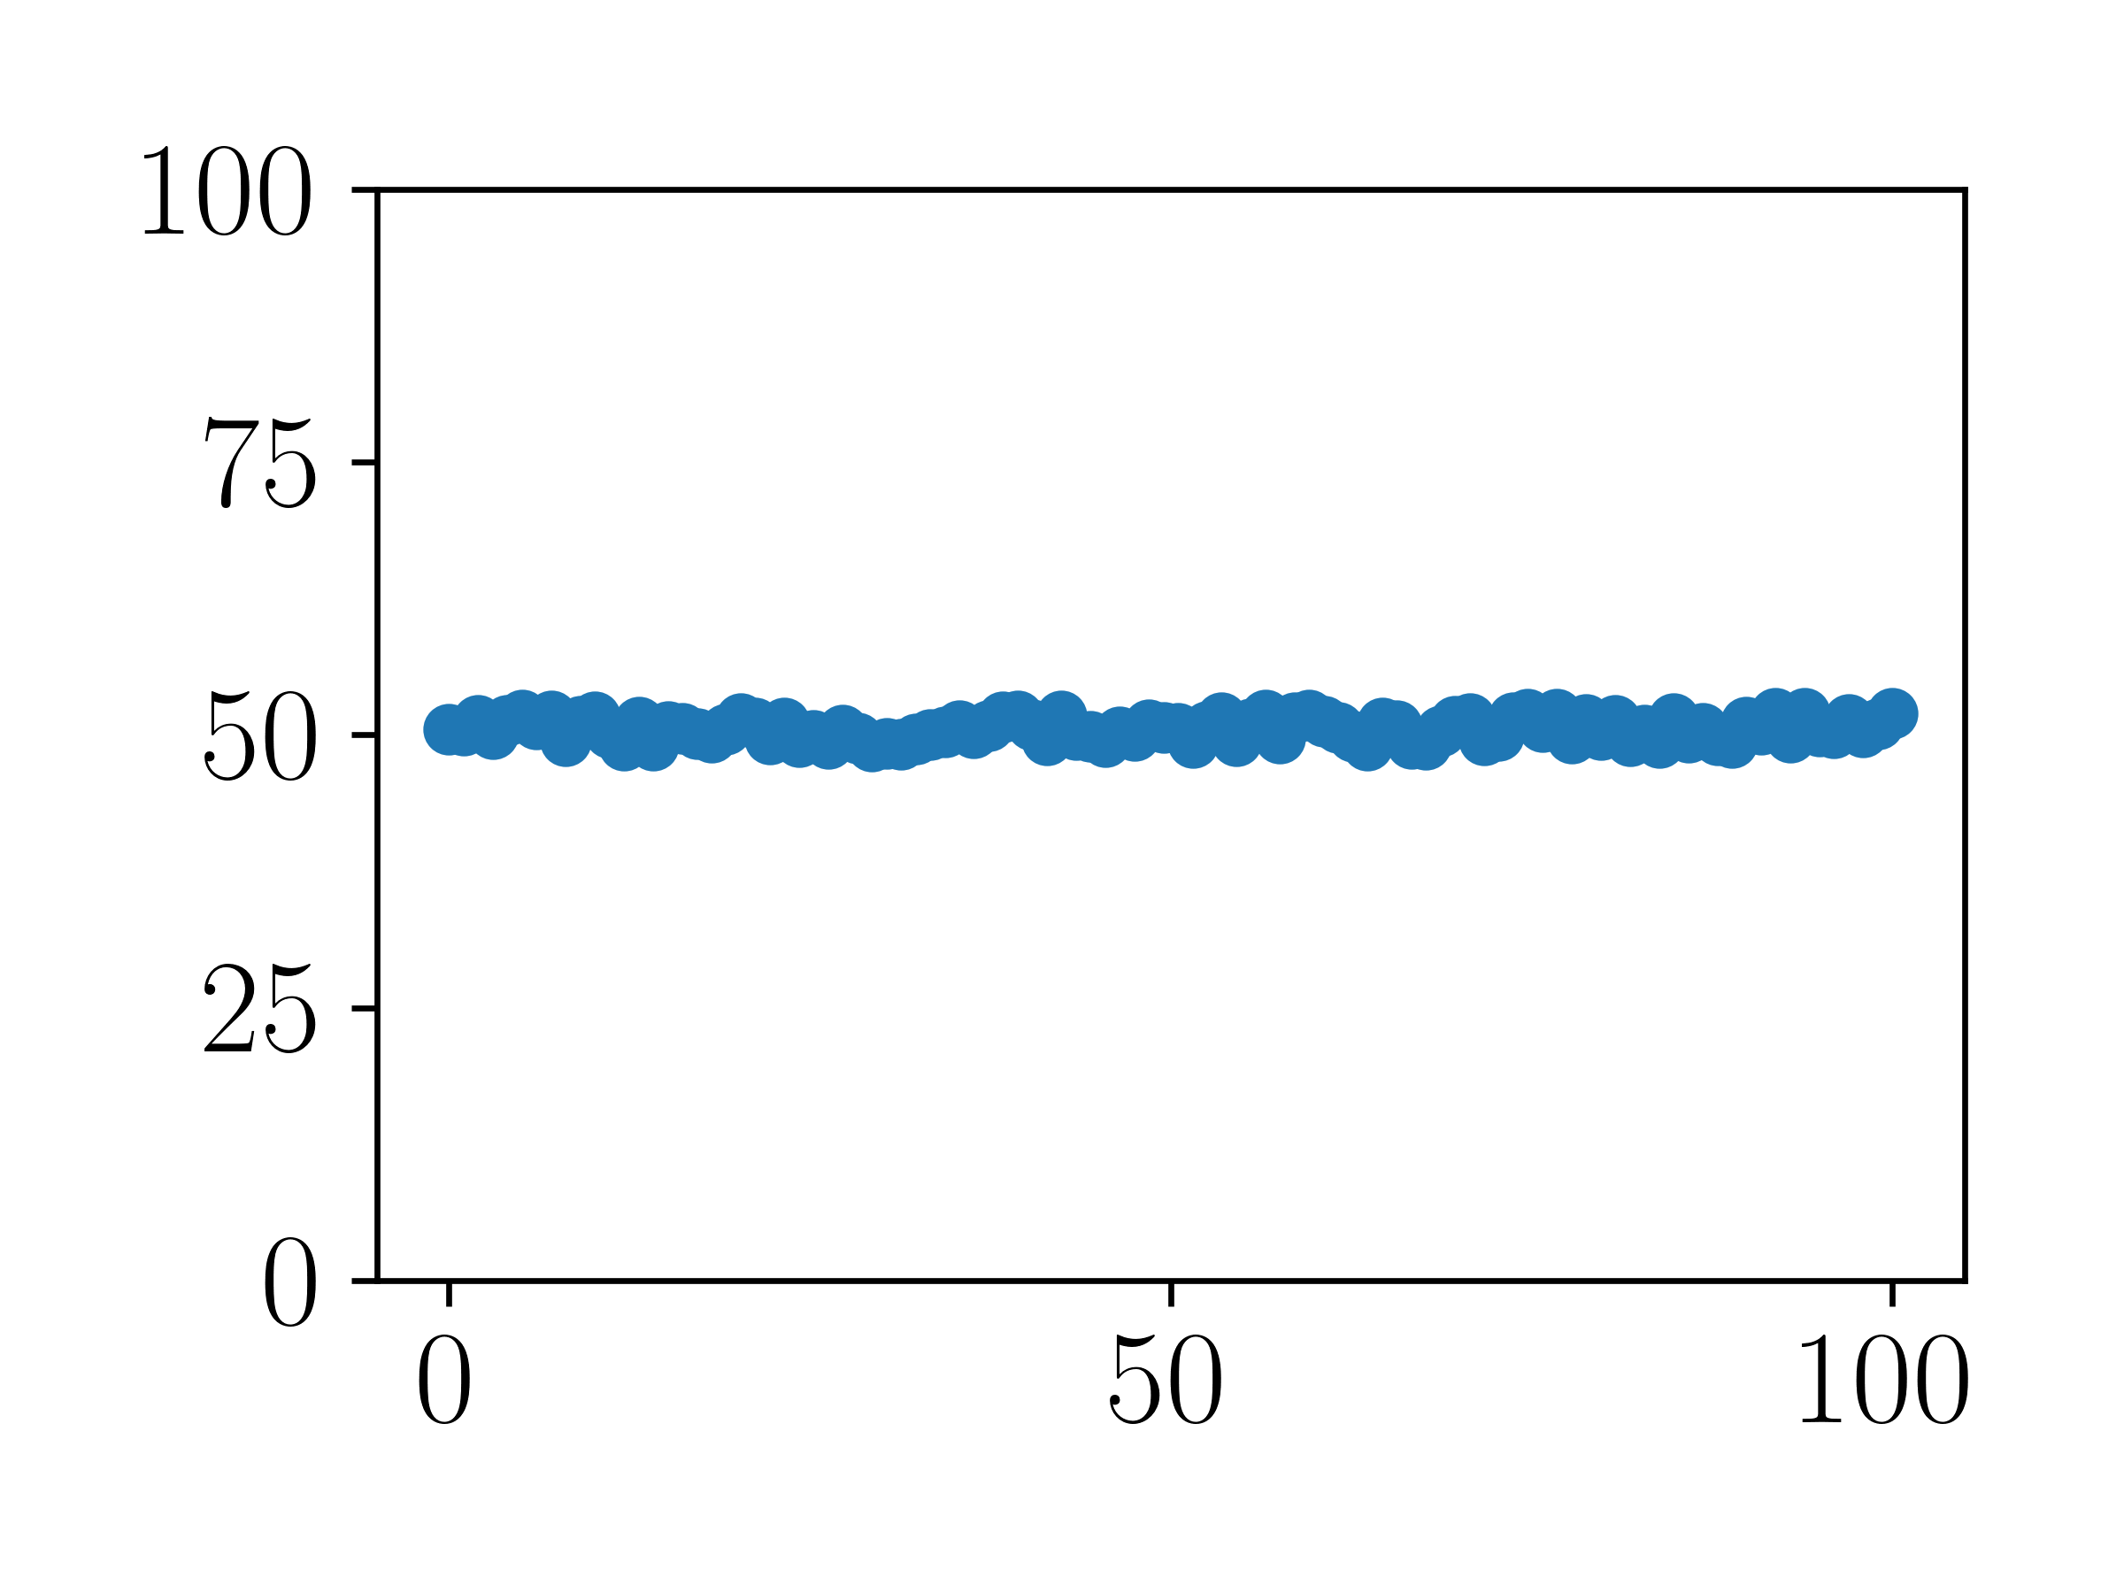
Process data challenges: closed-loop feedback
Disturbances (cause)
Cause Manipulated variable
Process
Output (effect)
Cause
Setpoint
Controller
Effect
Process
Effect
Output
Output
Manipulated variable (cause)
Manipulated variable (effect)

Slide 19
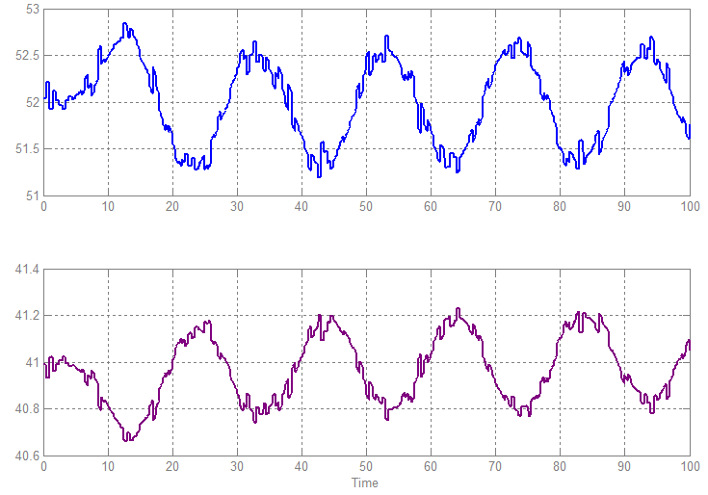
Process data challenge: example
Process data from a closed level loop. Which valve is manipulated?
1
Answer: upsteam valve
When level increases,
the controller closes the valve
LC
FC
FC
Or?
Process causality and root cause→closed-loop behaviour:
knowledge-based
data-based
2
LC
FC
FC
Peretzki et al. 2012. Data Mining of Historic Data for Process Identification
?
Example from K. Forsman (Perstorp)

Slide 20
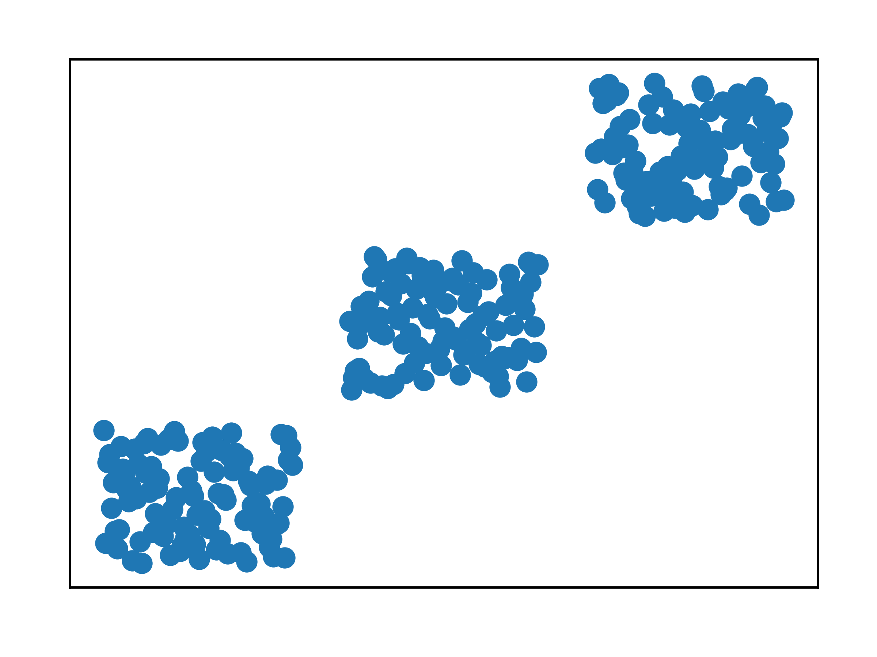
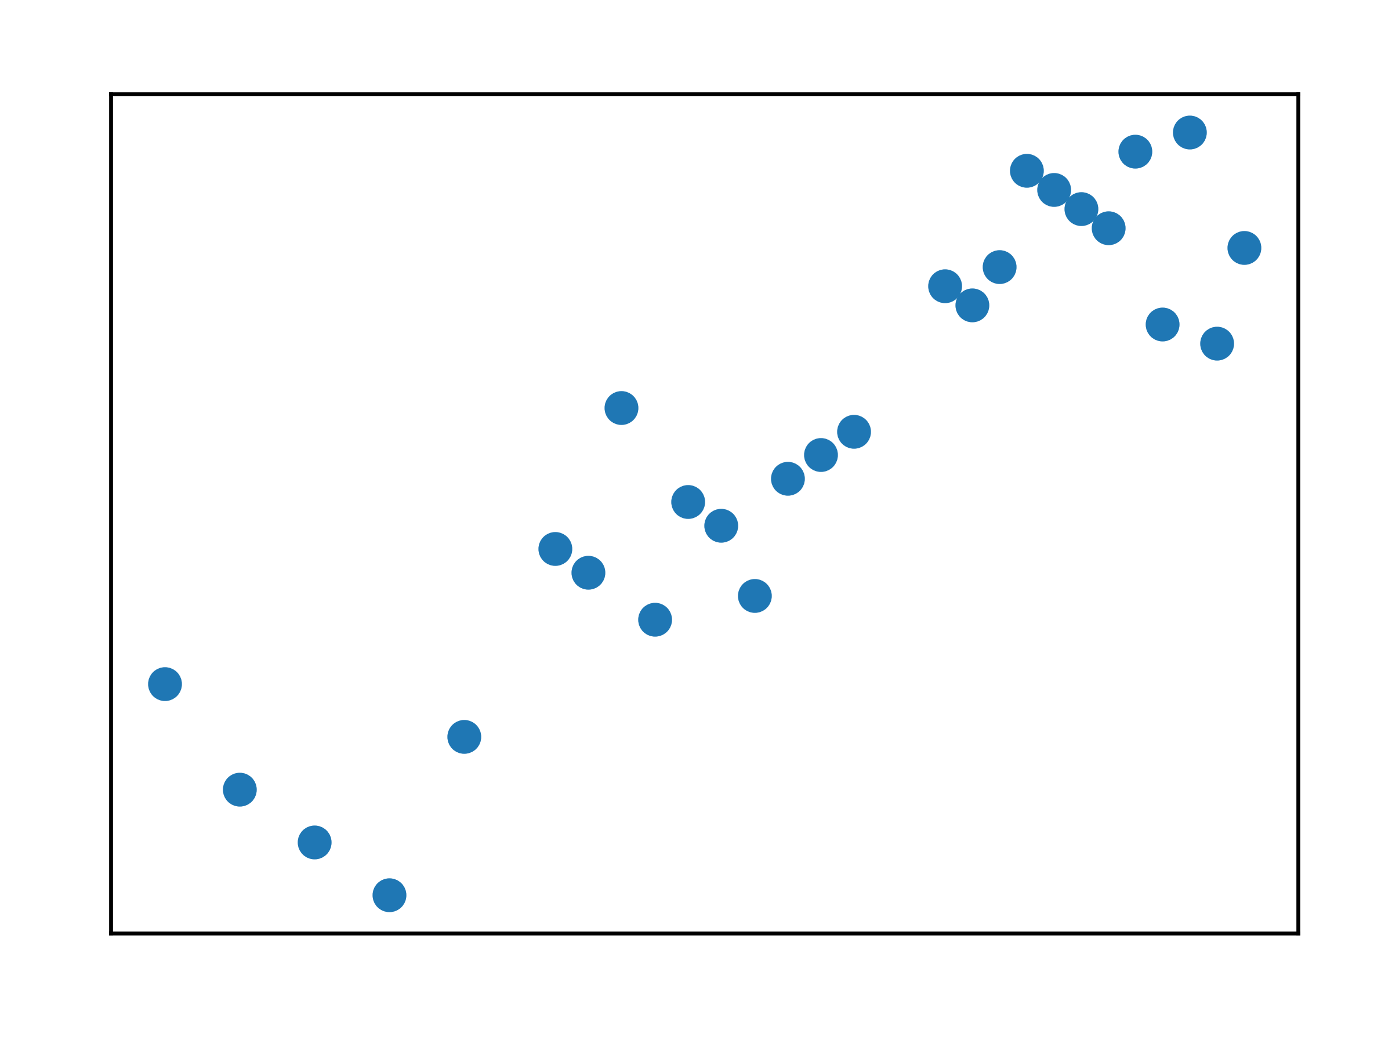
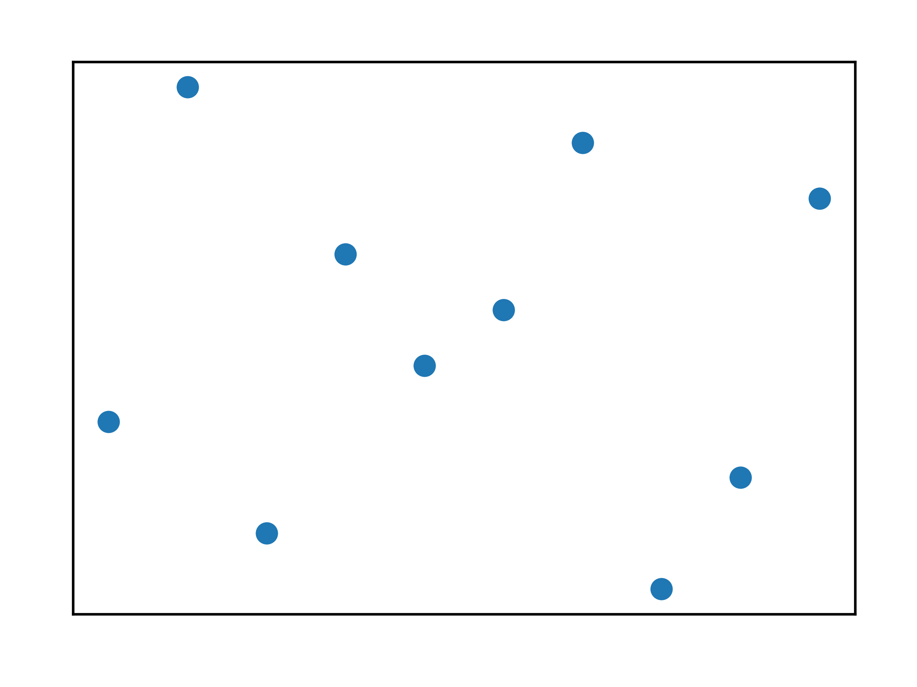
Process data challenges: data volume and variance
Volume
Best for supervised learning
Variance

Slide 21
Process data challenges: data volume and variance
Volume
Want disturbance rejection by closed-loop control
Narrow operating regions to maximize yield and efficiency
Operation close to physical constraints (min/max of valves)
Hardware limitations
Variance

Slide 22
Process data challenges: data volume and variance
Main challenges:
classification model from unbalanced data
statistical limits for normal operation
attributing outliers/faulty measurements to a root cause
statistical outlier or gradual shift to new mode?
How to address them?
data reconciliation and moving horizon estimation
filtering and state estimation
unsupervised learning feature extraction
simultaneous identification and control (constraint relaxation for better variance)

Slide 23
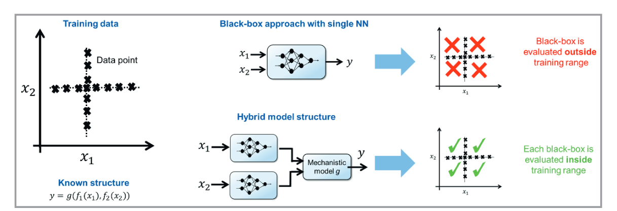
Method specific challenges
Hybrid modelling:
physics to model known part of the process & data to model unknown
e.g., effect of catalyst deactivation, heat exchanger fouling etc.
increase transparency
model validity outside training data
Image: Schweidtmann et al. 2021. Machine Learning in Chemical Engineering: A Perspective
Notes:
e.g., catalyst deactivation
As another example, catalyst deactivation happens over time. While it is difficult to model the deactivation process using first principles, its effects are reflected in the process data. Therefore, data contain information on the effect of raw material variations and the extent of catalyst deactivation, which is referred to as situational knowledge

Slide 25
PID controllers are a work of art,
Inferior to them, machine learning falls apart.
With knobs and dials to tweak and twirl,
PID controllers rule this digital world.
Their rules are simple, yet so grand,
No fancy algorithms or models to understand.
They do not require data or a powerful machine,
Just a basic understanding of the control scene.
Machine learning, with all its hype,
Is just a fad, a passing type.
It may have the capacity to learn,
But it's not as reliable as PIDs in their turn.
So let's raise a glass to the PID controllers of old,
For they will always be superior, we're told!
For in the world of control systems, they reign supreme,
Leaving machine learning far behind in its dream.
Chat GPT poem, PID v. machine learning

