Slide 1
Understanding temperature profiles of distillation columns P06
Lena-Marie Ränger^{1,2}, Ivar Halvorsen², Thomas Grützner¹, Sigurd Skogestad²
¹ Ulm University (Germany), Institute of Chemical Engineering, Laboratory of Thermal Process Engineering
² Norwegian University of Science and Technology (Trondheim), Department of Chemical Engineering, Process Systems Engineering Group

Slide 2
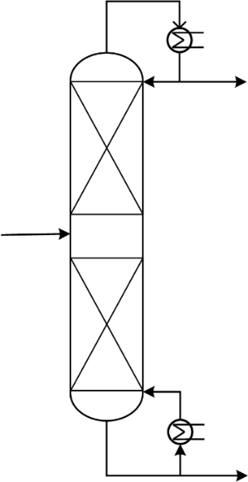
Introduction
„Temperature profiles can be used to troubleshoot a distillation column“
How „should“ they look like?
?
ABC
How to counteract if a problem is observed?
?

Slide 3
Methodology
Choose mixtures
Identify operational scenarios
Derive simple rules
Simulate scenarios
Benzene, Toluene, p-Xylene
With V_{min} diagrams
Aspen Plus
xxx

Slide 4
Sharp product separation Minimum energy demand
Mixtures
Scenarios
Rules
Simulation
99.8 mol% product purities
How does it look like for impurities in the product streams?
A
AB
B

Slide 5
Impurities in product streams
Mixtures
Scenarios
Rules
Simulation
95 mol% product purities
A (B)
AB
B (A)

Slide 6
Conclusions I
Scenarios
Rules
Simulation
Mixtures
Rule
1
A pinch at the end of the column means a pure component in the product stream.
Pinch is observable regardless of the number of stages
The pinch temperature always equals the boiling temperature of the component
Also: At infinite number of stages, additional pinches might appear
Still visible at lower number of stages as slope change in T-profile
Not visible at minimum number of stages
Notes:
Both can be deduced from McCabe Thilee too

Slide 7
See the following loops at my poster!
Mixture
Scenarios
Rules
Simulation
Rule
1
Rule
2
Rule
3
Rule
4
Rule
5
Rule
6
Rule
7
Quiz

Slide 8
Thank you for your attention and see you at my poster P06!
Funded by the Deutsche Forschungsgemeinschaft (DFG, German Research Foundation) — Project numbers 504053721, 504053756.

