Slide 1
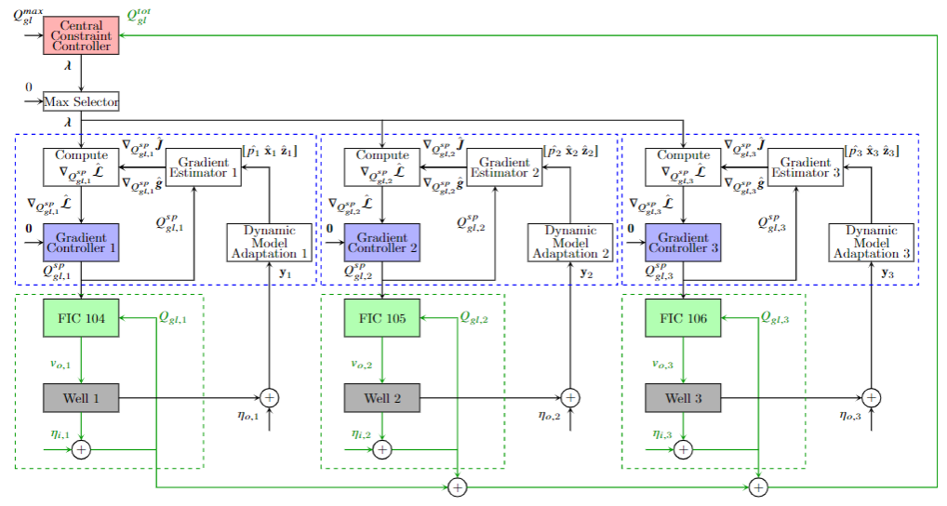
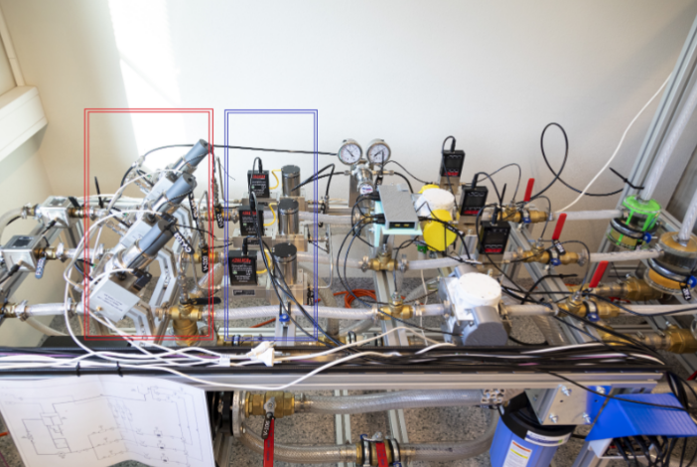
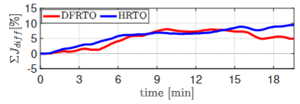
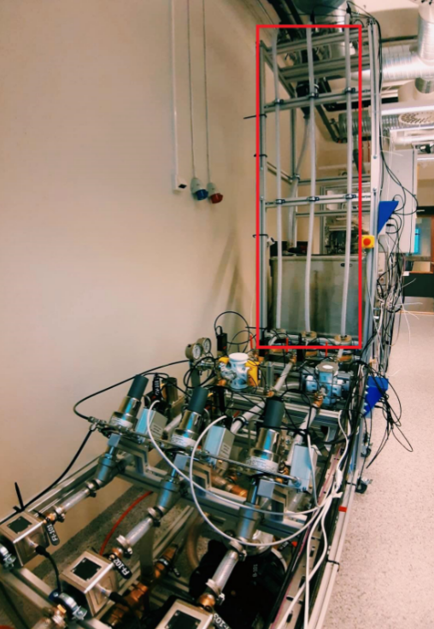
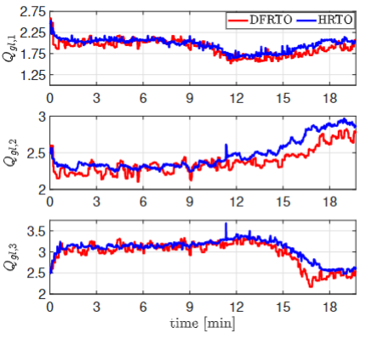

Experimental Validation of Distributed Feedback-based Real-Time Optimization in a Gas-lifted Oil Well Rig
Risvan Dirza, Jose Matias, Sigurd Skogestad, Dinesh Krishnamoorthy
Steady-state real-time optimization (RTO) of large-scale processes with a common constraint for several units, for example, a shared resource.
Standard Solution
Distributed optimization:
  A central coordinator (central problem)
  Local RTO (subproblems)
Problem Statement
In traditional RTO: repeatedly solving both problems
  Computationally expensive.
Proposed Solution
A distributed feedback-based RTO (DFRTO) scheme based on Lagrange decomposition
Convert both problems into feedback control problems.
Choose appropriately the controlled variables
Contribution:
Validation of DFRTO using a lab-scale experimental rig that emulates a subsea oil production network,
  Allocate the gas lift optimally among the wells.
Benchmark of DFRTO’s performance with a numerical optimization-based RTO scheme (HRTO).
Conclusion
Experimental validation shows that:
“DFRTO is able to provide the same optimal performance as HRTO (numerical-based RTO scheme).”
[1] Krishnamoorthy, D., 2021. A distributed feedback-based online process optimization framework for optimal resource sharing. Journal of Process Control,97, pp.72-83.
[2] Dirza, R., et. al. 2021. Optimal Resource Allocation using Distributed Feedback-based Real-time Optimization. IFAC-PapersOnLine 54 (3), 706-711.
[3] Dirza, R., et. al. 2022. Experimental validation of distributed feedback-based real-time optimization in a gas-lifted oil well rig. Control Engineering Practice, 126, pp. 105253

