Slide 1
Control of steam bottoming cycles using nonlinear input and output transformations for feedforward disturbance rejection
Cristina Zoticăª, Rubén M. Montañésª, Adriana Reyes-Lúaª,
Sigurd Skogestad^{b}
ªSINTEF Energy Research, Norway
^{b}Department of Chemical Engineering, Norwegian University of Science and Technology
DYCOPS 2022
Busan, Korea, 17th June 2022

Slide 2
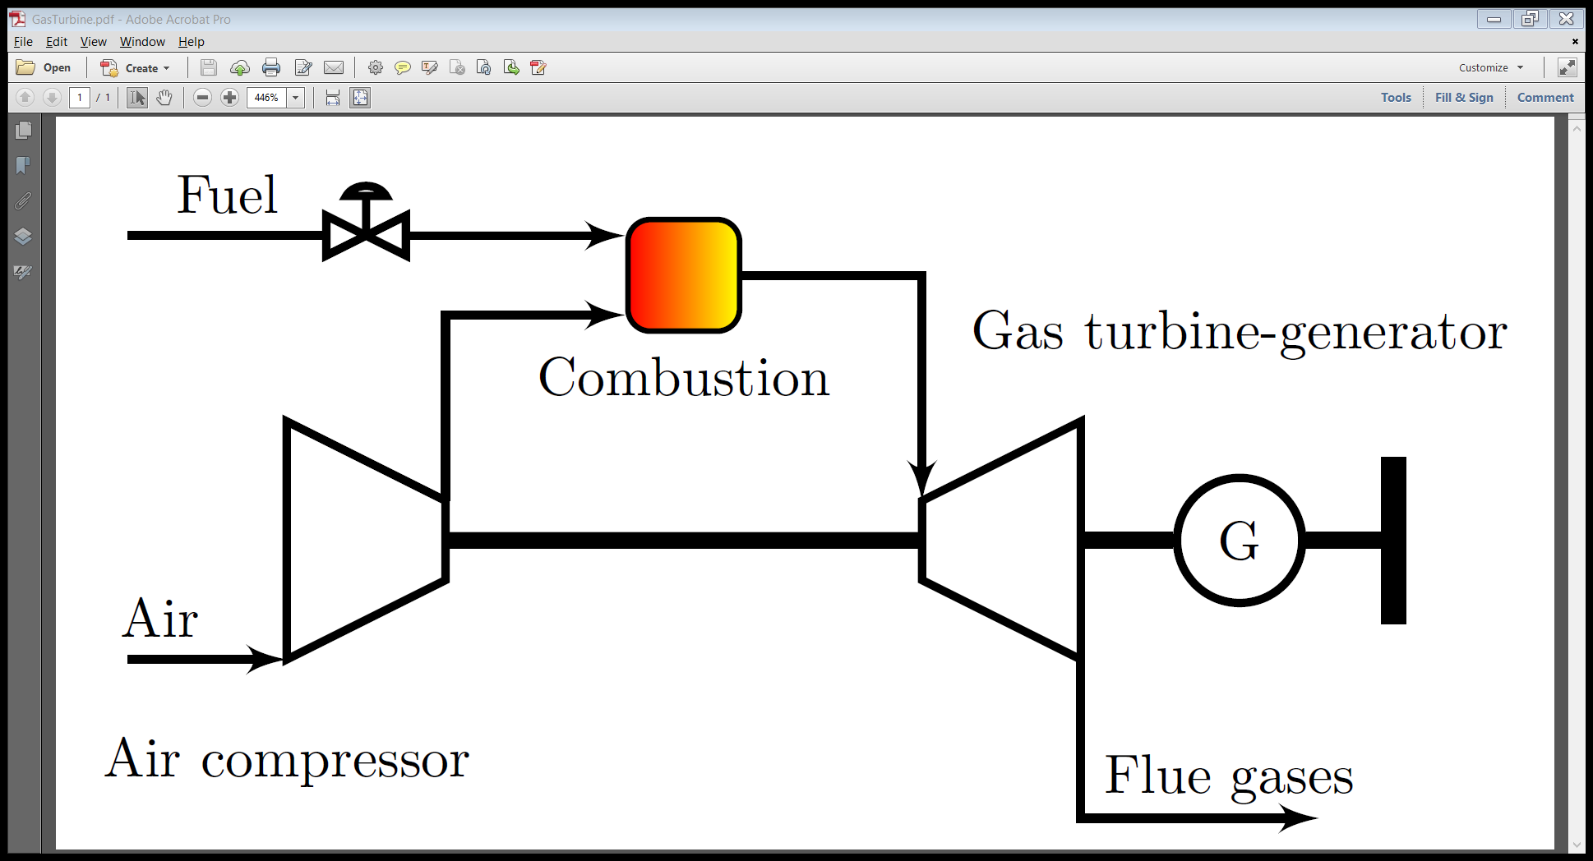

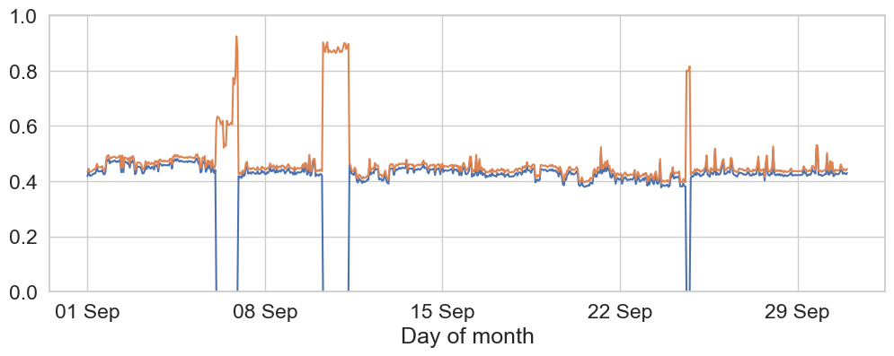
1. Motivation: current offshore installations
Fuel already available offshore
Reliable
Fast response
Normalized load of two gas turbines for one month.
Notes:
- Generator efficiency also drops, but from >96% to abt 88%. Sharp decrease also around 40% load. More or less constant >60% load

Slide 3
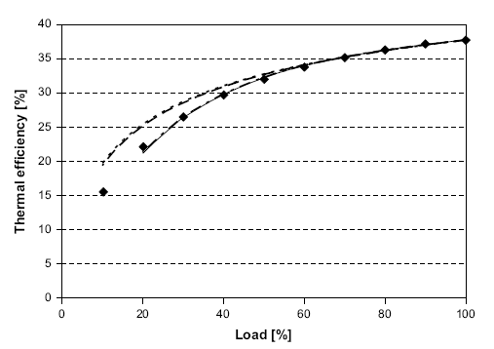
1. Motivation: current offshore installations
Fuel already available offshore
Reliable
Fast response
Part-load operation
CO₂ emissions
Normalized load of two gas turbines for one month.
Notes:
- Generator efficiency also drops, but from >96% to abt 88%. Sharp decrease also around 40% load. More or less constant >60% load

Slide 4
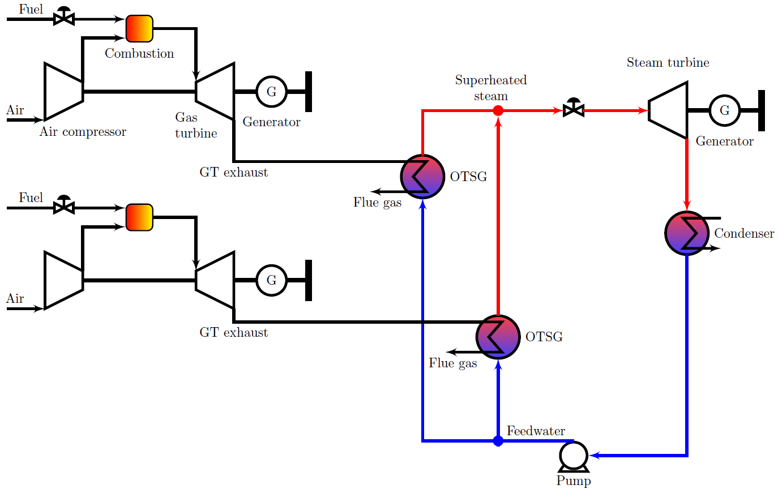



Gas turbines with a steam bottoming cycle
Gas turbine efficiency as a function of load (i.e. power output)
OTSG - once-through-steam-generator
Notes:
Also less CO2 from the two remaining GTs – higher efficiency

Slide 5
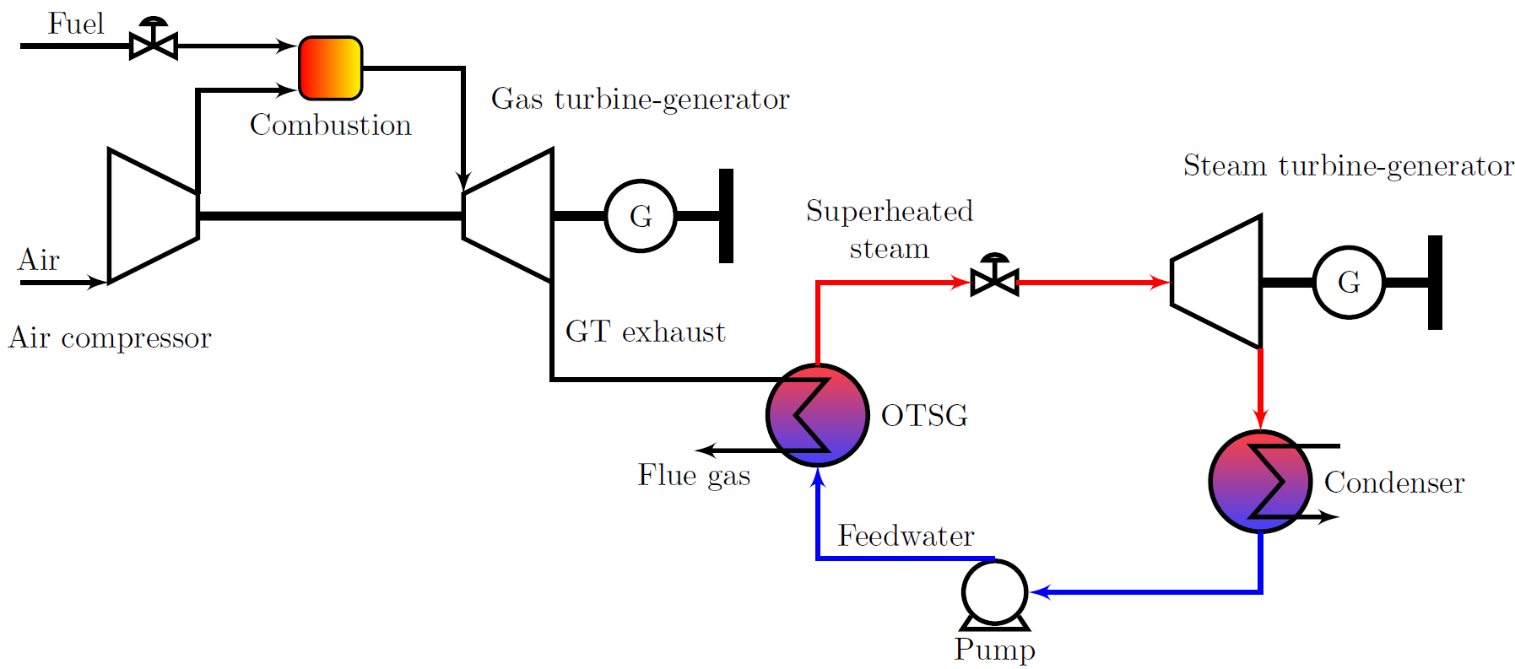
2. Operational objectives
Combined cycle
Produce power at the required frequency and voltage (island operation)
Steam bottoming cycle (OTSG)
Generate power with a given heat from the GT exhaust gases
Combined cycle
Gas turbine
Bottoming cycle

Slide 6
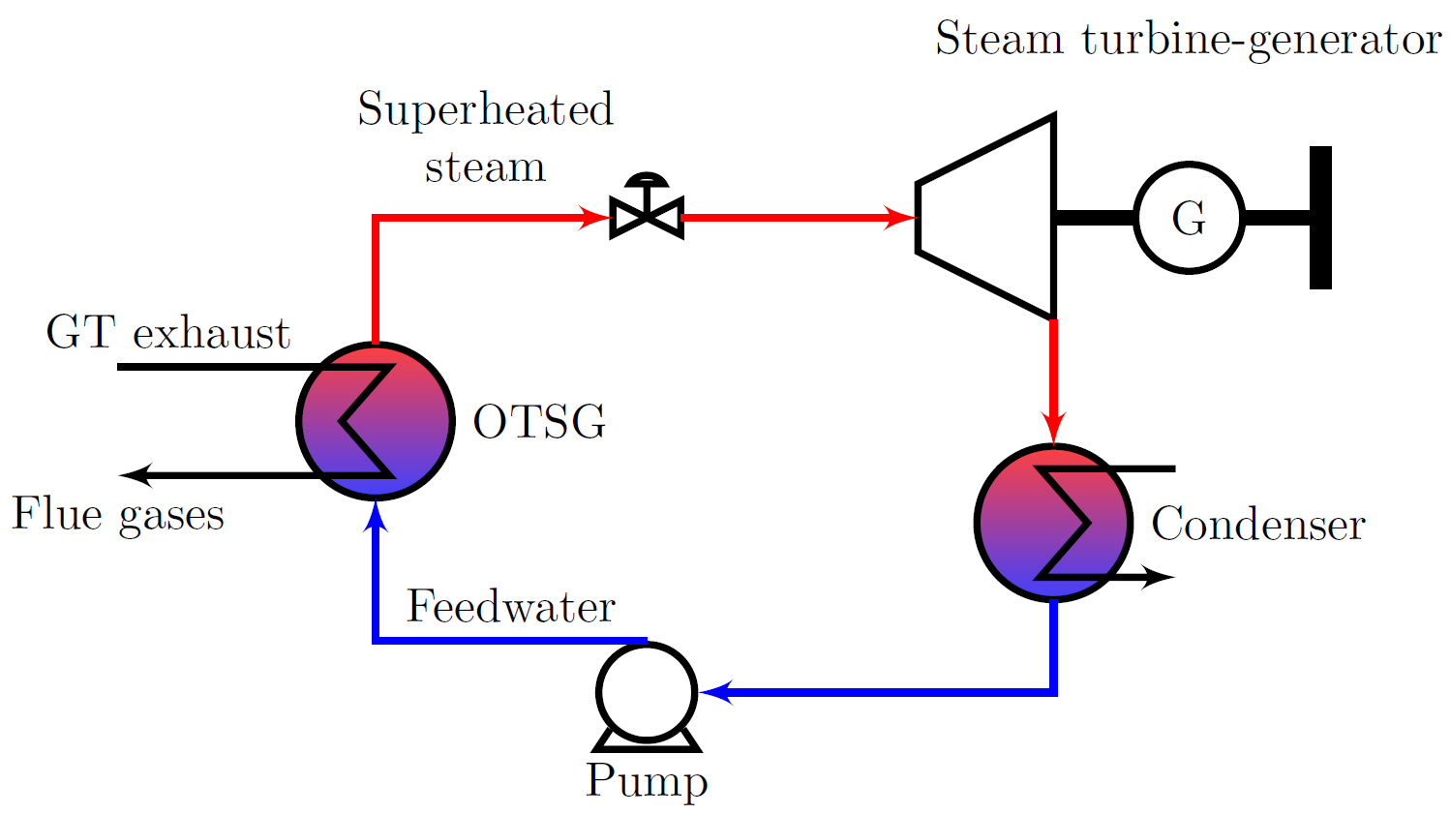

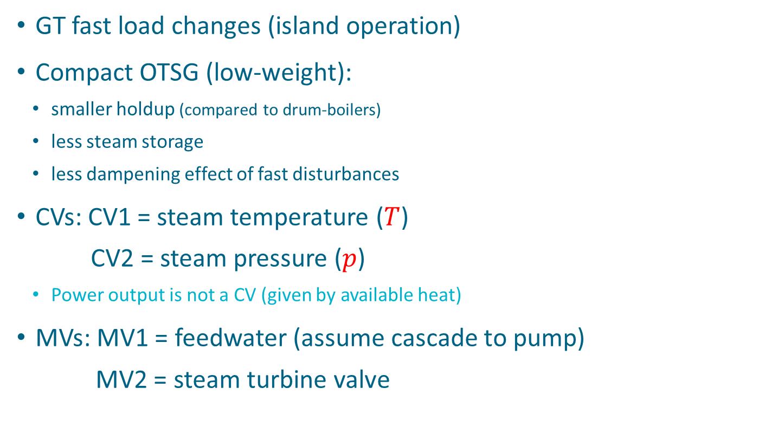
3. Control of the steam bottoming cycle
GT fast load changes (island operation)
Compact OTSG (low-weight):
  smaller holdup (compared to drum-boilers)
  less steam storage
  less dampening effect of fast disturbances
CVs: CV1 = steam temperature ($T$)
  CV2 = steam pressure ($p$)
  Power output is not a CV (given by available heat)
MVs: MV1 = feedwater (assume cascade to pump)
  MV2 = steam turbine valve
MV2
$$T,p$$
MV1

Slide 7
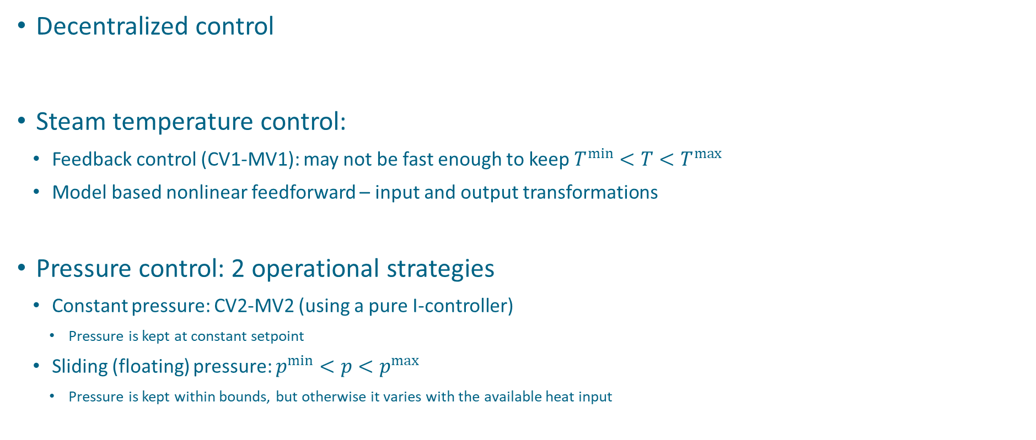

3.Control of the steam bottoming cycle
MV2
Decentralized control
Steam temperature control:
  Feedback control (CV1-MV1): may not be fast enough to keep $T^{min}<T<T^{max}$
  Model based nonlinear feedforward – input and output transformations
Pressure control: 2 operational strategies
  Constant pressure: CV2-MV2 (using a pure I-controller)
    Pressure is kept at constant setpoint
  Sliding (floating) pressure: $p^{min}<p<p^{max}$
    Pressure is kept within bounds, but otherwise it varies with the available heat input
$$T,p$$
MV1

Slide 8
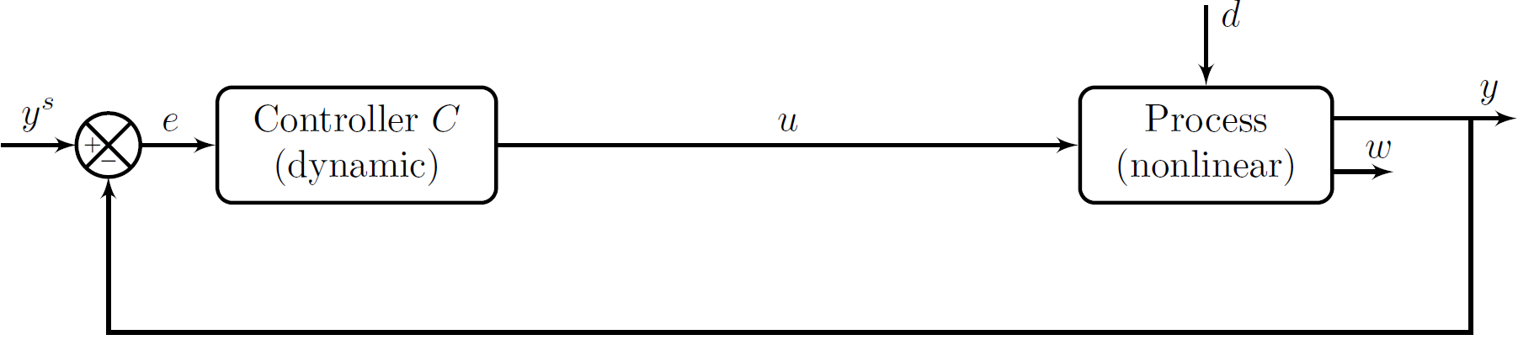
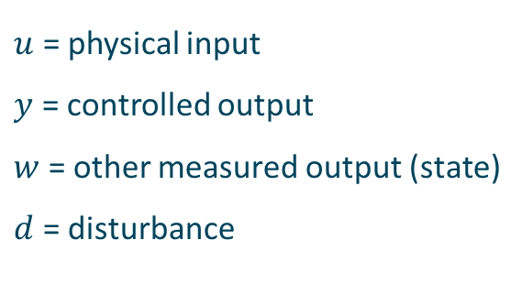
4.Definition of transformed inputs and outputs
$u$ = physical input
$y$ = controlled output
$w$ = other measured output (state)
$d$ = disturbance

Slide 9
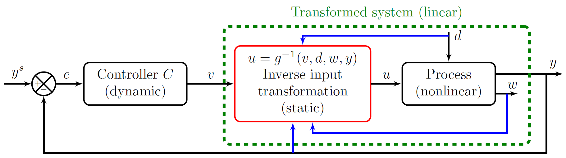
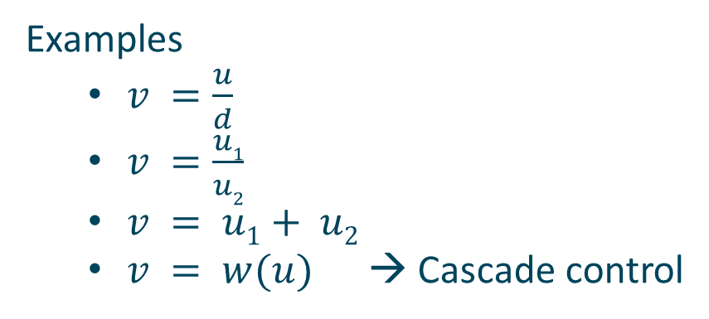
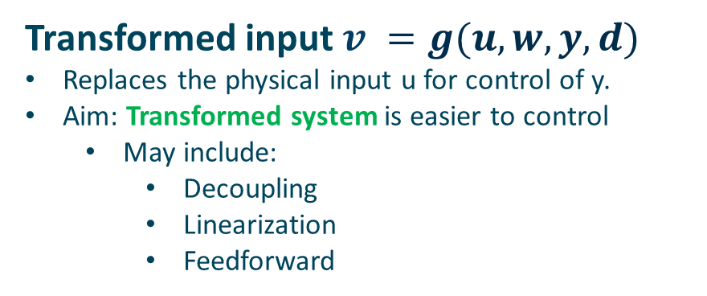
4. Input transformation
Transformed input $v =g(u,w,y,d)$
Replaces the physical input u for control of y.
Aim: Transformed system is easier to control
  May include:
    Decoupling
    Linearization
    Feedforward
Examples
  $v =\frac{u}{d}$
  $v =\frac{u1}{u2}$
  $v = u1+ u2$
  $v = w(u)$ → Cascade control
*Skogestad et el. Transformed inputs for linearization, decoupling and feedforward disturbance rejection, in preparation
*Zotică et al. Transformed Manipulated Variables for Linearization, Decoupling and Perfect Disturbance Rejection, IFAC-PapersOnLine, 2020

Slide 10
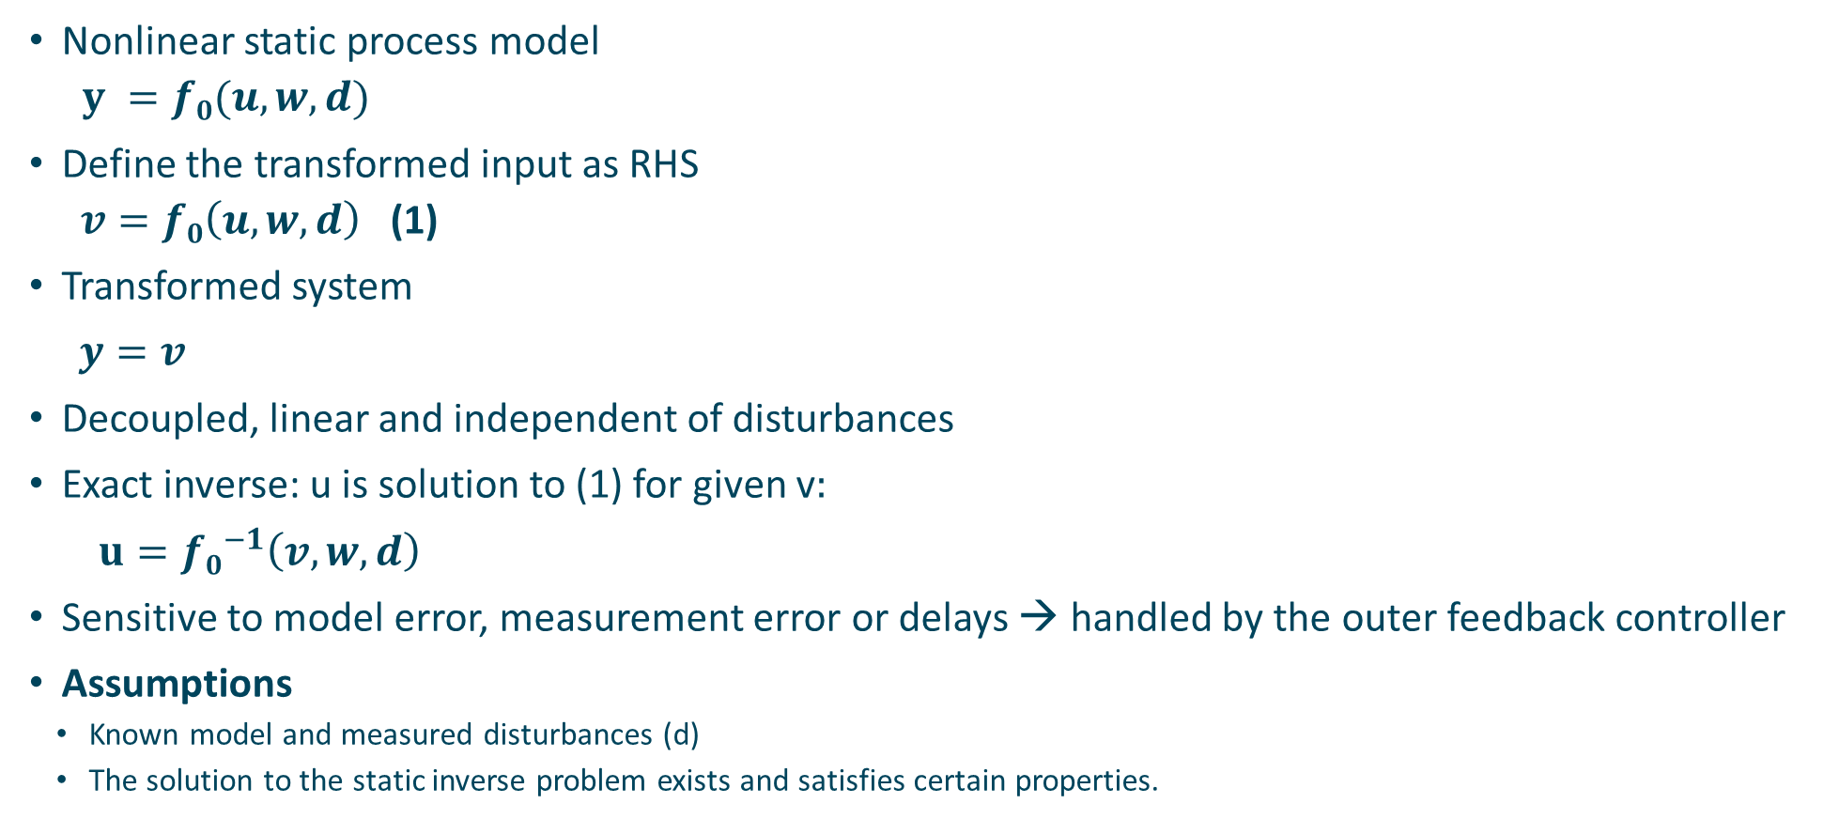
Input transformation from static model
Nonlinear static process model
  $y =f0(u,w, d)$
Define the transformed input as RHS
  $v=f0\left(u,w,d\right)$ (1)
Transformed system
$y=v$
Decoupled, linear and independent of disturbances
Exact inverse: u is solution to (1) for given v$:$
$u={f0}^{−1}\left(v,w,d\right)$
Sensitive to model error, measurement error or delays → handled by the outer feedback controller
Assumptions
  Known model and measured disturbances (d)
  The solution to the static inverse problem exists and satisfies certain properties.
$$g=f0$$

Slide 11
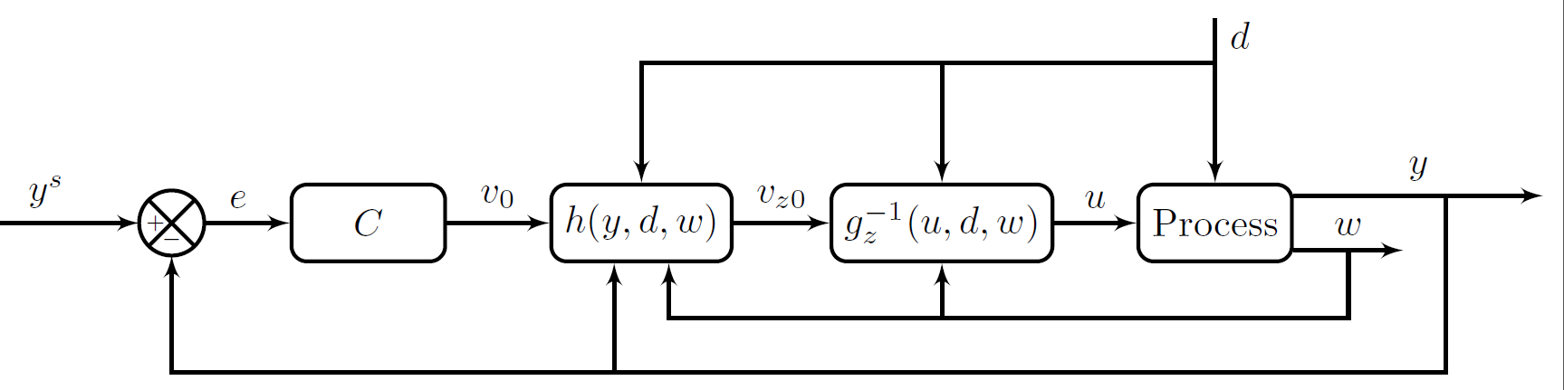
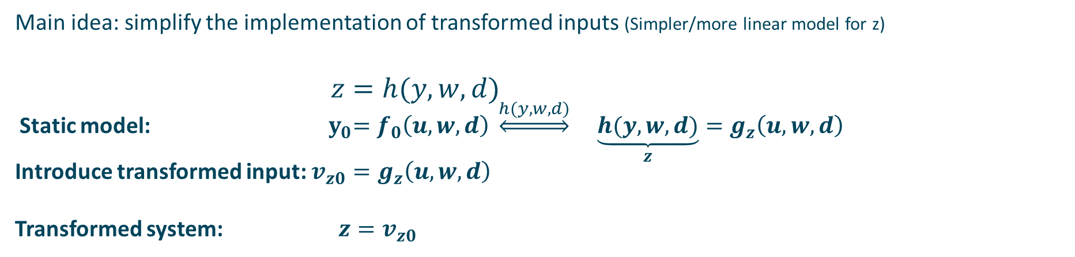
4. Output transformation
Main idea: simplify the implementation of transformed inputs (Simpler/more linear model for z)
$$z=h(y,w,d)$$
Static model: ${ y}_{0}=f_{0}\left(u,w,d\right) \underset{⇔}{h(y,w,d)}$ $\underset{z}{\underbrace{h(y,w,d)}}=g_{z}\left(u,w,d\right)$
Introduce transformed input: $v_{z0}=g_{z}\left(u,w,d\right)$
Transformed system: $z=v_{z0}$

Slide 12
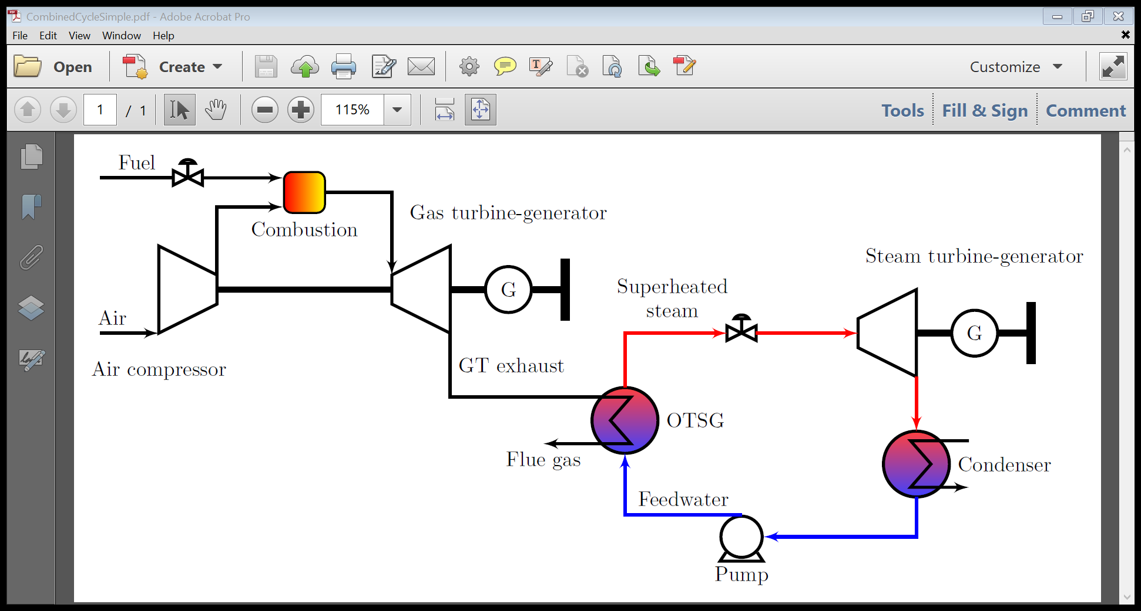



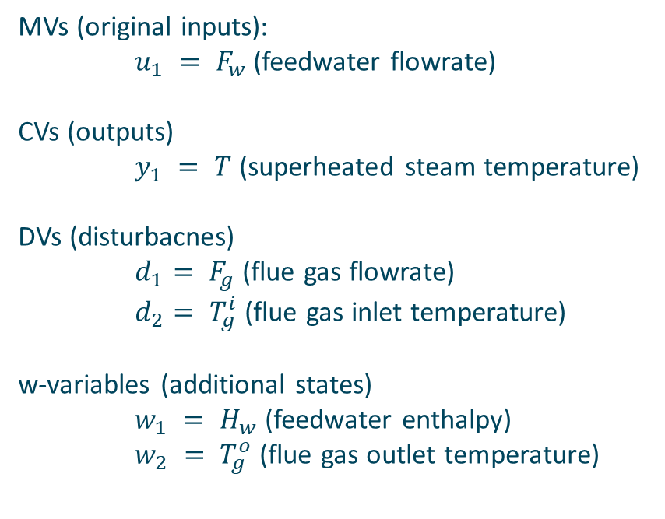
5. Input and output transformations for steam temperature control
MVs (original inputs):
$u_{1} = F_{w}$(feedwater flowrate)
CVs (outputs)
$y_{1} = T$(superheated steam temperature)
DVs (disturbacnes)
$d_{1}= F_{g}$(flue gas flowrate)
$d_{2}= T_{g}^{i}$(flue gas inlet temperature)
w-variables (additional states)
$w_{1} = H_{w}$(feedwater enthalpy)
$w_{2} = T_{g}^{o}$(flue gas outlet temperature)
$$T$$
$$F_{g},T_{g}^{i}$$
$$T_{g}^{o}$$
$$H_{w}$$

Slide 13



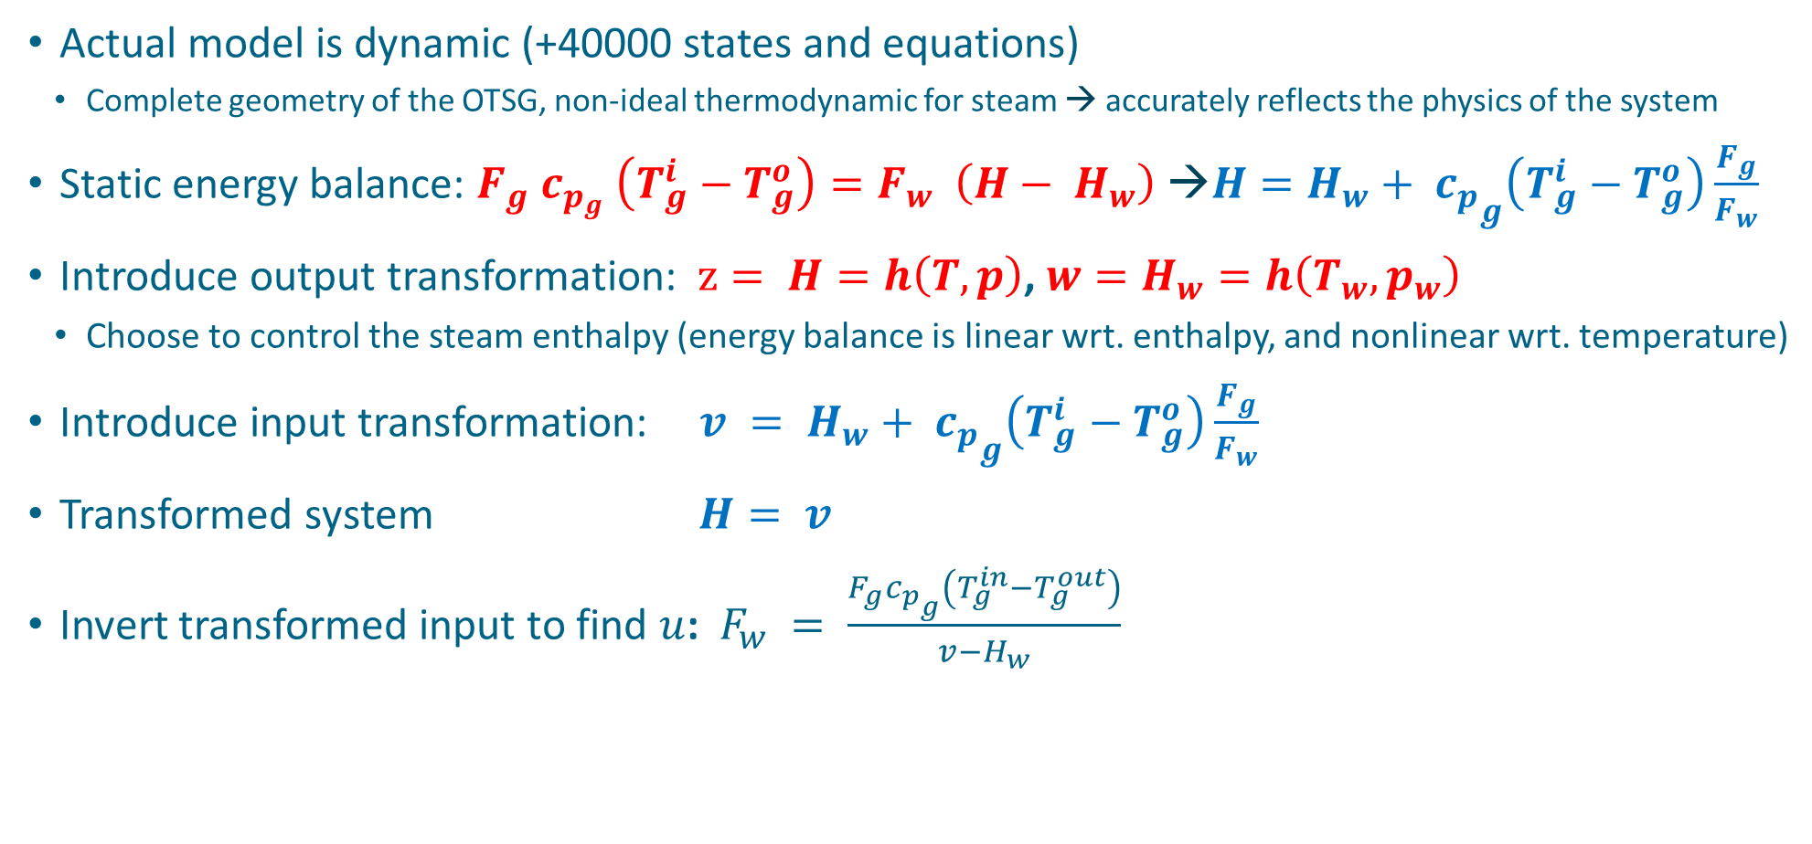
5. Input and output transformations for steam temperature control
Actual model is dynamic (+40000 states and equations)
  Complete geometry of the OTSG, non-ideal thermodynamic for steam → accurately reflects the physics of the system
Static energy balance: $F_{g} c_{p_{g}} \left(T_{g}^{i}−T_{g}^{o}\right)=F_{w} \left(H− H_{w}\right) {\text{→}H=H}_{w}+ {c_{p}}_{g}\left(T_{g}^{i}−T_{g}^{o}\right)\frac{F_{g}}{F_{w}}$
Introduce output transformation: $z= H=h\left(T,p\right)$, ${w=H}_{w}=h\left(T_{w},p_{w}\right)$
  Choose to control the steam enthalpy (energy balance is linear wrt. enthalpy, and nonlinear wrt. temperature)
Introduce input transformation: $v = H_{w}+ {c_{p}}_{g}\left(T_{g}^{i}−T_{g}^{o}\right)\frac{F_{g}}{F_{w}}$
Transformed system $H= v$
Invert transformed input to find $u$: $F_{w} = \frac{F_{g}{c_{p}}_{g}\left(T_{g}^{in}−T_{g}^{out}\right)}{{v−H}_{w}}$
$$F_{g},T_{g}^{i}$$
$$T_{g}^{o}$$
$$H_{w}$$

Slide 14
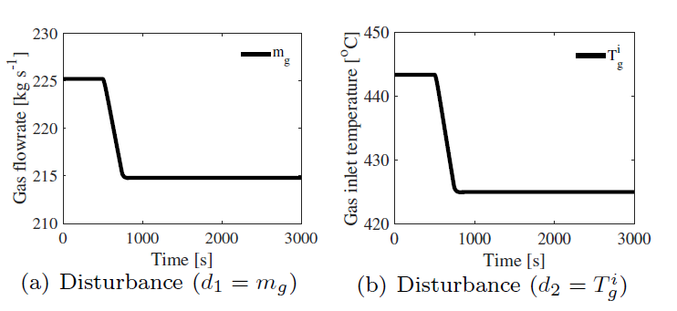
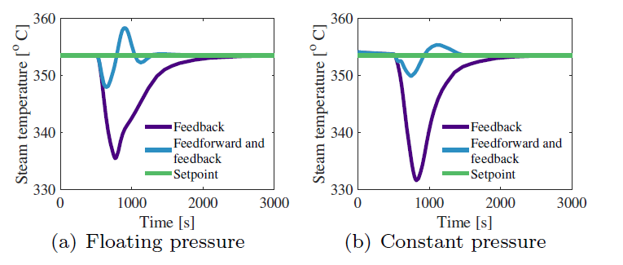
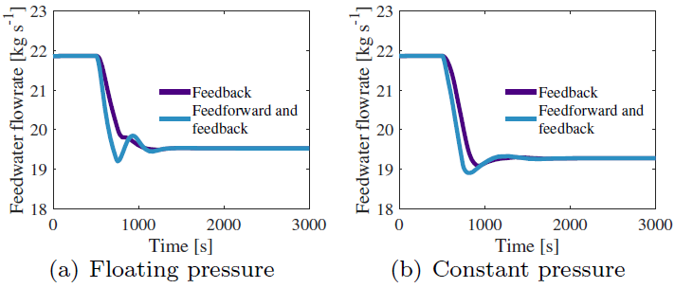
6. Temperature response for disturbance rejection to a ramp decrease in GT load
Boundary condition for the steam cycle
Notes:
we study the control problem for a steam bottoming cycle exposed to large disturbances from the upstream gas turbine
The temperature responses for the feedback and feedforward control strategy show an overshoot for disturbance rejection. The root cause of this behaviour is the feedforward and outer feedback controller doing independent corrections simultaneously. This effect can be reduced by slowing down the outer feedback loop. Nonetheless, the overshoot for power is small, and, compared to feedback only, the feedforward implementation shows the smallest deviation from the steam temperature setpoint for both floating pressure and constant pressure operation modes. This is desired in order to reduce the thermal stress on the steam turbine blades and rotor

Slide 15
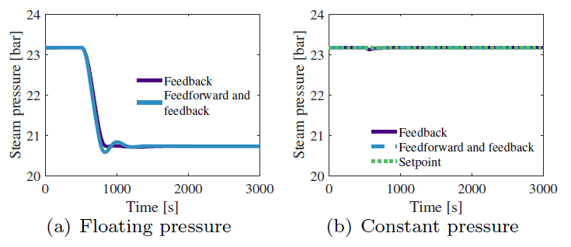
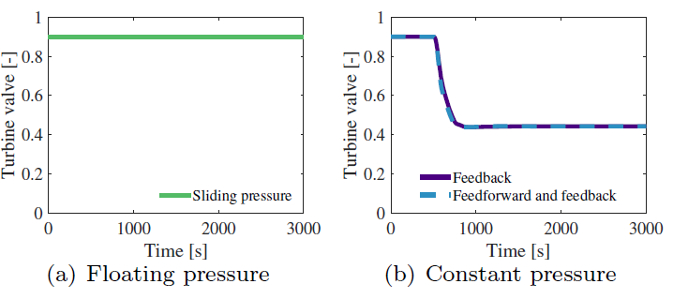
6. Pressure response for disturbance rejection to a ramp decrease in GT load
Steam temperature is controlled by feedback or feedforward
Notes:
We consider two pressure operation modes, floating and constant. In the former, the pressure is varying with the heat input while in the latter is kept at setpoint by manipulating the turbine valve

Slide 16
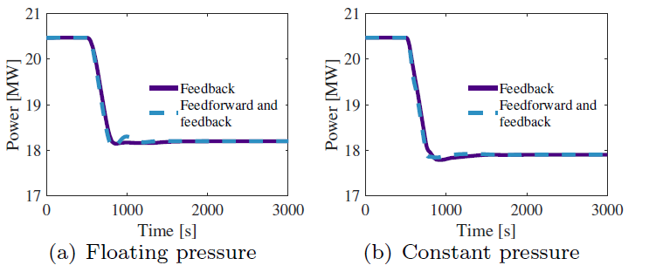
6. Steam cycle power output response to a ramp decrease in GT load.
Steam temperature is controlled by feedback or feedforward
Notes:
The steady-state value for power for the floating pressure operation mode is higher than the steady-state value for the constant pressure operation mode because of the throttling losses in the steam turbine valve.

Slide 17
7. Conclusion
Analyze the control problem for an offshore bottoming OTSG subject
to large disturbances from the upstream gas turbine
For simulations, we use a high-fidelity dynamic model developed in Dymola
Pressure control (feedback):
  Constant pressure operation keep the pressure at the setpoint, but gives lower power output due to throttling loses
Temperature control (feedback or feedforward):
  Input transformation derived from a simple steady-state energy balance has good disturbance rejection when applied to a high-fidelity dynamic model
Future work:
  integrate the gas turbine model in the simulation
  control strategies for load control of the combined cycle (decentralized and/or centralized)
This publication has been produced with support from the LowEmission Research Centre (www.lowemission.no), performed under the Norwegian research program PETROSENTER. The authors acknowledge the industry partners in LowEmission for their contributions and the Research Council of Norway (296207).

Slide 18



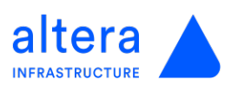













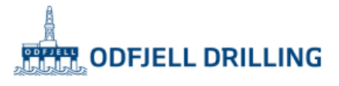











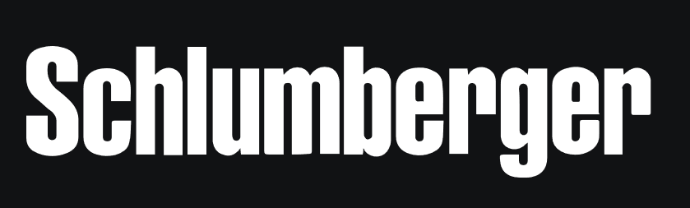
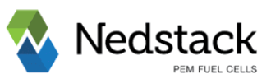

















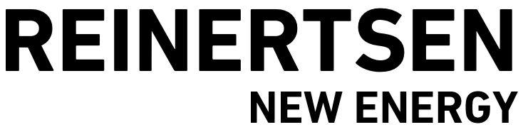

LOWEMISSION PARTNERS
Operators:
Service- & vendors:
Research & development:
Affiliated agencies:
Associated Research Entities
Public financing:

Slide 19
7. Conclusion
Analyze the control problem for an offshore bottoming OTSG subject large disturbances from the upstream gas turbine
For simulations, we use a high-fidelity dynamic model developed in Dymola
Pressure control (feedback):
  Constant pressure operation keep the pressure at the setpoint, but gives lower power output due to throttling loses
Temperature control (feedback or feedforward):
  Input transformation derived from a simple steady-state energy balance has good disturbance rejection when applied to a high-fidelity dynamic model
Future work:
  integrate the gas turbine model in the simulation
  control strategies for load control of the combined cycle (decentralized and/or centralized)
This publication has been produced with support from the LowEmission Research Centre (www.lowemission.no), performed under the Norwegian research program PETROSENTER. The authors acknowledge the industry partners in LowEmission for their contributions and the Research Council of Norway (296207).

