Slide 1
Economic Plantwide Control:
Automated Controlled Variable Selection for a Reactor-Separator-Recycle Process
Vladimiros Minasidis, Johannes Jäschke and
Sigurd Skogestad
Department of Chemical Engineering,
Trondheim, Norway
V. Minasidis et al, Automated Controlled Variable Selection for a Reactor-Separator-Recycle Process
Notes:
Thank you for the introduction. I am going to talk today about the automation the Economic plantwide control procedure, more specificly the automation of the key step of the procedure which is the selection of the economic controlled variables.

Slide 2
Outline
Introduction
Economic Plantwide Control
Case study - RSR process
Conclusions and future work
V. Minasidis et al, Automated Controlled Variable Selection for a Reactor-Separator-Recycle Process
Notes:
I will start my presentation with a short introduction to the subject. I will try to explain briefly the steps of the top-down part of the economic plantwide control procedure. And will go through a step by step application of that procedure to a reactor-separator with recycle loop process, with emphasis on the economic CVs selection. I will conclude my talk by discussing my future plans.

Slide 3
Introduction
Most industrial process control strategies are not designed to optimally handle frequent market conditions changes.
V. Minasidis et al, Automated Controlled Variable Selection for a Reactor-Separator-Recycle Process
Notes:
Production plants today are facing difficult challenges imposed by the modern globalized markets. Global competition demands cheaper and more flexible production, in order to retain competitiveness and profitability.

Slide 4
Introduction
Most industrial process control strategies are not designed to optimally handle frequent market conditions changes.
Integration between process optimization and control is needed to reduce the production cost
V. Minasidis et al, Automated Controlled Variable Selection for a Reactor-Separator-Recycle Process
Notes:
In order to minimize the production cost in such a demanding environment of frequent condition changes an integration between process control and process optimization is needed. ---→ In other words we need we need a systematic way to design control solutions that keep the production cost low and optimaly adapt to changing situations.

Slide 5
Introduction
Industry adapts simple control strategies that are easily understood by the operators and engineers.
V. Minasidis et al, Automated Controlled Variable Selection for a Reactor-Separator-Recycle Process
Notes:
Academia is working on different solutions that integrate optimization and control , still none of the solutions have been adapted widely by the industry. Usual industrial practice is to focus on unit operation control, because this is a simple strategy that is easily understood by the operators and engineers.

Slide 6
Introduction
Industry adapts simple control strategies that are easily understood by the operators and engineers.
Essential characteristics:
It has to be fairly simple
It has to be able to keep the process operation close-to-optimal while satisfying the operational constraints
It has to be easily designed
V. Minasidis et al, Automated Controlled Variable Selection for a Reactor-Separator-Recycle Process
Notes:
It seems that the control strategies have to have a few essential characteristics in order to be addapted be the industry or to be applied by the process industry practitioners: (1) it has to be simple ( like real-time optimization), (2) it has to be able to achieve near-optimal operation, and (3) it should be easy to design.
.

Slide 7
Introduction
Industry adapts simple control strategies that are easily understood by the operators and engineers.
Essential characteristics:
It has to be fairly simple
It has to be able to keep the process operation close-to-optimal while satisfying the operational constraints
It has to be easily designed.
Economic plantwide control can be used to design control structures that satisfy the first two characteristics
V. Minasidis et al, Automated Controlled Variable Selection for a Reactor-Separator-Recycle Process
Notes:
The economic plantwide control can be used to design control structures that have the rst two of the key characteris- tic mentioned above. The last characteristic can be satisfyed by automating most of the complicated steps thus reducing the amount of the expertise required to design such strategies. So what is the Economic Plantwide control ….
.

Slide 8
Economic Plantwide Control
“Formulate the economic operation as a mathematical optimization problem and then design a control structure that results in a close-to-optimal operation while satisfying the stability and robustness requirements”.
V. Minasidis et al, Automated Controlled Variable Selection for a Reactor-Separator-Recycle Process
Notes:
So lets look at the Part of Economic plantwide control procedure The main idea is to formulate the optimal economic operation as a mathematical optimization problem and then to design a control structure that ensures close-to-optimal operation while satisfying the stability and robustness requirements.

Slide 9
Economic Plantwide Control
“Formulate the economic operation as a mathematical optimization problem and then design a control structure that results in a close-to-optimal operation while satisfying the stability and robustness requirements”.
Top-down part:
Aims to find an optimal control structure based on plant steady state economics
Bottom-up part:
Aims to find a simple and robust regulatory control
V. Minasidis et al, Automated Controlled Variable Selection for a Reactor-Separator-Recycle Process
Notes:
The EPC is hierarchically decomposed in to two different procedures. That is the top-down part that aims to find an optimal control structure based on SS economics and the Bottom up part that is mainly consered with the stabiization and pairings.

Slide 10
Economic Plantwide Control
Steps from top-down part of plantwide control design procedure:
Define the operational objectives (economics) and constraints.
Details in [Skogestad, 2012]
V. Minasidis et al, Automated Controlled Variable Selection for a Reactor-Separator-Recycle Process
Notes:
Lets look at the first 3 steps from the EPC procedure that are required to select the economic CVs.

Slide 11
Economic Plantwide Control
Steps from top-down part of plantwide control design procedure:
Define the operational objectives (economics) and constraints.
Determine the steady state optimal operation:
Identify the steady-state DOFs
Identify the important disturbances and their expected range
Identify the expected active constrains regions
Details in [Skogestad, 2012]
V. Minasidis et al, Automated Controlled Variable Selection for a Reactor-Separator-Recycle Process
Notes:
Lets look at the first 3 steps from the EPC procedure that are required to select the economic CVs.

Slide 12
Economic Plantwide Control
Steps from top-down part of plantwide control design procedure:
Define the operational objectives (economics) and constraints.
Determine the steady state optimal operation:
Identify the steady-state DOFs
Identify the important disturbances and their expected range
Identify the expected active constrains regions
Select primary (economic) controlled variables:
Control the active constraints
Select self-optimizing CV’s
Details in [Skogestad, 2012]
V. Minasidis et al, Automated Controlled Variable Selection for a Reactor-Separator-Recycle Process
Notes:
Lets look briefly at the first 3 steps from the EPC procedure that are required to select the economic CVs.

Slide 13
Process description
CSTR
1st order kinetics
(undesired)
Details can be found in Jacobsen et. al, [2011]
V. Minasidis et al, Automated Controlled Variable Selection for a Reactor-Separator-Recycle Process
Notes:
A fresh feed F0 and a recycle stream r are fed to a CSTR. Were 2 parallel reaction with 1st order kinetics take place. A goes to B which is the desired product and A -> 2 C which is the undesired reaction. The CSTR outflow F is led to a distillation column where the heaviest component B get separated as a bottom product. And A + C which is the lightest component are led to a split here part of it is purged and part of it is fed back as a recycle.

Slide 14
Process description
CSTR
1st order kinetics
(undesired)
Column
30 stages
LV - configuration
Assumptions:
Constant relative volatilities
Constant molar overflows
Constant pressure
Details can be found in Jacobsen et. al, [2011]
V. Minasidis et al, Automated Controlled Variable Selection for a Reactor-Separator-Recycle Process
Notes:
The distillation column is modelled as a 30 stage ideal column with constant molar overflows, constant relative volatilities,
Constant pressure and Liquid dynamics based on Francis weir equation.

Slide 15
Economic Plantwide Control
Step 1:
Define the operational objectives (economics) and constraints.
V. Minasidis et al, Automated Controlled Variable Selection for a Reactor-Separator-Recycle Process

Slide 16
Step 1:
Cost function:
steam cost
cost feed
value products
V. Minasidis et al, Automated Controlled Variable Selection for a Reactor-Separator-Recycle Process
Notes:
We start the systematic procedure of selecting linear combination of measurements as self-optimizing variables by defining the cost function J. That is the cost of feed plus energy cost minus what we are getting paid for the value products.

Slide 17
Step 1:
Cost function:
steam cost
cost feed
value products
prices in $/kmol
V. Minasidis et al, Automated Controlled Variable Selection for a Reactor-Separator-Recycle Process
Notes:
Here are the prices. In our case study we assumed that we are getting paid for the purge product.

Slide 18
Step 1:
Cost function:
steam cost
cost feed
value products
prices in $/kmol
Operational constraints*:
*values are based on the work of Jacobsen et. al, [2011]
V. Minasidis et al, Automated Controlled Variable Selection for a Reactor-Separator-Recycle Process
Notes:
The operational constraint for this process are: Product specification Xbb, Maximum reactor temperature Tr, Maximum CSTR holdup Mr, and maximum steam production capacity and of course we have the physical limitation such as no negative flows and etc.

Slide 19
Economic Plantwide Control
Step 2:
Determine the steady state optimal operation:
Identify the steady-state DOFs
Identify the important disturbances and their expected range
Identify the expected active constrains regions
V. Minasidis et al, Automated Controlled Variable Selection for a Reactor-Separator-Recycle Process
Notes:
In order to select this magic variables in a systematic way we need to define the economic objectives and operational constraints. Using a nonlinear rigorous steady state model we determine the steady state optimal operation at the nominal operating point. Identify the ss DOFS. Identify the constraints region around the optimal nominal operating point for the expected disturbance range. For the Selection of primary controlled variables the ideal controlled variable for optimal operation under a constant set-point policy are the active constraints. We need to keep them at the constraints :D in order to achieve an optimal operation. So after pairing the active constraints , we select self-optimizing controlled variables for the rest of the DOFs in order to keep a close to optimal operation despite the occurrence of disturbances. There are different methods to do that, I am going to show you a simple elegant formula for selecting a linear combination of measurements as self-optimizing controlled variables. Lets see

Slide 20
Step 2a:
Degrees of freedom:
Steady state degrees of freedom:
V. Minasidis et al, Automated Controlled Variable Selection for a Reactor-Separator-Recycle Process
Notes:
The ss DOFs for this process are: The column operated in LV-configuration so we have the L and V, we have the reactor effluent, recycle flow and steam flow in the CSTR jacket.

Slide 21
Step 2b:
Degrees of freedom:
Steady state degrees of freedom:
Disturbances
Main disturbances:
Feed flow
Energy price
Expected disturbance range ±30%
V. Minasidis et al, Systematic controlled variable selection for a RSR process
Notes:
As the main disturbance we consider the fresh feed flow changes and we have also included the price variation.

Slide 22
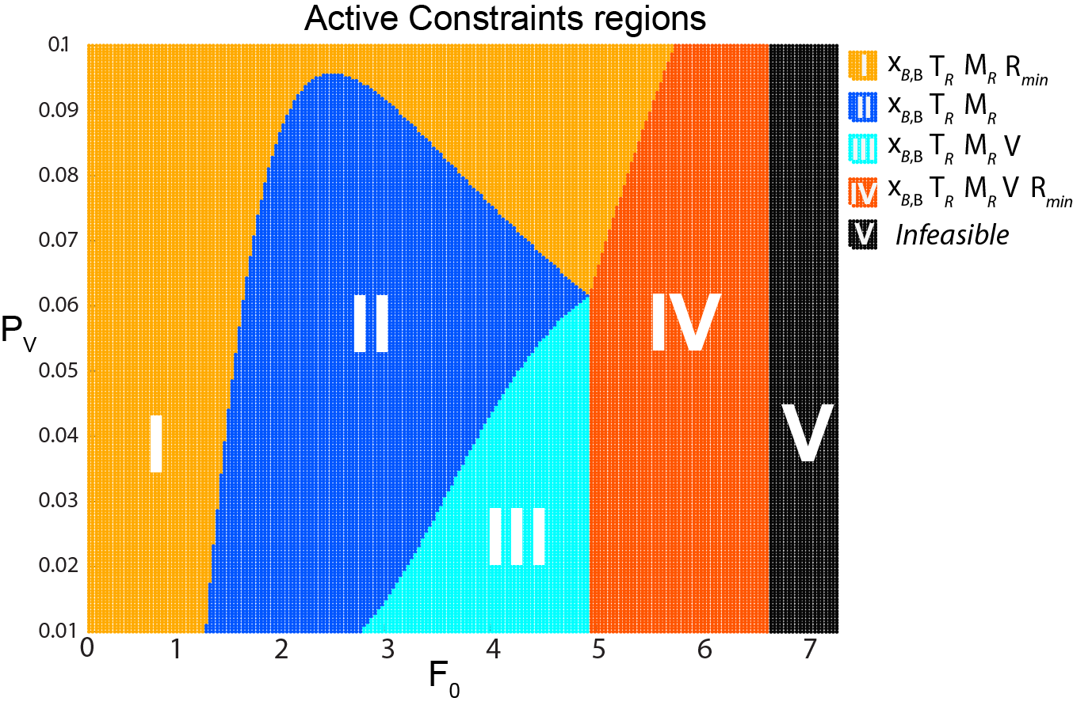
Step 2c:
Always active:
Remaining
active constraints regions:
Operational constraints:
Maximum number of
active constraint regions
V. Minasidis et al, Automated Controlled Variable Selection for a Reactor-Separator-Recycle Process
Notes:
This is an active constraints map over a large disturbance region. This is done to demonstrate the existance of all the possible active constraints regions.

Slide 23
Step 2c:
Always active:
Remaining
active constraints regions:
Operational constraints:
Operating point
V. Minasidis et al, Automated Controlled Variable Selection for a Reactor-Separator-Recycle Process
Notes:
This is an active constraints map over a large disturbance region. This is done to demonstrate the existance of all the possible active constraints regions.

Slide 24
Economic Plantwide Control
Step 3:
Select primary (economic) controlled variables:
Control the active constraints
Select the self-optimizing variables
V. Minasidis et al, Automated Controlled Variable Selection for a Reactor-Separator-Recycle Process
Notes:
In order to select this magic variables in a systematic way we need to define the economic objectives and operational constraints. Using a nonlinear rigorous steady state model we determine the steady state optimal operation at the nominal operating point. Identify the ss DOFS. Identify the constraints region around the optimal nominal operating point for the expected disturbance range. For the Selection of primary controlled variables the ideal controlled variable for optimal operation under a constant set-point policy are the active constraints. We need to keep them at the constraints :D in order to achieve an optimal operation. So after pairing the active constraints , we select self-optimizing controlled variables for the rest of the DOFs in order to keep a close to optimal operation despite the occurrence of disturbances. There are different methods to do that, I am going to show you a simple elegant formula for selecting a linear combination of measurements as self-optimizing controlled variables. Lets see

Slide 25
Step 3a:
An optimal operational point:
Active constraints:
Steady-state DOFs:
Active constraints pairings (input, output):
V. Minasidis et al, Automated Controlled Variable Selection for a Reactor-Separator-Recycle Process
Notes:
So how do we calculate those “magic” controlled variables.

Slide 26
Economic Plantwide Control
Step 3:
Select primary (economic) controlled variables:
Control the active constraints
Select the self-optimizing variables
V. Minasidis et al, Automated Controlled Variable Selection for a Reactor-Separator-Recycle Process
Notes:
In order to select this magic variables in a systematic way we need to define the economic objectives and operational constraints. Using a nonlinear rigorous steady state model we determine the steady state optimal operation at the nominal operating point. Identify the ss DOFS. Identify the constraints region around the optimal nominal operating point for the expected disturbance range. For the Selection of primary controlled variables the ideal controlled variable for optimal operation under a constant set-point policy are the active constraints. We need to keep them at the constraints :D in order to achieve an optimal operation. So after pairing the active constraints , we select self-optimizing controlled variables for the rest of the DOFs in order to keep a close to optimal operation despite the occurrence of disturbances. There are different methods to do that, I am going to show you a simple elegant formula for selecting a linear combination of measurements as self-optimizing controlled variables. Lets see

Slide 27
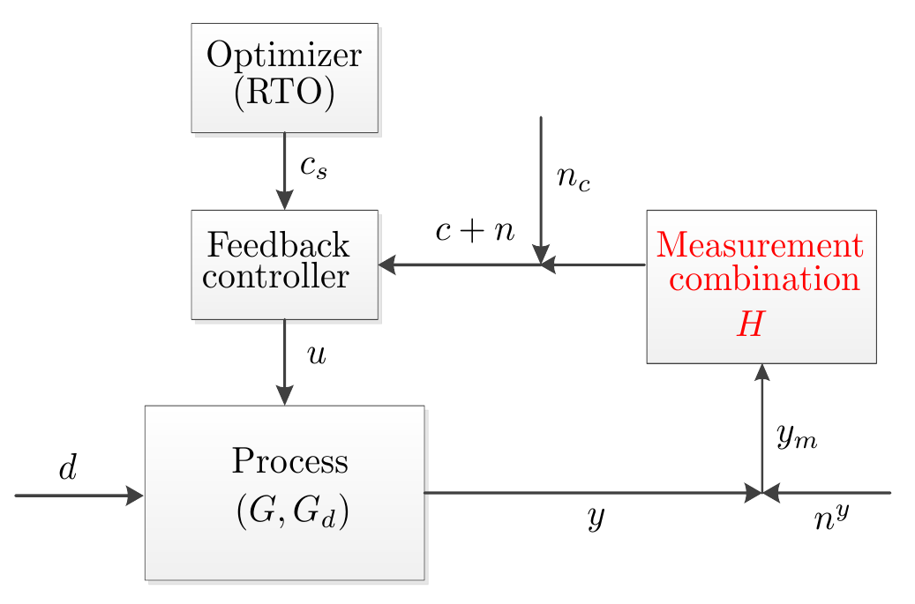
Self-optimizing CVs
Linearized model
Setpoint control
Feedback implementation of optimal operation with separate layers for optimization (RTO) and control
V. Minasidis et al, Automated Controlled Variable Selection for a Reactor-Separator-Recycle Process
Notes:
So if we look at the previous example using the usual control nomenclature then the feed controller is the head of runner, the scheduler or the optimizer is the trainer, the process is the body and the self-optimizing control here is select an H matrix that a simple set-point control would keep the process close to optimal despite the occurrence of disturbances!!! How do we select an H??? And can self-optimizing control structure design be automated. Lets see.

Slide 28
Available measurements
Candidate measurements (y):
Compositions (noise ±0.01):
Input flows (noise ±10%):
Reactor level (noise ±100 mol):
Column and reactor temperatures (noise ± 1 K):
V. Minasidis et al, Automated Controlled Variable Selection for a Reactor-Separator-Recycle Process
Notes:
The smallest posible drift from the optimal operation. As available measurements we assume that we measure the 3 compositions. All the flows, the level and the temperature of the reactor, and temperatures along the distillation column.

Slide 29
Self-optimizing CV’s selection
Combination of measurements based on Nullspace method [Alstad et. Al, 2009]
Analytical solution using all the measurements based on the Exact Local method [Halvorsen, 2003]
Individual or combination of measurements based on Branch&Bound method [Kariwala et. al, 2008]
Individual or combination of measurements with structural constraints based on MIQP formulation [Yelchuru et. al, 2011]
V. Minasidis et al, Automated Controlled Variable Selection for a Reactor-Separator-Recycle Process

Slide 30
Self optimizing CV’s selection
Remaining DOFs for Self-optimizing control:
Notes:
For example if we automate the easiest to calculate method, that is the method based on the analytical solution. These are the results f

Slide 31
Self optimizing CV’s selection
Remaining DOFs for Self-optimizing control:
Nullspace method [Alstad et. al, 2009]
where
- nullspace
- optimal sensitivity to disturbances
Need to estimate :
V. Minasidis et al, Automated Controlled Variable Selection for a Reactor-Separator-Recycle Process
Notes:
For example if we automate the easiest to calculate method, that is the method based on the analytical solution. These are the results f

Slide 32
Self optimizing CV’s selection
Remaining DOFs for Self-optimizing control:
Select the self-optimizing CV for L based on the analytical solution [Yelchuru et al, 2011]:
Scaled disturbances
and noise
where
- any non singular matrix of
Need to estimate :
and
V. Minasidis et al, Automated Controlled Variable Selection for a Reactor-Separator-Recycle Process
Notes:
For example if we automate the easiest to calculate method, that is the method based on the analytical solution. These are the results f

Slide 33
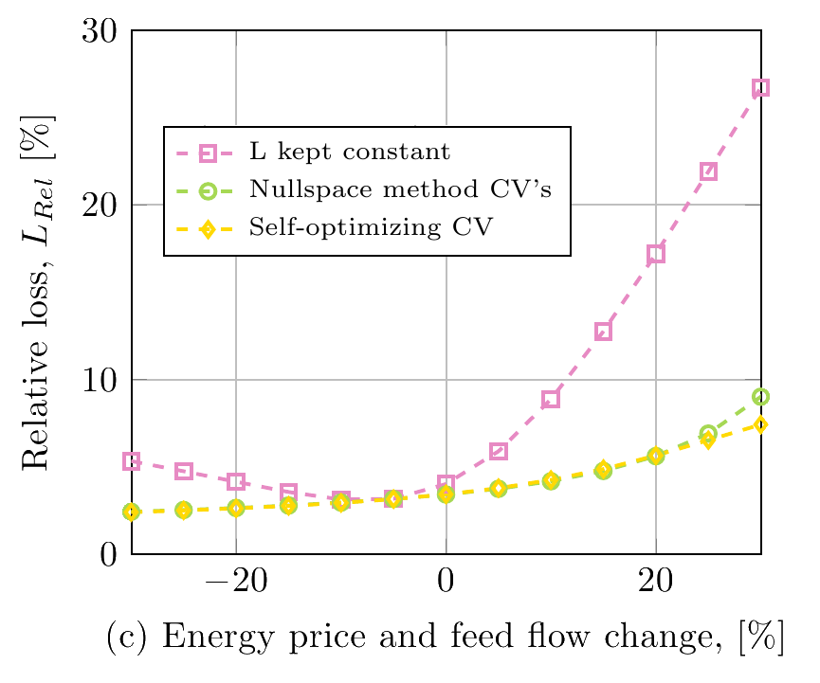
Performance comparisson
Relative loss
V. Minasidis et al, Automated Controlled Variable Selection for a Reactor-Separator-Recycle Process
Notes:
We evaluate the control structure using a nonlinear dynamic model of the process.

Slide 34
Conclusions
Automated economic CVs selection could be considered a successful first step for automating the entire procedure
Integration of Economic Plantwide Control design procedure in to popular process simulators could potentially improve the production costs on a global scale
V. Minasidis et al, Automated Controlled Variable Selection for a Reactor-Separator-Recycle Process
Notes:
Which is the ulterior goal behind our work.

Slide 35
Future Work
Handling active constraint changes
Finding a single control structure over multiple active constraints regions with an acceptable loss
Using the information from the active constraint maps to estimate
V. Minasidis et al, Automated Controlled Variable Selection for a Reactor-Separator-Recycle Process
Notes:
Which is the ulterior goal behind our work.

Slide 36
Future Work
Handling active constraint changes
Finding a single control structure over multiple active constraints regions with an acceptable loss
Using the information from the active constraint maps to estimate
Thank you !
V. Minasidis et al, Automated Controlled Variable Selection for a Reactor-Separator-Recycle Process
Notes:
Which is the ulterior goal behind our work.

