Slide 1
Sigurd Skogestad
Closing notes
1. A little about SUBPRO
2. Oil price history
3. Reflections OOGP

Slide 2


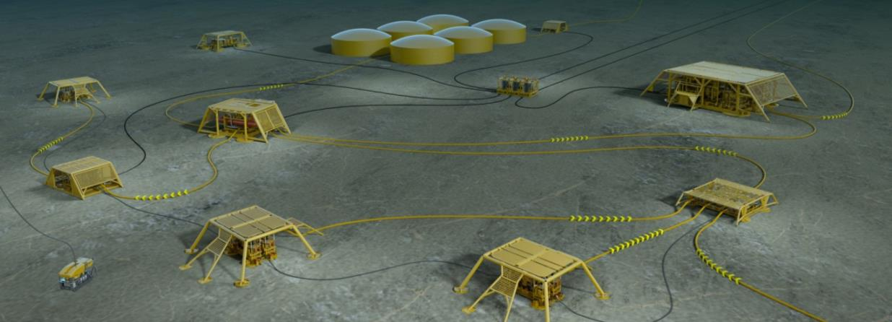
SUBPRO
SUBPRO
SUBSEA PRODUCTION AND PROCESSING
2015-23. About 3 million Euro per year
© Statoil ASA

Slide 3








SUBPRO Partners
SUBPRO

Slide 4
PROJECT STRUCTURE (Currrent)
SUBPRO
FIELD ARCHITECTURE
Sigbjørn Sangesland
RELIABILITY, MAINTENANCE AND SAFETY
Mary Ann Lundteigen
SEPARATION –
FLUID CHARACTERIZATION
Johan Sjöblom/Gisle Øye
SEPARATION -
PROCESS CONCEPTS
Hugo Jakobsen
SYSTEM CONTROL
Sigurd Skogestad
Subsea gate box
Mariana Diaz
New safety and control philosophy for subsea
HyungJu Kim
Produced water quality and injectivity
Marcin Dudek
Membranes for gas dehydration (modeling)
Kristin Dalane
Dynamic simulation model library
Christoph Backi
Field development
concepts
Diana Gonzalez
Reliability and availability in design Juntao Zhang
Influence of chemicals on produced water quality
Marcin Dudek
Membranes for gas dehydration (testing)
Mahdi Ahmadi
Modelling for control of subsea processes
Torstein Kristoffersen
Multiphase boosting models
Gilberto Nunez
Condition and prognostic maintenance
Yun Zhang
Prevention of wax deposition
Jost Ruwoldt
Combined H₂S and hydrate control
Eirini Skylogianni
Adaptive control of subsea processes
Sveinung Johan Ohrem
Optimizing condition monitoring
Himanshu Srivastav
Sequential separation
Are Bertheussen
Characterization of particle breakup
Nicolás La Forgia
Process control algorithms
Mishiga Vallabhan
Modeling of coalescence
Aleksandar Yordanov Mehandzhiyski
Experiments on fluid particle breakage
Eirik Helno Herø
Estimation of un-measured variables
Tamal Das
Compact separation
Håvard Slettahjell Skjefstad
Enhanced virtual flow metering
Timur Bikmukhametov
Control for extending component life
Adriaen Verheyleweghen
Production optimization under uncertainty
Dinesh Krishnamoorthy

Slide 5
PROJECT STRUCTURE (including new projects from 2018/2019)
SUBPRO
FIELD ARCHITECTURE
Sigbjørn Sangesland
RELIABILITY, MAINTENANCE AND SAFETY
Mary Ann Lundteigen
SEPARATION –
FLUID CHARACTERIZATION
Johan Sjöblom/Gisle Øye
SEPARATION -
PROCESS CONCEPTS
Hugo Jakobsen
SYSTEM CONTROL
Sigurd Skogestad
Subsea gate box
Mariana Diaz
New safety and control philosophy for subsea
HyungJu Kim
Produced water quality and injectivity
Marcin Dudek
Membranes for gas dehydration (modeling)
Kristin Dalane
Dynamic simulation model library
Christoph Backi
Control for extending component life
Adriaen Verheyleweghen
Field development
concepts
Diana Gonzalez
Reliability and availability in design Juntao Zhang
Influence of chemicals on produced water quality
Marcin Dudek
Membranes for gas dehydration (testing)
Mahdi Ahmadi
Modelling for control of subsea processes
Torstein Kristoffersen
Production optimization under uncertainty
Dinesh Krishnamoorthy
Multiphase boosting models
Gilberto Nunez
Condition and prognostic maintenance
Yun Zhang
Prevention of wax deposition
Jost Ruwoldt
Combined H₂S and hydrate control
Eirini Skylogianni
Adaptive control of subsea processes
Sveinung Johan Ohrem
Optimizing condition monitoring
Himanshu Srivastav
Sequential separation
Are Bertheussen
Characterization of particle breakup
Nicolás La Forgia
Process control algorithms
Mishiga Vallabhan
Modeling of coalescence
Aleksandar Yordanov Mehandzhiyski
Experiments on fluid particle breakage
Eirik Helno Herø
Estimation of un-measured variables
Tamal Das
Compact separation
Håvard Slettahjell Skjefstad
Enhanced virtual flow metering
Timur Bikmukhametov
Optimizing subsea layout to minimize risk and cost
TBN
Opimizing operating cost versus safety constraints TBN
Re-injection and re-use of produced water
TBN
Mechanistic modeling of droplet breakage
TBN
Experimental validation - Remaining Useful Life
TBN

Slide 6
PROJECT STRUCTURE (including new projects from 2018/2019)
SUBPRO
FIELD ARCHITECTURE
Sigbjørn Sangesland
RELIABILITY, MAINTENANCE AND SAFETY
Mary Ann Lundteigen
SEPARATION –
FLUID CHARACTERIZATION
Johan Sjöblom/Gisle Øye
SEPARATION -
PROCESS CONCEPTS
Hugo Jakobsen
SYSTEM CONTROL
Sigurd Skogestad
Subsea gate box
Mariana Diaz
New safety and control philosophy for subsea
HyungJu Kim
Produced water quality and injectivity
Marcin Dudek
Membranes for gas dehydration (modeling)
Kristin Dalane
Dynamic simulation model library
Christoph Backi
Production optimization under uncertainty
Dinesh Krishnamoorthy
Field development
concepts
Diana Gonzalez
Reliability and availability in design Juntao Zhang
Influence of chemicals on produced water quality
Marcin Dudek
Membranes for gas dehydration (testing)
Mahdi Ahmadi
Modelling for control of subsea processes
Torstein Kristoffersen
Multiphase boosting models
Gilberto Nunez
Opimizing operating cost versus safety constraints TBN
Re-injection and re-use of produced water
TBN
Combined H₂S and hydrate control
Eirini Skylogianni
Adaptive control of subsea processes
Sveinung Johan Ohrem
Optimizing subsea layout to minimize risk and cost
TBN
Condition and prognostic maintenance
Yun Zhang
Prevention of wax deposition
Jost Ruwoldt
Characterization of particle breakup
Nicolás La Forgia
Process control algorithms
Mishiga Vallabhan
Optimizing condition monitoring
Himanshu Srivastav
Sequential separation
Are Bertheussen
Experiments on fluid particle breakage
Eirik Helno Herø
Estimation of un-measured variables
Tamal Das
Modeling of coalescence
Aleksandar Yordanov Mehandzhiyski
Mechanistic modeling of droplet breakage
TBN
Enhanced virtual flow metering
Timur Bikmukhametov
Compact separation
Håvard Slettahjell Skjefstad
Control for extending component life
Adriaen Verheyleweghen
Experimental validation - Remaining Useful Life
TBN

Slide 7
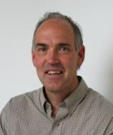
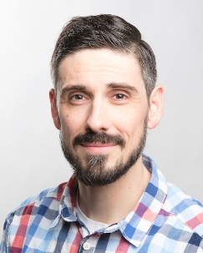
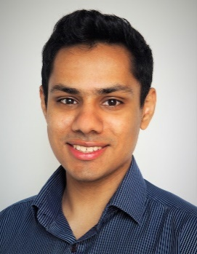
System Control
SUBPRO
Sigurd Skogestad, Professor
SUBPRO Director
Christoph Josef Backi, Postdoctoral Fellow
Project: Dynamic simulation model library
Models: Gravity separator, hydrocyclone, GLCC (gas-liquid),
compact flotation unit (CFU),
compressor (wet-gas, multiphase)
Dinesh Krishnamoorthy, PhD student
Project: Production optimization under uncertainty

Slide 8
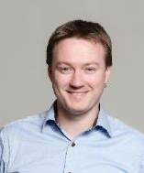
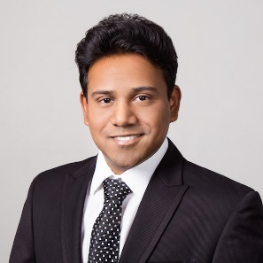
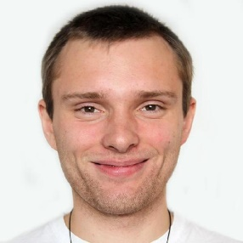
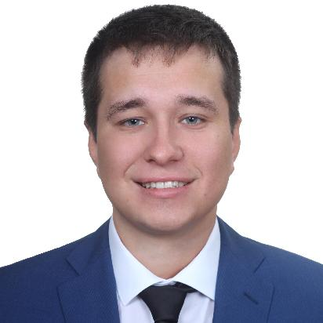
System Control
SUBPRO
Johannes Jäschke, Associate Professor
Supervisor
Tamal Das, PhD student
Project: Estimation of unmeasured variables
Adriaen Verheyleweghen, PhD student
Project: Control for extending component life
Timur Bikmukhametov, PhD student
Project: Enhanced virtual flow metering

Slide 9
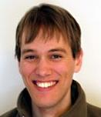
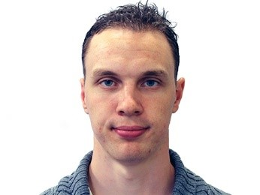
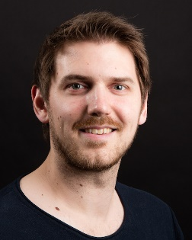
System Control
SUBPRO
Christian Holden, Associate Professor
Supervisor
Mishiga Vallabhan, PhD student
Project: Process control algorithms for subsea separation
Torstein Thode Kristoffersen, PhD student
Project: Modelling and multivariable control of subsea systems
Sveinung Ohrem, PhD student
Project: Control of subsea processes

Slide 10
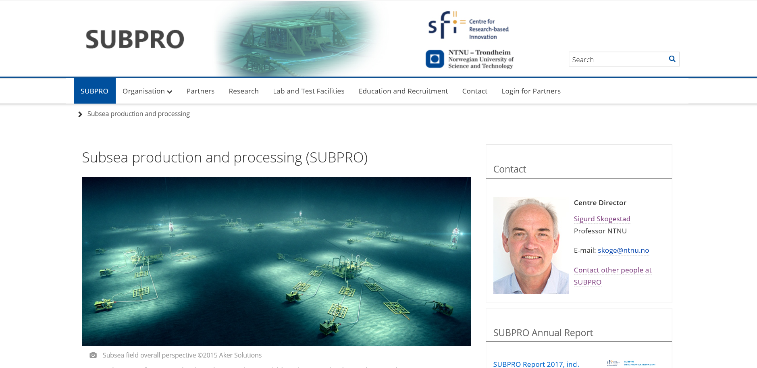

Slide 11
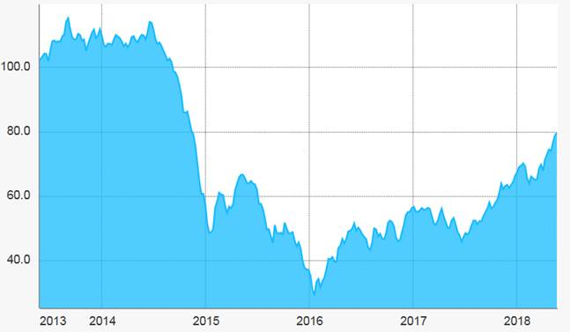
Control application offshore
Traditionally, lower automation level offshore compared to onshore
Lower margins → higher motivation for automatic production optimization (APO)
Oil price variations:

Slide 12
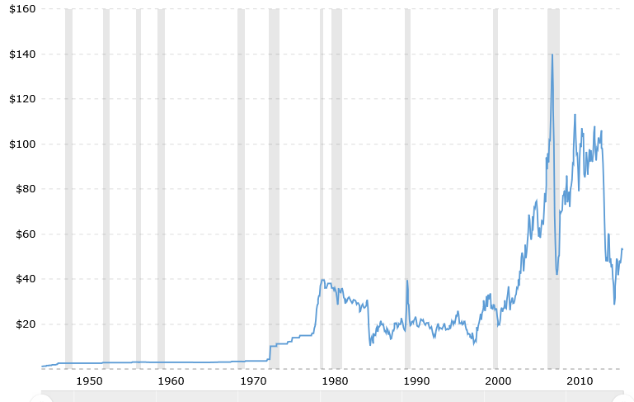
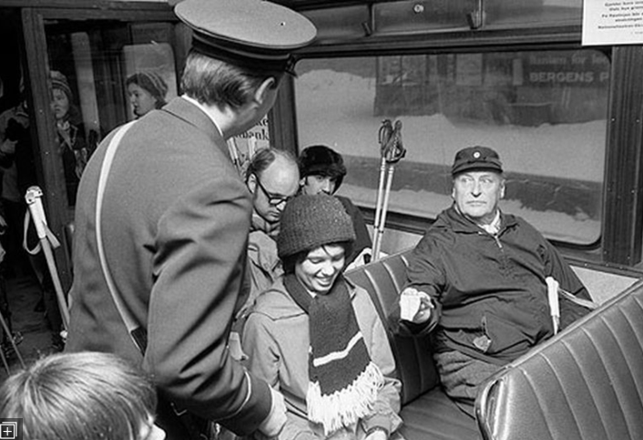
Historical oil price [$/bbl]
June 2008. $140
Financial crisis 2009
June 2014. $106
Dec. 1973. First «oil crisis»
Jan. 2015. $47
Jan. 2016. $28
Jan. 2017. $54
May 2018. $76
Apr. 1980. $40
Nov. 1998. $10
March 1986. $10
http://www.macrotrends.net/1369/crude-oil-price-history-chart

Slide 13
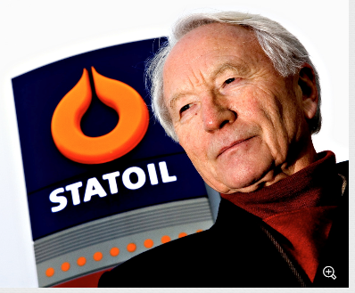
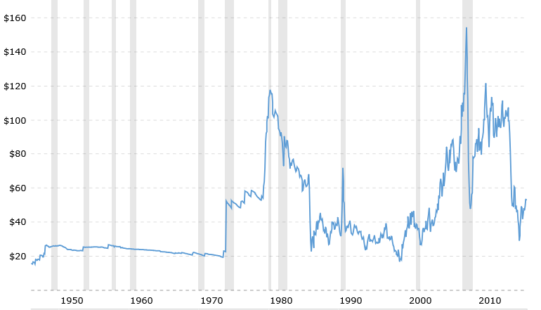
Oil price adjusted for inflation
2008
2014
Alternative green
power competetive
(Solar etc.)
2017
Sigurd’s steady-state curve
1998

Slide 14
Reflections OOGP 2018
Advantage of single session: Very wide range of problems and approaches.

Slide 15
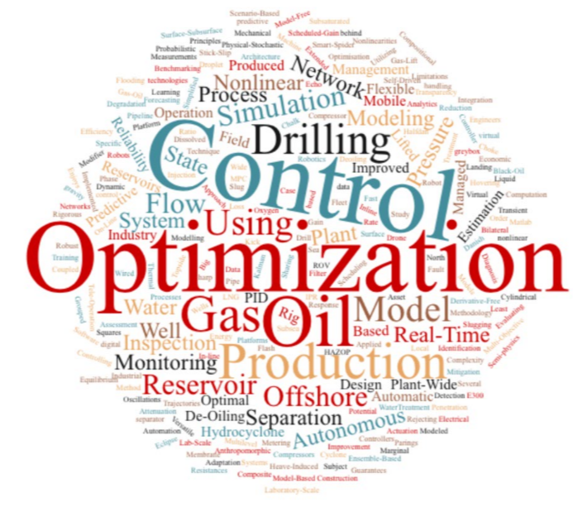
Title

Slide 16
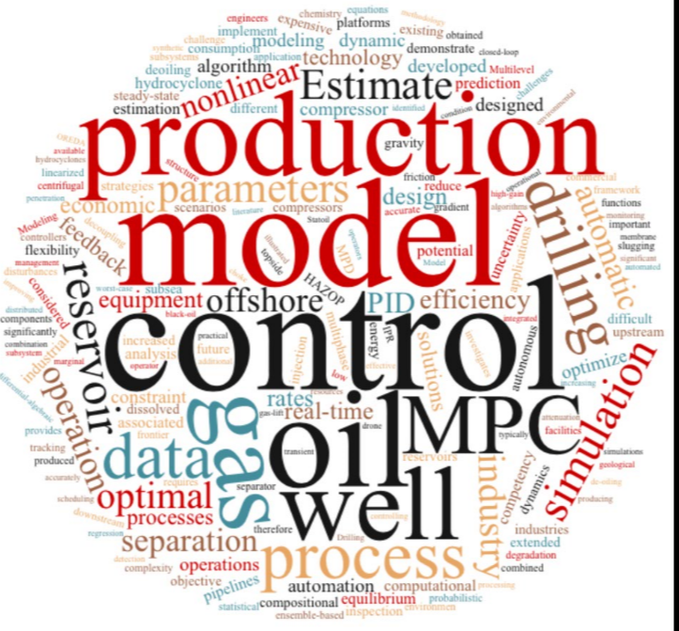
Abstracts

Slide 17
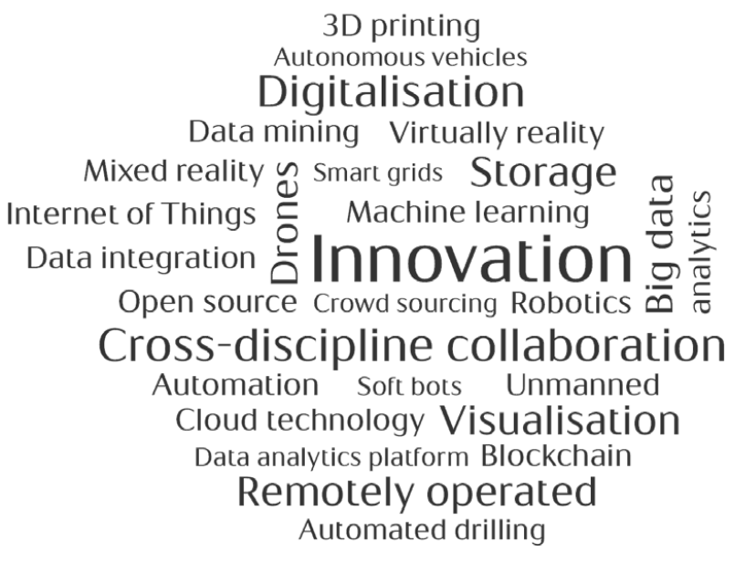
Reflections
Advantage of single session: Very wide range of problems and approaches.
Enormous potential for improved control if offshore oil and gas
Approaches to realize potential
Bottom-up
  «Drink coffee with the operator»
Top-down: Talk buzzwords with management
  Digitalization
Optimal
  Define control («optimal operation») as a required function in the organization
  Continue your good work!

