Slide 1
Increased offshore oil and gas production with automatic control in Equinor
Elvira Marie Bergheim, Pål Kittilsen, Robert Aasheim, Morten Fredriksen
Equinor

Slide 2
Content
Equinor technology strategy
Our in-house MPC tool: SEPTIC
Story from Heidrun oil field
Trends and development needs

Slide 3
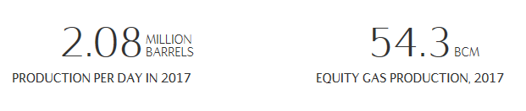
Equinor – who we are?
Former Statoil
Purpose: Turning natural resources into energy for people and progress for society
  Oil and gas production large part
Strategy: Always safe, high value, low carbon.
About 20000 employees

Slide 4
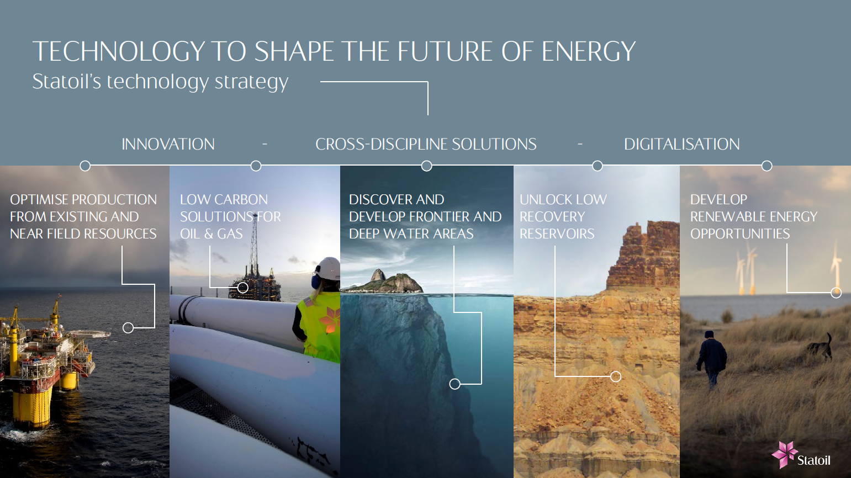

Slide 5
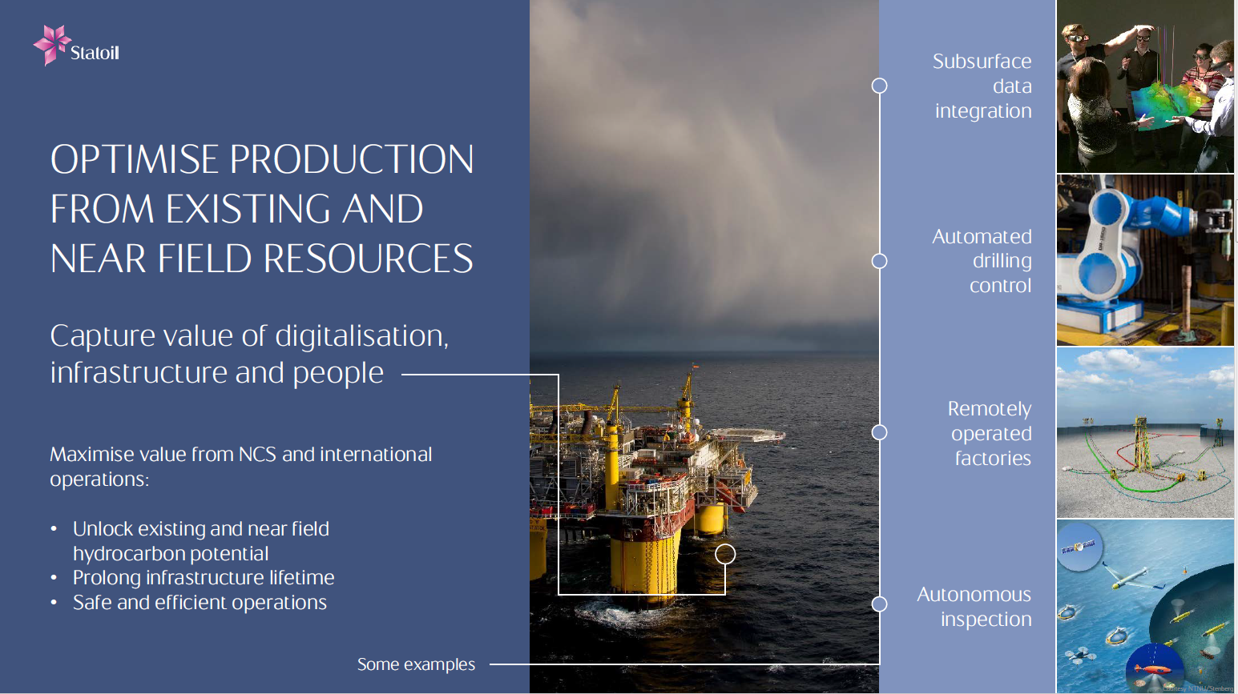

Slide 6
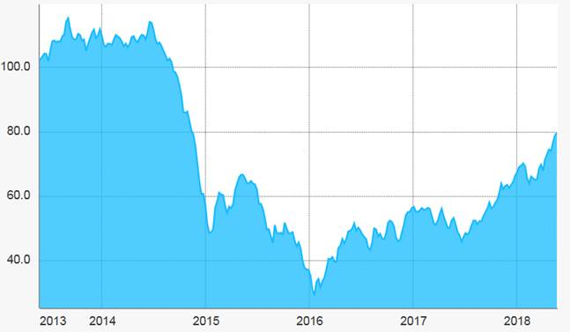
Control application offshore
Traditionally, lower automation level offshore compared to onshore
Lower margins → higher motivation for automatic production optimization (APO)
Oil price variations:

Slide 7
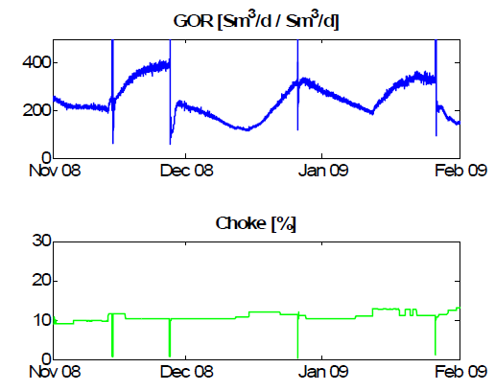
Offshore oil and gas production challenges
Field accessibility and personnel
Hardware
“Earth in the loop”
Inherent dynamics in a wells
  Longer time scale - from new well to tail-end
    Reservoir depletion – water/gas breakthrough
    Well treatment
    Well equipment
  Shorter time scale dynamics
Ambition: a solution that covers more of the well lifetime

Slide 8
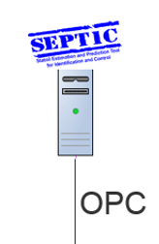
Examples of Equinor offshore automation applications we work with
Single loop - PID control
  Topside control
    Basic control (levels, pressures etc)
    Anti-surge control for compressors
  Well/line choke control
    Production well gas rate control
    Injection well downhole pressure control
    Slug control (riser, flowlines)
Model predictive control (MPC) - SEPTIC
  Automatic start-up of wells and pressure target control
  Use of wells to maintain topside constraints (gas capacity, water capacity, MEG)
  Slug handling and slug control
PID

Slide 9
Why MPC solution?
SP
PV
PID
CO
High limit PV1
SPs and Limits
Several and variable constraints
Different operation modes
  Start-up
  Continuous operation
  Swing producer
  Well tests
  Other
Low limit PV1
Set point PV2
PVs
MPC
COs
Model
SP
PV
PID
CO

Slide 10
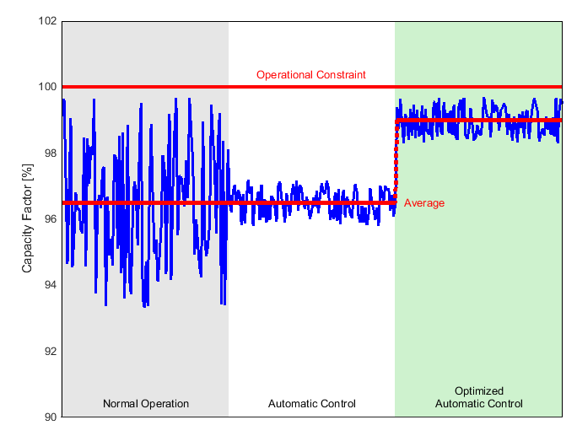

The SEPTIC story
Statoil Estimation and Prediction Tool For Identification and Control

Slide 11

«The SEPTIC story”
The philosophy with SEPTIC is to implement MPC applications together with the users, which have resulted in;
  Strong support of installed applications, ensure performance and active use
  Building in-house competence
  Flexible and quick installations
  Low cost solutions
  Non-bureaucratic way of work
The in-house developed SEPTIC MPC tool was established in 1997 and has continuously been improved since then, securing state-of-the-art technology
The process control group at R&D is responsible for SEPTIC, and works with Equinor customers only

Slide 12
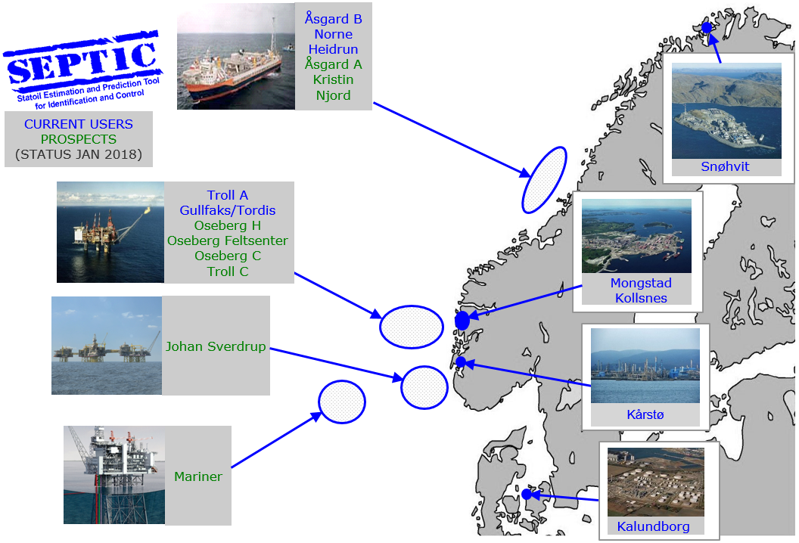
SEPTIC use
Notes:
Oil refining and gas processing – in 20 years
Distillation columns
Product blending (gasoline, gas oil)
Cracking, reforming and hydrotreating
Heat exchanger network (RTO)
Multi-unit optimisation (RTO/DRTO)
Gas quality control
Pipeline pressure control
Offshore production - more expansion last 10 years
Well target control
Capacity control
Extended slug control
Crude blending
Reservoir Pressure Control

Slide 13
MPC – Why?
Profitable!
Improved understanding (& consensus)
of process economics
Increased focus & understanding of
process dynamics
Challenge operating limits
Implement «best practice»
Utilize «cheap» technology
Utilize existing equipment

Slide 14
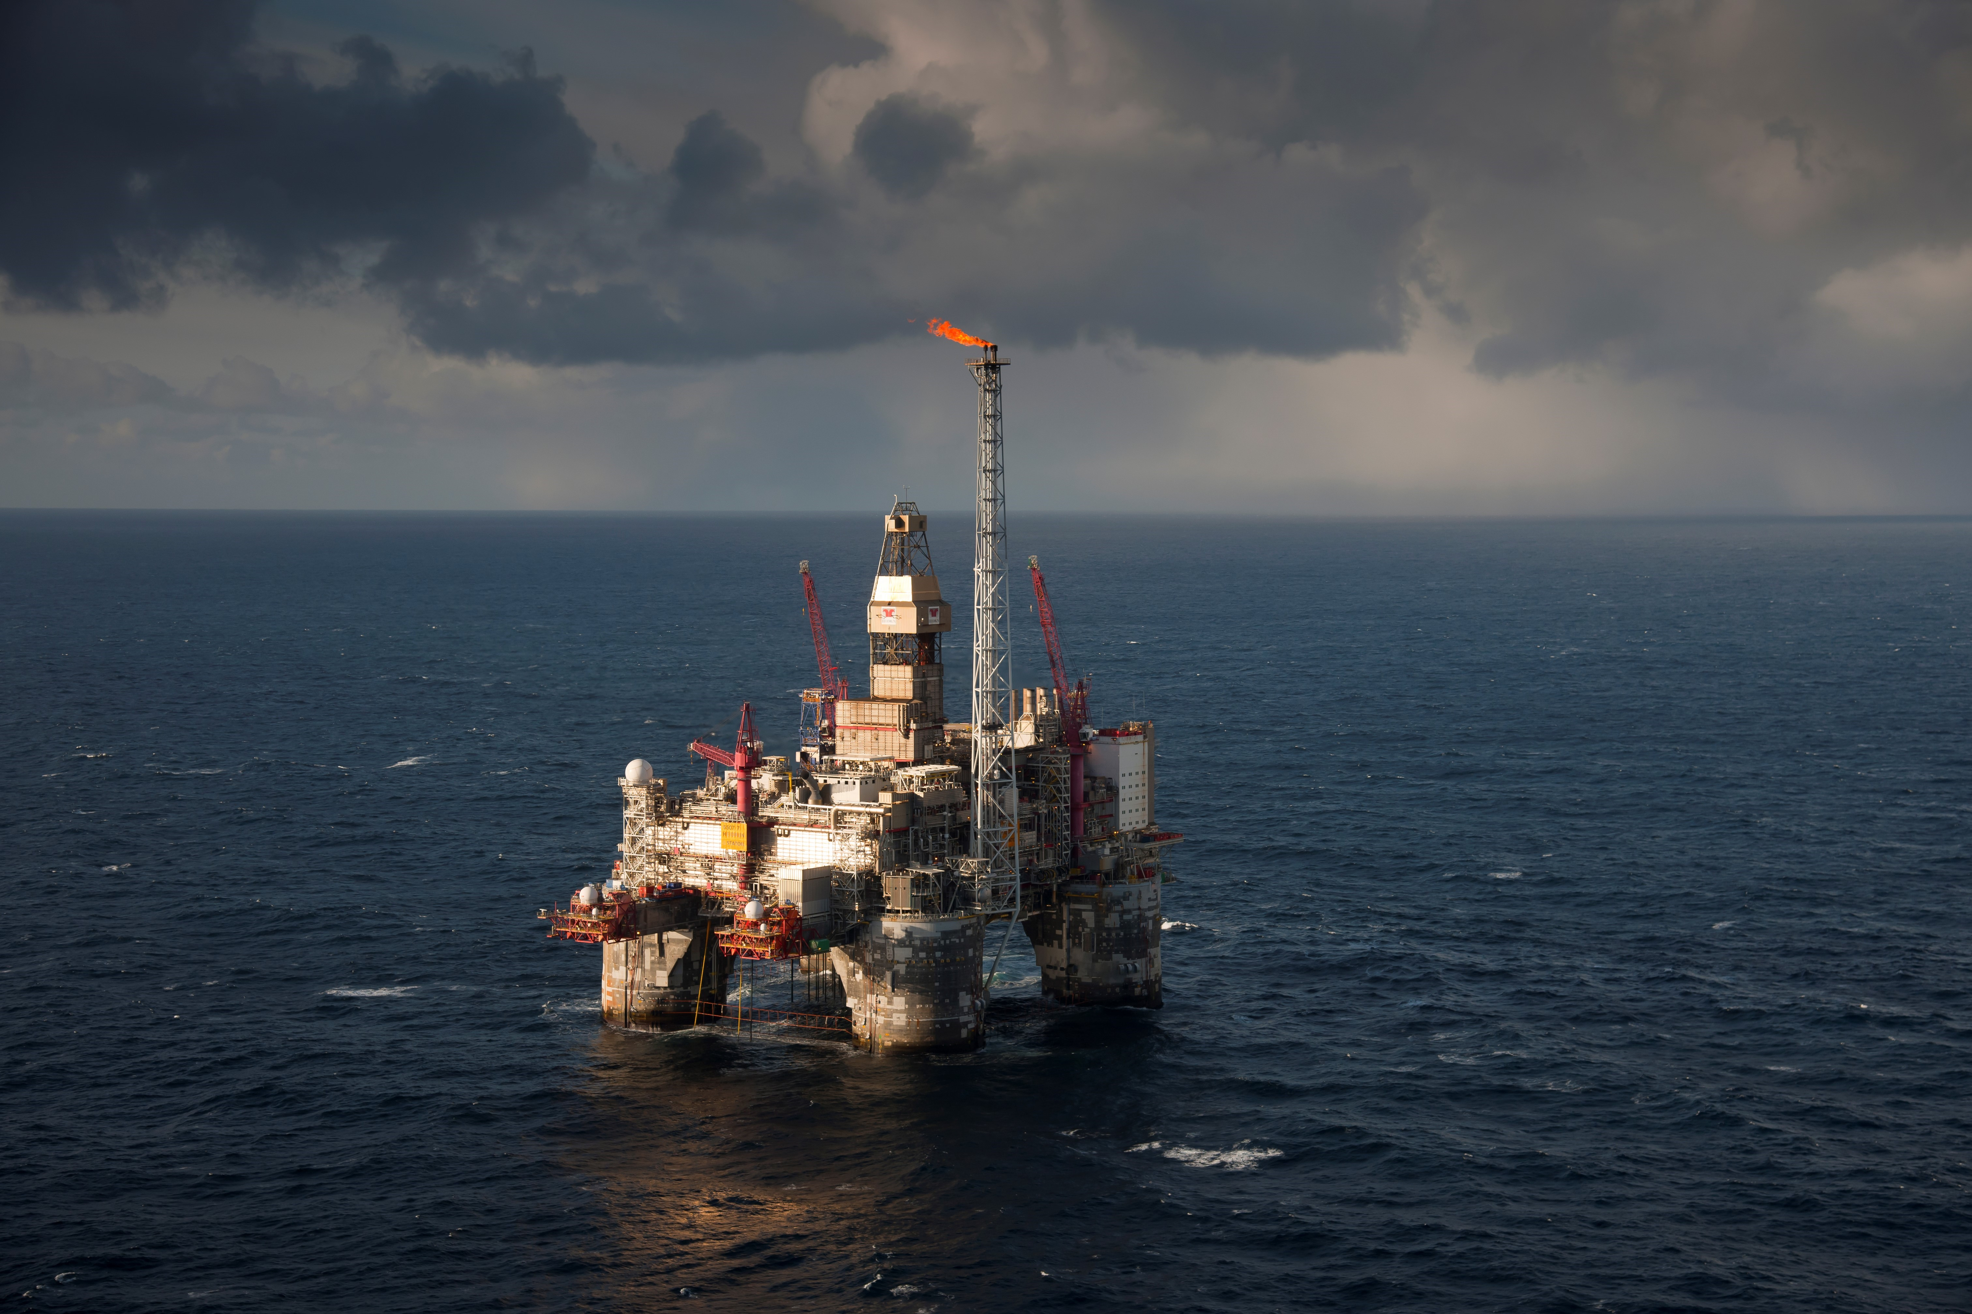
Heidrun story:
Motivation and challenges

Slide 15
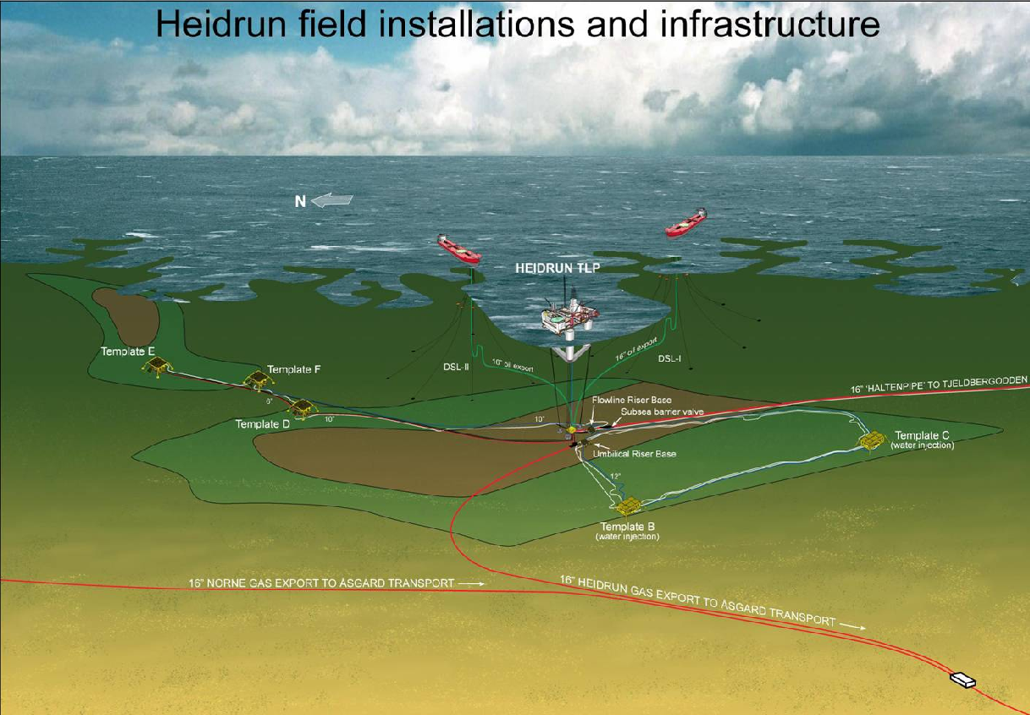
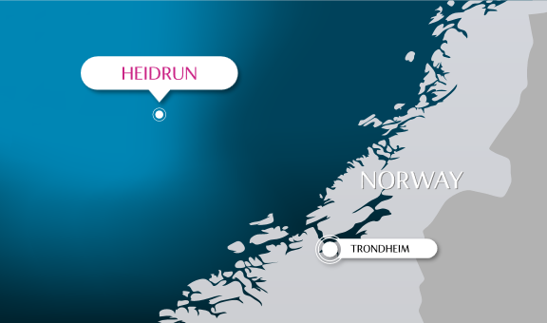
Heidrun Oil Field
Platform and subsea wells
In production since 1995,
  →produced 1.,0 billion barrels of oil May 2018
Gas export through pipelines
Oil shipped in shuttle tankers
Reservoir pressure support from water injection
Main production limitation is the gas handling capacity
Good instrumentation in wells: DHPG, MPM, Sand probes
Expected lifetime until 2045

Slide 16
Heidrun well portfolio
Heidrun production is limited by the gas handling capacity
  Max oil production achieved by prioritising wells with the lowest GOR and utilize the gas capacity.
  GOR changes with time, continuous follow-up required
  Fast changes in gas rates from wells (slugging, start-up, drifting) requires frequent adjustments for wells
  Sand challenges

Slide 17
Gas capacity control: use of swing producers

Slide 18
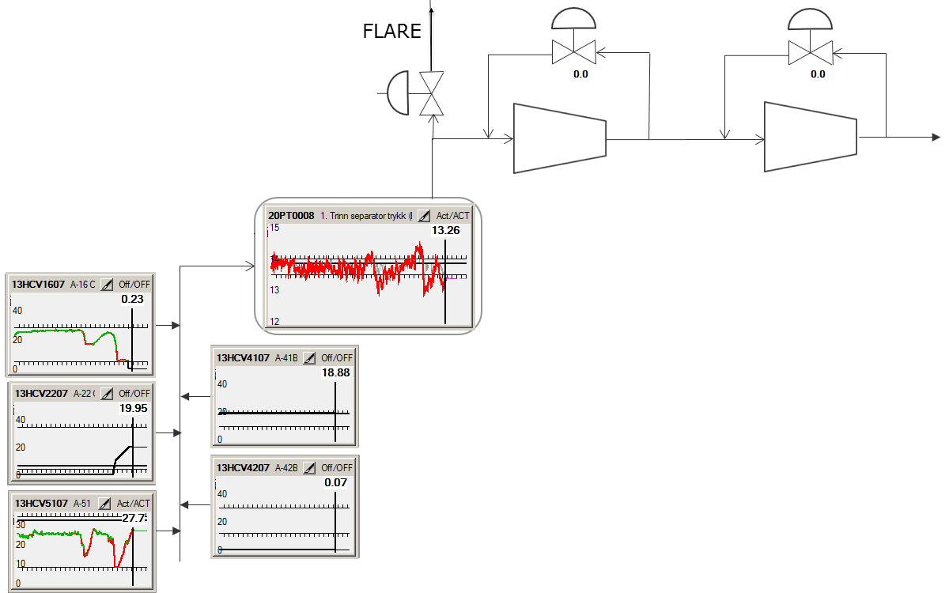
What is gas capacity control with swing producers?
Disturbances in pressure due to:
Shut-in/start-up of wells
Slugging
GOR changes
Pressure 1.stage separator
Choke positions automatically adjusted to maintain 1.stage separator pressure (minute scale)
Available swing producers

Slide 19
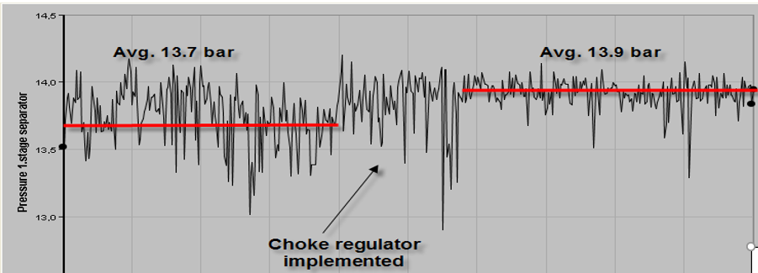
Business case gas capacity control
In use since 2006. Several modifications and extensions, like new and additional swing wells.
Results to date
  Increased production: inlet pressure increased by 0.2 bar → increased throughput due to higher compressor capacity
    ~ 50-100 Sm³/d increased oil rate (~80 MNOK/year)
  Reduced flaring (~60% reduction)
  Reduced need for manual operations
Choke controller implemented

Slide 20
Automatic start-up of wells and pressure target control

Slide 21
Challenges and goals for automatic choke control
Challenge: Risk of sand entrainment (at start-up)
  → Ensure soft start-up by precise draw-down control, reduce pressure gradients
Challenge: Bottom hole pressure not obtained precisely
  → Get and keep desired BHP (fast and accurate production target)
Challenge: High GOR wells tend to drift
  → Stabilize high GOR wells (stop increasing GOR)

Slide 22
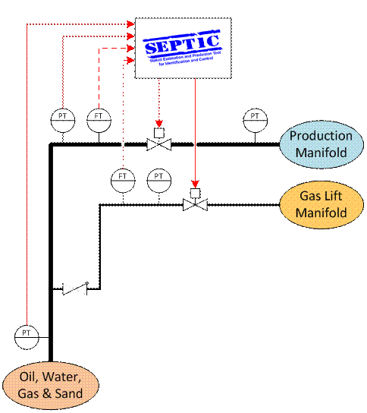
Technical solution
Requires minor modifications in the control system
Operate wells according to their physical properties (pressure, rates etc)
First-order step response models
Sampling time: 10 sec

Slide 23
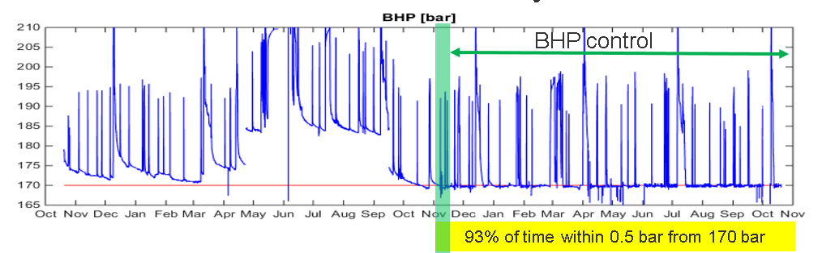
Automatic start-up of wells and pressure target control: Business case
Increase oil production by 2-15% for the first 7 wells
~ Equivalent to 100 000 Sm³ oil/ year (250 MNOK)
Less challenges related to sand

Slide 24
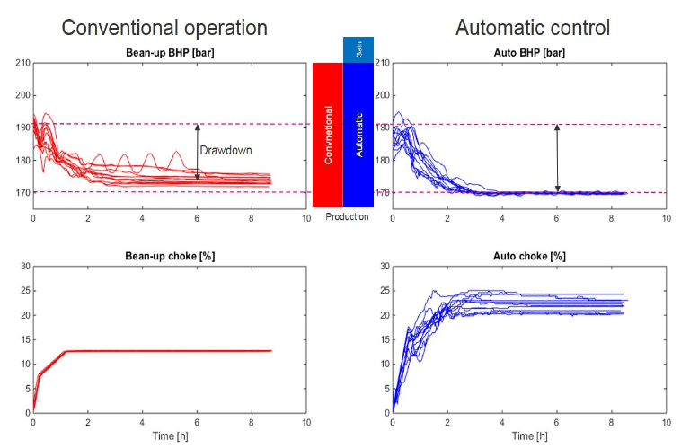
Control target: Bean-up versus auto control

Slide 25
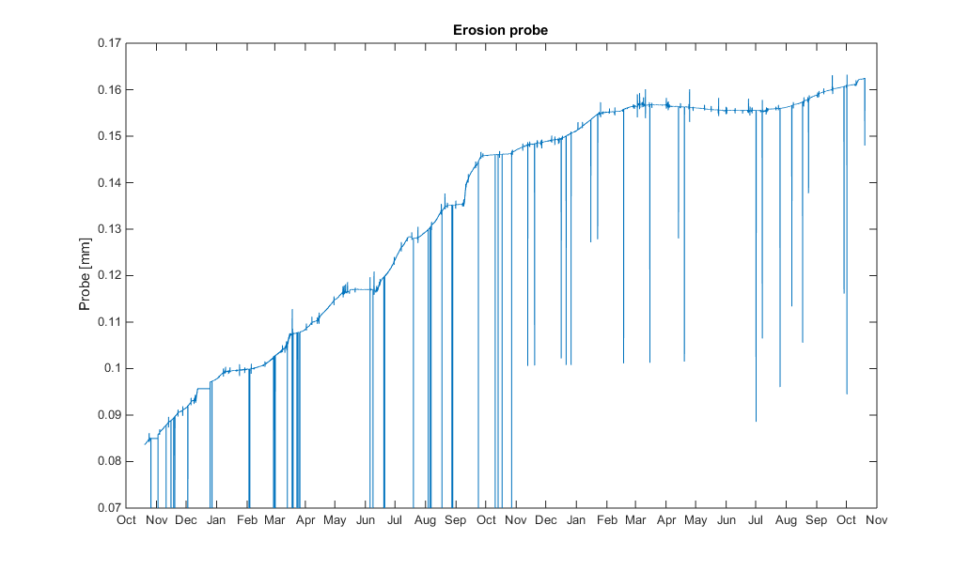
Measured erosion from the well
Conventional operation
Automatic BHP control
Erosion
Erosion

Slide 26
Success factors

Slide 27
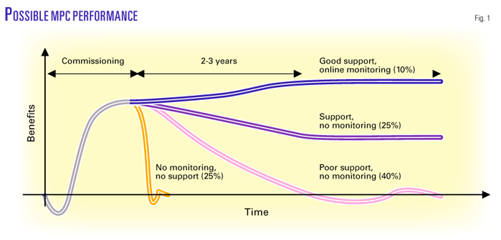
Success factors for applications
Flexibility highly desired, expect changes!
  In well behaviour
  In which wells to use
  In desired functionality
All users have necessary information to understand the application behaviour
Interface designed together with operators
Motivation and training for production engineers required
Access to application from shore

Slide 28

Way of working and competence is essential
  High focus on utilizing the capacity at all times
  Dedicated personnel follows up, build relation and trust –close collaboration
  Continuous activity («not implement and leave»)
  Integrated in daily optimization work
  PETECH og operations discover new opportunities (mindset)
  Process, well and reservoir knowledge

Slide 29
Trends and development needs

Slide 30
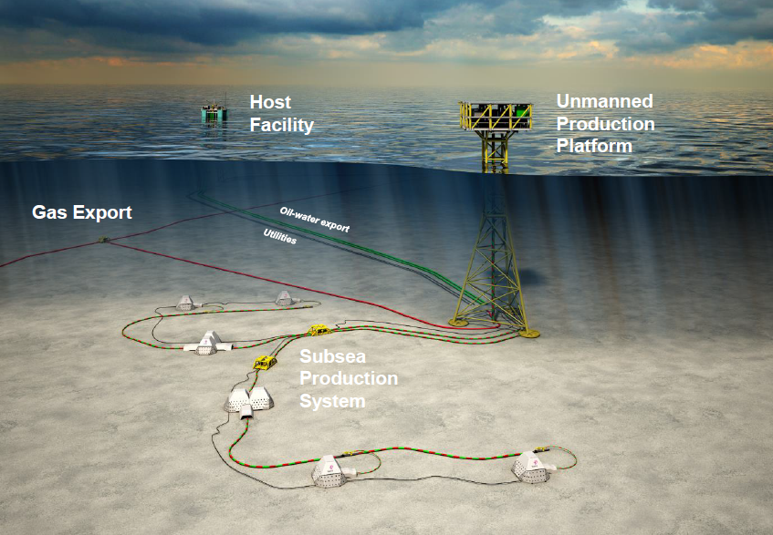
Future context
Cost reduction - always challenged!
Tail – end production
Be energy efficient (low carbon)
Always safe

Slide 31
Examples of development needs
Measurements
  How to ensure good quality measures and what is the uncertainty?
Data analytics and machine learning
  Detecting useful information and how to use them?
  What is adequate models and what is the correct way to update them?
  Data driven models?
  Prediction capabilities?
  Adaptive tuning of controllers?

Slide 32
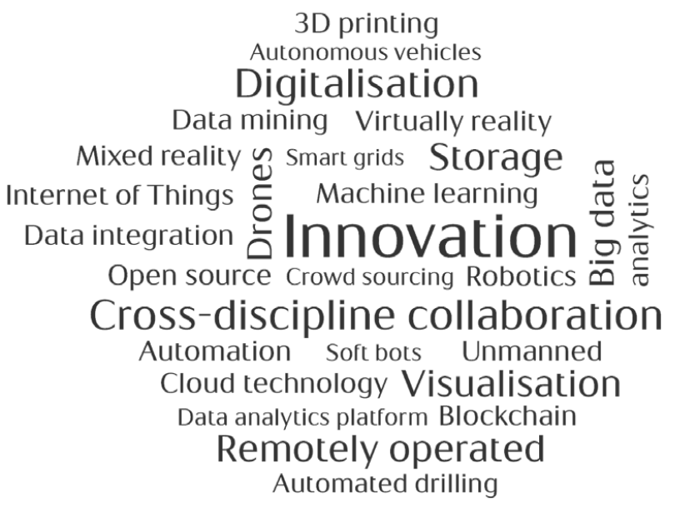
Examples of development needs
Field optimization
  Reservoir – well – topside
  From reservoir drainage strategy to daily production
Visualisation
  Dashboard
  Application performance surveillance

Slide 33
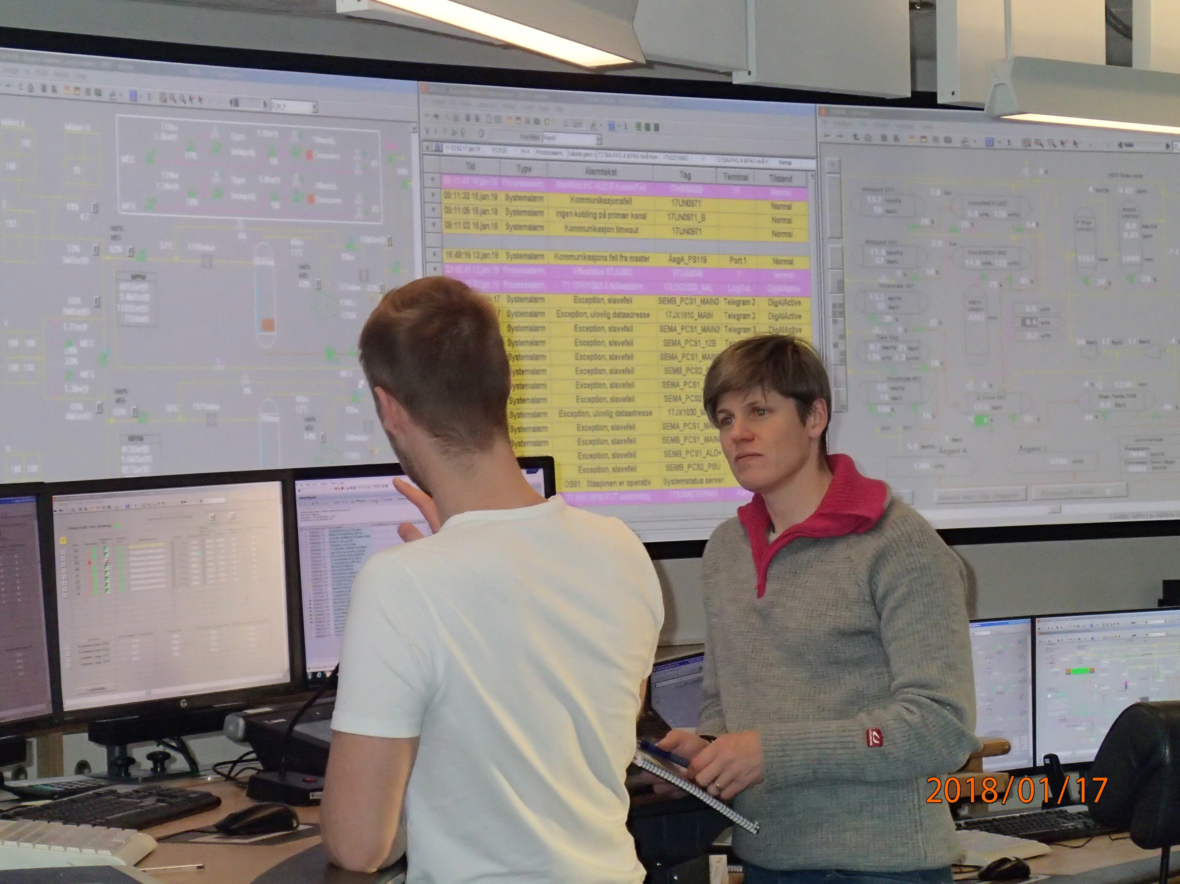
Summary
High focus in Equinor on automation, control and optimization offshore
Main success factor for MPC implementation: work process
Development needs

Slide 34
Increased production with automatic control in offshore oil and gas production in Equinor
Elvira Marie Bergheim, Pål Kittilsen, Robert Aasheim, Morten Fredriksen, Equinor

