Slide 1
Process control
Q&A session
Sigurd Skogestad
07 Dec. 2023

Slide 2
Exam.
Monday 11 Dec. 2023. 9-13 (Physical)
One sheet with own notes (both sides OK; printed OK)
Simple calculator
Note: Remember to state clearly all assumptions you make.
General: Look through the whole exam before you start, read the questions carefully!
Q&A session: Thursday 07 Dec. 14-16, (K5)
(please send questions before by email: sigurd.skogestad@ntnu.no)

Slide 3
Plotting of frequency and time responses:
In practice plots are done by simulation (e.g. matlab)
But it is very useful to know approximately how they should look so you can spot mistakes
So approximate plots (a sketch) is usually good enough
An accurate plot is better but it does not give more points than a sketch.

Slide 4
From: Nevena Cabrilo
Inventory control, TPM, radiation rule – skjønte ikke noe av dette
Kan du forklare Nyquist plot igjen? Hvordan tegner man de? Hva får man ut av de?
3. Hvis vi blir spurt om stabilitet og må bruke f.eks. Routh-Herwitz, får vi de formlene eller burde vi ha de med på arket?

Slide 5
From: Ane-Kristine Kjølner
Er det mulig å gå igjennom 2017 1b)
2016 6a),
og 2019 3c).
Og så lurer vi på hva som er konstant og ikke, for føler det ikke er alltid like lett å se (f.eks i oppgave 4 i 2018). Håper vi rekker å gå igjennom noe slik at vi blir litt mer kloke😊

Slide 6
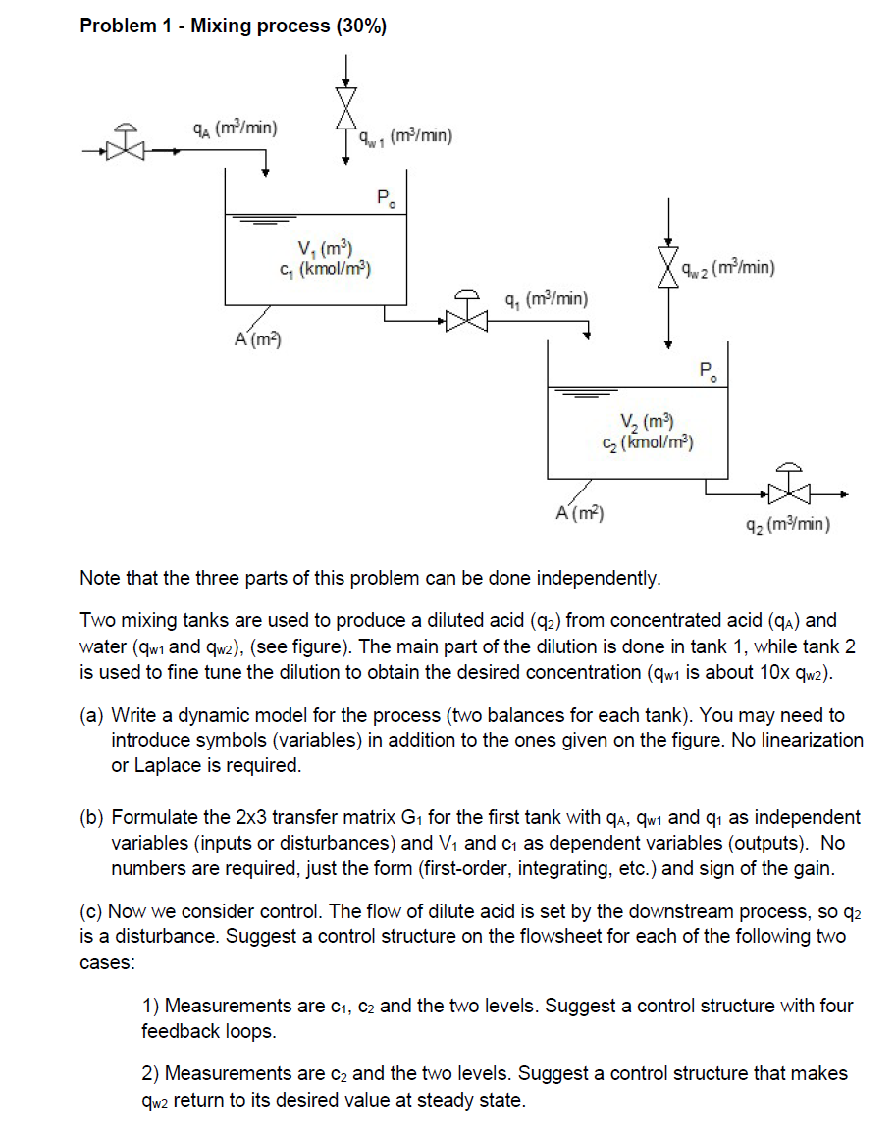
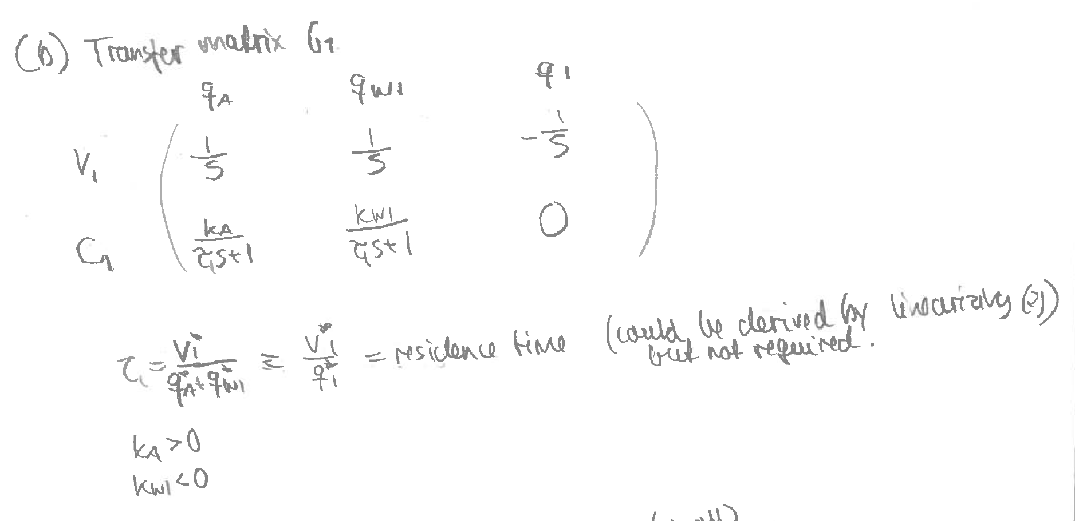
2017

Slide 7
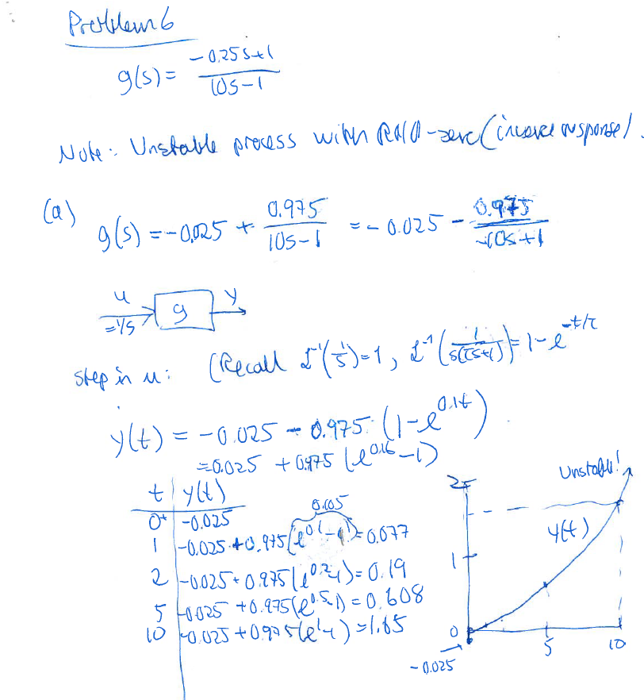
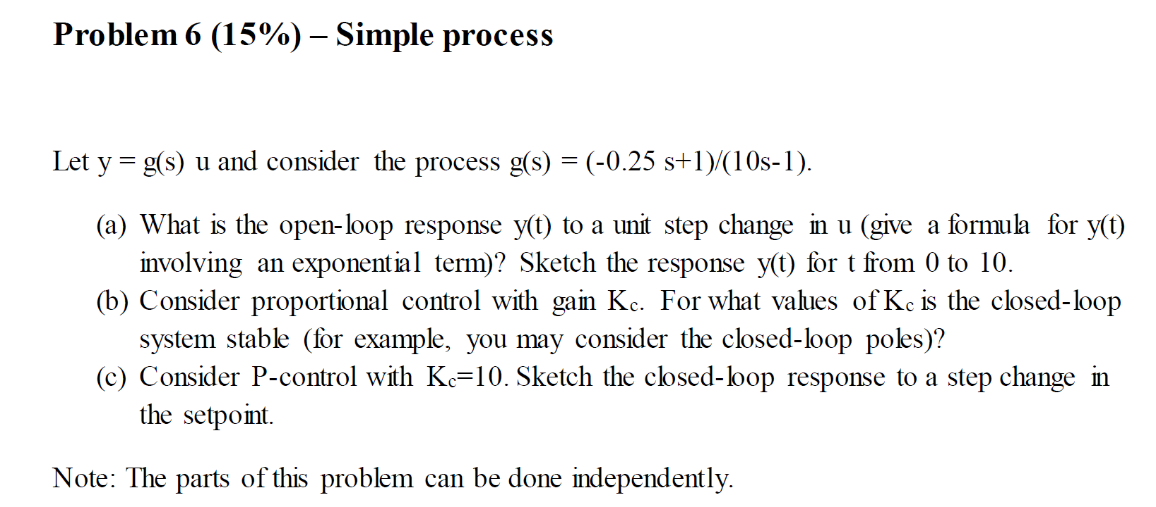
Exam 2016, 6a

Slide 8
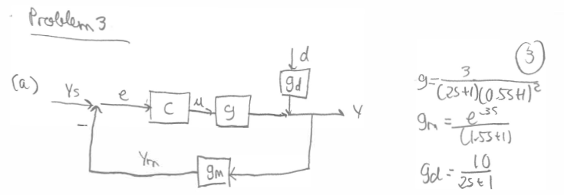
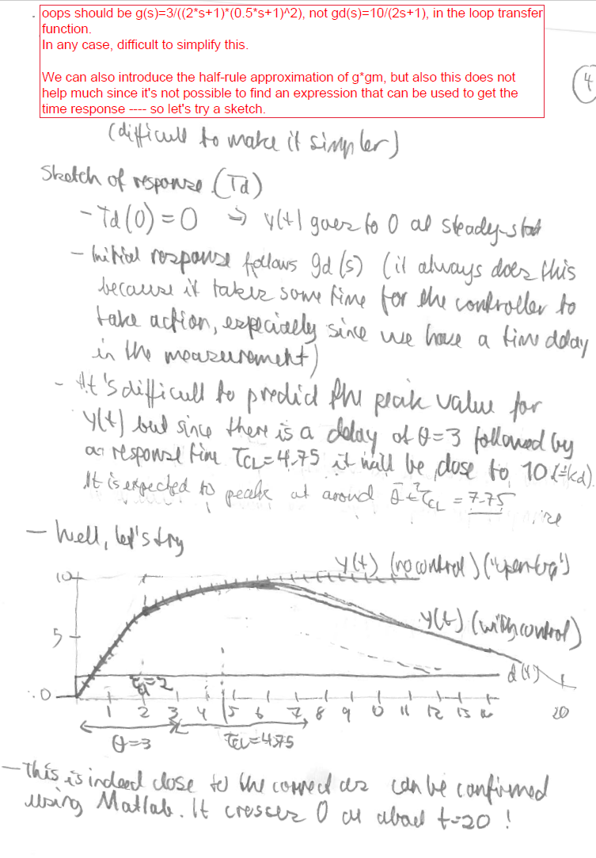
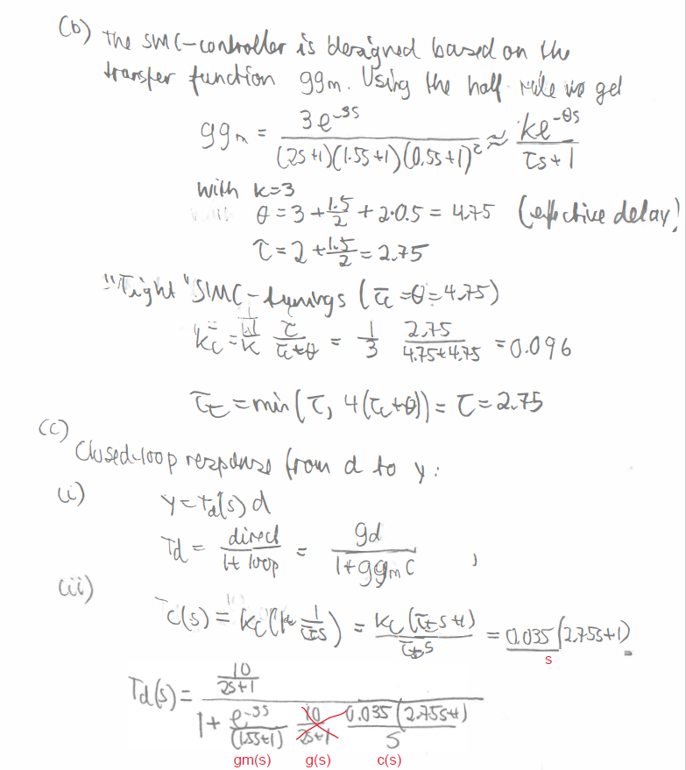
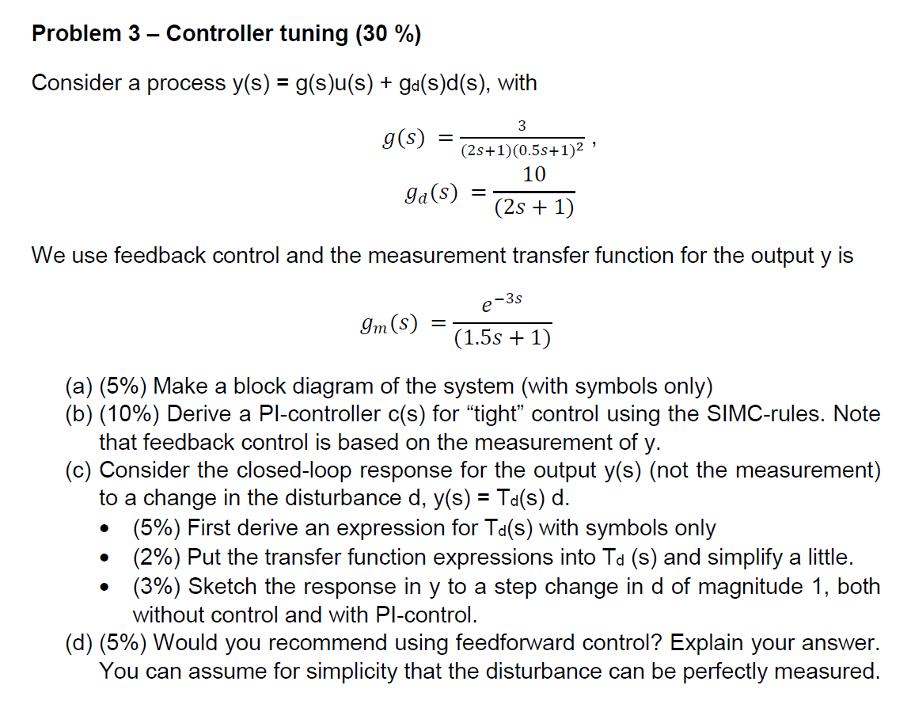
2019

Slide 9
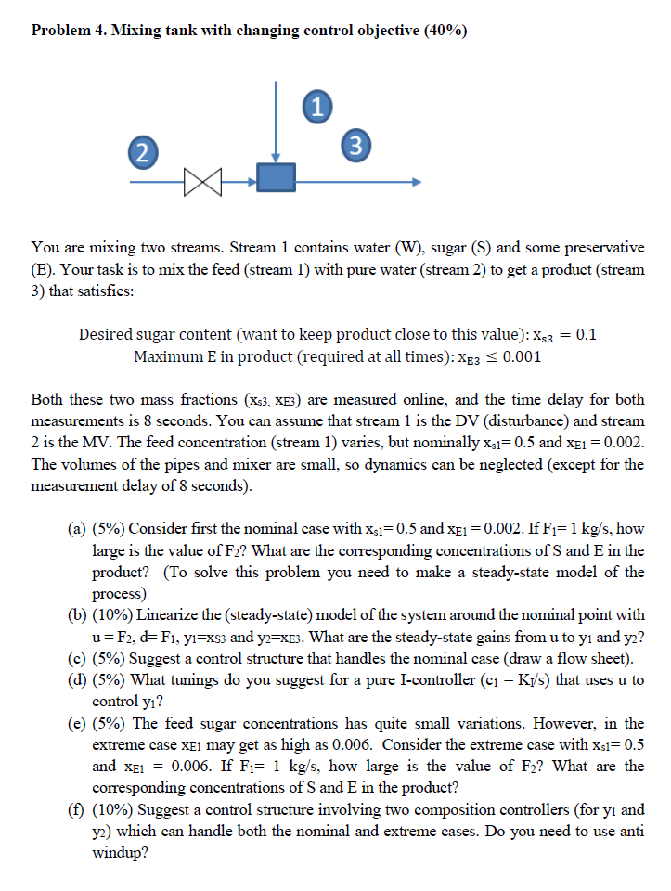
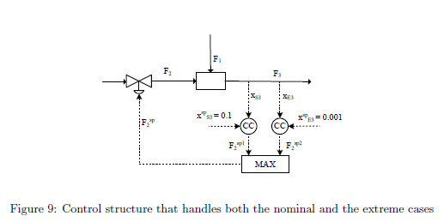
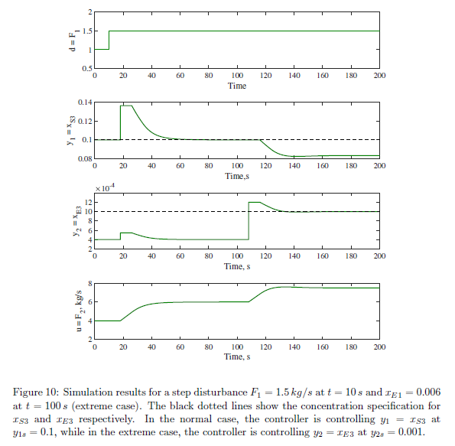
Og så lurer vi på hva som er konstant og ikke, for føler det ikke er alltid like lett å se (f.eks i oppgave 4 i 2018)..
These two plots show the measured mass fractions (concentrations). The actual concentrations are shifted 8 s earlier (to the left)

Slide 10
Process control
Q&A session
Sigurd Skogestad
05 Dec. 2022

Slide 11
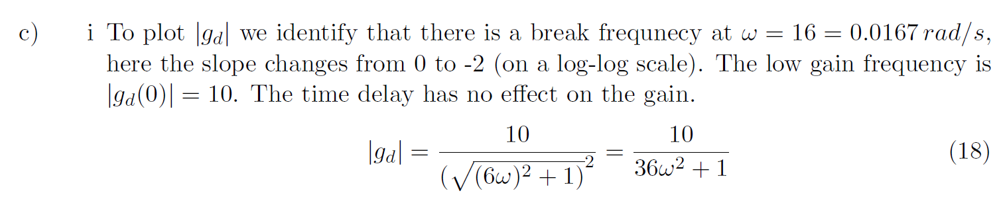
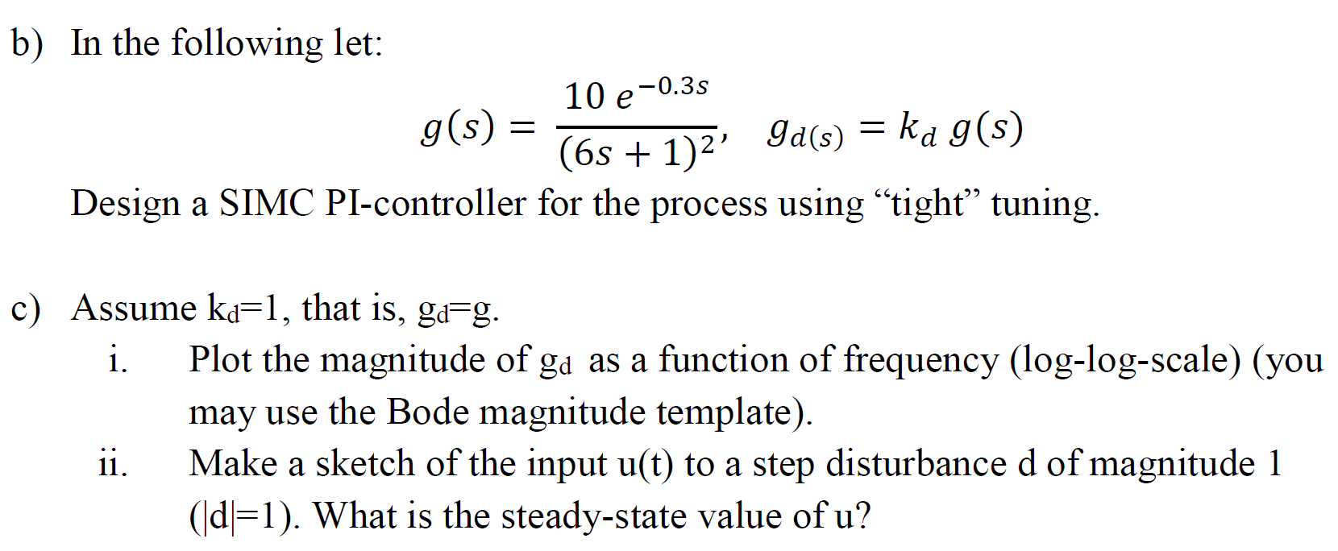
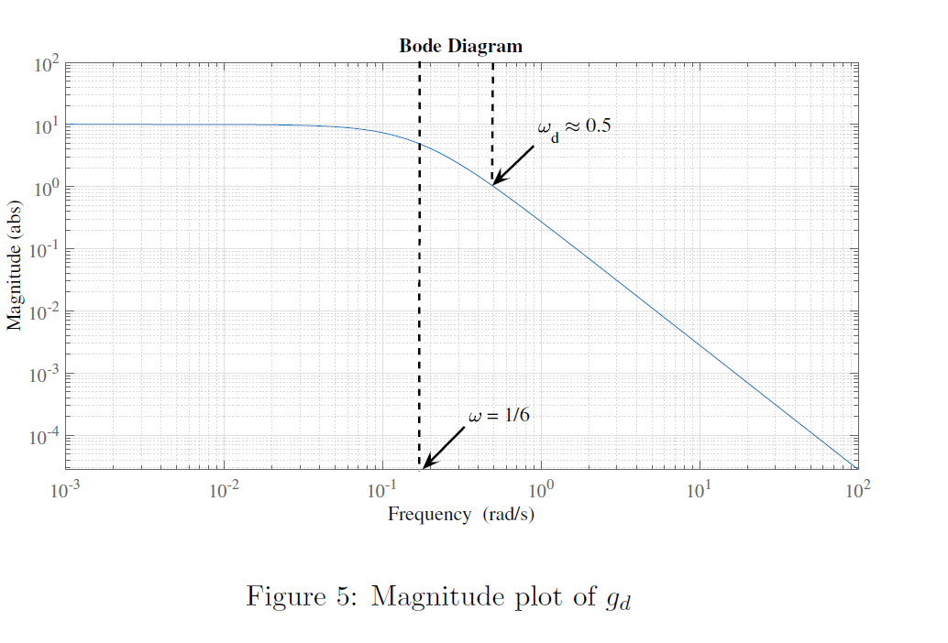
Kasper Dybvad
I would have liked to have had a small overview of Bode plots,
and especially break frequencies and how these are determined and how the slope changes.
Eg. in exam 2018 oppg. 3

Slide 12
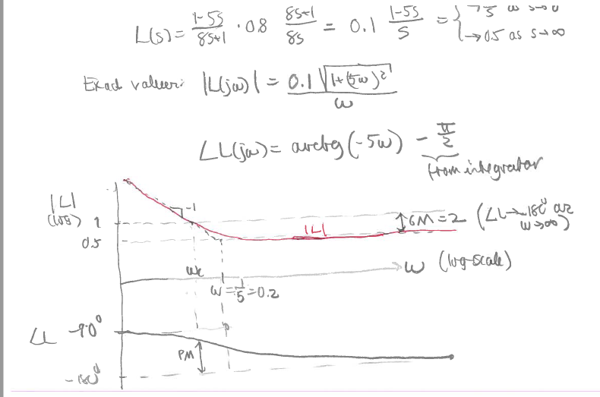
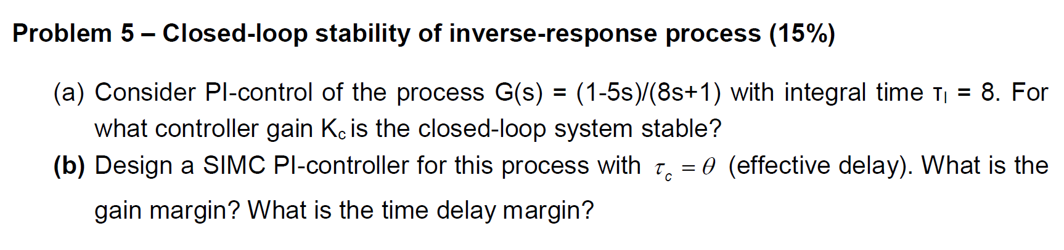
Silje Greidung. Exam 2017 , 5b)
* After we have found L(s) or L(jw) we will find Gain Margin and Delay Margin.
I am especially wondering about the formulas for <L and PM, since I come up with slightly different formulas.
«Slightly different»?
* In the solution, I also don't quite understand the sentence "Since Kc,max = 1.6, we have that GM = 2". Can one see directly from the function that GM = 2?
In part 5a) we considered the poles and found that the largest controller gain that gives stability Kc,max=1.6. Since GM is the amount we can increase the gain before we get instability it follows that Kc=0.8 corresponds to GM=2.

Slide 13
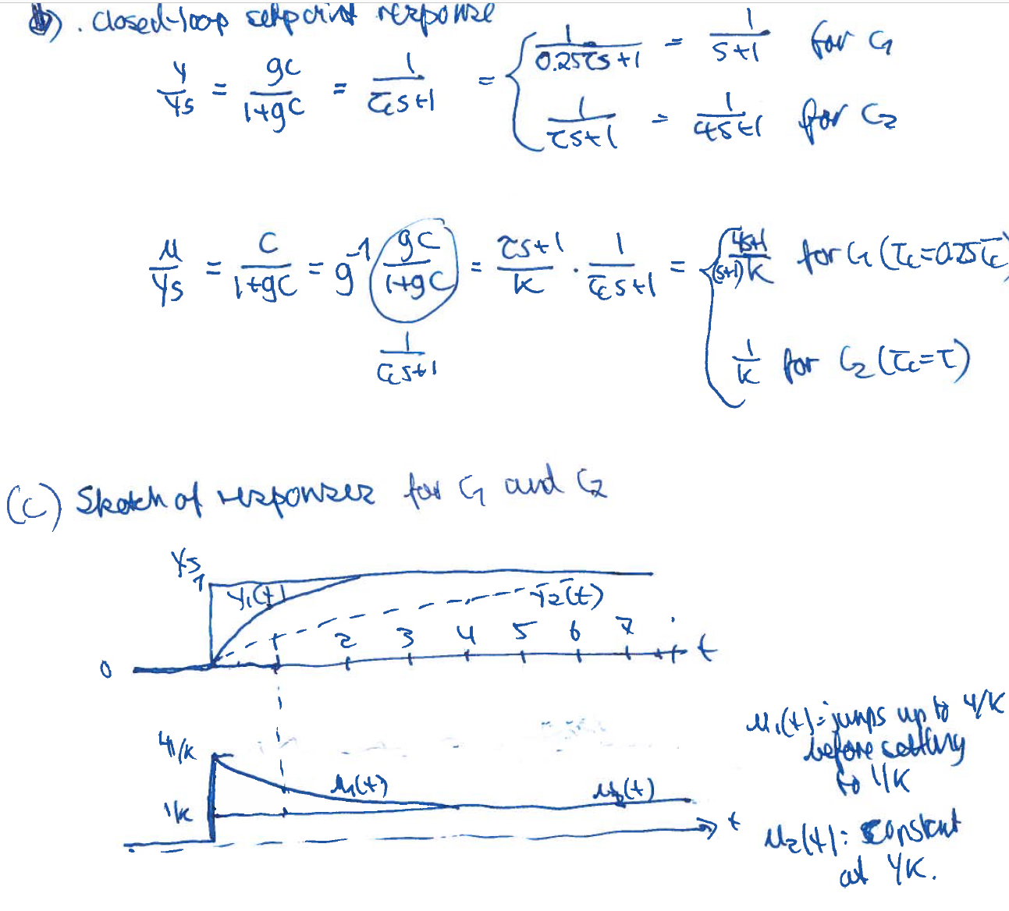
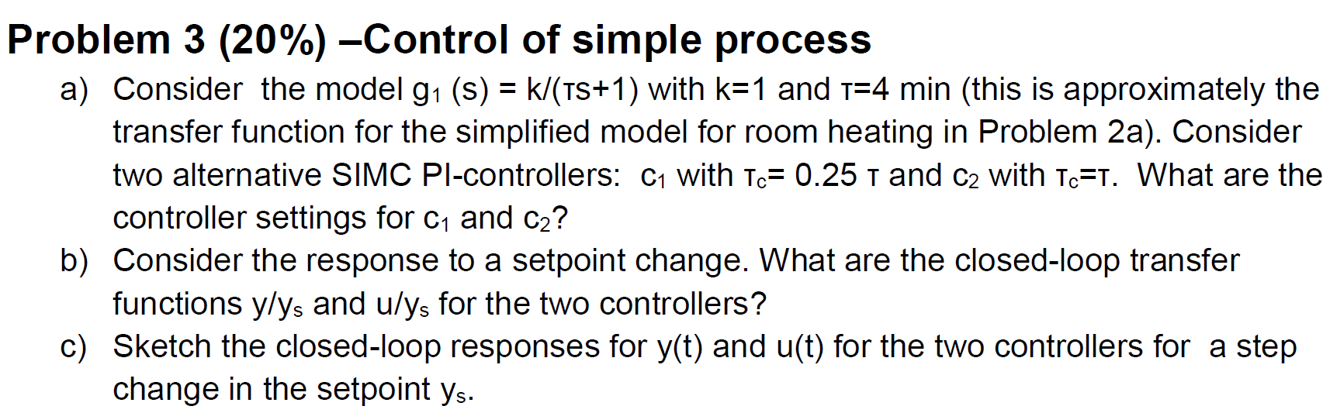
Kira Wang
While doing the earlier exams I realized that there is a lot of drawing the response of a step change in setpoint or the input. But as the answer mostly contains a hand drawing, I am quite unsure of how you construct the sketch and how detailed it needs to be. Which numbers/equations do you use?
I normally use the ss gain, initial gain, and initial slope, but I see that you also find the zeros sometimes.
Yes, for example, the RHP-zero may be used in some cases to get an idea of when the response may turn, but we could instead use the approximation (poles, zeros, half rule etc).
An example is problem 3c in the exam 2015. How do you construct that plot?

Slide 14
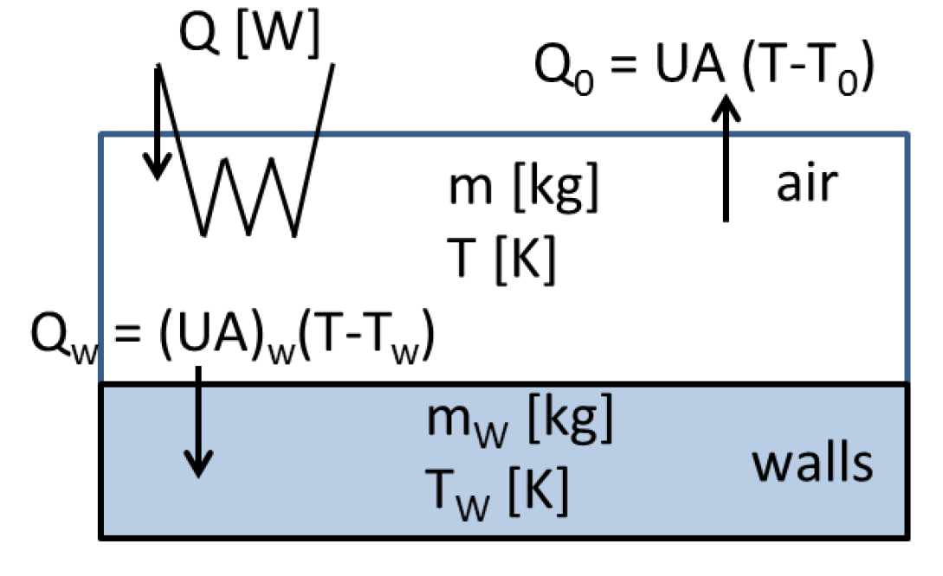
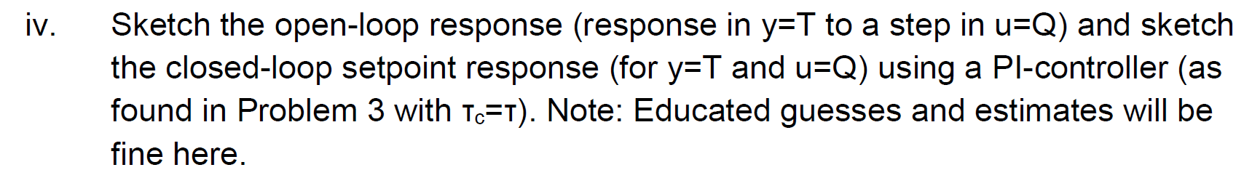
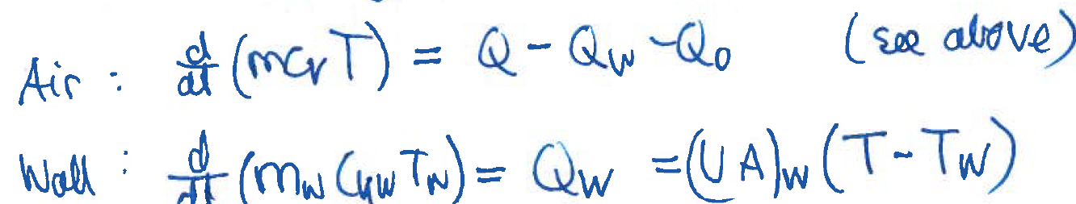
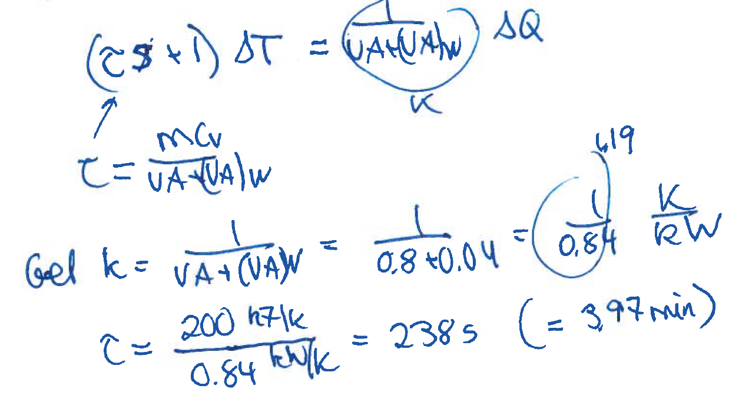
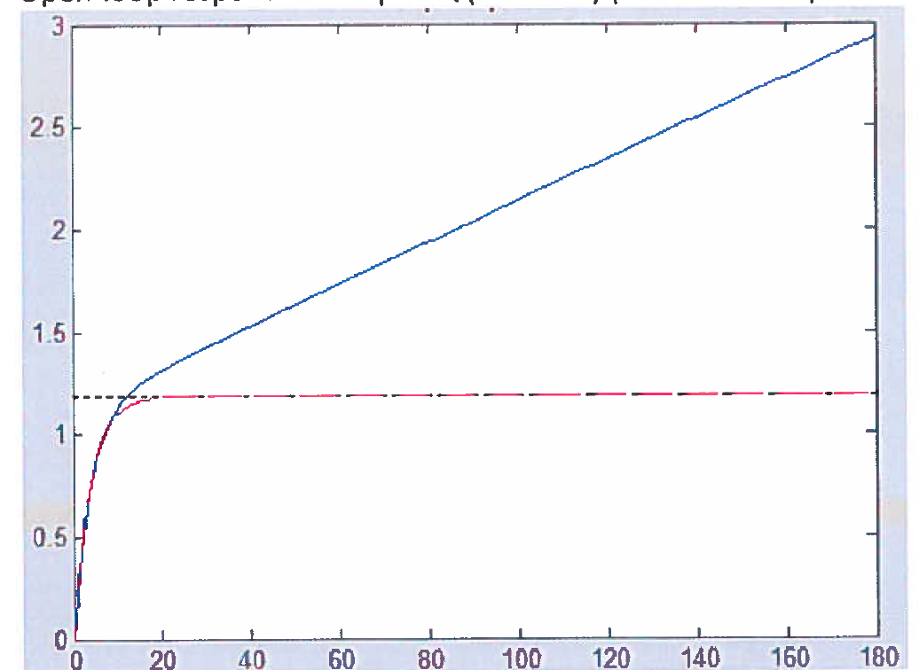
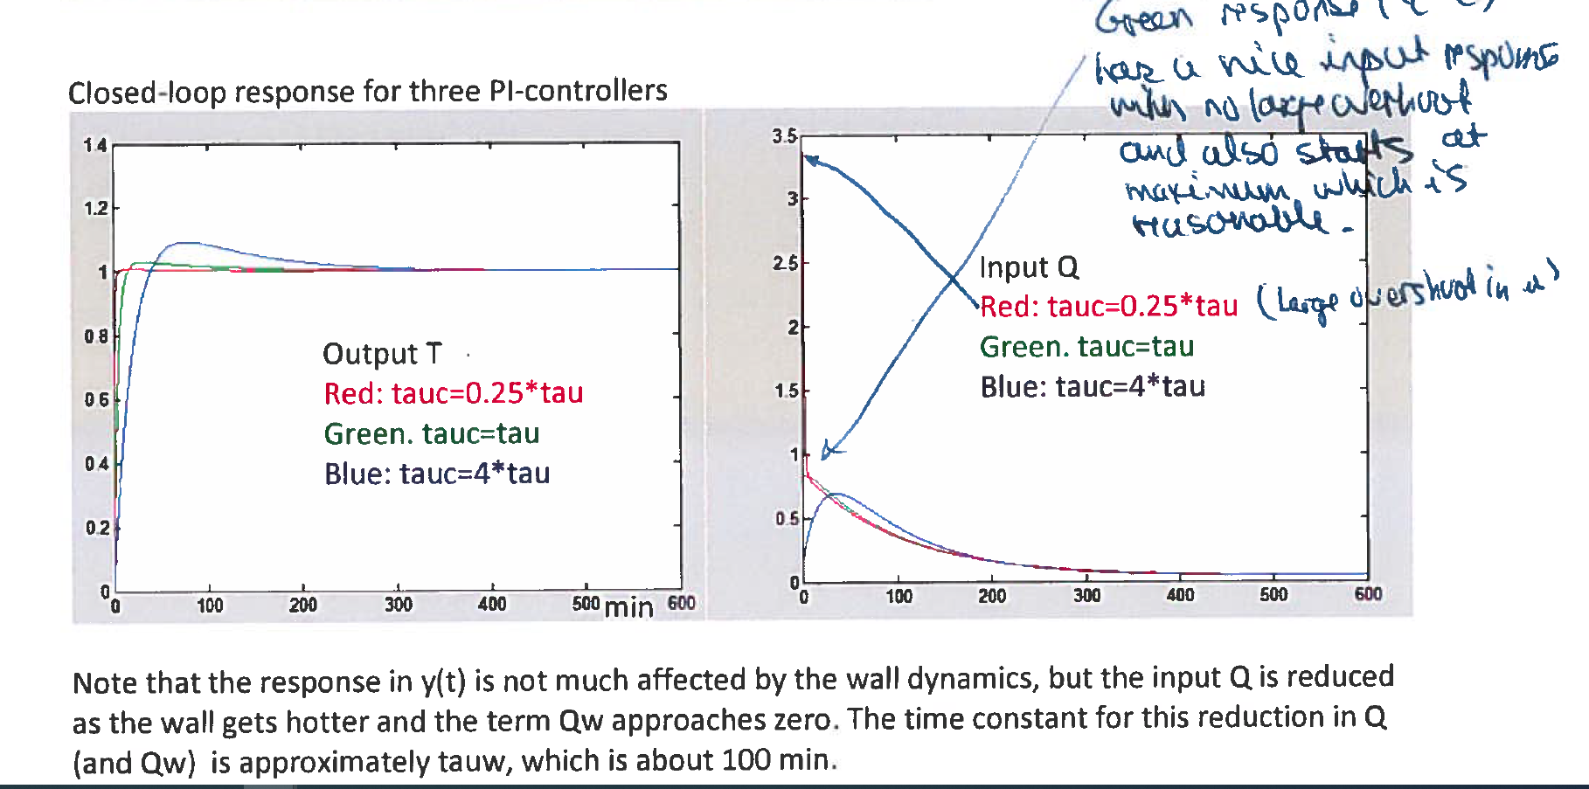
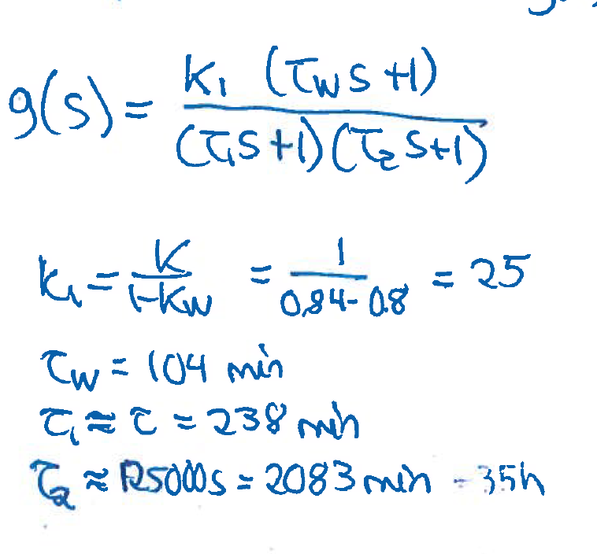
Thea Terjesen, 2015 2b
Kan du gå igjennom litt forskjellig sketching av systemer for hand?
Without wall
dynamics
With wall
dynamics
min
s = 4 min

Slide 15
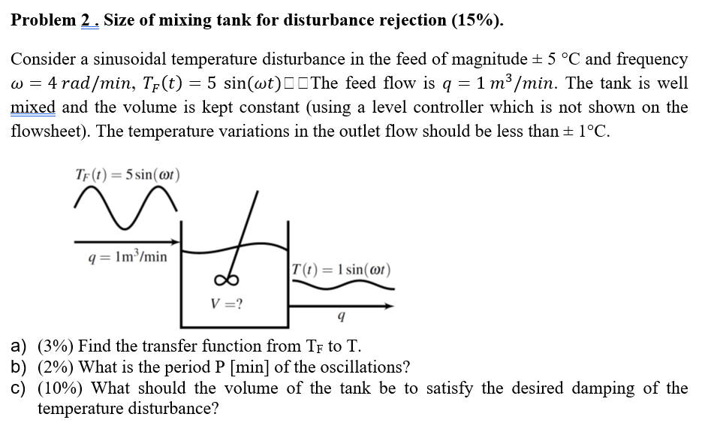
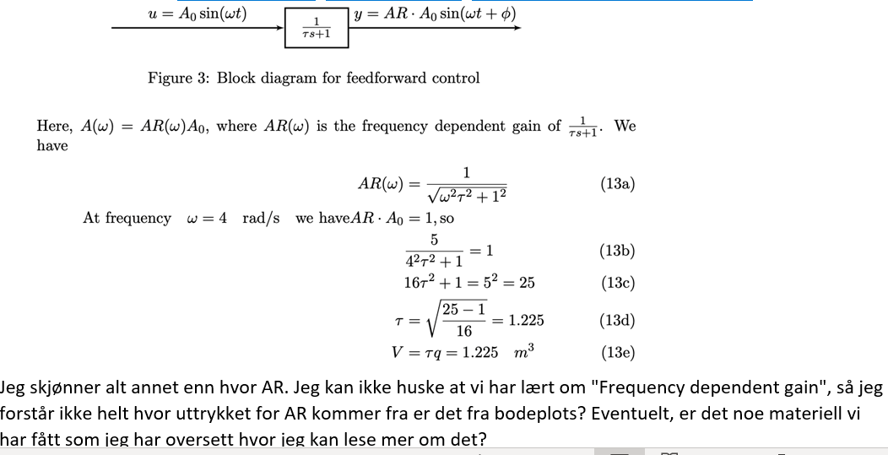
Erlend Sørlie , eksamen 2018
More correct: We want AR(4)*A0≤1
Frequency-dependent gain = AR(ω) = |g(jw)|.
Yes, it’s the same as we use in the Bode-plot

Slide 16
Brage Bang
H2021-2c) Why is PID control recommended for the second order process where the smallest time constant is larger than the delay?
  Because it gives a significant improvmement in performance (compared to PI). But then tauc needs to be reduced because of shorter theta (compared to PI).
- Slow integral control with fast delay . ?? A pure gain-with-delay process uses I-control, but it can be “fast” if the delay si small
- Must compensate with a differential (for some reason?) ?? You mean that you need a filter for D-action? Yes, usually. For cascade PID with filter is on the measurement choose tauf = 0.1 tauc (approx.). For ideal PID one often chooses tauf=0.2*taud
2 H2021-2c) Is there a definitive rule for when to choose PID control over PI? Not definite. Consider it for tau2>theta. If you want really fast control then also add theta/3 to taud.
3. How do you tune PID controllers without delay (to find tau_D)? You mean to find tauc. Need tauc < 1/wd.
4. Performing inverse Laplace transformation is tedious. What are the transformations you think we should know by heart? (ex. the integrator). See next page
5. Does the bode plot only apply to feed-back control. It can be used to see if control is needed (|gd|d > ymax), and can then decide if control (including ff) is needed, see exam 2018, 2019
6. Do we need to know how to derive the closed loop stability (Routh-Hurwitz)? No, don’t need proof.

Slide 17
Laplace transforms
Laplace transforms are not usually not included on the exam paper (but you have one sheet of notes)
The following are usually sufficient
  •L(unit step) = 1/s; L(unit impulse)=1,
  •L(exp(at)) = 1/(s-a)
  •L(1-exp(-t/τ)) = 1/(s*(τs+1)) (Step response for first-order system)
  •L(derivative) = s; L(integral) = 1/s:
  •L(delay θ)=exp(-θs)
+ should know how to do Inverse Laplace by partial fraction expansion

Slide 18
Maiken Ravn Rasmussen
Eksamen 2021, Problem 3c:? Why is q3 removed from the mass and energy balance`?
q3 is a disturbance, so we can set dq3=0 when deriving the model from u=[dq1 dq2] to y=[dq dT].
Eksamen 2016, Problem 1b: Where do the values 4 and 14 on the grapgh come from?
This is the 63% point, so they are equal to θ+τ_{c}. Here θ=2 and τ_{c} is 2 and 10.

Slide 19
OLD 2021: Laplace transforms

Slide 20
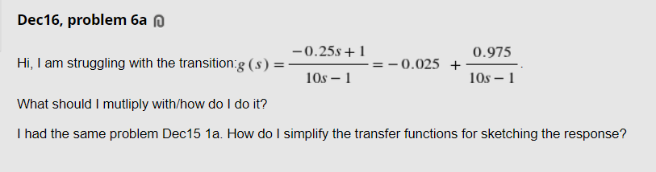
Inverse Laplace by partial fraction expansion

Slide 21
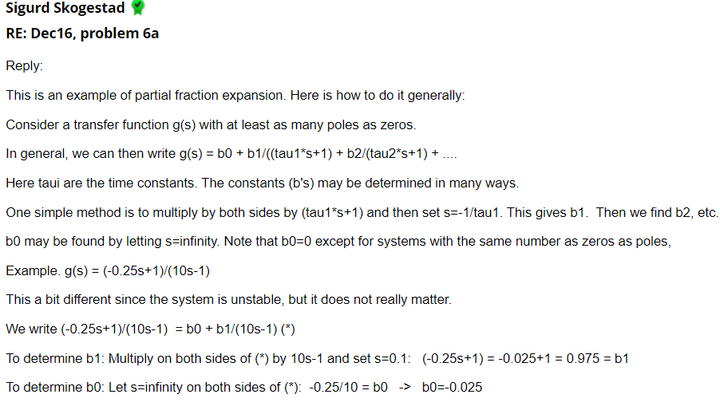

Slide 22
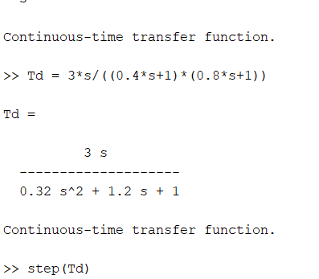
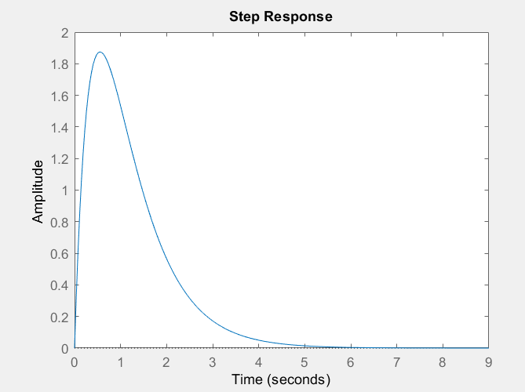
Another example of partial fraction expansion: Closed-loop disturbance response
Question: What is the analytical expression for step response y(t)? (Simple!)

Slide 23
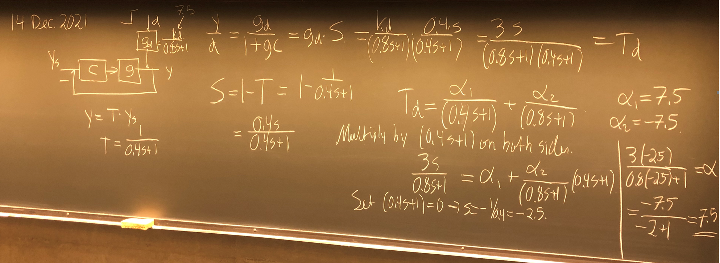
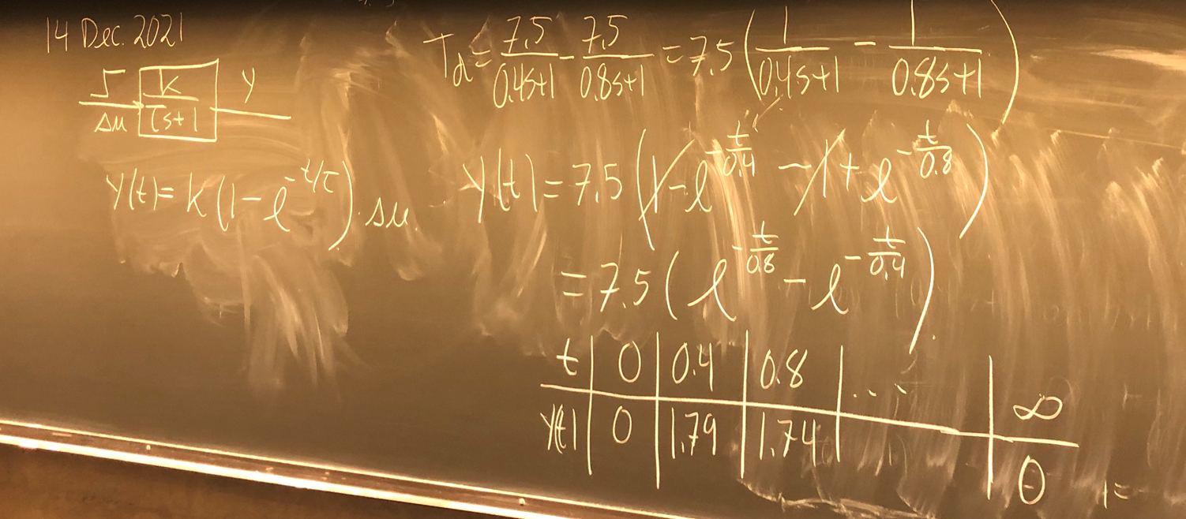

Slide 24
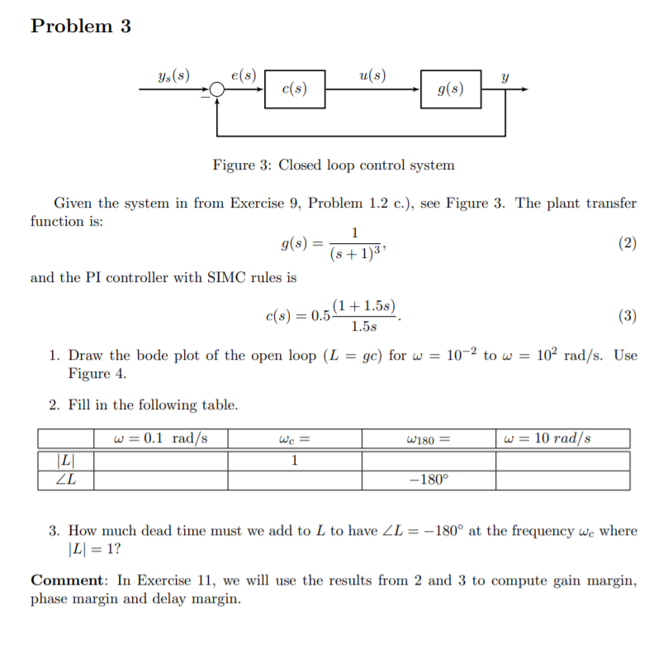
Exercise 10

Slide 25
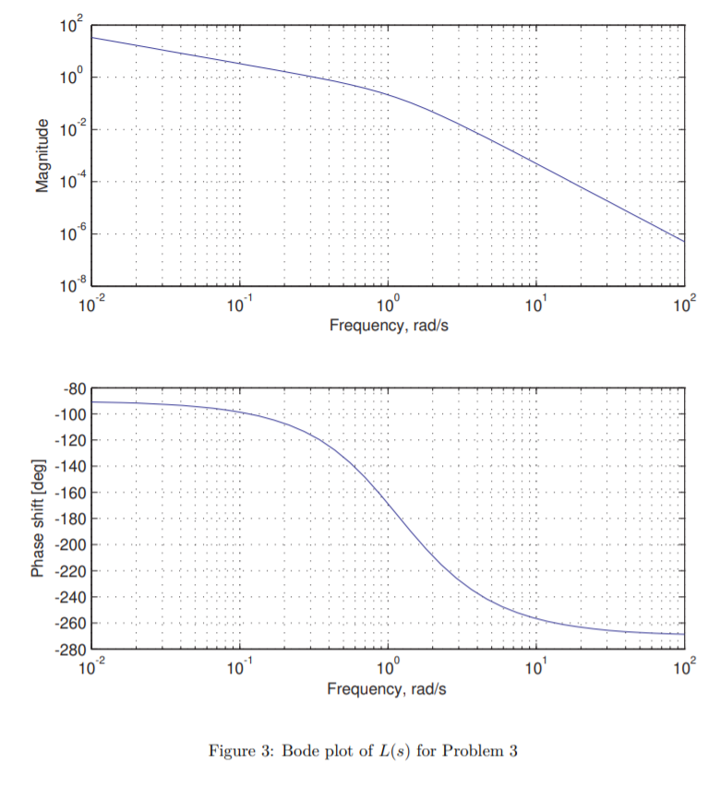
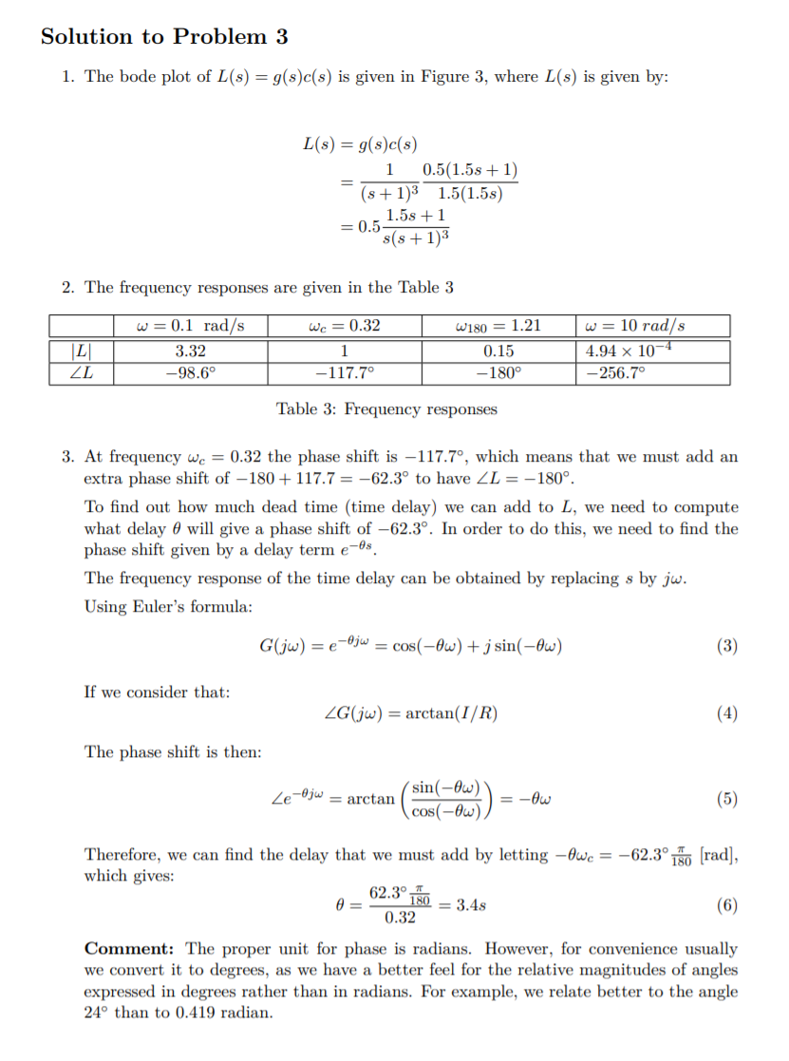

Slide 26
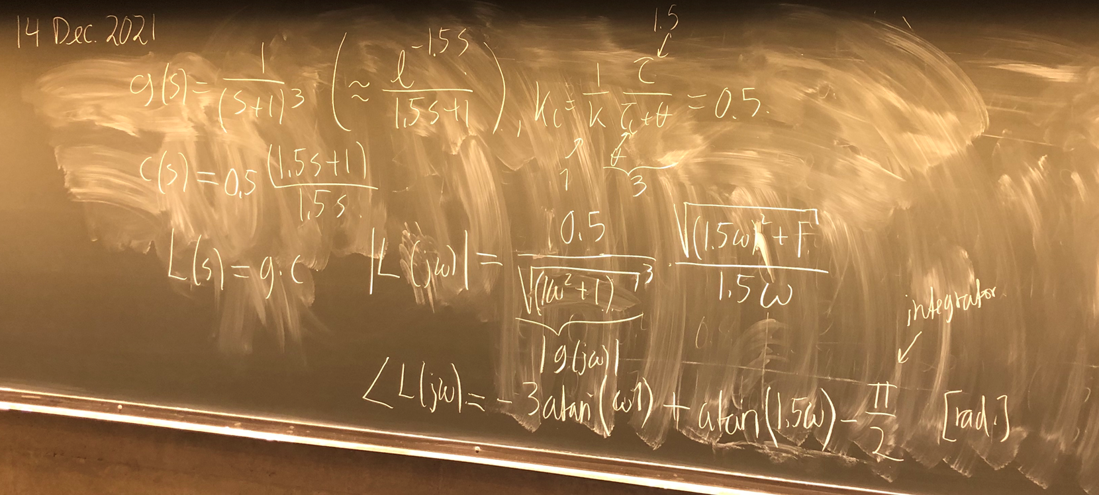
33333333333333333333333333333333333333333333333333333333333333333333333333333333333333333333333333333333333333333333336666

