Slide 1
Workshop on Online Process Optimization – Grand Challenges and Opportunities
NTNU 08 Nov. 2019
What is the correct problem formulation?
How to make use of new data-based methods, machine learning.
What approach will win in the end?
Hierarchical versus centralized approaches.

Slide 2
Program
09:00 - 09:15 | Coffee and mingling
09:15 - 09:30 | Welcome and Introduction by Sigurd Skogestad, NTNU
09:30 - 09:50 | Short introduction by NTNU groups working on online process optimization (one slide overview on each research group). Johannes Jäschke, Sebastien Gros, Lars Imsland, Morten Hovd, Alexey Pavlov, Sigurd Skogestad.
09:50 - 10:50 | Keynote talk by Jay H. Lee, KAIST, Korea (45min + 15 min discussion) Model based Control and Reinforcement Learning: Alternatives or Complementary?”
10:50 - 11:10 11:10 – 12:00 | Coffee Break Keynote talk by David Q. Mayne, Imperial College, UK (25min +25min) discussion). “Robust and Stochastic MPC; what is the correct formulation?”
12:00 - 13:00 | Lunch at Kjelhuset (all invited)
13:00 - 13:20 | Talk by Sergio Lucia, TU Berlin, Germany (10min + 10min discussion) “Approximate model predictive control based on machine learning and probabilistic verification”
13:20 - 13:40 | Talk by John B. Jørgensen, DTU, Denmark (10min + 10min discussion) "Nonlinear model predictive control based on stochastic differential equations”
13:40 - 14:00 14:00 - 14:40 | Industrial needs Discussions with Manfred Morari, ETH/U Penn, Switzerland/USA ** (30 min interview+ 10 min discussion). Discussant - Sigurd Skogestad
14:40 - 15:15 | Group Work – Open challenges (+ coffee)
15:15 - 15:30 | Each group presents short conclusions
15:30 - 16:00 | Concluding panel discussion – Good problems to work on for the future. Panel members: Mayne, Morari, Lee (Moderator: Skogestad)

Slide 3
Dinesh Krishnamoorthy (postdoc)
Adriana Reyes Lua
Cristina Zotica (MS NTNU, 2017) Energy efficient operation of power plants (HighEFF). From Aug 2017
Allyne Machado dos Santos (MS UFRJ, Brazil, 2019) Machine learning for process optimization (SUBPRO). From Feb. 2019
David Perez Pineiro (MS NTNU, 2019) Optimal operation of energy storage (HighEFF). From Aug. 2019
Lucas Ferreira (MS, UFRJ, 2019) Machine learning for process optimization (IKTPLUSS). From Sep. 2019
Saket Adhau (MS, Pune, India, 2019 Machine learning for process optimization (IKTPLUSS). From Sep. 2019

Slide 4
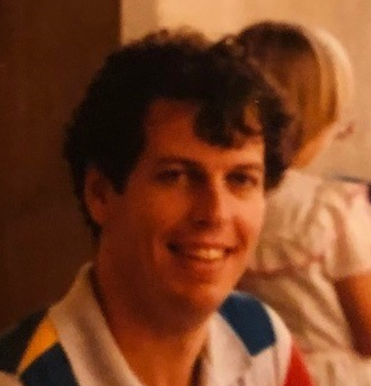
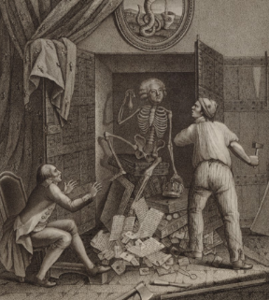
John Doyle (1985):
There are two ways a theorem can be wrong
(from an engineering point of view):
Either it’s simply wrong
Or the assumptions make no sense
Skeleton in the closet?
Fact:
Essentially all stability and convergence results for optimal control, MPC and nonlinear control assume full state information, that is, perfect measurement of all states

Slide 5
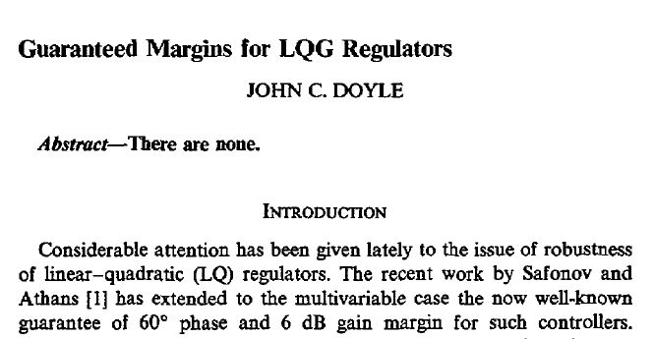
«Solution»: Loop transfer recovery (LTR).
Small weight on measurement noise to make estimator fast

