Slide 1
Online Process Optimization
Grand Challenges and Opportunities
Manfred Morari
Workshop 08 Nov. 2019
NTNU Trondheim

Slide 2
A Practitioner’s Perspective
Chemical Process Control
  Shell, BP, Exxon, DuPont, ICI PLC
Building Climate/Energy Control (HVAC)
  Siemens, Carrier
Automotive Systems
  Ford, Daimler-Chrysler
Aircraft Systems
  United Technologies
Power Electronics, Electrical Power Systems
  ABB
Notes:
Practitioner’s Perspective. What does this mean?
In my opinion, Ultimately only those control tools survive which are found useful in applications. Therefore throughout my career I have worked with industry in a number of sectors…
In my presentation when I make comments on what works and what does not, you always need to interpret the comments relative to these application domains only.
I will use the words “my problems” or “our problems” to emphasize this.
There are no universal tools,.
I am not indicating that we have not worked in other areas, say quadcopter, but there are people here who understand much more about these applications than I do.

Slide 3
09:00 - 09:15 | Coffee and mingling
09:15 - 09:30 | Welcome and Introduction by Sigurd Skogestad, NTNU
09:30 - 09:50 | Short introduction by NTNU groups working on online process optimization (One slider)*
09:50 - 10:50 | Keynote talk by Jay H. Lee, KAIST, Korea (45min + 15 min discussion)
10:50 - 11:10 11:10 – 12:00 | Coffee Break Keynote talk by David Q. Mayne, Imperial College, UK (25min +25min discussion)
12:00 - 13:00 | Lunch at Kjelhuset (all invited)
13:00 - 13:20 | Talk by Sergio Lucia, TU Berlin, Germany (10min + 10min discussion)
13:20 - 13:40 | Talk by John B. Jørgensen, DTU, Denmark (10min + 10min discussion)
13:40 - 14:00 14:00 - 14:40 | Industrial needs Discussions with Manfred Morari, ETH/U Penn, Switzerland/USA ** (30 min interview+ 10 min discussion)
14:40 - 15:15 | Group Work – Open challenges (+ coffee)
15:15 - 15:30 | Each group presents short conclusions
15:30 - 16:00 16:00 – 17:30 19:00 | Concluding panel discussion*** – Good problems to work on for the future Reception with drinks and snacks (all invited) Dinner (presenters invited)

Slide 6
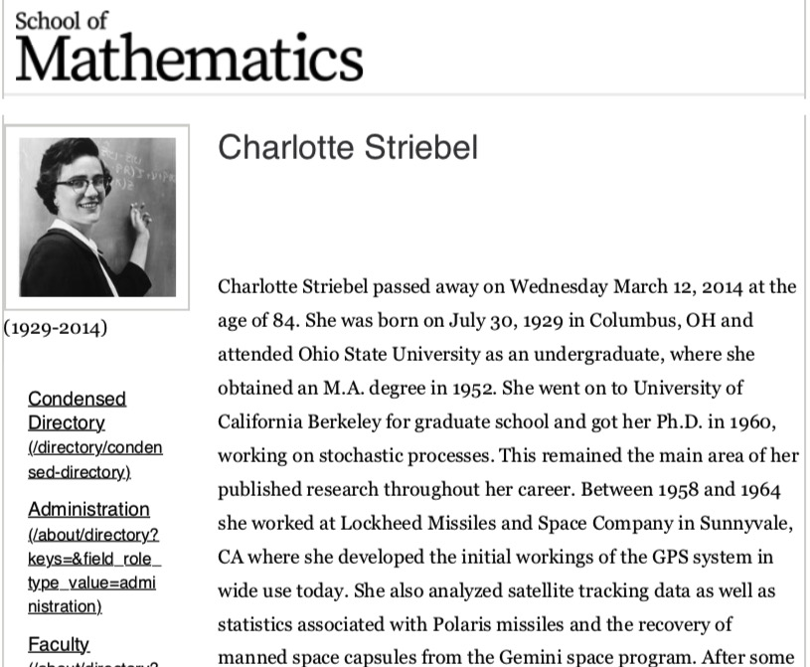
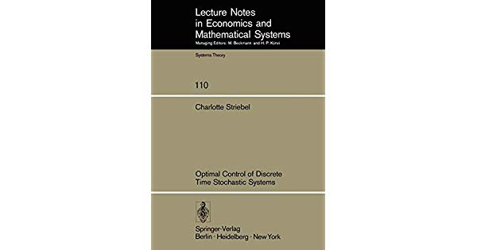
Notes:
One of her most significant achievements was on behalf of girls and athletics. In the early 1970s there were few athletic opportunities for young women in the schools. Charlotte's daughter was a swimmer, but was refused the opportunity to swim for her school. Charlotte took the case to the Human Rights Department in St Paul, filed a lawsuit, and won the case. She subsequently worked with Representative Phyllis Kahn to pass a state law that required equal opportunity in athletics for girls on a state level. We now take it for granted that girls can be athletes as well as boys. At the same time as all this Charlotte became a law student and was awarded a law degree by the University of Minnesota in 1981.

Slide 9
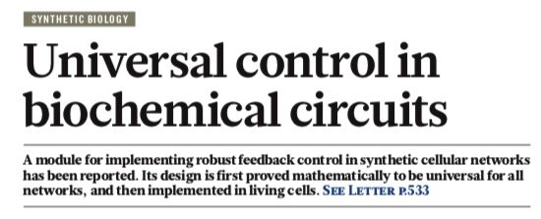
Notes:
Noah Olsman and Johan Paulsson are in
the Department of Systems Biology, Blavatnik Institute at Harvard Medical School,
Harvard University, Boston, Massachusetts 02115, USA.

Slide 10
Idea: Get rid of “Modeling” …
…in Model-Based-Design
Kalman (1958): Design of a self-optimizing control system. Trans. ASME
Bellman (1961): Adaptive Control Processes
Åström & Wittenmark (1973): On Self-Tuning Regulators. Automatica
Landau (1974): A survey of model reference adaptive techniques, Automatica
Narendra & Valavani (1976): Stable adaptive observers and controllers. Proc IEEE
Åström, Borisson, Ljung, Wittenmark (1977): Theory and applications of self-tuning regulators. Automatica
…..
Notes:
100 years ago “controller tuning” meant a screw driver, a wrench and experiments
Then Wiener and Kalman introduced revolutionary design techniques which enabled controller design based on mathematical models.. Model based design
After initial enthusiasm engineers were discouraged because they found that they spent most of their time building models.
Adaptive control of the 1970s was supposed to be the answer to this dilemma.
The intellectual center here, especially Karl Astrom, was genuinely in applications
Not only do the applications in mind dictate the use of adaptation, but also the choice of regulator structure. A simple regulator with few parameters is likely to do well if only a replacement of PID-regulators is intended. On the other hand, in demanding applications there may be a need to increase regulator complexity to achieve desired performance.
Successful autotuners: Phase lock, noise cancellation, cell phone communication

Slide 11
ASEA Novatune introduced in 1982…
Notes:
… In 1982 one of the first general products in this area, the ASEA NOVATUNE, was presented to the market place.
ASEA = ABB
Honeywell controller
In fact, one of the very first applications reported was carried out by ASEA, see Cegrell and Hedqvist (1973). The company has since then used adaptive techniques in some of its delivery projects, see e.g. Bengtsson (1979). In 1982 one of the first general products in this area, the ASEA NOVATUNE, was presented to the market place.
!;!_, 4.57-476.
Astrom K J, Hagglund T (1983): Autornatic Tuning of Simple regulators for phase and amplitude lllargins specifications. Preprints or IF AC Workshop on Adaptive Systems in Control and Signal Processing, San Francisco.
!.Q, 353-379.
64, 1198-1208.

Slide 12
…and mostly abandoned by 1995
“Even if Novatune in many cases provides very good control, the experience is that the effort it takes, to make it work that well, is discouraging. It is worth the effort in some cases, but not as a general tool. What is needed is a tool that is much easier to use. You shouldn’t be required to set any parameters, except to state what kind of result you desire.”
Per Erik Maden (1995) Experiences with Adaptive Control since 1982. CDC Proc.
Notes:
Those were the comments by Per Erik Maden
Proceedings of the 34th Conference on Decision & Control New Orleans, LA- December 1995
EXPERIENCES WITH ADAPTIVE CONTROL SINCE 1982
Per Erik Maden
The self-tuning control of 1982 in Novatune, with its roots
in the early 1970s has shown good results in many
applications. But it requires correct commissioning, which
in turn requires control engineers with special training and
education. It does not always produce better result than
conventional PID control, but often it does so when the
correct circumstances are at hand.

Slide 13
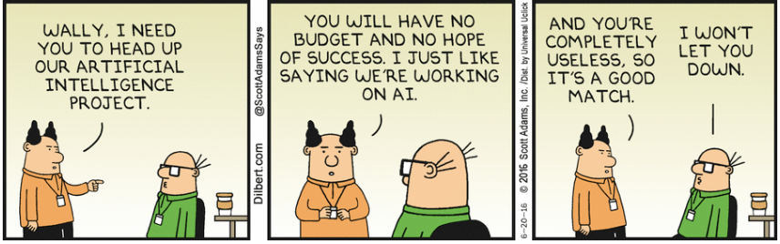
Embracing the Machine Learning and
Artificial Intelligence Contributions
Notes:
No, we do not only want to pay lip service but we want to analyze and understand what Learning can do for Dynamics and Control

Slide 14
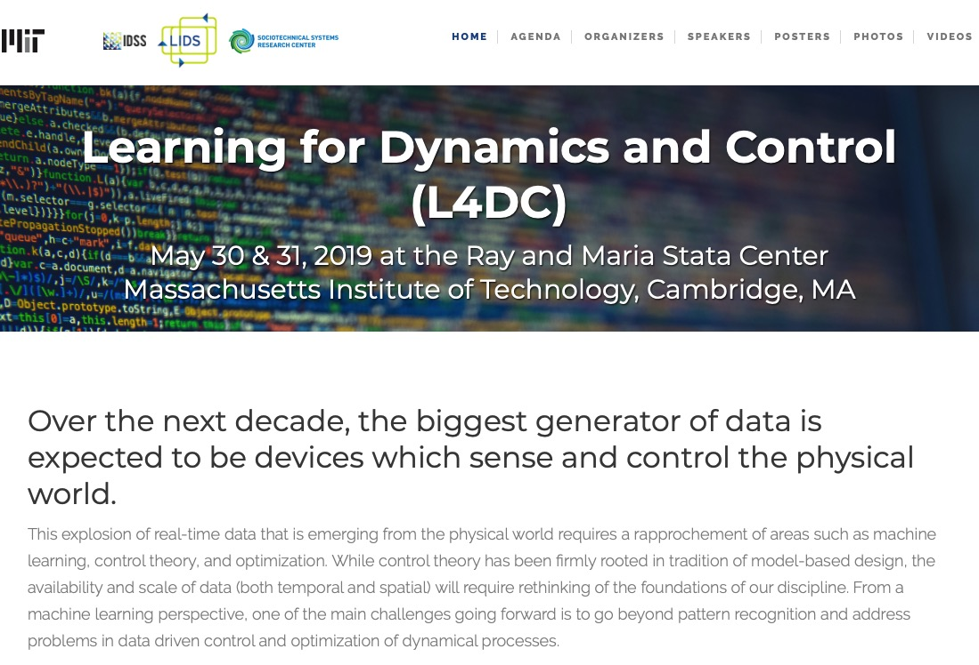
Notes:
You may be aware that at the end of May there was a workshop at MIT dedicated to this topic with 400 people attending
And I was invited to deliver the opening address.

Slide 15
Why did Adaptive Control “fail”?
--- It was not appropriate
Anything works
Nothing works
no specs
model simple
general solution
Learning Control
tight specs
model complex
specific solution
Notes:
depending on the problem this space between nothing and anything where adaptive control would be appropriate can be quite small.
Our discussion is about complex models, demanding performance specs, problems that cannot be solved by humans.

Slide 16
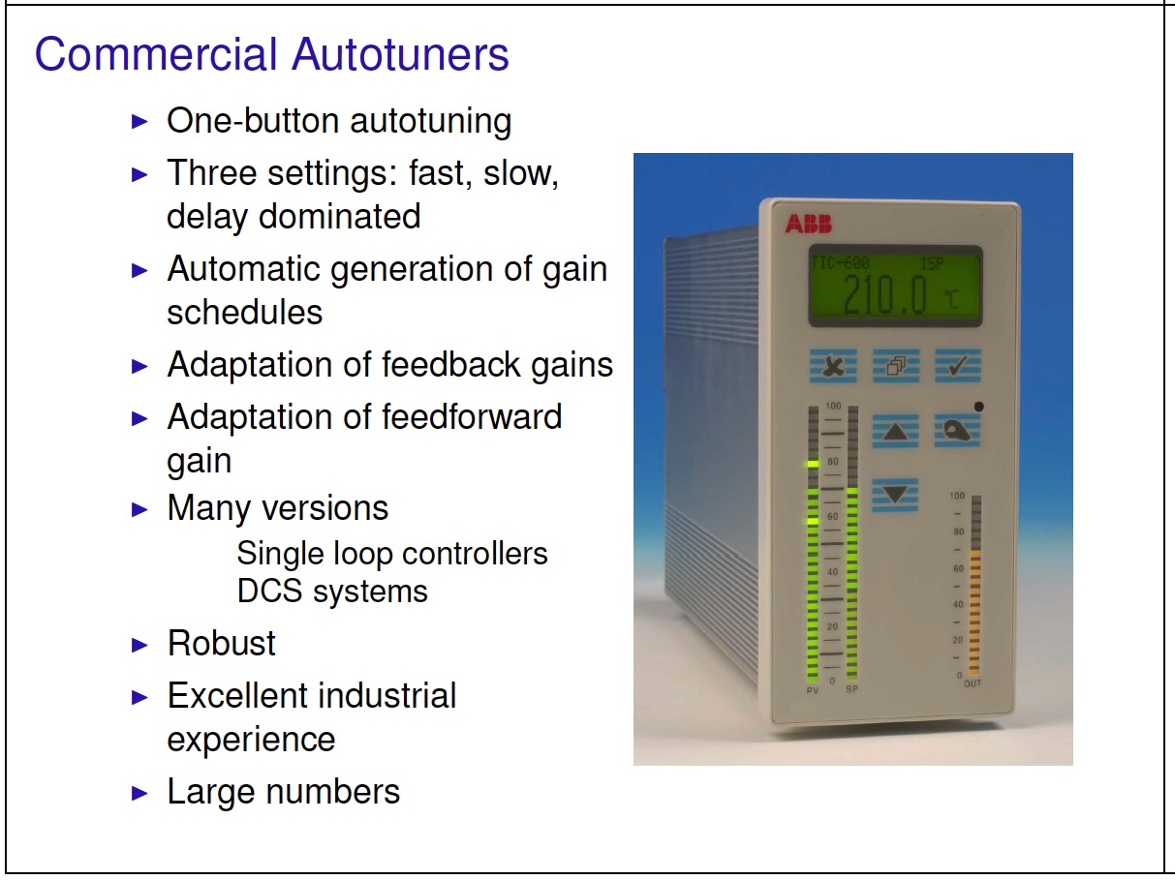
Why did Adaptive Control “fail”?
--- tuning all the time not needed
Åström & Hägglund (2000). Supervision of adaptive control algorithms
PID Autotuner: Tune on demand only
Thanks: Karl Aström
Notes:
Tuning all the time requires Complex supervisory systems and not needed
All these considerations led to the introduction of autotuners where simple controllers (advanced PID) are tuned at the push of a button.

Slide 17
Learning Controllers
Model-based vs. model-free
  If you do not have a model, how can you verify the performance of the closed-loop control system?
  If you do have a model, why would you use a model-free learning method?
Policy learning based on reward function
  Curse of dimensionality
  Specification guarantees via definition of reward function
Notes:
Let’s look at today’s generation of “Learning Controllers”
Let’s look at some features Independent of the particular flavors.
Model based vs. Model free
Major question:
… and without a minimal verification with a few simulations the controllers will not be used.

Slide 18
Learning Controllers
Model-based vs. model-free
  If you do not have a model, how can you verify the performance of the closed-loop control system?
  If you do have a model, why would you use a model-free learning method?
Policy learning based on reward function
  Curse of dimensionality
  Specification guarantees via definition of reward function
Notes:
Obviously this is not new. I was taught this by Prof. Rutherford Aris at Minnesota who wrote a couple of papers with Bellman. But it was taught largely as a curiosity. Because considered not to be useful
Two reasons: computational. Curse of dimensionality. Clearly great strides in dealing with problem
Second how can we guarantee that non-trivial specifications will be met by controller.

Slide 19
Design ≠ Optimization
Design ≈ Constraint Satisfaction
Propositional Logic Control Specifications for Refrigeration Cycle
Manipulated Inputs u_{i,min} ≤ u_{i} ≤ u_{i,max} i=1,2,3
Controlled / Monitored Outputs y_{i} = y_{i,set} i=1,2,3 / z_{i} = z_{i,set} i=1,..4
Prioritized Objectives
z₁ > z_{1,min} z₃ < z_{3,max} z₃ < z_{3,max} y₃ = y_{3,set}
z₂ < z_{2,max} z₄ < z_{4,max} z₄ < z_{4,max} y₂ = y_{2,set}
y₁ = y_{1,set} z₄ > z_{4,min} z₂ > z_{2,min}
y₂ = y_{2,set} y₃ = y_{3,set}
Specification guarantees via definition of reward function?
Notes:
The first thing I tell my students in any course on optimal control is that Design ≠ Optimization
Specifications are mostly in the form of constraints
Here is part of control system for refrigeration cycle (real example quite typical)
3 inputs u , 3 outputs y, 4 monitored variables ; satisfy ordered sets of constraints
I want to venture to say that there does not exist a reward function which can capture this.
LTL?

Slide 20

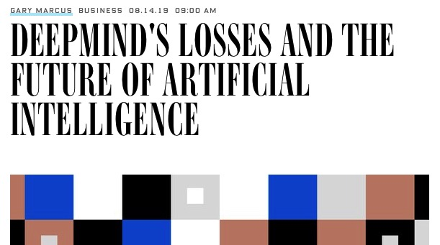
“…In some ways, deep reinforcement learning is a kind of turbocharged memorization; systems that use it are capable of awesome feats, but they have only a shallow understanding of what they are doing. As a consequence, current systems lack flexibility, and thus are unable to compensate if the world changes, sometimes even in tiny ways.”
Notes:
There are other people who are actually knowledgeable rather than just opinionated like I who question the wisdom of this focus on reward functions and RL.

Slide 21
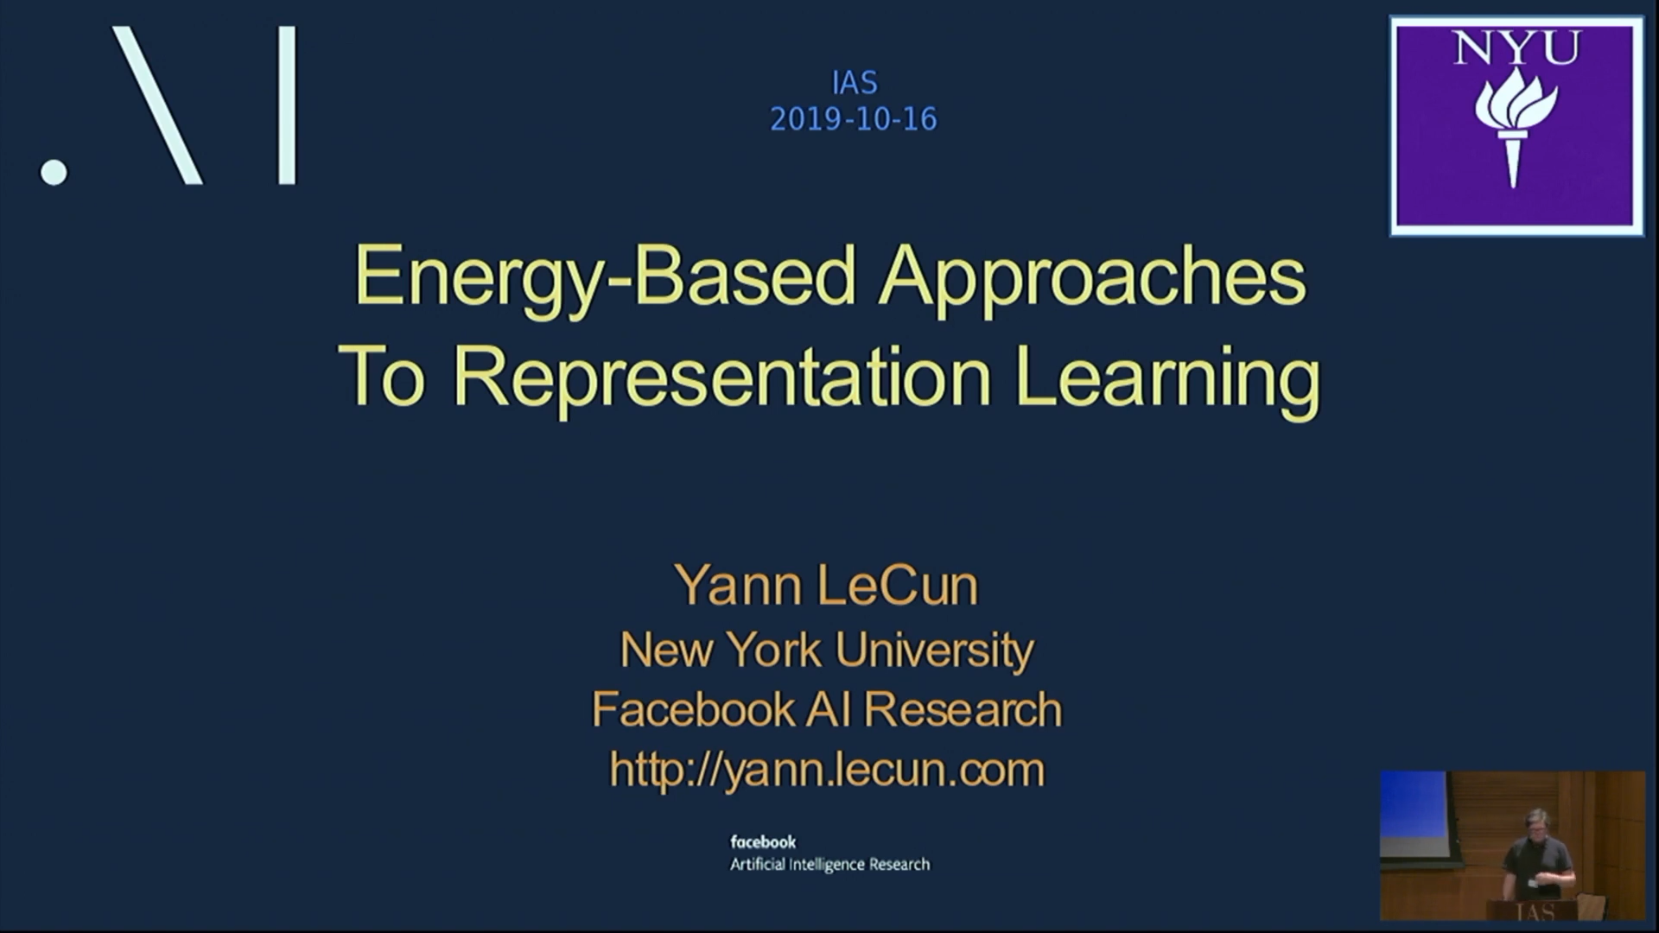

Slide 22
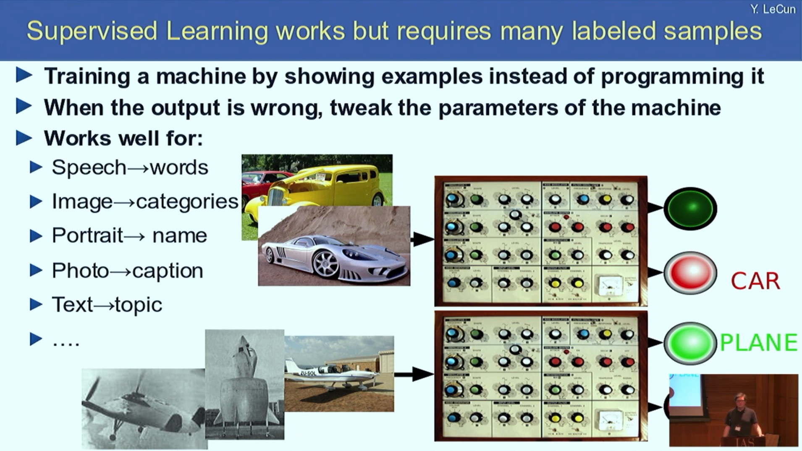

Slide 23
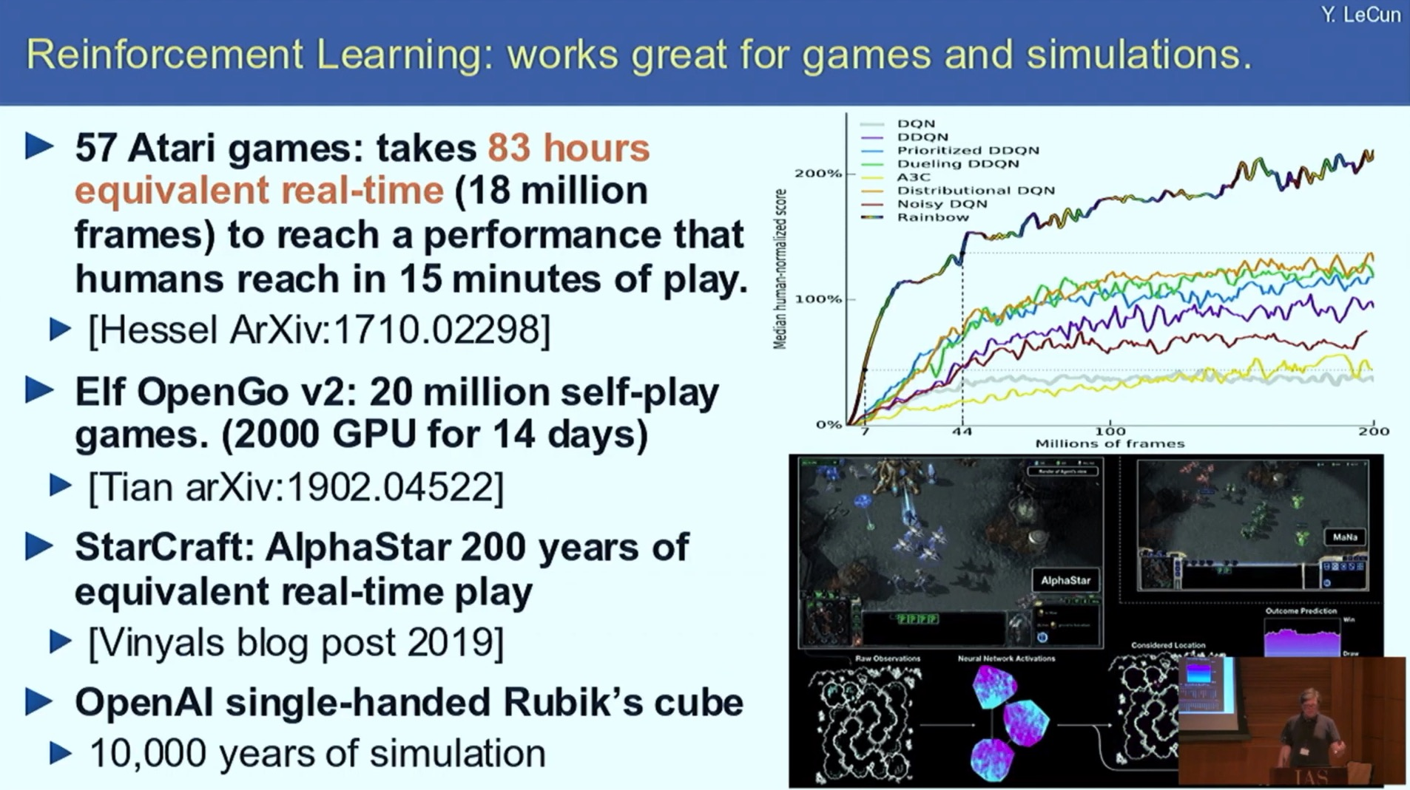

Slide 24
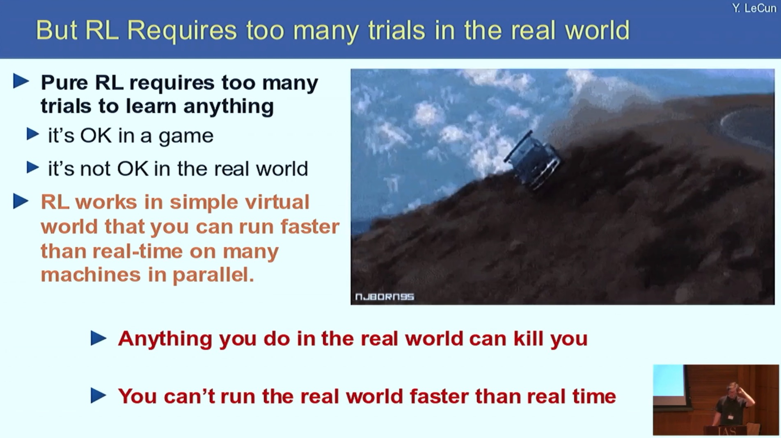

Slide 25
Some Research Directions
MPC Approximation via Neural Networks
Robustness Analysis of Learning Enabled Components
Gaussian-Process based Model Predictive Control
Notes:
There are a number of groups who are pursuing research in the indicated directions.
There are several projects I am pursuing with colleagues at Penn which I will sketch out for you next.

Slide 26
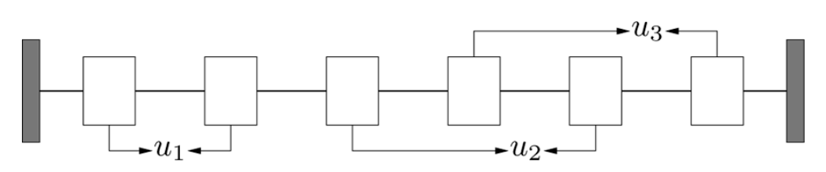
Example: Oscillating Masses
18 oscillating masses [1]
State dim: 36
Action dim: 9
Horizon: 50
6 mass version
Training Parameter | Value
Training Set Size | 2,500,000
Testing Set Size | 250,000
# Training Epochs | 200 Epochs (~40 hour)
Neural Network Depth | 7 layers
Neural Network Hidden Width | 128-512
# Neural Network Parameters | 1,668,554
[1] Y. Wang and S. Boyd. Fast Model Predictive Control Using Online Optimization. IEEE Transactions on Control Systems Technology. Vol 18, No. 2, 2010.
Notes:
Oscillating Masses
Training based on optimal trajectories computed for 2.5 Mill initial states.
Network has 1.7 Mill parameters and training is major effort (by my standards)
The training takes 40 hours: 2 NVIDIA Titan X GPUs using Tensor Flow
Trained NN with Tensorflow using supervised learning with the Lagrangian Loss function. The optimizer was Adam optimizer.
The NN has 36 inputs, and (36+9)*50=2250 outputs

Slide 27
DARPA Project: Assured Autonomy
Unmanned Underwater Vehicle (UUV)
Sonar data
NN to locate pipeline on sea floor
Steering control loop
Kothare, Morari, Automatica (1999)
Linear System
Neural
Network
General Interconnection of Linear System and
Quadratically-Constrained Nonlinearity
Notes:
Our DARPA project.

