Slide 1

Towards autonomous optimal process operations
Johannes Jäschke
Department of Chemical Engineering, NTNU
6.11.2019

Slide 2
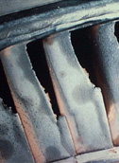
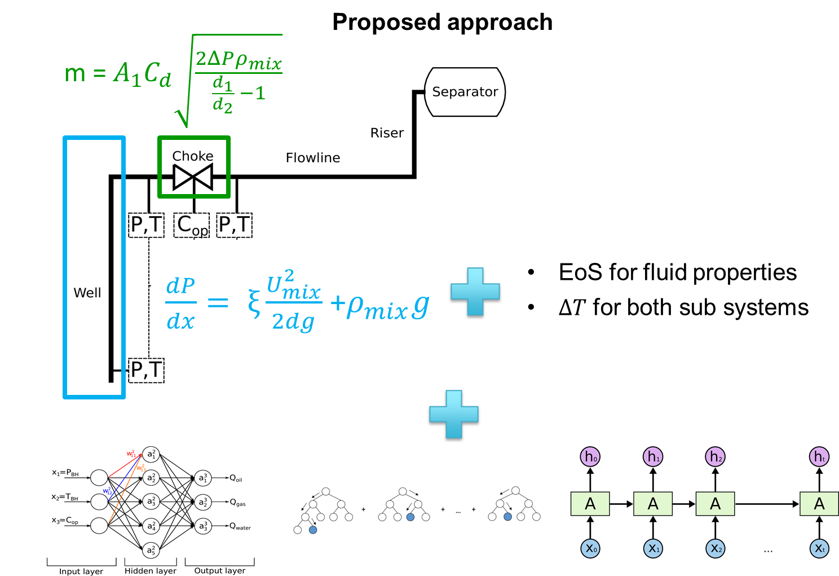
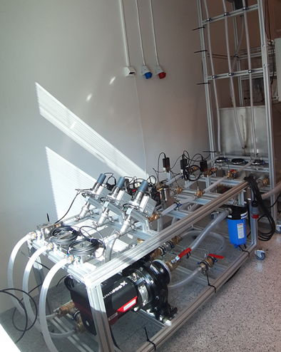


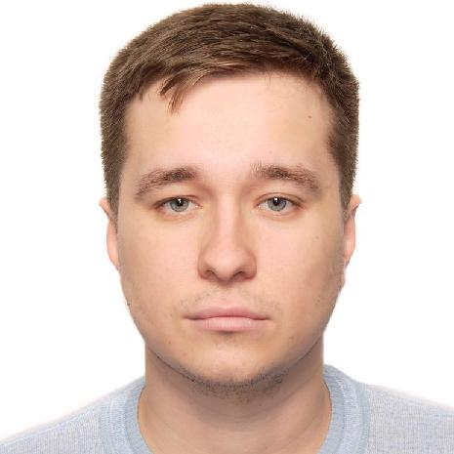



Ongoing Activities in Jäschke research group
Health-aware operation:
Combined optimization of production
and maintenance
Modeling:
Combined machine learning and first principles modeling for estimation and optimal operation
Optimal design and operation of energy systems
Theory + lab experiment
Industrial and synthetic data
Industrial and synthetic data
A. Verheyleweghen
J. Matias
T. Bikmukhametov
A. Dias
M. Thombre
Z. Mdoe

