Slide 1
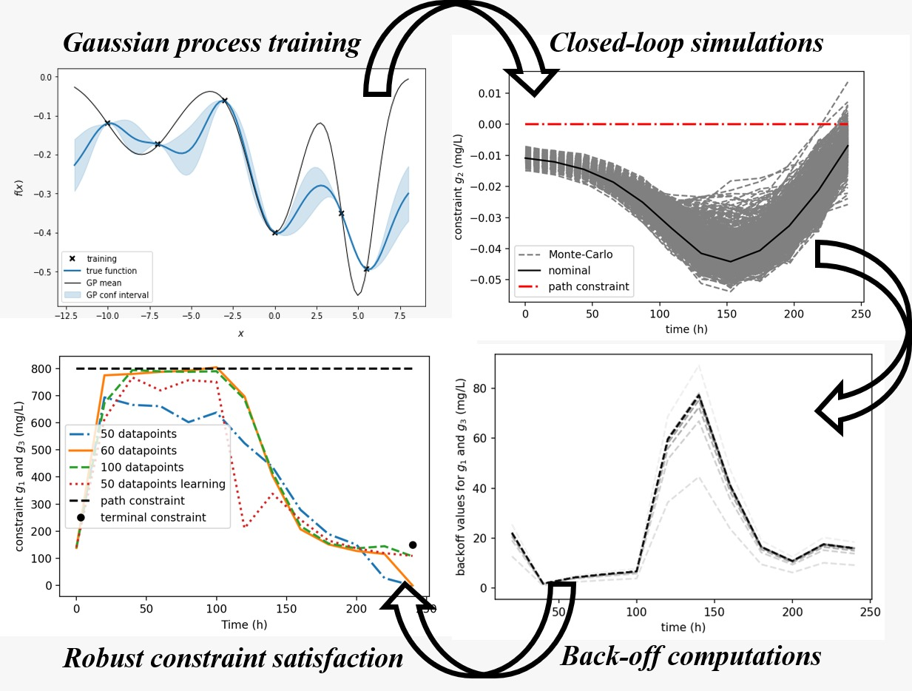
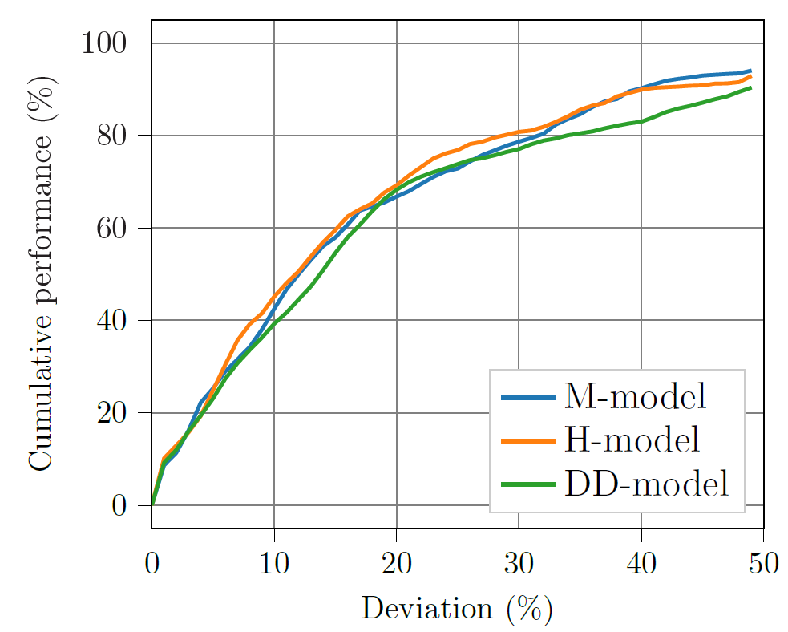
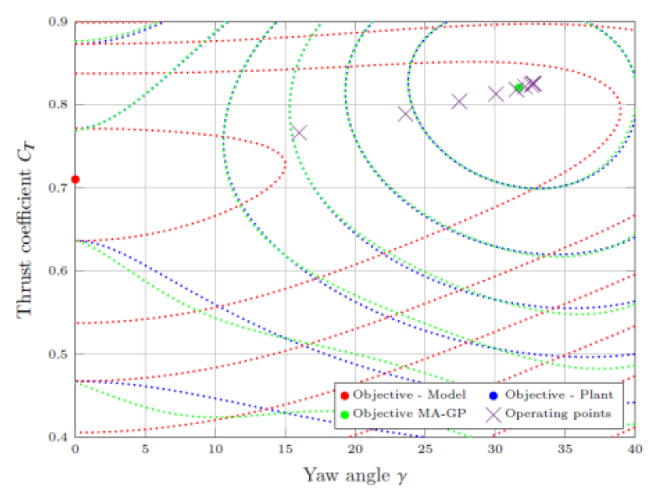
Optimization for control&estimation Research group of Lars Imsland
Examples of recent papers:
E. Bradford & L.I., “Combining Gaussian processes and polynomial chaos expansions for stochastic nonlinear model predictive control”, JPC, submitted
Model Predictive Control – nonlinear, stochastic, stability/performance, numerical algorithms
Stochastic NMPC (PhD Eric Bradford)
BRU21 Program Area manager: “Reservoir management and production optimization”
Production optimization across time-scales (PhD Joakim Andersen, PostDoc Mammad Mirzayev)
Hybrid modeling for production optimization (PhDs Mathilde Hotvedt, Otavio Ivo)
Optimal planning&scheduling under degradation (PhDs Ouyang Wu and Frederik Schulze-Spüntrup)
Wind energy
Wind farm optimization (PostDoc Leif Andersson)
Integration of renewables in offshore power systems – NMPC under large disturbances (PhD being recruited)
M. Hotvedt, B. Grimstad & L.I., “Developing a Hybrid Data-Driven, Mechanistic Virtual Flow Meter -- a Case Study”, IFAC WC 2020, submitted
L. Andersson, E. Bradford & L.I., “Distributed learning for wind farm optimization with Gaussian processes”, ACC 2020, submitted

