Slide 1




Changing between Active Constraint Regions for Optimal Operation:
Classical Advanced Control versus Model Predictive Control
Adriana Reyes-Lúa, Cristina Zotică, Tamal Das, Dinesh Krishnamoorthy and Sigurd Skogestad
Department of Chemical Engineering
Norwegian University of Science and Technology (NTNU)
Trondheim
ESCAPE’28. Graz, Austria, 13 June 2018

Slide 2
Outline
Introduction: optimal operation of a process plant
Alternatives for implementing optimal operation (control)
  Model predictive control (MPC)
  Classical advanced control structures
Case Study: optimal control of a cooler
Conclusion

Slide 3
Optimal operation (economics)
1. Introduction
Minimize cost J = J(u,x,d)
u = degrees of freedom
x = states (internal variables)
d = disturbances
J
J^{opt}
u^{opt}
J = cost feed + cost energy – value of products

Slide 4
Optimal operation (economics)
constraint
Minimize cost J = J(u,x,d)
Subject to satisfying constraints
u = degrees of freedom
x = states (internal variables)
d = disturbances
J
J^{opt}
u^{opt}
J = cost feed + cost energy – value of products

Slide 5
Active constraints
Active constraints:
  variables that should optimally be kept at their limiting value.
Active constraint region:
  region in the disturbance space defined by which constraints are active within it.
Region 3
Optimal operation:
How switch between regions?
Disturbance 2
Region 2
Region 1
Disturbance 1

Slide 6
Outline
Introduction: optimal operation of a process plant
Alternatives for implementing optimal operation (control)
  Model predictive control (MPC)
  Classical advanced control structures (ACS)
Case Study: optimal control of a cooler
Conclusion

Slide 7
Control hierarchy in a process plant
Regulatory control (PID):
  Stable operation (CV2)
Supervisory control (“Advanced control” or MPC):
  Economics: Switch between active constraints (CV1)
  Follow set points from long-term economic optimization layers.
CV = controlled variable

Slide 8
Control is about implementing optimal operation in practice
Many cases: Solution is fully constrained, but constraints change
→ Key is to control the active constraints
Region 3
Disturbance 2
Region 2
Region 1
Disturbance 1

Slide 9
Model predictive control (MPC)
Can include constraints explicitly
If lack of DOF to meet control specifications:
  Conventional: Use weights
    (Partially) give up variables with small weights in objective function.
  Use two-stage MPC with constraint priority list:
    Stage 1. Check for steady-state feasibility and give up low-priority constraints if necessary
    Stage 2. Solve conventional dynamic MPC

Slide 10
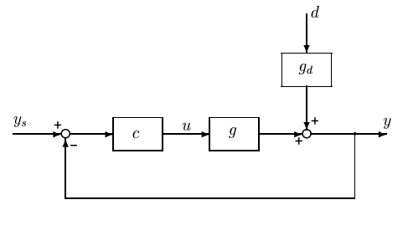
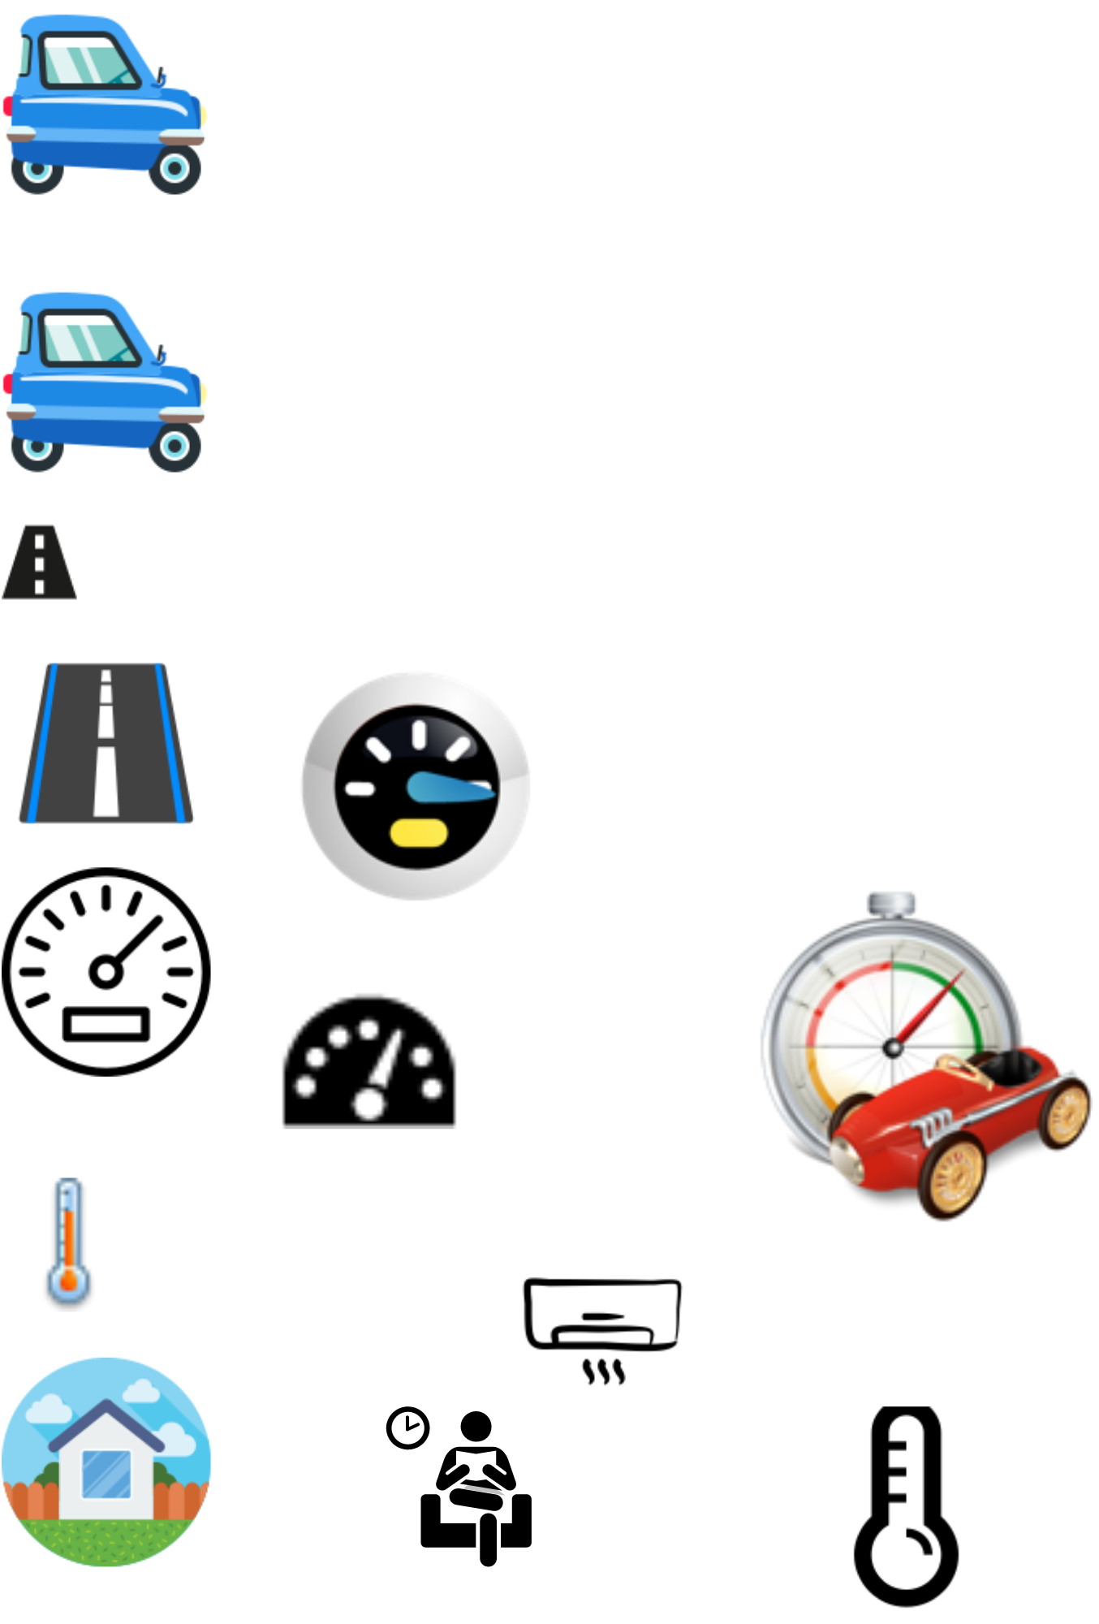
Optimization with PI-controller
y^{sp} = y^{max}
PI
max y
s.t. y ≤ y^{max}
u ≤ u^{max}
Example: Drive as fast as possible from Graz to Vienna (u=power, y=speed, y^{max} = 130 km/h)
Optimal solution has two active constraint regions:
  y = y^{max} → speed limit
  u = u^{max} → max power
Note: Positive gain from MV (u) to CV (y)
Solved with PI-controller
  y^{sp} = y^{max}
  Anti-windup: I-action is off when u=u^{max}
s.t. = subject to
y = CV = controlled variable

Slide 11
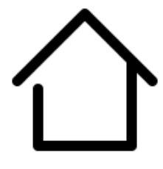
Optimization with PI-controller
y^{sp} = y^{min}
PI
min u
s.t. y ≥ y^{min}
u ≥ u^{min}
Example: Minimize heating cost (u=heating, y=temperature, y^{min}=20 °C)
Optimal solution has two active constraint regions:
  y = y^{min} → minimum temperature
  u = u^{min} → heating off
Note: Positive gain from MV (u) to CV (y)
Solved with PI-controller
  y^{sp} = y^{min}
  Anti-windup: I-action is off when u=u^{min}
s.t. = subject to
y = CV = controlled variable

Slide 12
Optimization with PI-controller
PI
Both cases:
Normal operation: y=y^{sp}
When u (MV) reaches constraint: control of y (CV) is given up
Generalization to multivariable case. Input saturation pairing rule:
Pair low-priority controlled variable (y, CV) (can be given up) with a manipulated variable (u, MV) that may saturate.
Or equivalently
Pair high-priority controlled variable (y, CV) (cannot be given up) with a manipulated variable (u, MV) that is not likely to saturate.

Slide 13
Multivariable using PI-control: Must decide on pairing
Input saturation pairing rule:
Pair high priority controlled variable (CV) (cannot be given up) with a manipulated variable (MV) that is not likely to saturate.
Example priority list
1. u₁ ≤ u₁^{max}
2. y₁ = y₁^{sp} ← high-priority CV
3. y₂ = y₂^{sp} ← low-priority CV
From rule: pair y₁ with u₂
PI
PI
If we don’t follow rule: Need to use selector (max/min)
when input constraint is reached

Slide 14
Classical advanced control structures (ACS)
Used when single-loop PID is not sufficient.
Examples:
  Cascade control
  Feedforward control / Ratio control
  Decoupling
  Selectors
  Split range control (SRC)
  Input resetting or valve positioning control (VPC)
Can handle constraint changes

Slide 15
Outline
Introduction: optimal operation of a process plant
Alternatives for optimal operation in the supervisory layer
  Model predictive control (MPC)
  Classical advanced control structures (ACS)
Case Study: optimal control of a cooler
Conclusion

Slide 16
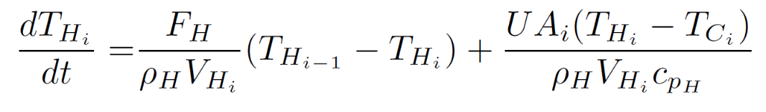
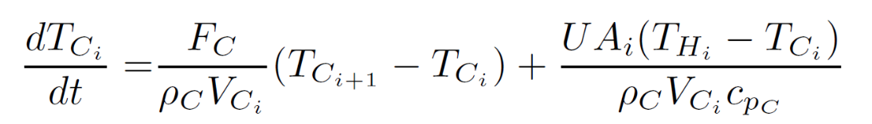
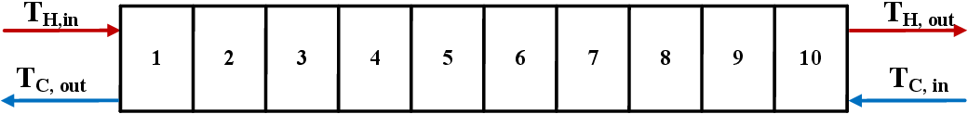
3. Optimal control of a cooler

Slide 17
3. Optimal control of a cooler
Main control objective:
y₁=T_{H}=T_{H}^{sp}
Secondary objective (can be given up)
y₂= F_{H}=F_{H}^{sp}
Manipulated Variables:
u₁=z_{C} , u₂=z_{H}
Both valves may satúrate at max
Disturbance:
T_{C}^{in}
Cooling water

Slide 18
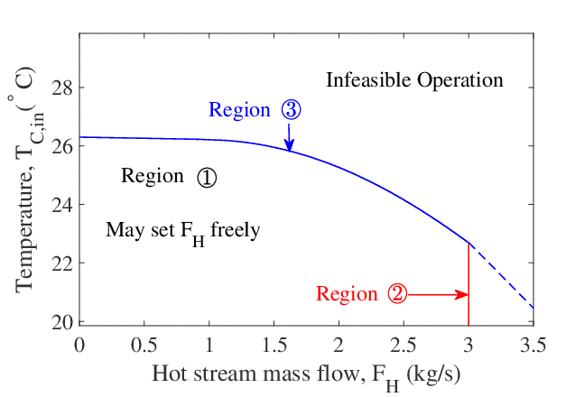
Multivariable: Cooler example
max y₂ (throughput)
s.t. y₁ = y₁^{sp} ← temperature
u₁ ≤ u₁^{max}
u₂ ≤ u₂^{max} ← max. throughput
y₂ ≤ y₂^{sp} ← desired throughput
Active constraint regions:
  y₁ = y₁^{sp}, y₂ = y₂^{sp} ← «unconstrained» region
  y₁ = y₁^{sp}, u₂ = u₂^{max}
  y₁ = y₁^{sp}, u₁ = u₁^{max}
Input saturation pairing rule: Pair y₁ (temperature) with a manipulated variable (MV) that is not likely to saturate.
It’s not possible to follow this rule since both MVs may saturate…
Will pair y₁ with u₁ for dynamic reasons
And will need logic (max/min-selector) for case when u₁ saturates

Slide 19
Pairings at nominal «unconstrained» operating point
F_{C} may saturate for a
large disturbance (T_{C}^{in})
Use F_{C} to control T_{H}

Slide 20
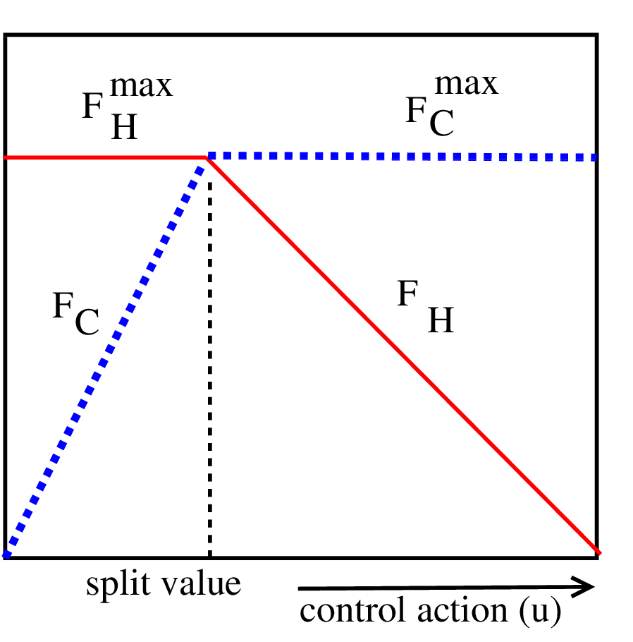
Solution: Split range control with min-selector
Tuning of TC using SIMC rule:
  τ_{c} = 2θ = 88 s
  Kc = -0.55
  τ_{I} = 74 s

Slide 21
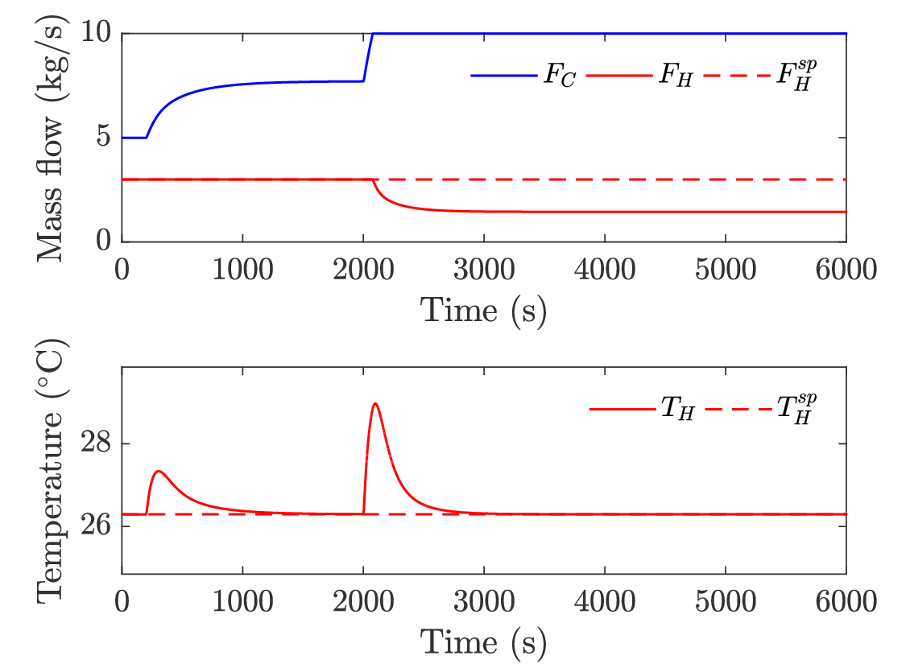
Simulation: Split range control with min-selector

Slide 22
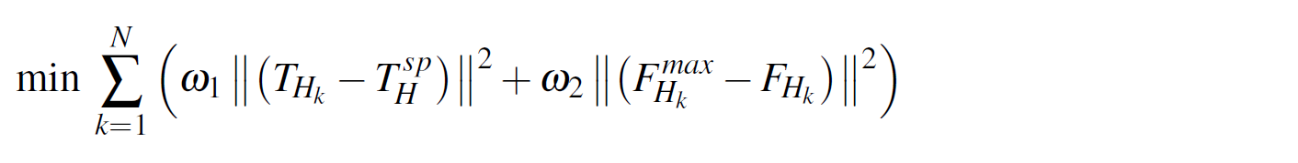
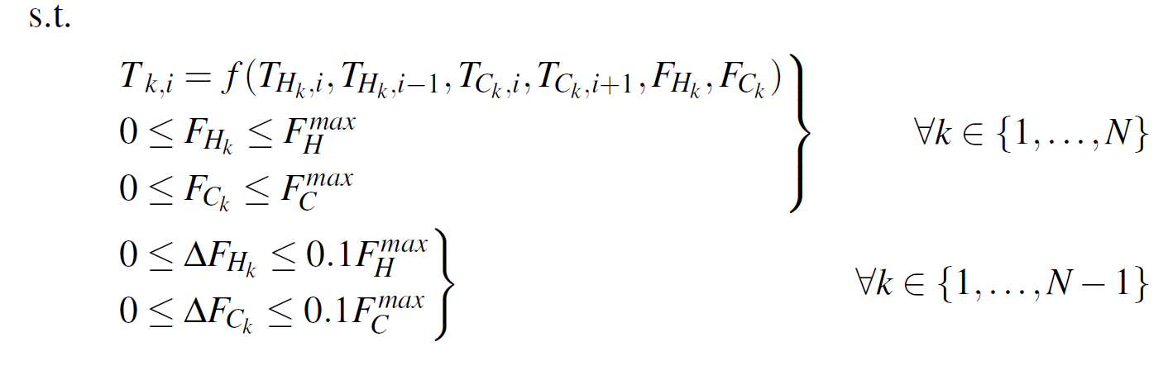


MPC for cooler
Tuning ← trial and error
← Objective function
(CV constraints)
Model →
MV constraints →
For represents the flow at the nominal point.

Slide 23
MPC weight selection
Tunings:
[ω₁ , ω₂ ]
α = [3.0, 0.1]
β = [1.0, 1.0]
γ = [0.1, 3.0]
Yellow:
Selected

Slide 24
MPC vs PI
Disturbance (T_{C}^{in})
t = 10 s; + 2°C
t = 1000 s; + 4°C
F_{C}
T_{H}
Red: Split Range Control (PI)
Yellow: MPC:
Δt = 50 s
ω₁ = 3
ω₂ = 0.1
F_{H}

Slide 25
4. Conclusion
Optimal control for most simple systems can be achieved using classical advanced control structures.
  Comparable response to MPC.
  Simpler implementation compared to MPC.
  Shorter computational time.
A priority list of constraints is an important tool to design the supervisory control layer.

Slide 26
Acknowledgement
This work was partly supported by the Norwegian Research Council under
HighEFF: Energy Efficient and Competitive Industry for the Future and
SUBPRO: Subsea Production and Processing

Slide 27
Extra slides

Slide 28
Optimize
Optimize for expected disturbances (d)
min J(u,x,d)
s.t.
f(u,x,d) = 0
g(u,x,d)≤ 0
_{u}
Model equations
Operational constraints
We need a good model, usually steady-state.
Optimization can be time consuming.
Main goal for control puposes: identify active constraint regions

Slide 29
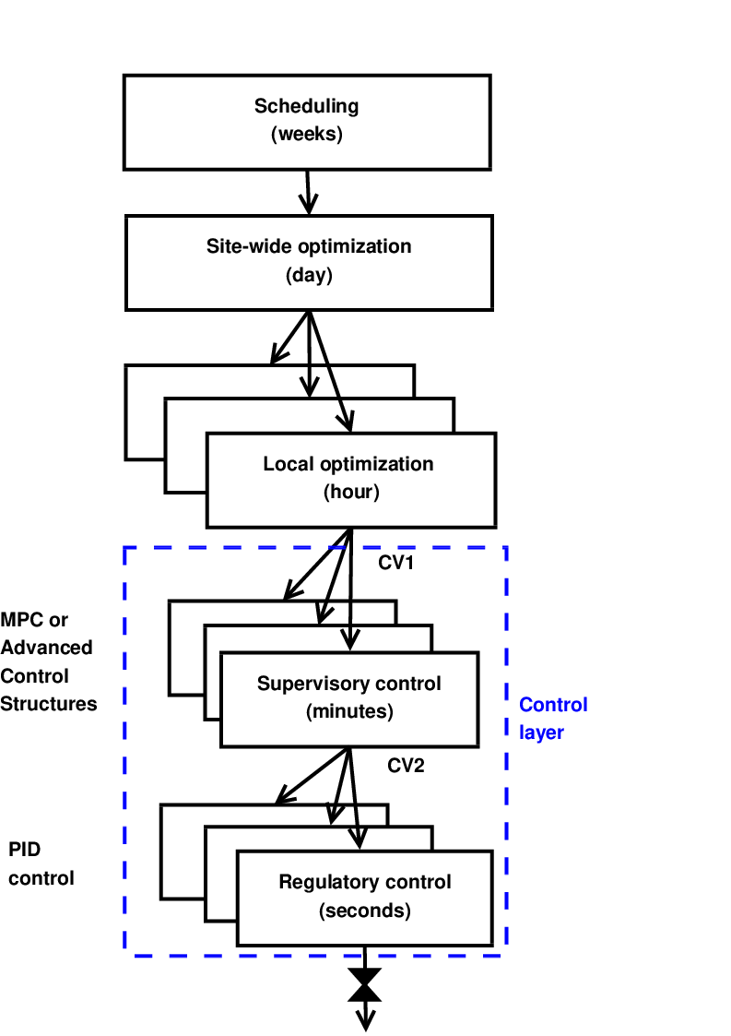
Systematic procedure for plantwide control
Start “top-down” with economics:
Step 1: Define operational objectives and constraints
Step 2: Optimize steady-state operation
Step 3: Decide what to control (CVs)
Step 4: TPM location
Then bottom-up:
Step 5: Regulatory control
Finally: Make link between “top-down” and “bottom up”
Step 6: “Advanced/supervisory control” system

Slide 30
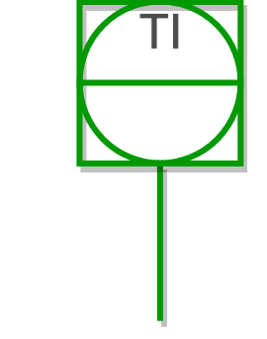

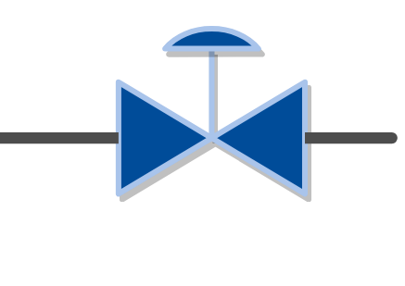
Requirement for the supervisory layer
Maintain optimal operation despite:
  disturbances
  changes of active constraint region
Usually:
≥
Number of controlled variables (CV)
Number of
degrees of freedom (MV)
How should we use the available MVs?

Slide 31
Priority list of constraints
P1: MV inequality constraints → physical constraints
P2: CV inequality constraints → may be given up
P3: MV or CV equality constraints → optimal operation
P4: Desired throughput → give up at bottleneck
P5: Self-optimizing variables → can be given up
A. Reyes-Lúa, C. Zotica, S. Skogestad, 2018. Optimal Operation with Changing Active Constraint Regions using Classical Advanced Control. In: 10th ADCHEM. IFAC, Shenyang, China.

Slide 32
Model predictive control (MPC)
Meets constraints “by design”.
Explicit model required.
If lack of DOF to meet control specifications:
  Modify weights in objective function.
  Use two-stage MPC with a priority list:
    Sequence of local steady state LPs and/or QPs
      Add constraints in order of priority
      Find feasibility
    MPC: dynamic optimization problem

Slide 33
Optimal operation using advanced control structures
Multivariable: Must decide on pairing
Input saturation pairing rule
Pair the high priority controlled variable (CV) (cannot be given up) with a manipulated variable (MV) that is not likely to saturate.

Slide 34
Optimal operation using advanced control structures
Control structure (pairing) may vary with the operating region.
Region 3
Disturbance 2
Region 2
Region 1
Disturbance 1
A. Reyes-Lúa, C. Zotica, S. Skogestad, 2018. Optimal Operation with Changing Active Constraint Regions using Classical Advanced Control. In: 10th ADCHEM. IFAC, Shenyang, China.

Slide 35
Priorities and constraints
MV constraints | CV constraints
F_{H} ≤ F_{H}^{max} F_{C} ≤ F_{c}^{max} | T_{H} = T_{H}^{sp} F_{H} = F_{H}^{sp}
Priority level | Description | Constraints
1 | Feasibility region | F_{H} ≤ F_{H}^{max} F_{C} ≤ F_{c}^{max}
2 | Main control objective | T_{H} = T_{H}^{sp}
3 | Desired throughput | F_{H} = F_{H}^{sp}

Slide 36
Handling constraints using ACS
Input saturation pairing rule
A high priority controlled variable (CV) (which cannot be given up) should be paired with a manipulated variable (MV) that is not likely to saturate.
Pairing rule was followed?
Do nothing: give-up controlling low priority CV
MV
YES
Reassign high priority CV to MV controlling low priority CV: ACS + min/max selector
Constraint reached
NO
Do nothing
CV
Low priority?
YES
NO
Give-up a low priority CV using selector

Slide 37
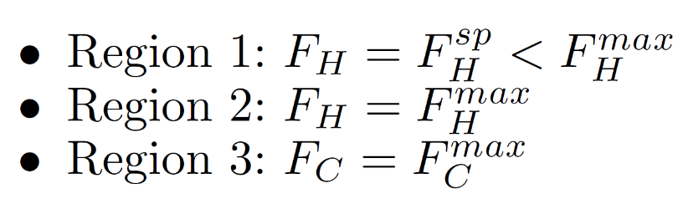
Active constraint regions
Active constraint in each region:

Slide 38
4. Alternatives for supervisory layer
  MPC
  Define:
  Priority list of constraints
  Objective function
  Prediction horizon
  Sampling time
  Control intervals
  Tuning (Δt, N, ω_{i}) ← trial and error
  Advanced Control Structures
  Define:
  Priority list of constraints
  Pairing at nominal point
  Gain of MVs on CV
  Tuning of PI-controller(s)
  → well-known rules
  Set-up and solve dynamic optimization problem at every step.
  Set-up control structure.

