Slide 1
PWC Basics: A Simple Chemical Process
Fresh A
Recycle A
REACTOR
C
O
L
U
M
N
Cooling
Duty
A → B
FEHE
MATERIAL RECYCLE
ENERGY RECYCLE
PROCESS INTEGRATION
Minimizes
A consumed per kg B product
Steam consumed per kg B product
ENHANCES PROCESS PROFITABILITY
Product B

Slide 2
PWC Basics: Chemical Process Operation
Key Production Objectives
Safety
Stability
Economics
Production
Rate
Product
Quality
Effluent
Specs
Operate plant to meet production objectives 24X7
Production Objective Itself Can Change
Process Disturbances
Ambient
Conditions
Raw material
Quality
Sensor
Noise
Equipment
Characteristics

Slide 3
PWC Basics
Safety
Stability
Operate Process at Steady State
≡
0
Accumulation Rate Rate Generation
Rate In Out Rate
=
−
+
Need PWC to drive accumulation of all independent inventories to zero

Slide 4
PWC Basics
Regulatory Control System
Drives all inventory accumulation terms to zero
Ensures plant operation around a steady state
What steady state to operate at
Economic Optimum
Minimize expensive utility consumption
Maximize production

Slide 5
Plantwide Control Hierarchy
PLANTWIDE CONTROL SYSTEM
Optimization Layer
(updates every few hrs)
Economic Operation
SETPOINT
Supervisory Control Layer
(updates every few mins)
Measurements
SETPOINT
Safe & Stable Operation
Regulatory Control Layer
(updates every few secs)
SIGNAL TO VALVE
PLANT

Slide 6
Regulatory PWCS Design
What to Control
All independent inventories (DOF)
Material – Liquid level or gas pressure
Energy – Temperature or vapor pressure
Component – Composition, tray temperature (inferential)
Throughput or Production Rate
Degree of tightness of control
Should energy inventories be tightly controlled?
Should surge level inventories be tightly controlled?
What to manipulate
Pair close
Fast dynamics
Tight closed loop control
Location of through-put manipulator a key decision for inventory management and economics

Slide 7
The Transformation of Variability Perspective
HEAT EXCHANGER EXAMPLE
TC
Steam in
Control
Valve
TT
Transmitter
Process Stream in
HEAT EXCHANGER
Process Stream out
Condensate out
Steam Flow
Steam Flow
Temperature
Temperature
CONTROL
SYSTEM
Agent for transformation / management of process variability

Slide 8
Where to Transform Variability
Surge level
Does not affect steady state
Regulate loosely for filtering out flow transients
Energy Inventories
Regulate tightly to guarantee safety (rxn runaway?)
Product quality
Regulate tightly
Minimize “free” product give-away
Production rate
Often “loose” is OK (eg meet the monthly target)
Recycle loop circulation rates
Regulate to avoid large drifts
All equipment inside recycle loop see acceptable variability

Slide 9
Nonlinearity in Material Recycle Loops
NO FEASIBLE STEADY STATES
Recycle Rate
Snowballing
Fresh Feed Rate
Fixing the fresh feed rate of a recycled component is NOT a good idea
Possibility of overfeeding induced instability

Slide 10
Material Recycle Snowball Effect
TPM
FC
Recycle A
Fresh A
PC
RC
LC
TC
REACTOR
C
O
L
U
M
N
Cooling
Water
A → B
LC
Recycle loop shows large swings
Large Throughput De-rating
R
TC
%
F_{A}
LC
Time
Product B

Slide 11
Material Recycle Snowball Effect
TPM
FC
Recycle A
Fresh A
PC
RC
LC
TC
REACTOR
C
O
L
U
M
N
Cooling
Water
A → B
LC
No large swings in recycle rate
Lower Throughput De-rating
TC
LC
Product B

Slide 12
Alternative Material Balance Control Schemes
IC
FC
IC
Fixed Feed
Recycle Floats
F
P
Recycle
FC
IC
Fixed Recycle
Feed Floats
F
IC
P
Recycle
Configure control structure to transform recycle rate variability out of the recycle loop

Slide 13
PWC Basics: Throughput Manipulation
THROUGHOUT MANIPULATOR (TPM)
The setpoint adjusted to effect a change in production/processing rate
TPM
*
FC
Unit 1
LC
Unit 2
LC
Unit 3
LC
Lost production
TPM
*
LC
Unit 1
LC
Unit 2
FC
Unit 3
LC
No (min) production loss

Slide 14
PWC Basics: TPM Selection
When is TPM choice flexible
Large storage tanks supply the fresh feed(s)
Variability in storage tank level is acceptable
Allows structures that bring in fresh feed(s) as make-up
Usually plant designs have large recycle rates
Design in the snowballing region
Capacity bottleneck then is likely inside the loop
Where to locate the TPM
Inside the recycle loop
If multiple recycle loops, on a common branch
If bottleneck is known, AT the bottleneck

Slide 15
Reactor Separator Recycle Process
F_{A}
Control DOFs 9
Surge Levels -2
Given Column Pr -1
---------------------------------
Steady State DOF 6
---------------------------------
F_{B}
C
O
L
U
M
N
A + B → C
Product C

Slide 16
PWCS Design: TPM at Fresh Feed
X
CC
PC
FC
F_{A}
TPM
FC
LC
FC
F_{B}
C
O
L
U
M
N
LC
A + B → C
TC
TC
LC
Product C

Slide 17
PWCS Design: Recycle Drifts
Beware of subtle plantwide recycle loop inventory drifts
Stoichiometric feed balancing
Plantwide balances close slowly due to recycle
Always examine process input-output structure
Every component must find a way out or get consumed (DOWNS’ DRILL)
FC
F_{A}
IC
Recycle A
P_{C}
IC
Recycle B
F_{B}
For (near) pure C product, F_{A} = F_{B}

Slide 18
PWCS Design: TPM at Column Boilup
X
CC
PC
FC
F_{A}
LC
LC
FC
F_{B}
C
O
L
U
M
N
TC
A + B → C
TPM
TC
FC
LC
Product C

Slide 19
PWCS Design Steps
DOF analysis and control objectives
Production rate, Product quality
Safety limits (eg UFL < gas loop composition < LFL)
Inventories
Economic
Choose TPM
Feed set by an upstream process
On demand operation (utility plants)
Flexible
Inside the recycle loop at the feed of the most non-linear/fragile unit
If bottleneck is known, at the bottleneck inside the recycle loop
Design “local” loops for closing all independent material and energy balances around the TPM
Radiate outwards from the TPM
Check consistency of material / energy balance closure (Downs’ Drill)
Design economic control loops
Active constraint control & SOCV control

Slide 20
Mode I Optimum Operation
OBJECTIVE
MIN J = Boilup
at given throughput
subject to process constraints
F_{A}
F_{B}
C
O
L
U
M
N
ACTIVE CONSTRAINTS
T_{rxr}^{MAX} Max reactor temperature
LVL_{rxr}^{MAX} MAX reactor level
x_{C}^{prdMIN} MIN product purity
EQUALITY CONSTRAINT
P Given throughput
UNCONSTRAINED DOFs
SOCV1 L/F Reflux to feed ratio
SOCV2 [A/B]_{rxr} Reactor A/B ratio
A + B → C
Product C

Slide 21
Mode II Optimum Operation
OBJECTIVE
MAX J = Throughput (P)
subject to process constraints
F_{A}
F_{B}
C
O
L
U
M
N
ACTIVE CONSTRAINTS
T_{rxr}^{MAX} Max reactor temperature
LVL_{rxr}^{MAX} MAX reactor level
x_{C}^{prdMIN} MIN product purity
∆P^{MAX} Capacity bottleneck
UNCONSTRAINED DOFs
SOCV1 L/F Reflux to feed ratio
SOCV2 [A/B]_{rxr} Reactor A/B ratio
A + B → C
Product C

Slide 22
PWCS Design: TPM at Fresh Feed
MODE II CONSTRAINTS
T_{rxr}^{MAX}, LVL_{rxr}^{MAX}
x_{C}^{prdMIN} ,ΔP^{MAX}
SOCVs
L/F, [A/B]_{rxr}
CRC
[A/B]_{rxr}
L/F
X
CC
PC
X
FC
F_{A}
TPM
FC
LC
FC
F_{B}
C
O
L
U
M
N
LVL_{rxr}^{MAX}
LC
A + B → C
T_{rxr}^{MAX}
TC
TC
MAX
MAX - δ
Long Loop → Large δ
∆PC
x_{C}^{prdMIN}
LC
∆P^{MAX} - δ
CC
Product C

Slide 23
PWCS Design: TPM at Fresh Feed
CRC
[A/B]_{rxr}
L/F
X
CC
PC
X
TPM
FC
F_{A}
LS
FC
LC
FC
F_{B}
LVL_{rxr}^{MAX}
C
O
L
U
M
N
LC
A + B → C
T_{rxr}^{MAX}
TC
TC
Long Loop → Large δ
∆PC
x_{C}^{prdMIN}
LC
∆P^{MAX} - δ
CC
Product C

Slide 24
PWCS Design: TPM at Bottleneck
MAX
MAX - δ
CRC
[A/B]_{rxr}
Negligible back-off
L/F
X
CC
PC
X
FC
F_{A}
LVL_{rxr}^{MAX}
LC
LC
FC
F_{B}
C
O
L
U
M
N
TC
A + B → C
TPM
T_{rxr}^{MAX}
TC
FC
LC
∆PC
x_{C}^{prdMIN}
CC
∆P^{MAX} - δ
Product C

Slide 25
PWCS Design: TPM at Bottleneck
CRC
[A/B]_{rxr}
L/F
X
CC
PC
X
FC
F_{A}
LVL_{rxr}^{MAX}
LC
LC
FC
F_{B}
C
O
L
U
M
N
TC
TPM
A + B → C
T_{rxr}^{MAX}
TC
LS
FC
LC
∆PC
x_{C}^{prdMIN}
CC
∆P^{MAX}
Product C

Slide 26
Switching Regulatory Control Structure
CRC
[A/B]_{rxr}
L/F
X
CC
PC
X
TPM
FC
F_{A}
LS
FC
LC
FC
F_{B}
−5%
Σ
HLC
LC
LS
C
O
L
U
M
N
LTC
LVL_{rxr}^{MAX}
A + B → C
TC
Σ
−2°C
TC
T_{rxr}^{MAX}
LS
∆PC
∆P^{MAX}
x_{C}^{prdMIN}
LC
CC
Product C

Slide 27
Summary
Locate TPM at bottleneck inside recycle loop
Economic considerations play a major role in regulatory control layer design
COMMON SENSE MUST PREVAIL
Everything must be carefully thought through
It pays to be systematic

Slide 28
Case Study I: Ester Purification Process
Recycle
Q_{Cnd}
L
D
F_{H2O}
F_{Col}
Distillation column
Q_{Reb}
Ethyl acetate
Ethanol
Water
Extractor
F_{Feed}
F_{Tot}
F_{Ester}
F_{Alc-wash}

Slide 29
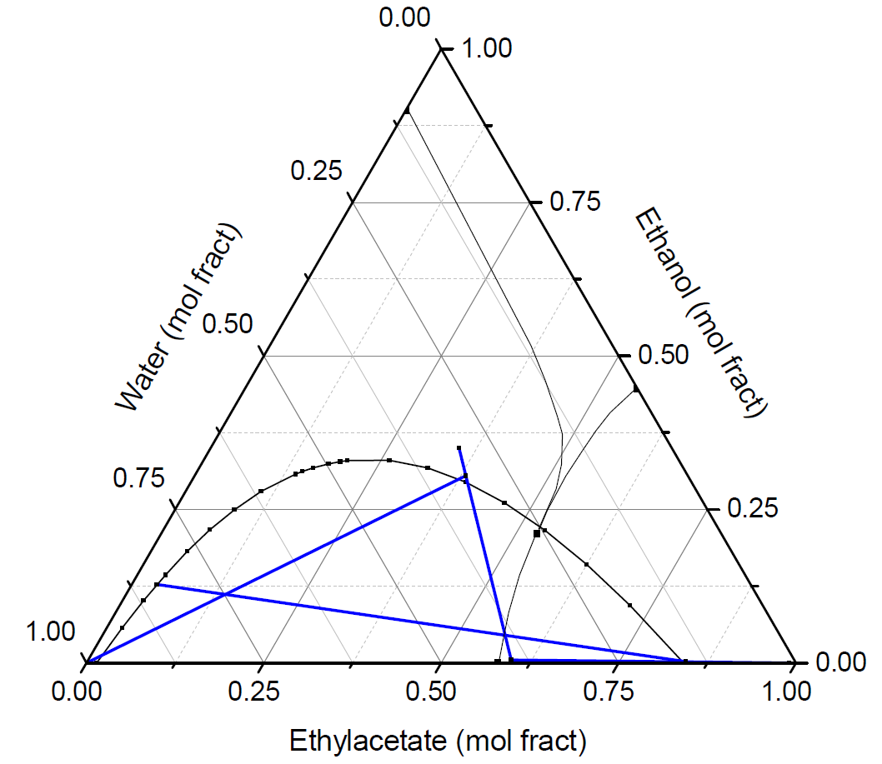
Flowsheet Material Balances
Recycle
Q_{Cnd}
L
D
F_{H2O}
F_{Col}
Alcohol wash
Fresh feed
Distillation column
LLX feed
Column feed
Q_{Reb}
Extractor
F_{Feed}
F_{Tot}
F_{Ester}
Water feed
Product
F_{Alc-wash}
EtOH-H2O recycle

Slide 30
Control Objective
Operate plant to maximize ester production
BOTTLENECK
Maximum water solvent rate to the extractor
Hydraulic constraint
Limits alcohol extraction capacity

Slide 31
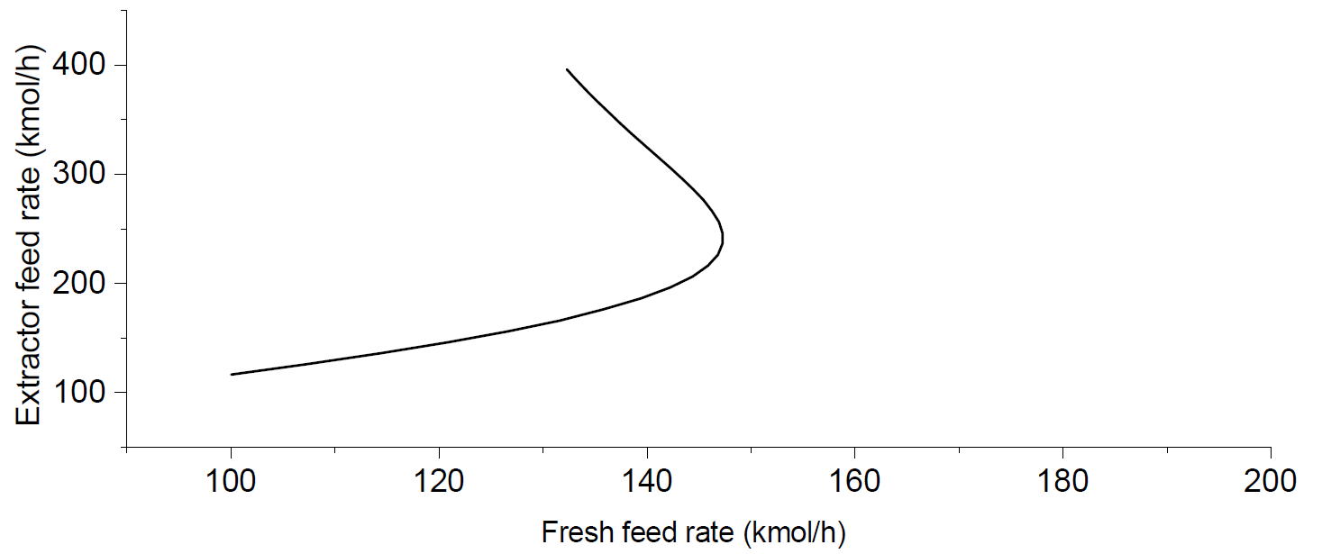
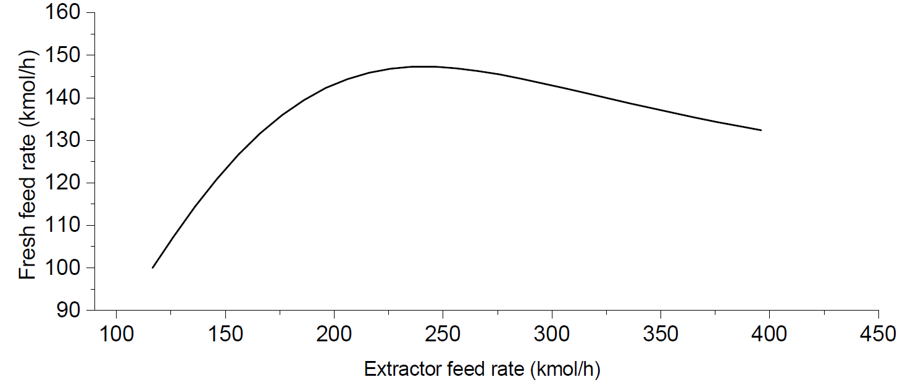
Steady State Bifurcation Analysis
Fresh Water Rate = MAX
(b)
(a)
Infeasible setpoint
No setpoint Infeasibility

Slide 32
Control Structure 2
Recycle
PC
Q_{Cnd}
MAX
X
FC
LC
FC
LC
L
D
F_{H2O}
F_{Col}
Distillation column
TC
Q_{Reb}
TPM
FC
Extractor
LC
F_{Feed}
F_{Tot}
F_{Ester}
LC
F_{Alc-wash}

Slide 33
CS1: TPM at Bottleneck Feed
Recycle
PC
Q_{Cnd}
MAX
X
FC
LC
FC
LC
L
D
F_{H2O}
F_{Col}
Distillation column
TC
Q_{Reb}
TPM
FC
Extractor
LC
F_{Feed}
F_{Tot}
F_{Ester}
LC
F_{Alc-wash}

Slide 34
CS1: TPM at Bottleneck Feed
Recycle
PC
Q_{Cnd}
MAX
X
FC
LC
FC
LC
L
D
F_{H2O}
F_{Col}
Distillation column
TC
Q_{Reb}
TPM
FC
Extractor
LC
F_{Feed}
F_{Tot}
F_{Ester}
LC
F_{Alc-wash}

Slide 35
CS2: TPM at Fresh Feed
Recycle
PC
Q_{Cnd}
MAX
X
FC
LC
FC
LC
L
D
F_{H2O}
F_{Col}
Distillation column
TC
Q_{Reb}
TPM
FC
Extractor
LC
F_{Feed}
F_{Tot}
F_{Ester}
LC
F_{Alc-wash}

Slide 36
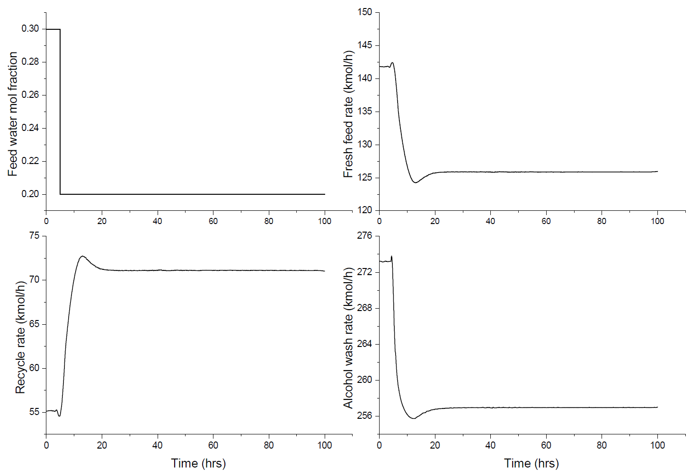
CS1 Closed Loop Transients Large Feed Composition Change

Slide 37
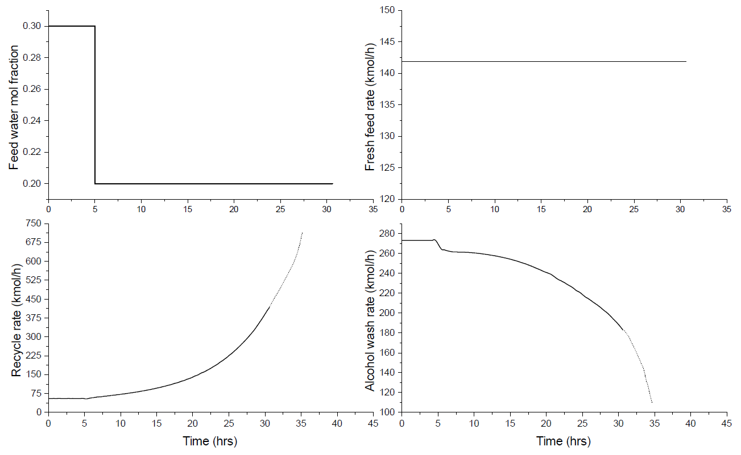
CS2 Closed Loop Transients Large Feed Composition Change

Slide 38
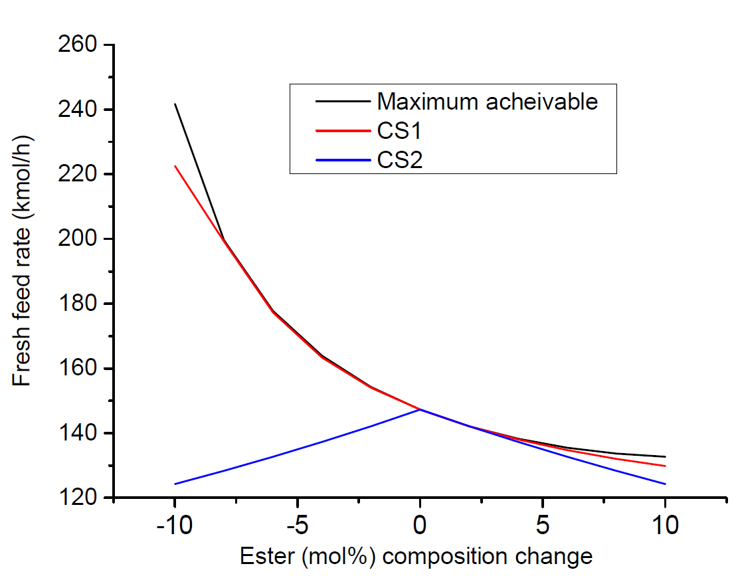
Throughout Maximization Results
CS1 → Self regulatory
CS2 → Overfeeding infeasibility
174 kmol/h
Nominal maximum throughput
147.3 kmol/h
136 kmol/h

