Slide 1
Nonlinear input transformations for disturbance rejection, decoupling and linearization
Sigurd Skogestad
Cristina Zotica
Department of Chemical Engineering
Norwegian University of Science and Technology (NTNU)
Trondheim
Virtual seminar UFRJ Brazil. 05 October 2020
Thanks to Nicholas Alsop and Christian Holden

Slide 2
Abstract
Title: “Nonlinear input transformations for disturbance rejection, decoupling and linearization”.
Abstract. The goal of my research is to develop simple yet rigorous methods to solve problems of engineering significance. The topic of input transformations is something I have been working on for the last year or so, and I think it has a lot of promise. The starting point is that I observed that industry frequently used static model-based calculation blocks for various purposes, such as counteracting nonlinearity, disturbances and coupling. Industry also frequently uses cascade control.
However, there is little theory for when to use these solutions, and we have found that the use of input transformations forms a good basis. The starting point is a nonlinear process model, which is transformed to a simpler model through the use of an input transformation. It is really very simple. Consider a nonlinear model dy/dt=f(y,u,d) and introduce v=f(y,u,d) as the transformed input to get a nonlinear transformed system dy/dt=v which is linear, decoupled and independent of disturbances. This transformation is a special case of feedback linearization, but we have extended the idea by adding a tuning parameter, by allowing for static process models and by making use of cascade control in a systematic way. The method has been tested on many process control examples.

Slide 3





Trondheim
Arctic circle

Slide 4
About Sigurd Skogestad
•1955: Born in Norway
•1978: MS (Siv.ing.) in chemical engineering at NTNU
•1979-1983: Worked at Norsk Hydro co. (process simulation)
•1987: PhD from Caltech (supervisor: Manfred Morari)
•1987-present: Professor of chemical engineering at NTNU
• 1994-95: Visiting Professor UC Berkeley
• 2001-02: Visiting Professor UC Santa Barbara
•1999-2009: Head of ChE Department, NTNU
•2015-..: Director SUBPRO (Subsea research center at NTNU)
Non-professional interests:
mountain skiing (cross country)
orienteering (running around with a map)
grouse hunting

Slide 5
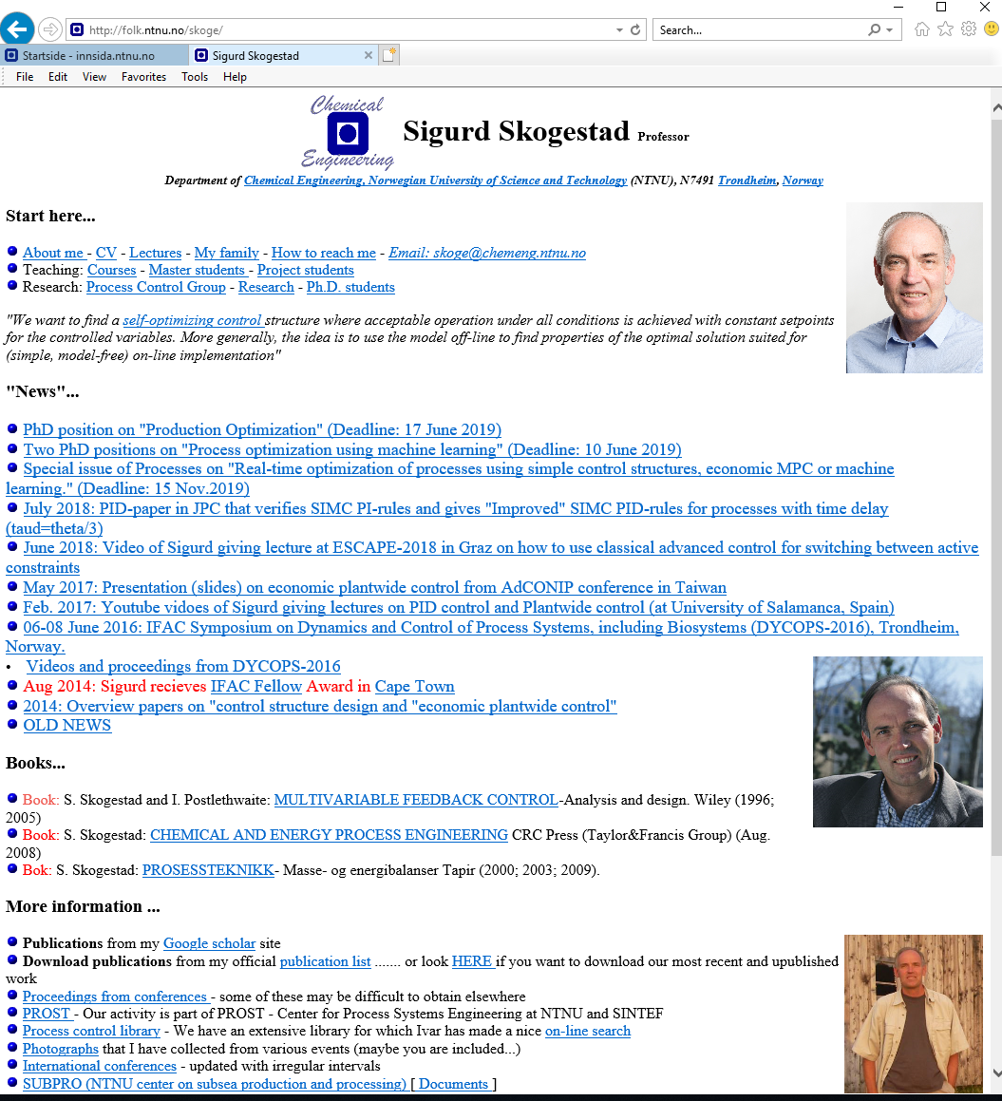
“The goal of my research is to develop simple yet rigorous methods to solve problems of engineering significance”

Slide 6

Optimal centralized
Solution (EMPC)
Academic process control community fish pond
Simple solution
that work (PID++)
Sigurd

Slide 7
Introduction
I have observed that industry frequently used model-based calculations blocks
… and they use a lot of cascade control
But no theory for when to use
Idea: Use nonlinear model equations to derive control strategy
“Control structures with embedded knowledge through input transformations”
Primary use:
  Nonlinear feedforward
  Decoupling
  Insight into when to use cascade control (extra measurements)

Slide 8
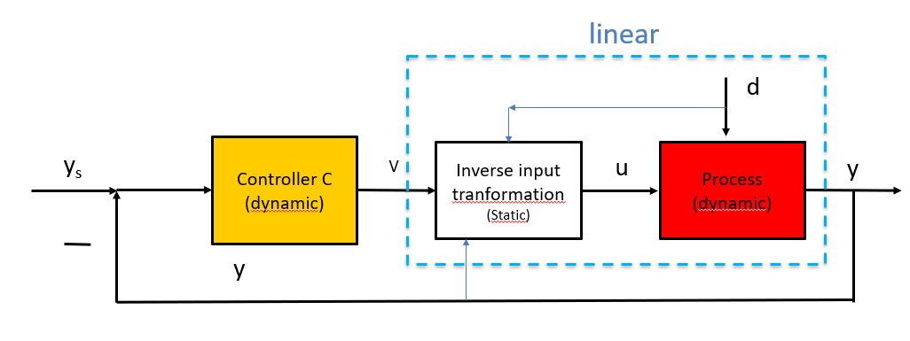
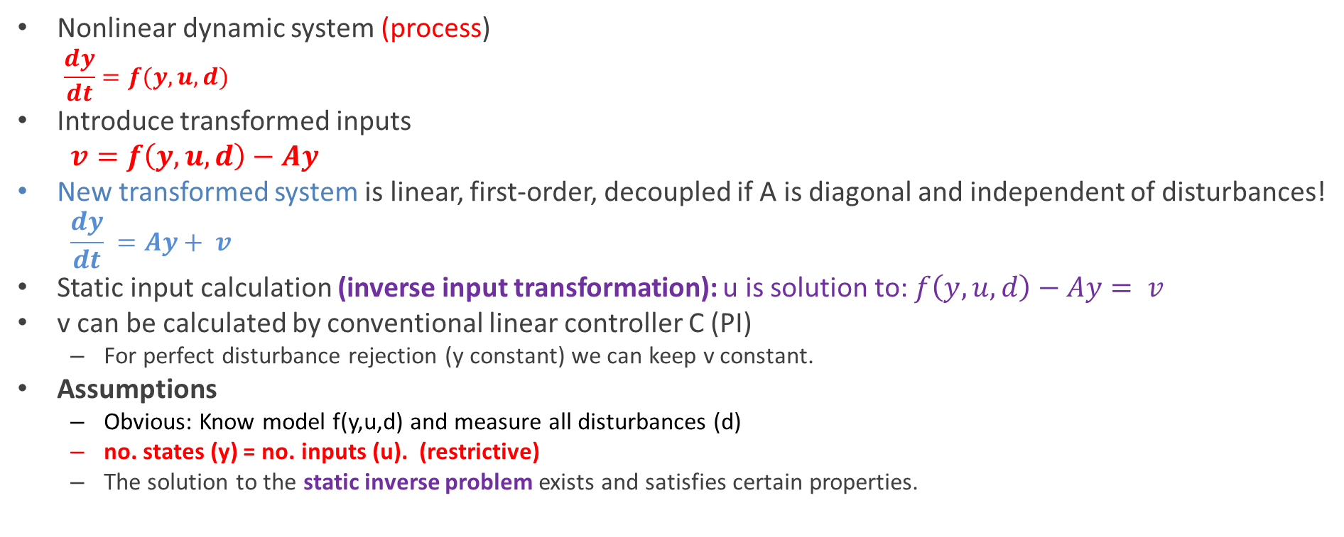
The main idea:
Trivial but almost magic
Nonlinear dynamic system (process)
  $$\frac{dy}{dt}=f(y,u,d)$$
Introduce transformed inputs
  $v=f\left(y,u,d\right)−Ay$
New transformed system is linear, first-order, decoupled if A is diagonal and independent of disturbances!
  $$\frac{dy}{dt} =Ay+ v$$
Static input calculation (inverse input transformation): u is solution to: $f\left(y,u,d\right)−Ay= v$
v can be calculated by conventional linear controller C (PI)
  For perfect disturbance rejection (y constant) we can keep v constant.
Assumptions
  Obvious: Know model f(y,u,d) and measure all disturbances (d)
  no. states (y) = no. inputs (u). (restrictive)
  The solution to the static inverse problem exists and satisfies certain properties.

Slide 9
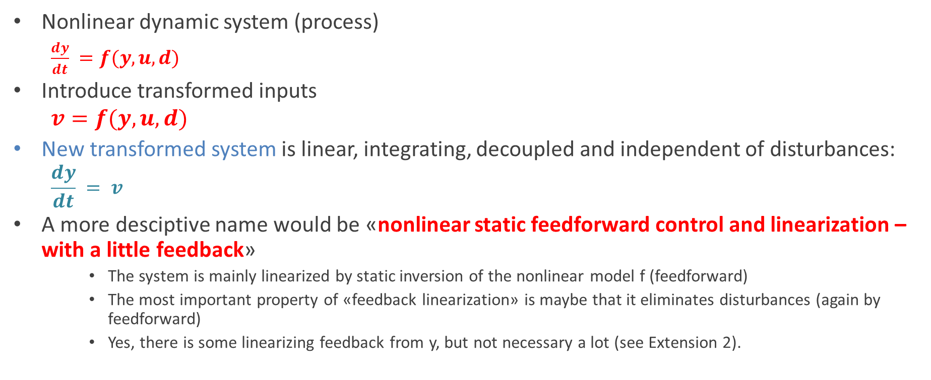
~ Feedback linearization
(Isidori)
Nonlinear dynamic system (process)
  $\frac{dy}{dt} =f(y,u,d)$
Introduce transformed inputs
  $$v=f(y,u,d)$$
New transformed system is linear, integrating, decoupled and independent of disturbances:
  $$\frac{dy}{dt} = v$$
A more desciptive name would be «nonlinear static feedforward control and linearization – with a little feedback»
    The system is mainly linearized by static inversion of the nonlinear model f (feedforward)
    The most important property of «feedback linearization» is maybe that it eliminates disturbances (again by feedforward)
    Yes, there is some linearizing feedback from y, but not necessary a lot (see Extension 2).

Slide 10
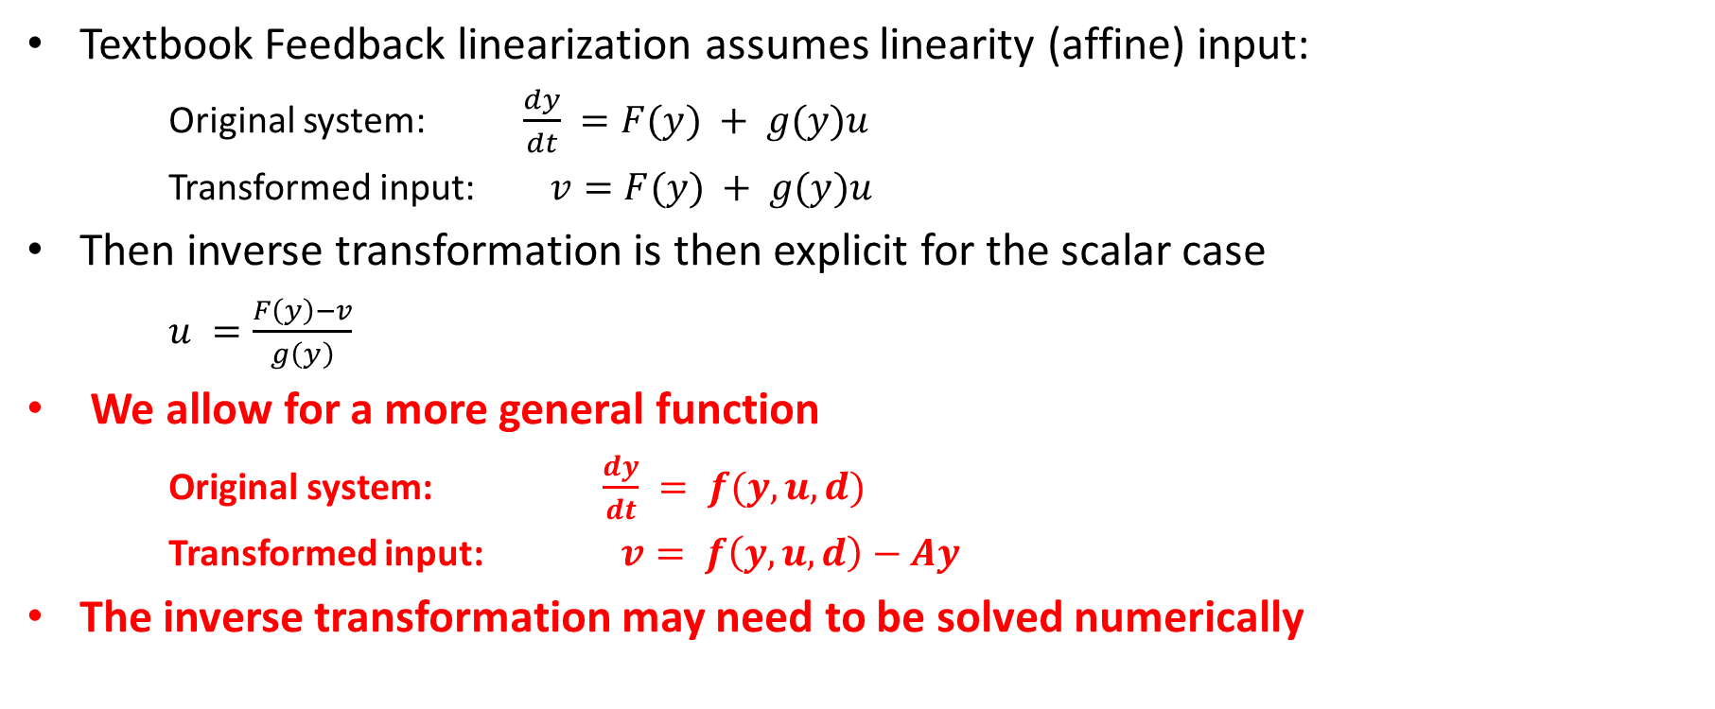
Extension 1: More general function f(y,u,d)
Textbook Feedback linearization assumes linearity (affine) input:
  Original system: $\frac{dy}{dt} =F(y) + g(y)u$
  Transformed input: $v=F(y) + g(y)u$
Then inverse transformation is then explicit for the scalar case
  $u =\frac{F\left(y\right)−v}{g\left(y\right)}$
We allow for a more general function
  Original system: $\frac{dy}{dt} = f(y,u,d)$
  Transformed input: $v= f\left(y,u,d\right)−Ay$
The inverse transformation may need to be solved numerically

Slide 11
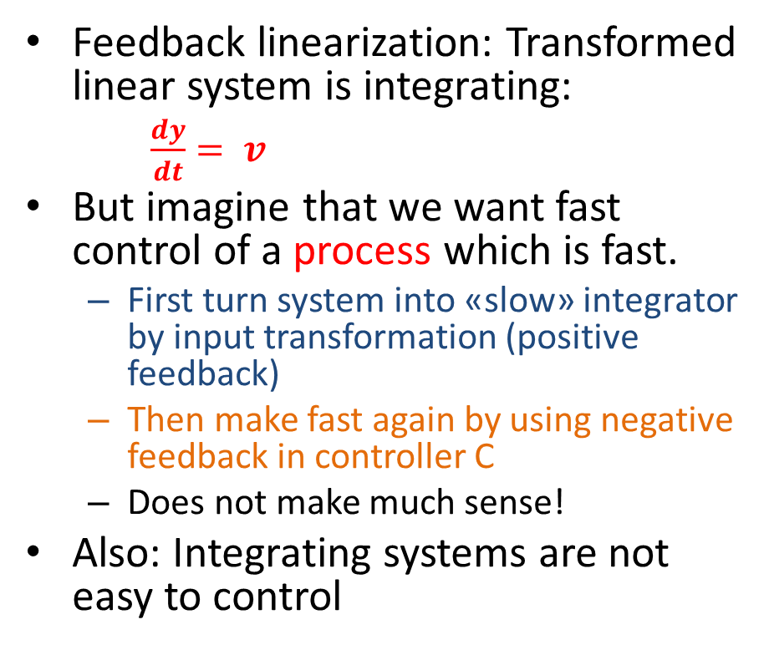
Why transform to integrating?
Feedback linearization: Transformed linear system is integrating:
  $\frac{dy}{dt}= v$
But imagine that we want fast control of a process which is fast.
  First turn system into «slow» integrator by input transformation (positive feedback)
  Then make fast again by using negative feedback in controller C
  Does not make much sense!
Also: Integrating systems are not easy to control

Slide 12
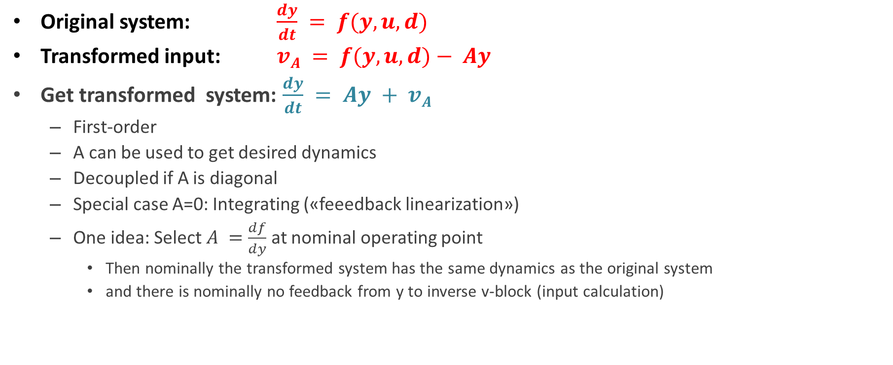
Extension 2: Introduce tuning parameter A for dynamics
Original system: $\frac{dy}{dt} = f(y,u,d)$
Transformed input: $vA = f(y,u,d)− Ay$
Get transformed system: $\frac{dy}{dt} = Ay + vA$
  First-order
  A can be used to get desired dynamics
  Decoupled if A is diagonal
  Special case A=0: Integrating («feeedback linearization»)
  One idea: Select $A =\frac{df}{dy}$ at nominal operating point
    Then nominally the transformed system has the same dynamics as the original system
    and there is nominally no feedback from y to inverse v-block (input calculation)

Slide 13
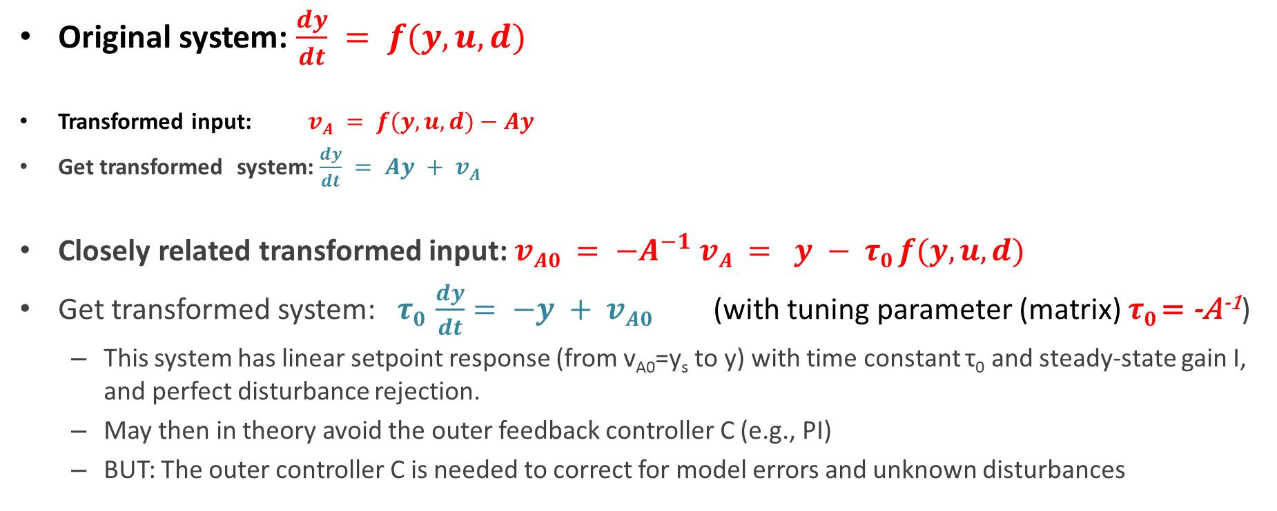
Extension 2’: Related transformation with steady-state gain I*
Original system: $\frac{dy}{dt} = f(y,u,d)$
Transformed input: $vA = f(y,u,d)−Ay$
Get transformed system: $\frac{dy}{dt} = Ay + vA$
Closely related transformed input: $vA0 = −A^{−1} vA = y − τ0 f(y,u,d)$
Get transformed system: $τ0 \frac{dy}{dt}= −y + vA0$(with tuning parameter (matrix) $τ0$= -A⁻¹)
  This system has linear setpoint response (from v_{A0}=y_{s} to y) with time constant τ₀ and steady-state gain I, and perfect disturbance rejection.
  May then in theory avoid the outer feedback controller C (e.g., PI)
  BUT: The outer controller C is needed to correct for model errors and unknown disturbances
*Zotica, Alsop and Skogestad. 2020 IFAC World Congress

Slide 14
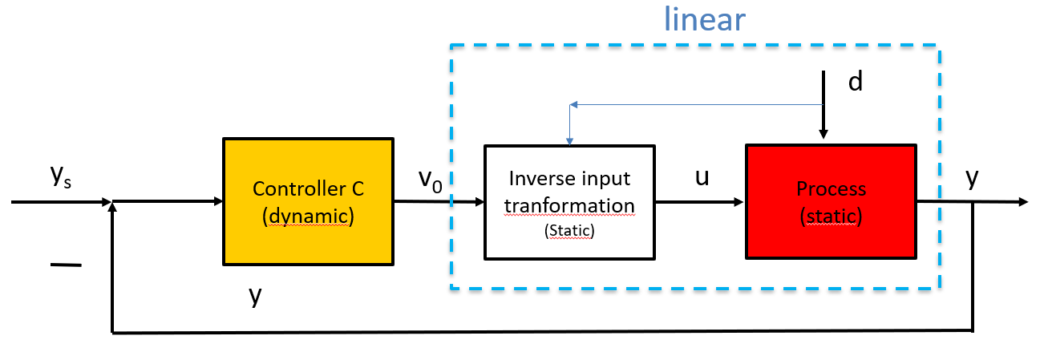
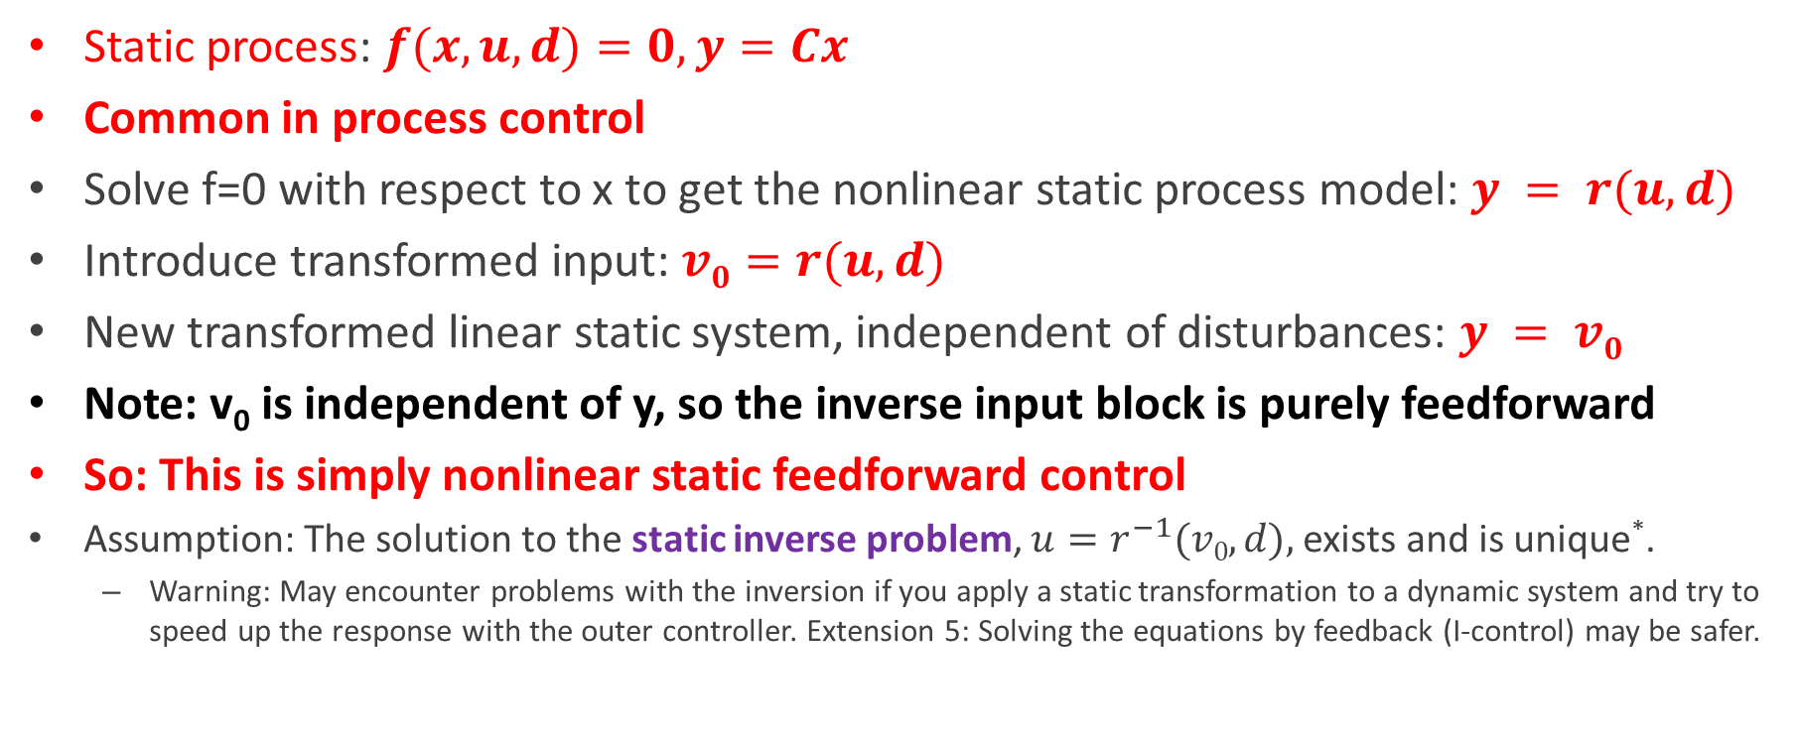
Extension 3: Static systems
Static process: $f(x,u,d)=0, y=Cx$
Common in process control
Solve f=0 with respect to x to get the nonlinear static process model: $y = r(u,d)$
Introduce transformed input: $v0=r(u,d)$
New transformed linear static system, independent of disturbances: $y = v0$
Note: v₀ is independent of y, so the inverse input block is purely feedforward
So: This is simply nonlinear static feedforward control
Assumption: The solution to the static inverse problem, $u=r^{−1}(v0,d),$exists and is unique*.
  Warning: May encounter problems with the inversion if you apply a static transformation to a dynamic system and try to speed up the response with the outer controller. Extension 5: Solving the equations by feedback (I-control) may be safer.
*Don’t really need to know r(u,d). u is solution to equations: f(x,u,d)=0 with Cx=v₀

Slide 15
Examples («magic»)
Example 1. Heater with y=T and u=q or u=Q
Example 2: Shower (mixing) with one static and one dynamic equation
Example 3: Heat exchanger (static applied to dynamic system)

Slide 16
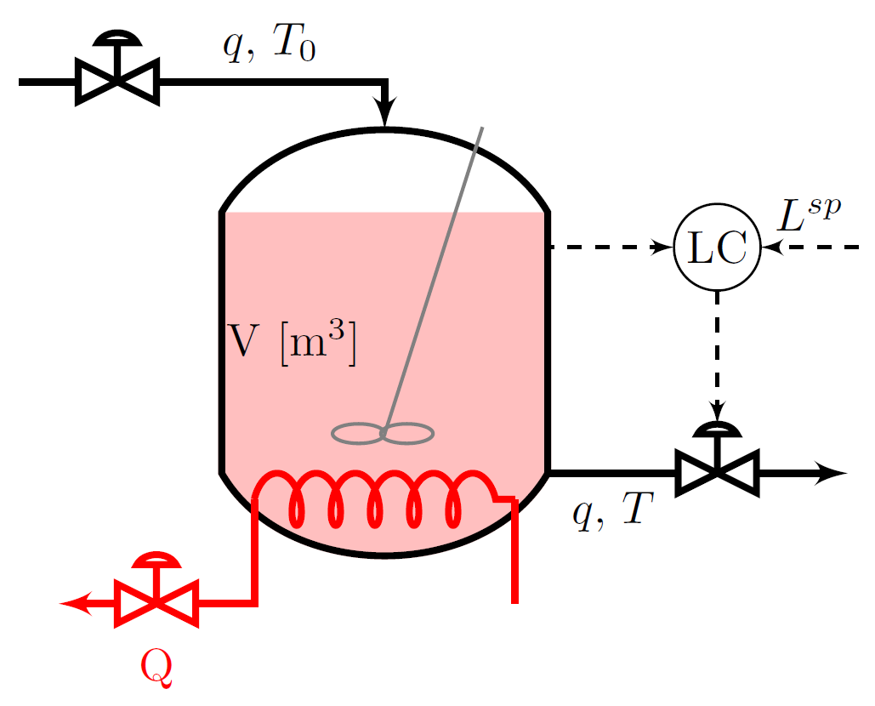
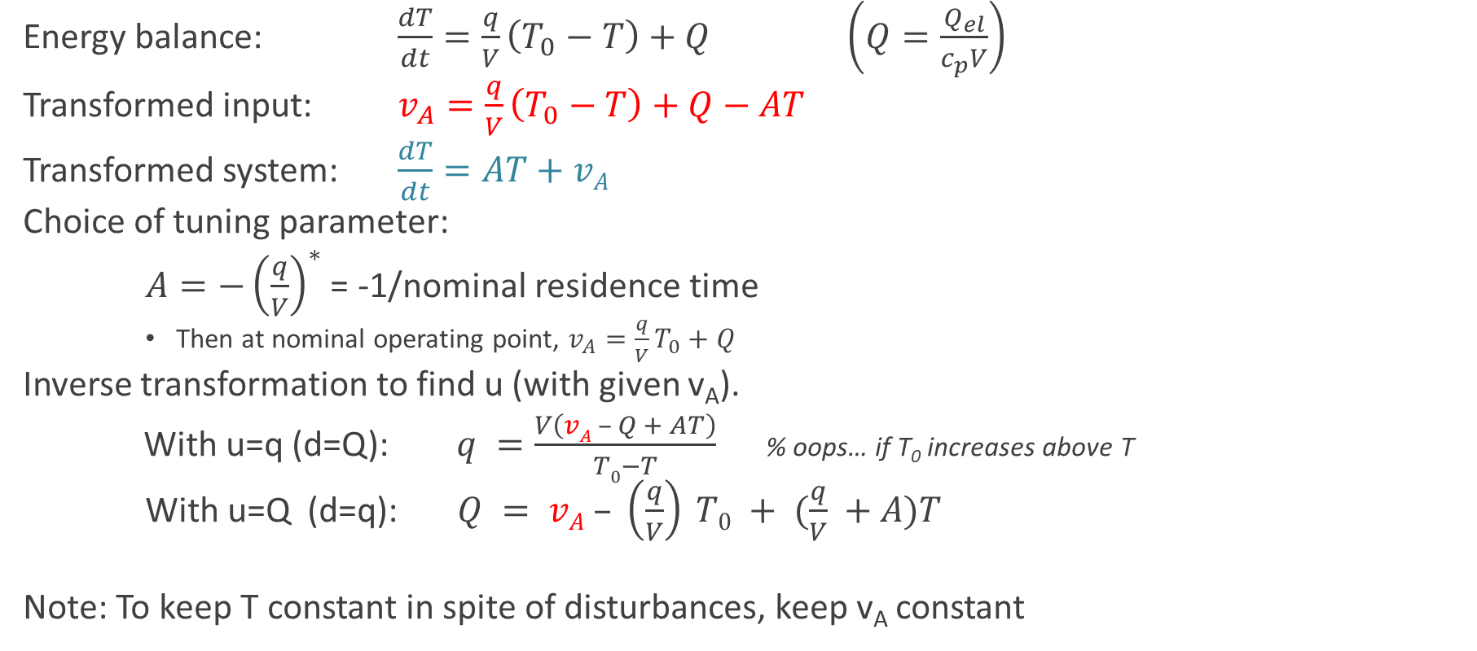
Example 1. Electric heater, y=T
Energy balance: $\frac{dT}{dt}=\frac{q}{V}\left(T_{0}−T\right)+Q$ $\left(Q=\frac{Q_{el}}{c_{p}V}\right)$
Transformed input: $v_{A}=\frac{q}{V}\left(T_{0}−T\right)+Q−AT$
Transformed system: $\frac{dT}{dt}=AT+vA$
Choice of tuning parameter:
$A=−{\left(\frac{q}{V}\right)}^{∗}$ = -1/nominal residence time
    Then at nominal operating point, $v_{A}=\frac{q}{V}T_{0}+Q$
Inverse transformation to find u (with given v_{A}).
With u=q (d=Q): $q =\frac{V\left(vA – Q + AT\right)}{T0−T}$% oops… if T₀ increases above T
With u=Q (d=q): $Q = vA – \left(\frac{q}{V}\right) T0 + (\frac{q}{V} +A)T$
Note: To keep T constant in spite of disturbances, keep v_{A} constant

Slide 17
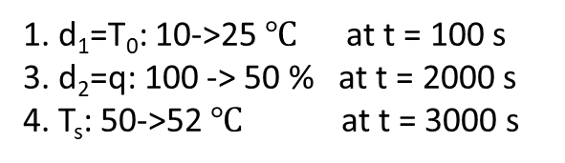

Example 1. Simulation results
u=Q (heat rate)
1. d₁=T₀: 10->25 $℃$ at t = 100 s
3. d₂=q: 100 -> 50 % at t = 2000 s
4. T_{s}: 50->52 $℃$ at t = 3000 s
y=T
u=Q
v_{A}
$$Q = vA – \left(\frac{q}{V}\right) T0 + (\frac{q}{V} +A)T$$

Slide 18
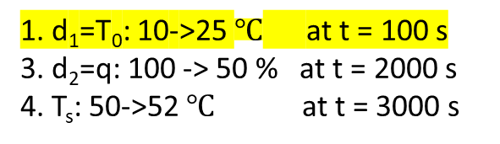
Example 1. Simulation results
u=Q (heat rate)
1. d₁=T₀: 10->25 $℃$ at t = 100 s
3. d₂=q: 100 -> 50 % at t = 2000 s
4. T_{s}: 50->52 $℃$ at t = 3000 s
y=T
u=Q
v_{A}
--- Dashed lines: Without measurement of d₁=T₀ (fixed at 10C in model). Need to use feedback (C) to change v_{A}

Slide 19
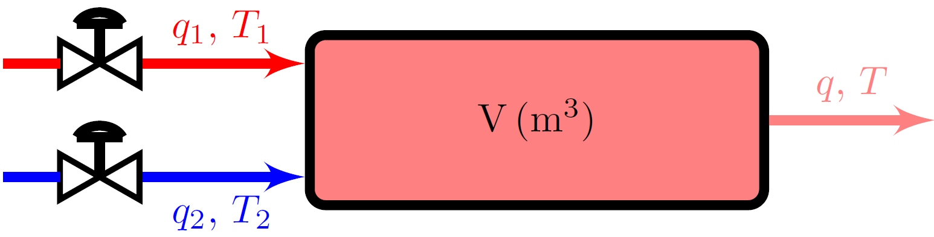
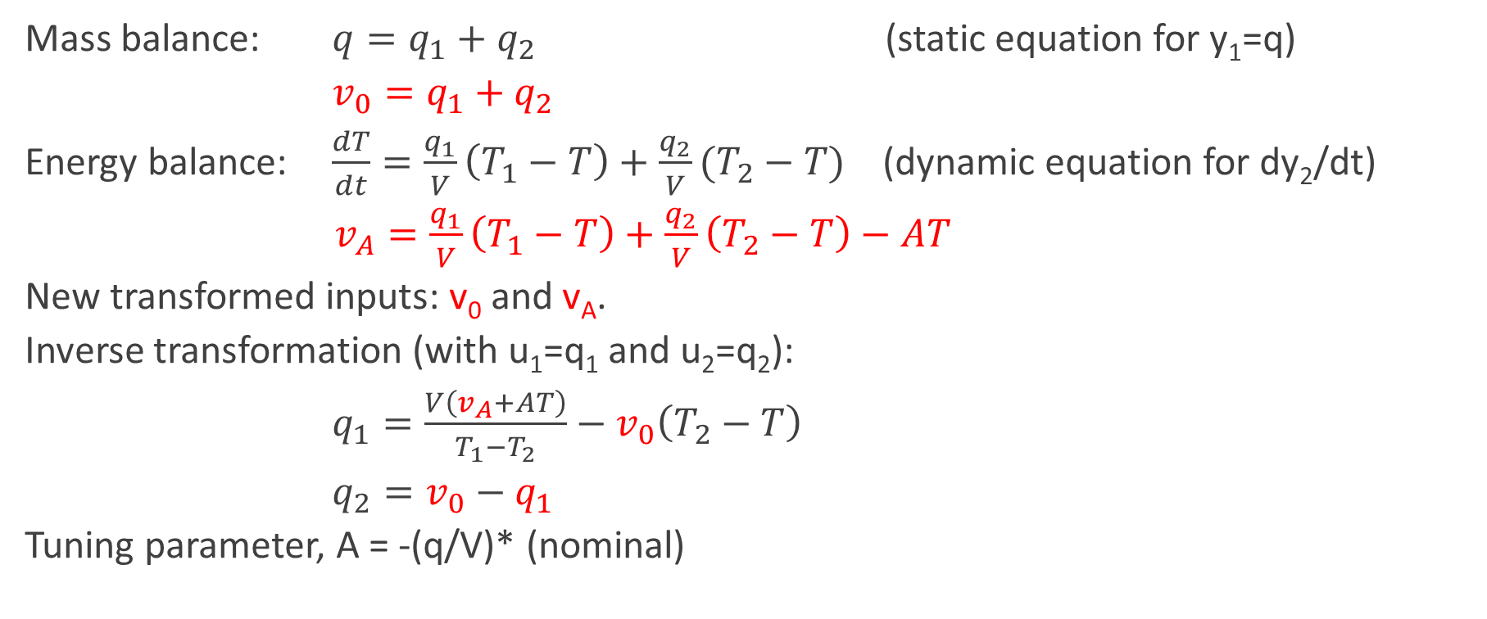
Example 2. Mix hot (1) and cold (2) water (shower), y=[q T]
Mass balance: $q=q_{1}+q_{2}$ (static equation for y₁=q)
$v_{0}=q_{1}+q_{2}$
Energy balance: $\frac{dT}{dt}=\frac{q_{1}}{V}\left(T_{1}−T\right)+\frac{q_{2}}{V}(T_{2}−T)$ (dynamic equation for dy₂/dt)
$v_{A}=\frac{q_{1}}{V}\left(T_{1}−T\right)+\frac{q_{2}}{V}\left(T_{2}−T\right)−AT$
New transformed inputs: v₀ and v_{A}.
Inverse transformation (with u₁=q₁ and u₂=q₂):
$q_{1}=\frac{V\left(v_{A}+AT\right)}{T_{1}−T_{2}}−v_{0}\left(T_{2}−T\right)$
$q_{2}=v_{0}−q_{1}$
Tuning parameter, A = -(q/V)* (nominal)

Slide 20
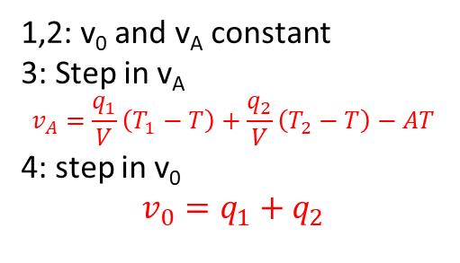
Shower. Simulation responses with transformation only.
-> Perfect disturbance rejection and decoupling
u
y₁
1. d₁=T₁: 20 ->22 °C at t = 50 s
2. d₂=T₂: 50 ->55 °C at t = 100 s
3. y_{2s}=T_{s}: 35 ->36 °C at t = 150 s
4. y_{1s}=q_{s}: 10 ->11 kg/s at t = 200 s
1,2: v₀ and v_{A} constant
3: Step in v_{A}
$$v_{A}=\frac{q_{1}}{V}\left(T_{1}−T\right)+\frac{q_{2}}{V}\left(T_{2}−T\right)−AT$$
4: step in v₀
$$v_{0}=q_{1}+q_{2}$$
y₂
d

Slide 21
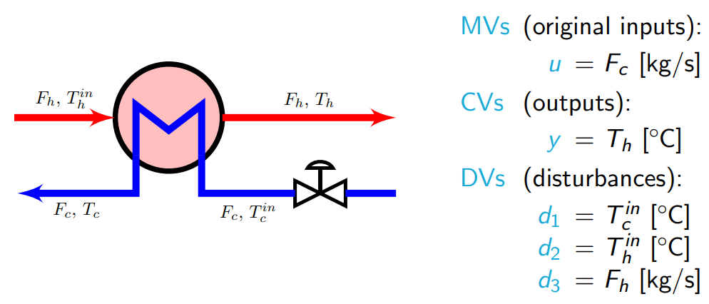
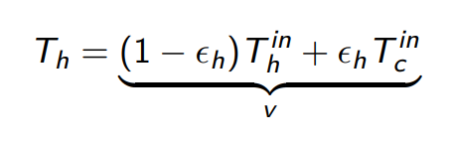





Example 3. Heat exchanger (static)
y
u
Energy balance, $Q = UAΔTLM$
$$N_{tu}=\frac{UA}{F_{c}c_{p,c}}$$
$$C=\frac{F_{c}c_{p,c}}{F_{h}c_{p,h}}$$
v₀
$$ε_{c}=1−\frac{\exp\left(−N_{tu}\left(C−1\right)\right)}{C−exp⁡(−N_{tu}\left(C−1\right))}$$
Use numerical inverse (to find u for given v₀)
$$ε_{h}=ε_{c}C$$

Slide 22
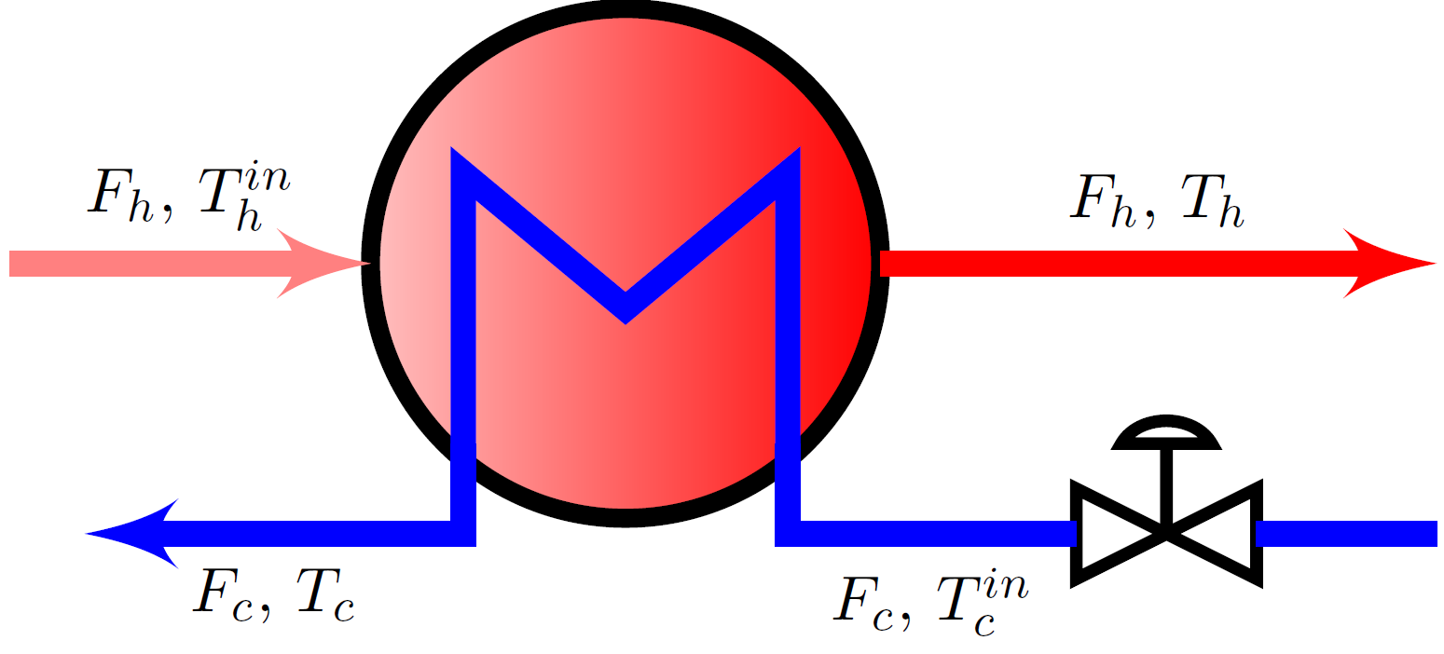



Simulation applied to cell dynamic model
$$d1=Δ T_{c}^{in} = +2 ℃$$
$$d2= Δ T_{h}^{in} = +2 ℃$$
$${v0=ΔT}_{h}^{s} = +5℃$$
u
u
u

Slide 23
But our dynamic transformation v_{A} assumes n_{u}=n
That is, we need as many inputs (n_{u}) as differential equations (n)
One input: Can only handle first-order system
Can use feedback linearization and get a chain of integrators
  But not easy (Lie derivatives….)
  and not so good in practise (integrators….)

Slide 24
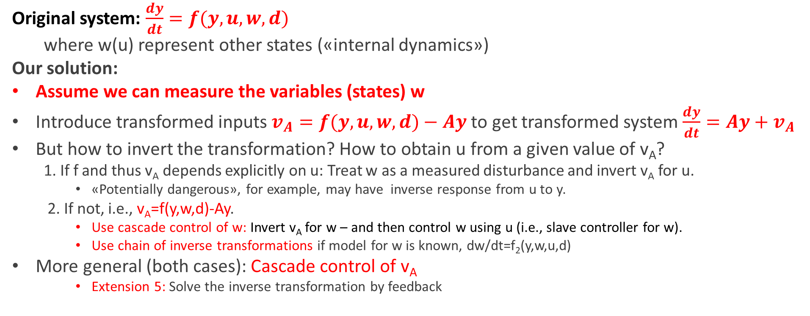
Extension 4: Higher-order systems (n > n_{u})
Original system: $\frac{dy}{dt}=f(y,u,w,d)$
where w(u) represent other states («internal dynamics»)
Our solution:
Assume we can measure the variables (states) w
Introduce transformed inputs $v_{A}=f(y,u,w,d)−Ay$to get transformed system $\frac{dy}{dt}=Ay+v_{A}$
But how to invert the transformation? How to obtain u from a given value of v_{A}?
  1. If f and thus v_{A} depends explicitly on u: Treat w as a measured disturbance and invert v_{A} for u.
    «Potentially dangerous», for example, may have inverse response from u to y.
  2. If not, i.e., v_{A}=f(y,w,d)-Ay.
    Use cascade control of w: Invert v_{A} for w – and then control w using u (i.e., slave controller for w).
    Use chain of inverse transformations if model for w is known, dw/dt=f₂(y,w,u,d)
More general (both cases): Cascade control of v_{A}
    Extension 5: Solve the inverse transformation by feedback

Slide 25
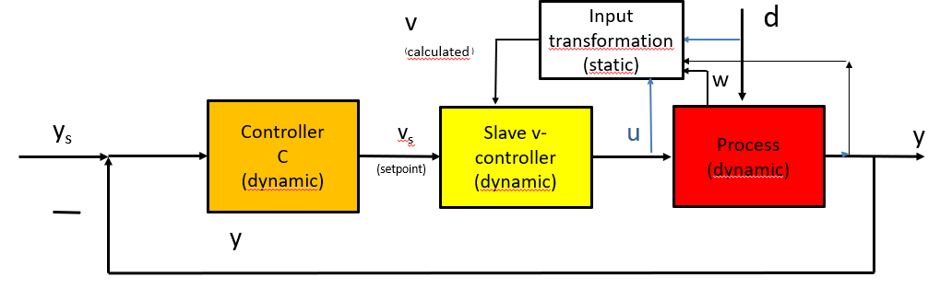

Inverse transformation using Cascade control of v
Measured
variables
$$v_{A} = f(y,u,w,d) –Ay$$
Use when actual system has additional (unknown) dynamics (w).
Slave controller: Tuned based on experimental response from u to calculated v (includes w-dynamics!)
Equivalent to static inverse transformation if slave controller is sufficiently fast
  Can be made arbitrary fast if response from u to v is static or first-order system with no effective delay
  Otherwise: Some «loss» dynamically (in terms of linearity and disturbance rejection)

Slide 26
Inverse transformation using Cascade control of v
Measured
variables
Comment: May use cascade control of v also for cases without additional dynamics (w).
  Static function w(u,d) is uncertain (so cannot find u), but we measure w (e.g., flow controller)
  Inversion of input transformation is difficult (numerically or analytically)
    Extension 5: Use feedback control to invert the static equations
      Typically use pure I-action for the slave controller
  We want to «slow down» the inversion
    Example: Static transformation v₀ = r(u,d) applied to dynamic system

Slide 27
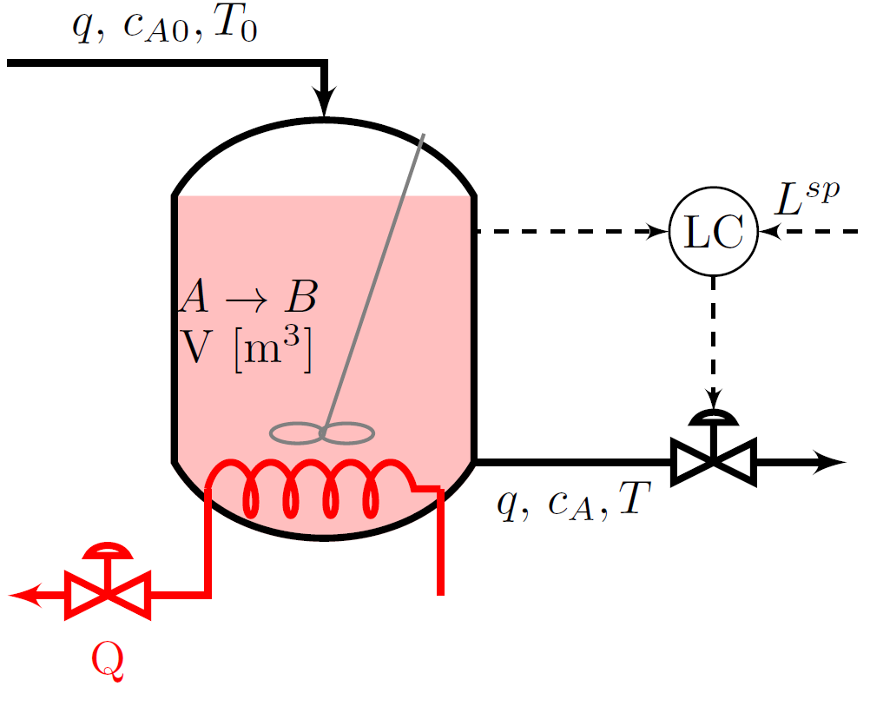
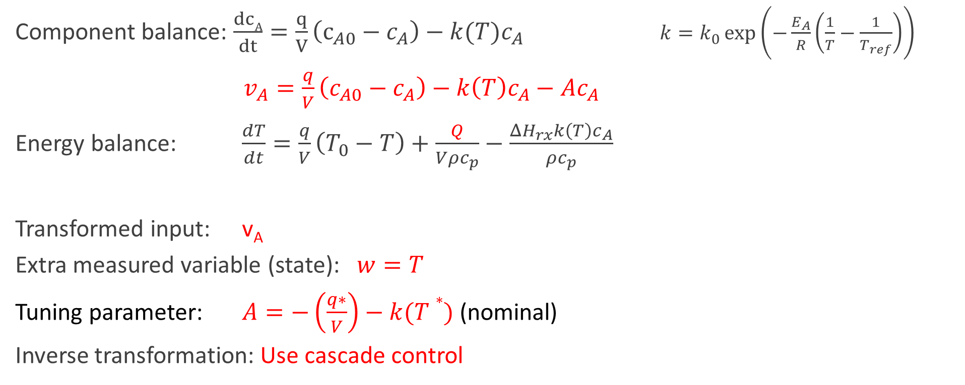

Example 4. CSTR. $y=c_{A}$ , $u=Q$
Component balance: $\frac{dcA}{dt}=\frac{q}{V}\left(c_{A0}−c_{A}\right)−k(T)c_{A}$ $k=k_{0}\exp\left(−\frac{E_{A}}{R}\left(\frac{1}{T}−\frac{1}{T_{ref}}\right)\right)$
$v_{A}=\frac{q}{V}\left(c_{A0}−c_{A}\right)−k\left(T\right)c_{A}−Ac_{A}$
Energy balance: $\frac{dT}{dt}=\frac{q}{V}\left(T_{0}−T\right)+\frac{Q}{Vρc_{p}}−\frac{ΔH_{rx}k\left(T\right)c_{A}}{ρc_{p}}$
Transformed input: v_{A}
Extra measured variable (state): $w=T$
Tuning parameter: $A=−\left(\frac{q∗}{V}\right)−k(T∗)$(nominal)
Inverse transformation: Use cascade control

Slide 28

General cascade of v
Measured
variables
Calculated
$$v_{A}=\frac{q}{V}\left(c_{A0}−c_{A}\right)−k\left(T\right)c_{A}−Ac_{A}$$
Static input transformation
v_{A}
C_{A0},q
d=C_{A0},q,T₀
w=T
y=c_{A}
y_{s}
Controller
C
(dynamic)
Slave v_{A}-controller
(dynamic)
Process
(dynamic)
v_{As}
u=Q
y=c_{A}
(setpoint)
y
Two reasons to use slave controller
u=Q does not appear in v_{A}
Avoid inverting expression for v_{A} with respect to T

Slide 29
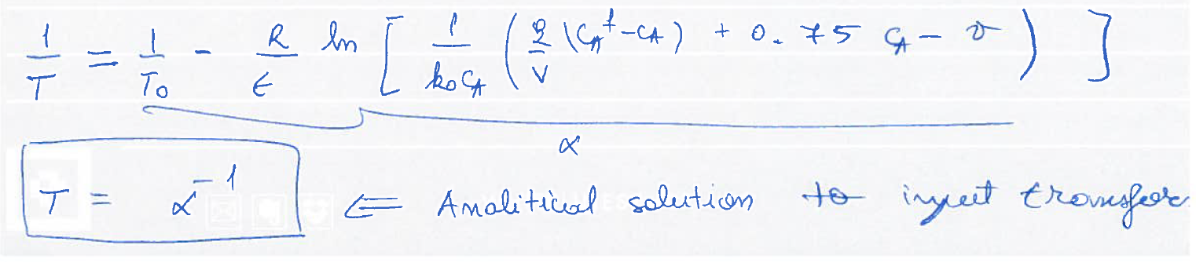

Alternative cascade of w
Measured variables
C_{A0},q
d=C_{A0},q,T₀
c_{A}
y=c_{A}
w=T
y_{s}
Controller
C
(dynamic)
Slave temperature controller
(dynamic)
Process
(dynamic)
v_{A}
Inverse static input transformation
T_{s}
u=Q
y=c_{A}
y
Need to invert expression for v_{A} with respect to T
=A
$$v_{As}=\frac{q}{V}\left(c_{A0}−c_{A}\right)−k\left(T\right)c_{A}−Ac_{A}$$

Slide 30
Example 4. Simulation results (alternative cascade of w)
1. d₁= T₀ : 77 ->87 °C at t = 10 s
2. d₂= c_{A0} : 2 ->2.1 kmol/m³ at t = 40 s
3. y_{s}=c_{As}: 0.67 ->0.8 kmol/m³ at t = 70 s
u
y
v
w

Slide 31

Alternative: Chain of inverse transformations with no slave
$$\frac{dcA}{dt}=\frac{q}{V}\left(c_{A0}−c_{A}\right)−k\left(T\right)c_{A} = AcA+vA$$
Measured variables
d=C_{A0},q,T₀
C_{A0},q
$\frac{dT}{dt}=\frac{q}{V}\left(T_{0}−T\right)+\frac{Q}{Vρc_{p}}−\frac{ΔH_{rx}k\left(T\right)c_{A}}{ρc_{p}}$ $= AT(T−vA0)$
c_{A}
y=c_{A}
T
T₀
y_{s}
Controller
C
(dynamic)
Process
(dynamic)
v_{A}
Inverse static
v_{A} input transformation
T_{s}=
v_{A0}
Inverse static v_{A0} input transformation
u=Q
y=c_{A}
y
Can be used for series («chain») system if model for w is known
Also includes feedforward from T_{0’}
  Feedforward control for T₀ will be perfect, but not for C_{A0} and q (τ = -1/A_{T}).
Need to invert expression for v_{A} with respect to T
=A
$$v_{As}=\frac{q}{V}\left(c_{A0}−c_{A}\right)−k\left(T\right)c_{A}−Ac_{A}$$

Slide 32
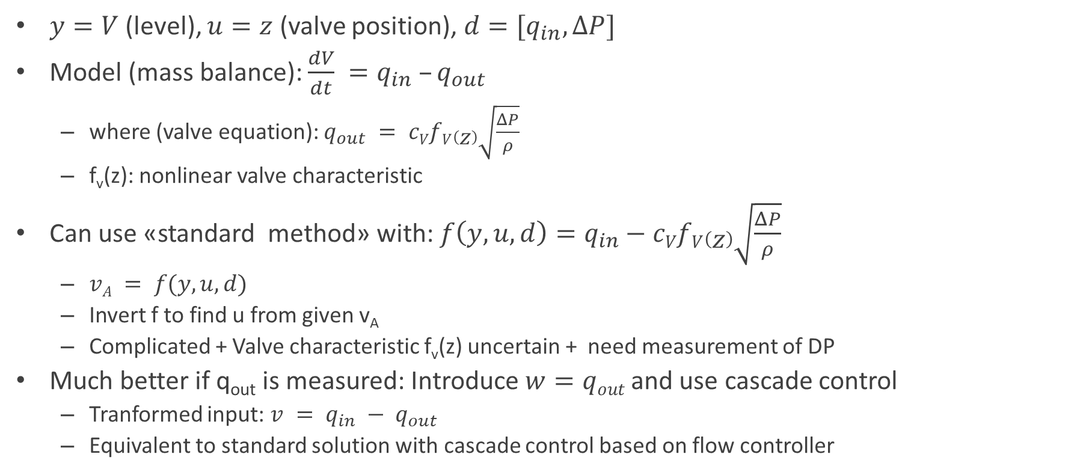
Example 5. Level control with flow controller
flow in
$y=V$ (level), $u=z$ (valve position), $d=[q_{in}, ΔP]$
Model (mass balance): $\frac{dV}{dt} =q_{in} –q_{out}$
  where (valve equation): $q_{out} = cVfV\left(z\right)\sqrt{\frac{ΔP}{ρ}}$
  f_{v}(z): nonlinear valve characteristic
Can use «standard method» with: $f\left(y,u,d\right)=q_{in}−cVfV\left(z\right)\sqrt{\frac{ΔP}{ρ}}$
  $vA = f(y,u,d)$
  Invert f to find u from given v_{A}
  Complicated + Valve characteristic f_{v}(z) uncertain + need measurement of DP
Much better if q_{out} is measured: Introduce $w=qout$and use cascade control
  Tranformed input: $v = q_{in} − q_{out}$
  Equivalent to standard solution with cascade control based on flow controller
y=V
u=z
flow out

Slide 33
v = q_{in}-q_{out}
Static input transformation
v = f(w,d)= q_{in}-q_{out}
d=q_{in}
Cascade control of v
Measured
variables
w=q_{out}
y_{s}
Controller
C
(dynamic)
Slave v- controller
(dynamic)
u=z
Process
(dynamic)
v_{s}
y
(setpoint)
y
flow in
y_{s}
y
q_{in}
LC
master
v_{s}
Static input transformation
FC
v
q_{out}
slave
u=z
flow out

Slide 34
q_{in}
d=q_{in}
Alternative: Cascade control of w
Measured
variables
w=q_{out}
y_{s}
Controller
C
(dynamic)
Slave w- controller
(dynamic)
Process
(dynamic)
v =
q_{in}-q_{out}
Inverse static input transformation
w_{s}
u=z
y
(setpoint)
y
flow in
y_{s}
y
LC
q_{in}
master
v=q_{in}-q_{out}
Inverse static input transformation
q_{out,s}
FC
w=q_{out}
slave
u=z
flow out

Slide 35
Discussion: Difficult systems for input transformations
Input transformation work best if we have a dominant dynamic equation involving the output of interest:
  M dy/dt = f(y,u,w,d) (where M is quite large)
But this does not always hold
Examples of «difficult» systems:
Example: Heat exchanger. y=T
  Partial differential eaquations (PDE). Use cell model withseries of interacting tanks.
  Can use static transformation. Works quite well, but will only be correct at steady state
Example: Distillation column, y = product composition
  Also modeled as series of interacting tanks (inside column)
  But have product tanks at the column ends

Slide 36
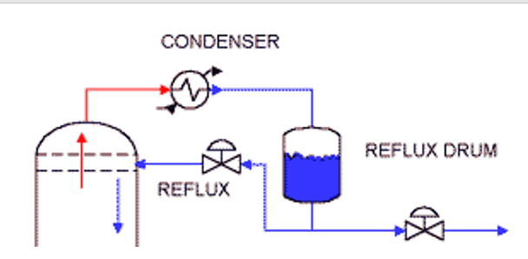
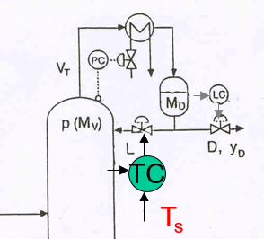
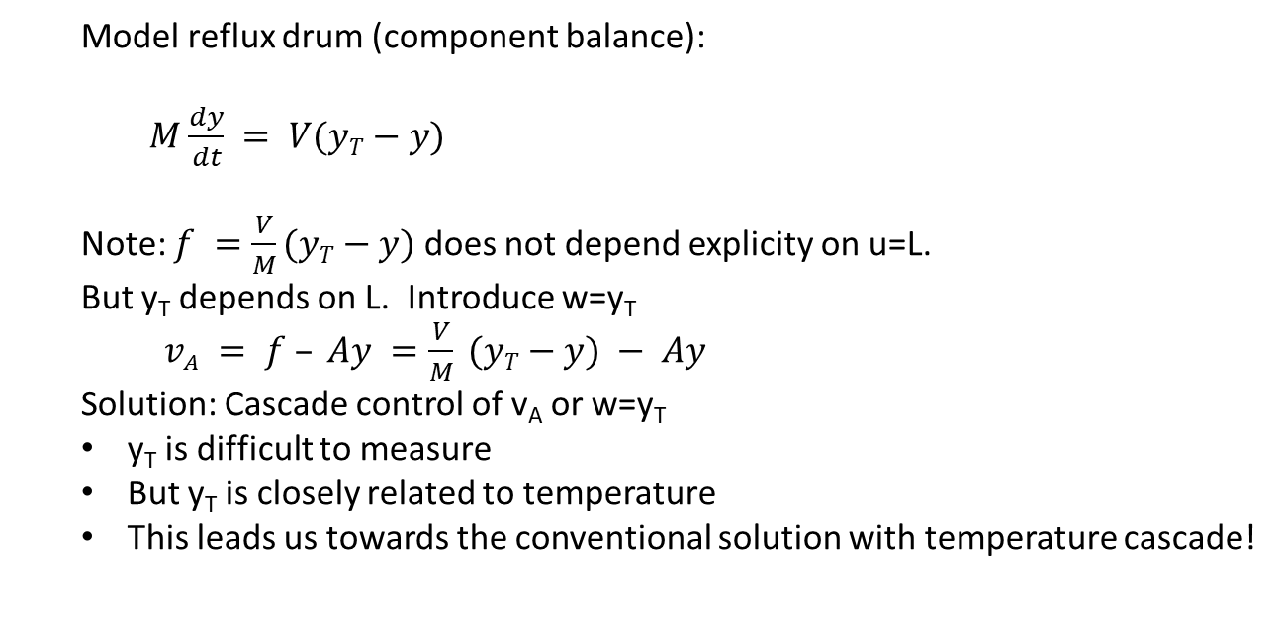
Example 6: Distillation
V
y_{T}
V
y_{T}
y = distillate compostion
u= L (reflux)
D
y
L
y
Model reflux drum (component balance):
$M\frac{dy}{dt} = V(yT−y)$
Note: $f =\frac{V}{M}(yT−y)$does not depend explicity on u=L.
But y_{T} depends on L. Introduce w=y_{T}
$v_{A} = f – Ay =\frac{V}{M} (yT−y) − Ay$
Solution: Cascade control of v_{A} or w=y_{T}
y_{T} is difficult to measure
But y_{T} is closely related to temperature
This leads us towards the conventional solution with temperature cascade!

Slide 37
Discussion of feedback linearization
«Feedback linearization» is powerful but rarely used in process control, because of perceived limitations and complexity.
Actully, the main idea is extremely simple!
And we have proposed extensions to overcome limitations:
Extension 1: More general function f(y,u,d)
Extension 2: Introduce tuning parameter A for dynamics
Extension 3: Static systems
Extension 4: Higher-order systems (n > n_{u}) by adding measurements
Extension 5: Use feedback control to invert the static equations
These extensions are not really new (except maybe Extension 3?).
Extensions 1, 2 and 5: see Example 1 in “Output feedback performance recovery in the presence of uncertainties”. J. Lee , R. Mukherjee, H.K. Khalil, Systems & Control Letters, 90 (2016) 31–37.

Slide 38
Discussion…
We have looked at many other examples
And in particular we have looked at the effect of uncertainty
  No big surprises
  It’s fairly robust!
  Mater theses by Callum Kingstree and Simen Bjorvand

Slide 39
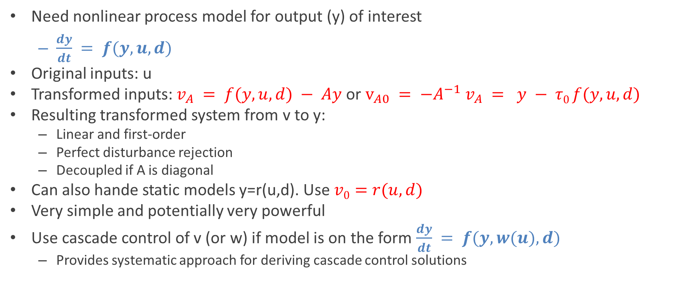
Conclusion
Need nonlinear process model for output (y) of interest
  $\frac{dy}{dt} = f(y,u,d)$
Original inputs: u
Transformed inputs: $v_{A} = f(y,u,d) − Ay$or $v_{A0} = −A^{−1} v_{A} = y − τ0 f(y,u,d)$
Resulting transformed system from v to y:
  Linear and first-order
  Perfect disturbance rejection
  Decoupled if A is diagonal
Can also hande static models y=r(u,d). Use $v0=r(u,d)$
Very simple and potentially very powerful
Use cascade control of v (or w) if model is on the form $\frac{dy}{dt} = f(y,w(u),d)$
  Provides systematic approach for deriving cascade control solutions

Slide 40
Extra

Slide 41
linear
d
y_{s}
Controller C
(dynamic)
v
Inverse input
tranformation
(Static)
u
Process
(dynamic)
y
y

Slide 42
v
_{(calculated )}
Input transformation
(static)
d
_{w}
y_{s}
Controller
C
(dynamic)
Slave v-controller
(dynamic)
u
Process
(dynamic)
v_{s}
y
(setpoint)
y

Slide 43
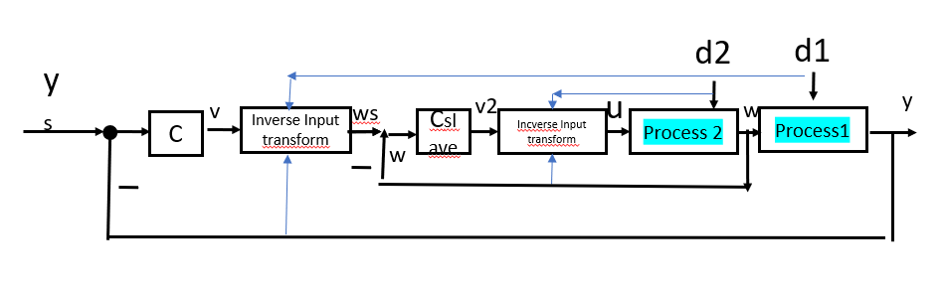
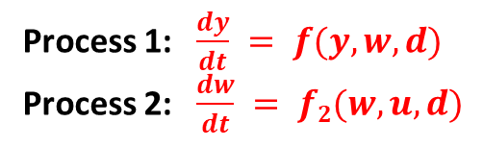
Special case (series system, f is independent of u) :
Control of by Chain of transformations
Process 1: $\frac{dy}{dt} = f(y,w,d)$
Process 2: $\frac{dw}{dt} = f2(w,u,d)$
w

Slide 44
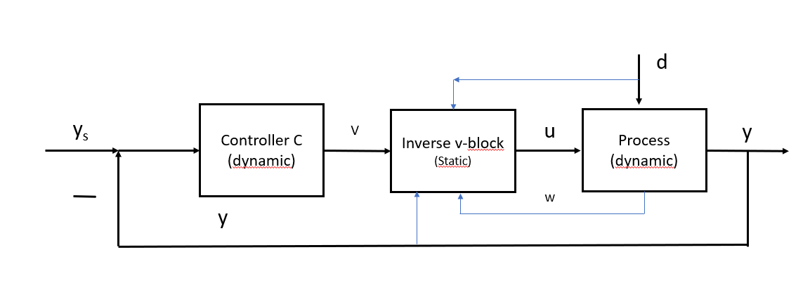
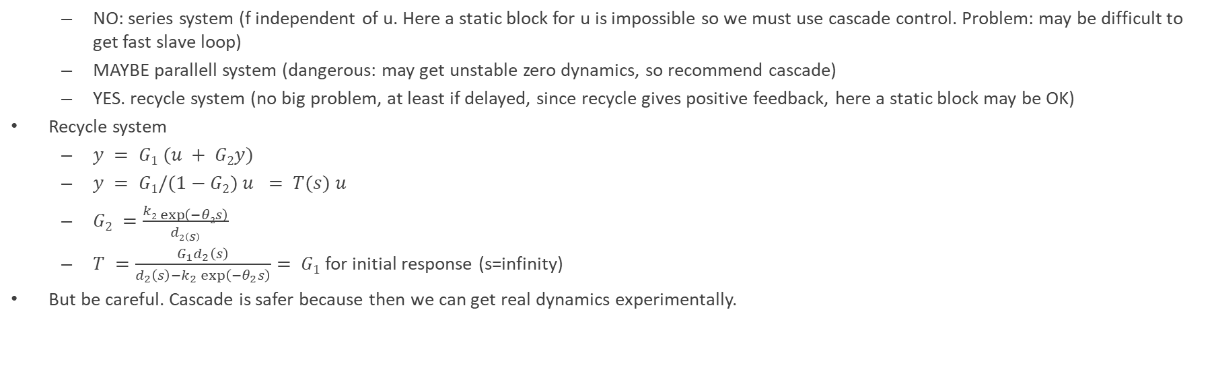
Some cases: Slave controller can be replaced by static block
  NO: series system (f independent of u. Here a static block for u is impossible so we must use cascade control. Problem: may be difficult to get fast slave loop)
  MAYBE parallell system (dangerous: may get unstable zero dynamics, so recommend cascade)
  YES. recycle system (no big problem, at least if delayed, since recycle gives positive feedback, here a static block may be OK)
Recycle system
  $y = G1 (u + G2y)$
  $y = G1/(1−G2) u = T(s) u$
  $G2 =\frac{k2\exp\left(−θ2s\right)}{d2\left(s\right)}$
  $T =\frac{G_{1}d_{2}\left(s\right)}{d_{2}\left(s\right)−k_{2}\exp\left(−θ_{2}s\right)}= G1$for initial response (s=infinity)
But be careful. Cascade is safer because then we can get real dynamics experimentally.

