Slide 1




ECONOMIC PROCESS CONTROL
Making system out of an apparent mess
Sigurd Skogestad
Department of Chemical Engineering
Norwegian University of Science and Technology (NTNU)
Trondheim
Manchester, 01 April 2019

Slide 2


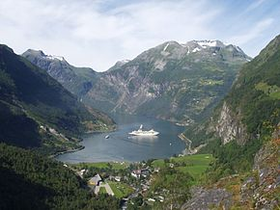
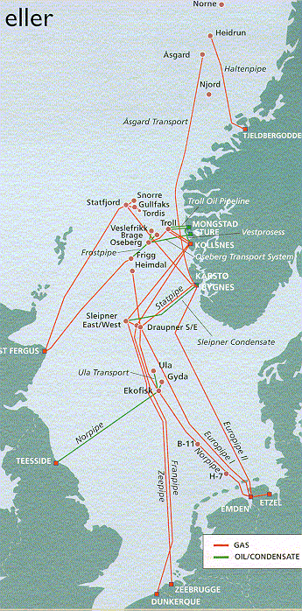
Arctic circle
North Sea
Trondheim
NORWAY
SWEDEN
Oslo
DENMARK
GERMANY
UK

Slide 3
Outline
Our paradigm: Decision hieararchy based on time scale separation
Control structure design procedure: Based on economics
  Implement optimal operation in control layer
  Control active constraints and «self-optimizing» variables
Example: Runner
Selection of self-optimizing controlled variables
Cooling cycle case study
Conclusion

Slide 4
How we design a control system for a complete chemical plant?
Where do we start?
What should we control? and why?
etc.
etc.
Notes:
4

Slide 5
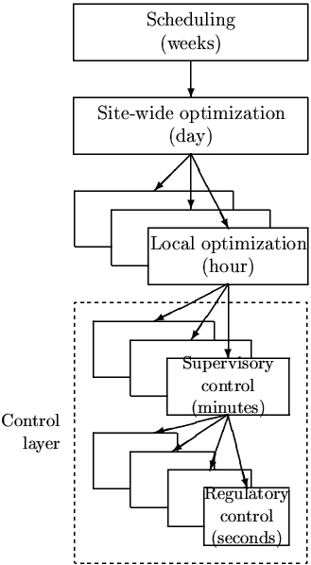
In theory: Centralized optimal controller
Objectives
Approach:
  Model of overall system
  Estimate present state
  Optimize all degrees of freedom
Process control:
  Excellent candidate for centralized control
Problems:
  Model not available
  Objectives = ?
  Optimization complex
  Not robust (difficult to handle uncertainty)
  Slow response time
CENTRALIZED
OPTIMIZER
Present state
Model of system
(Physical) Degrees of freedom

Slide 6
Practice: Engineering systems
Most (all?) large-scale engineering systems are controlled using hierarchies of quite simple controllers
  Large-scale chemical plant (refinery)
  Commercial aircraft
100’s of loops
Simple components:
  PI-control + selectors + cascade + nonlinear fixes + some feedforward
Same in biological systems
But: Not well understood

Slide 7
Alan Foss (“Critique of chemical process control theory”, AIChE Journal,1973):
The central issue to be resolved ... is the determination of control system structure. Which variables should be measured, which inputs should be manipulated and which links should be made between the two sets? There is more than a suspicion that the work of a genius is needed here, for without it the control configuration problem will likely remain in a primitive, hazily stated and wholly unmanageable form. The gap is present indeed, but contrary to the views of many, it is the theoretician who must close it.
Notes:
7

Slide 8
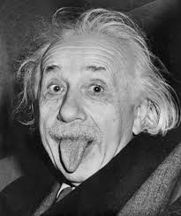
Alan Foss (“Critique of chemical process control theory”, AIChE Journal,1973):
The central issue to be resolved ... is the determination of control system structure. Which variables should be measured, which inputs should be manipulated and which links should be made between the two sets? There is more than a suspicion that the work of a genius is needed here, for without it the control configuration problem will likely remain in a primitive, hazily stated and wholly unmanageable form. The gap is present indeed, but contrary to the views of many, it is the theoretician who must close it.
Notes:
8

Slide 9
Main objectives control system
Economics: Implementation of acceptable (near-optimal) operation
Regulation: Stable operation
ARE THESE OBJECTIVES CONFLICTING?
Usually NOT
  Different time scales
    Stabilization fast time scale
  Stabilization doesn’t “use up” any degrees of freedom
    Reference value (setpoint) available for layer above
    But it “uses up” part of the time window (frequency range)

Slide 10
Control hierarchy in a process plant
Our Paradigm
Supervisory control (“Advanced control” or MPC):
  Follow set points from economic optimization layer
  Switch between active constraints (CV1)
  Look after regulatory layer
Regulatory control (PID):
  Stable operation (CV2)
CV = controlled variable

Slide 11
Engineer: Must choose what to control in both layers (H₂ and H)
Optimizer (RTO)
Optimally constant valves
CV_{1s}
Always active constraints
CV₁
Supervisory controller (MPC)
CV_{2s}
Regulatory controller (PID)
CV₂
H₂
H
Physical
inputs (valves)
d
PROCESS
y
Stabilized process
n^{y}

Slide 12
Control structure design procedure
I Top Down (mainly steady-state economics)
    Step 1: Define operational objectives (optimal operation)
      Cost function J (to be minimized)
      Operational constraints
    Step 2: Identify degrees of freedom (MVs) and optimize for
    expected disturbances
        Identify Active constraints
    Step 3: Select primary “economic” controlled variables (CV₁=Hy)
        Active constraints & Self-optimizing variables (find H)
    Step 4: Where locate the throughput manipulator (TPM)?
II Bottom Up (dynamics)
    Step 5: Regulatory / stabilizing control (PID layer)
      What more to control (local CV2=H₂ y)?
      Pairing of inputs and outputs
    Step 6: Supervisory control (MPC layer)
    Step 7: Real-time optimization (Do we need it?)
CV₁
CV₂
MVs
Process
S. Skogestad, ``Control structure design for complete chemical plants'',
Computers and Chemical Engineering, 28 (1-2), 219-234 (2004).

Slide 13
Step 1. Define optimal operation (economics)
Minimize cost J = J(u,x,d)
  subject to:
  Model equations: f(u,x,d) = 0
  Operational constraints: g(u,x,d) < 0
  u = degrees of freedom
  x = states (internal variables)
  d = disturbances
J
J^{opt}
u^{opt}
Typical cost function in process control:
J = cost feed + cost energy – value of products

Slide 14
(a) Identify degrees of freedom
(b) Optimize for expected disturbances
constraint
Step 2. Optimize
J
J^{opt}
Need good model, usually steady-state is OK
Optimization is time consuming! But it is offline
Main goal: Identify ACTIVE CONSTRAINTS
A good engineer can often guess the active constraints
u^{opt}

Slide 15
Active constraints
Active constraints:
  variables that should optimally be kept at their limiting value.
Active constraint region:
  region in the disturbance space defined by which constraints are active within it.
Region 3
Optimal operation:
Need to switch between regions using control system
Disturbance 2
Region 2
Region 1
Disturbance 1

Slide 16
How many active constraints regions?
Maximum:
  n_{c} = number of constraints
BUT there are usually fewer in practice
Certain constraints are always active (reduces effective n_{c})
Only n_{u} can be active at a given time
  n_{u} = number of MVs (degrees of freedom)
Certain constraints combinations are not possibe
  For example, max and min on the same variable (e.g. flow)
Certain regions are not reached by the assumed disturbance set
Distillation
n_{c} = 5
  2⁵ = 32
x_{B} always active
2^4 = 16
-1 = 15
In practice = 8

Slide 17
Step 3. Implementation of optimal operation
Have found the optimal way of operation. How should it be implemented?
What to control ? (CV₁).
  Active constraints
  Self-optimizing variables (for unconstrained degrees of freedom)
Objective: Move optimization into control layer

Slide 18
Implementation
Alternatives for implementing optimal operation into the control layer
  Model predictive control (MPC)
  Classical advanced control structures (PID, selectors, etc.)

Slide 19
Model predictive control (MPC)
Can include constraints explicitly
If lack of DOF to meet control specifications:
  Conventional MPC: Use weights
    (Partially) give up variables with small weights in objective function.
  Use two-stage MPC with constraint priority list:
    Stage 1. Check for steady-state feasibility and give up low-priority constraints if needed Stage 2. Solve conventional dynamic MPC
MPC: Massive amount of academic work

Slide 20
Classical “Advanced control” structures
Cascade control (measure and control internal variable)
Feedforward control (measure disturbance, d)
    Including ratio control
Change in CV: Selectors (max,min)
Extra MV dynamically: Valve position control (=Input resetting =midranging)
Extra MV steady state: Split range control (+2 alternatives)
Multivariable control (MIMO)
    Single-loop control (decentralized)
    Decoupling
    MPC (model predictive control)
Still extensively used in practice, but almost no academic work
CV = controlled variable (y)
MV = manipulated variable (u)

Slide 21
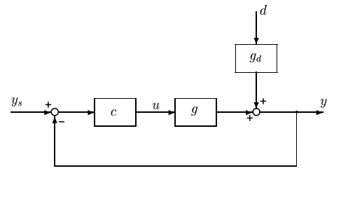
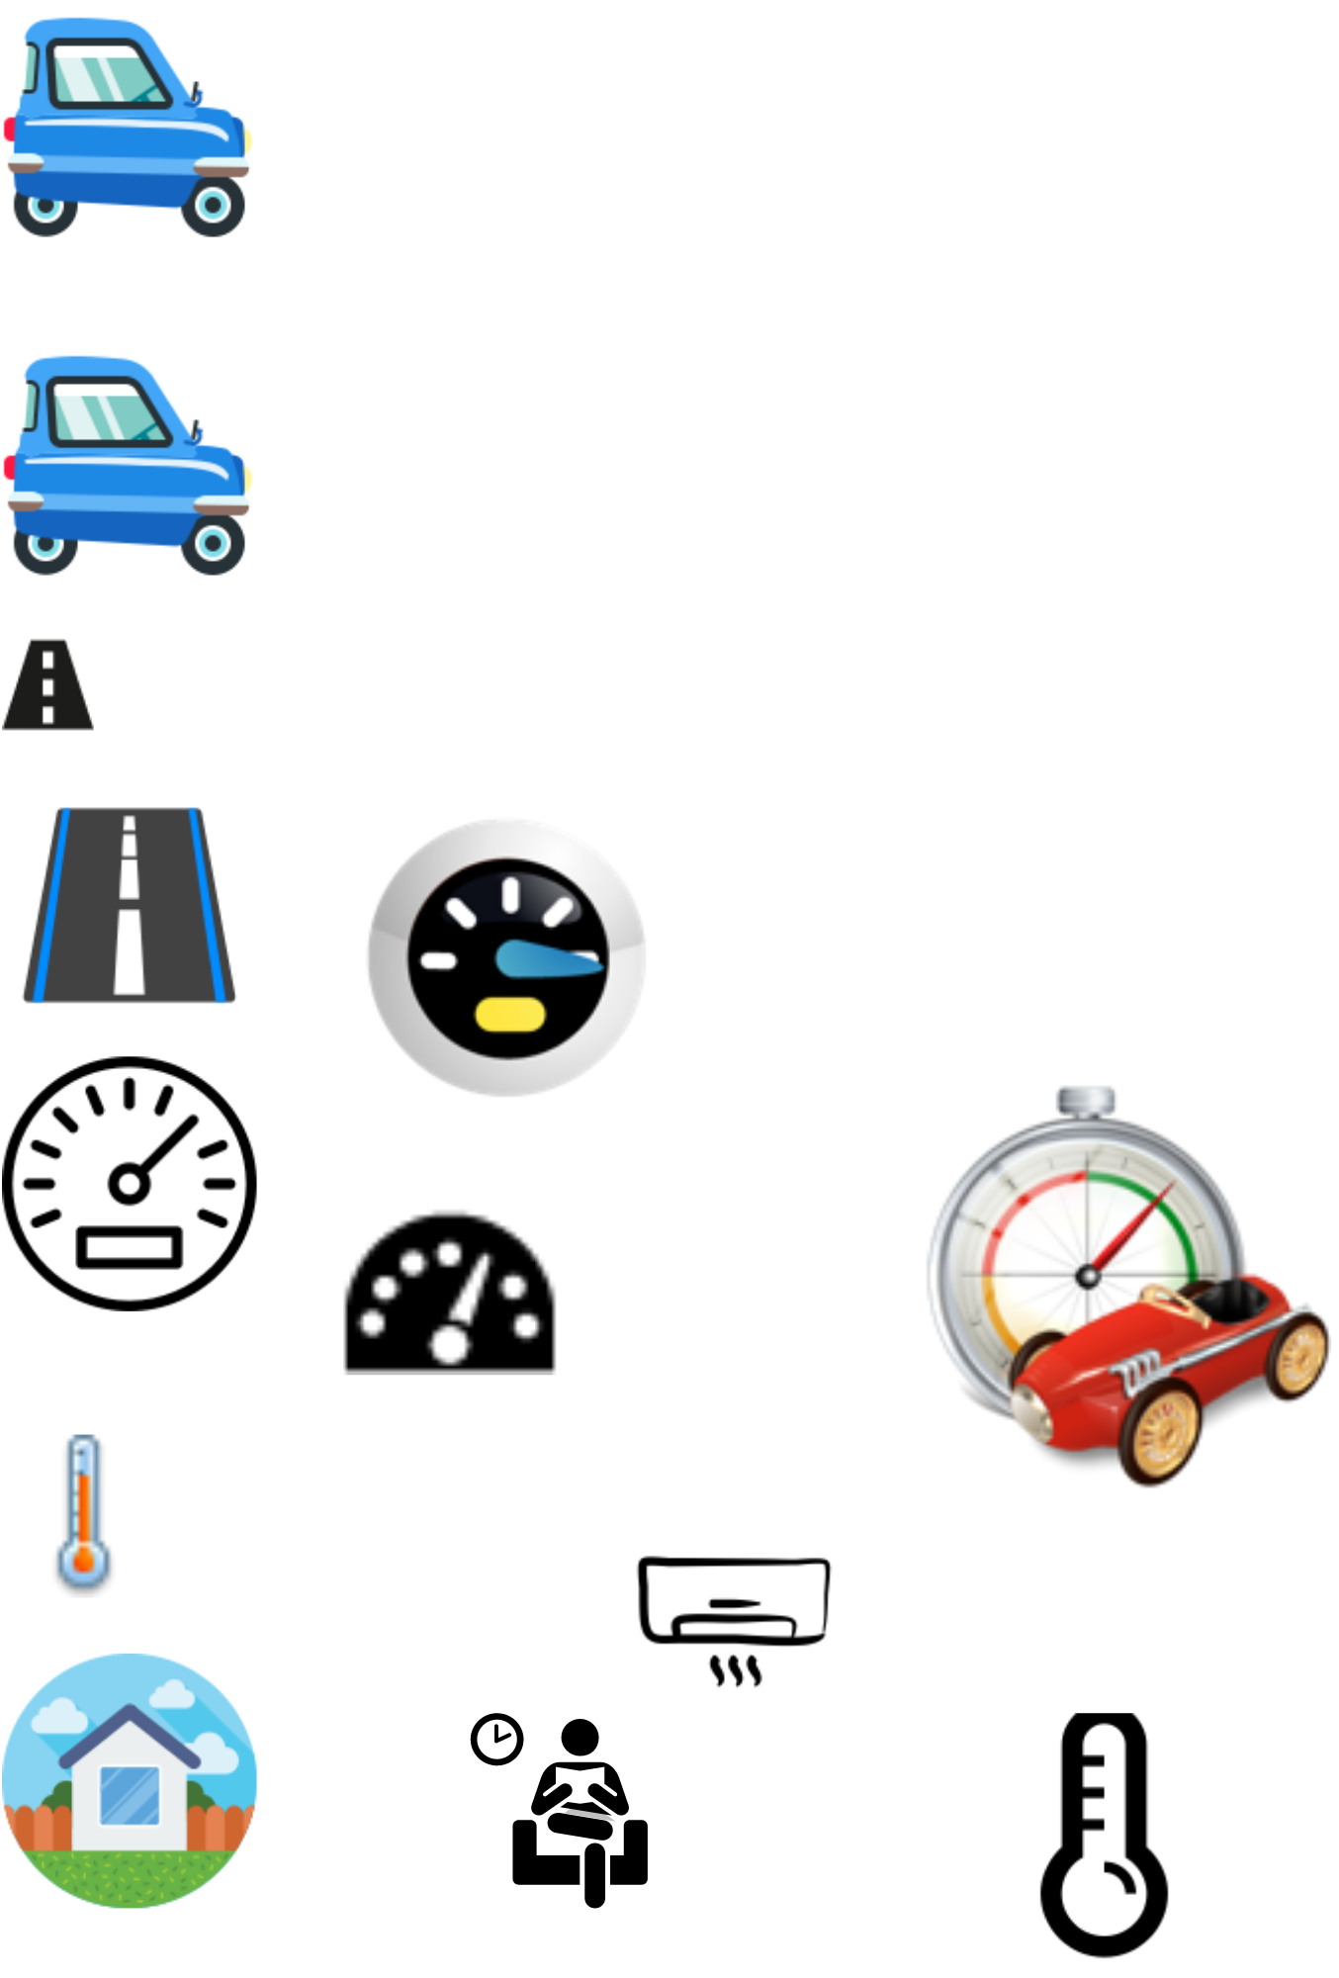
Optimization with PI-controller
y^{sp} = y^{max}
PI
max y
s.t. y ≤ y^{max}
u ≤ u^{max}
Example: Drive as fast as possible from Manchester to London (u=power, y=speed, y^{max} = 70 mph)
Optimal solution has two active constraint regions:
  y = y^{max} → speed limit
  u = u^{max} → max power
Note: Positive gain from MV (u) to CV (y)
Solved with PI-controller
  y^{sp} = y^{max}
  Anti-windup: I-action is off when u=u^{max}
s.t. = subject to
y = CV = controlled variable

Slide 22
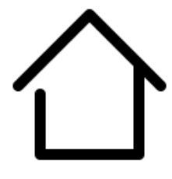
Optimization with PI-controller
y^{sp} = y^{min}
PI
min u
s.t. y ≥ y^{min}
u ≥ u^{min}
Example: Minimize heating cost (u=heating, y=temperature, y^{min}=20 °C)
Optimal solution has two active constraint regions:
  y = y^{min} → minimum temperature
  u = u^{min} → heating off
Note: Positive gain from MV (u) to CV (y)
Solved with PI-controller
  y^{sp} = y^{min}
  Anti-windup: I-action is off when u=u^{min}
s.t. = subject to
y = CV = controlled variable

Slide 23
Optimization with PI-controller
The two examples:
Optimal operation: Switch between CV constraint and MV saturation
A simple PI-controller was possible because we followed the pairing rule:
  «Pair MV that saturates with CV that can be given up»

Slide 24
Changing active contraints
Procedure for maintaining optimal operation when changing between active constraint regions
Step 1: Define all the constraints
Step 2: Identify relevant active constraint combinations and switches
Step 3: Propose a control structure for the nominal operating point.
Step 4: Propose switching schemes (see next)
Step 5: Design controllers for all cases (active constraint combinations)

Slide 25
Switching between active constraints
1. Output to Output (CV - CV) switching (SIMO)
  Selector
2. Input to output (CV – MV) switching
  Do nothing if we follow the pairing rule: «Pair MV that saturates with CV that can be given up»
3. Input to input (MV – MV) switching (MISO)
  Split range control
  OR: Controllers with different setpoint value
  OR: Valve position control (= midranging control)

Slide 26
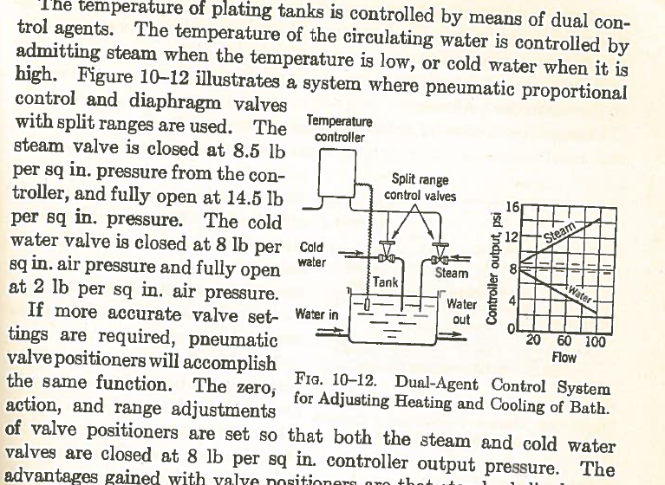
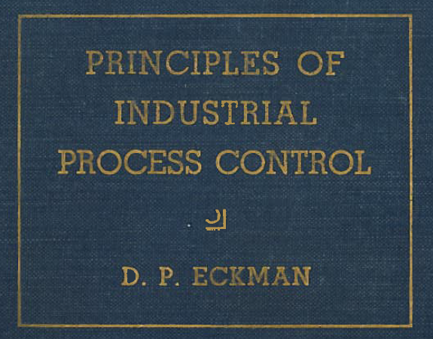
Split range control:
Donald Eckman (1945)

Slide 27
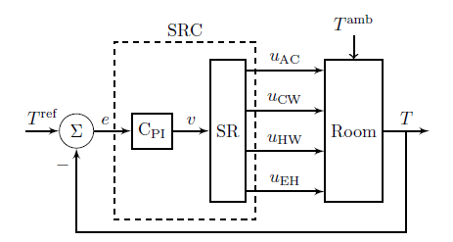
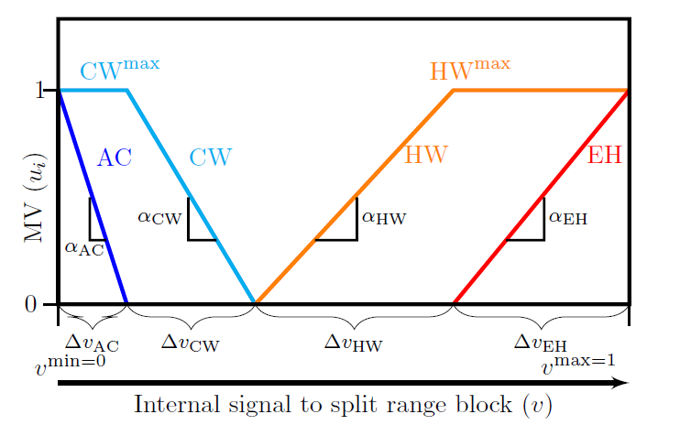
Split-range control (SRC): One CV (y). Two or more MVs (u1,u2)
Example: Room heating with 4 MVs
MVs:
AC (expensive cooling)
CW (cooling water; cheap)
HW (hot water, quite cheap)
Electric heat, EH (expensive)
y=T

Slide 28
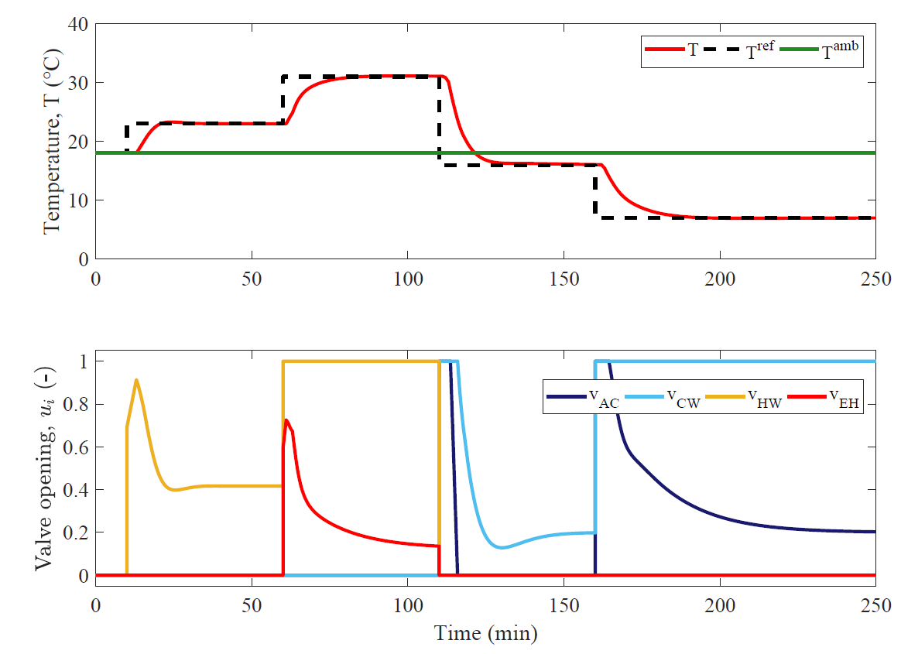
Simulation PI-control: Setpoint changes temperature

Slide 29
The less obvious case: Unconstrained optimum
u: unconstrained MV
What to control? y=?
J
J^{opt}
u^{opt}

Slide 30

Example: Optimal operation of runner
  Cost to be minimized, J=T
  One degree of freedom (u=power)
  What should we control?

Slide 31
1. Optimal operation of Sprinter
  100m. J=T
  Active constraint control:
    Maximum speed (”no thinking required”)
    CV = power (at max)

Slide 32
2. Optimal operation of Marathon runner
    40 km. J=T
    What should we control? CV=?
    Unconstrained optimum
J=T
u_{opt}
u=power

Slide 33
Marathon runner (40 km)
Any self-optimizing variable (to control at constant setpoint)?
    c₁ = distance to leader of race
    c₂ = speed
    c₃ = heart rate
    c₄ = level of lactate in muscles

Slide 34
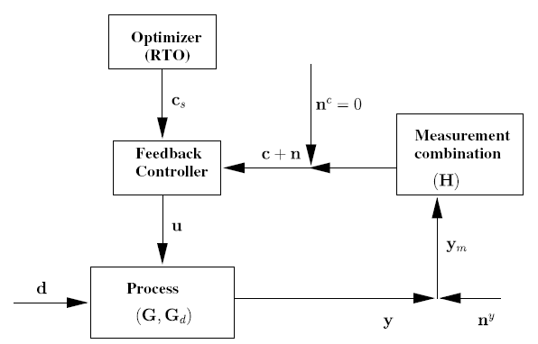

Conclusion Marathon runner
J=T
c_{opt}
c=heart rate
select one measurement
CV₁ = heart rate
CV = heart rate is good “self-optimizing” variable
Simple and robust implementation
Disturbances are indirectly handled by keeping a constant heart rate
May have infrequent adjustment of setpoint (c_{s})

Slide 35
Summary Step 3. What should we control (CV₁)?
Selection of primary controlled variables c = CV₁
  Control active constraints!
  Unconstrained variables: Control self-optimizing variables!
Self-optimizing control is an old idea (Morari et al., 1980):
“We want to find a function c of the process variables which when held constant, leads automatically to the optimal adjustments of the manipulated variables, and with it, the optimal operating conditions.”

Slide 36
The ideal “self-optimizing” variable is the gradient, J_{u}
Unconstrained degrees of freedom
c = ∂ J/∂ u = J_{u}
  Keep gradient at zero for all disturbances (c = J_{u}=0)
cost J
J_{u}<0
J_{u}<0
J_{u}=0
u_{opt}
u
J_{u}
0
Problem: Usually no measurement of gradient
Notes:
36

Slide 37
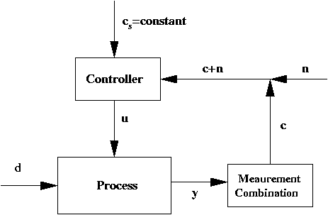
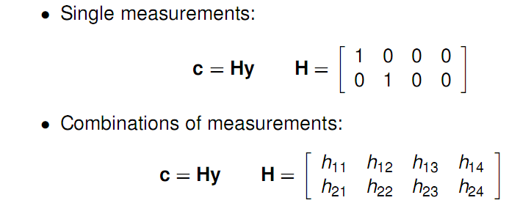
Unconstrained degrees of freedom
Ideal: c = J_{u}
In practise, use available measurements: c = H y. Task: Select H!
H

Slide 38
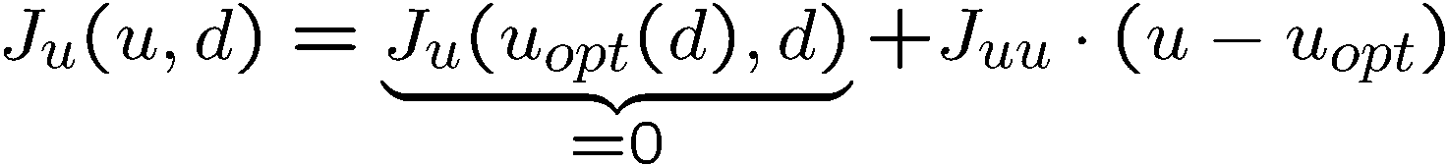
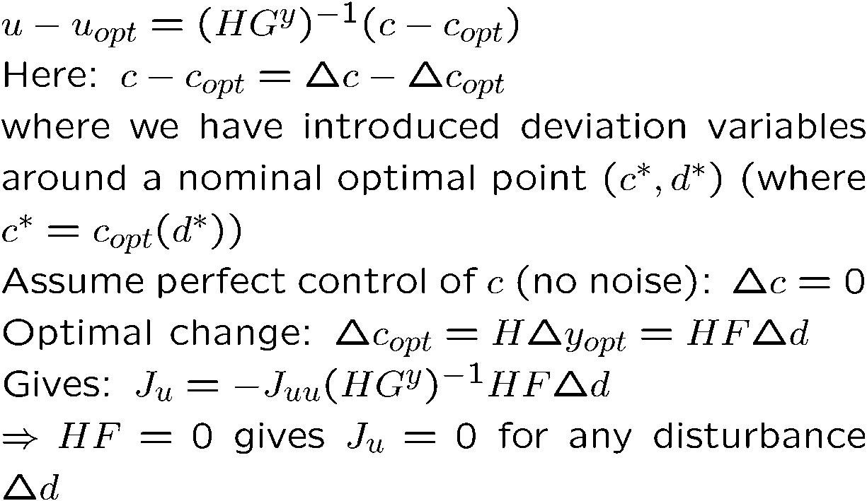
Combinations of measurements, c= Hy
Nullspace method for H (Alstad): HF=0 where F=dy_{opt}/dd
Unconstrained degrees of freedom
Proof:
Proof. Appendix B in: Jäschke and Skogestad, ”NCO tracking and self-optimizing control in the context of real-time optimization”, Journal of Process Control, 1407-1416 (2011)
.

Slide 39
Example. Nullspace Method for Marathon runner
Unconstrained degrees of freedom
u = power, d = slope [degrees]
y₁ = hr [beat/min], y₂ = v [m/s]
c = Hy, H = [h₁ h₂]]
F = dy_{opt}/dd = [0.25 -0.2]’
HF = 0 -> h₁ f₁ + h₂ f₂ = 0.25 h₁ – 0.2 h₂ = 0
Choose h₁ = 1 -> h₂ = 0.25/0.2 = 1.25
Conclusion: c = hr + 1.25 v
Control c = constant -> hr increases when v decreases (OK uphill!)

Slide 40
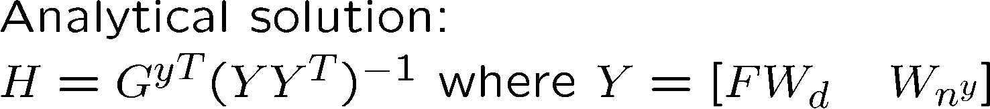
With measurement noise
Exact local method for H
“=0” in nullspace method (no noise)
“Minimize” in Maximum gain rule
( maximize S₁ G J_{uu}^{-1/2} , G=HG^{y} )
“Scaling” S₁
Notes:
40

Slide 41
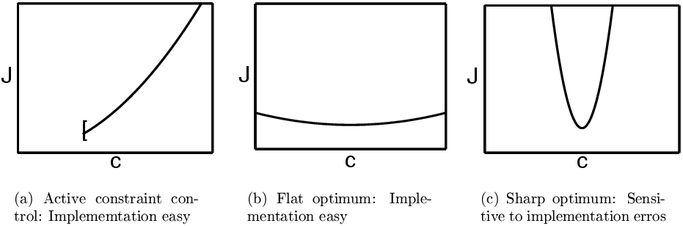
What variable c=Hy should we control? (self-optimizing variables)
Unconstrained degrees of freedom in practice
2
1
The optimal value of c should be insensitive to disturbances
  Small HF = dc_{opt}/dd
The value of c should be sensitive to the inputs (“maximum gain rule”)
  Large G = HG^{y} = dc/du
  Equivalent: Want flat optimum
Good
Good
BAD

Slide 42
Example: CO2 refrigeration cycle
p_{H}
J = W_{s} (work supplied)
DOF = u (valve opening, z)
Main disturbances:
  d₁ = T_{H}
  d₂ = T_{Cs} (setpoint)
  d₃ = UA_{loss}
What should we control?

Slide 43
CO2 refrigeration cycle
Step 1. One (remaining) degree of freedom (u=z)
Step 2. Objective function. J = W_{s} (compressor work)
Step 3. Optimize operation for disturbances (d₁=T_{C}, d₂=T_{H}, d₃=UA)
    Optimum always unconstrained
Step 4. Implementation of optimal operation
    No good single measurements (all give large losses):
      p_{h}, T_{h}, z, …
    Nullspace method: Need to combine n_{u}+n_{d}=1+3=4 measurements to have zero disturbance loss
    Simpler: Try combining two measurements. Exact local method:
      c = h₁ p_{h} + h₂ T_{h} = p_{h} + k T_{h}; k = -8.53 bar/K
    Nonlinear evaluation of loss: OK!

Slide 44



CO2 cycle: Maximum gain rule

Slide 45
Refrigeration cycle: Proposed control structure
CV=Measurement combination
CV1= Room temperature
CV2= “temperature-corrected high CO2 pressure”

Slide 46
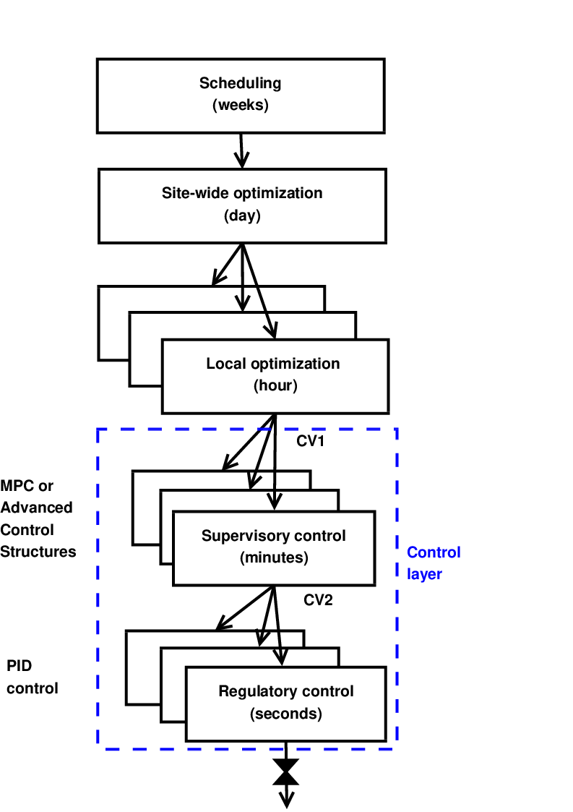
Conclusion: Systematic procedure for economic process control
Start “top-down” with economics:
Step 1: Define operational objectives and constraints
Step 2: Optimize steady-state operation
Step 3: Decide what to control (CVs)
  Step 3A: Identify active constraints = primary CV1.
  Step 3B: Remaining unconstrained DOFs: Self-optimizing CV1.
Step 4: TPM location
Then bottom-up:
Step 5: Regulatory control
  Control variables to stop “drift” (sensitive temperatures, pressures, ....)
Finally: Make link between “top-down” and “bottom up”
Step 6: “Advanced/supervisory control”
    Control economic CVs: Active constraints and self-optimizing variables
    Look after variables in regulatory layer below (e.g., avoid saturation)

Slide 47
References
The following paper summarizes the procedure:
  S. Skogestad, ``Control structure design for complete chemical plants'', Computers and Chemical Engineering, 28 (1-2), 219-234 (2004).
There are many approaches to plantwide control as discussed in the following review paper:
  T. Larsson and S. Skogestad, ``Plantwide control: A review and a new design procedure'' Modeling, Identification and Control, 21, 209-240 (2000).
The following paper updates the procedure:
  S. Skogestad, ``Economic plantwide control’’, Book chapter in V. Kariwala and V.P. Rangaiah (Eds), Plant-Wide Control: Recent Developments and Applications”, Wiley (2012).
Another paper:
  S. Skogestad “Plantwide control: the search for the self-optimizing control structure‘”, J. Proc. Control, 10, 487-507 (2000).
More information:
  Google skogestad

Slide 48
Acknowledgement
This work was partly supported by the Norwegian Research Council under
HighEFF: Energy Efficient and Competitive Industry for the Future and
SUBPRO: Subsea Production and Processing

Slide 49
Extra slides

Slide 50
The BigPicture: Economic plantwide control for complete processing plants
Sigurd Skogestad , Department of Chemical Engineering, Norwegian University of Science and Technology (NTNU), Trondheim, Norway
Abstract: A chemical plant may have thousands of measurements and control loops. By the term plantwide control it is not meant the tuning and behavior of each of these loops, but rather the control philosophy of the overall plant with emphasis on the structural decisions. In practice, the control system is usually divided into several layers, separated by time scale: scheduling (weeks) , site-wide optimization (day), local optimization (hour), supervisory and economic control (minutes) and regulatory control (seconds). Such a hierchical (cascade) decomposition with layers operating on different time scale is used in the control of all real (complex) systems including biological systems and airplanes, so the issues in this section are not limited to process control. In the talk the most important issues are discussed, especially related to the choice of ”self-optimizing” variables that provide the link the control layers. Examples are given for optimal operation of a runner and distillation columns.

Slide 51
CV
Sigurd Skogestad is a professor in chemical engineering at the Norwegian University of Science and Technology (NTNU) in Trondheim. Born in Norway in 1955, he received the Siv.Ing. degree (M.S.) in chemical engineering at NTNU in in 1978. After finishing his military service at the Norwegian Defence Research Institute, he worked from 1980 to 1983 with Norsk Hydro in the areas of process design and simulation at their Research Center in Porsgrunn, Norway. Moving to the US and working 3.5 years under the guidance of Manfred Morari, he received the Ph.D. degree from the California Institute of Technology in 1987. He has been a full professor at NTNU since 1987. During the period 1999 to 2009 he was Head of Department of Chemical Engineering ( Kjemisk prosessteknologi ). Since 2015 he is the Director of SUBPRO, a multi-disciplinary center on subsea technology at NTNU. He was at sabattical leave at the University of California at Berkeley in 1994-95, and at the University of California at Santa Barbara in 2001-02.
The author of more than 200 international journal publications and more than 200 conference publications, he is the principal author together with Ian Postlethwaite of the book "Multivariable feedback control" published by Wiley in 1996 (first edition) and 2005 (second edition). Dr. Skogestad was awarded "Innstilling to the King" for his Siv.Ing. degree in 1979, a Fullbright fellowship in 1983, received the Ted Peterson Award from AIChE in 1989, the George S. Axelby Outstanding Paper Award from IEEE in 1990, the O. Hugo Schuck Best Paper Award from the American Automatic Control Council in 1992, and the Best Paper of the Year 2004 Award from Computers and Chemical Engineering. He was an Editor of Automatica during the period 1996-2002, was is member of the International Dederation of Automatic Control (IFAC) Technical Board for the period 2008 to 2014, and become an IFAC Fellow in 2014. He is a Fellow of the American Institute of Chemical Engineers (2012) and was elected into the Process Control Hall of Fame in 20111. He is an honorary member of Norwegian Society of Automatic Control (2015) and was elected as member of The Norwegian Academy of Science and Letters, Oslo in 2015.
Professor Skogestad has graduated about 40 PhD candidates. He presently has a group of about 5 Ph.D. students. He is since 2015 Director of SUBPRO, a research-based innovation center in subsea production and processing at NTNU, funded by the by the Research Council of Norway and industry, and with a budget of about 35 million NOK per year (2015-2023). He is also the leader of PROST which is the strong point center in process systems engineering in Trondheim and involves about 50 people in various departments.
The goal of his research is to develop simple yet rigorous methods to solve problems of engineering significance. Research interests include the use of feedback as a tool to (1) reduce uncertainty (including robust control), (2) change the system dynamics (including stabilization), and (3) generally make the system more well-behaved (including self-optimizing control). Other interests include limitations on performance in linear systems, control structure design and plantwide control, interactions between process design and control, and distillation column design, control and dynamics. His other main interests are mountain skiing (cross country), orienteering (running around with a map) and grouse hunting.

Slide 52
Never try to control the cost function J
(or any other variable that reaches a maximum or minimum at the optimum)
Unconstrained degrees of freedom
J
J>J_{min}
?
J_{min}
J<J_{min}
Infeasible
u
Better: control its gradient, Ju, or an associated “self-optimizing” variable.

Slide 53
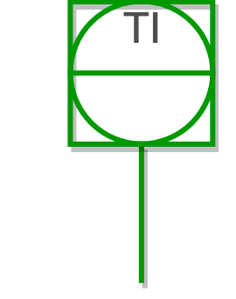

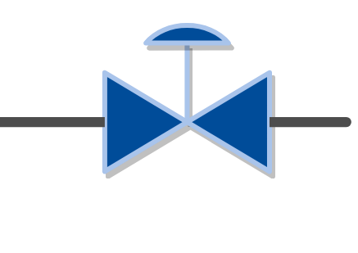
Requirement for the supervisory layer
Maintain optimal operation despite:
  disturbances
  changes of active constraint region
Usually:
≥
Number of controlled variables (CV)
Number of
degrees of freedom (MV)
How should we use the available MVs?

Slide 54
Priority list of constraints
P1: MV inequality constraints → physical constraints
P2: CV inequality constraints → may be given up
P3: MV or CV equality constraints → optimal operation
P4: Desired throughput → give up at bottleneck
P5: Self-optimizing variables → can be given up
A. Reyes-Lúa, C. Zotica, S. Skogestad, 2018. Optimal Operation with Changing Active Constraint Regions using Classical Advanced Control. In: 10th ADCHEM. IFAC, Shenyang, China.

Slide 55
Model predictive control (MPC)
Meets constraints “by design”.
Explicit model required.
If lack of DOF to meet control specifications:
  Modify weights in objective function.
  Use two-stage MPC with a priority list:
    Sequence of local steady state LPs and/or QPs
      Add constraints in order of priority
      Find feasibility
    MPC: dynamic optimization problem

Slide 56
Optimization with PI-controller
PI
Both cases:
Normal operation: y=y^{sp}
When u (MV) reaches constraint: control of y (CV) is given up
Generalization to multivariable case. Input saturation pairing rule:
Pair low-priority controlled variable (y, CV) (can be given up) with a manipulated variable (u, MV) that may saturate.
Or equivalently
Pair high-priority controlled variable (y, CV) (cannot be given up) with a manipulated variable (u, MV) that is not likely to saturate.

Slide 57
Optimal operation using advanced control structures
Multivariable: Must decide on pairing
Input saturation pairing rule
Pair the high priority controlled variable (CV) (cannot be given up) with a manipulated variable (MV) that is not likely to saturate.

Slide 58
Optimal operation using advanced control structures
Control structure (pairing) may vary with the operating region.
Region 3
Disturbance 2
Region 2
Region 1
Disturbance 1
A. Reyes-Lúa, C. Zotica, S. Skogestad, 2018. Optimal Operation with Changing Active Constraint Regions using Classical Advanced Control. In: 10th ADCHEM. IFAC, Shenyang, China.

Slide 59
Priorities and constraints
MV constraints | CV constraints
F_{H} ≤ F_{H}^{max} F_{C} ≤ F_{c}^{max} | T_{H} = T_{H}^{sp} F_{H} = F_{H}^{sp}
Priority level | Description | Constraints
1 | Feasibility region | F_{H} ≤ F_{H}^{max} F_{C} ≤ F_{c}^{max}
2 | Main control objective | T_{H} = T_{H}^{sp}
3 | Desired throughput | F_{H} = F_{H}^{sp}

Slide 60
Handling constraints using ACS
Input saturation pairing rule
A high priority controlled variable (CV) (which cannot be given up) should be paired with a manipulated variable (MV) that is not likely to saturate.
Pairing rule was followed?
Do nothing: give-up controlling low priority CV
MV
YES
Reassign high priority CV to MV controlling low priority CV: ACS + min/max selector
Constraint reached
NO
Do nothing
CV
Low priority?
YES
NO
Give-up a low priority CV using selector

Slide 61
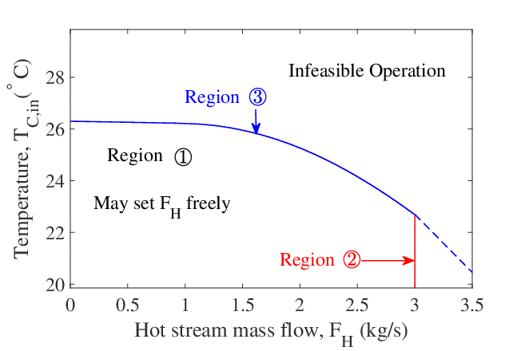
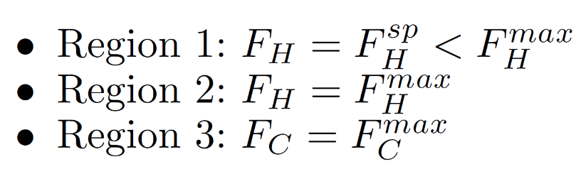
Active constraint regions
Active constraint in each region:

Slide 62
4. Alternatives for supervisory layer
  MPC
  Define:
  Priority list of constraints
  Objective function
  Prediction horizon
  Sampling time
  Control intervals
  Tuning (Δt, N, ω_{i}) ← trial and error
  Advanced Control Structures
  Define:
  Priority list of constraints
  Pairing at nominal point
  Gain of MVs on CV
  Tuning of PI-controller(s)
  → well-known rules
  Set-up and solve dynamic optimization problem at every step.
  Set-up control structure.

Slide 63
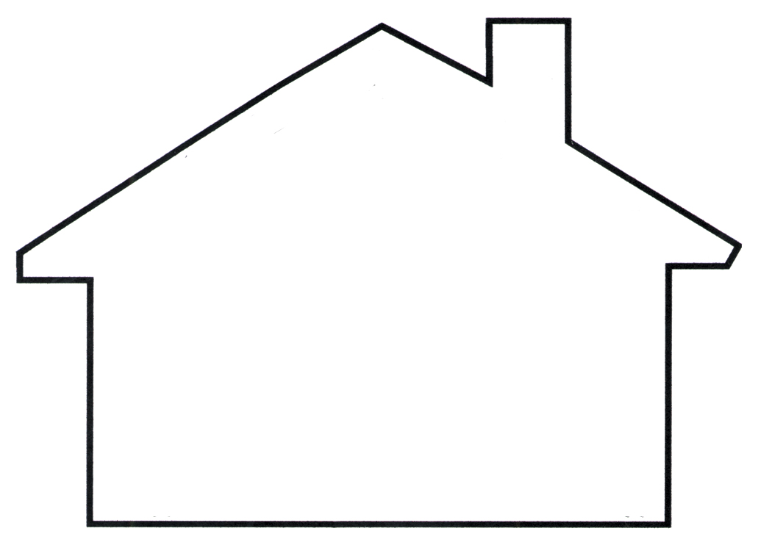
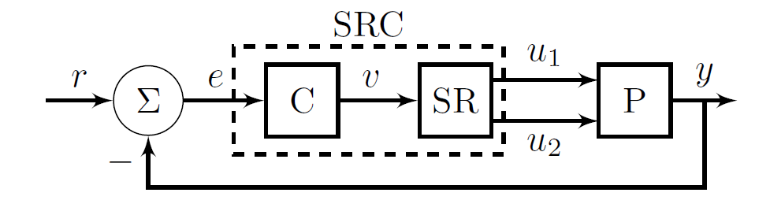
Split-range control (SRC): One CV (y). Two or more MVs (u1,u2)
Example: Temperature control
100%
u1=cooling
u1 = cooling
u2=
heating
y=T
Manipulated variable (u_{i})
u2=heating
0
Internal signal v

