Slide 1
Ratio and bidirectional control applied to distillation columns
Brage Bang
Sigurd Skogestad
Department of Chemical Engineering
Norwegian University of Science and Technology (NTNU)
Trondheim
17 June 2025
DYCOPS
Bratislava, Slovakia

Slide 2

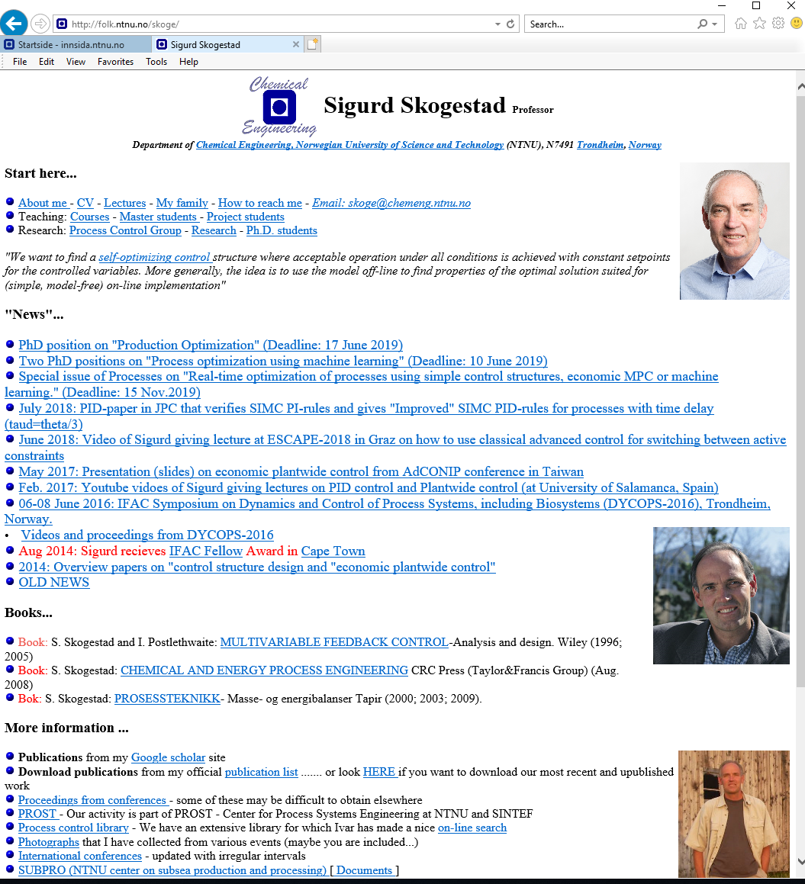
“The goal of my research is to develop simple yet rigorous methods to solve problems of engineering significance”

Slide 3
This talk
Simple data-based architectures applied to distillation control
PID control (feedback)
Ratio control
Bidirectional control with selectors

Slide 4
Ratio control
Feedforward control without a model y=f(u,d)
Just process insight
Example: Food recipe
  1 part sugar
  3 parts milk
  3 parts coffee
  MIX

Slide 5

Usually: Combine ratio (feedforward) with feedback
  Example cake baking: Use recipe (ratio control = feedforward), but a good cook adjusts the ratio to get desired result (feedback)

Slide 6
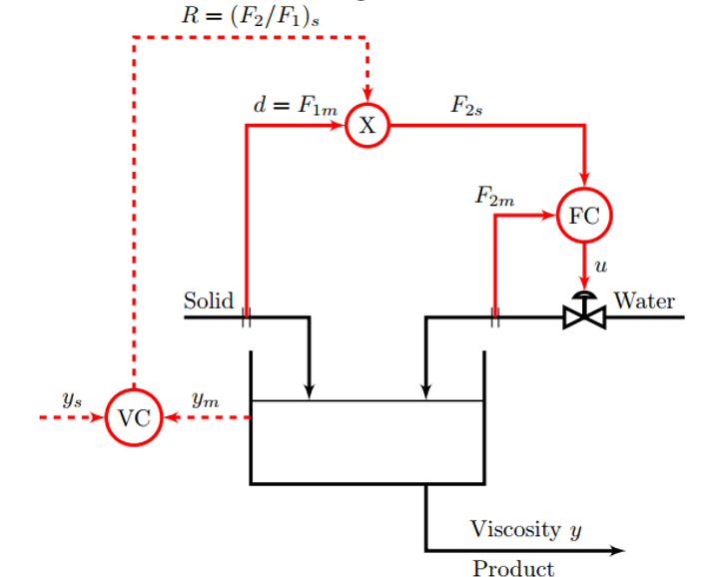
Ratio control combined with feedback
The correct ratio setpoint is found by feedback control (VC) based on keeping the measured controlled variable y at its desired setpoint y_{s}..
  So also here no model is needed (just data)
F₁
F₂
Mixing

Slide 7
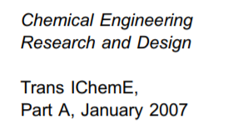
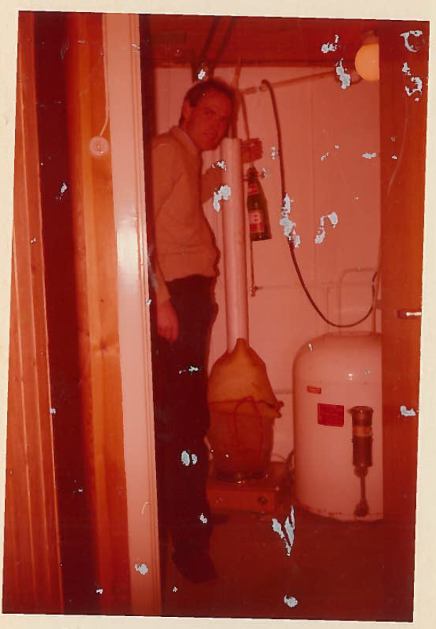
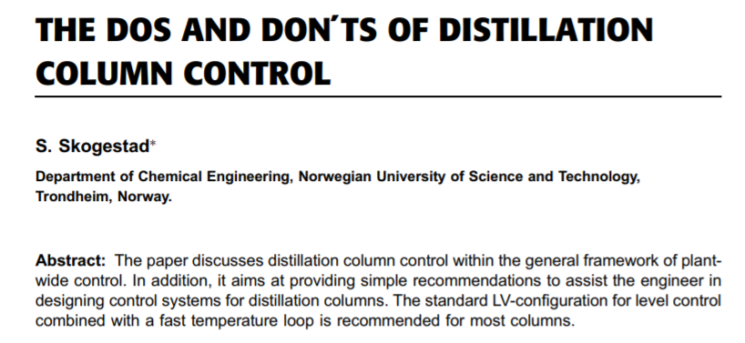
Distillation
At home doing moonshine
distillation (1979)

Slide 8
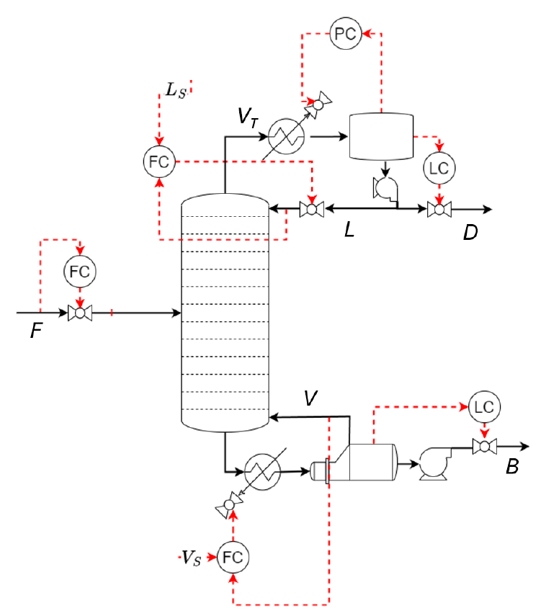
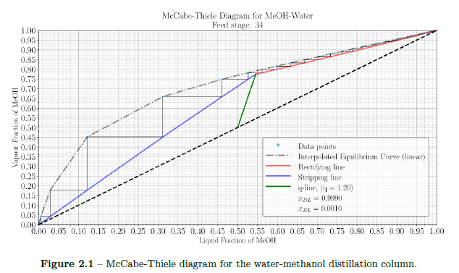
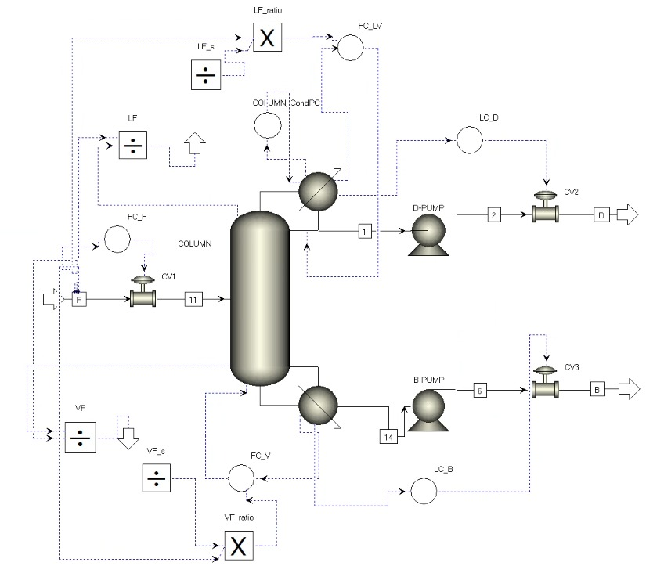
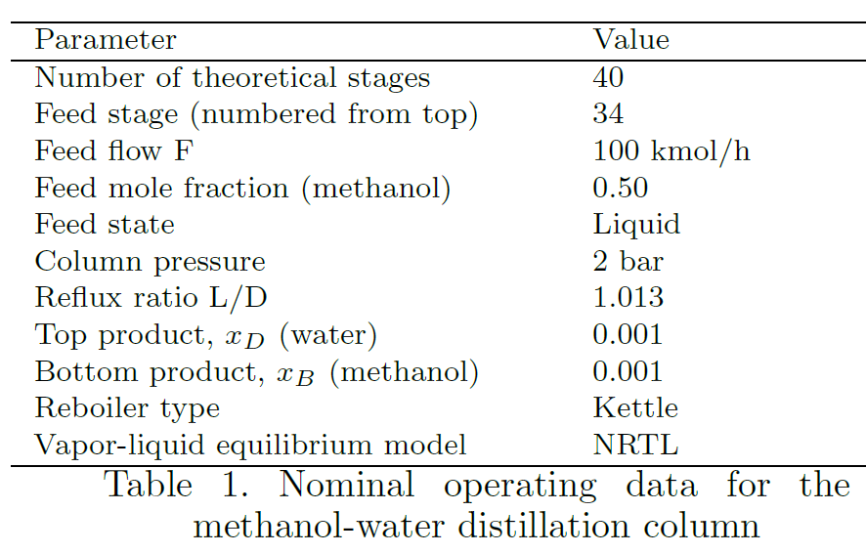
6 indpependent flows (valves):
Feed F (set F_{S}, disturbance)
Distillate D (top level control)
Bottom product B (bottom level control)
Cooling V_{T} (pressure control)
Reflux L (top composition control)
Boilup V (bottom composition control)
Feed:
0.50 methanol
0.50 water
F_{S}
Distillate product:
0.999 methanol
0.001 water
Increase feedrate
by 10%
Bottoms product:
0.001 methanol
0.999 water

Slide 9
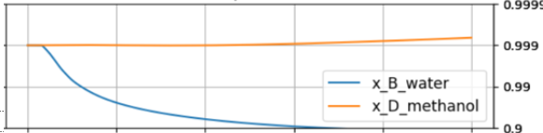
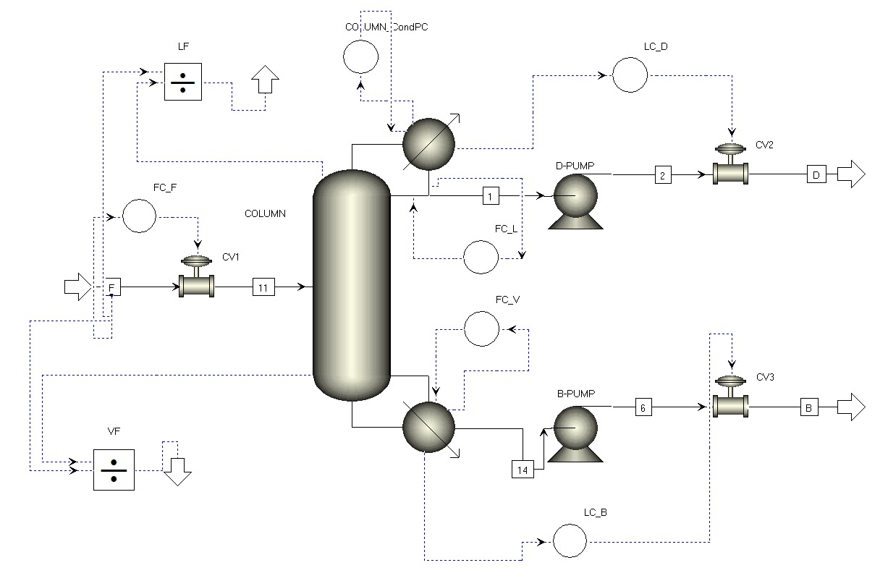
B1: L and V constant
F_{S}
Increase feedrate
by 10%
Aspen

Slide 10
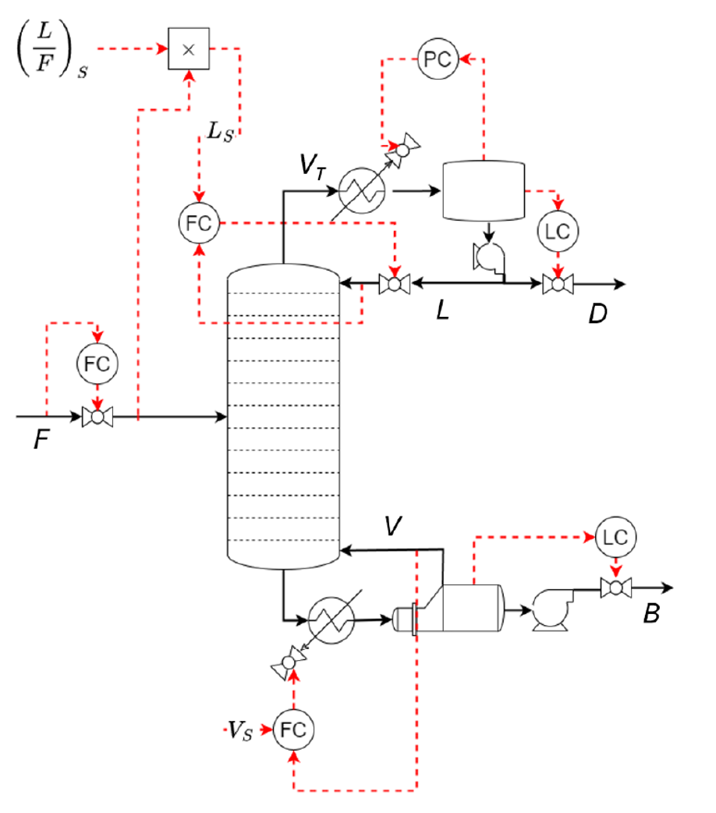
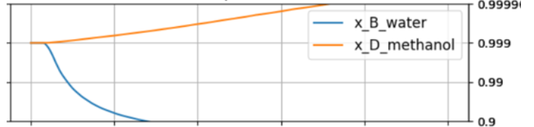
B2: L/F and V constant
F_{S}
Increase feedrate
by 10%

Slide 11
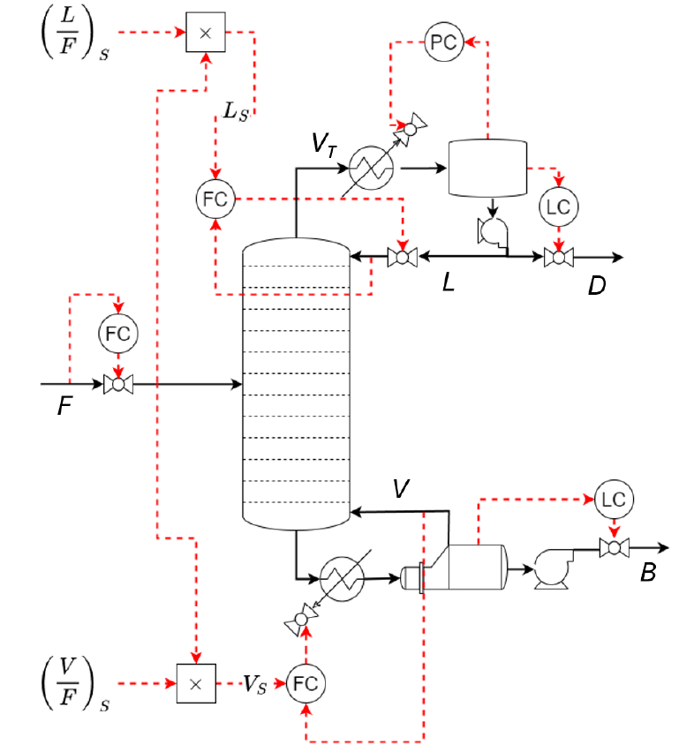
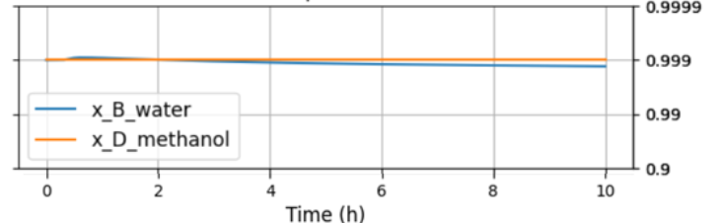
B4: L/F and V/F constant
F_{S}
Increase feedrate
by 10%
Oooops…. Drifting a little (even in simulation)….
…. Becuse feedforward

Slide 12
B3: L/F and T constant
Ratio with Cascade
F_{S}
TC

Slide 13
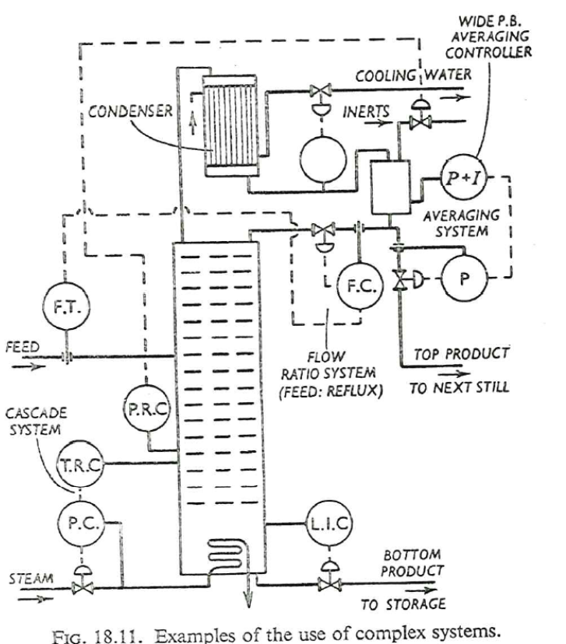
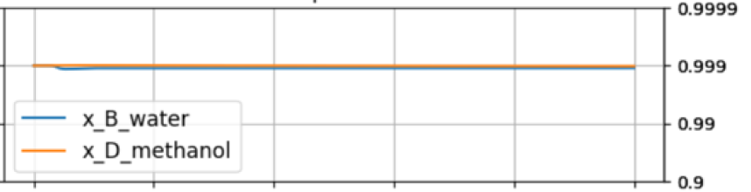
B3: L/F and T constant
Increase feedrate
by 10%
T
The best!
… but still one problem… V must not saturate!
V

Slide 14
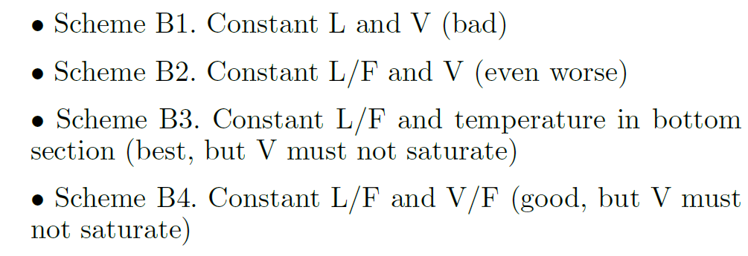
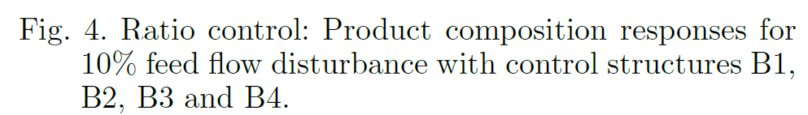
Summary

Slide 15
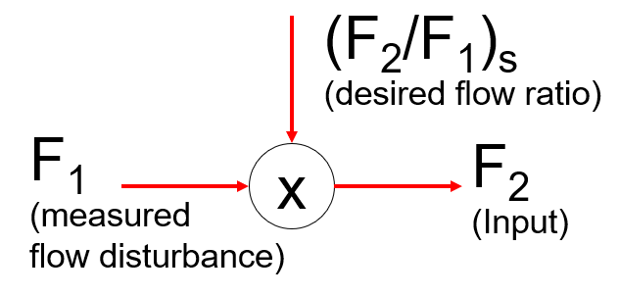
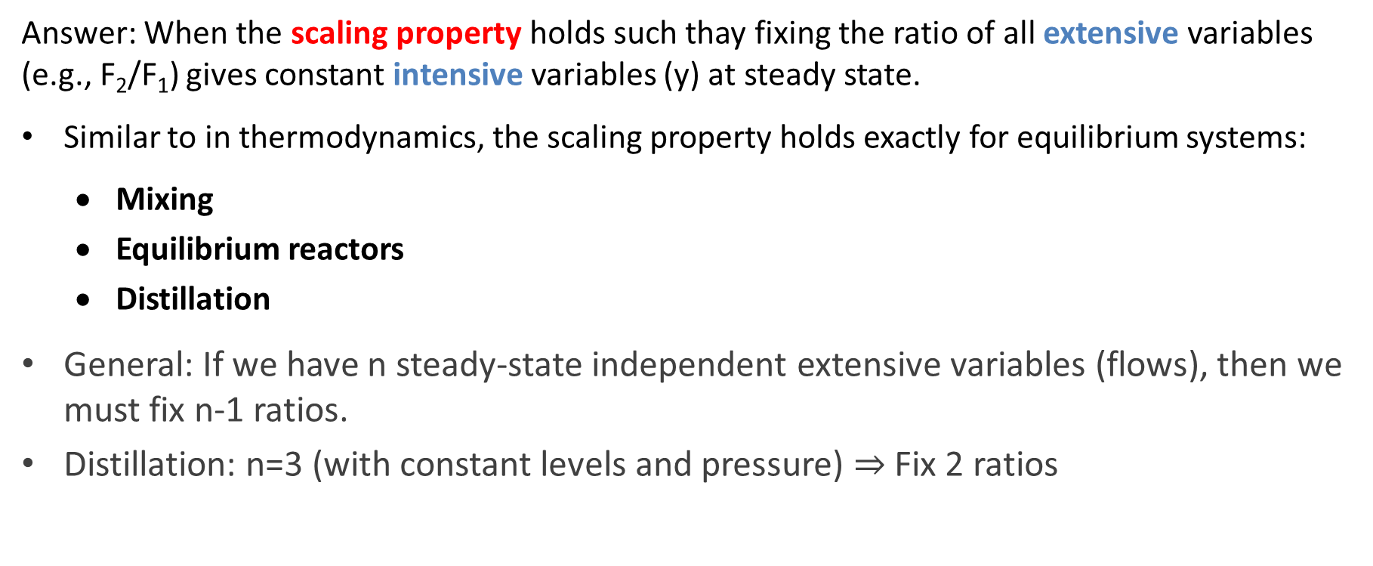
When should we use ratio control?
Answer: When the scaling property holds such thay fixing the ratio of all extensive variables (e.g., F₂/F₁) gives constant intensive variables (y) at steady state.
Similar to in thermodynamics, the scaling property holds exactly for equilibrium systems:
  Mixing
  Equilibrium reactors
  Distillation
General: If we have n steady-state independent extensive variables (flows), then we must fix n-1 ratios.
Distillation: n=3 (with constant levels and pressure) $⇒$ Fix 2 ratios

Slide 16
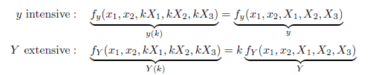
Mathematically: Theory of ratio control
SCALING PROPERTY (steady state):
Scaling all independent extensive variables by X the same factor,
with all independent intensive variables x constant,
scales all the dependent extensive extensive variables Y by the same factor
And keeps all intensive variables y constant

Slide 17
Conclusion ratio control
It’s a great idea!
  Very simple to implement
  Gives nonlinear feedforward action
Requires no model, just insight
  Theoretical basis: Scaling principle
For distillation: Must keep 2 ratios constant
  Or 1 ratio and 1 temperature/composition
  Don’t use ratio control for distillation if one flowrate saturates
  Could use L/D rather than L/F (even when F is the disturbance)

Slide 18
Bidirectional control
What should we do if B, D, L, V_{T} or V saturates (at max) so that we lose control?
One solution: «Override» to reduce throughput (feedrate F)
SP
SP_{H}
SP_{L}
LC
F_{s}
LC1
LC2
B_{s}
F_{s}
MIN
MIN
F
B
F
B

Slide 19
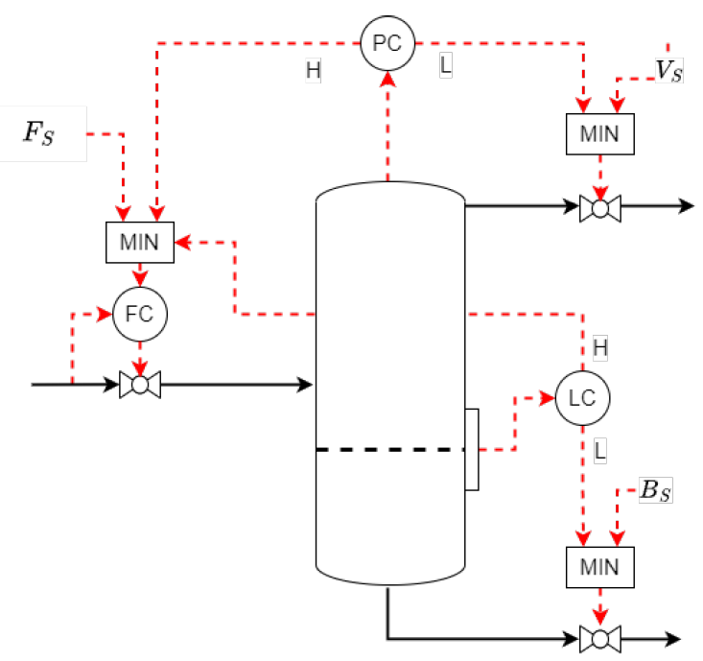
Bidirectional control of gas-liquid separator

Slide 20
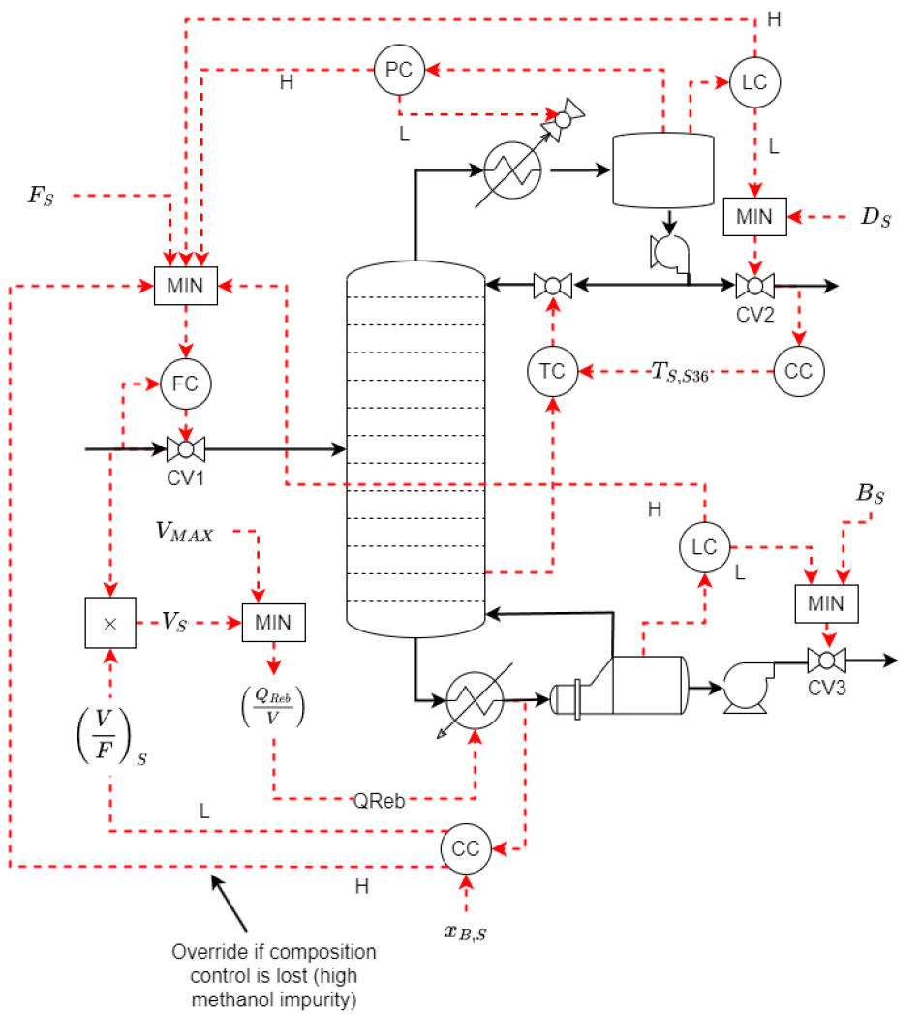
Bidirectional control of distillation
V_{T}
V/F with cascade in bottom
Top composition most important
4 flows may saturate at max:
B
D
V_{T} (cooling)
V (heating)
L (reflux) never saturates
L
V
Override if composition
control is lost because
V (heat input) saturates

Slide 21
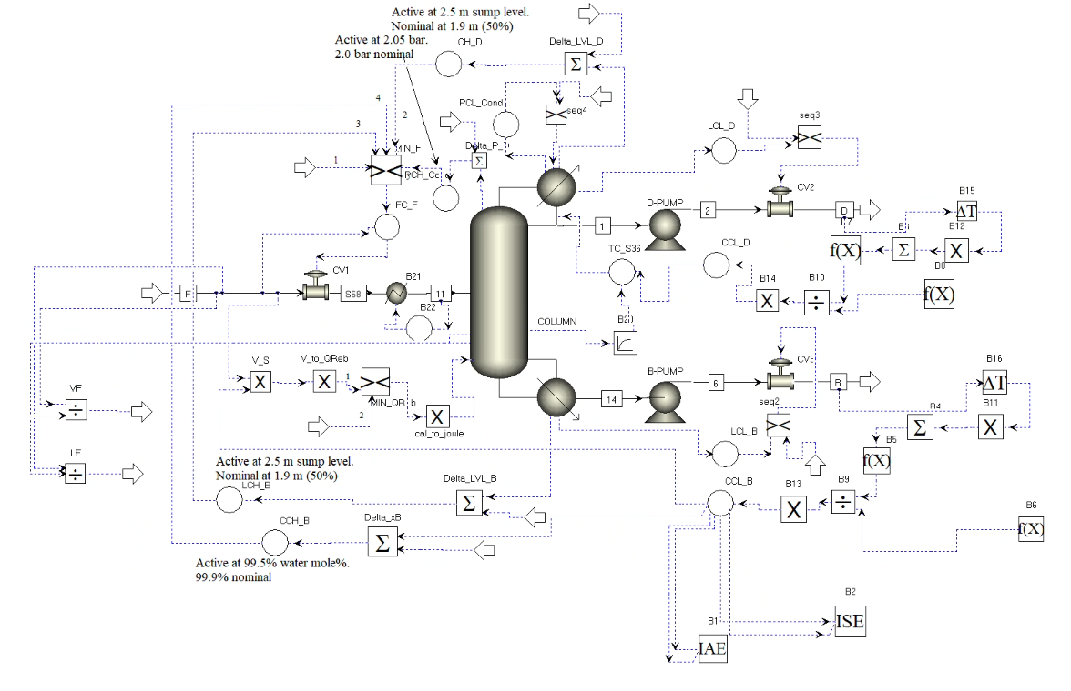
Dynamic simulation with Aspen

Slide 22
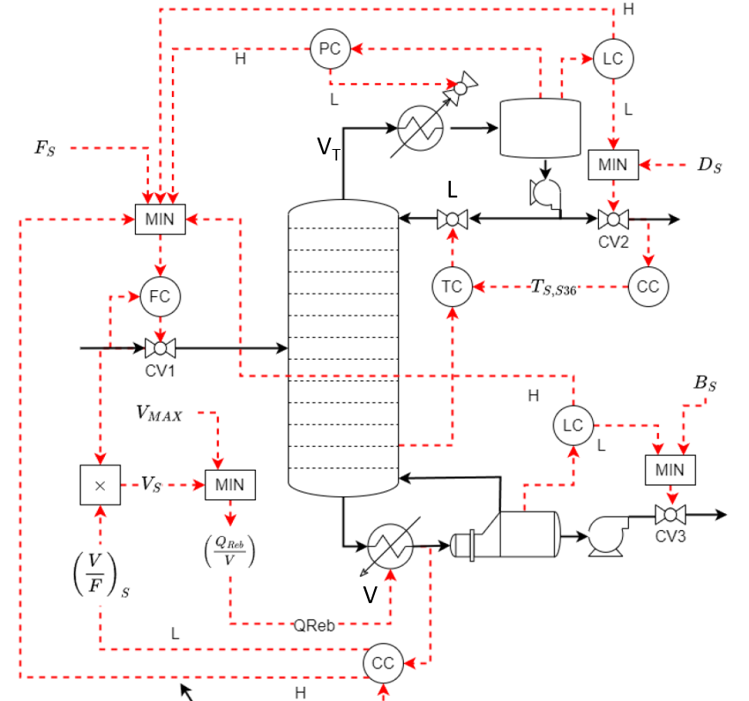
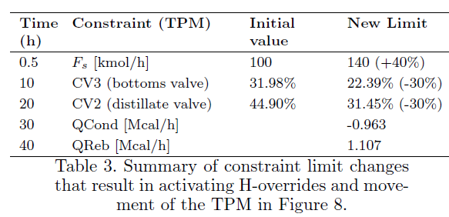
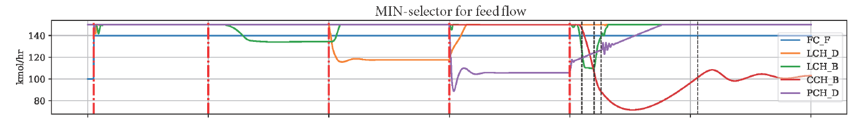
Dynamic simulation

Slide 23
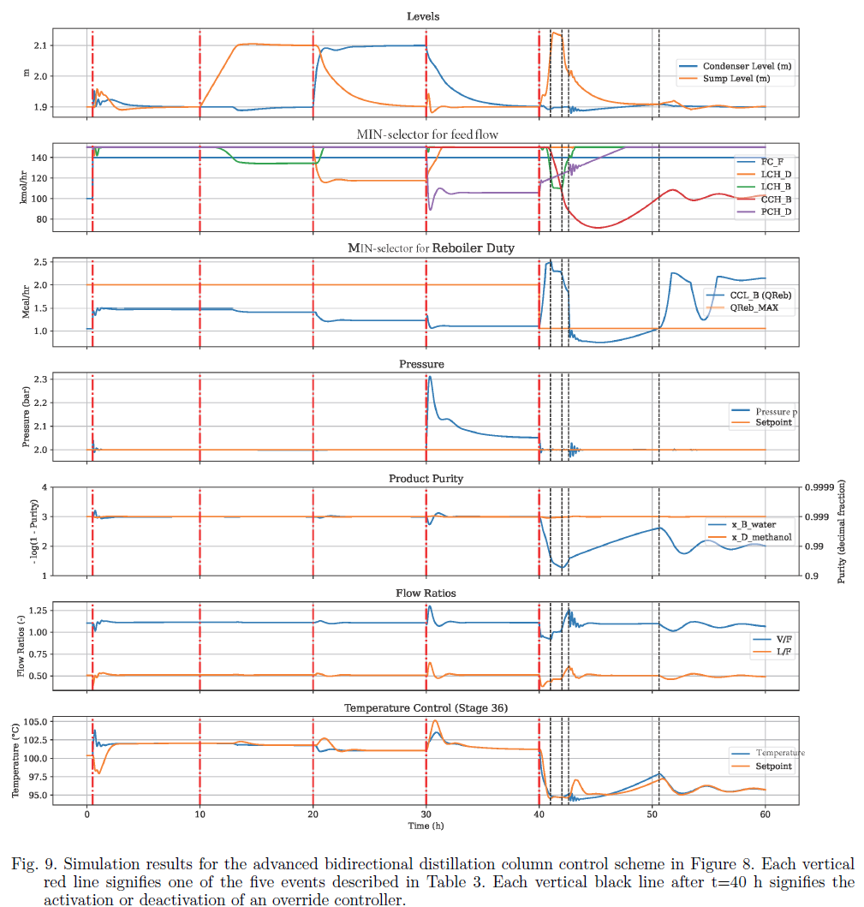

Slide 24
CONCLUSION
«Data-based» control using Advanced regulatory control
Simple control elements put together in an archirecture
No overall process model
Data (measurements) is the most important
Sigurd Skogestad, ”Advanced control using decomposition and simple elements‘’. Annual Reviews in Control, vol. 56 (2023)

Slide 25


Optimal centralized
Solution (EMPC)
Academic process control community fish pond
Simple solutions that
work (ARC = PID++)
Sigurd (me)
Nitin
Please join me, I feel a little alone

Slide 26
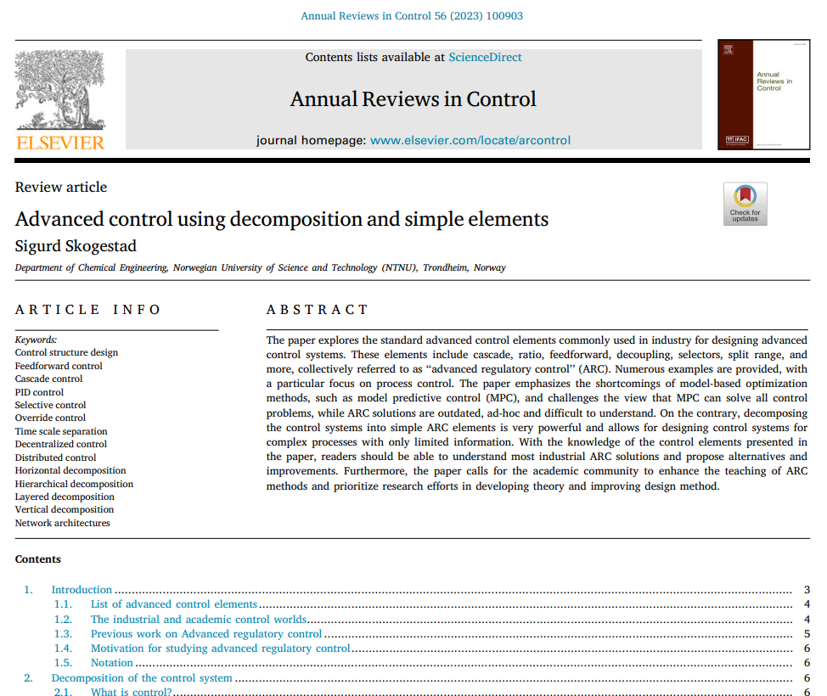

Slide 27
Backup slides

Slide 28
QUIZ
What are the three most important inventions of process control?
Hint 1: According to Sigurd Skogestad
Hint 2: All were in use around 1940
SOLUTION
PID controller, in particular, I-action
Cascade control
Ratio control
None of these are easily implemented using MPC

Slide 29
  Cases where ratio control should not be used:
Heat exchangers (because the area is fixed during operation)
  This means, for example, that we should not fix the ratio between hot and cold flow.
  For the scaling property to hold for a heat exchanger, we would need to increase the heat transfer area A proportionally to the flow rates. This is reasonable during design but not during operation.
Non-equilibrium reactors (because the volume is fixed)
  Extent of reaction depends on kinetics and reactor volume
Compressors with varying thermodynamic efficiency
  This includes most real compressors
Mixing processes where one feed stream is fixed
Distillation with a fixed stream (e.g. heat input)

Slide 30
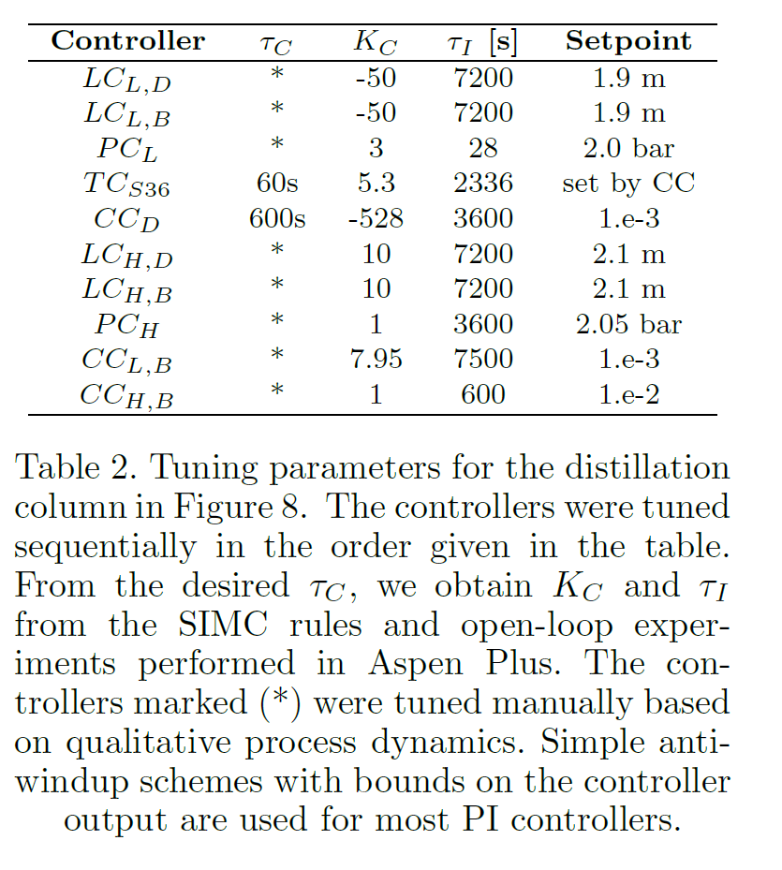

Slide 31
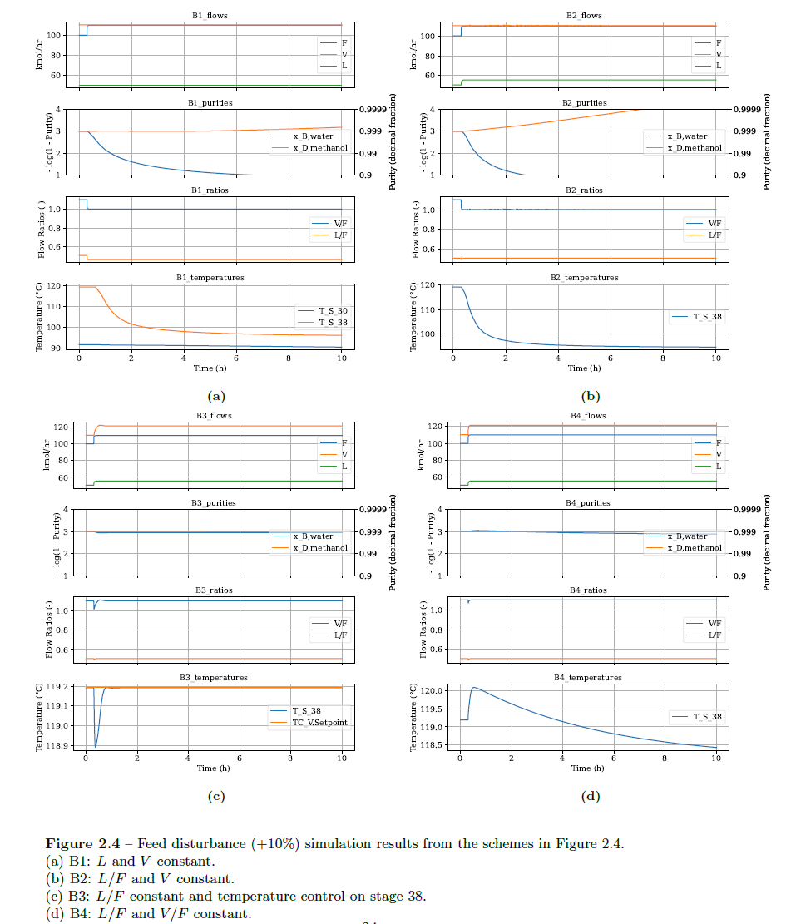
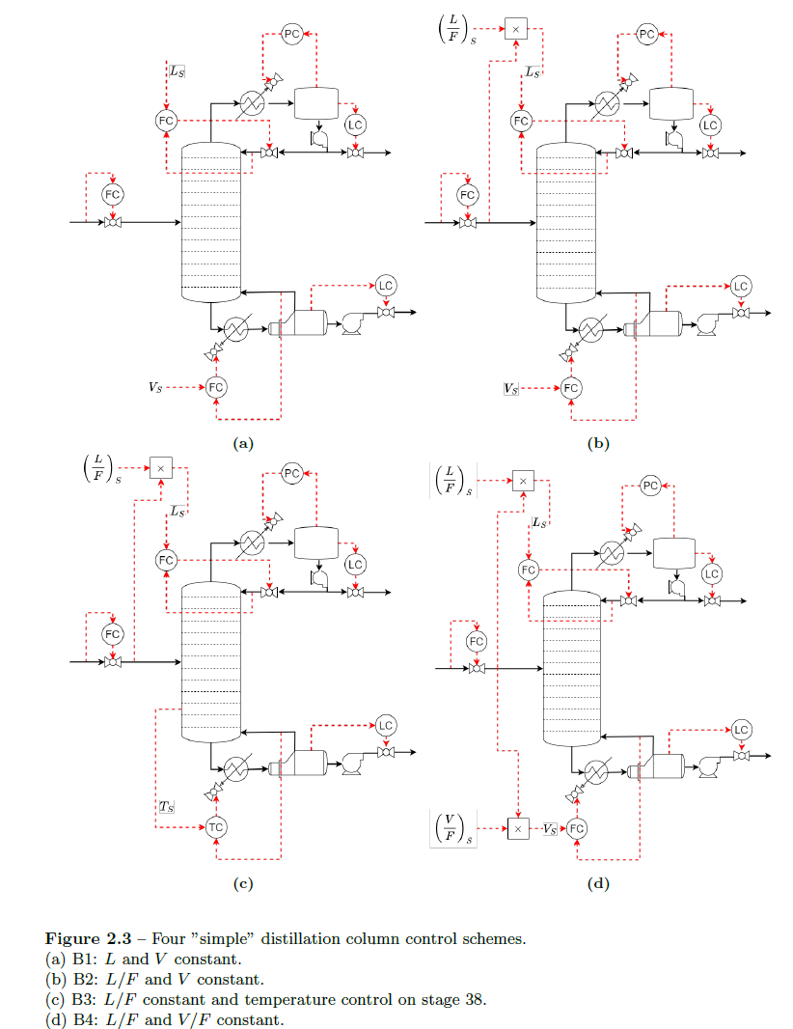

Slide 32




Trondheim
Arctic circle
Geiranger fjord
Midnight or midday?
Trondheim

Slide 33

About Sigurd Skogestad
•1955: Born in Flekkefjord, Norway
•1974-1978: MS (Siv.ing.) studies in chemical engineering at NTNU
• 1979: Military service (FFI)
•1980-1983: Worked at Norsk Hydro F-senter (process simulation)
•1983-1987: PhD student at Caltech (supervisor: Manfred Morari)
•1987-present: Professor of chemical engineering at NTNU
• 1994-95: Visiting Professor UC Berkeley
• 2001-02: Visiting Professor UC Santa Barbara
•1999-2009: Head of ChE Department, NTNU
•2015-..: Director SUBPRO (Subsea research center at NTNU)
Non-professional interests:
mountain skiing (cross country)
orienteering (running around with a map)
grouse hunting
1973

Slide 34
«Advanced» control
Mainly used in the «supervisory» control layer
Two main options
  Standard «Advanced regulatory control» (ARC) elements
    This option is preferred if it gives acceptable performance
  Model predictive control (MPC)
    Requires a lot more effort to implement and maintain
  What about machine learning (AI)?
    No, it requires way too much data - would take years to learn
setpoint
setpoint
PROCESS

Slide 35
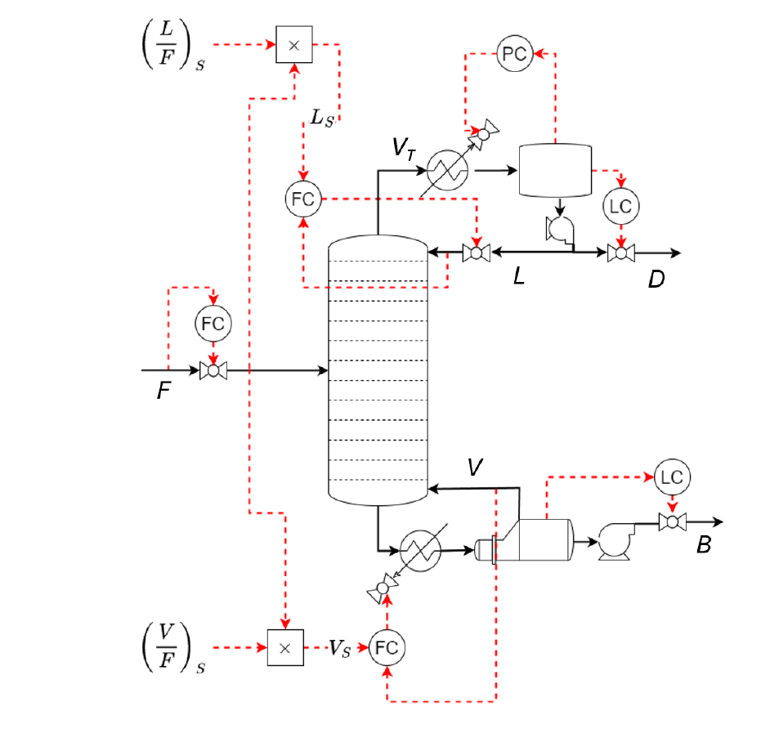

Slide 36
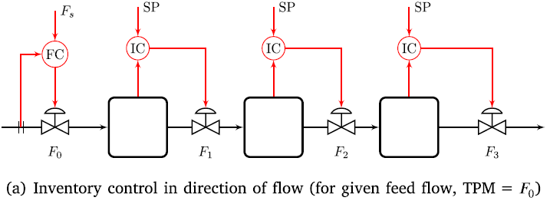
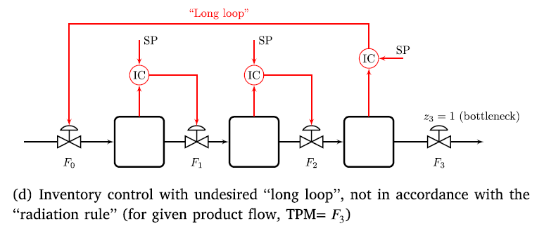
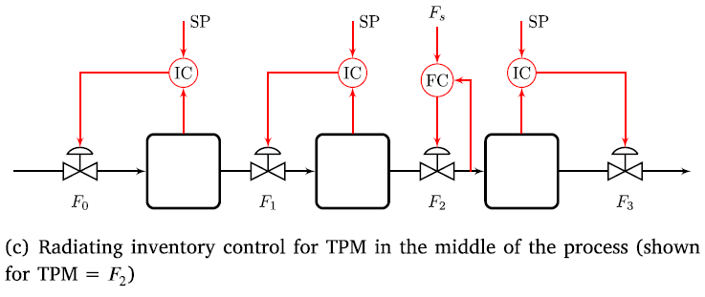
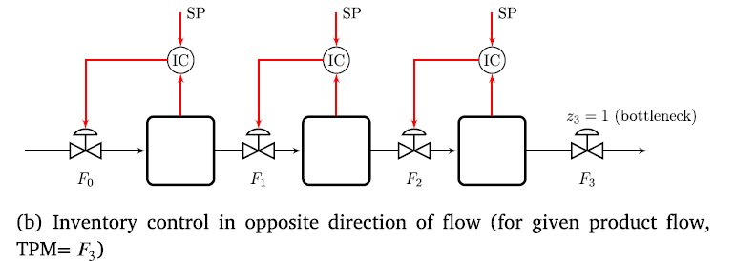
Example: Inventory control
TPM = throughput manipulator

Slide 37
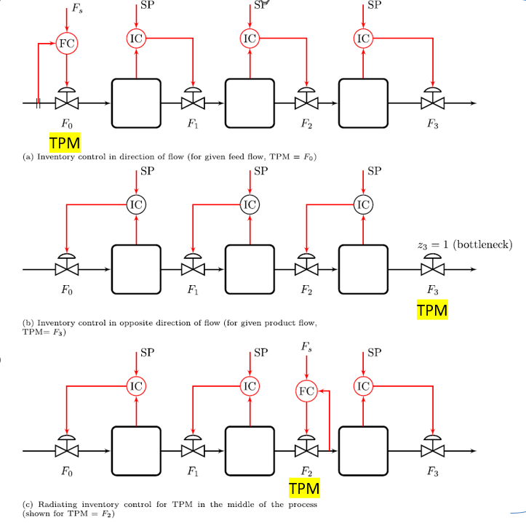
Inventory control for units in series
Follows radiation rule
Radiating rule:
Inventory control should be ‘‘radiating’’ around a given flow (TPM).
Need to reconfigure inventory loops if TPM moves

Slide 38
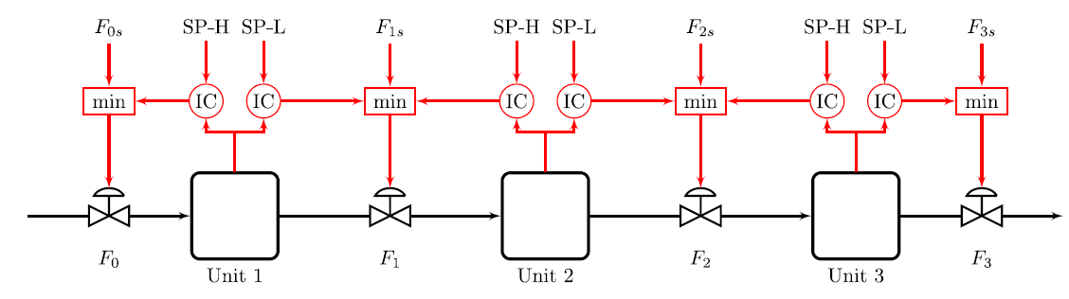

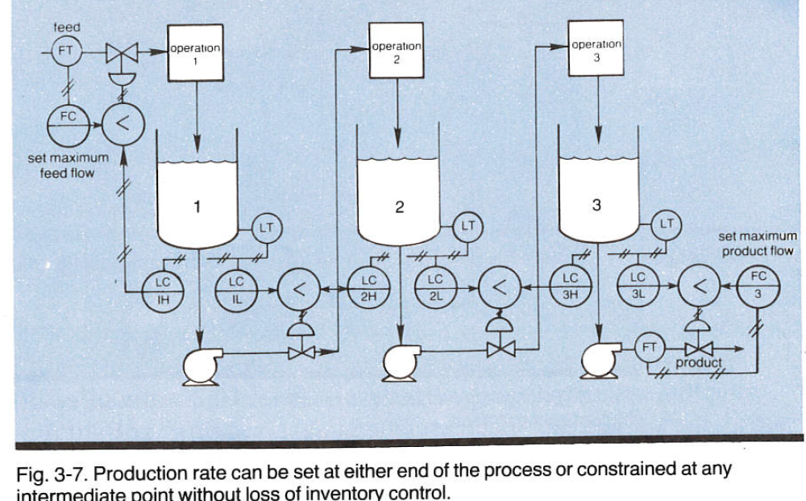
Generalization of bidirectional inventory control
Reconfigures TPM automatically with optimal buffer management!!
Maximize
throughput:
F_{s}=∞
F.G. Shinskey, «Controlling multivariable processes», ISA, 1981, Ch.3
Cristina Zotica, Krister Forsman, Sigurd Skogestad ,»Bidirectional inventory control with optimal use of
intermediate storage», Computers and chemical engineering, 2022
,

Slide 39
When use MPC?
When conventional APC performs poorly or becomes complex
Cases with many changing constraints (where we cannot assign one input to each constraint)
Interactive process
Know future disturbances and setpoint changes (predictive capability)

Slide 40
«Transformed inputs» v
Combining feedforward with feedback in an extremely simple way
Most effective for static feedforward
  Dynamic generalzation (= «feedback linearization») usually unrealistic because of many derivatives
Static model: y =f(u,d)
Select transformed inputs (= controller outputs): v = f(u,d)
Invert to get physical inputs: u = f⁻¹(v,d)
Then response from v to y is: y= I v (linear, decoupled, perfect disturbance rejection)
d
y_{s}
_{V}
u
y
FeedbackController
Calculation block (static FF)
Process
y
Looks like magic but ut works
S. Skogestad, C. Zotica, N. Alsop., «Transformed inputs for linearization, decoupling and feedforward control», J. Proc. Control, 2023

Slide 41
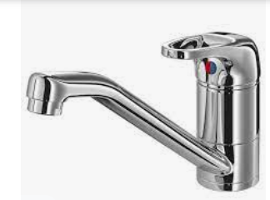
Example decoupling: Mixing of hot (u₁) and cold (u₂) water
Want to control
  y₁ = Temperature T
  y₂ = total flow F
Inputs, u=flowrates
May use two SISO PI-controllers
  TC
  FC
Insight: Get decoupled response with transformed inputs
  TC sets flow ratio, v₁ = u₁/u₂
  FC sets flow sum, v₂ = u₁ + u₂
Decoupler: Need «static calculation block» to solve for inputs
u₁ = v₁ v₂ / (1+ v₁)
u₂ = v₂ / (1 + v₁)
u₁
T
F
u₂
v₂=sum
v₁=ratio

Slide 42
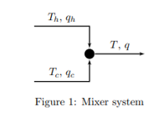

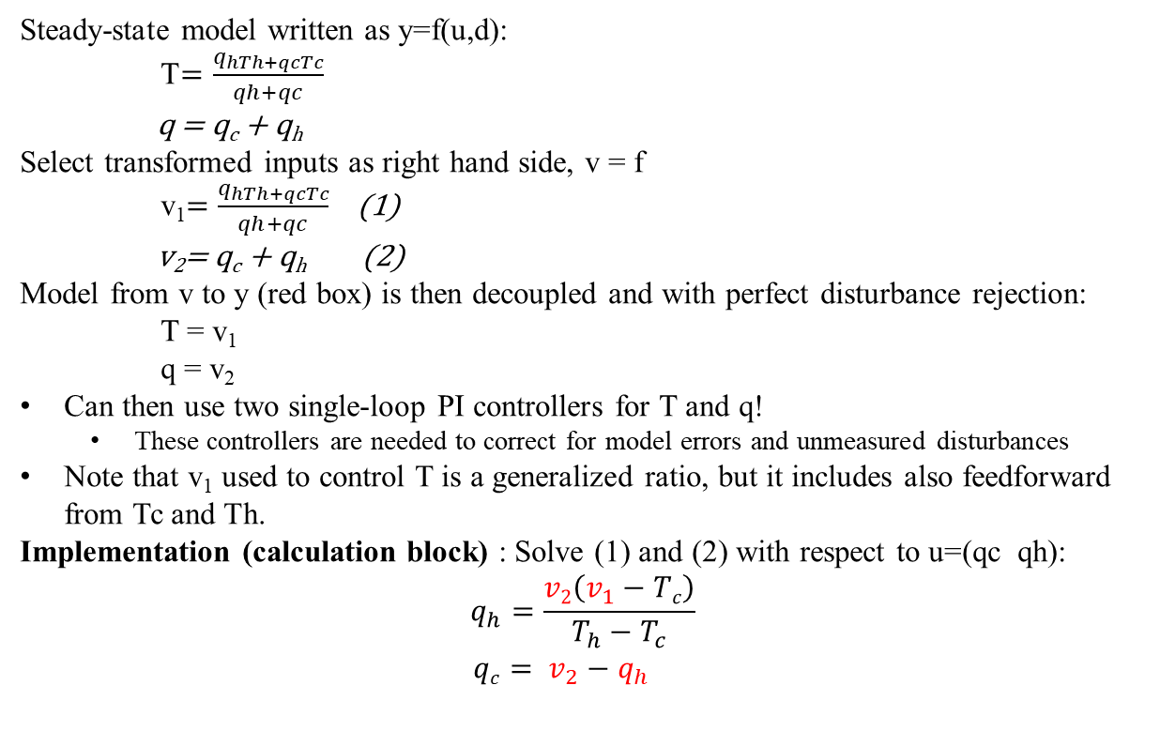
TRANSFORMED INPUTS v=f(u,d): GENERAL APPROACH FOR COMBINED FEEDBACK,
FEEDFORWARD, DECOUPLING AND LINEARIZATION
Example: Mixing of hot and cold water
d
y_{s}
_{V}
u
y
Controller
Calculation block (static)
Process
y
Generalized ratio
It’s almost magic!
Decoupler with feedforward:

