Slide 1
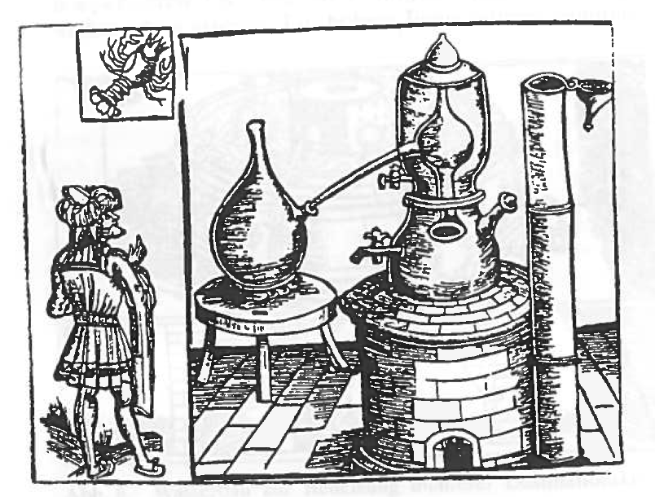
Distillation modelling and control
Sigurd Skogestad, NTNU
Webinar, Malaysia, April 2021

Slide 2
Sigurd Skogestad
1955: Born in Norway
1978: MS (Siv.ing.) in chemical engineering at NTNU
1979-1983: Worked at Norsk Hydro co. (distillation)
1987: PhD from Caltech (supervisor: Manfred Morari)
  Thesis: “Studies om robust control of distillation columns”
1987-present: Professor of chemical engineering at NTNU
  42 Phd students graduated (9 with distillation in title of thesis)
1999-2009: Head of Department
2015- : Director SUBPRO
200+ journal publications
Book: Multivariable Feedback Control (Wiley 1996; 2005)
Book: Chemical and energy process engineering (CRC Press, 2008)
  1989: Ted Peterson Best Paper Award by the CAST division of AIChE
  1990: George S. Axelby Outstanding Paper Award by the Control System Society of IEEE
  1992: O. Hugo Schuck Best Paper Award by the American Automatic Control Council
  2006: Best paper award in Computers and chemical engineering.
  2011: Process Automation Hall of Fame (US)
  2012: Fellow of American Institute of Chemical Engineers (AIChE)
  2014: Fellow of International Federation of Automatic Control (IFAC)
  2019: Best paper award at the ESCAPE 2019 Symposium (Eindhoven)
  2019: Computing in chemical engineering award from the American Institute of Chemical Engineers

Slide 3

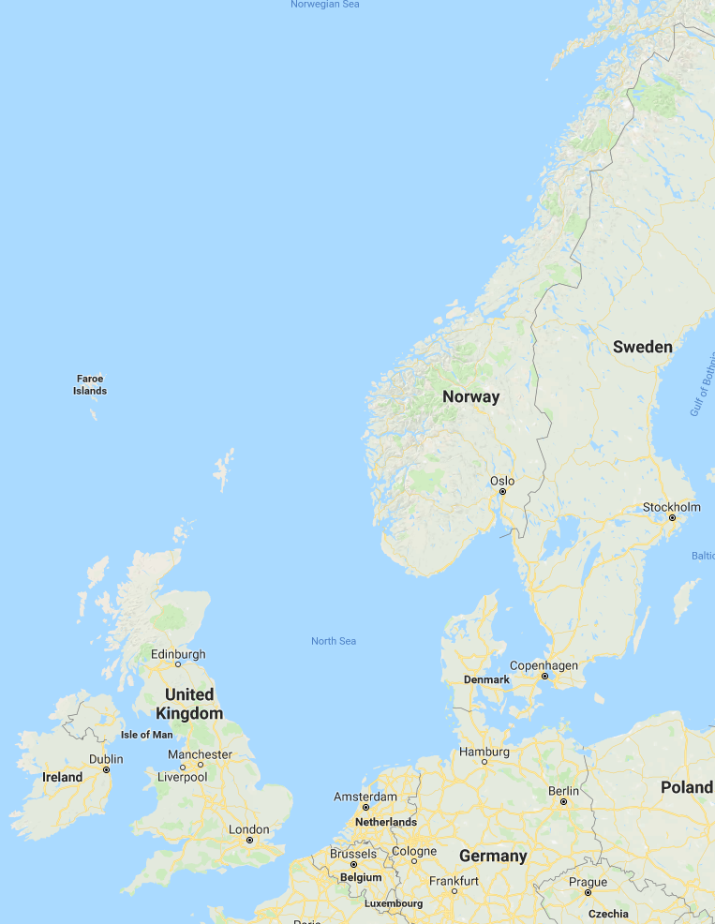

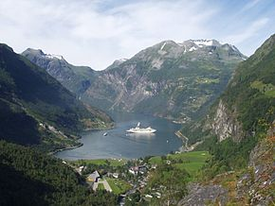
Midnight sun
Arctic circle
NTNU
Trondheim
Geiranger fjord

Slide 4
Abstract. Distillation is the most common separation process in the chemical industry. The aim of the webinar is to educate academia and industry of some of the complexities of a very important problem, which is on how to operate conventional single columns in the best way.
Some highlights of the talk:
1. Distillation as a separation process (In spite of claims to the contrary
it's an efficient process; it's the heat integration that may be inefficient)
2. Modelling (in principle it's simple using an equilibrium stage model, but the thermodynamics (VLE) may be
difficult to model and there are many coupled equations)
3. Dynamics (there is one dominant slow mode related to the holdup of light
and heavy key components in the column)
4. Optimal operation (minimize energy usage and maximize recovery subject to
satisfying purity specifications)
5. Control, single-loop and MPC
(stabilize the column and keep the operation close to optimal, preferably
using a simple control structure)
The focus will be on the two last issues, but it should be noted that an accurate
steady-state model is often needed to address issues of optimal operation and
control.

Slide 5
Details
1. Distillation as a separation process
- In spite of many claims it's an efficient separation process from a thermodynamic point of view.
- It uses heat. Qin at reboiler, About same Qout in top
- It's the heat integration that may be inefficient
i- It's unbeatable for high-purity separatioons
2. Modellering
- Relatively simple. Stage model OK
- Thermo (VLE) is main problem
- Shortcut models
3. Dynamics
- One slow mode
4. Optimal operationa:
1. satisfy specs,
2. eaximize valueable product (recovery)
3. save energy
Some simple rules:
- Always control expensive product spec.
- Sometimes overpurify other end (trade-off between recovery and energy; need model, steady-state OK)
- In many cases the whole process needsw to be modelled (recycle). The column may not have clear specs!
How about just saving energy?
Avoid overpurification of valueable product. Just wastes energy AND gives less product!
Note: If enough stages, then overpurification does not cost much..
5. Control
- Interesting process! Many options,
- 5x5, TPM location
- LV
- Good candidate for MPC.
- But single-loop also OK

Slide 6
Outline
1. Introduction / Distillation as a separation process
2. Modelling
3. Dynamics
4. Optimal operation
5. Control

Slide 7
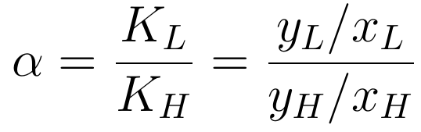
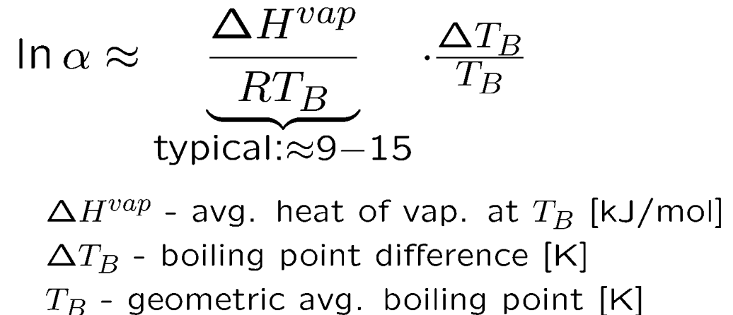

1. Basis: Difference in boiling points (volatility)
Relative volatility:
Gas (vapor)
y
L – light component
H – heavy component
Liquid
x
Example. iso-pentane (L) – pentane (H).
Boiling points: 28 ºC(L) and 36.2 ºC(H)
I.J. Halvorsen and S. Skogestad, ``Distillation Theory'', In: Encyclopedia of Separation Science. Ian D. Wilson, Academic Press, 2000, pp. 1117-1134.

Slide 8
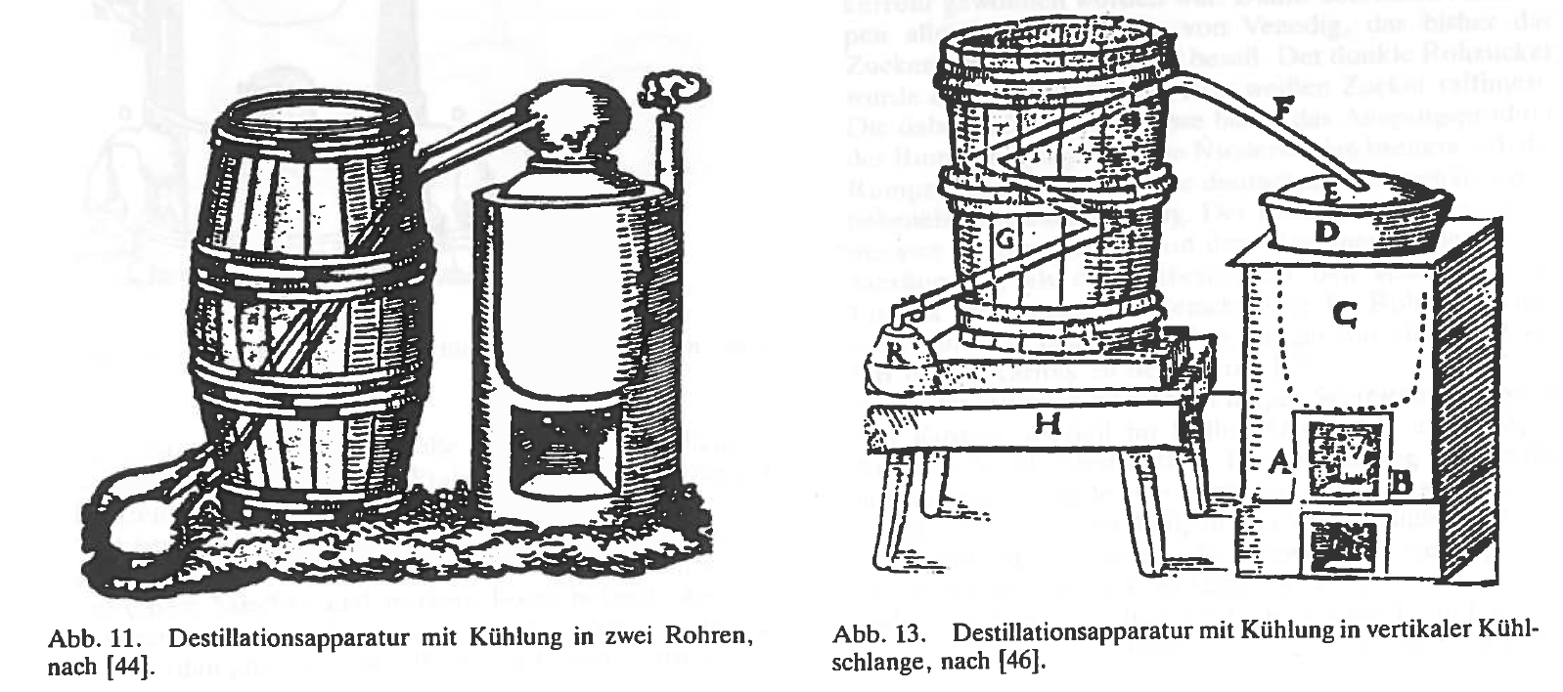
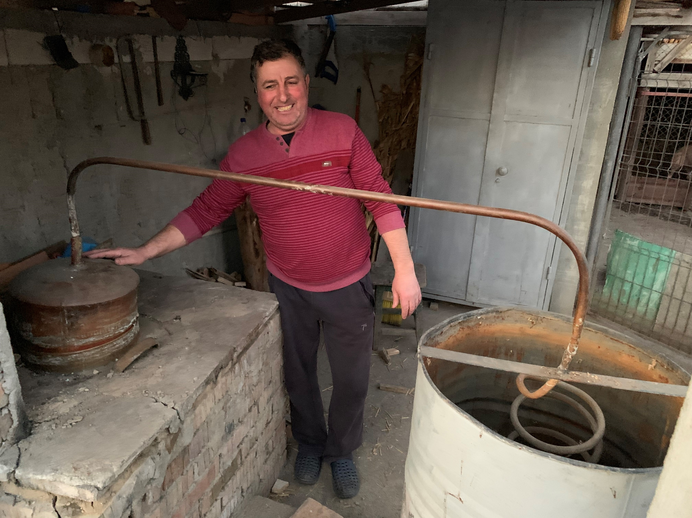
Batch distillation with no reflux (-> N=1)
1545
1593
2020

Slide 9
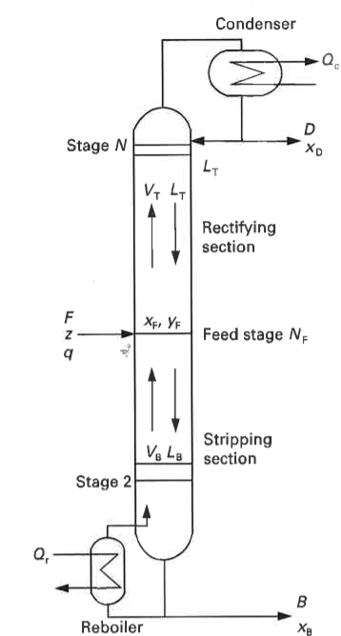
Continuous distillation with reflux (L)
L
V
stage 1

Slide 10
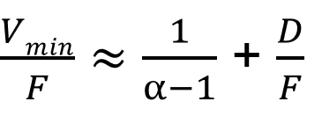
When use distillation?
Liquid mixtures with difference in boiling point
Unbeatable for high-purity separations
    Essentially same energy usage independent of purity!
    Number of stages increases only as log of impurity!
      Fenske: N_{min} = ln S / ln α
Well suited for scale-up
        Columns with diameters over 15 m
Examples of unlikely uses of distillation:
        High-purity silicon for computers (via SiCl₃ distillation)
        Water – heavy-water separation (boiling point difference only 1.4ºC)
Close-boiling mixture (α close to 1)
Need a lot of energy (heat)
and many stages

Slide 11
«Distillation is an inefficient process»
This is a myth!
By itself, distillation is an efficient process
  Typically, thermodynamic efficiency >50%
It’s the heat integration that may be inefficient.
  Yes, it can use a lot of energy (Q_{r}=heat), but it provides ~ the same energy as cooling (Q_{c}) at a lower temperature

Slide 12
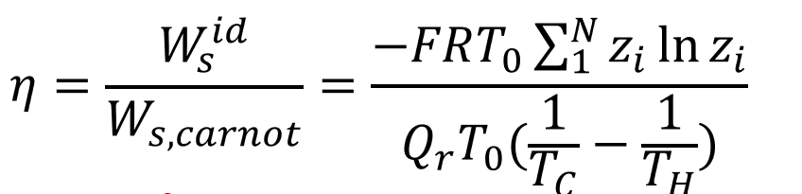



Thermodynamic efficiency of distillation
$$α=10$$
$$α=1$$
$$η$$
Separation into pure components
Plot is for liquid feed, binary mixture
z = fraction light component in feed
Plot from I.J. Halvorsen.
Ref: S. Skogestad, Chemical and Energy process engineering, CRC Press, 2009, pp. 224
Ref: C.J. King, Separation processes, McGraw-Hill, 1971, 1980
α = relative volatility

Slide 13
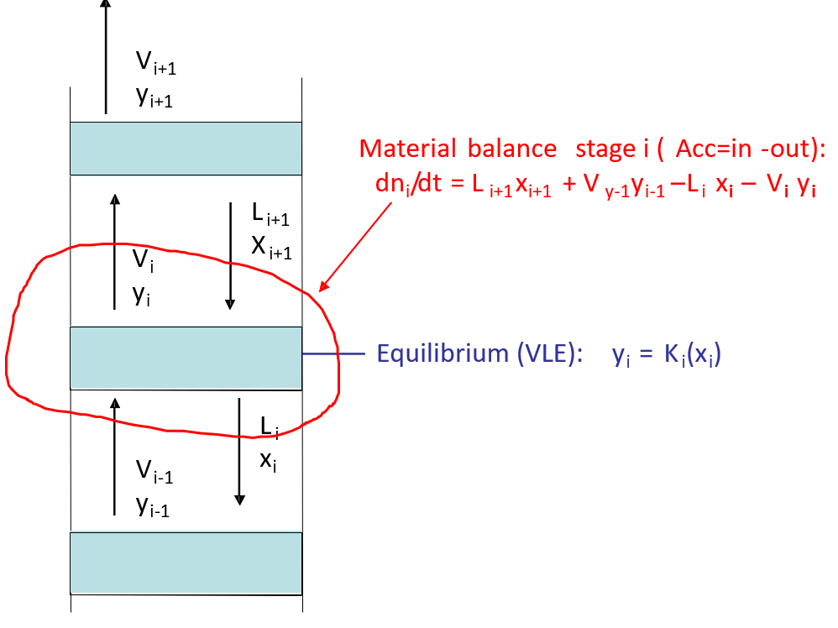

2. Simple to model. Equilibrium stage concept
M_{i}
Francis weir formula:
VLE: “Relative volatility model”
Usually most important!
Activity coefficient (e.g. UNIFAC)
Or: Equation of state (e.g. SRK, PR)
VLE = Vapor-Liquid Equlibrium

Slide 14
2. Simple to model. Equilibrium stage concept
M_{i}
Modelling. Adjusting parameters
VLE. May need experimental data
Stages (N)
  Use steady-state model
  Match steady-state compositions and temperature profiles
    Adjust N to get theoretical stages in each section (also for packed column)
    Tray column: Can use Murphee efficiency. I use bypass on V and/or L
Holdup Mi. Match with dynamic data for compositions
  Typical column holdup, M_{L} = ΣM_{i}
  Tray column: 10% of column volume
  Packed column: 5% of column volume
Liquid dynamics: Make step in L and see how long it takes for change to reach bottom
  Francis weir formula: θ_{L} ≈ (2/3) M_{L} / L
VLE: “Relative volatility model”
Usually most important!
Activity coefficient (e.g. UNIFAC)
Or: Equation of state (e.g. SRK, PR)

Slide 15

3. Dynamics
Example . Propylene-propane (C3-splitter, column D)
N = 110 theoretical stages
ΔT_{B}=5.6K
α = 1.12 (relative volatility at 15 bar)
Purities: 99.5% propylene (top) and 90% propane (bottom)
Assume constant molar flows
L/D = 19, D/F = 0.614
$$\frac{M_{tot}}{F}=\frac{\sum_{i}{M_{i}}}{F}=111min$$

Slide 16

External flow change
Propylene-propane. Simulated composition response.
Increase reflux 0.4% (ΔL = +0.05, Δ D=-0.05) with V constant:
X_{feed stage}
L
X_{D}
V
X_{B}
6 min
2000 min

Slide 17
Increase in L +0.05
feed stage

Slide 18
External flow change.
Propylene-propane. Simulated composition response with detailed model.
Increase boilup (V: +0.05, D: +0.05) with L constant
L
X_{D}
X_{feed stage}
V
X_{B}
Opposite of increase in L!

Slide 19
What happens if we increase both L and V at the same time?
Then D and B are constant
Internal flow change
L
V

Slide 20
Internal flow change.
Propylene-propane. Simulated composition response with detailed model.
Increase both L and V by same amount (Δ V = Δ L = +0.05)
feed stage
Very small effect

Slide 21
Increase both L and V by same amount (ΔV = ΔL = +0.05) (ΔD=ΔB=0)
Very small effect! Note axis: Have “blown up” to see details
0.9951
X_{D}
X_{feed stage}
0.9950
0.100
0.0998
Both products get purer.
Response for x_{B} a bit “strange”
(with very large overshoot)
because it takes some time for
L to reach the bottom
X_{B}
0.0992

Slide 22
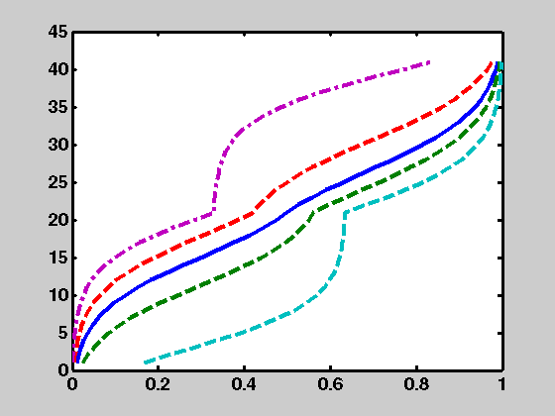
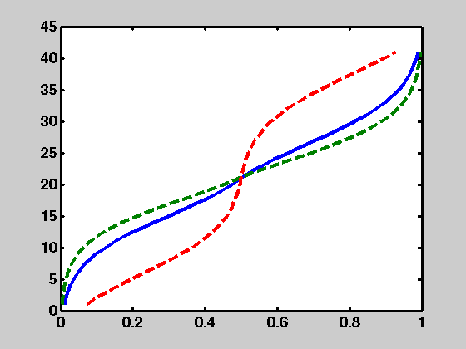
External and Internal Flows
Steady–state composition profiles (column A)
External flows
Internal flows (10X)
stage
0
COMP
0
COMP
Δ L = Δ B = - Δ D = (-0.1, -0.01, 0, 0.01, 0.1)
Δ V=Δ L = (1, 0, -1). Δ B=Δ D=0
Large effect on composition (large “gain”)
One products get purer – the other less pure
Small effect on composition (small “gain”)
Both products get purer or both less pure
«ILL-CONDITIONED INTERACTIVE PROCESS». Problem for control?
Column A: N=40, α=1.5, x_{D} & xB: 99%, L/D= 5.4

Slide 23
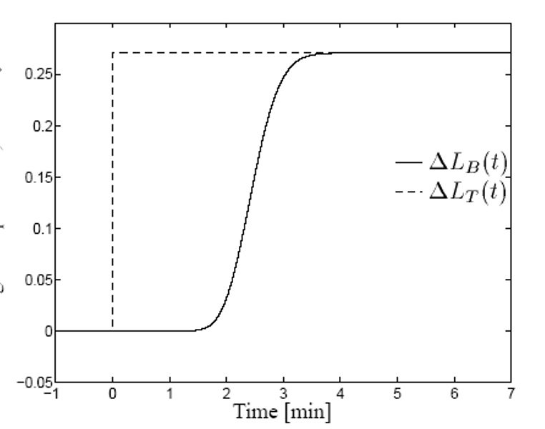
Liquid flow dynamics are essential for control
Liquid flow dynamics ”break” the initial two-way interaction between top and bottom.
  Want to close one loop (temperature or composition) with closed-loop time constant faster than the liquid flow dynamics
S. Skogestad, “Dynamics and control of distillation columns - A tutorial introduction”, Trans IChemE, Part A (Chemical Engineering Research and Design), 75, Sept. 1997, 539-562

Slide 24
Nonlinearity
Use logarithmic compositions
S. Skogestad, ``Dynamics and Control of Distillation Columns - A Critical Survey‘’, IFAC-symposium DYCORD+'92, Maryland, Apr. 27-29, 1992.
Reprinted in Modeling, Identification and Control, Vol. 18, 177-217, 1997.

Slide 25
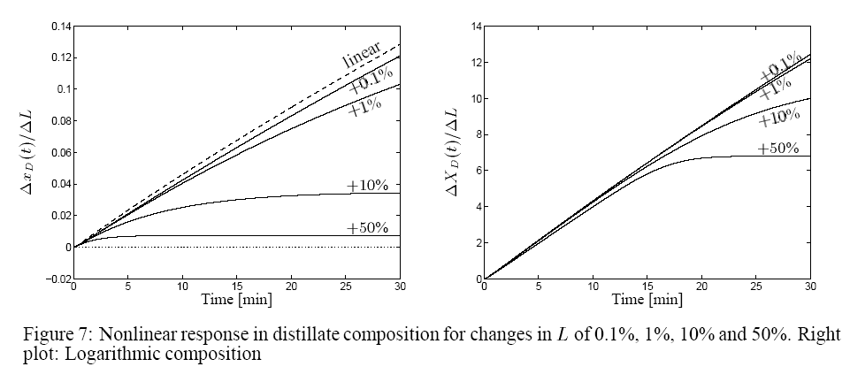
With logarithmic compositions
S. Skogestad, “Dynamics and control of distillation columns - A tutorial introduction”, Trans IChemE, Part A (Chemical Engineering Research and Design), 75, Sept. 1997, 539-562

Slide 26
Conclusion dynamics
Dominant first order response – often close to integrating from a control point of view
Liquid flow dynamics decouples the top and bottom on a short time scale, and make control easier
Logarithmic transformations linearize the response

Slide 27
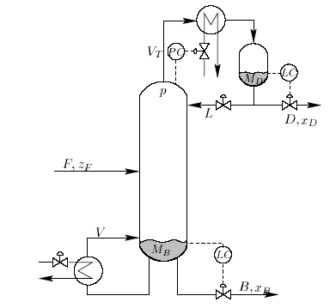
4. Optimal operation distillation column
Dynamic degrees of freedom (with given F): 5
Steady state (control levels and pressure): 2 degrees of freedom (e.g. L,V)
Optimal operation: Minimize cost J subject to satisfying constraints
Cost to be minimized (economics)
  J = - P where P= p_{D} D + p_{B} B – p_{F} F – p_{V} V
Constraints
  x_{D, impurity} < max
  x_{B, impurity} < max
  Column capacity (flooding): V < V_{max}, etc.
cost energy (heating+ cooling)
value products
cost feed

Slide 28
Expected active constraints distillation
Valueable product: Purity spec. always active
  Avoid product “give-away”
  (“Sell water as methanol”)
  Saves energy
Control implications:
  1. Control valueable product at spec.
    Control D at 0.5% water
  2. Overpurify other end to reduce loss
    Control B with methanol < 2%
    Overpurifying may not cost much energy (V) if enough stages
    If “few” stages: May be optimal to operate at max energy (V) to minimize loss of valuable product
methanol
+ water
valuable
product
methanol
+ max. 0.5%
water
cheap product
(byproduct)
water
+ max. 2%
methanol

Slide 29
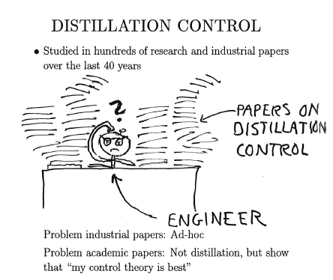
5. Control
S. Skogestad, “The dos and don'ts of distillation columns control”,
Chemical Engineering Research and Design (Trans IChemE, Part A), 85 (A1), 13-23 (2007).

Slide 30
Two objectives for control
Have 5 dynamic degrees of freedom
Stabilize (avoid drift)
  Levels (M_{D}, M_{B}, pressure)
  Temperature profile («level of heavy component»)
  NOTE: Temperature setpoint can be used as degree of freedom for composition control
Optimize operations
  Normally control product compositions (x_{D}, x_{B})

Slide 31
Issues distillation control
The “configuration” problem (pairings for level and pressure)
  Which are the two remaining degrees of freedom?
    e.g. LV-, DV-, DB- and L/D V/B-configurations
The temperature control problem
  Which temperature (if any) should be controlled?
Composition control problem
  Control two, one or no compositions?
L
T_{s}
TC
TC
V

Slide 32
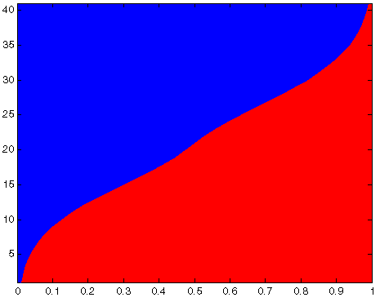
Stabilize temperature profile (“level of heavy component”)
D
LIGHT
TC
F
HEAVY
B
Temperature sensor should be located at «sensitive» stage (with high gain)
Typically in middle of top or bottom section

Slide 33
Which stage? Binary column
slope closely correlated with steady state gain
TEMPERATURE PROFILE
STAGE

Slide 34
Multicomponent column
Slope NOT correlated with steady-state gain
TEMPERATURE PROFILE
Conclusion: Temperature slope alone OK only for binary columns

Slide 35
Which configuration?
Level control top: Use L or D?
Would like to use D because L is most effective for composition control
V_{T} (large)
However, for large L/D (>5):
Seems almost impossible to control level with D (small range because need D>0)
LC
D (small)
L (large)
FORTUNATELY:
Tight level control is NOT important
Fast inner temperature loop gives indirect level control!
Conclusion: Recommend using D (and B) for level control!!
Gives LV-configuration

Slide 36
Conclusion configurations
Normally use LV-configuration
because it is
  simplest
  level tunings do not matter for column behavior
  can get smooth variations in product rates D and B
Usually add temperature loop using L or V
  Especially for difficult separations with large L and V
  Gives indirect level control
  Breaks interactions
LV-configuration

Slide 37
LV-configuration with temperature loop and dual composition control
LV
CC
x_{D}
FAST
TC
T_{s}
x_{B}
CC
Inner fast T-loop should be in the «important» end
  The figure above is when bottom composition is most important
Temperature sensor should be located at «sensitive» stage.

Slide 38
Myth of slow control
Let us get rid of it!!!
Compare manual (“perfect operator”) and automatic control for column A:
    40 stages,
    Binary mixture with 99% purity both ends,
    relative volatility = 1.5
    L/D = 5.4
  First “one-point” control: Control of top composition only
  Then “two-point” control: Control of both compositions
S. Skogestad, “Dynamics and control of distillation columns - A tutorial introduction”, Trans IChemE, Part A (Chemical Engineering Research and Design), 75, Sept. 1997, 539-562

Slide 39
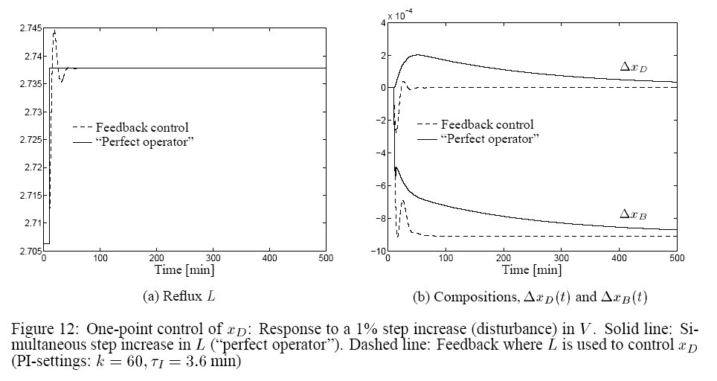
Myth about slow control
One-point control
“Perfect operator”: Steps L directly to
correct steady-state value
(from 2.70 to 2.74)
Want x_{D} constant
Can adjust reflux L
Disturbance
in V

Slide 40
Myth about slow control
One-point control
“Perfect operator”: Steps L directly
Feedback control: Simple PI control
Which response is best?
CC
x_{DS}
Disturbance
in V

Slide 41
Myth about slow control
One-point control

Slide 42
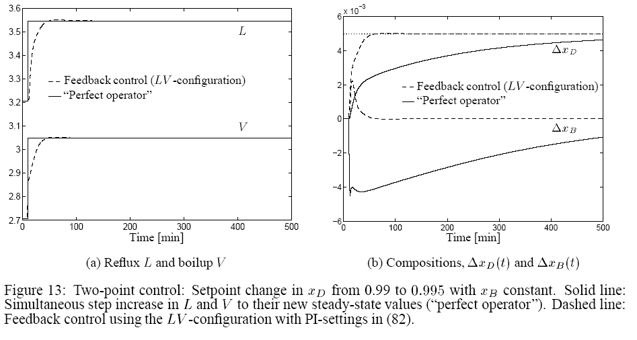
Myth about slow control
Two-point control
V
“Perfect operator”: Steps L and V directly
Feedback control: 2 PI controllers
Which response is best?
CC
x_{DS:} step up
L
CC
x_{BS:} constant

Slide 43
Myth about slow control
Two-point control
V
L

Slide 44
Myth about slow control
Conclusion:
Experience operator: Fast control impossible
  “takes hours or days before the columns settles”
BUT, with feedback control the response can be fast!
  Feedback changes the dynamics (eigenvalues)
  Requires continuous “active” control
Most columns have a single slow mode (without control)
  Sufficient to close a single loop (typical on temperature) to change the dynamics for the entire column

Slide 45
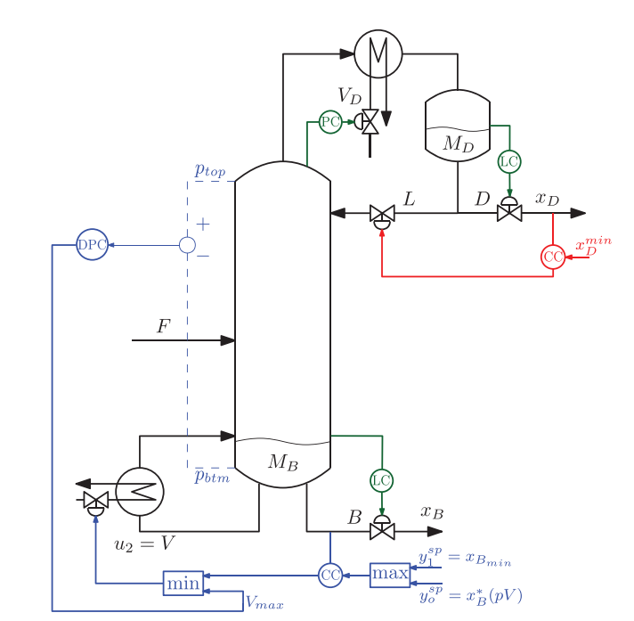
Advanced control
Constraint on pressure drop, DP
Top product valueable, x_{D}
Overpurify bottom
DP_{max}
T
TC
x_{Bmin}: Constraint
x_{B}*:Optimal x_{B} (overpurify)
May also add feedforward control from F (ratio V/F in this case)

Slide 46
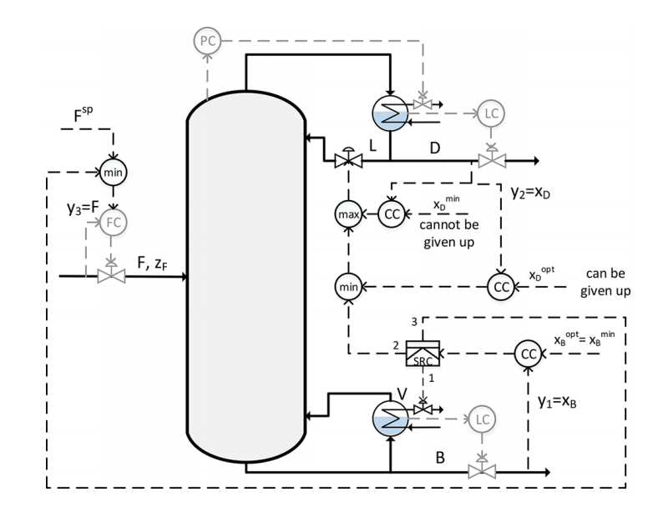
Advanced control….
Case with valuable bottom product, x_{B.}
Split range control (SRC):
1. Normally control x_{B} with boilup V
…. But boilup V may reach constraint
2. First let reflux L take over
3. Then cut back on feedrate F if top reaches constraint
"Systematic Design of Active Constraint Switching Using Classical Advanced Control Structures". A. Reyes-Lua and S. Skogestad, Ind. Eng. Chem. Res. 2020, 59 (6), 2229-2241.

Slide 47
Conclusion distillation control
Not as difficult as often claimed
LV-configurations recommended for most columns
Use log transformations to reduce nonlinearity
Use composition estimators based on temperature
Usually: Close temperature loop (P-control OK)
May use MPC if strong interactions between loops
Two-point
LV-configuration
with inner T-loop
LV
x_{D}
CC
TC
T_{s}
x_{B}
CC
S. Skogestad, “The dos and don'ts of distillation columns control”,
Chemical Engineering Research and Design (Trans IChemE, Part A), 85 (A1), 13-23 (2007).

Slide 48
Conclusion
Distillation as a separation process
  In spite of claims to the contrary it's an efficient process
    - it's the heat integration that may be inefficient
  Unbeatable for high-purity separations
2. Modelling
  In principle it's simple
  Normally use equilibrium stage model
  The thermodynamics (VLE) are the most important
3. Dynamics
  There is one dominant slow (drifting) mode
  related to the holdup of light and heavy key components inside the column
4. Optimal operation
  Minimize energy usage (V) and maximize recovery of valuable component (J = pF F – pD D – pB B + pV V)
  subject to satisfying purity specifications
  Always active constraint: Purity of valueable product («avoid give-away»)
5. Control
  Fist: stabilize the column (levels, pressure and one temperature)
    The temperature loop will speed up the slow mode, break interactions and provide indirect level control
  Next: Control active constraints and keep operation close to optimal
  May use MPC, but can usually do OK with advanced single-loop control
https://folk.ntnu.no/skoge/distillation/

