Slide 1
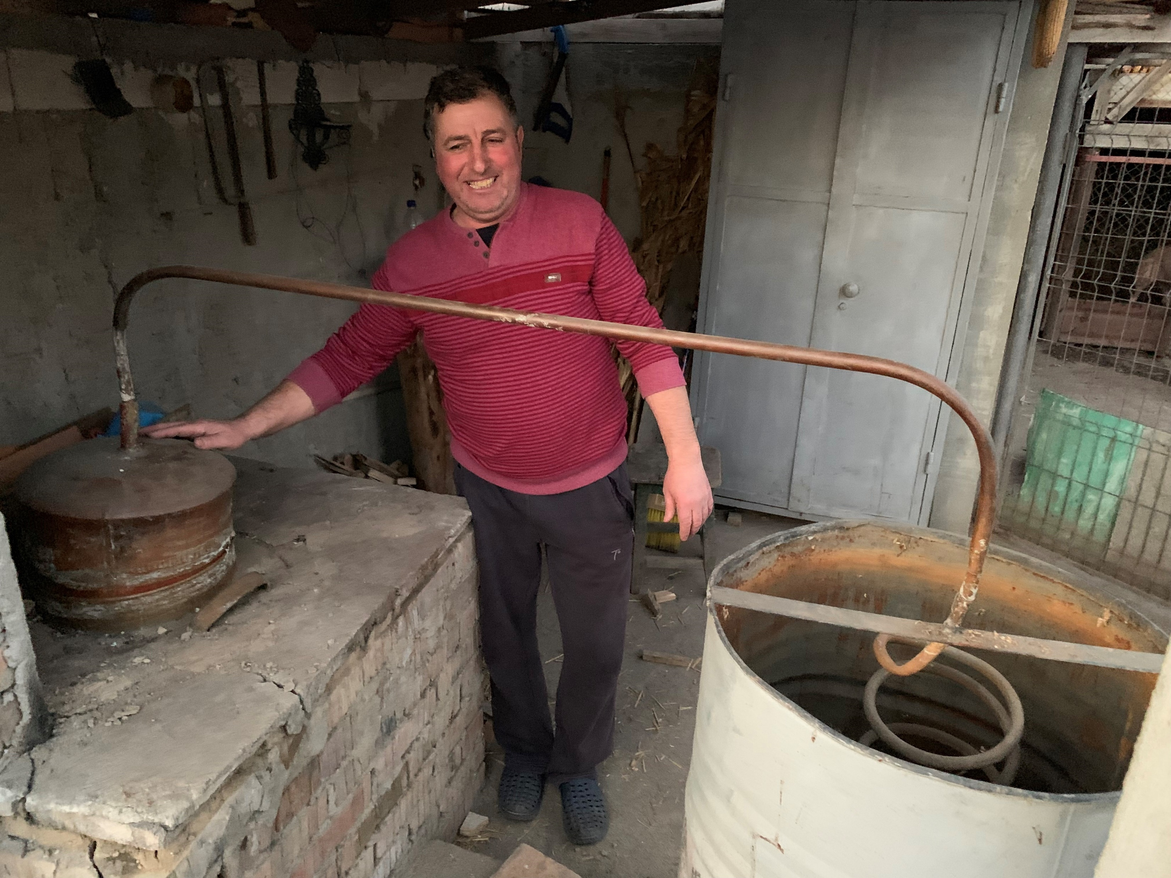
Distillation is part of the future
Sigurd Skogestad, NTNU
Mamaia, Romania, Sept. 2019

Slide 2
Abstract. Distillation is the most important separation process for liquids and it is an important part of the future of the chemical industry.
Some highlights of the talk:
Introduction: Importance of reflux
It’s a myth that distillation is bad in terms of energy
  Distillation is actually a thermodynamically efficient process
  Distillation is an ideal separation process if one has surplus heat.
Distillation is unbeatable for high-purity separations
Integrated schemes can save energy and capital
  Divided-wall / Petlyuk columns
For autonomous and energy-efficient batch distillation try multivessel distillation with closed operation
Azeotropes can be broken by using extractive agent and especially by making use of liquid-liquid splits
Better operation and control can improve quality and productivity
  It’s a myth that distillation columns are so slow
  Beware of using too much integral action in your controller

Slide 3
Outline
Introduction. Importance of reflux
Myth about distillation being inefficient
Distillation unbeatable for high-purity separations
Integrated schemes. Divided-wall / Petlyuk
Multivessel batch distillation
Adding a component to break azeotropes
Control: Myth about slow response

Slide 4
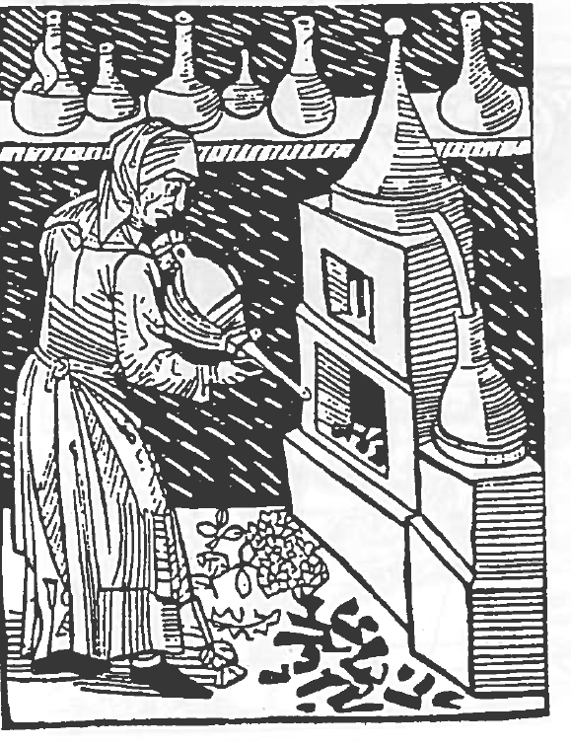
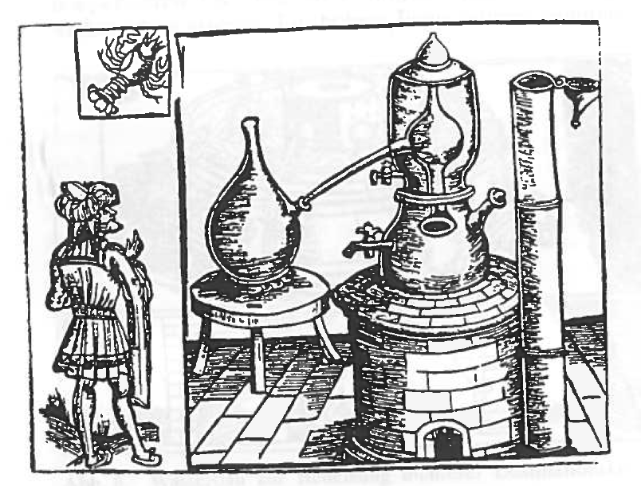
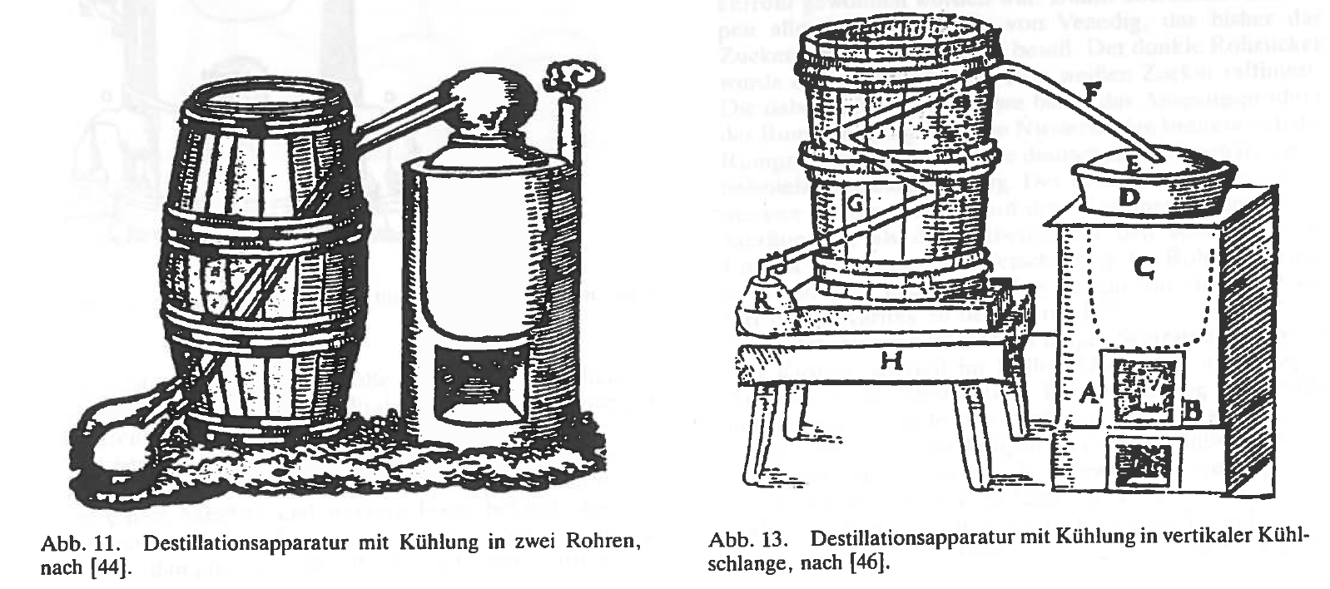
1. Introduction
1512
Water distillation. 1483
1545
1593

Slide 5
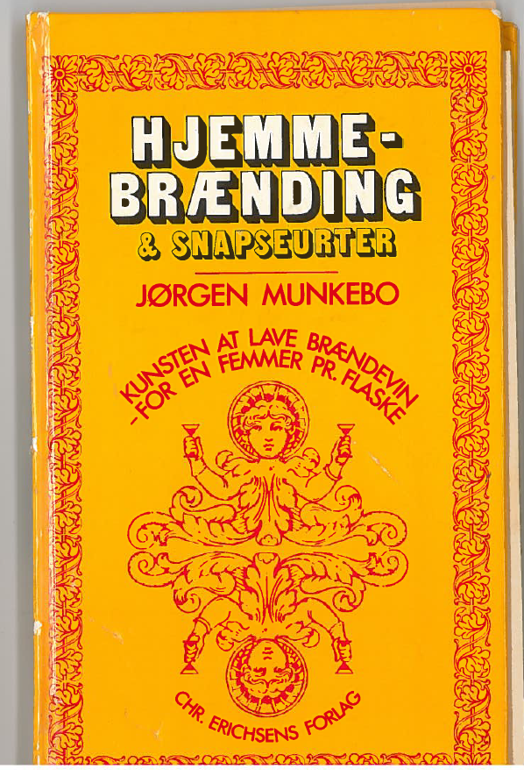
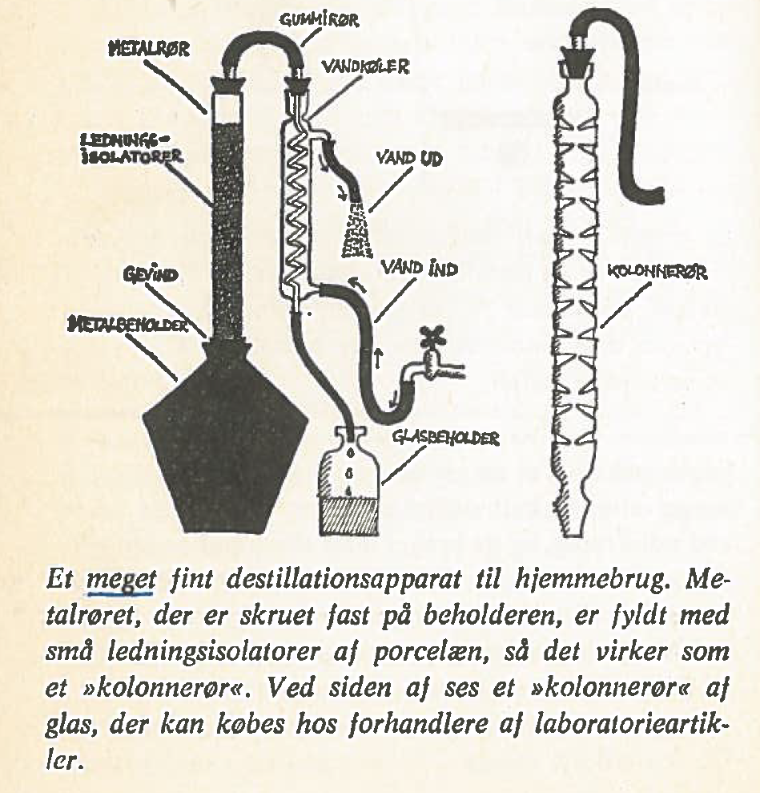
1972
What’s wrong?

Slide 6
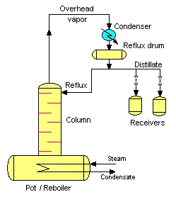
Batch distillation in wikipedia (2019)
V
Note: 1. Has column (multistage)
2. Has reflux
D
L

Slide 7
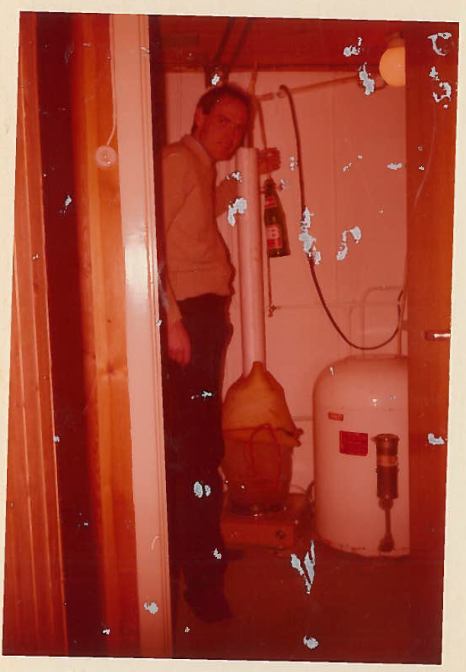
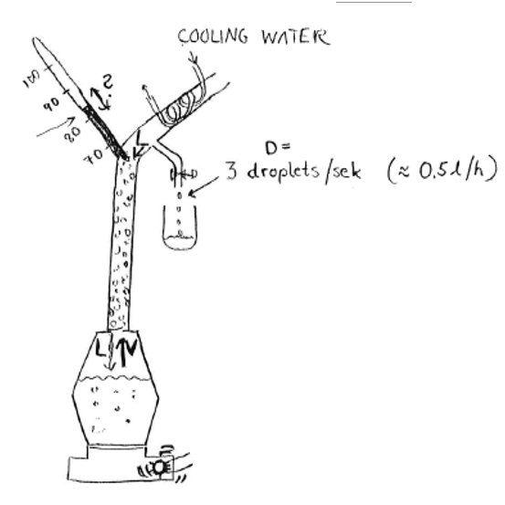
Good design
Packed column (about 10 stages)
Adjustable reflux

Slide 8
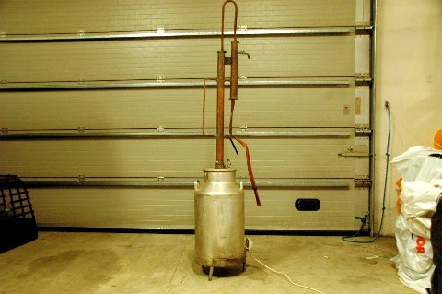
Strange design

Slide 9
Good design for tuica
No column, no reflux
1 theoretical stage

Slide 10
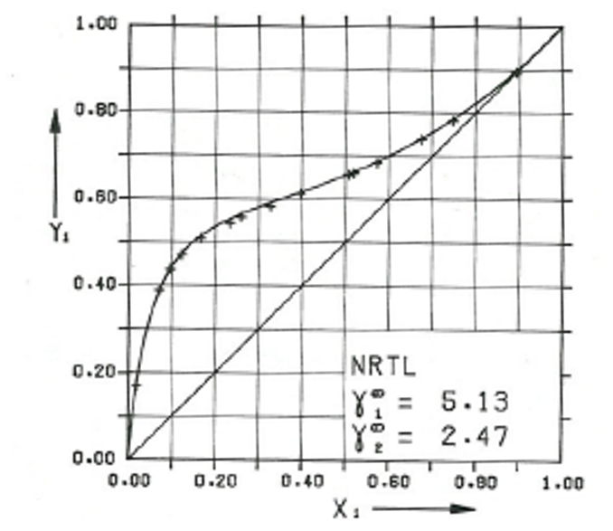
Vapor-liquid equlibrium for ethanol-water
.
78.4 C
78.1 C
Y₁: in vapor
Large activity cofficient:
Ethanol really does not like water
And water does not like ethanol
-> low-boiling azeotrope
100 C
X₁: Mole fraction ethanol (1) in liquid

Slide 11
McCabe-Thiele
.
Infinite stages: Azeotrope at Y=0.92 (96 vol%)
Y₁: in vapor
3 stages: Y=0.70 (84 vol%)
3
2 stages: Y=0.60 (77 vol%)
2
1
1 stage: Y=0.35 (55 vol%)
X=0.07 (14.5 vol%)
X₁: Mole fraction ethanol (1) in liquid

Slide 12
Finite reflux
.
Y₁: in vapor
3 stages: Y=0.675 (82 vol%)
3
2
Diagonal: reflux ratio is infinite
Blue line: reflux ratio is L/D=5
Red line: reflux ratio is zero (L=0)
1
3 stages: Y=0.35 (55 vol%)
X₁: Mole fraction ethanol (1) in liquid

Slide 13
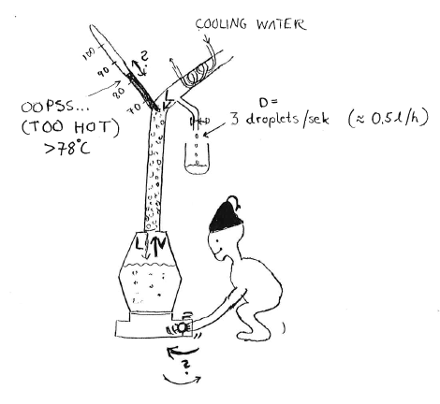
Reflux gives strange effects
With fixed product rate (D):
Must increase heat in the bottom to get lower temperature

Slide 14
2. «Distillation is an inefficient process which uses a lot of energy»
This is a myth!
By itself, distillation is an efficient process.
It’s the heat integration that may be inefficient.
Yes, it can use a lot of energy (heat), but it provides the same energy as cooling at a lower temperature

Slide 15
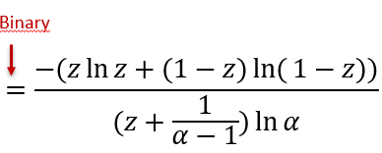
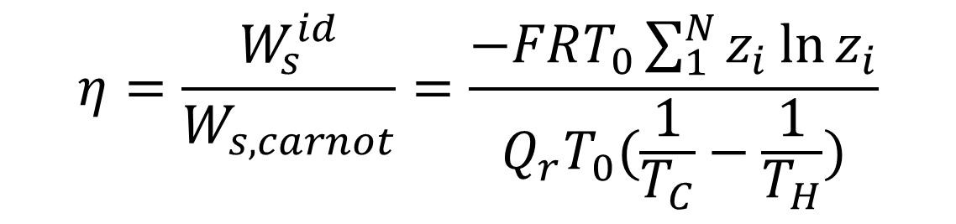
Thermodynamic (exergy) efficiency for conventional distillation
Thermodynamic Efficiency =
Ideal work for the separation/Actual work:
$$η=\frac{W_{s}^{id}}{W_{s,carnot}}=\frac{−FRT_{0}\sum_{1}^{N}{z_{i}{\ln{z}}_{i}}}{Q_{r}T_{0}(\frac{1}{T_{C}}−\frac{1}{T_{H}})}$$
Approximate for

Slide 16

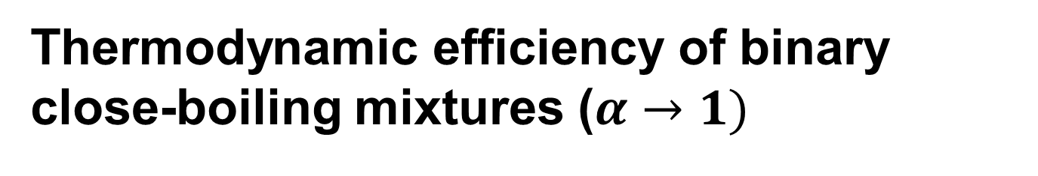
Thermodynamic efficiency of binary close-boiling mixtures ($α→1)$
$$\lim_{α→1}{η}=−(z\ln{z}+(1−z)\ln{(}1−z))$$
Peak efficiency is -ln0.5 = 0.693 at z=0.5
Comment: Above 50% for z from 0.2 to 0.8
α = relative volatility
z = feed composition (mole fraction light component)

Slide 17



Thermodynamic efficiency of binary distillation
$$α=10$$
$$α=1$$
$$η$$
High efficiency at small z for easy separations with large α
Reason: Must evaporate light component to get it over top
z = fraction light component in feed
α = relative volatility

Slide 18
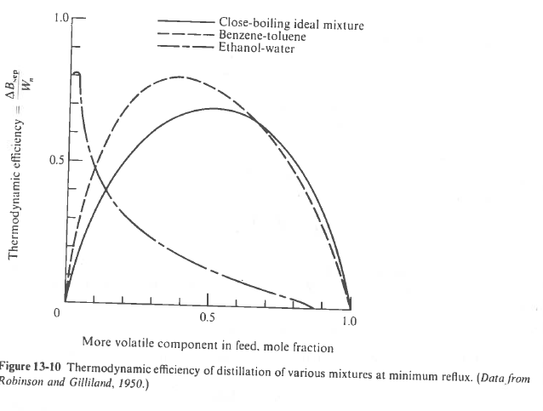
King (1971)
Note: Non-ideality does not necessarily imply lower thermodynamic efficiency

Slide 19
Why is it not perfect – where are the losses?
Irreversible mixing loss at every stage.
Largest losses in the middle of each section – where the bulk separation takes place
Small losses at the high-purity column ends

Slide 20
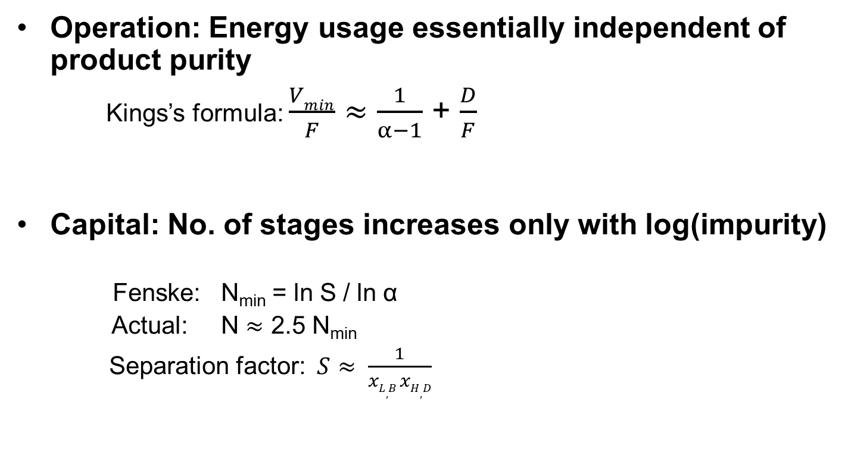
3. Distillation is unbeatable for high-purity separations
Operation: Energy usage essentially independent of product purity
  Kings’s formula: $\frac{Vmin}{F}$ $≈$ $\frac{1}{α−1}$ + $\frac{D}{F}$
Capital: No. of stages increases only with log(impurity)
Fenske: N_{min} = ln S / ln α
Actual: N $≈$ 2.5 N_{min}
Separation factor: $S≈ \frac{1}{xL,B xH,D}$
α = relative volatility

Slide 21
4. Integrated / complex schemes can save energy and capital

Slide 22
Divided wall columns: starting to catch on
1940’s: first patent
1960’s: Thermodynamic analysis (Petlyuk)
1984: First implementation (BASF)
2005: BASF has about 50 divided wall columns
2019: Several hundreds
  also in Japan, South Africa, China ...

Slide 23
Typical sequence: “Direct split”
A
B
C
D
E
A,B,C,D,E,F
F

Slide 24
3-product mixture
A
A
A
A+B
A+B
B
A+B+C
A+B+C
A+B+C
B
B
B+C
C
B+C
C
1. Direct split
2. Indirect split
3. Combined
(with prefractionator)
C

Slide 25
Towards the Petlyuk column
A
A
A
A+B
A+B
A+B
liquid split
A+B+C
B
A+B+C
B
A+B+C
B
B+C
B+C
vapor split
B+C
C
C
C
3.
4. Prefractionator
+ sidestream column
5. Petlyuk
30-40% less energy

Slide 26
4-product mixture
Conventional sequence with 3 columns
A
A – methanol
B – ethanol
C – propanol
D – butanol
B
C
A,B,C,D
D
Direct optimal extension of Petlyuk ideas requires two divided walls.
Will look for something simpler

Slide 27
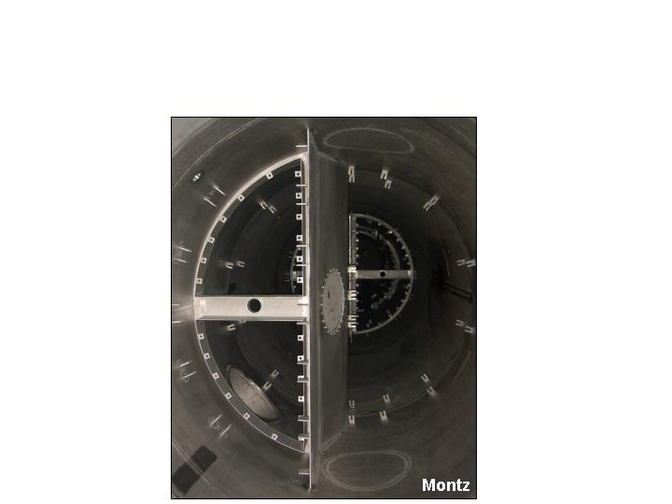
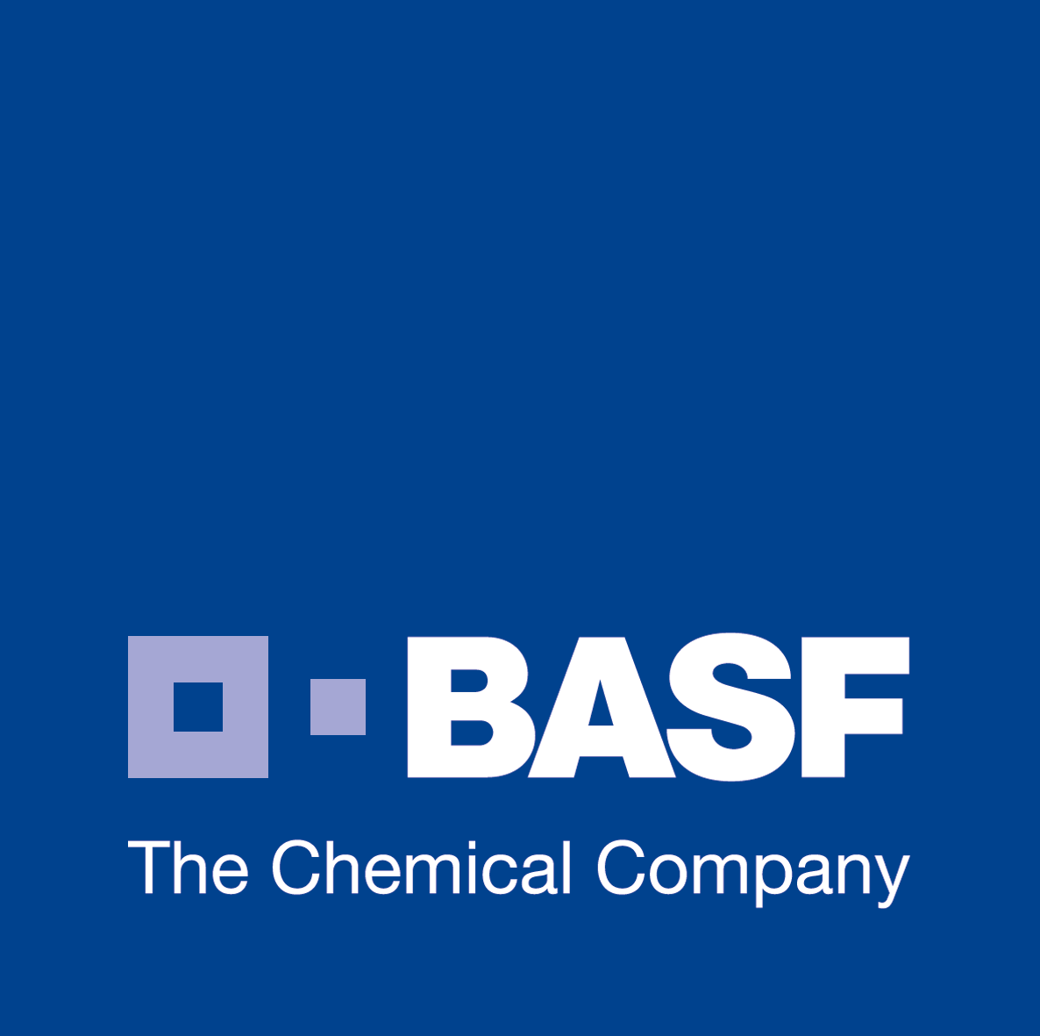
GC – Chemicals Research and Engineering
Dividing Wall Columns
Off-center Position of the Dividing Wall
≈
≈
Montz

Slide 28
4-product mixture: Kaibel column
A
A
A – methanol
B – ethanol
C – propanol
D – butanol
A+B
B (pure!)
ABCD
B
ABCD
C
C (pure!)
C+D
D
D
Alternative 3-column
sequence
Kaibel: 1 column!! More then 50% capital savings
Also saves energy (but maybe not exergy)

Slide 29
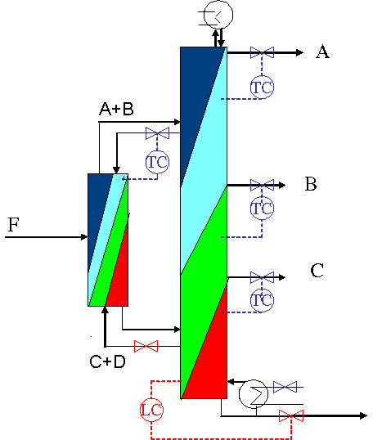
Control of Kaibel column
Close a “stabilizing” temperature
(profile) loop for each split
Prefractionator:
  Close 1 “stabilizing” temperature loop
Main column
  Close 3 “stabilizing” temperature loops
D

Slide 30
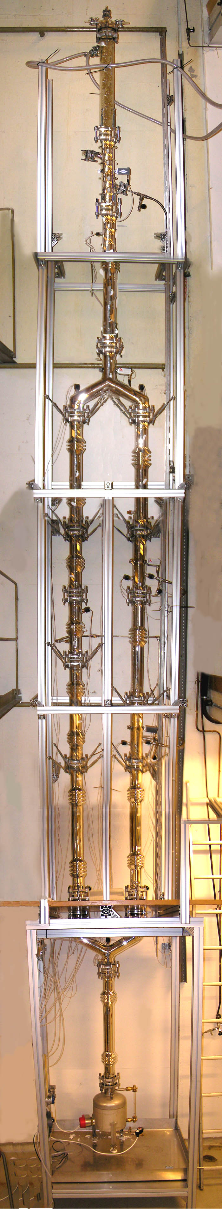
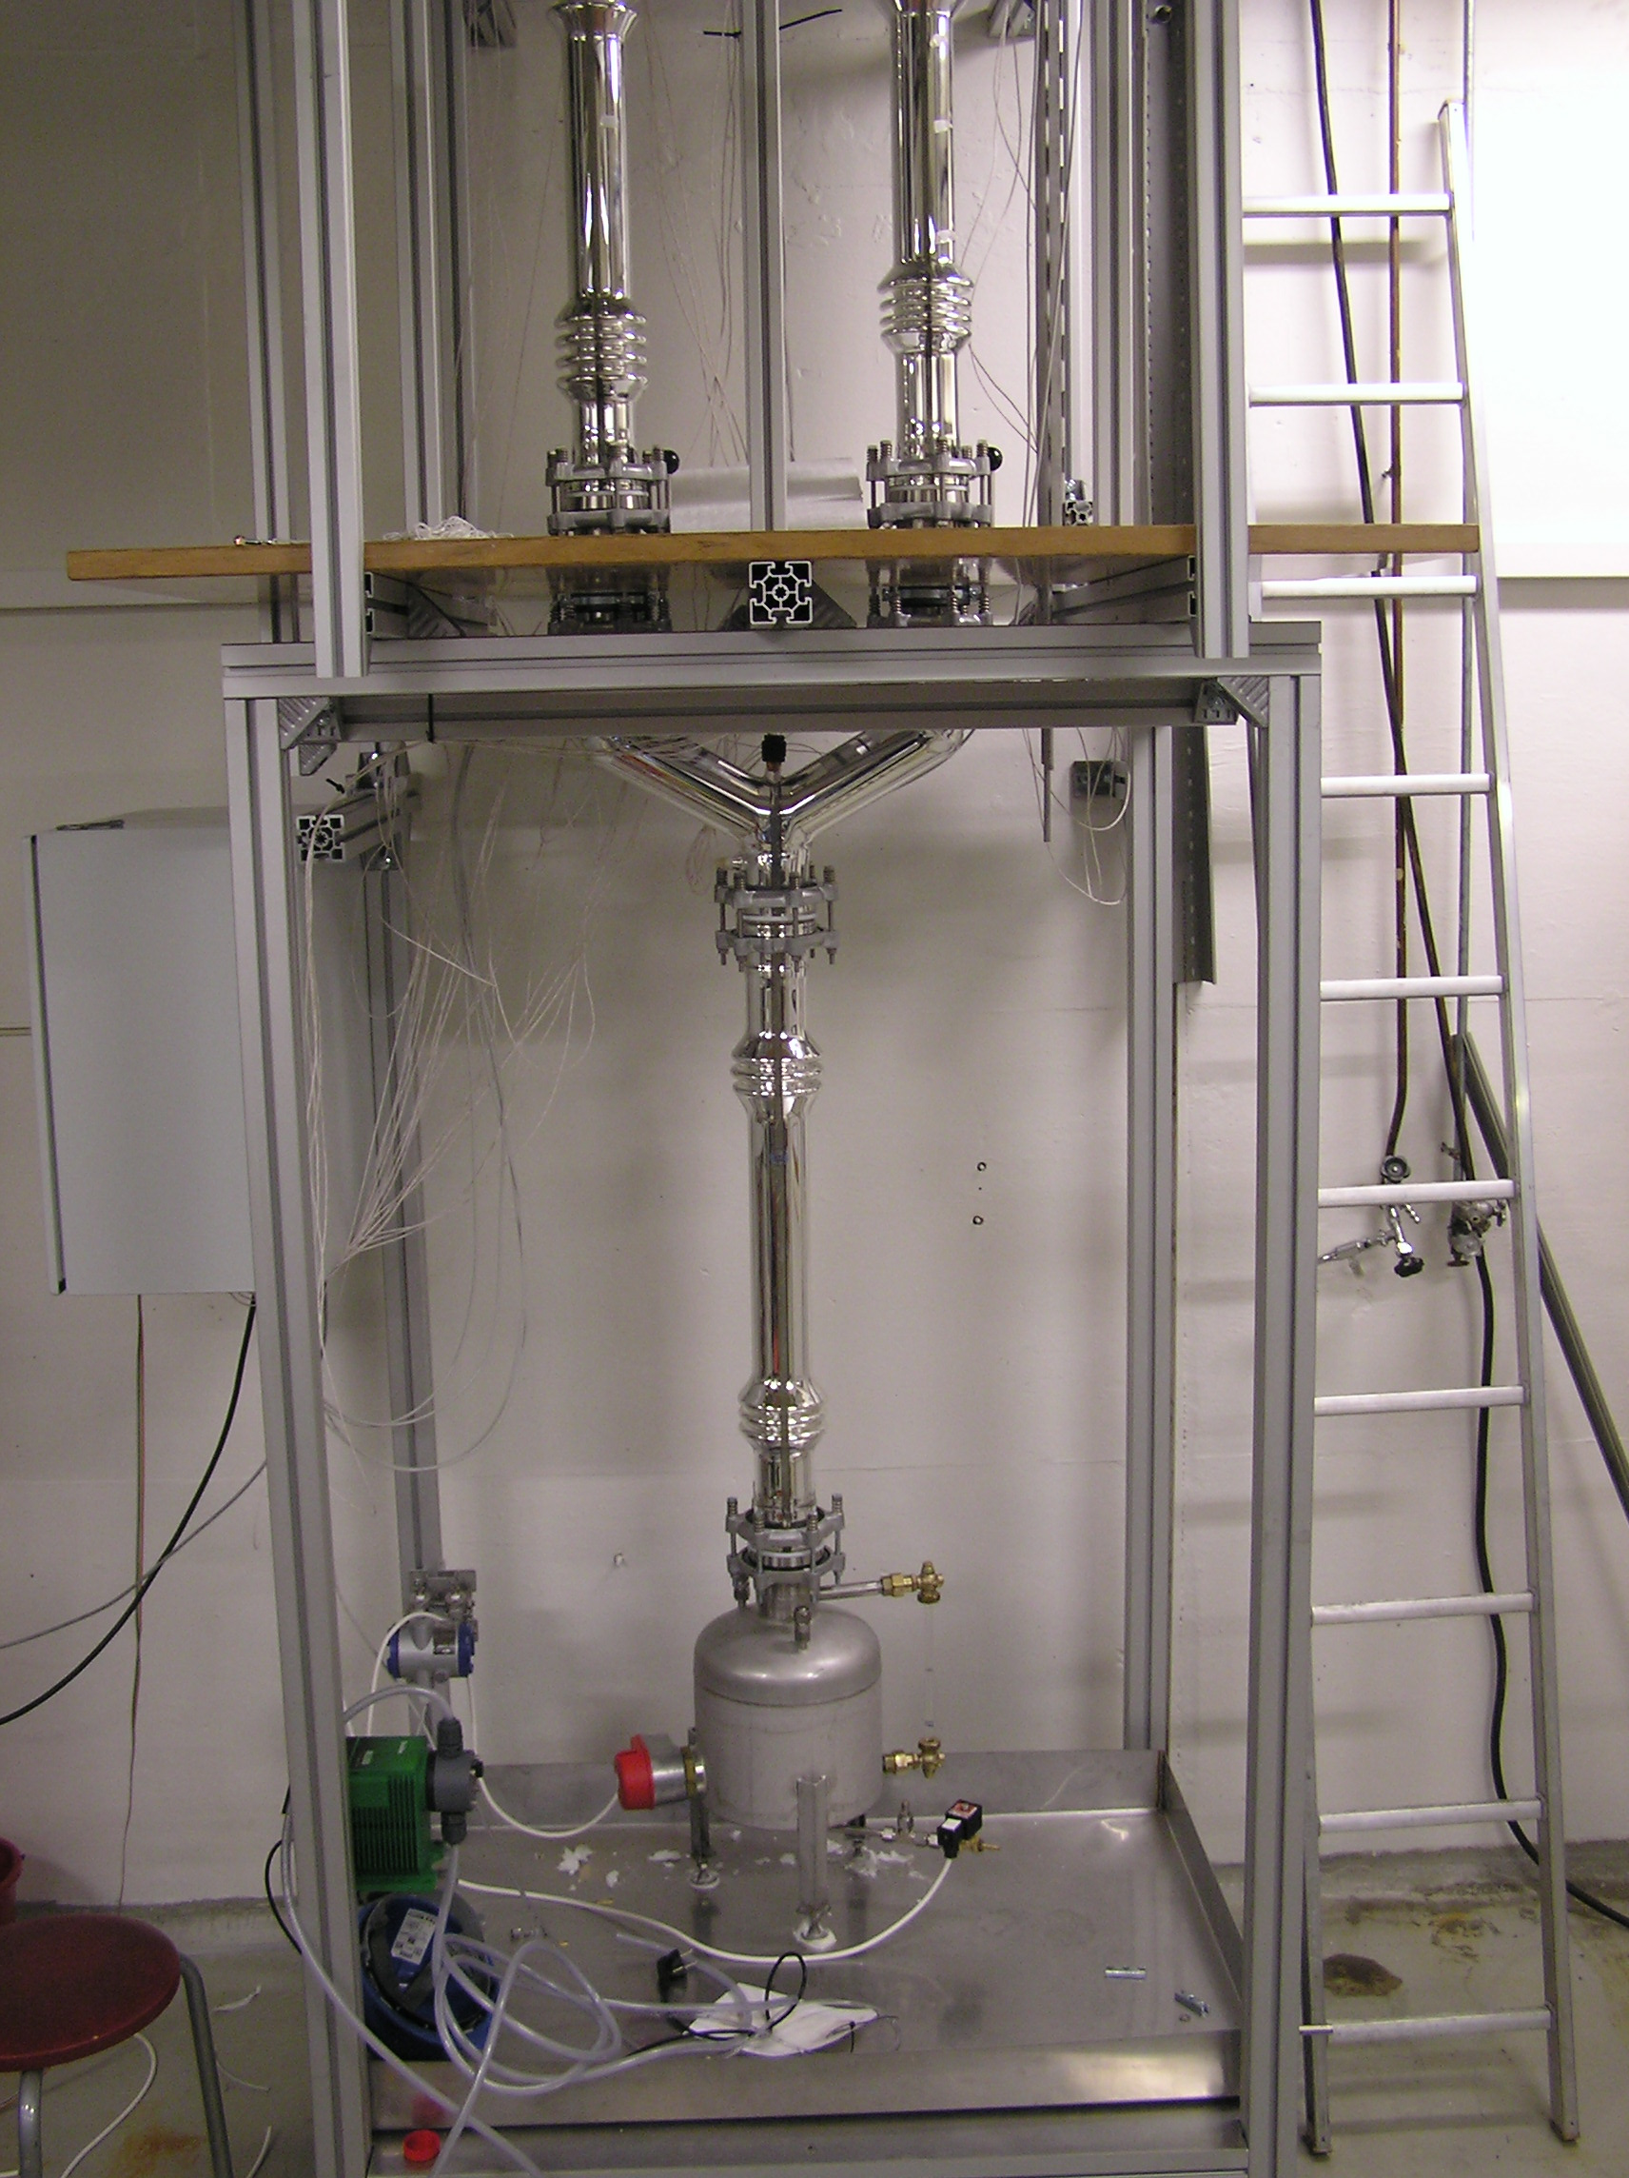
D
S1
H=6m
F
S2
D=5cm
B

Slide 31
5. For autonomous and energy-efficient batch distillation try multivessel distillation with closed operation

Slide 32
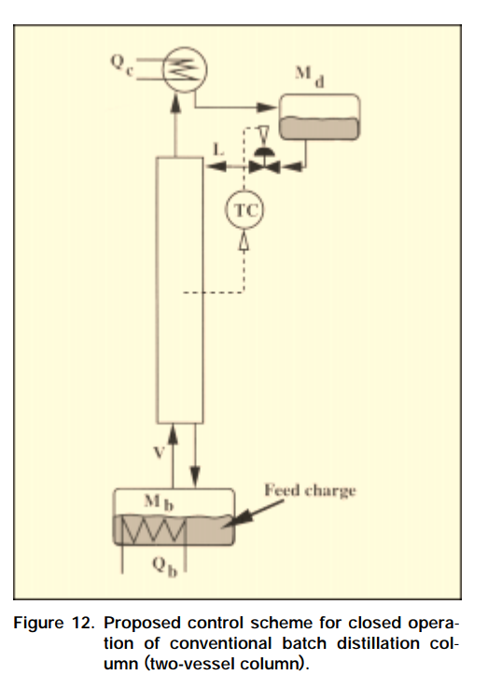
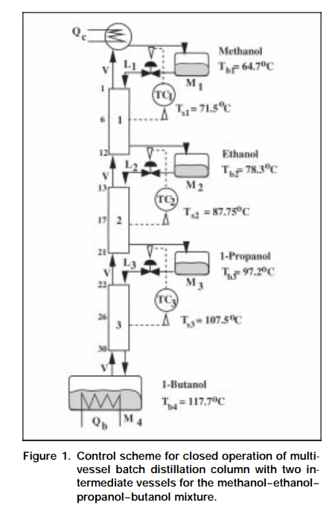
Closed operation of batch distillation
Two-vessel
Multivessel
Closed Operation of Multivessel Batch Distillation: Experimental Verification
Bernd Wittgens and Sigurd Skogestad. AIChE Journal. 46 (6), pages 1209-1217 (June 2000)

Slide 33
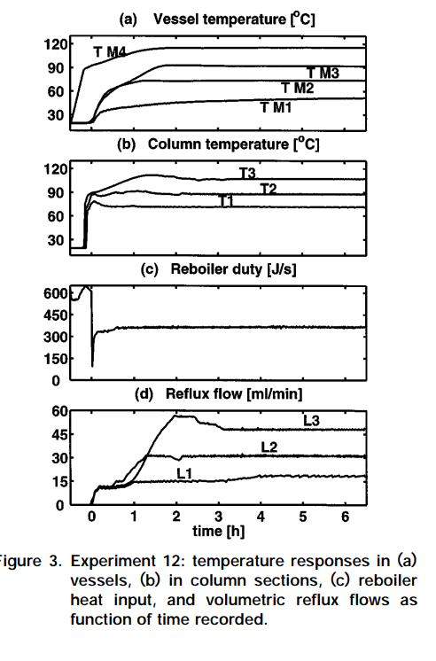
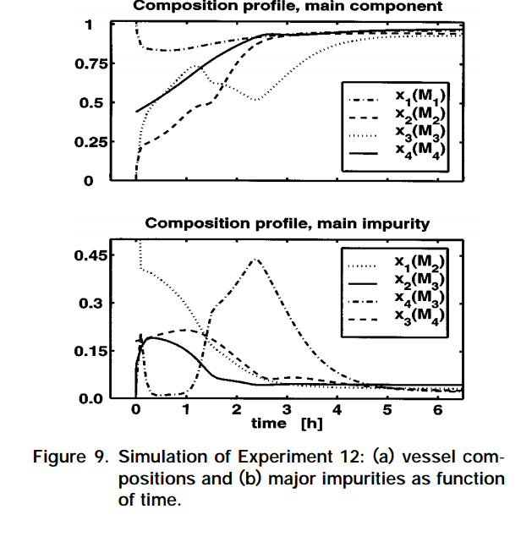

Slide 34
6. Azeotropes can be broken by adding extractive component and especially by making use of liquid-liquid splits

Slide 35
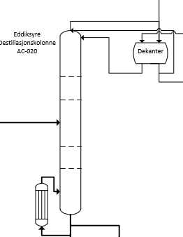
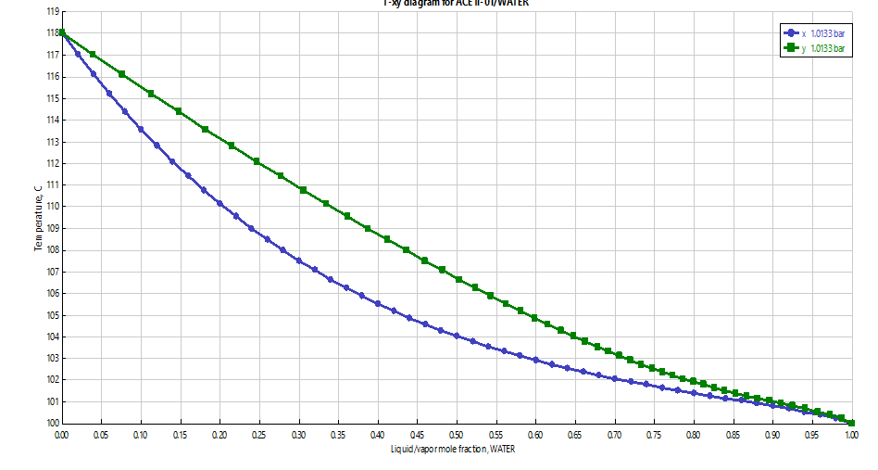
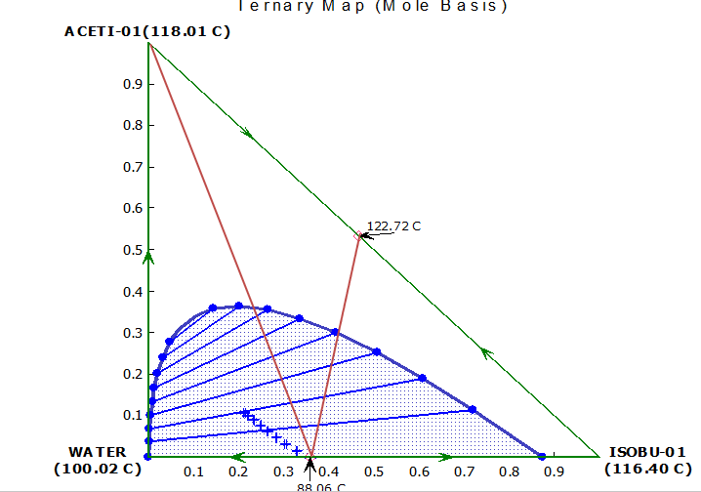
Solvent recovery. Explosives plant, Norway
cooling
N-butyl-actate
Water
60% acetic acid
Acetic acid

Slide 36
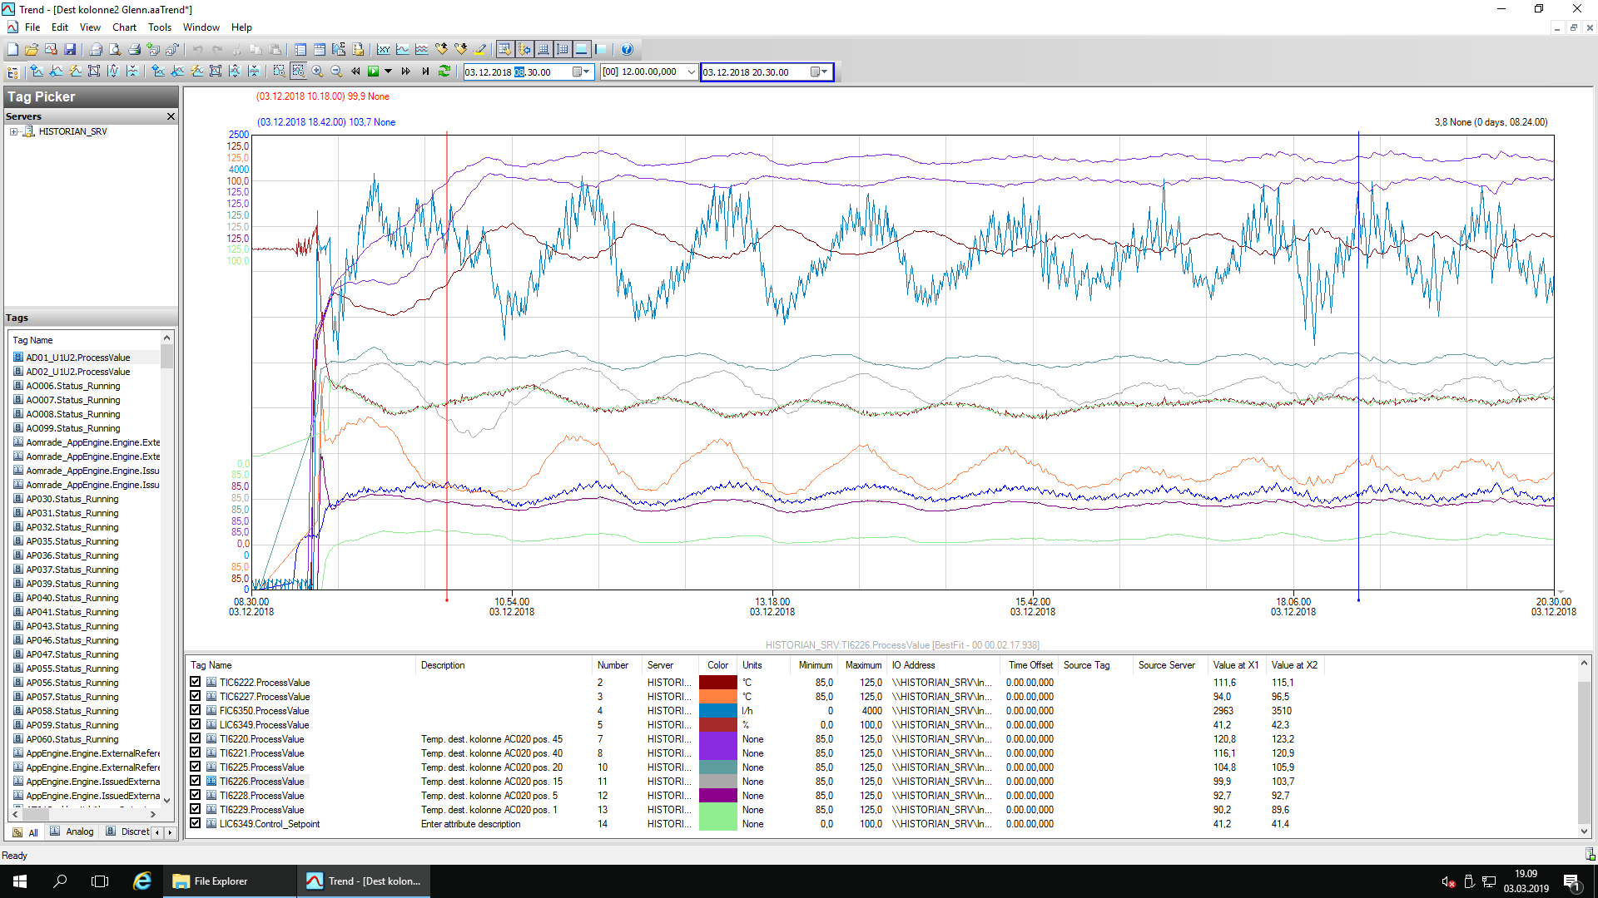
oppstart i starten av desember 2018 (startet med 100% syre i kolonna)
Temp plate 45
Temp plate 40
Temp plate 35 (Sp = 117)
Flow BuAC
Temp plate 20
Temp plate 15
Nivå dekanter
Temp plate 10 (Sp=95,5)
Temp plate 5
Damppådrag
Temp plate 1

Slide 37
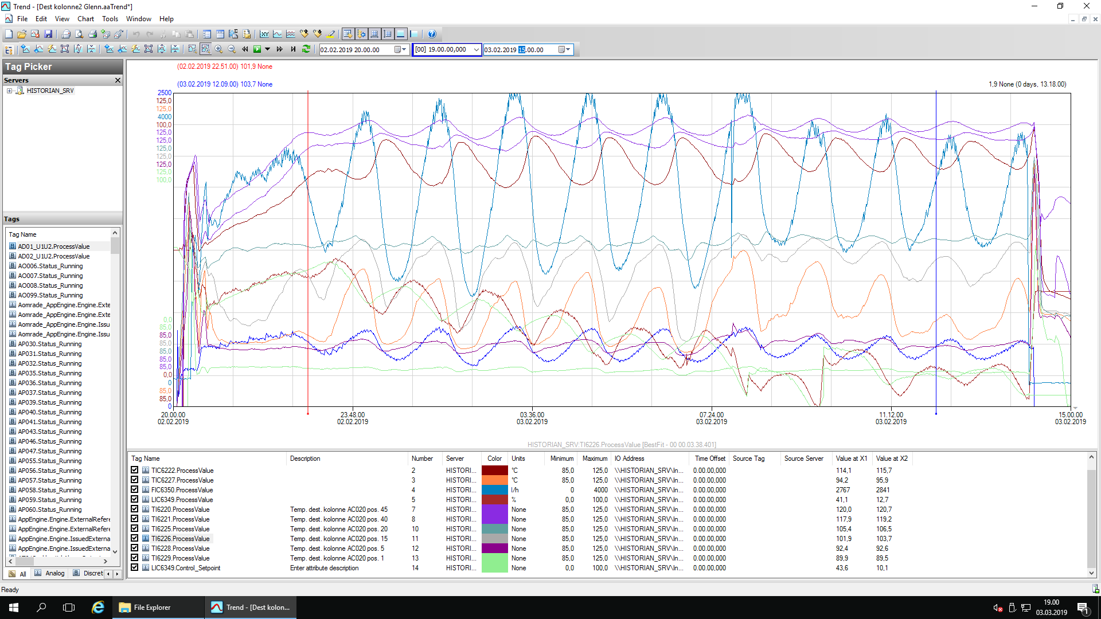
02 feb. 2019. Siste kjøring før rep av kolonne
Temp plate 45
Temp plate 40
Temp plate 35 (Sp = 117)
Flow BuAC
Temp plate 20
Temp plate 15
Temp plate 10 (Sp=95,5)
Temp plate 5
Damppådrag
Nivå dekanter
Temp plate 1

Slide 38
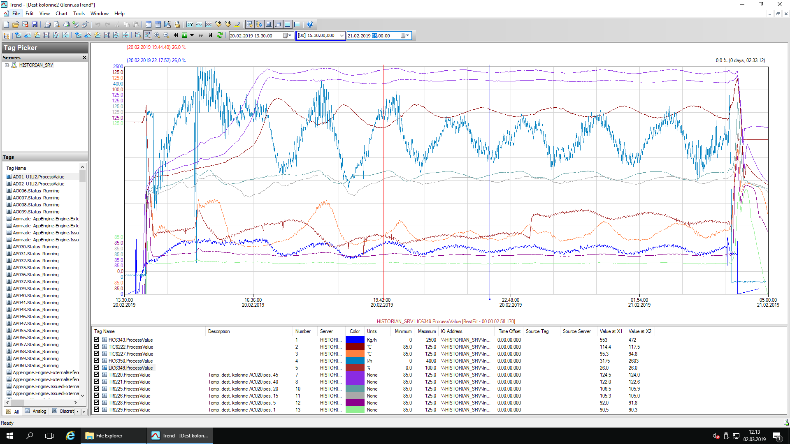
20 feb. 2019. Første oppstart (after Koch-Glitch repair)
P = 100 min
Temp plate 40
Temp plate 45
Temp plate 35 (Sp = 117)
Flow BuAC
Temp plate 20
Temp plate 15
Nivå dekanter
Damppådrag
Temp plate 10 (Sp=95,5)
Temp plate 5
Temp plate 1
Controller integral time for temperature loop = 10 minutes

Slide 39
Slow oscillations were caused by too slow control
Tray 10 temperature controlled using butyl-acetate reflux: Integral time (taui) = 10 minutes.
TOO MUCH INTEGRAL ACTION!
Sigurd’s formula*: Increase Kc*taui by factor f = 0.1*(P/taui0)^2 = 0.1*(100/10)^2 = 10.
Problem solved by increasing integral time to 50 minutes.
*Sigurd Skogestad. ''Simple analytic rules for model reduction and PID controller tuning''
J. Process Control, vol. 13 (2003), 291-309

Slide 40
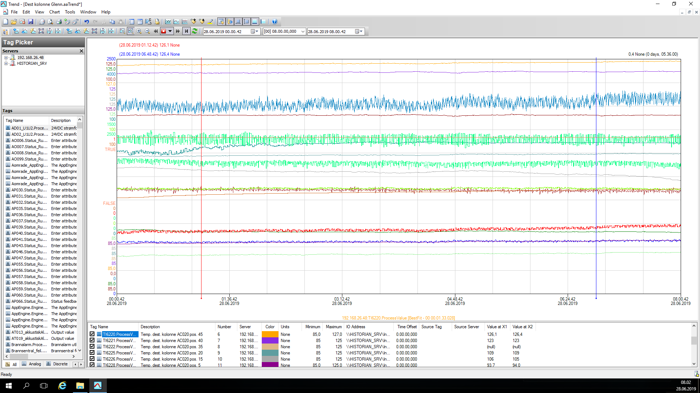
Drift juni 2019, 8 timers periode
Temp plate 45
Temp plate 40
Flow BuAC
Temp plate 35 (Sp = 117)
feed kolonne
Temp AcOH feed kolonne
Discharge kolonne
Temp plate 20
Temp plate 15
Temp dekanter
Nivå dekanter/kolonne
Damppådrag
Temp plate 10 (Sp=95,5)
Temp plate 5
Temp plate 1

Slide 41
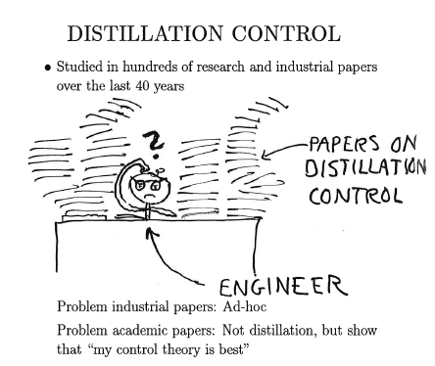
7. Better operation and control can improve quality and productivity
S. Skogestad, “The dos and don'ts of distillation columns control”,
Chemical Engineering Research and Design (Trans IChemE, Part A), 85 (A1), 13-23 (2007).

Slide 42
Myth of slow control
Let us get rid of it!!!
Compare manual (“perfect operator”) and automatic control for typical column:
    40 stages,
    Binary mixture with 99% purity both ends,
    relative volatility = 1.5
  First “one-point” control: Control of top composition only
  Then “two-point” control: Control of both compositions

Slide 43
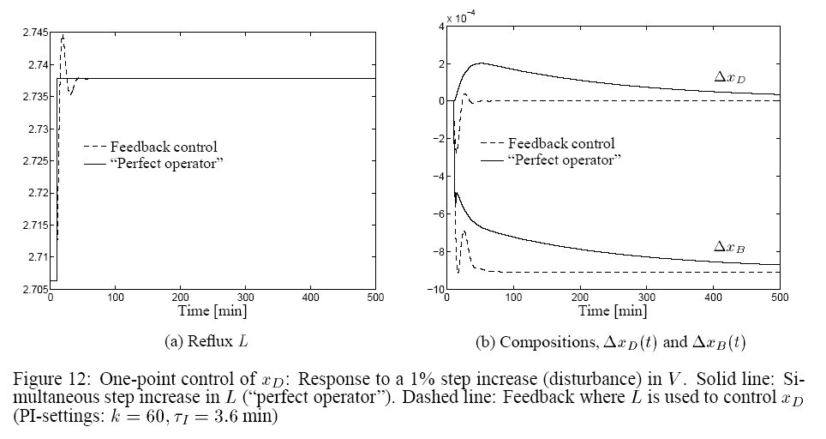
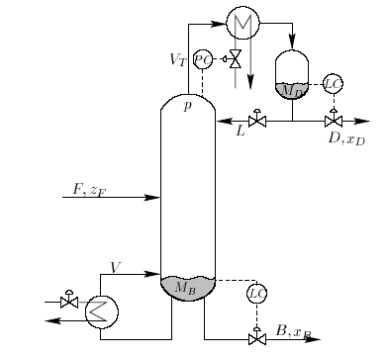
Myth about slow control
One-point control
“Perfect operator”: Steps L directly to
correct steady-state value
(from 2.70 to 2.74)
Want x_{D} constant
Can adjust reflux L
Disturbance
in V

Slide 44
Myth about slow control
One-point control
“Perfect operator”: Steps L directly
Feedback control: Simple PI control
Which response is best?
CC
x_{DS}
Disturbance
in V

Slide 45
Myth about slow control
One-point control

Slide 46
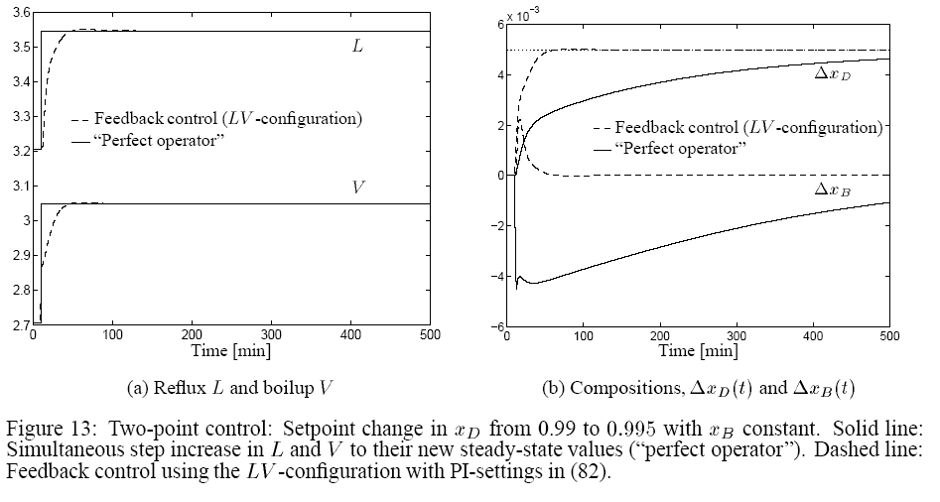
Myth about slow control
Two-point control
V
“Perfect operator”: Steps L and V directly
Feedback control: 2 PI controllers
Which response is best?
CC
x_{DS:} step up
L
CC
x_{BS:} constant

Slide 47
Myth about slow control
Two-point control
V
L

Slide 48
Myth about slow control
Conclusion:
Experience operator: Fast control impossible
  “takes hours or days before the columns settles”
BUT, with feedback control the response can be fast!
  Feedback changes the dynamics (eigenvalues)
  Requires continuous “active” control
Most columns have a single slow mode (without control)
  Sufficient to close a single loop (typical on temperature) to change the dynamics for the entire column

Slide 49
Conclusion
Distillation is important
Distillation is unbeatable (in some cases)
Distillation is fun
Distillation is complex yet simple
Distillation is part of the future

