Slide 1
Optimal operation* of distillation columns using simple control structures
Sigurd Skogestad, NTNU, Trondheim
EFCE Working Group on Separations, Gøteborg, Sweden, June 2019
*Optimal in the meaning of economics or sustainability

Slide 2
Distillation is part of the future
It’s a myth that distillation is bad in terms of energy
Better operation and control can save energy
Integrated schemes can save energy and capital
  Divided-wall / Petlyuk columns

Slide 3
«Distillation is an inefficient process which uses a lot of energy»
This is a myth!
By itself, distillation is an efficient process.
It’s the heat integration that may be inefficient.
Yes, it can use a lot of energy, but it provides the same energy at a lower temperature
  Difficult separations (close-boiling): use a lot of energy -- but well suited for heat pumps
  Easy separations: Use little energy

Slide 4
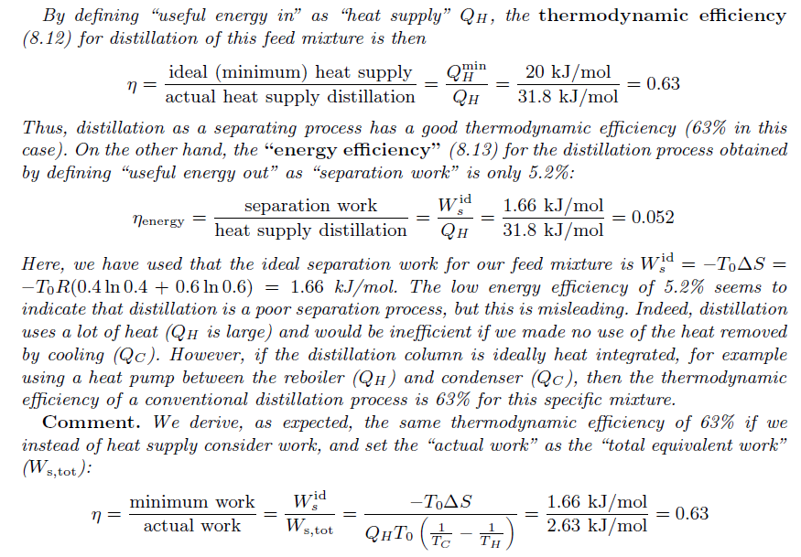
Typical distillation Case
Example 8.20 from Skogestad (2008)
Thermodynamic efficiency is 63%
Energy efficiency is only 5% (with no heat Integration)

Slide 5
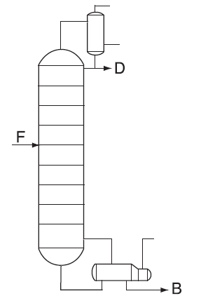
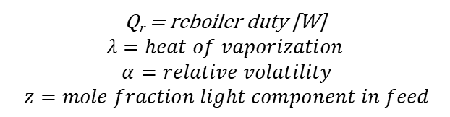
Q_{c}
z
V
Q_{r}
King’s formula:
(binary, feed liquid, constant α,
Infinite* no. Stages, pure products)
Q_{r} = reboiler duty [W]
$$λ=heat of vaporization$$
$$α=relative volatility$$
$$z=mole fraction light component in feed$$
*Actual energy only 5-10% higher

Slide 6

Ideal separation work
Minimum supplied work (for any process)
W_{s,id}= ΔH - T₀ΔS
Assume ΔH=0 for the separation. Minimum separation work
W_{s,id}= - F T₀ ΔS
Separation of feed into pure products
This is a negative number so the minimuim separation work W_{s,id} is positive!
$$ΔS=RF\sum_{i=1}^{N}{z_{i}lnz_{i}}$$

Slide 7
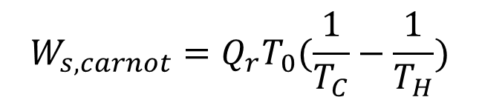

(g)
T_{c}
Q_{c}
Distillation with heat pump
Low p
(l)
W_{s}
z
(g)
(g)
High p
V
Q_{r}
T_{H}
Minimum work (Carnot)
$$W_{s,carnot}=Q_{r}T_{0}(\frac{1}{T_{C}}−\frac{1}{T_{H}})$$
$${Assume Q}_{c}≈−Q_{r}$$

Slide 8
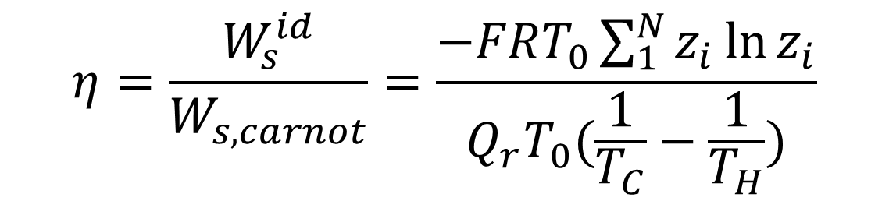
Thermodynamic efficiency for conventional distillation
Thermodynamic Efficiency = Ideal work/Actual work:
$$η=\frac{W_{s}^{id}}{W_{s,carnot}}=\frac{−FRT_{0}\sum_{1}^{N}{z_{i}{\ln{z}}_{i}}}{Q_{r}T_{0}(\frac{1}{T_{C}}−\frac{1}{T_{H}})}$$
Note that T₀ drops out

Slide 9
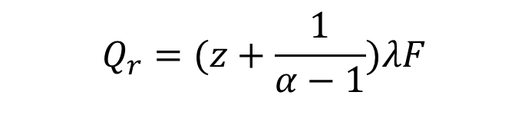
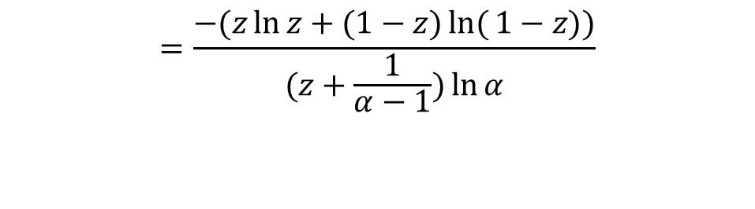

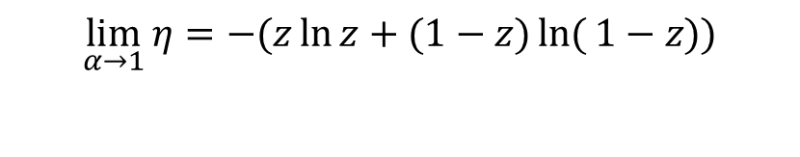
Thermodynamic efficiency
Special case: Binary, constant α
King's formula
Ideal binary mixture (Claperyon equation) + no pressure drop. King shows:
So
$$Q_{r}=(z+\frac{1}{α−1})λF$$
Binary
$$η=\frac{W_{s}^{id}}{W_{s,carnot}}=\frac{−F\sum_{1}^{N}{z_{i}{\ln{z}}_{i}}}{Q_{r} (\frac{1}{T_{C}}−\frac{1}{T_{H}})}$$
$$=\frac{−(z\ln{z}+(1−z)\ln{(}1−z))}{(z+\frac{1}{α−1})\ln{α}}$$
Note that λ drops out
$$\lim_{α→1}{η}=−(z\ln{z}+(1−z)\ln{(}1−z))$$

Slide 10

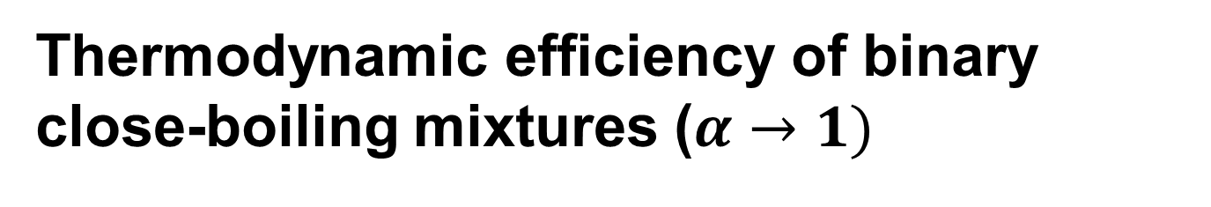
Thermodynamic efficiency of binary close-boiling mixtures ($α→1)$
$$\lim_{α→1}{η}=−(z\ln{z}+(1−z)\ln{(}1−z))$$
Comment: Above 50% for z from 0.2 to 0.8
Peak efficiency is -ln0.5 = 0.693 at z=0.5

Slide 11



Thermodynamic efficiency of binary distillation
$$α=10$$
$$α=1$$
$$η$$
High efficiency at small z for easy separations with large α
Reason: Must evaporate light component to get it over top
z = fraction light component in feed

Slide 12
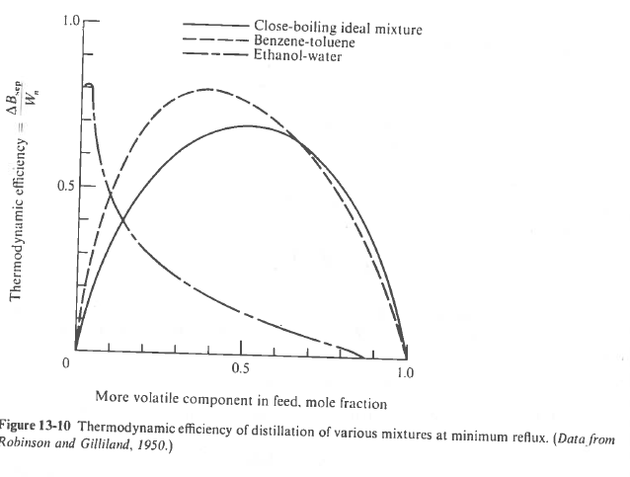
King (1971)
Note: Non-ideality does not necessarily imply lower thermodynamic efficiency

Slide 13
Why is it not perfect – where are the losses?
Irreversible mixing loss at every stage.
Largest losses in the middle of each section – where the bulk separation takes place
Small losses at the high-purity column ends

Slide 14
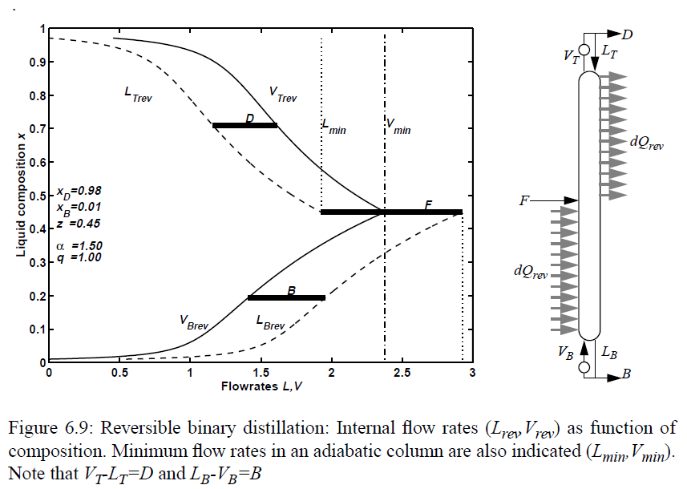
Reversible binary distillation
Reversible binary distillation

Slide 15
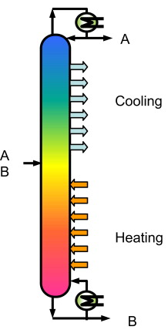
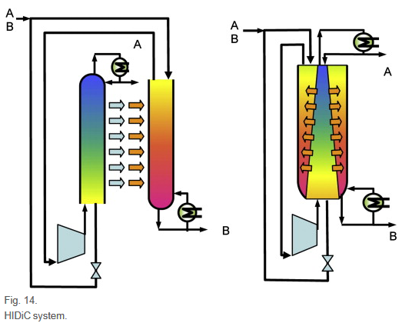
HIDiC (Heat Integrated Distillation Column)
I don’t believe in HIDiC.
Too complicated, too much investment, not enough savings

Slide 16
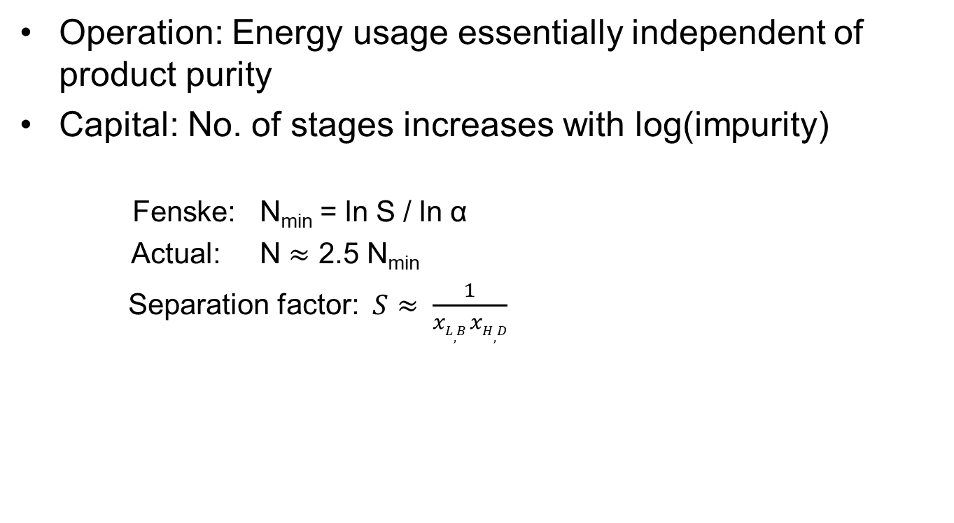
Distillation is unbeatable for high-purity separations
Operation: Energy usage essentially independent of product purity
Capital: No. of stages increases with log(impurity)
Fenske: N_{min} = ln S / ln α
Actual: N $≈$ 2.5 N_{min}
Separation factor: $S≈ \frac{1}{xL,B xH,D}$

Slide 17
OPERATION

Slide 18
Economics and sustainability for operation of distillation columns
Is there a trade-off?
No, not as long as the column is operated in a region of constant (optimal) stage efficiency
Yes, if we operate at too high or too load so that the stage efficiency drops

Slide 19
Can save a lot of energy by improved control
Especially by avoiding over-refluxing

Slide 20
Acknowledgement
Ivar Halvorsen, NTNU (20%) and SINTEF (80%)

Slide 21
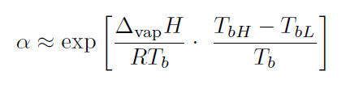

Slide 22
Thermodynamic efficiency for conventional distillation
Use heat pumps for reboiler and condenser. Ideal work with surroundings at T₀ (Carnot):
Assume feed liquid and constant molar flows so
Thermodynamic Efficiency = Ideal work/Actual work:

