Slide 1
An overview and evaluation of approaches for online process optimization
SUBPRO SUBSEA PRODUCTION AND PROCESSING
Sigurd Skogestad, Dinesh Krishnamoorthy
Department of Chemical Engineering
Norwegian University of Science and Technology, Trondheim, Norway
Plenary talk. PSE Asia, Bangkok, Jan. 2019
“Steady-state real-time optimization using transient measurements”, D. Krishnamoorthy, B. Foss, S. Skogestad, Comp. Chem. Eng.. 115, 34-45 (2018)
“A Feedback RTO strategy using Transient Measurements”, D. Krishnamoorthy, E. Jahanshahi, S. Skogestad, Ind.Eng.Chem.Res. (in print, 2018), Also ESCAPE Graz, 2018
“On combining extremum seeking control and self-optimizing control.” Straus. J, Krishnamoorthy, D., and Skogestad, S., J. Proc. Control (under revision, 2018).

Slide 2
Abstract
Traditional real-time optimization (RTO) is an established technology, where the process economics are optimized using rigorous steady-state models. However, a fundamental limiting factor of current steady-state RTO implementation is the steady-state wait time. In order to address the steady-state wait time issue, we first propose a “hybrid” approach where the model adaptation is done using dynamic models and transient measurements and the optimization is performed using static models. Using simulation case studies, we show that similar performance to dynamic RTO can be achieved at computation times similar to static RTO.
The hybrid RTO approach requires solving a numerical optimization problem in order to compute the optimal setpoints. It also requires regular maintenance of both the dynamic model and its static counterpart. In order to address the numerical issues associated with solving numerical optimization problems, we then propose to convert the hybrid RTO strategy into a feedback-based hybrid RTO strategy. This is based on the principle that optimal operation can be achieved by estimating and controlling the steady-state gradient from the inputs to the cost at a constant setpoint of zero. To be more specific, the nonlinear dynamic model is used to estimate the states and parameters by means of a dynamic estimation scheme using transient measurements in the same fashion as in the hybrid and dynamic RTO approaches. However, instead of using the updated model in an optimization problem, the state and the parameter estimates are used to linearize the updated dynamic model from the inputs to the cost. This linearized dynamic model is then used to obtain the estimate of the steady-state gradient at the current operating point. Optimal operation is then achieved by controlling the estimated steady-state gradient to constant setpoint of zero by any feedback controller. Using a simulation case study, the proposed method is compared with the traditional static RTO, dynamic RTO and the newer hybrid RTO approach.

Slide 3
Trondheim
Arctic circle

Slide 4
Outline
Introduction.
Why is traditional static RTO not used much?
Alternative approaches
Dynamic RTO
Hybrid RTO
Feedback RTO
Self-optimizing control
Extremum seeking control
Case studies
Gas lift, CSTR, Ammonia reactor

Slide 5
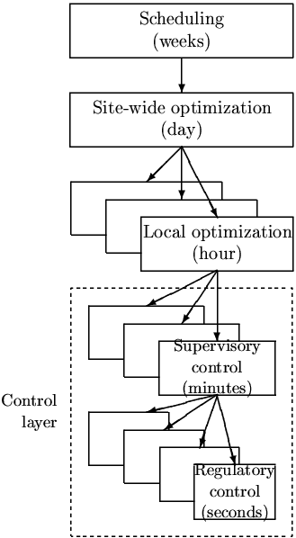
Hierarchical decision system
Manager
Process engineer
min J (economics)
_{hour}
Operator/RTO
Focus of this talk
Setpoint control
(+ look after other variables)
minute
”Advanced control”/MPC
Stabilize + avoid drift
second
PID-control
u = valves

Slide 6
Real time optimization (RTO)
Process Model
Process constraints
Optimal decision variables
Economic Model

Slide 7
Traditional static RTO
Most common in commercial RTO
Steady-state models
Two-step approach
“Data reconciliation”:
Steady-state detection
Update model parameters, disturbances (feed), constraints
Re-optimize to find new optimal steady state
Data reconciliation
D. E. Seborg, D. A. Mellichamp, T. F. Edgar, F. J. Doyle III, Process dynamics and control, John Wiley & Sons, 2010.

Slide 8
Traditional static RTO
Minimize static economic cost
$$J = pF F + pQ Q – pP P$$
Steady-state wait time – fundamental limiting factor
Process operates sub-optimally for long periods of time
Frequent disturbances
Long settling times

Slide 9
Why is traditional static RTO not commonly used?
In expected order of importance:
Cost of developing and updating the model (costly offline model update)
Wrong value of model parameters and disturbances (slow online model update)
Not robust, including computational issues
Frequent grade changes make steady-state optimization less relevant
Dynamic limitations, including infeasibility due to (dynamic) constraint violation
«wait time»
It may seem that reasons 2, 4, and 5 suggest towards dynamic optimization.
However, except reason 4, static optimization may be close to the economic optimum, at a much lower computational cost.

Slide 10
Traditional static RTO: Long steady-state wait time
Challenges with steady-state detection
Erroneously accept transient data as stationary data
Large chunks of data discarded
Câmara MM, Quelhas AD, Pinto JC. Performance Evaluation of Real Industrial RTO Systems. Processes. 2016, 4(4).

Slide 11
How to address steady-state wait time?
OBVIOUS: DYNAMIC RTO

Slide 12
Dynamic real-time optimization (DRTO)
Uses all (transient) data
Dynamic models
Dynamic optimization is computationally intensive
Closely related to economic MPC
optimization

Slide 13
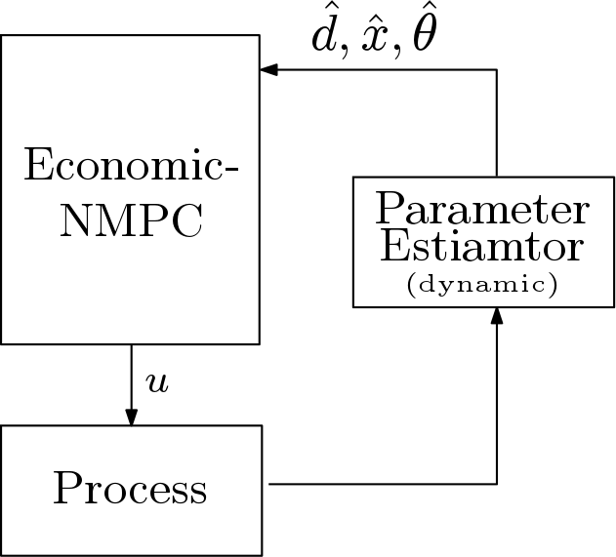
Economic MPC ~ Dynamic RTO
MPC/PID
Centralized “All-in-one” optimizer
Higher sampling rates
Hierarchical layers with time scale separation
Lower sampling rates

Slide 14
Dynamic RTO has problems
Slow and not robust
Dynamic optimization is computationally expensive - even with today’s computing power
Numerical issues, convergence problems
Mixed-integer variables
Still an open problem, especially for dynamic problems

Slide 15
How to address problems with dynamic RTO?
Hybrid RTO
Feedback based RTO

Slide 16
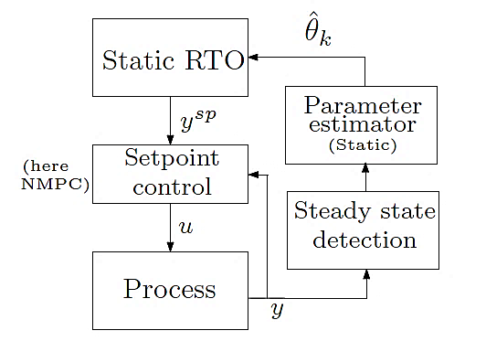
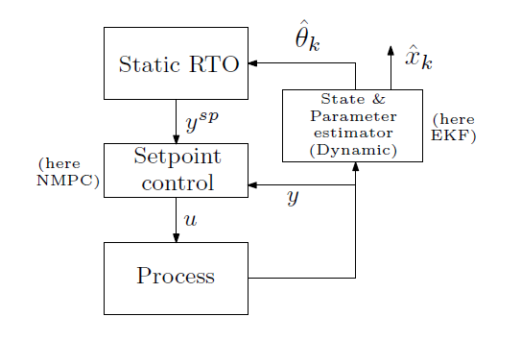
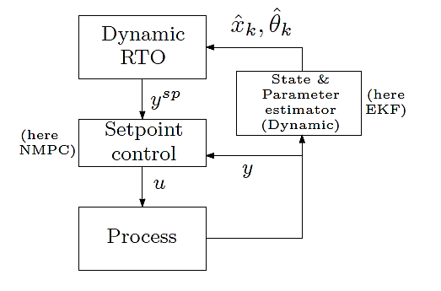
Hybrid RTO
Static RTO
“Hybrid” RTO
Dynamic RTO
Dynamic Estimation
+
Static Optimization
Krishnamoorthy, et al. (2018). Steady-State Real-time Optimization using Transient Measurements. Comput. & Chem. Eng., Vol 115, p.34-45.

Slide 17
CASE STUDY: Gas lift
Constraint: Max Gas capacity
Main objective: Max oil prod.
$$w_{po}$$
$$w_{pg}$$
$$w_{gl}$$
MV₁
MV₂
Reservoir
GOR = Gas/Oil ratio in feed (reservoir)
Main disturbance (d): GOR variation
Notes:
$$\max_{w_{gl}}{}\$_{o}\sum{w_{po}} −\$_{gl}\sum{w_{gl}} −\$_{fl} w_{fl}$$
s.t.
$$\sum{w_{pg}}≤w_{g}^{max}+w_{fl}$$

Slide 18
Disturbance: GOR variation

Slide 19
Typical measured data (pressures and flowrates)

Slide 20
GOR estimation - using “data reconciliation” (traditional static RTO)
Problem: Steady-state wait time for data reconciliation

Slide 21
GOR estimation – using extended Kalman filter (DRTO & HRTO)

Slide 22
Oil and gas rates
SRTO = traditional static RTO
HRTO = hybrid RTO
DRTO = dynamic RTO

Slide 23
Results

Slide 24
Why is traditional static RTO not commonly used?
In expected order of importance:
Cost of developing and updating the model (costly offline model update)
Wrong value of model parameters and disturbances (slow online model update)
Not robust, including computational issues
Frequent grade changes make steady-state optimization less relevant
Dynamic limitations, including infeasibility due to (dynamic) constraint violation
It may seem that reasons 2, 4, and 5 suggest towards dynamic optimization.
However, except reason 4, static optimization may be close to the economic optimum, at a much lower computational cost.

Slide 25
Dynamic limitations – not a big issue with MPC-layer below
MV2: Setpoint provided to tracking controller
Actual MV move by setpoint tracking controller
SRTO = traditional static RTO
HRTO = hybrid RTO
DRTO = dynamic RTO

Slide 26
Discussion of Hybrid RTO
Addresses steady-state wait time issue
Need to maintain two models – Static and Dynamic
But not a big problem
But still have computational issues related to the static optimization

Slide 27
Advantage of steady-state optimization (SRTO & HRTO)
Computation time
Avoids causality issue: Allows optimization on decision variables other than the MVs
Simplifies the optimization
Slower time scale (choose slow varying variables as decision variables)
Example: Can specify directly maximum temperature and let controller find required input.

Slide 28
Alternative feedback-based approaches
New: Feedback RTO (faster computation)
Self-optimizing Control (SOC) (no online model update needed)
Extremum-seeking control (model free). Closely related:
Evolutionary control (60’s)
Hill-climbing (Shinskey)
NCO-tracking

Slide 29
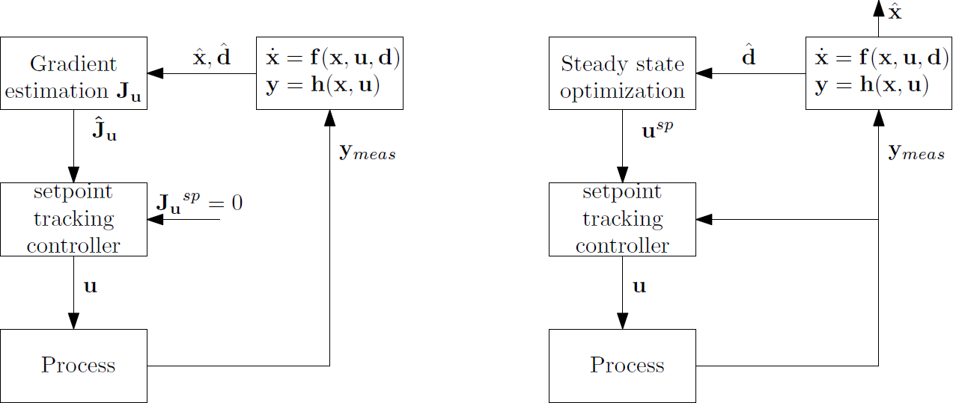
Feedback RTO: Replace steady-state optimization by feedback control
Feedback RTO
Hybrid RTO
Krishnamoorthy, D., Jahanshahi, E. and Skogestad, S., 2018. A feedback real-time optimization strategy, Ind. Eng. Res. Chem (submitted).

Slide 30
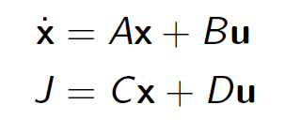
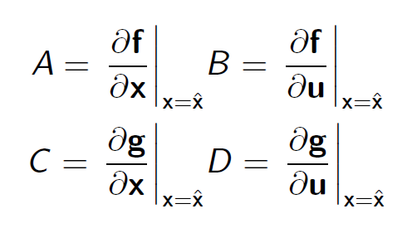
Feedback RTO

Slide 31
CSTR case study
Economou, C. G.; Morari, M.; Palsson, B. O. Internal model control: Extension to nonlinear system. Industrial & Engineering Chemistry Process Design and Development 1986, 25, 403–411.
Ye, L.; Cao, Y.; Li, Y.; Song, Z. Approximating Necessary Conditions of Optimality as Controlled Variables. Industrial & Engineering Chemistry Research 2013, 52, 798–808.

Slide 32
Comparison of RTO approaches: MV
SRTO = traditional static RTO
HRTO = hybrid RTO
DRTO = dynamic RTO
New method = Feedback RTO
closer look
t = 400 s, d1: Increase C_{Ain}
t = 1400 s, d2: Increase C_{Bin}

Slide 33
Comparison of RTO approaches
342.3
257.1
248.1
247.1
2
4
3
1

Slide 34
Feedback RTO - Other case studies
Evaporator process¹
Gas lift wells²
Ammonia reactor³
(14.45. Room 2)
Krishnamoorthy, D., Jahanshahi, E. and Skogestad, S., Control of steady-state gradient for an Evaporator process, PSE Asia (Submitted 2019)
Krishnamoorthy, D., Jahanshahi, E. and Skogestad, S., 2018. Gas-lift Optimization by Controlling Marginal Gas-Oil Ratio using Transient Measurements (in-Press), IFAC OOGP, Esbjerg, Denmark
Bonnowitz, H., Straus, J., Krishnamoorthy, D., and Skogestad, S., 2018. Control of the Steady-State Gradient of an Ammonia Reactor usingTransient Measurements, Computer aided chemical engineering, Vol.43, p.1111-1116 (ESCAPE 28)

Slide 35
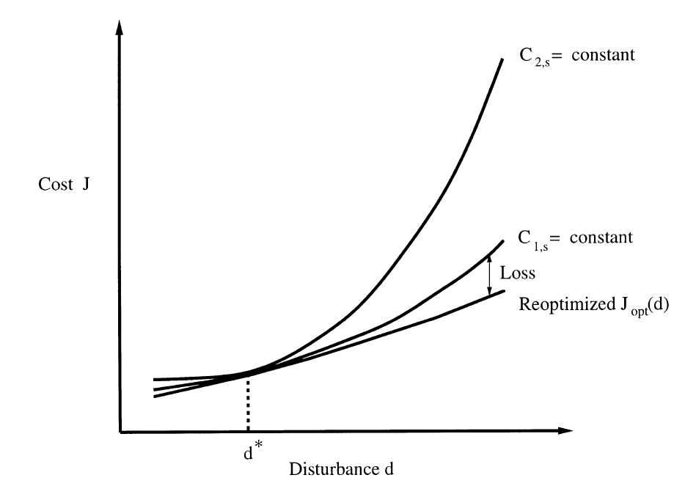
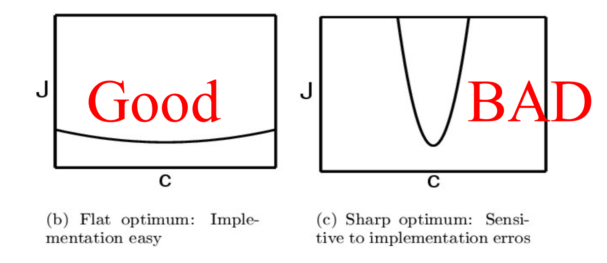
Self-optimizing control
Self-optimizing control is when we can achieve an acceptable loss with constant setpoint values for the controlled variables

Slide 36
Self-optimizing control (SOC)
Local approximation: c = Hy.
Need detailed steady-state model to find optimal H
Nullspace method
Exact local method
Must reoptimize for each expected disturbance
But calculations are offline
Challenges SOC:
Nonlinearity
Need new SOC variables for each active constraint region
Similar to multiparametric optimization and lookup tables

Slide 37
CSTR case study
Feedback RTO («new method»)
Self-optimizing control
Krishnamoorthy, D., Jahanshahi, E. and Skogestad, S., 2018. A feedback real-time optimization strategy, Ind. Eng. Res. Chem (submitted).

Slide 38
Why is traditional static RTO not commonly used?
Cost of developing and updating the model (costly offline model update)
Wrong value of model parameters and disturbances (slow online model update)
Not robust, including computational issues
Frequent grade changes make steady-state optimization less relevant
Dynamic limitations, including infeasibility due to (dynamic) constraint violation

Slide 39
Challenges with structural uncertainty
Structural mismatch / unmodelled disturbances
Model simplification
Lack of knowledge
Modifier Adaptation
Model-free RTO approaches

Slide 40
Model-free methods
Extremum seeking control
NCO-tracking
Hill-climbing control

Slide 41
Serious challenges with model free methods
Needs cost measurement
Need additional perturbations
Steady-state limitation
Very slow convergence

Slide 42
Fix: ESC/RTO + Self-optimizing control
Self-optimization control is always complementary
Can combine with
Extremum-seeking control
Traditional Static RTO
Straus. J, Krishnamoorthy, D., and Skogestad, S., 2018. On combining extremum seeking control and self-optimizing control. J. Proc. Control (under revision).

Slide 43
Case study: Ammonia Reactor
Objective: Maximize extent of reaction
Response to disturbance in inlet mass flow rate
Bonnowitz, H., Straus, J., Krishnamoorthy, D., and Skogestad, S., 2018. Control of the Steady-State Gradient of an Ammonia Reactor usingTransient Measurements, Computer aided chemical engineering, Vol.43, p.1111-1116 (ESCAPE 28)

Slide 44
Why is traditional static RTO not commonly used? Some alternatives
Cost of developing and updating the model (costly offline model update)
→ Fix: model free methods, like extremum-seeking
2. Wrong value of model parameters and disturbances (slow online model update)
→ Fix: DRTO, HRTO, self-optimizing control (fastest)
Not robust, including computational issues
→ Fix: Feedback RTO, self-optimizing control
Frequent grade changes make steady-state optimization less relevant
→ Fix: Dynamic RTO (DRTO) or EMPC
Dynamic limitations, including infeasibility due to (dynamic) constraint violation
→ Fix: MPC-layer below

Slide 45
Proposal : Combine RTO with other approaches
ESC / modifier adaptation layer: make RTO approach the real optimum .
SOC layer: make optimization faster, reduce wait time for model update and online optimization

Slide 46
Conclusion
SUBPRO SUBSEA PRODUCTION AND PROCESSING
Extremum seeking control/
Modifier adaptation
J_{u}
Extremely slow (days)
Model free
J_{u,s}
Gradient estimator
Real-time optimization
(SRTO/DRTO/HRTO)
RTO:
Detailed model
(online)
Slow (hour)
y
c_{s}
Self-optimizing control
(in MPC/PID layer)
c
y
SOC:
Detailed model
(offline)
Fast (minute)
H
u
y
Process
d
Measurements
J
Thank you !

Slide 47
Comments based on discussions afterwards
In practice:
Implement active constraints using supervisory layer (selectors, SRC) or standrd MPC
Optimize unconstrained DOFs using extremum seeking control. But economic cost can usually not be measured directly, J = pF F + pQ Q – pP P
To obtain economic cost we need a model to get flows F, P andc Q using data reconciliation.

Slide 48
Summary/Comparison on next slide
Red box = bad
green box = good
No box = neutral

