Slide 1

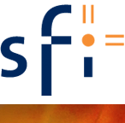
Production optimization using simple control loops
SUBPRO
SUBSEA PRODUCTION AND PROCESSING
Dinesh Krishnamoorthy* and Sigurd Skogestad
NTNU, Trondheim, Norway
*Also with Equinor (20%)

Slide 2
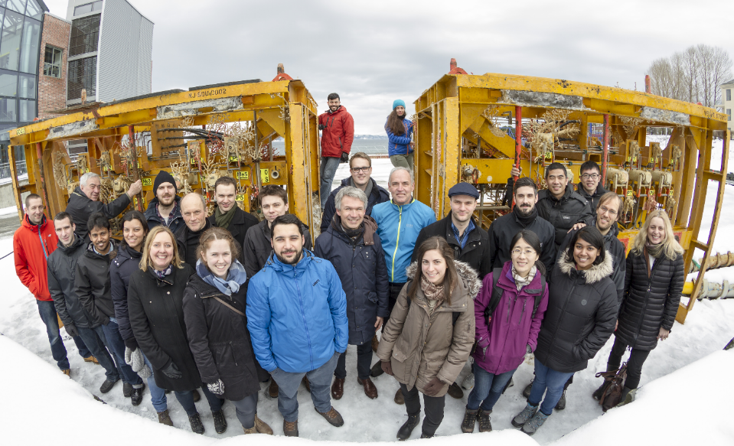

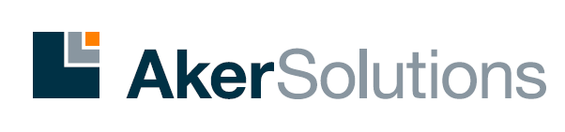
SUBPRO: Center for research-based innovation on subsea production and processing. 2015 - 2023
SUBPRO
Why did we start SUBPRO?
    Improve academic basis in selected subsea areas
    Provide the basis for future industrial innovation
43 PhD students/Postdocs in 8-year period
    12 completed PhD/postdoc projects
    16 ongoing PhD/Postdoc projects (as of April 2019)
    15 Planned new projects
21 Professors from three NTNU departments
    Chemical Engineering
    Geoscience and Petroleum
    Mechanical and Industrial Engineering
About 20 Master students every year
Annual budget: 3.5 million Euro
7 Partners (2019):

Slide 3
Project structure, 2015 – March 2019
SUBPRO
5 RESEARCH AREAS
FIELD ARCHITECTURE
Prof. Sigbjørn Sangesland
RELIABILITY, AVAILABILITY, MAINTENANCE AND SAFETY (RAMS)
Prof. Mary Ann Lundteigen
SEPARATION –
FLUID CHARACTERIZATION
Prof. Johan Sjöblom/
Prof. Gisle Øye
SEPARATION -
PROCESS CONCEPTS
Prof. Hugo Jakobsen
SYSTEM CONTROL
Prof. Sigurd Skogestad
Ass. Prof. Johannes Jäschke
30 PROJECTS
Subsea gate box
New safety and control philosophy for subsea systems *
Produced water quality and
Injectivity*
Membranes for gas dehydration *
Dynamic simulation model library*
Control for extending component life
Adriaen
Field development concepts *
Reliability and availa-bility assessment in subsea design*
Influence of production and EOR chemicals on produced water quality
Membrane testing for gas dehydration
Modelling and* multivariable control of subsea processes
Experimental validation of methods for optimizing remaining Useful Life
Otavio
Multiphase booster models
Condition based maintenance models*
Wax crystallization and inhibition*
H₂S and hydrate control
Automatic control of subsea separation
Production optimization under uncertainty
Dinesh
Methods for minimizing cost and risk in subsea field development
Optimizing condition monitoring
Sequential separation*
Characterization of fluid particle breakup in turbulent flow
Adaptive control of subsea processes
Machine learning for production and process optimization
Himanshu
Allyne
Safety 4.0 Demonstrating safety of novel subsea technologies
Modeling of coalescence*
Mechanistic modeling of droplet breakage
Estimation of un-measured variables*
Production optimization
2 New PhDs late 2019
16 ongoing projects
* 12 completed projects
2 associated projects
Compact separation concepts
Enhanced virtual flow metering
Timur
Petrobras
Schlumberger
Technip FMC
«Did you copy our slides?»

Slide 4
What are the challenges with Advanced Production optimization?
SUBPRO
Technological limitations
Human aspects (probably the most important !)

Slide 5
Human aspects
SUBPRO
Corporate culture
Technical Competence
Talent and knowledge number one barrier for adopting advanced technologies¹
¹Report from McKinsey & Company, Nov 2017

Slide 6
Technological limitations
SUBPRO
Complex systems – lack of good models
Large chunks of data are discarded
Numerical robustness and computational issues

Slide 7
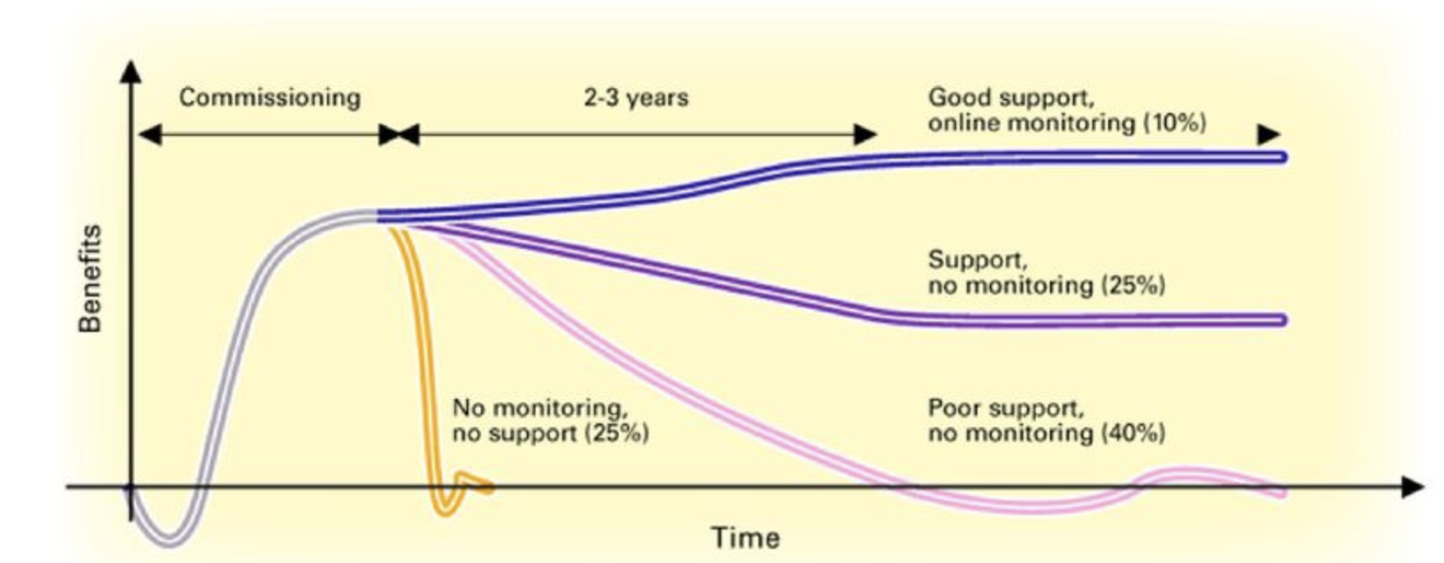
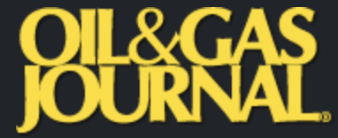
Maintenance
SUBPRO
Special report on Process Control
Sept 2006

Slide 8
Current needs of the industry
SUBPRO
Need simple tools that do not require:
  Complex models
  Heavy data pre-processing
  Solving computationally intensive problems online
  Major overhaul of hardware or software infrastructure
  Frequent update and maintanence by expert engineers

Slide 9
Supervisory control layer
Alternative implementations:
Model predictive control (MPC)
Classical advanced control structures (PID, selectors, etc.)
RTO

Slide 10
Model predictive control (MPC)
Can include constraints explicitly
If lack of DOF to meet control specifications:
  Conventional: Use weights
    (Partially) give up variables with small weights in objective function.
  Use two-stage MPC with constraint priority list:
    Stage 1. Check for steady-state feasibility and give up low-priority constraints if needed Stage 2. Solve conventional dynamic MPC

Slide 11
Classical “Advanced control” structures
Cascade control (measure and control internal variable)
Feedforward control (measure disturbance, d)
    Including ratio control
Change in CV: Selectors (max,min)
Extra MV dynamically: Valve position control (=Input resetting =midranging)
Extra MV steady state: Split range control (+2 alternatives)
Multivariable control (MIMO)
    Single-loop control (decentralized)
    Decoupling
    MPC (model predictive control)
Extensively used in practice, but almost no academic work
CV = controlled variable (y)
MV = manipulated variable (u)

Slide 12
Do we really need real-time optimization?
Often not!
We often know or can guess the active constraints
  Example: Assume it’s optimal with max. light ends in oil product (TVP).
  No need to have a complex dynamic model with energy balance and thermodynamics to find the optimal cooling
  Just use a PI-controller
    CV = flash temperature
    MV = cooling

Slide 13
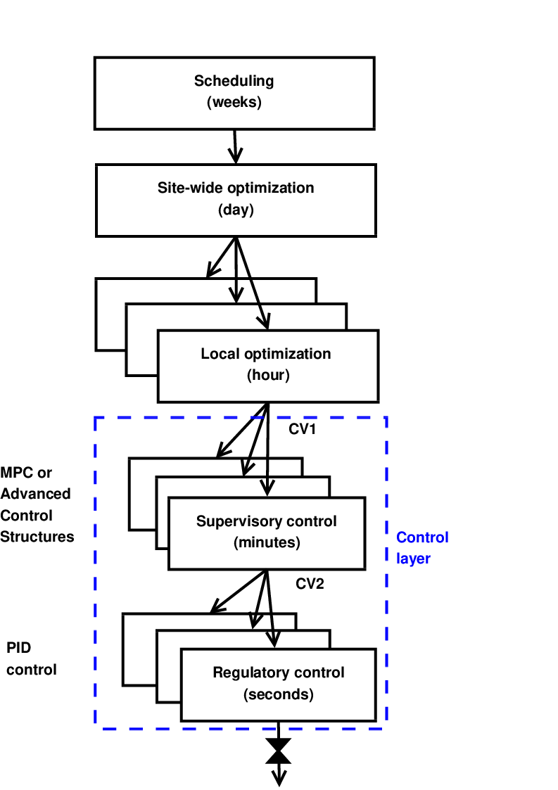
Systematic procedure for economic process control
Start “top-down” with economics (steady state):
Step 1: Define operational objectives (J) and constraints
Step 2: Optimize steady-state operation
Step 3: Decide what to control (CVs)
  Step 3A: Identify active constraints = primary CV1.
  Step 3B: Remaining unconstrained DOFs: Self-optimizing CV1 (find H)
Step 4: Where do we set the throughput? TPM location
Then bottom-up (dynamics):
Step 5: Regulatory control
  Control variables to stop “drift” (sensitive temperatures, pressures, ....)
Finally: Make link between “top-down” and “bottom up”
Step 6: “Advanced/supervisory control”
    Control economic CVs: Active constraints and self-optimizing variables
    Look after variables in regulatory layer below (e.g., avoid saturation)
Step 7: Real-time optimization (Do we need it?)
RTO
CV₁
CV₂
MVs
Process
S. Skogestad, ``Control structure design for complete chemical plants'',
Computers and Chemical Engineering, 28 (1-2), 219-234 (2004).

Slide 14
Simple feedback controllers
SUBPRO
No need for additional software development
Easy to commission
Easy to understand and maintain
Within the framework of safety and automation system (SAS)
Has been in use for several decades

Slide 15
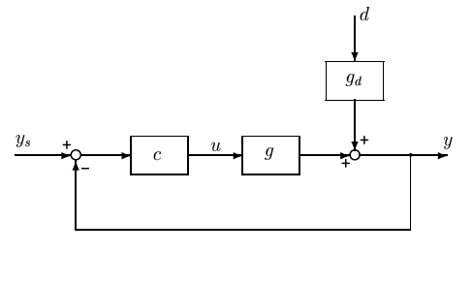
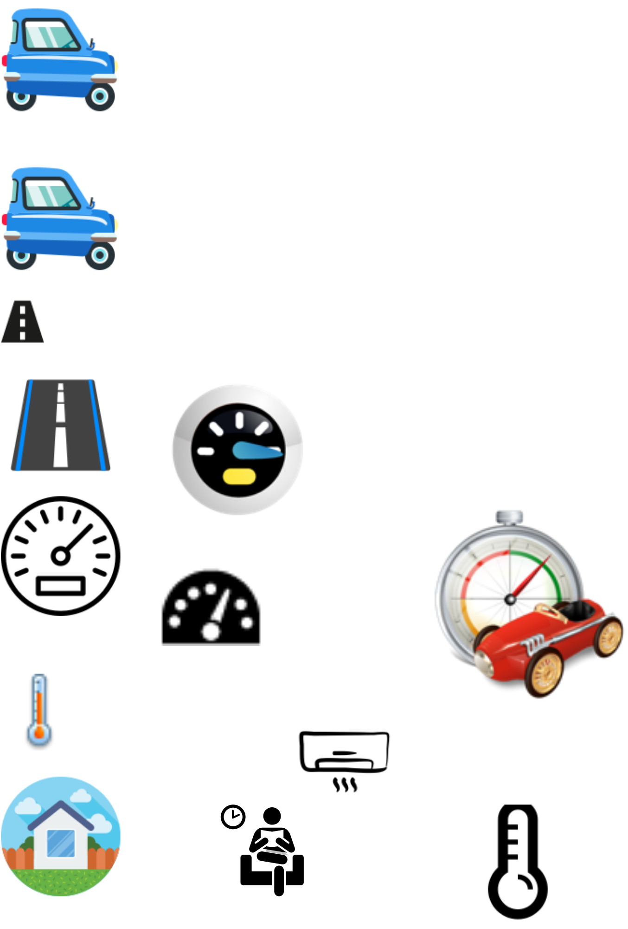
Optimization with PI-controller
Active constraint control using PI-controller
y^{sp} = y^{max}
PI
max y
s.t. y ≤ y^{max}
u ≤ u^{max}
Example: Drive as fast as possible to Belo Horizonte (u=power, y=speed, y^{max} = 100 km/h)
Optimal solution has two active constraint regions:
  y = y^{max} → speed limit
  u = u^{max} → max power
Note: Positive gain from MV (u) to CV (y)
Solved with PI-controller
  y^{sp} = y^{max}
  Anti-windup: I-action is off when u=u^{max}
s.t. = subject to
y = CV = controlled variable

Slide 16
Optimization with PI-controller
CV-MV switching
The example:
Optimal operation: Switch between CV constraint and MV saturation
A simple PI-controller was possible because we followed the pairing rule:
  «Pair MV that saturates with CV that can be given up»

Slide 17
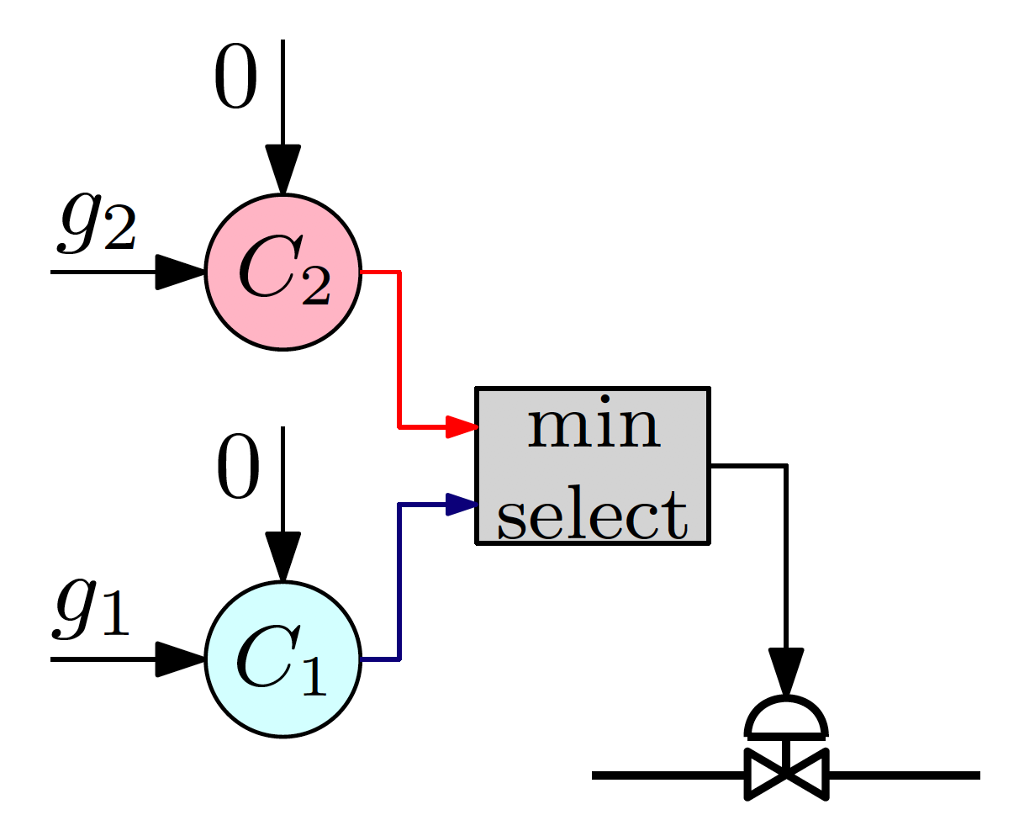
Simple feedback controllers + logics
CV-CV switching
SUBPRO

Slide 18
Switching between active constraints
1. Output to Output (CV - CV) switching (SIMO)
  Selector
2. Input to output (CV – MV) switching
  Do nothing if we follow the pairing rule: «Pair MV that saturates with CV that can be given up»
3. Input to input (MV – MV) switching (MISO)
  Split range control
  OR: Controllers with different setpoint value
  OR: Valve position control (= midranging control)
We are working on providing systematic procedures for the design of such control strategies

Slide 19
The less obvious case: Unconstrained optimum
J
u: unconstrained MV
What to control? y=CV=?
  Self-optimizing variable
J^{opt}
u^{opt}

Slide 20
The ideal “self-optimizing” variable is the gradient, J_{u}
Unconstrained degrees of freedom
c = ∂ J/∂ u = J_{u}
  Keep gradient at zero for all disturbances (c = J_{u}=0)
cost J
J_{u}<0
For Parallel units, optimal operation happens when gradients are equal
J_{u}<0
J_{u}=0
u_{opt}
u
J_{u}
0
Problem: Usually no measurement of gradient
Notes:
20

Slide 21
Gas-lift optimization problem
w_oil
w_gas
Limited gas lift supply
Gas processing constraint
Unconstrained operation
How to optimally allocate the gas lift using simple PI controllers?
That is: Have N gas lifts (MVs). What should we control?
w_gl1
w_gl2
w_gl3
w_glN

Slide 22
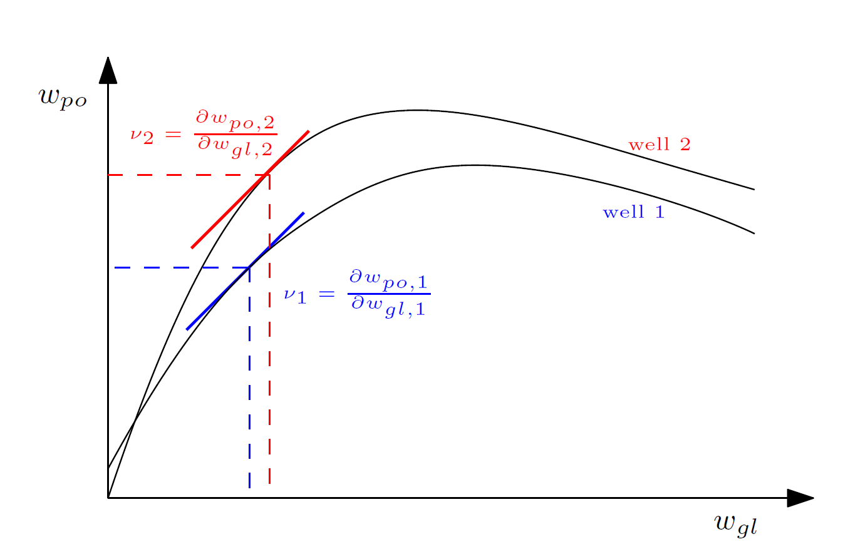
Gas lift performance curves
SUBPRO
Marginal Gas-lift-to-oil ratio (mGOR)

Slide 23
Case 1: Limited Gas Lift supply
Gas-lift optimization problem
w_oil
w_gas
CV:mGOR₂–mGOR₁
CV:mGOR₃–mGOR₁
CV:mGOR_{N}–mGOR₁
SP: 0
SP: 0
SP: 0
SP: w_gl_max
a
a
a
a
+
w_gl1
w_gl2
w_gl3
w_glN

Slide 24
Case 2: Gas processing contraint
Gas-lift optimization problem
w_oil
w_gas
CV:mGOR₂–mGOR₁
CV:mGOR₃–mGOR₁
CV:mGOR_{N}–mGOR₁
CV:w_gas
SP: 0
SP: 0
SP: 0
SP: w_gas_max
a
a
a
a
w_gl1
w_gl2
w_gl3
w_glN

Slide 25
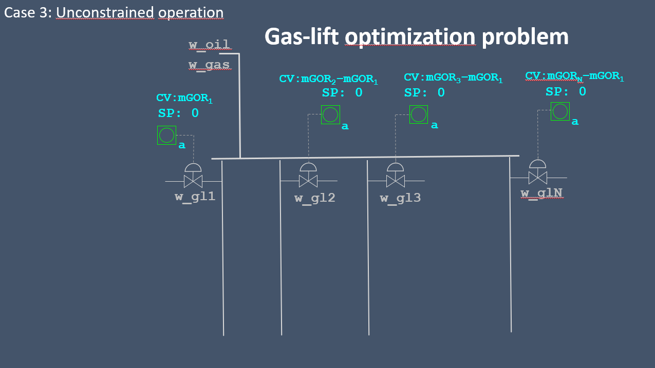
Gas lift performance curves
SUBPRO
Marginal Gas-lift-to-oil ratio (mGOR)

Slide 26
All 3 Cases combined
Gas-lift optimization problem
w_oil
w_gas
Marginal GL-oil-ratio Controllers
SP: 0
SP: 0
SP: 0
Ctrl 1
min select
Ctrl 2
Ctrl 3
w_gl1
w_gl2
w_gl3
w_glN

Slide 27
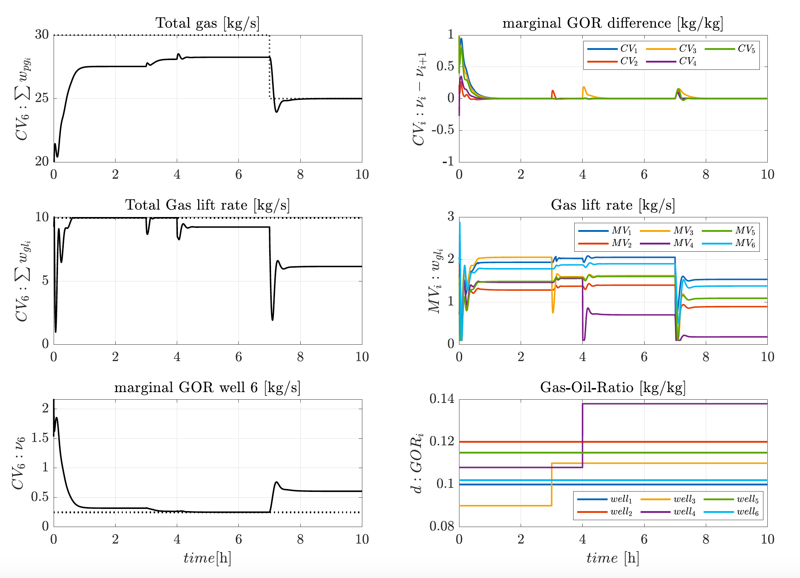
Results

Slide 28
Conclusion
SUBPRO
SUBSEA PRODUCTION AND PROCESSING
Optimal operation using simple controller structures
Logics to switch between different operating regions
Beneficial for brownfield and late-life fields
Thank you !

