Slide 1


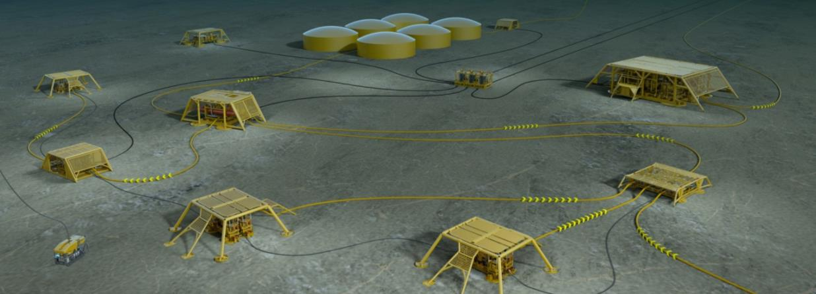
SUBPRO research project
Sigurd Skogestad (Director)
SUBPRO
SUBSEA PRODUCTION AND PROCESSING
© Statoil ASA
© 2016 SUBPRO/NTNU. Distribution, copying and publishing only with written consent from NTNU

Slide 2
Objective
SUBPRO
The primary objective of the SUBPRO* center is to become
a global leader for research based innovation within
subsea production and processing, providing:
  International excellence in fundamental and applied research
  Knowledge, methods, technology and system understanding – as basis for industrial innovation
  Internationally high level of graduated master and PhD candidates
SUBPRO*: - Subsea Production and Processing

Slide 3
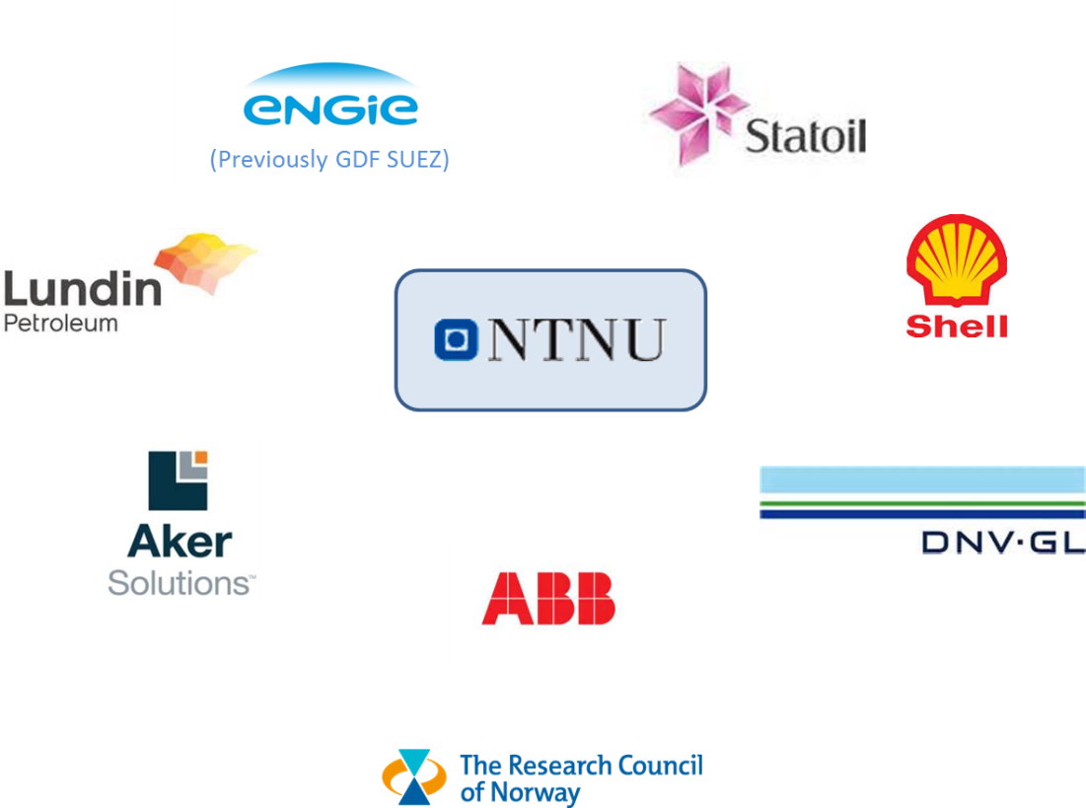
Partners
SUBPRO

Slide 4
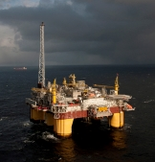
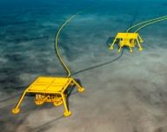

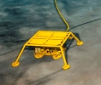

Subsea Processing
- any active treatment / handling of fluids at (or below) the seabed
SUBPRO
Receiving Facility
(Platform / Onshore)
Subsea
Production System
Flowlines, Umbilicals
& HV Power Cables
Risers
Subsea Processing Station
Subsea Injection
XTs & Manifolds
(if required)
Current Solutions:
Boosting
  Liquid / multiphase boosting to topside
  Raw sea water injection
Separation
  Liquid / liquid separation and water disposal / reinjection
  Gas / liquid separation and liquid boosting
Gas compression (incl. cooling) and wet gas compression
Production
Wells
Injection
Wells
Production Reservoir
Disposal / Production Reservoir
Source for illustrations & photos: Statoil ASA

Slide 5
Organization
SUBPRO
Centre Board
(Chair: Audun Faanes)
Technical Committee
(Chair: Dag Morten Jahr)
Centre Director
Sigurd Skogestad
Deputy Director
Mary Ann Lundteigen
Adm. Coordinator
Jon Lippe
Techn. Coordinator
Gro Mogseth
Reference group
Reference group
Reference group
Research areas
Field architecture
Sigbjørn Sangesland
RAMS
Mary Ann Lundteigen
Separation –
Fluid characterization
Johan Sjöblom / Gisle Øye
Separation Process Concepts
Hanna Knuutila
System Control
Sigurd Skogestad
Industry partners
Notes:
- Close cooperation with the Industry Partners (Board meetings, TC meetings, Reference group meetings, Sub-project meetings, In kind contribution)
- Cross dicipline cooperation (courses, industry visits, phd colloquim, sharepoint, cross-project meetings ++)

Slide 6
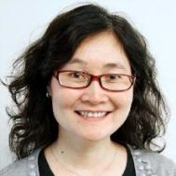
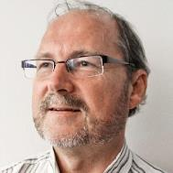
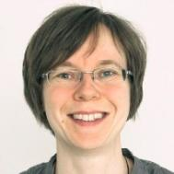
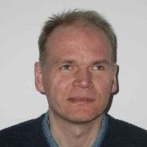
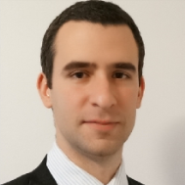
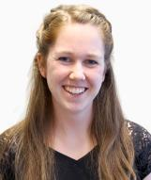
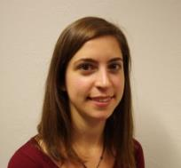
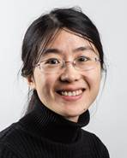
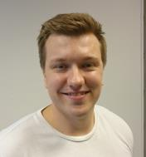
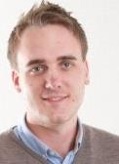
Process Concepts – Projects & People
SUBPRO
Sub-projects:
  2.4 Membranes for gas dehydration
  2.5 H2S and hydrate control
  2.6 Particle breakup and contactor studies
  2.7 Experiments on fluid particle breakage
  2.9 Compact separation
Main resources involved:
Assoc. Professor
Liyuan Deng
Professor
Magne Hillestad
Assoc. Professor
Hanna Knuutila
Professor
Hugo Jakobsen
Assoc. Professor
Milan Stanko
Post doc
Jannike Solsvik
Kristin Dalane
(PhD cand. – Proj. 2.4)
Eirini Skylogianni
(PhD cand. – Proj. 2.5)
Jing Shi
(PostDoc - Proj. 2.6)
Eirik Helno Herø
(PhD cand. – Proj. 2.7)
Håvard Skjefstad
PhD cand. – Proj. 2.9)

Slide 7
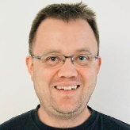
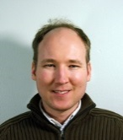
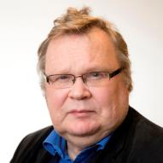
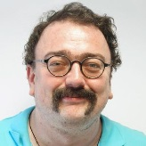

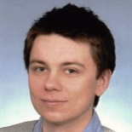
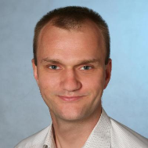
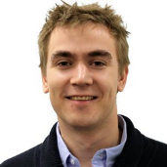
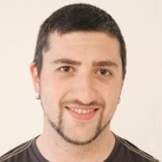
Fluid Characterization – Projects & People
SUBPRO
Sub-projects:
  2.1 Produced water quality and injectivity
  2.2 Modelling of wax deposition
  2.3 Sequential separation
  2.8 Modelling of coalescence
Main resources involved:
Professor
Gisle Øye
Assoc. Professor
Kristofer Paso
Professor
Johan Sjöblom
Researcher
Sebastien Simon
Assoc. Professor
Brian Grimes
Marcin Dudek
(PhD cand. – Proj. 2.1)
Jost Ruwold
(PhD cand. – Proj. 2.2)
Are Bertheussen
(PhD cand. – Proj. 2.3)
Aleksandar Mehandzhiyski
(PostDoc - Proj. 2.8)

Slide 8
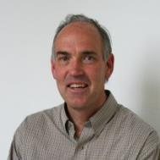
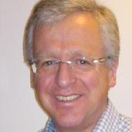
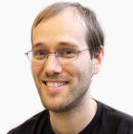
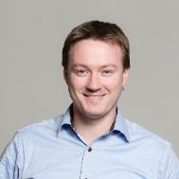
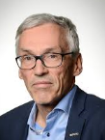
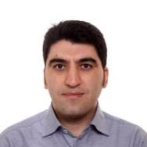
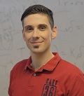
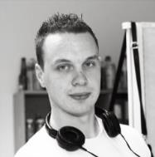
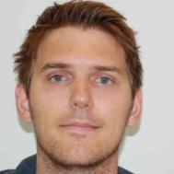
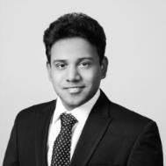
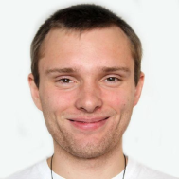
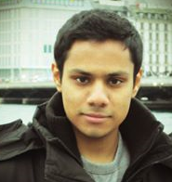
System Control – Projects & People
SUBPRO
Sub-projects:
  3.4 Dynamic simulation model library
  3.5 Modelling of subsea systems
  3.6 Control of subsea processes
  3.7 Estimation of unmeasurable variables
  3.8 Control for extending component life
  3.9 Production Optimization (NEW)
Main resources involved:
Professor
Sigurd Skogestad
Professor
Olav Egeland
Assoc. Professor
Christian Holden
Assoc. Professor
Johannes Jäschke
Professor
Bjarne Anton Foss
Researcher (20%)
Esmaeil Jahanshahi
Christoph Backi
(PostDoc - Proj. 3.4)
Torstein T. Kristoffersen
(PhD cand. – Proj. 3.5)
Sveinung Johan Ohrem
(PhD cand. – Proj. 3.6)
Tamal Das
(PhD cand. – Proj. 3.7)
Adriaen Verheyleweghen
(PhD cand. – Proj. 3.8)
Dinesh Krishnamoorthy
PhD student
Notes:
Sett inn bilde av Dinesh

Slide 9
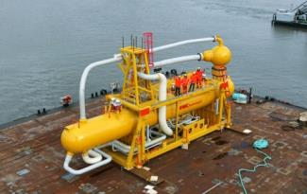
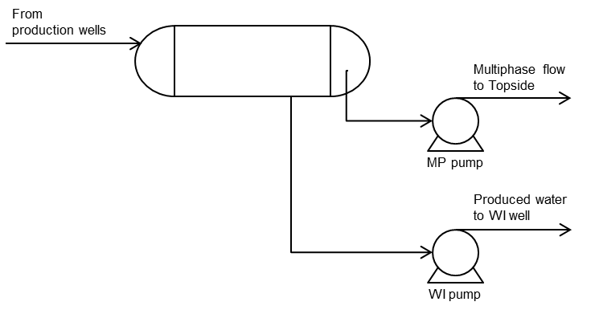
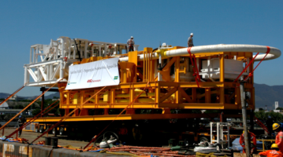
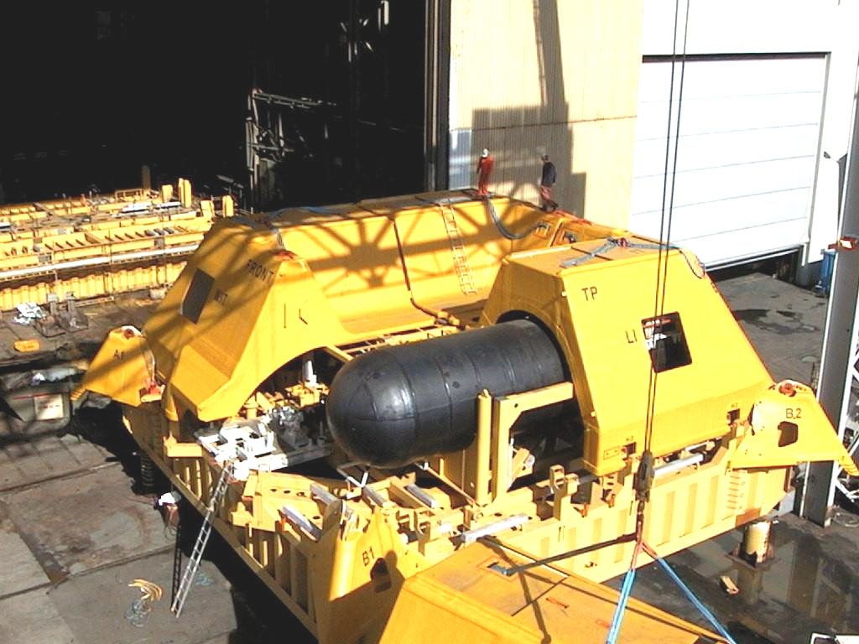
Liquid/Liquid Separation & Boosting Projects
- Typical: Water separation and injection / disposal of produced water
SUBPRO
Name | Start-up | Separation equipment | Pumps | Water depth (m) | Operator/ Supplier
Troll Pilot | 2000/ 2001 | Horizontal gravity separator | WI (1,6 MW) | 340 | Statoil / GE (former ABB)
Tordis | 2007 | Semi-compact horizontal gravity separator Desander tank | WI (2,3 MW) MP (2,3 MW) | 200 | Statoil / FMC
Marlim | 2013 | Pipeseparator, inline desanders and hydrocyclones for water polishing | WI (1,9 MW) | 876 | Petrobras / FMC
Source: Statoil
Source: Statoil
Source: Petrobras

Slide 10
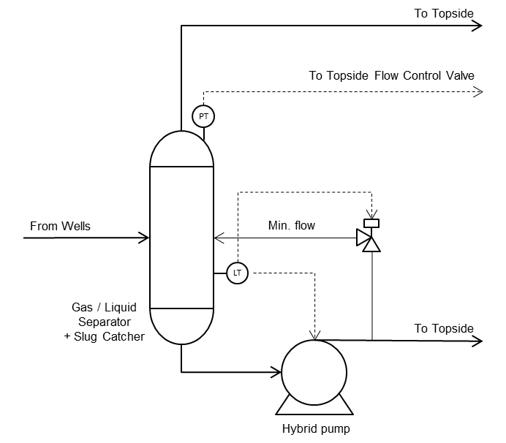
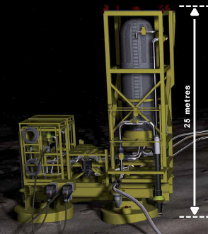
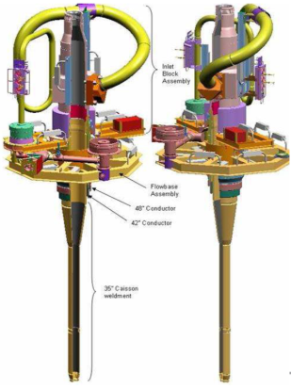
Gas / Liquid Separation & Boosting Projects
SUBPRO
Name | Start-up | Separation equipment | Pumps Compressors | Water depth (m) | Operator / Supplier
BC10 | 2009 | 6 x Caisson | ESP (downhole pump) | 1500-2000 | Shell / FMC
Perdido | 2010 | 5 x Caisson | ESP (downhole pump) | 2880 | Shell / FMC
Pazflor | 2011 | 3 x Vertical gravity | Hybrid pump | 600-1000 | Total, Sonangol / FMC
Source: Statoil / Total
Source: Shell / FMC

Slide 11
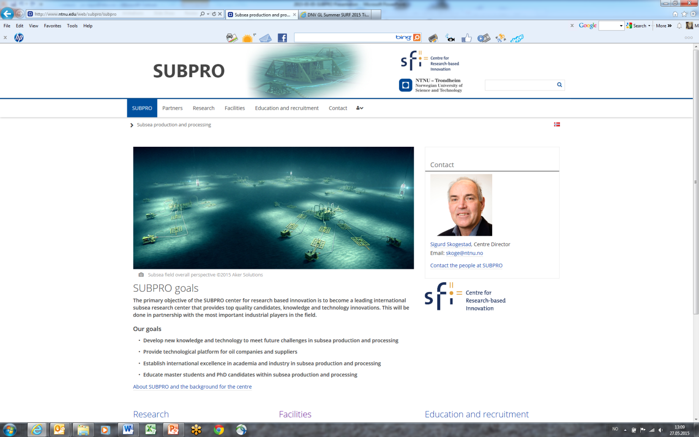
SUBPRO
Visit us at www.ntnu.edu/subpro

