Slide 2
Academic history
1217 Schola Cathedralis Nidrosiensis
1760 Royal Norwegian Society of Sciences and Letters
1910 Norwegian Institute of Technology (NTH)
1922 Norwegian Teachers’ College [in Trondheim] (NLHT)
1950 SINTEF (the Foundation for Technical and Industrial Research at NTH)
1955 Norwegian Academy of Technological Sciences (NTVA) (Trondheim)
1968 University in Trondheim (UNIT)
1973 Trøndelag Music Conservatory
1974 Department of Medicine (from 1984: The Faculty of Medicine)
Trondheim Academy of Fine Art
Norwegian College of General Sciences (AVH) (previously NLHT)
1994 University Colleges in Sør-Trøndelag, Gjøvik and Ålesund are established
1996 Norwegian University of Science and Technology (NTNU)
Trondheim celebrates 250 years as an academic city
2016 University Colleges in Sør-Trøndelag, Gjøvik and Ålesund merge with NTNU

Slide 3
NTNU’s vision: Knowledge for a better world
Set the standard for developing cutting-edge knowledge.
Create economic, cultural and social value.
Use the university’s technical and scientific main profile, its academic breadth and interdisciplinary expertise to address the challenges facing Norway and the world.

Slide 4
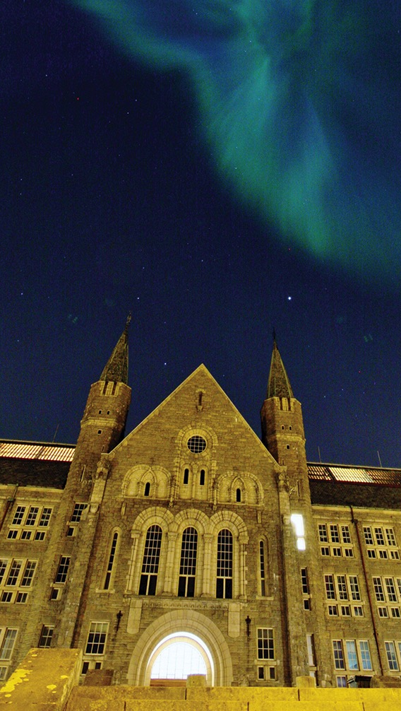
Organization, budget and staff
14 faculties and 70 departments and divisions
Operating income: NOK 7.6 billion.
FTE: 6700, of which 4053 are in teaching, research and outreach positions (39 % female).
Premises: 734 000 square metres either owned or rented.
Close cooperation with SINTEF, St. Olavs Hospital and NTNU Social Research AS.

Slide 5
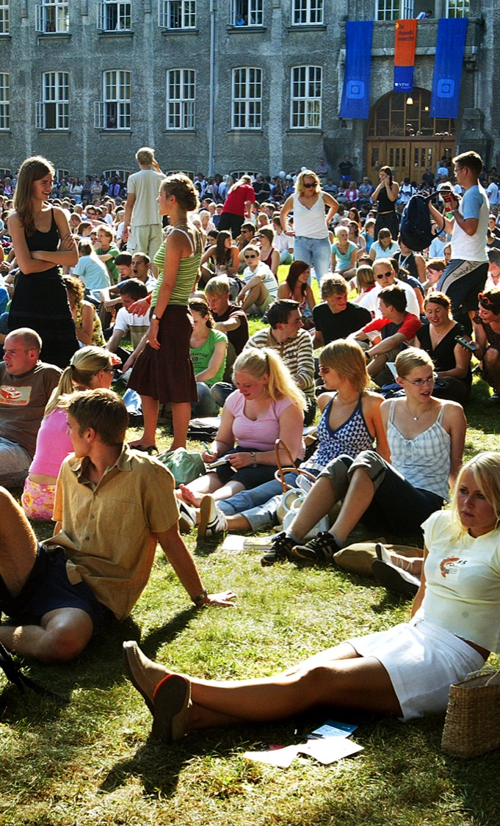
Studies
Primary responsibility for educating Norway’s engineers and technical experts.
33 000 students in Trondheim, 3 500 students in Gjøvik and 2500 students in Ålesund (round numbers).
6553 graduated with a completed degree in 2014.
6000 participants in continuing education courses with credit in 2014.
3000 international students.

Slide 6
Research and industry partnerships
PhDs: 340 doctoral degrees awarded in 2015.
Approximately 120 laboratories.
Norway’s largest participant in the EU’s Horizon 2020 (H2020). Participant in 38 projects, of which 2 are ERC projects and 10 for which the university is coordinator.

Slide 8
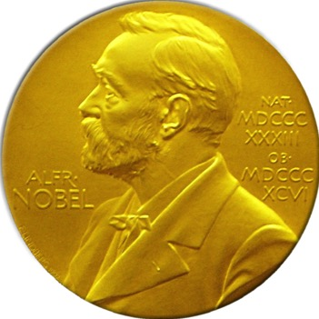
2014 Nobel Prize
NTNU professors
May-Britt Moser and
Edvard Moser were awarded the 2014 Nobel Prize in Physiology or Medicine for their discovery of cells that constitute an “inner GPS” in the brain.

Slide 9
Trondheim
– Norway’s best student city
Every fifth Trondheim resident is a student.
Studentersamfundet is a building owned by and for students, offering concerts and events.
UKA is Norway’s largest cultural event.
International student festival (ISFiT).
NTNUI is Norway’s largest and most comprehensive sports association with more than 12 000 members.
New vision to be the best Nordic student city

Slide 10
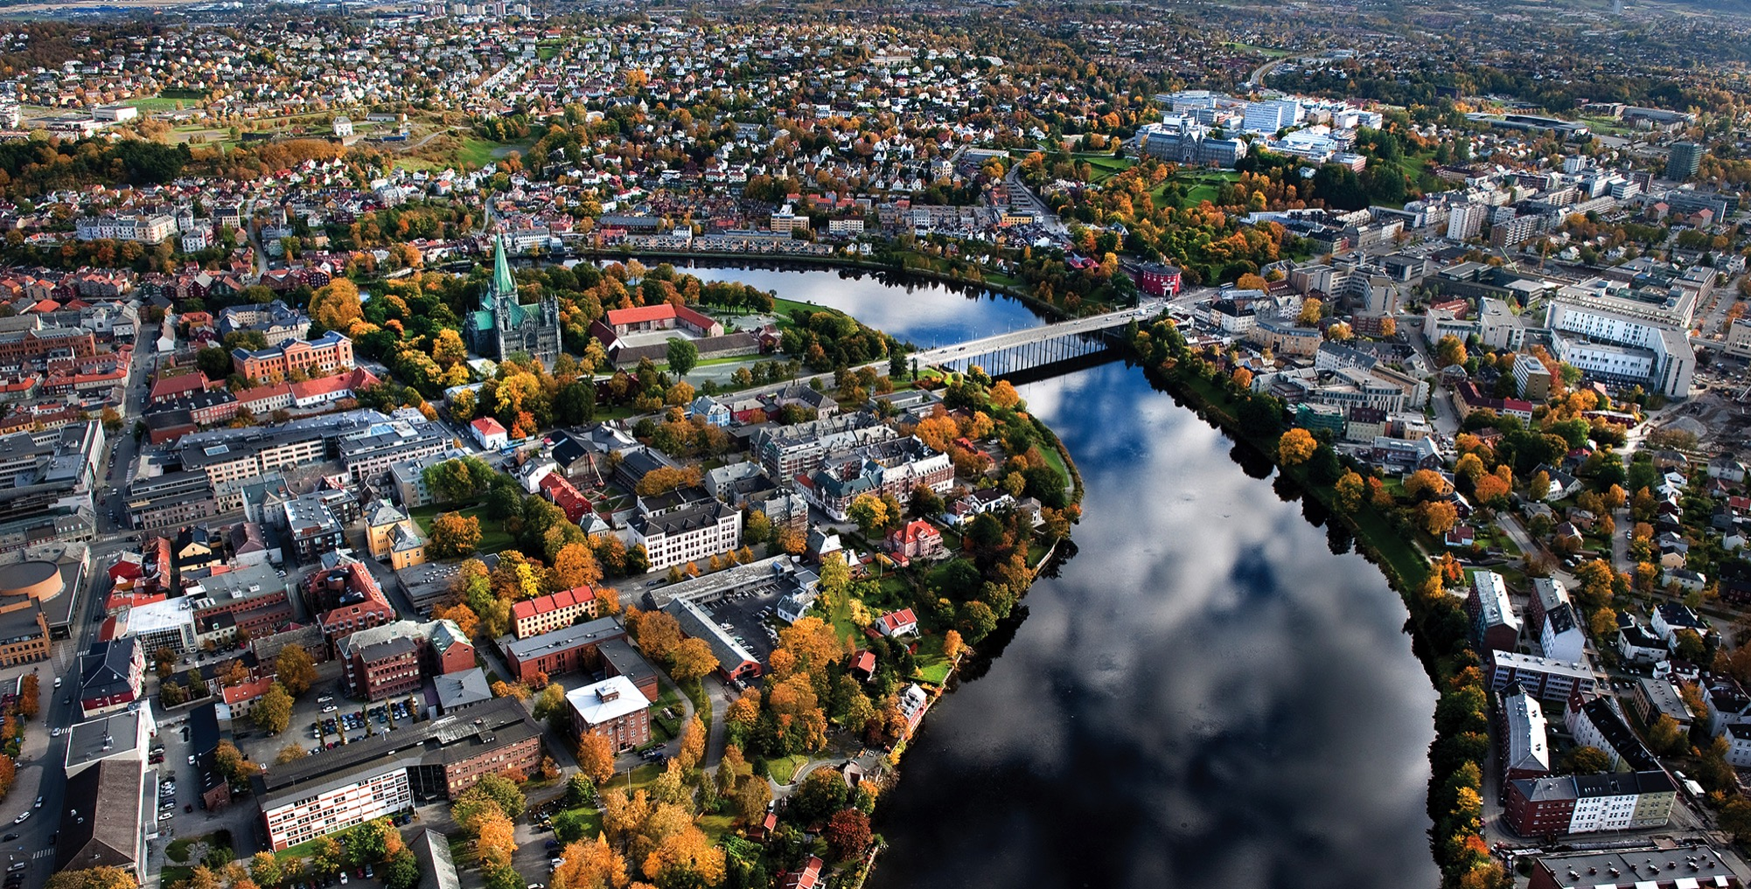
Foto: Carl-Erik Eriksson

Slide 11
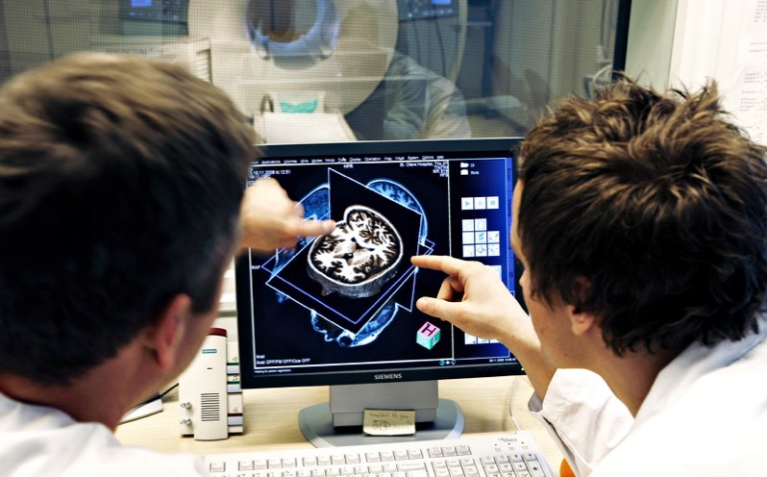
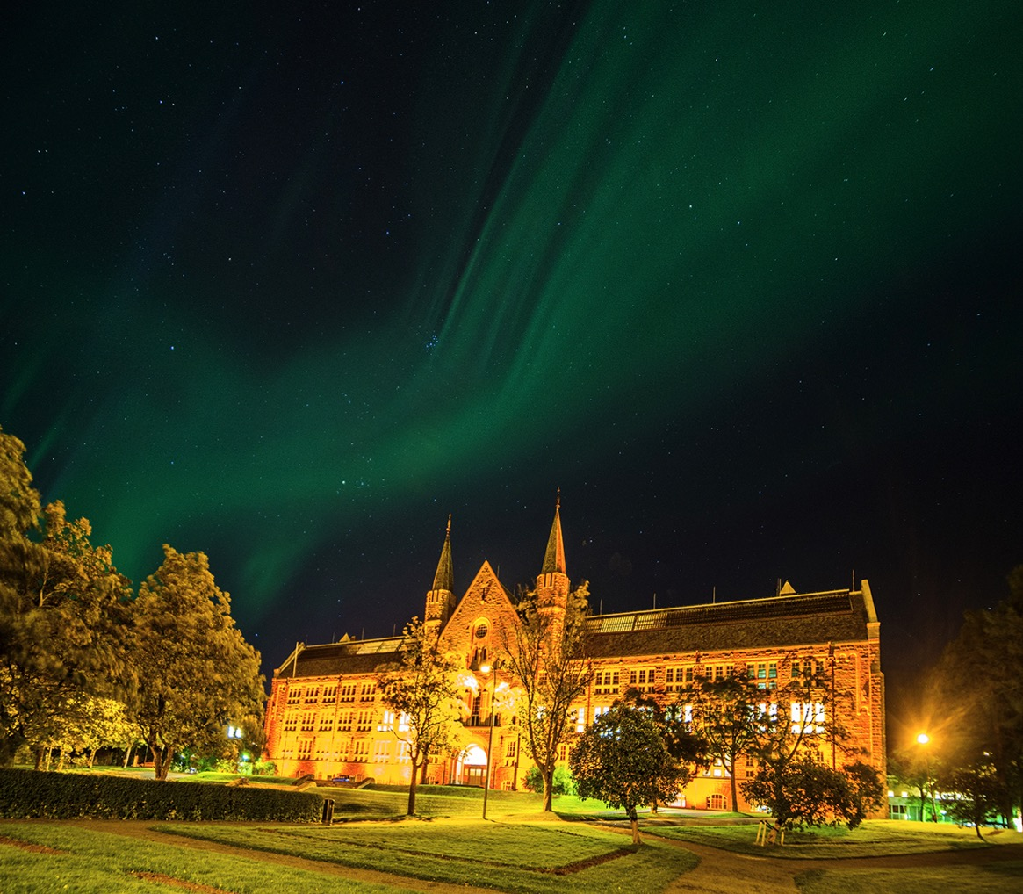
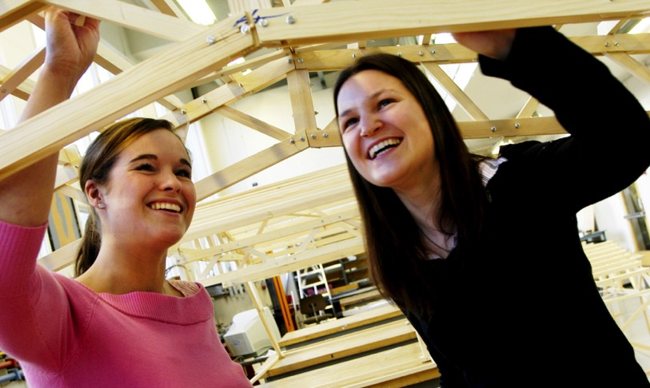

Slide 12
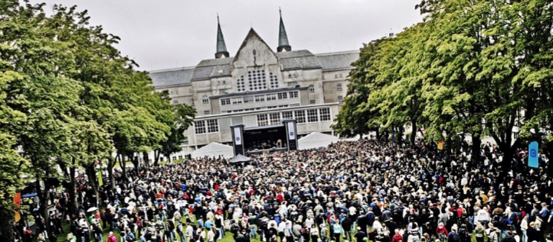
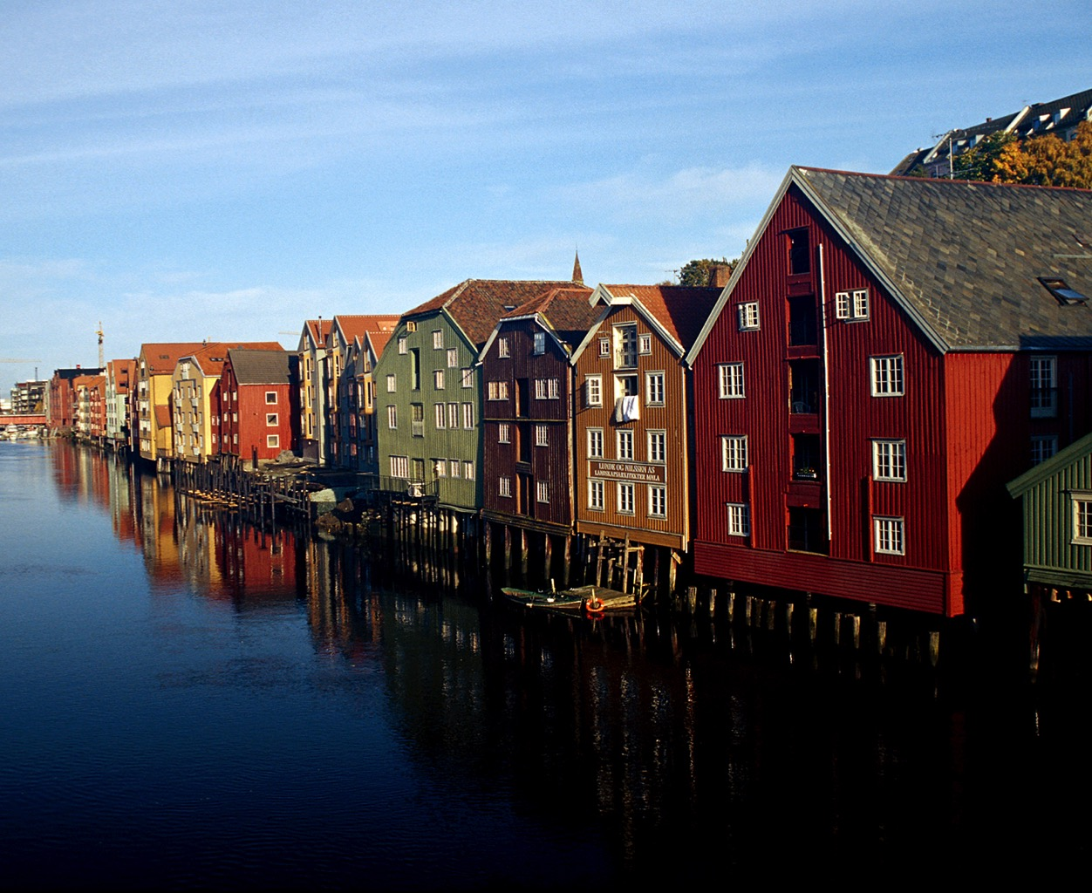
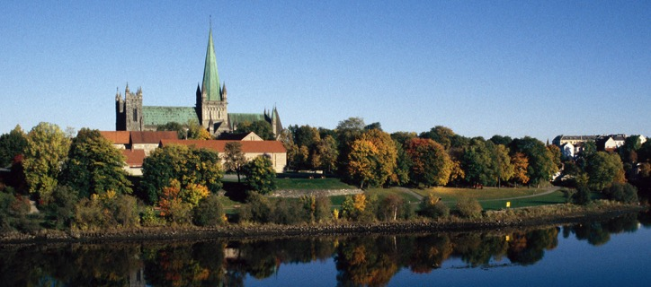

Slide 13
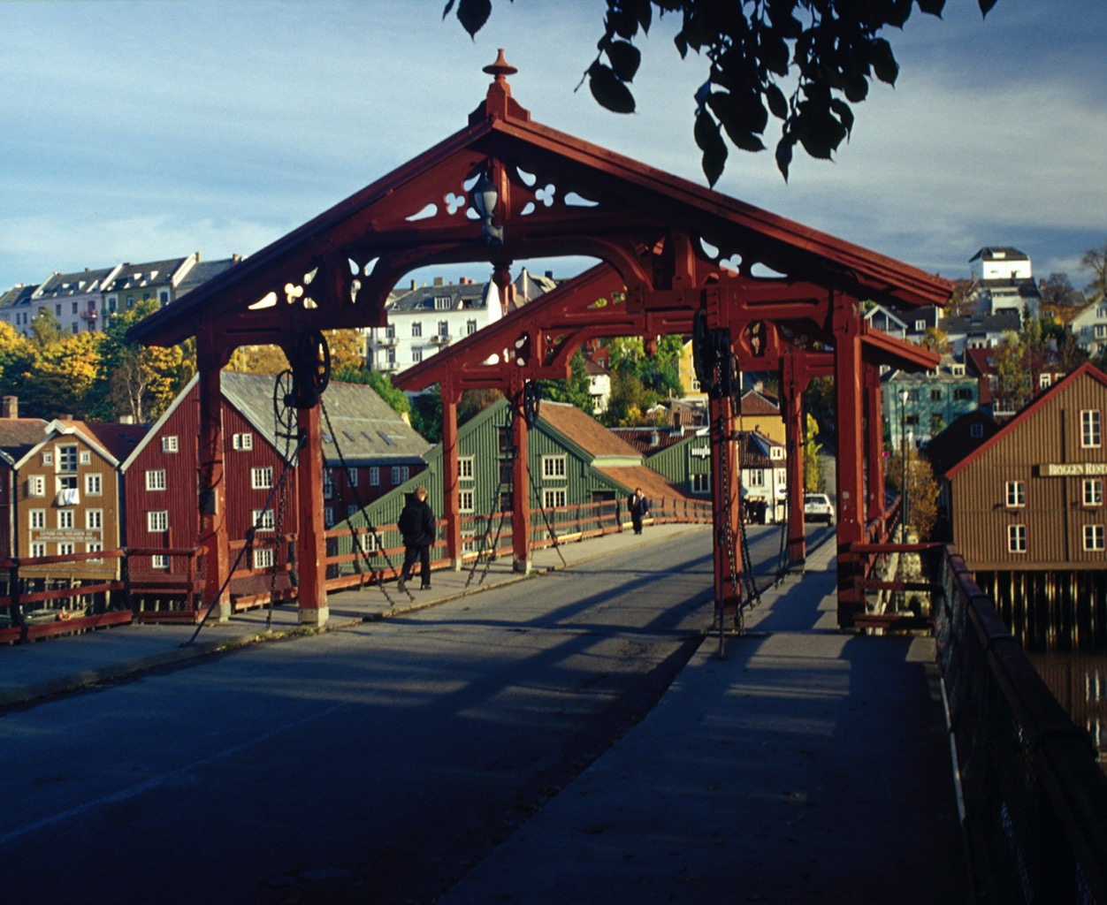

Slide 14
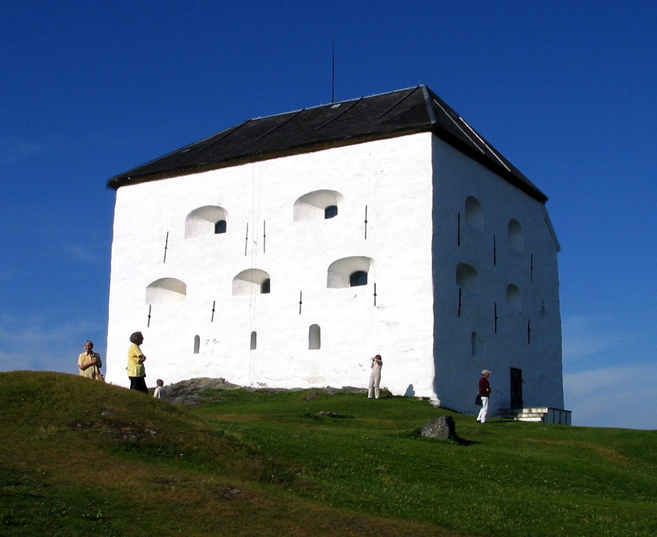

Slide 15
