Slide 1
Control strategies for optimal operation of complete plants
Plantwide control - With focus on selecting economic controlled variables
Sigurd Skogestad, NTNU
Short course, Technion, Israel, 11 April 2016

Slide 2
Sigurd Skogestad
1955: Born in Flekkefjord, Norway
1978: MS (Siv.ing.) in chemical engineering at NTNU
1979-1983: Worked at Norsk Hydro co. (process simulation)
1987: PhD from Caltech (supervisor: Manfred Morari)
1987-present: Professor of chemical engineering at NTNU
1999-2009: Head of Department
2015-..: Director SUBPRO (Subsea research center at NTNU)
Book: Multivariable Feedback Control (Wiley 1996; 2005)
  1989: Ted Peterson Best Paper Award by the CAST division of AIChE
  1990: George S. Axelby Outstanding Paper Award by the Control System Society of IEEE
  1992: O. Hugo Schuck Best Paper Award by the American Automatic Control Council
  2006: Best paper award for paper published in 2004 in Computers and chemical engineering.
  2011: Process Automation Hall of Fame (US)
  2012: Fellow of American Institute of Chemical Engineers (AIChE)
  2014: Fellow of International Federation of Automatic Control (IFAC)

Slide 3


Trondheim, Norway

Slide 4


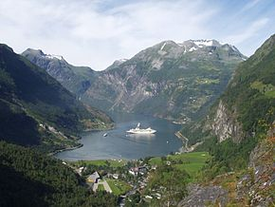
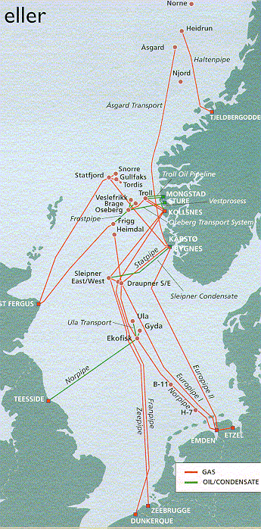
Arctic circle
North Sea
Trondheim
NORWAY
SWEDEN
Oslo
DENMARK
GERMANY
UK

Slide 5
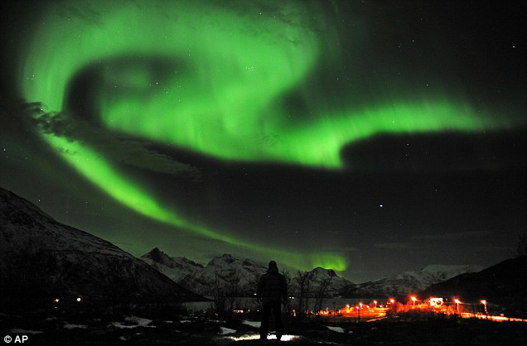
Winter: No sun, but sometimes
Aurora Borealis = Northern Lights
Tromsø

Slide 6
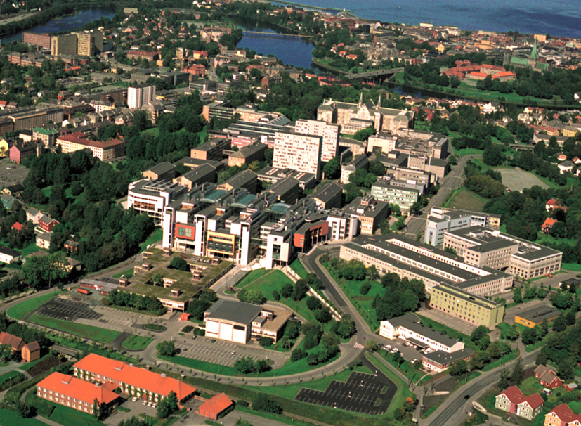
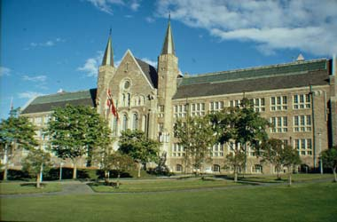
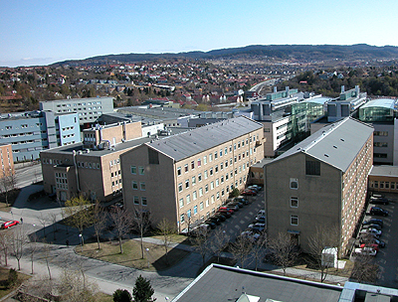
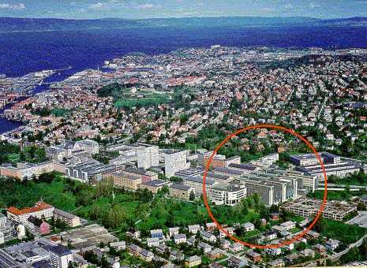
NTNU,Trondheim
200 000 people
30 000 students

Slide 7
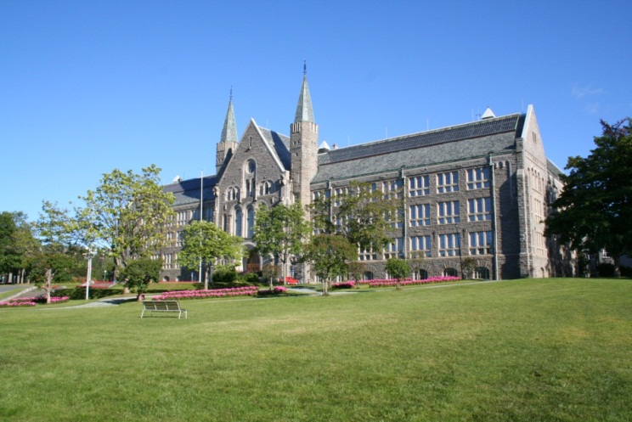
11th International Symposium of Dynamics and Control of Process Systems including Biosystems
DYCOPS + CAB 2016
6-8 JUNE 2016 (Mon-Wed)
S
Welcome to:
IFAC sponsor TC6.1. Co-sponsor: TC8.4
Location: Trondheim, Norway (NTNU)
Organizer: NTNU (Sigurd Skogestad, Bjarne Foss, Morten Hovd, Lars Imsland,),
Norwegian University of Science and Technology (NTNU), Trondheim
dycops2016.org/

Slide 8
Course outline
Session 1. Overview of plantwide control
  - The link between the optimization (RTO) and the control (MPC; PID) layers
  - Our paradigm
  - Introductory example
Session 2. What to control? (Selection of primary controlled variables based on economics)
  - Degrees of freedom
  - Optimization
  - Active constraints
  - Self-optimizing control
Session 3. Where to set the production rate and bottleneck
  - Inventory control
  - Consistency
  - Radiation rule
  - Location of throughput manipulator (TPM)
Session 4. PID control
  - Obtaining the model
  - SIMC tuning (simple and close to optimal)
  - Feedforward design
Session 5. Design of the regulatory control layer ("what more should we control")
  - Stabilization
  - Secondary controlled variables (measurements)
  - Pairing with inputs
  - Cascade control and time scale separation.
Session 6. Design of supervisory control layer
  - Decentralized versus centralized (MPC)
  - Design of decentralized controllers: Sequential and independent design
  - Pairing and RGA-analysis

Slide 9
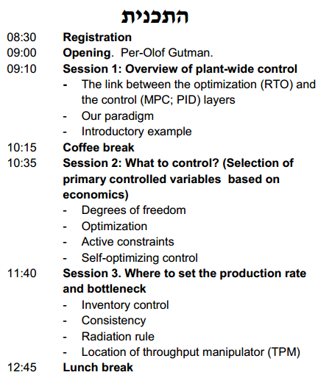
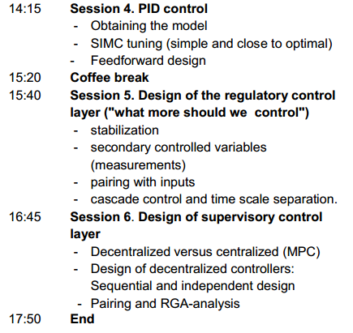

Slide 10
Plantwide process control
Part 1 : Plantwide control
Part 2 : More on self-optimizing control.
Part 3 : Consistent inventory control, TPM location, Structure of regulatory control layer
Part 4 : PID tuning
Part 5 : “Advanced” control and case studies

Slide 11
Part 1: Plantwide control
Introduction to plantwide control (what should we really control?)
Introduction.
  Objective: Put controllers on flow sheet (make P&ID)
  Two main objectives for control: Longer-term economics (CV1) and shorter-term stability (CV2)
  Regulatory (basic) and supervisory (advanced) control layer
Optimal operation (economics)
  Define cost J and constraints
  Active constraints (as a function of disturbances)
  Selection of economic controlled variables (CV1). Self-optimizing variables.

Slide 12
Part 2: Self-optimizing control theory
  Ideal CV1 = Gradient (J_{u})
  Nullspace method
  Exact local method
  Link to other approaches
  Examples, exercises

Slide 13
Part 3: Regulatory («stabilizing») control
Inventory (level) control structure
  Location of throughput manipulator
  Consistency and radiation rule
Structure of regulatory control layer (PID)
  Selection of controlled variables (CV2) and pairing with manipulated variables (MV2)
  Main rule: Control drifting variables and "pair close"
Summary: Sigurd’s rules for plantwide control

Slide 14
Part 4: PID tuning
PID controller tuning: It pays off to be systematic!
Derivation SIMC PID tuning rules
  Controller gain, Integral time, derivative time
Obtaining first-order plus delay models
  Open-loop step response
  From detailed model (half rule)
  From closed-loop setpoint response
Special topics
  Integrating processes (level control)
  Other special processes and examples
  When do we need derivative action?
  Near-optimality of SIMC PID tuning rules
  Non PID-control: Is there an advantage in using Smith Predictor? (No)
Examples

Slide 15
Part 5: Advanced control + case studies
Advanced control layer
Design based on simple elements:
  Ratio control
  Cascade control
  Selectors
  Input resetting (valve position control)
  Split range control
  Decouplers (including phsically based)
  When should these elements be used?
When use MPC instead?
Case studies
Example: Distillation column control
Example: Plantwide control of complete plant Recycle processes: How to avoid snowballing

