Slide 1
SUBPRO Student presentation
SUBPRO SUBSEA PRODUCTION AND PROCESSING

Slide 2
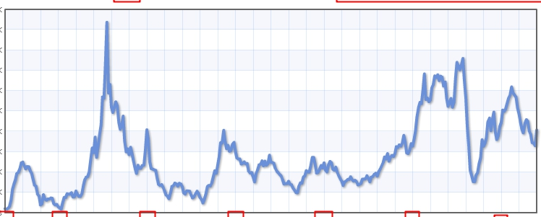
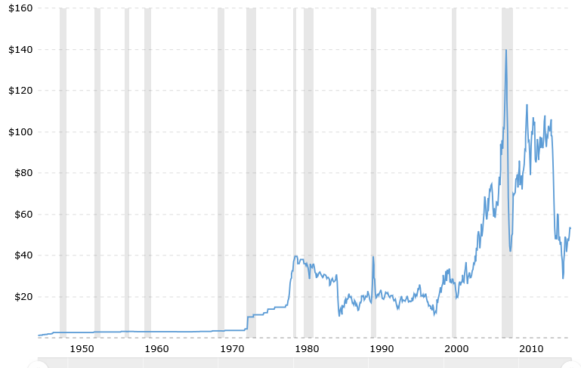
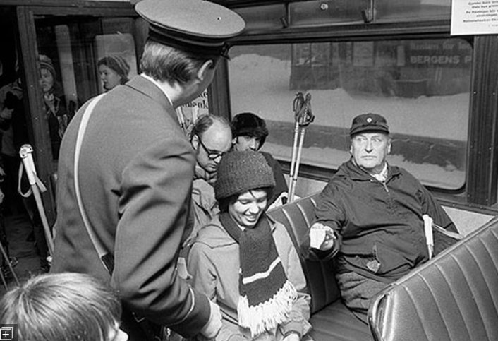
Historical oil price [$/bbl]
Aluminium
June 2008. $140
Financial crisis 2009
June 2014. $106
Dec. 1973. First «oil crisis»
Jan. 2015. $47
Jan. 2016. $28
Jan. 2017. $54
Apr. 1980. $40
«Dot-com crisis» 2000
Nov. 1998. $10
March 1986. $10
http://www.macrotrends.net/1369/crude-oil-price-history-chart

Slide 3
Historical oil price [$/bbl]
June 2008. $140
Financial crisis 2009
June 2014. $106
Dec. 1973. First «oil crisis»
Jan. 2015. $47
Jan. 2016. $28
Jan. 2017. $54
Apr. 1980. $40
«Dot-com crisis» 2000
Nov. 1998. $10
March 1986. $10
http://www.macrotrends.net/1369/crude-oil-price-history-chart

Slide 4
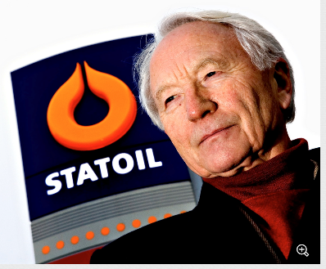
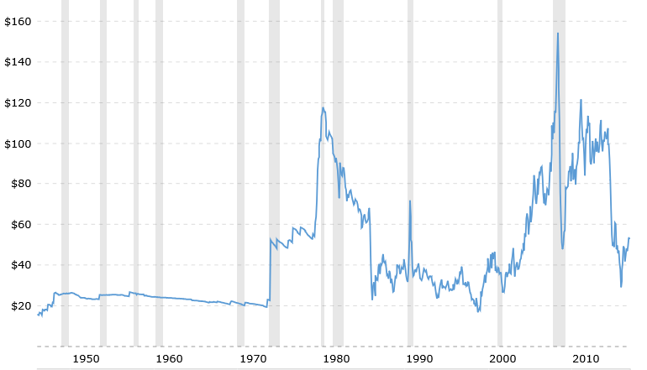
Oil price adjusted for inflation
2008
Arve Johsen, CEO Statoil, 1982.
«Oljeprisen kan kun gå en vei – oppover»
2014
Alternative green
power competetive
(Solar etc.)
2017
Sigurd’s steady-state curve
1998

