Slide 1

SIMPLE RULES FOR ECONOMIC PLANTWIDE CONTROL
Vladimiros Minasidisª, Sigurd Skogestadª, Nitin Kaistha^{b}
ªDept. of Chemical Engineering, Norwegian University of Science and Technology, Trondheim, Norway
^{b}Dept. of Chemical Engineering, Indian Institute of Technology, Kanpur, India
Simple Rules for Economic Plantwide Control, PSE & ESCAPE 2015
Notes:
The thematic content of the series:
1 Facts
Revenue from the last two years; Localization; History and surroundings
2 Research
Six strategic areas; Three Centres of Excellence; Laboratories; Cooperation with SINTEF;
3 Education and student activities
Study areas and programmes of study; Quality Reform; Further- and continuing education; Internationalization
4 Innovation and relationships with business and industry
Innovative activities; Agreements with the public and private sectors
5 Dissemination
Publications, events and the mass media
Museum of Natural History and Archaeology, NTNU Library
6 Organization and strategy
Board and organization; Vision, goal and strategies;
For more on terminology, see www.uhr.no/informasjon/index.htm (“terminologiliste”)
See also www.ntnu.no/intersek/english_matters/ (”Selected administrative terms with translations”)

Slide 2
OUTLINE
INTRODUCTION
PROCEDURE FOR ECONOMIC PLANTWIDE CONTROL
REACTOR-SEPARATOR-RECYCLE CASE STUDY
PRACTICAL RULES
DYNAMIC SIMULATIONS
CONCLUSIONS

Slide 3
HOW TO DESIGN THE CONTROL SYSTEM FOR A COMPLETE PLANT ?
Famous critique article on process control by Foss (1973):
The central issue to be resolved ... is the determination of control system structure. Which variables should be measured, which inputs should be manipulated and which links should be made between the two sets?
There is more than a suspicion that the work of a genius is needed here, for without it the control configuration problem will likely remain in a primitive, hazily stated and wholly unmanageable form. The gap is present indeed, but contrary to the views of many, it is the theoretician who must close it.
NEED A SYSTEMATIC APPROACH

Slide 4
MAIN OBJECTIVES FOR A CONTROL SYSTEM
Economics: Implementation of close-to-optimal economic operation
Regulation: Stable operation
ARE THESE OBJECTIVES CONFLICTING?
Usually NOT
  Different time scales
    Stabilization fast time scale
  Stabilization doesn’t “use up” any degrees of freedom
    Reference value (setpoint) available for layer above
    But it “uses up” part of the time window (frequency range)

Slide 5
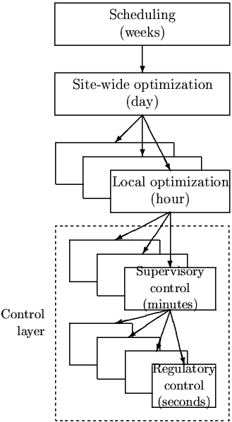
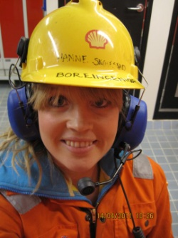

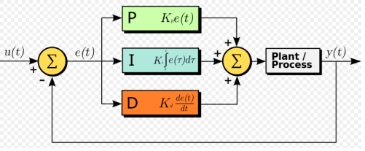
Our Paradigm
PRACTICAL OPERATION: HIERARCHICAL STRUCTURE
Manager
Process engineer
Operator/RTO
CV1
Operator/”Advanced control”/MPC
PID-control
u = valves

Slide 6
ECONOMIC PLANTWIDE CONTROL PROCEDURE
Decompose the structural decisions into two parts:
Top-down part, which attempts to find a slow-time-scale supervisory control structure that achieves a close-to-optimal economic operation.
Figure 1: Typical control hierarchy in a chemical plant

Slide 7
ECONOMIC PLANTWIDE CONTROL PROCEDURE
Decompose the structural decisions into two parts:
Top-down part, which attempts to find a slow-time-scale supervisory control structure that achieves a close-to-optimal economic operation.
Bottom - up part, that aims to design a stable and robust fast-time-scale regulatory control structure, which stabilizes the plant and follows the setpoints from the supervisory layer.
Figure 1: Typical control hierarchy in a chemical plant

Slide 8
ECONOMIC PLANTWIDE CONTROL
STEPWISE PROCEDURE (Skogestad, 2004)
Top Down
    Step S1: Define operational objectives (optimal operation)
      Cost function J (to be minimized)
      Operational constraints
    Step S2: Identify degrees of freedom (MVs) and optimize for expected disturbances
    Step S3: Select primary controlled variables CV₁ (economic CVs)
    Step S4: Where to set the production rate? (TPM)
Bottom Up
    Step S5: Regulatory / stabilizing control (PID layer)
      What more to control CV₂ (stabilizing CVs)?
      Pairing of inputs and outputs
    Step S6: Supervisory control (MPC layer)
    Step S7: Real-time optimization (Do we need it?)

Slide 9
ECONOMIC PLANTWIDE CONTROL
Top-down part (mainly steady-state): :
Step S1: Define the operational objectives (economics) and constraints.
  Identify
    A scalar cost function J
      J = cost feed + cost energy – value products
    operational constraints
    disturbances d and their ranges
Two main cases (modes/regions) depending on market conditions:
  Mode 1. Given feedrate
  Mode 2. Maximum production (max feedrate)

Slide 10
ECONOMIC PLANTWIDE CONTROL
Top-down part (mainly steady-state): :
Step S2: Determine the degrees of freedom and find the steady-state optimal operation.
  Must optimize for the range of expected disturbances d
  Requires a rigorous model (usually steady-state)
  POTENSIALLY VERY TIME CONSUMING
  Main goal: Identify the ACTIVE CONSTRAINTS

Slide 11
ECONOMIC PLANTWIDE CONTROL
Top-down part (mainly steady-state): :
Step S3: Select primary (economic) controlled variables (CV₁)
  Identify the candidate measurements y_{m} and from these select a set CV₁ (one CV for each steady-state degree of freedom):
    Control the active constraints!
    For the remaining unconstrained degrees of freedom:
    Control “self-optimizing” variables
Figure 1: Typical control hierarchy in a chemical plant

Slide 12
“Self-optimizing” variables:
Controlled variables (CV1), which when kept at constant setpoint, indirectly achieve close-to-optimal operation in spite of unknown disturbances
Minimize the need for
re-optimization

Slide 13
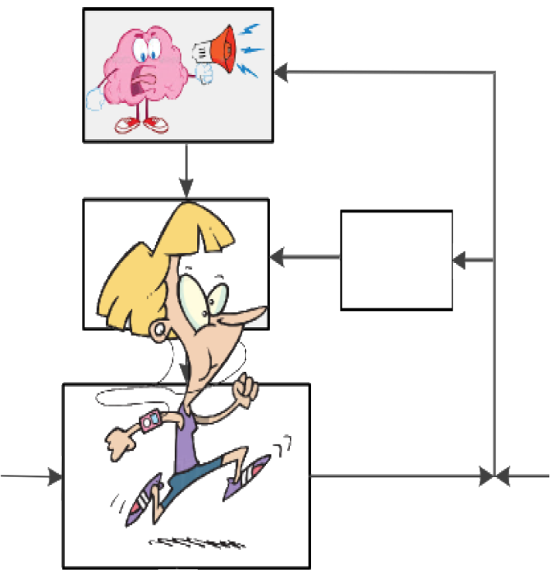
Famous example – Marathon runner:
Objective: Minemise J=T
Any self-optimizing variable to control ?
CV₁ = Hy_{m} ?
d=hill
J=T
CV_{1s}
Loss
CV₁ = Speed?
CV₁
H
CV_{opt}
CV_{2s}
y_{m}
CV=speed
d
n^{y}
Disturbance (d) = hill
Candidate measurements (y_{m}): speed, heart rate, …

Slide 14


Famous example – Marathon runner:
Objective: Minemise J=T
Any self-optimizing variable to control ?
CV₁ = Hy_{m} ?
d=hill
J=T
CV_{1s}
CV₁
H
CV_{opt}
CV_{2s}
y_{m}
CV=heart
rate
d
n^{y}
SELF-OPTIMIZING VARIABLE:
Disturbance (d) = hill
Candidate measurements (y_{m}): speed, heart rate, …
CV₁ =

Slide 15
ECONOMIC PLANTWIDE CONTROL
Top-down part (mainly steady-state):
Step S4: Select the location of throughput manipulator (TPM)
  Q: Where should the plant’s “gas pedal” (TPM) be located ?
    Usually one for each plant
    The location of the TPM is a dynamic issue but has an economic impact
  A: Often located at the feed, but
    to maximize throughput (Mode 2), should be located
    close the production bottleneck
    to avoid “snowballing”, locate inside recycle loop

Slide 16
ECONOMIC PLANTWIDE CONTROL
Bottom-up part (mainly dynamic):
Step S5: Select the control structure for the Regulatory Control layer
  Q₁: What variables (CV2) should be controlled to stabilize the plant operation ?
  A₁: Select “drifting” process variables
  CV₂ = H₂y_{m} that need to be controlled to ensure safe and stable operation
  e.g. inventories, pressures, temperatures.
  Q₂: How should CV₂ be controlled (pairing)?
  A₂: Controllability analysis
Figure 1: Typical control hierarchy in a chemical plant

Slide 17
ECONOMIC PLANTWIDE CONTROL
Bottom-up part (mainly dynamic):
Step S6: Select the control structure for the Supervisory (Advanced) Control layer
  How should the economic controlled variables CV₁ be controlled ?
  (MVs: Setpoints CV_{2s} to regulatory layer)
  Two alternatives:
  Multivariable controller (e.g. MPC)
  Mix of various “advanced” controllers including PID, selectors, feedforward…

Slide 18
ECONOMIC PLANTWIDE CONTROL
Bottom-up part (mainly dynamic):
Step S7: Select the control structure for the Process Optimization layer (RTO)
  How should the optimal setpoints for CV₁ be updated ?
  A good choice of controlled variables (CV1) may remove the need for this layer.
Figure 1: Typical control hierarchy in a chemical plant

Slide 19
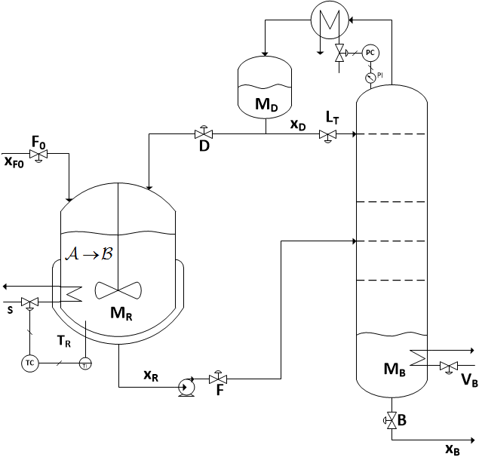
REACTOR-SEPARATOR- RECYCLE
CASE STUDY (Luyben)
Feed F₀ contains mostly A.
Reactor (CSTR)
  1st order A -> B reaction
  Constant temperature
Separator (distillation column)
  Distillate D (mostly A ): recycled back to CSTR.
  Bottom product B (mostly B )
  22 stages
  Constant pressure
  Constant relative volatility
D
F₀
B
Reactor-separator-recycle process

Slide 20
CASE STUDY: Step S1
Definition of optimal operation:
Given feedrate (Mode 1)
  J = cost feed + cost energy – value products J = c_{F} F₀ + c_{V} V_{B} – c_{B} B
  Since F₀ = B is given, this simplifies to
  min J = V_{B}
Reactor-separator-recycle process

Slide 21
CASE STUDY: Step S1
Definition of optimal operation:
Given feedrate (Mode 1)
  J = cost feed + cost energy – value products J = c_{F} F₀ + c_{V} V_{B} – c_{B} B
  Since F₀ = B is given, this simplifies to
  min J = V_{B}
Operational constraints
  M_{R} ≤ 2800 kmol
  V_{B} ≤ 50 kmol/min
  x_{B} ≤ 0.0105 (max. 1.05% A in product)
Reactor-separator-recycle process

Slide 22
CASE STUDY: Step S2
Step S2: Determine the degrees of freedom and find the steady-state optimal operation.
Given pressure and reactor temperature:
6 dynamic manipulated variables (valves)
u_{D} = {F₀, V_{B}, D, B, F, L_{T}}
M_{D} and M_{B} have no steady-state effect and need to be controlled
Steady state and given feed:
3 steady-state degrees of freedom
  Step S3: Must find 3 economic variables to control (CV1)
  ???
Reactor-separator-recycle process

Slide 23
11 Practical rules
(to HELP with THE REMAINING Steps)
“Plantwide control for dummies”

Slide 24
PRACTICAL RULES for Step S3
Step S3: Selection of economic CV1
Rule 1: Control the active constraints
  In general, process optimization is required to determine the active constraints.
  but a good engineer can often guess the active constraints.

Slide 25
PRACTICAL RULES for Step S3
Step S3: Selection of economic CV1
Rule 1: Control the active constraints
  In general, process optimization is required to determine the active constraints.
  but a good engineer can often guess the active constraints
Rule 1A: The purity constraint of the valuable product is always active and should be controlled.
  To maximize valuable product and avoid product “give away”.

Slide 26
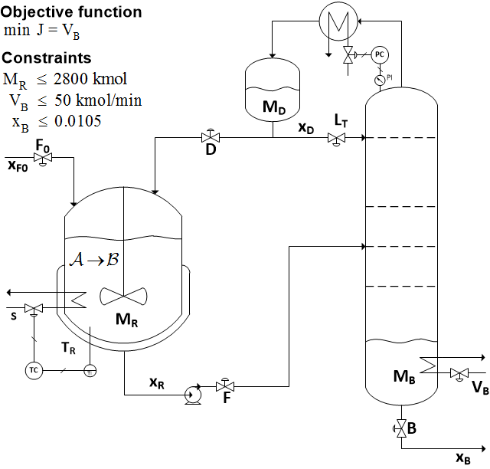
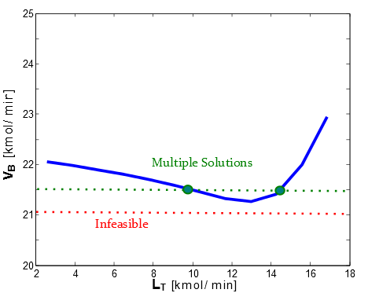
CASE STUDY
Practical rules for Step S3: Selection of economic CV₁
Rule 1: Control the active constraints
Rule 1A: The purity constraint of the valuable product is always active and should be controlled.
Case study: Both M_{R} (max) and x_{B} (purity valuable product) are active.
Need to find one more CV1
Unconstrained optimum
J=V_{B}
Reactor-separator-recycle process
u = L_{T}

Slide 27
PRACTICAL RULES for Step S3
Step S3: Selection of economic CV₁
Rule 2: (for remaining unconstrained steady-state degrees of freedom, if any): Control the “self-optimizing” variables.
  The two main properties of a good “self-optimizing” variable are:
    Ιts optimal value is insensitive to disturbances
      so F = ΔCV_{1,opt} /Δd is small
    Ιt is sensitive to the plant inputs (= “flat optimum”)
      so the process gain G = ΔCV₁/Δu is large

Slide 28
PRACTICAL RULES for Step S3
Step S3: Selection of economic CV₁
Rule 2: (for remaining unconstrained steady-state degrees of freedom, if any): Control the “self-optimizing” variables.
  The two main properties of a good “self-optimizing” variable are:
    Ιts optimal value is insensitive to disturbances (such that F = ΔCV_{1,opt} /Δd is small)
    Ιt is sensitive to the plant inputs (so the process scaled gain G = ΔCV₁/Δu is large).
The following rule combines the two desired properties:
Rule 2A: Select the set CV₁ such that the “ratio” G⁻¹F is minimized.
  This rule is often called the “Maximum scaled gain rule”.

Slide 29
CASE STUDY: Self-optimizing variables
Practical rules for Step S3: Selection of economic CV₁
Rule 2: (for remaining unconstrained steady-state degrees of freedom, if any): Control the “self-optimizing” variables.
  The two main properties of a good “self-optimizing” variable are:
    Ιts optimal value is insensitive to disturbances (such that F = ΔCV_{1,opt} /Δd is small)
    Ιt is sensitive to the plant inputs (so the process scaled gain G = ΔCV₁/Δu is large).
The following rule shows how to combine the two desired properties:
Rule 2A: Select the set CV₁ such that the ratio G⁻¹F is minimized.
  This rule is often called the “Maximum scaled gain rule”.
“Sensitive variables” (with large scaled gain):
Some good candidates for CV_{1,SOC} : {L_{T}/F , x_{D}}.

Slide 30
PRACTICAL RULES for Step S3
Step S3: Selection of economic CV₁
Rule 3: (for remaining unconstrained steady-state degrees of freedom, if any): Never try to control the cost function J
(or any other variable with min or max at the optimal point).
  The cost function J has no sensitivity to the plant inputs so G = 0, (which violates Rule 2A)

Slide 31
PRACTICAL RULES for Step S3
Step S3: Selection of economic CV₁
Rule 3: (for remaining unconstrained steady-state degrees of freedom, if any): Never try to control the cost function J
(or any other variable with min or max at the optimal point).
  The cost function J has no sensitivity to the plant inputs at the optimal point and so G = 0, which violates Rule 2A.
  Potential infeasibility :
J
u

Slide 32
CASE STUDY
Practical rules for Step S3: Selection of economic CV₁
Rule 3: (for remaining unconstrained steady-state degrees of freedom, if any): Never try to control the cost function J
(or any other variable that reaches a min or max at the optimal point).
Case study: Do not keep V_{B} constant (but may be used as a TPM)

Slide 33
PRACTICAL RULES for Step S4
Step S4: Location of throughput manipulator (TPM)
Rule 4: Locate the TPM close to the process bottleneck.
  This is to be able to maximize the production rate (Mode 2)
  Gives a simpler transition between mode 1 (given feed) and mode 2
  (Process bottleneck is defined as the last constraint to become active when increasing the throughput rate.)
Rule 5: (for processes with recycle)
Locate the TPM inside the recycle loop.
  This is to avoid “overfeeding” the recycle loop = “snowballing” (Luyben)

Slide 34
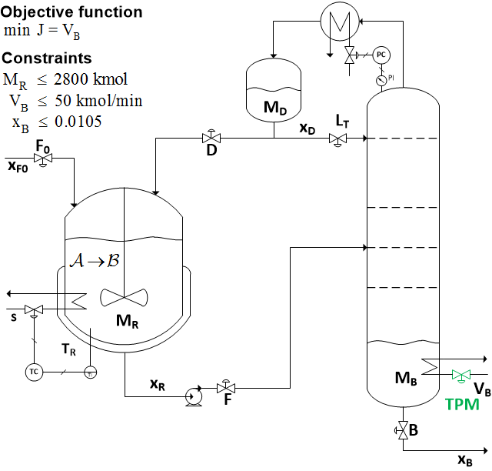
CASE STUDY
Practical rules for Step S4: Location of throughput manipulator (TPM)
Rule 4: Locate the TPM close to the process bottleneck.
Rule 5: (for processes with recycle)
Locate the TPM inside the recycle loop.
According to Rules 4 and 5 the best candidate for TPM location is V_{B.}

Slide 35
PRACTICAL RULES for Step S5
Step S5: Structure of regulatory control layer
Rule 6: Arrange the inventory control loops (for level, pressures, etc.) around the TPM location according to the radiation rule (Georgakis)
  This ensures “local consistency” i.e. all inventories are controlled by their local in or outflows.
TPM
TPM
TPM

Slide 36
PRACTICAL RULES for Step S5
Step S5: Structure of regulatory control layer
Rule 7: Select “sensitive/drifting” variables as controlled variables CV₂ for regulatory control.
  Typically include inventories (levels and pressures), reactor temperature, or a sensitive temperature in a distillation column.

Slide 37
PRACTICAL RULES for Step S5
Step S5: Structure of regulatory control layer
Rule 8: Economically important active constraints (CV₁) should be selected as CVs (CV₂) in the regulatory layer.
  Economic variables CV₁ are generally controlled in the supervisory layer.
  But moving CV₁ to a faster layer may ensure tighter control with a smaller back-off.

Slide 38
PRACTICAL RULES for Step S5
Step S5: Structure of regulatory control layer
Rule 9: (“Pair-close” rule): The pairings should be selected such that, effective delays and loop interactions are minimal.

Slide 39
PRACTICAL RULES for Step S5
Step S5: Structure of regulatory control layer
Rule 10: Avoid using MVs that may optimally saturate (at steady state) to control CVs in CV₂.
  The reason is that we want to avoid re-configuring the regulatory control layer.
  To follow this rule, one needs to consider also other regions of operation than the nominal.

Slide 40
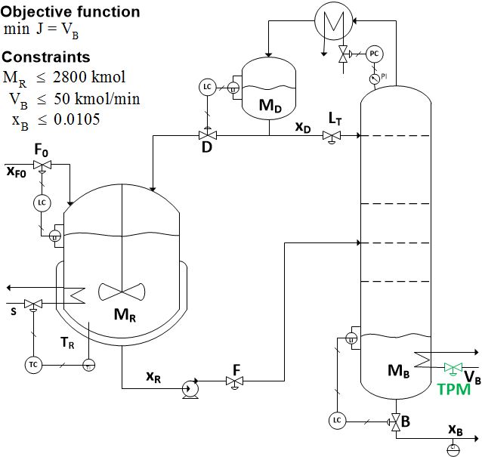
CASE STUDY
Practical rules for Step S5: Structure of regulatory control layer
Rule 7: Select “sensitive/drifting” variables as controlled variables CV₂ for regulatory control.
  Typically include inventories (levels and pressures), reactor temperature, or a sensitive temperature in a distillation column
Rule 6: Arrange the inventory control loops (for level, etc.) around the TPM location according to the radiation rule.
Rule 8: Economically important active constraints (CV1) should be selected as CVs (CV₂) in the regulatory layer
Rule 9: (“Pair-close” rule): The pairings should be selected such that, effective delays and loop interactions are minimal.
Rule 10: Avoid using MVs that may optimally saturate (at steady state) to control CVs in CV₂.

Slide 41
PRACTICAL RULES for Step S6
Step S6: Structure of supervisory control layer
Rule 11: MVs that may optimally saturate (at steady state) should be paired with the subset of CV₁ that may be given up.
  This rule applies for cases when we use decentralized control in the supervisory layer and we have changes in active constraints
  The idea is to avoid reconfiguration of loops.
  This rule should be considered together with Rule 10.

Slide 42
CASE STUDY
Practical rules for Step S6: Structure of supervisory control layer
Two remaining degrees of freedom
  L_{T}
  F
Have two remaining variables to control (CV1):
  Active constraint x_{B}
  Self-optimizing variable x_{D}

Slide 43
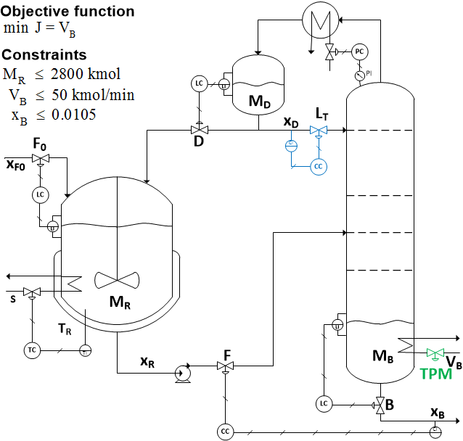
CASE STUDY: Final control structure

Slide 44
DYNAMIC SIMULATIONS
Important dynamic issue: TPM location
Initially the TPM is ramped to achieve 40% increase in fresh feed (F₀), starting at 400 min till 600 min.
Later the TPM is ramped down to its original value, starting at 1800 min till 2000 min.

Slide 45
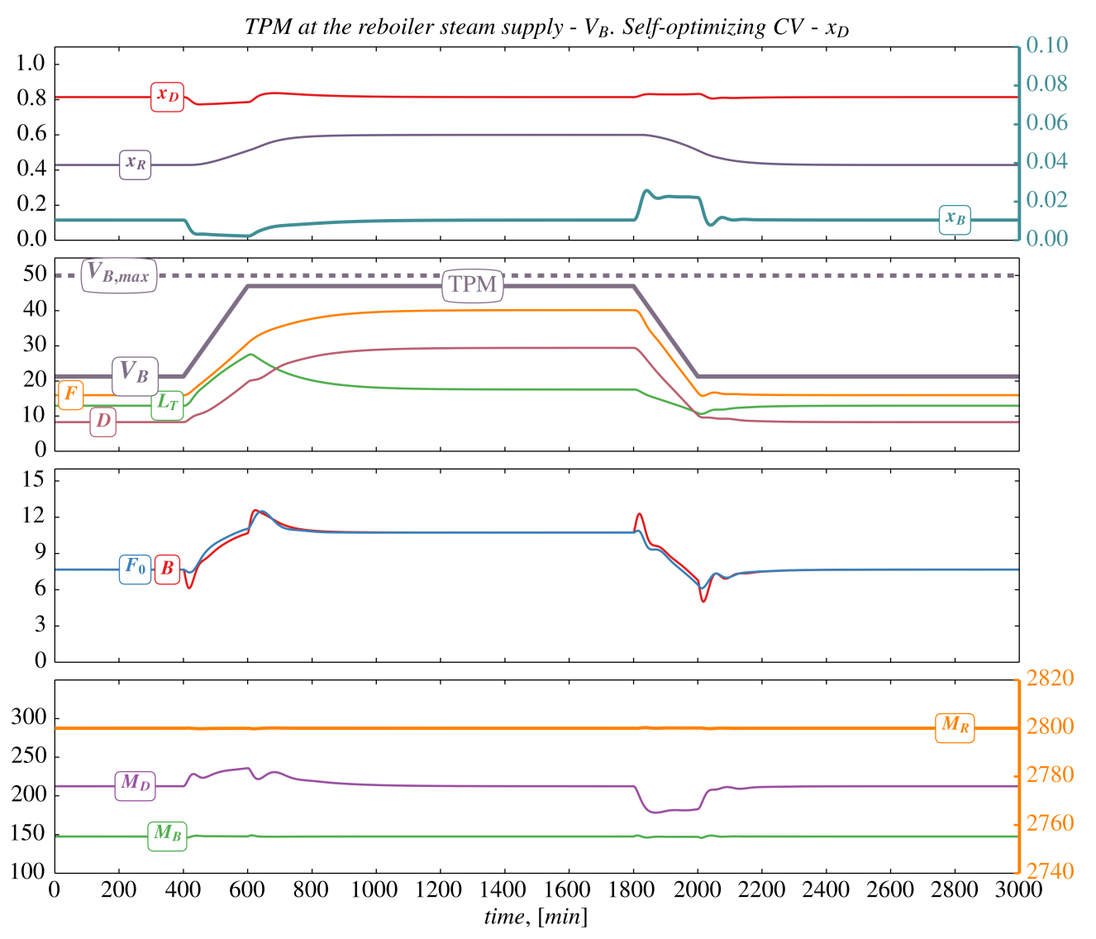
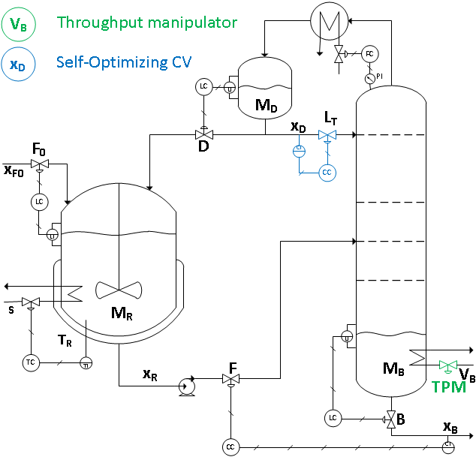
Proposed structure: TPM at reboiler duty (V_{B})

Slide 46
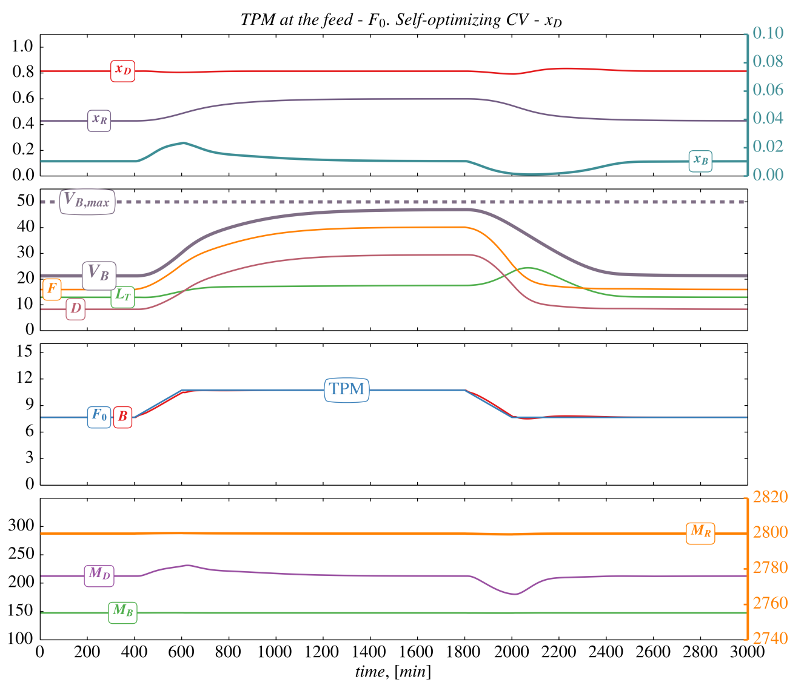
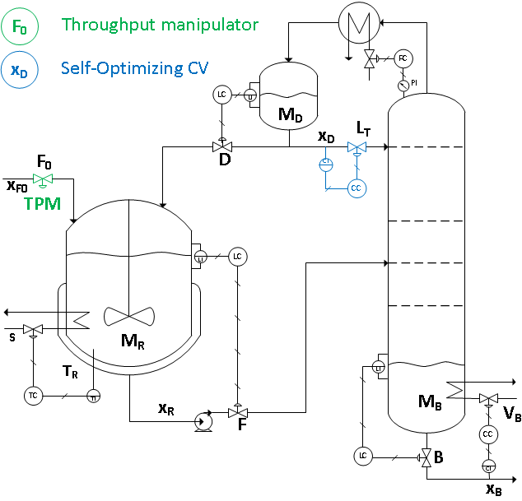
Alternative structure: TPM at feed (F0)

Slide 47
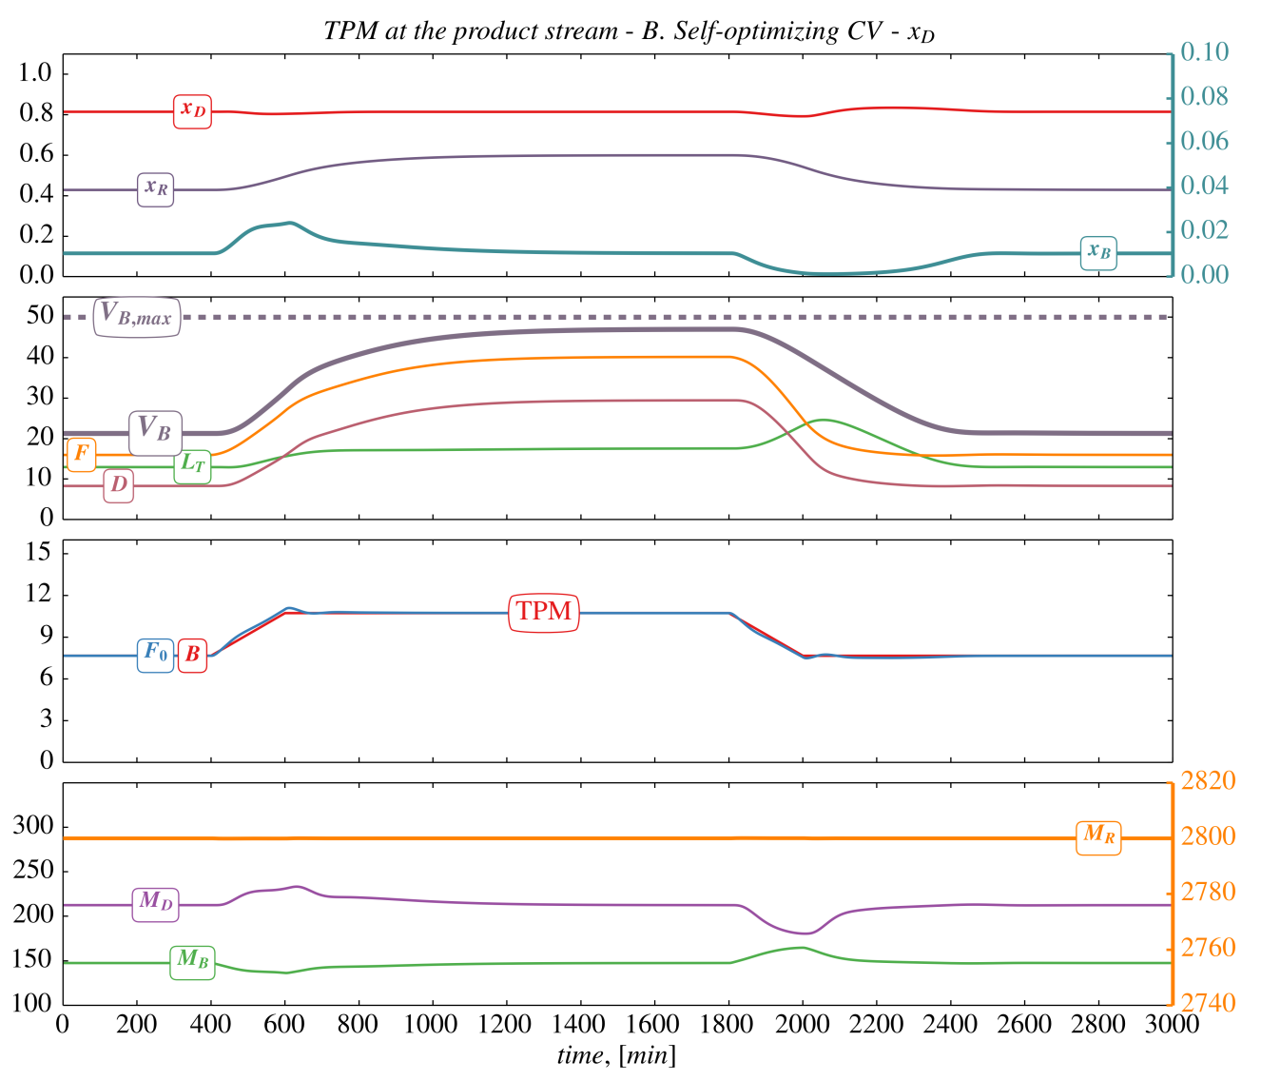
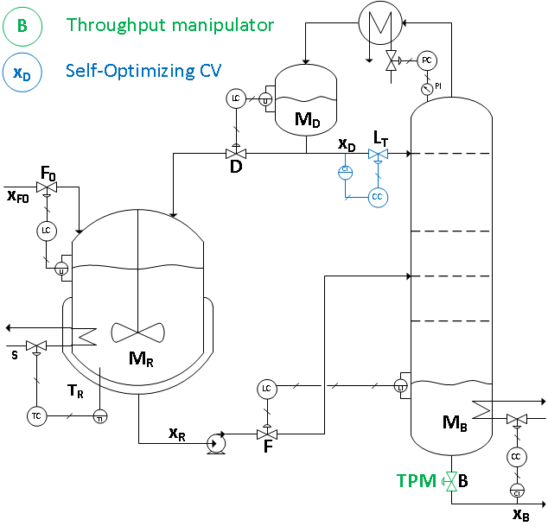
Alternative structure: TPM at the product stream – B

Slide 48
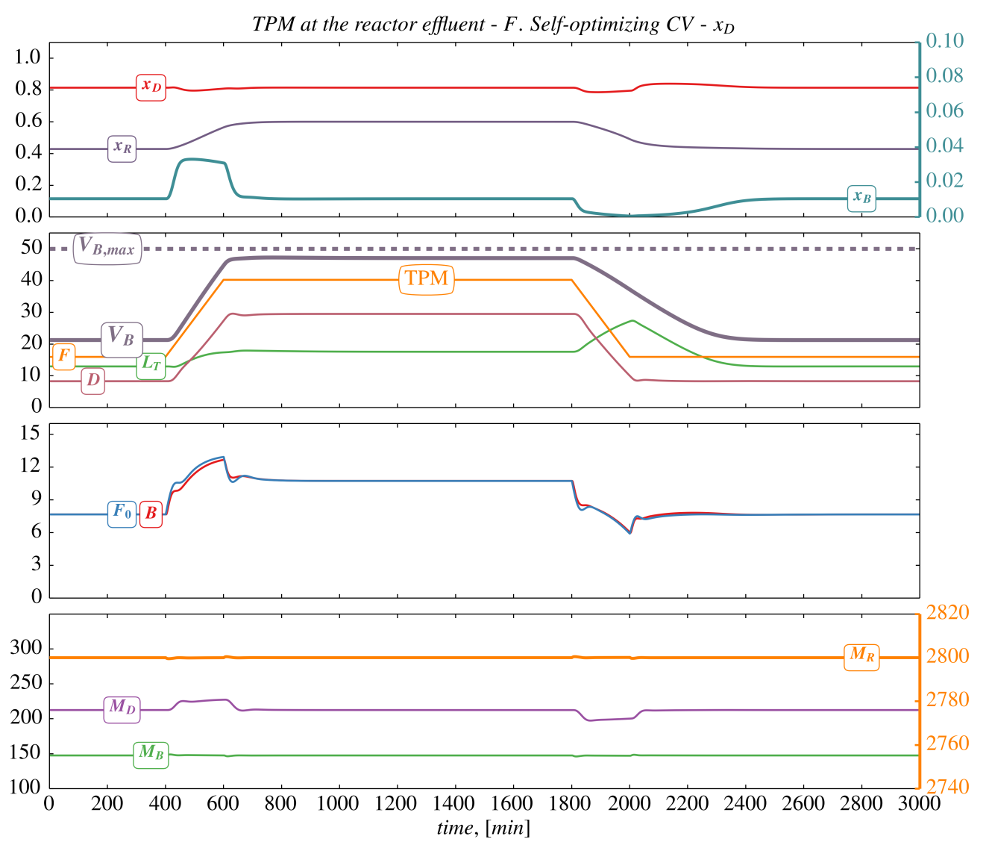
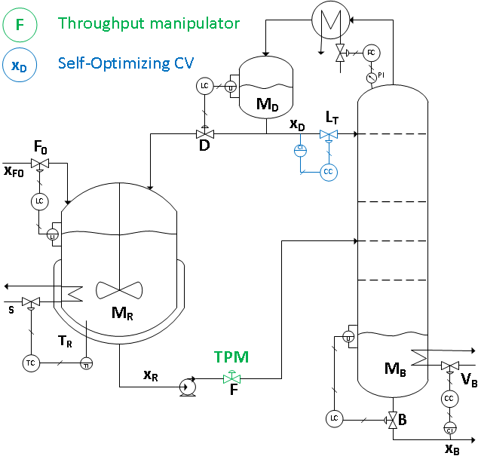
Alternative structure: TPM at the reactor effluent – F
Needs longer ramping time to be feasible

Slide 49
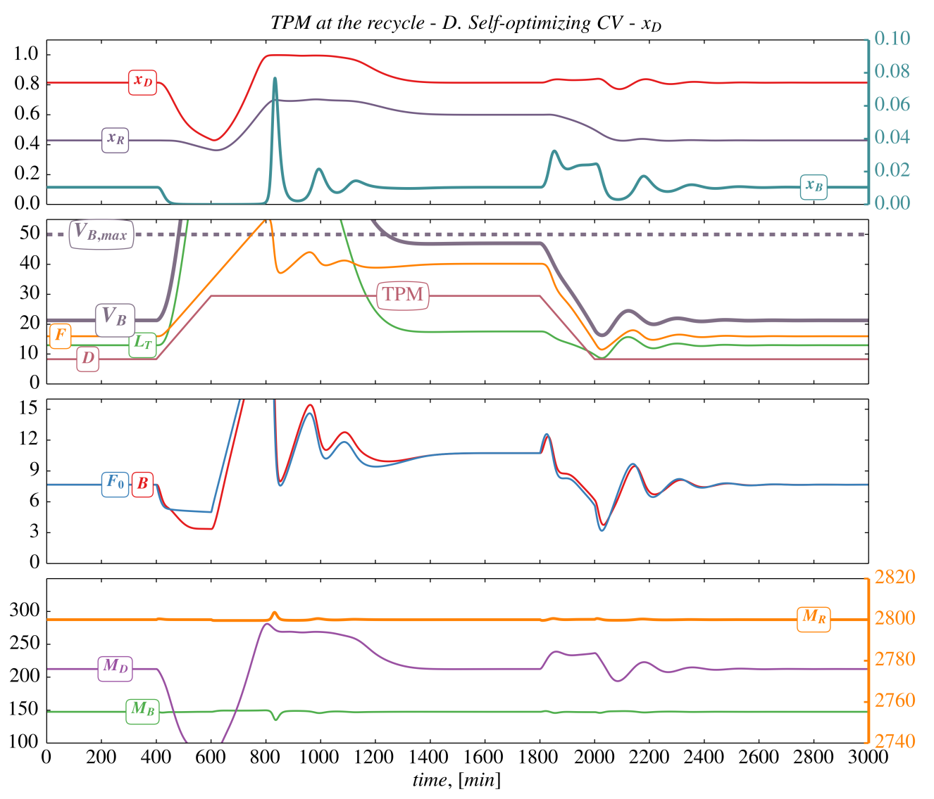
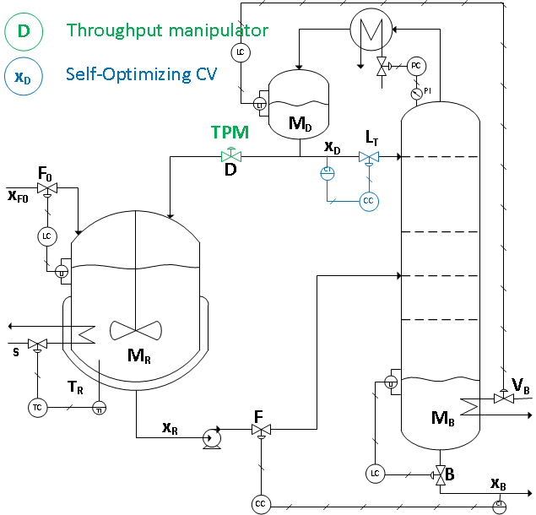
Alternative structure: TPM at the recycle stream – D

Slide 50
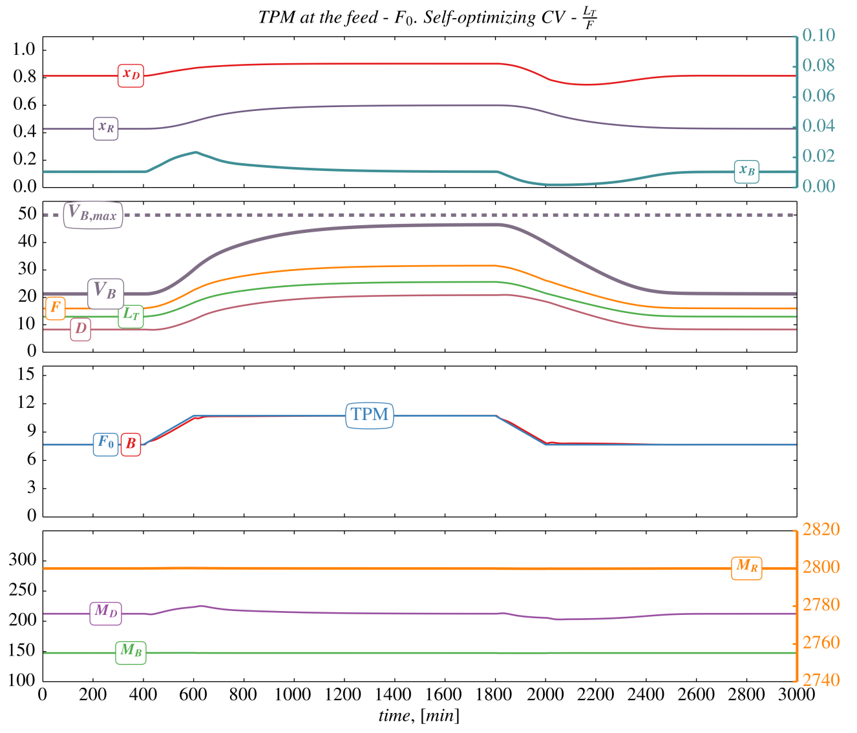
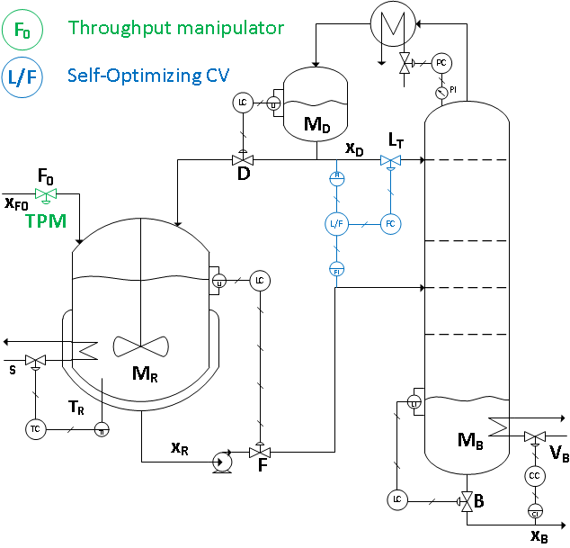
RESULTS: TPM at feed – F0
Figure 5:
TPM at the feed – F₀.
Self-optimizing CV – L_{T}/F.

Slide 51
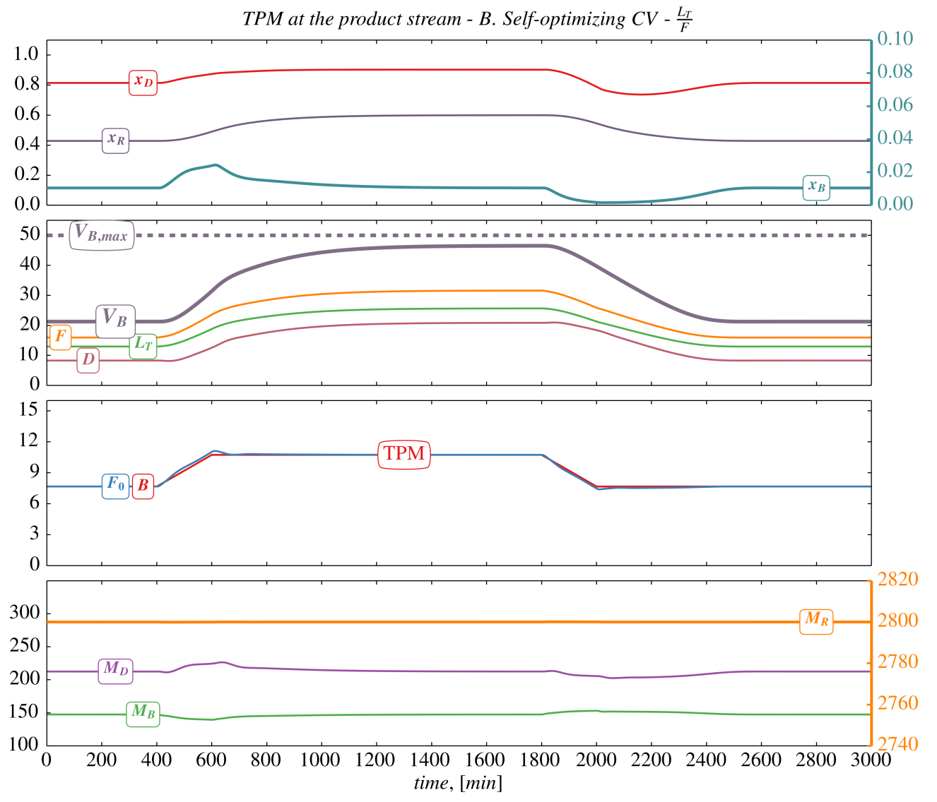
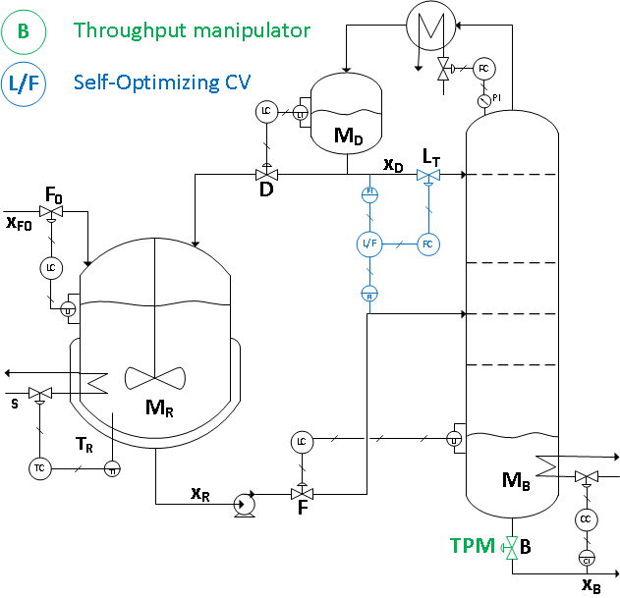
RESULTS: TPM at the product stream – B
Figure 14:
TPM at the product stream – B. Self-optimizing CV – L_{T}/F.

Slide 52
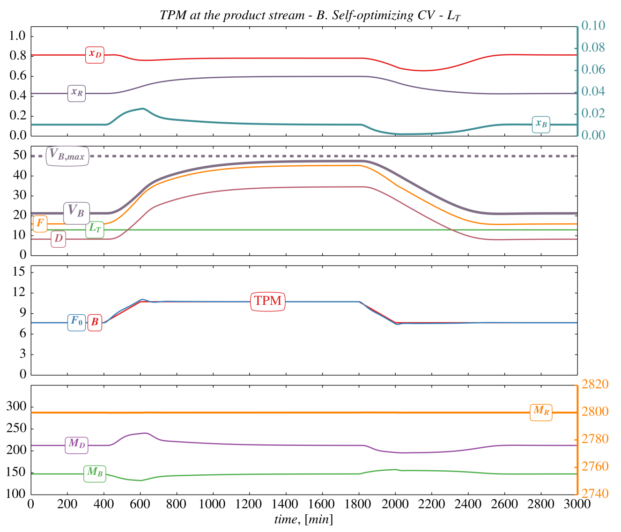
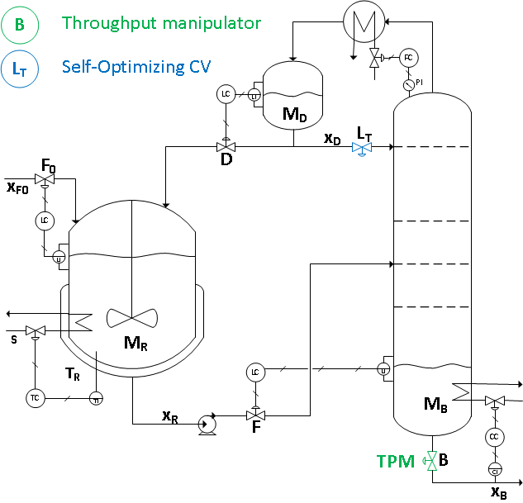
Alternative structure: TPM at the product stream – B
Figure 12:
TPM at the product stream – B.
L_{T}- constant.

Slide 53
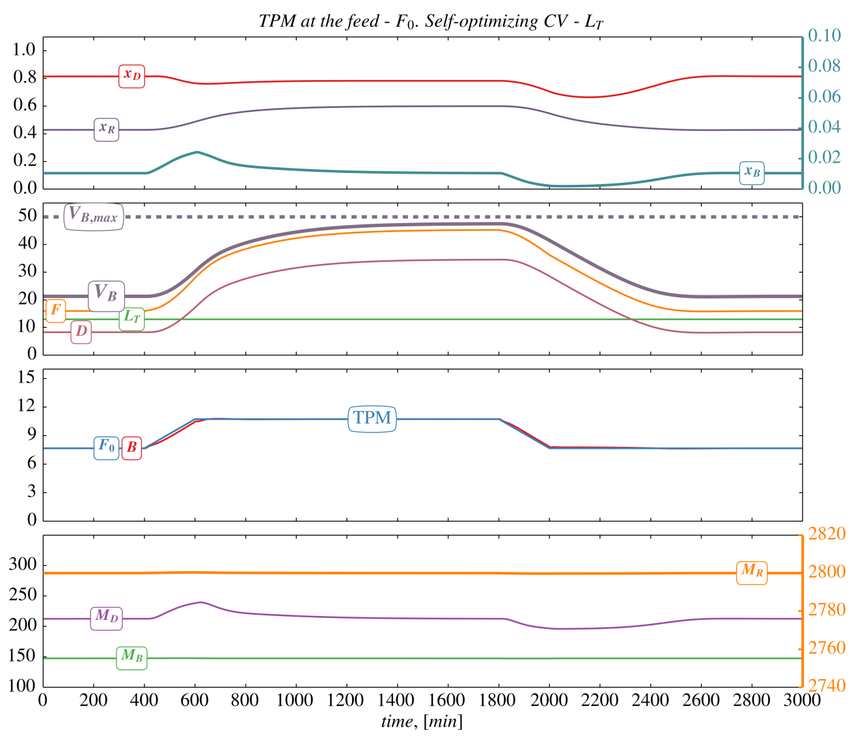
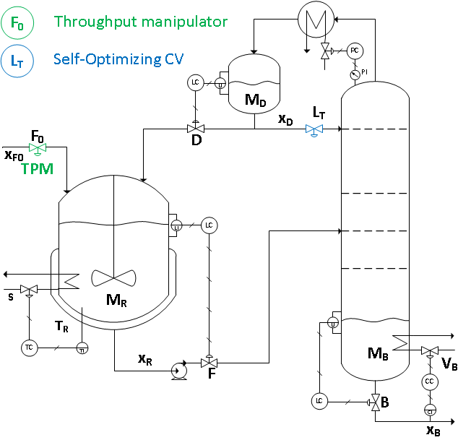
RESULTS: TPM at feed – F₀
Figure 3:
TPM at the feed - F₀. L_{T} – constant.

Slide 54
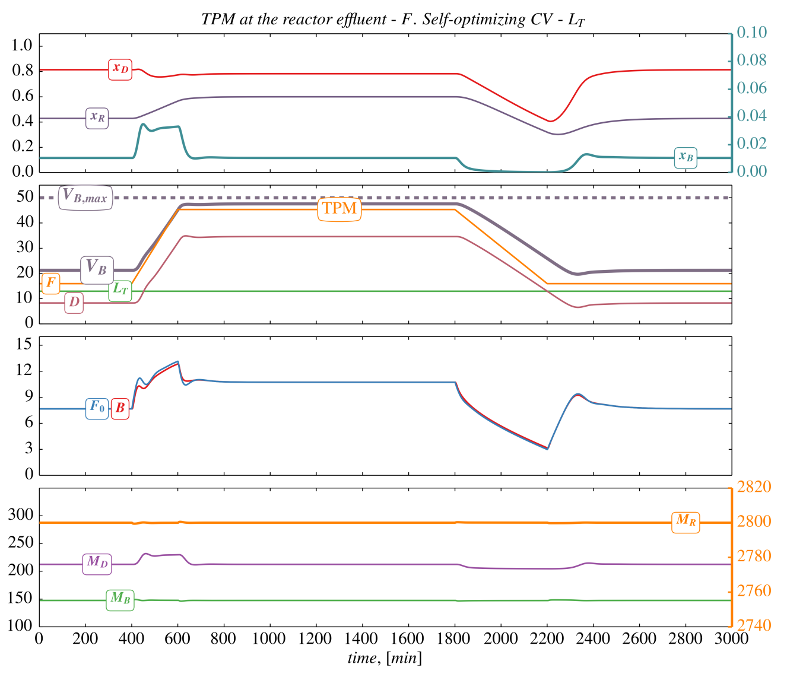
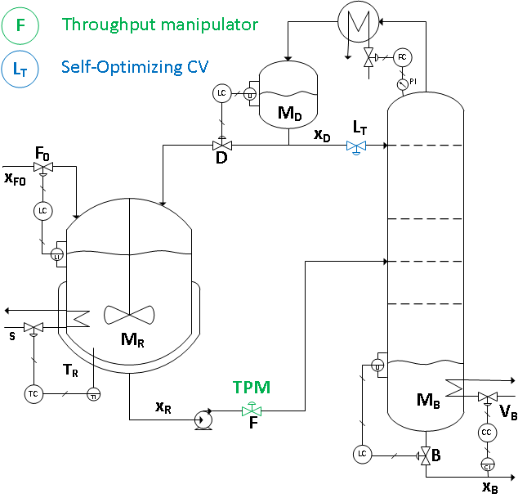
RESULTS: TPM at the reactor effluent – F
Figure 4:

Slide 55
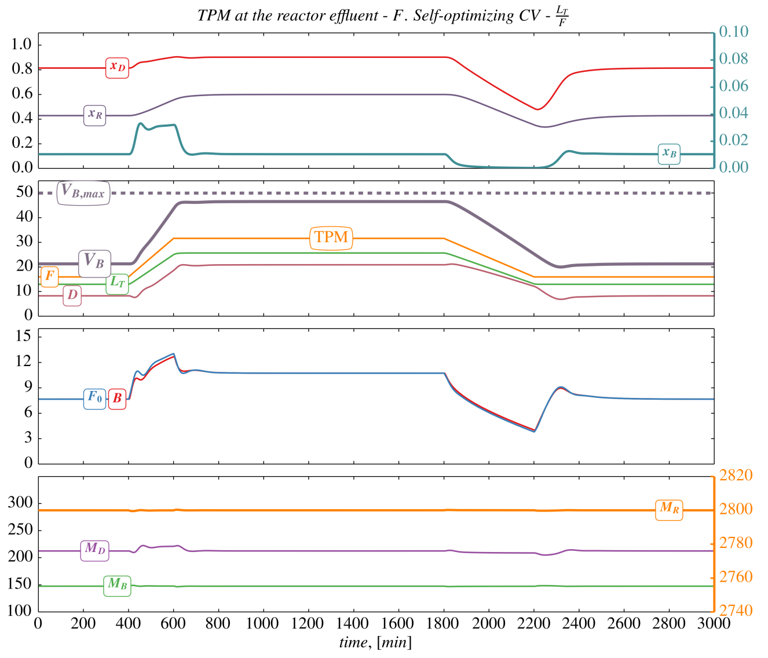
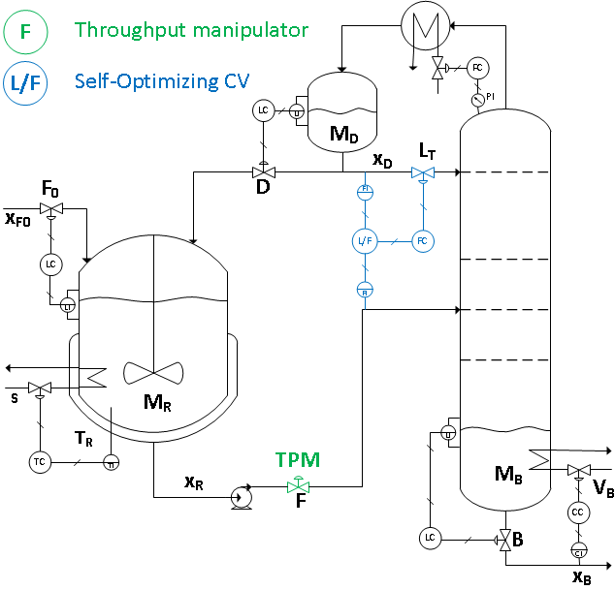
RESULTS: TPM at the reactor effluent – F
Figure 6:

Slide 56
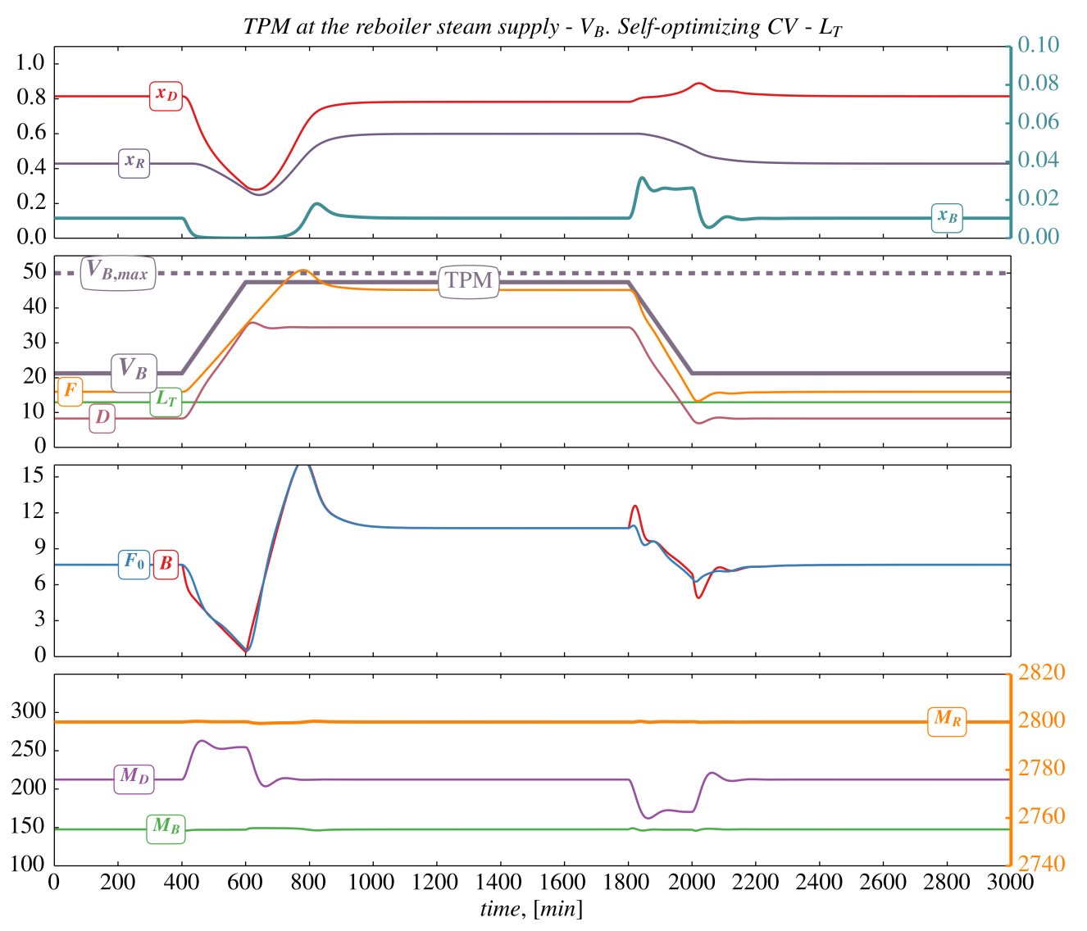
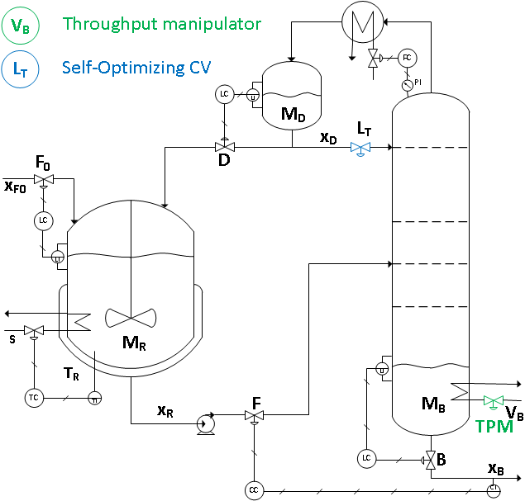
RESULTS: TPM at reboiler’s steam supply – V_{B}
Figure 6:
TPM at reboiler’s steam supply – V_{B}. L_{T} – constant.

Slide 57
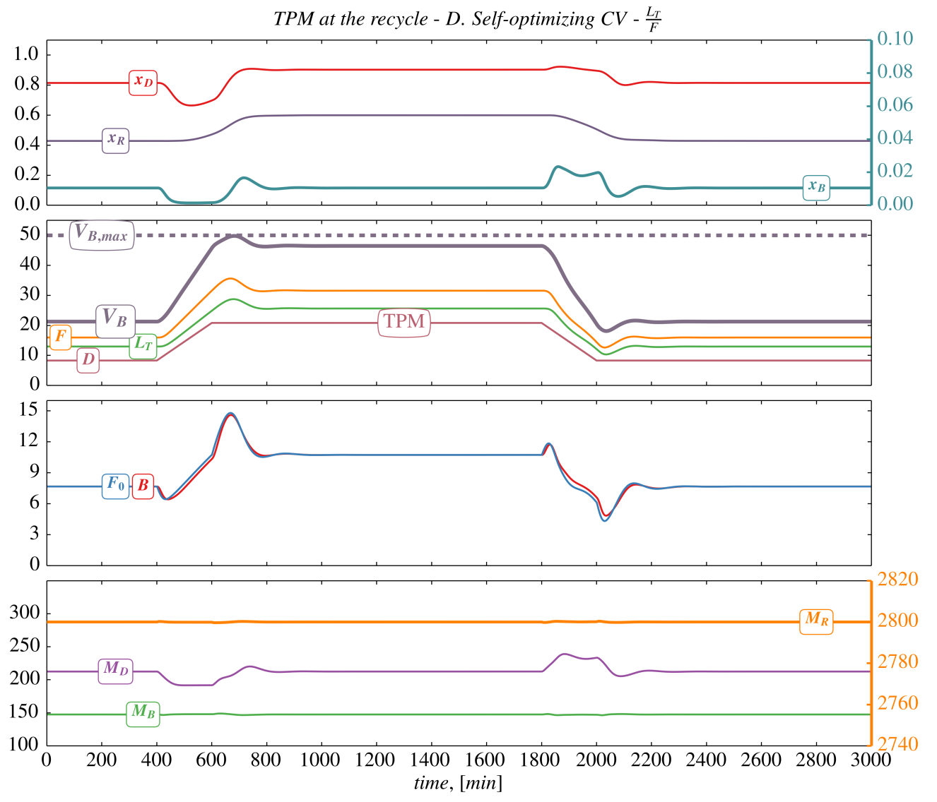
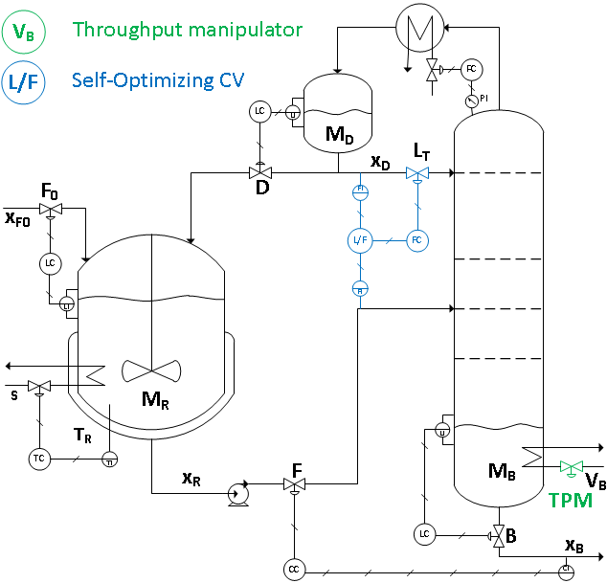
RESULTS: TPM at reboiler’s steam supply – V_{B}
Figure 8:
TPM at reboiler’s steam supply – V_{B}. Self-optimizing CV – L_{T}/F.

Slide 58
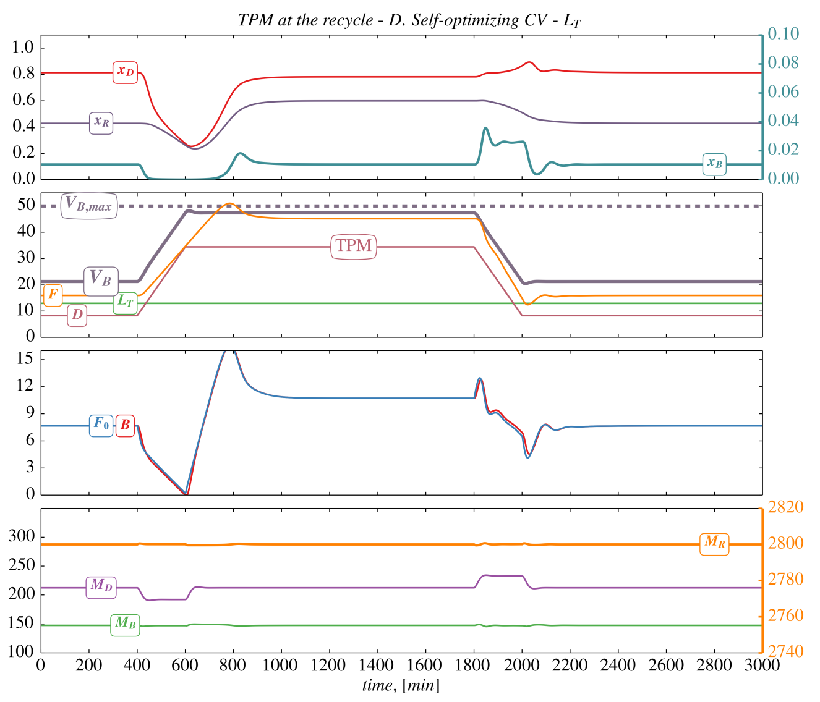
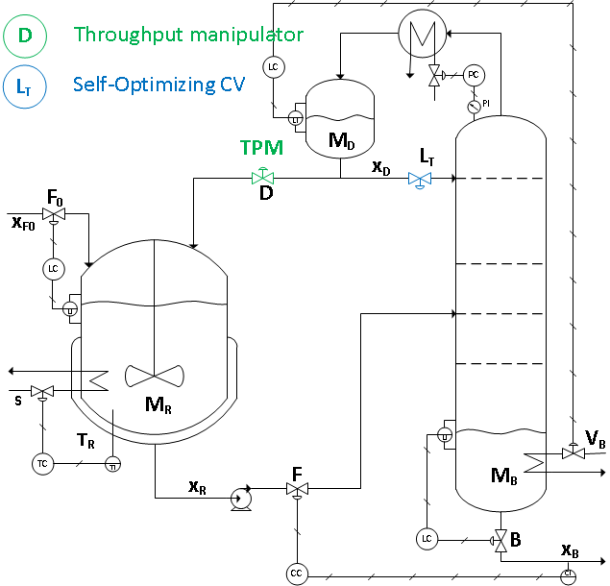
RESULTS: TPM at the recycle stream – D
Figure 9:
TPM at the recycle stream – D.
L_{T} – constant.

Slide 59
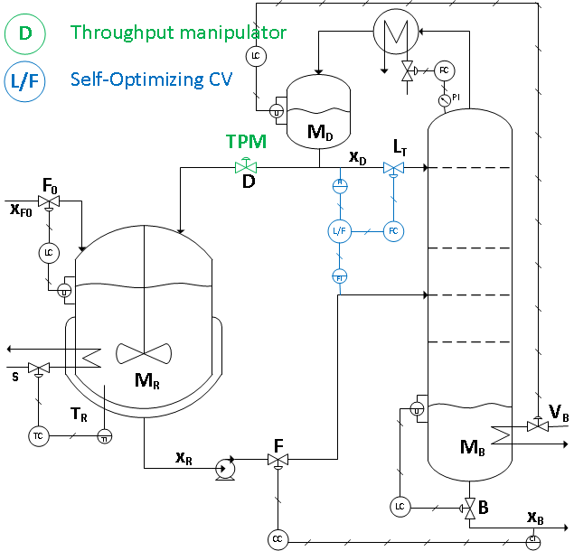
RESULTS: TPM at the recycle stream – D
Figure 11:
TPM at the recycle stream – D.
Self-optimizing CV – L_{T}/F.

Slide 60
CONCLUSIONS
SYSTEMATIC APPROACH TO PLANTWIDE CONTROL:
Define the cost function and operational constraints
Determine the active constraints
  possibly based on process insight
Find CV1’s for each steady-state degree of freedom:
  active constraints
  + "self-optimizing" unconstrained variables.
Determine the TPM location
Determine the structure of the control layers (pairing)
11 practical rules

Slide 61
ECONOMIC PLANTWIDE CONTROL
SUMMARY AND REFERENCES
The following paper summarizes the procedure:
  S. Skogestad, “Control structure design for complete chemical plant”, Computers and Chemical Engineering, 28 (1-2), 219-234 (2004).
The following paper updates the procedure:
  S. Skogestad, “Economic plantwide control”, Book chapter in V. Kariwala and V.P. Rangaiah (Eds), Plant-Wide Control: Recent Developments and Applications”, Wiley (2012).
There are many approaches to plantwide control as discussed in the following review paper:
  T. Larsson and S. Skogestad, “Plantwide control: A review and a new design procedure”, Modeling, Identification and Control, 21, 209-240 (2000).
More information:
  http://www.nt.ntnu.no/users/skoge/plantwide

