Slide 1
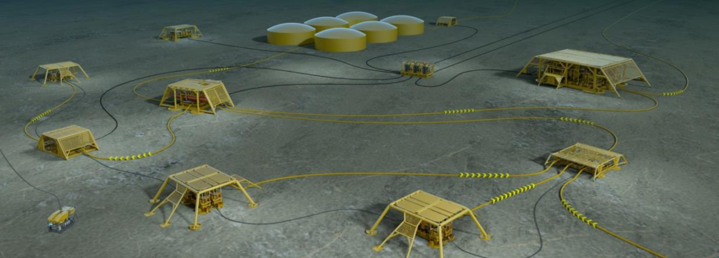
SUBPRO – Student Presentation
SUBPRO SUBSEA PRODUCTION AND PROCESSING
15.02.2017
© Statoil ASA
© 2016 SUBPRO/NTNU. Distribution, copying and publishing only with written consent from NTNU

Slide 2
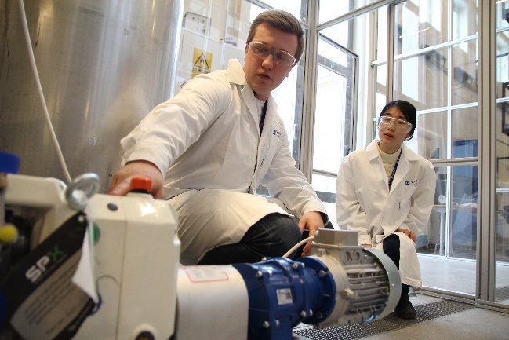
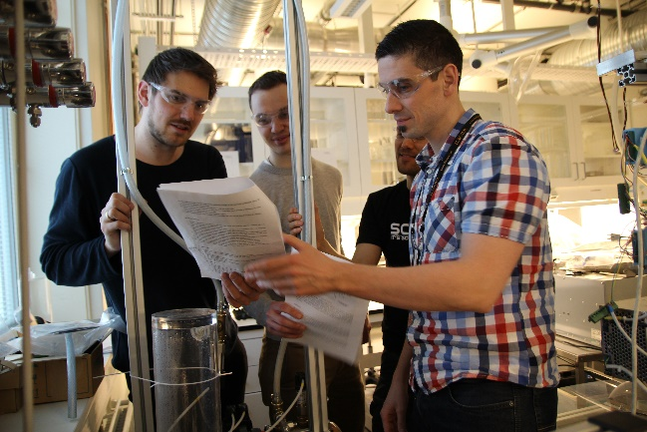
Agenda
SUBPRO
SUBPRO presentation (Sigurd Skogestad) – 10 min
Master students (Jon and Melissa) – 10 min
PhD students (Kristin and Sveinung) – 10 min
Industry presentations (Statoil, DNV GL, ABB) – 15-30 min

Slide 3
Subsea Production and Processing
SUBPRO
Receiving Facility (Platform / Onshore)
Subsea Production (“Xmas tree”)
Subsea Separation and processing
Subsea Boosting
SUBPRO is a “Senter for Forskningsdrevet Innovasjon” (SFI)
3 Departments at NTNU
Funds from industry and Research Council
300 million NOK over 8 years
Source for photos: Statoil ASA

Slide 4
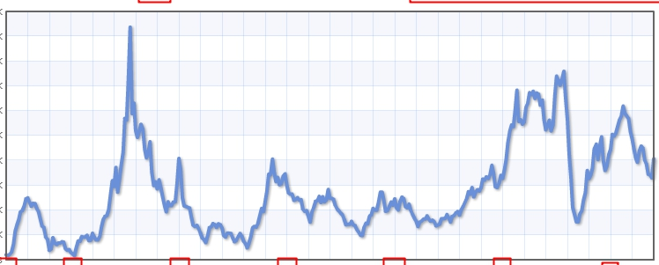
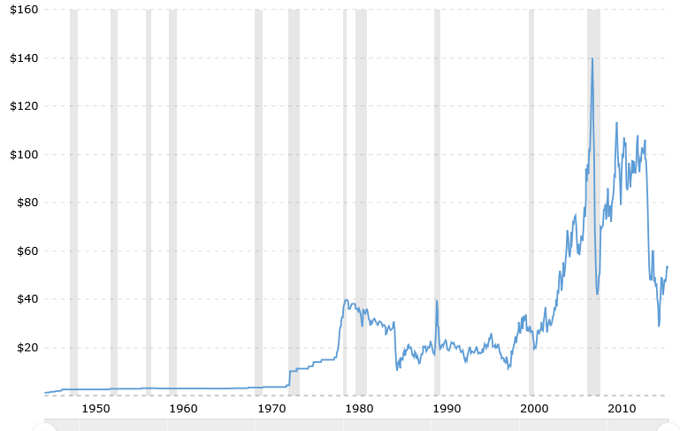
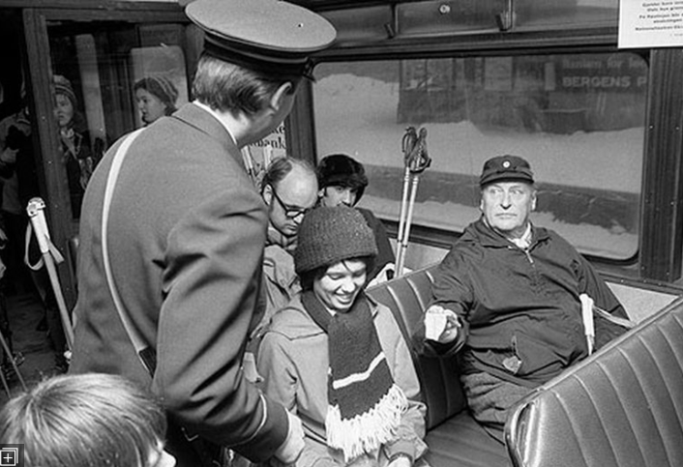
Historical oil price [$/bbl]
Aluminium
June 2008. $140
Financial crisis 2009
June 2014. $106
Dec. 1973. First «oil crisis»
Jan. 2015. $47
Jan. 2016. $28
Jan. 2017. $54
Apr. 1980. $40
Nov. 1998. $10
March 1986. $10
http://www.macrotrends.net/1369/crude-oil-price-history-chart

Slide 5
Historical oil price [$/bbl]
June 2008. $140
Financial crisis 2009
June 2014. $106
Dec. 1973. First «oil crisis»
Jan. 2015. $47
Jan. 2016. $28
Jan. 2017. $54
Apr. 1980. $40
Nov. 1998. $10
March 1986. $10
http://www.macrotrends.net/1369/crude-oil-price-history-chart

Slide 6
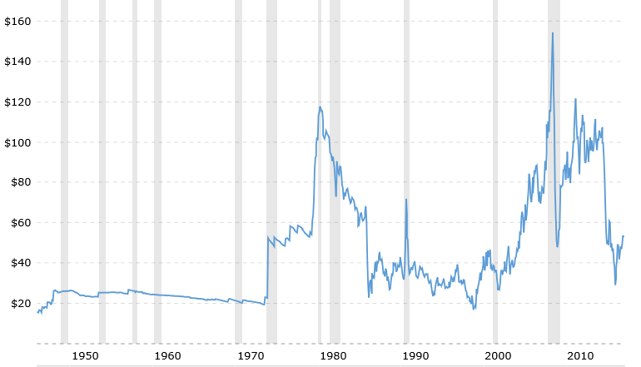
Oil price adjusted for inflation
2008
Arve Johsen, CEO Statoil, 1982.
«Oljeprisen kan kun gå en vei – oppover»
2014
Alternative green
power competetive
(Solar etc.)
2017
Sigurd’s steady-state curve
1998

Slide 7
SUBPRO Partners
SUBPRO
Ny industri-partner fra 2017!
Operatør for utbyggingen av Pil&Bue-feltet

Slide 8
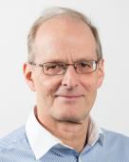
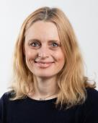
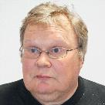
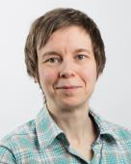
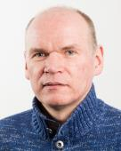
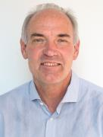
Organization
SUBPRO
Centre Board
(Chair: Audun Faanes)
Technical Committee
(Chair: Richard Arntzen)
Centre Director
Sigurd Skogestad
Deputy Director
Mary Ann Lundteigen
Adm. Coordinator
Jon Lippe
Techn. Coordinator
Gro Mogseth
Reference group
Reference group
Reference group
Research areas
Field architecture
Sigbjørn Sangesland
RAMS
Mary Ann Lundteigen
Separation – Fluid characterization
Johan Sjöblom / Gisle Øye
Separation Process Concepts
Hanna Knuutila / Hugo Jakobsen
System Control
Sigurd Skogestad
Industry Partners

Slide 9
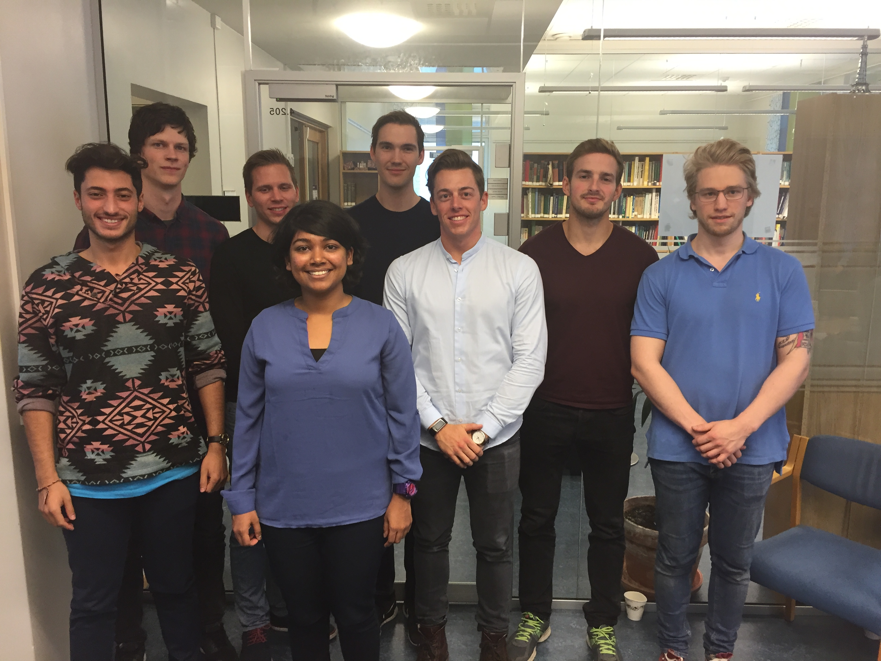
SUBPRO resources
SUBPRO
Currently 16 PhD and 5 PostDoc projects is ongoing
25 - 30 Master students per year on topics of relevance for the center and the subsea industry
20 professors / associated professors from three NTNU departments – cross discipline collaboration
Chemical Engineering
Geoscience and Petroleum
Mechanical and Industrial Engineering
Contributions from industry partners (personnel, knowledge, data)
Budget of approx. 33 million NOK per year, for a period of 8 years (started up the summer of 2015)
Systems control Master students 2016

Slide 10
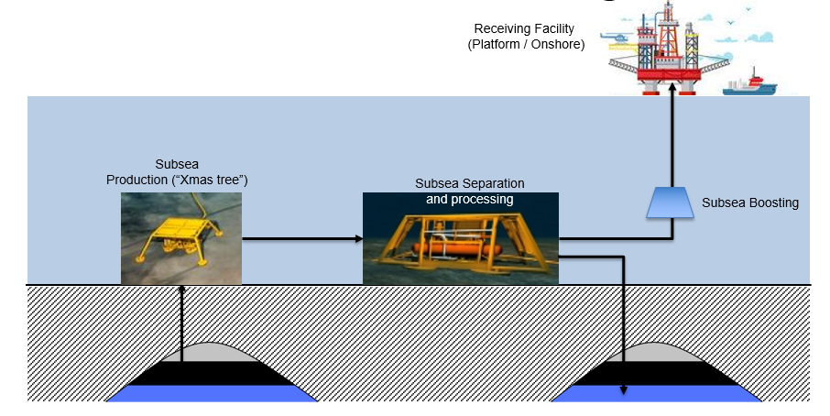
Summer jobs SUBPRO 2017
SUBPRO
2016: 5 summer jobs at NTNU
2017: SUBPRO plans to have 8 summer jobs at NTNU
Field architecture (Petroleum Dept.)
RAMS (Mechanical & Industrial Eng. Dept.)
System control (Chem. Eng. + Mechanical & Industrial Eng.)
Separation concepts (Chem. Eng,)
Fluid characterization (Chem. Eng.)
Application deadline: 23 March 2017

Slide 11
Agenda
SUBPRO
SUBPRO presentation – 10 min
Master students (Jon and Melissa) – 10 min
PhD students (Kristin and Sveinung) – 10 min
Industry presentations (Statoil, DNV GL, ABB) – 15-30 min

