Slide 1



Advanced process control –
A new beginning
Sigurd Skogestad
Department of Chemical Engineering
Norwegian University of Science and Technology (NTNU)
Trondheim
19th IFAC Symposium on Control, Optimization and Automation in Mining, Mineral and Metal Processing (IFAC MMM 2022)
August 15-17, 2022
Montreal, Canada
Thanks to: Adriana Reyes-Lúa, Cristina Zotică, Dinesh Krishnamoorthy, Krister Forsman

Slide 2




Trondheim
Arctic circle
Geiranger fjord
Trondheim

Slide 3
About Sigurd Skogestad
•1955: Born in Flekkefjord, Norway
• 1956-1961: Lived in South Africa
•1974-1978: MS (Siv.ing.) studies in chemical engineering at NTNU
•1979-1983: Worked at Norsk Hydro co. (process simulation)
•1983-1987: PhD student at Caltech (supervisor: Manfred Morari)
•1987-present: Professor of chemical engineering at NTNU
• 1994-95: Visiting Professor UC Berkeley
• 2001-02: Visiting Professor UC Santa Barbara
•1999-2009: Head of ChE Department, NTNU
•2015-..: Director SUBPRO (Subsea research center at NTNU)
Non-professional interests:
mountain skiing (cross country)
orienteering (running around with a map)
grouse hunting
1973

Slide 4
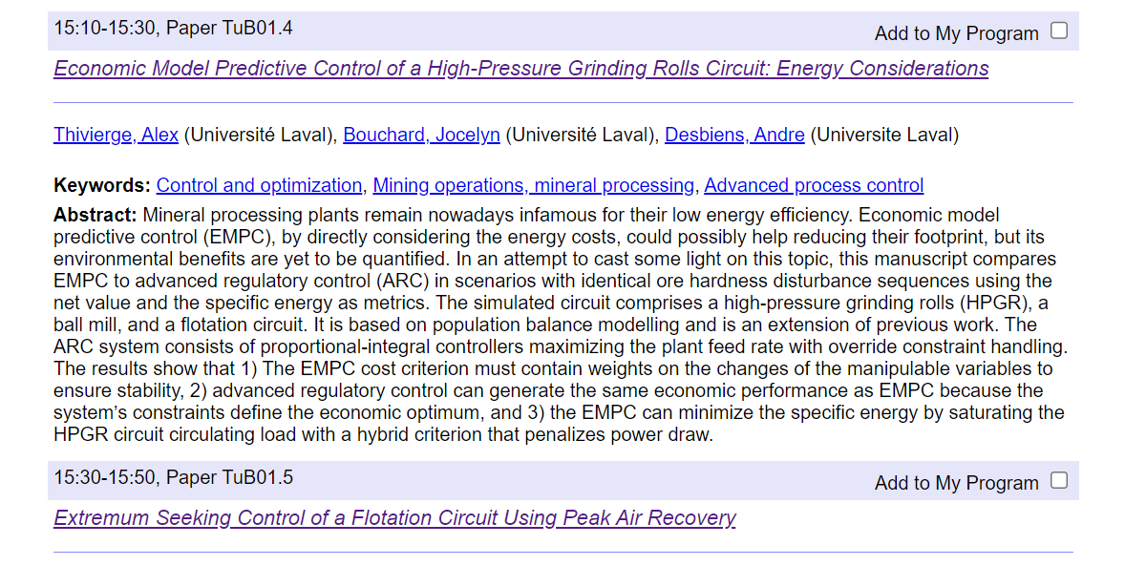

Slide 5
Advanced process control - a new beginning
Sigurd Skogestad, NTNU, Norway
Abstract (for short version, delete the parts in red)
Control engineers rely on many tools, and although some people may think that in the future there will be one general universal tool that solves all problems, like economic model predictive control (EMPC), this is not likely to happen. The main reason is that the possible benefits of using more general tools may not be worth the increased implementation costs (including modelling efforts) compared to using simpler "conventional" advanced process control (APC) solutions. In particular, this applies to process control, where each process is often unique. In addition, for a new process, a model may not be available, so at least for the initial period of operation a conventional scheme must be implemented. Control is about implementing optimal operation in practice under varying conditions (disturbances, prices, etc.). Most people think that on-line optimization (RTO) is needed to achieve this, but in many cases it’s possible to put the optimization into the control layer using the magic of feedback.
Since its introduction in the 1940’s, about 80 years ago, conventional advanced process control (APC) has largely been overlooked by the academic community, yet it is still thriving in industrial practice, even after 40 years with model-based multivariable control (MPC). So it is safe to predict that conventional APC (including PID control) will not be replaced by MPC, but will remain in the toolbox along with MPC. Thus, it is time to give conventional APC a “new beginning” in terms of strengthening its theoretical basis and training engineers and students on how to use it in an effective manner.
Conventional APC includes the standard control elements that industry commonly uses to enhance control when simple single-loop PID controllers do not give acceptable control performance. Examples of such control elements are cascade control, selectors, split range control, input or valve position control (VPC), multiple controllers (and MVs) for the same CV, and nonlinear calculation blocks. The goal of this talk is to take a systematic view on how to design a conventional APC system. The starting point is usually optimal steady-state economic operation. The process may have many manipulated variables (MVs) for control (typically valves), but usually most of these are used to control “active” constraints, which are the constraints which optimally should be kept at their limits at steady state. For the remaining unconstrained degrees of freedom, we should look for self-optimizing variables, which are measured variables for which the optimal values depend weakly on the disturbances.
The starting point is then to design a good control system for the normal (nominal) operating point, preferably based on single-loop PID controllers where each manipulated variable (MV) which is not optimally at a constraint is paired with a controlled variable (CV). To handle interactions, disturbances and nonlinearity, one may add cascade control and calculation blocks.
However, during operation one may reach new (active) constraints, either on MVs or CVs, which may be easily observed from measurements of the potential constraints. Since the number of degrees of freedom doesn’t change, we will need to give up the control of another variable, which will either by another constraint (on CV or MV) or an unconstrained CV (self-optimizing variable). The key is then to know which variable give up, and in many cases we may determine this based on physical insight, and implement it using conventional APC elements. A key new observation is that there are only four cases of switching and these may be handled by using standard APC control elements. For CV-CV switching we use selectors (overrides), for MV-MV switching we use split range control or similar, for simple CV-MV switching (where the two variables are already paired) we don’t need to do anything (except for including anti-windup in the controller) and for complex CV-MW switching we need to combine CV-CV and MV-MV switching.
The main disadvantage with conventional APC compared to MPC is that it is based on single-loop controllers, so one needs to pair outputs (CVs) with inputs (MVs). For most processes this works well, but for more complex cases with many constraint switches one may get significant benefits and simplifications with MPC. Other cases where MP may offer significant benefits compared to conventional APC is for interactive processes and for cases with known future disturbances
In summary, optimal economic operation may in many cases be achieved by use of simple conventional APC elements, but there is a lack of understanding, both in industry and academia, on how such control systems should be designed. The presentation offers a new beginning in terms of providing a systematic approach.
Bio
Sigurd Skogestad received his Ph.D. degree from the California Institute of Technology, Pasadena, USA in 1987. He has been a full professor at Norwegian University of Science and Technology (NTNU), Trondheim, Norway since 1987. He is the principal author, together with Prof. Ian Postlethwaite, of the book "Multivariable feedback control" published by Wiley in 1996 (first edition) and 2005 (second edition). His research interests include the use of feedback as a tool to make the system well-behaved (including self-optimizing control), limitations on performance in linear systems, control structure design and plantwide control, interactions between process design and control, and distillation column design, control and dynamics. His other main interests are mountain skiing (cross country), orienteering (running around with a map) and grouse hunting. He is a Fellow of the American Institute of Chemical Engineers (2012) and IFAC (2014).

Slide 6

“The goal of my research is to develop simple yet rigorous methods to solve problems of engineering significance”

Slide 7
Outline
Introduction: Why do we need control?
Control: The two approaches to control
  Centralized: “One big controller”. Model predictive control (MPC) and EMPC
  Decomposed: PID, Conventional advanced Process control (APC)
Conventional APC elements
Using conventional APC to handle Optimization – with changing active constraints
  Many examples
  PID-control, Selectors, Split range control
Conclusion

Slide 8
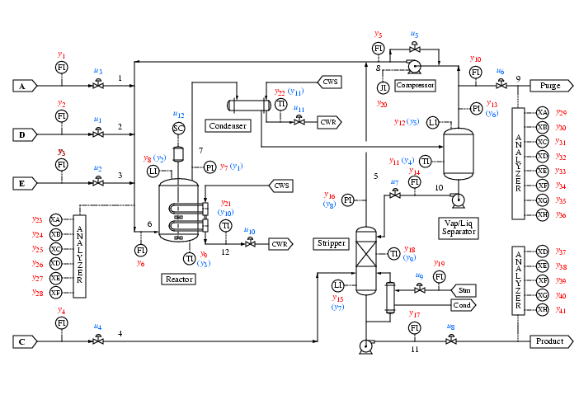
How design a control system for a complete plant?
How should we use the inputs u (valves)?
How use measurements y?
What should we control? and why?
Where do we start?
etc.
etc.
Tennessee Eastman challenge problem (1991)
Notes:
8

Slide 9
Control is about implementing optimal operation
What is Optimal operation?
Given process plant
Want to Maximize profit P => Minimize cost J=-P [$/s]
  J = cost feed + cost energy – value products
    Excluding fixed costs (capital costs, personell costs, etc)
Subject to satisfying constraints on
    Products (quality)
    Inputs (max, min)
    States
Degrees of freedom = manipulated variables (MVs) = inputs u

Slide 10
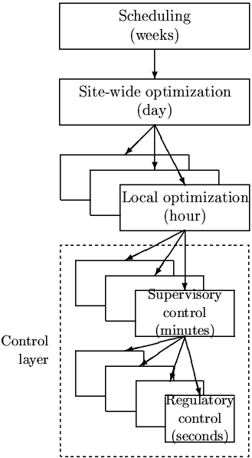
In theory: Centralized controller is always optimal (e.g., EMPC)
Objectives
Approach:
  Model of overall system
  Estimate present state
  Optimize all degrees of freedom
Process control:
  Excellent candidate for centralized control
Problems:
  Model not available
  Objectives = ?
  Optimization complex
  Tuning
  Not robust (difficult to handle uncertainty)
  Slow response time
CENTRALIZED
OPTIMIZER
Present state
Model of system
(Physical) Degrees of freedom, u= valve positions

Slide 11
In practice: Hierarchical decision system based on time scale separation
Degrees of freedom, u= valve positions

Slide 12
Notation
DV
DV
CV
MV
MV
CV
Controller
Process
MV = Manipulated Variable = Input (u)
CV = Controlled Variable = Output (y)
DV = Disturbance Variable (d)

Slide 13
Main objectives control
Economics: Implementation of optimal operation (changing setpoint)
Regulation: Stable (non-drifting) operation (around given setpoint)
ARE THESE OBJECTIVES CONFLICTING?
IS THERE ANY LOSS IN ECONOMICS?
Usually NOT
  Different time scales
    Stabilization fast time scale
  Stabilization doesn’t “use up” any degrees of freedom
    Reference value (setpoint) available for layer above
    But it “uses up” part of the time window

Slide 14
Hierarchical structure: Degrees of freedom unchanged
No degrees of freedom lost as setpoints y_{2s} replace inputs u as new degrees of freedom for control of y₁
Cascade control:
y₁
y_{2s}
C_{PID}
u
G
y₂
y_{2s}=New DOF
u=Original DOF

Slide 15
Two ways of decomposing the control system
Vertical (hierarchical; cascade)
Based on time scale separation
Decision: Selection of CVs that connect layers
Horizontal (decentralized)
Usually based on distance
Decision: Pairing of MVs and CVs with layers
CV1
CV2

Slide 16
Control layers
Sometimes divided in two
Supervisory (“advanced”) control:
  Follow set points for CV1 from economic optimization layer
  Switch between active constraints (change CV1)
  Look after regulatory layer (avoid that MVs saturate, etc.)
  Implementation:
  Alternative 1: APC: “Advanced control” based on ”simple elements”
  Alternative 2: MPC: Model predictive control
Regulatory control (PID):
  Stable operation (CV2)
(day)
PROCESS
CV = controlled variable

Slide 17
Supervisory control: Conventional APC vs. MPC
Need both in our toolbox
Conventional APC («advanced regulatory control»):
  More general than most people think
  In many cases it’s all you need
  But: May get complex for larger problems
  But: Cannot handle all cases
  Need something before you consider a MPC project
MPC needed for more complex problems
  Main problem MPC: Need dynamic model
  Costly to implement and maintain
  Requires experts

Slide 18
Conventional advanced process control (APC)
Also called: Advanced regulatory control (ARC)
«Advanced» is a relative term: When single-loop PID is not sufficient.
Common APC elements:
  Cascade control
  Feedforward control / Ratio control
  Decoupling
  Selectors
  Split range control (SRC)
  Multiple controllers for same CV
  Valve (input) position control (VPC)
Can handle constraint changes

Slide 19
Standard control element | Solution to task | Input | Output
E1. Linear feedback controller (PID) with anti-windup | T1 | CV | MV
E2. Cascade control. | T2 | CV1, CV2 | MV
E3. Feedforward control | T3 | DV | MV
E4. Decoupling element | T4 | MV_{d} | MV
E5. Ratio control | T3, T4 | SP, DV or MV | MV
E6. Nonlinear element | T5 | u (scalar) | y=f(u)
E7. Calculation block | T2, T3, T4, T5 | u | y=f(u)
E8. Split-range control | TS1. TS4 | CV | MV1, MV2, …
E9. Multiple controllers for the same CV | TS1, TS4 | CV | MV1, MV2, …
E10. Valve (input) position control (VPC) | T6, TS1, TS4 | CV=MV1 | MV2
E11. Selector | TS2, TS4 | CV1, CV2, … (MV1, MV2, …) | MV
E12. Gain scheduling | T5 | CV | MV
E13. Simple dynamic element | T11 | u | y (=u static)
E14. Soft sensor (static calculation block) | T12 | u | CV=f(u)
Standard APC control elements

Slide 20
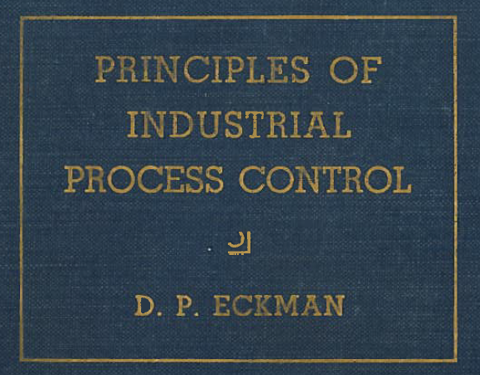
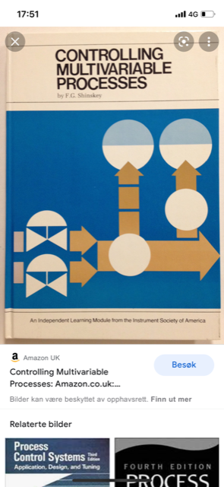
Conventional «Advanced» process control (APC)
  Extensively used by industry
    Has been around since 1930’s
    Present form: Since 1960’s
    Supported by all control vendors (Honeywell, Yokogawa, ABB, etc.)
  Literature
    Industry: Book by Donald Eckman (1945) and books by Greg Shinskey (1967-1981)
    Almost completely ignored by academic researchers (except Luyben case studies)
  Problem for engineers: Lack of theory and design methods
  Main fundamental limitation: Based on single-loop (need to choose pairing)

Slide 21
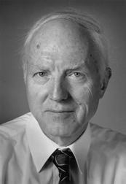
Alan Foss (“Critique of chemical process control theory”, AIChE Journal,1973):
The central issue to be resolved ... is the determination of control system structure. Which variables should be measured, which inputs should be manipulated and which links should be made between the two sets? There is more than a suspicion that the work of a genius is needed here, for without it the control configuration problem will likely remain in a primitive, hazily stated and wholly unmanageable form. The gap is present indeed, but contrary to the views of many, it is the theoretician who must close it.
Some academic interest:
Stephanoplous, Morari, Skogestad
Balchen, Åstrøm, Hägglund
Notes:
21

Slide 22
Rest of the talk
Show how to use simple control elements for optimal operation under changing constraints

Slide 23
MV-CV Pairing
Two main rules
DV
MV
CV
Process
“Pair-close rule”
  The MV should have a large, fast, and direct effect on the CV.
“Input saturation rule”
  Pair a MV that may saturate with a CV that can be given up (when the MV saturates)

Slide 24
Changing active constraints and APC
Two main cases
MV-MV switching
  Need many MVs to cover whole steady-state range
  Use only one MV at a time
  Three options: 1. Split range control, 2. Different setpoints, 3. Valve position control (VPC)
CV-CV switching («override»)
  Must select between CVs
  Only one option: Many controllers with Max-or min-selector
Plus the combination. CV-MV switching (because MV saturates)
3. Simple: CV can be given up (follow «input saturation rule»)
  Don’t need to do anything (except anti-windup in controller)
4. Complex: CV cannot be given up
  Combine MV-MV switching (three options) with CV-CV switching (selector)
Process
Process
Process
Process
Adriana Reyes-Lua and Sigurd Skogestad, Systematic Design of Active Constraint Switching Using Classical Advanced Control Structures, Ind.Eng.Chem.Res, 2020

Slide 25
MV-MV switching
Process
Need several MVs to cover whole steady-state range (because primary MV may saturate)
Note that we only want to use one MV at the time.
Three main solutions for “selecting the right MV”:
  Alt.1: A. (Standard) Split-range control (SRC) (one controller)
  B. Generalized SRC (many controllers)
  Alt.2 Many controllers with different setpoints
  Alt.3 Valve position control
In addition: MPC
Which is best? It depends on the case!
* Adriana Reyes-Lua Cristina Zotica, Sigurd Skogestad, «Optimal Operation with Changing Active Constraint Regions using Classical Advanced Control,, Adchem Conference, Shenyang, China. July 2018 ,
A. Reyes-Lúa and S. Skogestad. “Multi-input single-output control for extending the operating range: Generalized split range control using the baton strategy”. Journal of Process Control 91 (2020)

Slide 26
Example MV-MV switching
MV-MV switching
Break and gas pedal in a car

Slide 27
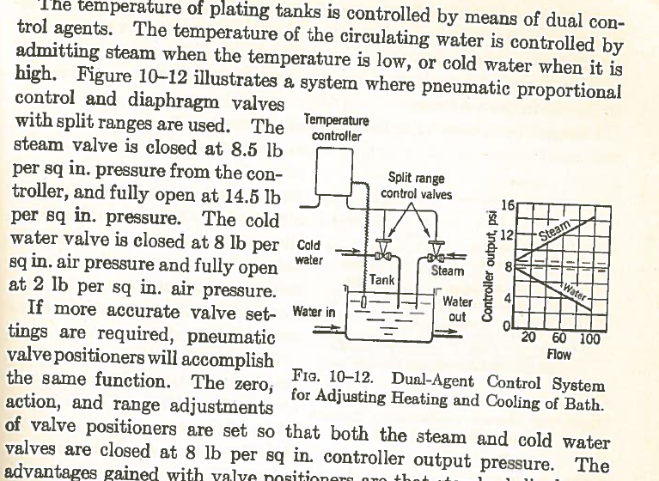
Split range control:
Donald Eckman (1945)
MV-MV switching

Slide 28
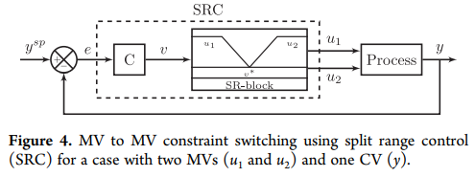
MV-MV switching
Alt. 1A. Split-range control (SRC)
C – same controller for all inputs (u1, u2)
But can get different gains by adjusting the slopes in the SR-block
v = internal signal
A. Reyes-Lúa, C. Zotica, K. Forsman, S. Skogestad, Systematic design of split range controllers,
12th IFAC Symposium on Dynamics and Control of Process Systems, Including Biosystems (DYCOPS), Florianópolis, Brazil, 2019.

Slide 29
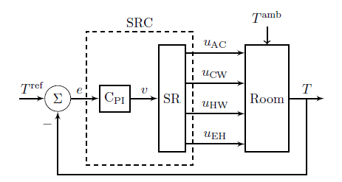
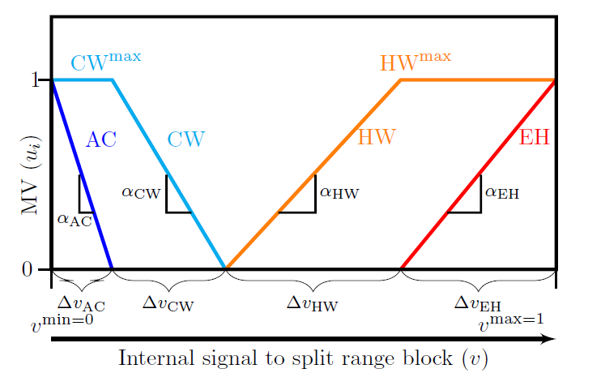
MV-MV switching
Example: Room heating/cooling with 4 MVs
Alt. 1A. Split-range control (SRC)
MVs:
AC (expensive cooling)
CW (cooling water; cheap)
HW (hot water, quite cheap)
Electric heat, EH (expensive)
y=T
d=T^{amb}
C_{PI} – same controller for all inputs (one integral time)
But get different gains by adjusting slopes α in SR-block

Slide 30
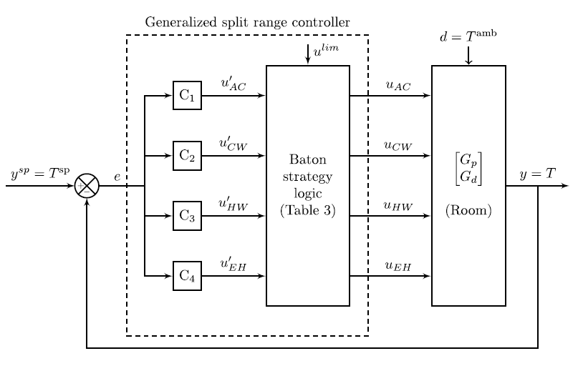
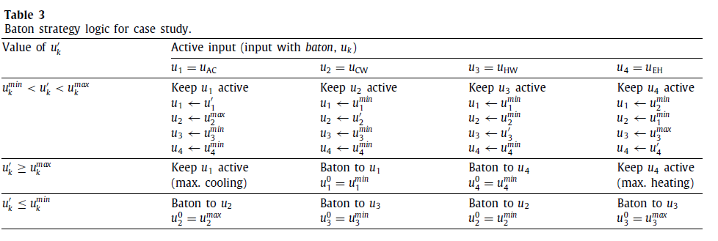
MV-MV switching
Disadvantages Alt. 1A. Standard Split-range control (SRC):
Must use same integral/derivative time for all MVs
Does not work well when constraint values change (SR-block problem)
Alt. 1B. Generalized SRC (Baton strategy: multiple independent controllers)
y=T
d=T^{amb}
All four controllers need anti-windup
A. Reyes-Lúa and S. Skogestad. “Multi-input single-output control for extending the operating range:
Generalized split range control using the baton strategy”. Journal of Process Control 91 (2020)

Slide 31
MV-MV switching
Disadvantages Alt. 1A. Standard Split-range control (SRC):
Must use same integral/derivative time for all MVs
Does not work well when constraint values change (SR-block problem)
Alt. 1B. Generalized SRC (Baton strategy: multiple independent controllers)
y=T
d=T^{amb}
All four controllers need anti-windup
A. Reyes-Lúa and S. Skogestad. “Multi-input single-output control for extending the operating range:
Generalized split range control using the baton strategy”. Journal of Process Control 91 (2020)

Slide 32
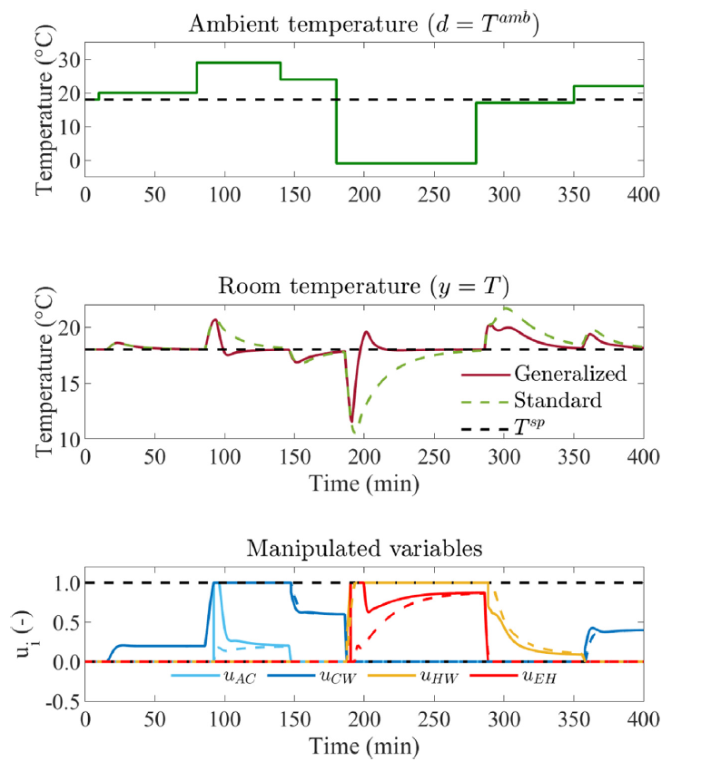
Simulation of standard and generalized SRC
MV-MV switching
Generalized split range control:
Different (smaller) integral times for each input
Gives faster settling for most inputs
A. Reyes-Lúa and S. Skogestad. “Multi-input single-output control for extending the operating range:
Generalized split range control using the baton strategy”. Journal of Process Control 91 (2020)

Slide 33
What about Model Predictive control (MPC)?

Slide 34
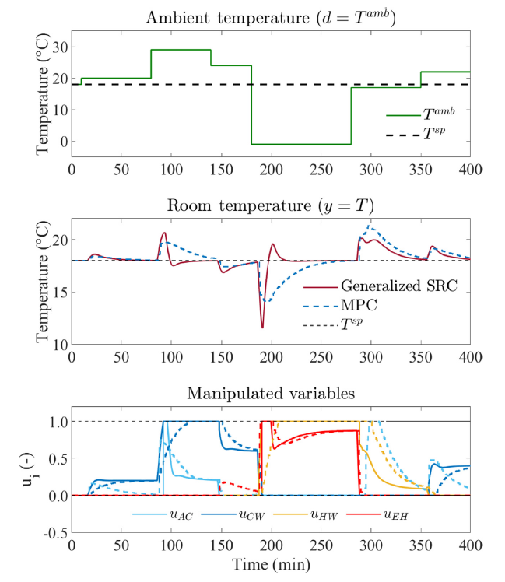
Comparison of
Generalized SRC and MPC
MV-MV switching
Responses
MPC: Similar response to standard SRC
MPC: Faster initially, uses several input simultanously
MPC: Slower settling
Disadvantage MPC:
Complex: Requires full dynamic model
Does not use on input at a time
Uses both heating and cooling at the same time
  See at t=300 min (not optimal economics)
A. Reyes-Lúa and S. Skogestad. “Multi-input single-output control for extending the operating range:
Generalized split range control using the baton strategy”. Journal of Process Control 91 (2020)

Slide 35
MV-MV switching
Disadvantages Alt. 1A Standard Split-range control (SRC):
Must use same integral time for all MVs
Does not work well when constraint values change
Alt. 2. Multiple controllers with different setpoints
Ts1=23ºC
C₁
Ts2=Ts1-1C=22ºC
C₂
y=T
d=T^{amb}
Ts3=Ts1-2C=21ºC
C₃
Ts4=Ts1-3C=20ºC
C₄
Advantages Alt. 2 :
Simple to implement (no logic)
Controllers can be tuned independently
Switching by feedback: Do not need to know constraint values
Disadvantage Alt. 2: Setpoint not constant
  Can be an advantage (gives energy savings for room heating)
  Fix: Use master controller on T (with setpoint Ts=22c) that resets the setpoint Ts1 (but keeps differences)
A. Reyes-Lúa, S. Skogestad, Multiple-input single-output control for extending the steady-state operating range—Use of controllers with different setpoints, Processes, 2019

Slide 36
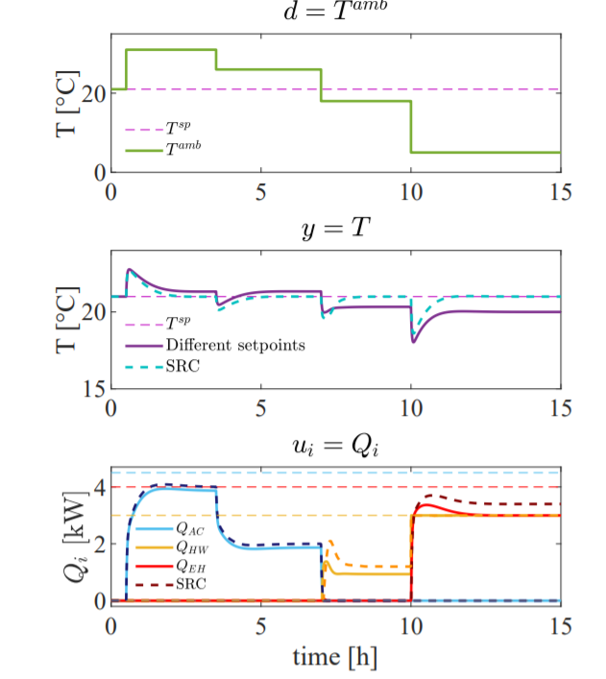
MV-MV switching
Comparison of Alternatives 1 (SRC) and 2 (different setpoints)
d=T^{amb}
y=T
A Reyes-Lua, S Skogestad. Multiple-Input Single-Output Control for Extending the Steady-State Operating Range - Use of Controllers with Different Setpoints. Processes 7 (12), 941, 2019

Slide 37
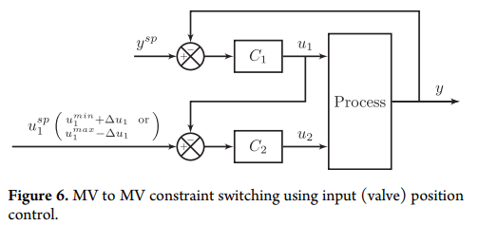
Alt. 3. Input (valve) position control (VPC)
MV-MV switching
VPC
Advantage: Always control output y with same input (u1=MV1)
  Good if tight control of CV is important and cannot be achieved with u2=MV2
When u1 approaches saturation: Use u2 to control u1 (VPC)
  Disadvantages: Ecomomic loss because we cannot use full range for u1
  Example: With electric heat (u1=EH) to control temperature (y=T) we will use some heat also in summer

Slide 38
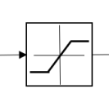
CV-CV switching: Use selectors (only* option!)
Process
Many CVs paired with one MV.
But only one CV controlled at a time.
Use: Max or Min selector
Sometimes called “override”
Selector is generally on MV (compare output from many controllers)
>
=
MAX
=
HS
Note: Selectors are logic blocks
<
=
MIN
=
LS
*Selectors may be implemented in other ways, for example, using «if-then»-logic.
*In some cases a max- and min- selector in series may be replaced by a saturation element

Slide 39
Furnace control
CV-CV switching
with safety constraint
u₁
TC
T_{1s} = 500C
Input (MV)
u = Fuel gas flowrate
Output (CV)
y₁ = process temperature T₁
(desired setpoint or max constraint)
y₂ = furnace temperature T₂
(max constraint)
Rule: Use min-selector for constraints that are satisfied with a small input
MIN
u₂
TC
T_{2max}=700C
y₁=T₁
HP steam
u=min(u₁,u₂)
y₂=T₂
Flue gas
Process fluid (water)
u = input = manipulated variable (MV)
y = output = controlled variable (CV)
u=Fuel gas
Air

Slide 40
Furnace control with cascade (selector on CV)
CV-CV switching
T_{2max}
T_{2s}
MIN
u₁
TC
T_{1s} = 500C
u₂
TC
y₁=T₁
y₂=T₂
Flue gas
Process fluid
u=Fuel gas
Air

Slide 41
Design of selector structure
CV-CV switching
Rule 1 (max or min selector)
Use max-selector for constraints that are satisfied with a large input
Use min-selector for constraints that are satisfied with a small input
Rule 2 (order of max and min selectors):
If need both max and min selector: Potential infeasibility
Order does not matter if problem is feasible
If infeasible: Put highest priority constraint at the end
“Systematic design of active constraint switching using selectors.”
Dinesh Krishnamoorthy , Sigurd Skogestad. Computers & Chemical Engineering, Volume 143, (2020)

Slide 42
Valves have “built-in” selectors
CV-CV switching
A min-flow (z=0) gives a “built-in” max-selector (to avoid negative flow)
A max-flow (z=1) gives a “built-in” min-selector
So it’s not necessary to add these as selector blocks (but it will not be wrong).
Another way to see this is to note that a valve works as a saturation element

Slide 43
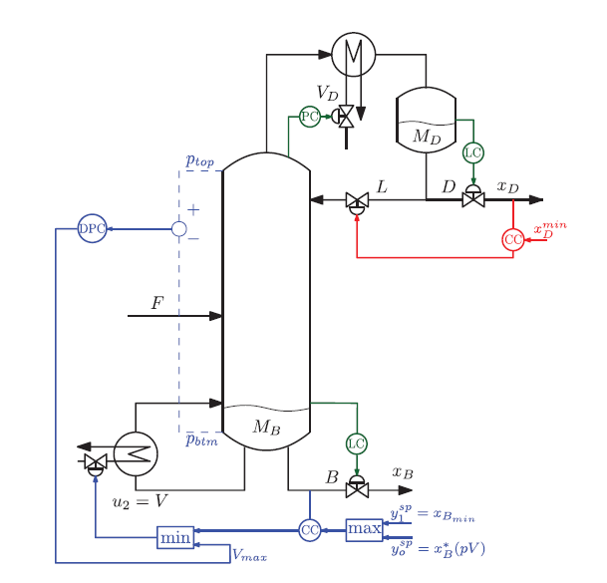
Example:
Optimal operation of distillation column.
Top product valueable
CV-CV switching
Always control xD at constraint
(valueable product) to
avoid «product give-way»
Avoid flooding using constraint on DP
May overpurity bottom to get more of the valuable product

Slide 44
Example: Adaptive cruise control
CV-CV switching

Slide 45
Challenges selectors
CV-CV switching
Standard approach requires pairing of each active constraint with a single input
  May not be possible in complex cases
Stability analysis of switched systems is still an open problem
  Undesired switching may be avoided in many ways:
    Filtering of measurement
    Tuning of anti-windup scheme
    Minimum time between switching
    Minimum input change

Slide 46
CV-MV switching (because of constraint on MV)
Simple CV-MV switching
  Don’t need to do anything if we paired the MV with a CV that can be given up
Complex CV-MV switching
  This is a repairing of loops (CV-MV switching)
  Need to combine MV-MV switching with CV-CV-switching
The CV-CV switching always uses a selector
As usual, there are three alternatives for the MV-MV switching:
  Split range control (block /\): Has problems because limits may change
  Different setpoints for level. Actually, may have additional advantages
  Valve position control («long loop»). avoids repairing.
  + Shinskey-alternative

Slide 47
Anti-surge control
Simple CV-MV switching
F₀
y=F
F^{sp}=F^{min}
FC
u^{min}=0
MAX
u=F_{R}
MAX-block to avoid negative flow.
Not needed because the input (valve) has «built-in» selector, u ≥ 0.
We satisfy the input saturation rule:
«When the MV (u) saturates, control of the CV (y) can be given up»

Slide 48
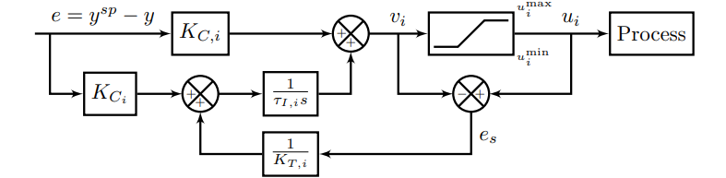
Anti-windup
All the controllers shown need anti-windup to «stop integration» during periods when the control action (v_{i}) is not affecting the process:
  Controller is disconnected (because of selector)
  Physical MV (u_{i}) is saturated
Selector or
saturation
K_{T,i}
Anti-windup using back-calculation. Typical choice for tracking constant, K_{T}=1

Slide 49
Example: Furnace control
Complex CV-MV switching
Furnace control : Cannot give up control of y₁=T₁. What to do?
u_{A}
TC
T_{1s} = 500C
MIN
u_{B}
T_{2max}=700C
LS
TC
y₁=T₁
Inputs (MV)
u = Fuel gas flowrate
u₂ = Process flowrate
Output (CV)
y₁ = process temperature T₁
(with desired setpoint)
u=min(u_{A},u_{B})
y₂=T₂
Flue gas
Process fluid
u₂
u=Fuel gas
Air

Slide 50
Cannot give up controlling T₁
Solution: Cut back on process feed (u₂) when T₁ drops too low
Complex CV-MV switching
TC
Using Input-input switching
T_{1s} = 500C
T’_{1s} = T_{1s}-5C=495C
u_{A}
TC
TC
MIN
u_{B}
T_{2max}=700C
LS
TC
y₁=T₁
Inputs (MV)
u = Fuel gas flowrate
u2 = Process flowrate
Output (CV)
y₁ = process temperature
(with desired setpoint)
u=min(u_{A},u_{B})
y₂=T₂
Flue gas
u₂
Note: Standard Split Range Control (Alt. 1) is not good here.
Could be two reasons for too little fuel
  Fuel is cut back by override (safety)
  Fuel at max,
So don’t know limit for MV1 to use in SRC-block.
Process fluid
u=Fuel gas
Air
u = input = manipulated variable (MV)
y = output = controlled variable (CV)

Slide 51
Use Alt. 2: Two controllers
Complex CV-MV switching
T_{1s} = 500C
T’_{1s} = T_{1s}-5C=495C
u_{A}
TC
TC
MIN
u_{B}
T_{2max}=700C
LS
TC
y₁=T₁
Inputs (MV)
u = Fuel gas flowrate
u2 = Process flowrate
Output (CV)
y₁ = process temperature
(with desired setpoint)
u=min(u_{A},u_{B})
y₂=T₂
Flue gas
u₂
  Solution: Two controllers with different setpoints
Process fluid
u=Fuel gas
Air
u = input = manipulated variable (MV)
y = output = controlled variable (CV)

Slide 52
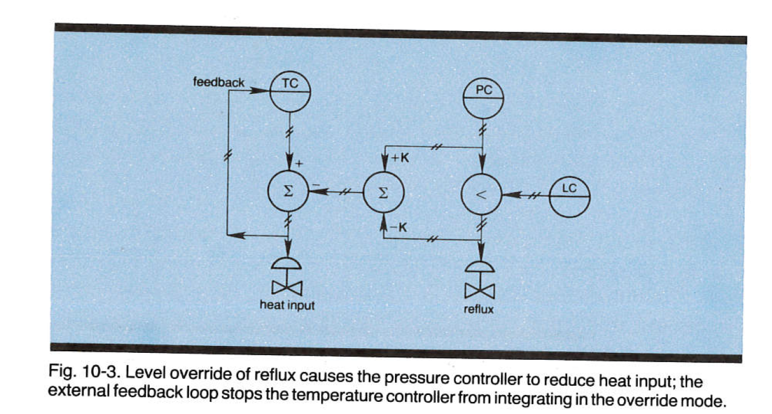
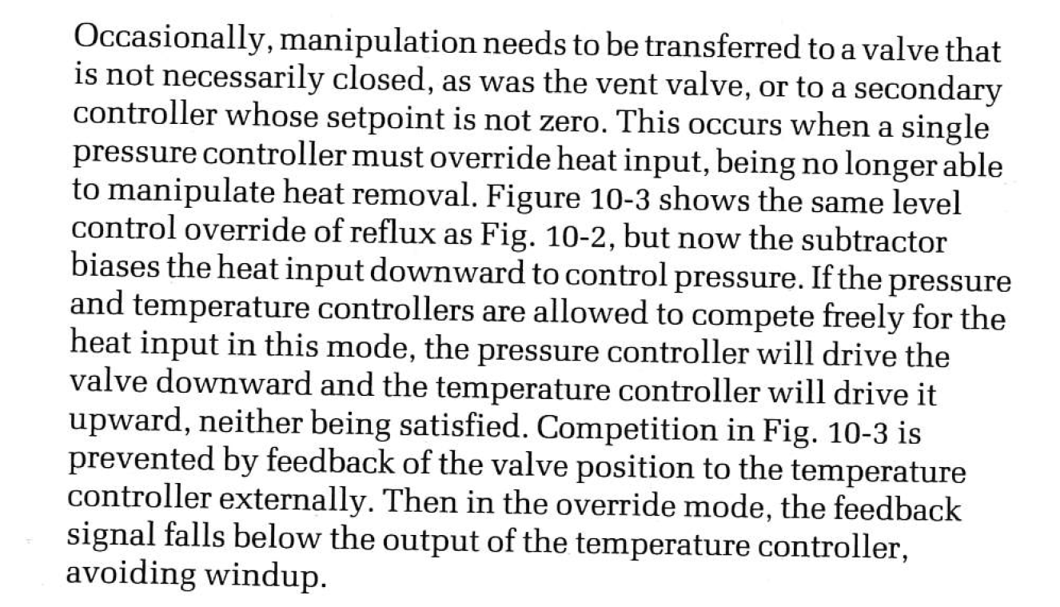
Complex CV-MV switching + CV-CV switching (Alt. 4)
Alt. 4. Shinskey. Flooded condenser,
y3
y1
y2
u1
u2
Two controllers (TC for y3, PC for y1) are in some cases competing for the same input (u1), but PC wins because of the smart use of anti-windup back to TC, which stops TC from working (integrating) when the input from PC is non-zero
Normally: Use u1 to control y3, and u2 to control y1
When y2 reaches min: Must use to u2 to control y2, and since y1 cannot be given up we must do a repairing of loops where y3 is given up and u1 is used to control y1
Comment: Alt.2 with two controllers (PC) works fine here and is simpler,
See next page.

Slide 53
Examples: Important insight
Many problems: Optimal steady-state solution always at constraints
In this case optimization layer may not be needed
  if we can identify the active constraints and control them using selectors

Slide 54
Systematic design of simple advanced controllers (APC)
Process
First design simple control system for nominal operation
  With single-loop PID control we need to make pairing between inputs (MVs) and outputs (CVs):
  Should try to follow two rules
    «Pair close rule» (for dynamics).
    «Input saturation rule»:

Slide 55
Systematic design of simple advanced controllers (APC)
Then make a list of possible new contraints that may be encountered (because of disturbances, parameter changes, price changes)
Reach constraint on new CV
  Simplest: Find an unused input (simple CV-MV switching)
  Otherwise: CV-CV switching using selector (may involve giving up a CV-constraint or a self-optimizing CV)
Reach constraint on MV (which is used to control a CV)
  Simplest (If we followed input saturation rule):
    Can give ip controlling the CV (Simple CV-MV switching)
    Don’t ned to do anything
  Otherwise (if we cannot give up controlling CV)
    Simplest: Find an unused input
      MV-MV switching
    Otherwise: Pair with a MV that already controls another CV
      Complex CV-MV switching
      Must combine MV-MV and CV-CV switching
Is this always possible? No, pairing inputs and outputs may be impossible with many constraints.
May then use MPC instead

Slide 56
Example : Level control
MV1 = z1 (inflow valve position)
MV2 = z2 (outflow valve position) (likely to saturate)
CV1 = F1 (inflow): Should be controlled at setpoint F_{1,s} (if possible)
CV2 = level: must always be controlled (at some SP)
Process
SP
Nomimal design with “pair-close” rule
F_{1,s}
LC
FC
F₁ [m3/s]
F_{1,m}
z1
Disturbance
F₂ [m3/s]
z2
Problem: outflow-valve may saturate at fully open (z2=1) and then we lose level control
Note: We did not following the “input saturation rule” which says:
Pair MV that may saturate (z2) with CV that can be given up (F1)

Slide 57
This gives simple CV-MV switching (if z2 saturates at fully open)
Nominal design with Reverse pairing (follows “input saturation rule”):
SP
LC
F_{2,s}
F_{1,m}
F₁ [m3/s]
FC
«long loop»
Disturbance
F₂ [m3/s]
BUT with Reverse pairing: Get “long loop” for flow control
In addition: loose control of y2= level if z1 (F1-valve) saturates
«Long loop» = Works through other loops

Slide 58
This is complex CV-MV switching
Alternative solution: Follow “Pair close”-rule and use Complex CV-MV switching.
When z2 saturates at max, use the other MV (z1) for level control and give up controlling F1
Get: “Bidirectional inventory control”
LC
Using
MV-MV
switching
SP-H
SP-L
F_{1,s}
MIN
LC
LC
FC
F₁ [m3/s]
F_{1,m}
Disturbance
F₂ [m3/s]
Avoid long loop for control of F1
Works both when F1-valve or F2-valve saturate at open
Overall: seems to be the best solution

Slide 59
This is complex CV-MV switching
Alternative solution: Follow “Pair close”-rule and use Complex CV-MV switching.
When z2 saturates at max, use the other MV (z1) for level control and give up controlling F1
Get: “Bidirectional inventory control”
SP-H
SP-L
F_{1,s}
MIN
LC
LC
FC
F₁ [m3/s]
F_{1,m}
Disturbance
F₂ [m3/s]
Recommended: Two controllers
SP-L = low level setpoint
SP-H = high level setpoint
Use of two setpoints is good for using buffer dynamically!!

Slide 60
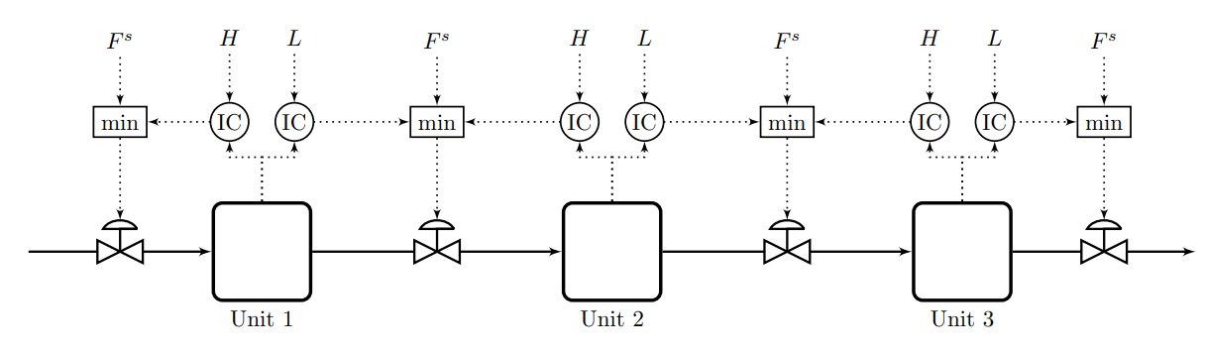
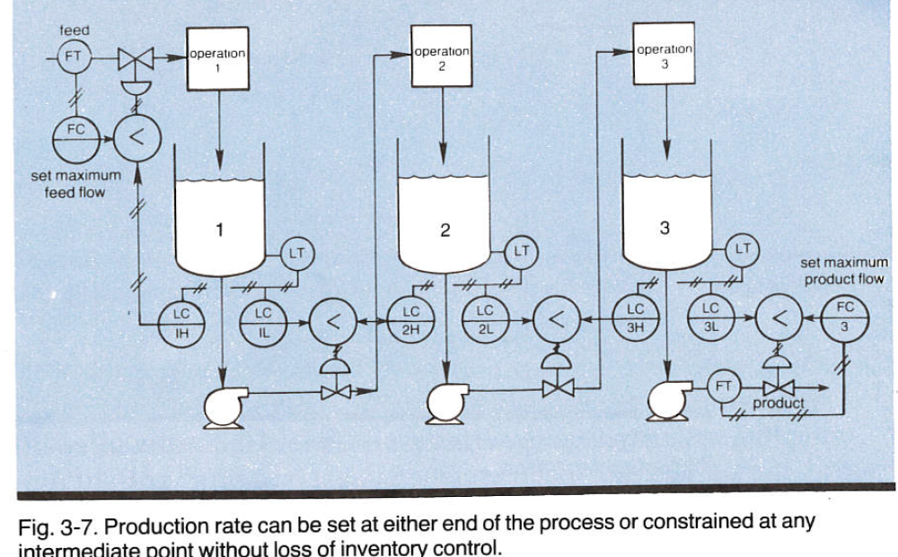
Generalization of bidirectional inventory control
Reconfigures automatically with optimal buffer management!!
Max flow:
F^{s}=∞
F.G. Shinskey, «Controlling multivariable processes», ISA, 1981, Ch.3
Cristina Zotica, Krister Forsman, Sigurd Skogestad ,»Bidirectional inventory control with optimal use of
intermediate storage», Computers and chemical engineering, 2022
,

Slide 61



=∞
=∞
=∞
1
F₀=1
F₁=1
F₂=1
F₃=1

Slide 62
=∞
=∞
1
0.5
F₀=1
F₁=0.5
F₂=1
F₃=1

Slide 63
=∞
=∞
1
0.5
F₀=0.5
F₁=0.5
F₂=1
F₃=1

Slide 64

=∞
=∞
1
0.5
F₀=0.5
F₁=0.5
F₂=0.5
F₃=1

Slide 65
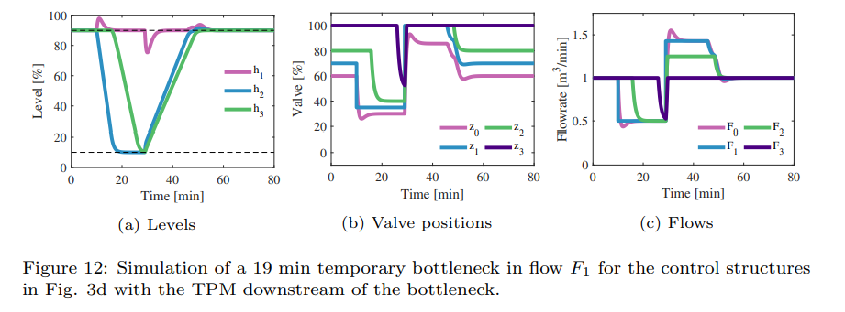

=∞
=∞
=∞
1
F₀=0.5
Fully open
F₂=0.5
F₃=0.5

Slide 66
=∞
=∞
1
F₀=1
F₁=1
F₂=1
F₃=1
Challenge: Can MPC be made to do his? Optimally reconfigure loops and find optimal buffer?
YES. Give unachievable high setpoints on all flows

Slide 67
16 July 2022
Extension . Bidirectional inventory control with minimum flow for F₂
M
F^{s}
F₂^{min}
IC
min
max
Max flow:
F^{s}=∞
F₀
F₁
F₂
F₃
Level M (medium) in Unit 2 is the new «normal low» level.
M should be large to keep F₂>F₂^{min} for a temporary drop in F₁
M may be set by the operators (because they may know about expected stops)
Note: The order of selectors is important
Gets complicated…… but not sure if MPC can be made to work

Slide 68
Implementing optimal operation
Summary
Most people think
  You need a detailed nonlinear model and an on-line optimizer (RTO) if you want to optimize the process
  You need a dynamic model and model predictive control (MPC) if you want to handle constraints
  The alternative is Machine Learning
No! In many cases you just need to measure the constraints and use PID control
  «Conventional advanced process control (APC)»
How can this be possible?
  Because optimal operation is usually at constraints
  PID-controllers can be used to identify and control the active constraints
  For unconstrained degrees of freedom, one often have «self-optimizing» variables
This fact is not well known, even to control professors
  Because most APC-applications are ad hoc
  Few systematic design methods exists
Today APC (ARC) and MPC are in parallel universes
  Both are needed in the control engineer's toolbox

Slide 69
Conclusion
Put optimization into the control layer
  It’s much faster and more effective
Conventional Advanced process control (APC) works very well in many cases
  Optimization by feedback
    Self-optimizing control
    Active constraint switching
  Need to pair input and output.
    Advantage: The engineer can specify directly the solution
    Problem: May not be possible for complex cases
  Need model only for parts of the process (for tuning)
  Conventional APC: A new beginning needed in terms of developing theory and design methods

Slide 70

Optimal centralized
Solution (EMPC)
Academic process control community fish pond
Simple solutions that
work (selector, PID++)
Sigurd (me)

