Slide 1
Putting Optimization into process control
Sigurd Skogestad
Department of Chemical Engineering
Norwegian University of Science and Technology (NTNU)
Trondheim
Imperial College, London, 29 April 2022(virtual)

Slide 2
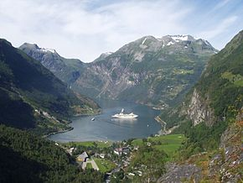
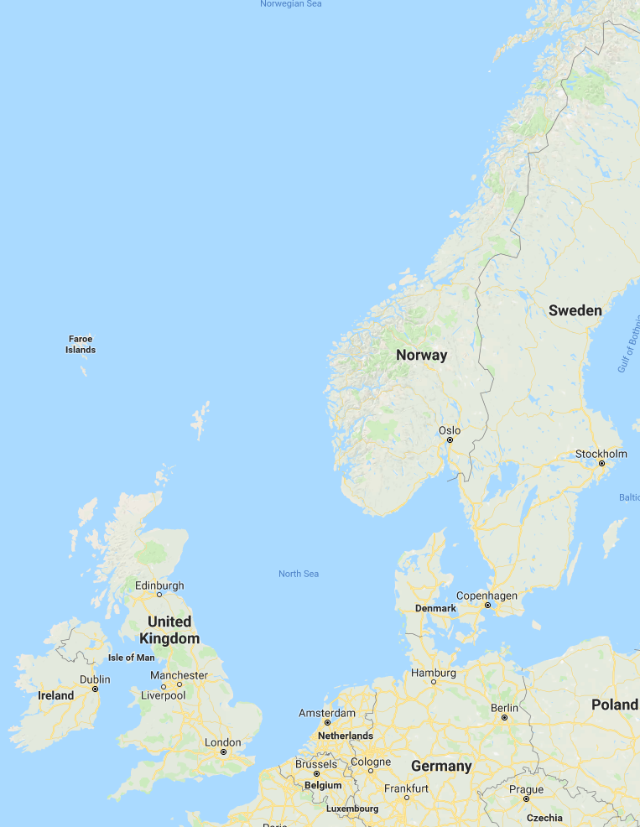


Trondheim
Arctic circle
Geiranger fjord
Trondheim

Slide 3
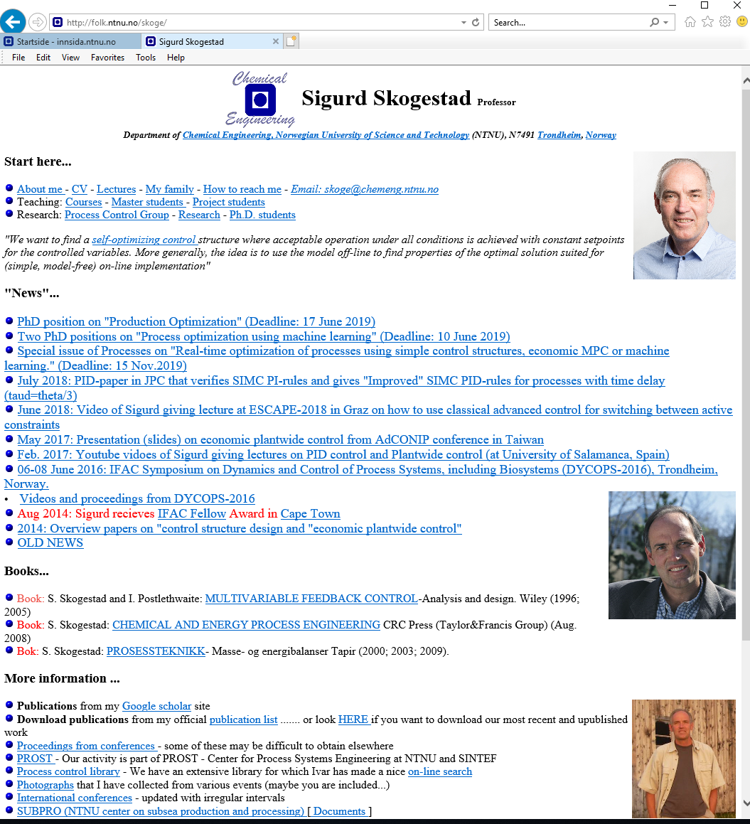
“The goal of my research is to develop simple yet rigorous methods to solve problems of engineering significance”

Slide 4

About Sigurd Skogestad
•1955: Born in Flekkefjord, Norway
• 1956-1961: Lived in South Africa
•1974-1978: MS (Siv.ing.) studies in chemical engineering at NTNU
•1979-1983: Worked at Norsk Hydro co. (process simulation)
•1983-1987: PhD student at Caltech (supervisor: Manfred Morari)
•1987-present: Professor of chemical engineering at NTNU
• 1994-95: Visiting Professor UC Berkeley
• 2001-02: Visiting Professor UC Santa Barbara
•1999-2009: Head of ChE Department, NTNU
•2015-..: Director SUBPRO (Subsea research center at NTNU)
Non-professional interests:
mountain skiing (cross country)
orienteering (running around with a map)
grouse hunting
1973

Slide 5
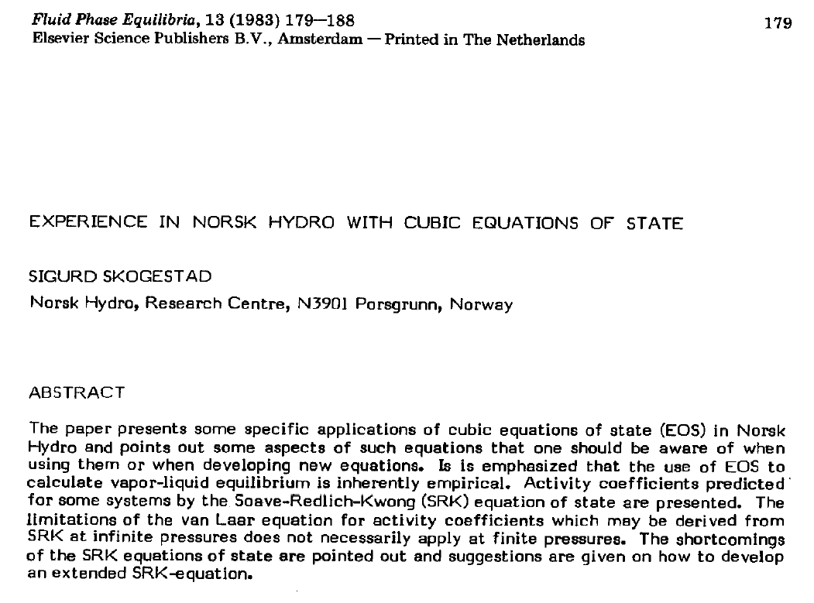
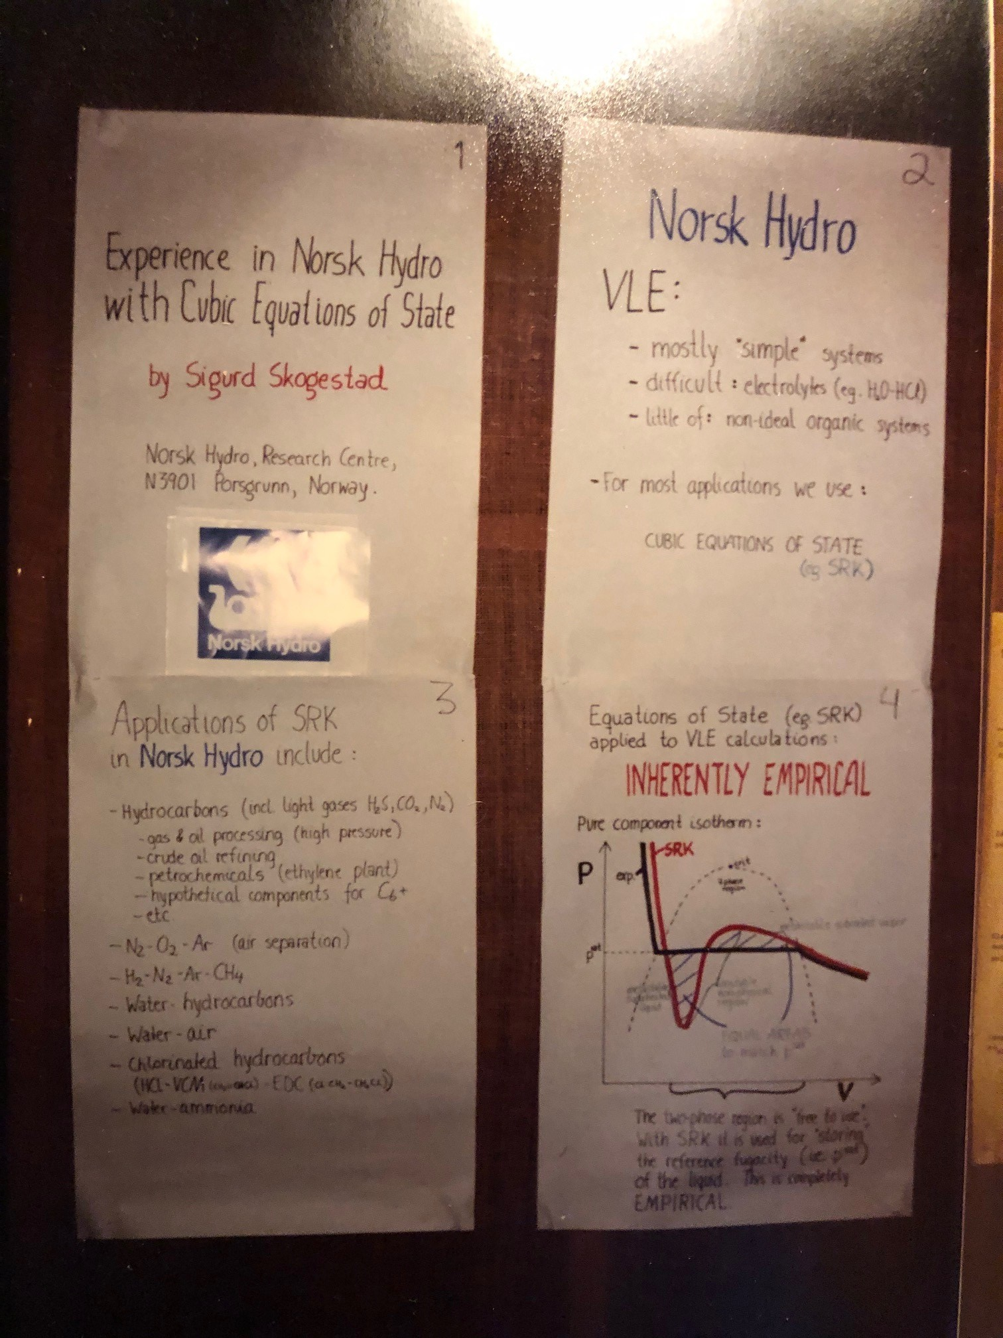

Slide 6
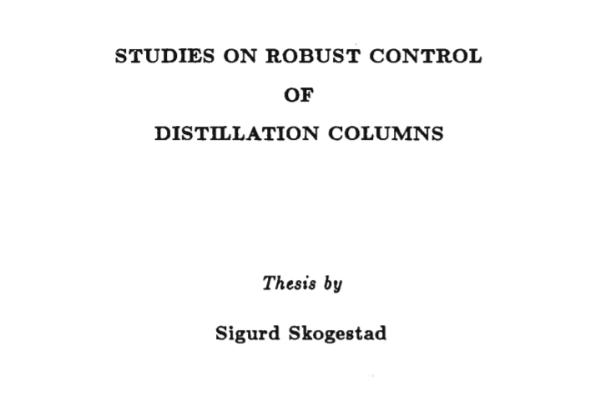
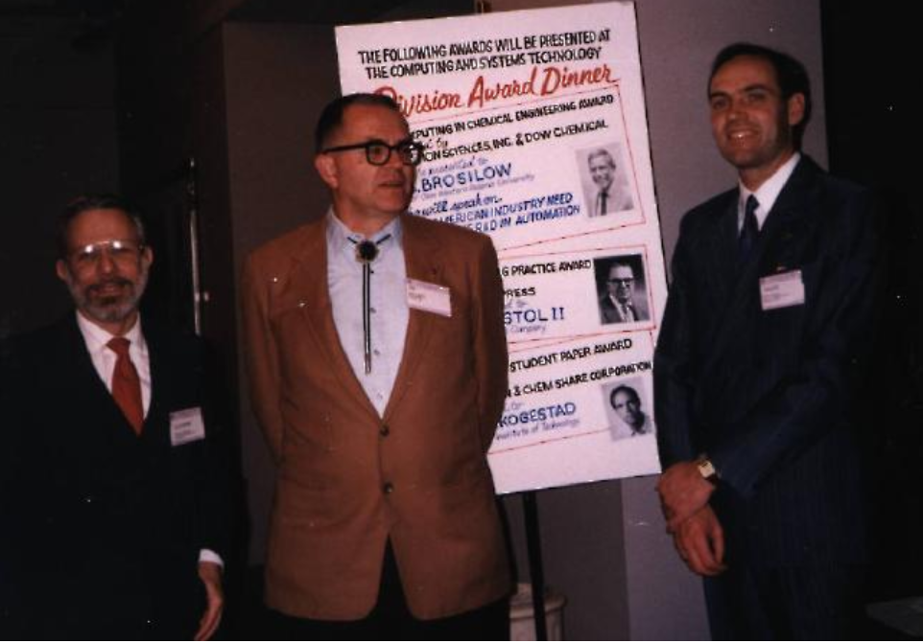
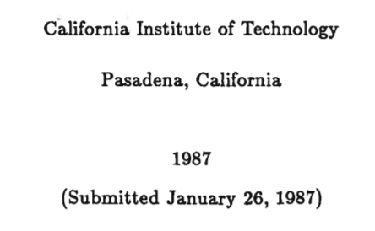
1983-87: Caltech
Robust control
Distillation
PID (IMC)

Slide 7
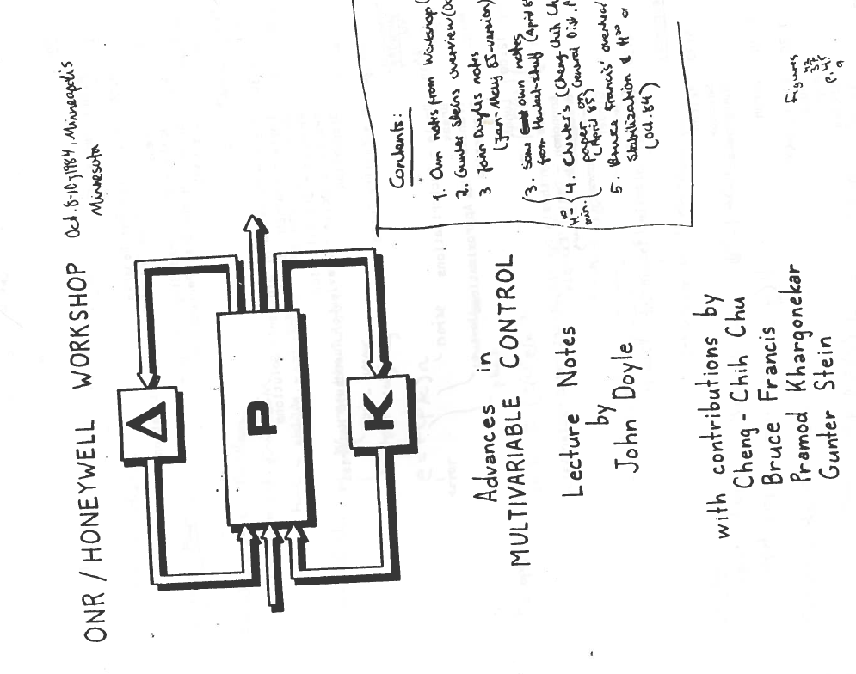
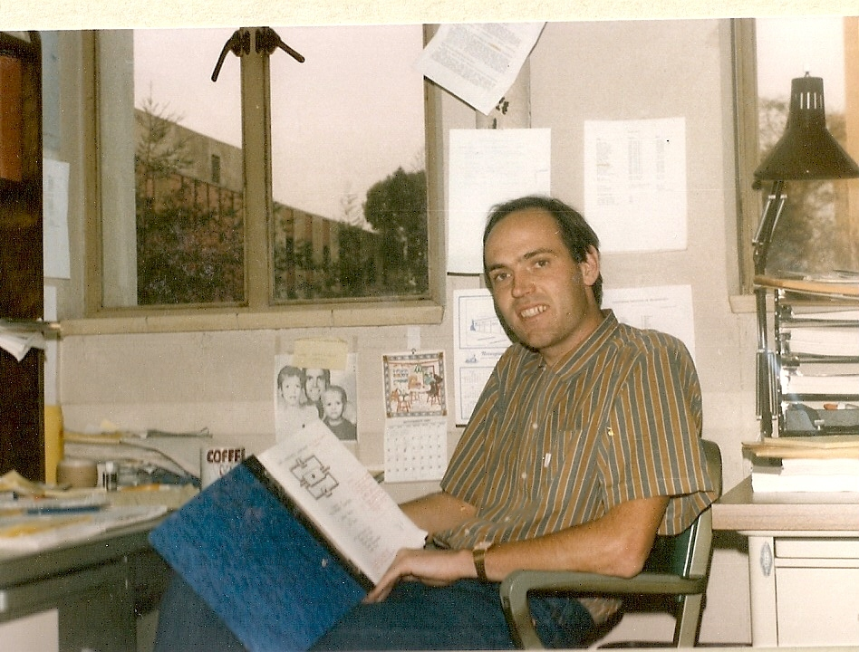
October 1984
Robust control takes off!

Slide 8
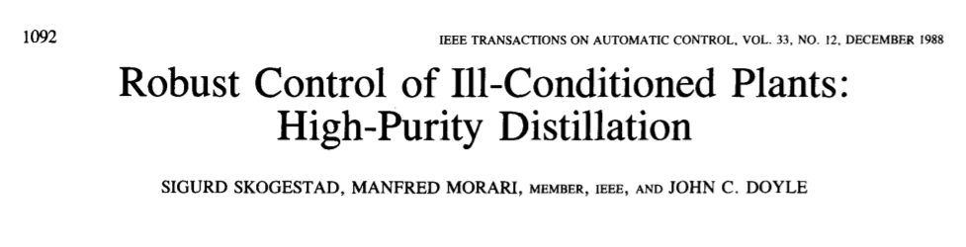
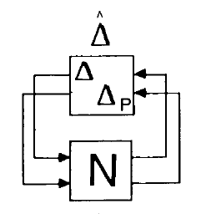
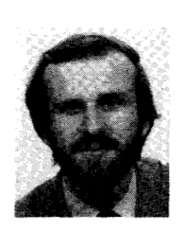
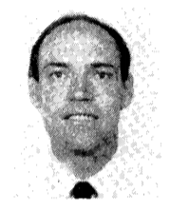
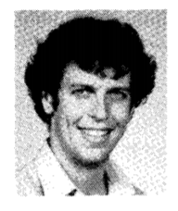
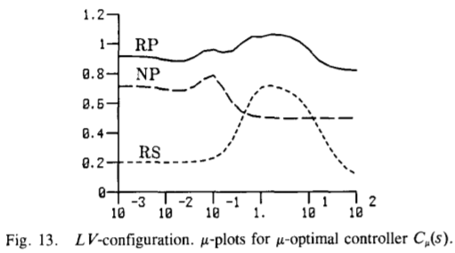

Slide 9
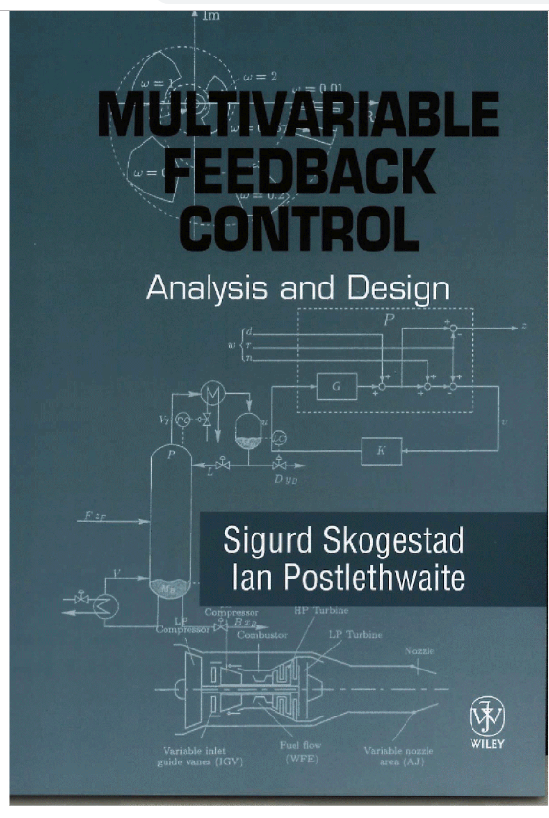
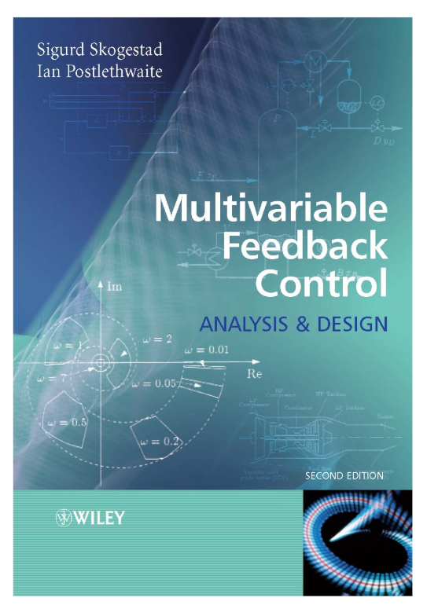
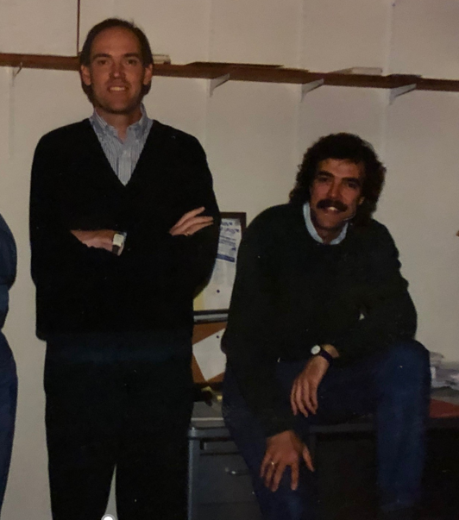
Robust control
Berkeley, Dec. 1994
1996
2005

Slide 10
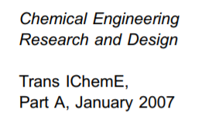
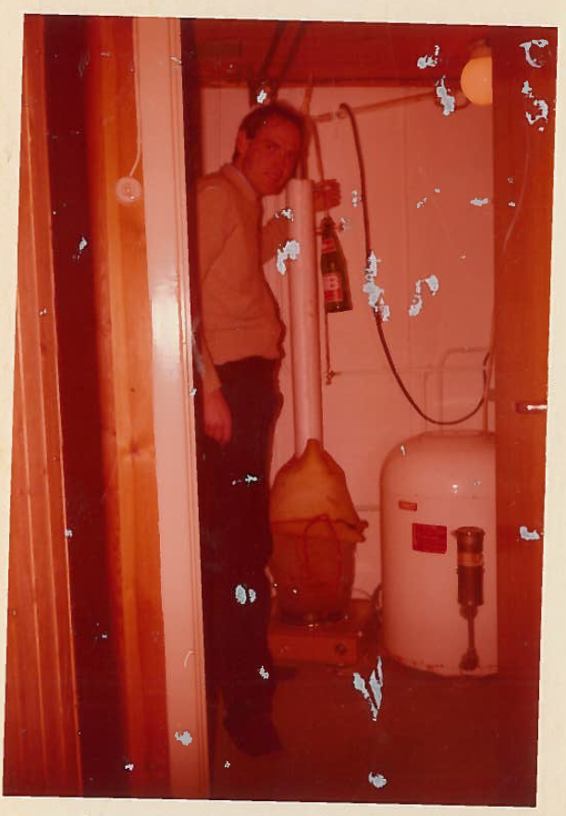
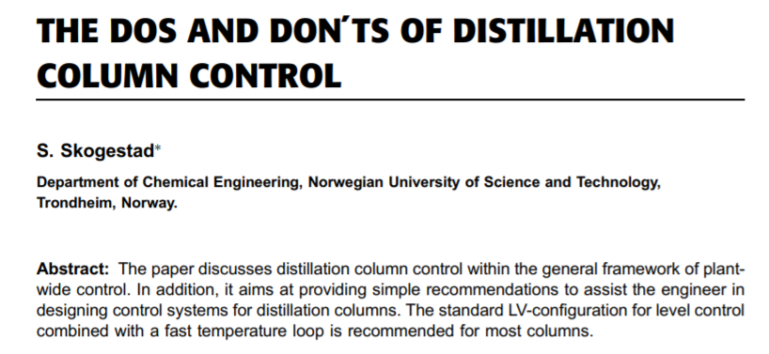
Distillation
At home doing moonshine
distillation (1979)

Slide 11
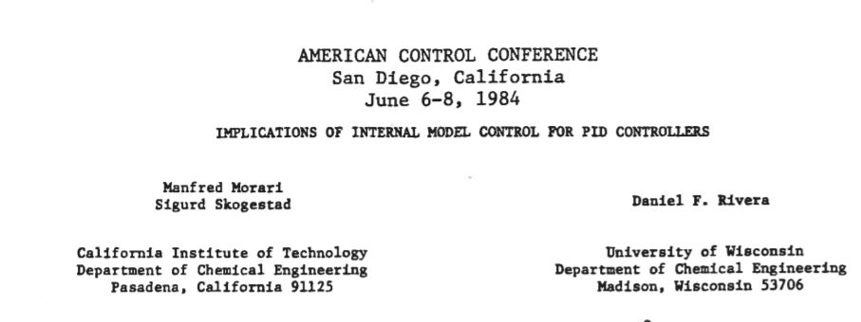
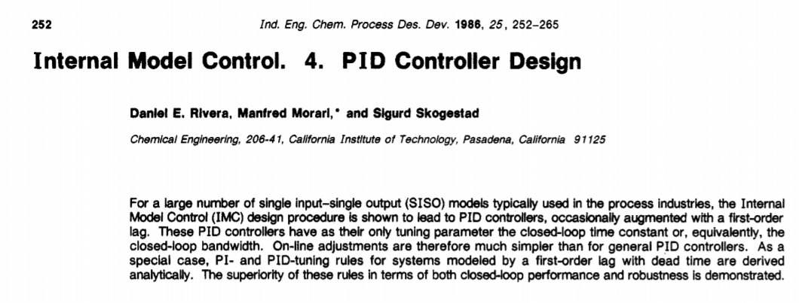

Slide 12

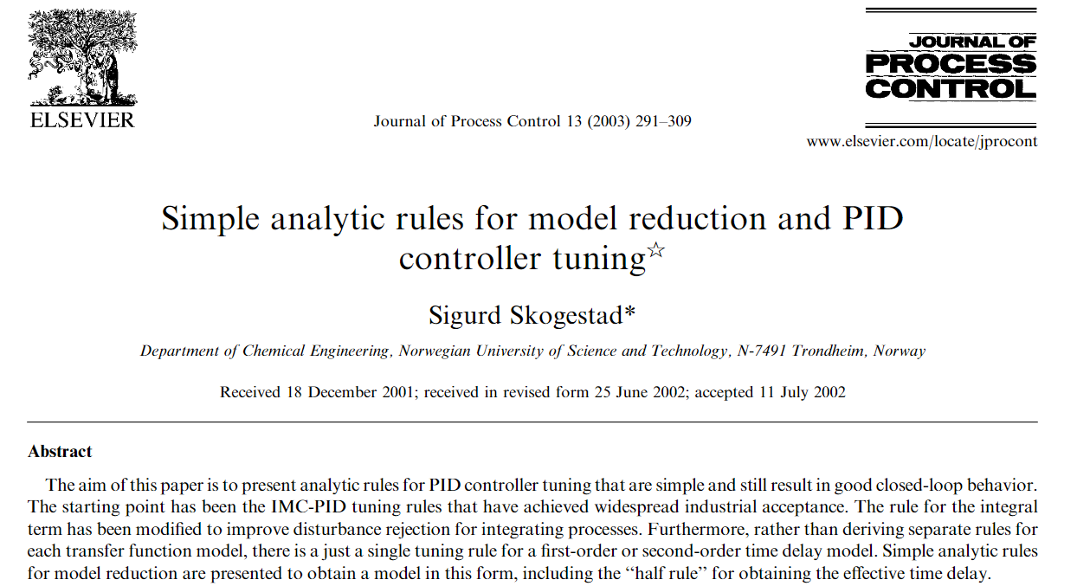
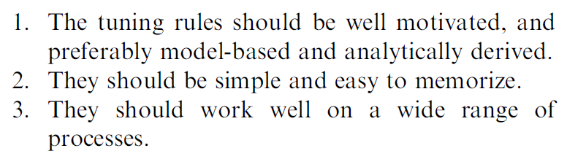
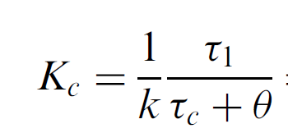




SIMC PID tuning rule (2001)
Tuning parameter:
$$τ_{c}≥θ$$

Slide 13
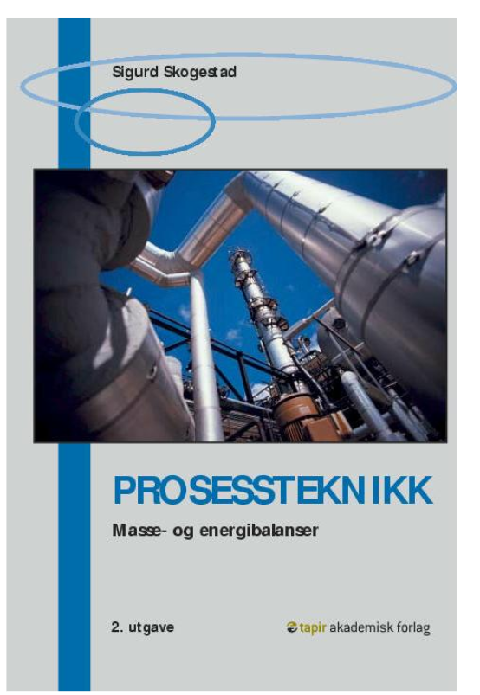
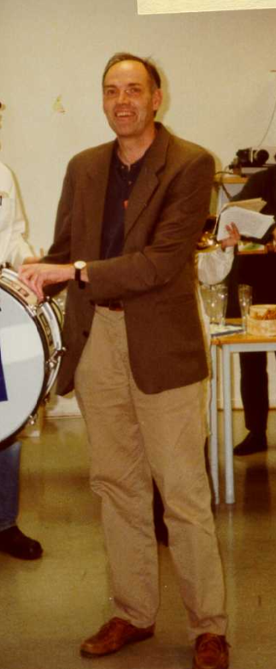
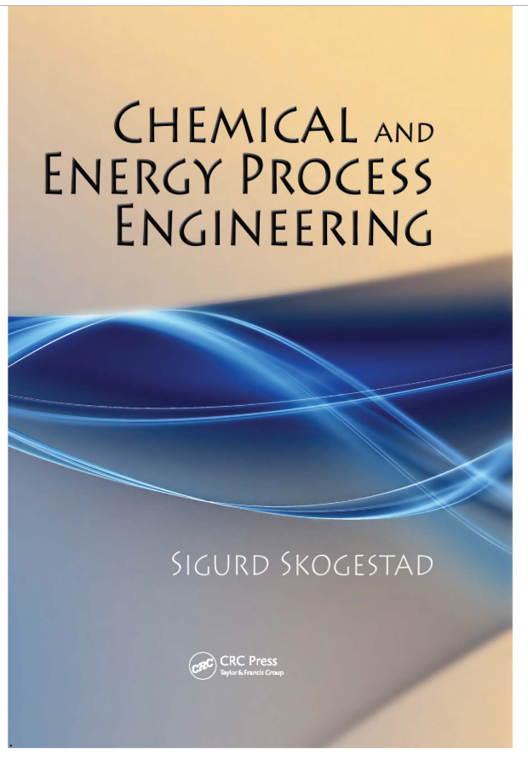
2000, 2003, 2009
2009
2000

Slide 14
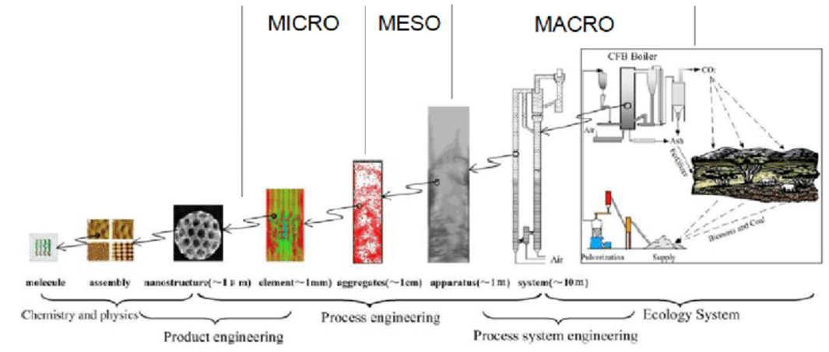
Chemical Engineering and Process Systems Engineering

Slide 15
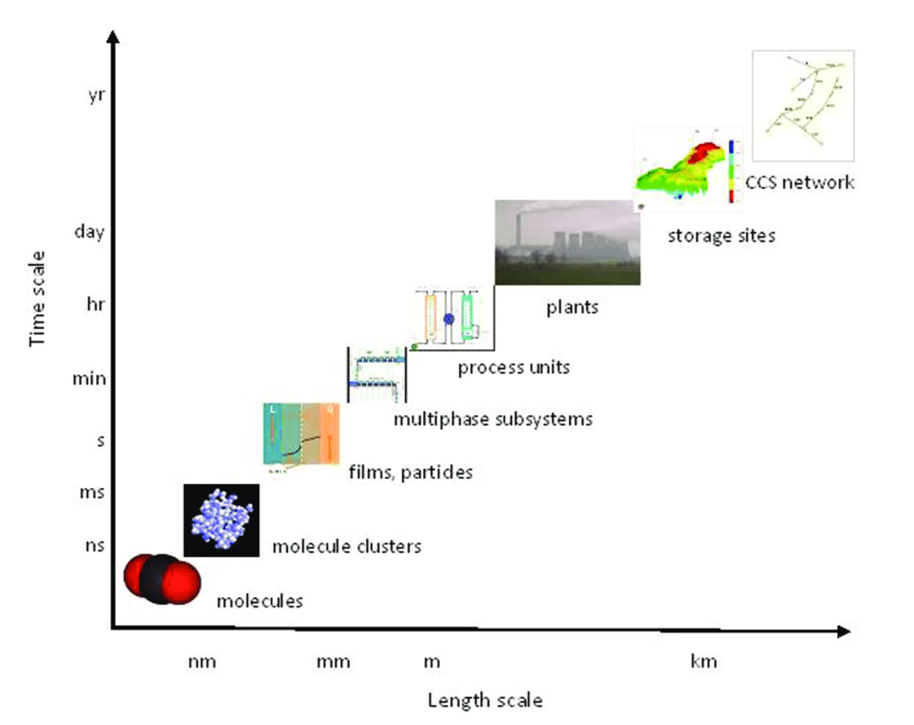

Slide 16
Process systems engineering
About getting the big picture without loosing the details
Studying and combining different length scales (nm to km)
… different time scales
Also: … combining physical models and data
Classical solution: Make «boxes»
Get rid of the boxes? Tempting, but it’s not a good idea
This talk: Breaking an optimization problem into boxes and make use of process control for solving

Slide 17
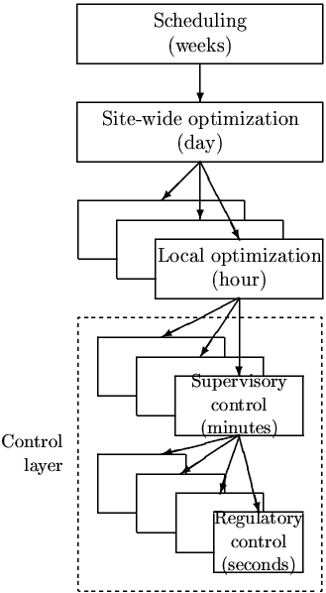
Process control: Hierarchical decision system based on time scale separation

Slide 18
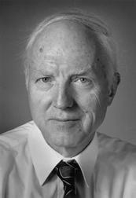
Control structure design = Plantwide control
Alan Foss (“Critique of chemical process control theory”, AIChE Journal,1973):
The central issue to be resolved ... is the determination of control system structure. Which variables should be measured, which inputs should be manipulated and which links should be made between the two sets? There is more than a suspicion that the work of a genius is needed here, for without it the control configuration problem will likely remain in a primitive, hazily stated and wholly unmanageable form. The gap is present indeed, but contrary to the views of many, it is the theoretician who must close it.
Notes:
18

Slide 19
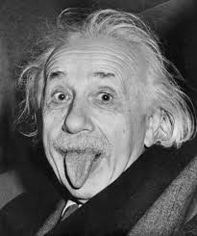
Control structure design = Plantwide control
Alan Foss (“Critique of chemical process control theory”, AIChE Journal,1973):
The central issue to be resolved ... is the determination of control system structure. Which variables should be measured, which inputs should be manipulated and which links should be made between the two sets? There is more than a suspicion that the work of a genius is needed here, for without it the control configuration problem will likely remain in a primitive, hazily stated and wholly unmanageable form. The gap is present indeed, but contrary to the views of many, it is the theoretician who must close it.
Notes:
19

Slide 20
How we design a control system for a complete chemical plant?
Where do we start?
What should we control? and why?
etc.
etc.
Notes:
20

Slide 21
Process control: Hierarchical decision system
Manager
Process engineer
min J (economics)
_{hour}
Operator/RTO (usually steady-state)
CV1s
Setpoint control
(+ look after other variables)
J_{c} = (y-y_{s})² + Δu²
minute
Supervisory control layer
”Advanced control”/MPC
CV2s
Stabilize + avoid drift
Gain margin…
second
Regulatory (basic) control layer
PID-control
u (MV) = valves
CV = controlled variable (with setpoint)

Slide 22
Process control: Hierarchical decision system
Manager
Process engineer
min J (economics)
_{hour}
Economic MPC
(EMPC)
or
Dynamic RTO
J = J_{econ} + Δu²
Setpoint control
(+ look after other variables)
J_{c} = (y-y_{s})² + Δu²
minute
Stabilize + avoid drift
Gain margin…
second
u (MV) = valves

Slide 23
Process control: Hierarchical decision system
Manager
Process engineer
min J (economics)
_{hour}
Economic MPC
(EMPC)
or
Dynamic RTO
Setpoint control
(+ look after other variables)
minute
Stabilize + avoid drift
second
CV2s
u (MV) = valves

Slide 24
Control layer
Supervisory control (“Advanced classical control” or MPC):
  Follow set points for CV1 from economic optimization layer
  Switch between active constraints (change CV1)
  Look after regulatory layer (avoid that MVs saturate, etc.)
  Implementation:
  Alternative 1: “Advanced control” based on ”simple elements” Alternative 2: MPC
Regulatory control (PID):
  Stable operation (CV2)
(day)
PROCESS
CV = controlled variable

Slide 25
«Advanced» control
This is a relative term
Usually used for anything than comes in addition to (or in top of) basic PID loops
Main options
  Standard «advanced control elements»
    Cascade, feedforward, selectors, etc.
    This option is preferred if it gives acceptable performance and it’s not too complicated
  Model predictive control (MPC)
    Requires more effort to implement

Slide 26
Academia: MPC
MPC
    General approch, but we need a dynamic model
    MPC is usually implemented after some time of operation
    Not all problems are easily formulated using MPC

Slide 27
Research question: Alternative simpler solutions to MPC
Would like: Feedback solutions that can be implemented without a detailed models
Machine learning?
  Requires a lot of data
  Can only be implemented after the process has been in operation
But we have "classical advanced control“ based on single-loop PIDs
  Extensively used by industry
  Problem for engineers: Lack of design methods
    Has been around since 1940’s
    But almost completely neglected by academic researchers
  Main fundamental limitation: Based on single-loop (need to choose pairing)

Slide 28
“Classical Advanced control” using simple control elements
Cascade controllers
Have Extra output (state) measurements
2. Feedforward elements
Have measured disturbance
3. Decoupling elements
Have interactive process
4. Linearization elements / Adaptive gain
Have Nonlinear process
5. Split-range control (or multiple controllers or VPC)
Need extra inputs (MV) to handle all conditions (steady state) (MV-MV switch)
6. Valve position control (VPC) (Input resetting/Midranging control)
Have extra inputs dynamically
7. Selectors
Have changes in active constraints (CV-CV switch)
Often static nonlinear «function block»
One unifying approach is «Transformed inputs» (similar to feedback linearization)

Slide 29
How design classical APC elements?
Industrial literature (e.g., Shinskey).
Many nice ideas. But not systematic. Difficult to understand reasoning
Academia: Very little work

Slide 30
7. Change in CVs (active constraints) using selectors

Slide 31
Want tight control of constraints for economic reasons
min_{u} J(u,d)
s.t. g(u,d) ≥ 0
Active constraint: g_{A}=0
Tight control of g_{A} minimizes «back-off»
How can we identify and control active constraints?

Slide 32

Want tight control of constraints for economic reasons
min_{u} J(u,d)
s.t. g(u,d) ≥ 0
Active constraint: g_{A}=0
Tight control of g_{A} minimizes «back-off»
How can we identify and control active constraints?
Example. Drive from a to B in shortest time
J = T
u = power (gas pedal)
g₁ = speed limit = v_{max} - v
g₂ = max power
Straight road:
g_{A} = g₁ (Speed limit)
B
A

Slide 33

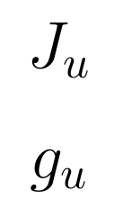

Feedback solution that automatically tracks active constraints by adjusting Lagrange multipliers (= shadow prices = dual variables) λ
Constraint control
(n_{c} slower PI/I-controllers)
g (measured constraint)
SP=0
Primal-dual feedback control.
Makes use of «dual decomposition» of constrained optimization
Selector on dual variables λ
Problem: Constraint control using dual variables is on slow time scale
0
MAX
Dual variables
Unconstrained optimization
(n_{u} PID-controllers)
SP=0
Gradient estimation
u
Primal variables
d
Process
y
g (measured constraint)
«Optimal Resource Allocation using Distributed Feedback-based Real-time Optimization». Risvan Dirza, Sigurd Skogestad, Dinesh Krishnamoorthy. IFAC Adchem Conference, 2021

Slide 34


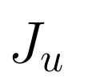
Alternative: Feedback solution with «direct» constraint control
Constraint controllers
(fast PID-controllers)
g (constraints paired with u1)
SP=0
SP=0
J_{u1}, J_{u2} = N^{T}J_{u} reduced gradients
(«self-optimizing variables»)
u1
u1o
J_{u1}
MAX/
MIN
PID
(changes!)
J_{u2}
Selector on primal variables (inputs)
Similar to selectors in APC
Gradient estimation
u1
u2
d
Process
y
g (measured constraint)
«Online Process Optimization with Active Constraint Set Changes using Simple Control Structure», D. Krishnamoorthy and S. Skogestad, I&EC Res., 2019
«Optimal controlled variables for ̈ polynomial systems». Jaschke, J.; Skogestad, S., J. Process Control, 2012

Slide 35
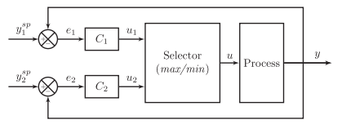
Selector: One input (u), several outputs (y₁,y₂)
y₁
>
=
MAX
=
HS
u=min(u₁,u₂)
<
=
MIN
=
LS
y₂
Sometimes called “override”
Selectors are used for output-output (CV-CV) switching
Selectors work well, but require pairing each constraint with a given input (not always possible)

Slide 36
Design of selector structure
Rule 1 (max or min selector)
Use max-selector for constraints that are satisfied with a large input
Use min-selector for constraints that are satisfied with a small input
Rule 2 (order of max and min selectors):
If need both max and min selector: Potential infeasibility
Order does not matter if problem is feasible
If infeasible: Put highest priority constraint at the end
“Systematic design of active constraint switching using selectors.”
Dinesh Krishnamoorthy , Sigurd Skogestad. Computers & Chemical Engineering, Volume 143, (2020)

Slide 37
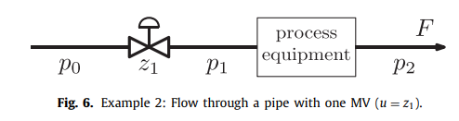
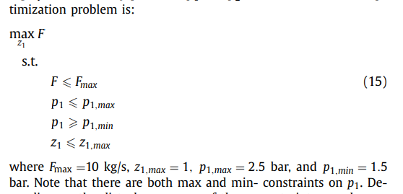
Example A. Maximize flow with pressure constraints
Input u = z₁
Want to maximize flow, J=-F:
Op

Slide 38
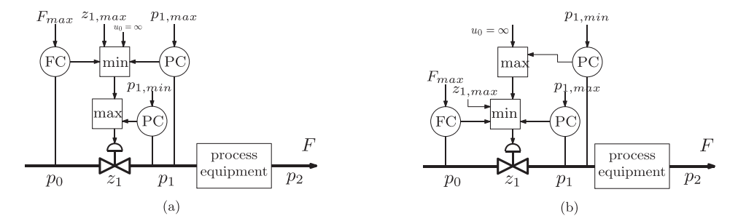
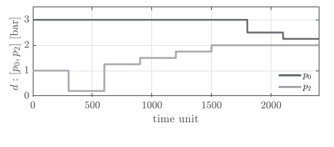
Disturbances in p₀ and p₂ (unmeasured)

Slide 39
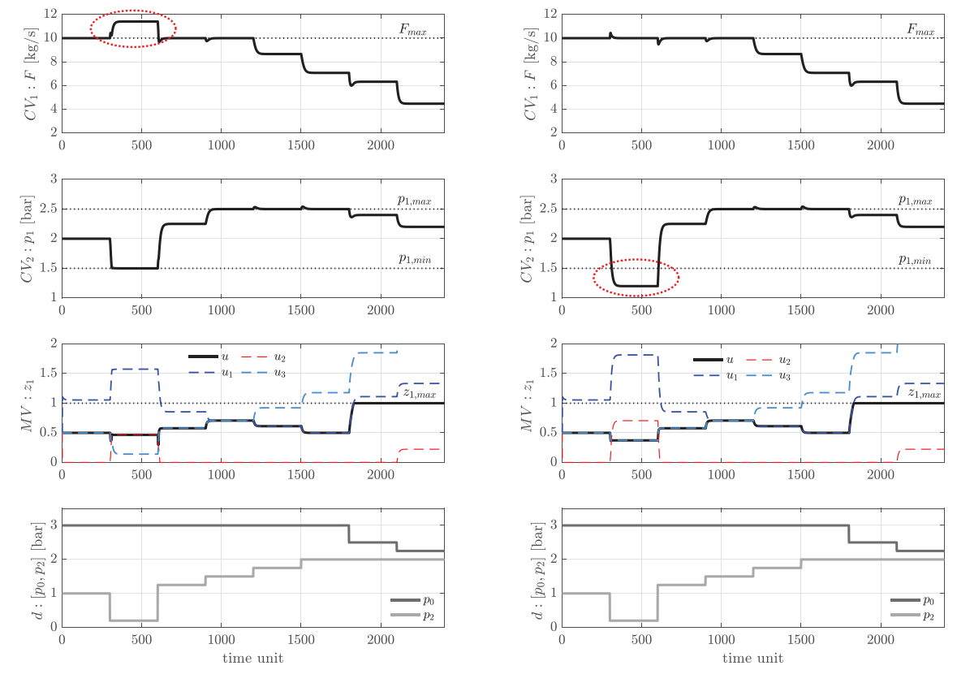
t>1800: u=zmax=1

Slide 40
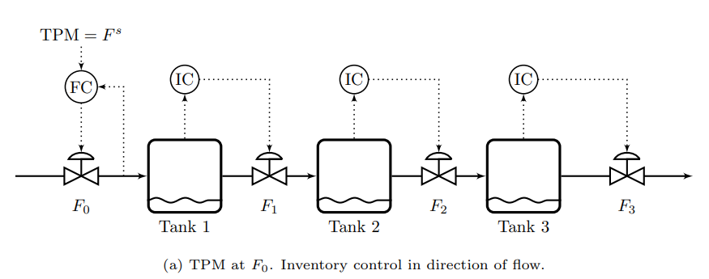
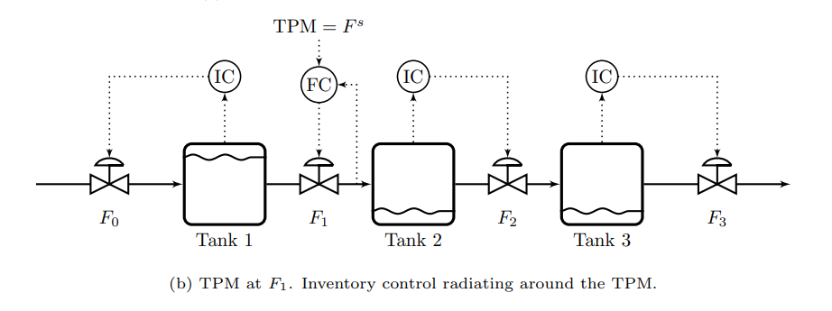
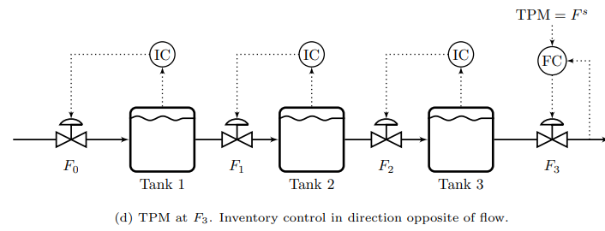
Radiation rule for
Inventory control
TPM = throughput manipulator
(located at bottleneck)

Slide 41
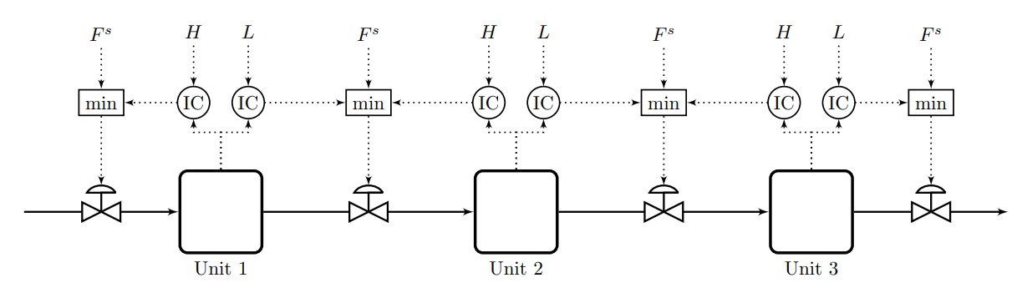
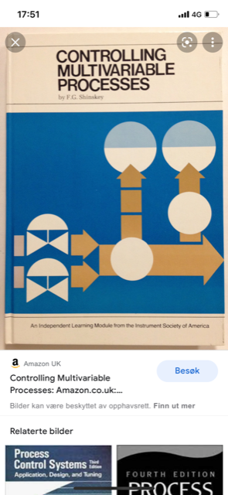
Example B. Very smart selector strategy: Bidirectional inventory control
Reconfigures automatically with optimal buffer management!!
Max flow:
F^{s}=∞
F.G. Shinskey, «Controlling multivariable processes», ISA, 1981
C. Zotica, S. Skogestad and K. Forsman, Comp. Chem. Eng, 2021

Slide 42



=∞
=∞
=∞
1
F₀=1
F₁=1
F₂=1
F₃=1

Slide 43
=∞
=∞
1
0.5
F₀=1
F₁=0.5
F₂=1
F₃=1

Slide 44
=∞
=∞
1
0.5
F₀=0.5
F₁=0.5
F₂=1
F₃=1

Slide 45

=∞
=∞
1
0.5
F₀=0.5
F₁=0.5
F₂=0.5
F₃=1

Slide 46
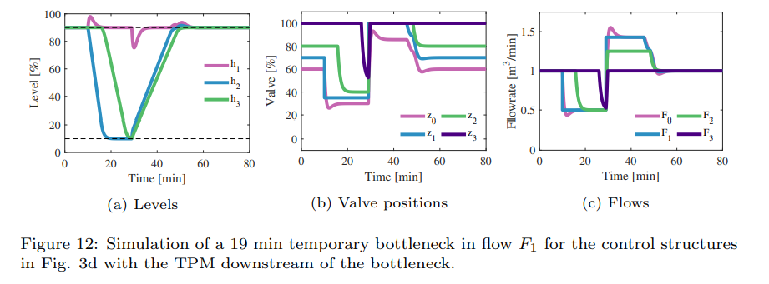

=∞
=∞
=∞
1
F₀=0.5
Fully open
F₂=0.5
F₃=0.5

Slide 47
=∞
=∞
1
F₀=1
F₁=1
F₂=1
F₃=1
Challenge: Can MPC be made to do his? Optimally reconfigure loops and find optimal buffer? I doubt it. We tried.

Slide 48
Important insight
Many problems: Optimal steady-state solution always at constraints
In this case optimization layer may not be needed
  if we can identify the active constraints and control them using selectors (Examples A and B).

Slide 49
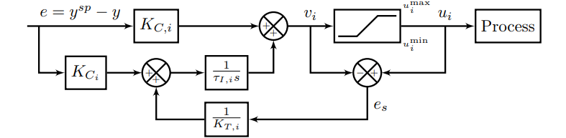
Anti-windup
All the controllers shown need anti-windup to «stop integration» during periods when the control action (v_{i}) is not affecting the process:
  Controller is disconnected (because of selector)
  Physical MV u_{i} is saturated
Selector or
saturation
K_{T,i}
Anti-windup using back-calculation. Typical choice for tracking constant, K_{T}=1

Slide 50
Challenges selector design
Standard approach requires pairing of each active constraint with a single input
  May not be possible in complex cases
Stability analysis of switched systems is still an open problem
  Undesired switching may be avoided in many ways:
    Filtering of measurement
    Tuning of anti-windup scheme
    Minimum time between switching
    Minimum input change

Slide 51
When use MPC?
When conventional APC performs poorly or becomes complex
Cases with many changing constraints (where we cannot assign one input to each constraint)
Interactive process
Know future disturbances and setpoint changes (predictive capability)

Slide 52
Conclusion Advanced process control
Conventional APC works very well in may cases
  Optimization by feedback (active constraint switching)
  Need to pair input and output.
    Advantage: The engineer can specify directly the solution
    Problem: Unique pairing may not be possible for complex cases
  Need model only for parts of the process (for tuning)
  Challenge: Need better teaching and design methods
MPC may be better (and simpler) for more complex multivariable cases
  But MPC may not work on all problems (Bidirectional inventorycontrol)
  Main challenge: Need dynamic model for whole process
  Other challenge: Tuning may be difficult

Slide 53

Optimal centralized
Solution (EMPC)
Academic process control community fish pond
Simple solutions that
work (selector, PID++)
Sigurd (me)

