Slide 1
Putting Optimization into process control
Sigurd Skogestad
Department of Chemical Engineering
Norwegian University of Science and Technology (NTNU)
Trondheim
University of Porto (FEUP)
21 Feb. 2024

Slide 2
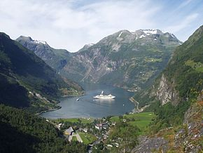



Trondheim
Arctic circle
Geiranger fjord
Midnight or midday?
Trondheim

Slide 3

About Sigurd Skogestad
•1955: Born in Flekkefjord, Norway
• 1956-1961: Lived in South Africa
•1974-1978: MS (Siv.ing.) studies in chemical engineering at NTNU
•1979-1983: Worked at Norsk Hydro co. (process simulation)
•1983-1987: PhD student at Caltech (supervisor: Manfred Morari)
•1987-present: Professor of chemical engineering at NTNU
• 1994-95: Visiting Professor UC Berkeley
• 2001-02: Visiting Professor UC Santa Barbara
•1999-2009: Head of ChE Department, NTNU
•2015-..: Director SUBPRO (Subsea research center at NTNU)
Non-professional interests:
mountain skiing (cross country)
orienteering (running around with a map)
grouse hunting
1973

Slide 4
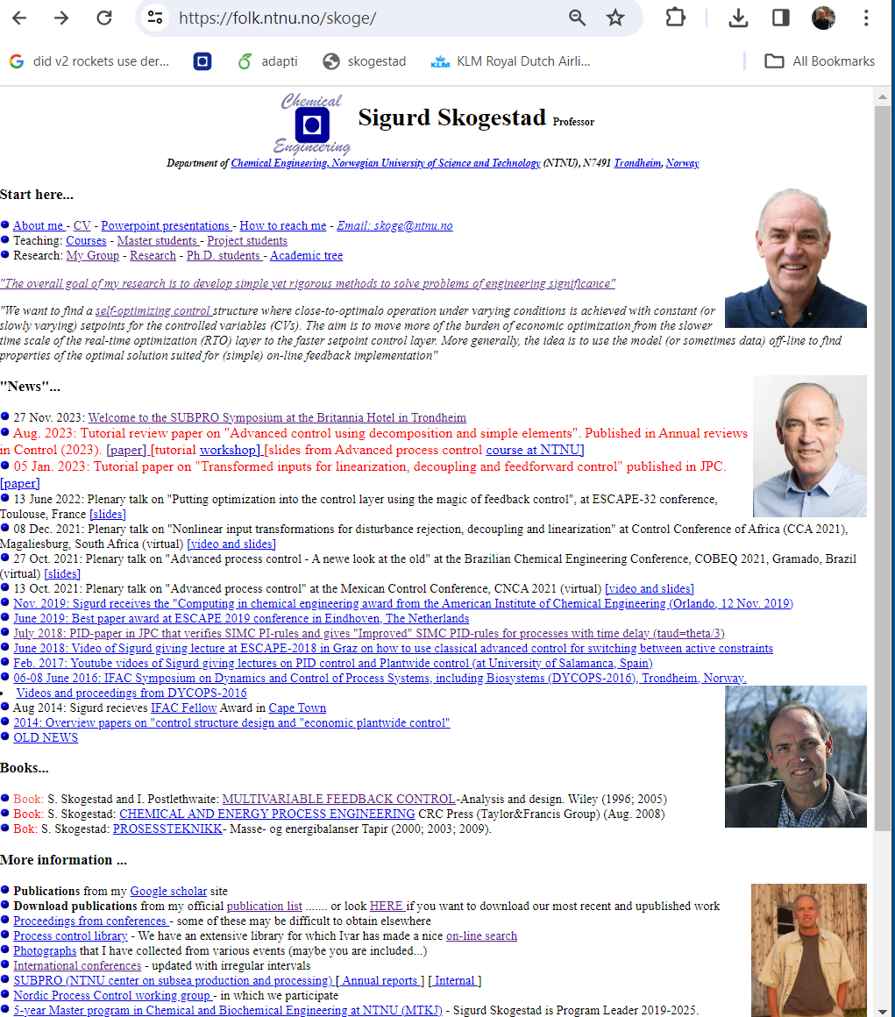
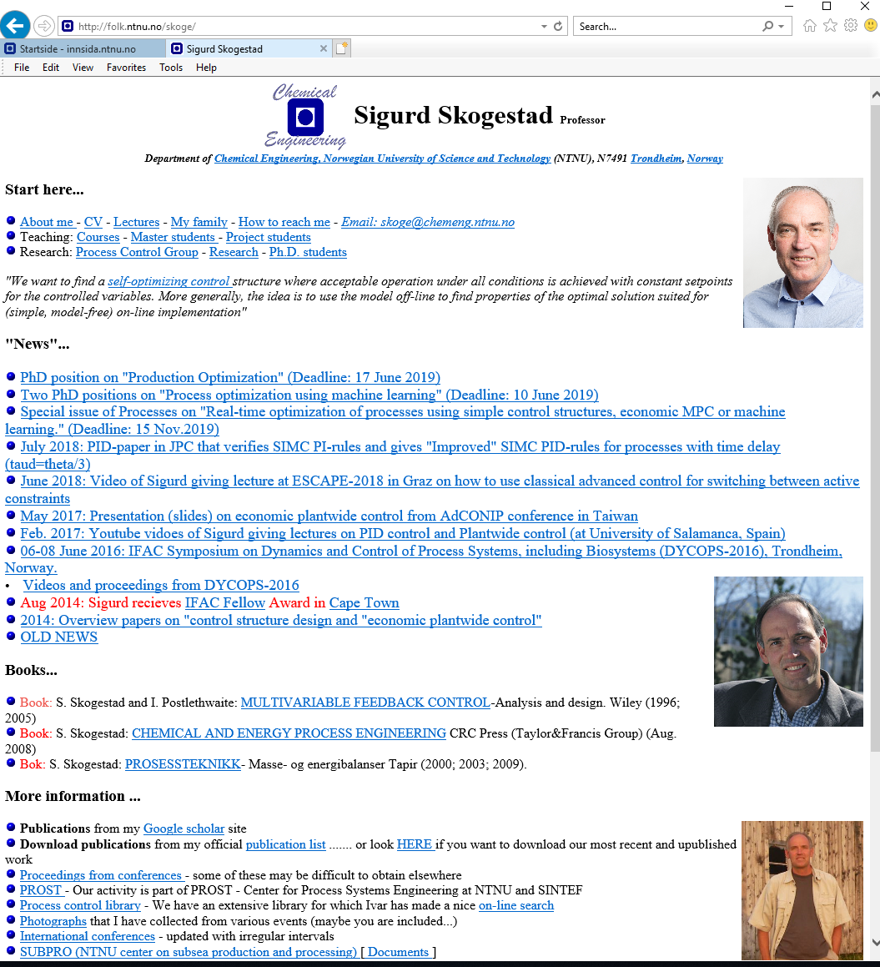
“The goal of my research is to develop simple yet rigorous methods to solve problems of engineering significance”

Slide 5
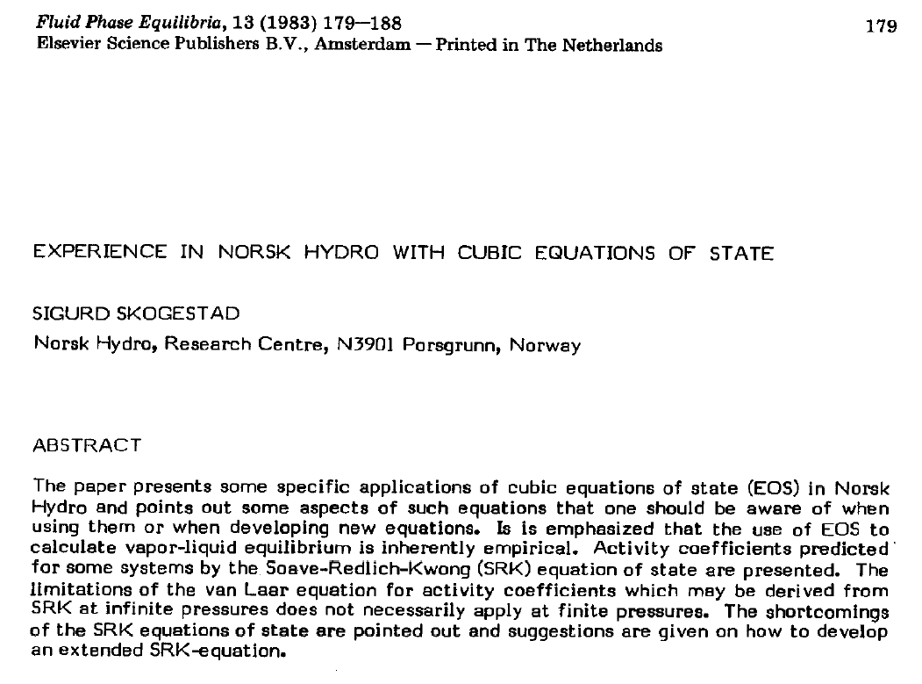
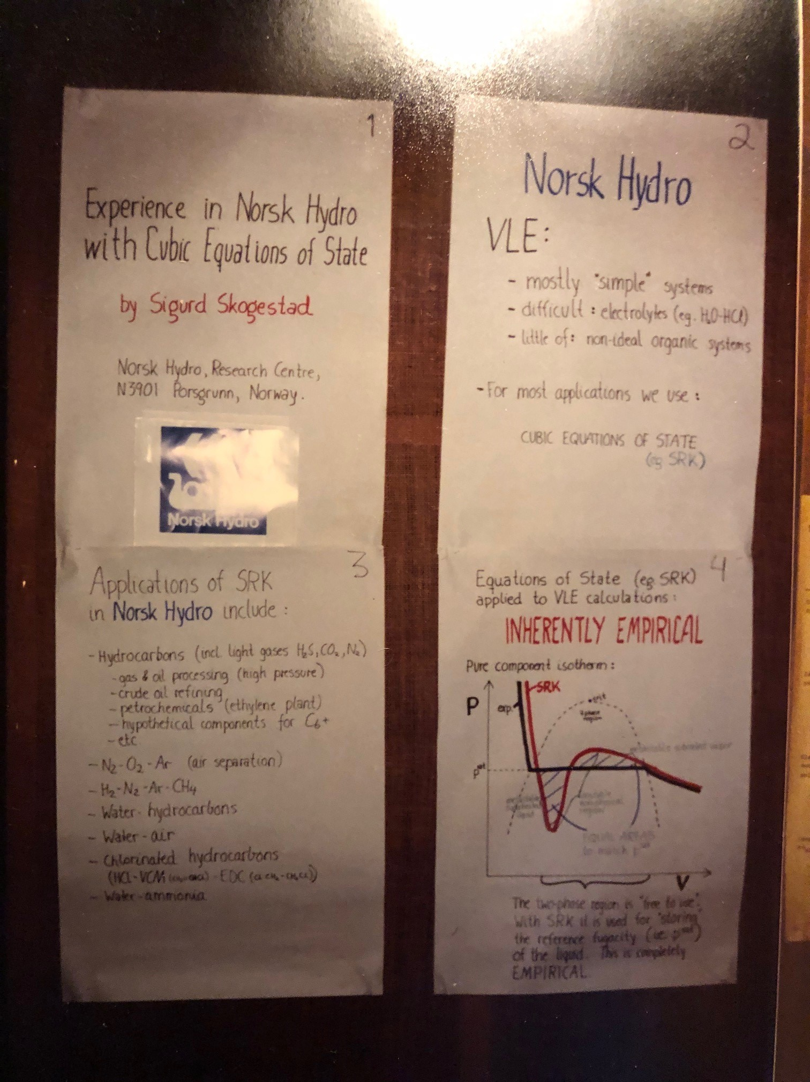

Slide 6
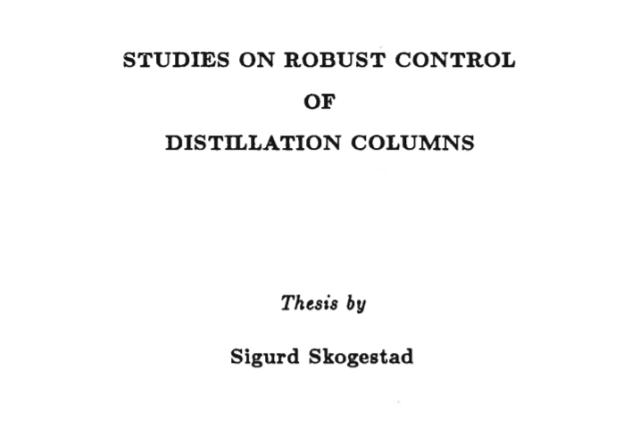
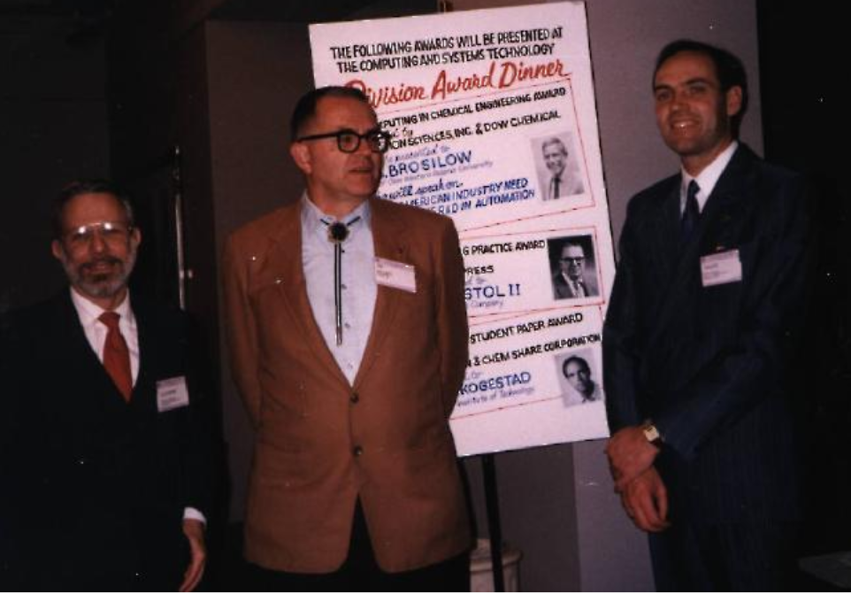
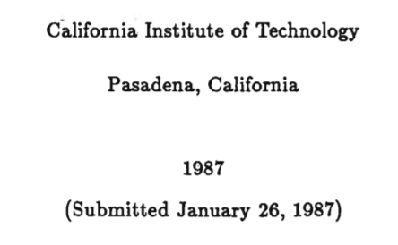
1983-87: Caltech
Robust control
Distillation
PID (IMC)

Slide 7
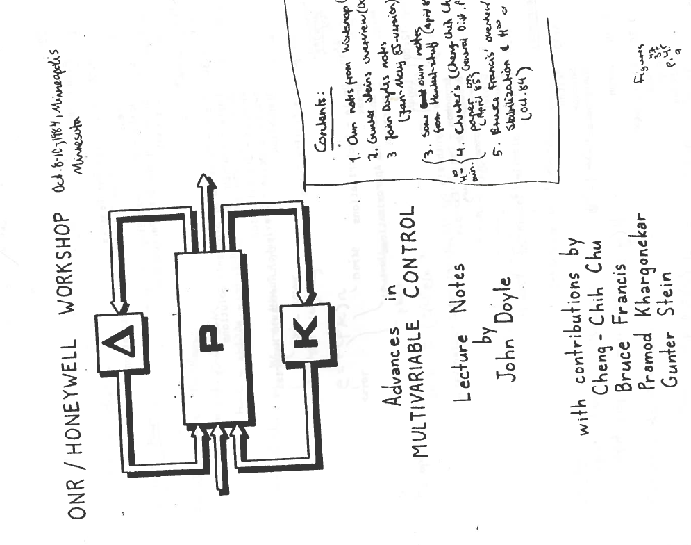
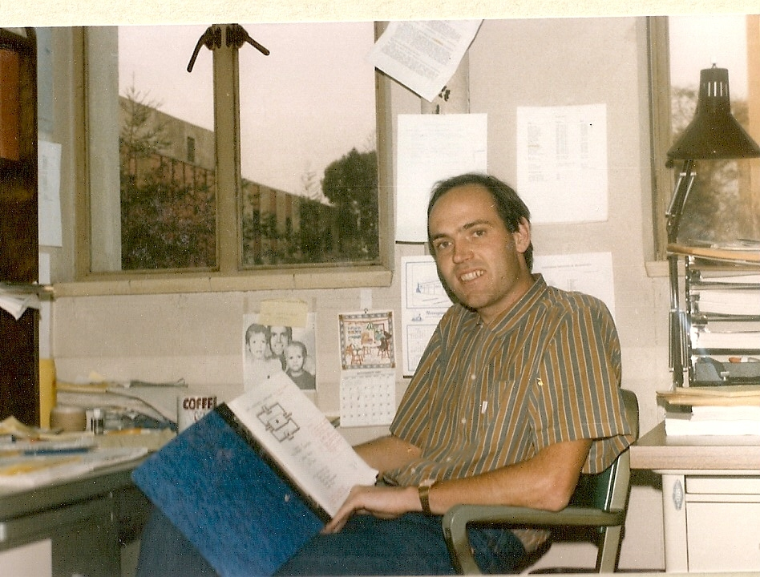
October 1984
Robust control takes off!

Slide 8
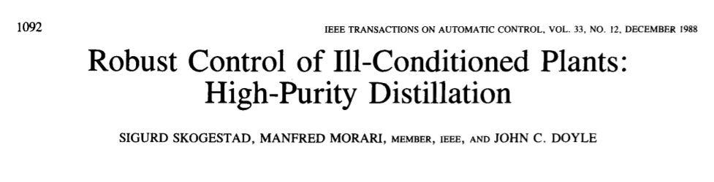
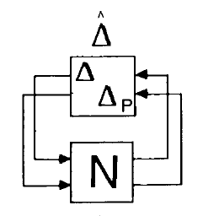
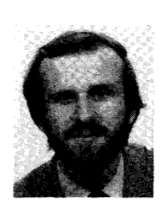
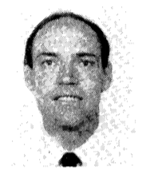
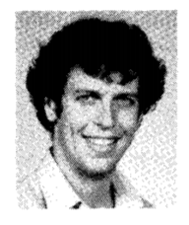
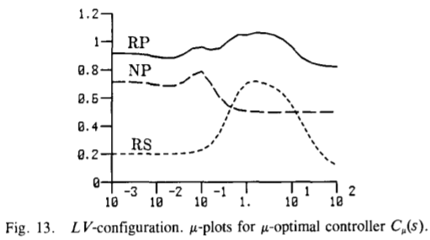

Slide 9
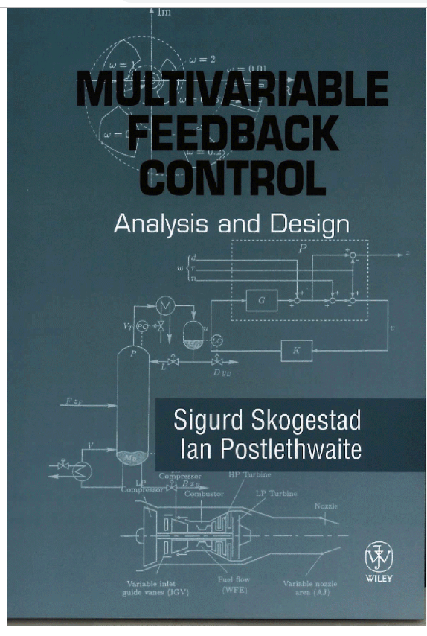
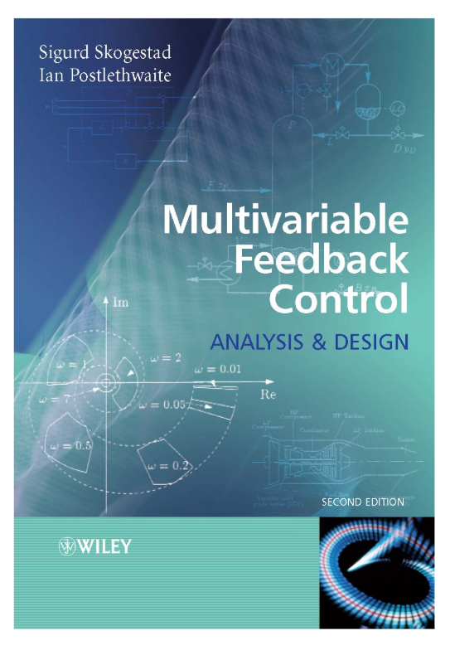
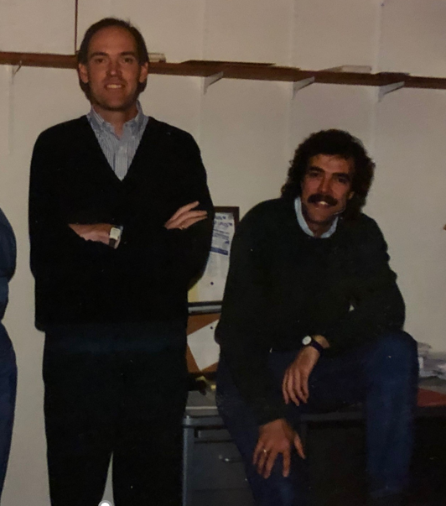
Robust control
Berkeley, Dec. 1994
1996
2005

Slide 10
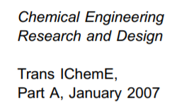
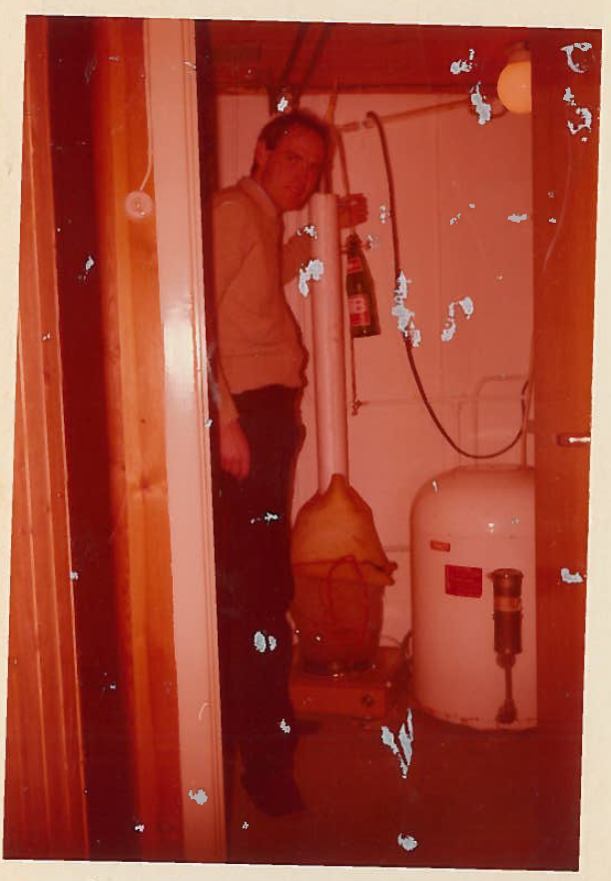
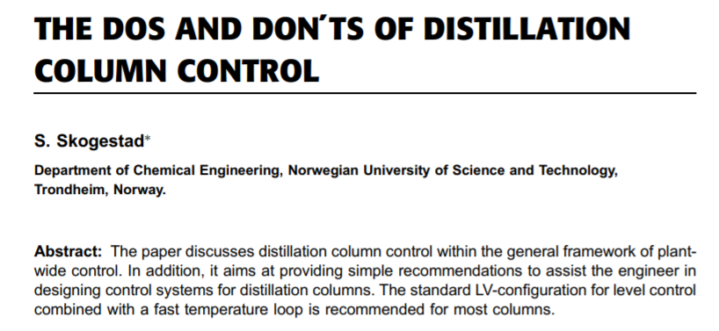
Distillation
At home doing moonshine
distillation (1979)

Slide 11
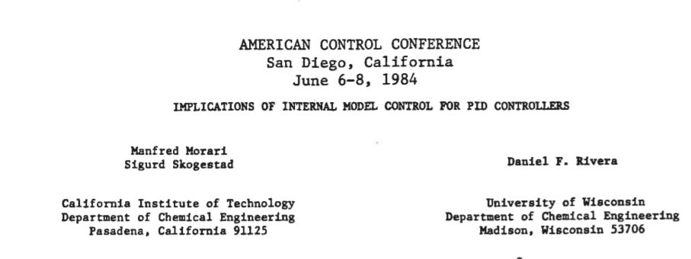
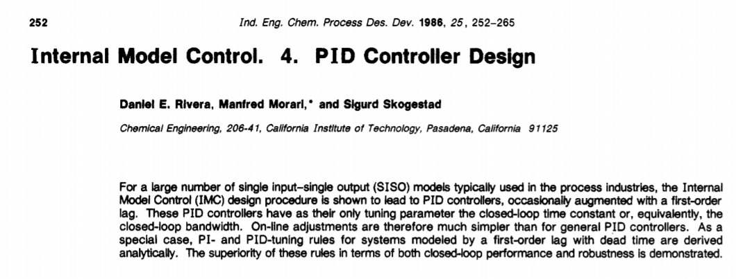

Slide 12

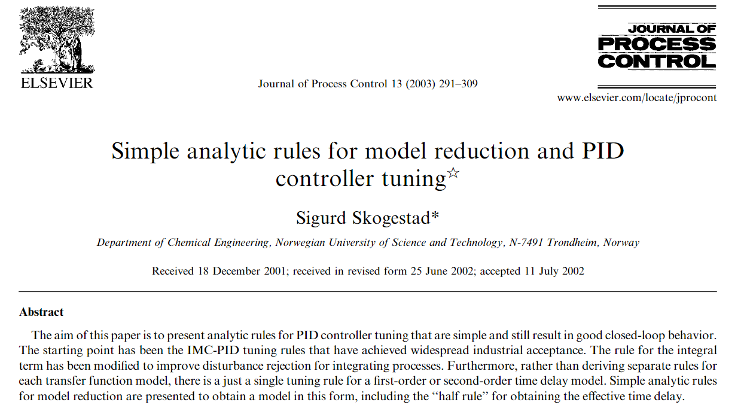
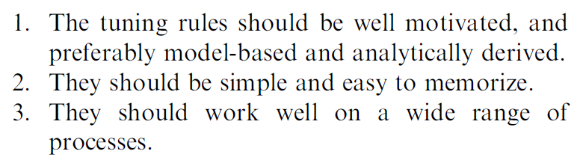
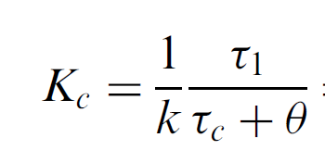




SIMC PID tuning rule (2001)
Tuning parameter:
$$τ_{c}≥θ$$

Slide 13
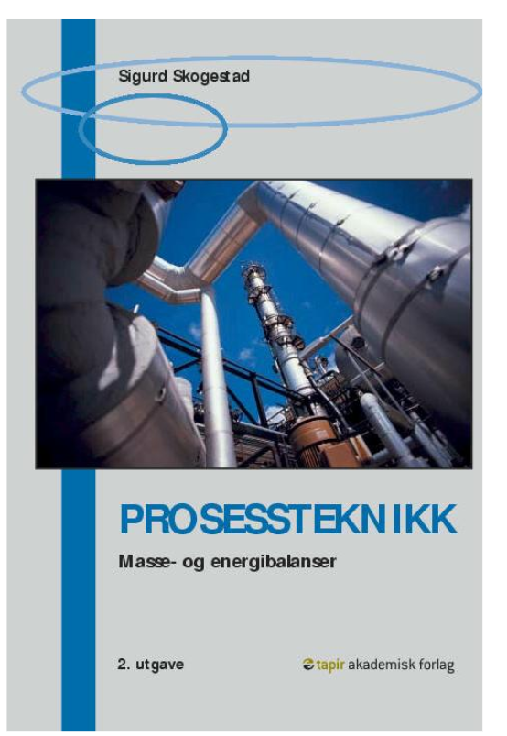
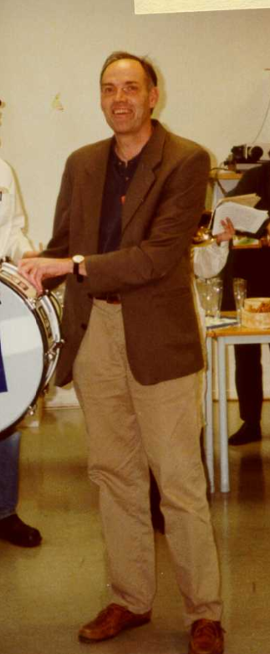
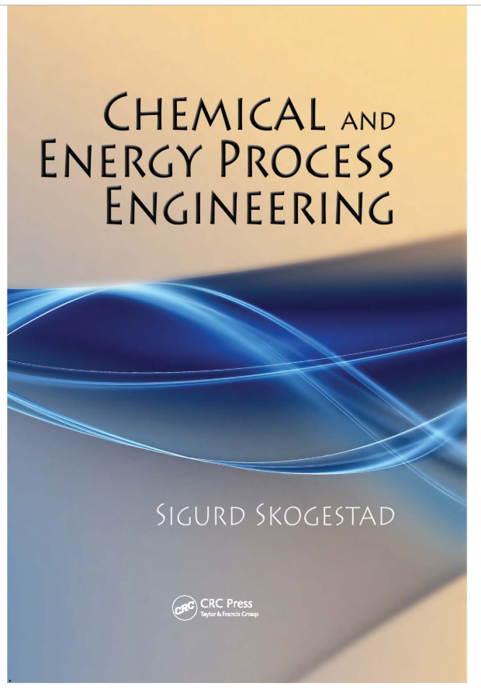
2000, 2003, 2009
2009
2000

Slide 14
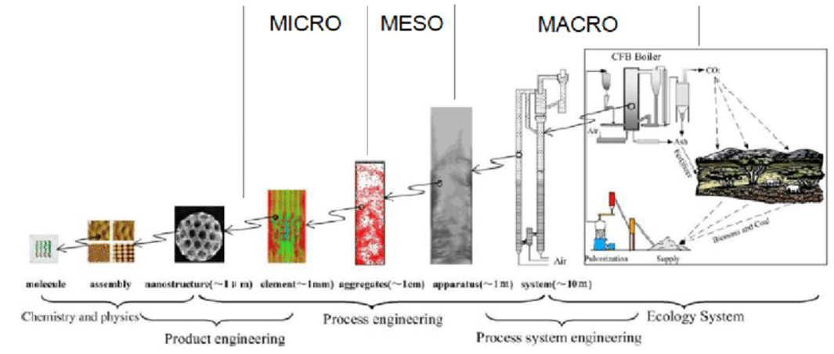
Chemical Engineering and Process Systems Engineering

Slide 15
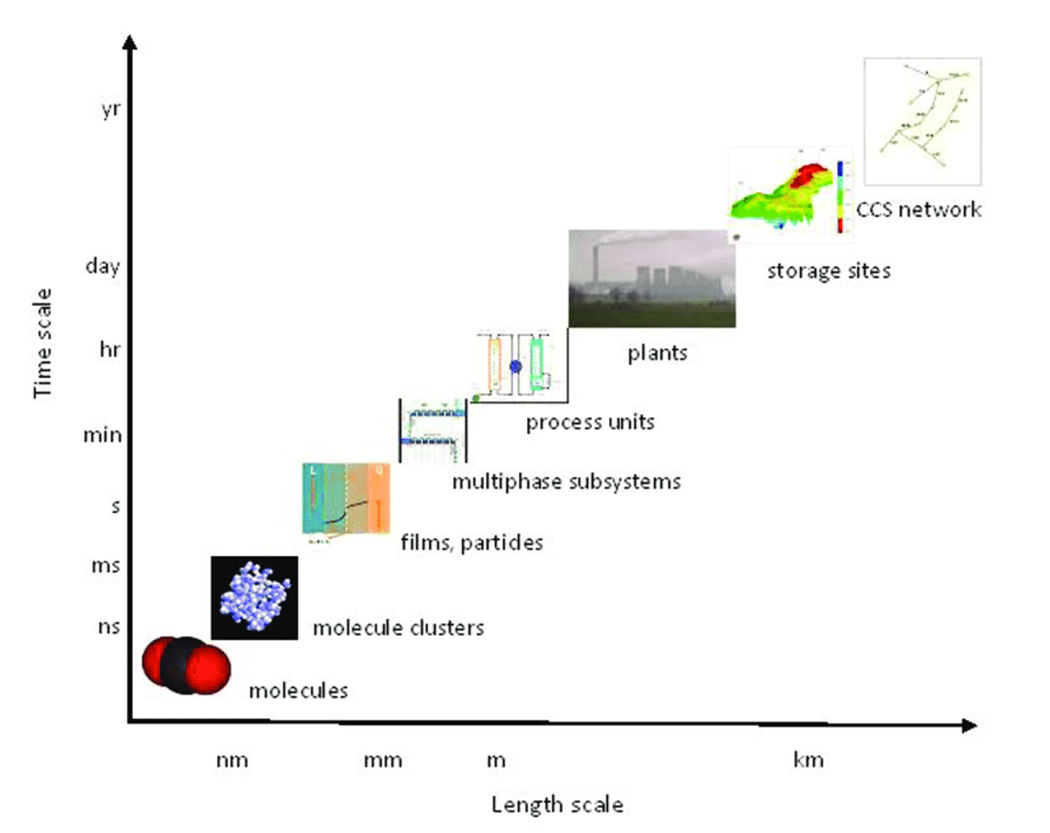

Slide 16
Process systems engineering
About getting the big picture without loosing the details
Studying and combining different length scales (nm to km)
… different time scales
Also: … combining physical models and data
Classical solution: Make «boxes»
Get rid of the boxes? Tempting, but it’s not a good idea
This talk: Break the optimization into smaller pieces (boxes) and make use of process control for solving

Slide 17
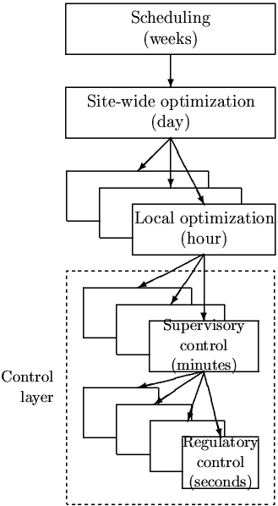
Process control: Hierarchical decision system based on time scale separation

Slide 18
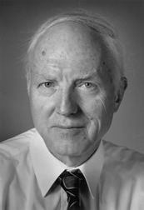
Control structure design = Plantwide control
Alan Foss (“Critique of chemical process control theory”, AIChE Journal,1973):
The central issue to be resolved ... is the determination of control system structure. Which variables should be measured, which inputs should be manipulated and which links should be made between the two sets? There is more than a suspicion that the work of a genius is needed here, for without it the control configuration problem will likely remain in a primitive, hazily stated and wholly unmanageable form. The gap is present indeed, but contrary to the views of many, it is the theoretician who must close it.
Notes:
18

Slide 19
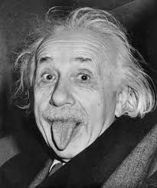
Control structure design = Plantwide control
Alan Foss (“Critique of chemical process control theory”, AIChE Journal,1973):
The central issue to be resolved ... is the determination of control system structure. Which variables should be measured, which inputs should be manipulated and which links should be made between the two sets? There is more than a suspicion that the work of a genius is needed here, for without it the control configuration problem will likely remain in a primitive, hazily stated and wholly unmanageable form. The gap is present indeed, but contrary to the views of many, it is the theoretician who must close it.
Notes:
19

Slide 20
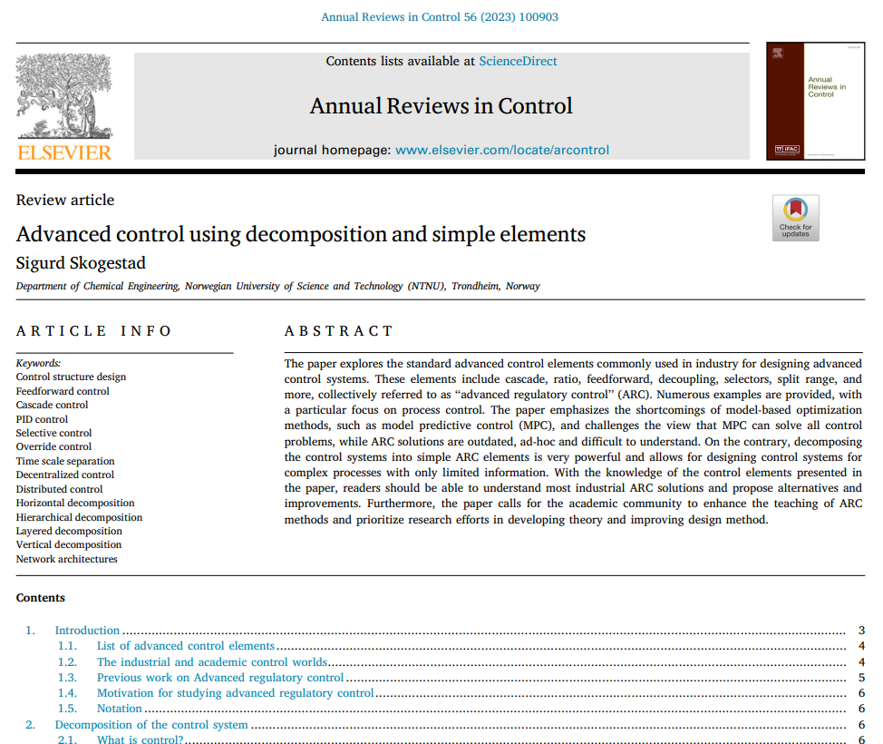
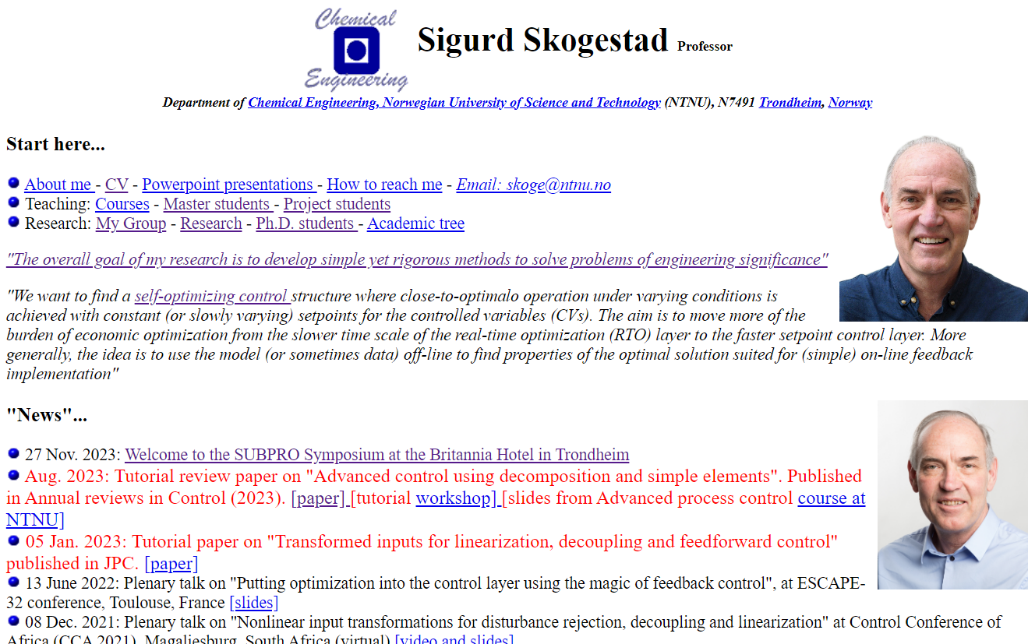
Well, I’m not a genius, but I didn’t give up
I started on this in 1983. 40 years later:

Slide 21
How we design a control system for a complete chemical plant?
Where do we start?
What should we control? and why?
etc.
etc.
Notes:
21

Slide 22
Optimal steady-state operation (economics)
Typical cost function*:
*No need to include fixed costs (capital costs, operators, maintainance) at ”our” time scale (hours)
Note: J=-P where P= Operational profit
J [$/s] = cost feed + cost energy – value products

Slide 23
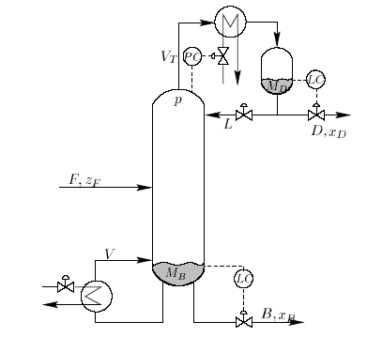
Example: distillation column
Cost J [$s] to be minimized (economics):
cost energy (heating + cooling)
J = - P where P = p_{D} D + p_{B} B – p_{F} F – p_{V}V
value products
cost feed
Subject to Constraints:
  Purity D: For example, x_{D, impurity} ≤ max
  Purity B: For example, x_{B, impurity} ≤ max
  Flow constraints: min ≤ D, B, L etc. ≤ max
  Column capacity (flooding): V ≤ V_{max}, etc.
Optimal operation: Minimize J with respect to steady-state degrees of freedoms (inputs u)
    u = reflux L + heat input V

Slide 24
Process control: Hierarchical decision system
Objective
Responsible
Manager
Process engineer
min J (economics)
_{hour}
Operator/RTO (usually steady-state)
CV1s
Setpoint control
(+ look after other variables)
J_{c} = (y-y_{s})² + Δu²
minute
Supervisory control layer
”Advanced control”/MPC
CV2s
Stabilize + avoid drift
Gain margin…
second
Regulatory (basic) control layer
PID-control
u (MV) = valves
CV = controlled variable (with setpoint)

Slide 25
Process control: Hierarchical decision system
Objective|
Manager
Process engineer
min J (economics)
_{hour}
Economic MPC
(EMPC)
or
Dynamic RTO
J = J_{econ} + Δu²
Setpoint control
(+ look after other variables)
J_{c} = (y-y_{s})² + Δu²
minute
Stabilize + avoid drift
Gain margin…
second
u (MV) = valves

Slide 26
Process control: Hierarchical decision system
Objective|
Manager
Process engineer
min J (economics)
_{hour}
Economic MPC
(EMPC)
or
Dynamic RTO
Setpoint control
(+ look after other variables)
J_{c} = (y-y_{s})² + Δu²
minute
Stabilize + avoid drift
Gain margin…
second
CV2s
u (MV) = valves

Slide 27
Process control: Hierarchical decision system
CV1s
CV2s
u (MV) = valves

Slide 28
Control layers (have setpoints)
Supervisory/”Advanced” control (ARC or MPC):
  Follow set points for CV1 from economic optimization layer
  Switch between active constraints (change CV1)
  Look after regulatory layer (avoid that MVs saturate, etc.)
  Implementation:
  Alternative 1: ARC based on ”simple elements”
  Alternative 2: MPC (model predictive control)
Regulatory control (PID):
  Stable operation (CV2)
CV1s
CV2s
u (MV) = valves
CV = controlled variable. MV = manipulated variable. ARC = Advanced regulatory (PID) control

Slide 29
«Advanced» control
This is a relative term
Usually used for anything than comes in addition to (or in top of) basic PID loops
Main options
  ARC using advanced control elements
    PID + Cascade, feedforward, selectors, etc.
    This option is preferred if it gives acceptable performance and it’s not too complicated
  Model predictive control (MPC)
    Requires more effort to implement and maintain
ARC = Advanced regulatory (PID) control

Slide 30
Academia: MPC
MPC
    General approach, but we need a dynamic model
    MPC is usually implemented after some time of operation
    Not all problems are easily formulated using MPC

Slide 31
Research question: Alternative simpler solutions to MPC
Would like: Feedback solutions that can be implemented without a detailed models
Machine learning?
  Requires a lot of data
  Can only be implemented after the process has been in operation
But we have "classical advanced control“ (ARC) based on single-loop PIDs
  Extensively used by industry
  Problem for engineers: Lack of design methods
    Has been around since 1940’s
    But almost completely neglected by academic researchers
  Main fundamental limitation: Based on single-loop (need to choose pairing)
ARC = Advanced regulatory (PID) control

Slide 32
QUIZ: What are the three most important inventions of process control
Hint 1: According to Sigurd Skogestad
Hint 2: All three are from the 1930’s

Slide 33
“Classical Advanced control” (ARC) using simple control elements
Cascade controllers
Have Extra output (state) measurements
2. Feedforward elements
Have measured disturbance
3. Decoupling elements
Have interactive process
4. Linearization elements / Adaptive gain
Have Nonlinear process
5. Split-range control (or multiple controllers or VPC)
Need extra inputs (MV) to handle all conditions (steady state) (MV-MV switch)
6. Valve position control (VPC) (Input resetting/Midranging control)
Have extra inputs dynamically
7. Selectors
Have changes in active constraints (CV-CV switch)
Often static nonlinear «function block»
One unifying approach is «Transformed inputs» (similar to feedback linearization)
ARC = Advanced regulatory (PID) control

Slide 34
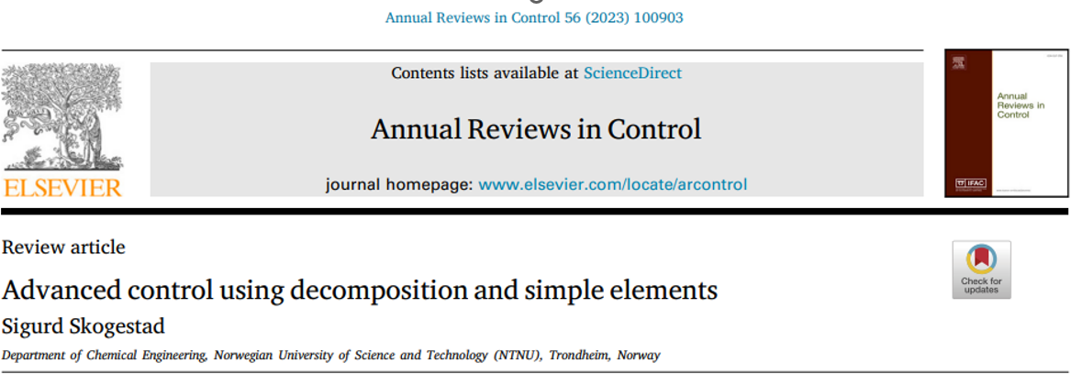
How design classical APC elements?
Industrial literature (e.g., Shinskey).
Many nice ideas. But not systematic. Difficult to understand reasoning
Academia: Very little work
  I feel alone

Slide 35
7. Change in CVs (active constraints) using selectors

Slide 36
Optimal steady-state operation
min_{u} J(u,d)
s.t. g(u,d) ≥ 0 (constraints)
J = economic cost [$/s]
Unconstrained degrees of freedom: Optimal to keep gradient J_{u} = ∂J/∂u =0
cost J
J_{u}<0
J_{u}<0
J_{u}=0
u_{opt}
u
J_{u}
0

Slide 37
Optimal steady-state operation
Want tight control of constraints for economic reasons
  Active constraint: g_{A}=0
  Tight control of g_{A} minimizes «back-off»
How can we identify and control active constraints?
How can we switch constraints?

Slide 38

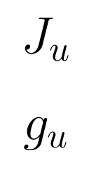

Feedback solution that automatically tracks active constraints by adjusting Lagrange multipliers (= shadow prices = dual variables) λ
Constraint control
(n_{c} slower PI/I-controllers)
g (measured constraint)
SP=0
Primal-dual feedback control.
Makes use of «dual decomposition» of constrained optimization
Selector on dual variables λ
Problem: Constraint control using dual variables is on slow time scale
0
MAX
Dual variables
Unconstrained optimization
(n_{u} PID-controllers)
SP=0
Gradient estimation
u
Primal variables
d
Process
y
g (measured constraint)
«Optimal Resource Allocation using Distributed Feedback-based Real-time Optimization». Risvan Dirza, Sigurd Skogestad, Dinesh Krishnamoorthy. IFAC Adchem Conference, 2021
+ PhD Thesis Dirza (2024) with override for hard constraints

Slide 39


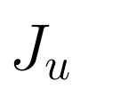
Alternative: Feedback solution with «direct» constraint control
Constraint controllers
(fast PID-controllers)
g (constraints paired with u1)
SP=0
SP=0
J_{u1}, J_{u2} = N^{T}J_{u} reduced gradients
(«self-optimizing variables»)
u1
u1o
J_{u1}
MAX/
MIN
PID
(changes!)
J_{u2}
Selector on primal variables (inputs)
Similar to selectors in APC
Gradient estimation
u1
u2
d
Process
y
g (measured constraint)
«Optimal controlled variables for ̈ polynomial systems». Jaschke, J.; Skogestad, S., J. Process Control, 2012
«Online Process Optimization with Active Constraint Set Changes using Simple Control Structure», D. Krishnamoorthy and S. Skogestad, I&EC Res., 2019
+ PhD Thesis Bernardino (2024)

Slide 40
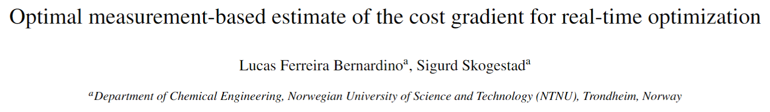
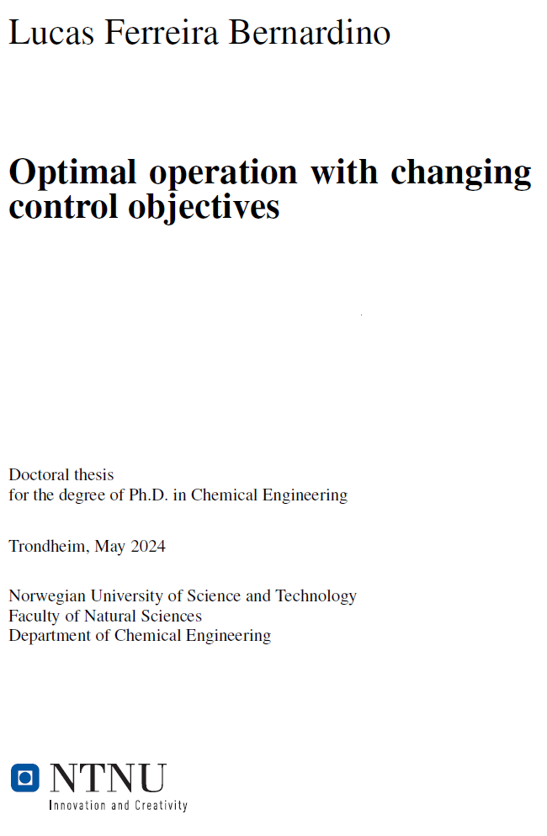
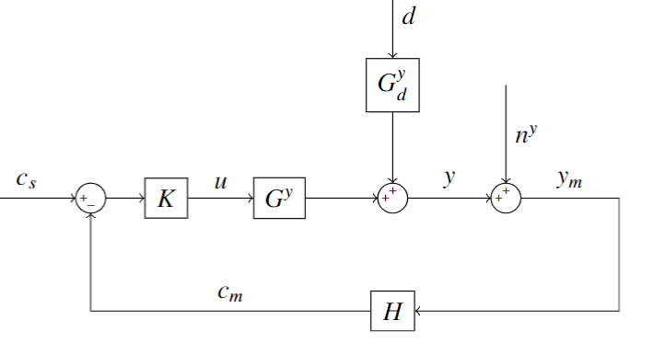


Gradient estimation
From «exact local method» of self-optimizing control:

Slide 41
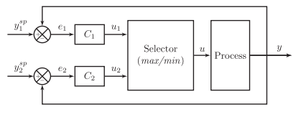
Selector: One input (u), several outputs (y₁,y₂)
y₁
>
=
MAX
=
HS
u=min(u₁,u₂)
<
=
MIN
=
LS
y₂
Sometimes called “override”
Selectors are used for output-output (CV-CV) switching
Selectors work well, but require pairing each constraint with a given input (not always possible)

Slide 42
Design of selector structure
Rule 1 (max or min selector)
Use max-selector for constraints that are satisfied with a large input
Use min-selector for constraints that are satisfied with a small input
Rule 2 (order of max and min selectors):
If need both max and min selector: Potential infeasibility
Order does not matter if problem is feasible
If infeasible: Put highest priority constraint at the end
“Systematic design of active constraint switching using selectors.”
Dinesh Krishnamoorthy , Sigurd Skogestad. Computers & Chemical Engineering, Volume 143, (2020)

Slide 43
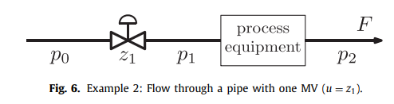
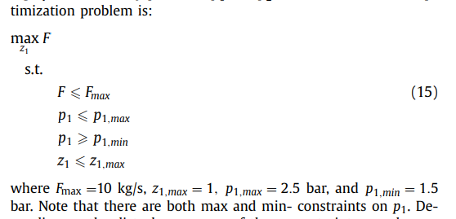
Example. Maximize flow with pressure constraints
Input u = z₁
Want to maximize flow, J=-F:
Op

Slide 44
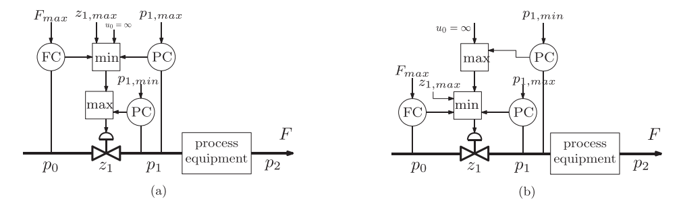
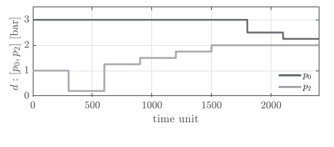
Disturbances in p₀ and p₂ (unmeasured)

Slide 45
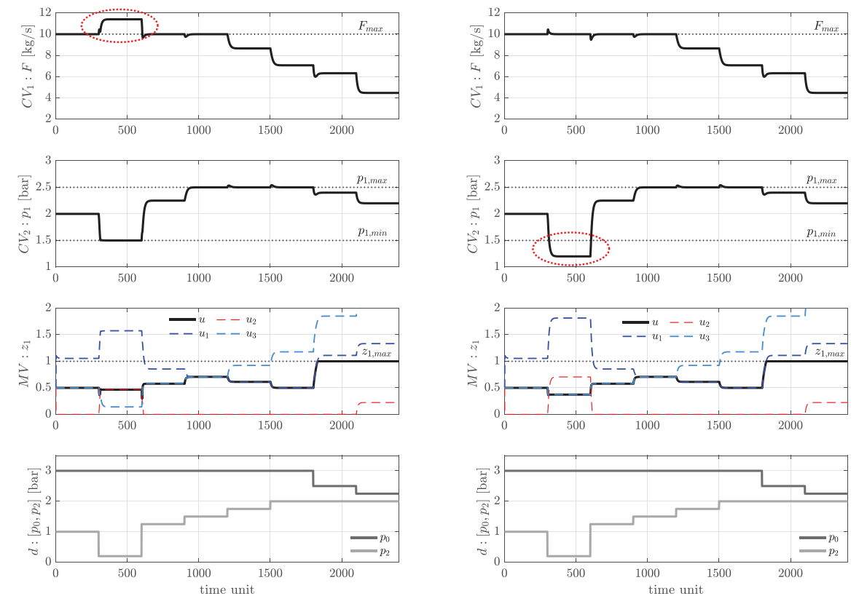
t>1800: u=zmax=1

Slide 46
Dynamic issues
Use of selectors to avoid «long loop»

Slide 47




Radiation rule for
Inventory control
TPM = throughput manipulator
(located at bottleneck)

Slide 48


Example . Very smart selector strategy: Bidirectional inventory control
Reconfigures automatically with optimal buffer management!!
Max flow:
F^{s}=∞
F.G. Shinskey, «Controlling multivariable processes», ISA, 1981
C. Zotica, S. Skogestad and K. Forsman, Comp. Chem. Eng, 2021

Slide 49



=∞
=∞
=∞
1
F₀=1
F₁=1
F₂=1
F₃=1

Slide 50
=∞
=∞
1
0.5
F₀=1
F₁=0.5
F₂=1
F₃=1

Slide 51
=∞
=∞
1
0.5
F₀=0.5
F₁=0.5
F₂=1
F₃=1

Slide 52

=∞
=∞
1
0.5
F₀=0.5
F₁=0.5
F₂=0.5
F₃=1

Slide 53


=∞
=∞
=∞
1
F₀=0.5
Fully open
F₂=0.5
F₃=0.5

Slide 54
=∞
=∞
1
F₀=1
F₁=1
F₂=1
F₃=1
Challenge: Can MPC be made to do his? Optimally reconfigure loops and find optimal buffer? I doubt it. We tried.

Slide 55
Important insight
Many problems: Optimal steady-state solution always at constraints
In this case optimization layer may not be needed
  if we can identify the active constraints and control them using selectors

Slide 56

Anti-windup
All the controllers shown need anti-windup to «stop integration» during periods when the control action (v_{i}) is not affecting the process:
  Controller is disconnected (because of selector)
  Physical MV u_{i} is saturated
Selector or
saturation
K_{T,i}
Anti-windup using back-calculation. Typical choice for tracking constant, K_{T}=1

Slide 57
Challenges selector design
Standard approach requires pairing of each active constraint with a single input
  May not be possible in complex cases
Stability analysis of switched systems is still an open problem
  Undesired switching may be avoided in many ways:
    Filtering of measurement
    Tuning of anti-windup scheme
    Minimum time between switching
    Minimum input change

Slide 58
When use MPC?
When conventional APC performs poorly or becomes complex
Cases with many changing constraints (where we cannot assign one input to each constraint)
Interactive process
Know future disturbances and setpoint changes (predictive capability)

Slide 59
Conclusion Advanced process control (APC)
Classical APC, aka «Advanced regulatory control» (ARC) or «Advanced PID»:
  Works very well in many cases
  Optimization by feedback (active constraint switching)
  Need to pair input and output.
    Advantage: The engineer can specify directly the solution
    Problem: Unique pairing may not be possible for complex cases
  Need model only for parts of the process (for tuning)
  Challenge: Need better teaching and design methods
MPC may be better (and simpler) for more complex multivariable cases
  But MPC may not work on all problems (Bidirectional inventorycontrol)
  Main challenge: Need dynamic model for whole process
  Other challenge: Tuning may be difficult

Slide 60

Optimal centralized
Solution (EMPC)
Academic process control community fish pond
Simple solutions that
work (ARC = PID++)
Sigurd (me)
Please join me, I feel a little alone

