Slide 1
A systematic approach for using control to optimize energy efficiency in existing plants
Sigurd Skogestad
Department of Chemical Engineering
Norwegian University of Science and Tecnology (NTNU)
Trondheim, Norway
13 Jan. 2017
HighEff, 02 May 2018
TexPoint fonts used in EMF.
Read the TexPoint manual before you delete this box.: AAA

Slide 2
Outline
Be systematic! Start by defining
  Degrees of freedom (MVs)
  Constraints
  Economic objective (cost J)
  Important disturbances
Find optimal operation.
  Identify active constraints
Propose control structure
Examples:
  Runner
  Steam Power plant
  CO2 refrigeration cycle
Summary of procedure

Slide 3
Main objectives control system
Economics: Implementation of acceptable (near-optimal) operation
Regulation: Stable operation
ARE THESE OBJECTIVES CONFLICTING?
Usually NOT
  Different time scales
    Stabilization fast time scale
  Stabilization doesn’t “use up” any degrees of freedom
    Reference value (setpoint) available for layer above (cascade control)
    But it “uses up” part of the time window (frequency range)

Slide 4
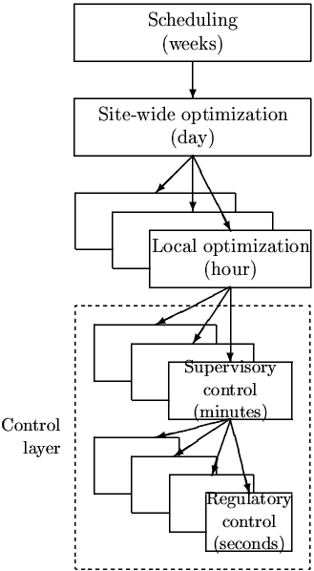
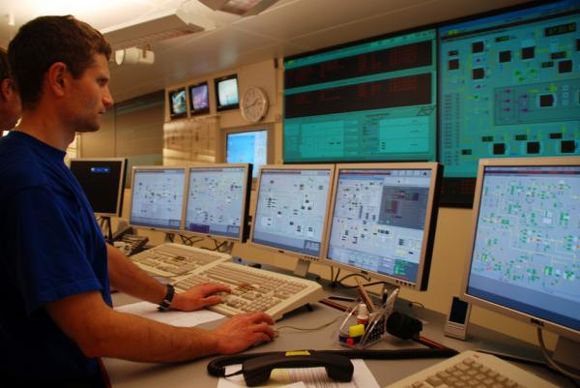
Practical operation: Hierarchical structure
Planning
constraints, prices
CV1-setpoints
”Advanced control”/MPC
CV2-setpoints
PID-control
u = valves

Slide 5
Systematic procedure for plantwide control
Start “top-down” with economics:
  Step 1: Define operational objectives and constraints
  Step 2: Optimize steady-state operation.
  Step 3: Decide what to control (CVs)
  Step 4: TPM location
Then bottom-up
  Step 5: Regulatory control
Finally: Make link between “top-down” and “bottom up”.
  Step 6: “Advanced/supervisory control” system (MPC)
c_{s}
http://www.nt.ntnu.no/users/skoge/plantwide

Slide 6
Step 1. Define optimal operation (economics)
What are we going to use our degrees of freedom u (MVs) for?
Define operation constraints
Define scalar cost function J(u,x,d)
  u: degrees of freedom (usually steady-state)
  d: disturbances
  x: states (internal variables)
  Typical cost function:
J = cost feed + cost energy – value products

Slide 7
Step S2. Optimize
(a) Identify degrees of freedom (u)
(b) Optimize for expected disturbances
  min_{u} J(u,x,d)
  subject to:
  Model equations: f(u,x,d) = 0
  Operational constraints: g(u,x,d) < 0
Need good model, usually steady-state
Optimization is time consuming! But it is offline
Main goal: Identify ACTIVE CONSTRAINTS
A good engineer can often guess the active constraints

Slide 8
Active constraints
Optimization with computer model…..
  Time consuming
Guessing (engineering insight):
  Avoid valves (pressure drops), especially for gas
  Mixing of streams with different temperature or composition gives loss
  Bypass flows should ideally be zero
  Compositions of valueable products should be controlled at spec (don’t give the customer more than he is paying for)

Slide 9
Step S3: Implementation of optimal operation
Have found the optimal way of operation. How should it be implemented?
What to control ? (CV₁).
  Active constraints
  Self-optimizing variables (for unconstrained degrees of freedom)
Objective: Move optimization into control layer

Slide 10
Step 4. Where set production rate?
Where locale the TPM (throughput manipulator)?
  The ”gas pedal” of the process
Very important!
Determines structure of remaining inventory (level) control system
Suggestion: Set production rate at (dynamic) bottleneck
Link between Top-down and Bottom-up parts
NOTE: TPM location is a dynamic issue.
  Link to economics: Better control of active constraints (reduce backoff)

Slide 11

Optimal operation of runner
Optimal operation - Runner
  Cost to be minimized, J=T
  One degree of freedom (u=power)
  What should we control?

Slide 12
1. Optimal operation of Sprinter
Optimal operation - Runner
  100m. J=T
  Active constraint control:
    Maximum speed (”no thinking required”)
    CV = power (at max)

Slide 13
2. Optimal operation of Marathon runner
Optimal operation - Runner
    40 km. J=T
    What should we control? CV=?
    Unconstrained optimum
J=T
u_{opt}
u=power

Slide 14
Optimal operation - Runner
Self-optimizing control: Marathon (40 km)
Any self-optimizing variable (to control at constant setpoint)?
    c₁ = distance to leader of race
    c₂ = speed
    c₃ = heart rate
    c₄ = level of lactate in muscles

Slide 15
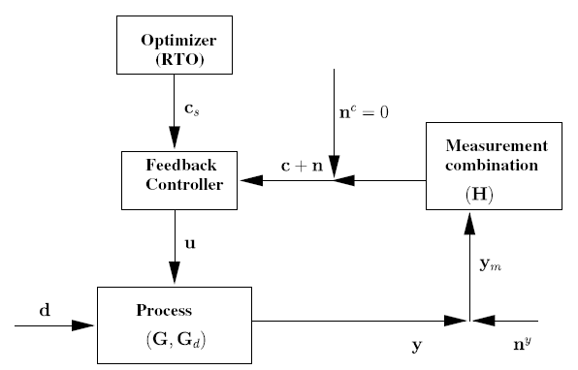

Conclusion Marathon runner
Optimal operation - Runner
J=T
c_{opt}
c=heart rate
select one measurement
CV₁ = heart rate
CV = heart rate is good “self-optimizing” variable
Simple and robust implementation
Disturbances are indirectly handled by keeping a constant heart rate
May have infrequent adjustment of setpoint (c_{s})

Slide 16
Summary Step 3.
What should we control (CV₁)?
Selection of primary controlled variables c = CV₁
  Control active constraints!
  Unconstrained variables: Control self-optimizing variables!
Self-optimizing control is an old idea (Morari et al., 1980):
“We want to find a function c of the process variables which when held constant, leads automatically to the optimal adjustments of the manipulated variables, and with it, the optimal operating conditions.”

Slide 17
Process plants: Optimal operation
minimize J = cost feed + cost energy – value products
Two main cases (modes) depending on marked conditions:
Given load (given federate or given product rate)
  Then J = cost energy. Optimal operation is then usually unconstrained:
Maximize load
  Products often much more valuable than cost of feed + energy.
  Optimal operation is then usually constrained:
“maximize efficiency (energy)”
Control: Operate at optimal trade-off (not obvious what to control to achieve this)
“maximize production”
Control: Operate at bottleneck
(“obvious what to control”)

Slide 18
Example: Steam Power plant
minimize J = cost feed + cost energy – value power
Given load
  Given feed (fuel): Maximize power production
  Given power production: Minimize feedrate
  Both cases: Maximize efficiency
  Expected active constraints:
    Turbine: max. temperature + Steam valve max. open
    Combustion: Max. combustion temp & Min. exhaust gas temperature (want to use Min. air)
Max. load (max. power)
  Additional active constraint («bottleneck»): Max pressure

Slide 19
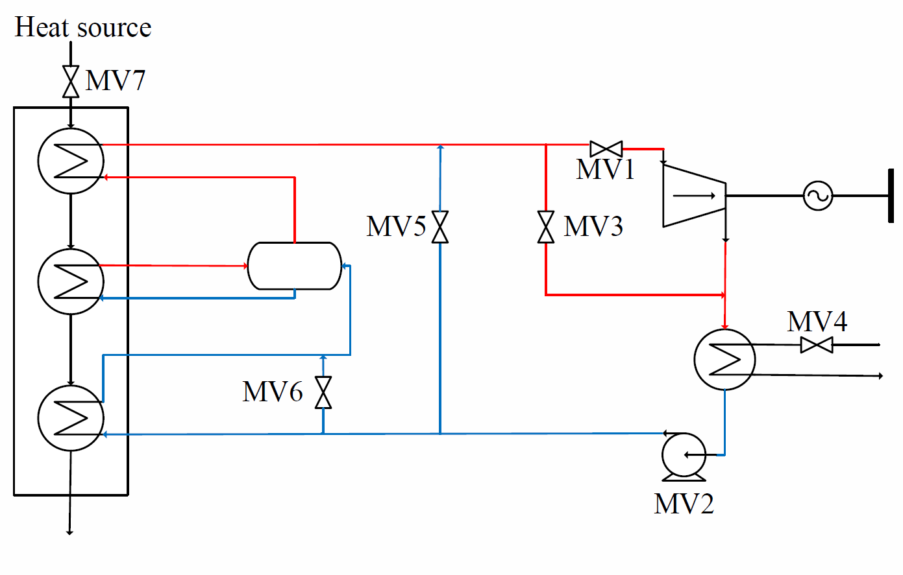
Example: Steam power plant
Cristina Zotica
MV = manipulated variable for control

Slide 20
Expected active constraints
6. Max. steam pressure (?)
5. Max. steam temperature (550C)
3. Max. open
1. Closed
2. Max. open
4. Min. flue gas temperature (100C)
In addition:
7. Follow given load (W_{s})
8. Control level

Slide 21
Control structure
TC
T_{s}=550C
Closed
Max open
LC
TC
T_{s}=100C
MV = manipulated variable for control

Slide 22
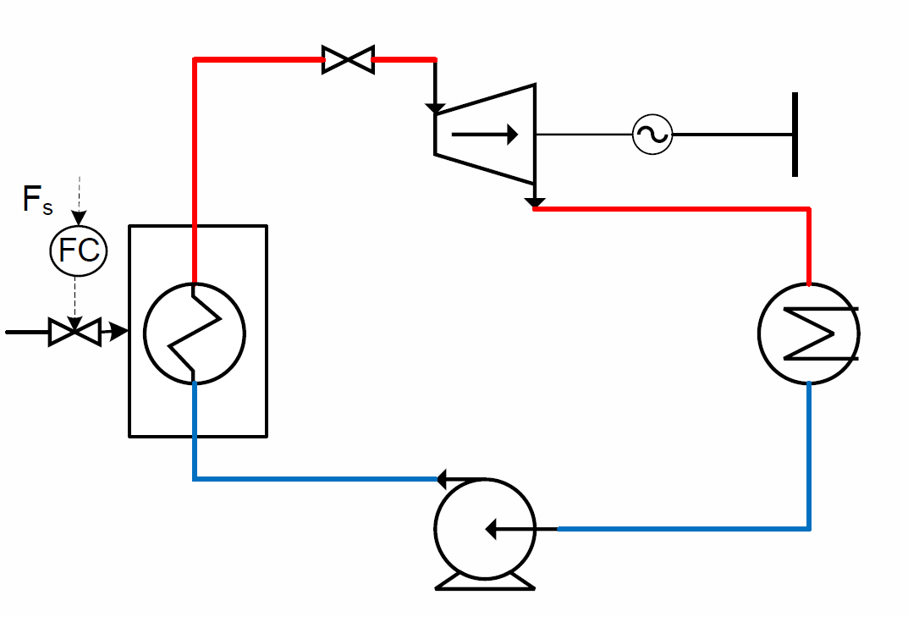
Simplified

Slide 23
Stabilization: Speed control
n_{s}=50 Hz
SC

Slide 24
If variable speed turbine
W_{s}
WC
p_{s}=p_{max}
Max. open
SC
PC

Slide 25
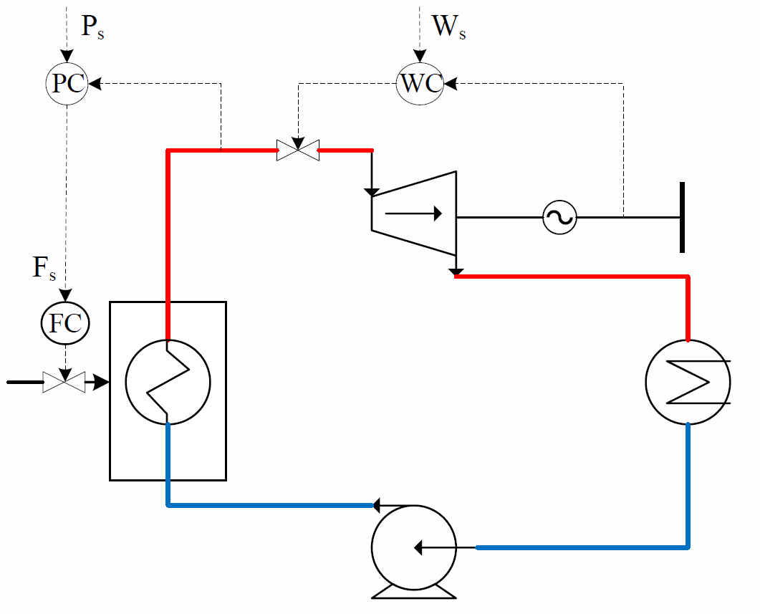
Common control structure
«Turbine leading»
TPM

Slide 26
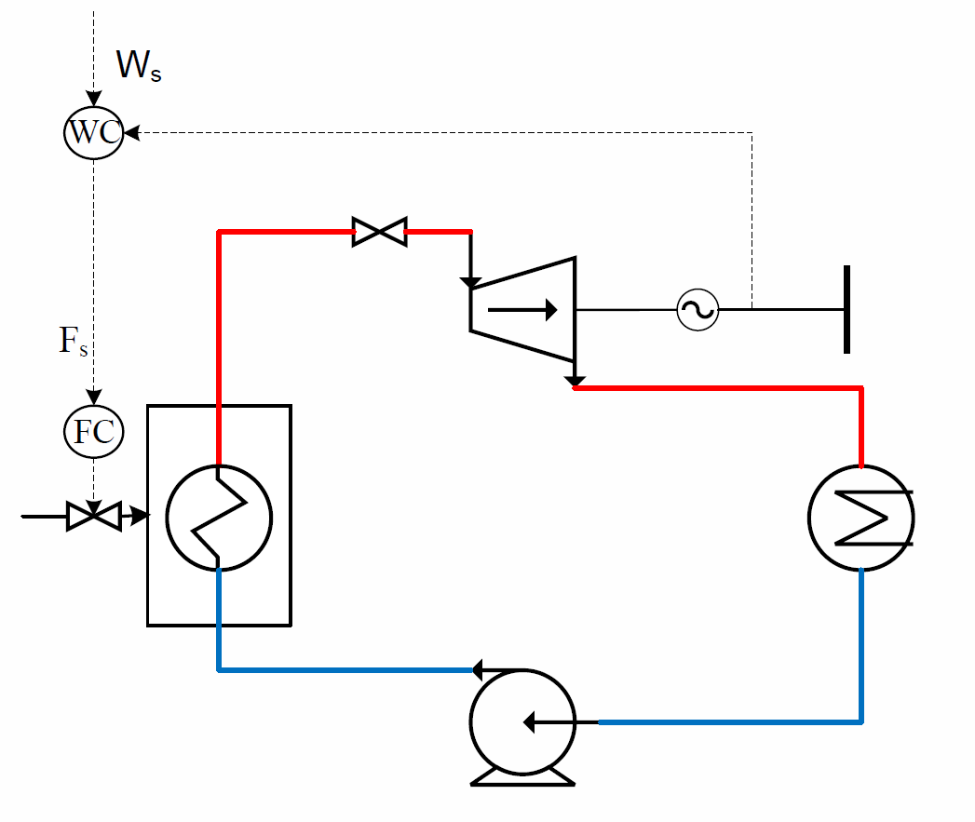
More optimal: Floating pressure
Max. open
SC
TPM

Slide 27
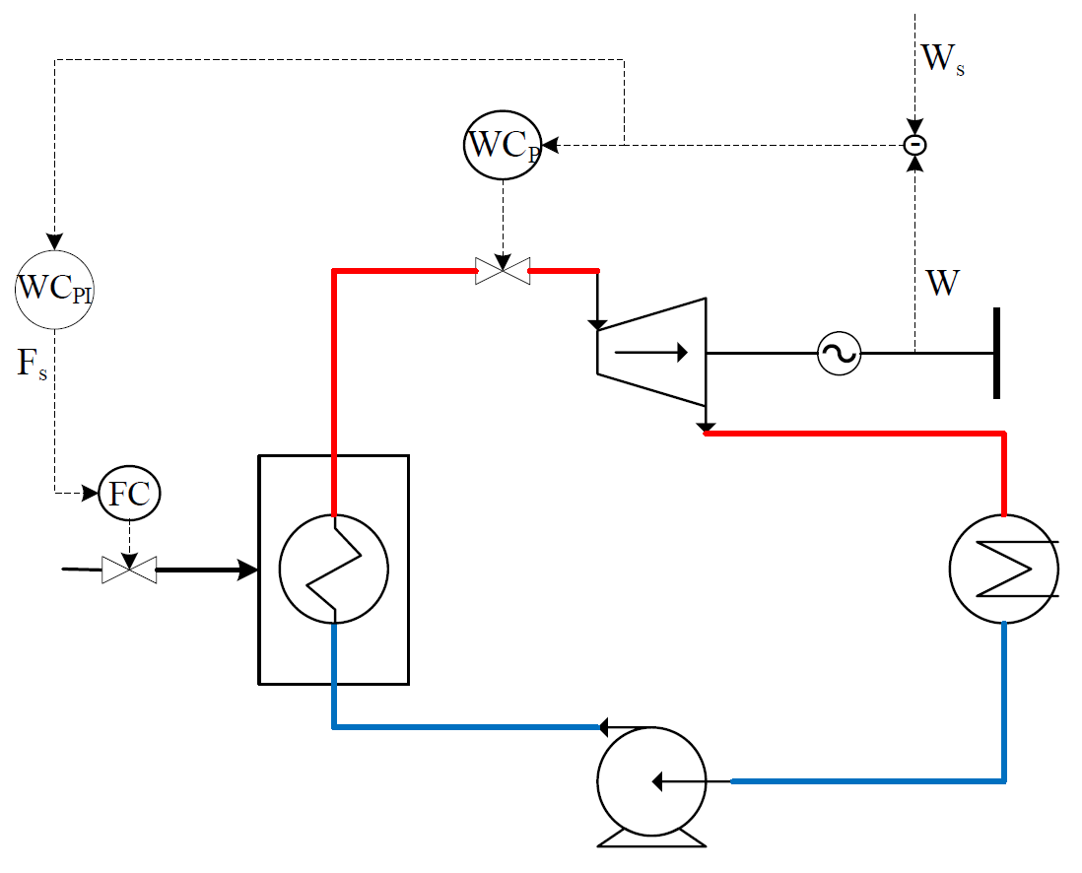
Improved floating pressure
Initial
TPM
TPM

Slide 28
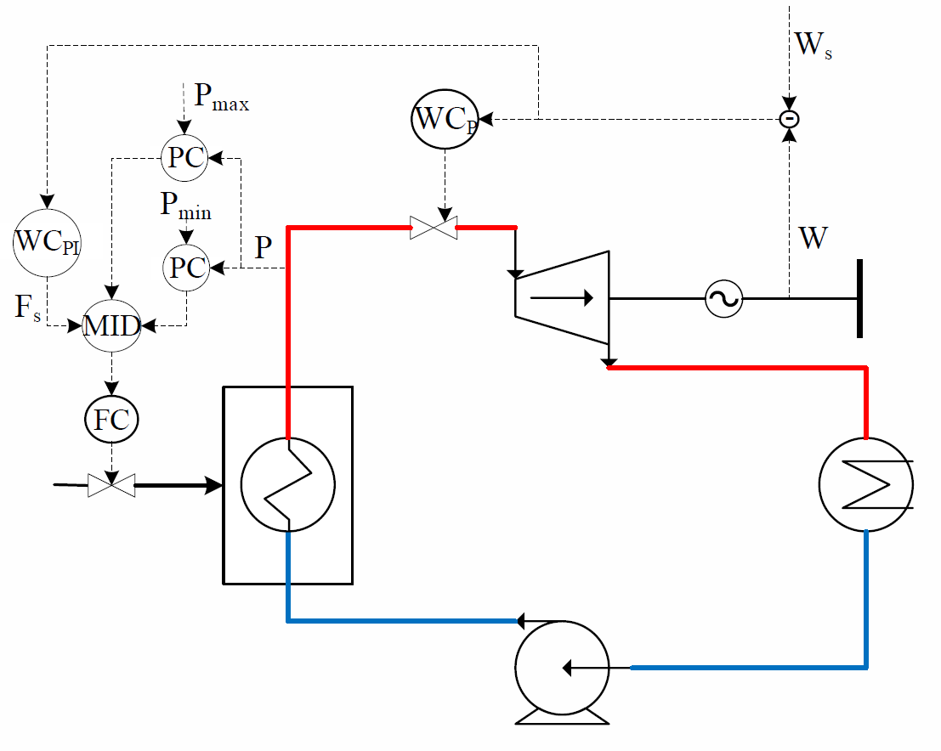
Improved Floating pressure w/ limits

Slide 29
The ideal “self-optimizing” variable is the gradient, J_{u}
Unconstrained degrees of freedom
c = ∂ J/∂ u = J_{u}
  Keep gradient at zero for all disturbances (c = J_{u}=0)
cost J
J_{u}<0
J_{u}<0
J_{u}=0
u_{opt}
u
J_{u}
0
Problem: Usually no measurement of gradient
Notes:
29

Slide 30
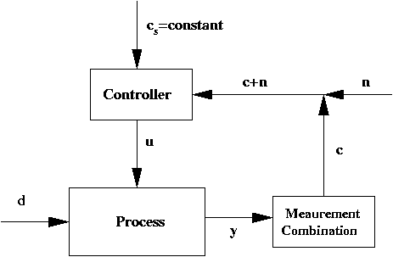
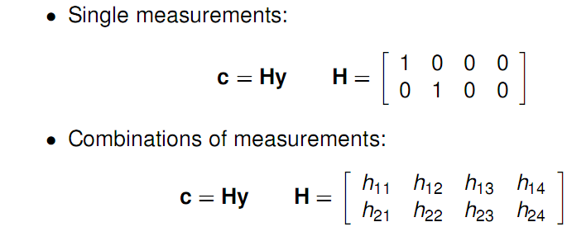
Ideal: c = J_{u}
In practise, use available measurements: c = H y.
Task: Select H!
H

Slide 31
Example: CO2 refrigeration cycle
J = W_{s} (work supplied)
DOF = u (valve opening, z)
Main disturbances:
  d₁ = T_{H}
  d₂ = T_{Cs} (setpoint)
  d₃ = UA_{loss}
What should we control?
p_{H}
J. B. Jensen and S. Skogestad, ``Optimal operation of simple refrigeration cycles. Part I: Degrees of freedom and optimality of sub-cooling'', Computers and Chemical Engineering, 31, 712-721 (2007).
J. B. Jensen and S. Skogestad, ``Optimal operation of simple refrigeration cycles. Part II: Selection of controlled variables'', Computers and Chemical Engineering, 31, 1590-1601 (2007).

Slide 32
CO2 refrigeration cycle
Step 1. Step 1. Objective function. J = W_{s} (compressor work)
Step 2. Optimize operation for disturbances (d₁=T_{C}, d₂=T_{H}, d₃=UA)
    One (remaining) degree of freedom (u=z)
    Optimum always unconstrained
Step 3. Implementation of optimal operation
    No good single measurements (all give large losses):
      p_{h}, T_{h}, z, …
    Try combining two measurements. “Exact local method”:
      c = h₁ p_{h} + h₂ T_{h} = p_{h} + k T_{h}; k = -8.53 bar/K
    Nonlinear simulations with disturbances: OK!
J=W
u_{opt}
u=z

Slide 33
Refrigeration cycle: Proposed control structure
CV1= Room temperature
CV2= “temperature-corrected high CO2 pressure”

Slide 34
Conclusion:
Systematic procedure for plantwide control
Start “top-down” with economics:
  Step 1: Define operational objectives and identify degrees of freeedom
  Step 2: Optimize steady-state operation.
  Step 3A: Identify active constraints = primary CVs c.
  Step 3B: Remaining unconstrained DOFs: Self-optimizing CVs c.
  Step 4: Where to set the throughput (often best: at bottleneck)
Regulatory control I: Move mass through the plant:
    Step 5A: Propose “local-consistent” inventory (level) control structure.
Regulatory control II: “Bottom-up” stabilization of the plant
    Step 5B: Control variables to stop “drift” (sensitive temperatures, pressures, ....)
      Pair variables to avoid interaction and saturation
Finally: Make link between “top-down” and “bottom up”.
  Step 6: “Advanced/supervisory control” system (MPC):
    CVs: Active constraints and self-optimizing economic variables +
    look after variables in layer below (e.g., avoid saturation)
    MVs: Setpoints to regulatory control layer.
    Coordinates within units and possibly between units
c_{s}
http://www.nt.ntnu.no/users/skoge/plantwide

Slide 35
Har lagt ved både regulering for luft/røykgass og oppdatert vann/damp. Si fra hvis du mener noe burde endres eller legges til i tegningene.
Kan være verdt å nevne at reguleringsstrukturen for sekundærluft er kraftig forenklet i oversikten som er vedlagt. Det er egentlig egne flow-kontrollere på hver av de fire innløpene til sekundærluften. Det er i disse flow-kontrollerene mengden sekundærluft blir satt. Sekundærluftviften brukes bare til å opprettholde trykket i sek.luften rett før de fire flow-kontrollerene. Jeg droppet å ta det med fordi tegningen fort blir uoversiktlig.
Måten operatørene kjører kjelen på under normal operasjon kan oppsummeres i to punkter:
-Operatøren velger hvor mye damp som skal produseres [kg/s]. Dette blir omgjort til et signal som angir mengden fuel som tilsettes.
-Operatøren endrer på air/fuel-ratio sånn at CO og NOx holder seg under gitte grenser (CO < 75 mg/Nm3 og NOx < 360 mg/Nm3). Ved for høy CO økes air/fuel-ratio, og ved for høy NOx senkes air/fuel ratio. De kan også endre setpunktet til O2-regulatoren. Denne regulatoren fungerer som en korreksjon til mengden sek.luft.
Active constraints :
-Trykk i kjelen er satt til -1 mbarg og reguleres med røykgassviften. Røykgassviften er en begrensende faktor ved høy last pga. lekkasjer.
-Temperatur i bed holdes under 850 grader celsius ved å tilføre kald røykgass via resirkulasjonsviften. For høy temperatur kan føre til sintring.
Burde være active constraints (normal operasjon, ikke oljefyring):
-Shunt pumpe for matevann burde stå stille for å få mest mulig varmeveksling i ekonomiseren. Denne går istedet på maks hele tiden.
-Røykgassetemperaturen etter luftforvarmeren ligger som regel over 150 grader. Denne burde være mye lavere for å utnytte energien best mulig. I driftsinstruksjonen er nedre temperatur satt til 130 grader. Det er ingen måte å redusere røykgasstemperaturen ytterligere bortsett fra å stoppe shunt pumpen for matevann.
-Mengden luft burde være minst mulig for å unngå å varme opp overflødig luft. Ved lave luftmengder går CO-konstentrasjonen opp. Å ha CO nærmest mulig grensen på 75 mg/Nm3 burde derfor være en active constraint.
Vi lekte oss litt med shunt pumpen for matevann i dag, men det ga ikke veldig stor effekt på røykgasstemperaturen. Vi fortsetter på fredag med litt mer drastiske endringer for å se om vi får en tydeligere effekt.
Hilsen Eirik

Slide 36
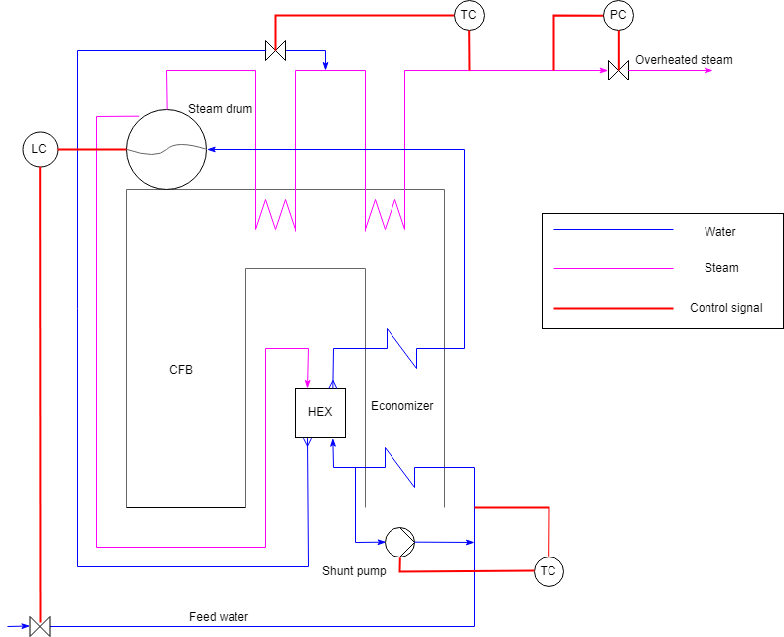
Norske Skog Skogn

Slide 37
